Slide 1
Cat-Selfie Machine
$_
Raspberry Pi 101
Jasia.stuart@concordia.ca

Slide 2
$_
Hi, my name is
Jasia Stuart
let me tell you about the
Sandbox

Slide 3
$_
Intro + Component Overview ~ 25 min
Make it work ~ 60 min
Overview and resources ~ 15 min
Questions

Slide 4
Workshop Objectives
$_
Hook up a motion detector to a camera
First steps with Linux, electronics, Python
When and why to use a Pi
Next steps and inspiration

Slide 5
$_
WARNING!
Linux, electronics, Python= A LOT!!!
It may take a few projects to become clear ☺

Slide 6
What is a Raspberry Pi?
$_
Single Board Computer
Compared with a Micro-controller?
Compared with a desktop workstation?
What is Raspbian?
Power it on - but always power down before wiring/rewiring
Who developed this and why?

Slide 7
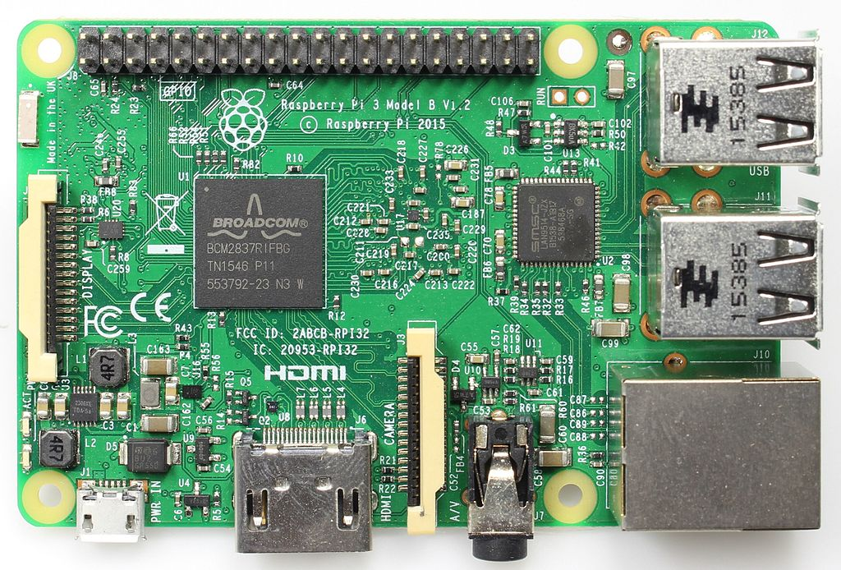
$_
Image: Make Magazine [CC BY-SA (https://creativecommons.org/licenses/by-sa/4.0)]

Slide 8
What is Linux?
$_
Family of operating systems
Check out our workshop
Open source and free, preferred by some tech people for these reasons and others
Often we use the “terminal” to accomplish certain tasks faster ( other OS’s have equivalents )

Slide 9
What is Python?
$_
Friendly scripting language and NOT a reptile
Allows the computer (the Pi) to control and communicate with the hardware components (GPIO library)
By default installed on Raspbian
http://www.learnpython.org/
https://learnpythonthehardway.org/book/
https://stephensugden.com/crash_into_python/ ( for programmers)

Slide 10
What hardware components are we using?
$_
Rpi Camera
Passive Infrared motion detector (PIR)
Ribbon cable helps identify pins
Screen comes in our kit – in theory you can run this headless

Slide 11
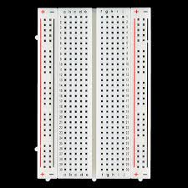
What is a breadboard?
$_
A better prototyping alternative to twisting wires together!
Rows connected a:e and f:j
The outermost columns are connected (labeled + and-)
Image: CC by 2.0 by SparkFun Electronics https://www.flickr.com/photos/41898857@N04/10843197283

Slide 12
$_
Hands-on overview:
hook up hardward
adjust settings
run script,
debug
☺

Slide 13
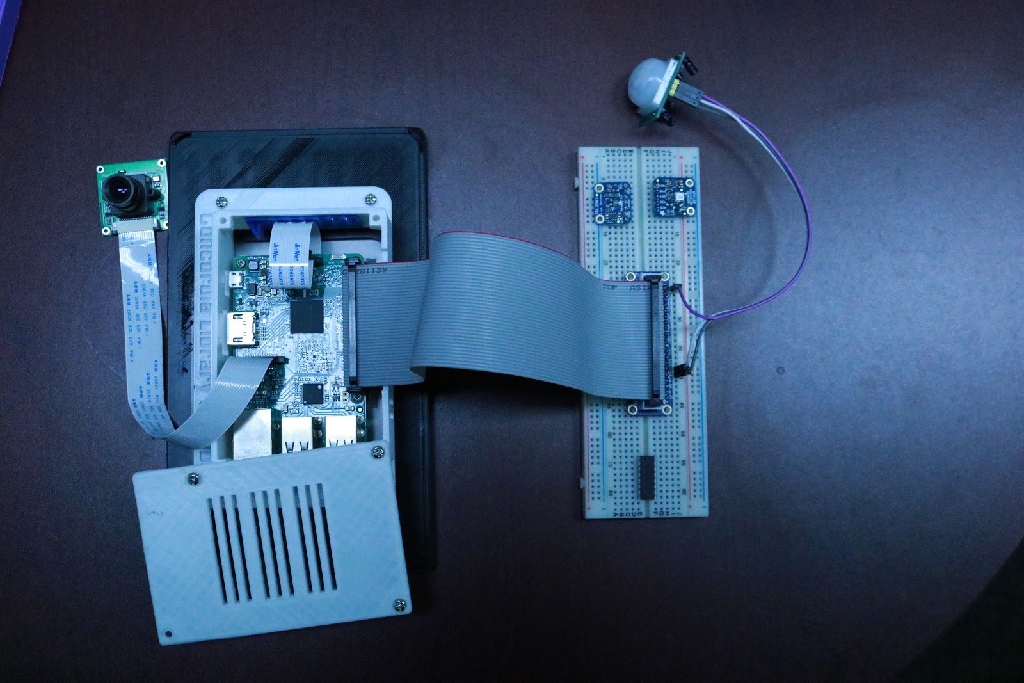
Hook up the Pi to the Bread Board
$_
Power off (from menu)
Screen is attached – open case with screwdriver
Open back and attach ribbon with red wire near SD card
Attach other side of ribbon to “cobbler”

Slide 14
Hook up the sensor and camera
$_
For the PIR
GND to GND
VCC to 5V
Out to 12
For the Camera: ribbon goes into camera slot
Power on !

Slide 15
$_
Enable the Camera
main menu -> preferences -> rpi configuration -> interfaces ->enable camera
Reboot

Slide 16
Verify you have the Python script (pircam.py) file in your home directory
Open a terminal window and type:
ls
There should be a file called pircamp.py type a command to open it:
nano pircam.py

Slide 17
What is the command line?
$_
A text-based interface with your computer
AKA terminal, console, prompt
Almost all operating systems have one. FYI the Windows version has different commands.
Image: CC by 2.0 by SparkFun Electronics https://www.flickr.com/photos/41898857@N04/10843197283

Slide 18
What is a nano?
$_
A small text editor for the terminal
You could edit code in anything that can open text but the command line is convenient because it will also run the code
For larger projects, you will want an Integrated Development Environment (IDE) to help you write you code ( colors, autocomplete, multiple files, AI help and more)
Image: CC by 2.0 by SparkFun Electronics https://www.flickr.com/photos/41898857@N04/10843197283

Slide 19
import RPi.GPIO as GPIO
import time
from picamera import PiCamera
camera = PiCamera()
GPIO.setwarnings(False)
GPIO.setmode(GPIO.BCM)
GPIO.setup(12, GPIO.IN) #set pin12 as input to receive data from the PIR sensor
picNum=0
while True:
inP=GPIO.input(12) #read input for PIR and store in variable inP
if inP==0:
print "no cats :(", inP
time.sleep(0.1)
elif inP==1:
print "CAT!!! :)", inP
camera.capture('/home/pi/Desktop/Cats/cat%s.jpg' %picNum)
picNum +=1
time.sleep(2)

Slide 20
$_
Create a ‘Cats’ folder on the Desktop
In the terminal with ls, cd .., mkdir
Or
Use the graphical file manager …pretty much like windows/mac

Slide 21
Run the script!
Making sure you are in the same folder as the pircam.py file
Open a terminal window and type:
sudo python pircam.py
Ctrl-c to stop the script

Slide 22
Check that it worked (else Debug)
$_
Are there images in the Cats folder?
Does the ‘cats’/ ‘no cats’ message change in response to motion?

Slide 23
Debug ideas
$_
Are all the wires connected solidly and in the right places?
Is the code correct? pircam.py ( typos?)
Adjust sensor sensitivity (both sample speed and sensitivity)
Is the camera the right way around?
!! If everything worked first try…you are missing out on fun. Ask your neighbor if you can help them !!

Slide 24
Test your knowledge
$_
What can you change in the pircam.py code?
How would you improve the code?
How would you improve the setup (sensors, camera etc.)
What functionality could be added

Slide 25
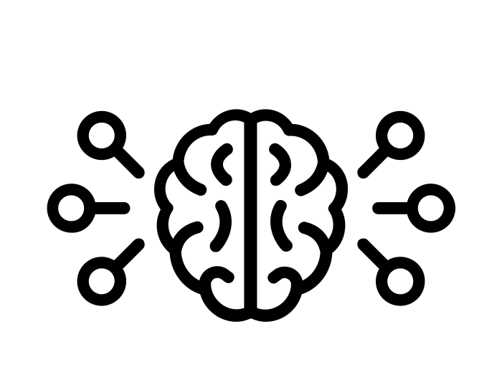
What did we learn?
$_
How a breadboard works
Basic intuition about circuits
Basic intuition about Python
What a Raspberry Pi is, some of its capabilities
Controlling a computer through the command line
Intro to physical computing
Debugging physical computing (and beyond!)
Debugging is hard!

Slide 26
Next Steps
$_
Improve the code
Learn some Linux skills
Plan your own project - look at similar examples and work from there
Bonus: Learn some of the theory behind the electronics to get further faster

Slide 27
Information/inspiration
https://www.raspberrypi.org/
https://www.raspberrypi.org/resources/
https://www.raspberrypi.org/documentation/linux/
https://www.raspberrypi.org/learning/getting-started-with-picamera/worksheet/ (pi camera)
https://diyhacking.com/raspberry-pi-gpio-control/ (PIR sensor)
http://learnpython.org/ (Python resource 1)
https://learnpythonthehardway.org/book/ (Python resource 2)
https://stephensugden.com/crash_into_python/ ( Python for programmers)
https://www.buyapi.ca/product/raspberry-pi-iot-learning-kit-powered-by-cayenne/ (Raspberry Pi Kits in Sandbox – list of sensors)
https://learn.sparkfun.com/tutorials/raspberry-gpio/python-rpigpio-example (GPIO)
https://www.instructables.com/id/Raspberry-Pi-Projects/
https://learn.adafruit.com/category/raspberry-pi /
https://hackaday.com/?s=raspberry+pi
https://magpi.raspberrypi.org/

Slide 28
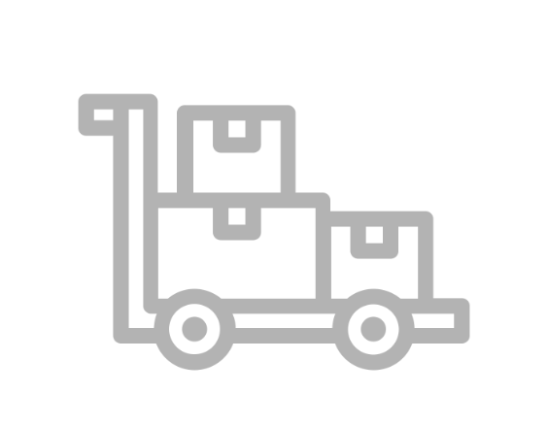
Suppliers
https://abra-electronics.com (Montreal)
https://addison-electronique.com (Montreal)
https://www.buyapi.ca (Ottawa - reasonable shipping)
https://www.spikenzielabs.com/Catalog/ (Montreal)
Amazon and many others online….

Slide 29
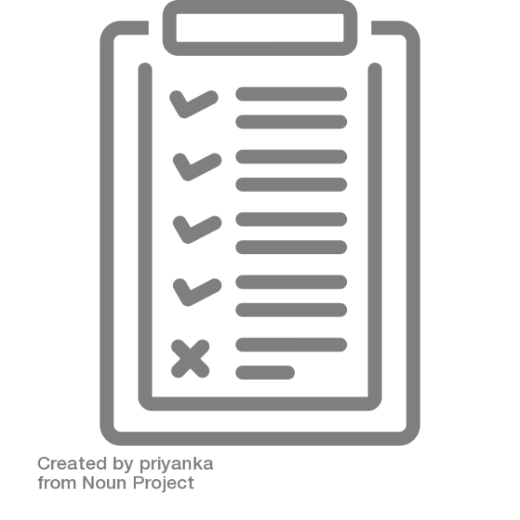
Vocabulary
Breadboard - a solderless device for temporary prototype with electronics and test circuit designs.
Command line - The Linux command line is a text interface to your computer.
Debugging - the routine process of locating and removing computer program bugs, errors or abnormalities, which is methodically handled by software programmers via debugging tools
Light-Emitting Diode (LED) - a device that emits light when an electric current passes through it
Linux – a family of open source operating systems
(Linux)Terminal – a way of referring to the text based interface (as a opposed to a GUI – graphical user interface). Clarification on the difference between terminal, console and shell provided in the link.
Microcontroller - a computer present in a single integrated circuit which is dedicated to perform one task and execute one specific application.
Operating System (OS) – the software that manages all the other programs ( and their access to hardware) on a computing device
Physical Computing - means building interactive physical systems by the use of software and hardware that can sense and respond to the analog world.
PIR sensor – Passive infrared sensor
Platform - a group of technologies that are used as a base upon which other applications, processes or technologies are developed.
Printed Circuit Board (PCB) - an electronic circuit used in devices to provide mechanical support and a pathway to its electronic components.
Prototyping - an early sample, model, or release of a product built to test a concept or process.
Single-Board Computer - a computer which is a complete computer in which a single circuit board comprises memory, input/output, a microprocessor and all other necessary features.

Slide 30
$_
Technology Sandbox info and resources:
https://library.concordia.ca/technology/sandbox/
(Subscribe to our newsletter!)
Jasia.stuart@concordia.ca

