Slide 1
Arduino 101
Make your own gadgets
Presented by Ariana Hipsagh
Ariana.Hipsagh@concordia.ca
Notes:
Me: Have browser open with JUST 1) TinkerCAD 2) Arduino site
Have Arduino IDE Open
Have various Arduino boards/examples out

Slide 2

Intro + Theory ~ 25 min
Try it~ 25 min
Demo ~ 15 min
Recap & resources ~ 15 min
Questions ~ 15 min

Slide 3
Workshop Objectives
Describe the purpose and applications of Arduino
Explore Arduino Kit with hands-on examples
Practice using TinkerCAD simulator
Learn how to go between physical hardware & simulator
Next steps – research for your prototype
Notes:
Notes are added here

Slide 4
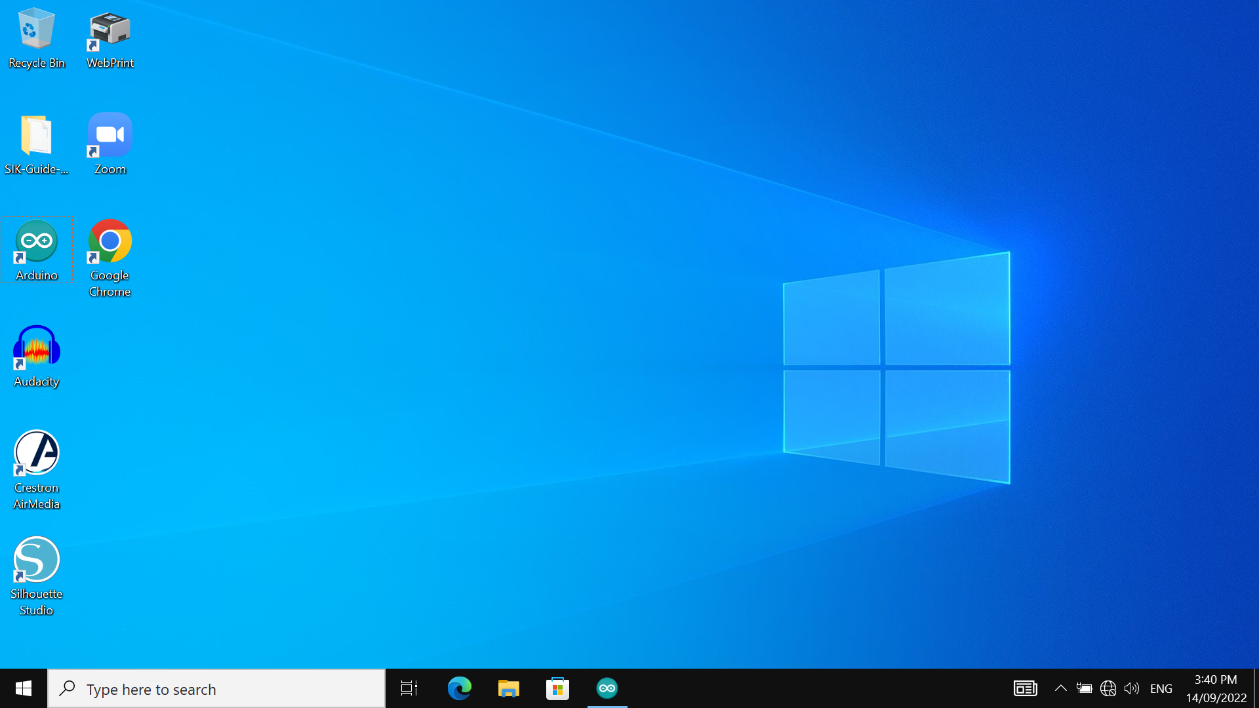
16 Circuit Arduino code
Double click on the Arduino icon
Double click on the globe icon
connect with Netname/password

Slide 5
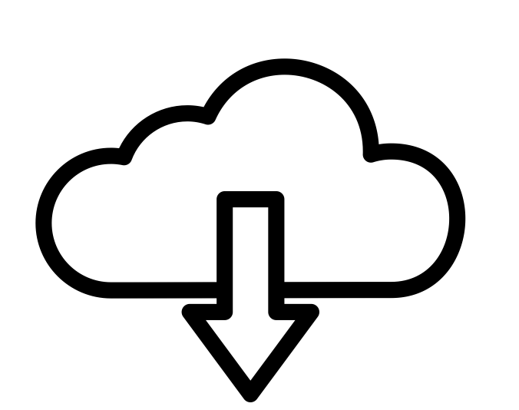
Make a TinkerCAD account: https://www.tinkercad.com
If you have a board and want to try the hardware version (OPTIONAL): https://www.arduino.cc/en/Main/Software
Notes:
Note: Keep the Tinkercad page OPEN on your account!
Me: Put links in chat

Slide 6

What is Arduino?
arduino.cc (IDE)
Platform
What is a microcontroller?
Compare with a Single Board Computer
Why SIK and RedBoard ?
When would I be better with a Raspberry Pi?

Slide 7
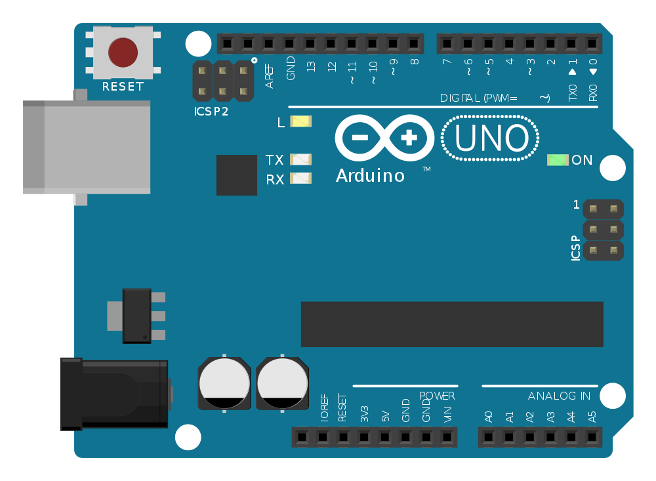
Image: PhilippHenkel CC4.0 : https://commons.wikimedia.org/wiki/File:ArduinoUno.svg

Slide 8
What is the Arduino simulator?
TinkerCAD.com
AutoDesk Product
EAGLE, SPICE “simulation program with integrated circuit emphasis”

Slide 9
Why use Arduino?
Prototyping, before large scale production
Building small, unique projects (Data collection, Artwork, robotics, sensors, gadgets!)
Very standard, lots of off the shelf examples, projects, libraries
Quick to start
Small and inexpensive
Learn to code

Slide 10
Why use the Arduino simulator?
You don’t have an Arduino on hand
You want to check a circuit works before hooking up components IRL
You want to check your component list is correct before placing an order
Debugging !This is a simulation, there can (and will be bugs) it does not GUARENTEE it will work.

Slide 11

“Physical computing”
!! You can’t break ANYTHING in this workshop!!
Usually we blink an LED – its less exciting on a screen SO:
Use the SIK guide for instructions TinkCAD to set it up
https://learn.sparkfun.com/tutorials/sik-experiment-guide-for-arduino---v33/experiment-1-blinking-an-led
Notes:
Why are there air quote? Because we are using a simulator. What is real, anyway?

Slide 12
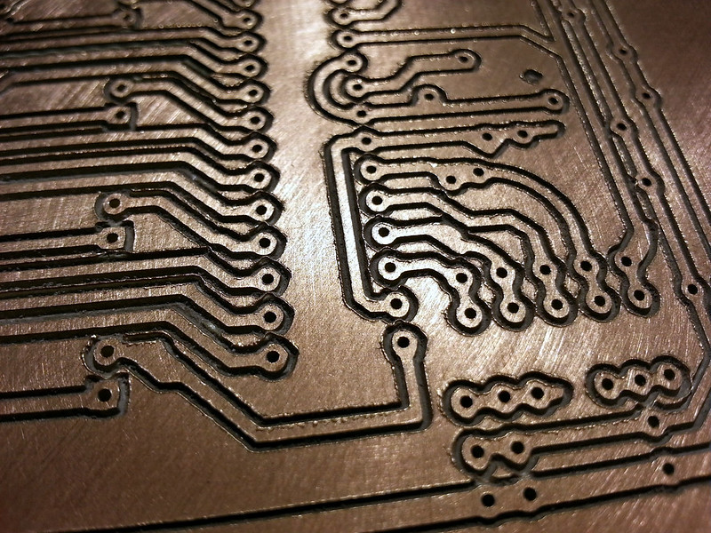
Prototyping electronics
Test on the simulator
Connect via breadboard
Solder wires ( directly or on protoboard)
Produce custom PCB (CNC)
Professional small batch production & assembly
Image attribution / reference link

Slide 13
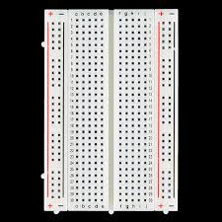
What is a breadboard?
A better prototyping alternative to twisting wires together!
Rows connected a:e and f:j
The outermost columns are connected (labeled + and-)
Image: CC by 2.0 by SparkFun Electronics https://www.flickr.com/photos/41898857@N04/10843197283

Slide 14
https://learn.sparkfun.com/tutorials/sik-experiment-guide-for-arduino---v33/experiment-1-blinking-an-led

Slide 15
“Wire it up”
LED, 330 Ω resistor, 3 jumper wires
Follow diagram on pages 20 and 21 of SIK guide
Use of the bread board is optional, but it will help you in other projects

Slide 16
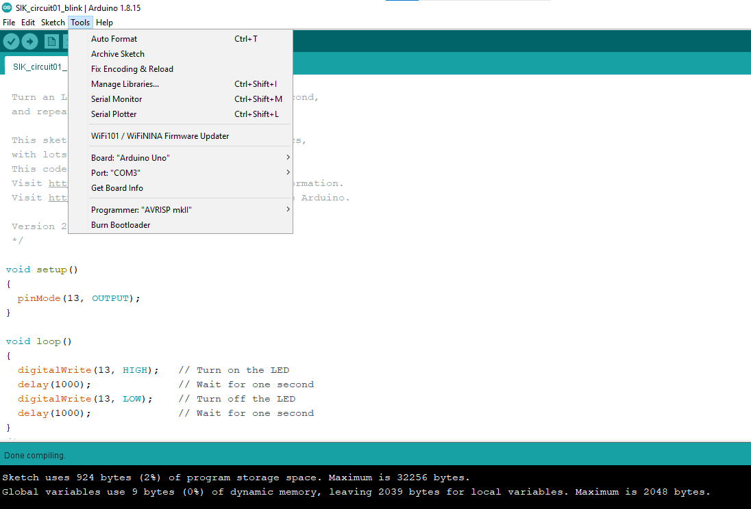

Slide 17
$_
TinkerCAD dashboard ->
Circuits ->
New circuit

Slide 18
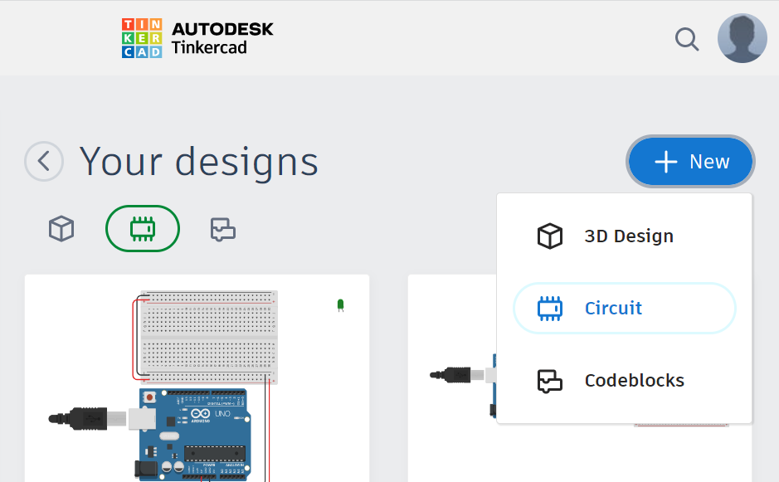

Slide 19
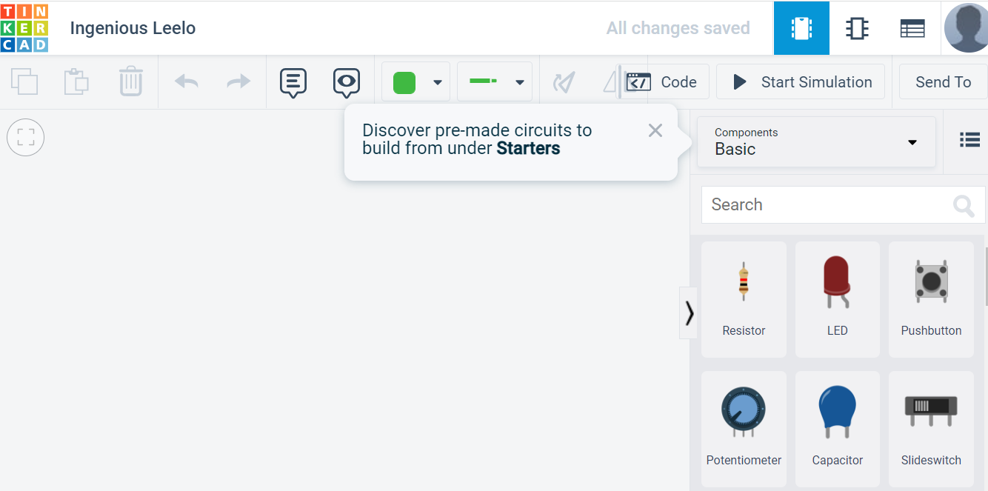
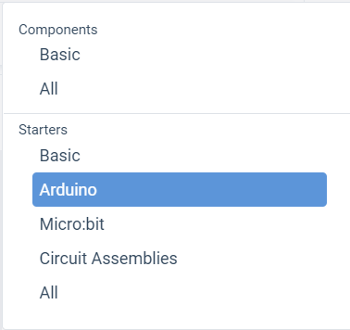

Slide 20
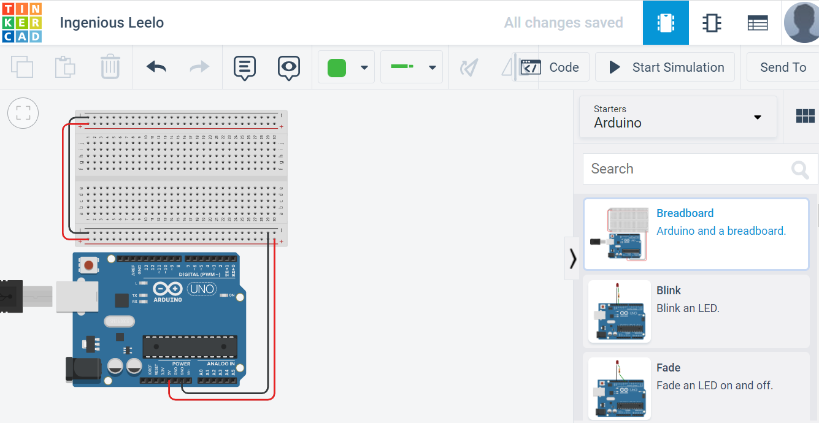

Slide 21
Just add code
Copy paste the code from the SIK guide
Make sure you put the TinkerCAD code box is text mode
Click ‘START SIMULATION’

Slide 22
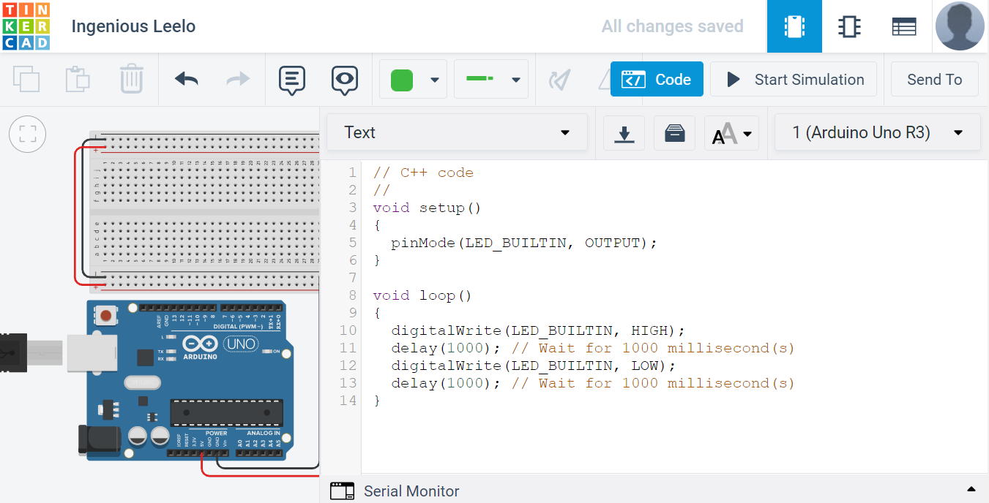

Slide 23
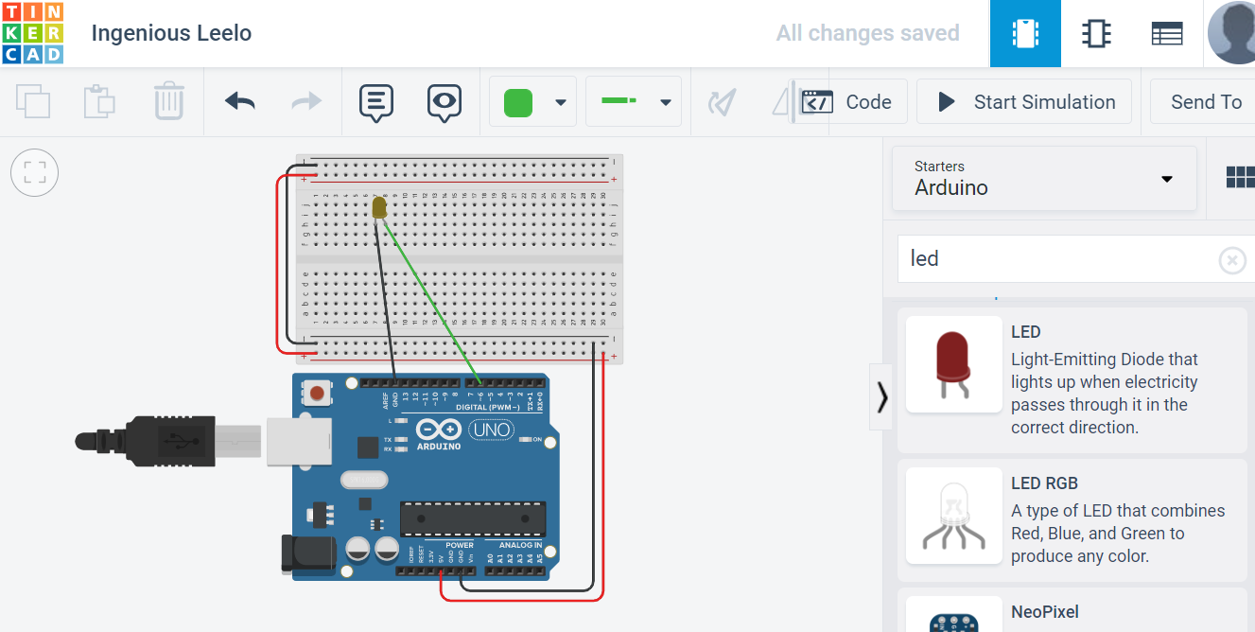

Slide 24
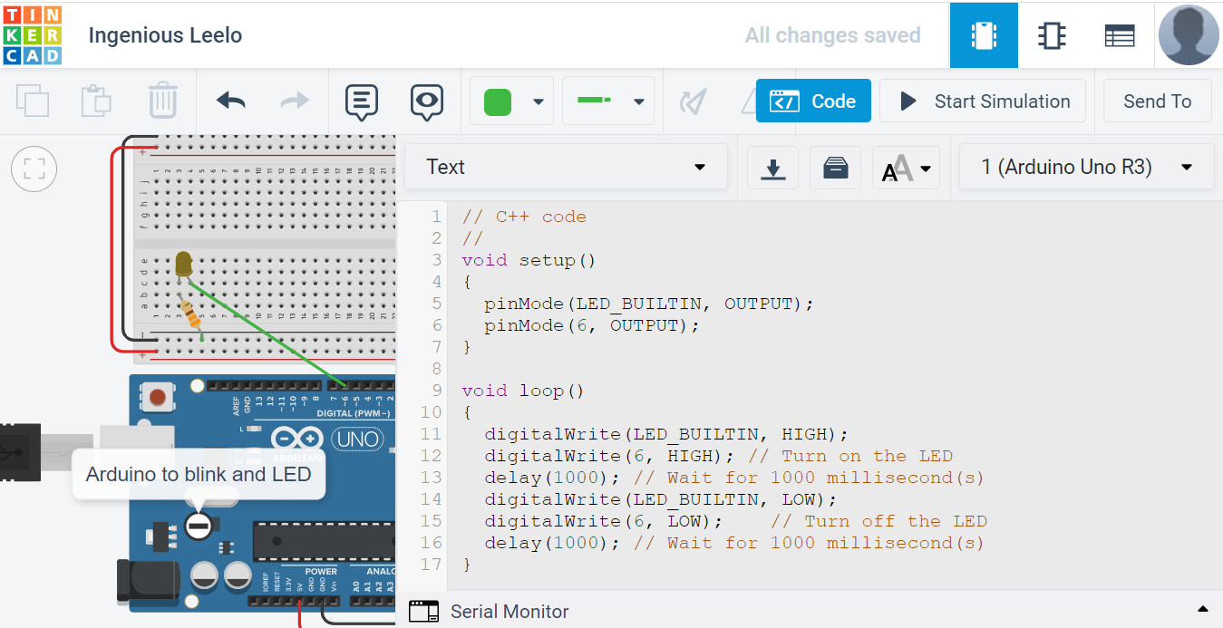
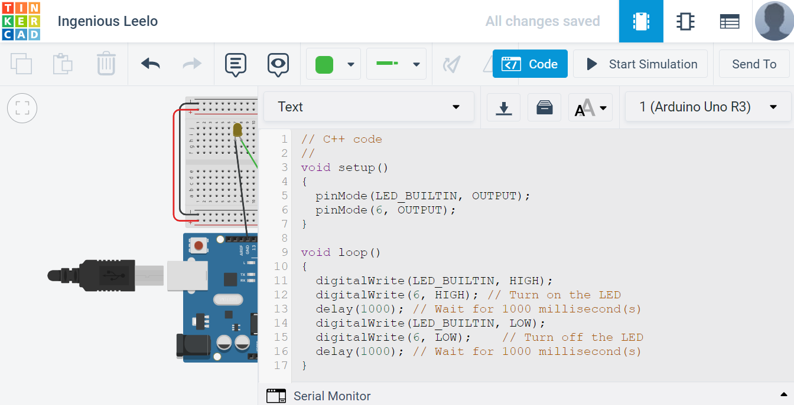

Slide 25
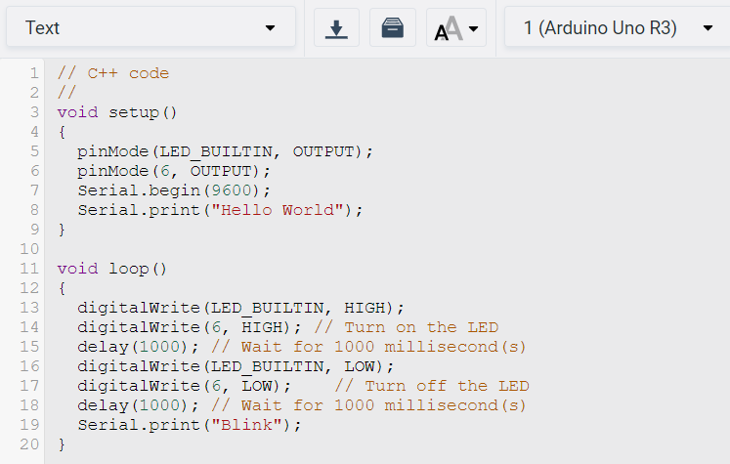
Serial Monitor

Slide 26
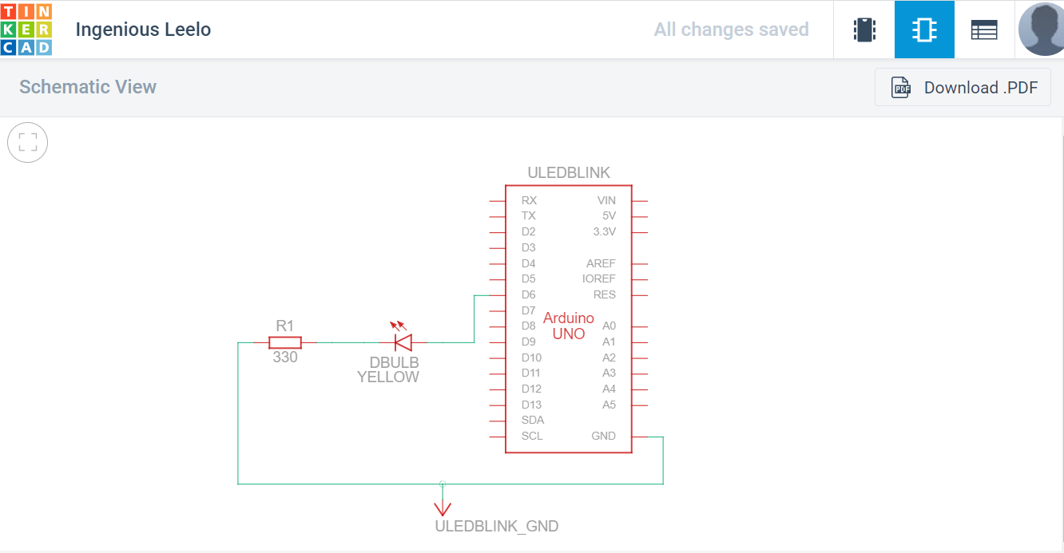

Slide 27
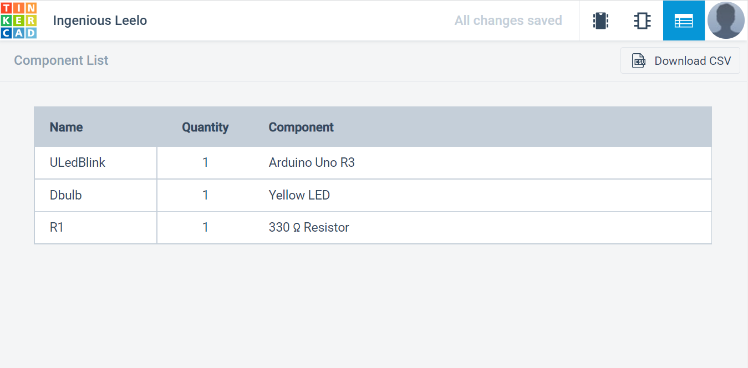

Slide 28
Test your knowledge
Is it blinking? If not hit simulate again
Read the code ESPECIALLY THE COMMENTS. That is the value of the SIK examples code.
Challenge:
1) use the serial monitor
2) try another circuit
3) Transfer to Hardware (Arduino)

Slide 29
Next Steps
Do all/most of the examples
Read + modify the code
Change the example slightly
Plan your own project - look at similar examples and work from there
Bonus: Learn some of the theory behind the electronics to get further faster

Slide 30
Ideas?
Components either:
Do: light-up (LED), Move (Motors), heat up, power-on (relay), buzz/make noise (piezo)
Sense: buttons, temperature, touch, level
Other part connect, modify, secure and communicate

Slide 31
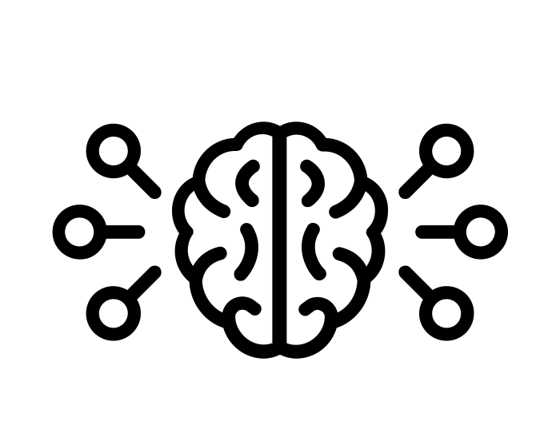
What did we learn?
What is Arduino
How a breadboard works
Basic intuition about circuits
Basic intuition about c/c++
How to test a project on the Arduino simulator
Transfer your simulation to hardware
Debugging is hard!

Slide 32

Continue Learning
https://concordia.udemy.com/course/arduino-programming-and-hardware-fundamentals-with-hackster (course uses simulator)
https://concordia.udemy.com/course/arduino-bootcamp
https://concordia.udemy.com/course/the-complete-basic-electronics-cours (electronics)

Slide 33
Information/inspiration
https://www.arduino.cc/
https://www.instructables.com/technology/arduino/
https://learn.adafruit.com/category/learn-arduino
https://hackaday.com/tag/arduino/
http://blog.makezine.com/tag/collinslab/
https://create.arduino.cc/projecthub/Hack-star-Arduino/tinkercad-versus-wokwi-arduino-simulator-2022-5ab08d (other Arduino simulator options discussed)
https://www.kobakant.at/DIY/ (wearables+)

Slide 34
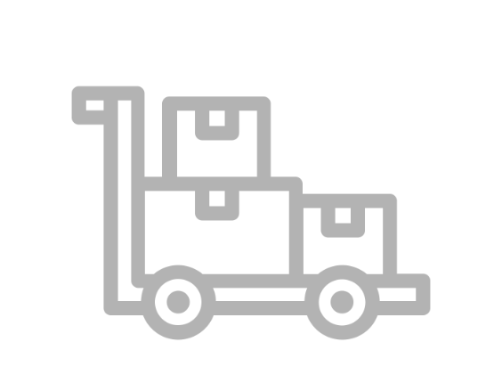
Suppliers
https://abra-electronics.com (Montreal)
https://addison-electronique.com (Montreal)
https://www.buyapi.ca (Ottawa - reasonable shipping)
https://www.spikenzielabs.com/Catalog/ (Montreal)
https://www.digikey.ca/ (a complete but hard to navigate catalog – online only)
Amazon, Aliexpress and many others online….

Slide 35
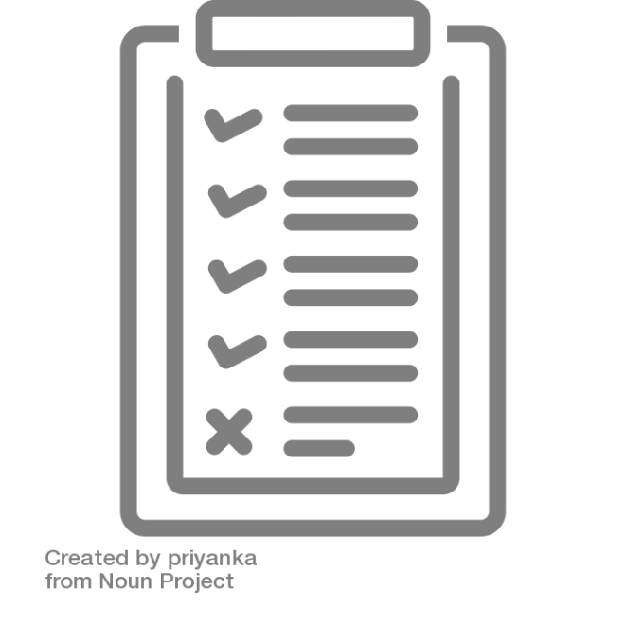
Vocabulary
Platform - a group of technologies that are used as a base upon which other applications, processes or technologies are developed.
Microcontroller - a computer present in a single integrated circuit which is dedicated to perform one task and execute one specific application.
Single-Board Computer - a computer which is a complete computer in which a single circuit board comprises memory, input/output, a microprocessor and all other necessary features.
Physical Computing - means building interactive physical systems by the use of software and hardware that can sense and respond to the analog world.
Integrated Development Environment (IDE) - An Integrated Development Environment (IDE) is an application that facilitates application development.
(Computer) Port - a connection point or interface between a computer and an external or internal device.
Breadboard - a solderless device for temporary prototype with electronics and test circuit designs.
Prototyping - an early sample, model, or release of a product built to test a concept or process.
Resistor - an electrical component with two terminals that is used to limit or regulate the flow of electrical current in electronic circuits.
Light-Emitting Diode (LED) - a device that emits light when an electric current passes through it
Debugging - the routine process of locating and removing computer program bugs, errors or abnormalities, which is methodically handled by software programmers via debugging tools
Printed Circuit Board (PCB) - an electronic circuit used in devices to provide mechanical support and a pathway to its electronic components.

Slide 36
Technology Sandbox info and resources:
https://library.concordia.ca/technology/sandbox/
(Subscribe to our newsletter!)
Technology.Sandbox@concordia.ca

