Slide 1
Methodology and the Study of Religion
RELI 409
Library Workshop
Wednesday, October 28, 2026
Éthel Gamache, Librarian
ethel.gamache@concordia.ca

Slide 2
Agenda
Our (possible) plan for tonight:
Library spaces and services
Searching for information
  Using search operators
  Sofia, the Library search tool
  Databases
    Academic Search Complete
    ATLA
    Google Scholar
Citing
Zotero
Ask a librarian!
Notes:
Ice-breaker activity – introverts friendly : )

Slide 3
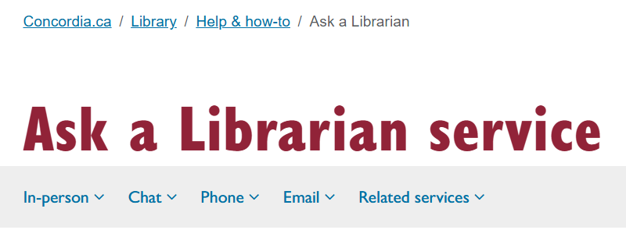
The Library is here to help with all your research needs!
Notes:
Remember that there are lots of specially trained people here to help! You can contact the library by chat, by email, by phone, or in person at the ask us desks in both libraries. Remember that you can also look up your subject librarian and send them an email or set up a meeting if you need more specialized help.

Slide 4
Library spaces and services

Slide 5
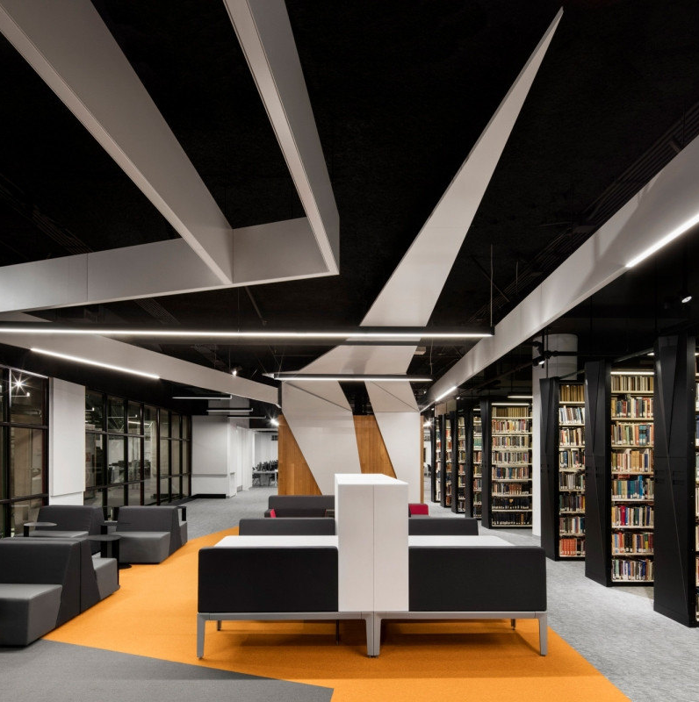
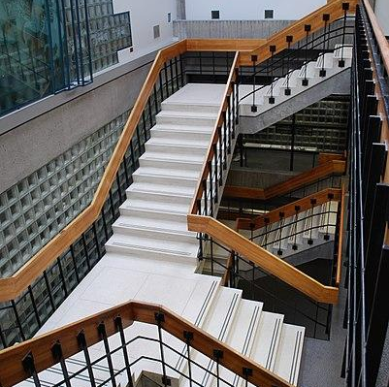
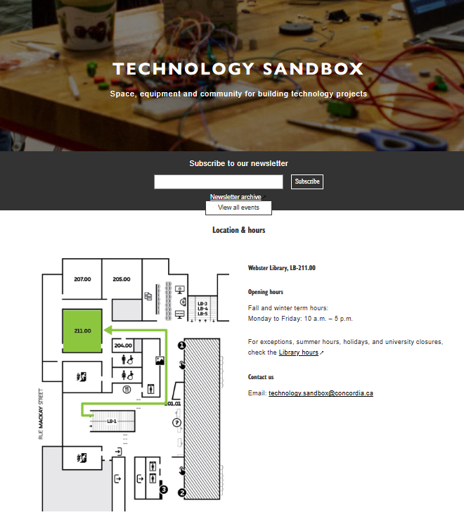
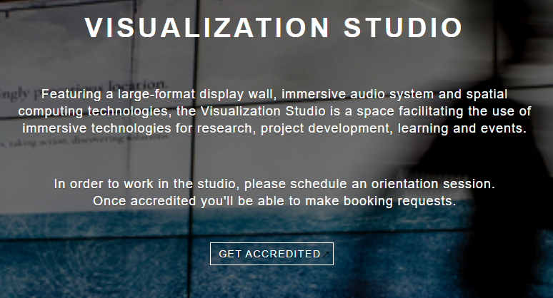
Library Spaces
Webster
Vanier
Notes:
At the Concordia University Library, you will find two buildings: Webster library at the downtown or the SGW campus, and the Vanier library which is at the Loyola campus.

Slide 6
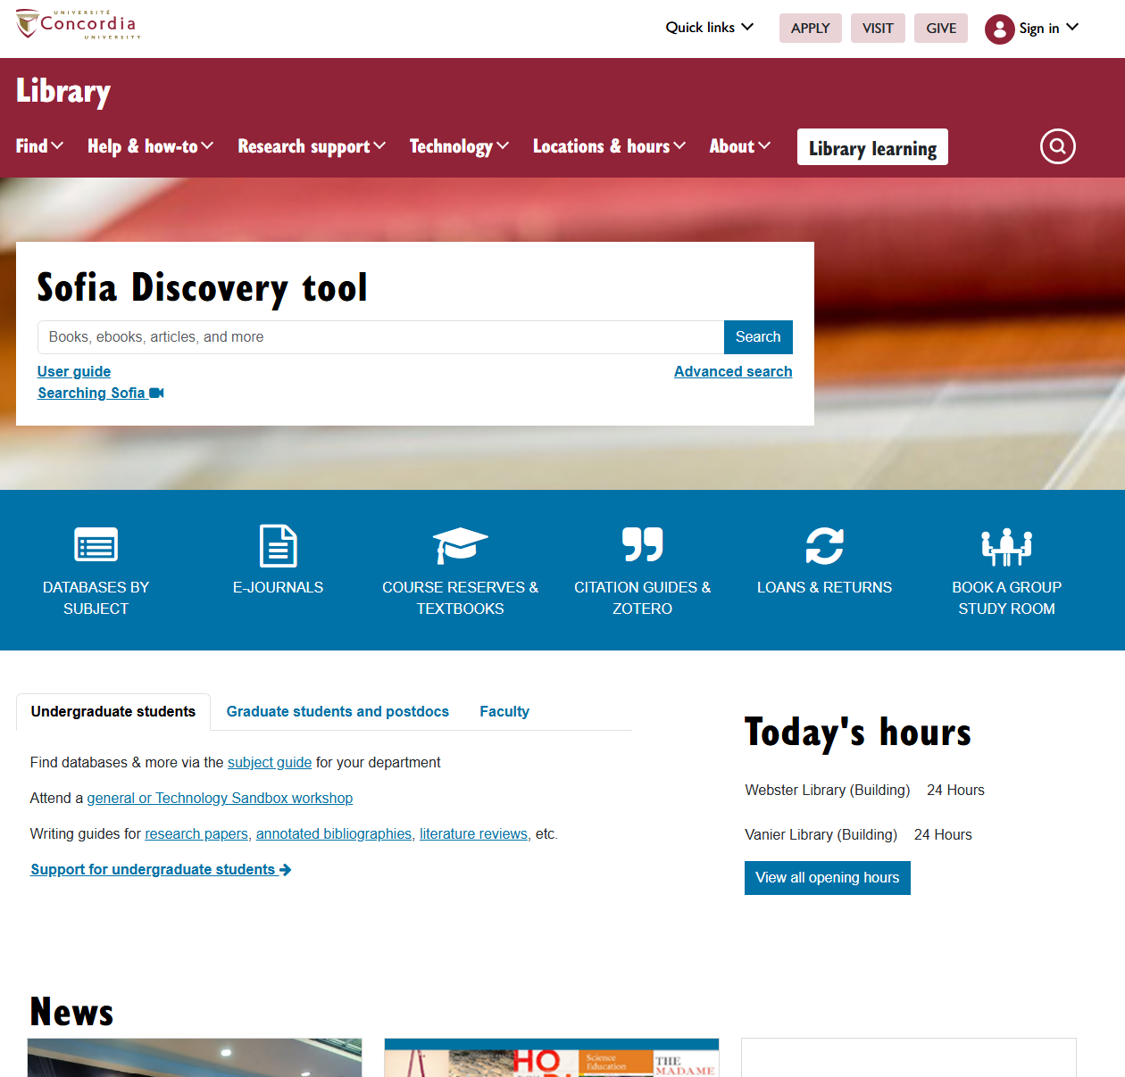
Library Website
Library homepage: library.concordia.ca

Slide 7
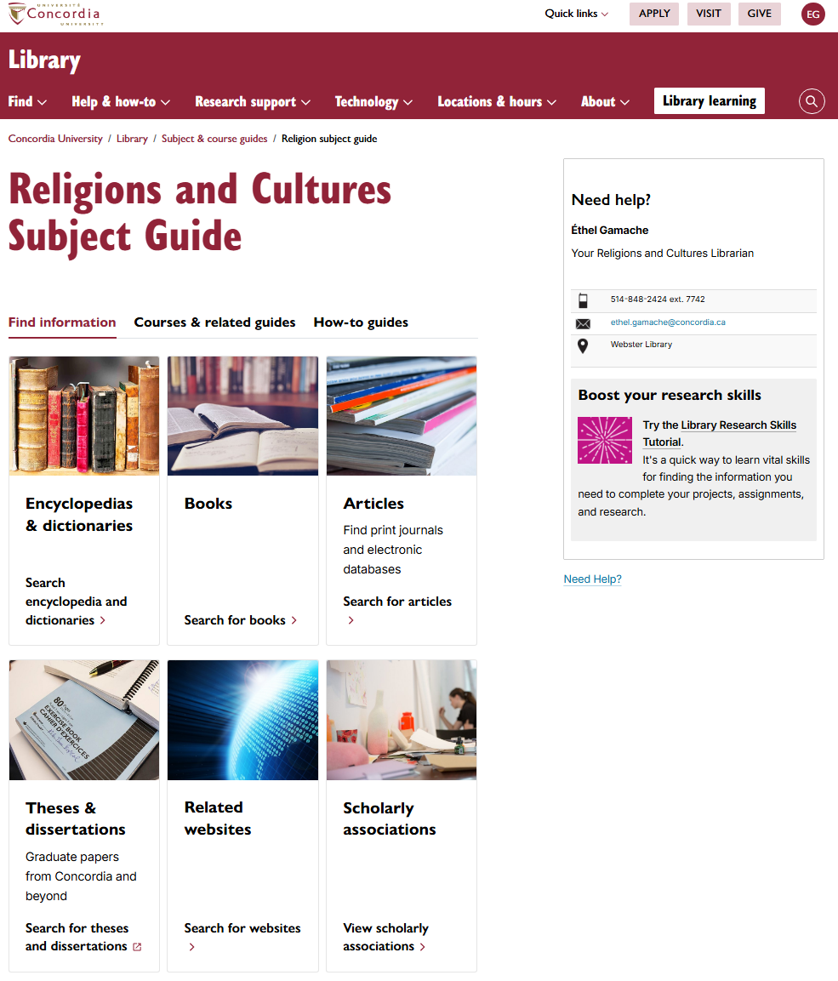
Research guide
Religions and Cultures Subject Guide
https://www.concordia.ca/library/guides/religion.html

Slide 8
Searching for information

Slide 9
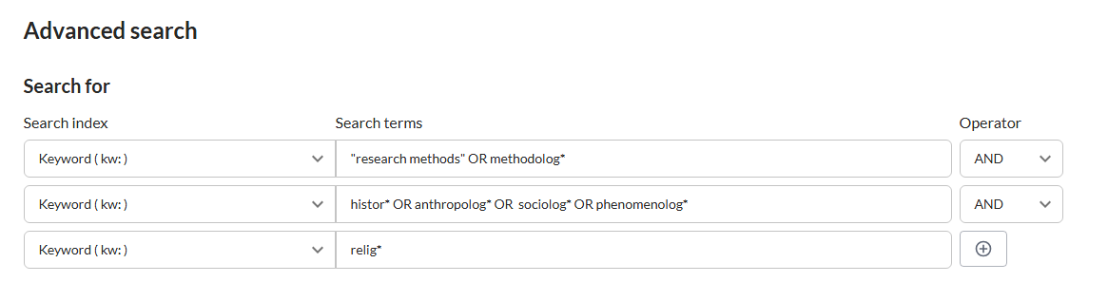
Sofia
Sofia Discovery tool
https://concordiauniversity.on.worldcat.org/discovery

Slide 10
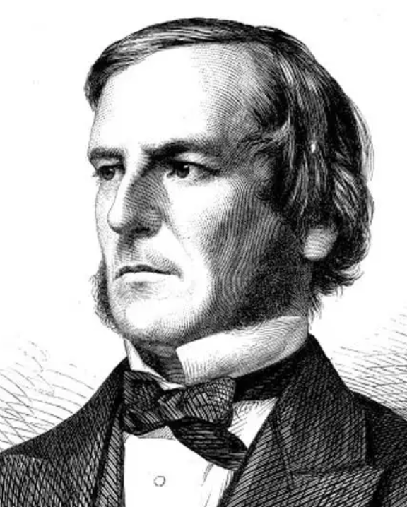
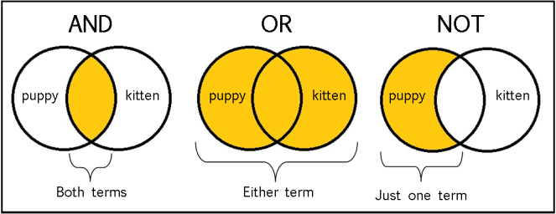
Boolean search operators
George Boole
1815-1864
Mathematician, logician
Image source: Library Of Antiquity. « Forgotten Skills: Boolean Searches ». The Library of Antiquity, 8 octobre 2016. https://libraryofantiquity.wordpress.com/2016/10/07/forgotten-skills-boolean-searches/.

Slide 11

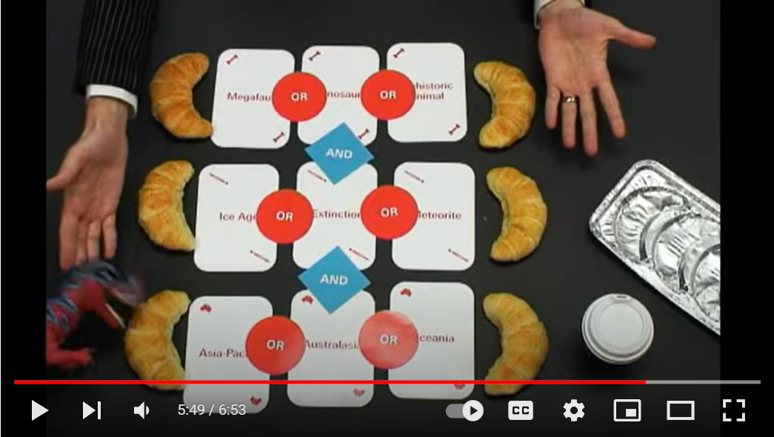
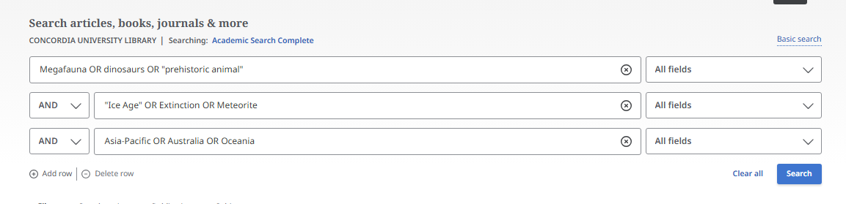
What is a Boolean Search?
Extrait du vidéo Search Smarter, Search Faster de l’Université de Sydney.
Notes:
Megafauna OR dinosaurs OR prehistoric animal
Ice Age OR Extinction OR Meteorite
Asia-Pacific OR Australia OR Oceania

Slide 12
Other Search operators
  Exact phrase searching
  Quotation marks (” ”) are used to search for an expression in its exact form (phrase searching). They are useful for expressions containing more than one word. For example, “rite of passage” or “research methods” will find these words written together, without their variants, in that order.
  Truncation
  The asterisk (*), placed at the end of a word, replaces 0, 1 or more characters. For example, chat* will find chat, chats, chatte, chaton, but also château, Chateaubriand, Châtelaine... It will not, however, find matou, félin, or lynx. Another example: relig*: religion, religions, religare, religious, religieux, religieuse.

Slide 13
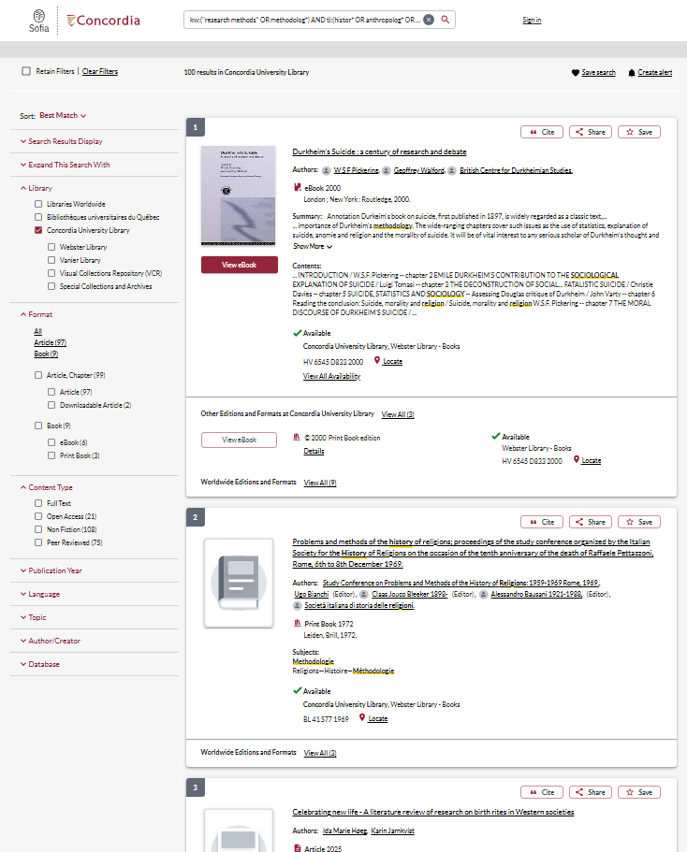

Slide 14
Sofia

Slide 15
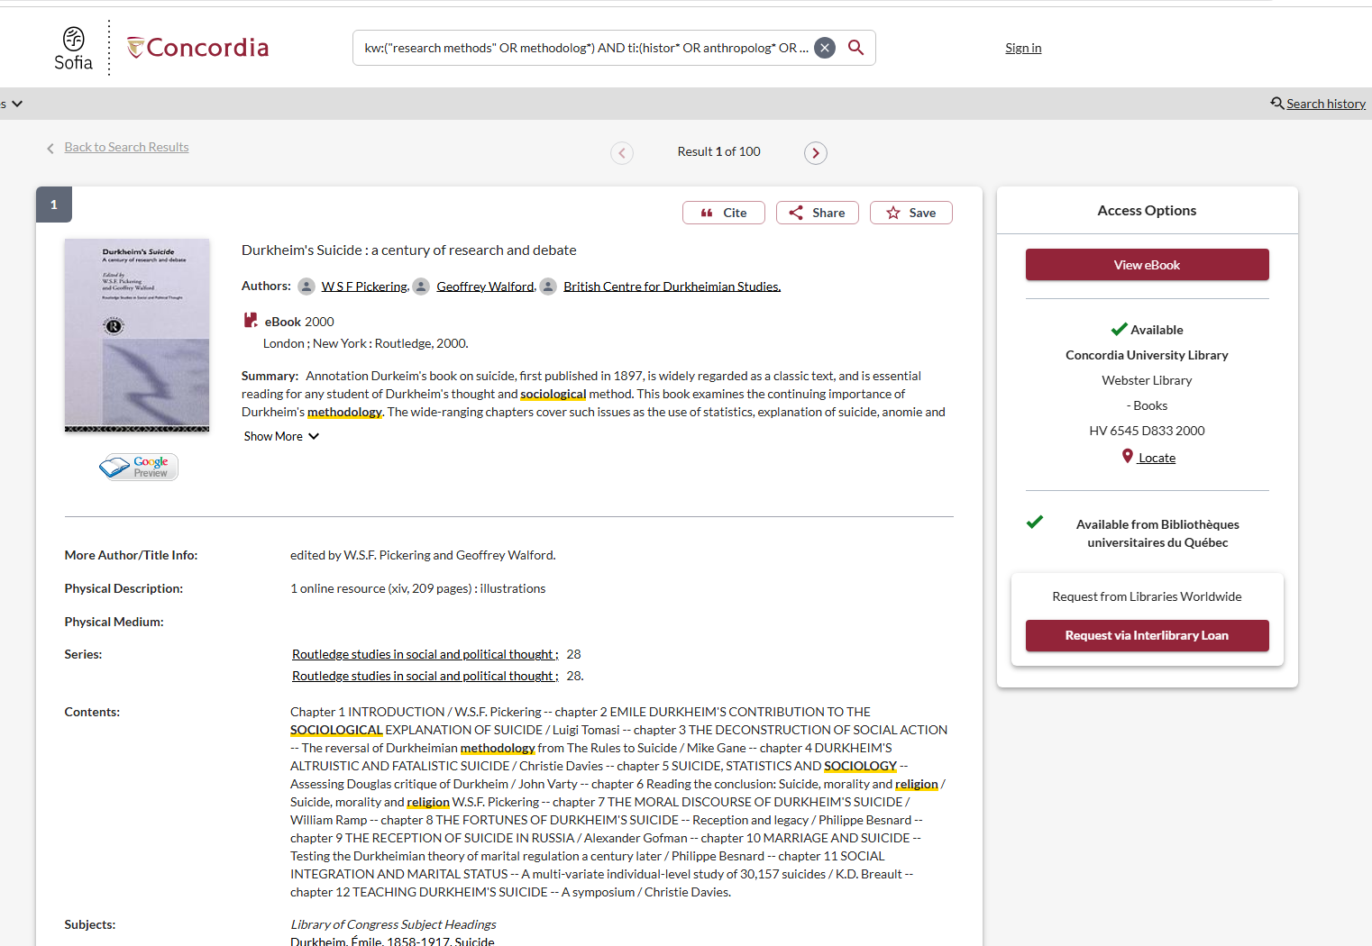
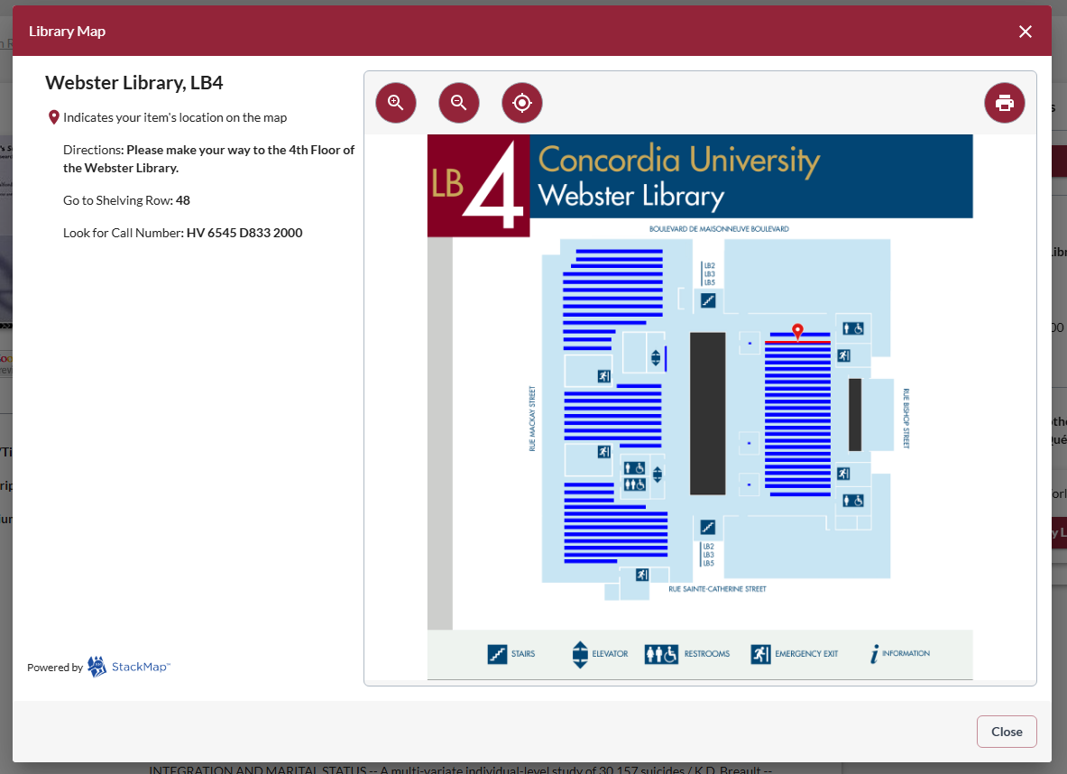

Slide 16
Interlibrary loans

Slide 17
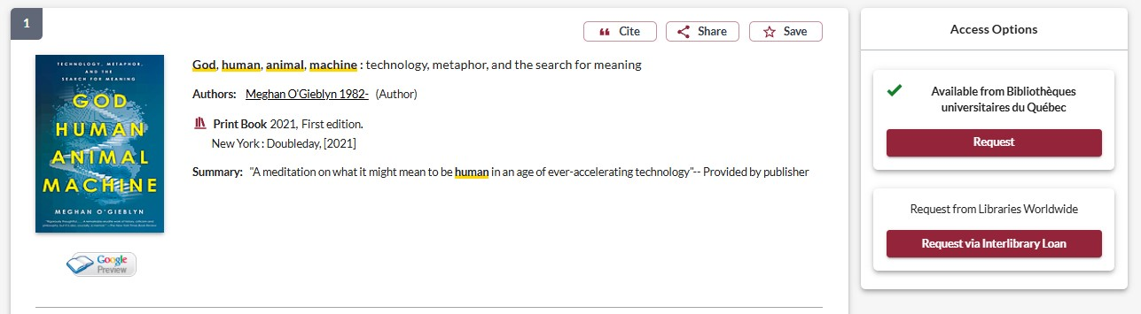
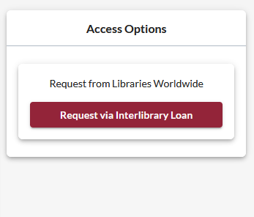
How to place an interlibrary loan request
Notes:
This is what the Interlibrary loan process will look like. The process for requesting a book through the Quebec universities is less complicated, so I will only show you the ILL request process for now.
Once you find what you need, you can place an interlibrary loan request by selecting the "request via interlibrary loan“ button in the panel to the right of the record. If the thing you’re looking for is just one chapter of a book, you can also request a chapter scan using the interlibrary loan request.

Slide 18
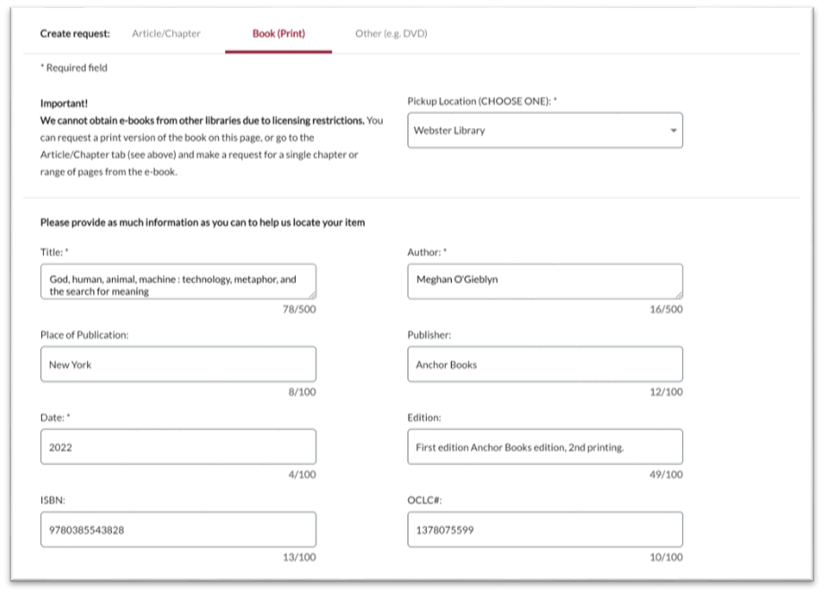
How to place an interlibrary loan request

Slide 19
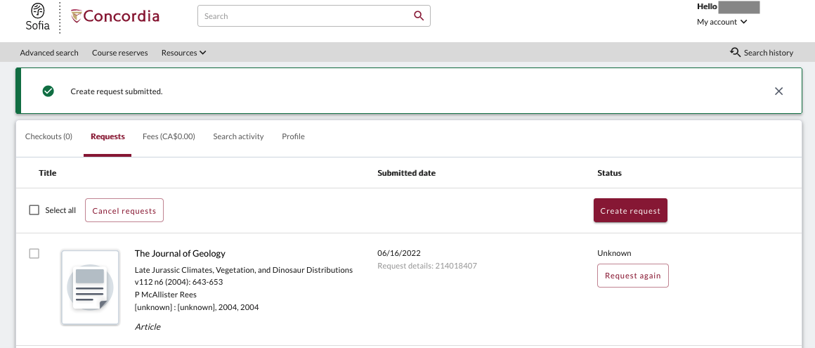
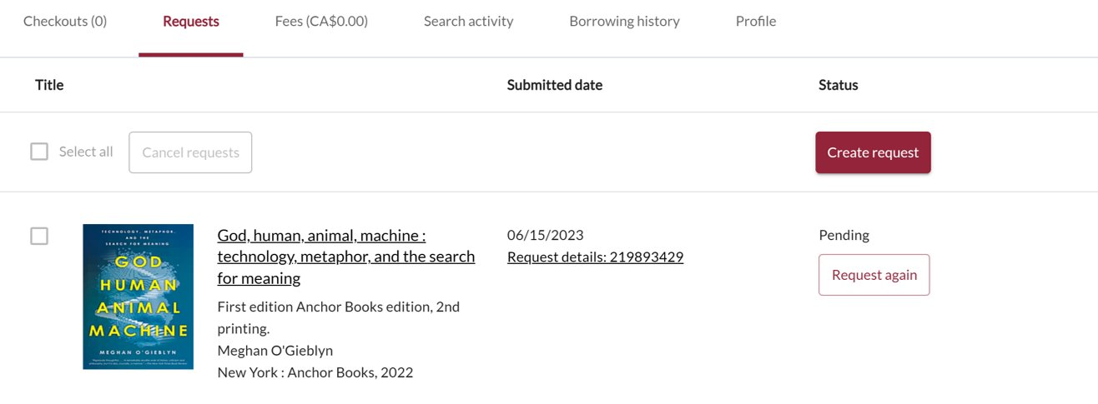
Notes:
Both kinds of requests – ILLs and scan requests – can be viewed under the requests tab when you log into your library account. The request up top here is for an article scan, the second is for a book through interlibrary loan.

Slide 20
Interlibrary Loans
The Interlibrary Loans service is free and illimited.
You will receive email notifications when your ILL request is available for pickup or download.
Physical items can be picked up at the Circulation/Loans desks at either Vanier or Webster Library.
ILLs can be borrowed for 6 weeks.

Slide 21
Chapter scan & course reserves

Slide 22
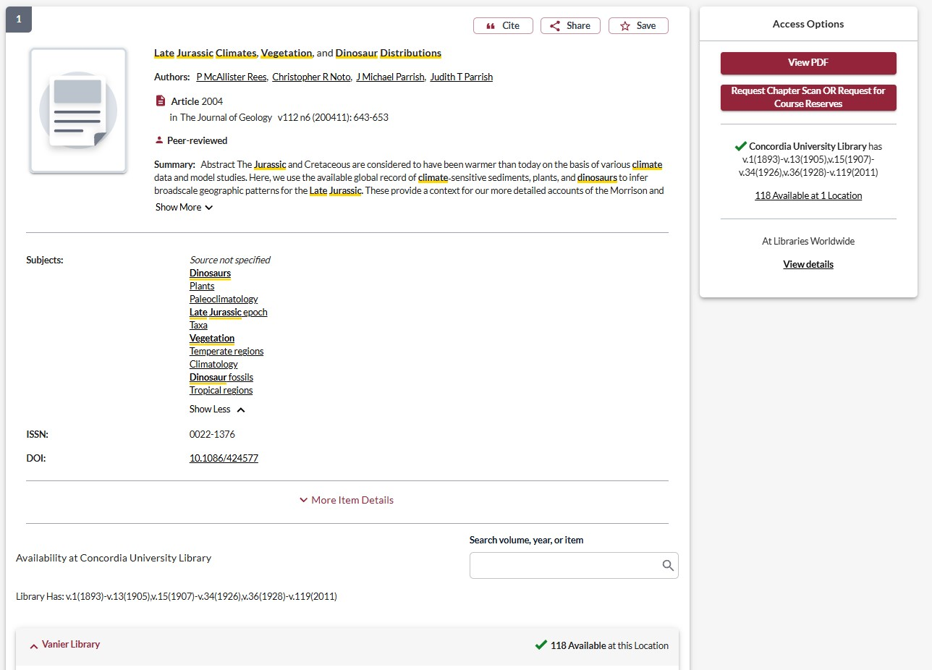

Chapter scan & course reserves
Notes:
You might also notice this button next to books in Concordia’s collection. You can use this to request scans of chapters, articles, or microfilm if you are unable to come to the library to consult them. It usually takes about 5 days to receive your scans after you place the request.

Slide 23
E-journals via Sofia

Slide 24
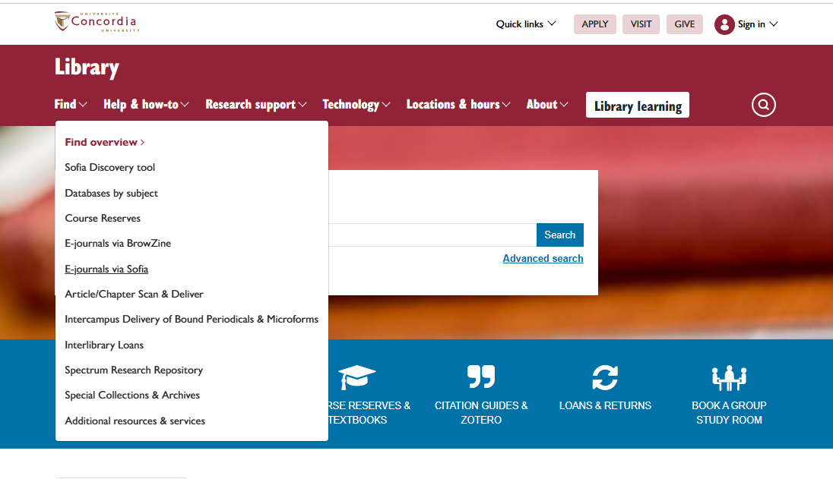
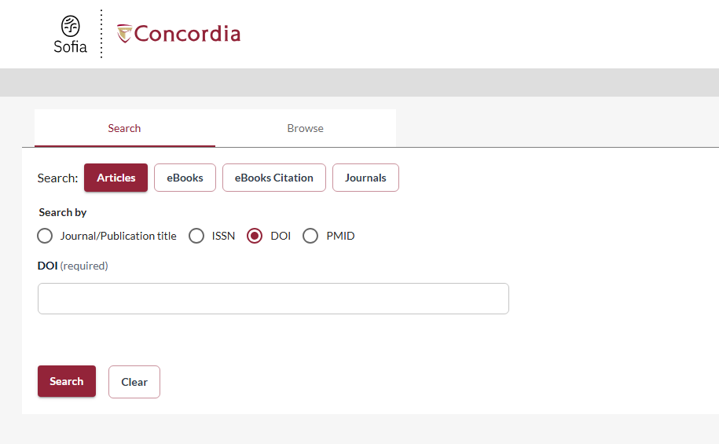
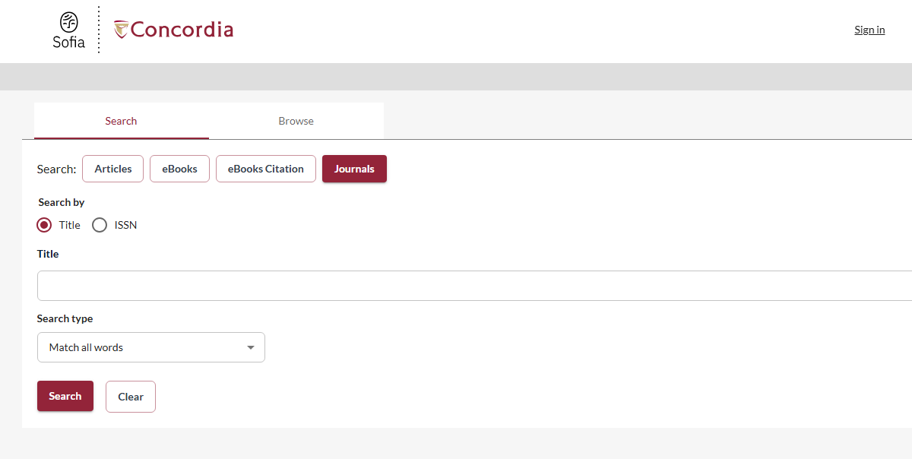
E-journals via Sofia
Notes:
Example DOI: 10.1111/j.1532-5415.2005.53271.x
Journal example: Canadian Jewish Studies / études juives canadiennes

Slide 25
DOI example
Høeg, Ida Marie, and Karin Jarnkvist. “Celebrating New Life - A Literature Review of Research on Birth Rites in Western Societies.” International Journal of Sociology and Social Policy 45, no. 7-8 (2025): 710–24. https://doi.org/10.1108/IJSSP-09-2024-0449
Notes:
10.1111/j.1532-5415.2005.53271.x

Slide 26
Databases

Slide 27
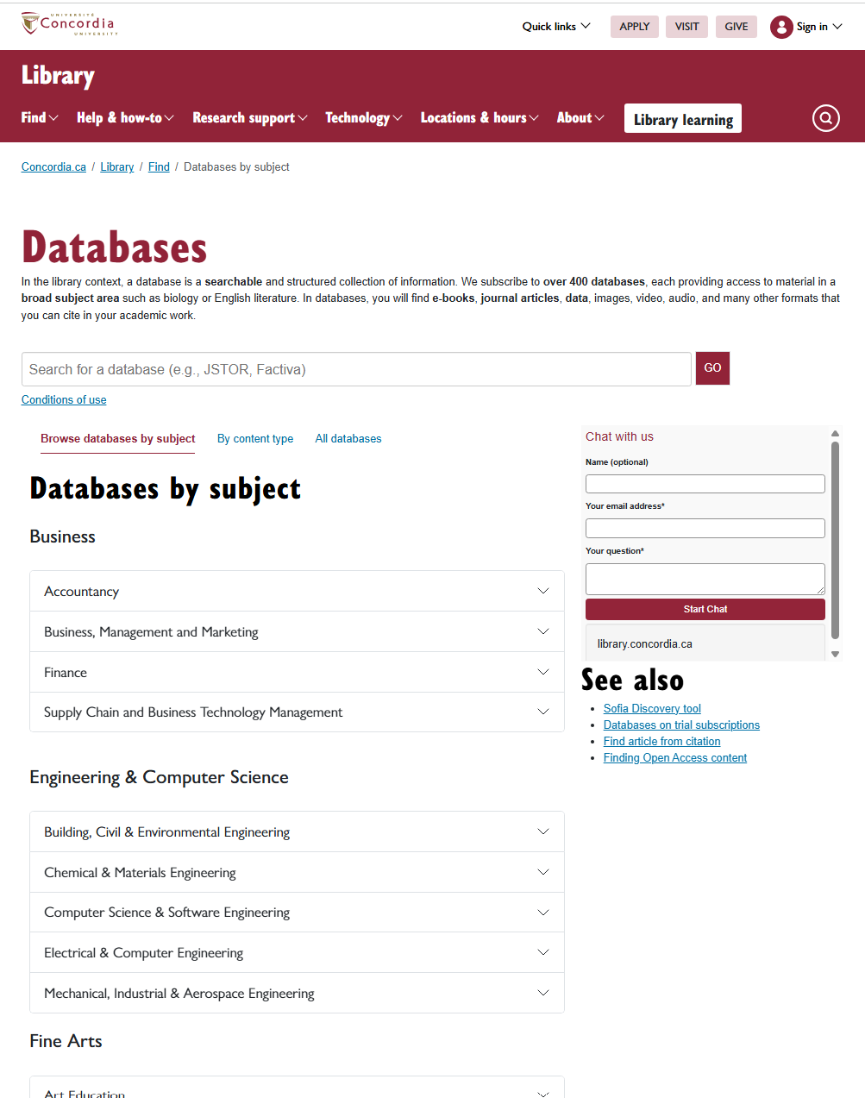
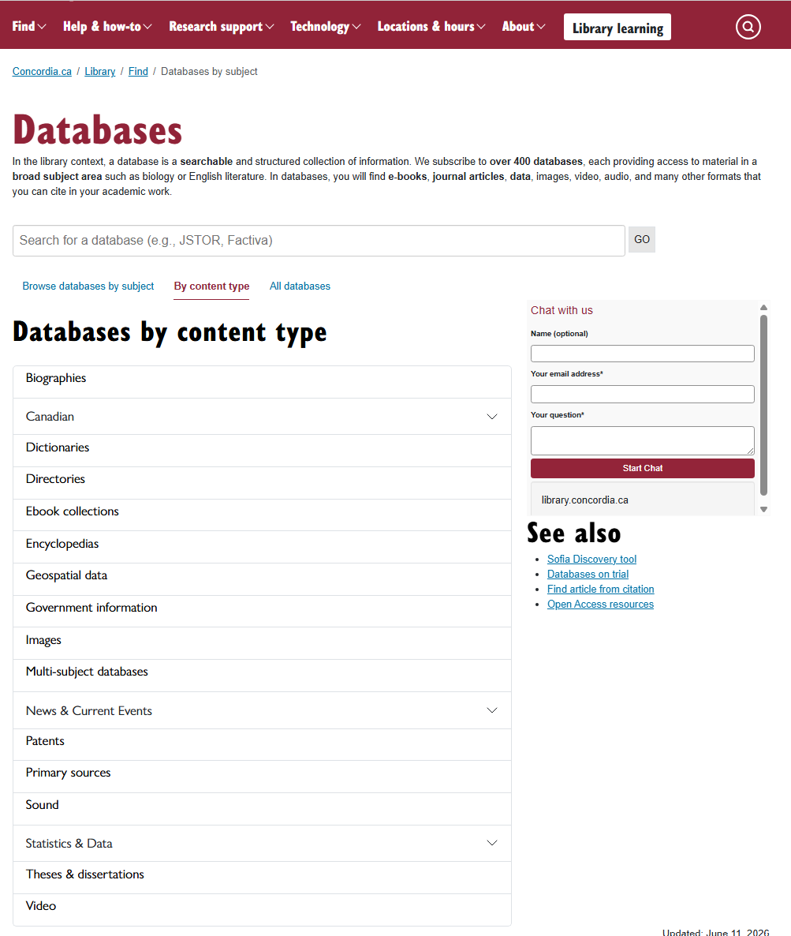
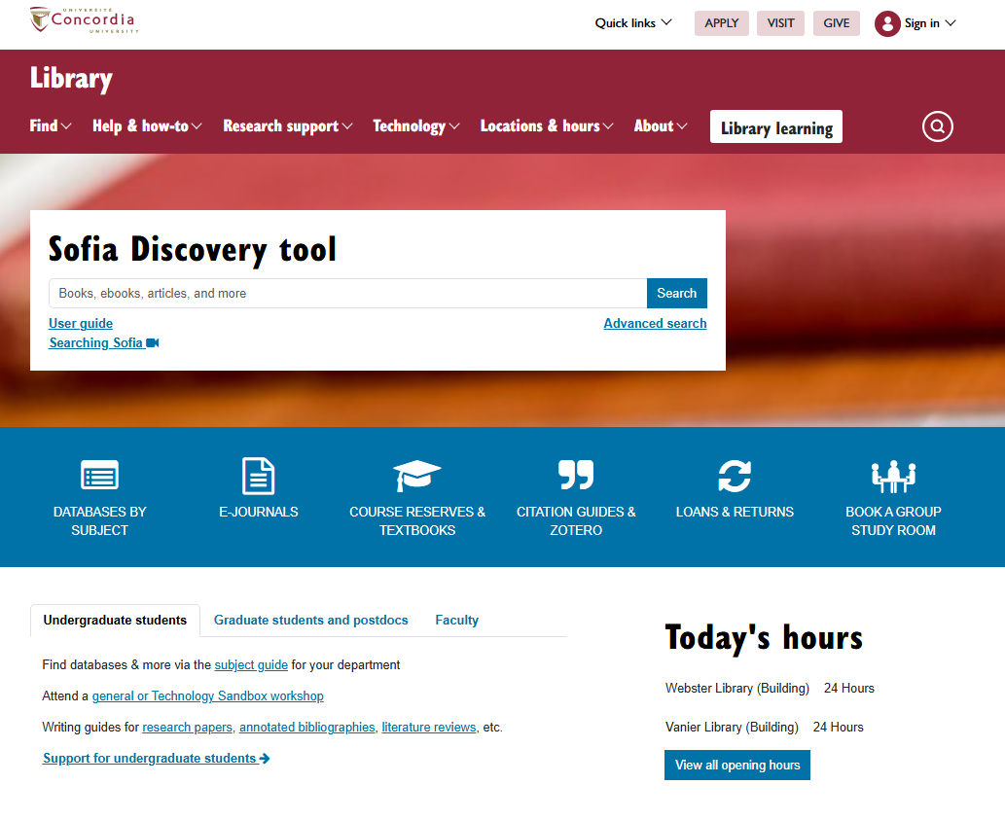
Databases

Slide 28
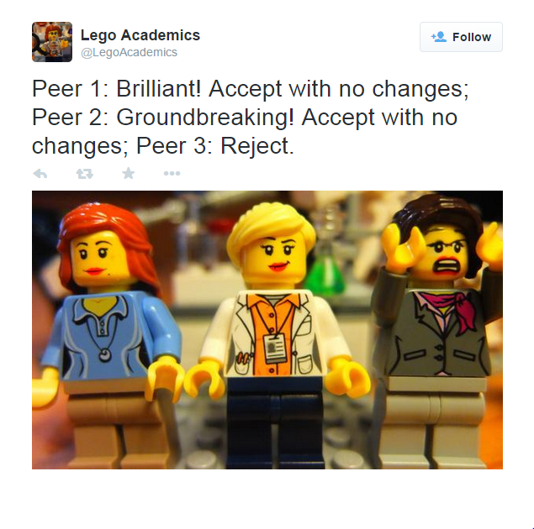
The peer-review process
Image source: Yates, D. [@LegoAcademics]. (2014, August 12). Peer 1: Brillant! Accept with no changes; Peer 2: Groundbreaking! Accept with no changes; Peer 3: Reject. [Tweet]. Twitter. https://twitter.com/LegoAcademics/status/499205005468262400/photo/1

Slide 29
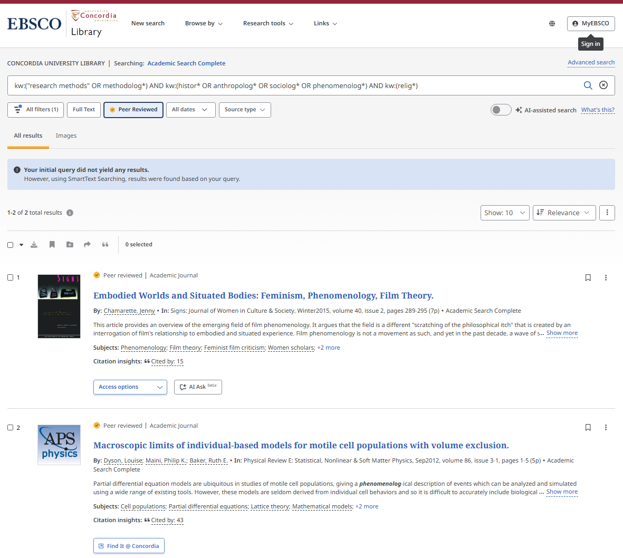
Academic Search Complete

Slide 30
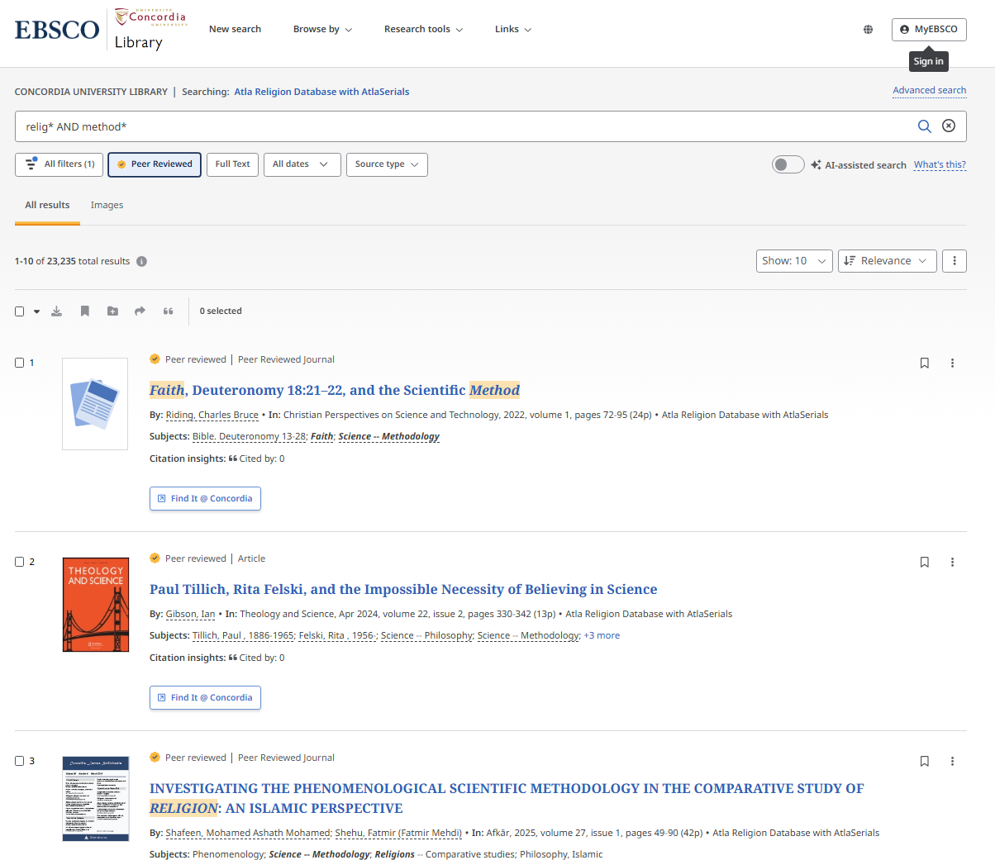
ATLA
Notes:
kw:("research methods" OR methodolog*) AND kw:(histor* OR anthropolog* OR sociolog* OR phenomenolog*) AND kw:(relig*)

Slide 31
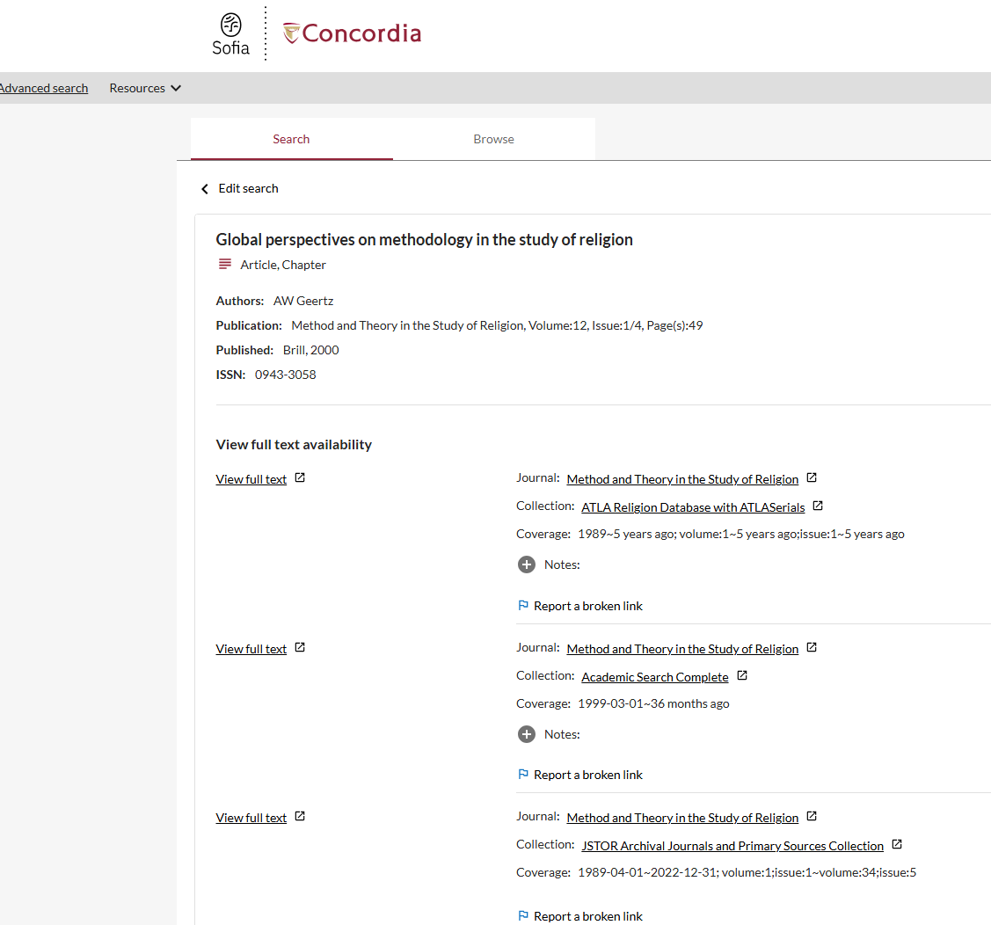
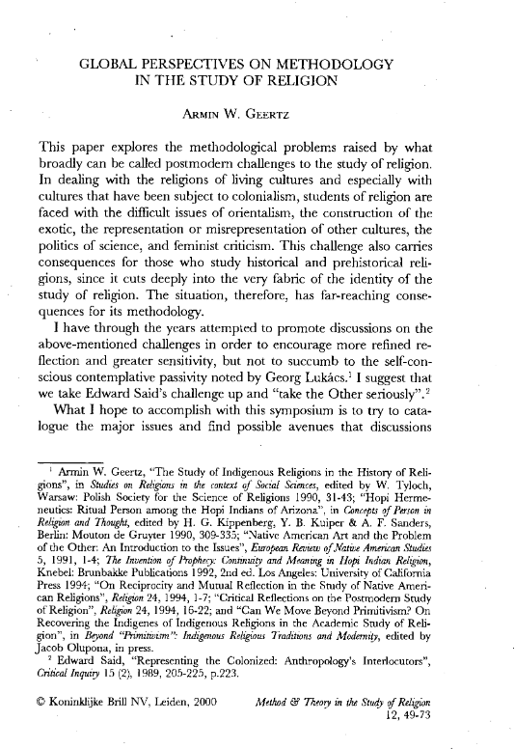
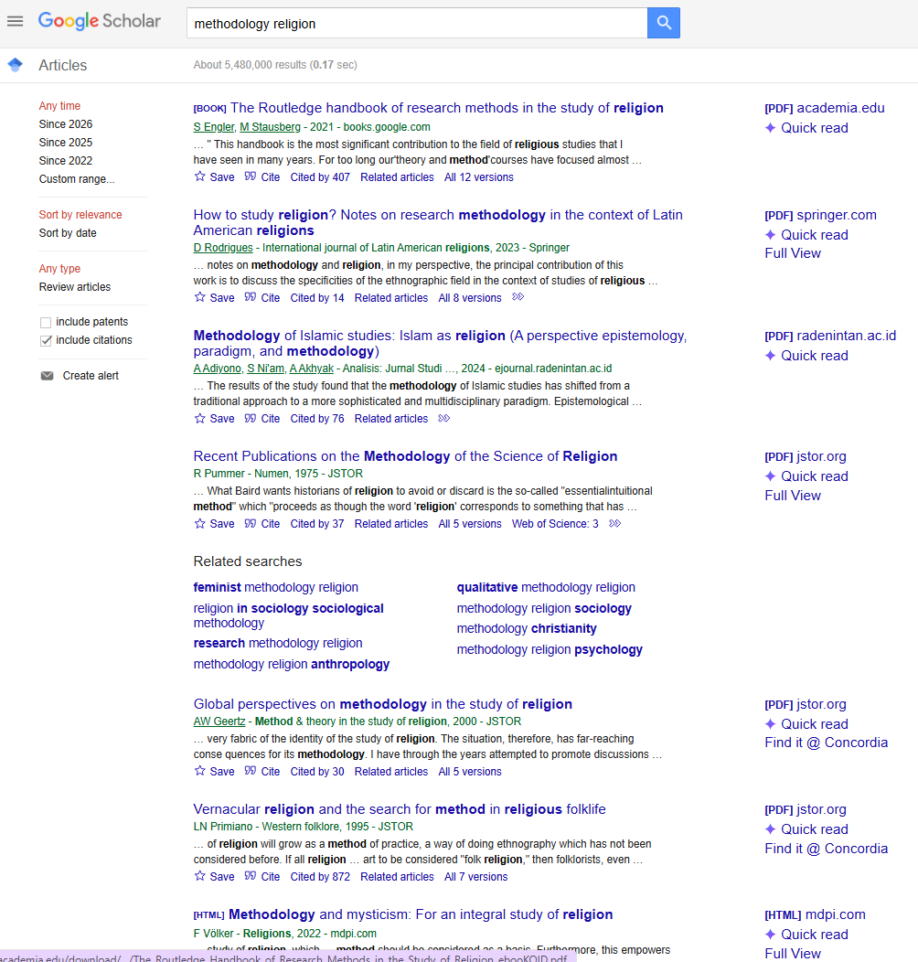
Google scholar

Slide 32

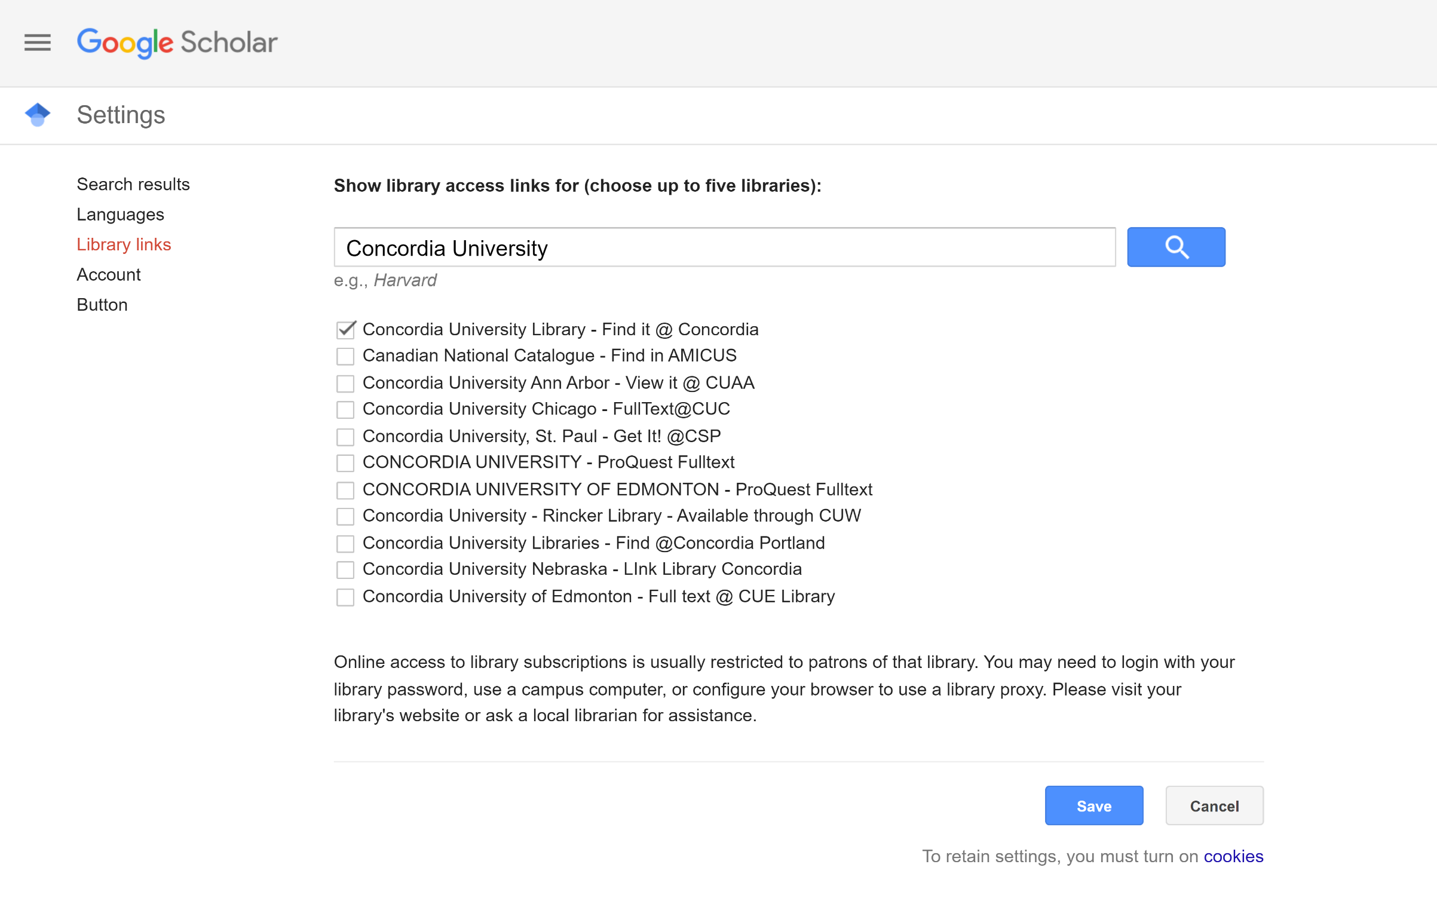
Google Scholar – select a library access link

Slide 33
Citing

Slide 34
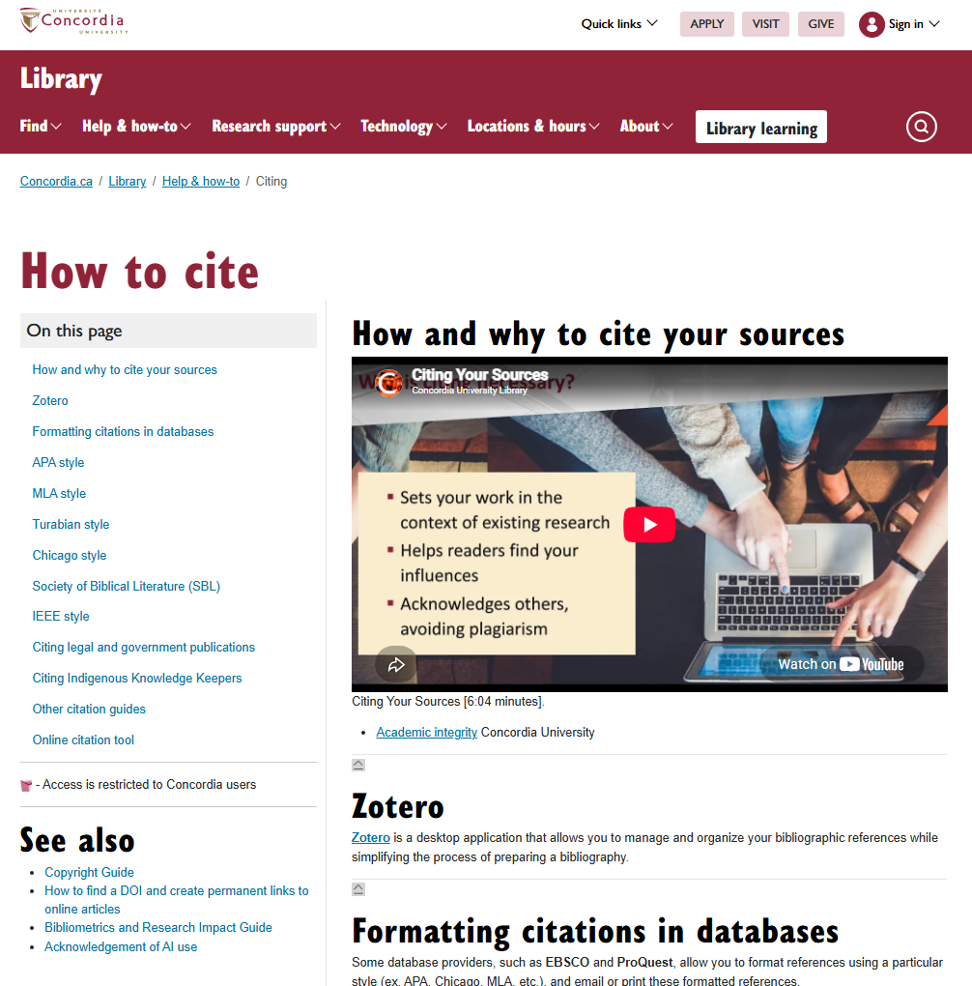
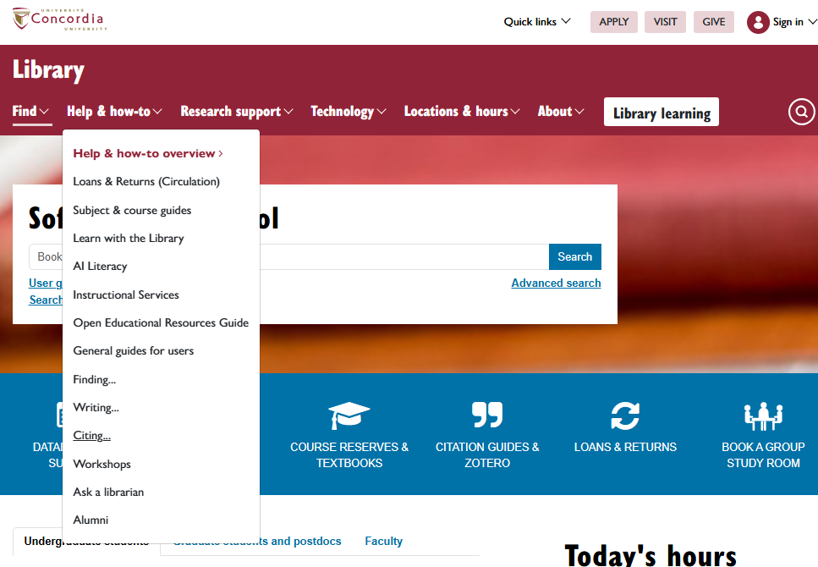
Citation help

Slide 35
Zotero

Slide 36
Zotero
Is a bibliographic management tool
Stores and organizes citations from various sources (journal articles, books, websites, artworks, data sets, etc.).
Supports tagging, collections, attachments (PDF, Word files), notes and folders for easy organization.
Generates citations and bibliographies in multiple styles.
It allows you to create a library/collection of your own. It acts as a repository, not a discovery tool.
Integrate Zotero with a text editor
Share research collections with collaborators.
This is an overview; the Library offers Zotero workshops, the complete workshop lasts 90 minutes.

Slide 37
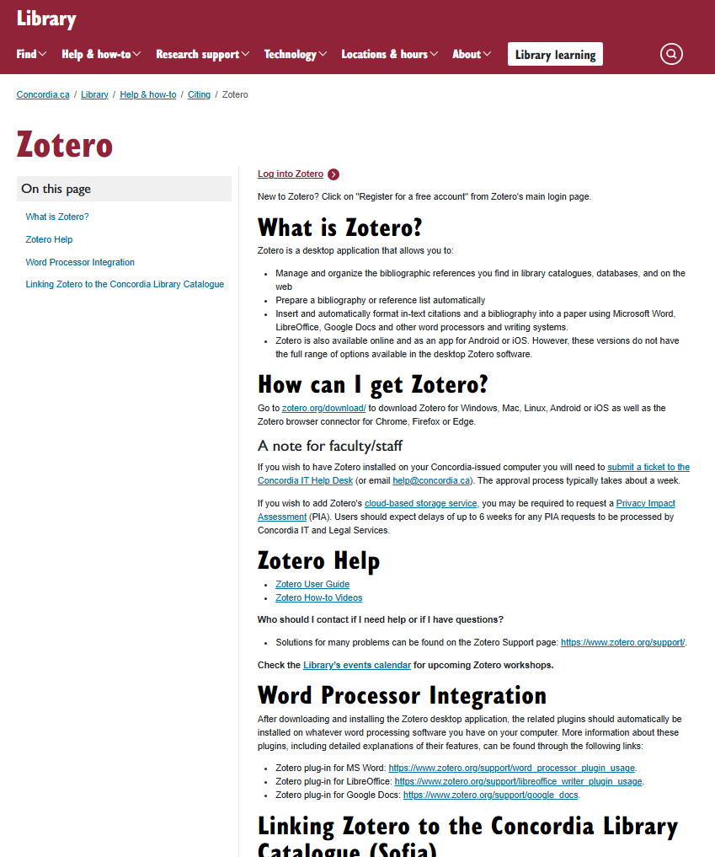
https://library.concordia.ca/help/citing/zotero/index.php

Slide 38
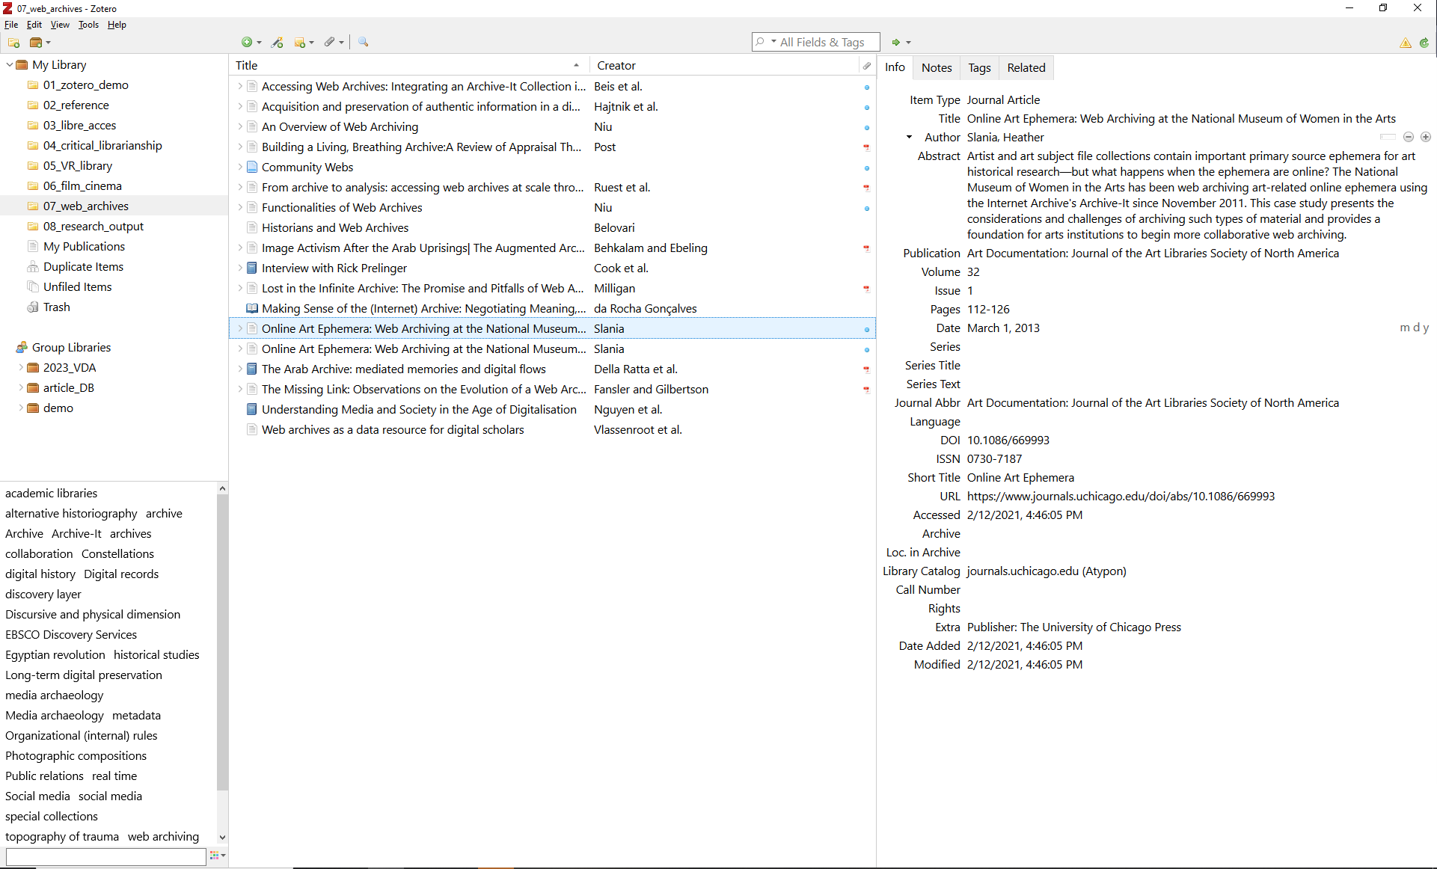
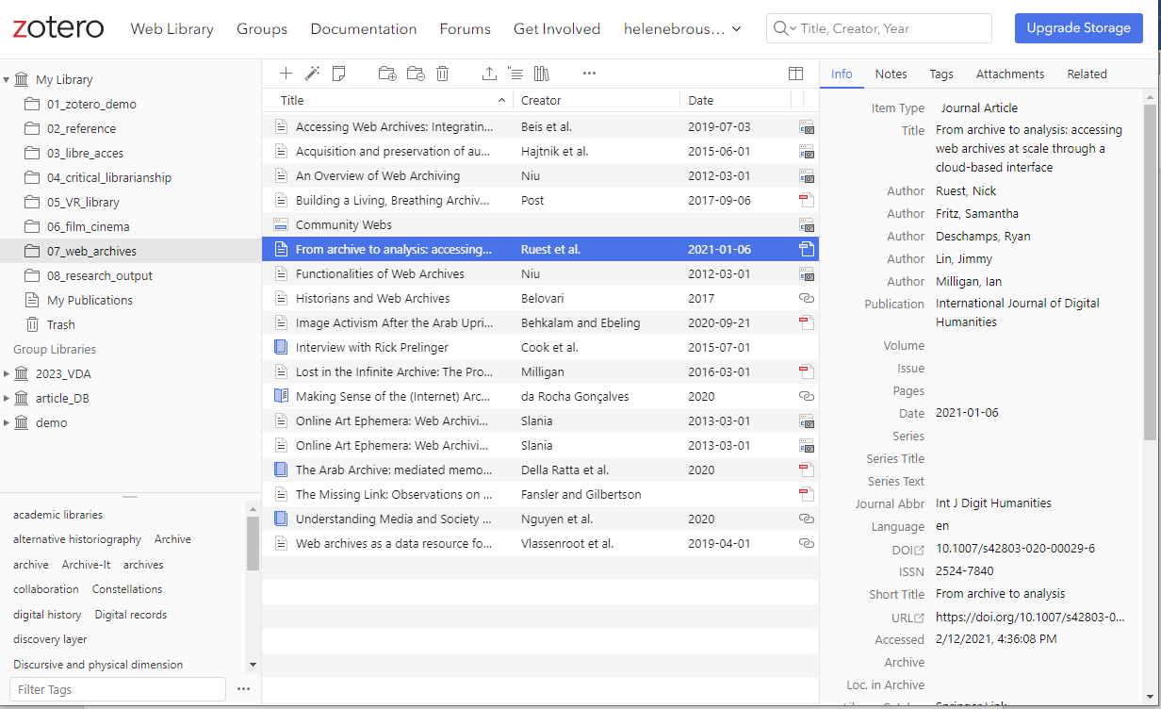
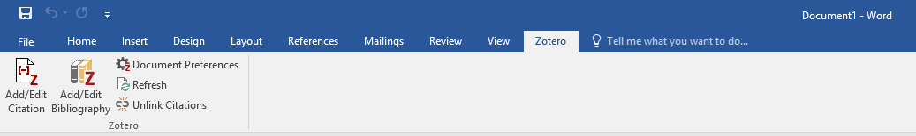
How do I access Zotero?
Desktop application
Web browser version
Web browser extension
Add-on for writing software
38 /
Notes:
2026-10-27
38
38

Slide 39
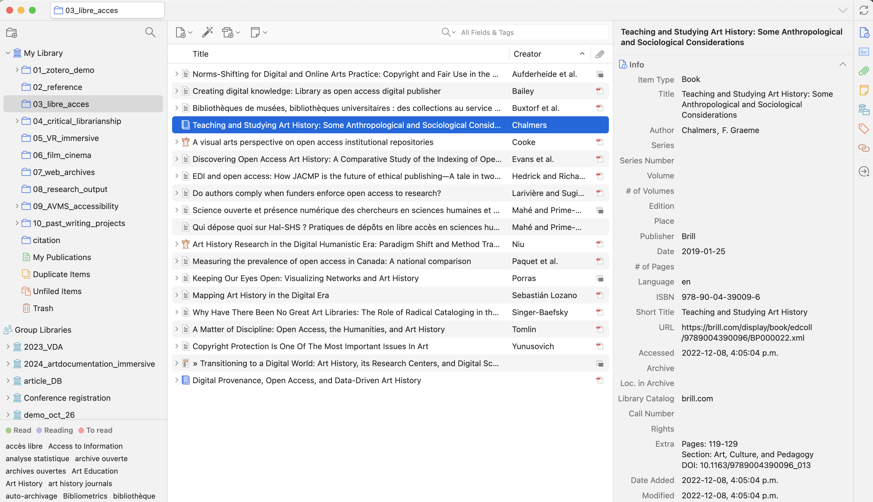
Introduction to Zotero for desktop
4
1
2
39 /
3
Notes:
2026-10-27
39
39
Present the three main navigation panes and menu
1-Libray and Group libraries
2-List of resources in the selected library
3-Item pane
4-Navigation menu

Slide 40
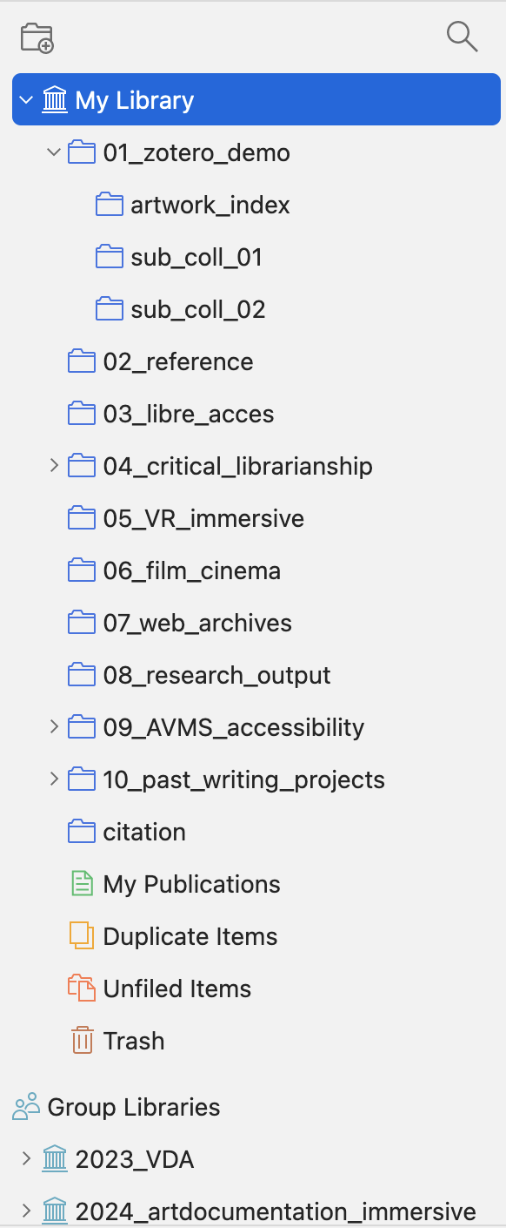
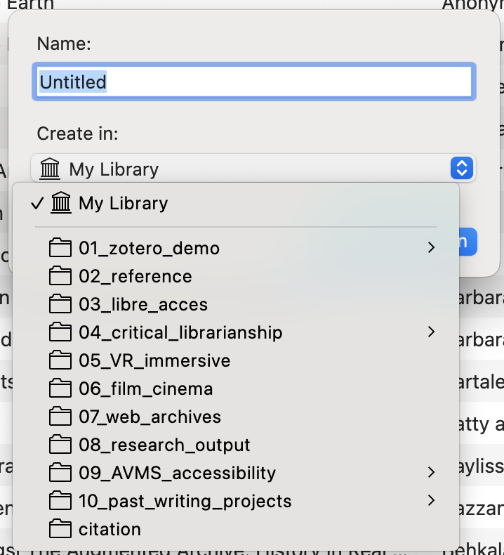
Introduction to Zotero for desktop
3
4
2
1
40 /
Notes:
2026-10-27
40
40
A closer look at the Libraries pane
1-Present folder system, discuss organisation of libraries in folders, naming convention, etc.
2-Show sub-folders
3-Button to create new folders
4-pop-up menu when you create a new folder, discuss the ability to select where the folder will be created: for example in the main library or a sub-folder in an existing library

Slide 41
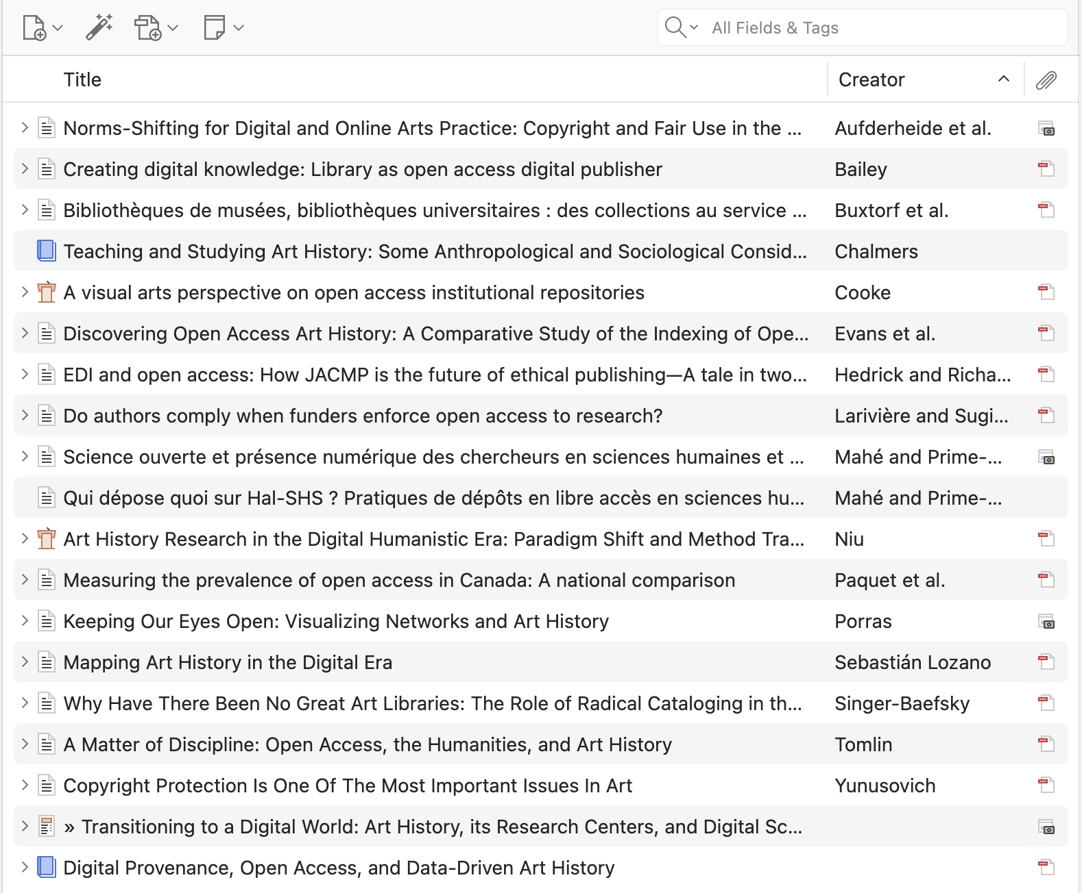
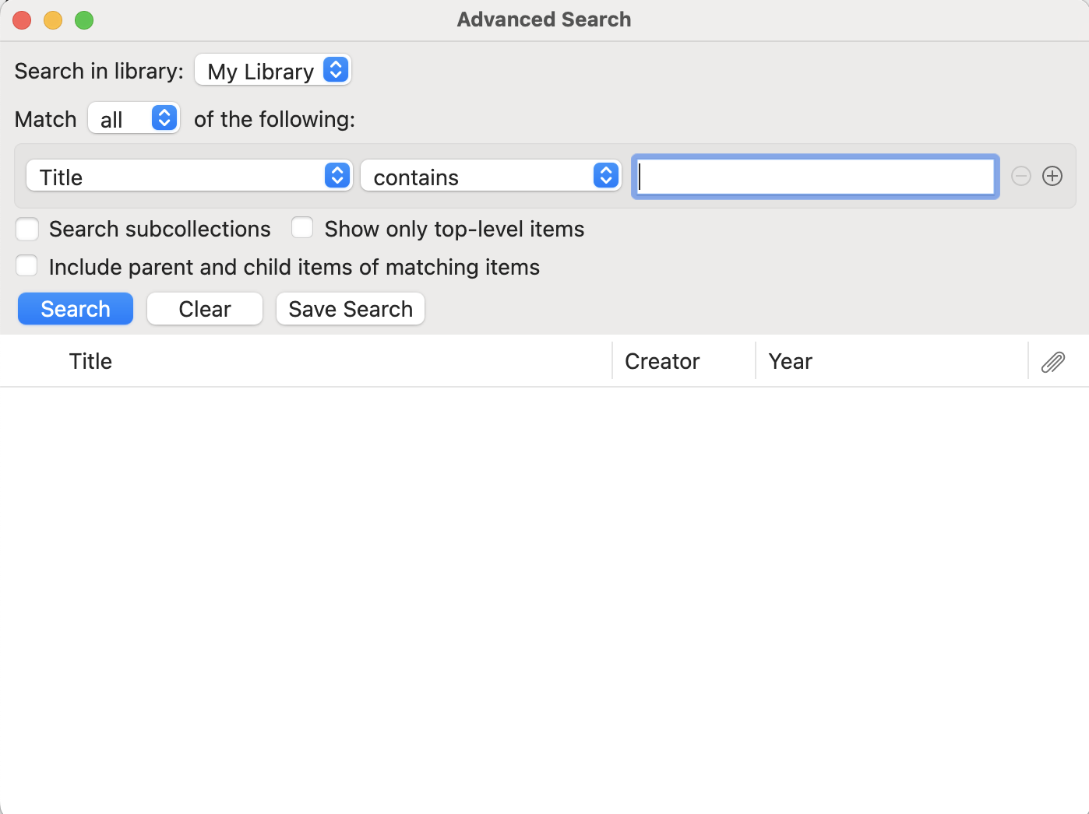
Introduction to Zotero for desktop
1
2
3
2
Notes:
2026-10-27
41
41
A colser look at the list of resources pane:
1- Create a new item manually or import useing magic wand with ISBN, DOI, PMID, arXiv id, etc.
2-Add to your reference: attach a file button and create a new note buttons
3-search box and pop-up window

Slide 42
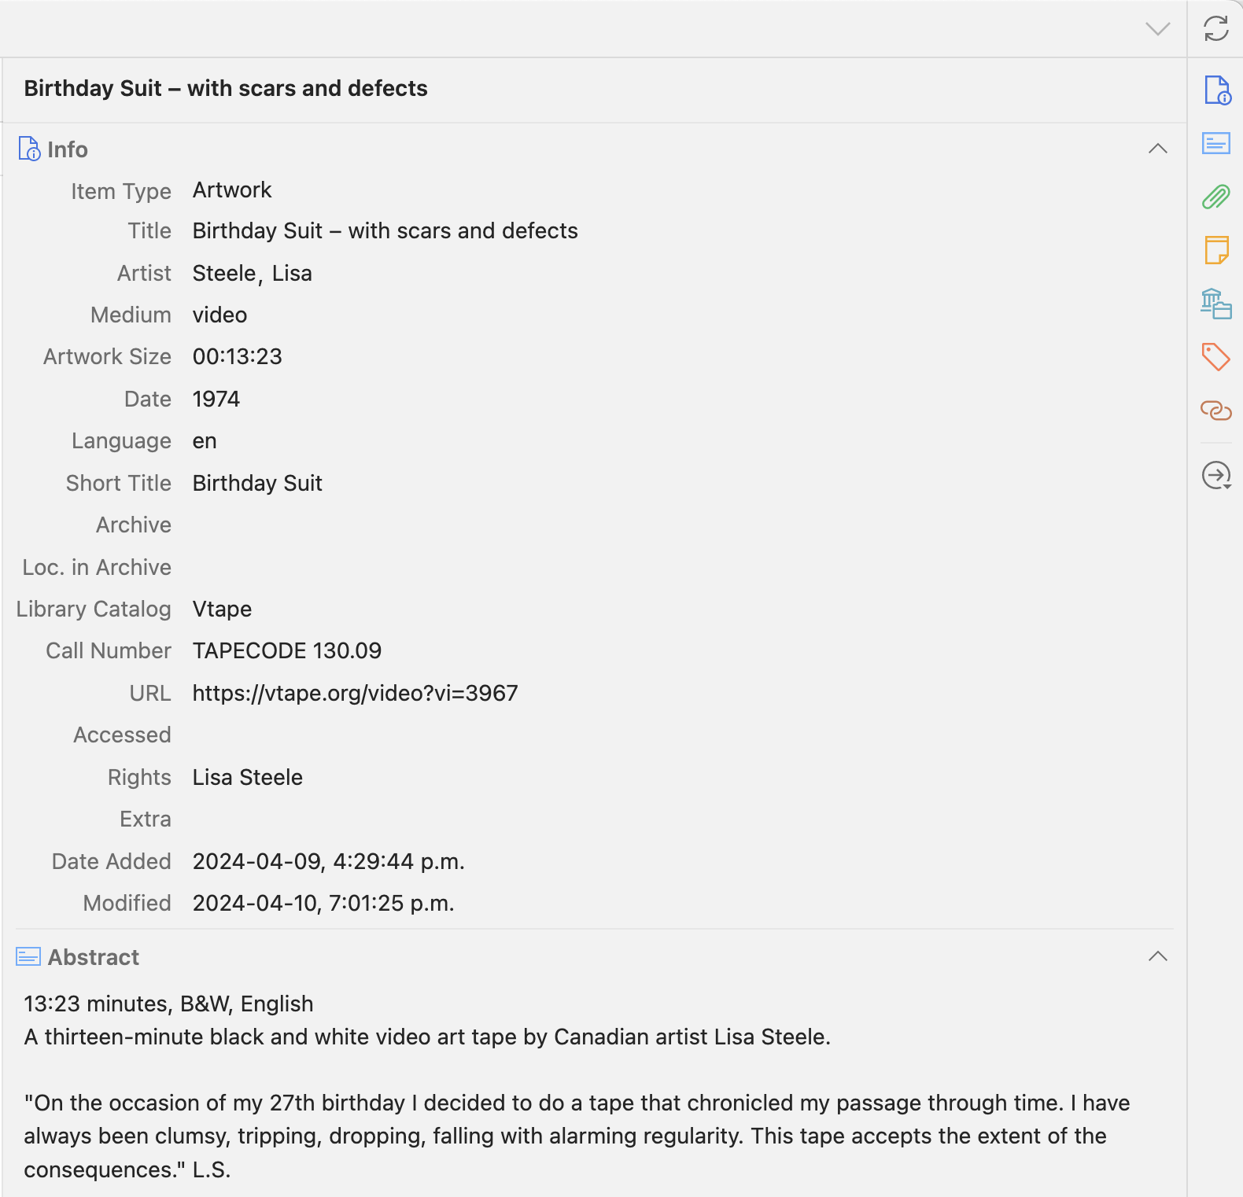
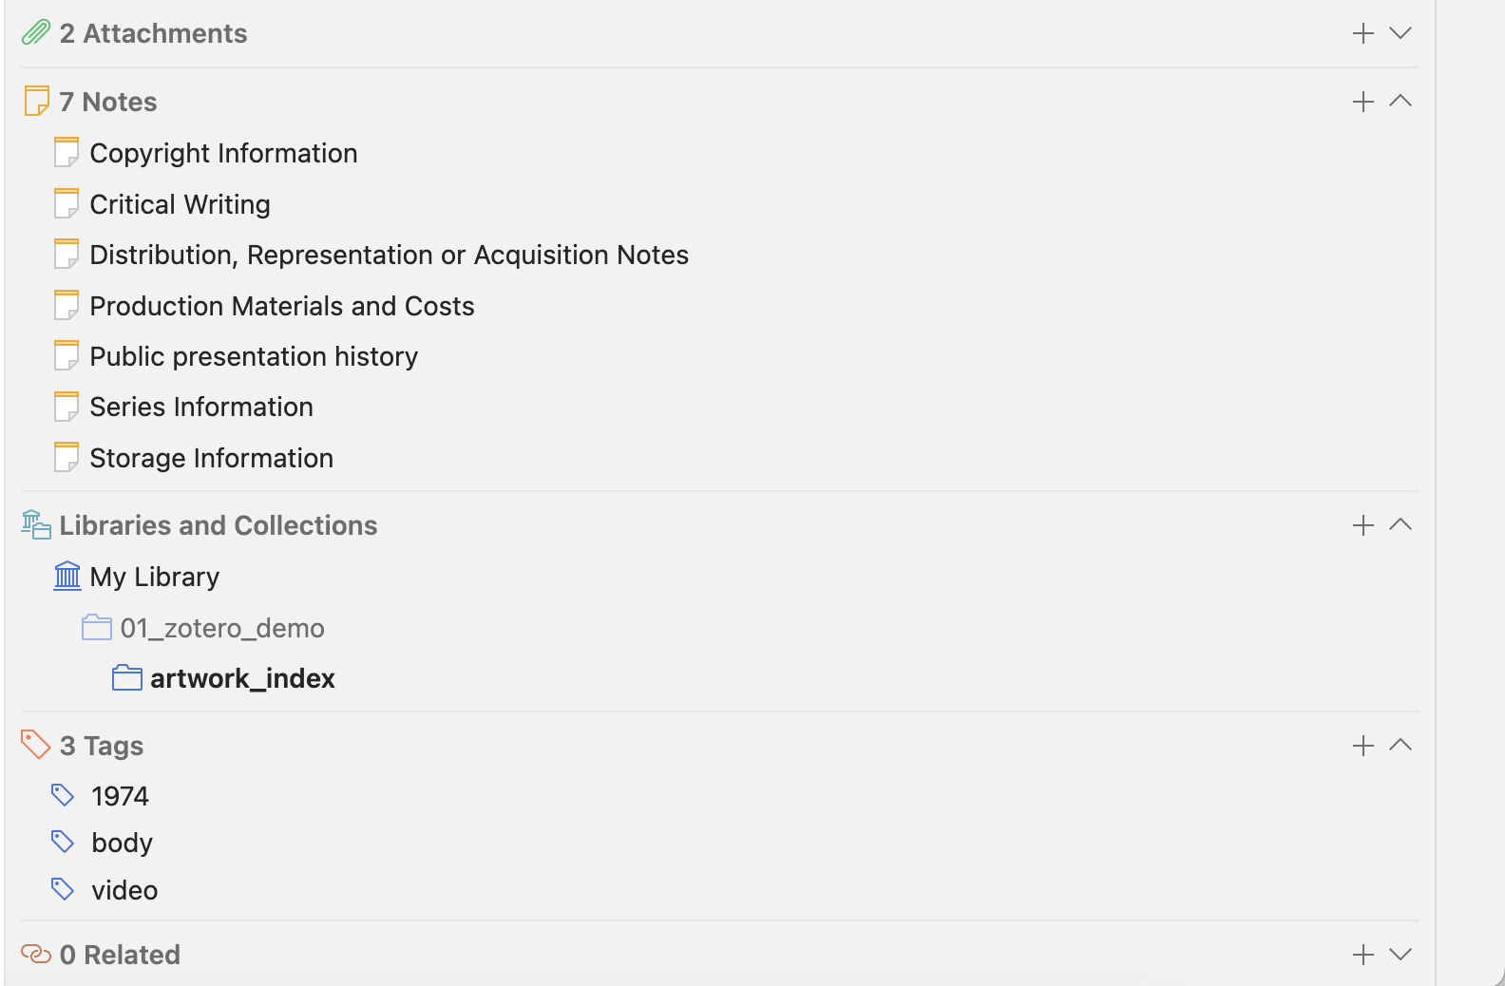
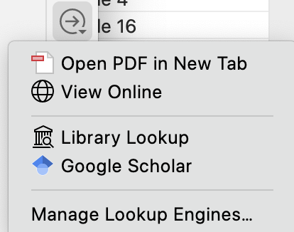
Introduction to Zotero for desktop
2
4
3
1
42 /
Notes:
2026-10-27
42
42
A closer look at the item level pane and menu for item éléments
1-General box, space to verify and edit information (note that you have to scroll to see full record)
2-Refresh button, to syncronize your libraries with collaborators, with the web version or other devices.
3-Navigation menu for all éléments available in the resource record. Click and it scrolls to the right place in the record. Note the repeated icons in the record’s left hand side.
4-Look-up the item: open the pdf or view online

Slide 43
Some highlights and comparisons
Desktop version
Web version
Import references from web browser
Create a bibliography
Add/edit/remove references from a shared library
Insert citations in LibreOffice, Microsoft Office or Google Docs
Add features (e.g. auto-capture PDF annotations)
Import references from a web browser
Create a bibliography
Add/edit/remove references from a shared library
Create a shared library
Access from any computer
Requires Internet connection
300 MB free storage
43 /
Notes:
2026-10-27
43
43
Office software / word processing software

Slide 44
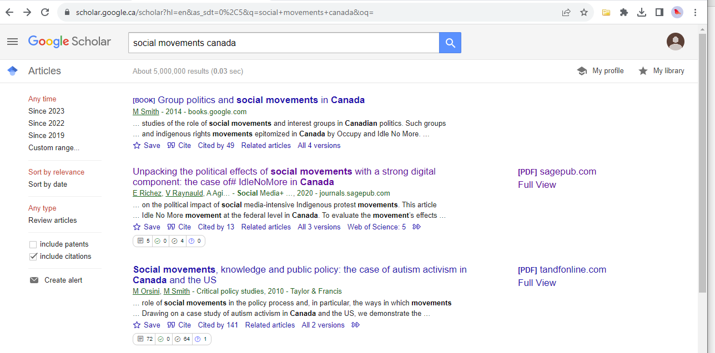
Building your personal Database of References:
Importing from Google Scholar
44 /
Notes:
2026-10-27
44
44

Slide 45
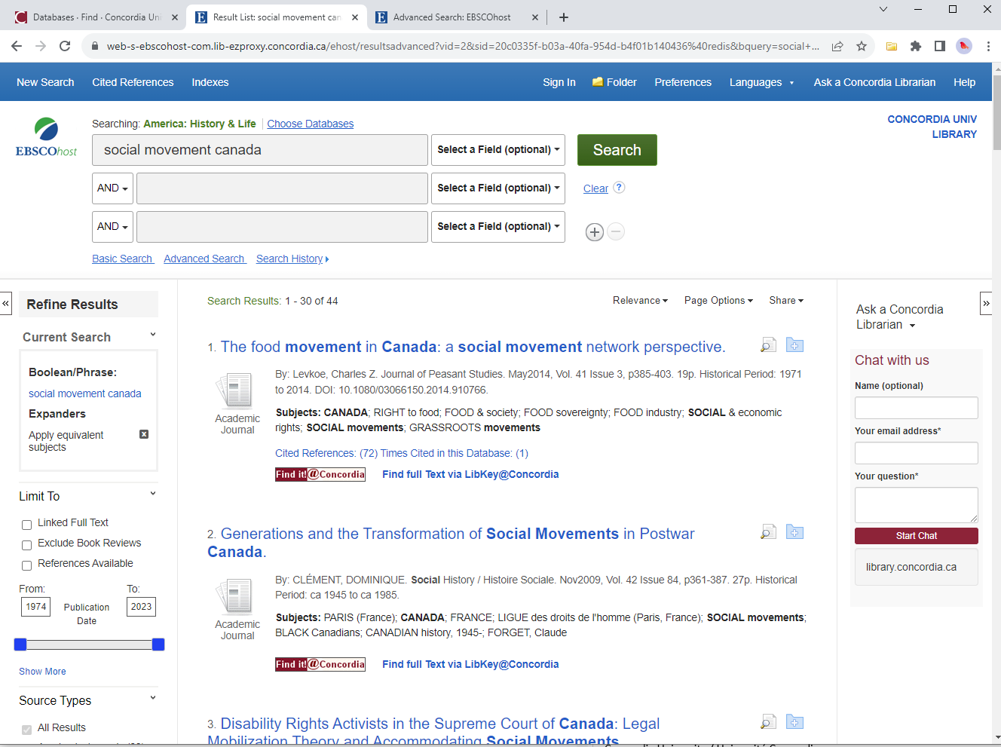

Building your personal Database of References:
Saving a list of references
45 /
Notes:
2026-10-27
45
45

Slide 46

Building your personal Database of References: citation button
46 /
Notes:
2026-10-27
46
46

Slide 47
Ask a Librarian

Slide 48





https://library.concordia.ca/help/questions/
Ask Us desk, chat, email or phone

Slide 49
Thank you for your participation!
Questions?
Éthel Gamache
ethel.gamache@concordia.ca

