Slide 1


RELI 409
METHODOLOGY AND
THE STUDY OF RELIGION
LIBRARY WORKSHOP
Monday, October 27, 2025
Éthel Gamache, Librarian | ethel.gamache@concordia.ca

Slide 2
Sources to support your fieldwork research project
Consulting at least three academic sources.
Searching for popular media related to the community (newspapers, magazine and other media).
Exploring the website of the researched religious communities.

Slide 3
Outline
How to find and access resources
  Search operators
  Introduction to the Library website & the Religions and Cultures subject guide
  Using Sofia and Interlibrary loans
  Using the databases Academic Search Complete, ATLA and Google Scholar to find academic articles
  Using the databases Canadian Newsstream and Eureka.cc to find newspaper articles
  Using Google Advanced Search to explore websites

Slide 4
Ice-breaker Activity
I use or have used online library services.
I know how to apply boolean logic to searching.
When I search for articles, I often don’t find what I’m looking for.
I prefer to use Google / Scholar to find scholarly articles.
I have attended a library workshop before.
I’ve met with a librarian to find relevant sources for an assignment.
Move your fingers
Touch your head
Play air piano
Wave
Take a bow
Clap your hands
This activity was created by K-Lee Fraser, University of Toronto Scarborough, K-Lee's Remixed Information Literacy Games. (unpublished)

Slide 5

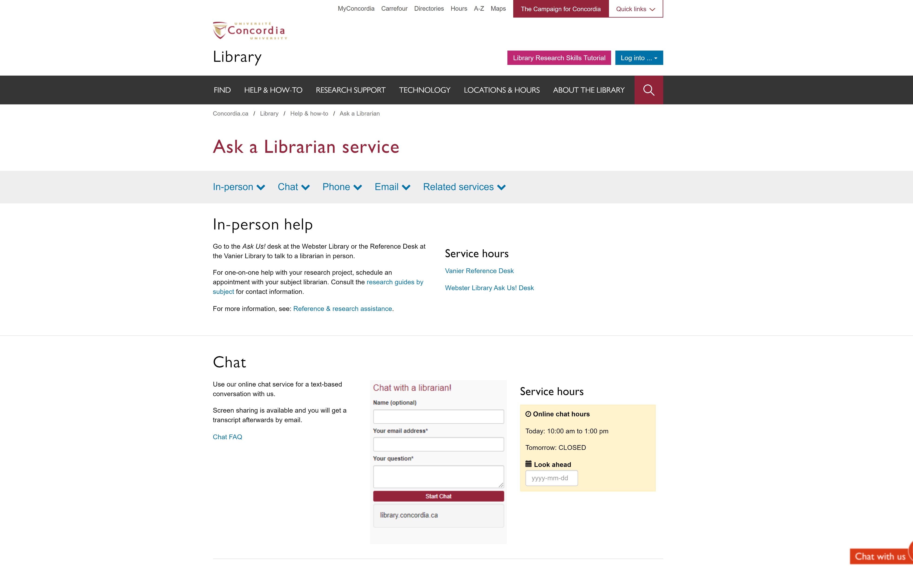
Concordia Library Website – Ask a Librarian

Slide 6

SEARCH OPERATORS

Slide 7
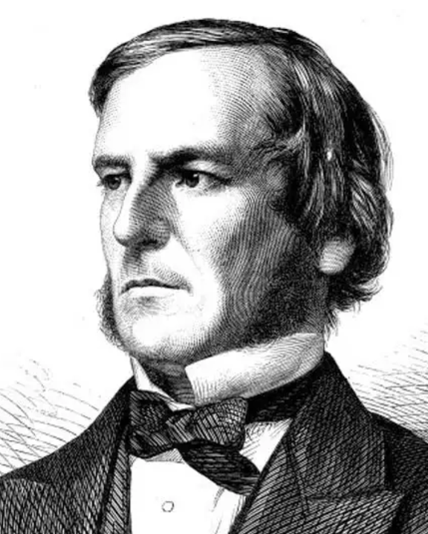
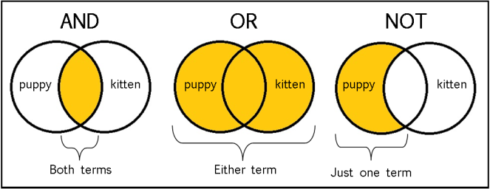
The Concept of a Boolean search illustrated
Boolean operators
From: The Library of Antiquity, https://libraryofantiquity.wordpress.com/2016/10/07/forgotten-skills-boolean-searches/

Slide 8
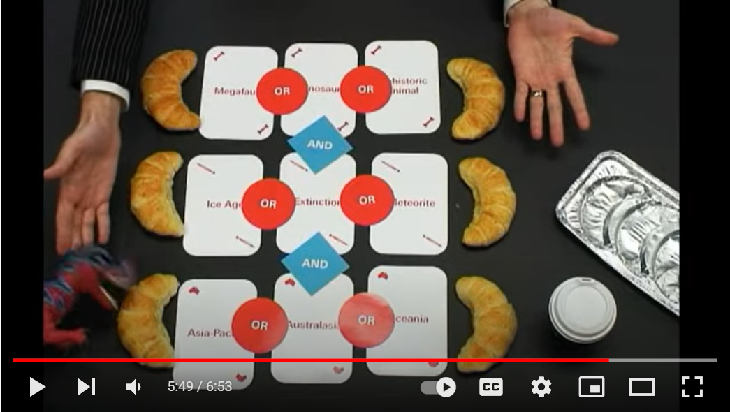
What is a Boolean Search?
Source: The University of Sydney. 2008. “Search Smarter, Search Faster.” https://youtu.be/Oa66AxTbjxA?si=j-_6sR6_LlD3O89a

Slide 9
Other search operators
  Searching for an exact phrase (phrase searching): Quotation marks: “ ” are an operator that searches for adjacent words
  “rite of passage”, “salvation army”
  Truncation: *
  relig*: religion, religions, religare, religious, religieux, religieuse, religieuses

Slide 10
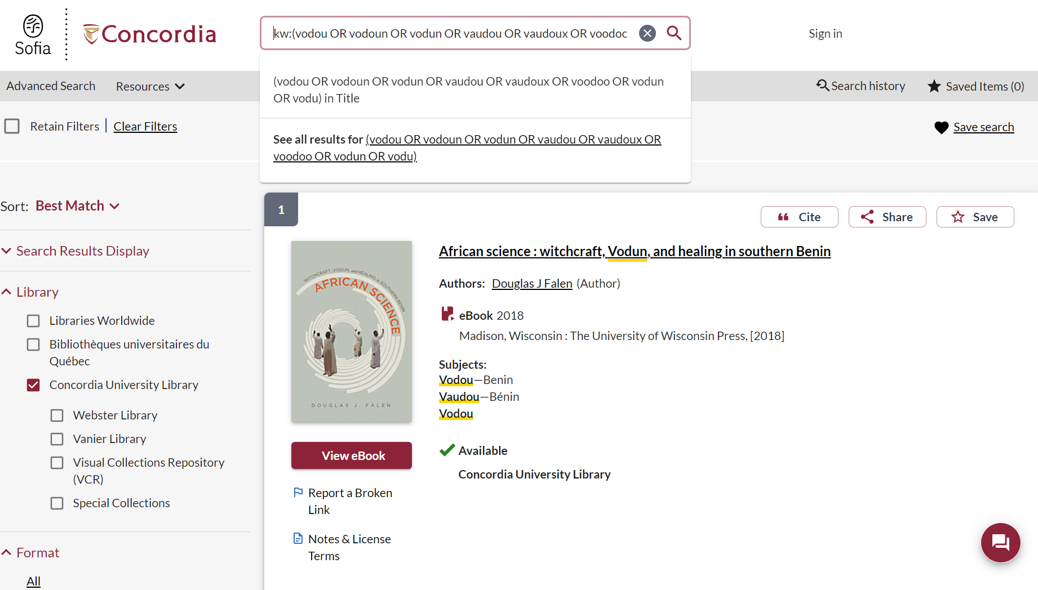

Slide 11
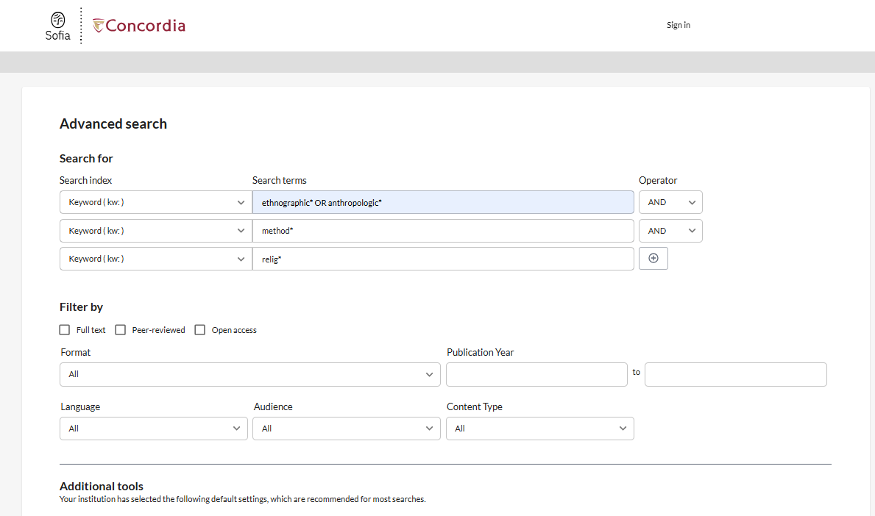

Slide 12
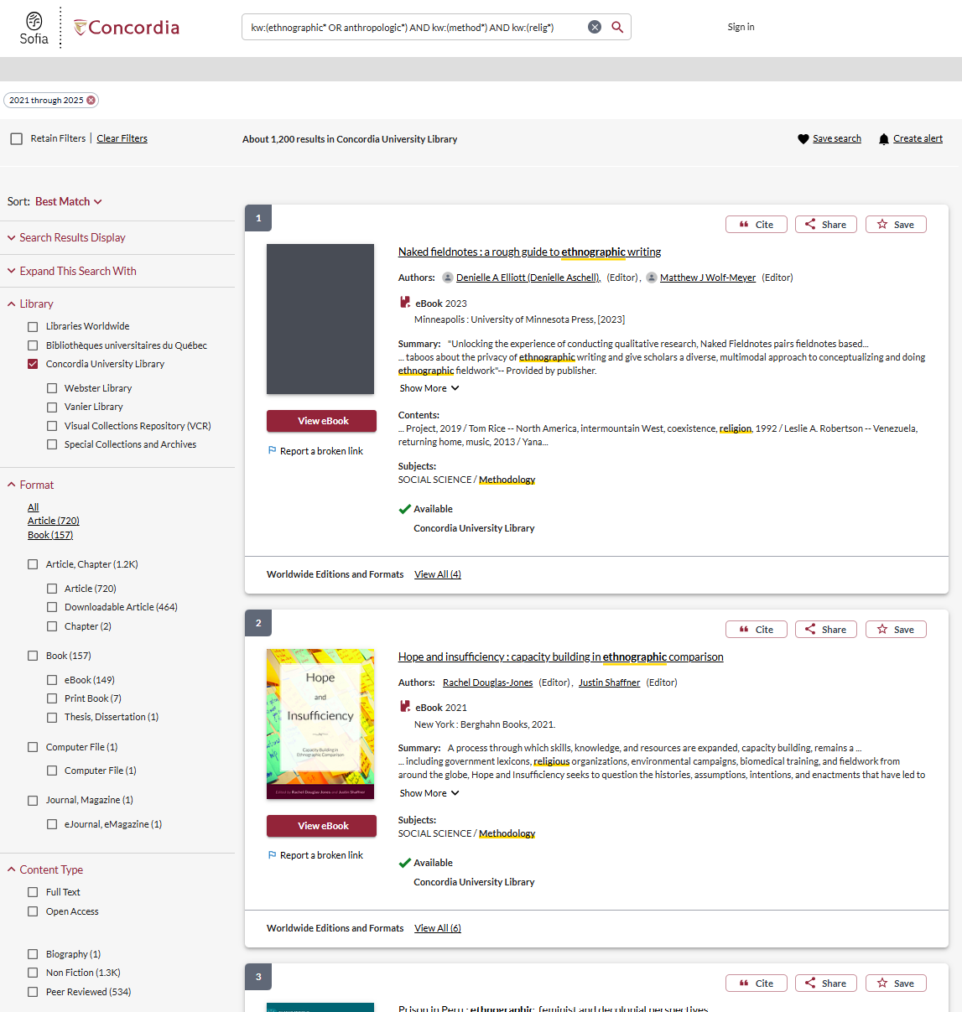

Slide 13

INTRODUCTION TO THE
LIBRARY WEBSITE & SUBJECT GUIDE

Slide 14
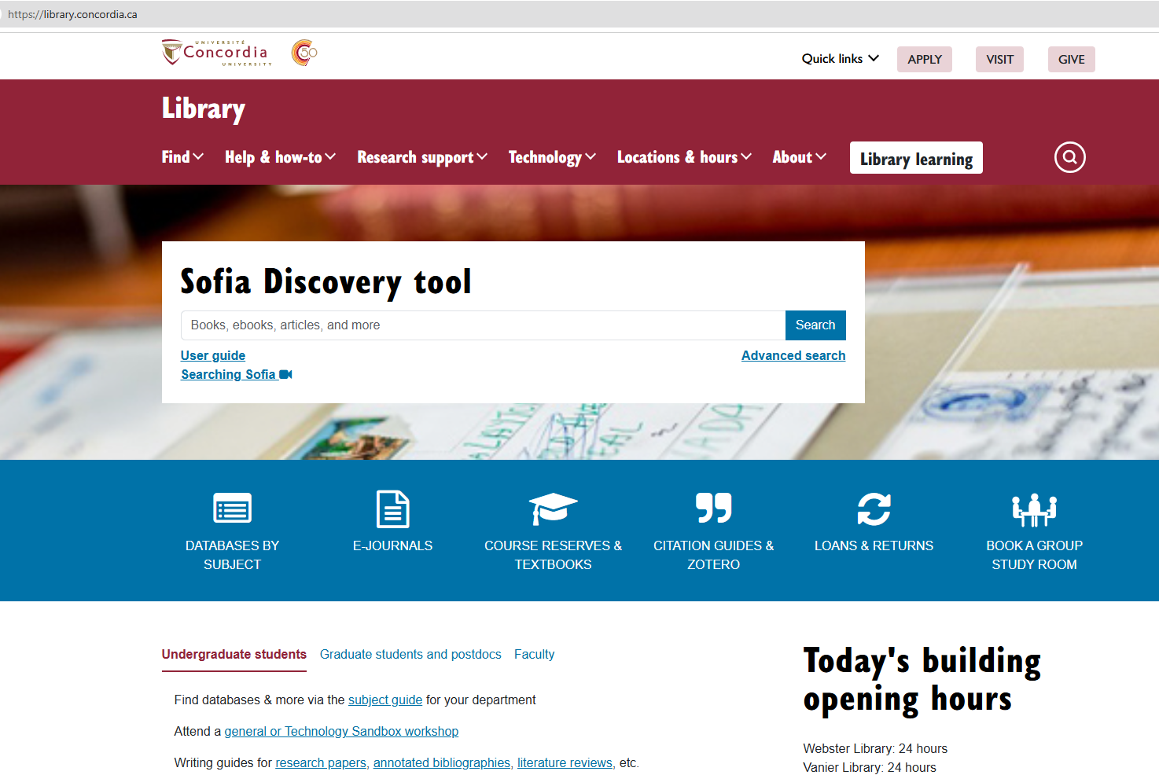
Concordia Library Website
library.concordia.ca

Slide 15
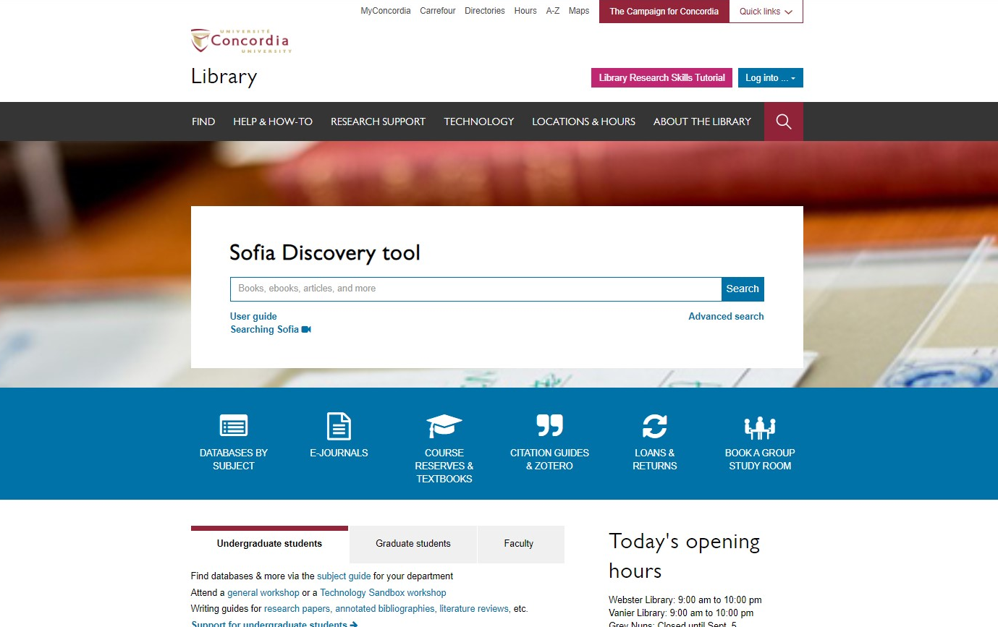
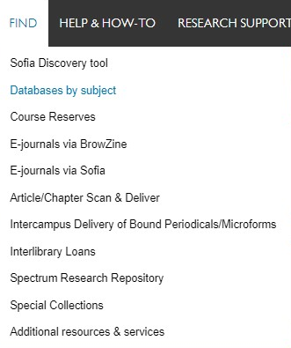
Concordia Library Website “FIND” dropdown menu
library.concordia.ca

Slide 16
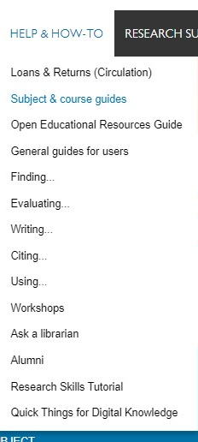
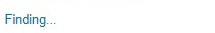
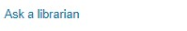
Concordia Library “Help & How To” dropdown menu
library.concordia.ca

Slide 17

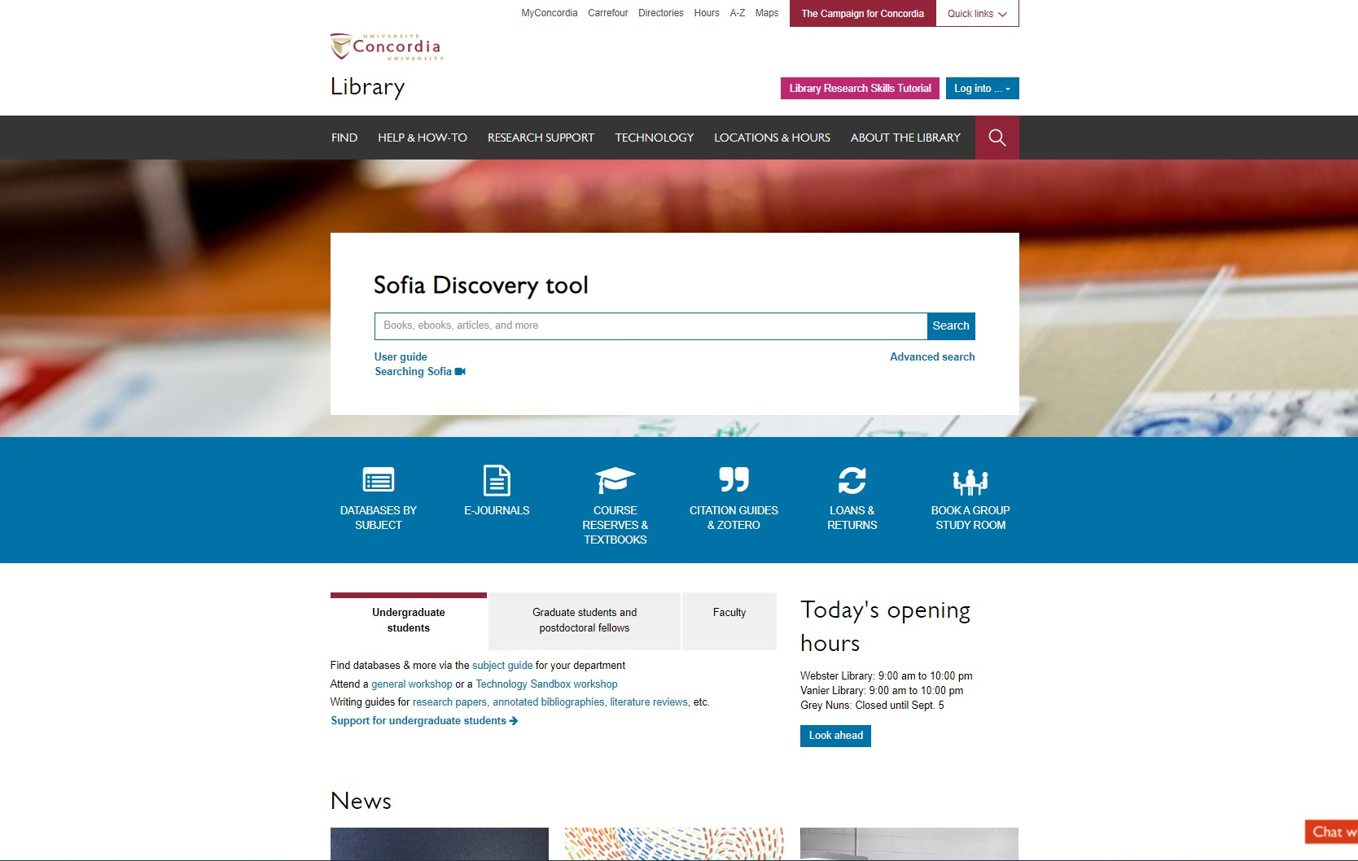
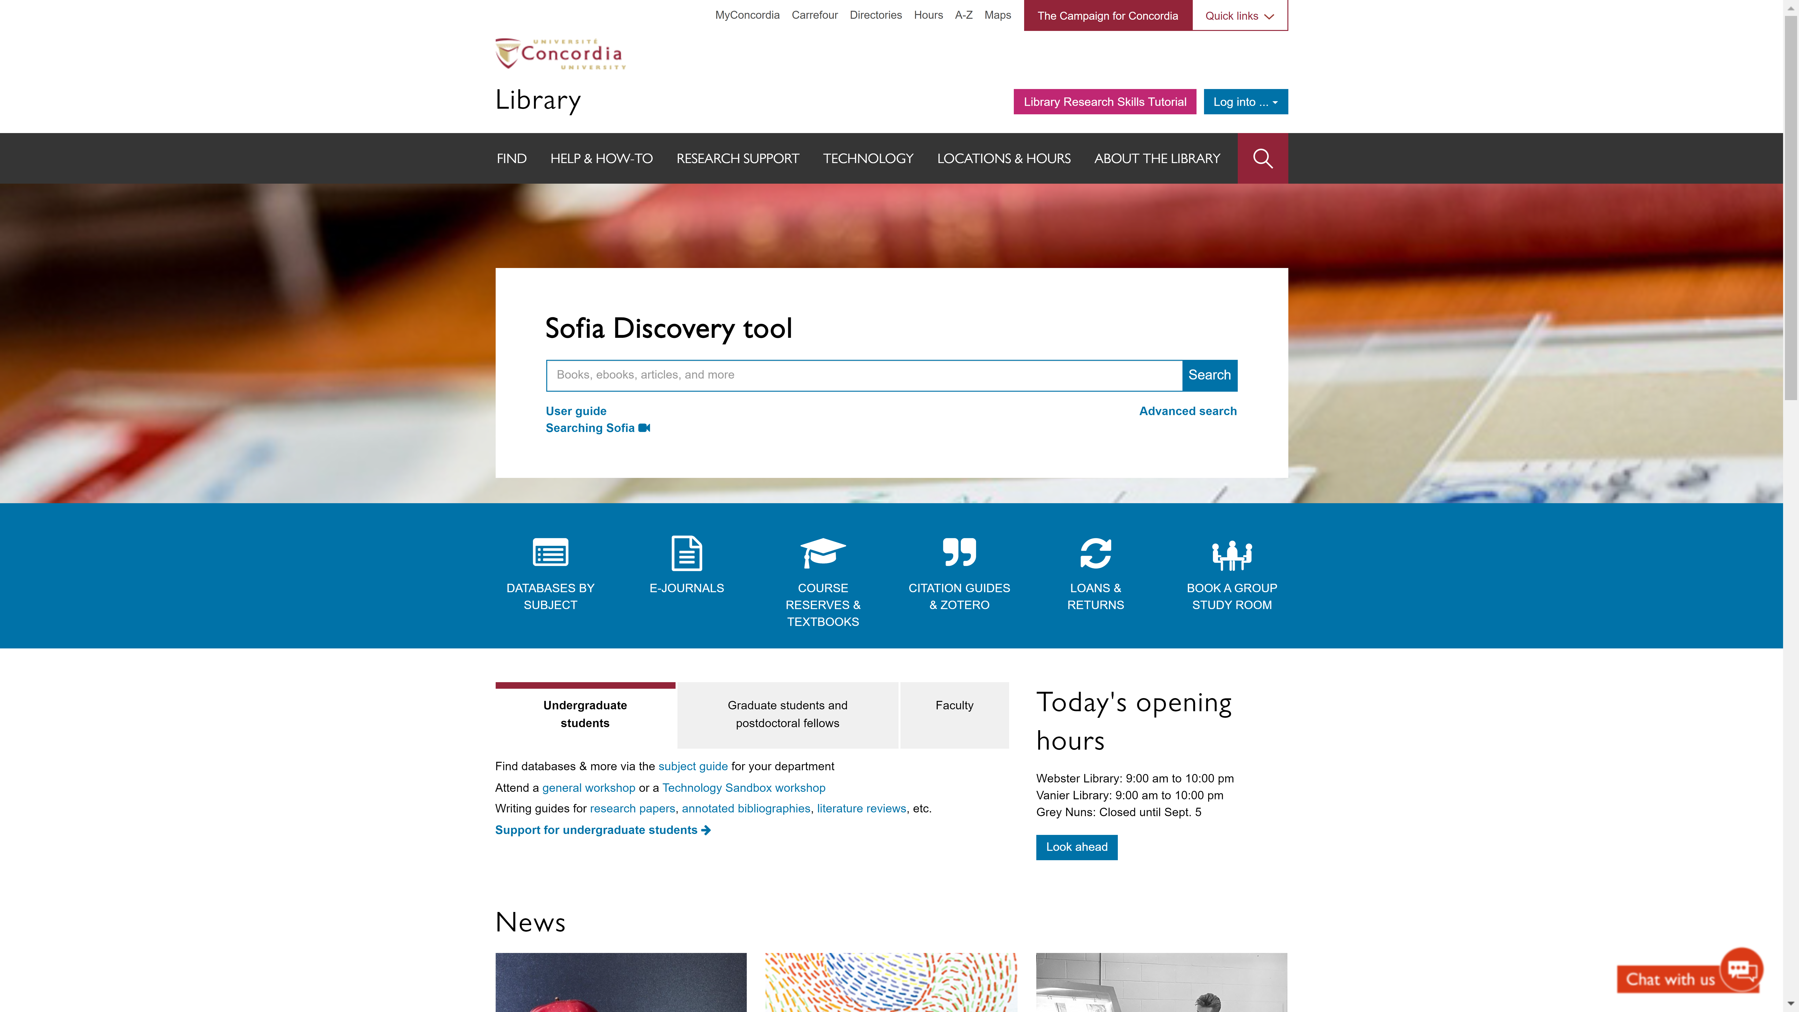
Sofia Discovery Tool – Databases By Subject
library.concordia.ca

Slide 18
Concordia Library Website “FIND” dropdown menu
library.concordia.ca

Slide 19
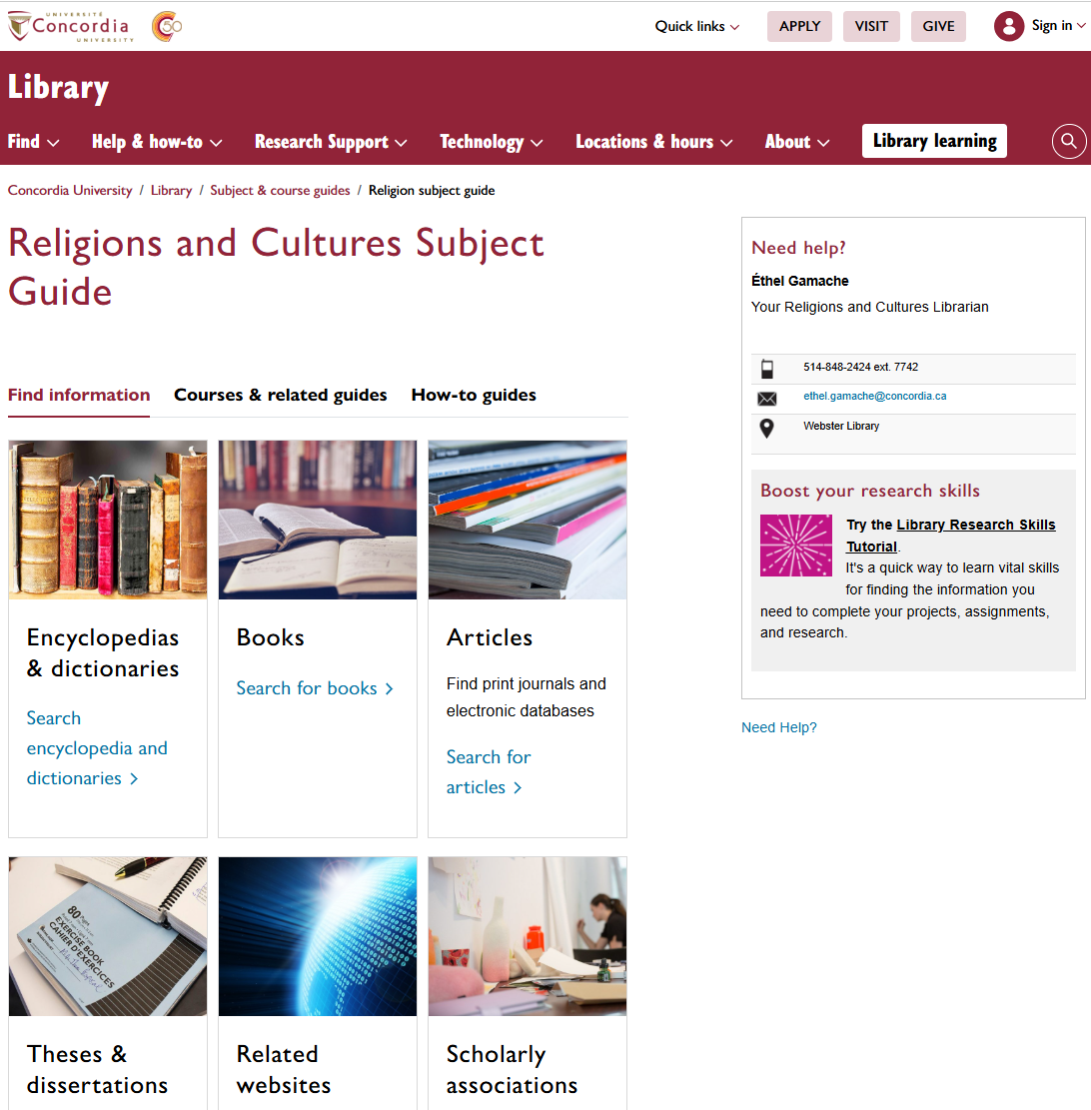
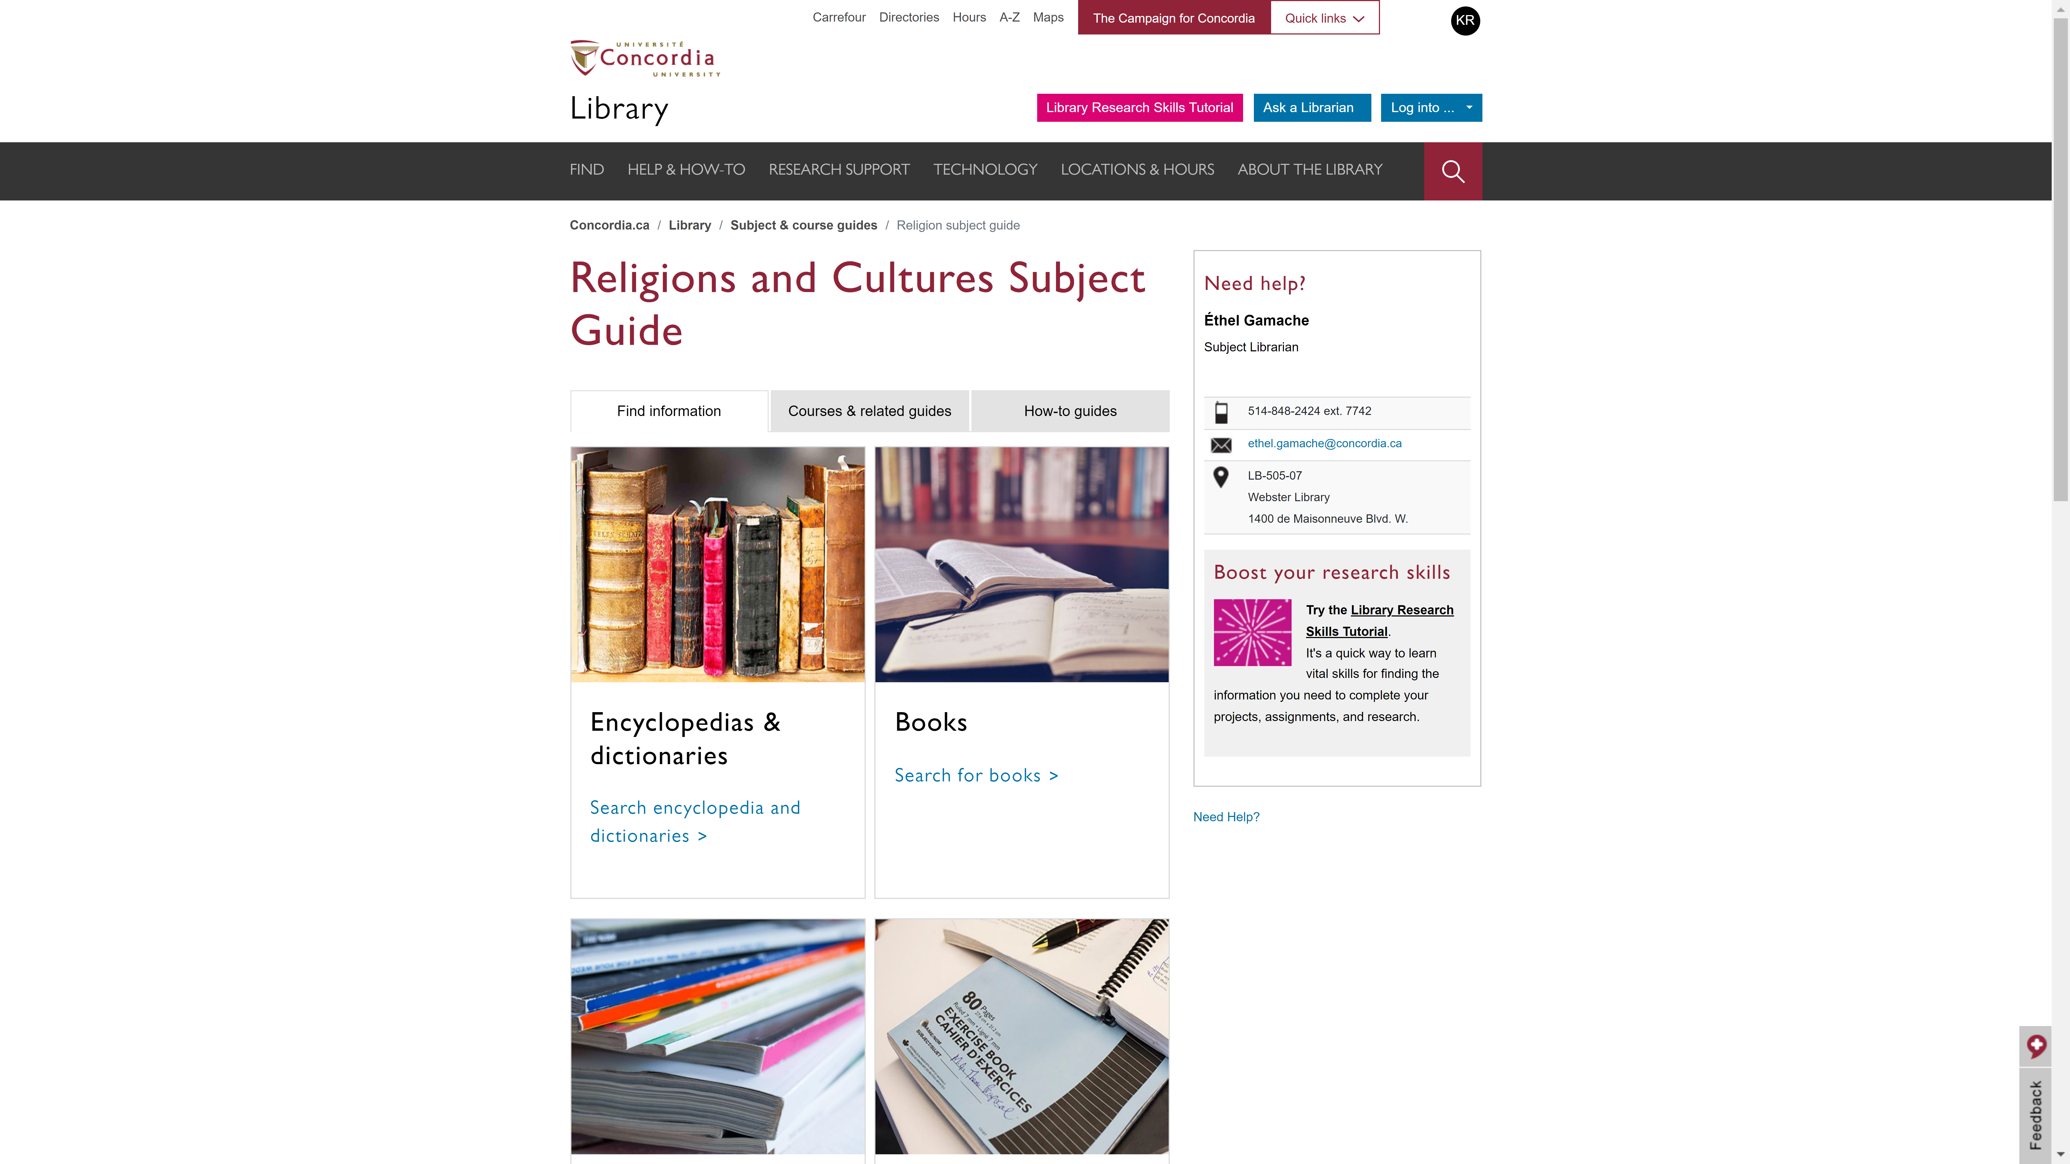
Religions and Cultures Subject Guides
concordia.ca/library/guides/religion.html

Slide 20
Consulting at least three academic sources, with Sofia and databases

Slide 21
USING SOFIA & INTERLIBRARY LOANS

Slide 22
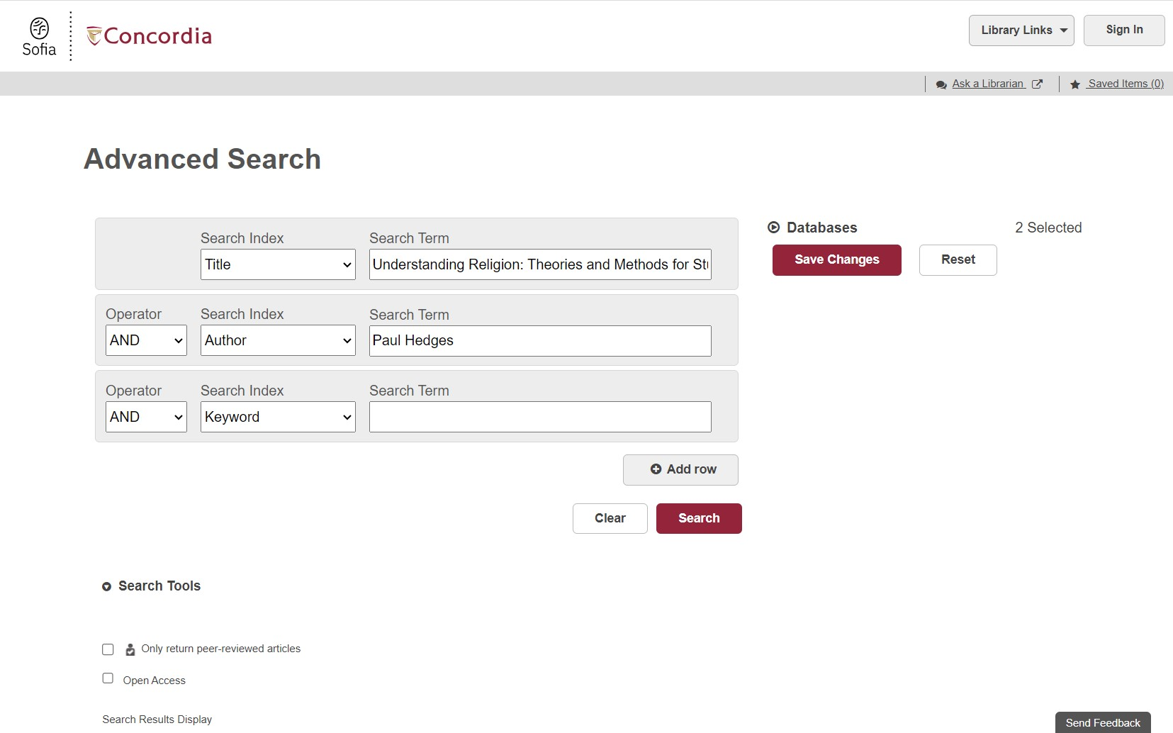
Advanced search in Sofia

Slide 23
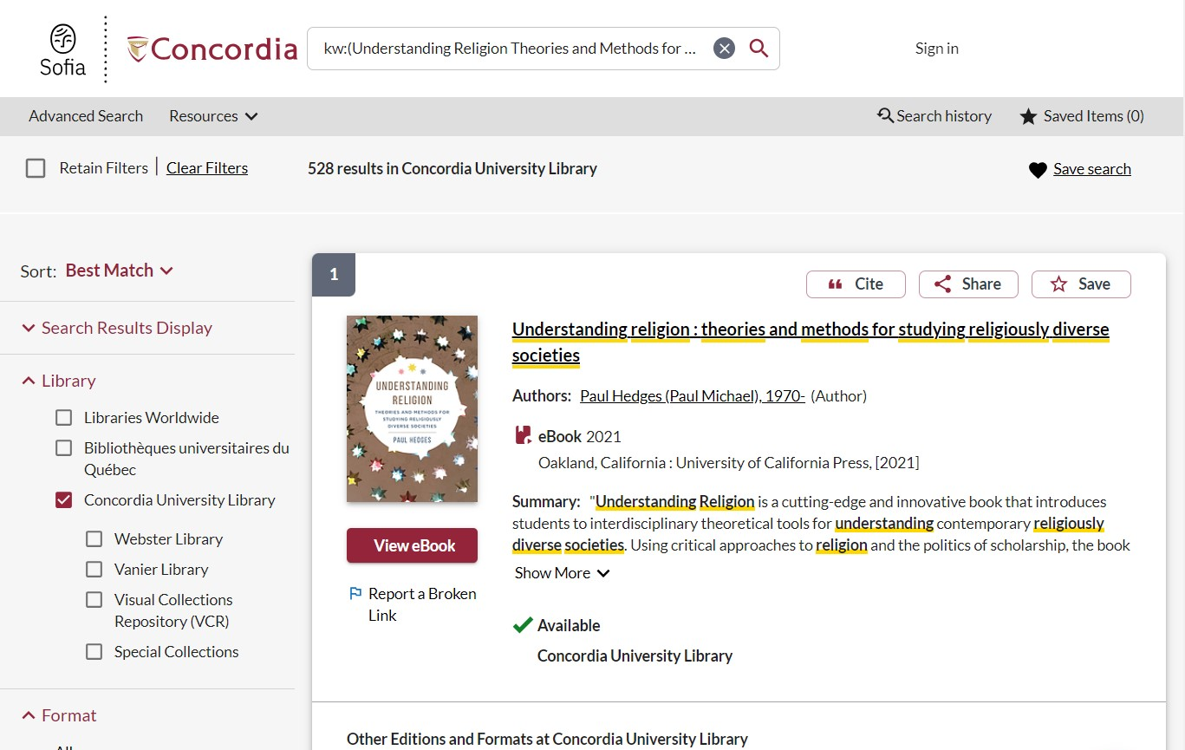
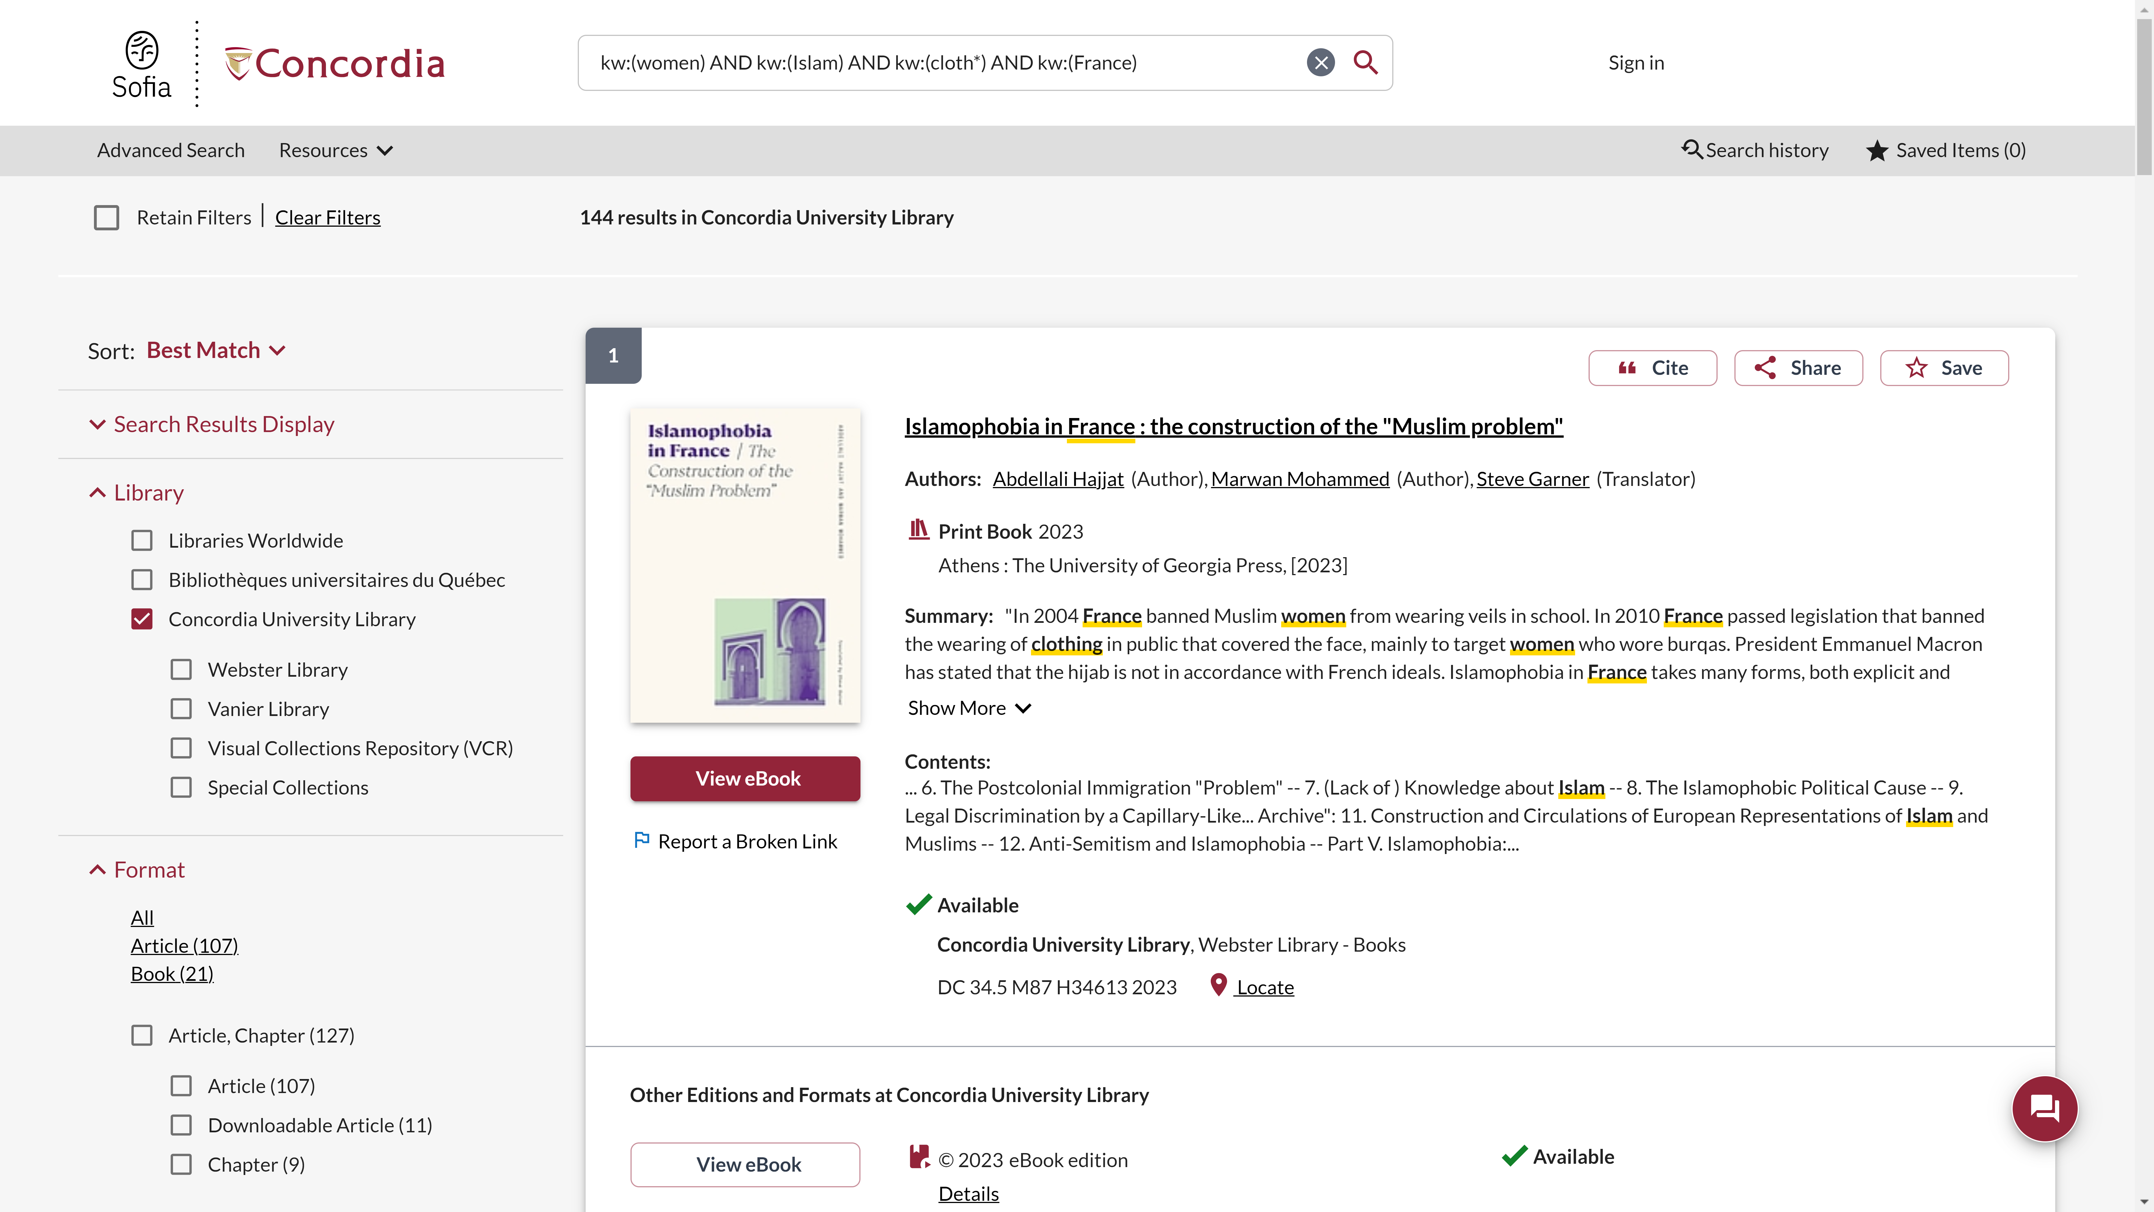
Advanced search in Sofia continued 1
Advanced search in Sofia

Slide 24
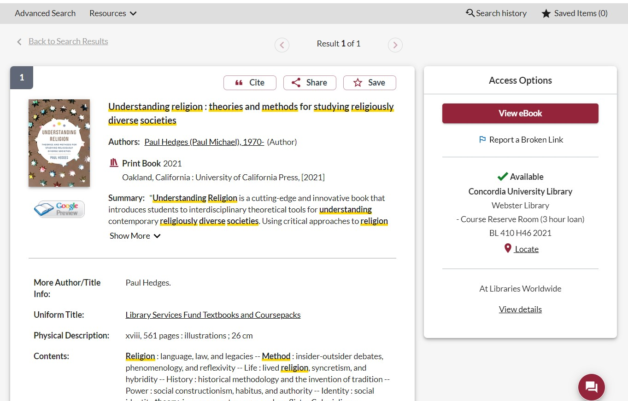
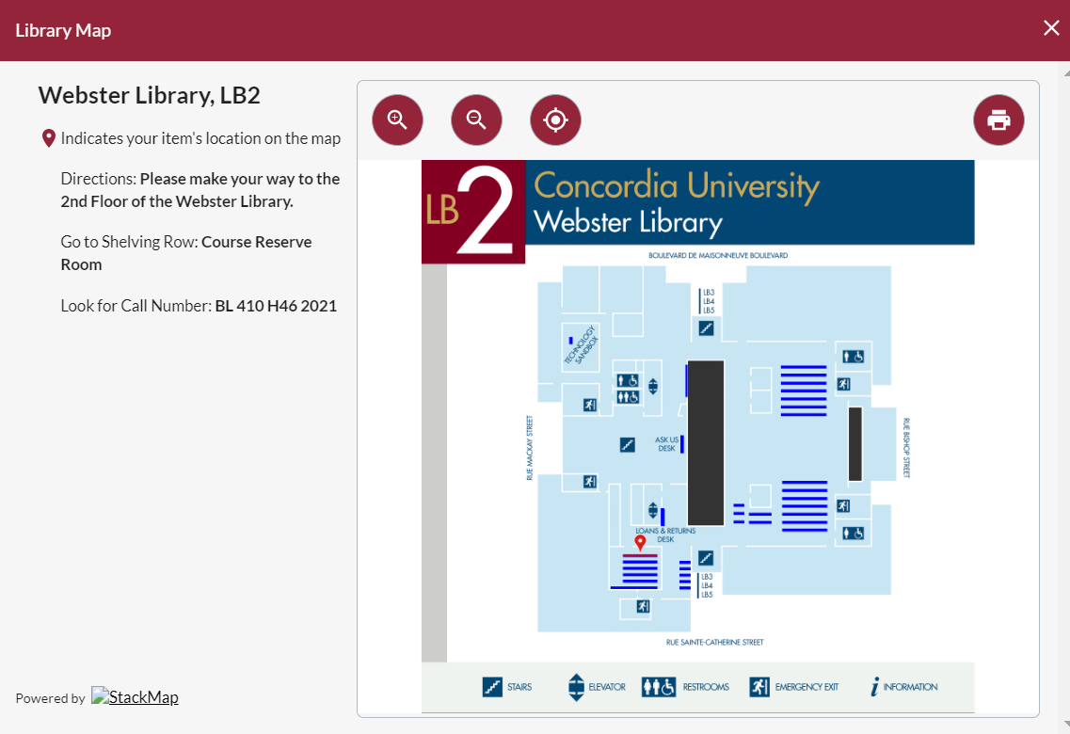
Advanced search in Sofia continued 2
Advanced search in Sofia

Slide 25
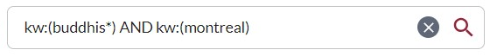
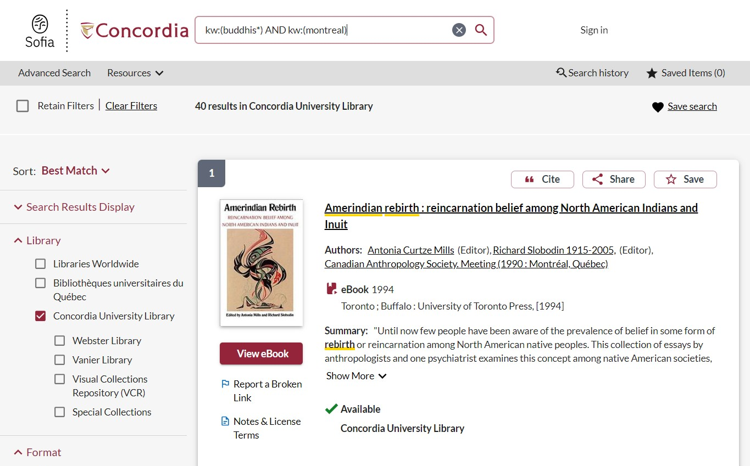
Advanced search in Sofia continued 3
Advanced search in Sofia

Slide 26
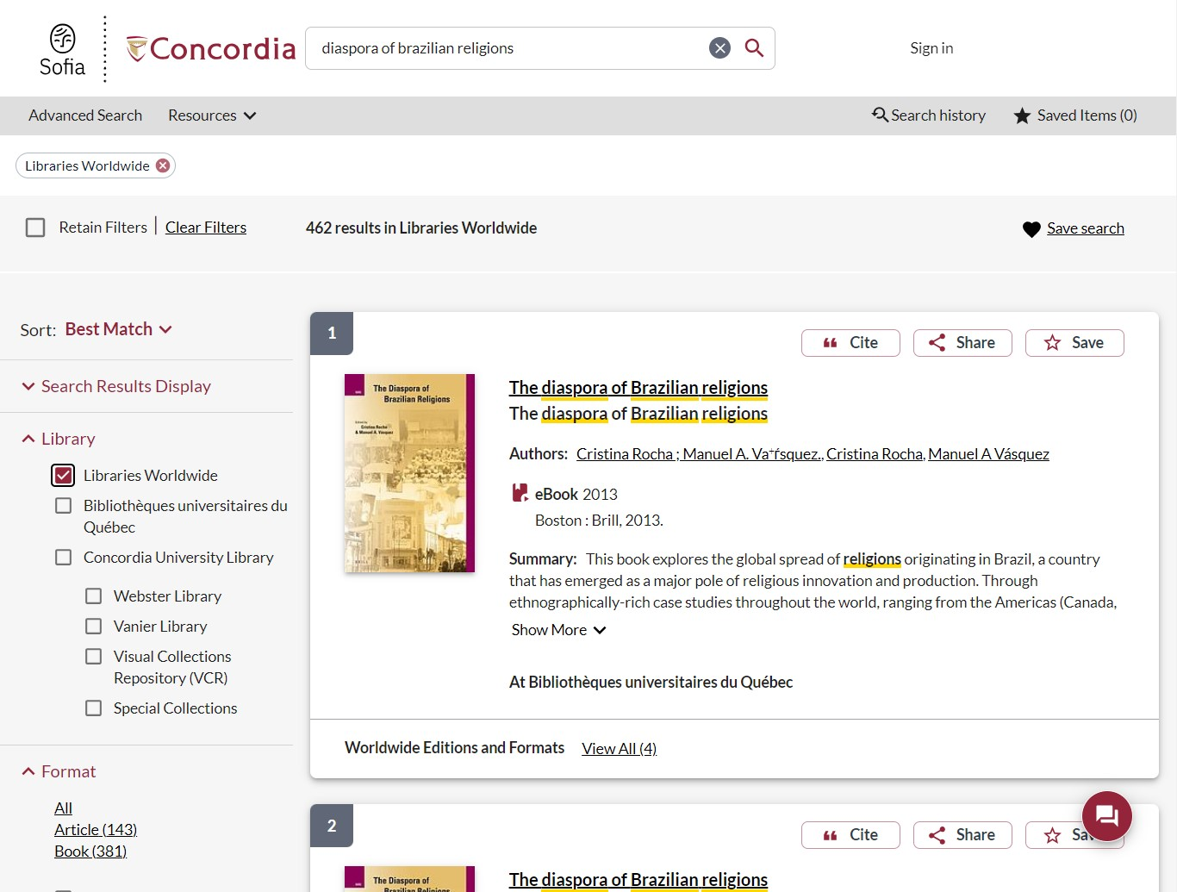
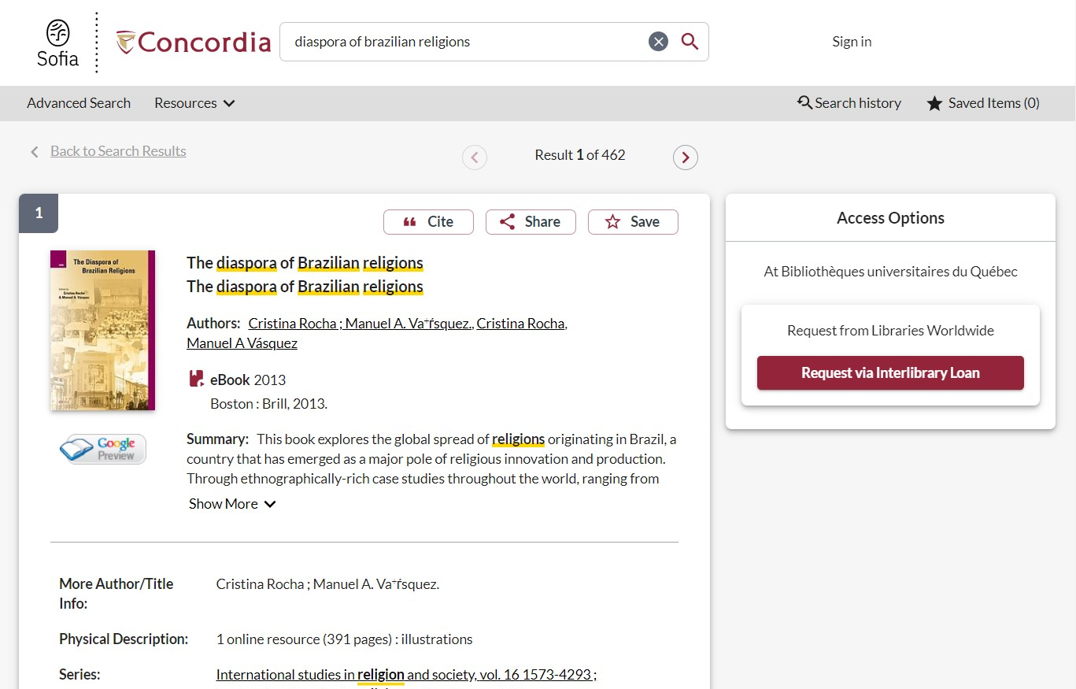
Advanced search in Sofia continued 4
Advanced search in Sofia

Slide 27
USING INTERLIBRARY LOANS
WITHIN SOFIA

Slide 28

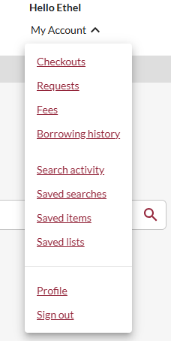
How does the interlibrary loans (ILL) service work?
ILL requests are made directly in the Sofia Discovery tool:
“Request via Interlibrary Loan” button
Form available under the “Requests” tab in "My Account".

Slide 29

Concordia article/chapter scan & deliver service
Book chapter and journal article scans from Concordia’s print collection can now be requested and tracked in Sofia.
Look for the “Chapter Scan” button in the Access Options panel.

Slide 30
REQUEST A BOOK
VIA INTERLIBRARY LOAN
EXAMPLE

Slide 31
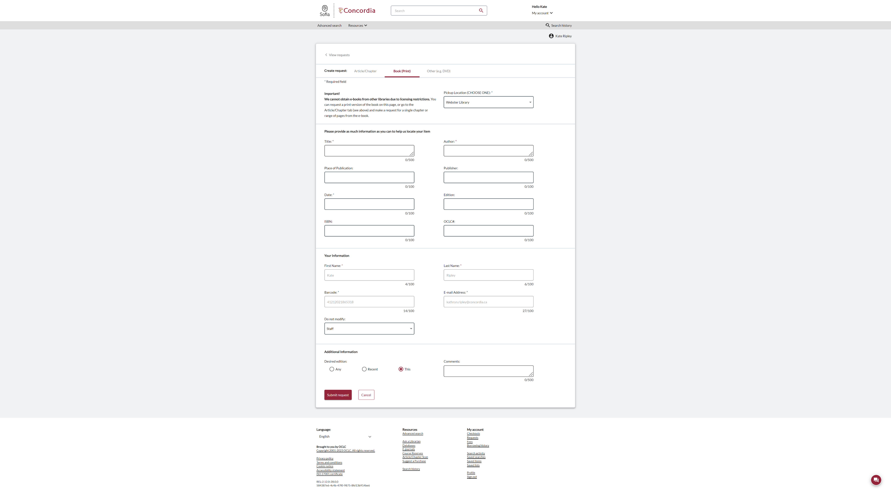
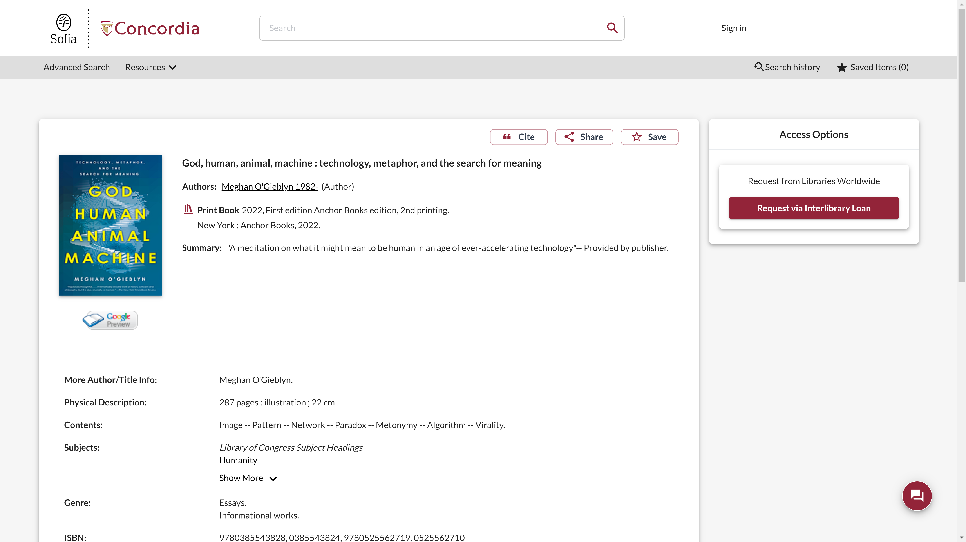
Sofia Discovery Tool request via Interlibrary loan

Slide 32
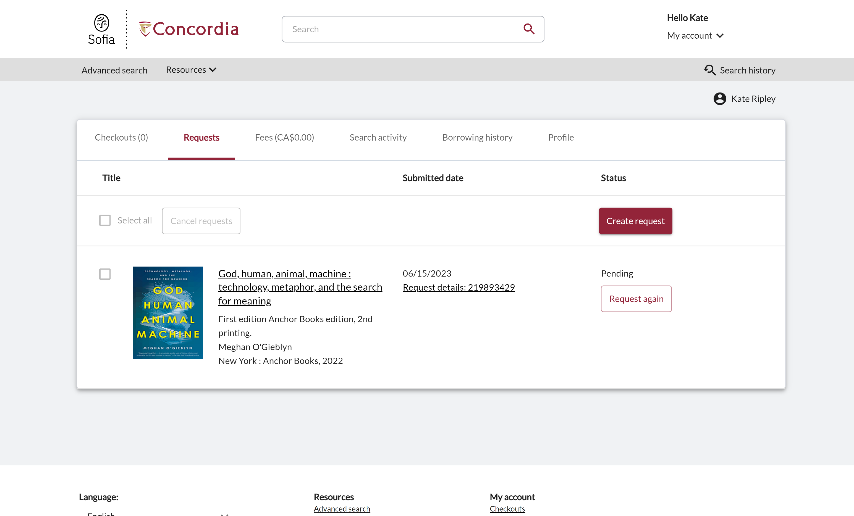
Check the status of your request under the "Requests" tab.

Slide 33
About
Interlibrary loan
You will receive email notifications when your ILL request is available for pickup or download.
Physical items can be picked up at the Circulation/Loans desks at either Vanier or Webster Library.
ILL requests can be borrowed for 30 days, with up to 4 automatic renewals, or until item is recalled.

Slide 34
REQUEST A BOOK
BLANK FORM
EXAMPLE

Slide 35
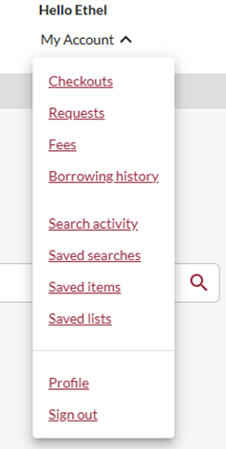
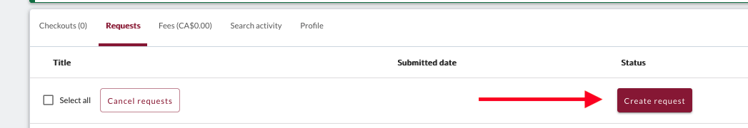
Create an Interlibrary Loan request
Sign in to "My Account" and select "Requests".
Click on "Create request".

Slide 36
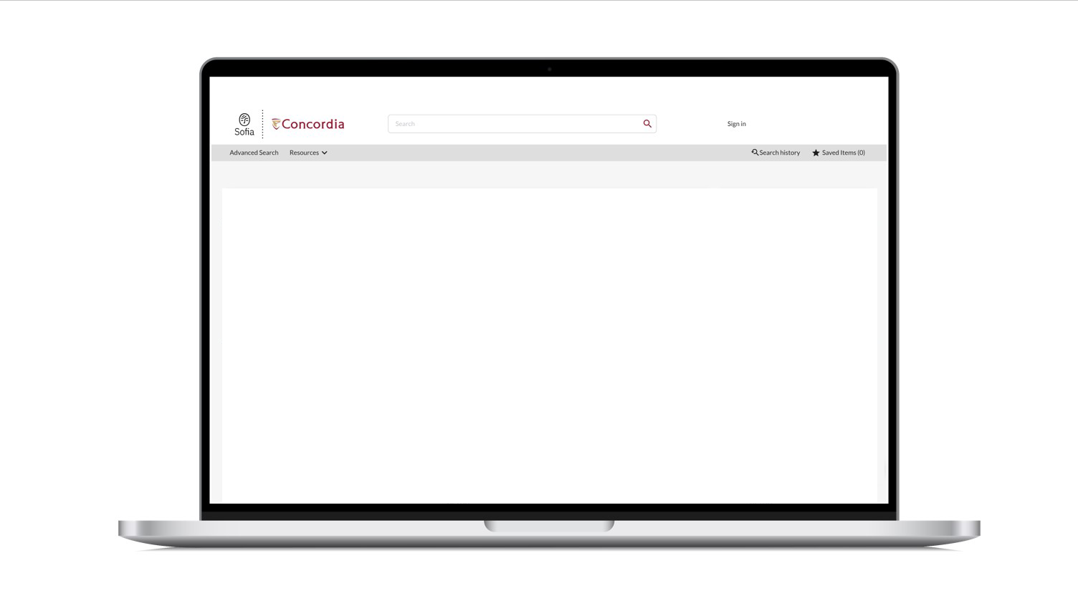
Sofia Discovery Tool – request a book form

Slide 37
If you have any difficulty finding a document, reach out!

Slide 38
SEARCHING FOR PEER-REVIEWED ARTICLES WITH DATABASES

Slide 39
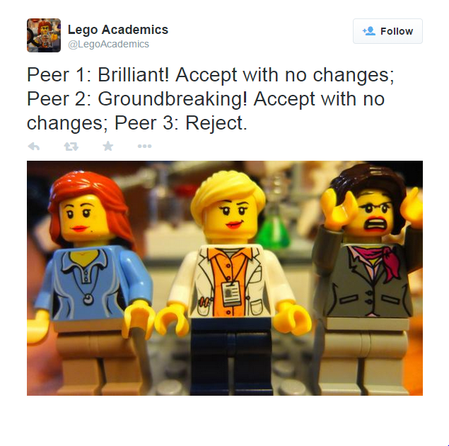
The peer-reviewed process
Yates, D. [@LegoAcademics]. (2014, August 12). Peer 1: Brillant! Accept with no changes; Peer 2: Groundbreaking! Accept with no changes; Peer 3: Reject. [Tweet]. Twitter. https://twitter.com/LegoAcademics/status/499205005468262400/photo/1

Slide 40
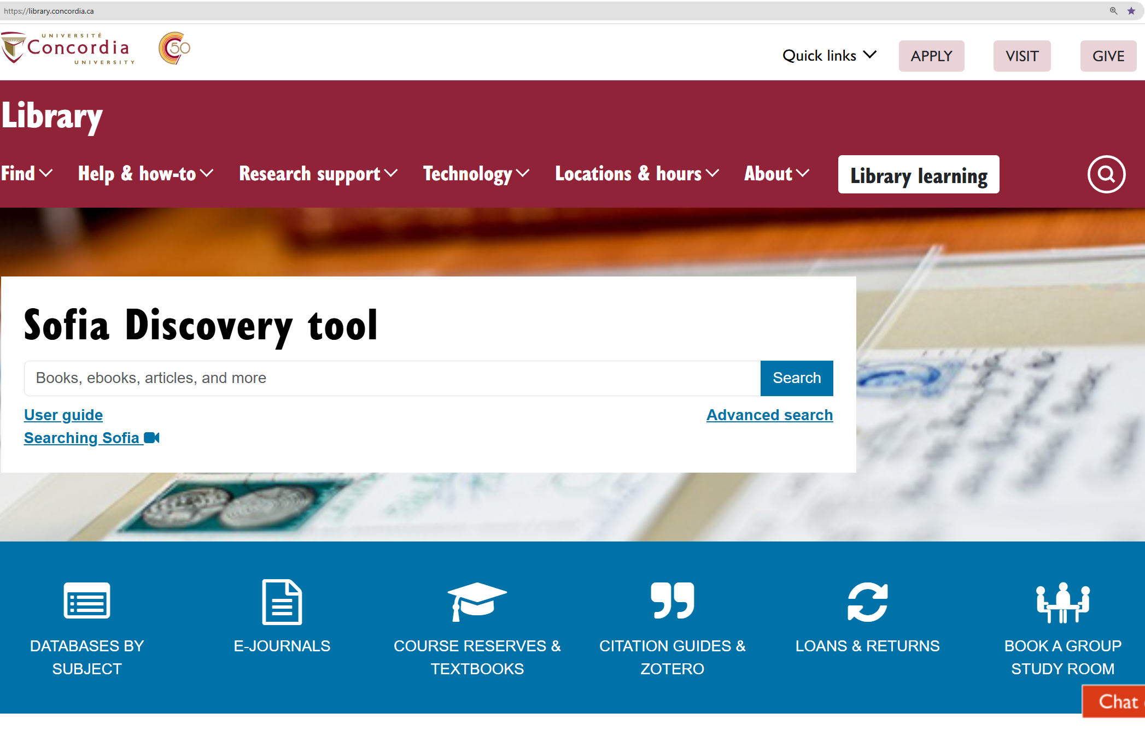
Sofia Discovery Tool – Databases By Subject 1

Slide 41
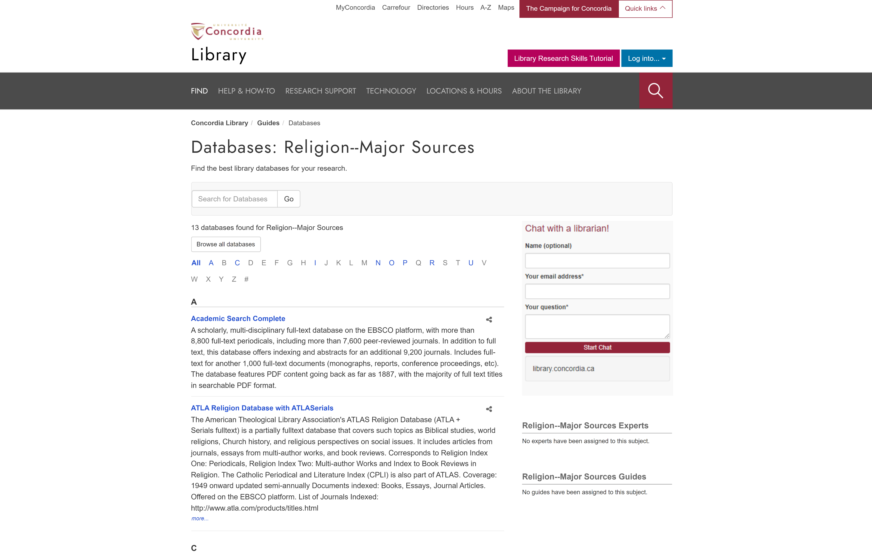
library.concordia.ca/find/databases/index.php

Slide 42
Searching for peer-reviewed articles with the database Academic Search Complete

Slide 43
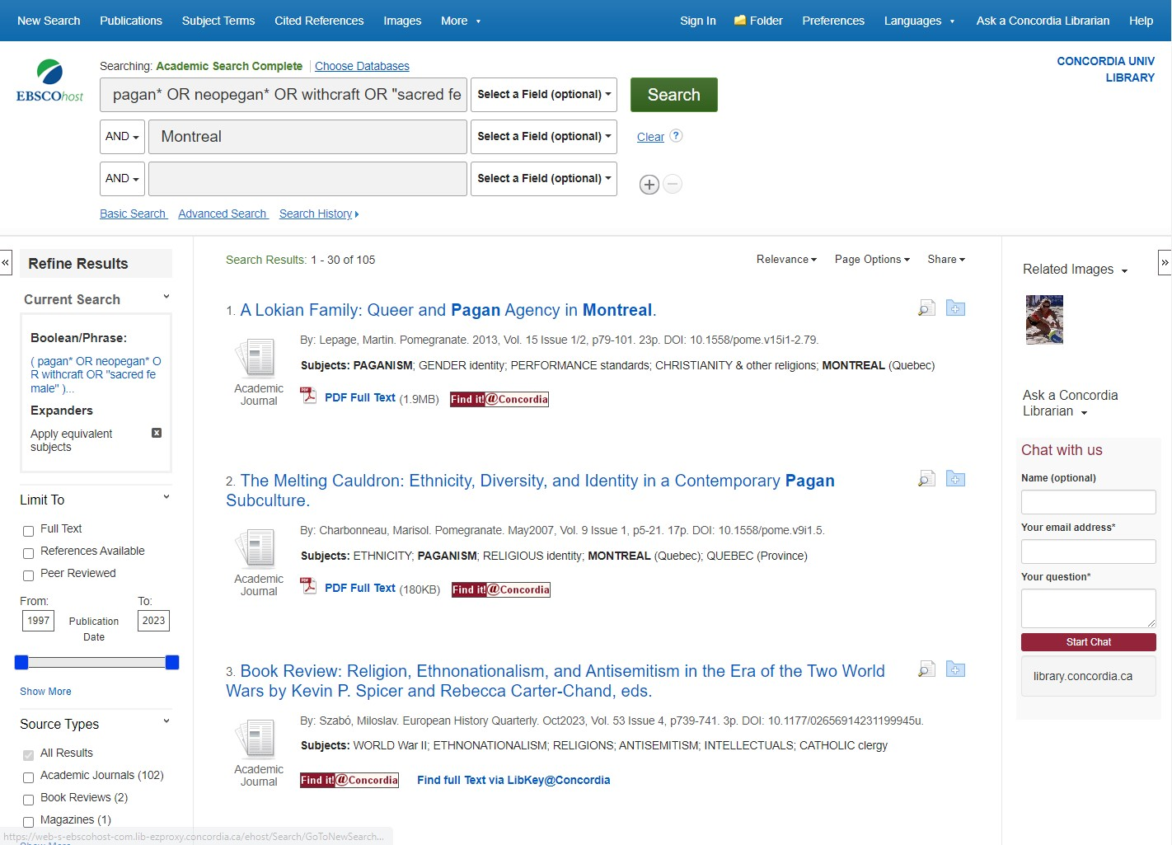
Concordia Library – Database Searching

Slide 44
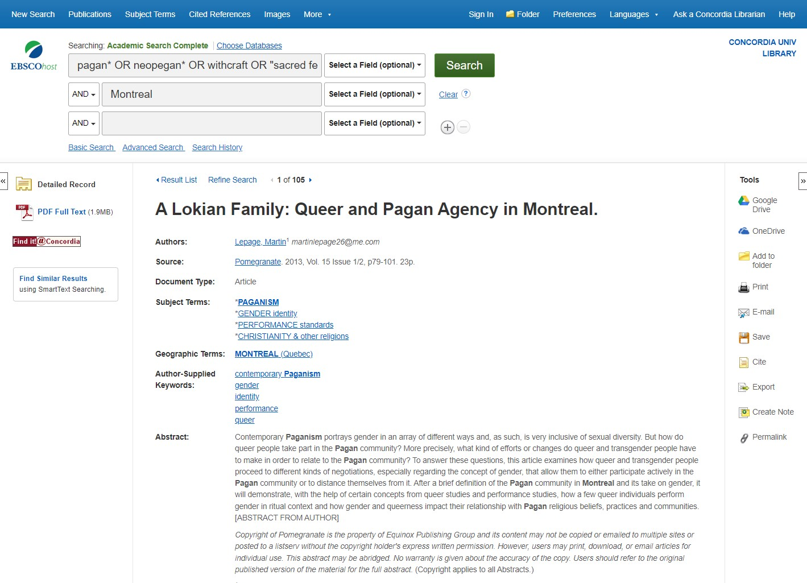
Database Boolean Search

Slide 45
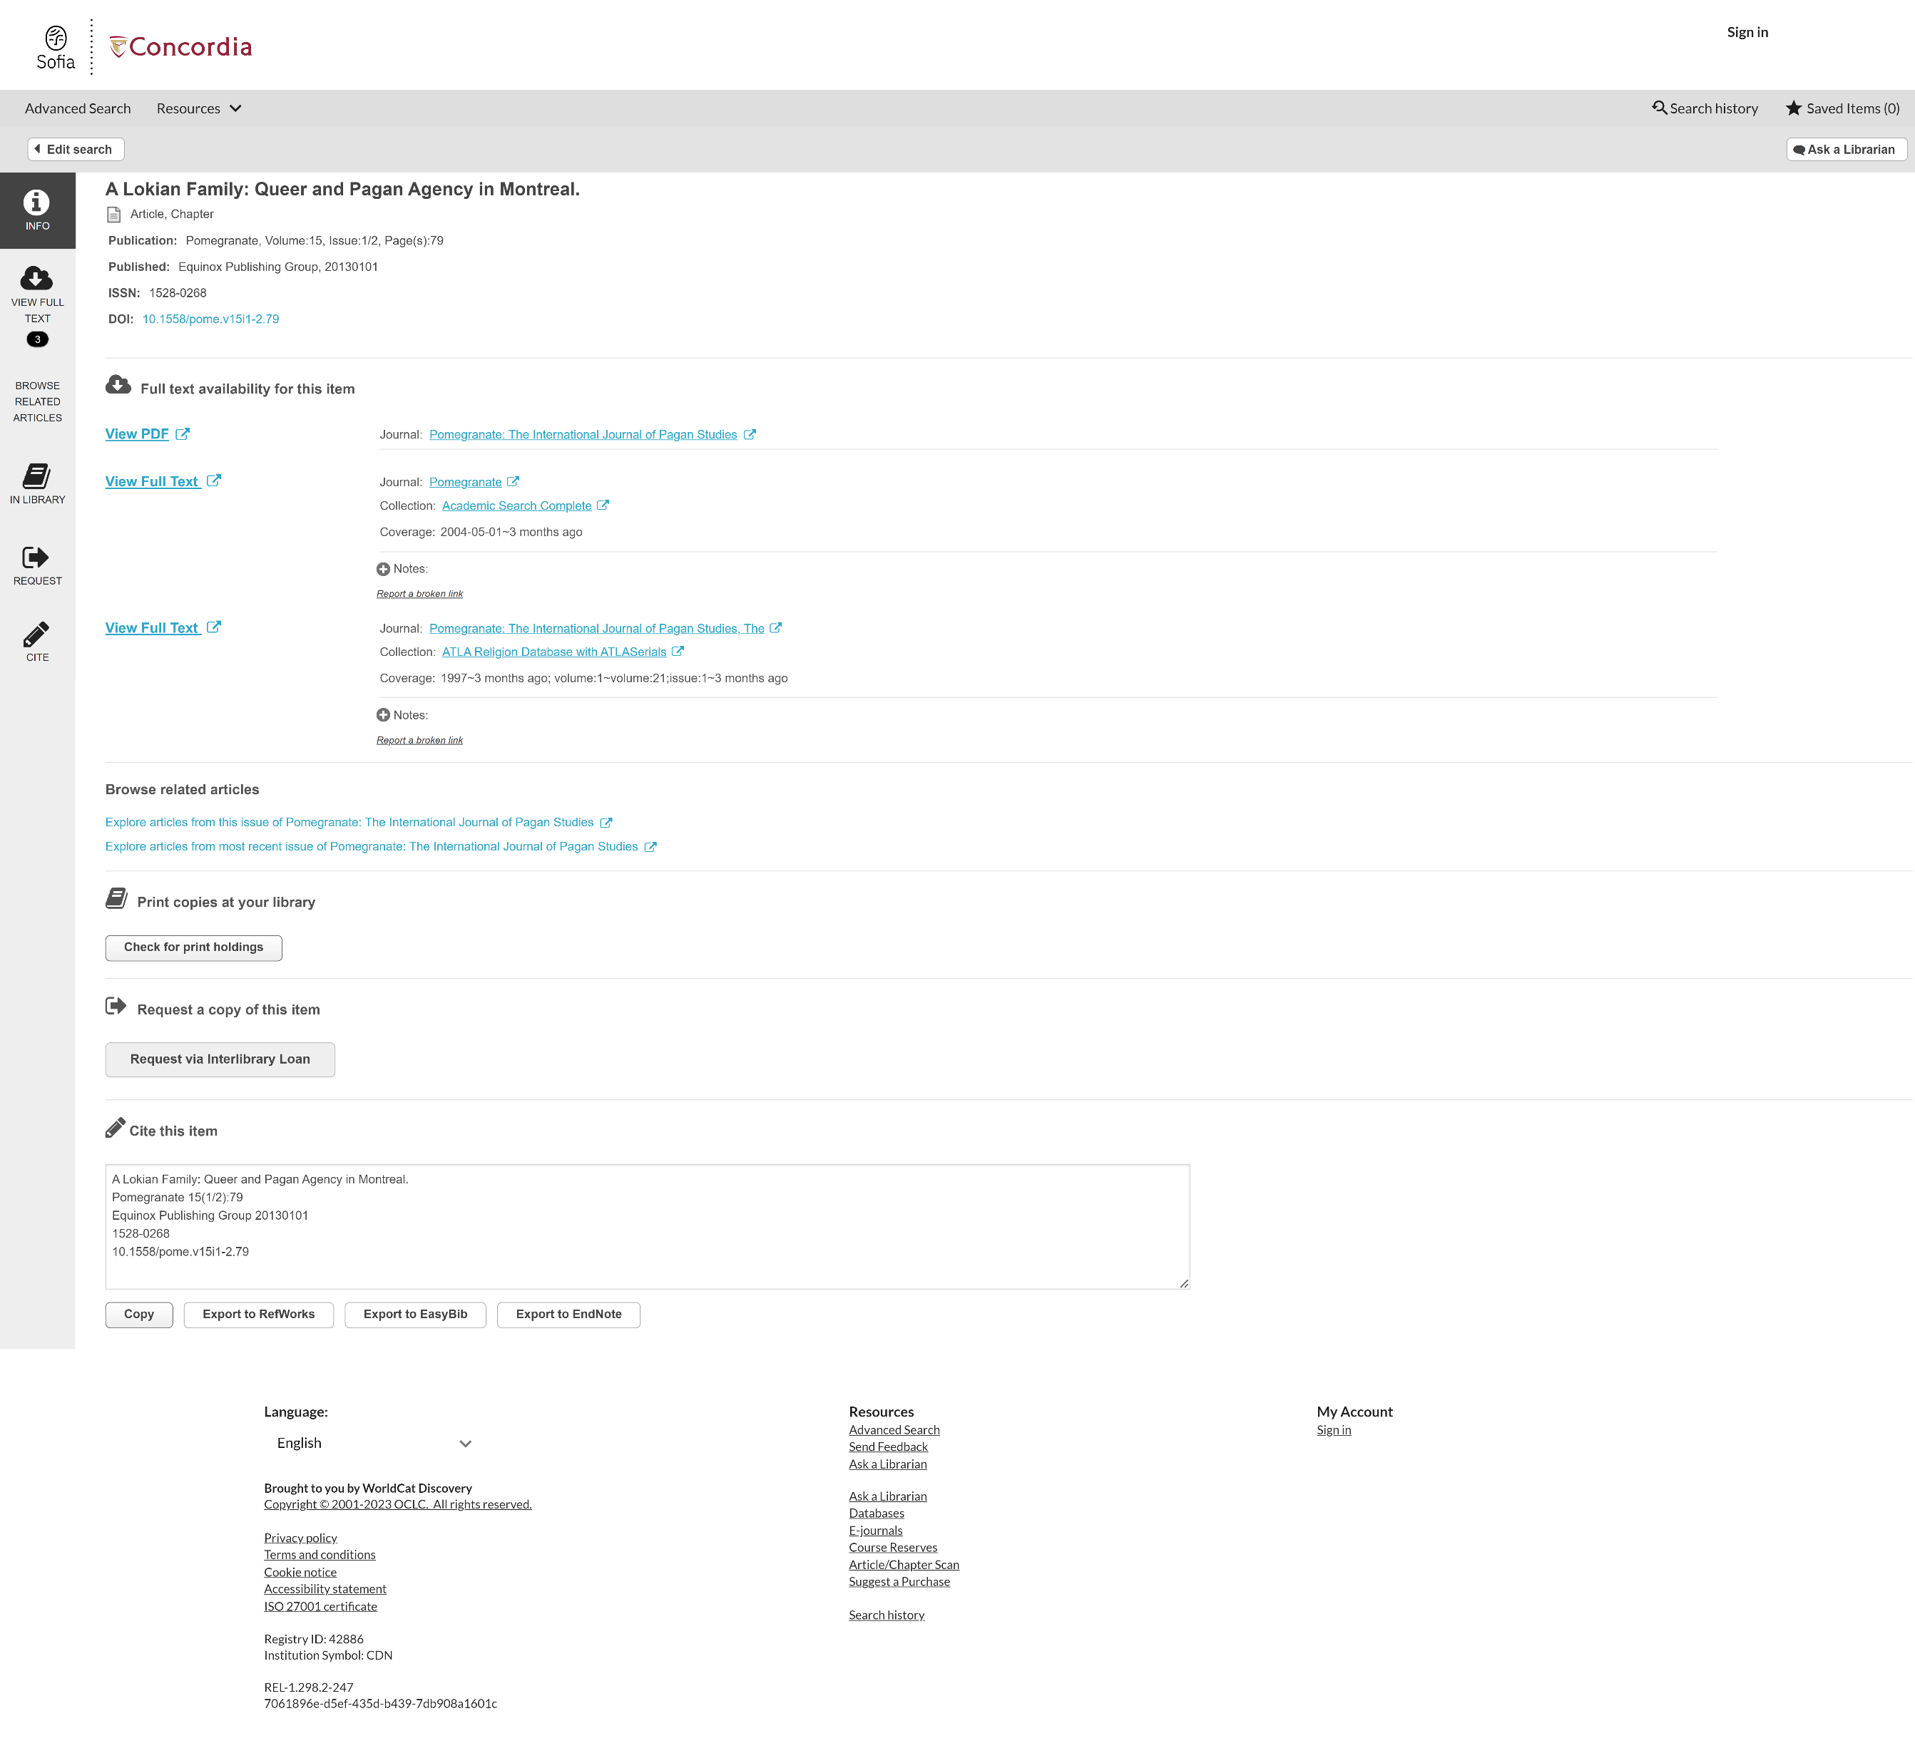
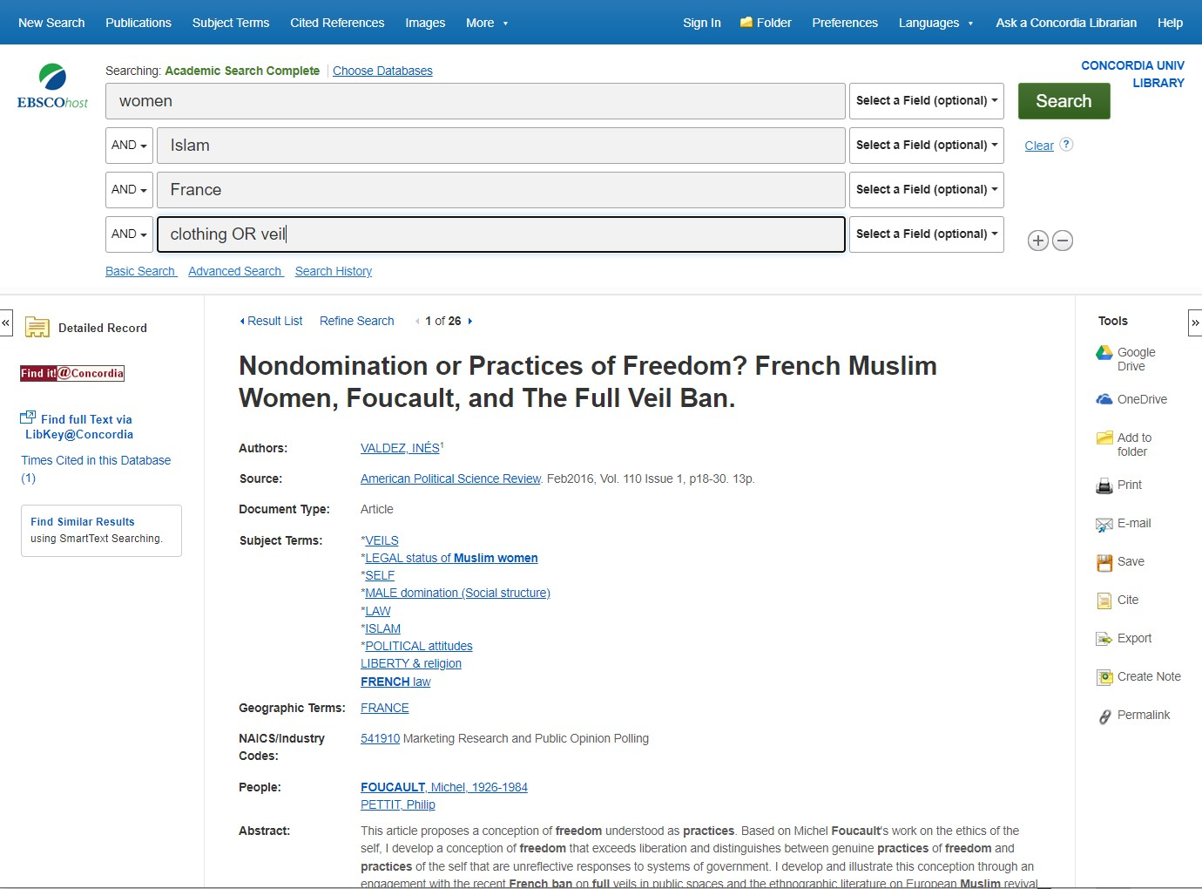
View full article via Find it@Concordia button

Slide 46
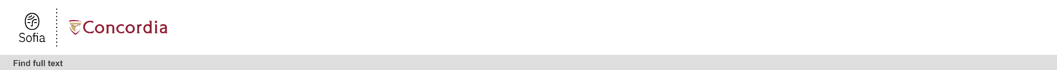
Find it@Concordia results webpage

Slide 47
Database tools

Slide 48
Searching for peer-reviewed articles with the database ATLA

Slide 49
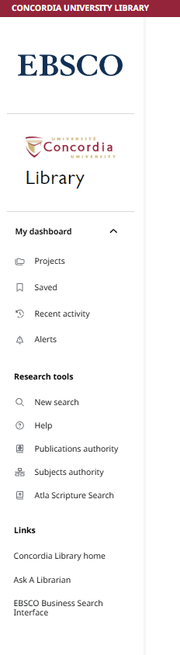
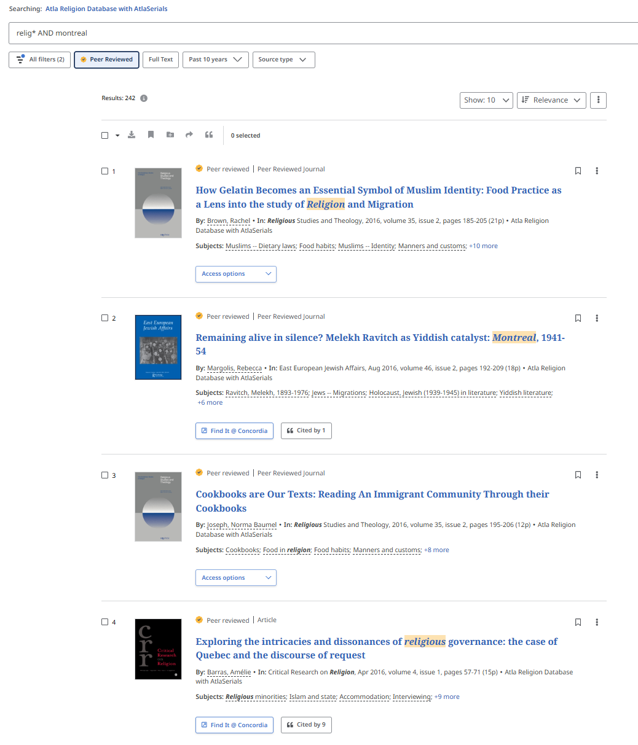

Slide 50
Searching for peer-reviewed articles with Google Scholar

Slide 51
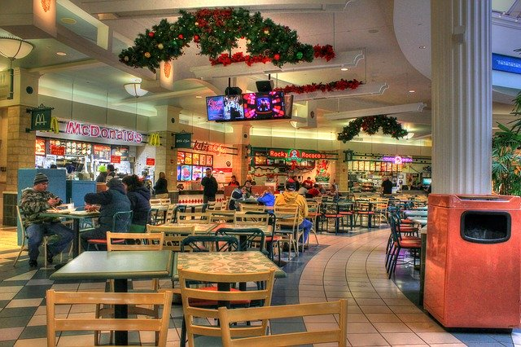

What is the difference?
Google scholar
Library databases
Volume | Quantity | Quick
Depth | Quality | Thorough
Left image: Yinan Chen, Dining Court, public domain, https://pixabay.com/photos/dining-court-shopping-mall-corridor-347314/
Right image: Jason Briscoe, Cooking, public domain, https://unsplash.com/photos/VBsG1VOgLIU

Slide 52
Where should you search?
Library Discovery Tool
Academic Search Complete
(Library Database)
Google Scholar
Eureka.cc
(Library Database)
Grey literature (e.g. government documents, NGO reports, working papers, newsletters, preprints)

Slide 53
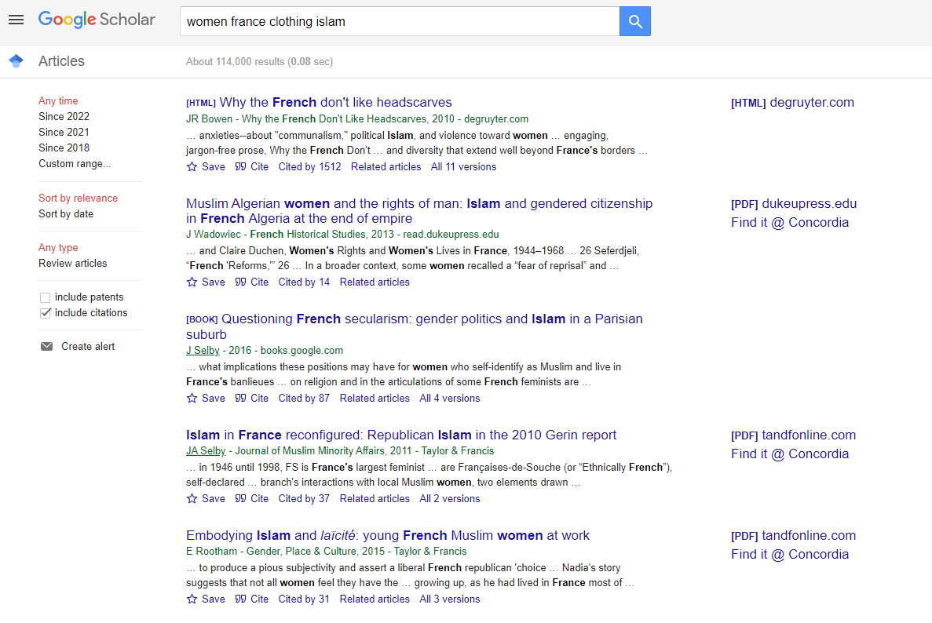
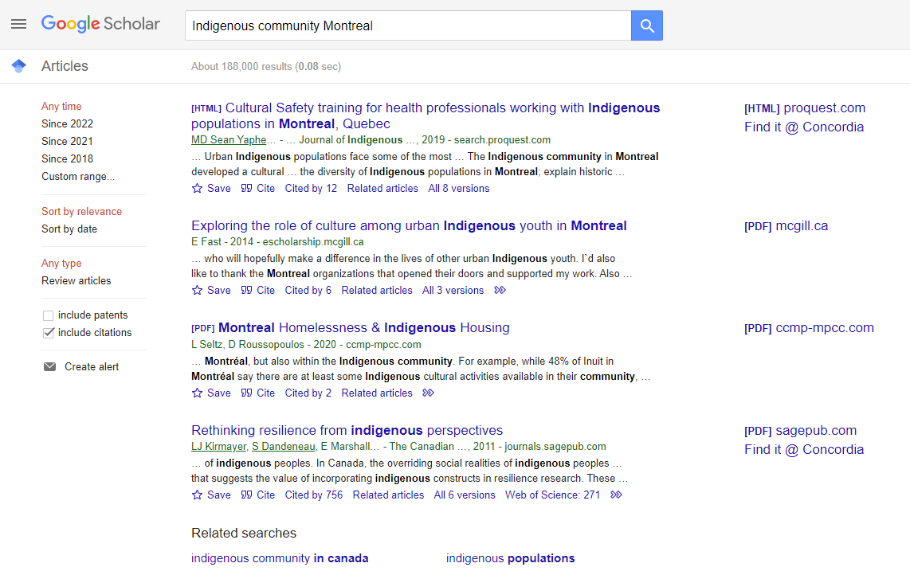
Searching in Google Scholar

Slide 54
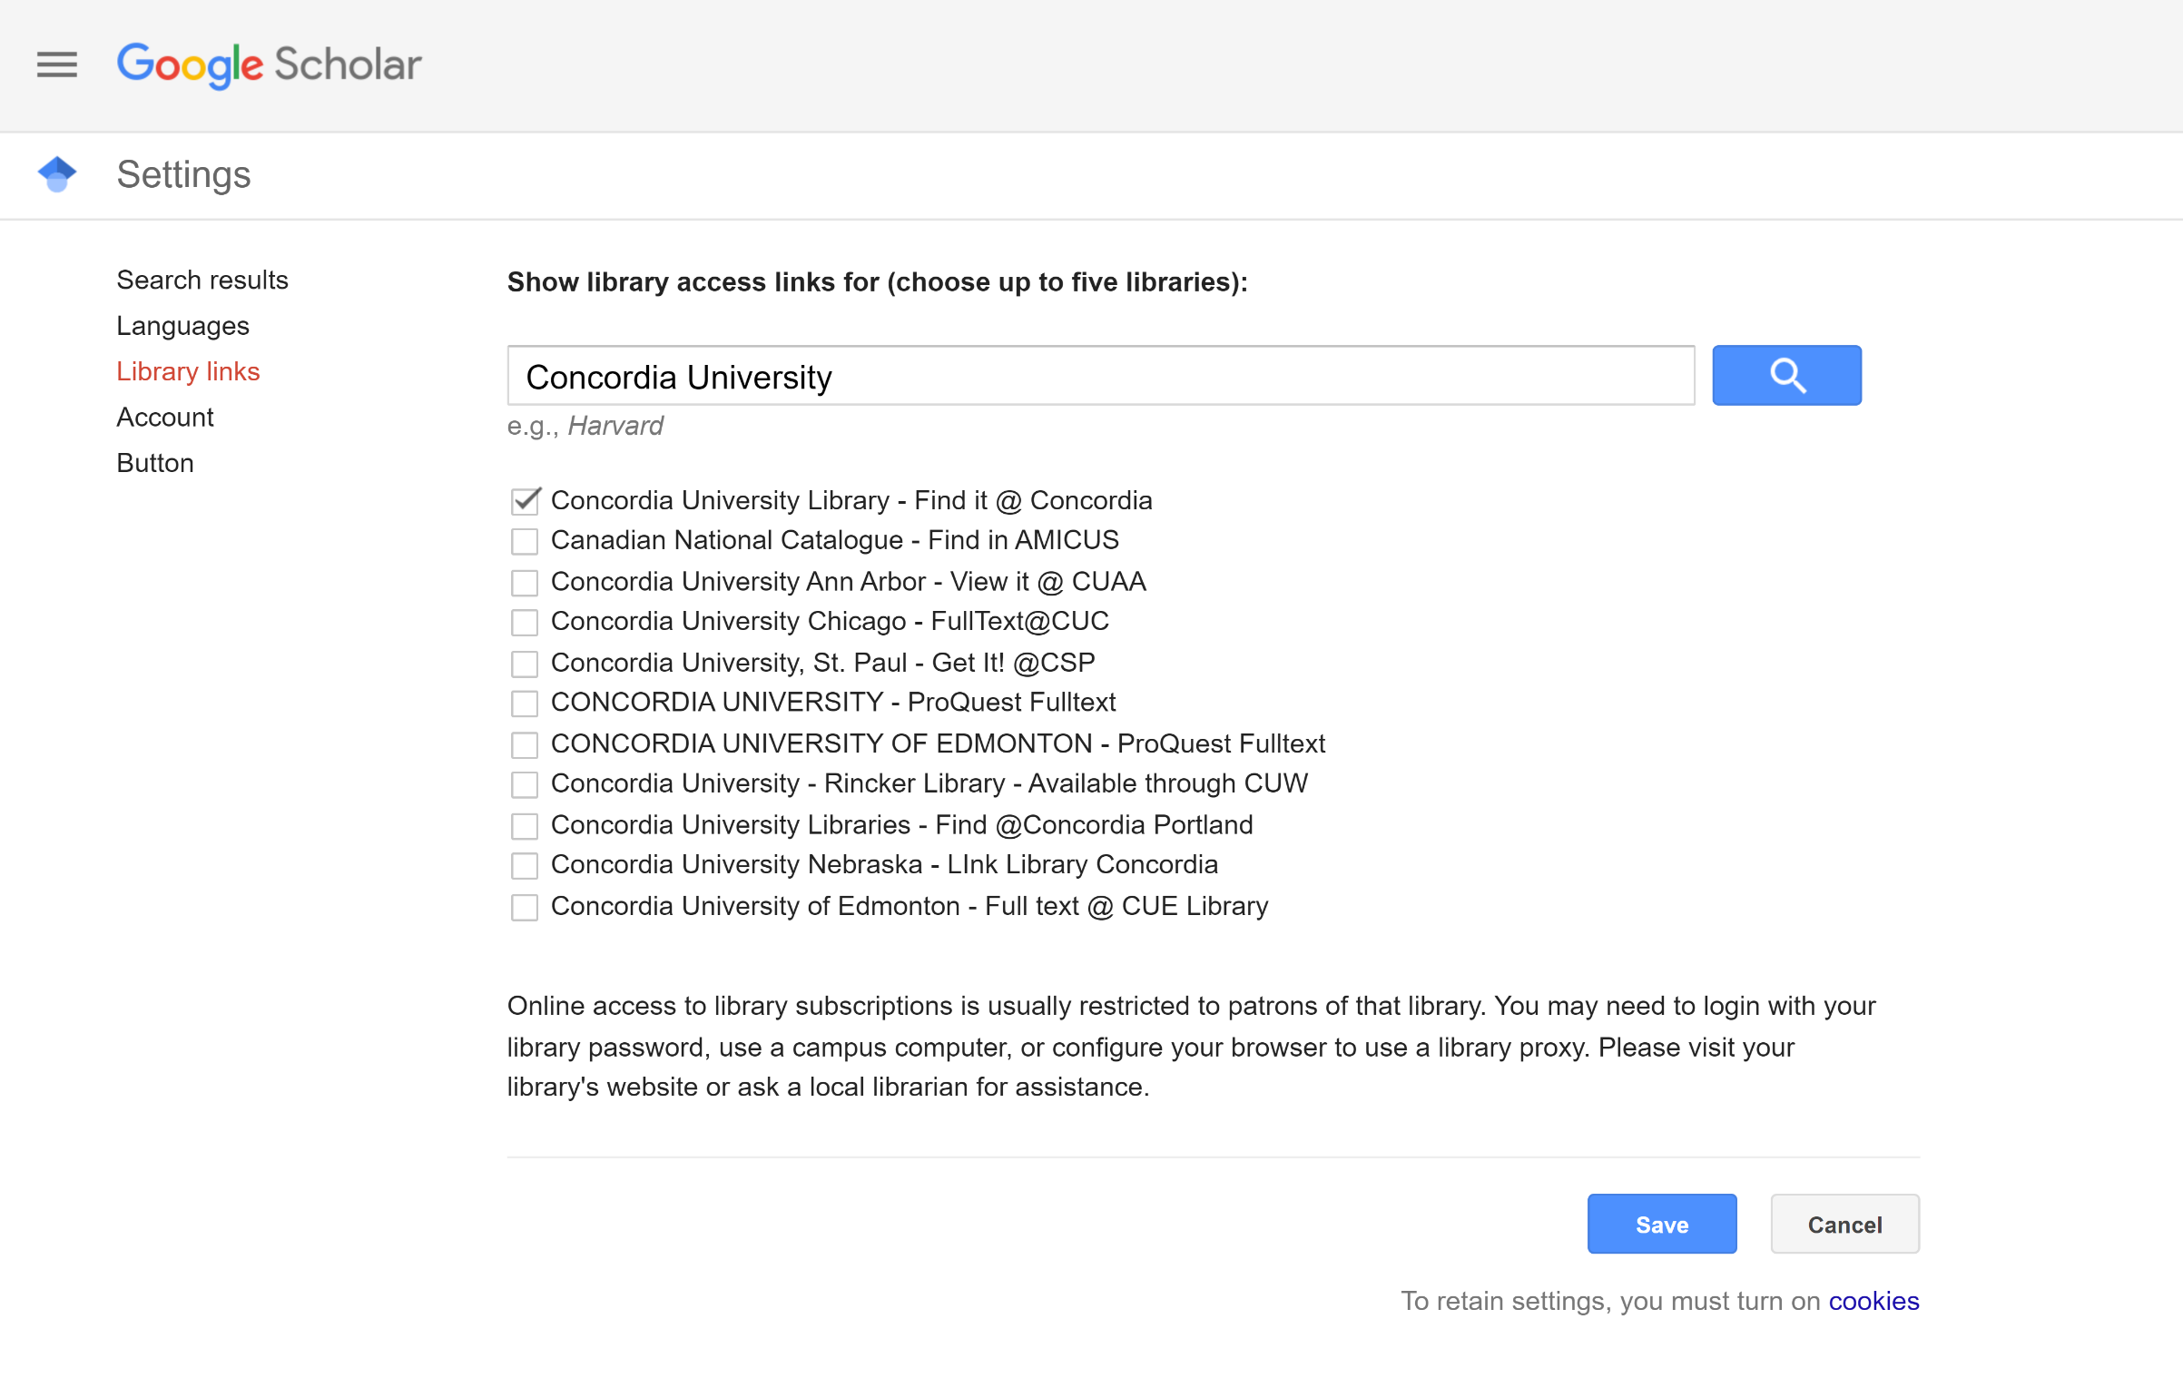
Google Scholar – select a library access link

Slide 55
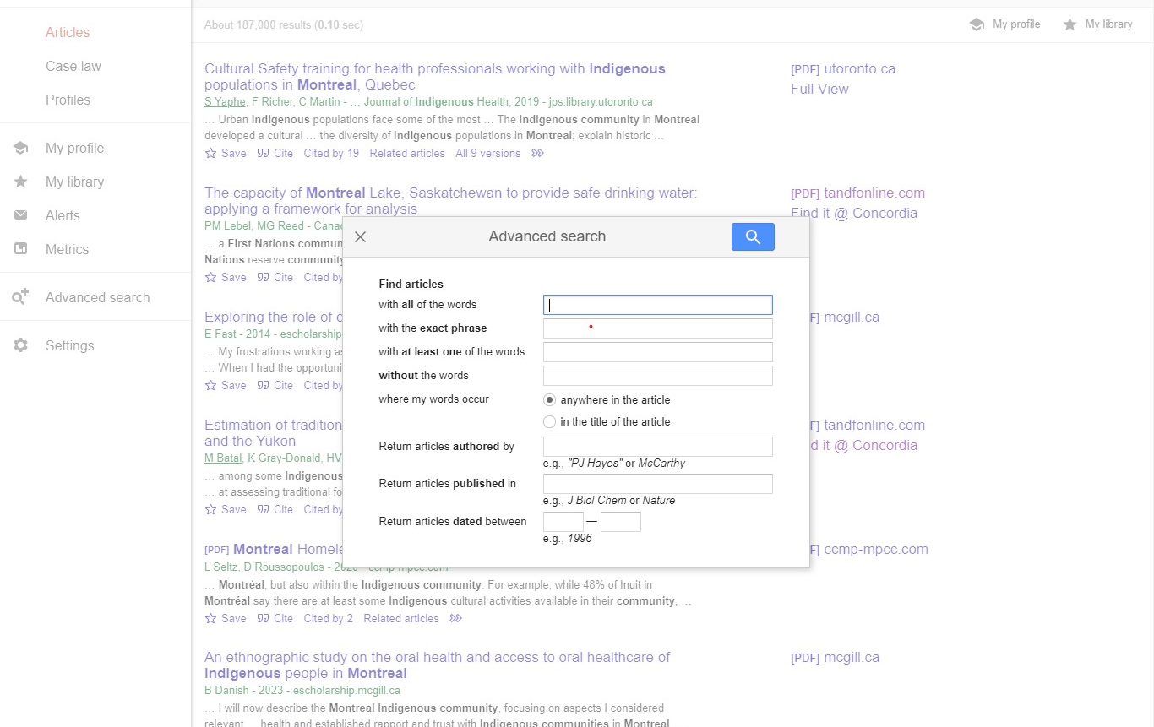
Google Scholar – advanced search

Slide 56
Searching for popular media related to the community (newspapers, magazine and other media); with Canadian Newsstream and Eureka.cc)

Slide 57
SEARCHING FOR NEWSPAPER ARTICLES WITH THE
CANADIAN NEWSSTREAM DATABASE

Slide 58
SEARCHING FOR NEWSPAPER ARTICLES WITH THE DATABASE
CANADIAN NEWSSTREAM

Slide 59
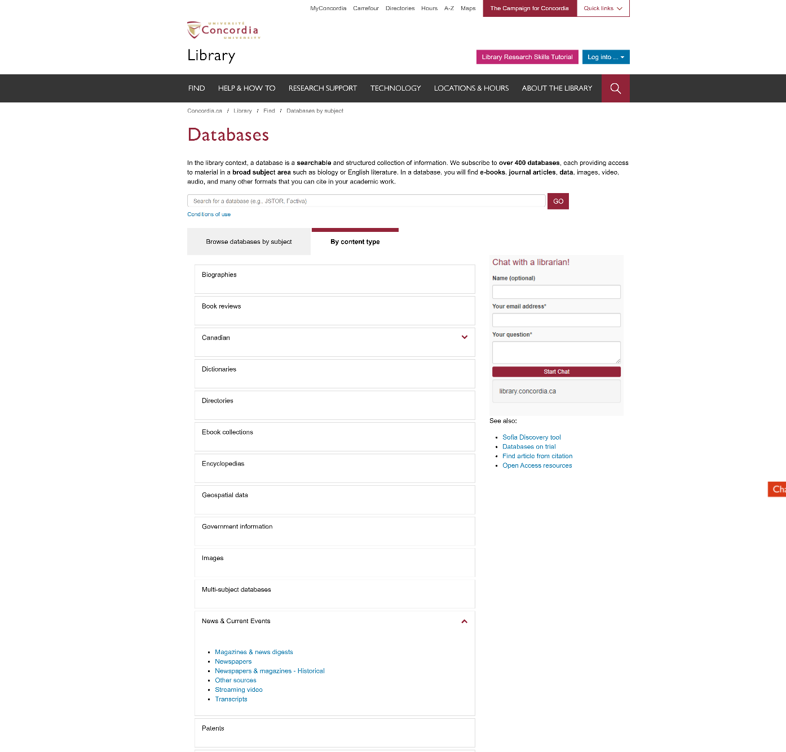
Searching Newspaper articles using Canadian Newsstream database.
How to get
to this page:
Find
Databases by subject
By content type
News & Current Events
Newspapers

Slide 60
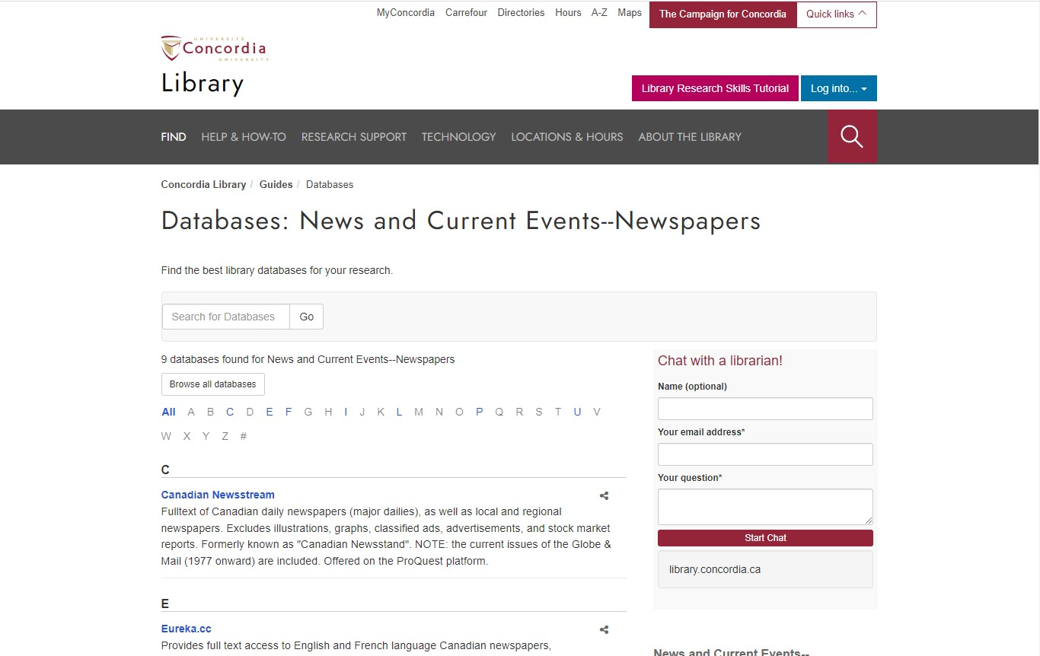
Database: News and Current Events--Newspapers

Slide 61


Canadian Newsstream advanced search Look up Locations

Slide 62

Canadian Newsstream Database search results

Slide 63


Article found on Canadian Newsstream database

Slide 64
SEARCHING FOR NEWSPAPER ARTICLES WITH THE DATABASE
EUREKA.CC

Slide 65

Advanced search with the database Eureka.cc

Slide 66


Slide 67
Exploring the website of the researched religious communities, with Google advanced search

Slide 68

Google advanced search

Slide 69


Searching “faith” on the St Jax Church website
Searching "religion" on the Canada Scouts website

Slide 70

Questions?

Slide 71
Concordia Library Website – Ask a Librarian

Slide 72
QUESTIONS? COMMENTS?
ETHEL GAMACHE
ethel.gamache@concordia.ca
Presentation and handouts will be on the subject guide,
https://www.concordia.ca/library/guides/religion/courseguides.html

Slide 73

Eureka website – Advanced Search

Slide 74

Eureka website

