Slide 1
RELI 409
METHODOLOGY AND
THE STUDY OF RELIGION
LIBRARY WORKSHOP
Éthel Gamache, Librarian | ethel.gamache@concordia.ca

Slide 2
Sources to support your assignment (as specified in the course syllabus)
The student is to consult at least 3 academic sources beyond the class text.
The student is to explore 1-3 relevant web sites.
The student is to search out popular media related to their community: for example, newspaper or news radio or T.V. reports, magazines, brochures or newsletters produced by the community in question.

Slide 3
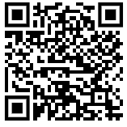
Outline
Takeaways from the video Search Smarter, Search Faster
How to find and access resources
Introduction to the Library website & the Religions and Cultures subject guide
Using Sofia and Interlibrary loans
Using the database Academic Search Complete to find academic articles
Using Google Scholar to find articles
Using the database Canadian Newsstream to find newspaper articles

Slide 4
TAKEAWAYS FROM THE VIDEO SEARCH SMARTER, SEARCH FASTER

Slide 5
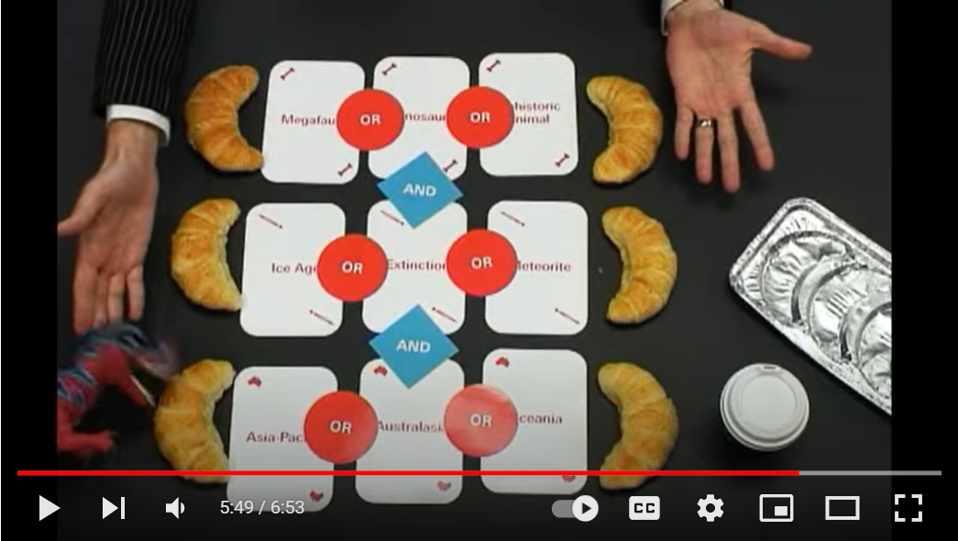
What is a Boolean Search?

Slide 6
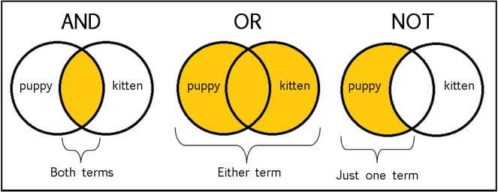
The Concept of a Boolean search illustrated
From: The Library of Antiquity, https://libraryofantiquity.wordpress.com/2016/10/07/forgotten-skills-boolean-searches/

Slide 7
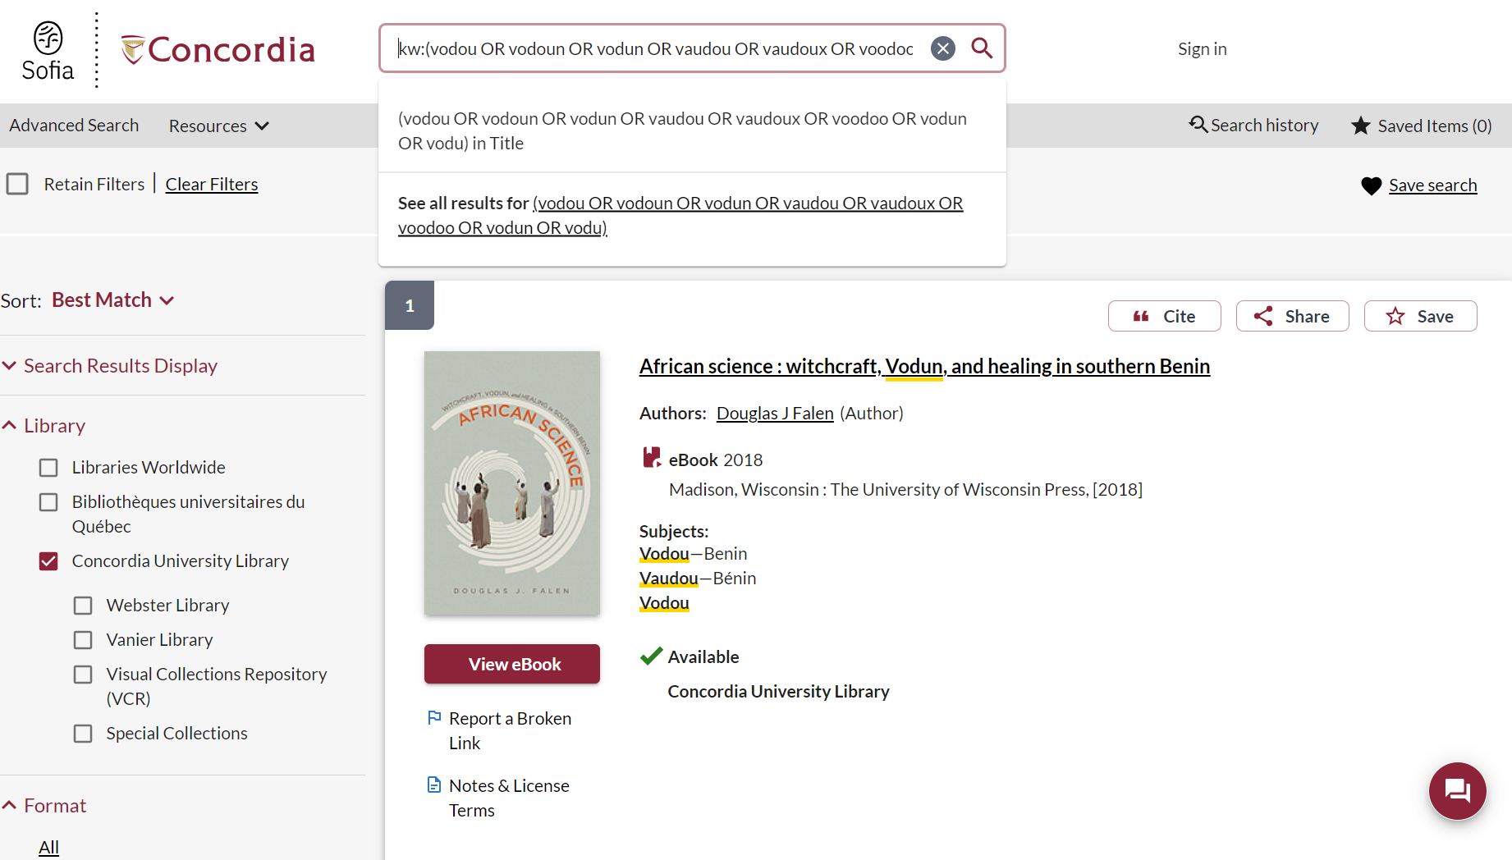

Slide 8
Other search operators
Searching for an exact phrase (phrase searching): Quotation marks: “ ”, looks for adjacent words
“rite of passage”, “salvation army”
Truncation: *
relig*: religion, religions, religare, religious, religieux, religieuse, religieuses

Slide 9
INTRODUCTION TO THE LIBRARY WEBSITE & SUBJECT GUIDE

Slide 10
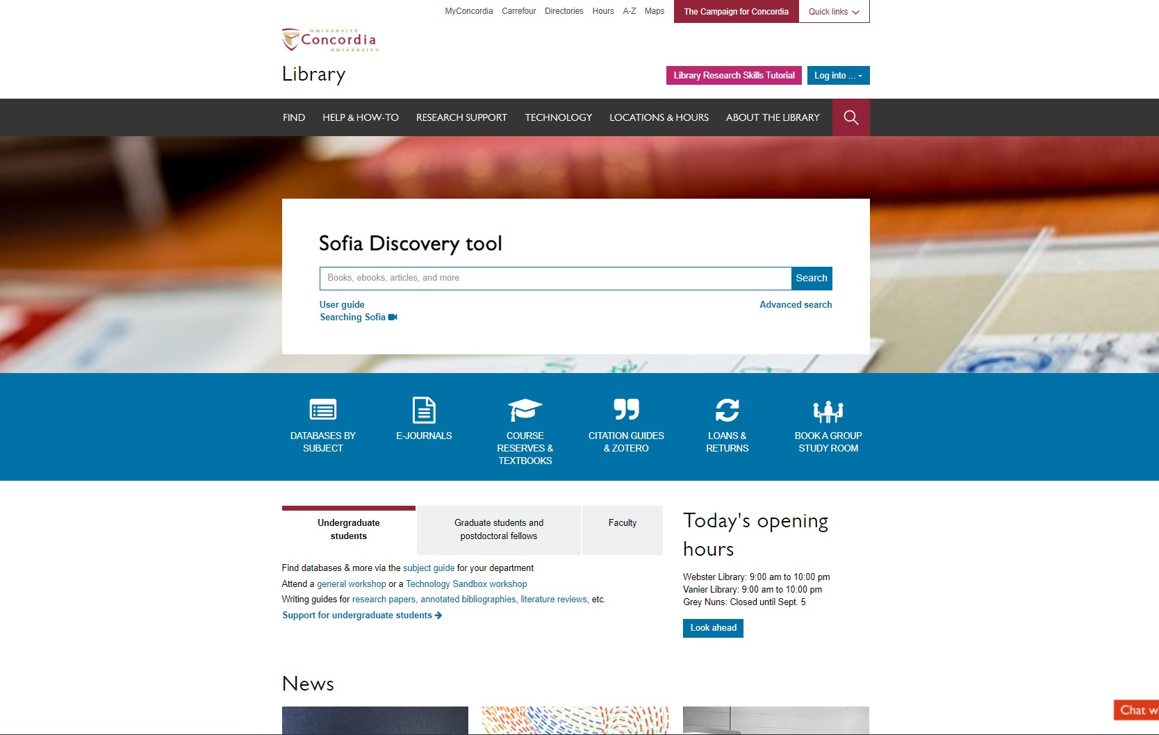
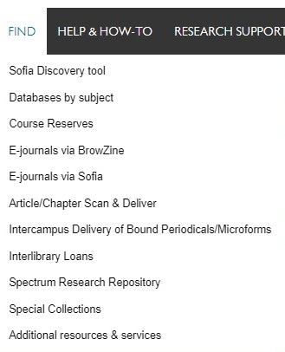
Sofia Discovery Tool – Databases By Subject
library.concordia.ca

Slide 11
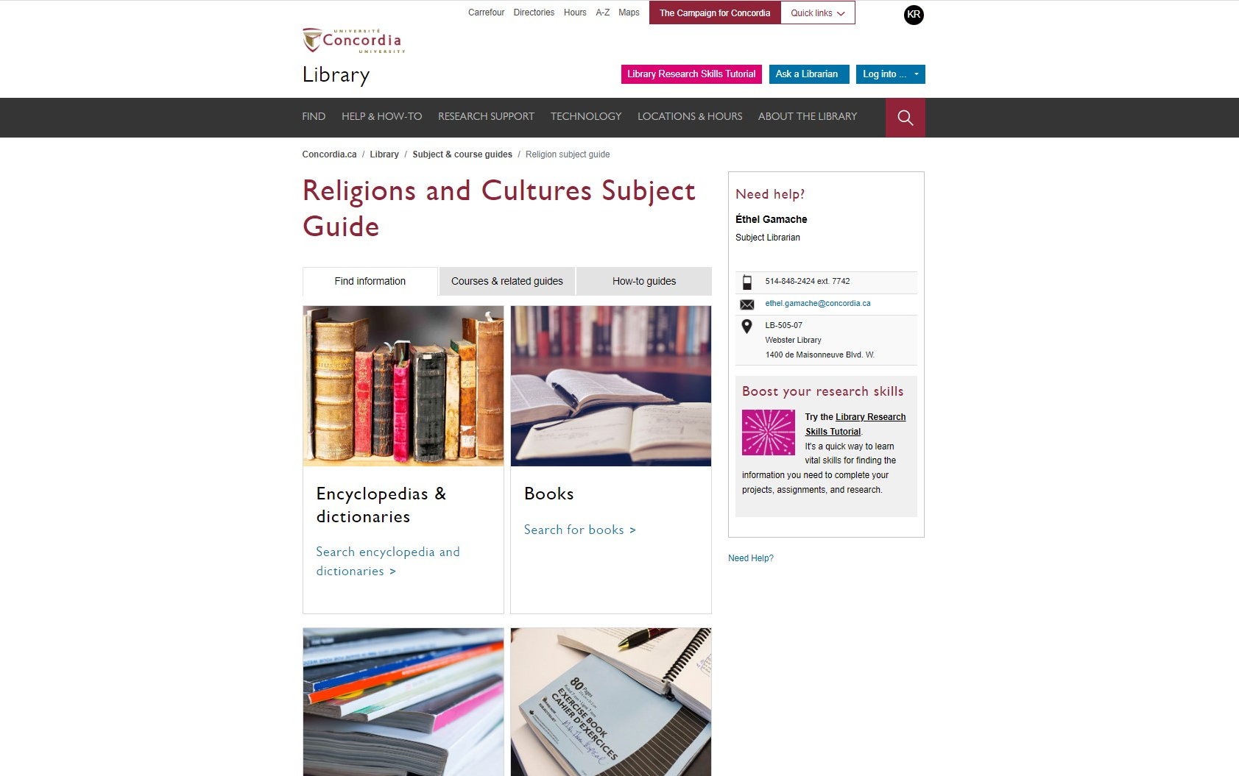
Religions and Cultures Subject Guides
concordia.ca/library/guides/religion.html

Slide 12
USING SOFIA & INTERLIBRARY LOANS

Slide 13
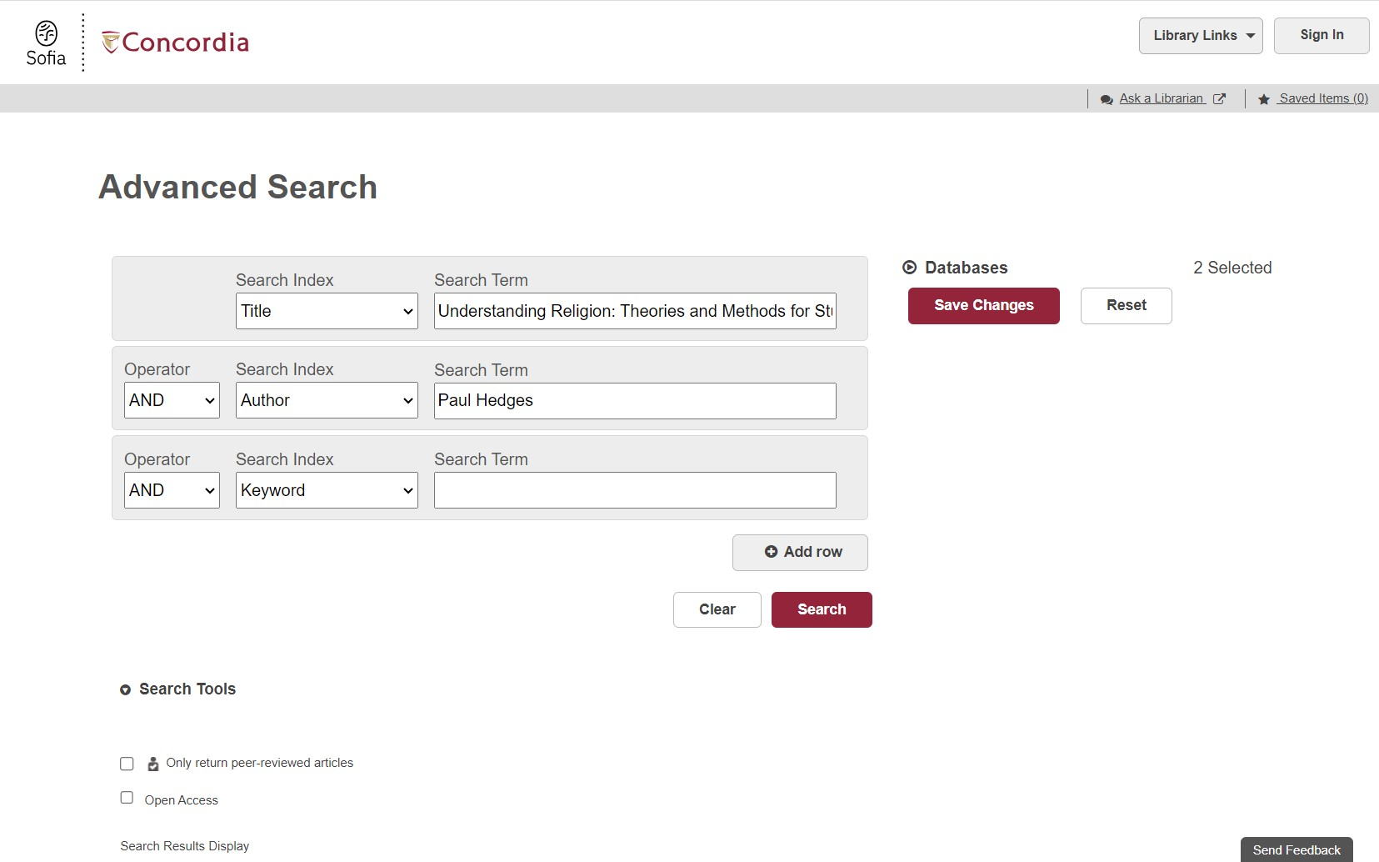
Advanced search in Sofia

Slide 14
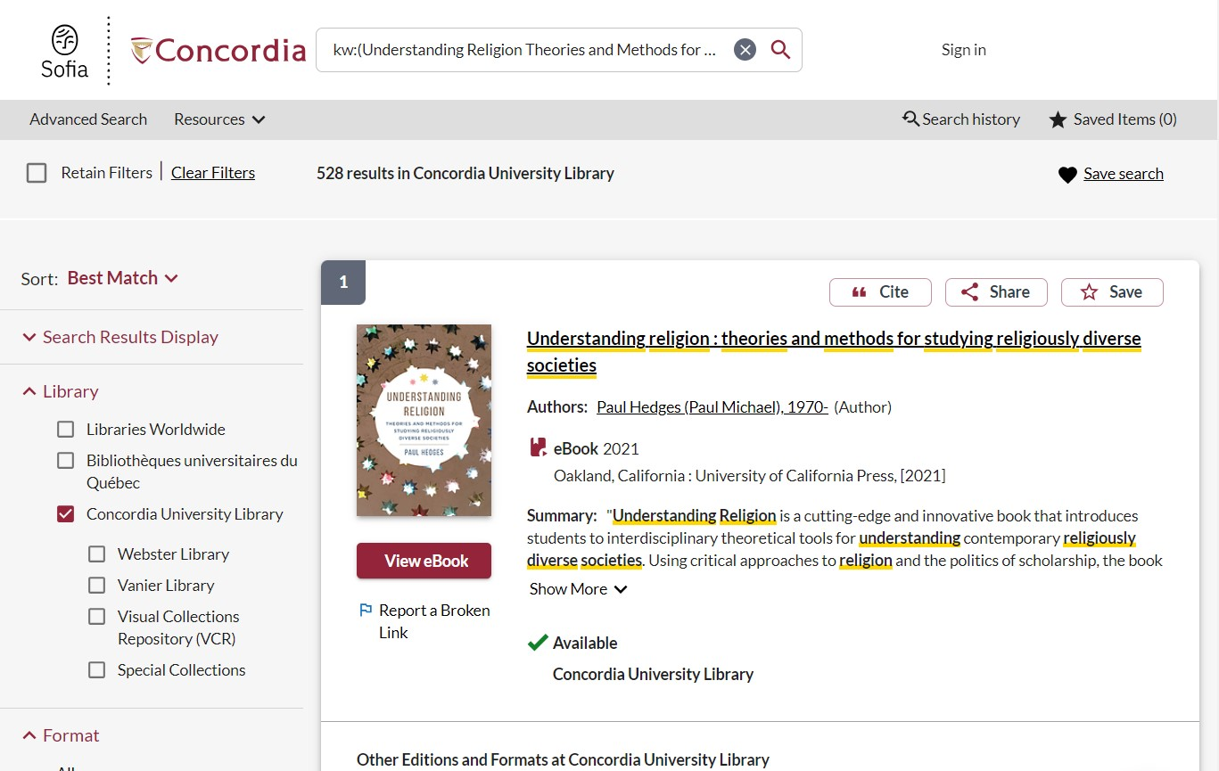
Advanced search in Sofia continued 1
Advanced search in Sofia

Slide 15
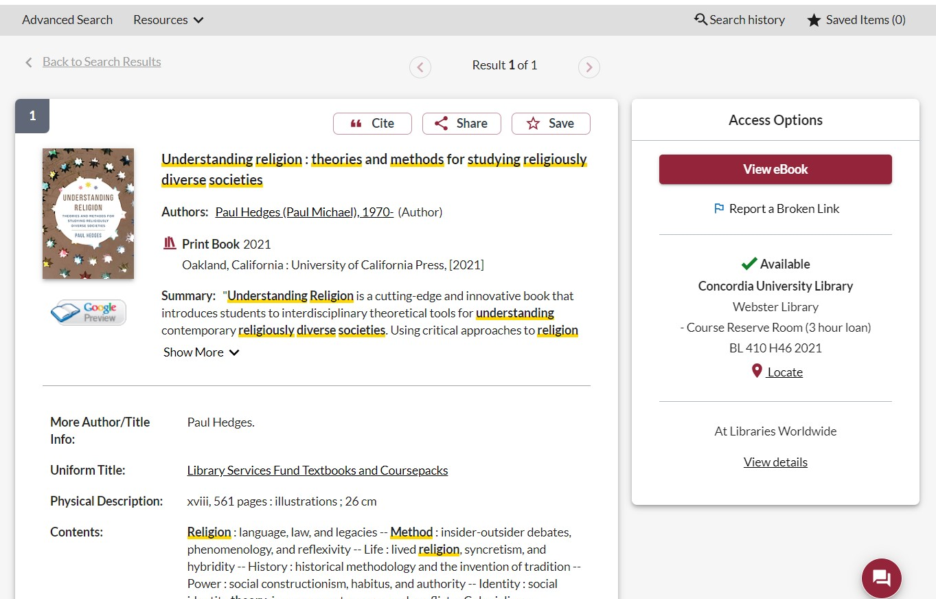
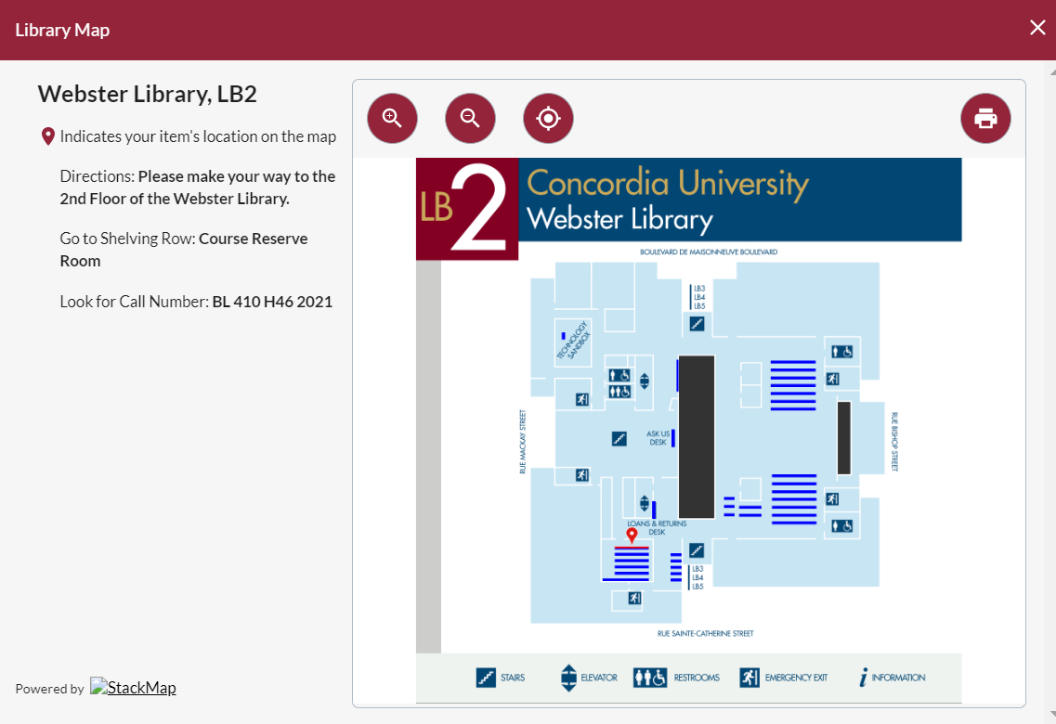
Advanced search in Sofia continued 2
Advanced search in Sofia

Slide 16
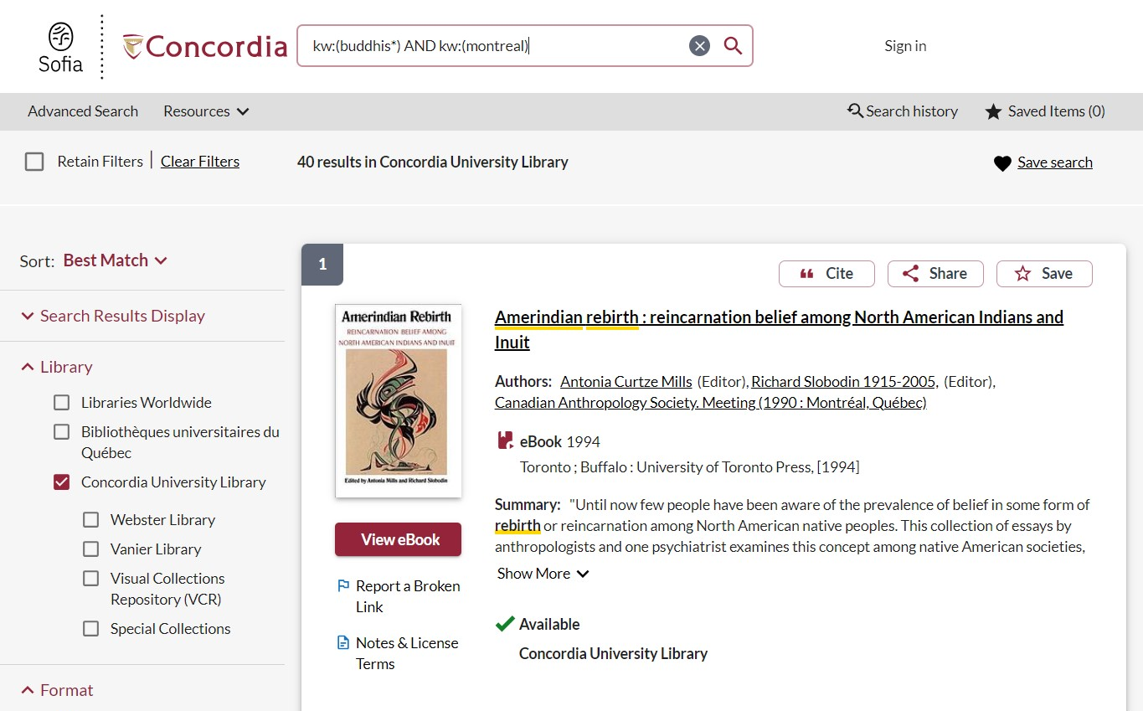
Advanced search in Sofia continued 3
Advanced search in Sofia

Slide 17
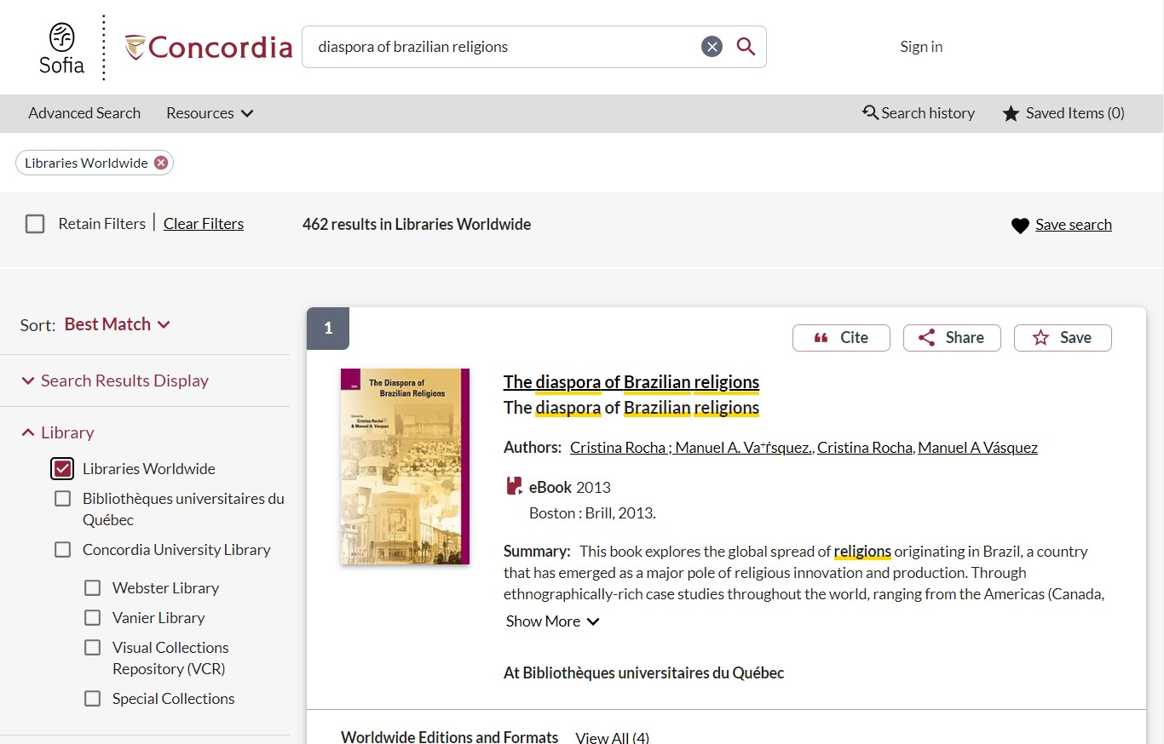
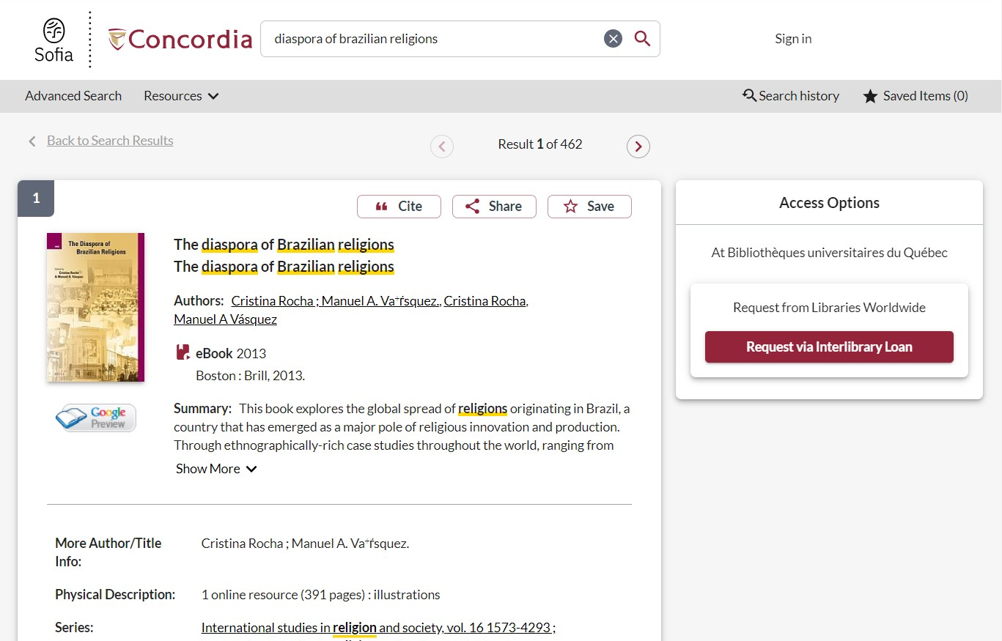
Advanced search in Sofia continued 4
Advanced search in Sofia

Slide 18
USING INTERLIBRARY LOANS WITHIN SOFIA

Slide 19
What is the new interlibrary loans (ILL) service?
ILL requests are made directly in the Sofia Discovery tool:
“Request via Interlibrary Loan” button
Form available under the “Requests” tab in "My Account".

Slide 20
Concordia article/chapter scan & deliver service
Book chapter and journal article scans from Concordia’s print collection can now be requested and tracked in Sofia.
Look for the “Chapter Scan” button in the Access Options panel.

Slide 21
REQUEST A BOOK VIA INTERLIBRARY LOAN
EXAMPLE

Slide 22
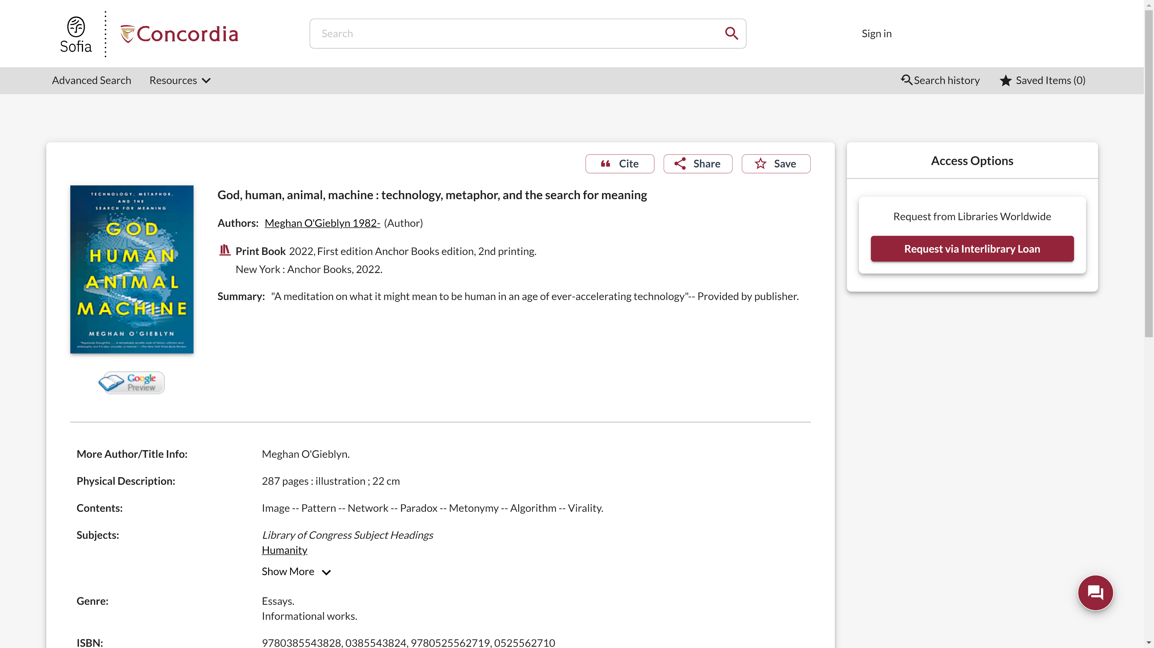
Sofia Discovery Tool request via Interlibrary loan

Slide 23
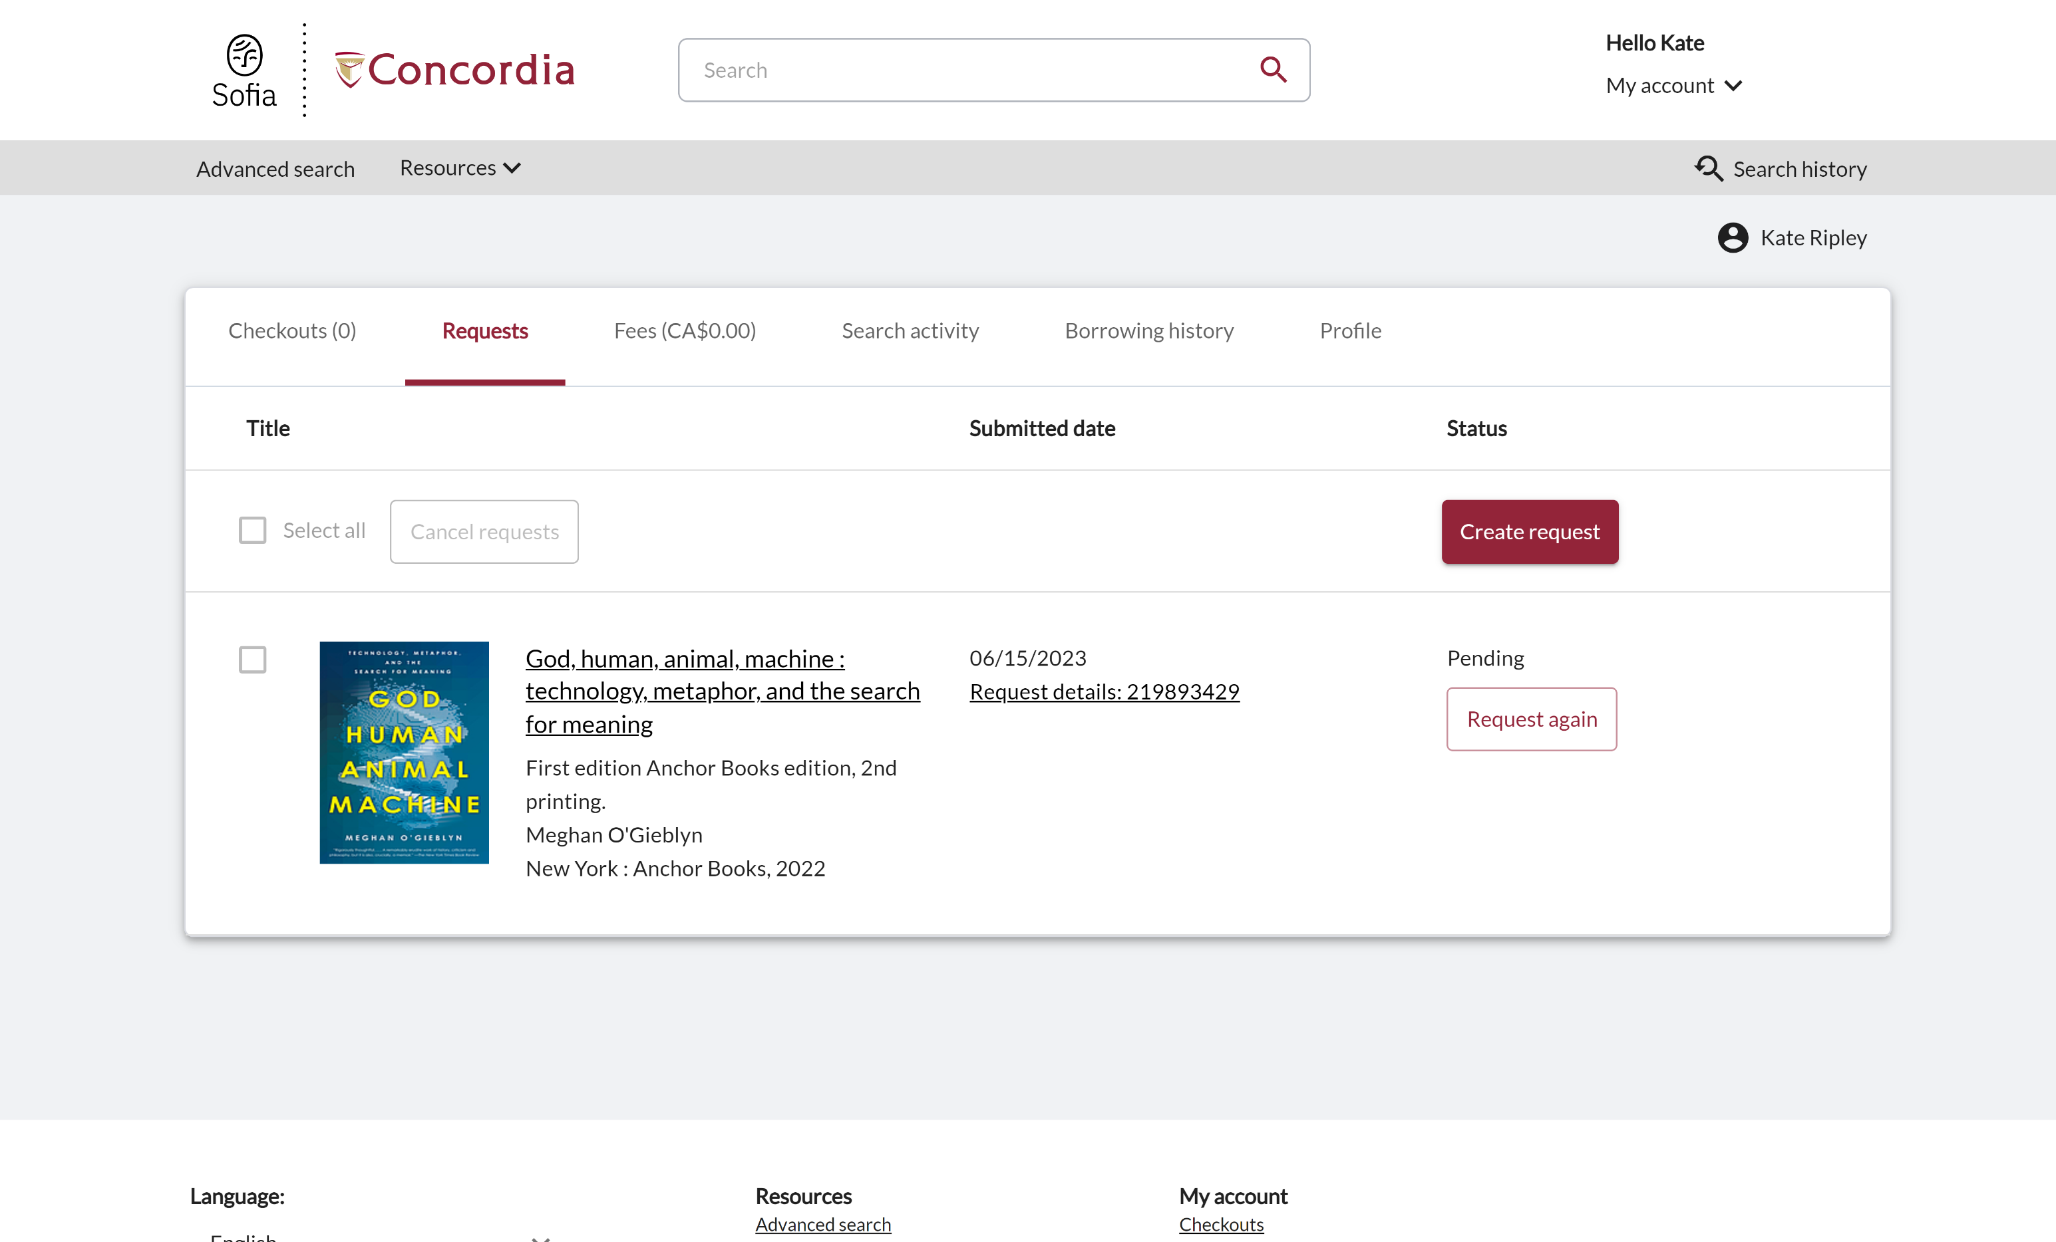
Check the status of your request under the "Requests" tab.

Slide 24
About Interlibrary loan
You will receive email notifications when your ILL request is available for pickup or download.
Physical items can be picked up at the Circulation/Loans desks at either Vanier or Webster Library.
ILL requests can be borrowed for 30 days, with up to 4 automatic renewals, or until item is recalled.

Slide 25
REQUEST A BOOK BLANK FORM
EXAMPLE

Slide 26
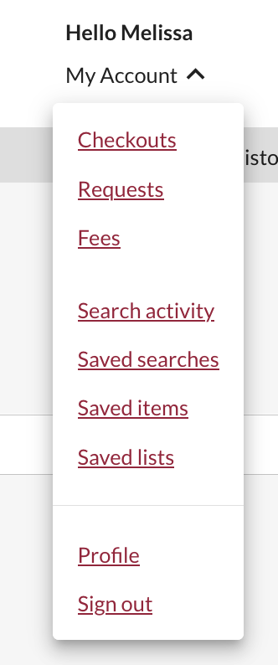
Create an Interlibrary Loan request
Sign in to "My Account" and select "Requests".
Click on "Create request".

Slide 27
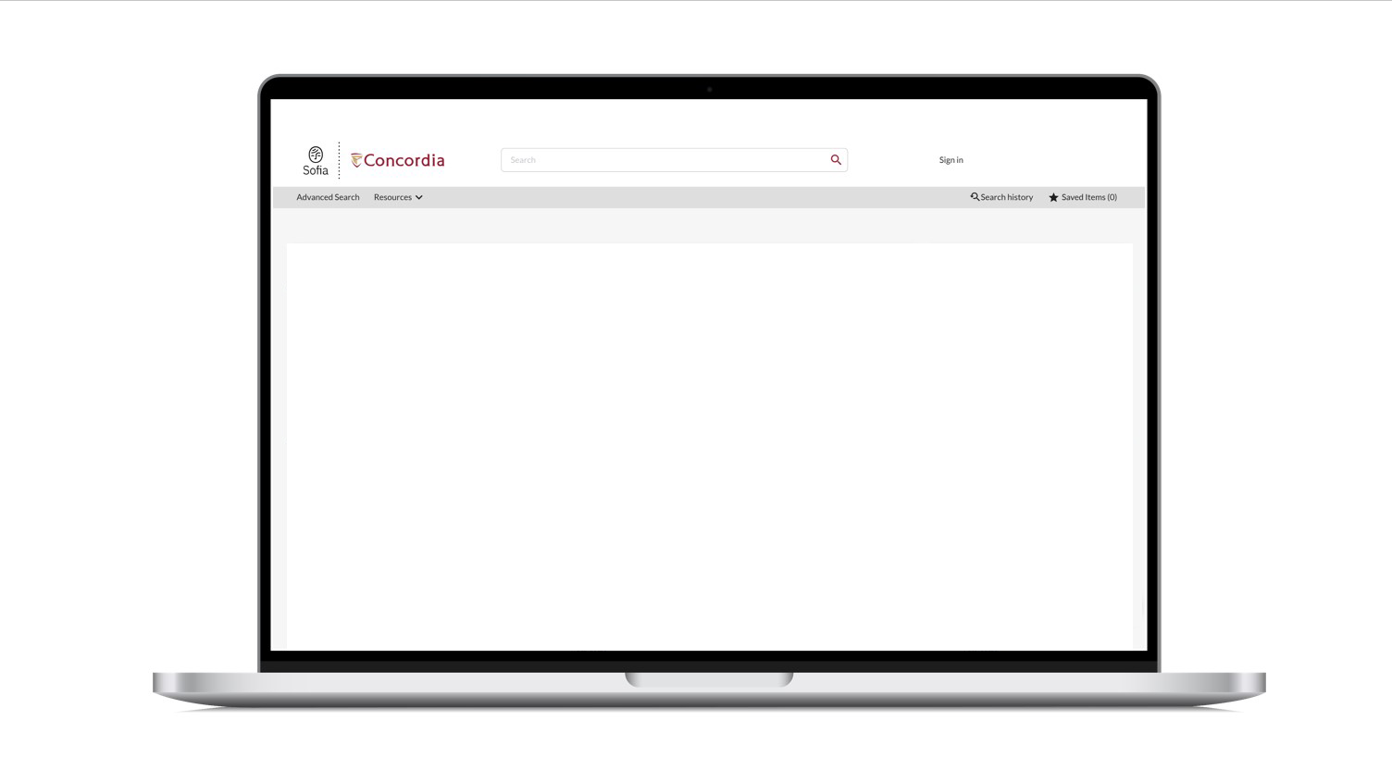
Sofia Discovery Tool – request a book form

Slide 28
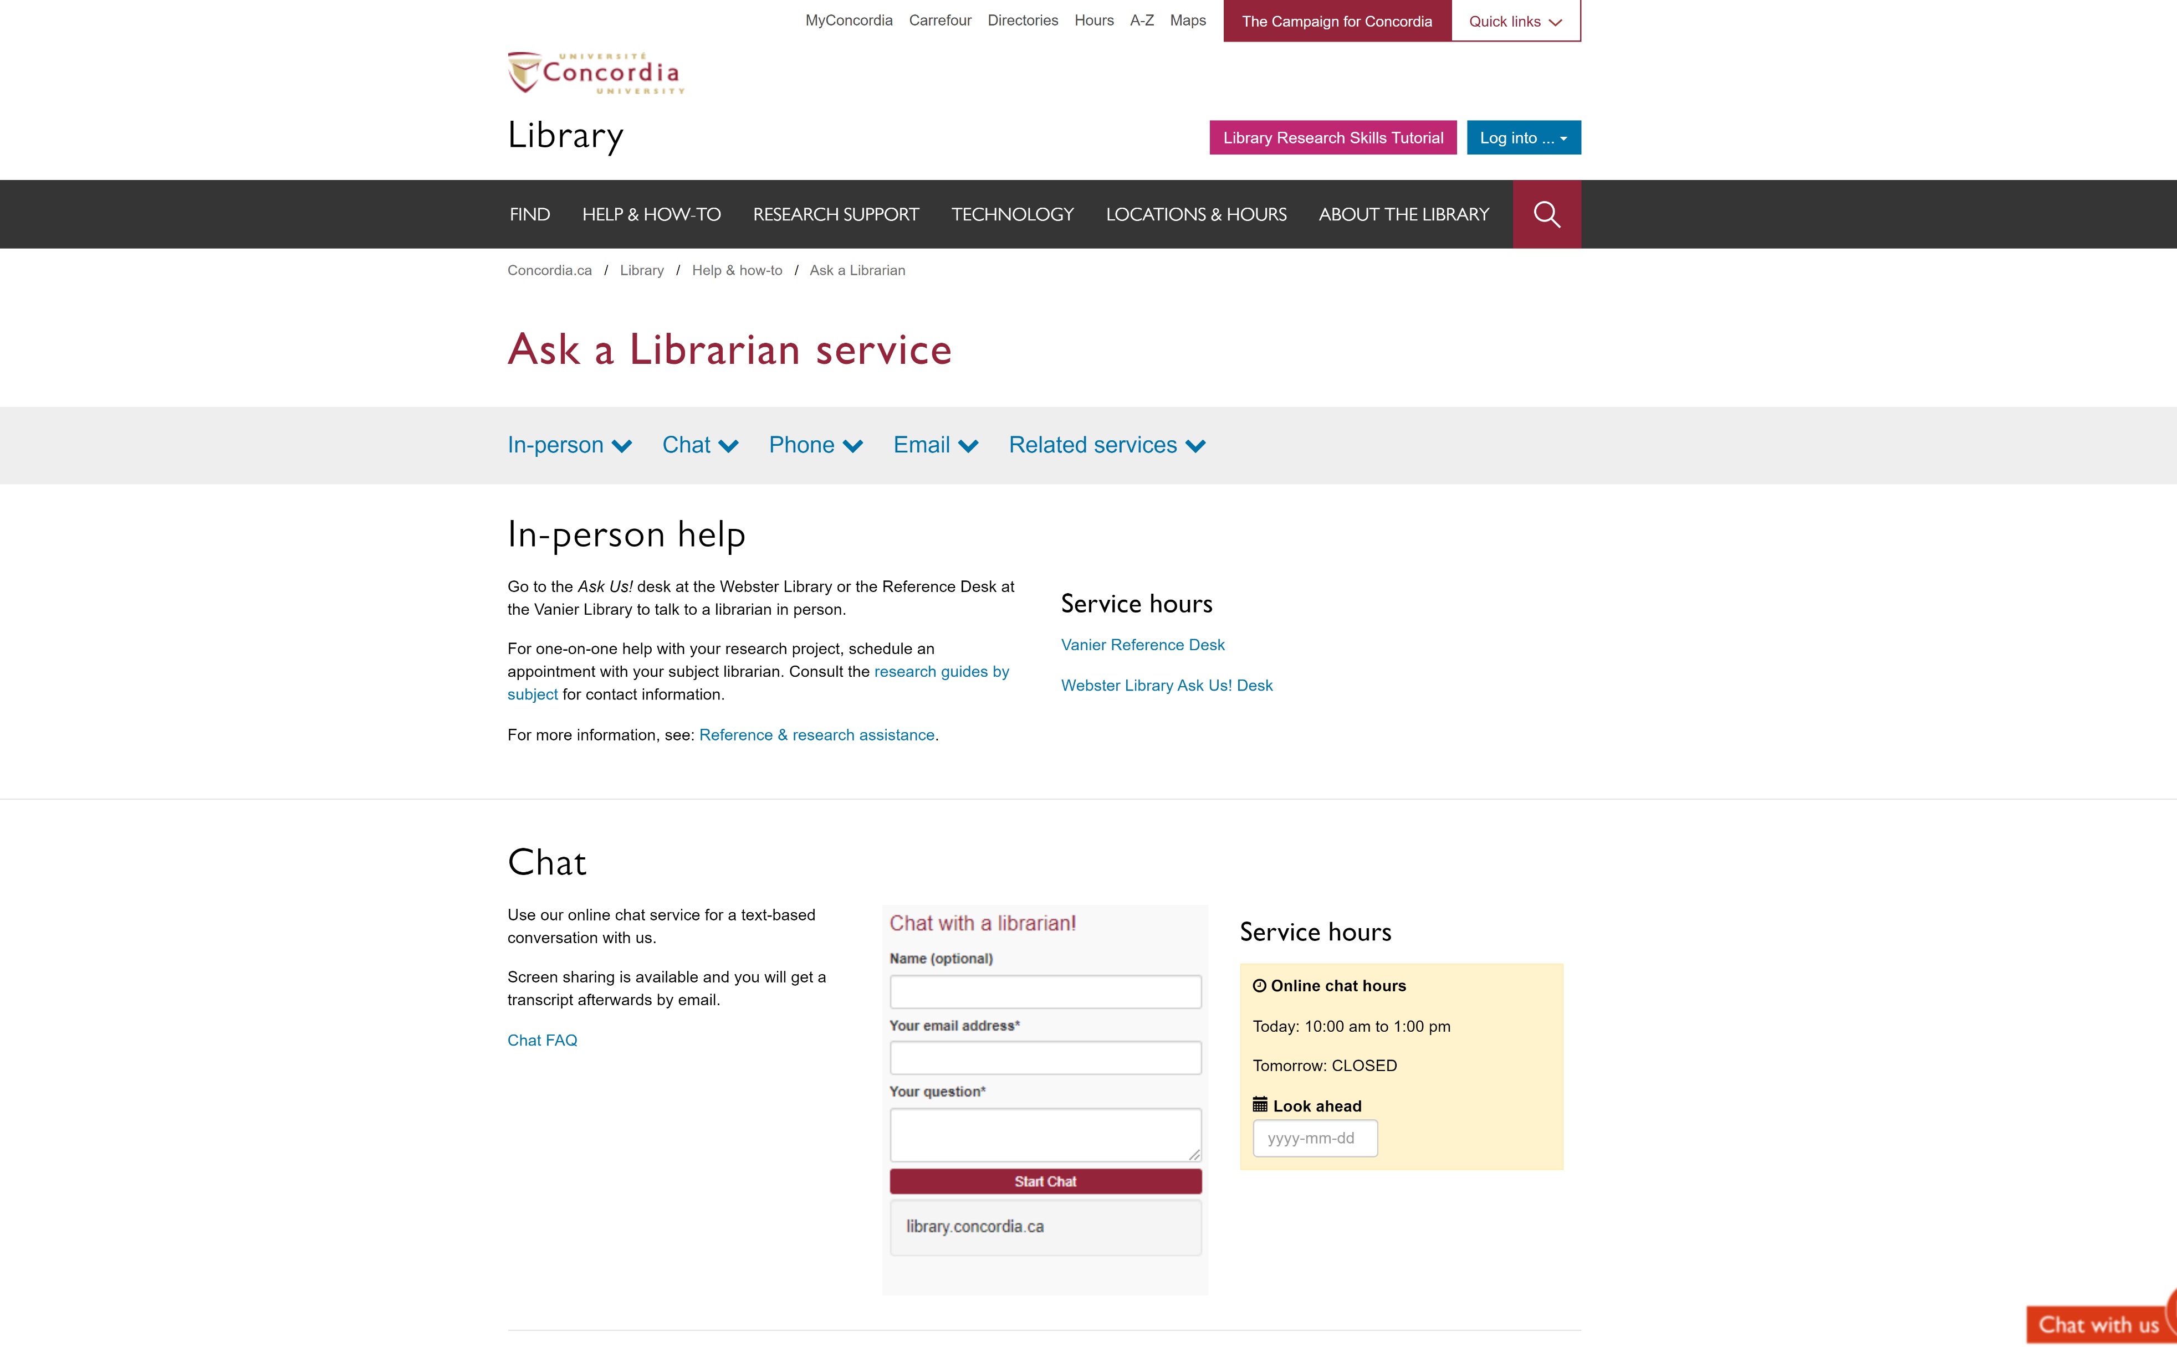
If you have any difficulty finding a document, reach out!

Slide 29
SEARCHING FOR PEER-REVIEWED ARTICLES WITH DATABASES ACADEMIC SEARCH COMPLETE

Slide 30
The peer-reviewed process
Yates, D. [@LegoAcademics]. (2014, August 12). Peer 1: Brillant! Accept with no changes; Peer 2: Groundbreaking! Accept with no changes; Peer 3: Reject. [Tweet]. Twitter. https://twitter.com/LegoAcademics/status/499205005468262400/photo/1

Slide 31
Sofia Discovery Tool – Databases By Subject 1

Slide 32
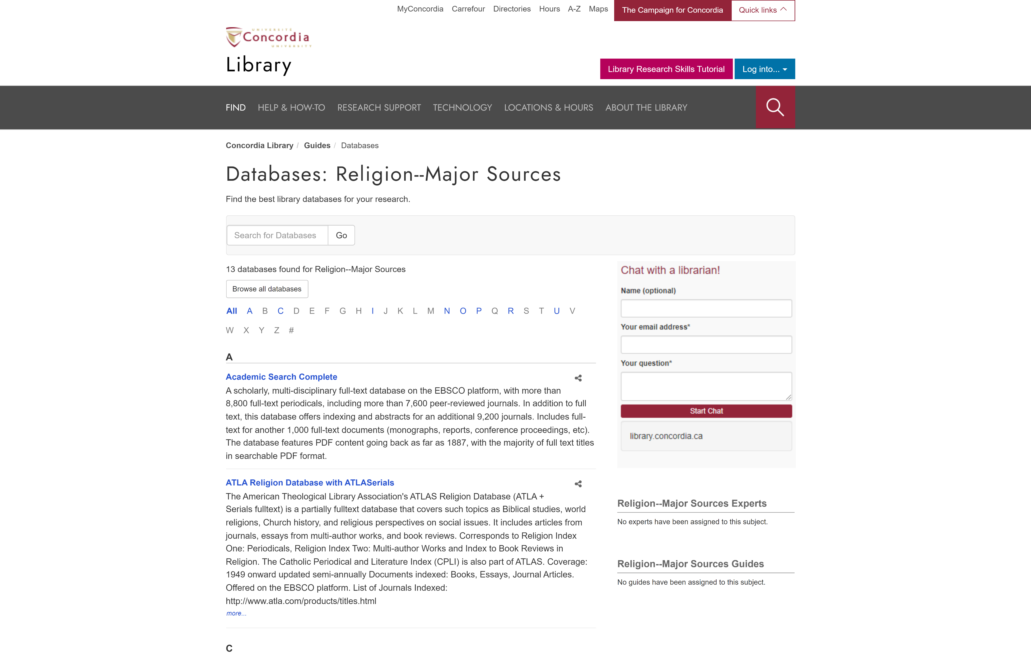
library.concordia.ca/find/databases/index.php

Slide 33
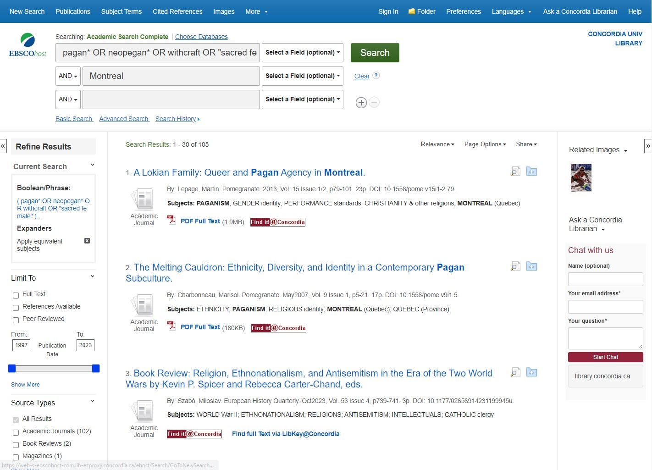
Concordia Library – Database Searching

Slide 34
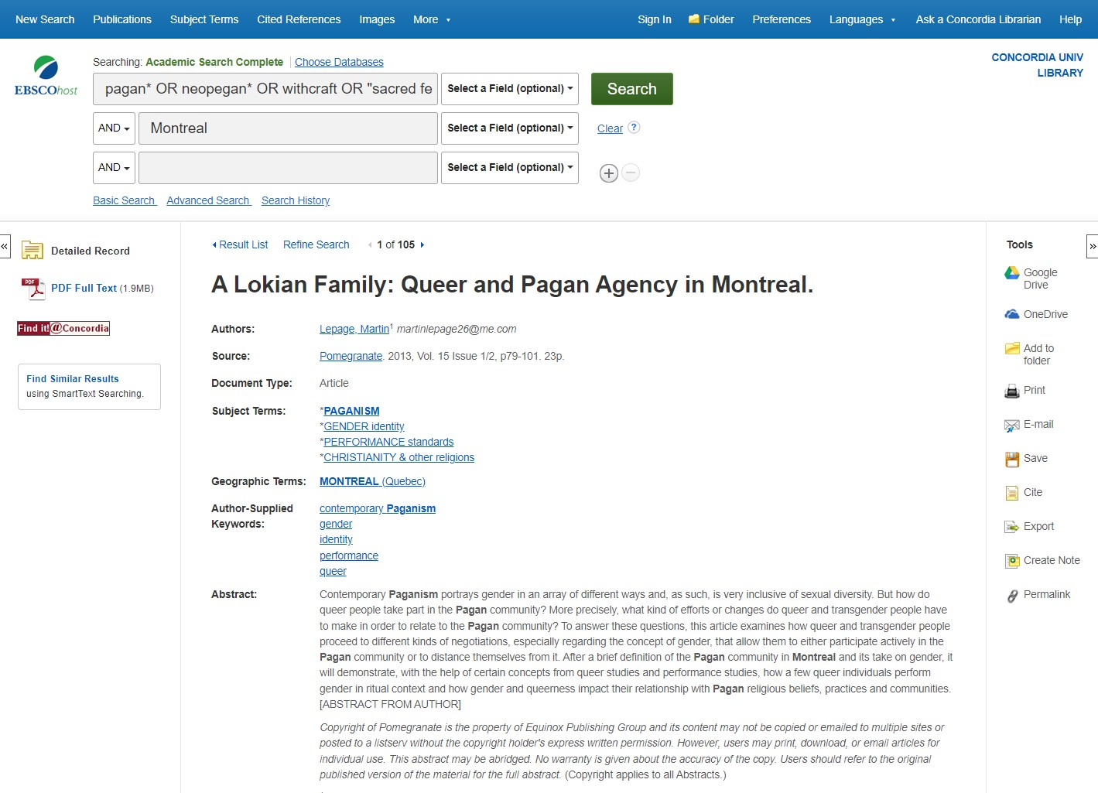
Database Boolean Search

Slide 35
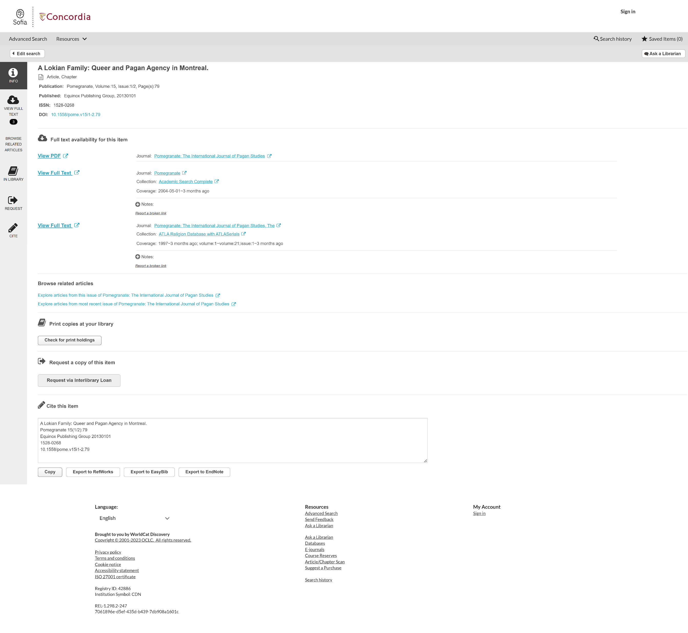
View full article via Find it@Concordia button

Slide 36
Find it@Concordia results webpage

Slide 37
Database tools

Slide 38
SEARCHING FOR PEER-REVIEWED ARTICLES WITH GOOGLE SCHOLAR

Slide 39
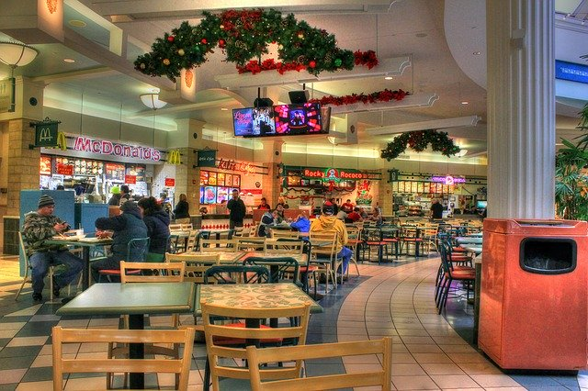
What is the difference?
Google scholar
Library databases
Volume | Quantity | Quick
Depth | Quality | Thorough
Left image: Yinan Chen, Dining Court, public domain, https://pixabay.com/photos/dining-court-shopping-mall-corridor-347314/
Right image: Jason Briscoe, Cooking, public domain, https://unsplash.com/photos/VBsG1VOgLIU

Slide 40
Where should you search?
Library Discovery Tool
Academic Search Complete
(Library Database)
Google Scholar
Eureka.cc
(Library Database)
Grey literature (e.g. government documents, NGO reports, working papers, newsletters, preprints)

Slide 41
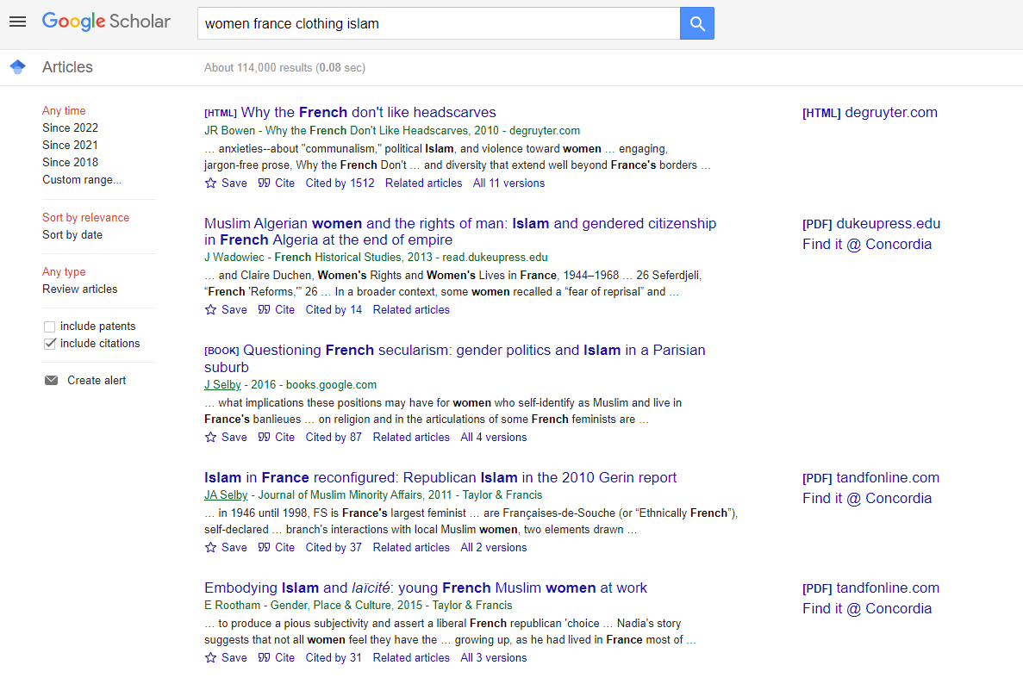
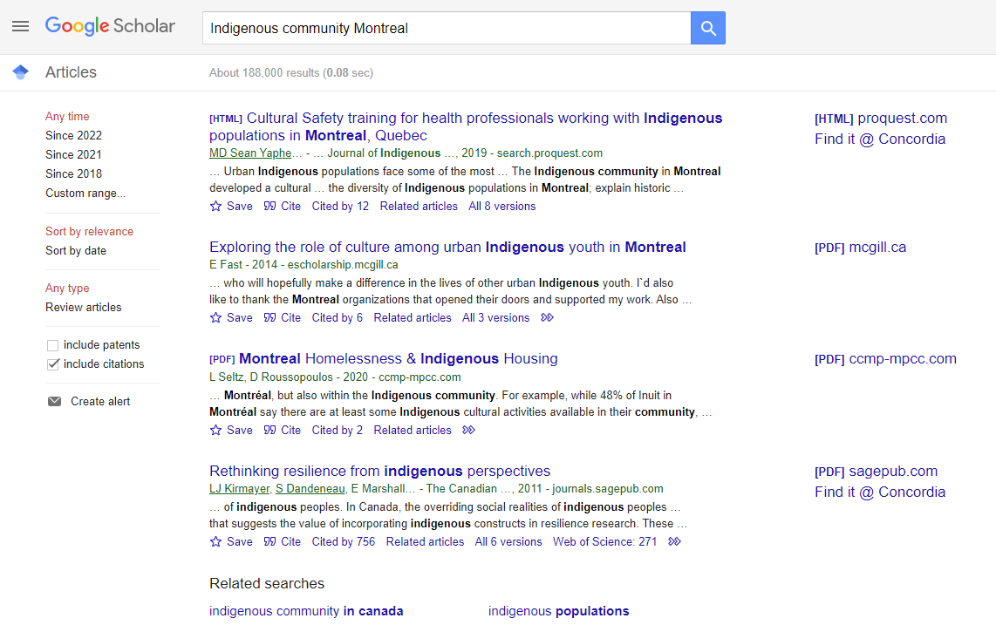
Searching in Google Scholar

Slide 42
Google Scholar – select a library access link

Slide 43
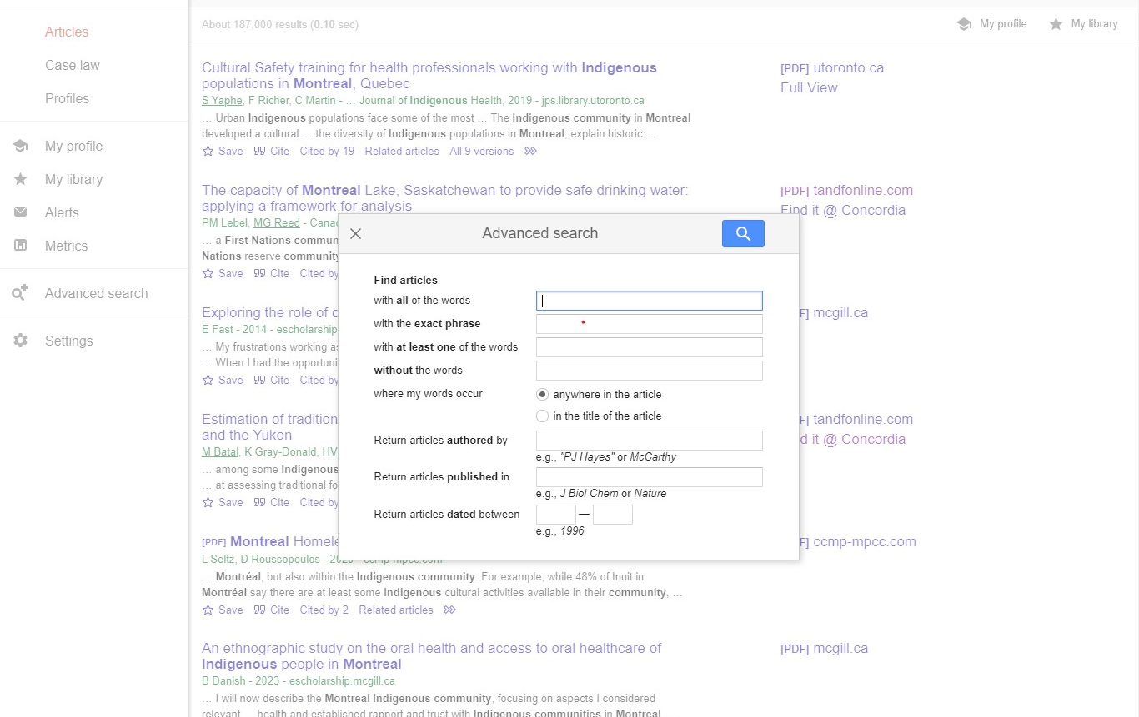
Google Scholar – advanced search

Slide 44
SEARCHING FOR NEWSPAPER ARTICLES WITH THE CANADIAN NEWSSTREAM DATABASE

Slide 45
Searching Newspaper articles using Canadian Newsstream database.
How to get
to this page:
Find
Databases by subject
By content type
News & Current Events
Newspapers

Slide 46
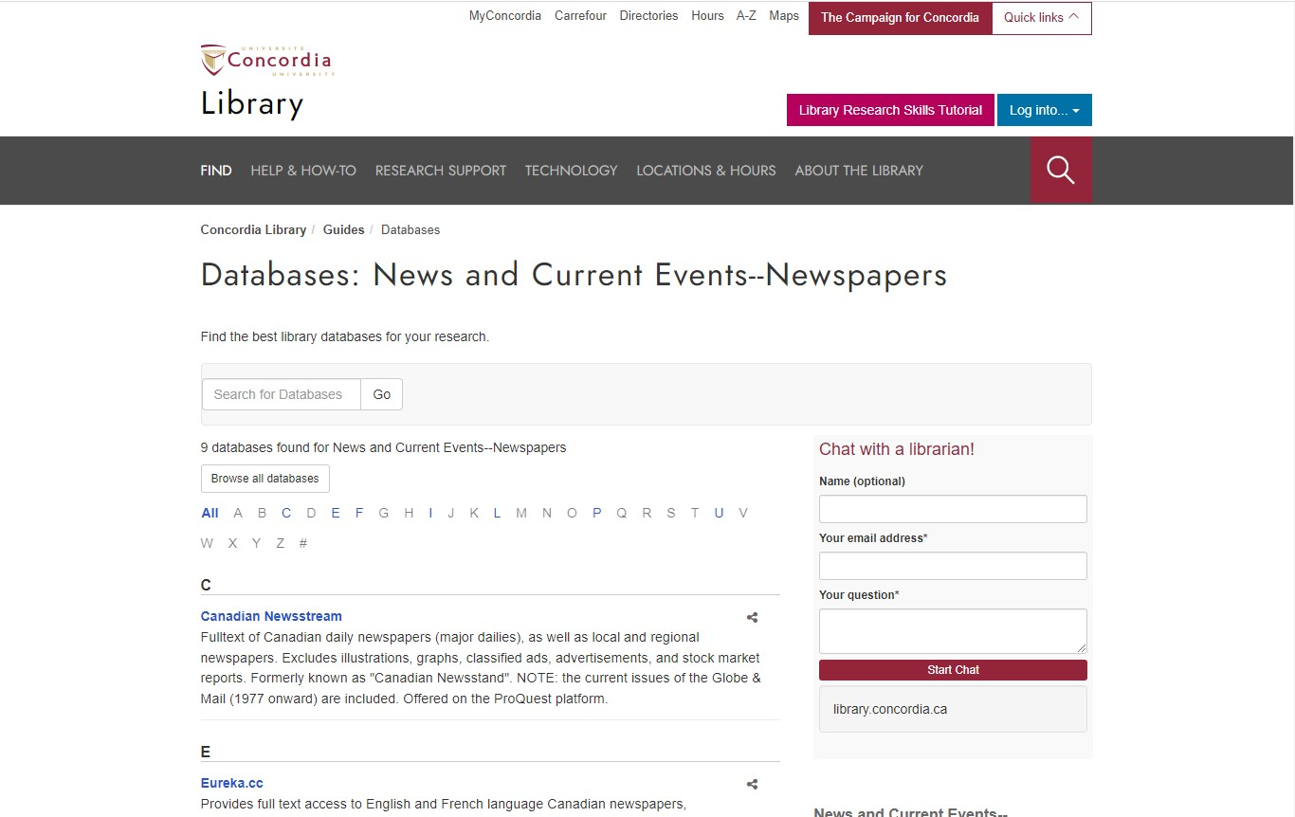
Database: News and Current Events--Newspapers

Slide 47
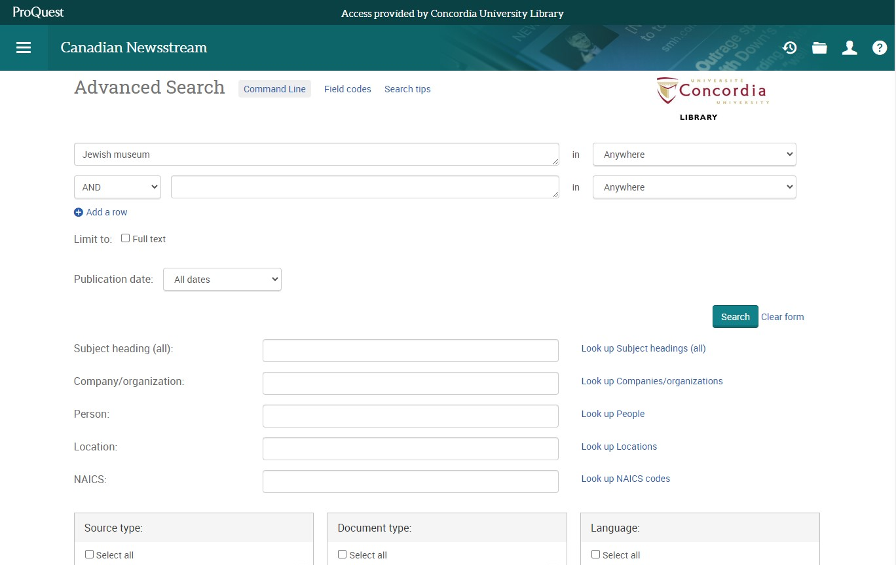
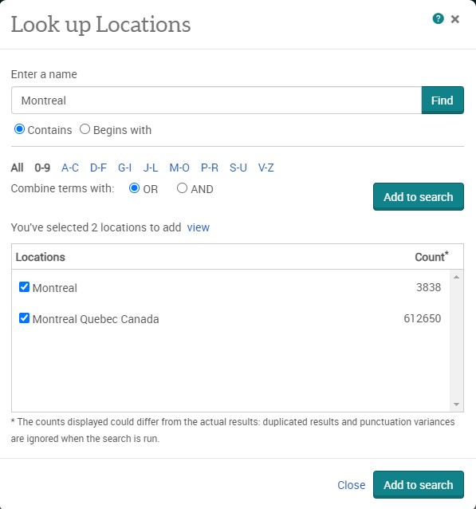
Canadian Newsstream advanced search Look up Locations

Slide 48
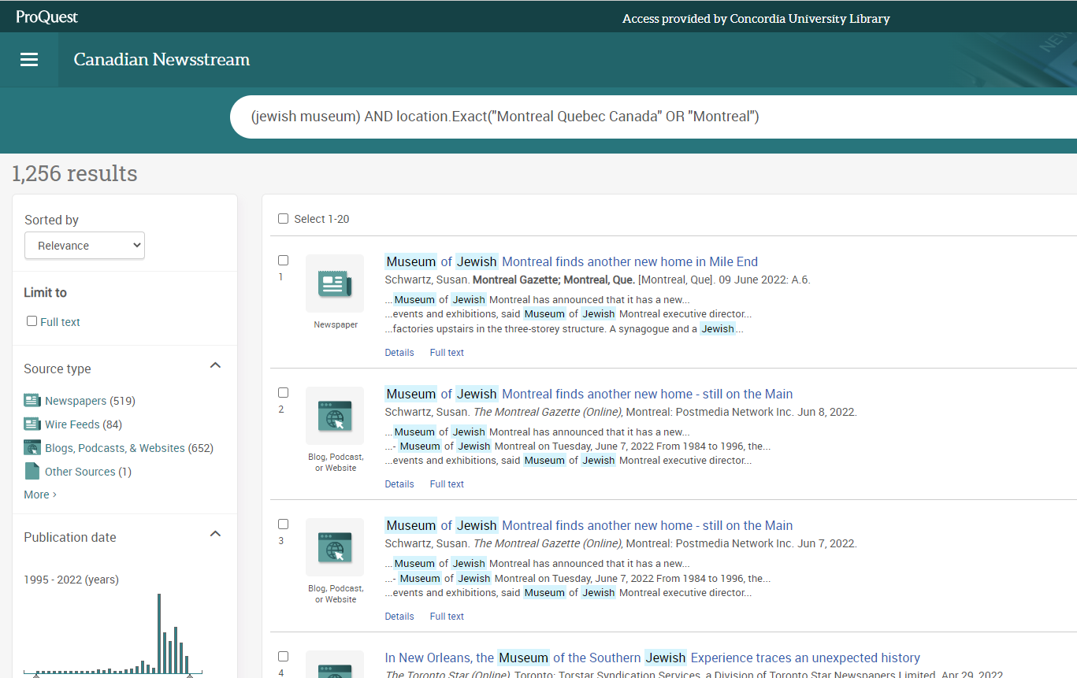
Canadian Newsstream Database search results

Slide 49
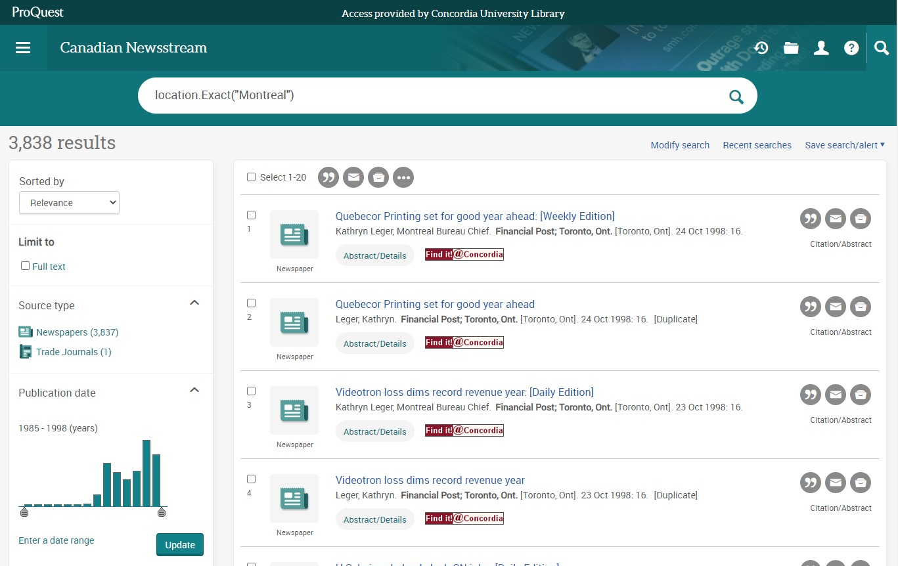
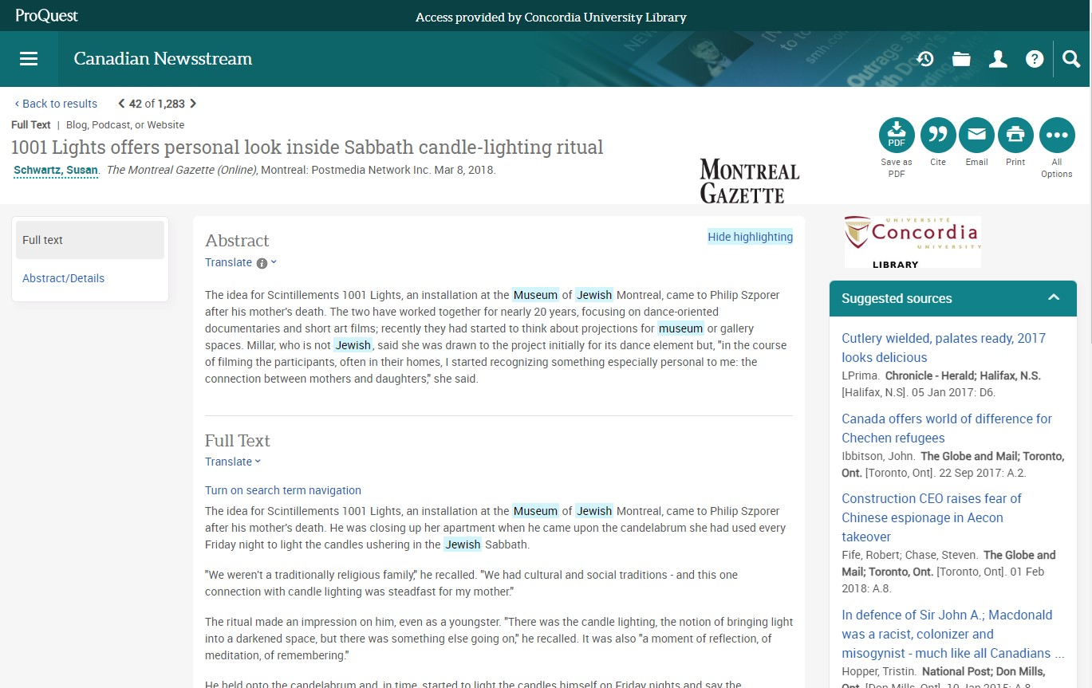
Article found on Canadian Newsstream database

Slide 50
Advanced search with the database Eureka.caa

Slide 51
Questions?

Slide 52
Concordia Library Website – Ask a Librarian

Slide 53
QUESTIONS? COMMENTS?
ETHEL GAMACHE
ethel.gamache@concordia.ca
Presentation and handouts will be on the subject guide, https://www.concordia.ca/library/guides/religion/courseguides.html

Slide 54
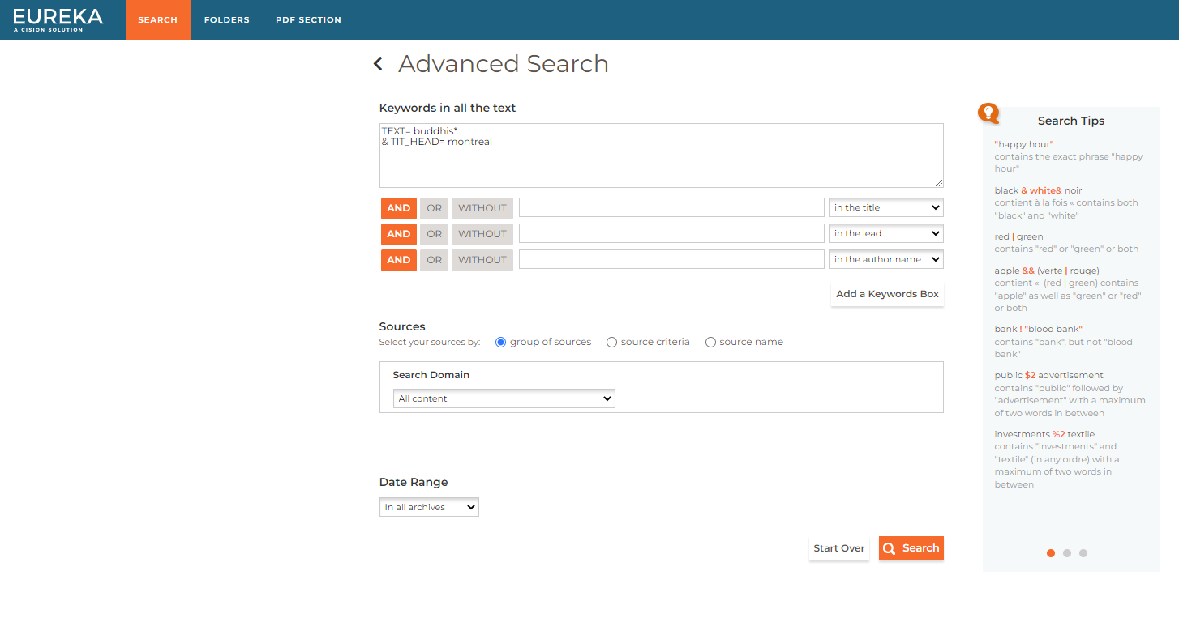
Eureka website – Advanced Search

Slide 55
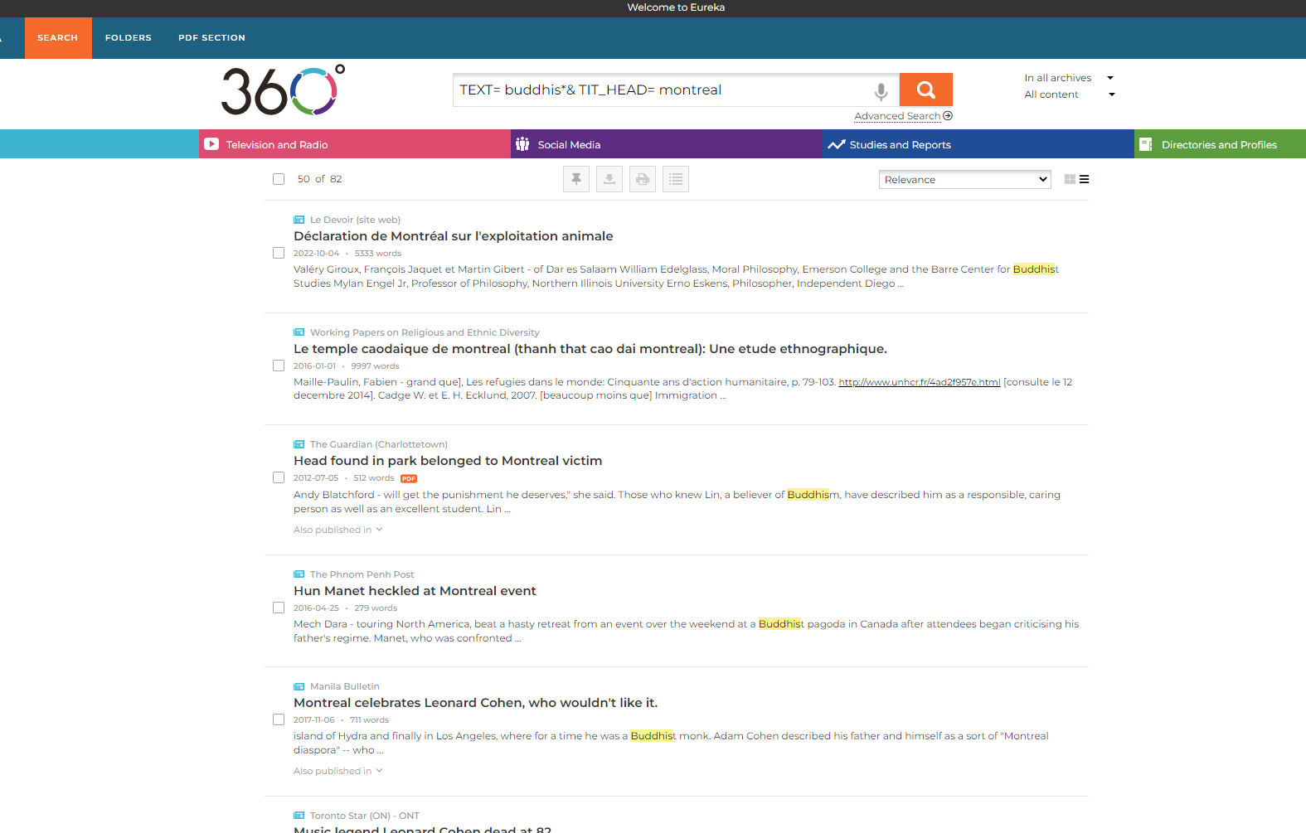
Eureka website

