Slide 1
Éthel Gamache, Librarian | ethel.gamache@concordia.ca
RELI 383
WOMEN AND RELIGION: ISLAM
LIBRARY WORKSHOP

Slide 2
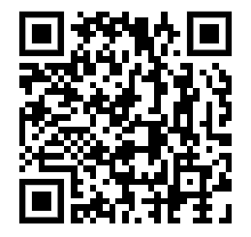
Plan
How to narrow a research topic
How to find and access resources
Subject guide
Sofia, the Library discovery tool
Using Interlibrary loans within Sofia
Searching for articles with Google Scholar, Academic Search Complete and JSTOR
Evaluating resources and asking for support
This QR code links to the Library’s Religions and Cultures Subject Guide, where these slides are hosted (under Courses & related guides). The slides and other workshop material are also available on Moodle.

Slide 3
CHOOSING A RESEARCH TOPIC

Slide 4
It’s a process
Choosing a research topic is research.
The process is iterative, not linear.
Notes:
Give it time : )

Slide 5
Technique to narrow your research topic: The 5 W and 1 H
What?
Who?
When?
Where?
Why?
How?

Slide 6
Example
General topic: Women, islam, clothing
What? Women’s clothing policing
Who? Adult women
When? 21st century
Where? France
Why? Political motivation
How? Legal aspects
Notes:
Prof. Clarke: What I often tell them is to think of an area of the world they are interested in with a Muslim population - e.g. Egypt, Indonesia, Iran, countries in North and sub-Saharan Africa, France, Britain, Quebec – and then enter that search term along with keywords such as “women”, “divorce”, “sexual minority community”.
LC subject headings found with relevant items can lead them to more, until they finally find a topic with enough written to support it – but not too general and wide.

Slide 7
Research question
women AND (cloth* OR veil) AND (Islam OR Muslim) AND France AND (law or legal)
Search parameter: after 1999

Slide 8
HOW TO FIND AND ACCESS RESOURCES NAVIGATING THE LIBRARY WEBSITE

Slide 9
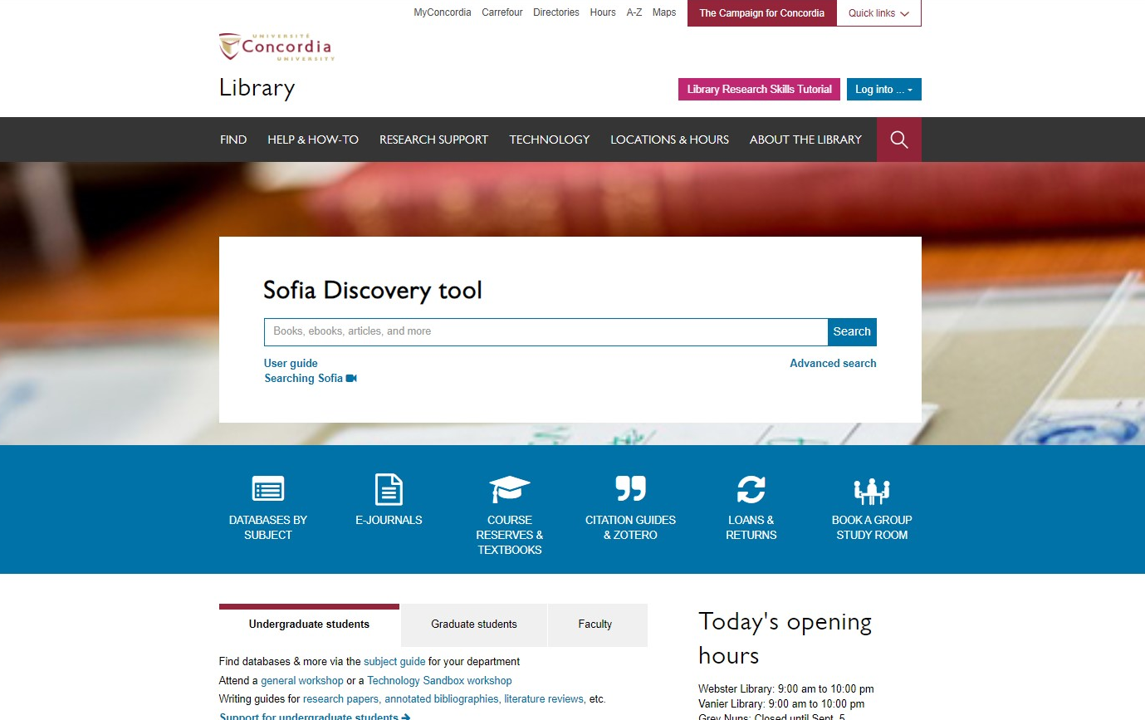
Concordia Library Website
library.concordia.ca

Slide 10
Concordia Library Website “FIND” dropdown menu
library.concordia.ca

Slide 11
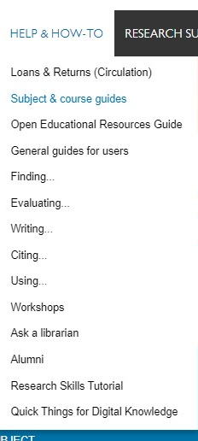
Concordia Library “Help & How To” dropdown menu
library.concordia.ca

Slide 12
HOW TO FIND AND ACCESS RESOURCES YOUR SUBJECT GUIDE

Slide 13
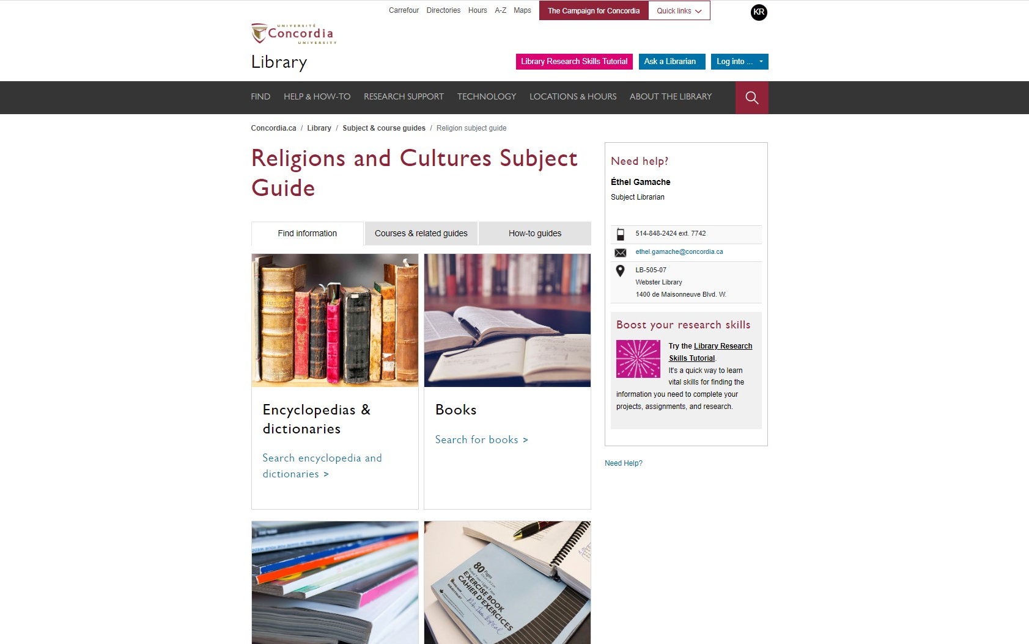
Religions and Cultures Subject Guides

Slide 14
HOW TO FIND AND ACCESS RESOURCES USING SOFIA, THE DISCOVERY TOOL

Slide 15
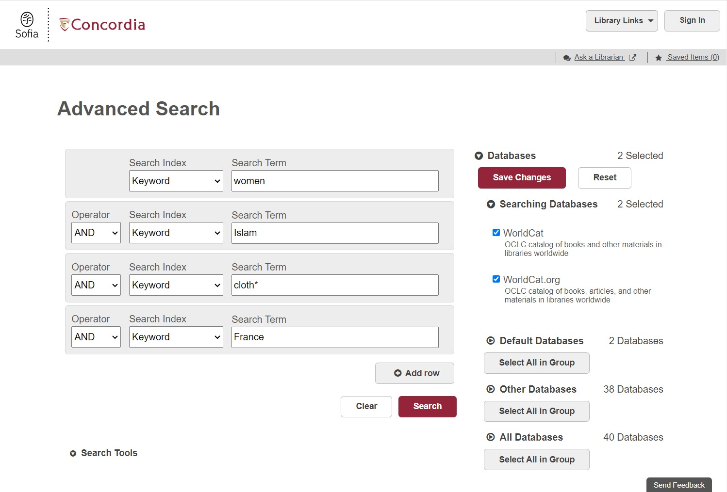
Sofia Discovery Took Advanced Search

Slide 16
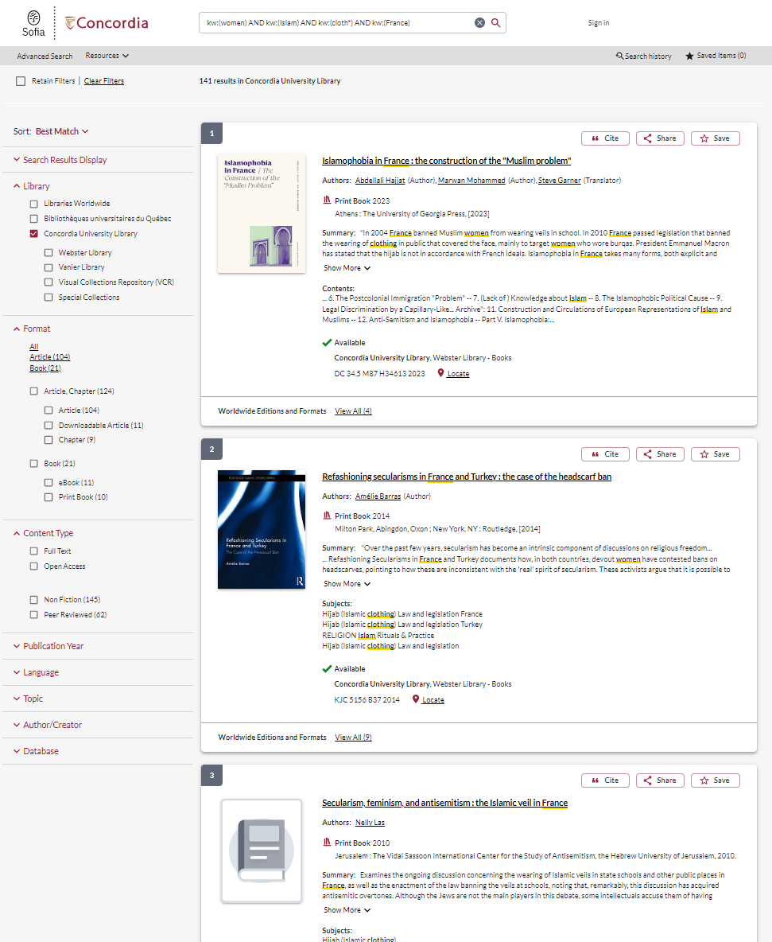
Sofia Discovery Tool search limiters

Slide 17
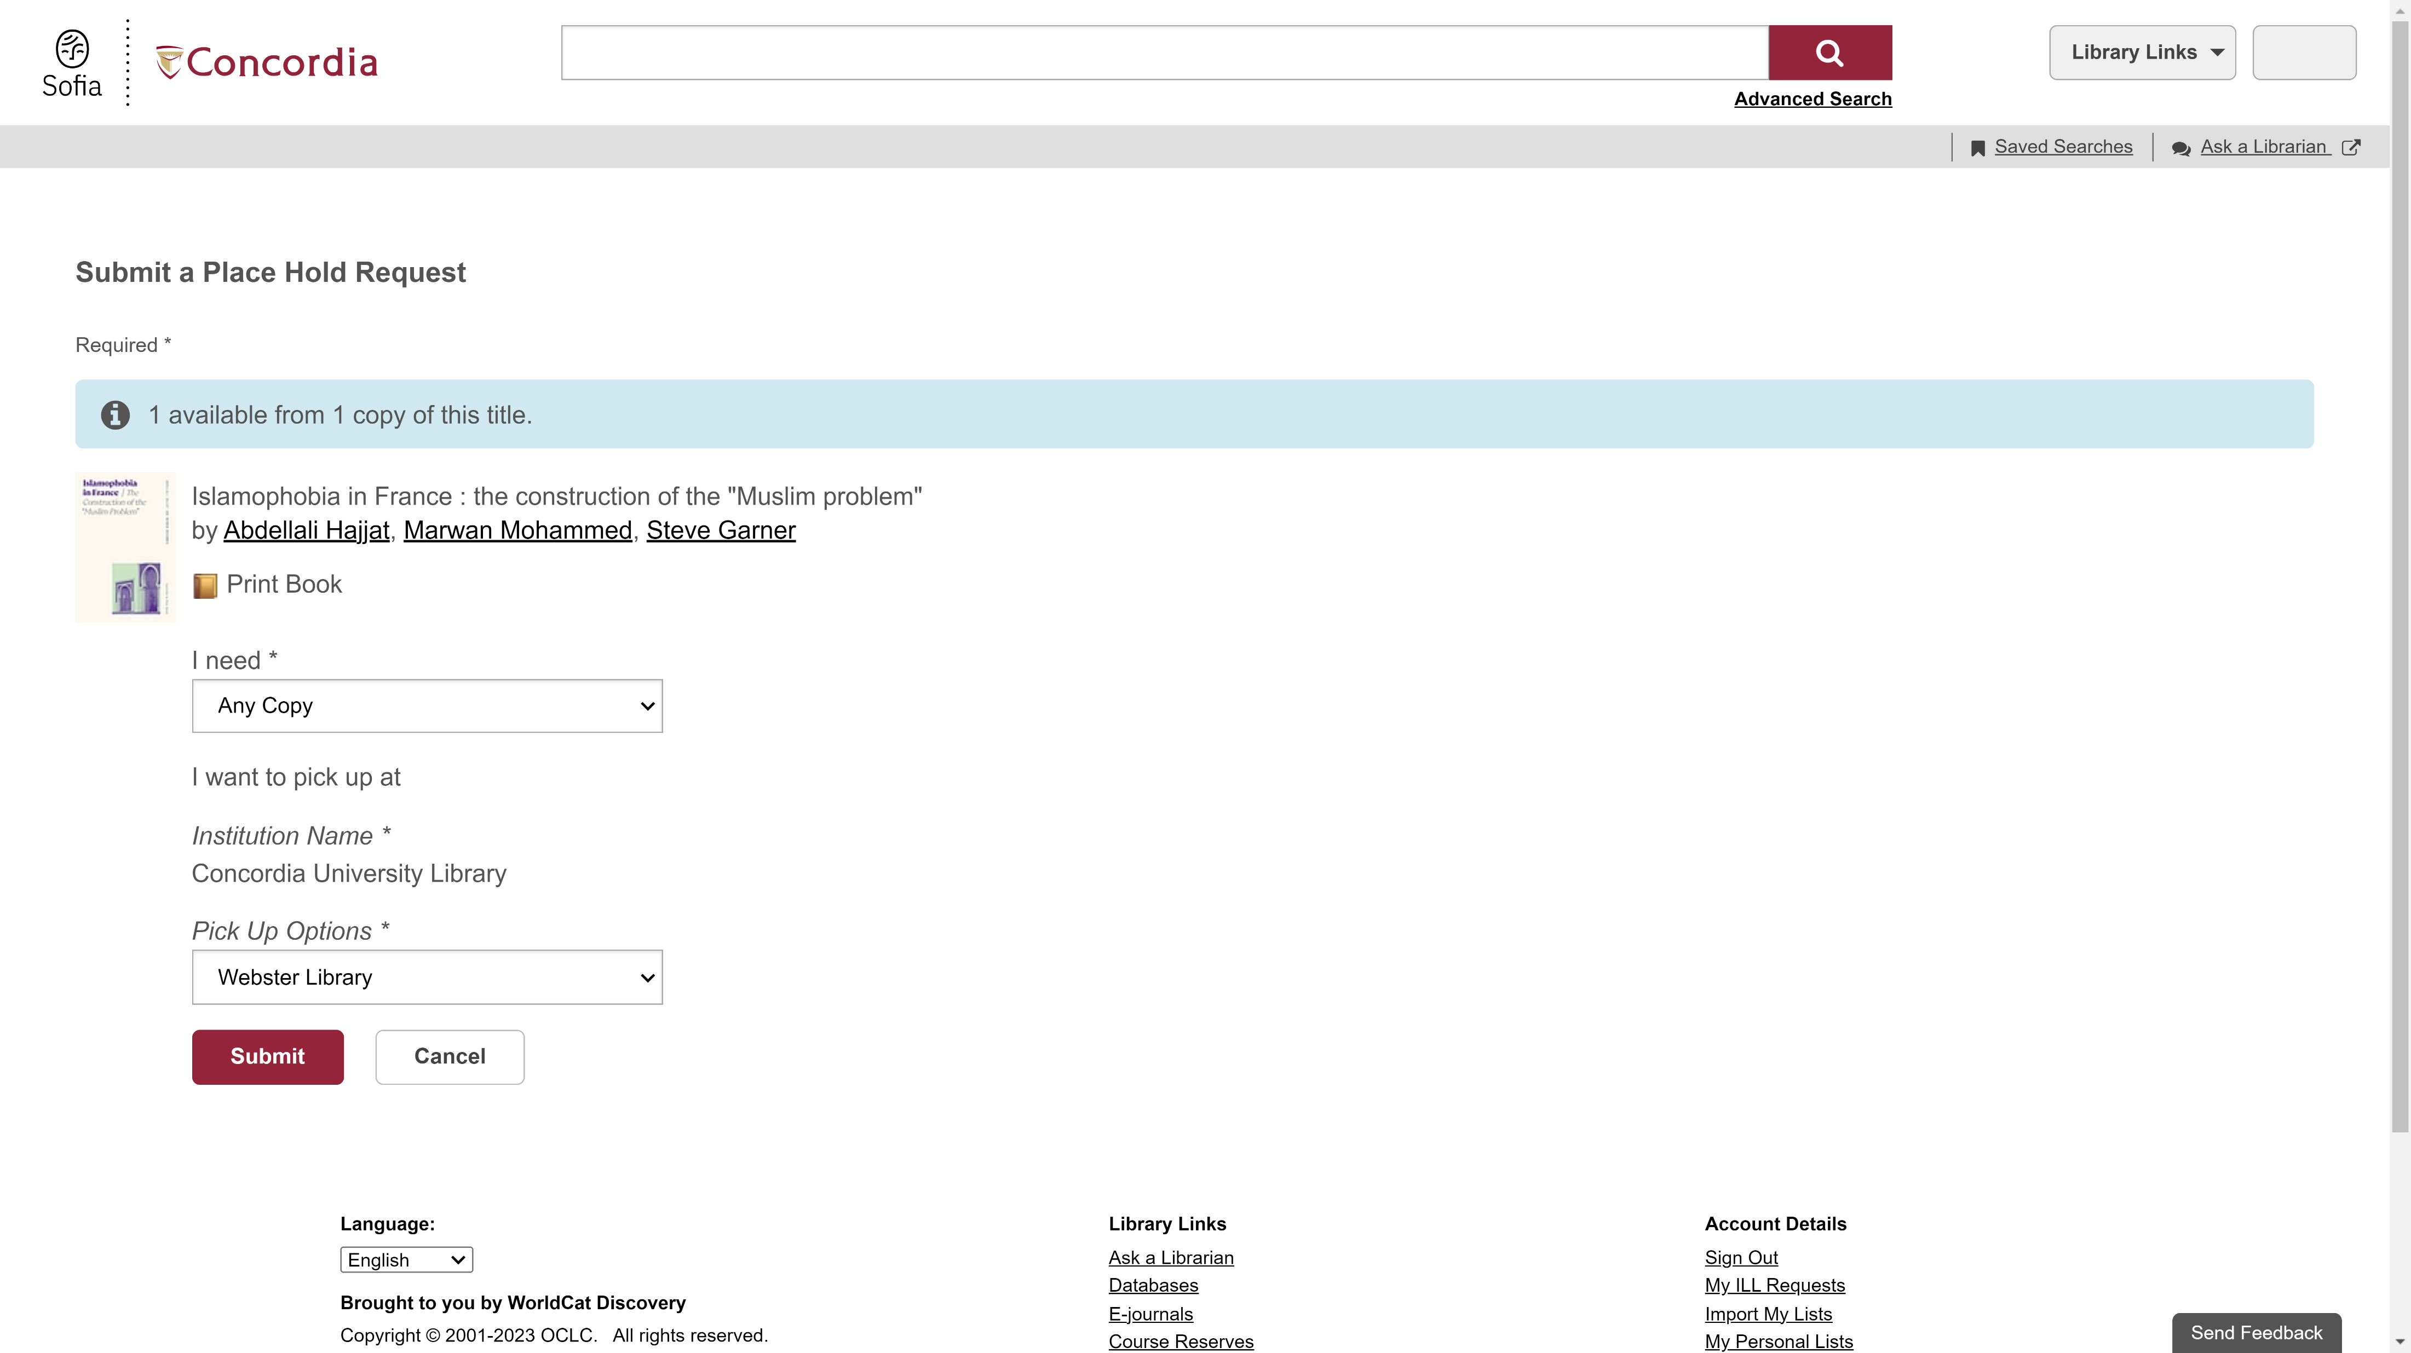
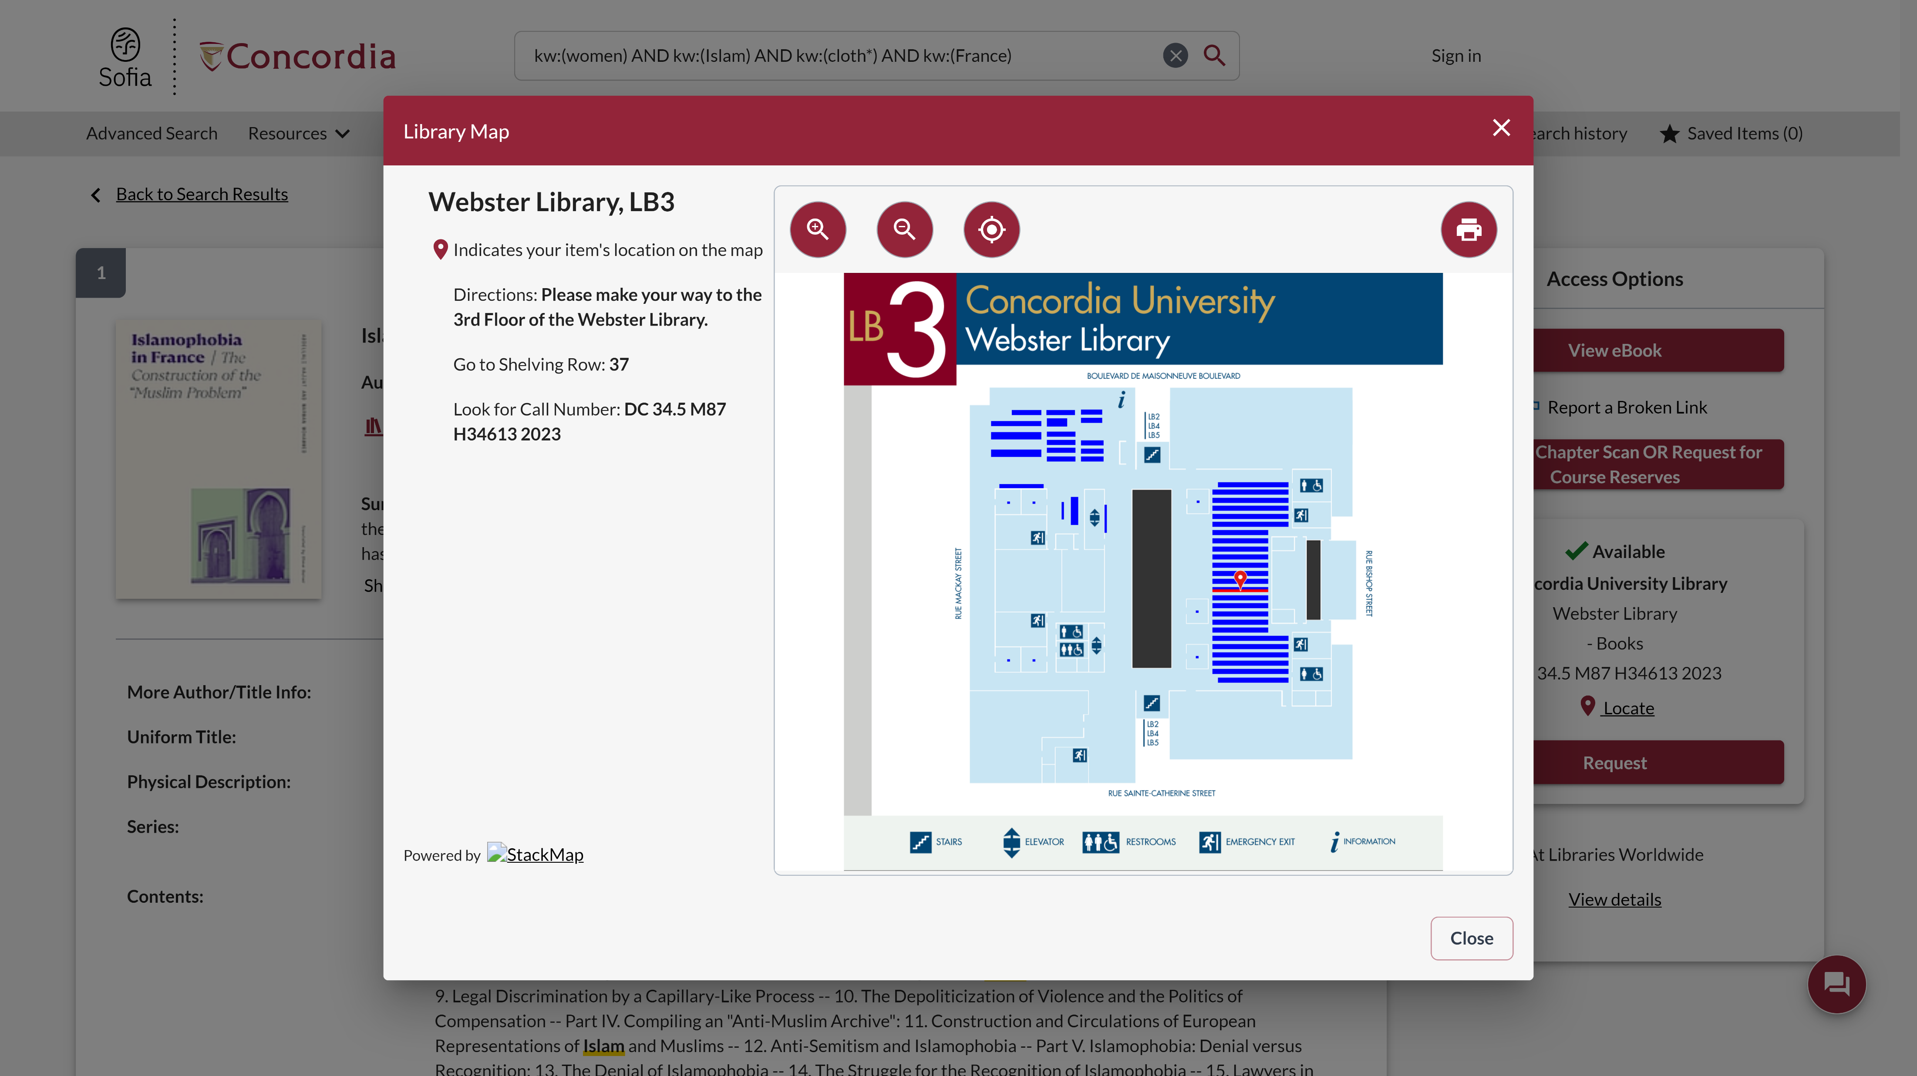
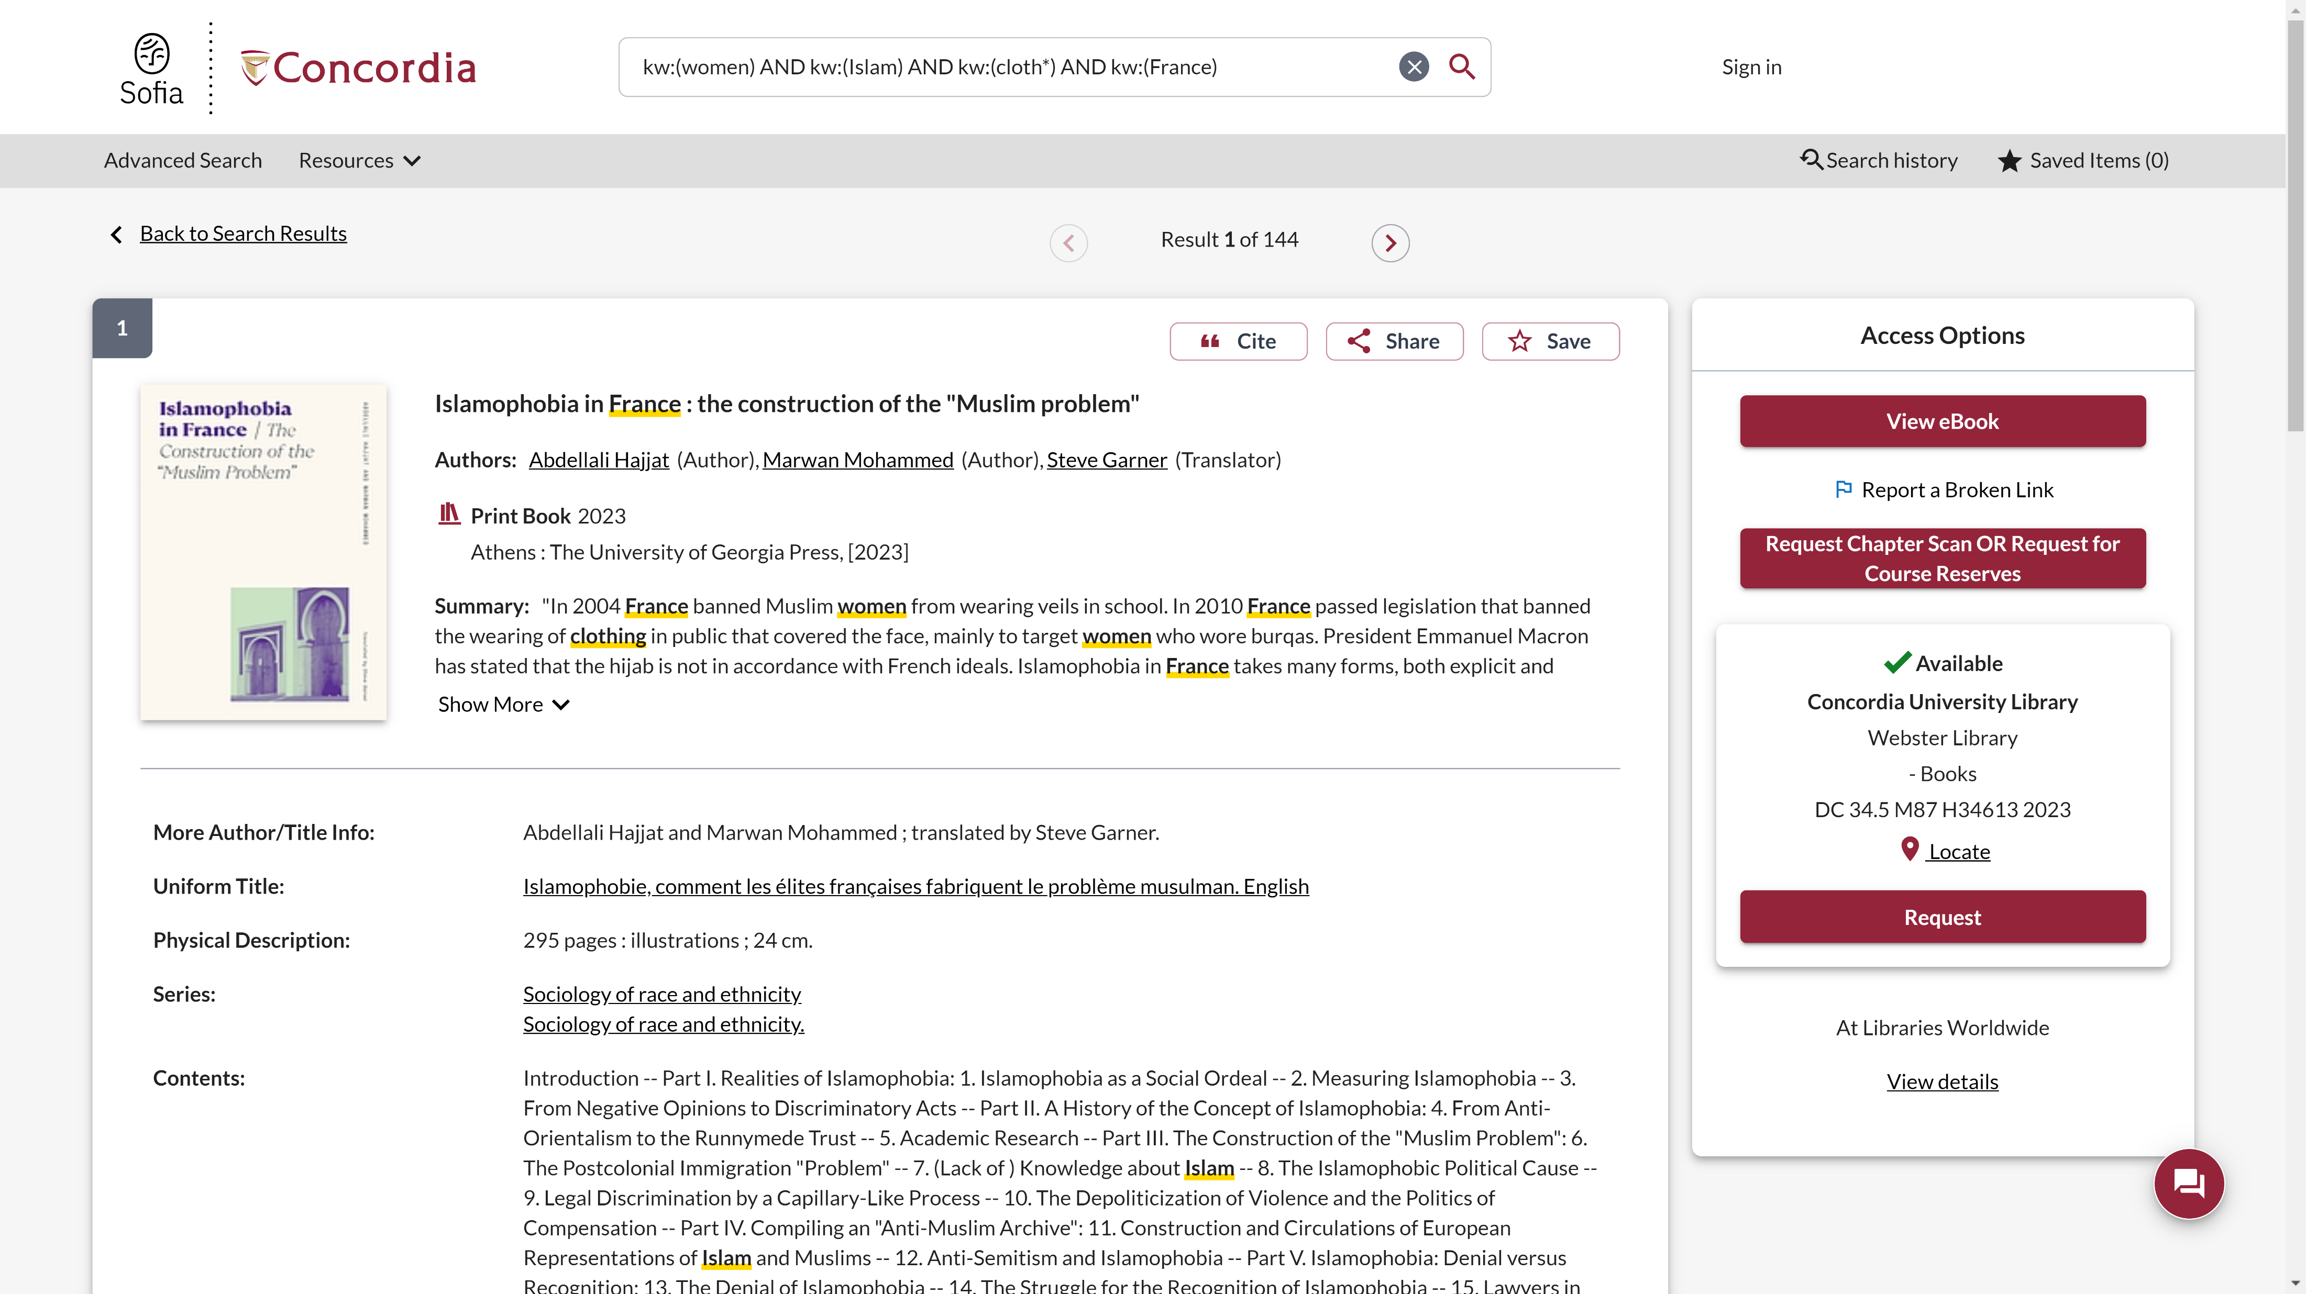
Sofia Discovery Tool Hold Request

Slide 18
Sofia Live demonstration
gay OR LGBTIQA2+ OR sexual minority AND Indonesia
Notes:
LC subject headings

Slide 19
USING INTERLIBRARY LOAN WITHIN SOFIA

Slide 20
What is the new Interlibrary Loans (ILL) service?
ILL requests are made directly in the Sofia Discovery tool:
“Request via Interlibrary Loan” button
Form available under the “Requests” tab in "My Account".

Slide 21
Concordia article/chapter scan & deliver service
Book chapter and journal article scans from Concordia’s print collection can now be requested and tracked in Sofia.
Look for the “Chapter Scan” button in the Access Options panel.

Slide 22
REQUEST A BOOK VIA INTERLIBRARY LOAN
EXAMPLE

Slide 23
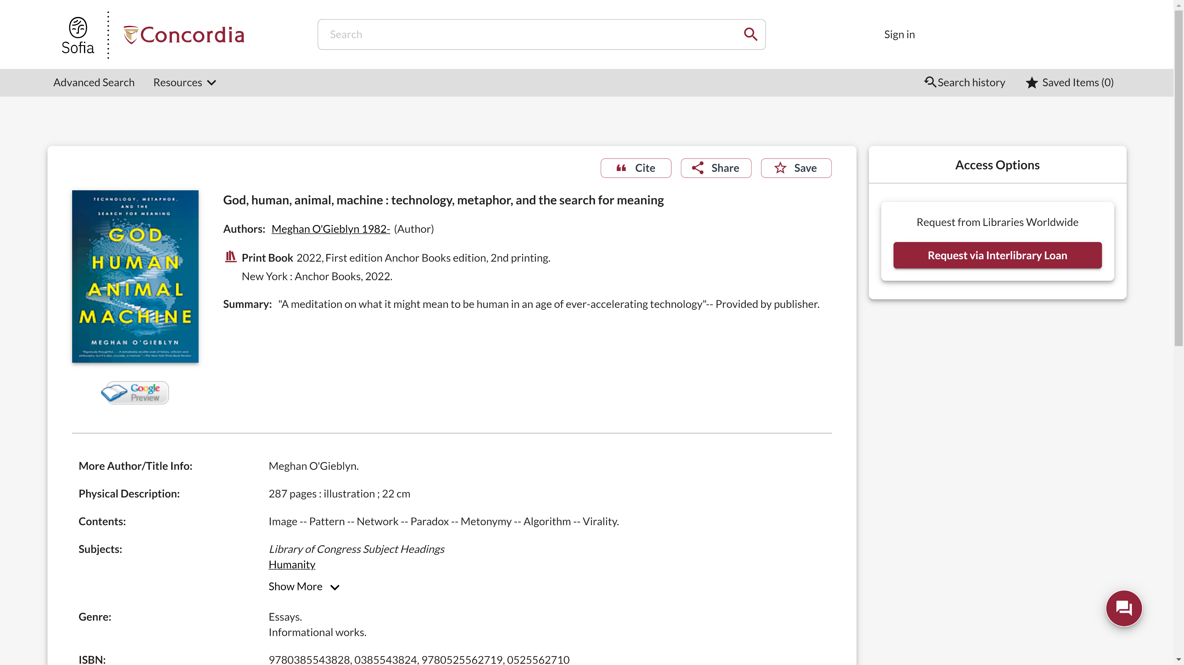
Sofia Discovery Tool request via Interlibrary loan

Slide 24
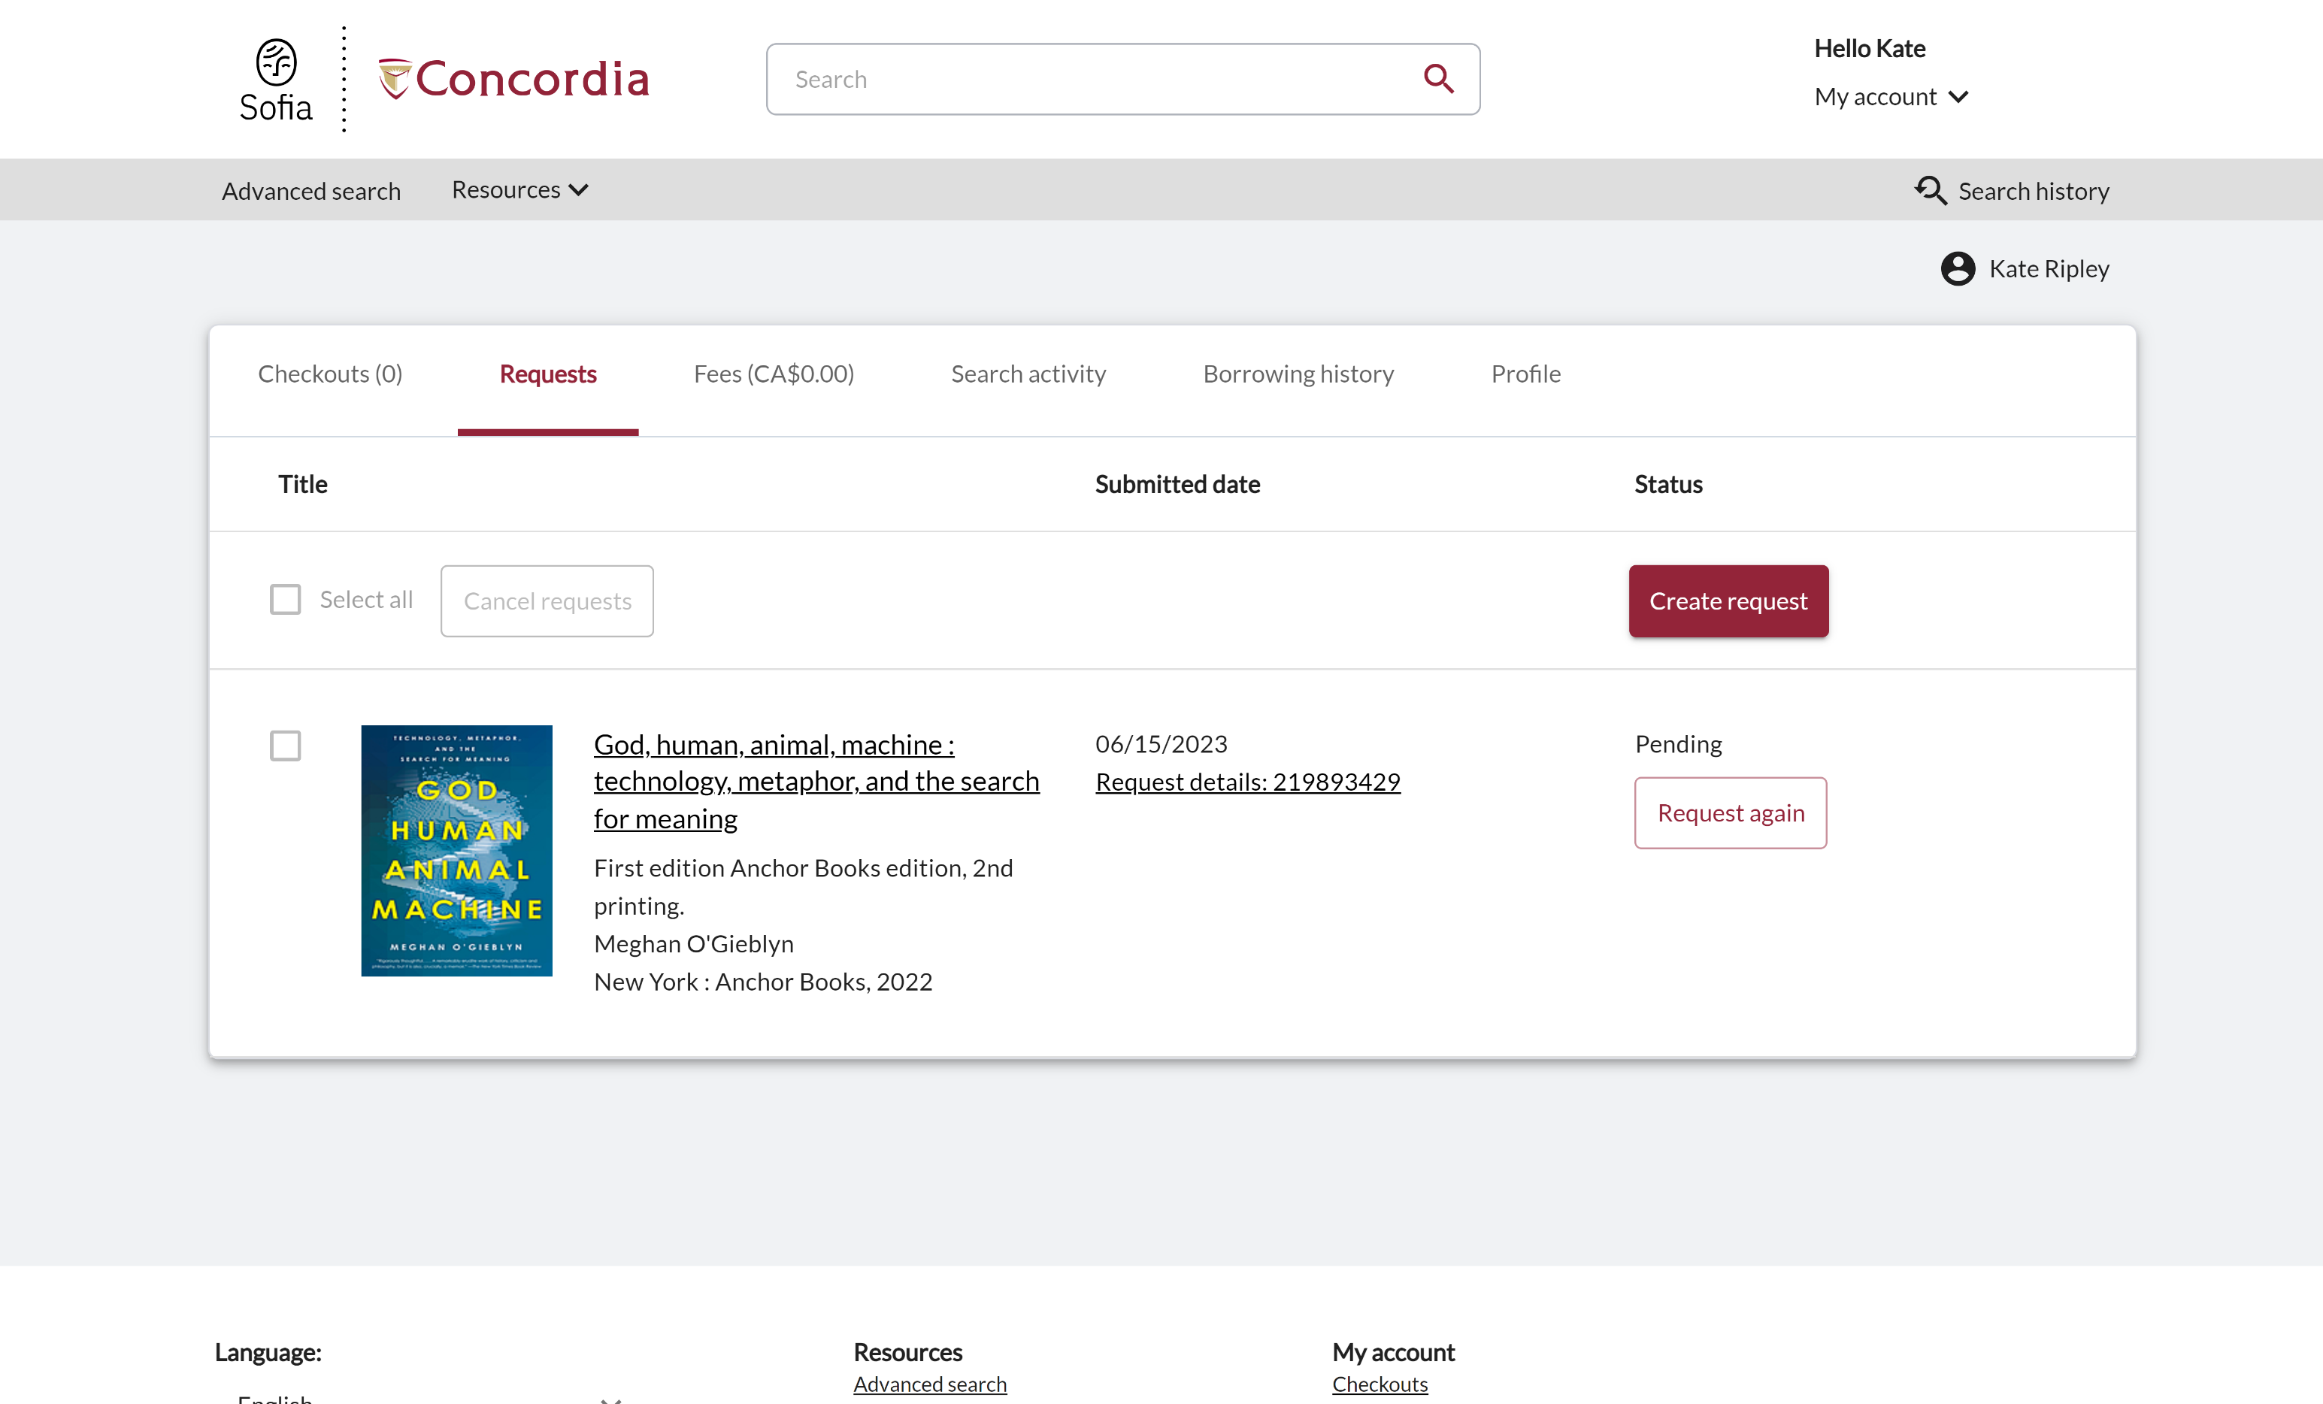
Check the status of your request under the "Requests" tab.

Slide 25
About Interlibrary loan
You will receive email notifications when your ILL request is available for pickup or download.
Physical items can be picked up at the Circulation/Loans desks at either Vanier or Webster Library.
ILL requests can be borrowed for 30 days, with up to 4 automatic renewals, or until item is recalled.

Slide 26
REQUEST A BOOK BLANK FORM
EXAMPLE

Slide 27
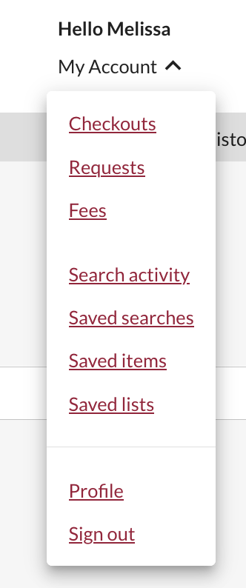
Create an Interlibrary Loan request
Sign in to "My Account" and select "Requests".
Click on "Create request".

Slide 28
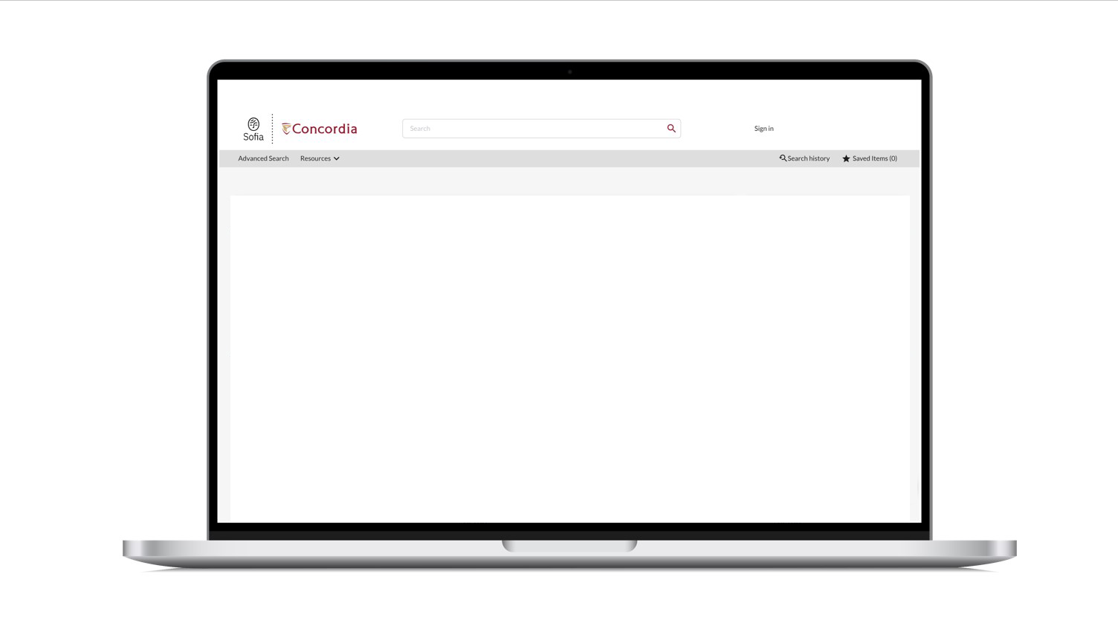
Sofia Discovery Tool – request a book form

Slide 29
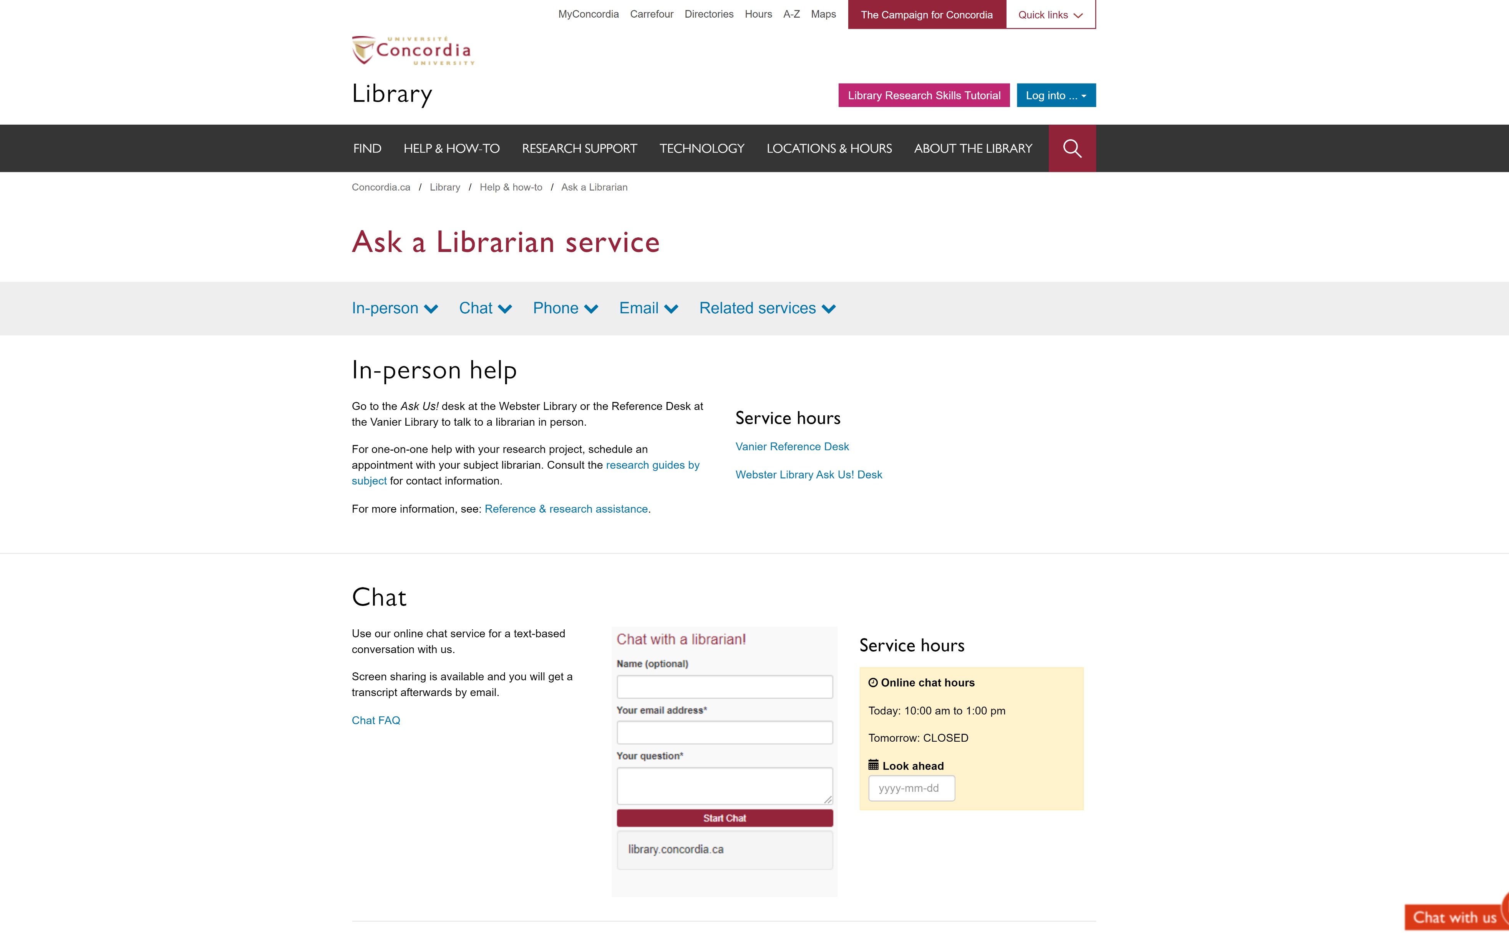
If you have any difficulty finding a document, reach out!

Slide 30
What would you do to find this?
Scott, Joan Wallach. 2007. The Politics of the Veil. Public Square Book Series. Princeton, NJ: Princeton University Press.
Hoel, N., & Shaikh, S. (2007). Veiling, secularism and islamism: gender constructions in France and iran. Journal for the Study of Religion, 20(1), 111–129.

Slide 31
SEARCHING FOR ARTICLES WITH GOOGLE SCHOLAR AND THE DATABASE ACADEMIC SEARCH COMPLETE

Slide 32
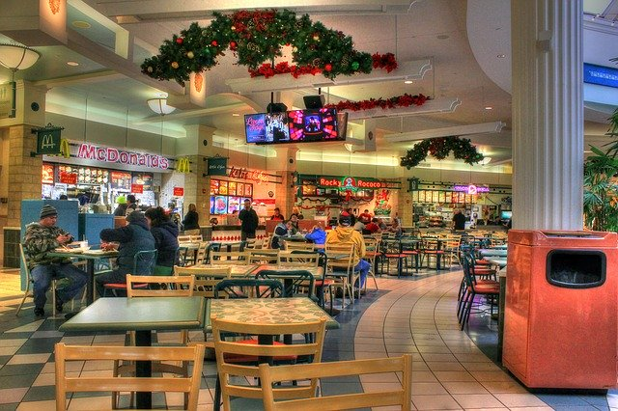
What is the difference?
Google scholar
Library databases
Volume | Quantity | Quick
Depth | Quality | Thorough
Left image: Yinan Chen, Dining Court, public domain, https://pixabay.com/photos/dining-court-shopping-mall-corridor-347314/
Right image: Jason Briscoe, Cooking, public domain, https://unsplash.com/photos/VBsG1VOgLIU

Slide 33
Where should you search?
Library Discovery Tool
Academic Search Complete
(Library Database)
Google Scholar
Eureka.cc
(Library Database)
Grey literature (e.g. government documents, NGO reports, working papers, newsletters, preprints)

Slide 34
HOW TO FIND AND ACCESS RESOURCES USING GOOGLE SCHOLAR

Slide 35
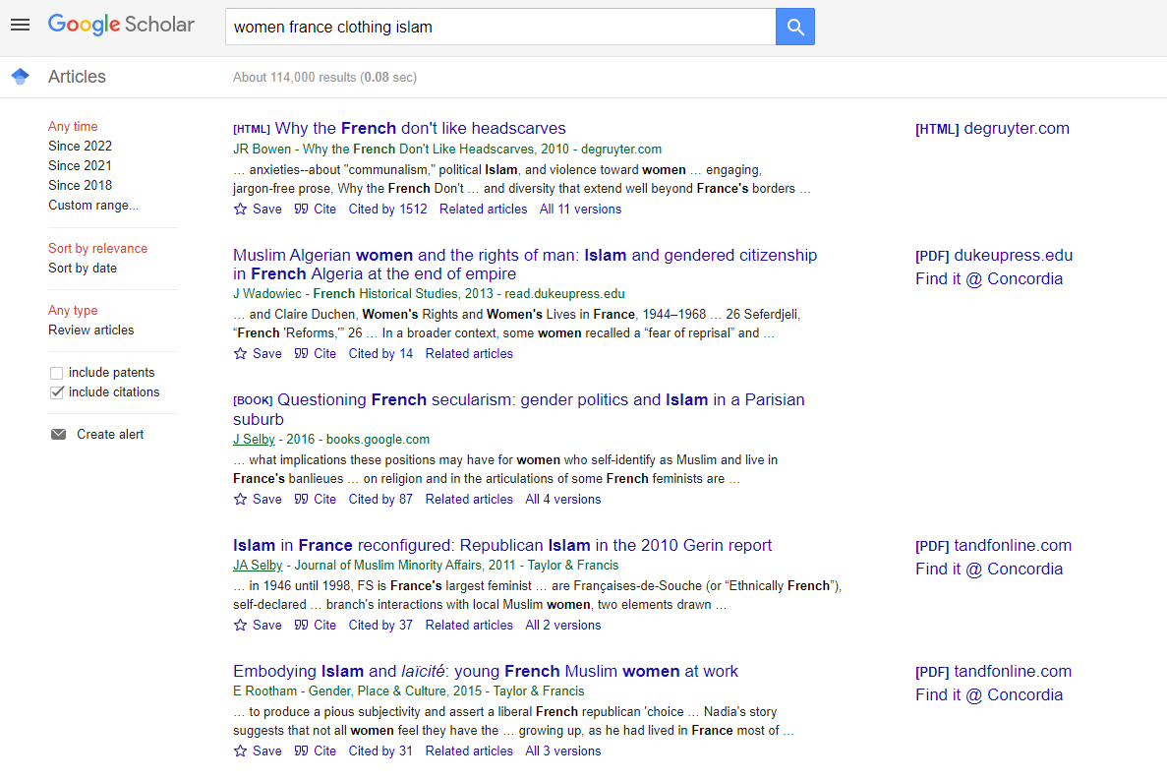
Searching in Google Scholar

Slide 36
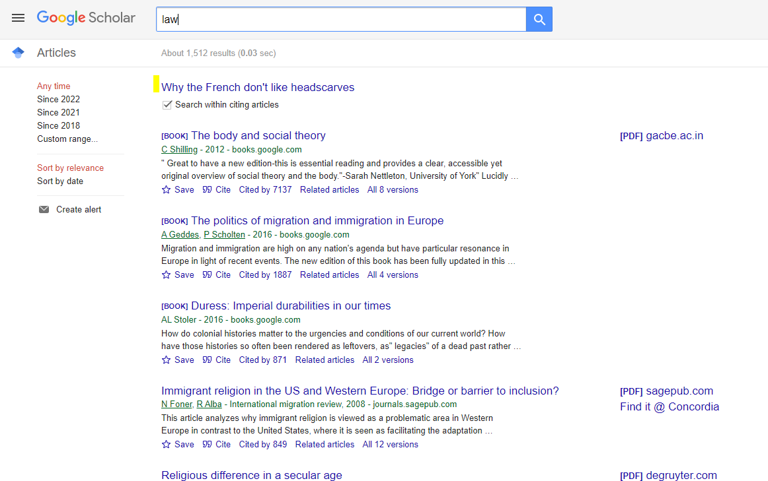
Google Scholar – Searching within a search result

Slide 37
Google Scholar – select a library access link

Slide 38
HOW TO FIND AND ACCESS RESOURCES USING ACADEMIC SEARCH COMPLETE

Slide 39
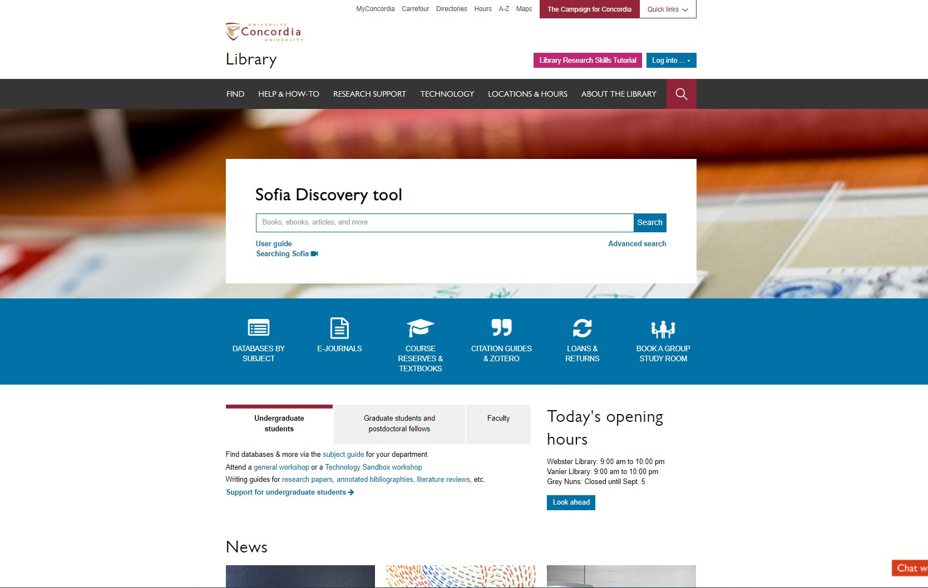
Sofia Discovery Tool – Databases By Subject

Slide 40
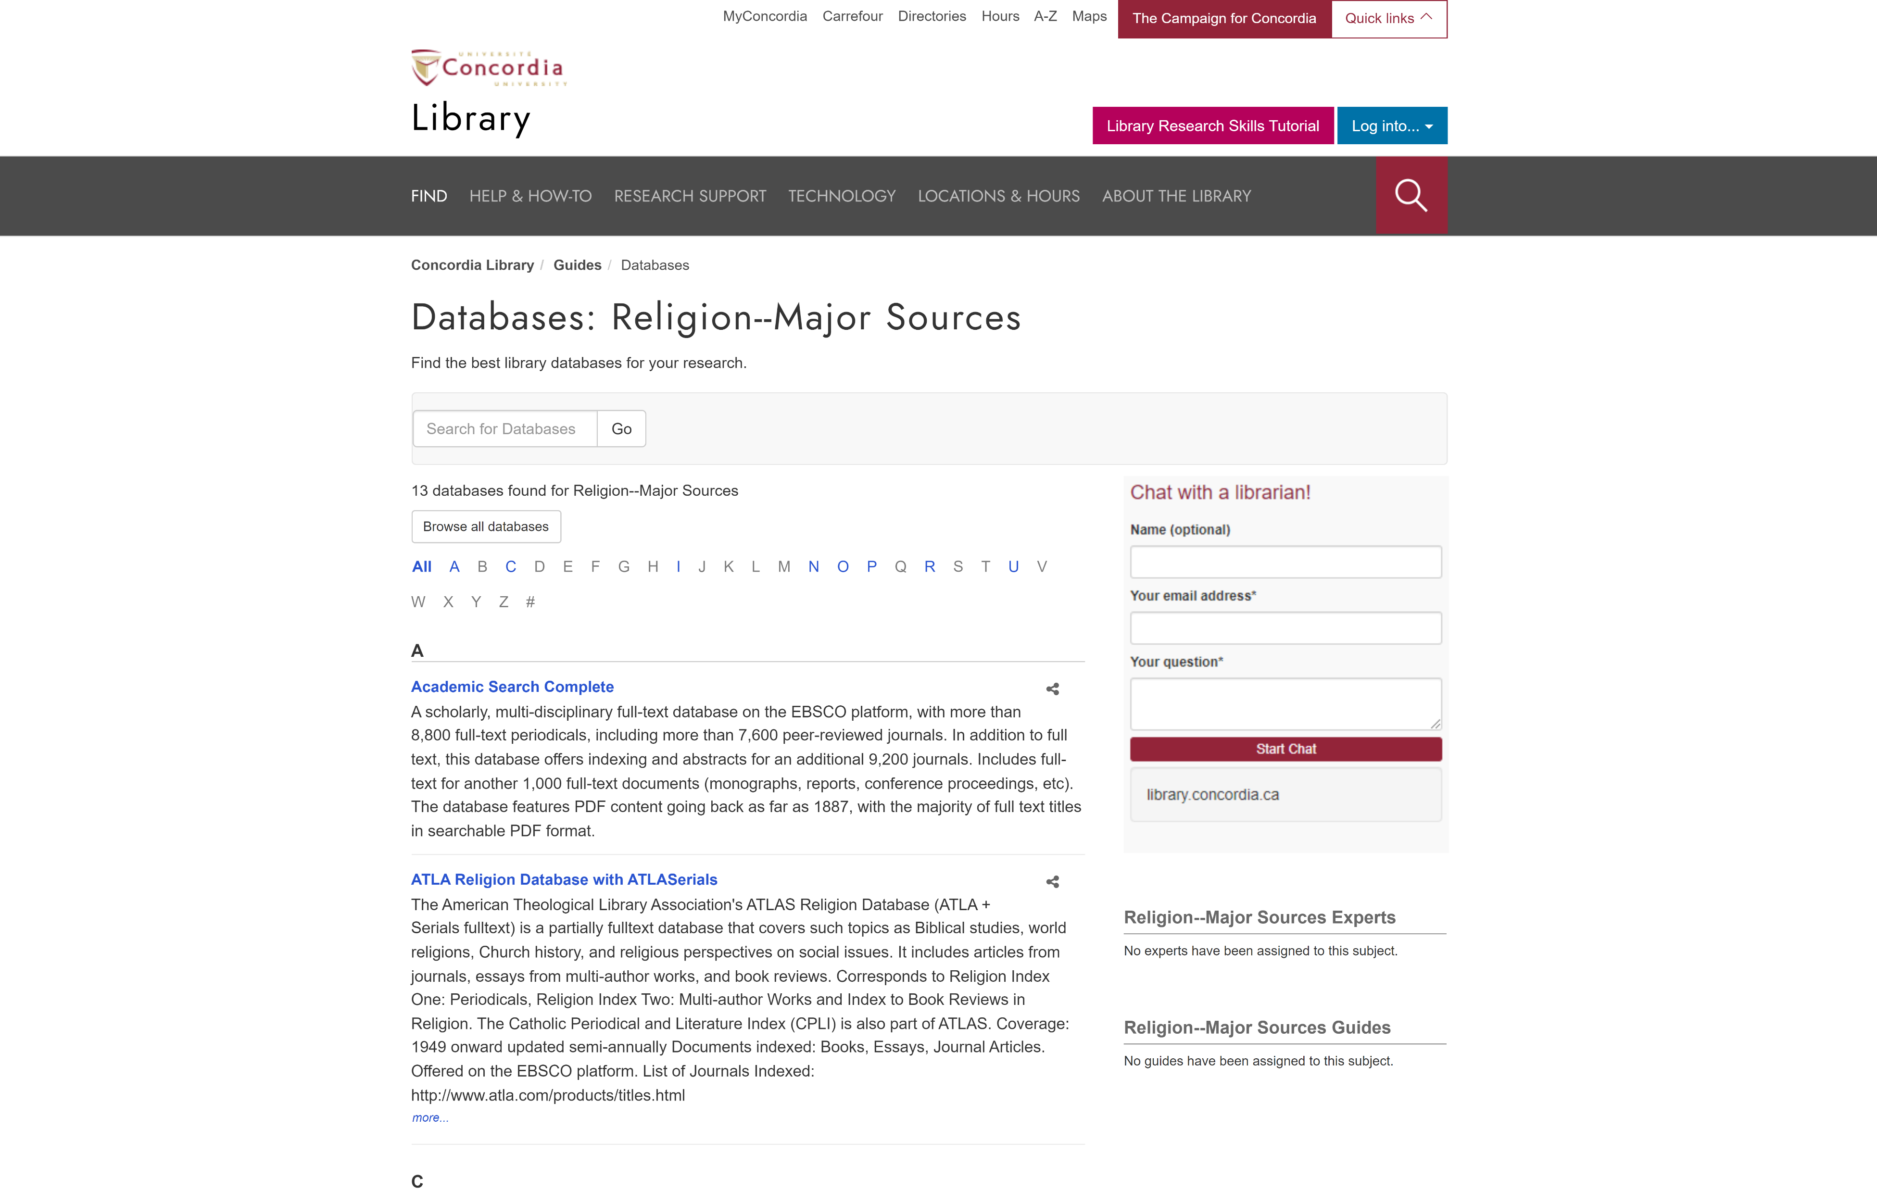
library.concordia.ca/find/databases/index.php

Slide 41
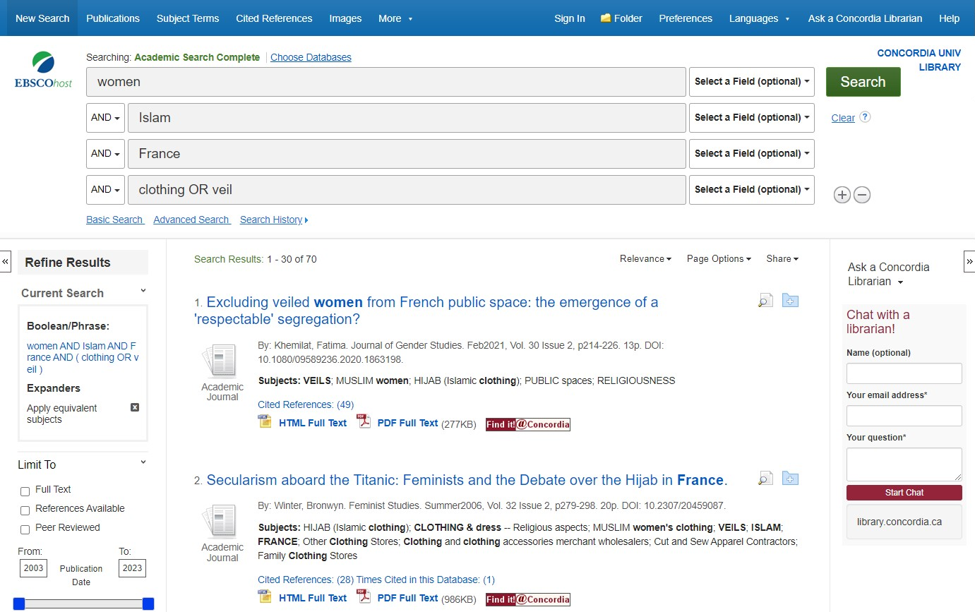
Concordia Library – Database Searching

Slide 42
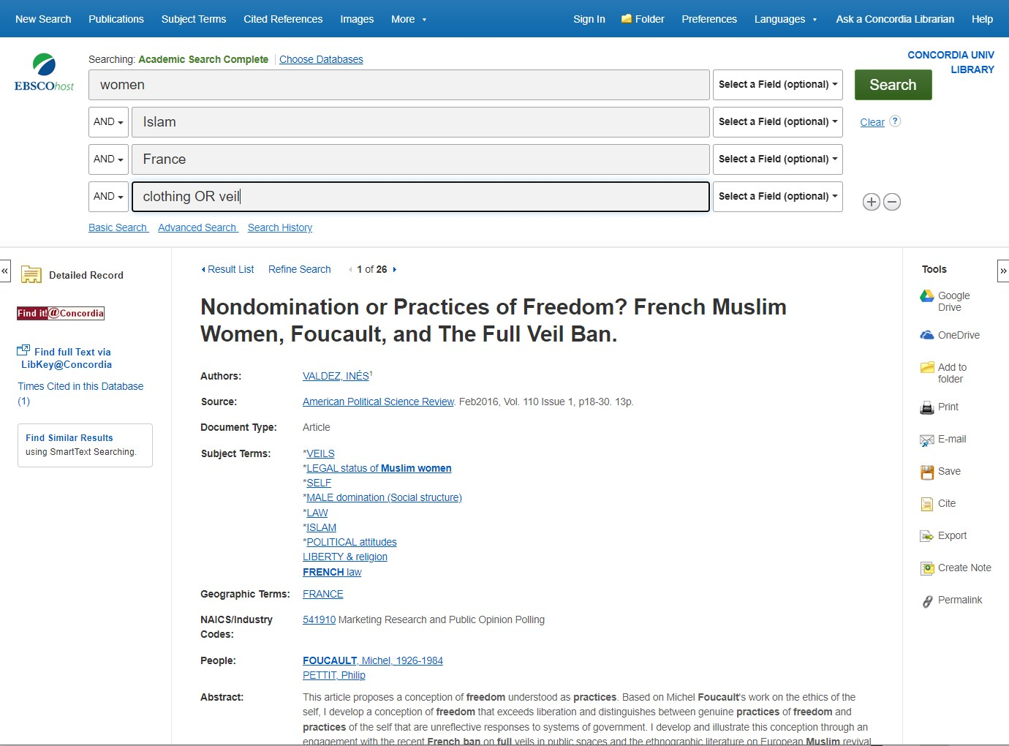
Database Boolean Search

Slide 43
View full article via Find it@Concordia button

Slide 44
Find it@Concordia results webpage

Slide 45
Database tools

Slide 46
HOW TO FIND AND ACCESS RESOURCES USING JSTOR

Slide 47
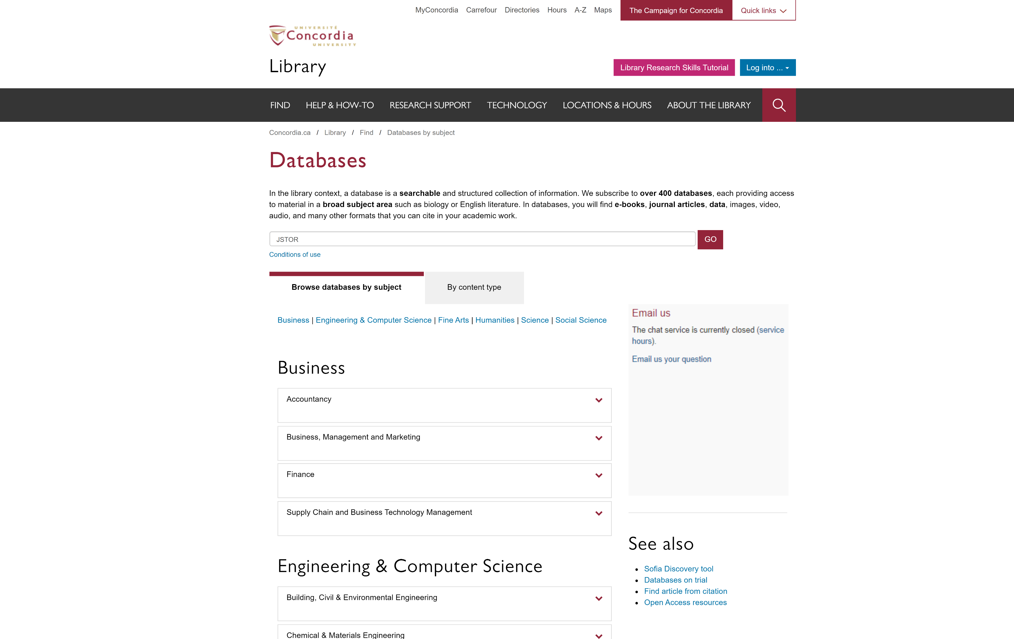
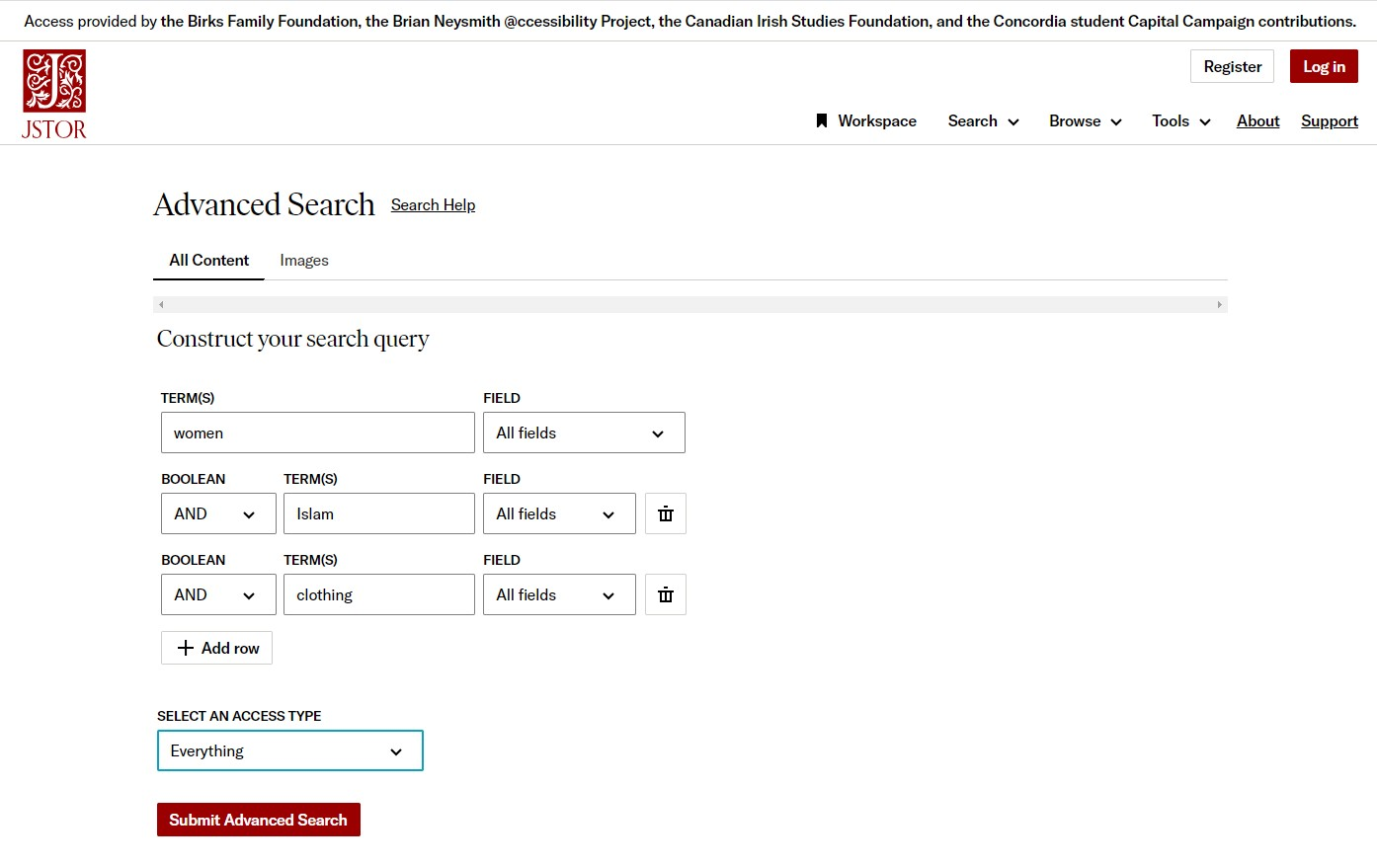
JSTOR advanced search

Slide 48
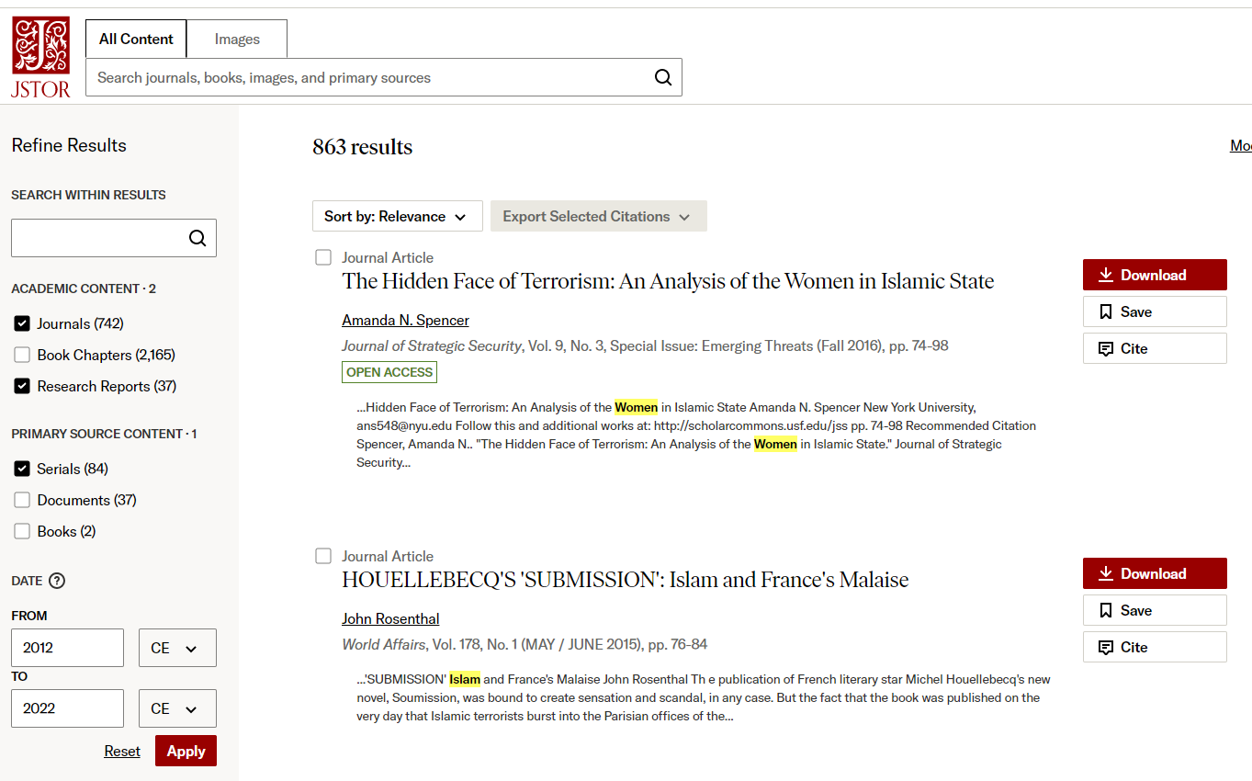
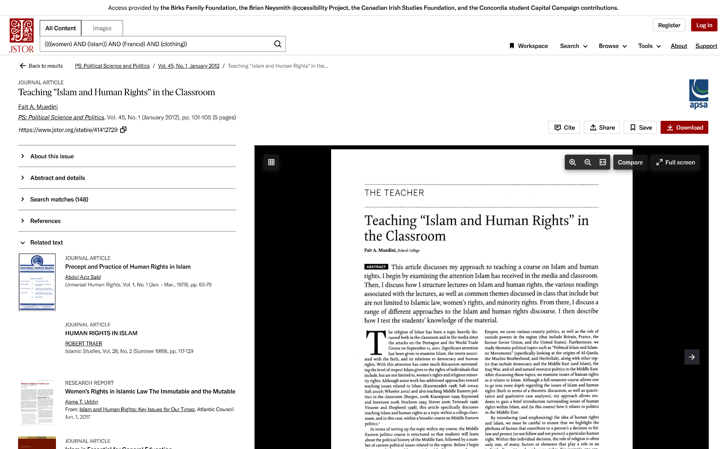
JSTOR search results page

Slide 49
You do have access to many resources!

Slide 50
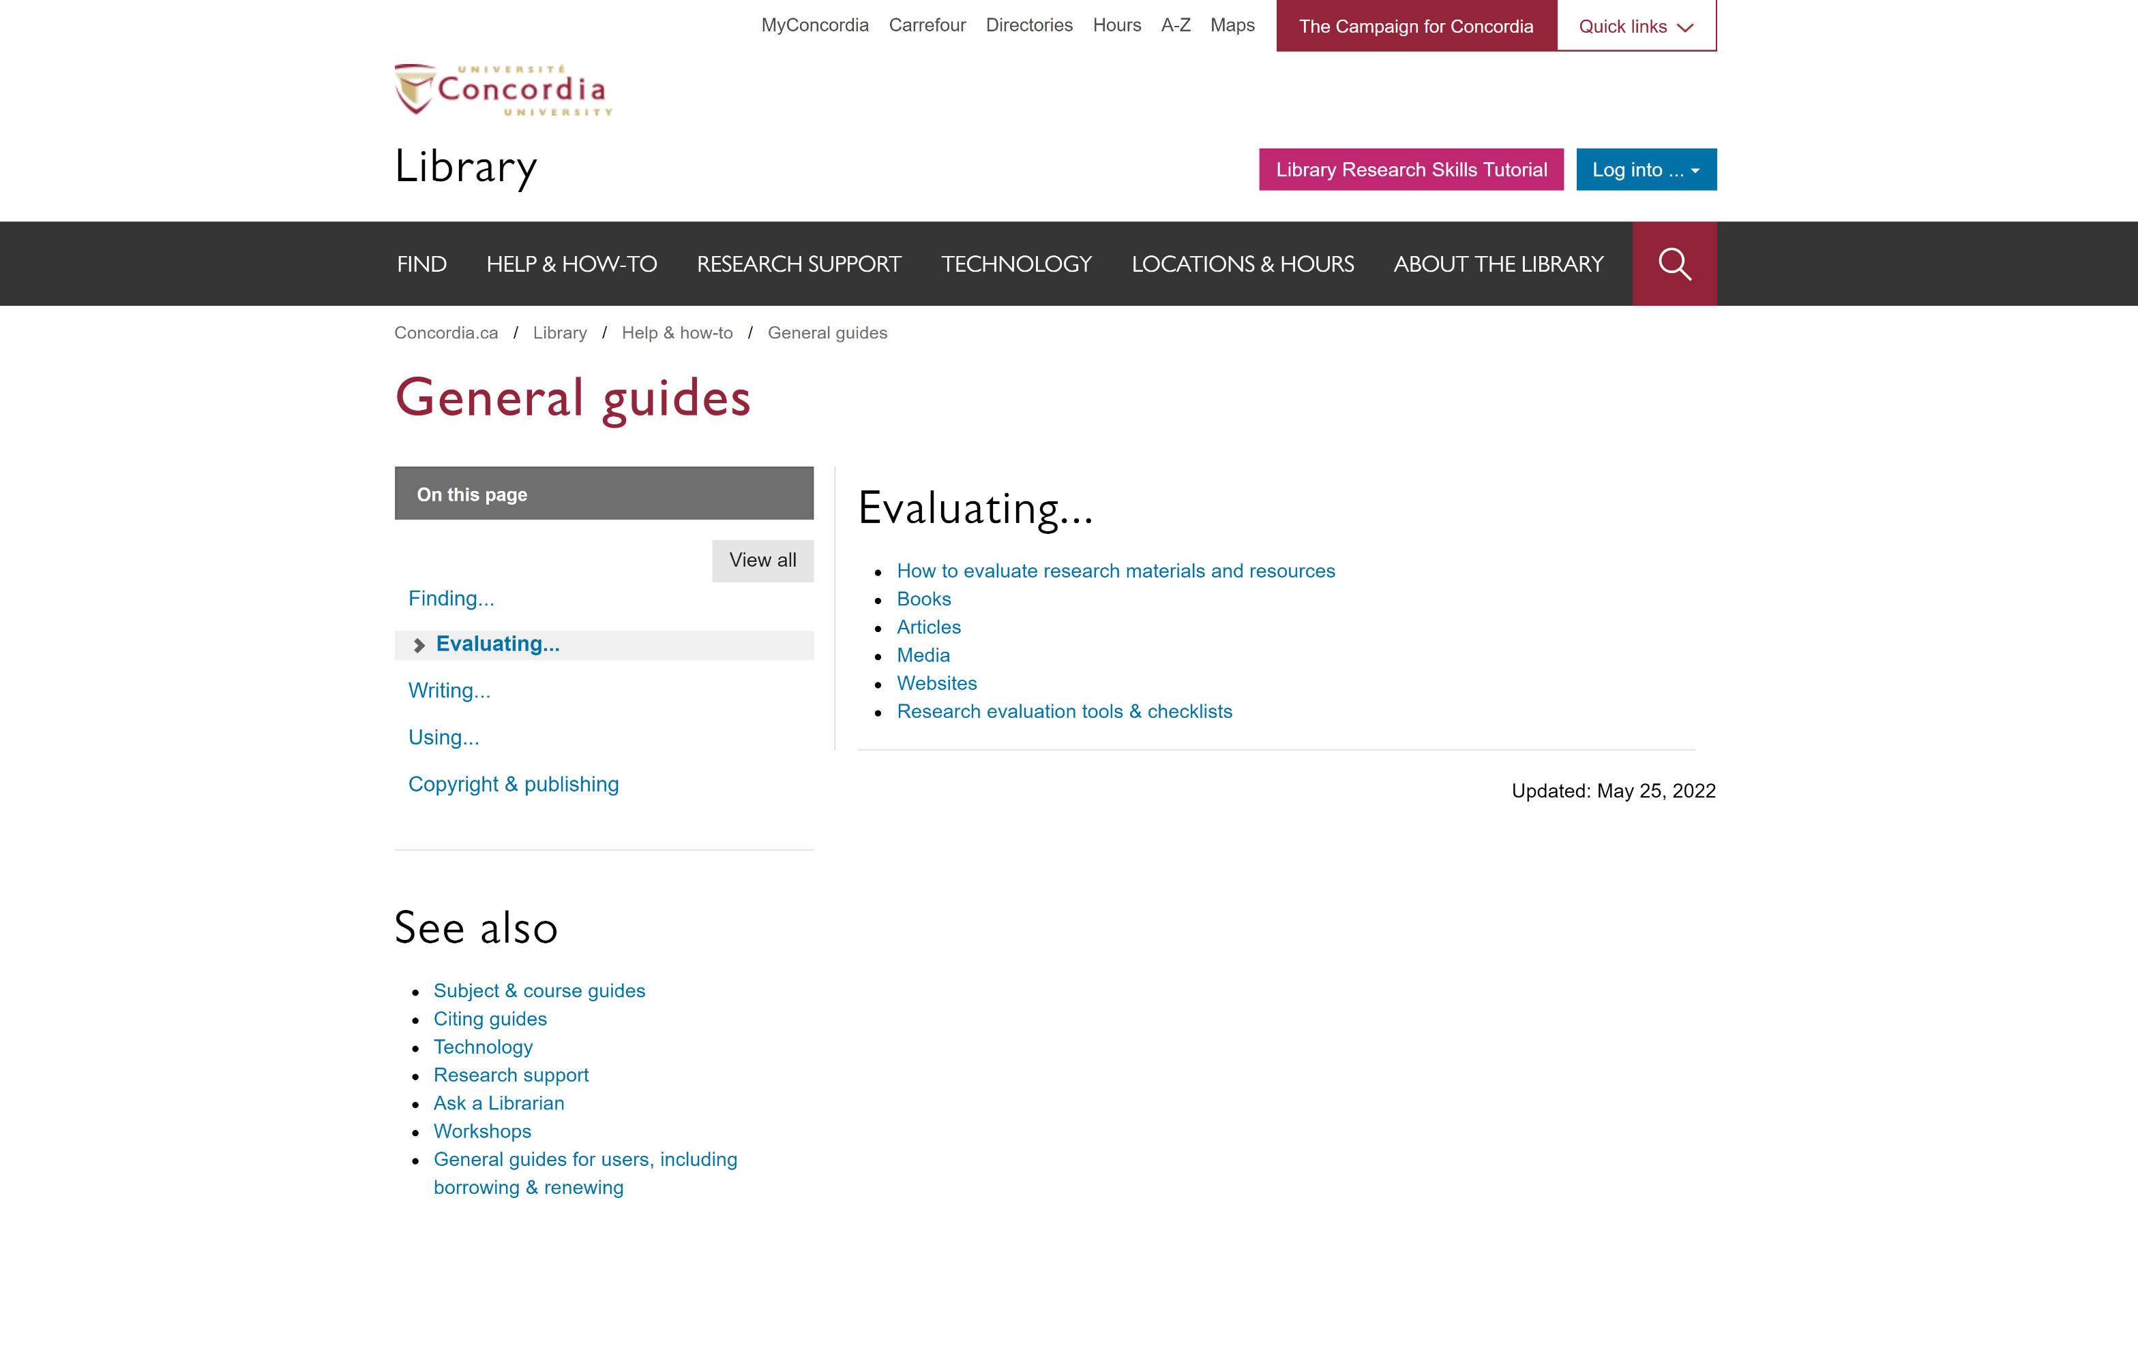
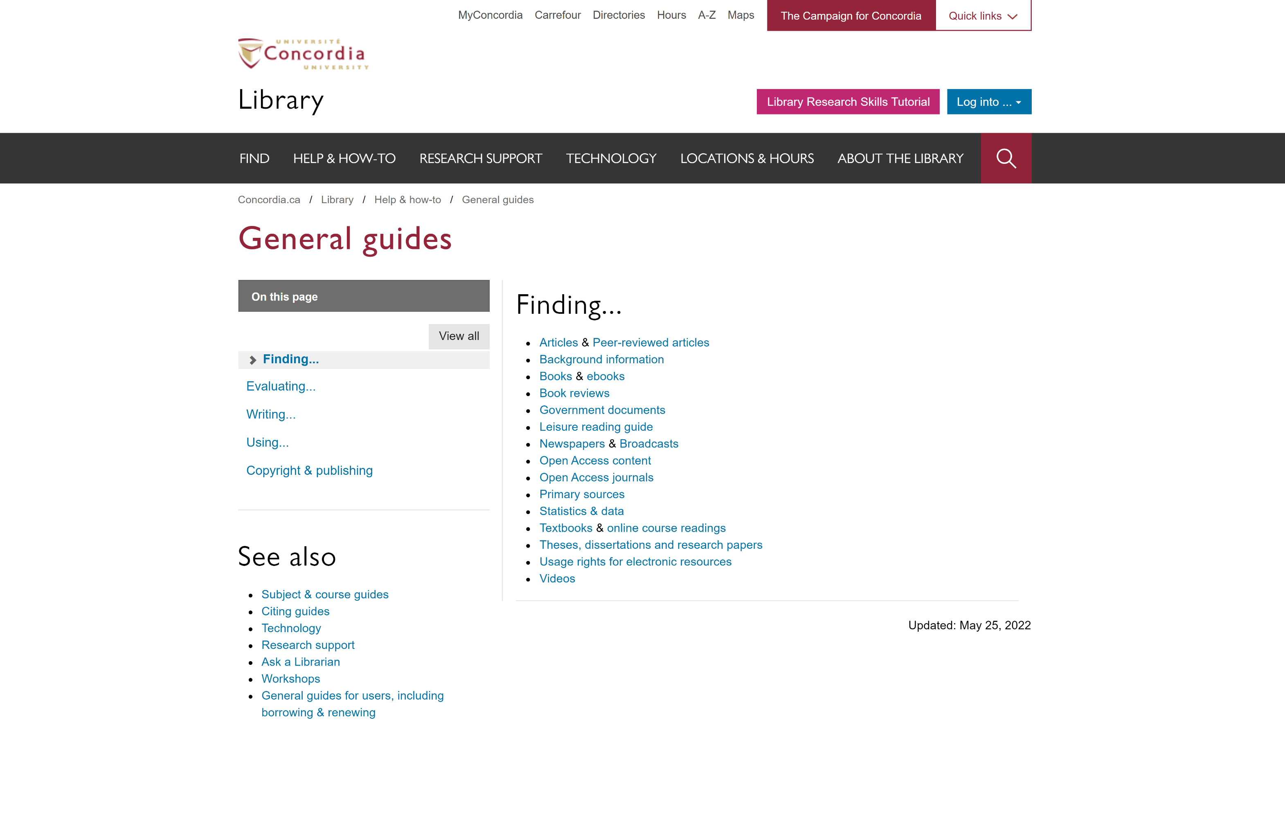
Concordia Library Website - Navigating General Guides
library.concordia.ca/help/guides.php?guid=finding

Slide 52
The Library is there to support you with your research too.

Slide 53
Concordia Library Website – Ask a Librarian

Slide 54
QUESTIONS? COMMENTS?
ÉTHEL GAMACHE
ethel.gamache@concordia.ca
Presentation and handouts will be on the subject guide, https://www.concordia.ca/library/guides/religion/courseguides.html

