Slide 1
RELI 380 Religion and Sexuality Library workshop
Éthel Gamache, librarian
ethel.gamache@concordia.ca
February 12, 2025

Slide 2
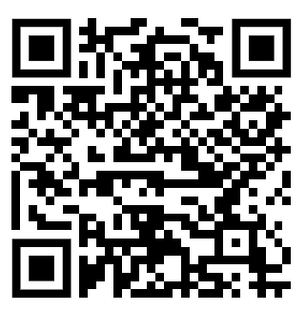
Agenda
Library website and research guide
Using Sofia, the Library Discovery tool, and Interlibrary loans
What is a peer-reviewed article? The peer-review process
Finding peer-reviewed articles in databases
Citing with MLA, writing resources
Other considerations
Notes:
Other considerations: citational justice, evaluating resources

Slide 3
Ice-breaker activity
I use or have used online library services.
I know how to apply boolean logic to searching.
When I search for articles, I often don’t find what I’m looking for.
I prefer to use Google / Scholar to find scholarly articles.
I have attended a library workshop before.
I’ve met with a librarian to find relevant sources for an assignment.
Move your fingers
Touch your head
Play air piano
Wave
Take a bow
Clap your hands
This activity was created by K-Lee Fraser, University of Toronto Scarborough, K-Lee's Remixed Information Literacy Games. (unpublished)

Slide 4
Library website & research guide

Slide 5
Library website
https://library.concordia.ca/

Slide 6
Religions and Cultures Subject Guide
https://www.concordia.ca/library/guides/religion.html

Slide 7
Exercise
Discuss your research project with a neighbour and note three keywords that describe it.
Find the Sexuality studies subject guide on the Library website.

Slide 8
Using Sofia and Interlibrary loans (ILL)

Slide 9
Search operators - boolean
Source: Library Of Antiquity. « Forgotten Skills: Boolean Searches ». The Library of Antiquity, 8 octobre 2016. https://libraryofantiquity.wordpress.com/2016/10/07/forgotten-skills-boolean-searches/.

Slide 10
Other search operators
Exact phrase searching
Quotation marks (” ”) are used to search for an expression in its exact form (phrase searching). They are useful for expressions containing more than one word.
For example, “rite of passage” will find these words written together, without their variants, in that order.
Truncation
The asterisk (*), placed at the end of a word, replaces 0, 1 or more characters.
For example, chat* will find chat, chats, chatte, chaton, but also château, Chateaubriand, Châtelaine... It will not, however, find matou, félin, or lynx.
Another example: relig*: religion, religions, religare, religious, religieux, religieuse.

Slide 11
Sofia, the Library Discovery tool
https://concordiauniversity.on.worldcat.org/discovery

Slide 12
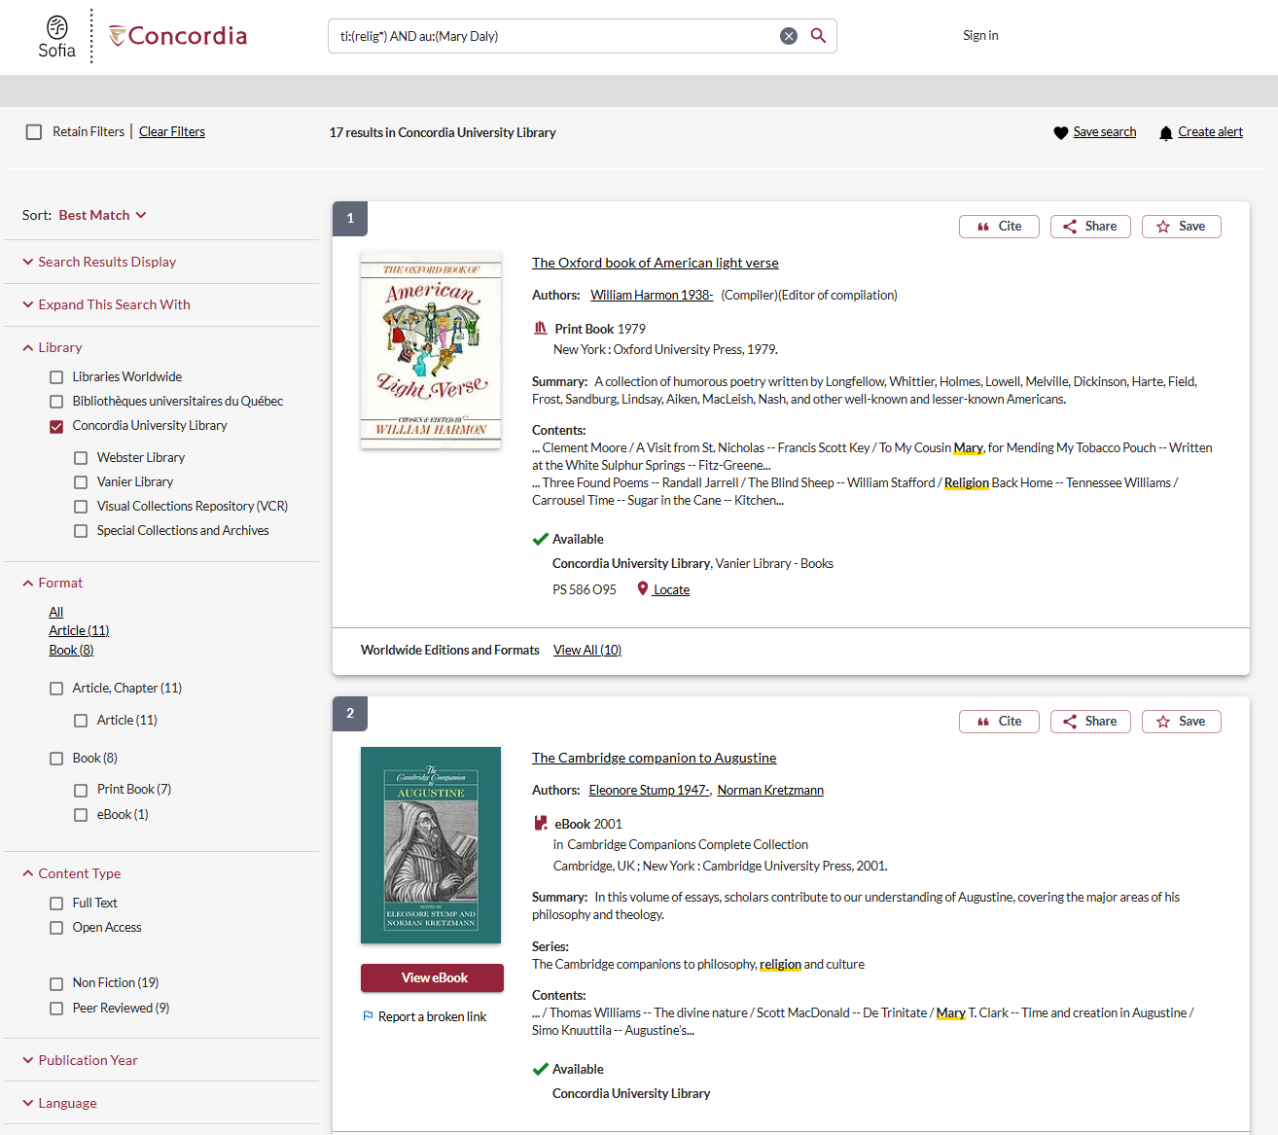

Slide 13
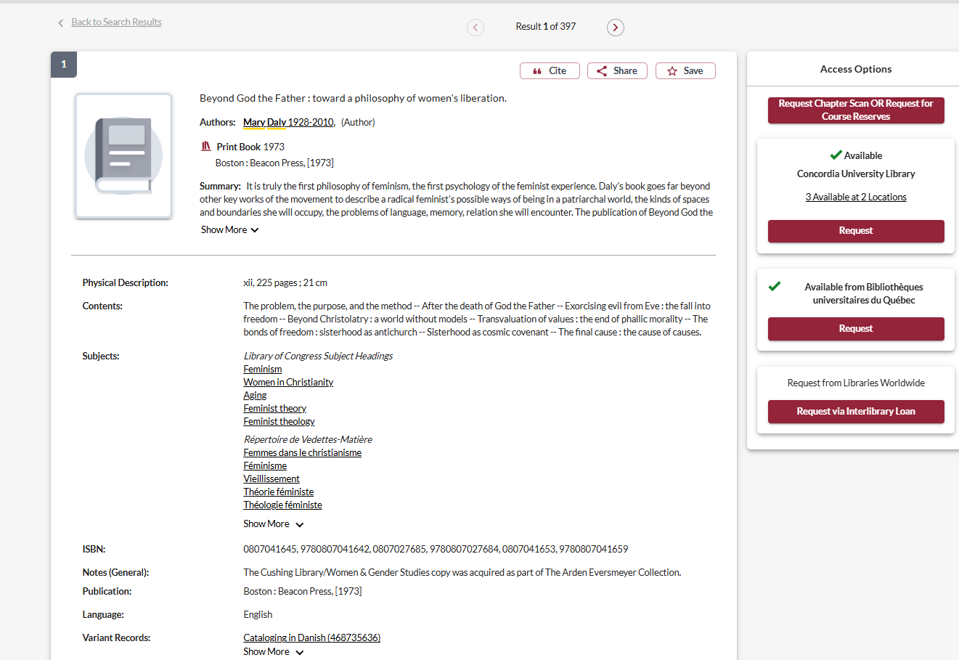

Slide 14
Exercise
Identify in Sofia a document that includes the three keywords you selected in the previous exercise.
What steps would you take to access this resource?
Jakobsen, Janet. 2020. “Chapter 1: Because Religion" in The Sex Obsession: Perversity and Possibility in American politics (33-66).

Slide 15
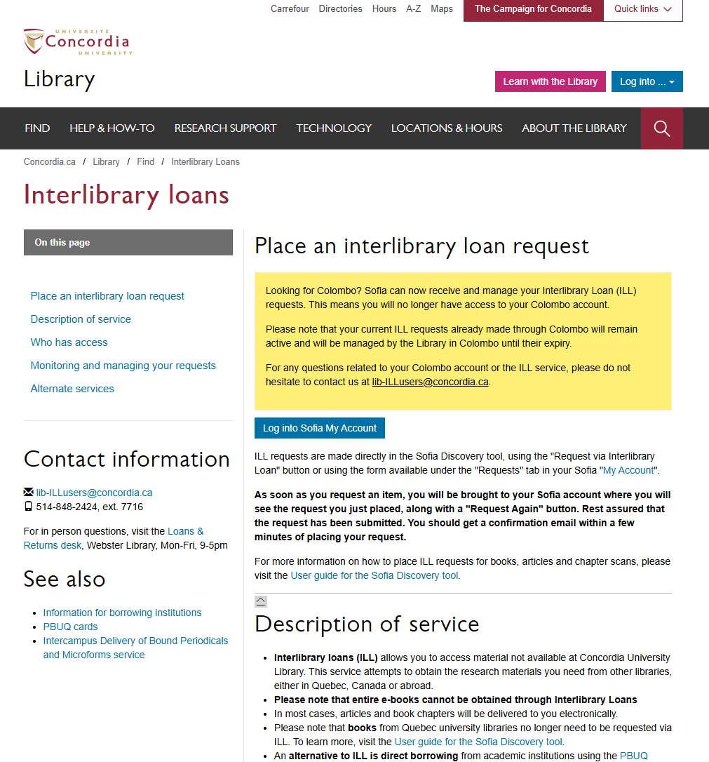
Interlibrary loans
https://library.concordia.ca/find/interlibrary-loans/

Slide 16
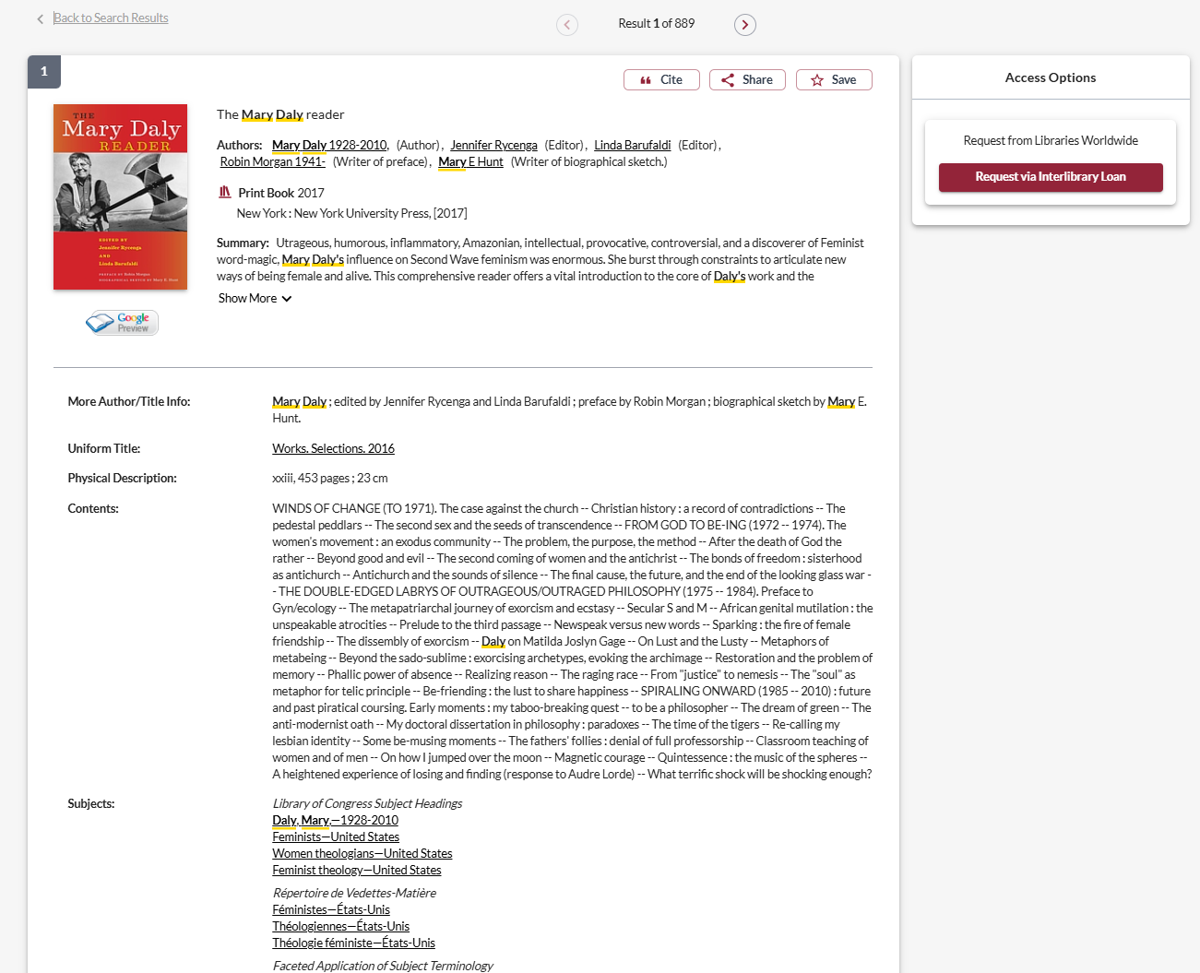
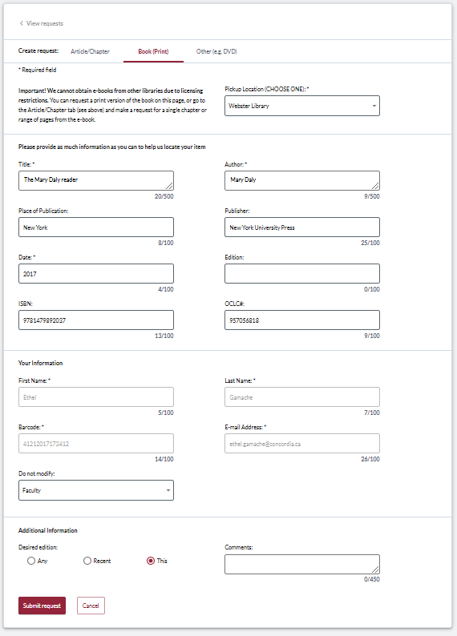
Interlibrary loans – via Sofia

Slide 17
What is the new Interlibrary Loans (ILL) service?
ILL requests are made directly in the Sofia Discovery tool:
“Request via Interlibrary Loan” button
Form available under the “Requests” tab in "My Account".

Slide 18
Concordia article/chapter scan & deliver service
Book chapter and journal article scans from Concordia’s print collection can now be requested and tracked in Sofia.
Look for the “Chapter Scan” button in the Access Options panel.

Slide 19
Requesting a book via Interlibrary loans (ILL)

Slide 20
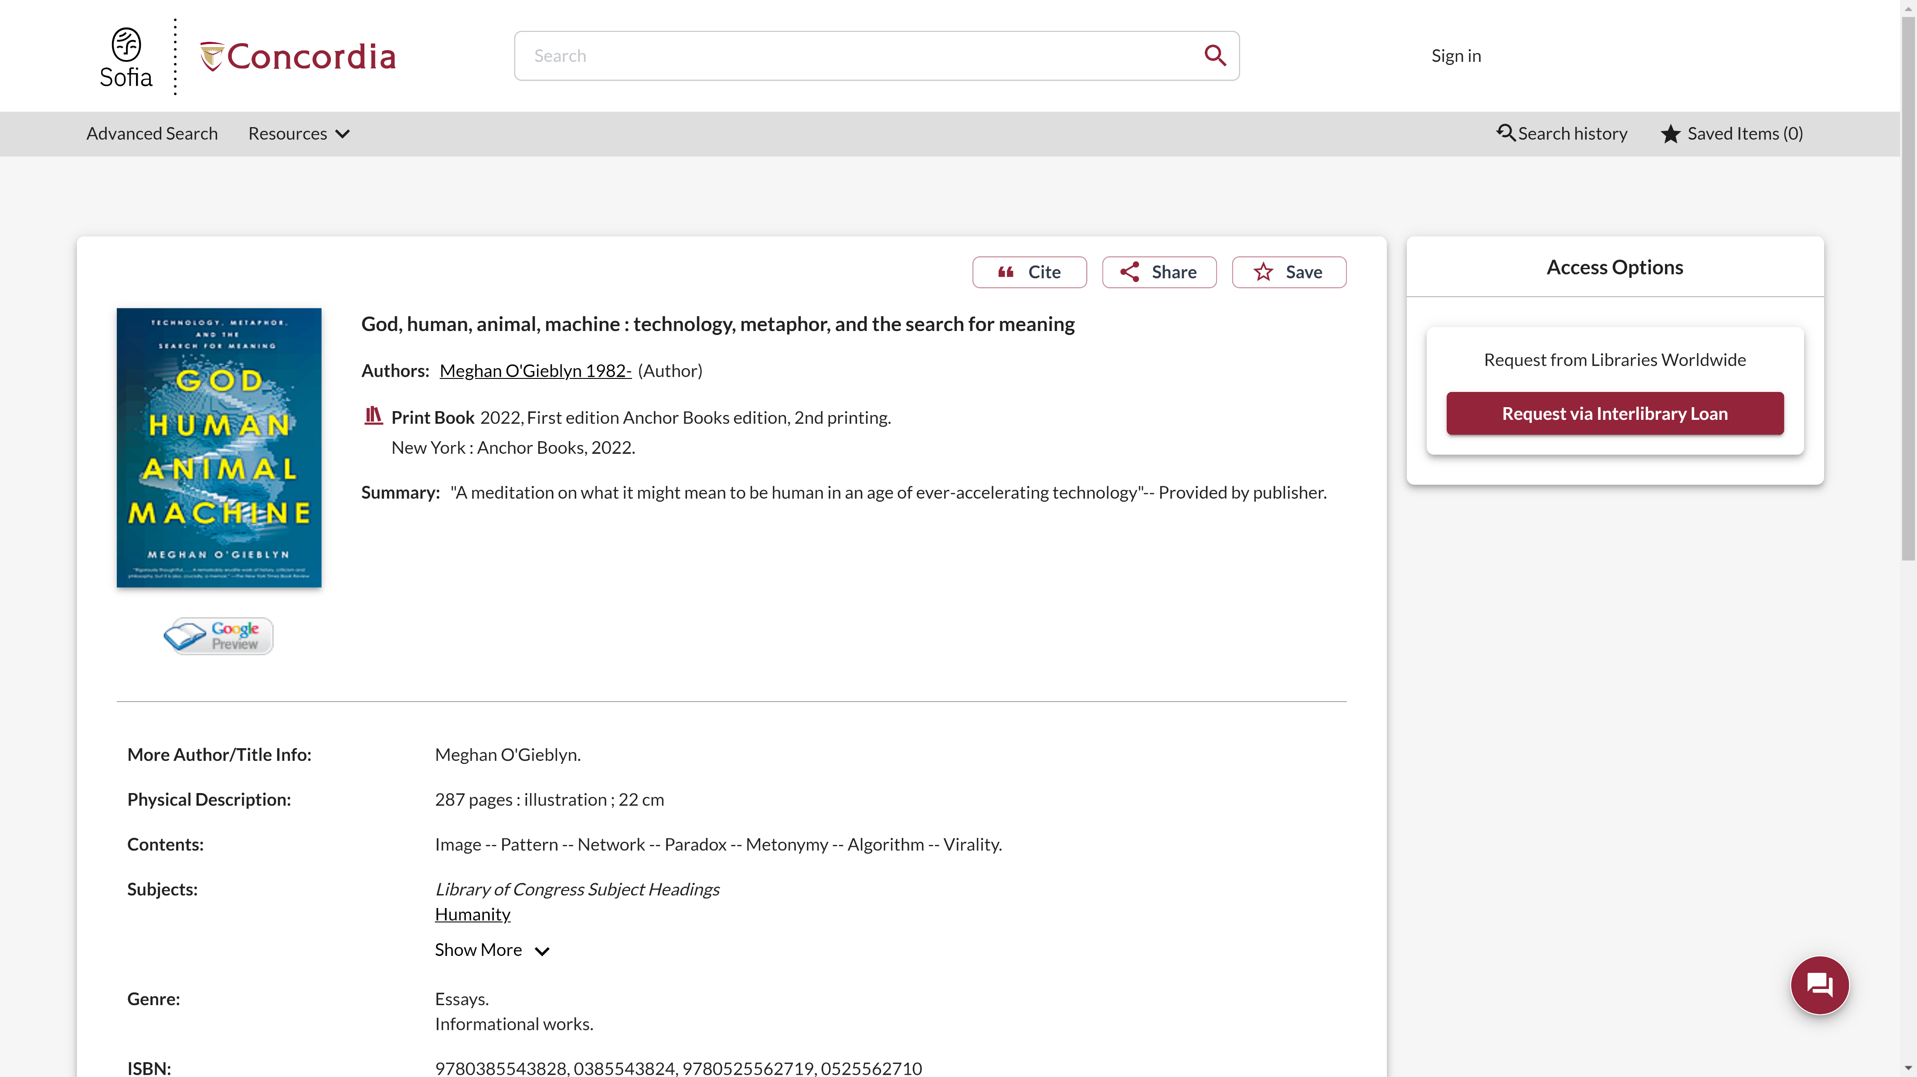
Sofia Discovery Tool request via Interlibrary loan

Slide 21
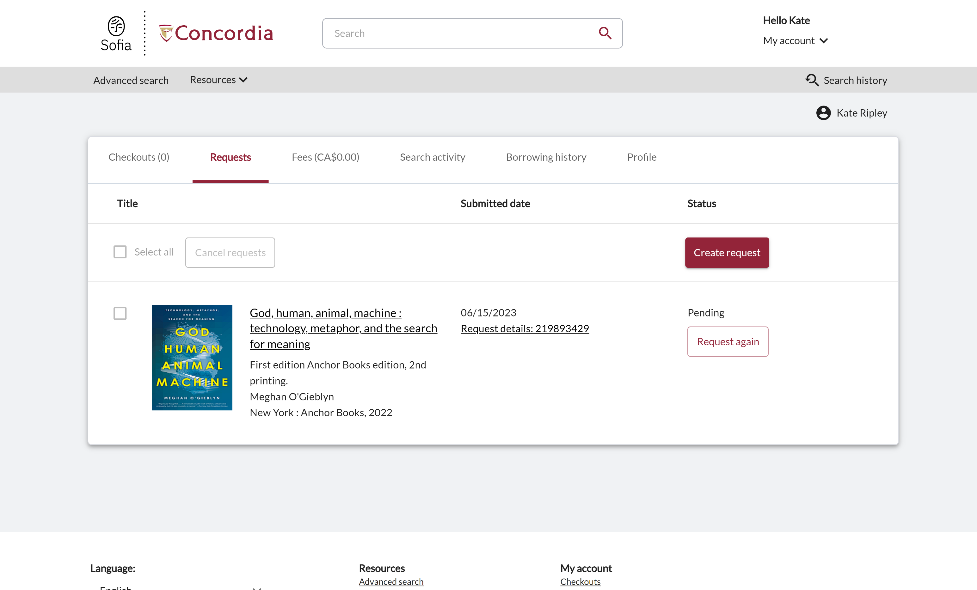
Check the status of your request under the "Requests" tab.

Slide 22
About Interlibrary loan
You will receive email notifications when your ILL request is available for pickup or download.
Physical items can be picked up at the Circulation/Loans desks at either Vanier or Webster Library.
You will be able to borrow your ILL requested items for 30 days, and it will be automatically renewed up to 4 times unless the item is recalled.

Slide 23
The peer-review process

Slide 24
The peer-review process
Image source:
Yates, D. [@LegoAcademics]. (2014, August 12). Peer 1: Brillant! Accept with no changes; Peer 2: Groundbreaking! Accept with no changes; Peer 3: Reject. [Tweet]. Twitter. https://twitter.com/LegoAcademics/status/499205005468262400/photo/1

Slide 25
Finding peer-reviewed articles in databases

Slide 26
Finding peer-reviewed articles in databases
https://concordiauniversity.libguides.com/az/databases

Slide 27
Demonstration in the database Academic Search Complete

Slide 28
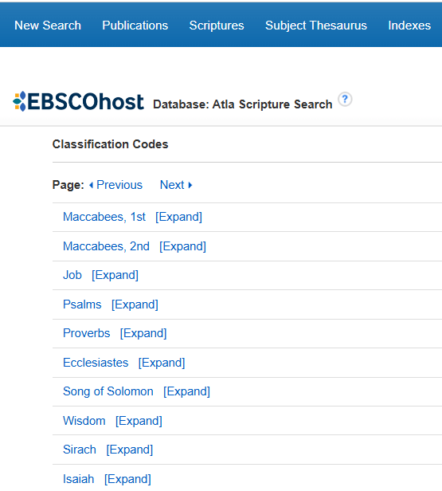
Demonstration in the database ATLA - with the Scriptures Search Index

Slide 29
Databases to consider
Academic Search Complete (EBSCOhost)
ATLA Religion Database with ATLASerials
Gender Studies Database
LGBT Life with Full Text
New Testament abstracts
Old Testament Abstracts
Religion & Philosophy Collection (EBSCO)

Slide 30
If you are unable to access the document directly in the database, I recommend using the link resolver available through “Find It @ Concordia” for assistance.

Slide 31
Exercise
Locate a peer-reviewed article in a library database using the three keywords selected in the first exercise.

Slide 32
Citing with the MLA citation style, writing resources

Slide 33
Citing with MLA (Modern Language Association)
https://library.concordia.ca/help/citing/?guid=mla

Slide 34
Writing resources
https://library.concordia.ca/help/writing/annotated-bibliography.php

Slide 35
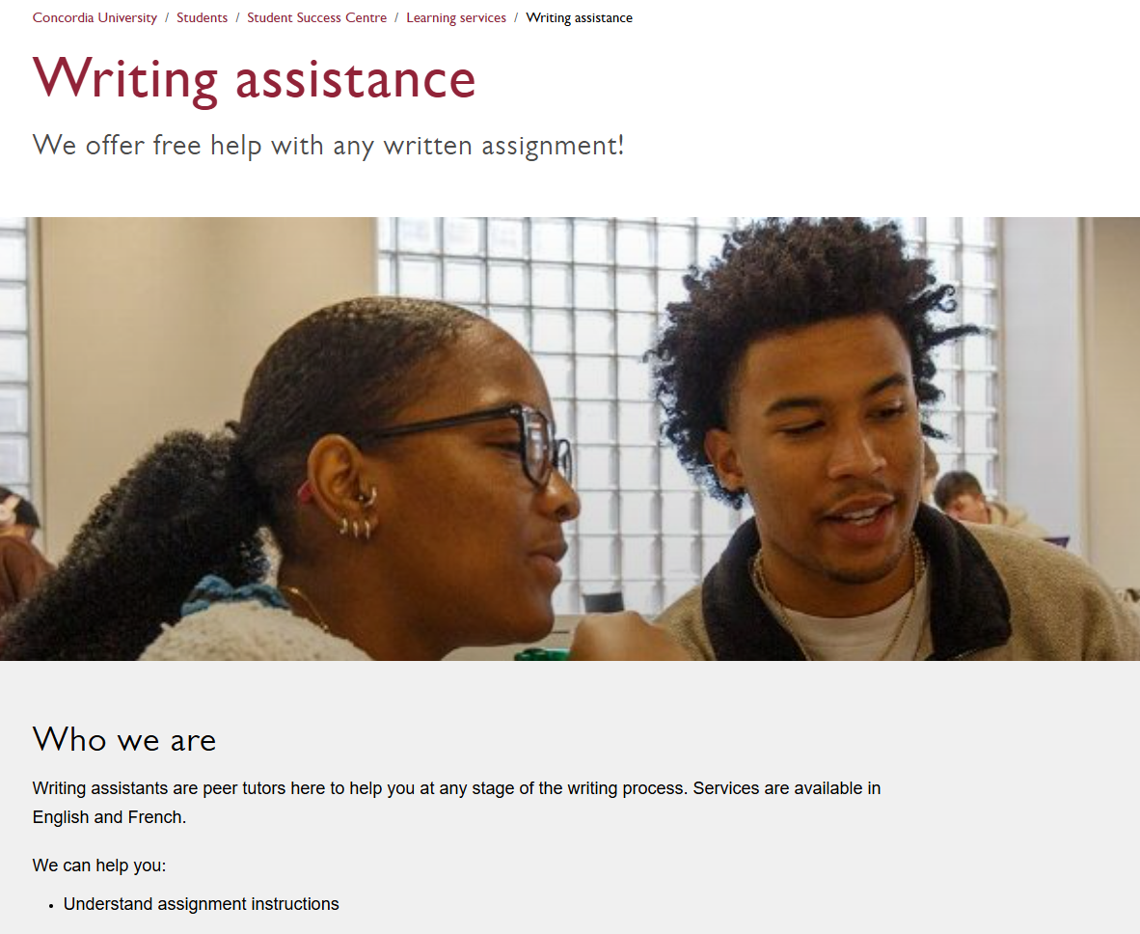
Writing assistance (outside the Library)
https://www.concordia.ca/students/success/learning-support/writing-assistance.html

Slide 36
Other considerations

Slide 37
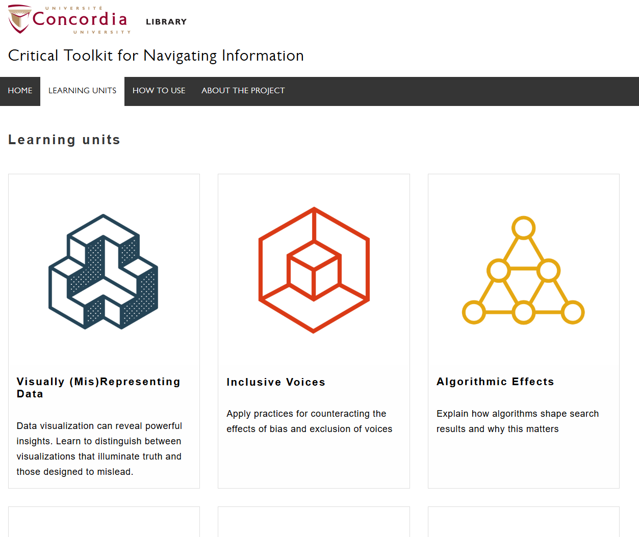
Critical Toolkit for Navigating Information
https://library.concordia.ca/apps/critical-toolkit/browse.html

Slide 38
Evaluating resources
https://library.concordia.ca/help/evaluating/evaluating.php
https://library.concordia.ca/apps/critical-toolkit/course.html?courseID=27406

Slide 39
Questions?

Slide 40
Thank you for your participation!
Éthel Gamache
ethel.gamache@concordia.ca
https://library.concordia.ca/help/questions/

