Slide 1
RELI 347 Religious and the Arts of South and Southeast Asia LIBRARY WORKSHOP Éthel Gamache ethel.gamache@concordia.ca Presentation and Resources handout available here:

Slide 2
Plan
Search strategies
How to find and access resources
Introduction to the Library website & subject guides
Using Sofia and Interlibrary loans
Using the database Academic Search Complete to find academic articles
Using Artstor to find images
3. Evaluating and citing sources

Slide 3
Search Strategies

Slide 4
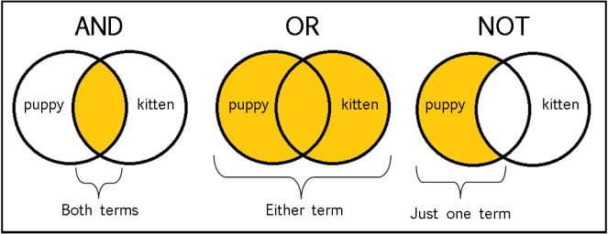
The Concept of a Boolean search illustrated
From: The Library of Antiquity, https://libraryofantiquity.wordpress.com/2016/10/07/forgotten-skills-boolean-searches/

Slide 5
Other search operators
Searching for an exact phrase (phrase searching): Quotation marks: “ ”, looks for adjacent words
“rite of passage”, “service desk”
Truncation: *
relig*: religion, religions, religare, religious, religieux, religieuse

Slide 7
How to find and access resources

Slide 8
Introduction to the Library website & subject guides

Slide 9
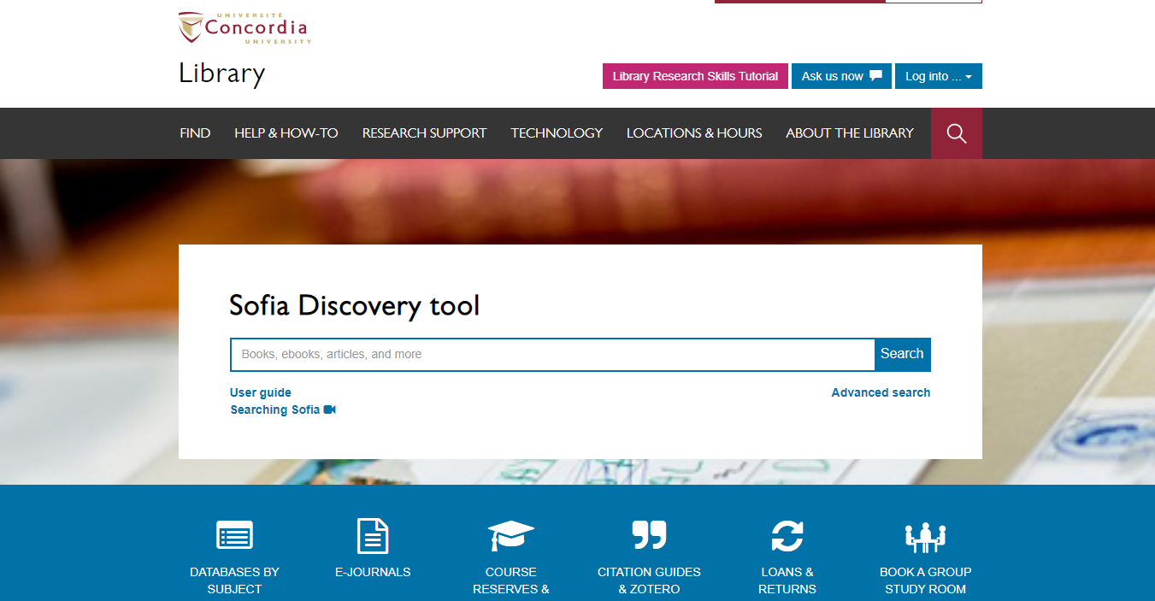

Slide 10
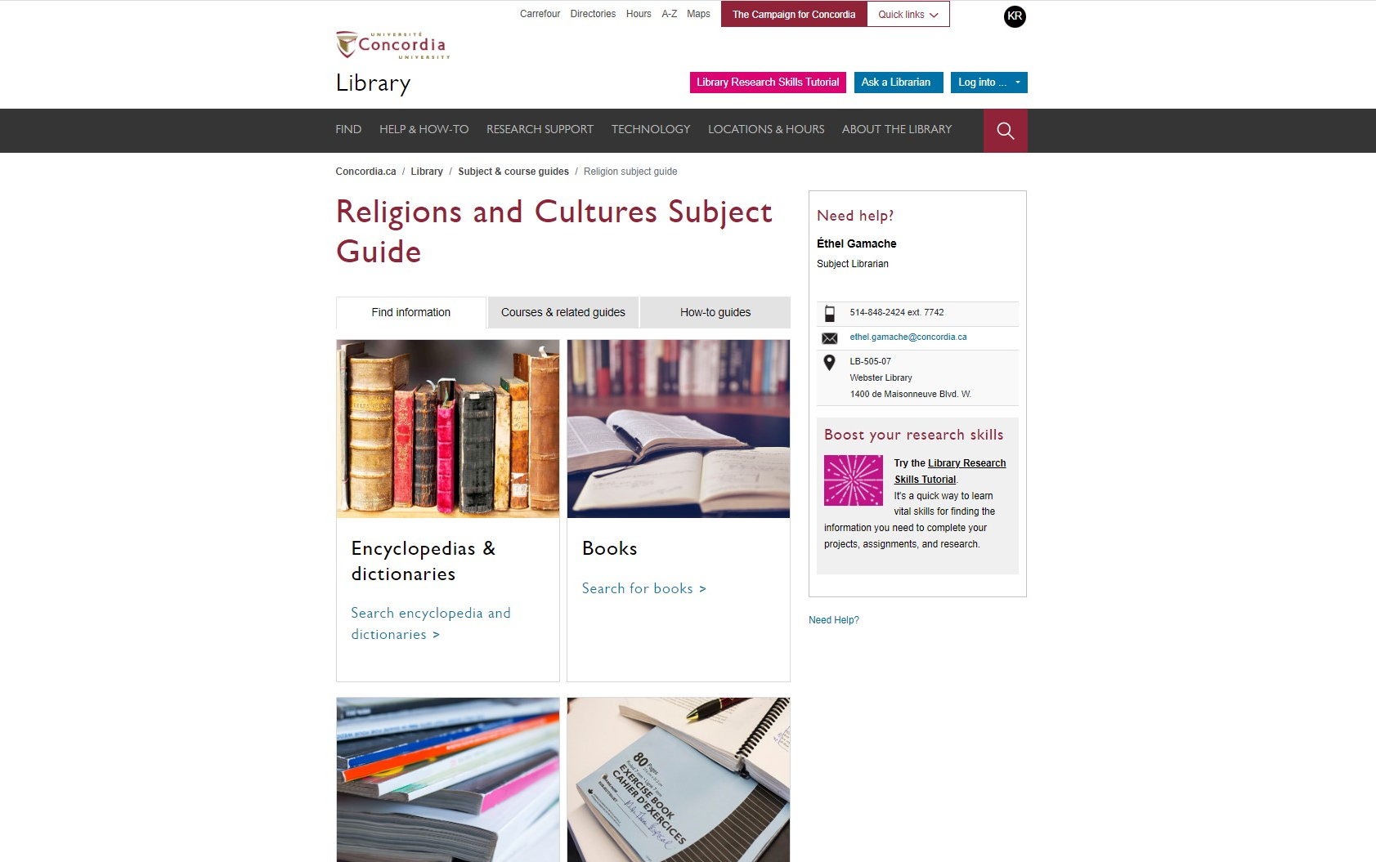
Religions and Cultures Subject Guides
concordia.ca/library/guides/religion.html

Slide 11
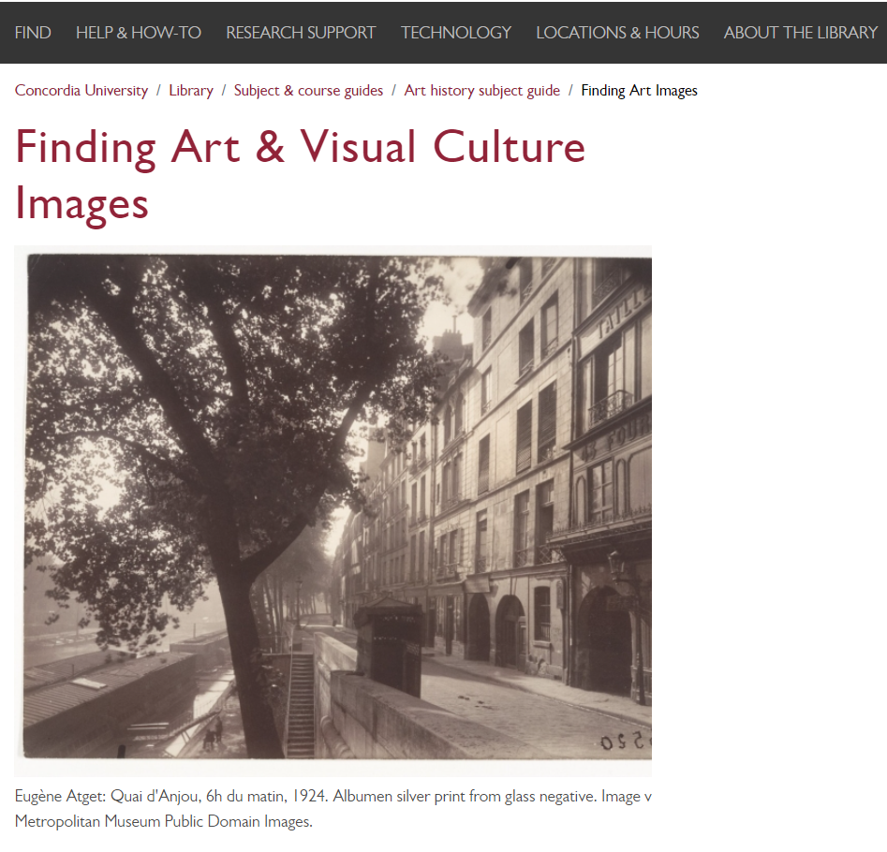
Religions and Cultures Subject Guides
concordia.ca/library/guides/art-history/artimages.html

Slide 12
Using Sofia and Interlibrary loans

Slide 13
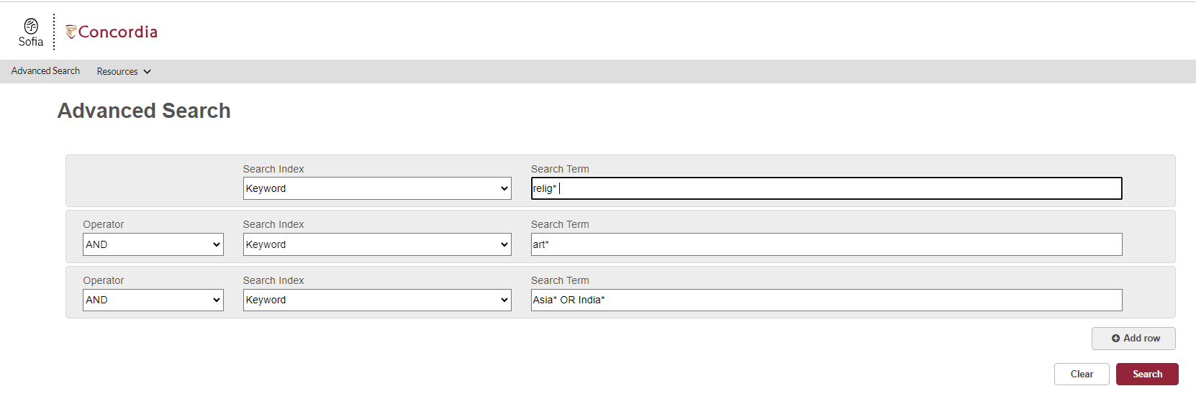
Advanced search in Sofia

Slide 14
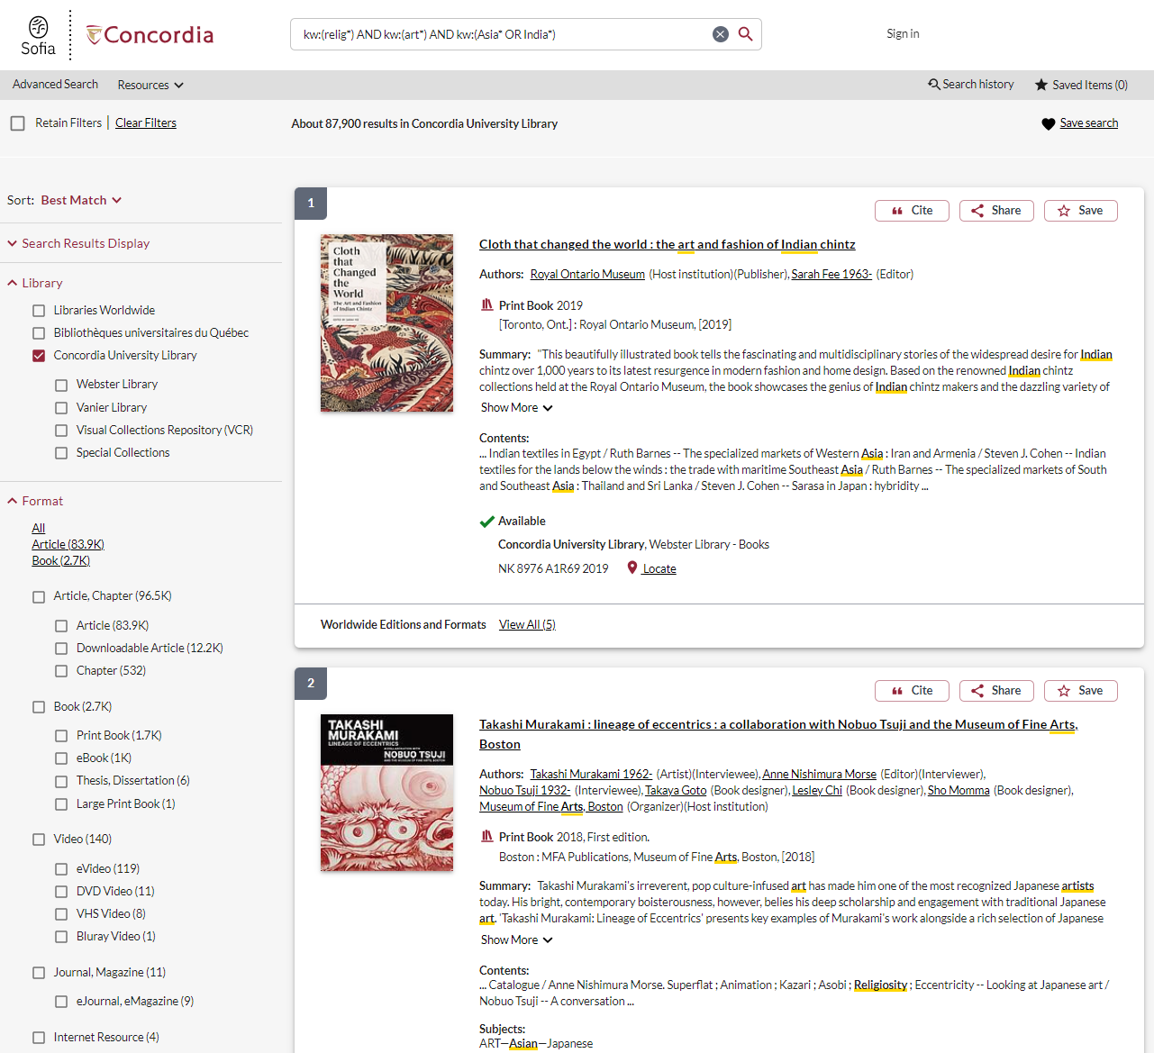
Advanced search in Sofia

Slide 15
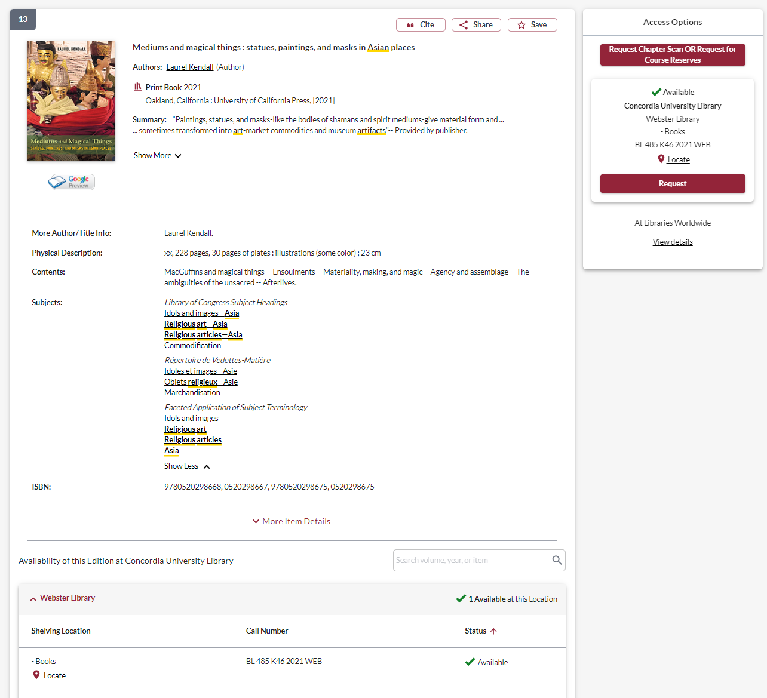

Slide 16
USING INTERLIBRARY LOANS WITHIN SOFIA

Slide 17
What is the new interlibrary loans (ILL) service?
ILL requests are made directly in the Sofia Discovery tool:
“Request via Interlibrary Loan” button
Form available under the “Requests” tab in "My Account".

Slide 18
Concordia article/chapter scan & deliver service
Book chapter and journal article scans from Concordia’s print collection can now be requested and tracked in Sofia.
Look for the “Chapter Scan” button in the Access Options panel.

Slide 19
REQUEST A BOOK VIA INTERLIBRARY LOAN
EXAMPLE

Slide 20
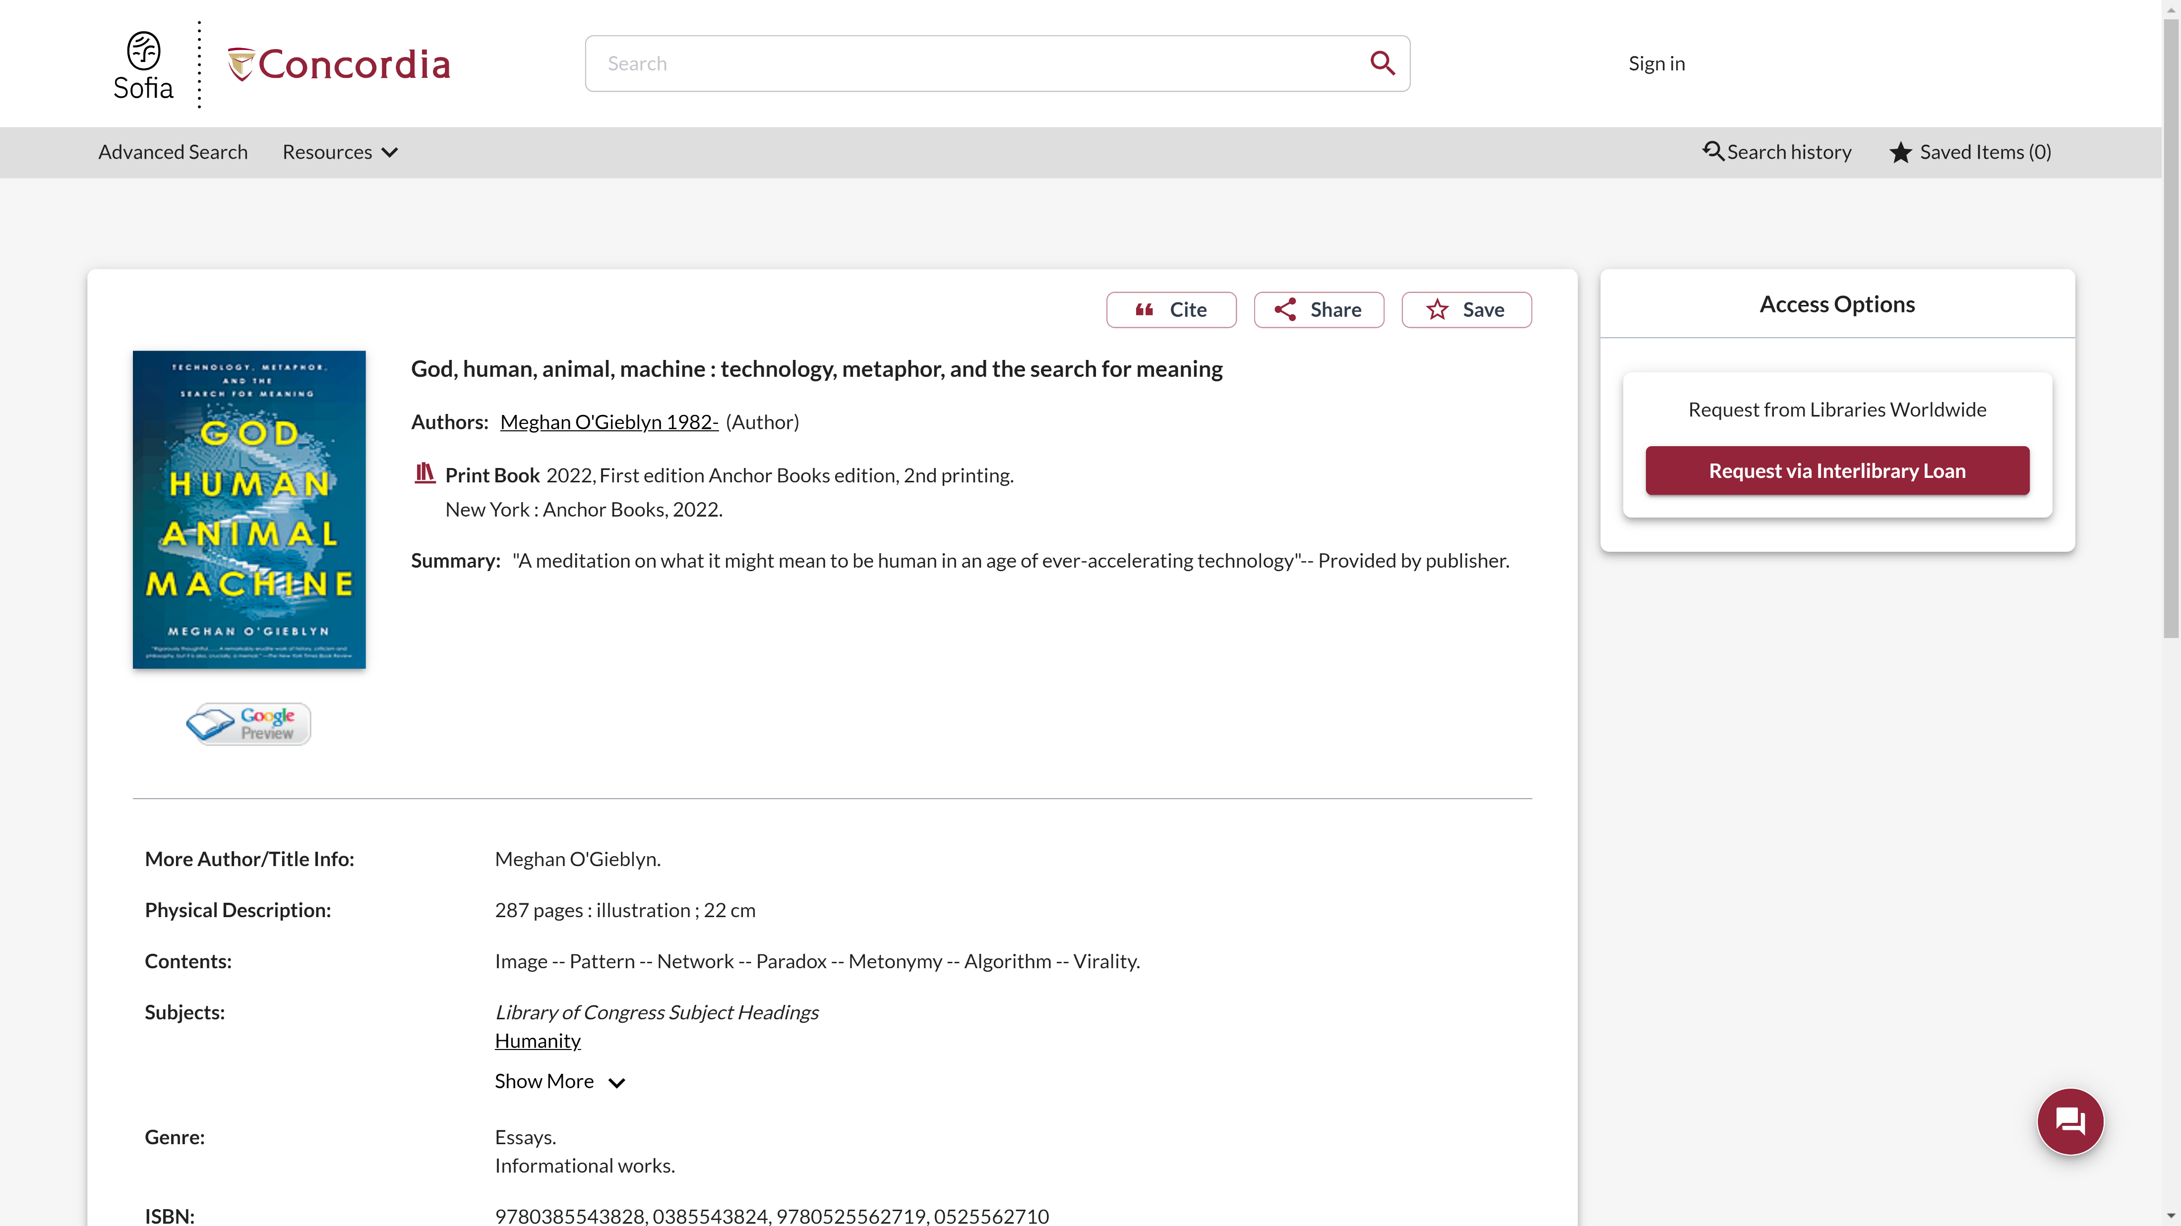
Sofia Discovery Tool request via Interlibrary loan

Slide 21
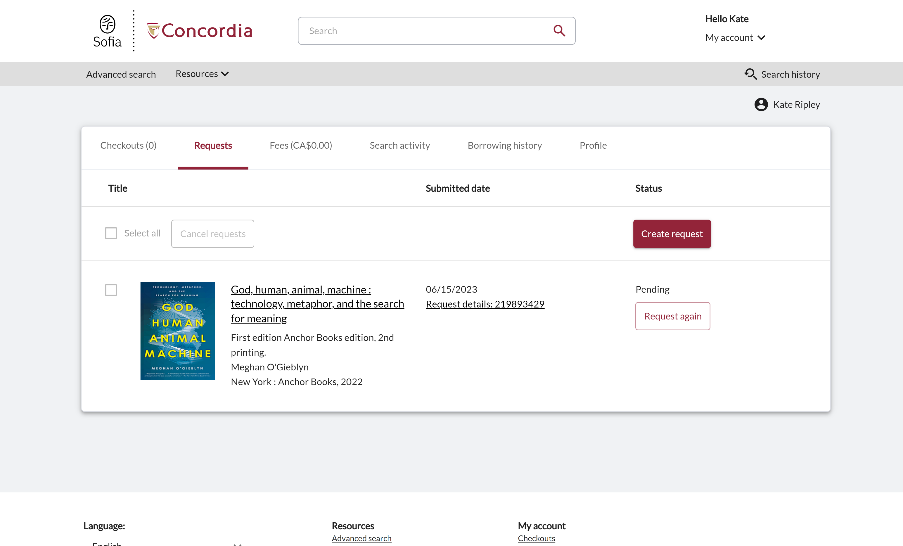
Check the status of your request under the "Requests" tab.

Slide 22
About Interlibrary loan
You will receive email notifications when your ILL request is available for pickup or download.
Physical items can be picked up at the Circulation/Loans desks at either Vanier or Webster Library.
ILL requests can be borrowed for 30 days, with up to 4 automatic renewals, or until item is recalled.

Slide 23
REQUEST A BOOK BLANK FORM
EXAMPLE

Slide 24
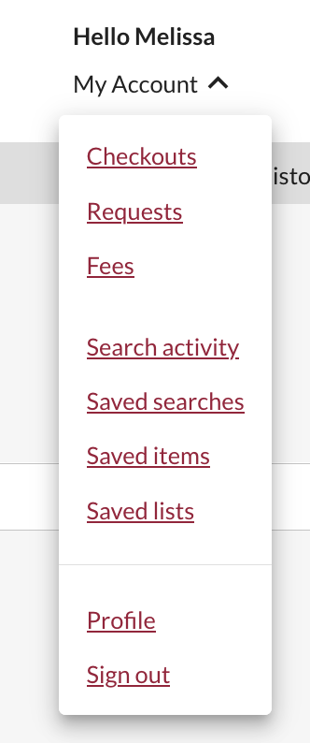
Create an Interlibrary Loan request
Sign in to "My Account" and select "Requests".
Click on "Create request".

Slide 25
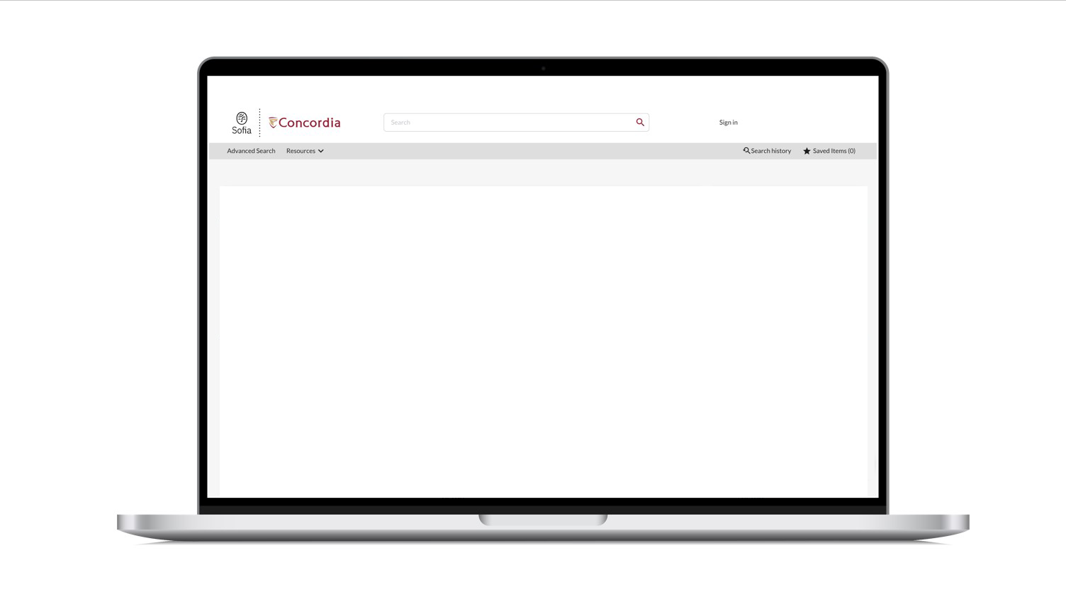
Sofia Discovery Tool – request a book form

Slide 26
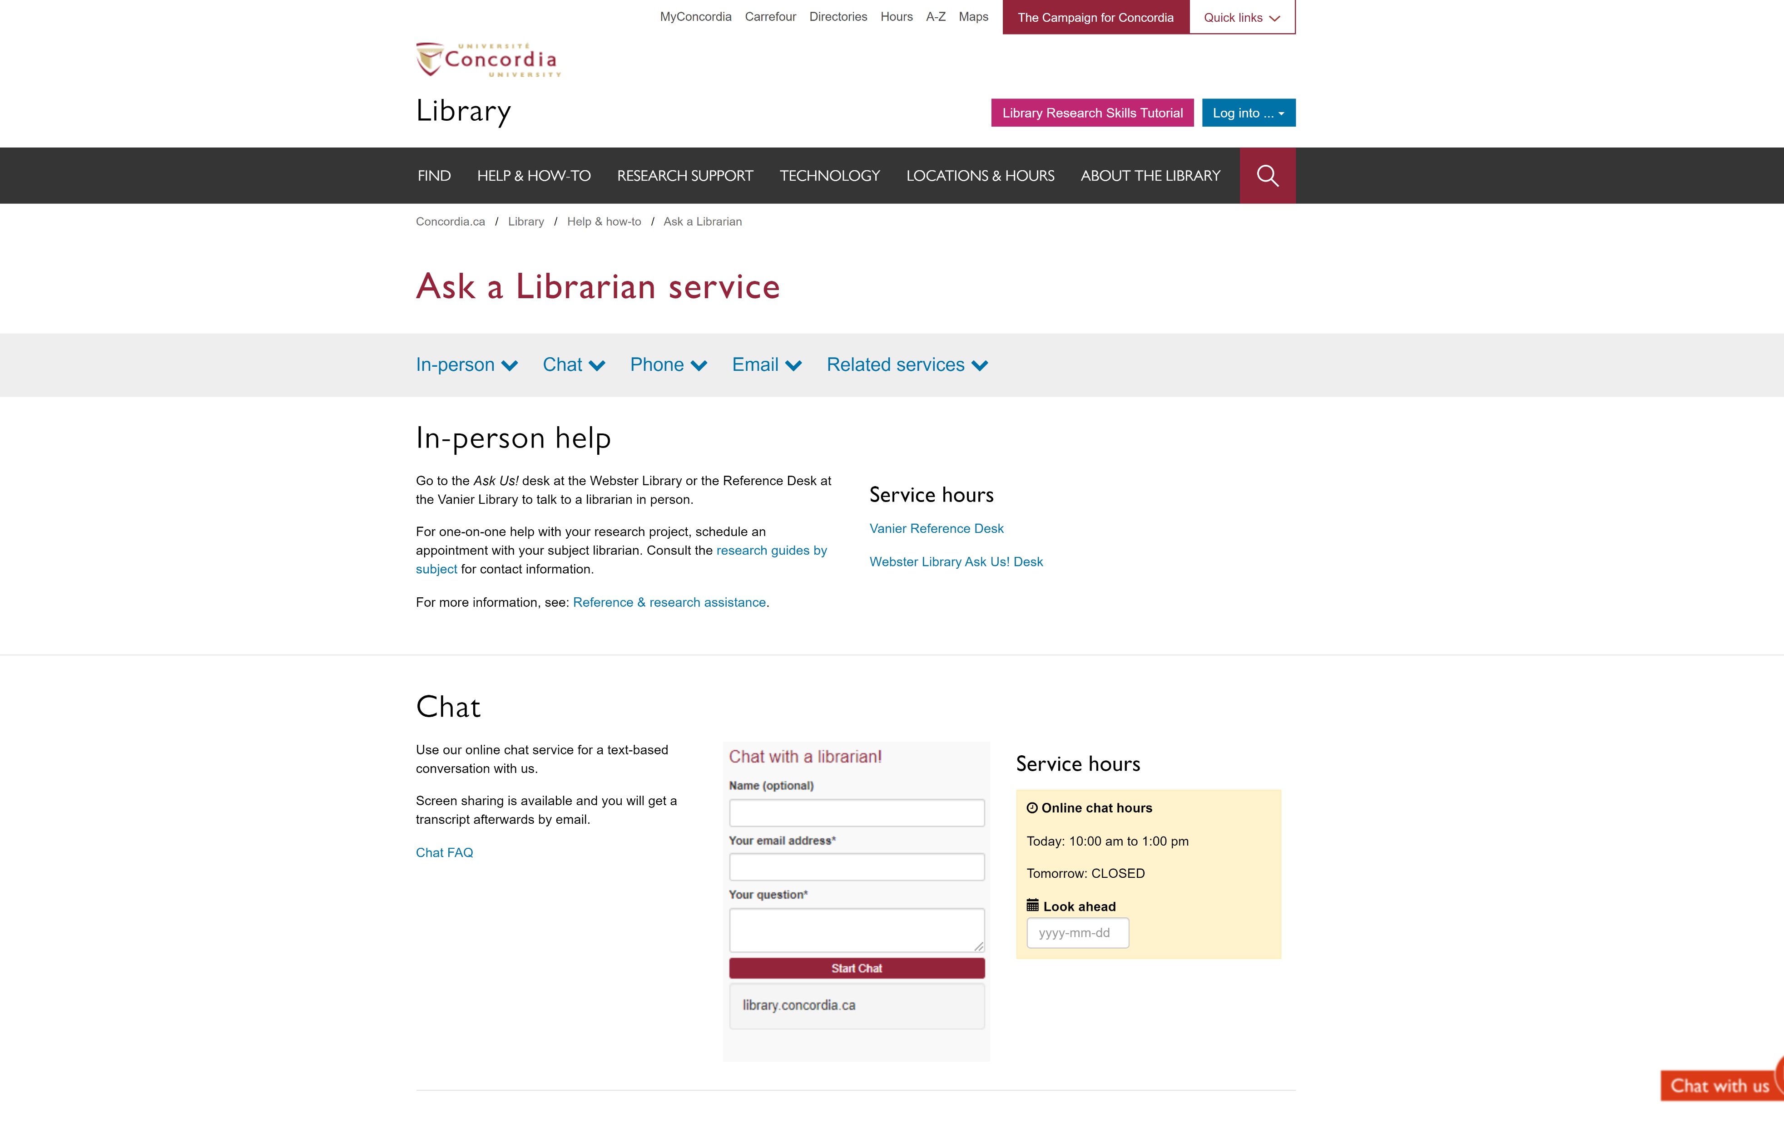
If you have any difficulty finding a document, reach out!

Slide 27
Using the database Academic Search Complete to find academic articles

Slide 28
Peer-reviewed articles
Yates, D. [@LegoAcademics]. (2014, August 12). Peer 1: Brillant! Accept with no changes; Peer 2: Groundbreaking! Accept with no changes; Peer 3: Reject. [Tweet]. Twitter. https://twitter.com/LegoAcademics/status/499205005468262400/photo/1

Slide 29
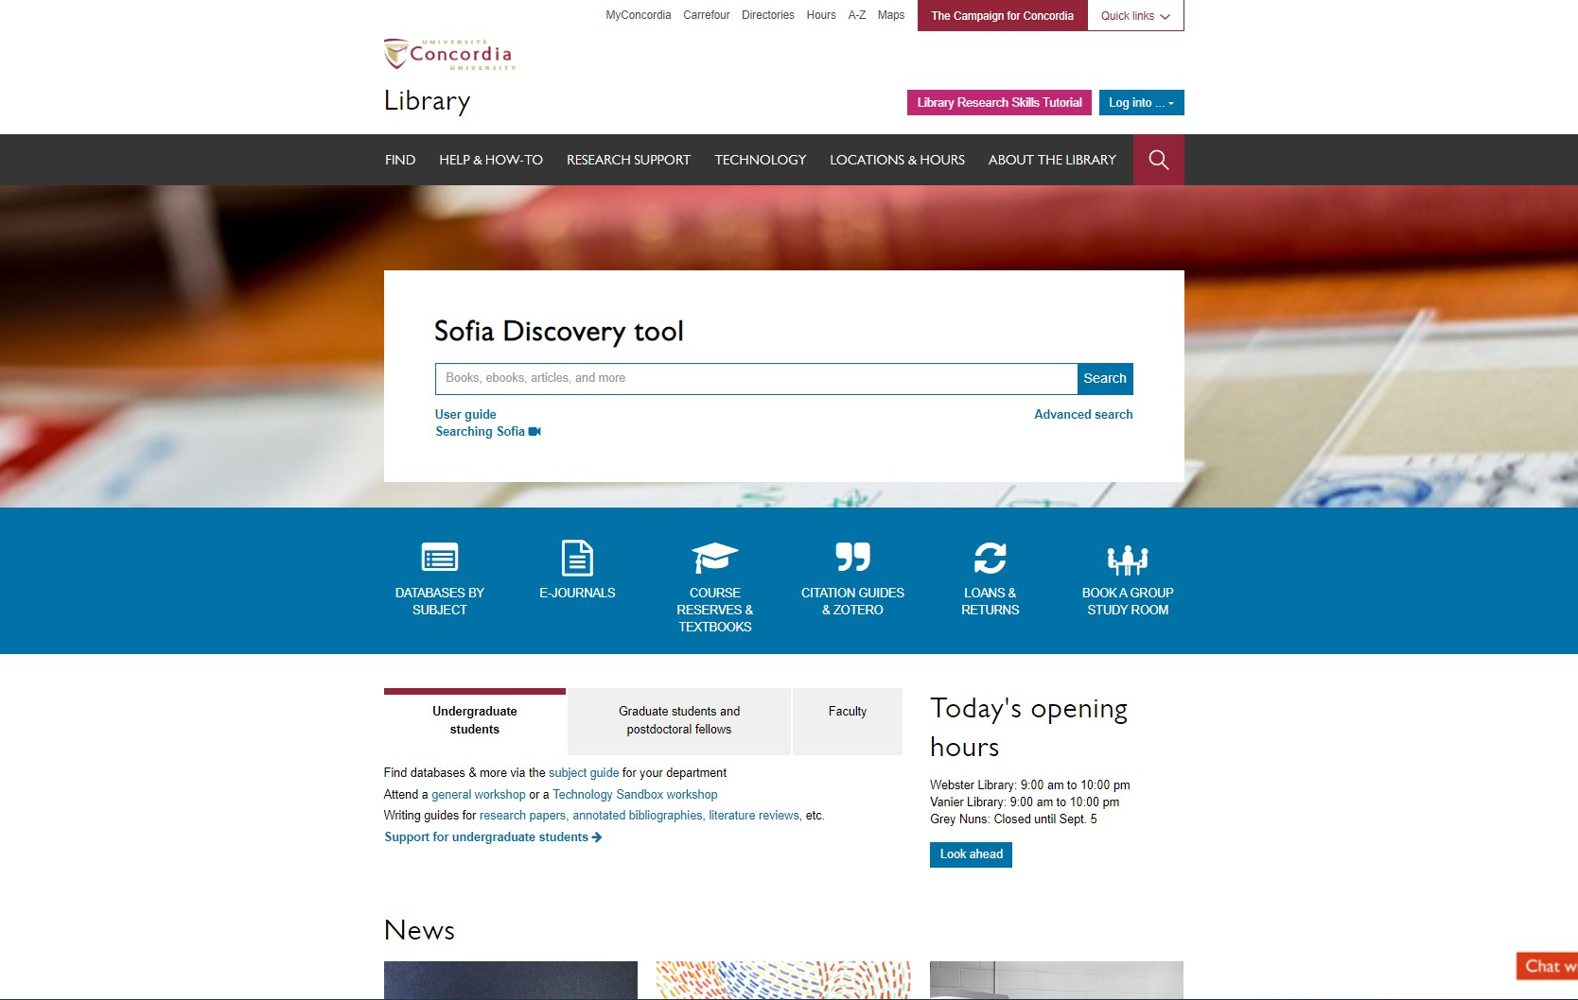
Sofia Discovery Tool – Databases By Subject

Slide 30
Databases

Slide 31
Academic Search COmplete

Slide 32
Academic Search COmplete

Slide 33
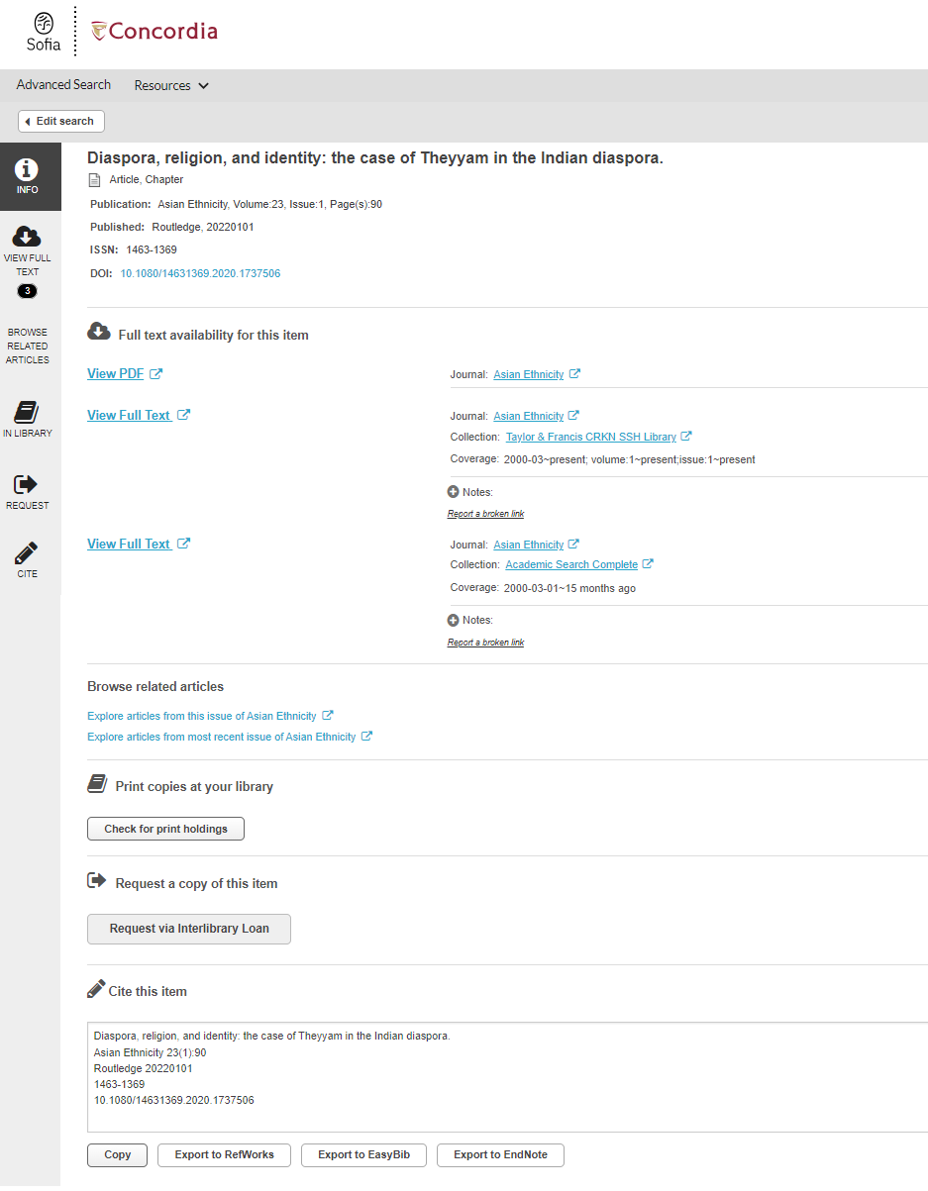
Using the link resolver

Slide 34
Using ArtStore to find images

Slide 35
Finding Images via The Library resources

Slide 36
ARTStor

Slide 37
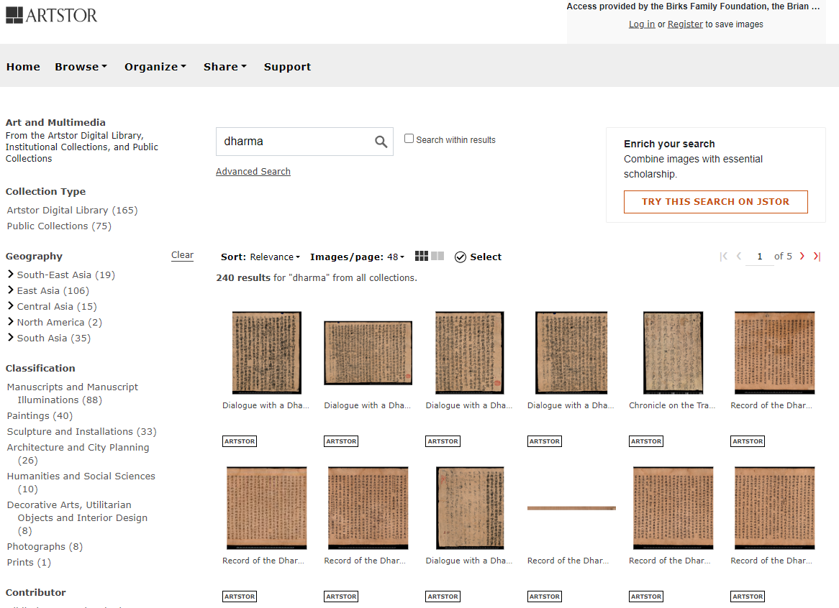

Slide 38
Evaluating and citing sources

Slide 39
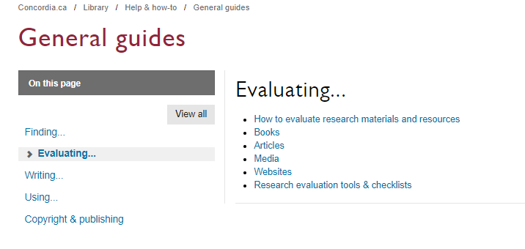

Slide 40
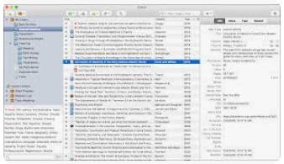
library.concordia.ca/help/citing/

Slide 41
Questions?

Slide 42
Concordia Library Website – Ask a Librarian

Slide 43
Thank you for your attention!
ÉTHEL GAMACHE
ethel.gamache@concordia.ca
Presentation and handouts are on the subject guide, https://www.concordia.ca/library/guides/religion/courseguides.html

Slide 44
Going further
Search Smarter, Search Faster par l’Université de Sydney
Types of Information Sources par CSUN University Library
How do I Select Relevant Web or Online Resources? par Concordia University Library

