Slide 1

RELI 317 Sufism
Library workshop
Éthel Gamache
Librarian
ethel.gamache@concordia.ca

Slide 2
Plan
How to find and access resources
  Search operators
  Library website and Subject guide
  Sofia, discovery tool
    Using Interlibrary loan within Sofia
  Searching for articles with Academic Search Complete and Index Islamicus
  Encyclopedia – Oxford encyclopedia of the Islamic world
  General guides
  Generative Artificial Intelligence (AI)

Slide 3
Search operators

Slide 4
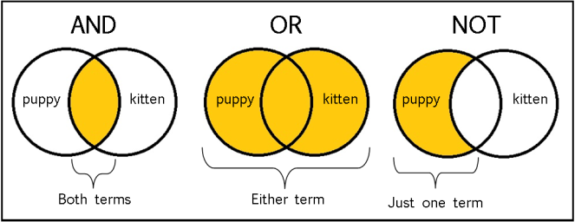
From: The Library of Antiquity, https://libraryofantiquity.wordpress.com/2016/10/07/forgotten-skills-boolean-searches/

Slide 5
Other search operators
  Searching for an exact phrase (phrase searching):
  Quotation marks: “ ”, looks for adjacent words
  “Islamic mysticism”, "attention deficit disorder"
  Truncation: *
  relig*: religion, religions, religare, religious, religieux, religieuse

Slide 6
How to find and access resources – Navigating the Library website and Subject guide

Slide 7
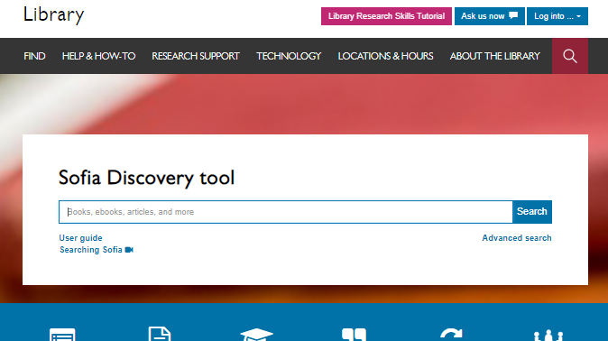

Slide 8
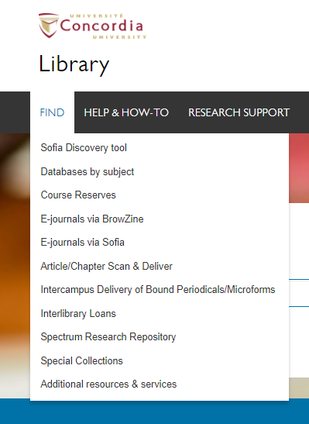



Slide 9
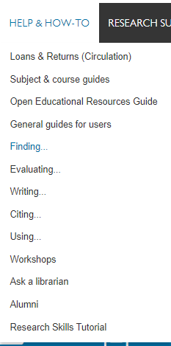




Slide 10
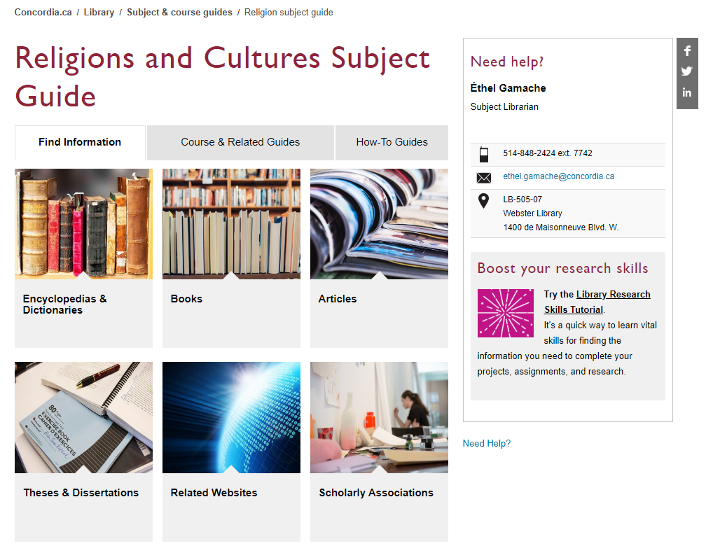

Slide 11
How to find and access resources – Using Sofia, the discovery tool

Slide 12
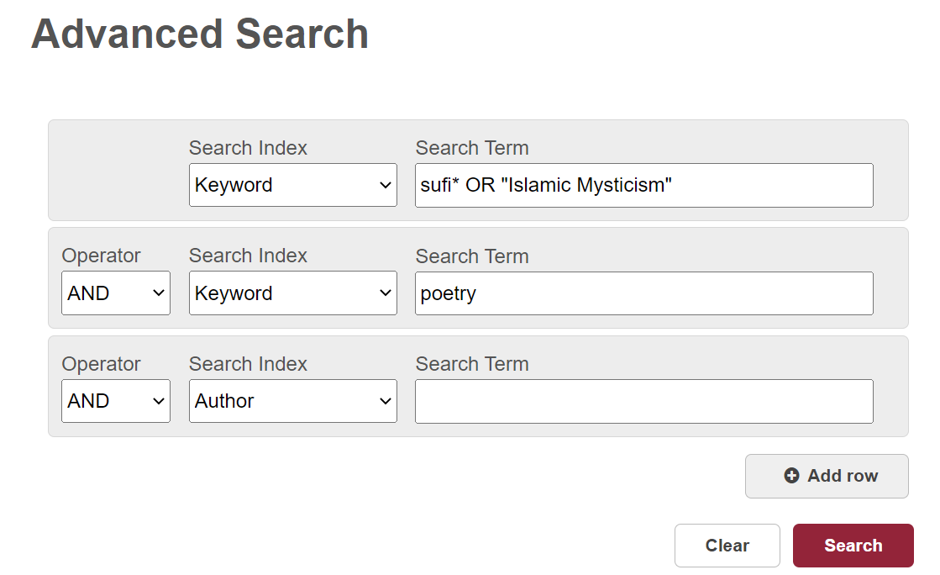
Sofia

Slide 13
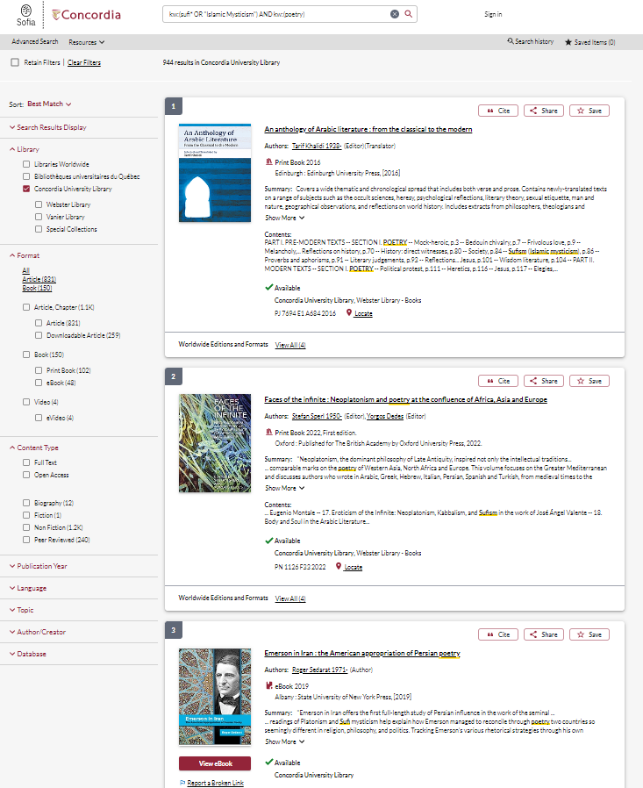

Slide 14
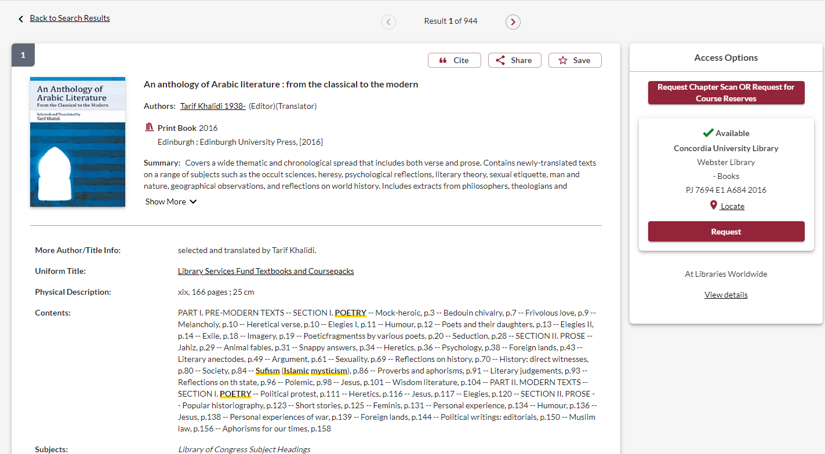

Slide 15
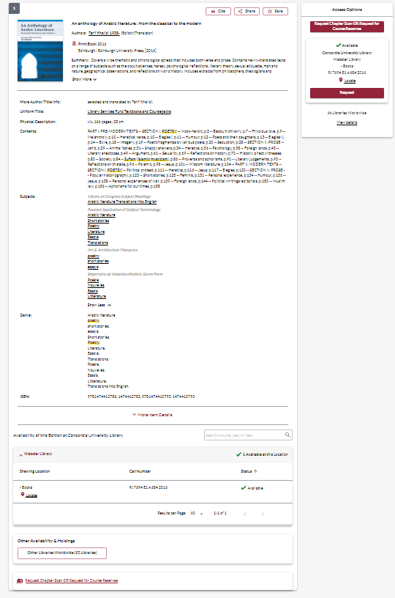
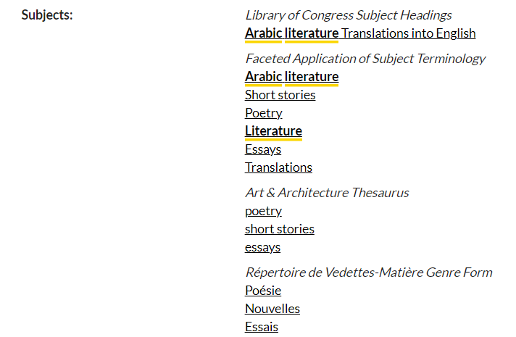


Slide 16
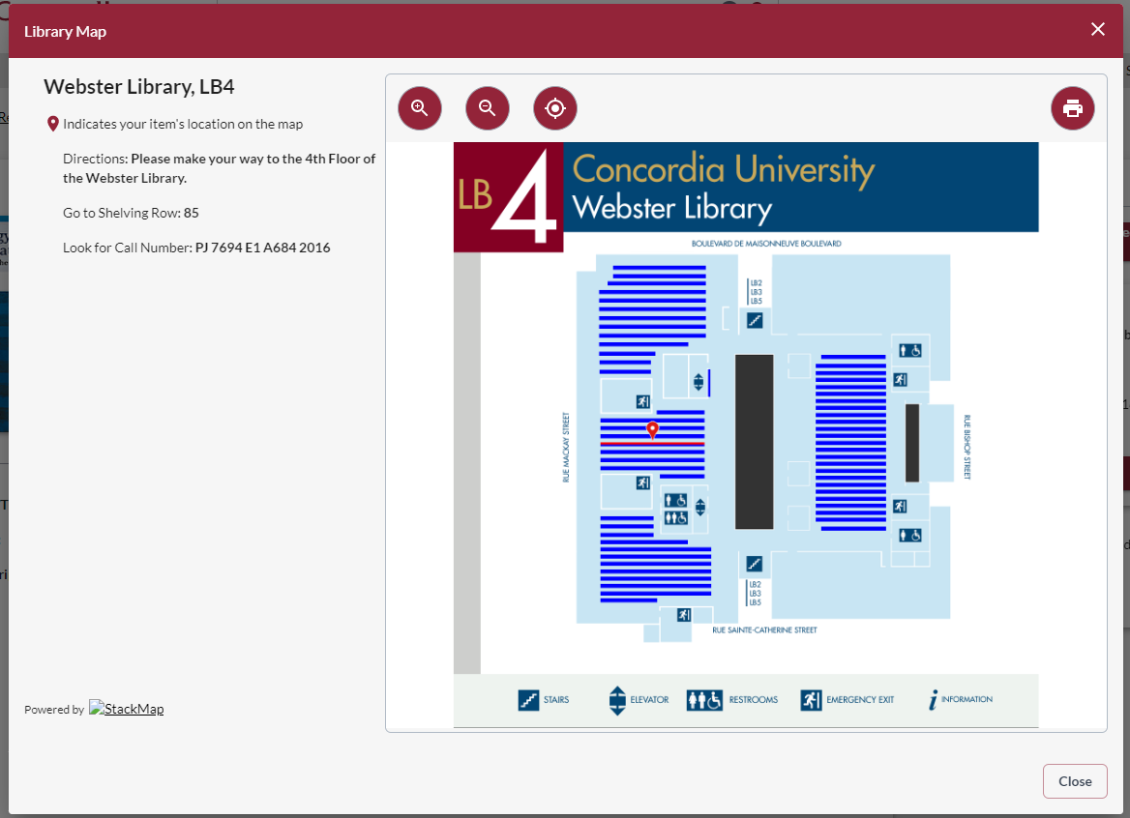

Slide 17
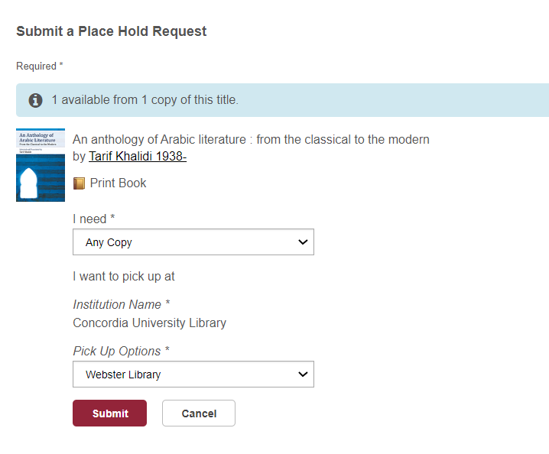

Slide 18
Using Interlibrary loan within Sofia

Slide 19
What is the new interlibrary loans (ILL) service?
ILL requests are made directly in the Sofia Discovery tool:
  “Request via Interlibrary Loan” button
  Form available under the “Requests” tab in "My Account".

Slide 20
Concordia article/chapter scan & deliver service
Book chapter and journal article scans from Concordia’s print collection can now be requested and tracked in Sofia.
Look for the “Chapter Scan” button in the Access Options panel.

Slide 21
Example – Request a book ("Request via Interlibrary Loan")

Slide 22
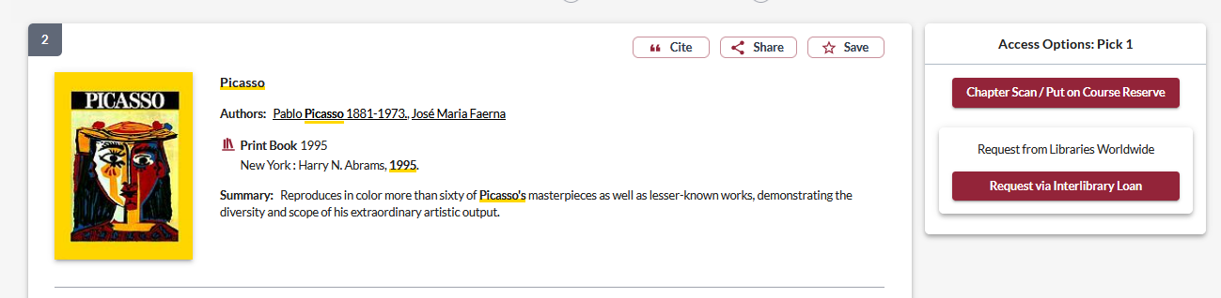
Notes:
Let's take a look first at requesting a book via libraries worldwide. If users are having trouble finding an item through Concordia Library or one of the Quebec university libraries, they can expand their search to "libraries worldwide" in Sofia.
If a user was looking to request this book, we can see that there is no "request" button through Concordia or network loans. Users will need to place an ILL request by selecting the "request via interlibrary loan" under the "access options panel". If they wanted a specific chapter scan, they would be able to select the "chapter scan" button, but we will take a look at that process later in today's presentation.

Slide 23
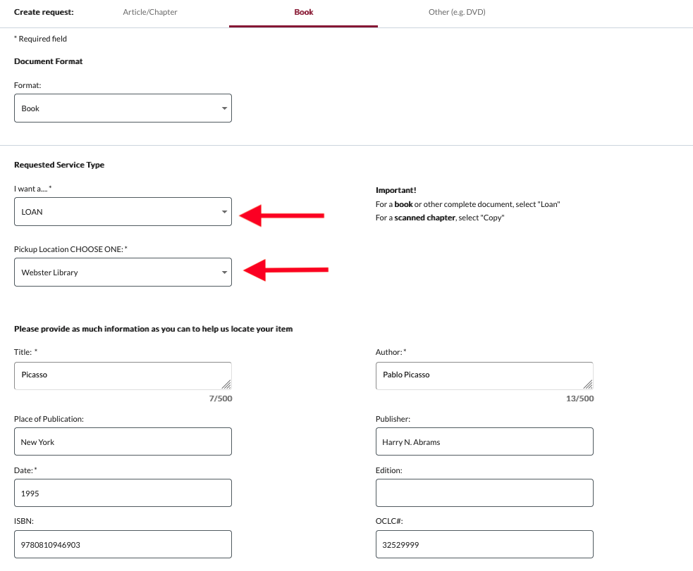
Notes:
The user will need to login to their Sofia account, and will then be brought to this form for book requests (this is a partial view of the form on the screen here). We want to encourage users to try as often as they can to find the record in Sofia, as if they place the ILL through the "request via ILL button", the request form will autofill a lot of information from the record such as ISBN, OCLC#, title, etc. Which is very helpful for staff.
The form will default to a "LOAN" service type. There is messaging to the right explaining that users should select LOAN for a complete document. For a scanned chapter they can select "copy". If by chance users wanted a chapter scan and request it in this way, it won't necessarily be a big issue as the request will still appear in Tipasa. I'll explain this in more detail when we go over article/chapter scan requests.
Be sure to specify the pickup location as Webster or Vanier. It defaults to Webster – we could not get the form to have a blank default for this field.

Slide 24
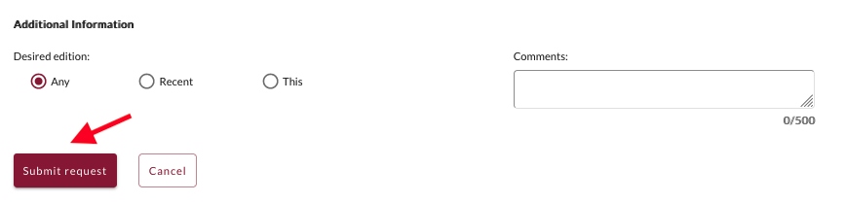
Notes:
At the bottom of the form, you will see an “additional information” section. You can add in any other information pertaining to the request and/or specify the desired edition.
Submit request.

Slide 25
Notes:
At the bottom of the form, you will see an “additional information” section. You can add in any other information pertaining to the request and/or specify the desired edition.
Submit request.

Slide 26
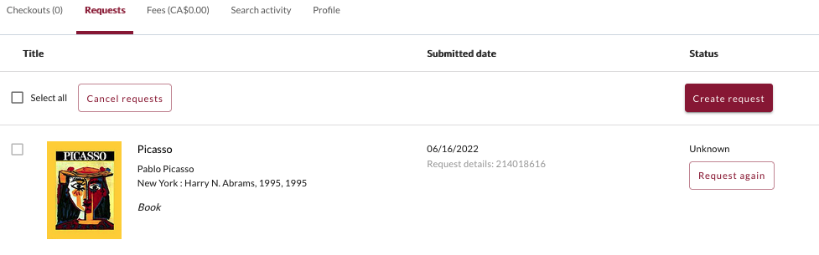
Check the status of your request under the "Requests" tab.
Notes:
The request can then be found in the requests tab, along with the status. I will show you examples later on of all the different kinds of statuses a user might see, along with how they can monitor their requests.
This "unknown" status shows up for a few moments right after placing a request, it will update quickly to a "submitted" status.

Slide 27
You will receive email notifications when your ILL request is available for pickup or download.
Physical items can be picked up at the Circulation/Loans desks at either Vanier or Webster Library.
ILL requests can be borrowed for 30 days, with up to 4 automatic renewals, or until item is recalled.

Slide 28
Example – Request a book (blank form)

Slide 29
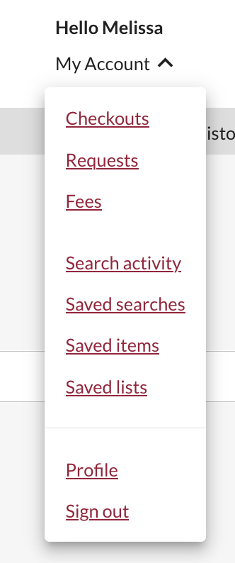
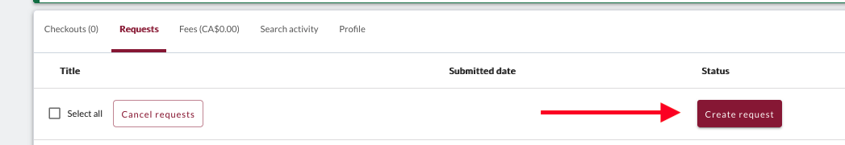
Sign in to "My Account" and select "Requests".
Click on "Create request".
Notes:
Some users might have all the information on hand for their request, or simply just have a difficult time finding the record in Sofia.
Their other option for placing a book request via ILL is to fill out the blank book request form.
Users will need to sign into their My account, and go to the requests option in the drop down menu. Then click on create request

Slide 30
Notes:
Submit the request and then the user can go to their requests tab to view all their requests.

Slide 31
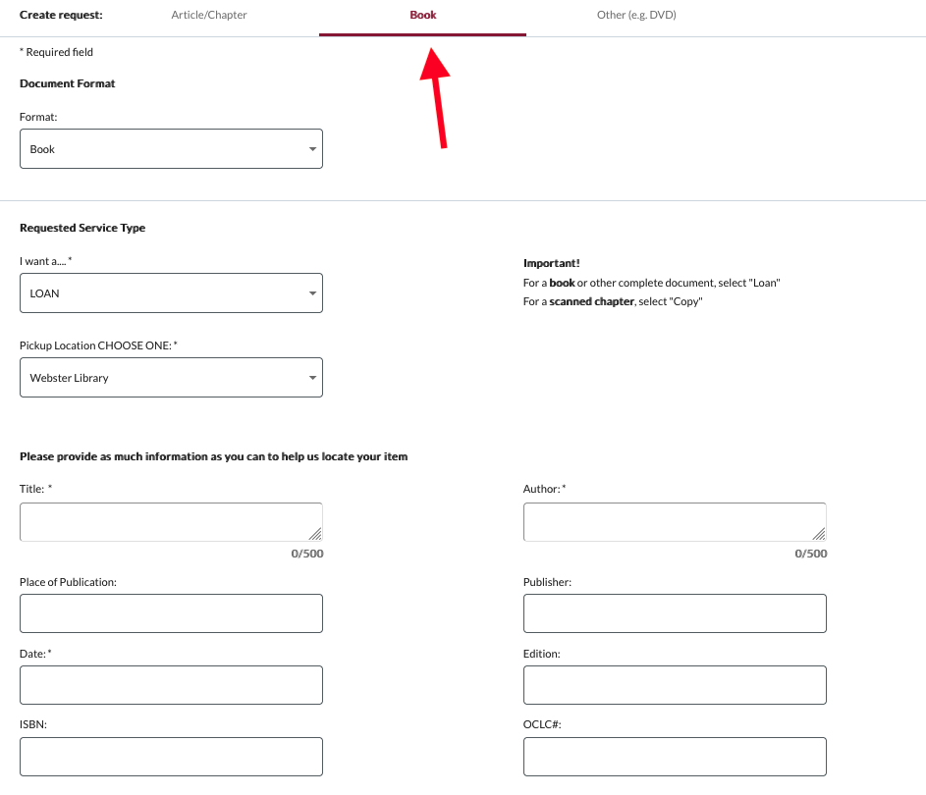
Select Webster or Vanier Library.
Notes:
Select the “Book” form. Fill out the form by providing as much detail as they can to help us locate the item. For the complete book, be sure to select “LOAN”. Select the desired pickup location.

Slide 32
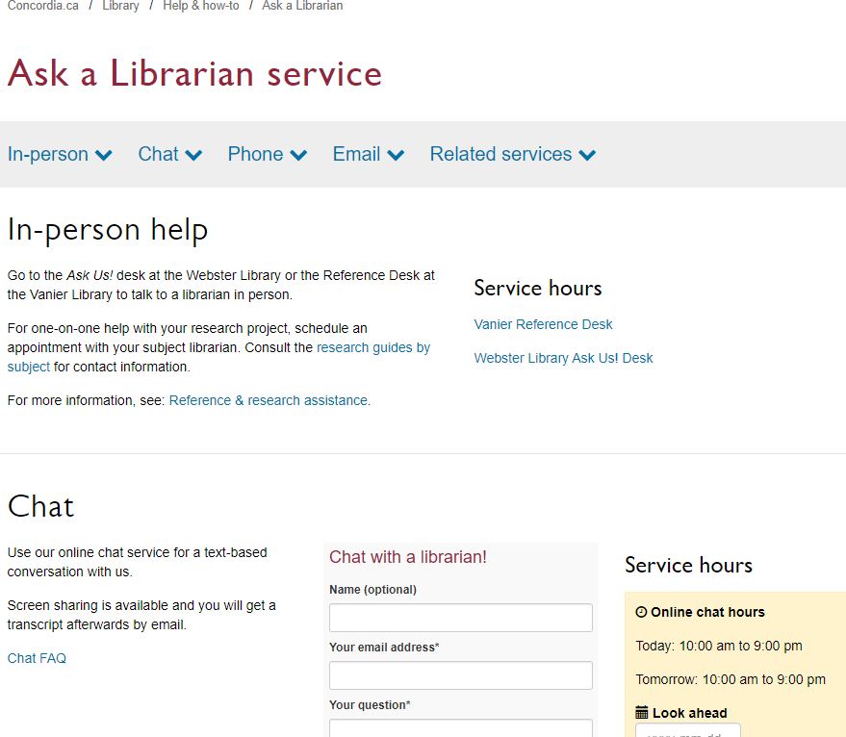
If you have any difficulty finding a document,
reach out!

Slide 33
What would you do to find this?
Dominguez Diaz, M. (2015). Women in sufism : female religiosities in a transnational order. Routledge.
Neubauer, A., & Sargut, C. (2016). ‘This is the age of women’: legitimizing female authority in contemporary Turkish sufism. Journal for the Academic Study of Religion, 29 ii, 150–166.

Slide 34
Searching for articles with the databases Academic Search Complete and Index Islamicus

Slide 35
How to find and access resources – Academic Search Complete

Slide 36
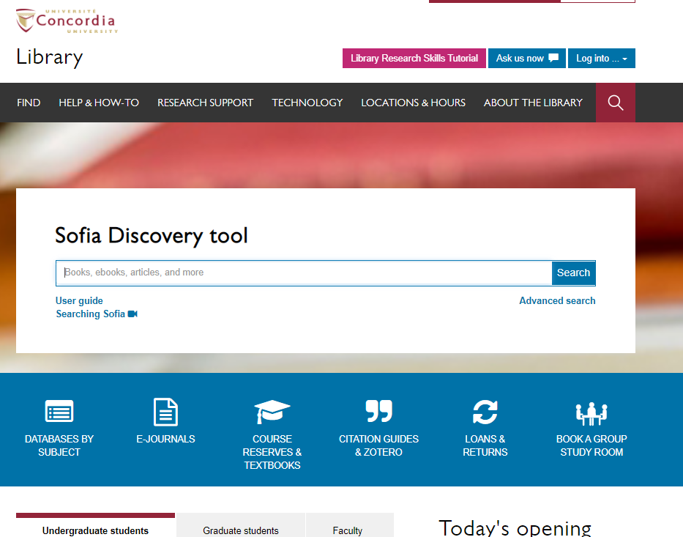

Slide 37
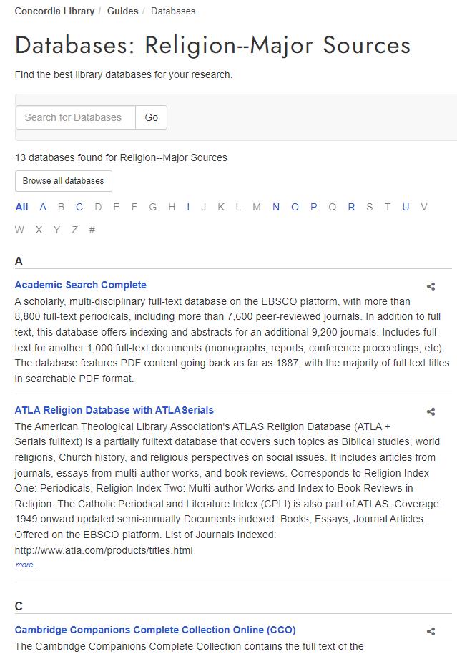

Slide 38
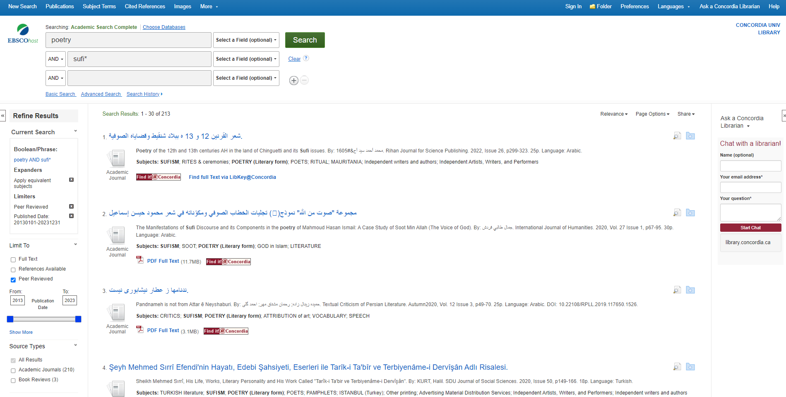

Slide 39
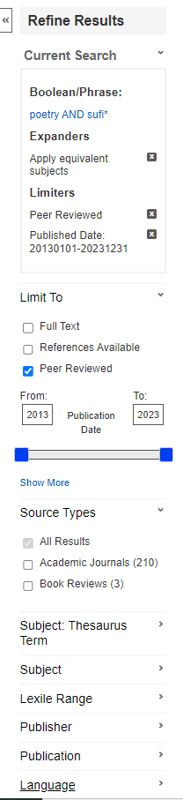

Slide 40
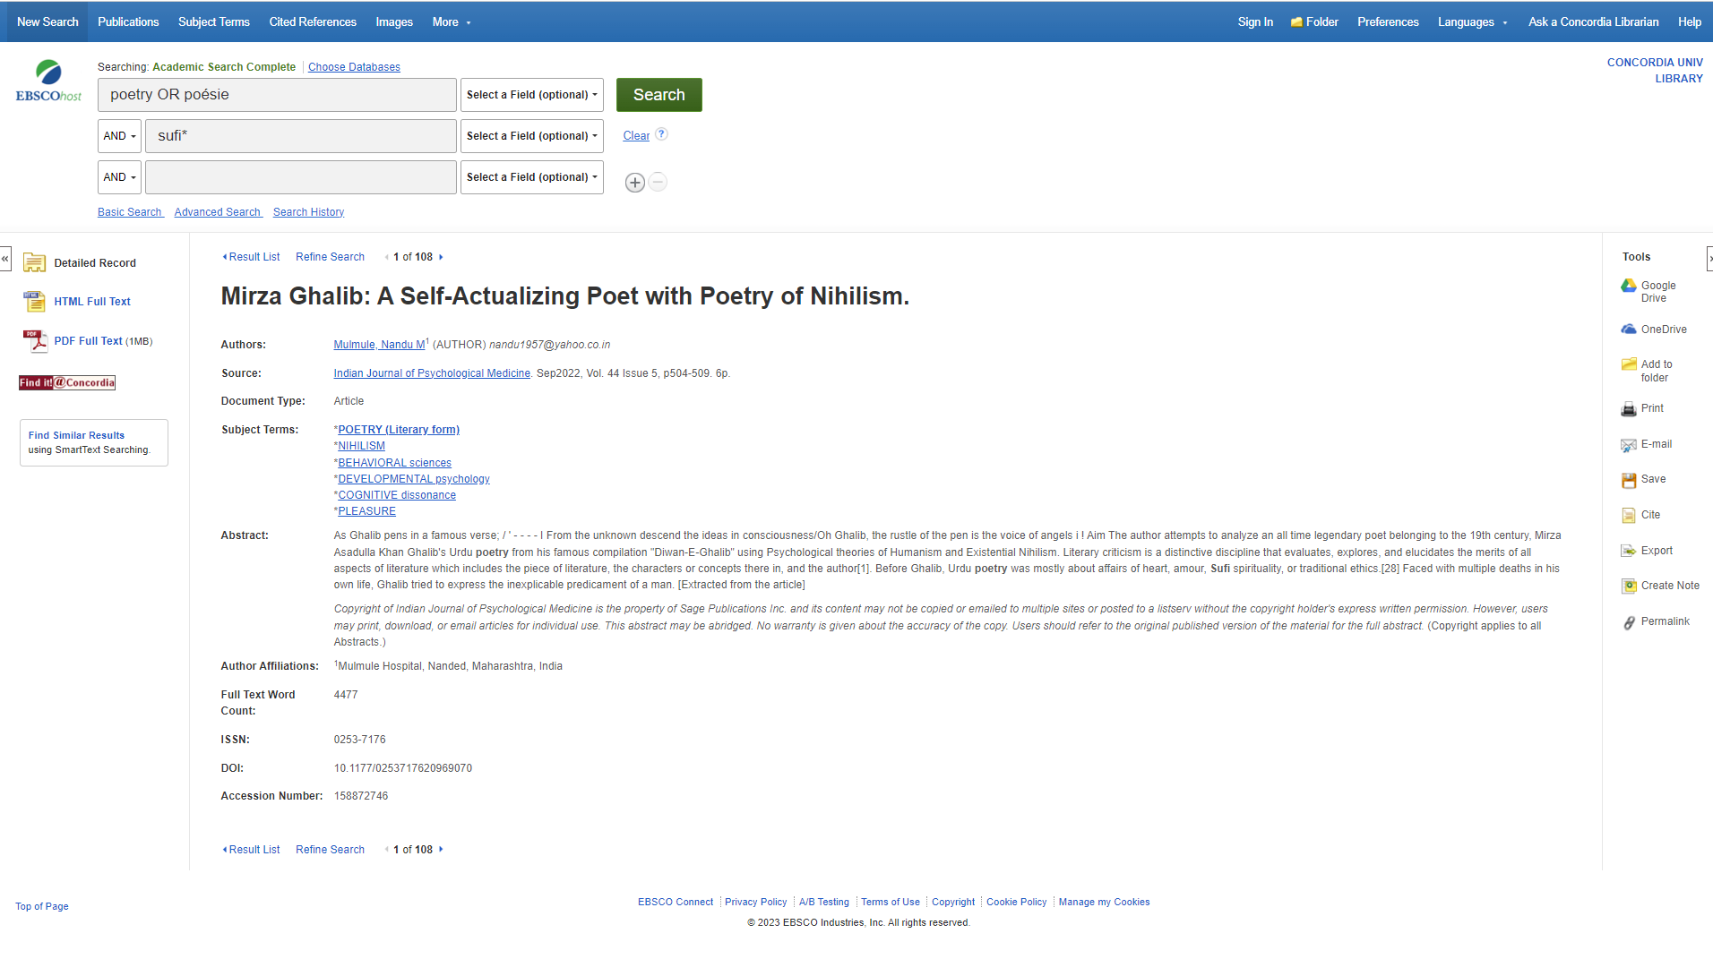

Slide 41
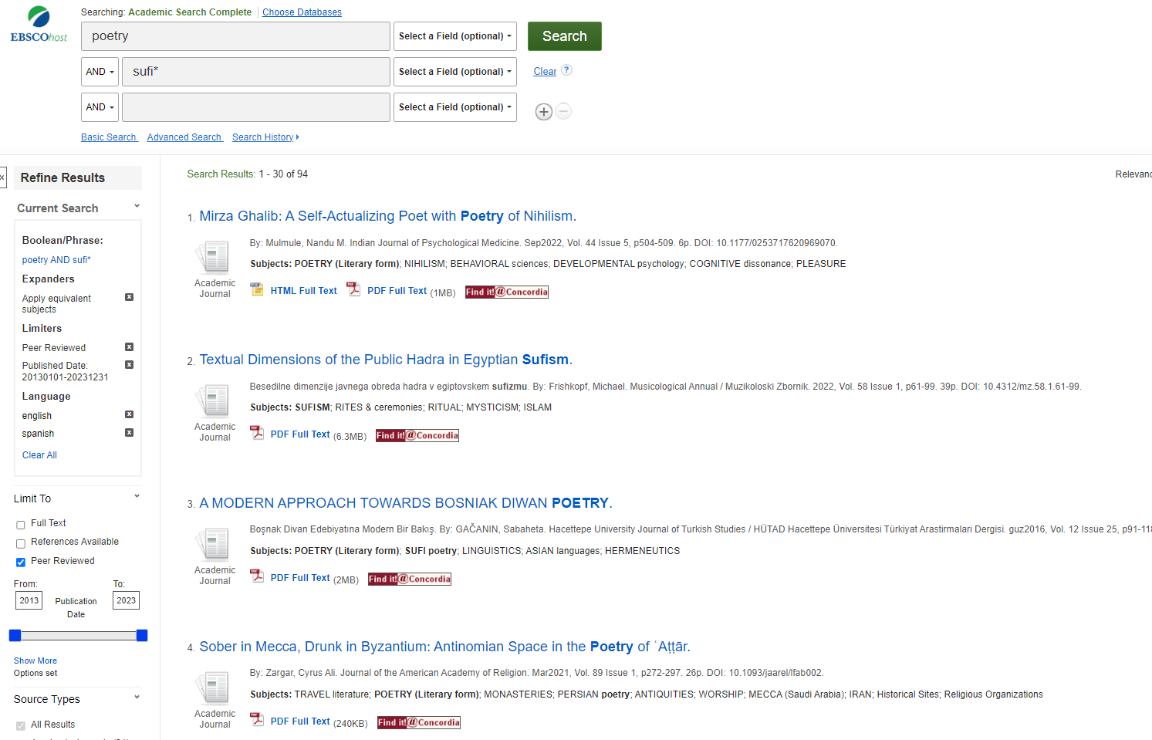

Slide 42
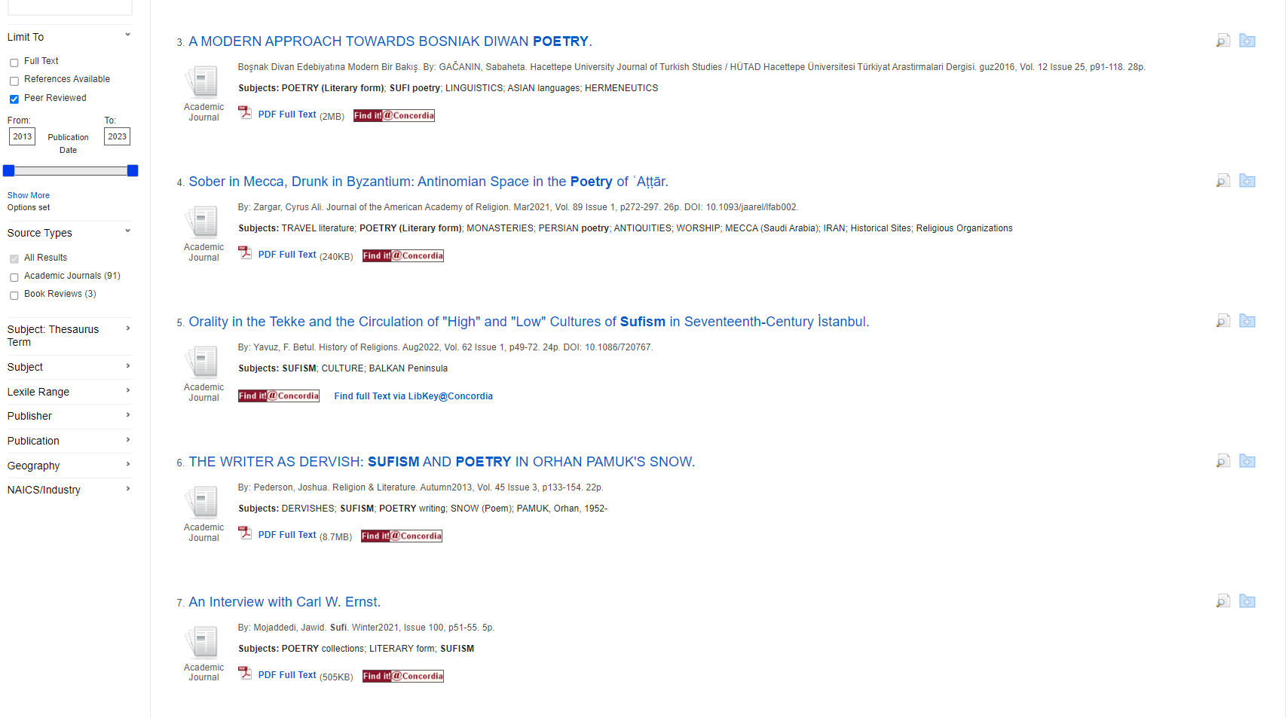

Slide 43
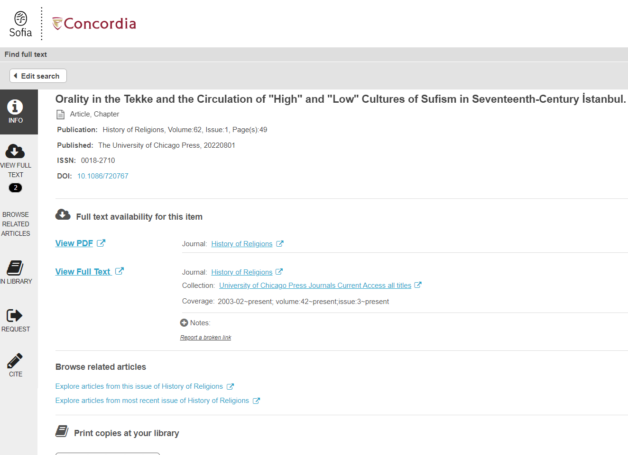

Slide 44
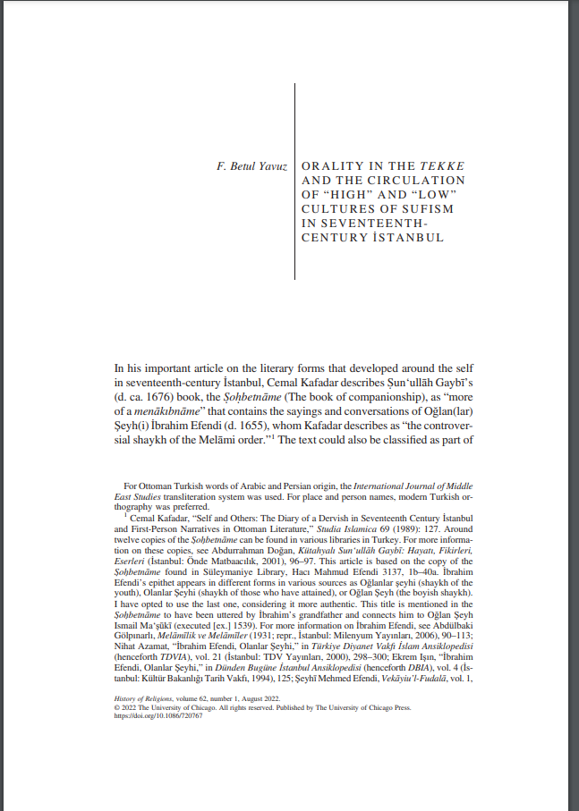

Slide 45
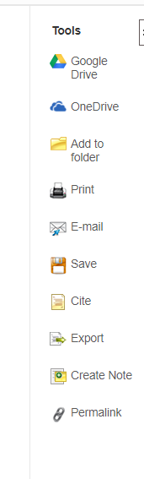
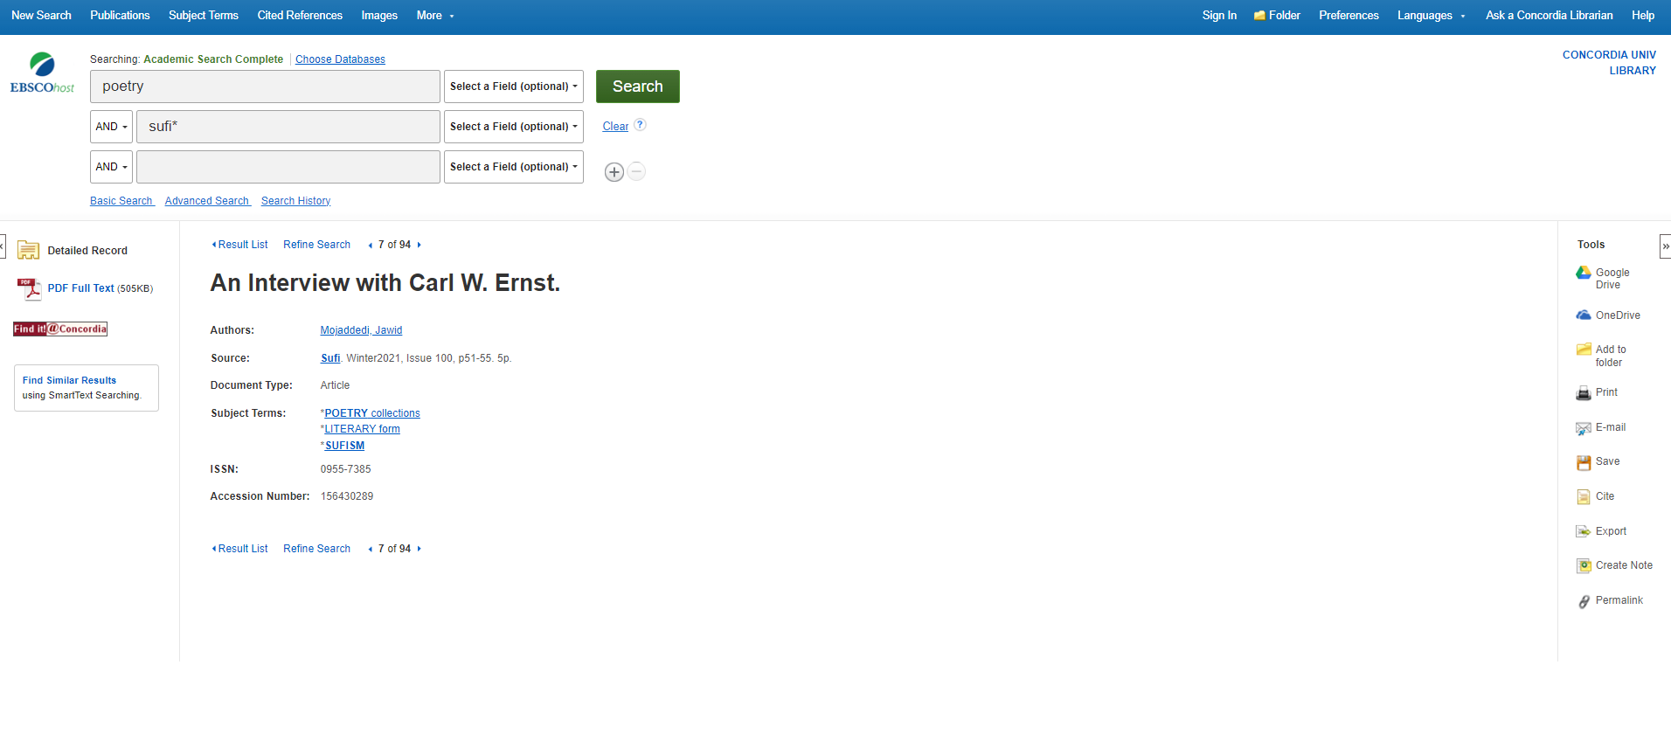

Slide 46
How to find and access resources – Index Islamicus

Slide 48
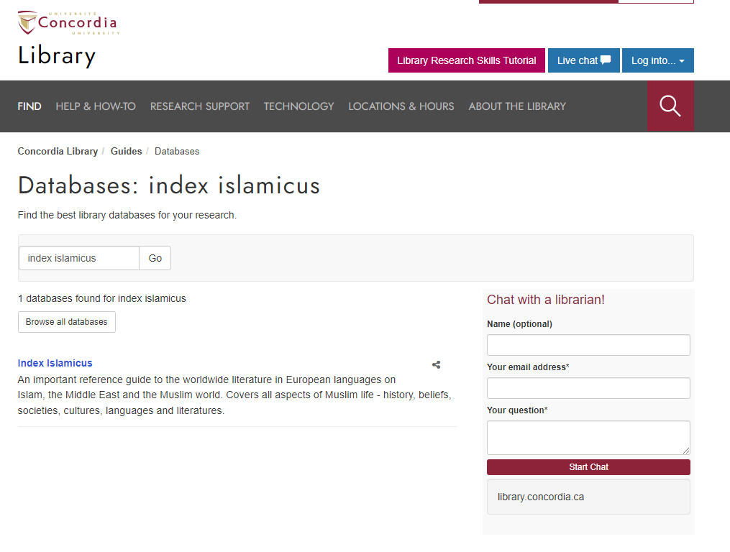

Slide 49
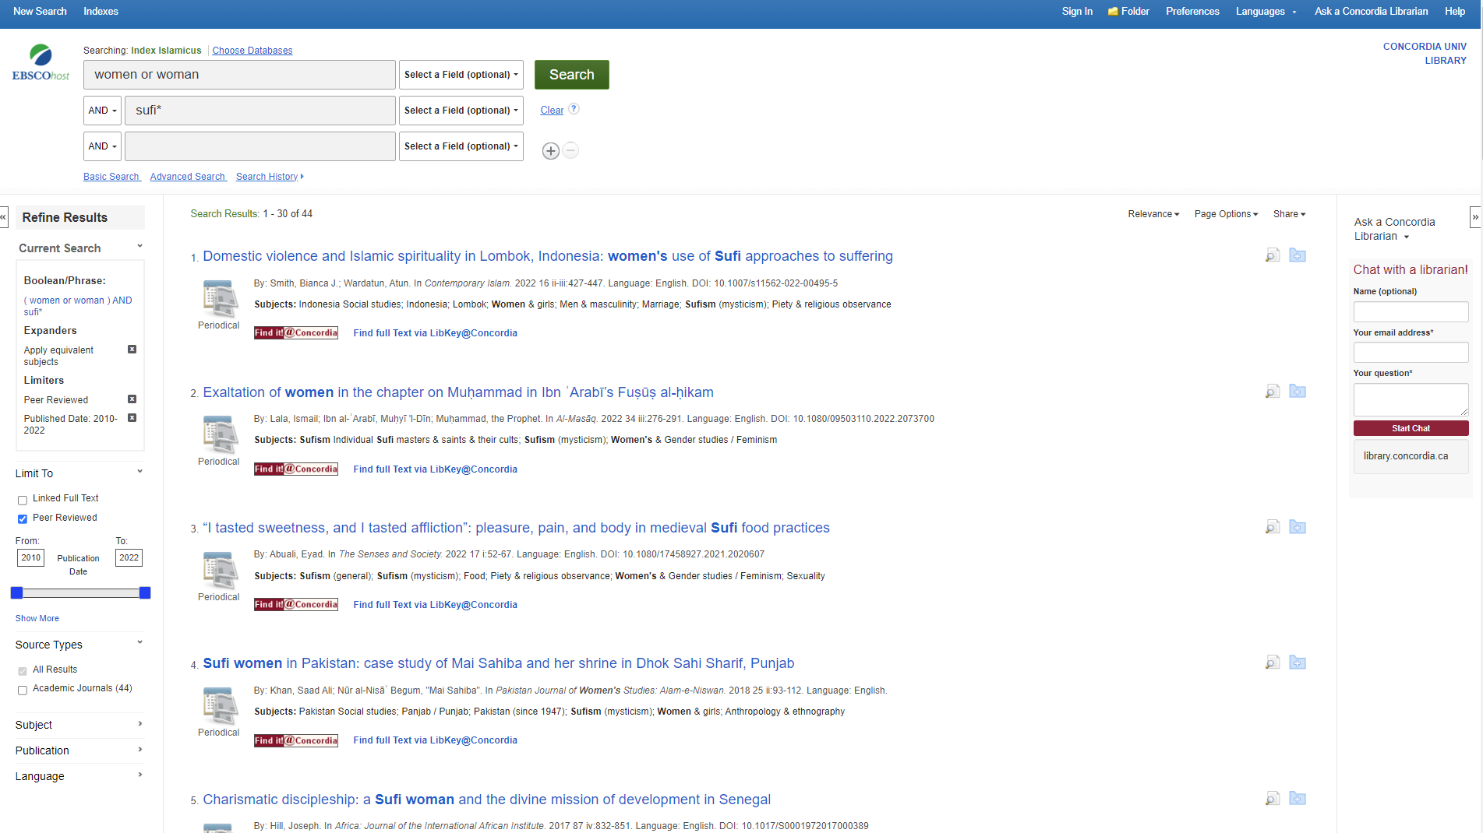

Slide 50
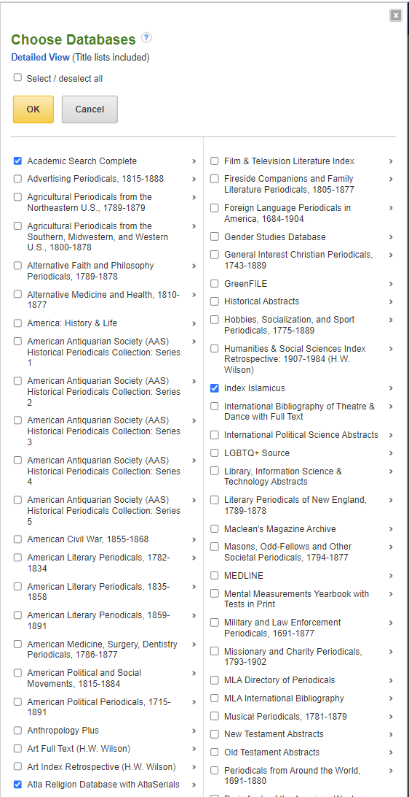

Slide 51
Encyclopedia - Oxford encyclopedia of the Islamic world : digital collection
https://concordiauniversity.on.worldcat.org/oclc/1321243045

Slide 52
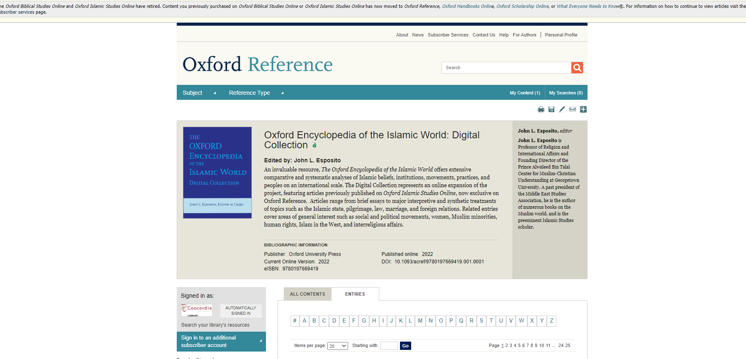

Slide 53
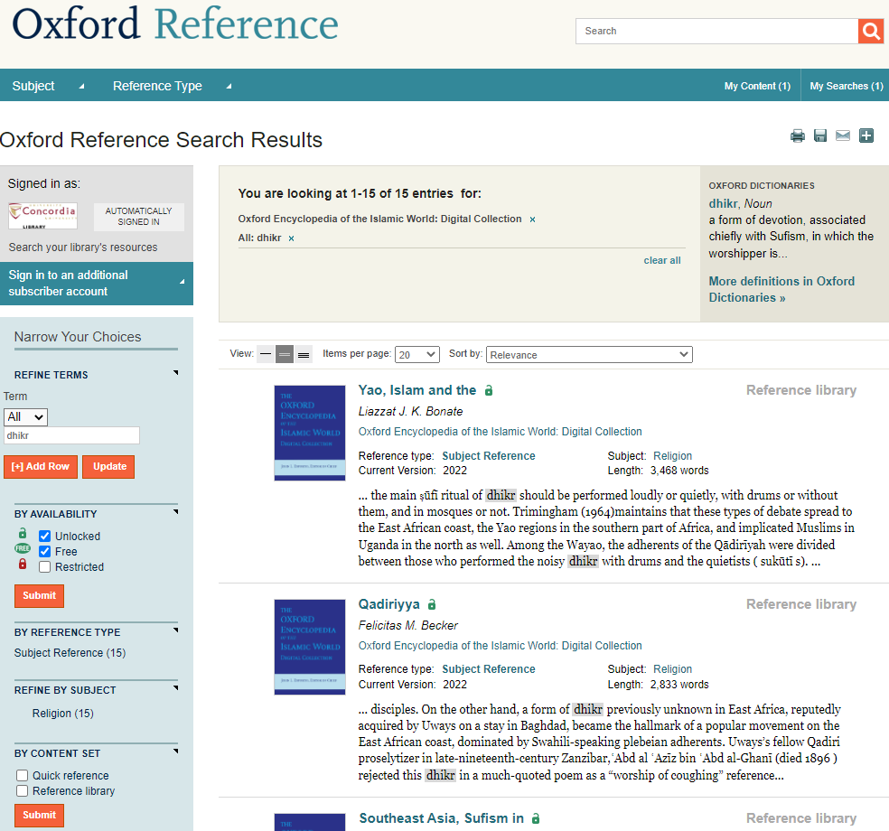
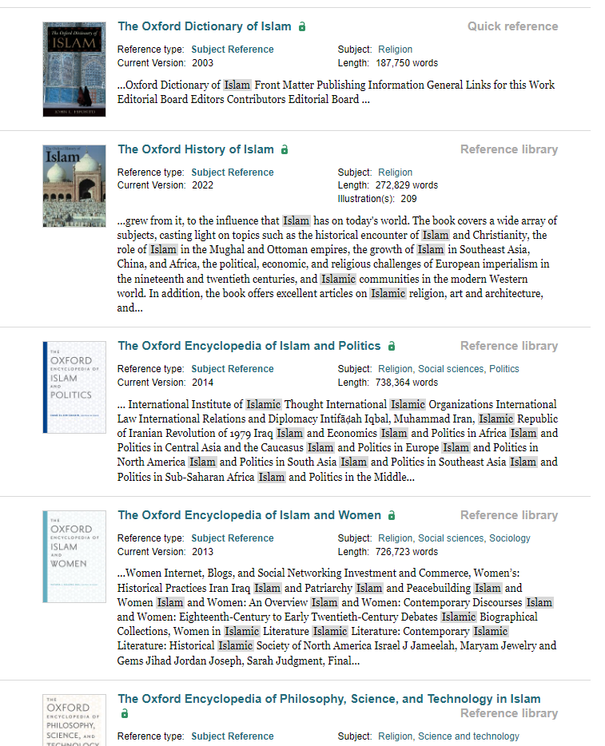

Slide 54

You have access to many resources!

Slide 55
General guides

Slide 56
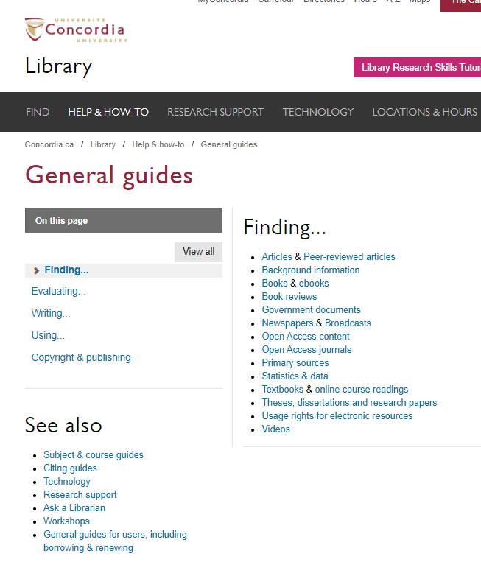


Slide 57
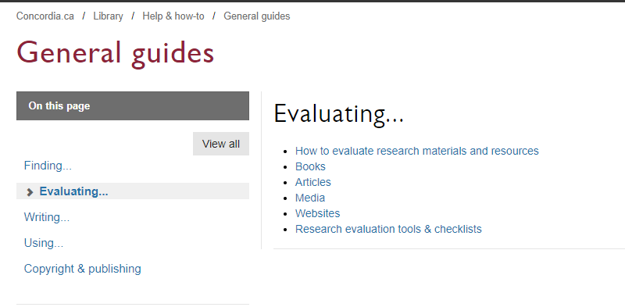


Slide 58
A word on generative AI

Slide 59
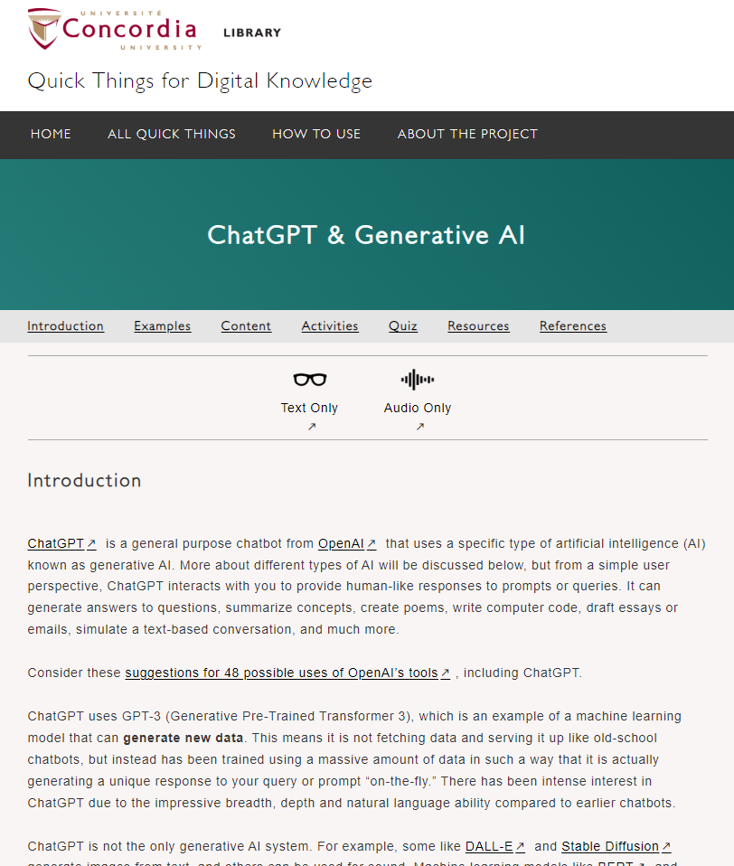
Pitfalls Of Generative Artificial Intelligence (AI)
Of note:
“[i]t identifies and imitates patterns, but it cannot verify information, leading it to routinely return absurdly incorrect information.”
“That said, to take full advantage of AI in your learning or work, you still need to understand your subject matter well enough that you can both guide the tool as well as critically assess its output. This means that generative AI tools like ChatGPT cannot replace the necessity of developing your own knowledge on a subject and exercising deep critical thinking skills.”
https://library.concordia.ca/apps/things/thing.html?thingID=22032

Slide 60
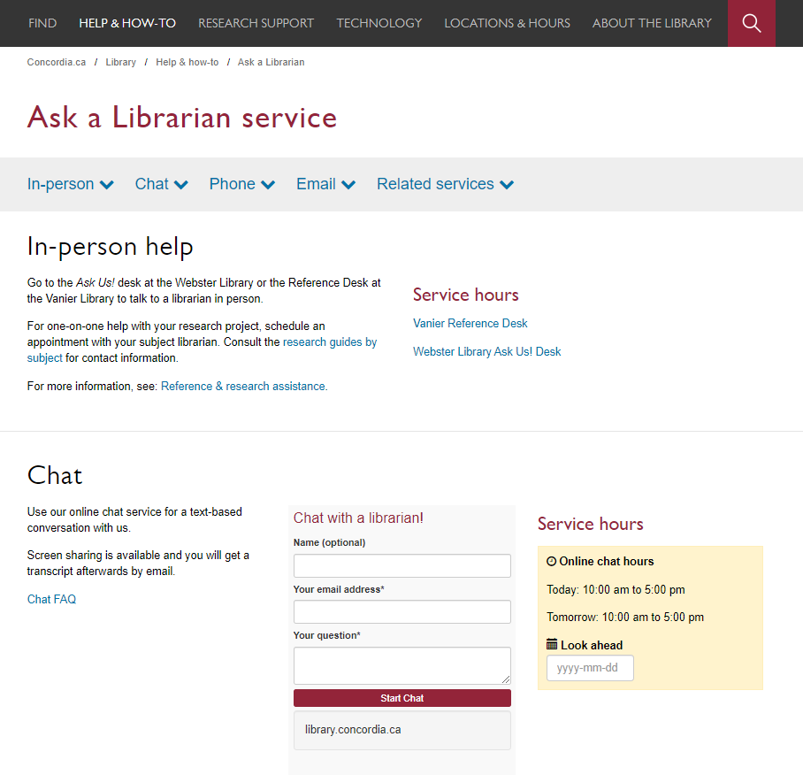


Slide 61

Questions? Comments?
Éthel Gamache
ethel.gamache@concordia.ca
Presentation and handouts will be on the subject guide,
https://www.concordia.ca/library/guides/religion/courseguides.html

