Slide 1
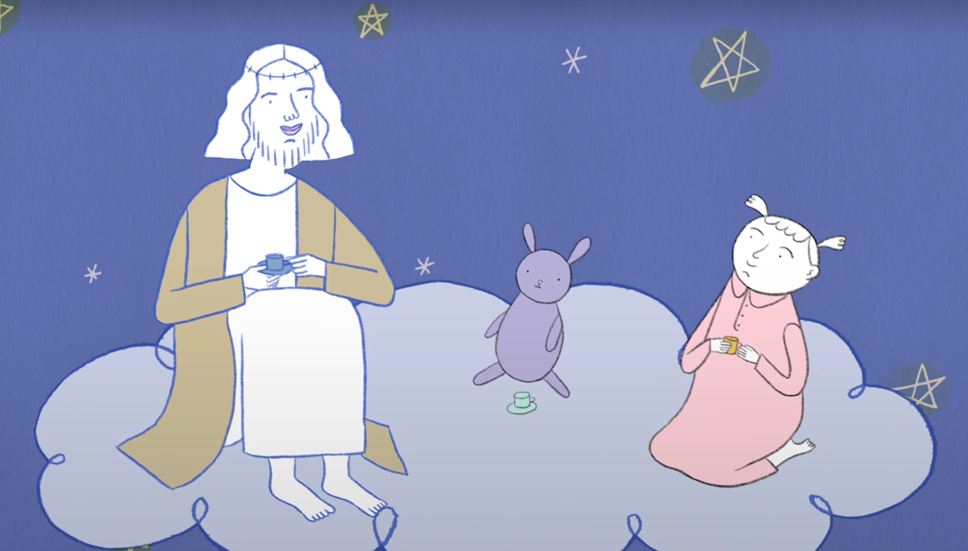
RELI 209
The Religious Imagination
Library Workshop
Tuesday, September 15, 2026
By your subject librarian: Éthel Gamache
ethel.gamache@concordia.ca
Image source: Sweet Jesus, by Lori Malépart-Traversy

Slide 2
Agenda
Our plan for this morning:
Ice-breaker activity
Library spaces and services
Searching for information
  Via Sofia, the Library search tool
  Via databases
    Academic Search Complete
    ATLA
    Google Scholar
Citing
Ask a librarian!
Notes:
Ice-breaker activity – introverts friendly : )

Slide 3
Ice-breaker activity
Move your fingers
Touch your head
Play air piano
Wave
Take a bow
Clap your hands
I use or have used library services.
I know how to evaluate a source (is it reliable, of good quality?).
When I search for articles, I often find what I’m looking for.
I prefer to use Google / Scholar to find scholarly articles.
I have attended a library workshop before.
I’ve met with a librarian to find relevant sources for an assignment.
This activity was created by K-Lee Fraser, University of Toronto Scarborough, K-Lee's Remixed Information Literacy Games. (unpublished)

Slide 4
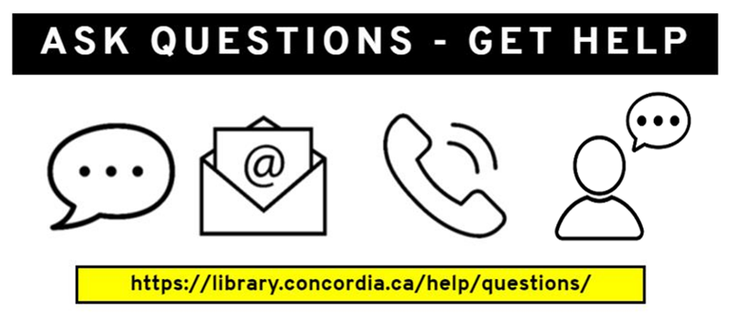
The Library is here to help with all your research needs!
Notes:
Remember that there are lots of specially trained people here to help! You can contact the library by chat, by email, by phone, or in person at the ask us desks in both libraries. Remember that you can also look up your subject librarian and send them an email or set up a meeting if you need more specialized help.

Slide 5
Library spaces and services

Slide 6
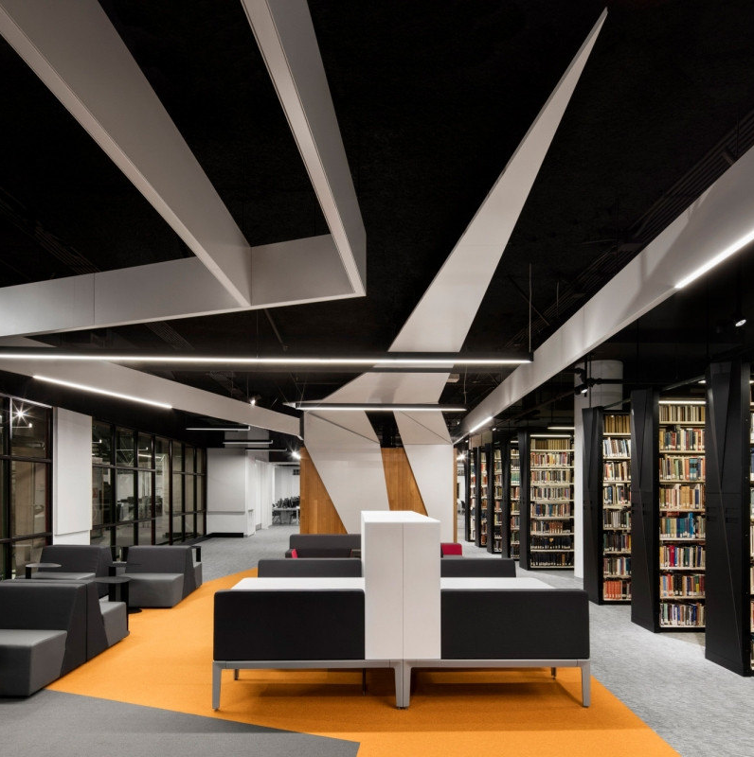
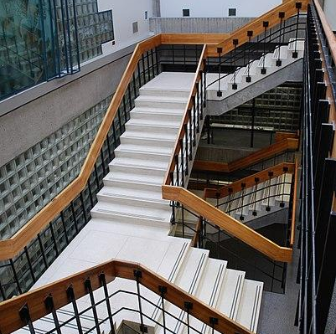
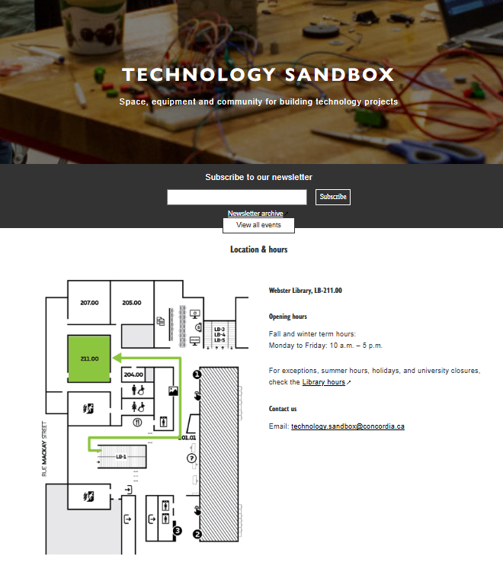
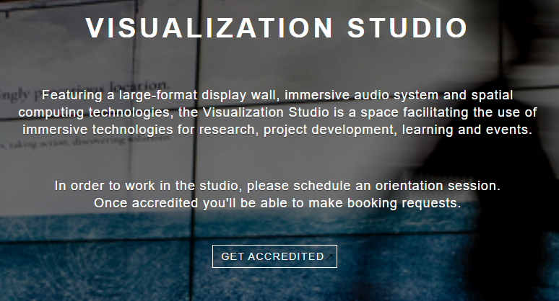
Library Spaces
Webster
Vanier
Notes:
At the Concordia University Library, you will find two buildings: Webster library at the downtown or the SGW campus, and the Vanier library which is at the Loyola campus.
[Show of hands – how many of you have visited one of Concordia’s libraries?]

Slide 7
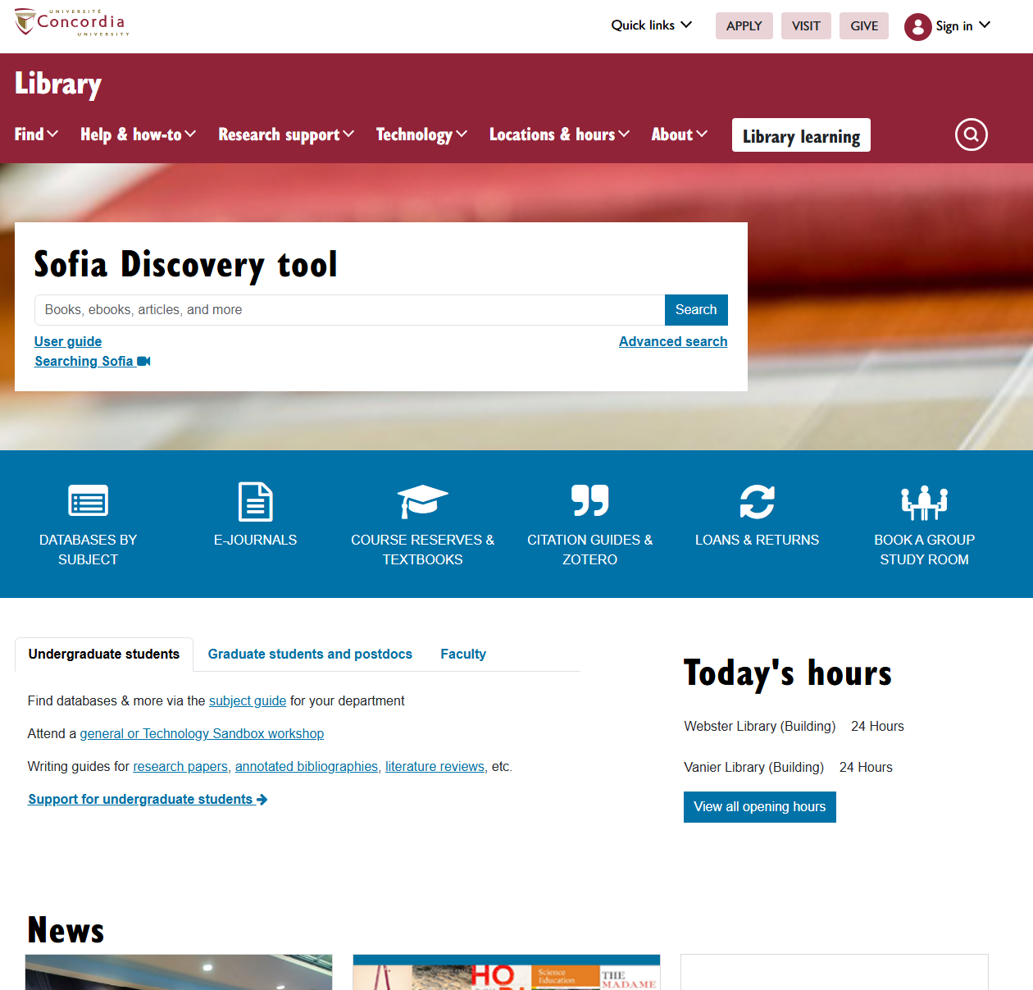
Library Website
Library homepage: library.concordia.ca

Slide 8
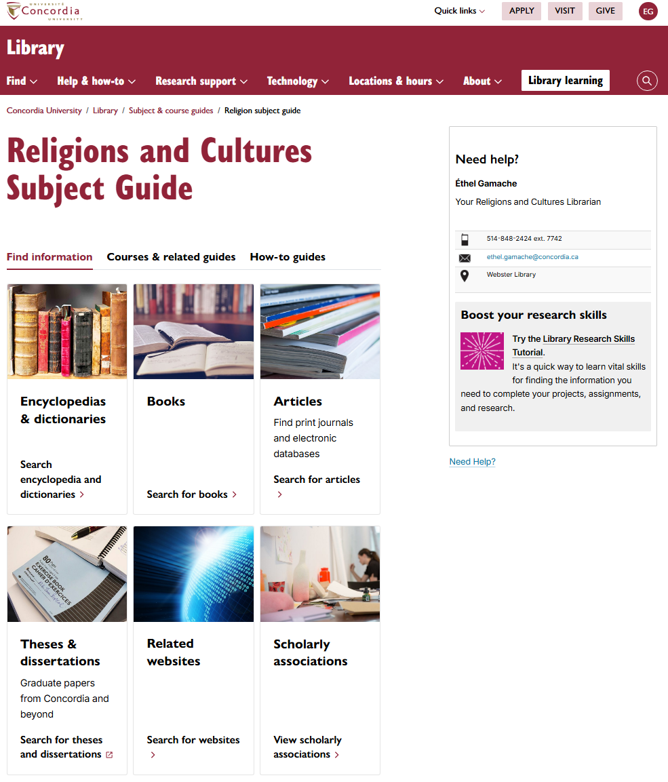
Research guide
Religions and Cultures Subject Guide
https://www.concordia.ca/library/guides/religion.html

Slide 9
Searching for information

Slide 10
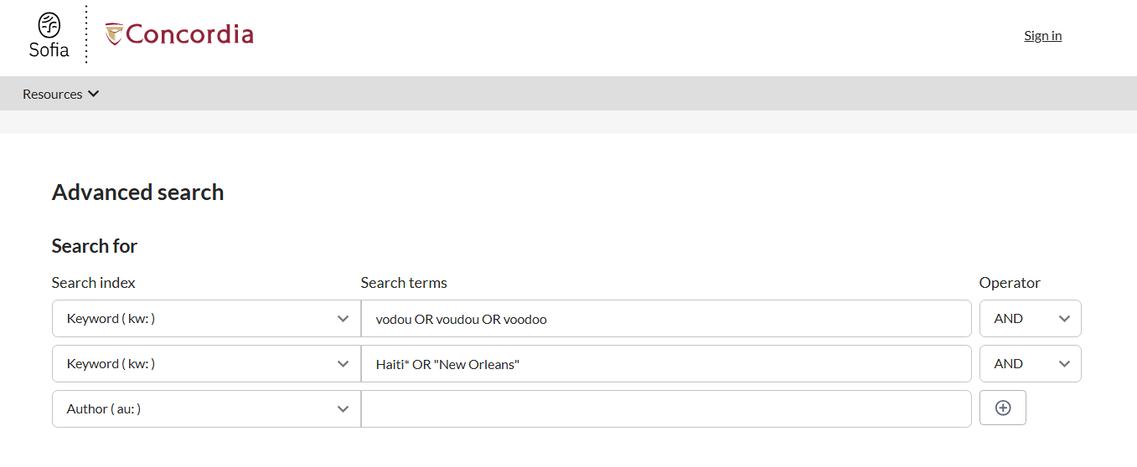
Sofia
Sofia Discovery tool
https://concordiauniversity.on.worldcat.org/discovery

Slide 11
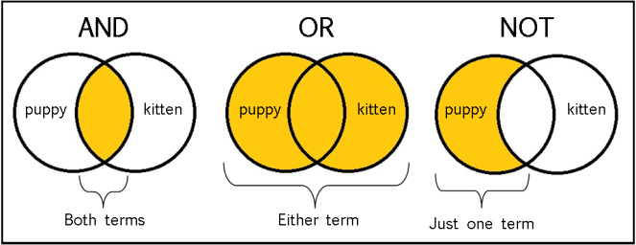
Boolean search operators
Image source: Library Of Antiquity. « Forgotten Skills: Boolean Searches ». The Library of Antiquity, 8 octobre 2016. https://libraryofantiquity.wordpress.com/2016/10/07/forgotten-skills-boolean-searches/.

Slide 12
Other Search operators
  Exact phrase searching
  Quotation marks (” ”) are used to search for an expression in its exact form (phrase searching). They are useful for expressions containing more than one word. For example, “rite of passage”or “black Christ” will find these words written together, without their variants, in that order.
  Truncation
  The asterisk (*), placed at the end of a word, replaces 0, 1 or more characters. For example, chat* will find chat, chats, chatte, chaton, but also château, Chateaubriand, Châtelaine... It will not, however, find matou, félin, or lynx. Another example: relig*: religion, religions, religare, religious, religieux, religieuse.

Slide 13
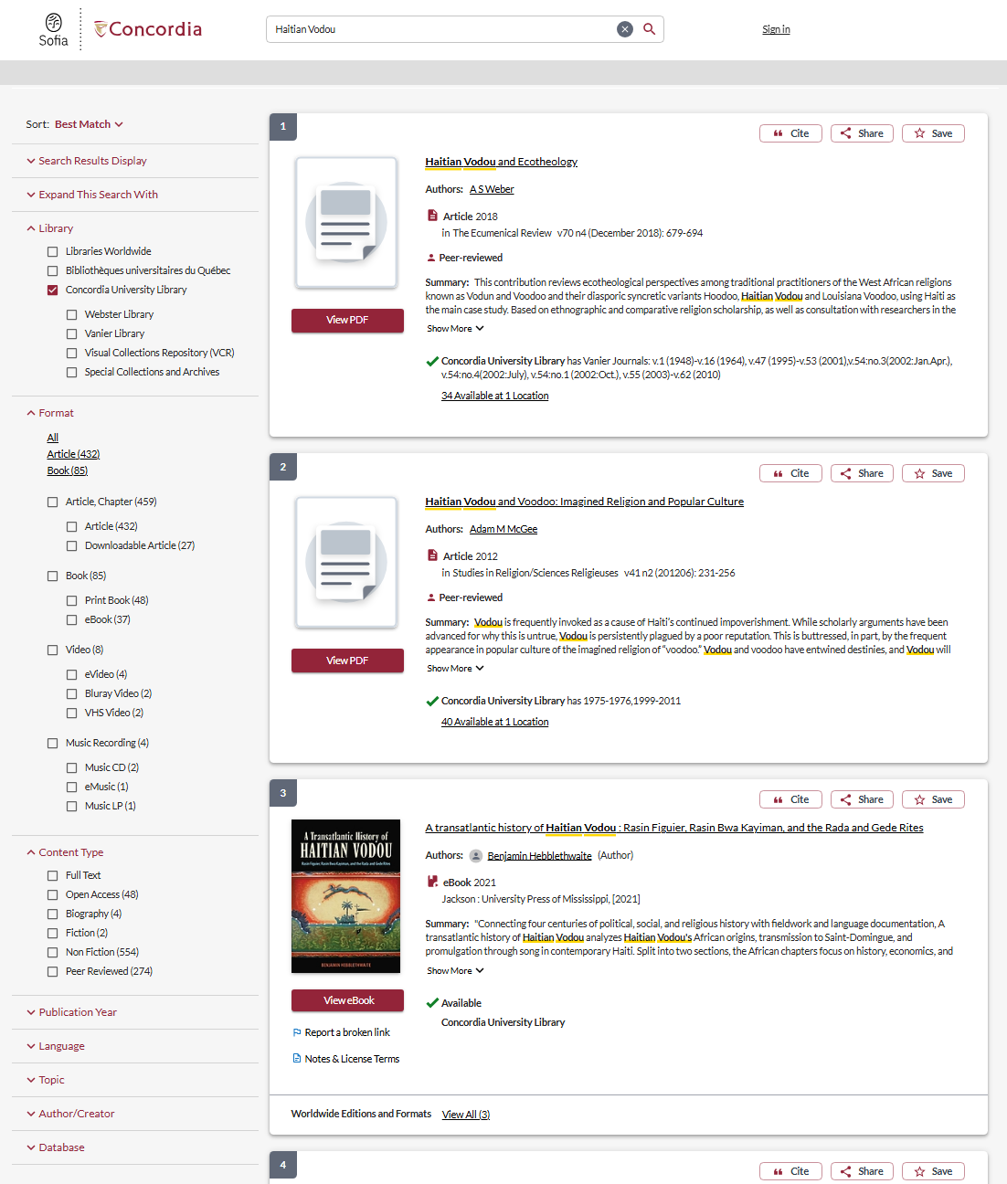

Slide 14
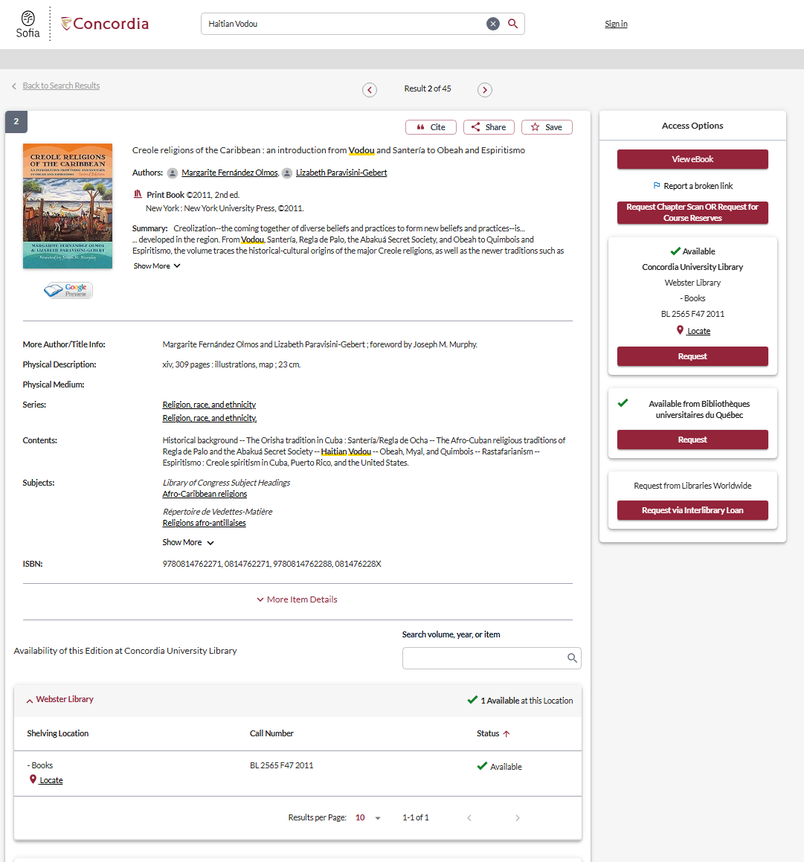

Slide 15
How would you search for…
Douglas, Kelly B. “The Roots of the Black Christ,” in The Black Christ, (25th Anniversary edition), NY: Orbis, 2019, pp. 1 – 32
Any type of documents on:
  The Rapture (and limiting to religious documents)
  BDSM (in religions, religious views, …)
  Are you finding mostly books, ebooks, films, …?
Notes:
BDSM AND religions: 24 results; su=sexual dominance and submission AND relig*: 1 résultat
su:(Rapture (Christian eschatology) ) NOT su=Christian fiction, American

Slide 16
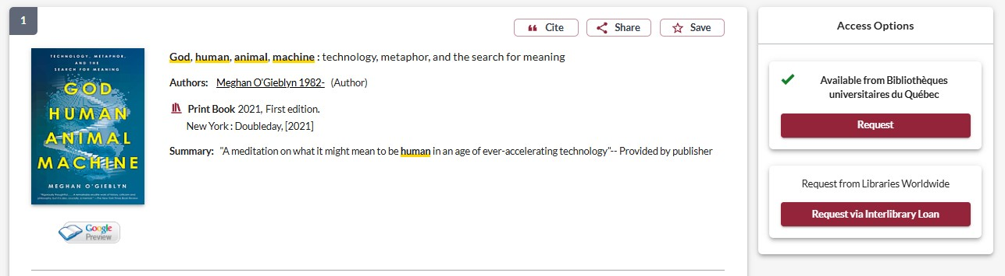
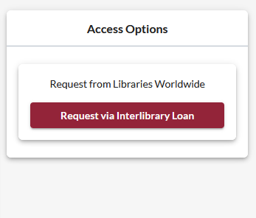
How to place an interlibrary loan request
Notes:
This is what the Interlibrary loan process will look like. The process for requesting a book through the Quebec universities is less complicated, so I will only show you the ILL request process for now.
Once you find what you need, you can place an interlibrary loan request by selecting the "request via interlibrary loan“ button in the panel to the right of the record. If the thing you’re looking for is just one chapter of a book, you can also request a chapter scan using the interlibrary loan request.

Slide 17
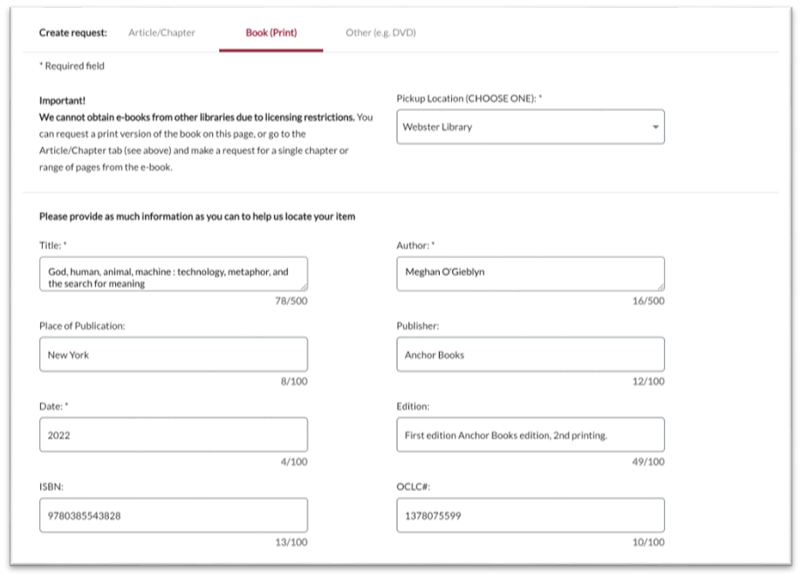
How to place an interlibrary loan request

Slide 18
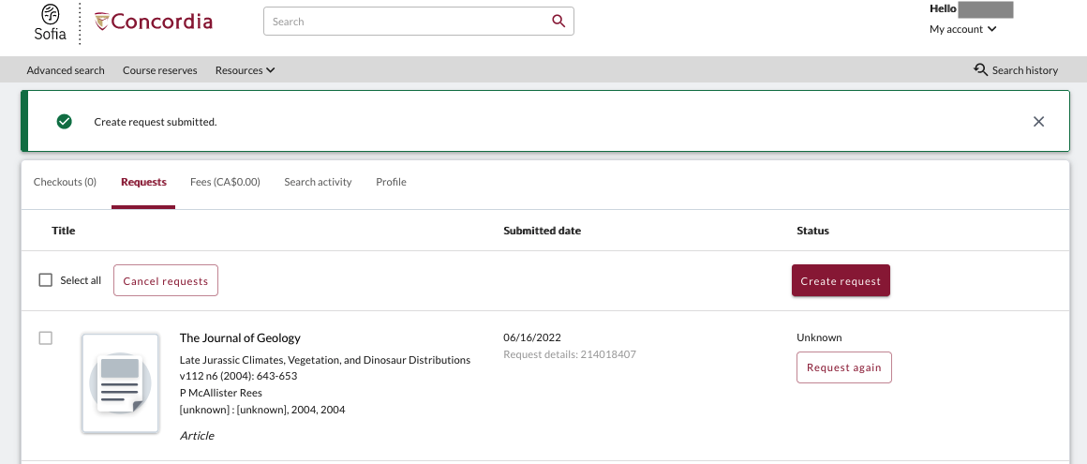
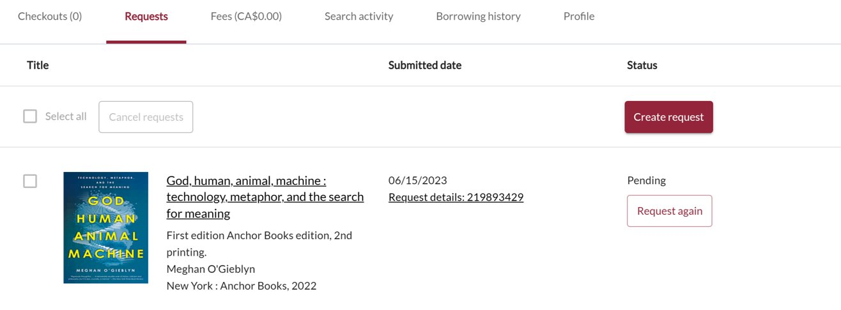
Notes:
Both kinds of requests – ILLs and scan requests – can be viewed under the requests tab when you log into your library account. The request up top here is for an article scan, the second is for a book through interlibrary loan.

Slide 19
Interlibrary Loans
The Interlibrary Loans service is free and illimited.
You will receive email notifications when your ILL request is available for pickup or download.
Physical items can be picked up at the Circulation/Loans desks at either Vanier or Webster Library.
ILLs can be borrowed for 6 weeks.

Slide 20
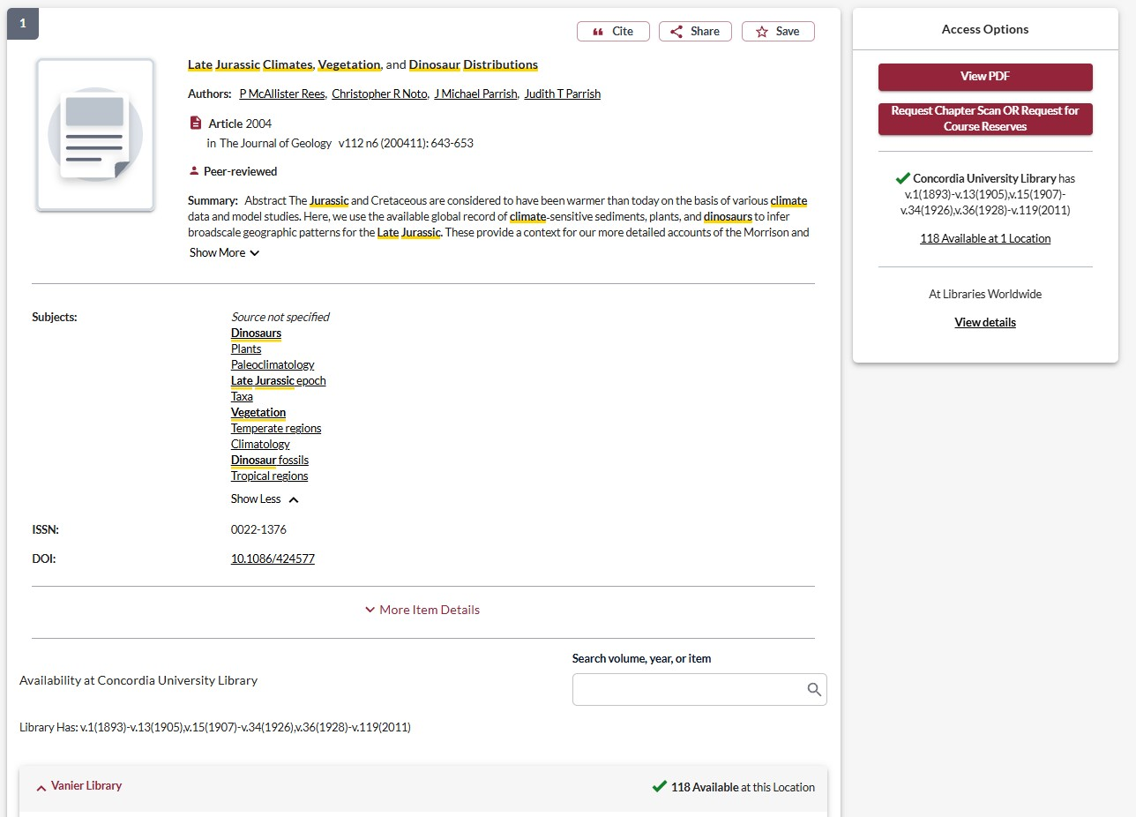

Chapter scan & course reserves
Notes:
You might also notice this button next to books in Concordia’s collection. You can use this to request scans of chapters, articles, or microfilm if you are unable to come to the library to consult them. It usually takes about 5 days to receive your scans after you place the request.

Slide 21
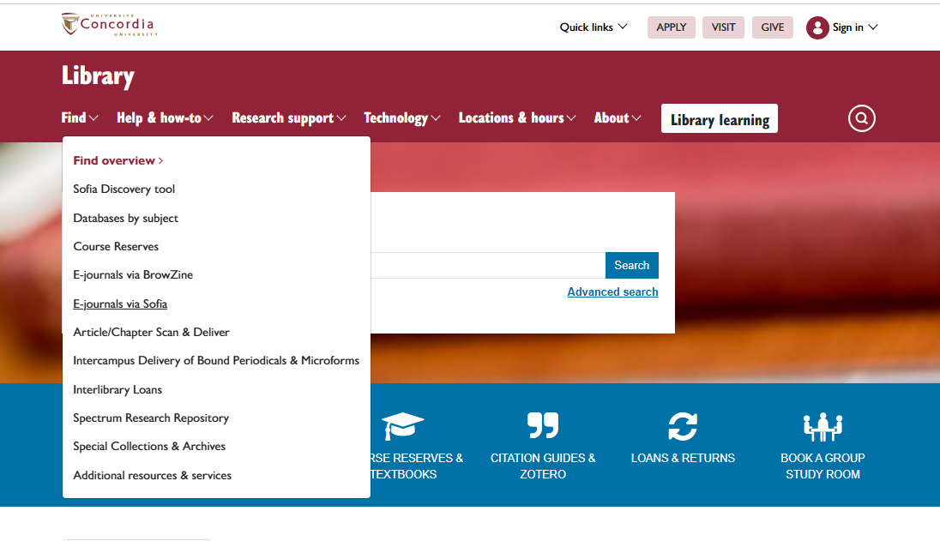
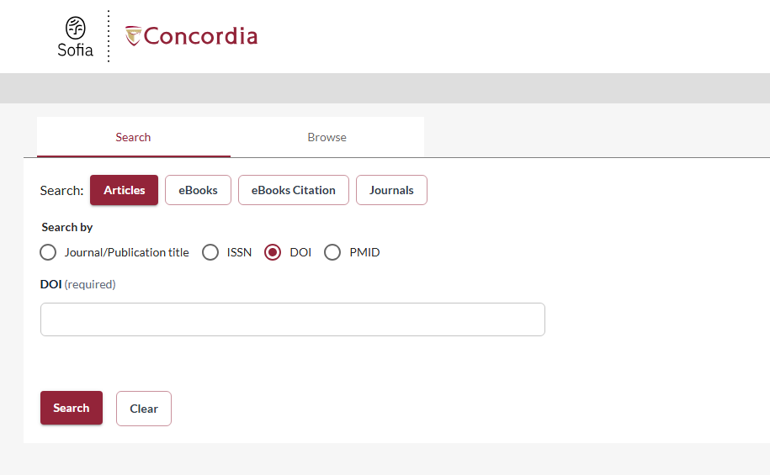
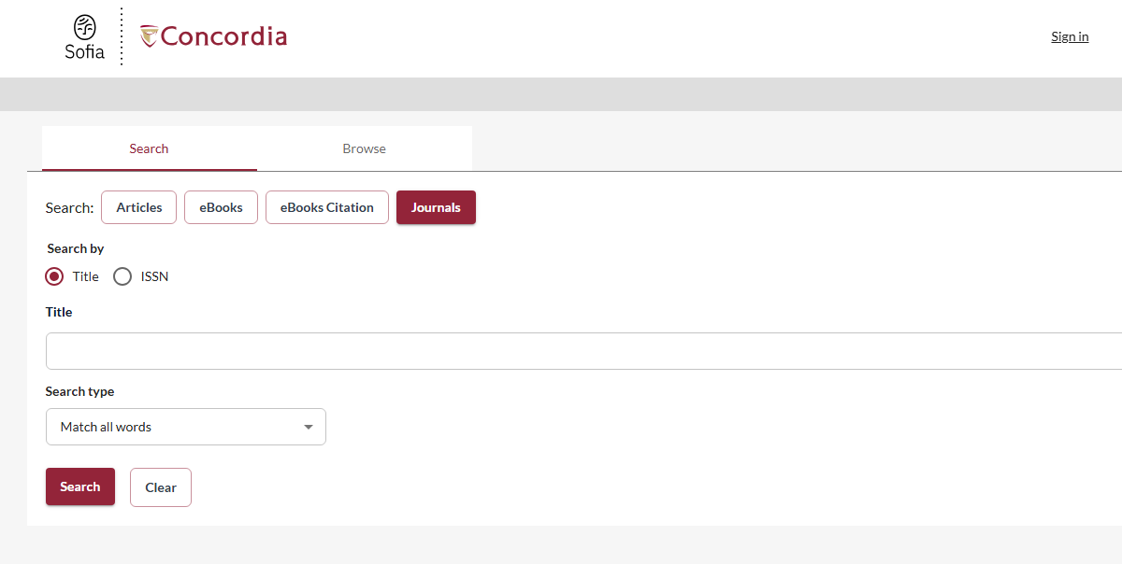
E-journal via Sofia

Slide 22
How would you search for…
Greenberg, Sam E. “Divine Kink: A Consideration of the Evidence for BDSM as Spiritual Ritual,” International Journal of Transpersonal Studies, 38(1), 2019, 220-35. https://doi.org/10.24972/ijts.2019.38.1.220
Ladin, Joy. “In The Image of God, God Created Them: Toward Trans Theology,” Journal of Feminist Studies in Religion, Vol. 34(1), 2018, pp. 53-58

Slide 23
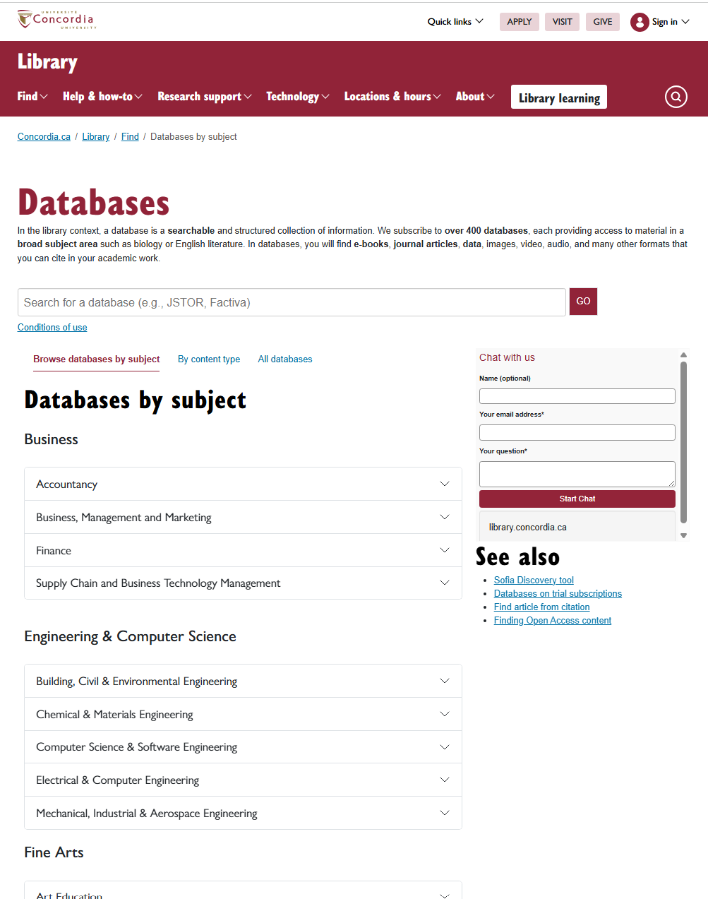
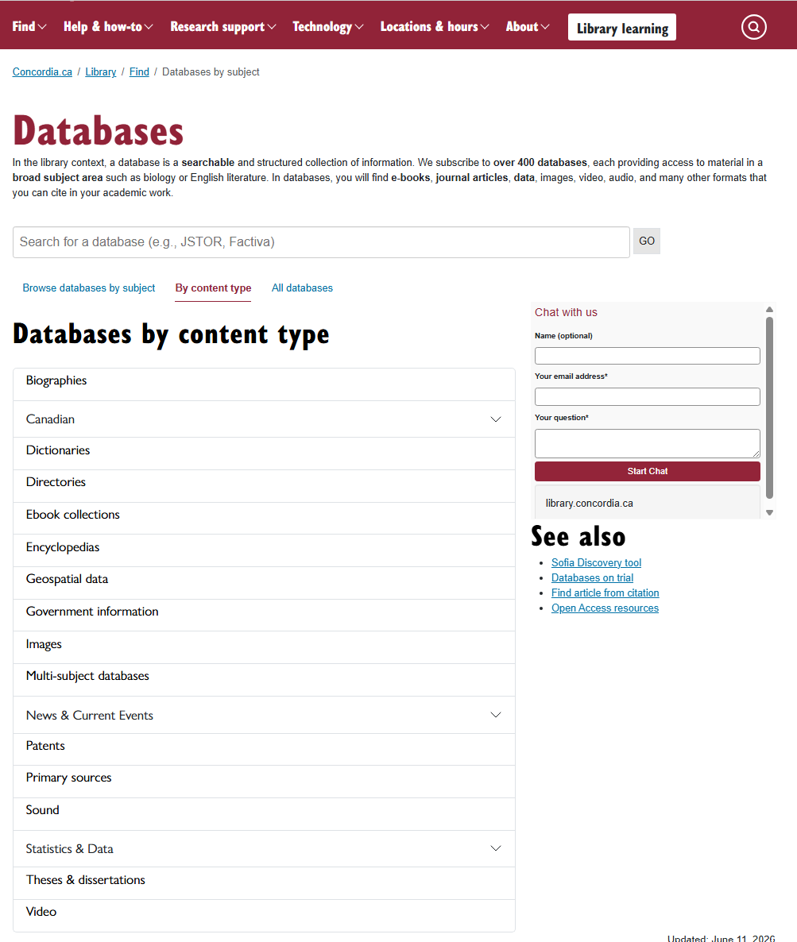
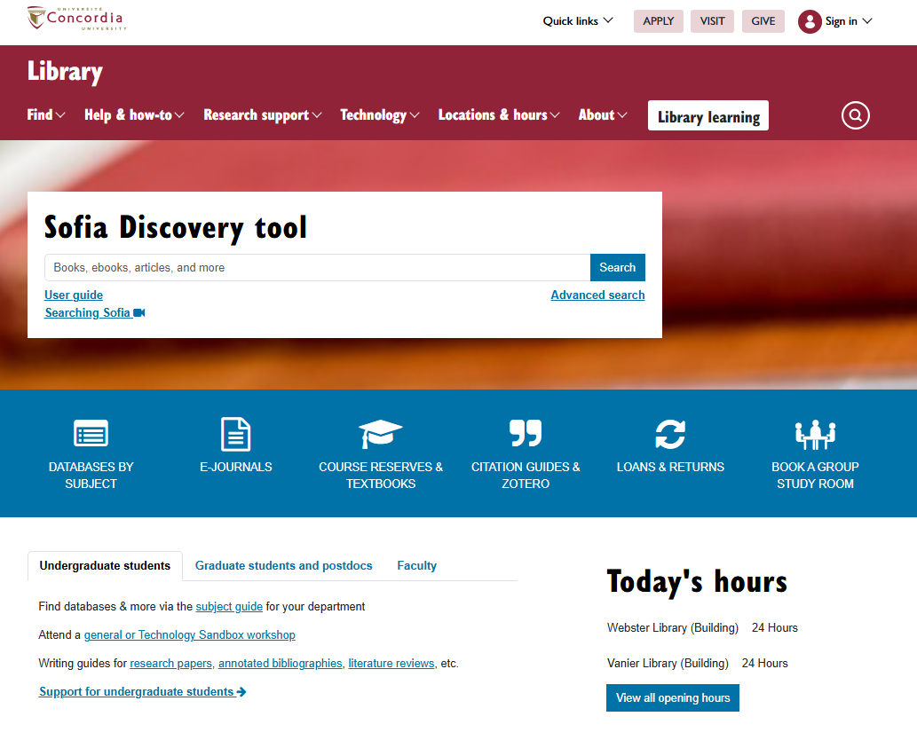
Databases
Notes:
ONF – Sweet Jesus

Slide 24
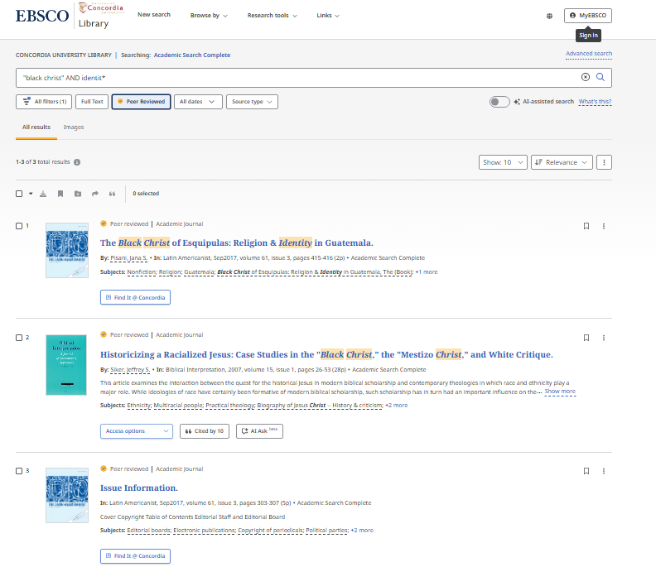
Academic Search Complete

Slide 25
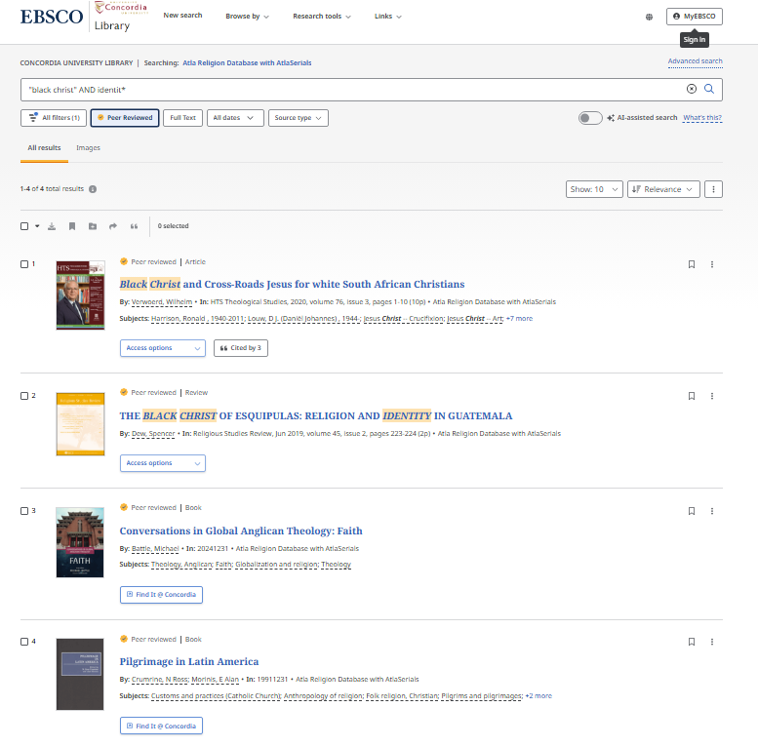
ATLA

Slide 26
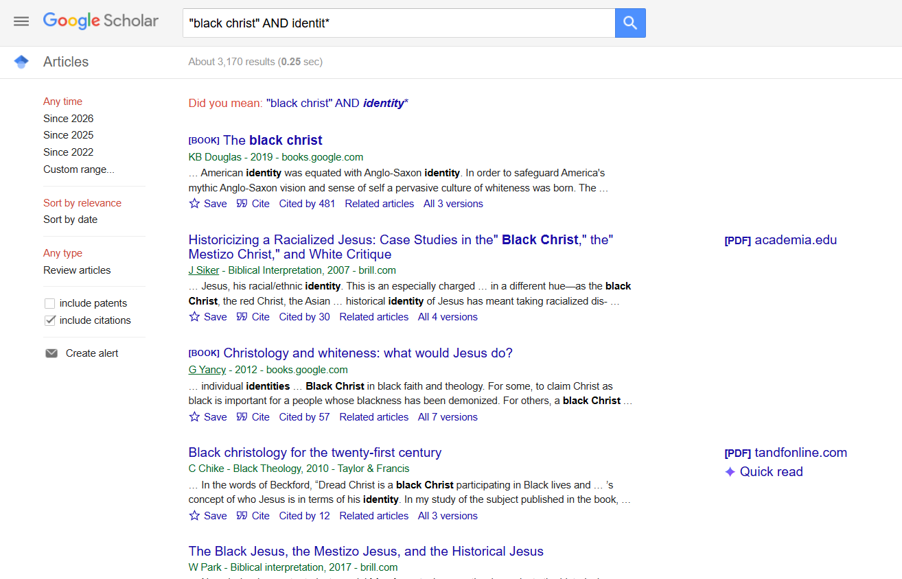
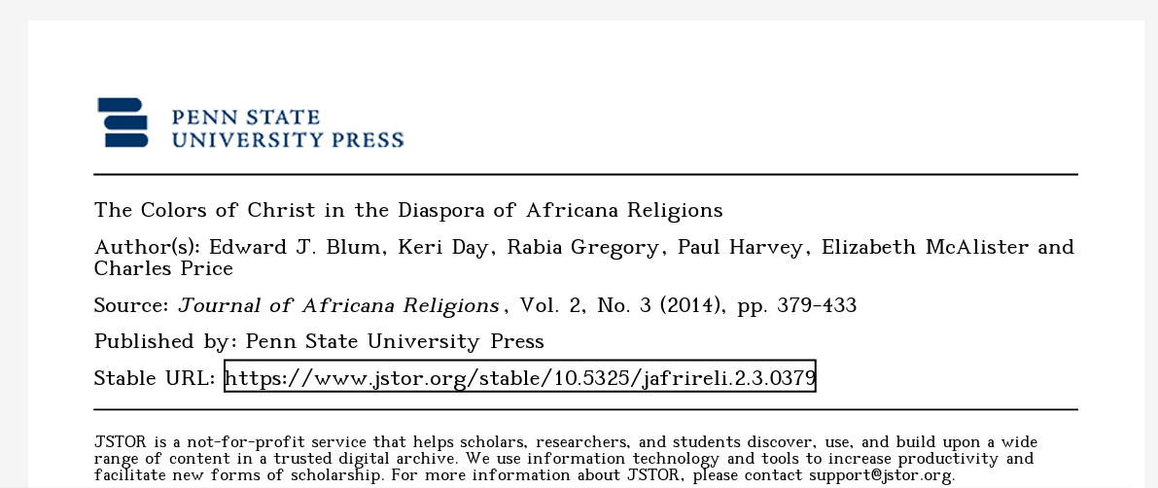
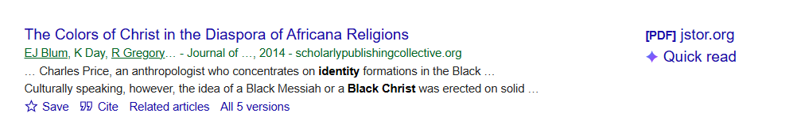
Google scholar

Slide 27
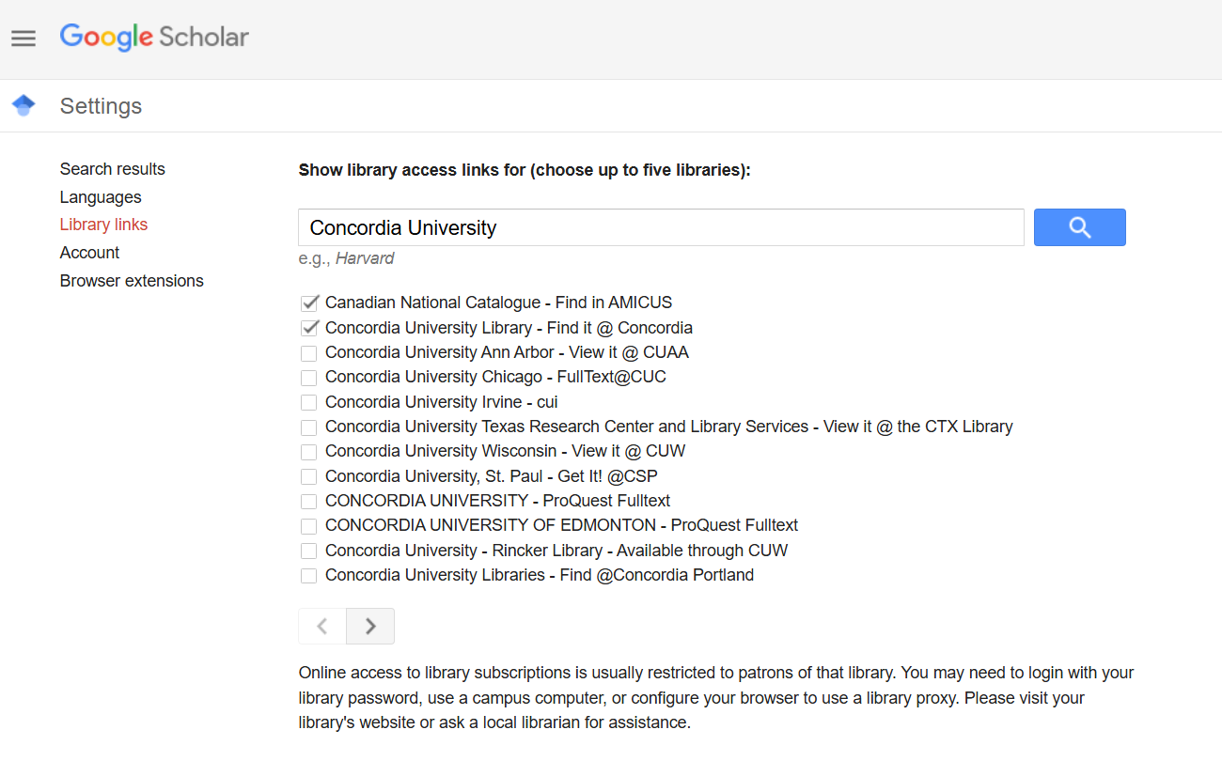



Connecting Google Scholar to the Library’s collections

Slide 28
Citing

Slide 29
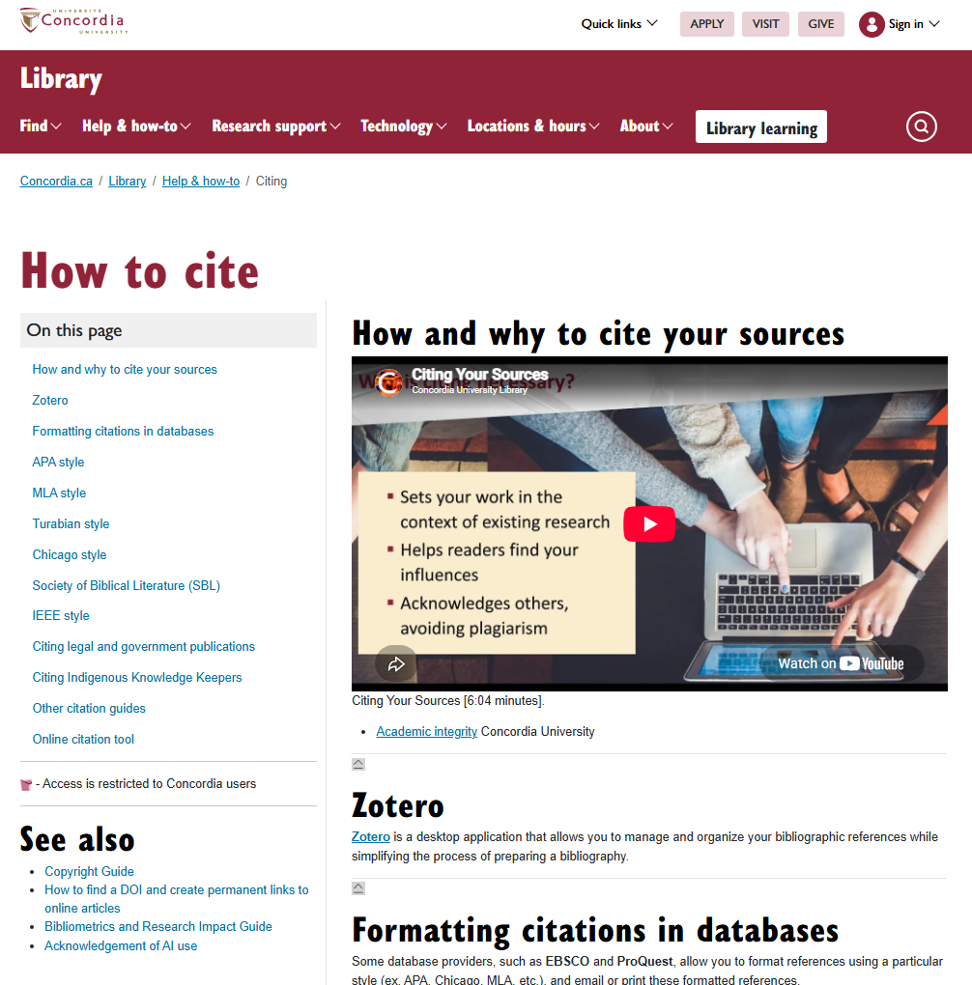
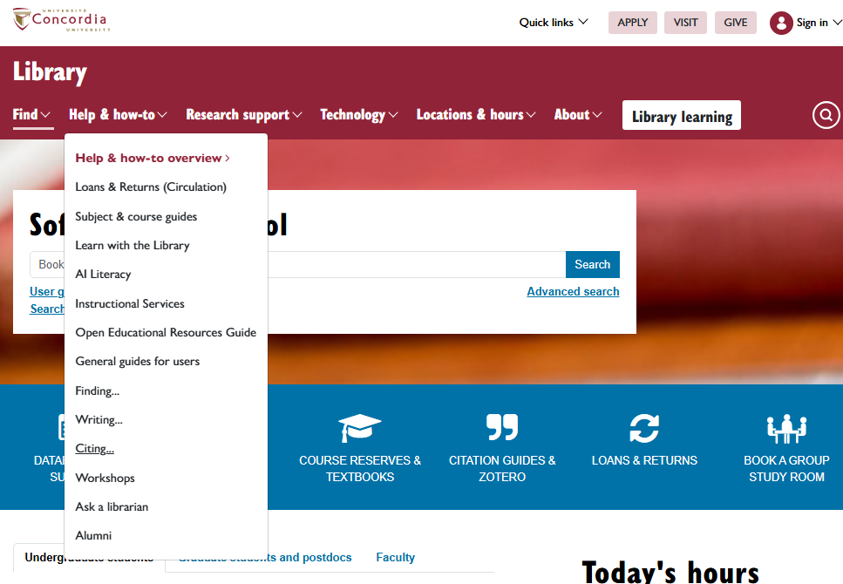
Citation help

Slide 30
Ask a Librarian

Slide 31





https://library.concordia.ca/help/questions/
Ask Us desk, chat, email or phone

Slide 32
Thank you for your participation!
Questions?
Éthel Gamache
ethel.gamache@concordia.ca

