Slide 1

Political Science Graduate Library Orientation
Michelle Lake
Subject Librarian for Political Science, School of Community and Public Affairs, First Peoples Studies and Government Publications
Michelle.Lake@concordia.ca

Slide 2
Your Subject Librarian
Who am I?
Michelle Lake, librarian for Political Science, the School of Community and Public Affairs, First Peoples Studies and Government Publications
Michelle.Lake@Concordia.ca / Book a one-on-one Zoom consultation or an in-person appointment
What do I do?
  Provide research support in consultations & teach workshops
  Academic research topics: search development & strategies, keywords, subject searching, library databases, journals and books
  Help you find and access materials, including scholarly materials, newspapers & media, government documents, grey literature, etc.
  Assist with citation issues
  Choose the books we buy for the above subject areas

Slide 3
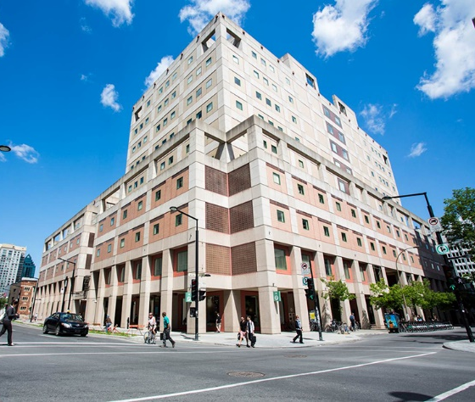
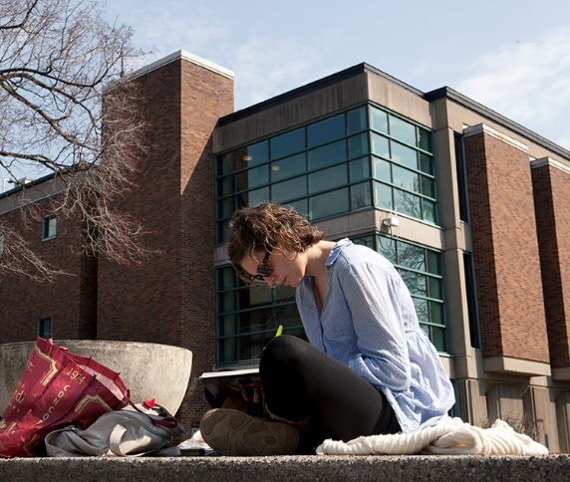
The Librar(ies)
24/7 access, with student card, after 11pm
Webster Library (LB 2-5) – downtown on SGW campus: Social Sciences, Humanities, Business, Engineering & Fine Arts
Vanier Library (VL 1-3) on Loyola campus: Sciences, Health, Communications, Journalism & Psychology
Graduate study spaces at both campus libraries
Special Collections and Archives at Vanier Library, by appointment
The Technology Sandbox /Makerspace at Webster Library, 10am-5pm weekdays

Slide 4
Library Services
Your student card is your library card.
You need it to:
borrow books (up to 100 a time)
borrow a laptop (for 3 days) & other technology (tablets, headsets, charger cables, DVD drives, media equipment)
print on campus (add money to your Dprint account)
access the library overnight during 24/7 hours and to access Webster grad space at all times
Webster library has 5 book scanners (And Vanier has 2!) that can be used for free to scan chapters from our print books and email them to yourself as a PDF.
Access from home: To use Library databases, access online articles and ebooks when you are off campus, login with your Concordia Netname and password and access electronic materials the library website.

Slide 5
Library Resources

Slide 6

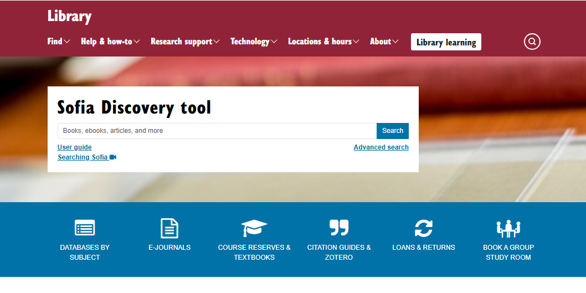
Sofia Discovery Tool, your library catalogue+
A general search across library resources
find print books, ebooks, and journal articles
Notes:
The Sophia discovery tool is Concordia library's main search tool, and you can find it in the middle of the main library web page. You can use Sophia to find a wide range of physical and digital items, such as books, journal articles, videos, and much more. Sofia is the best place to start you research, and has handy filtering tools, including a “peer-reviewed” check box.

Slide 7
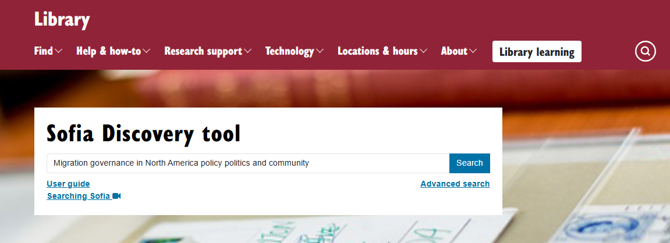
Using Sofia to locate known items
Smith, C. D. (2024). Migration governance in North America : policy, politics, and community (K. Banerjee, Ed.). McGill-Queen’s University Press.

Slide 8
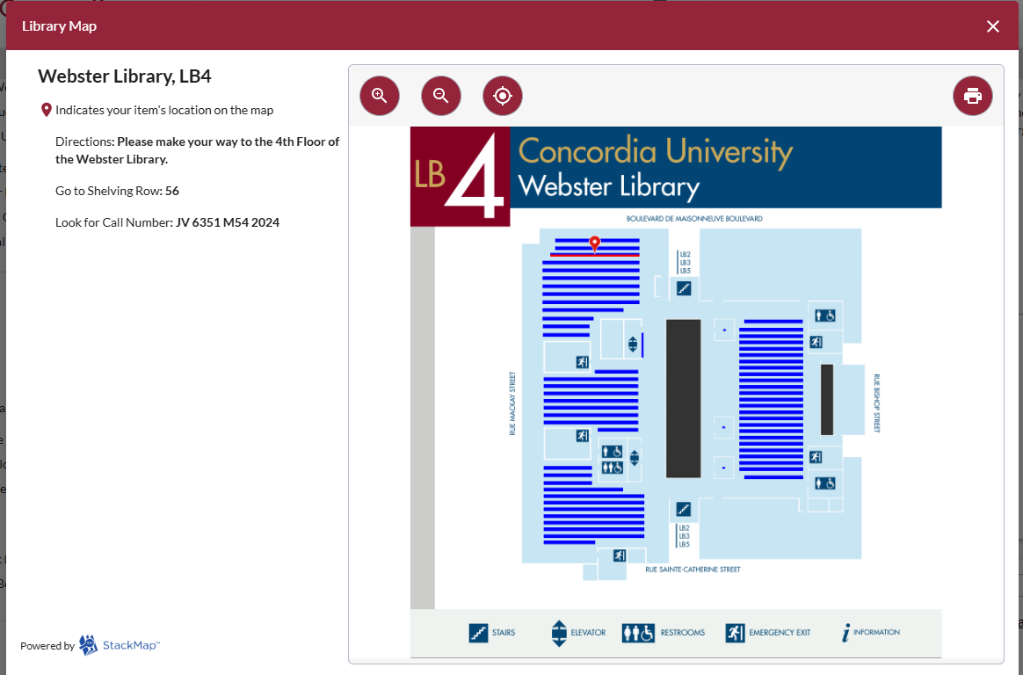
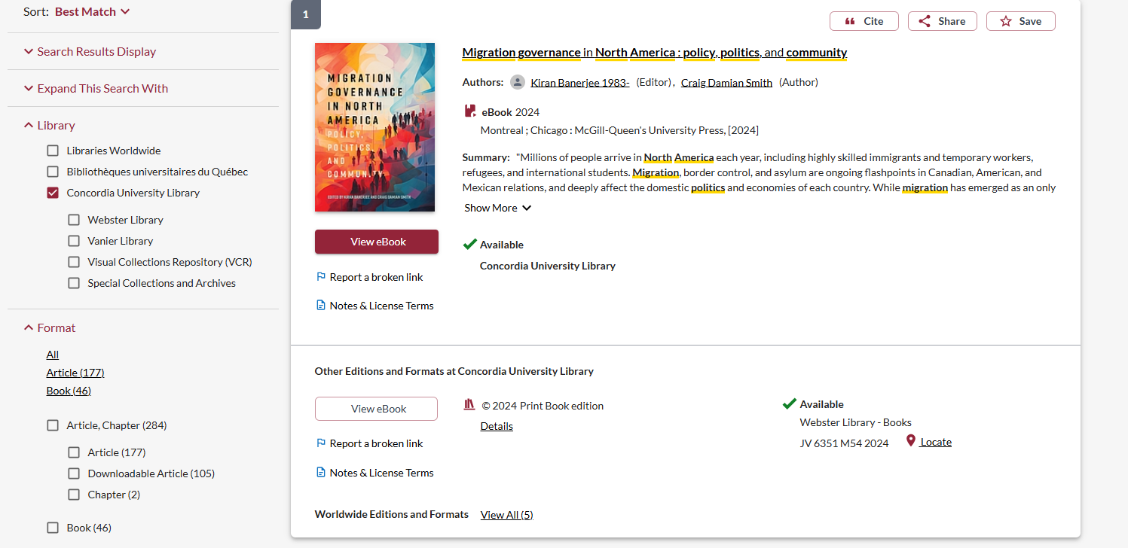

Slide 9
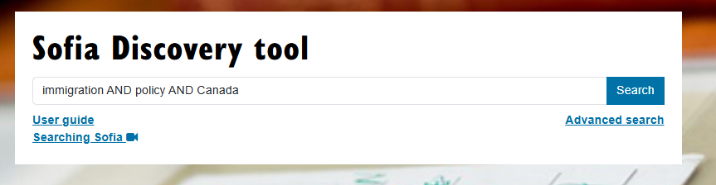
Searching Sofia with a topic/keywords
Search Tip: In Sofia, AND/OR must be in ALL CAPS to be recognized as stop words in the search

Slide 10
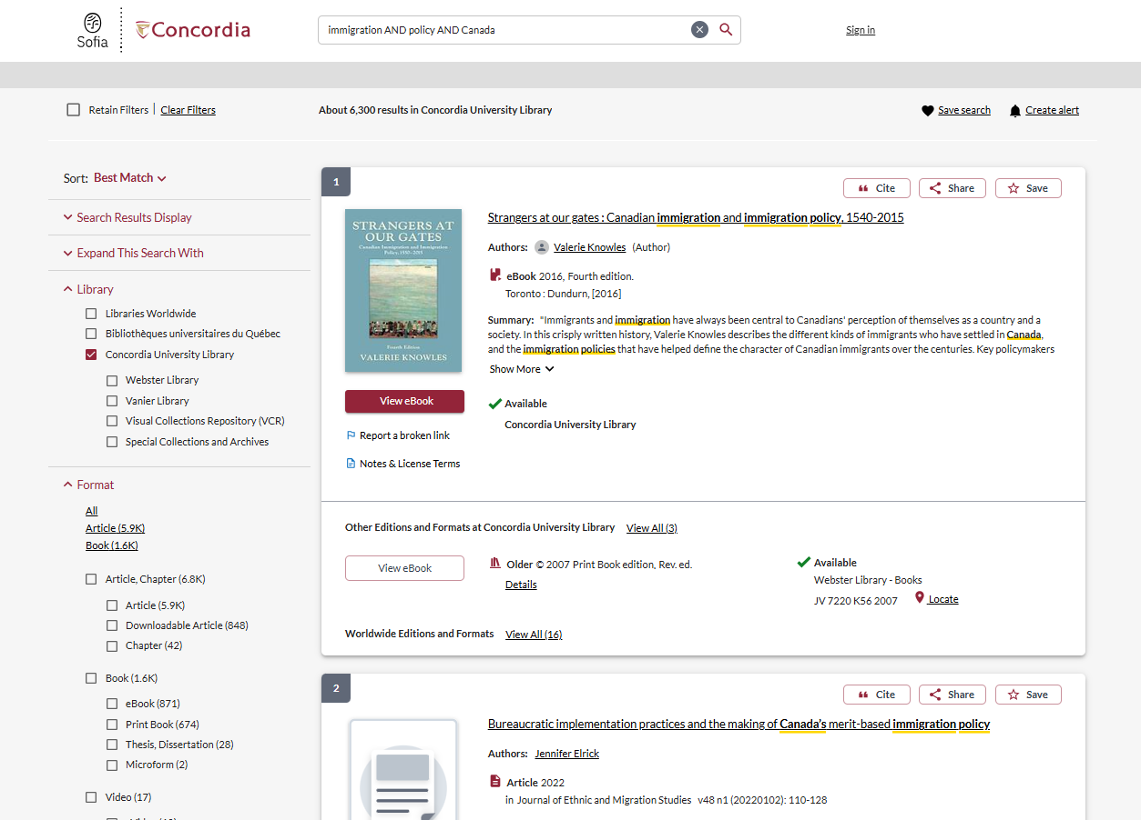
Use the limits menu to narrow by format or date

Slide 11
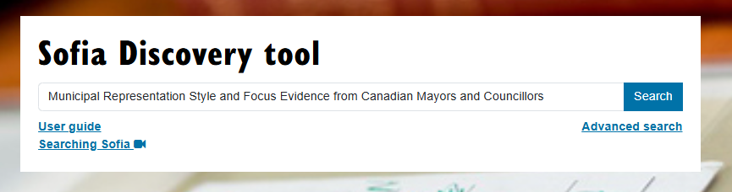
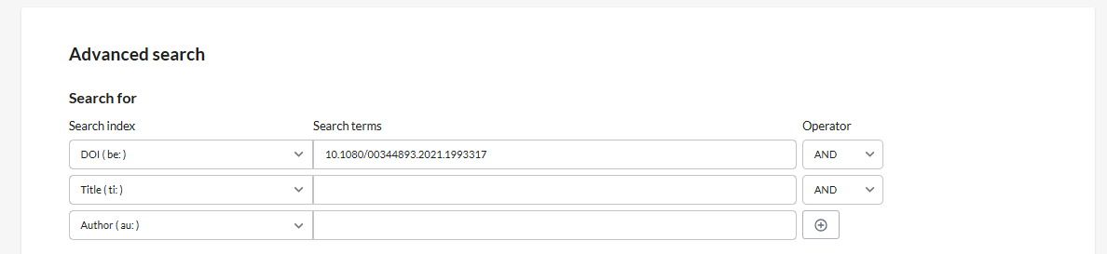
Blidook, K., Koop, R., & Lucas, J. (2022). Municipal Representation Style and Focus: Evidence from Canadian Mayors and Councillors. Representation, 58(4), 603–622. https://doi.org/10.1080/00344893.2021.1993317
Using Sofia to locate known items

Slide 12
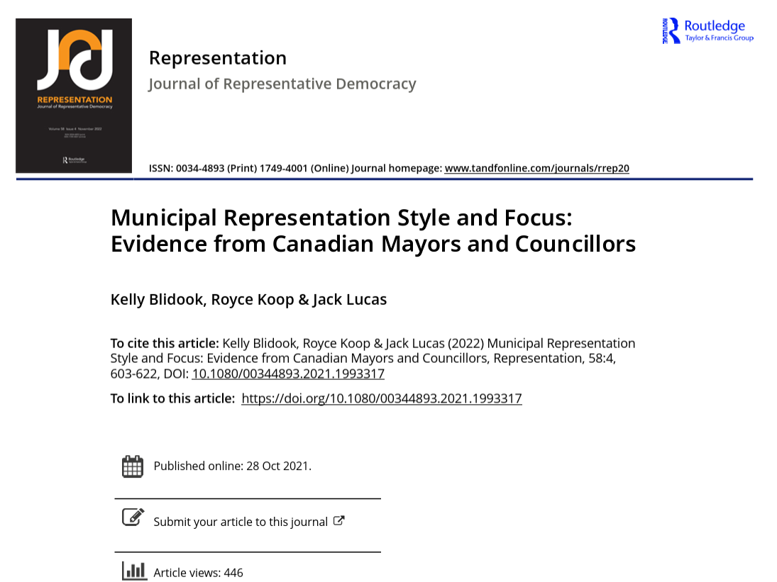
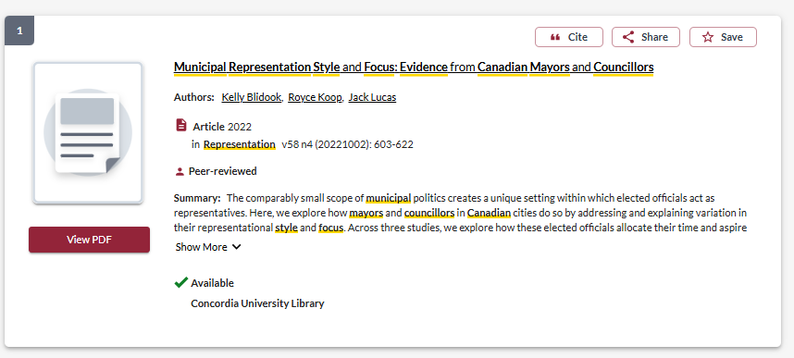
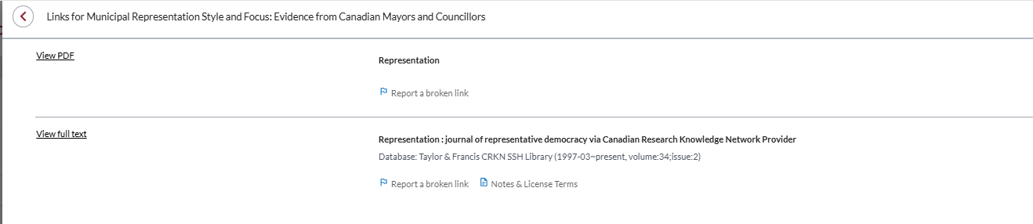

Slide 13
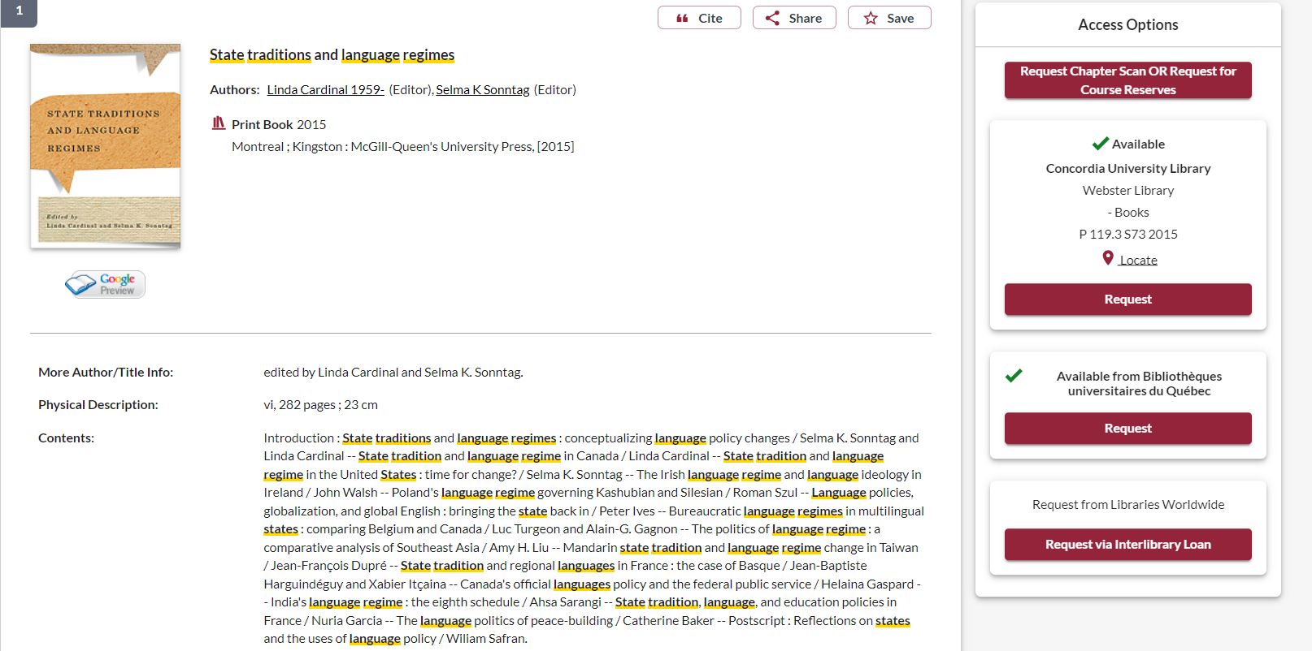
To request a scan of one chapter from the print book, click this button

Slide 14
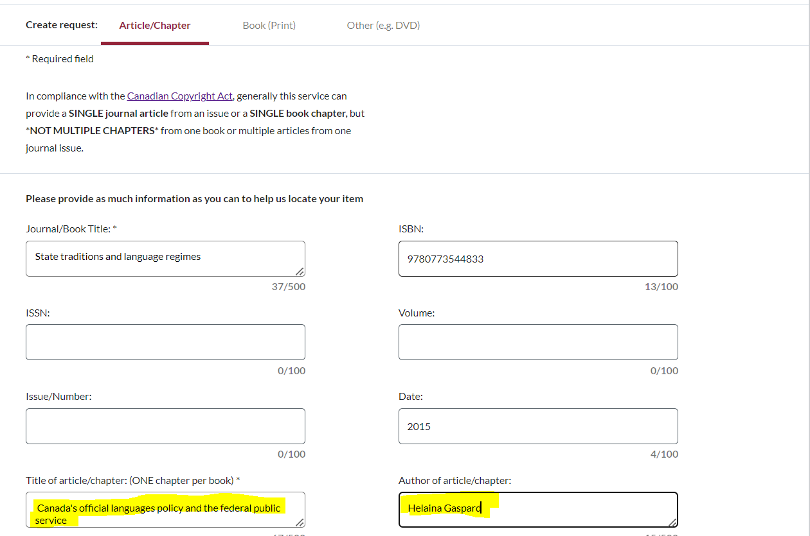
The book’s title and ISBN will be automatically filled in, you just need to provide the chapter title and author of the chapter.

Slide 15
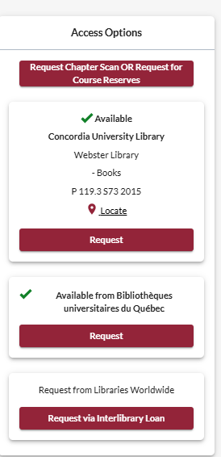
Request a scan of single chapter, from a Concordia print book, or a book from another library.
Speed: within 5 working days
Request a Concordia print book be pulled off the shelf and put on hold for you.
Speed: a couple working days
Request to borrow a physical copy of a print book from another Quebec university library.
Speed: about a week
Request to borrow a physical copy of a print book from another library outside of Quebec.
Speed: a week or more

Slide 16
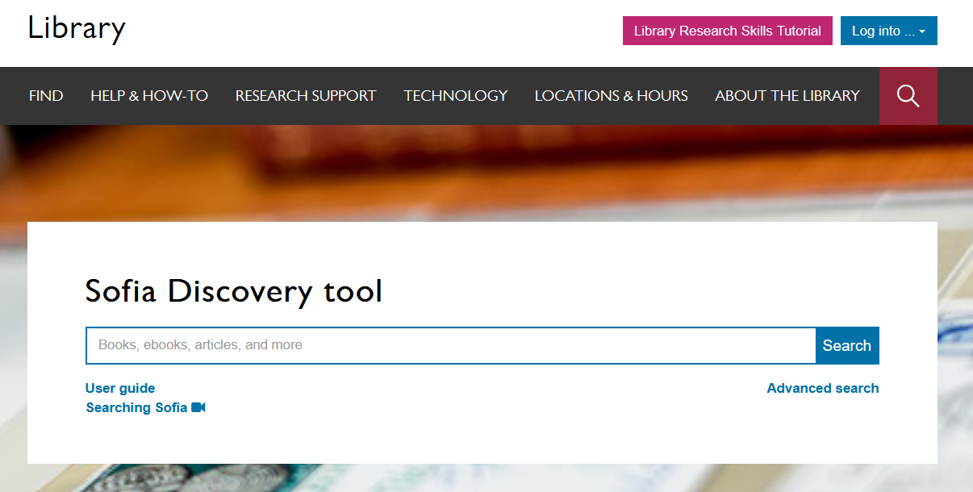
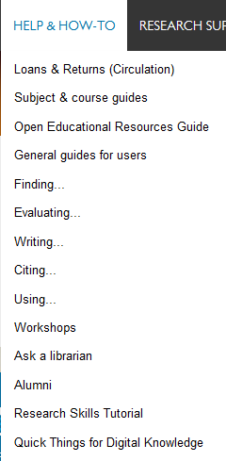
Notes:
You can also access these guides from the main library homepage by clicking on the help and how to menu and then select subject and course guides. These are great place to start for finding databases and other information for your discipline.

Slide 17
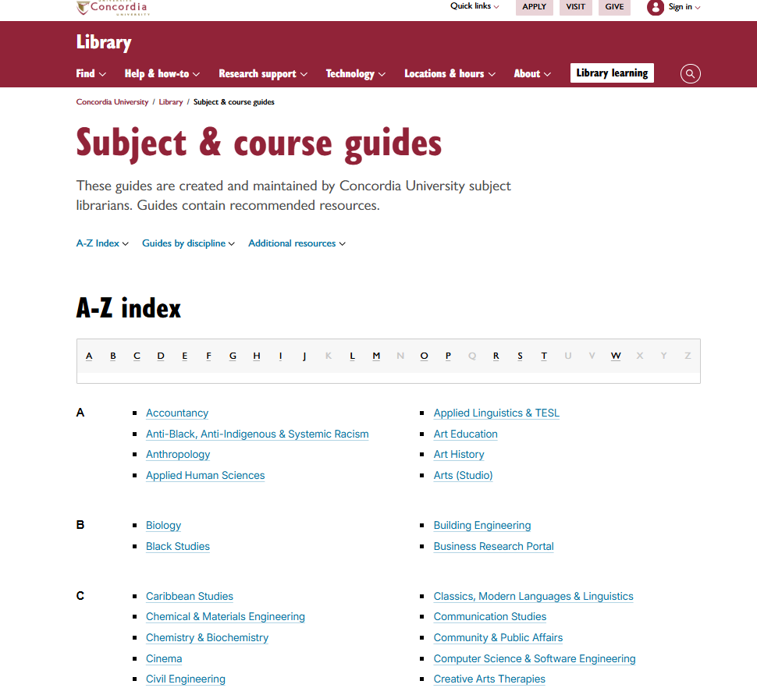
Subject and course guides
Notes:
The subject and course guides are some of the most helpful guides. They are created and maintained by the library’s subject librarians – librarians who are experts at supporting research in your field. The guides contain recommended resources for each subject, including the best databases to use, background sources like encyclopedias and handbooks, how-to guides for finding trickier resources like primary sources, lists of useful websites and online tools. The guides also have links you can use to contact your subject librarians if you have any questions or need help working on a project.

Slide 18
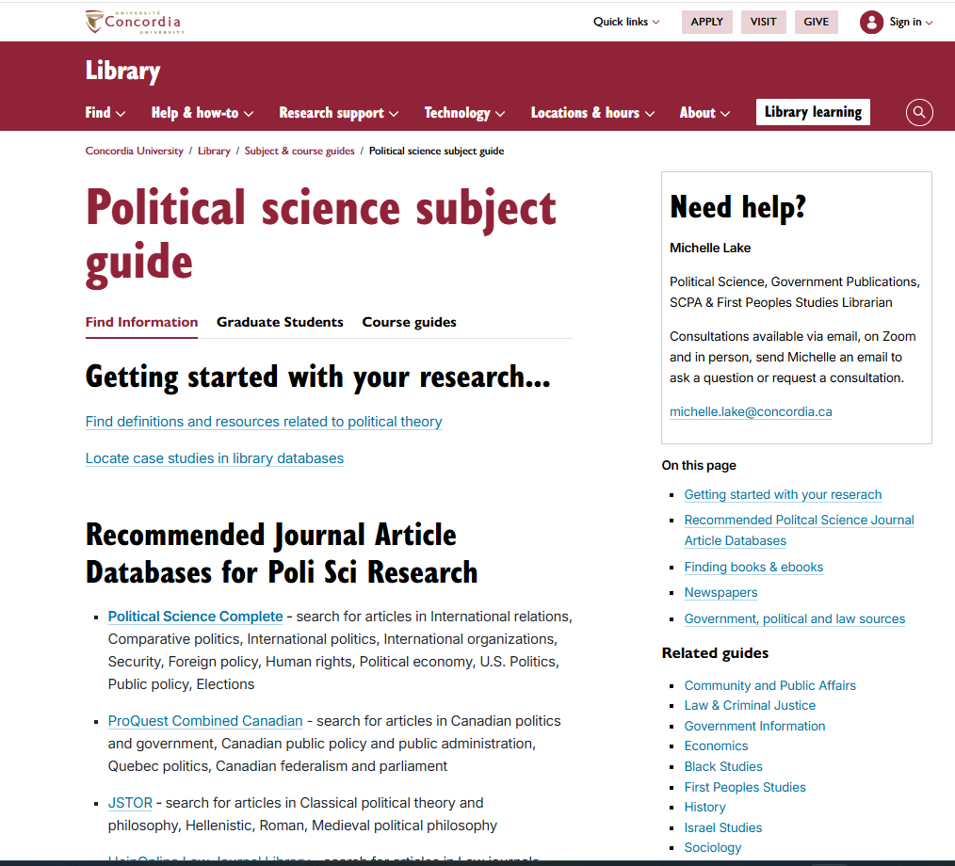
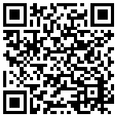
The Political Science subject guide is a great place to start your research and find recommended resources.

Slide 19
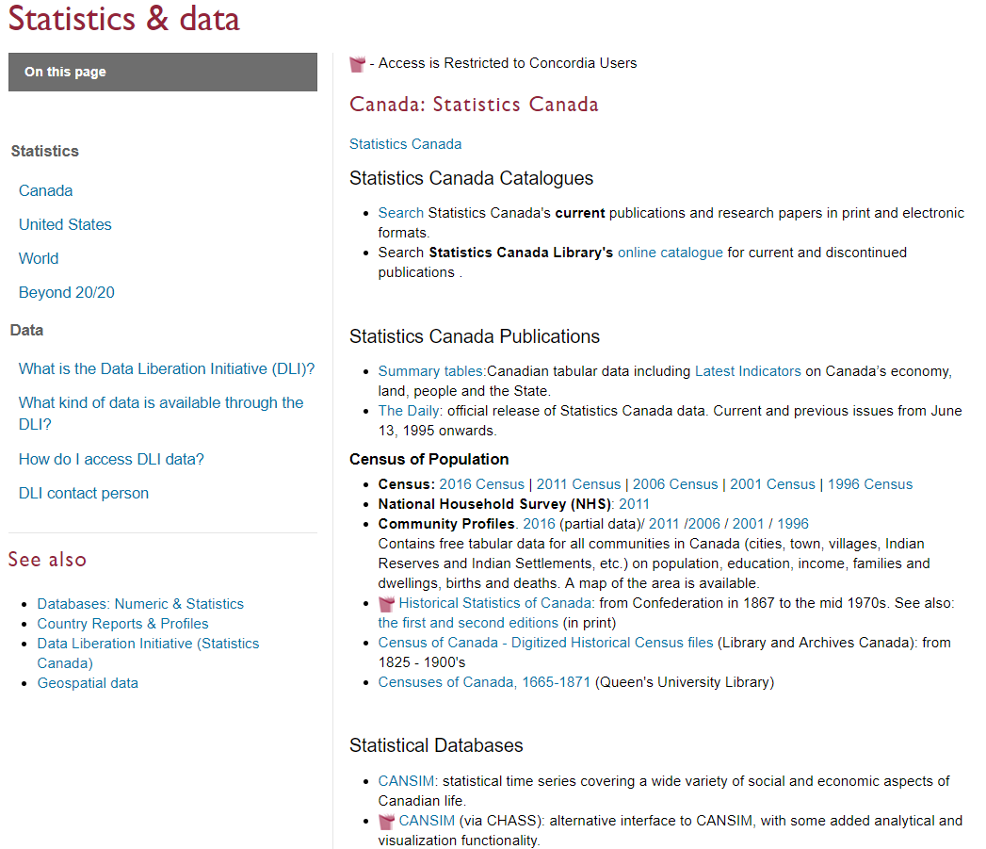

Data & Statistics
Consult with the data librarian or get started with data and statistics using the help guides.
https://library.concordia.ca/find/statistics.php

Slide 20

How do you keep track of all the great articles and documents you find? How do you cite them?
Using Zotero for Grads – GradProSkills workshop
Oct 22, 2026 3:00-4:30pm online
Zotero library help page
Bibliographic management software
Notes:
Once you’ve started finding really good sources to support your research project, how do you keep track of them all? And how should you cite them? These are some of the most common questions we get at the library. There are a bunch of tools you can use to help you manage your sources and reading notes, but one that I would highly recommend is Zotero. It's a free bibliographic management software that integrates well with the Sofia discovery tool, and has plugins for your browser and your word processing software. It helps you manage your sources, organize reading notes, and will automatically generate lists of references in different citation styles. If you’re interested, we provide workshops, guides, and help through the library for using Zotero.

Slide 21
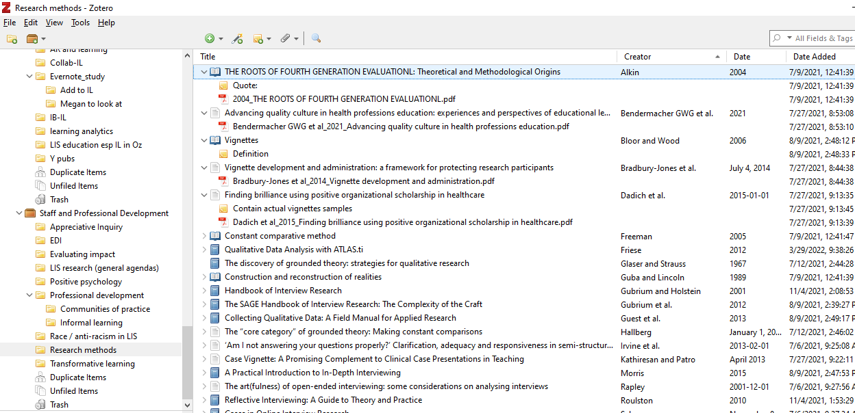
Notes:
This is just an example screenshot from a Zotero library, to give you a sense of what a powerful tool it is. On the left side of the screen, there are lots of folders with labels, divided by research project. In the center, you see the titles of different resources that I found with different icons, these represent books, articles, dissertations, and more. These records include the bibliographic information for these resources like the author, and the publication date and so on. You can also see the little notes with the yellow post-it icon, these are reading notes I’ve added, as well as some PDF files that I've attached.
Zotero is a really powerful tool for organizing your information, allowing you to take notes, highlight PDFS, and keep track of references as you're writing. So I highly recommend learning more about Zotero for your research and your studies.

Slide 22
GradProSkills Library Workshops
Workshop title | Date, time & location
Library skills & resources: research tools and tricks which can be indispensable for effective graduate level research at Concordia in all subject areas. | Sept 21, 2026, 11:00 – 1:00pm, Webster Library, LB 207
Using GenAI tools in graduate research | Sept 24, 2026, 1:00-3:00pm, Webster Library LB 207
Let’s demystify journal publishing | Oct 1, 2026, 11:00-12:00pm, Webster Library, LB 205
Researching Indigenous Topics -, an intro workshop for all disciplines who wish to better understand and include Indigenous perspectives in their research. | Oct 2, 2026, 1:00-3:00pm, Online Instructor: Michelle Lake
Introduction to Note Taking Tools for Research: introduction to the modern, no-cost, digital note-taking tool, Obsidian (or Zettlr). Integrated with Zotero and used in an academic framework, these tools can foster productive research writing. | Oct 9, 2026, 9:00am-12:00pm, Webster Library, LB 207
Using Zotero for Grads: learn how to use Zotero, a desktop and web-based tool to organize the references you find in library catalogues and databases, insert citations in your papers, and prepare bibliographies or reference lists quickly. | Oct 22, 2026, 3:00-4:30pm, Online
Basics of QualCoder: basics of a software tool called QualCoder, which is useful for qualitative analysis. | Nov 11, 2026, 9:00-10:30am, Webster Library, LB 207

Slide 23
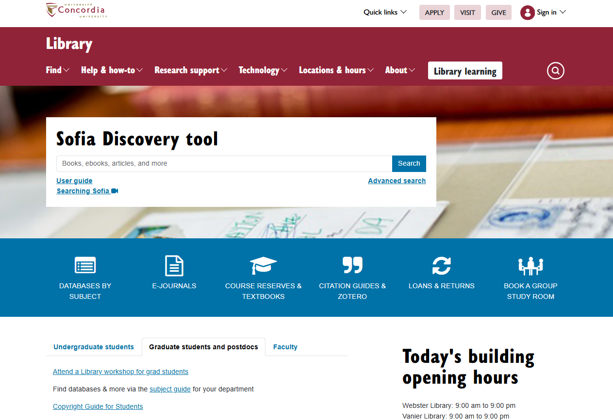
Graduate Students tab
Notes:
You can also find space specifically for graduate students by clicking the Graduate students and postdoctoral fellows tab under the Sofia Discovery Tool. There’s a link here to the “Support for graduate students and postdoctoral fellows” page. That page is a hub for grad students and has links to the resources that we're going to talk about today, as well as other useful information. So it’s a good page to have bookmarked and to spend some time exploring on your own. We’ll come back to some of the other resources there, but let’s start with grad student spaces.

Slide 24
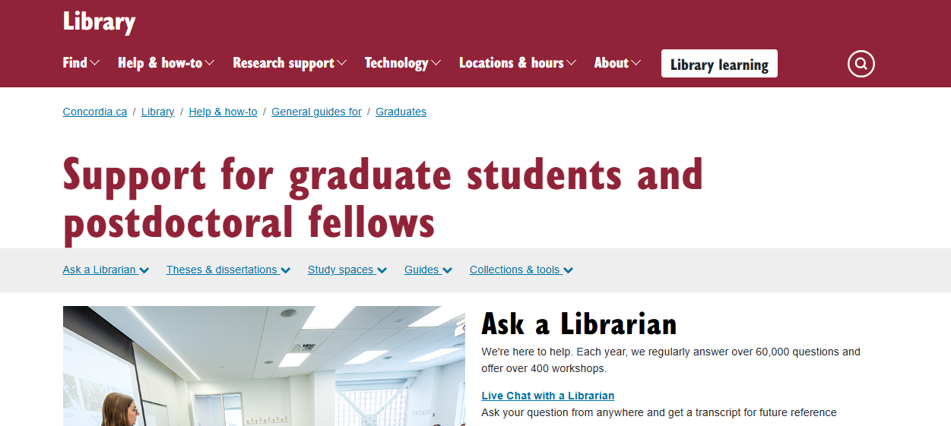
Support for graduate students
Graduate Students library page: https://library.concordia.ca/help/users/graduates/index.php
Notes:
Click the “Study spaces” tab near the top of the “Support for graduate students” page.

Slide 25
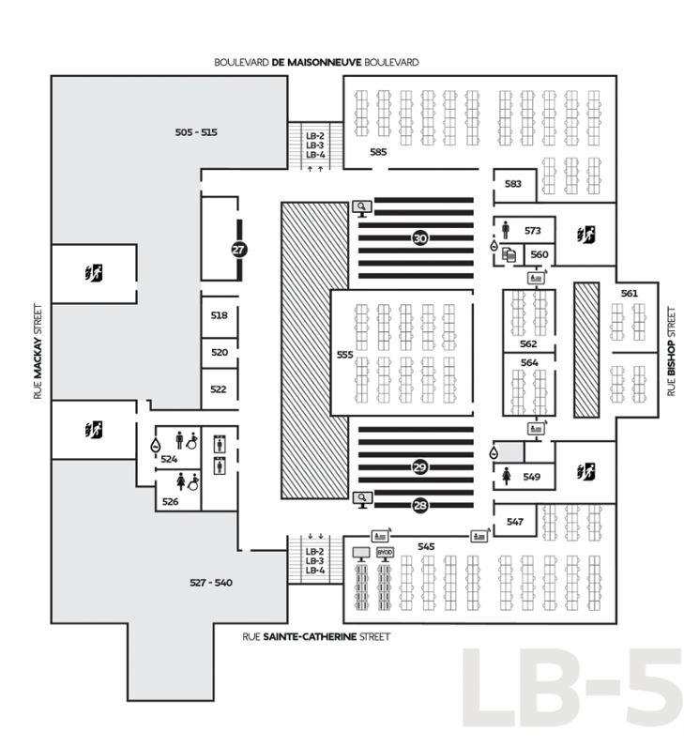
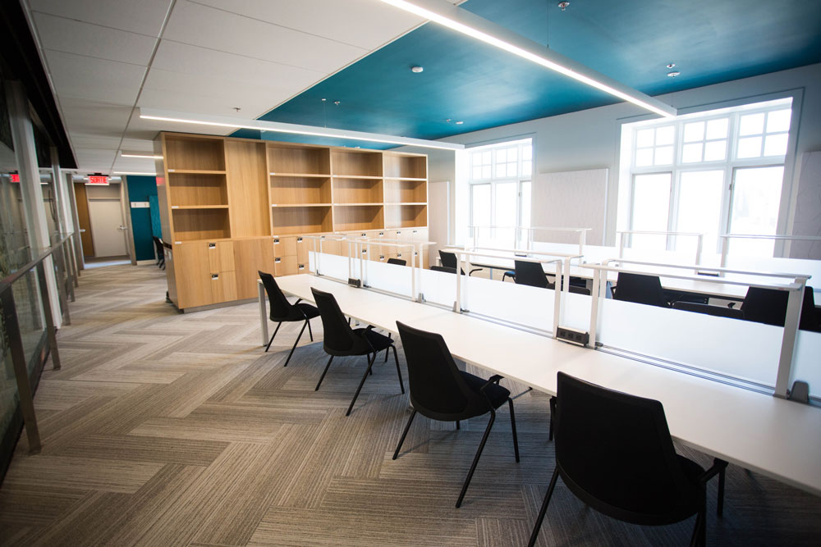
Graduate spaces - SGW
Webster 5th Floor
Dissertation writer’s rooms (LB 561, 562 & 564)
Lounge
Kitchenette
Dedicated printer/copier/scanner
Lockers & Shelves
Notes:
At the Webster library, on the downtown campus, all of the grad space is on the fifth floor, with the exception of the seminar room and a thesis defense room which are on the third floor. On the fifth floor, you'll find reading rooms and writing rooms that are reserved only for graduate students, and you need your Concordia ID card to be able to enter these rooms. There's also a lounge with comfortable seating and a small kitchenette with a microwave where you can heat up food or eat your lunch.

Slide 26
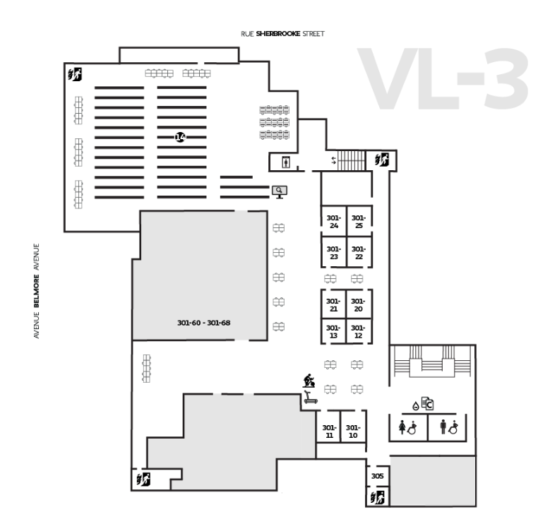
Graduate space - Loyola
Vanier Library 3rd Floor
Graduate Study Room VL-305
A valid Concordia student ID must be presented at the Vanier Library Circulation Desk to obtain an access code to the Graduate Study Room.
The code is assigned to an individual student and must not be shared with others.
For security reasons, this room is open from 7 a.m. to 11 p.m. during Fall and Winter semesters.
Can be booked ahead of time for 3 hour periods, by grad students only.
Notes:
At the Vanier library on the Loyola campus, the third floor has a room, room 307, which is reserved for graduate students. To get an access code for the room, you need to show your valid Concordia student ID at the Ask us Desk. You'll be assigned individual code for accessing the room. There’s quiet reading space in the room and assigned shelves where you can leave your books throughout the semester. There’s also a group study room for grad students next door in room 305.

Slide 27
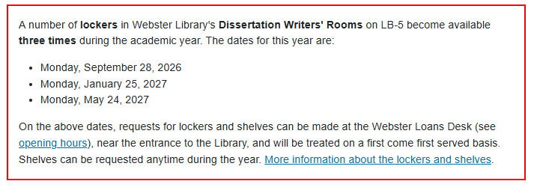
Webster Library – Graduate student spaces
To request a shelf or locker, you must be a currently registered graduate student:
Only one shelf or locker can be assigned to each student
Shelves and lockers are assigned to an individual student and must not be shared with others
Library books that you want to keep on a shelf must be checked out at the Loans Desk

