Slide 1

SOCI/POLI 398: Selected Topics in Sociology –
Public Policy and the Politics of Equity Library workshop
Michelle Lake
Subject Librarian for Political Science, First Peoples Studies, the School of Community and Public Affairs and Government information
Michelle.Lake@Concordia

Slide 2
Who am I?
Michelle Lake, librarian for Political Science, the School of Community and Public Affairs, First Peoples Studies, and Government Publications
Michelle.Lake@Concordia.ca / Make an appointment (on Zoom or in person) or ask a question
What do I do?
  Provide research support, assist with search strategies
  Help students navigate library databases, assist with selection and evaluation of sources
  Help students find and access materials they need
  Build guides, resources and pathfinders to help students locate research materials
  Help with citation issues
  Choose the books we buy for the above subject areas

Slide 3
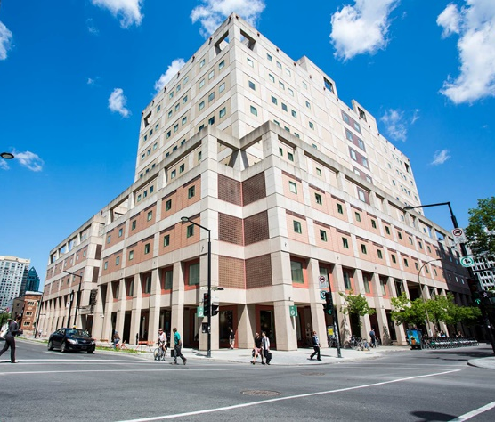
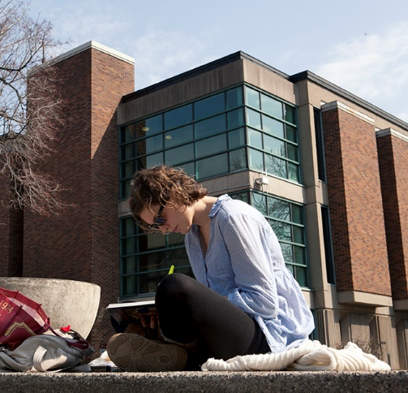
The Librar(ies)
24/7 access, with student card, after 11pm
Webster Library (LB) – downtown on SGW campus & Vanier Library (VL) on Loyola campus
Webster: Social Sciences, Humanities, Business, Engineering & Fine Arts
Vanier: Science(s), Health, Communications, Journalism and Psychology
Course Reserves Room(s): have the required undergraduate print textbooks for the courses taught at that campus (for example: Webster has the Political Science and SCPA course reserves)

Slide 4

Library Services
Your student card is your library card.
You need it to:
borrow books (up to 100 a time)
borrow a laptop (3 day loan) and other technology
print on campus (add money to your Dprint account)
access the library overnight during 24/7 hours.
Webster library has 5 book scanners (And Vanier has 2!) that can be used for free to scan chapters from our print books and email them to yourself as a PDF.
To use Library databases, access online articles and ebooks when you are off campus, login with your Concordia Netname and password.

Slide 5
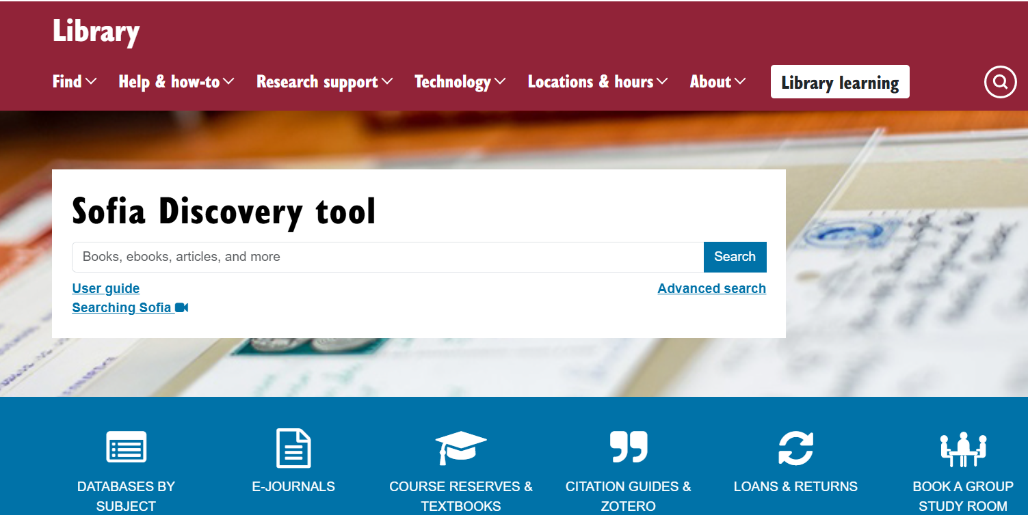
https://library.concordia.ca/
Use the Sofia Discovery tool to find print books, ebooks, journal articles, government documents, theses, and films from the library.

Slide 6
How can I find out if the library has access to an item I’m looking for?

Slide 7
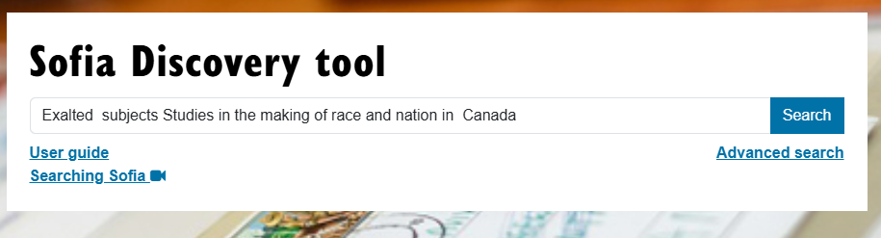
Thobani, S. (2007). Exalted subjects: Studies in the making of race and nation in Canada. University of Toronto Press.

Slide 8
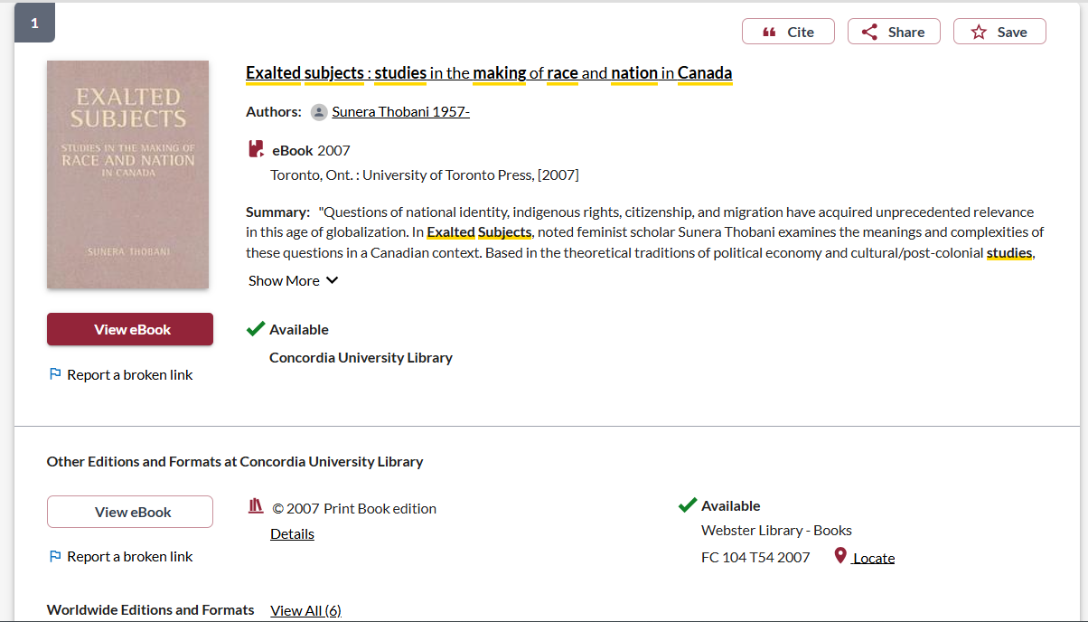
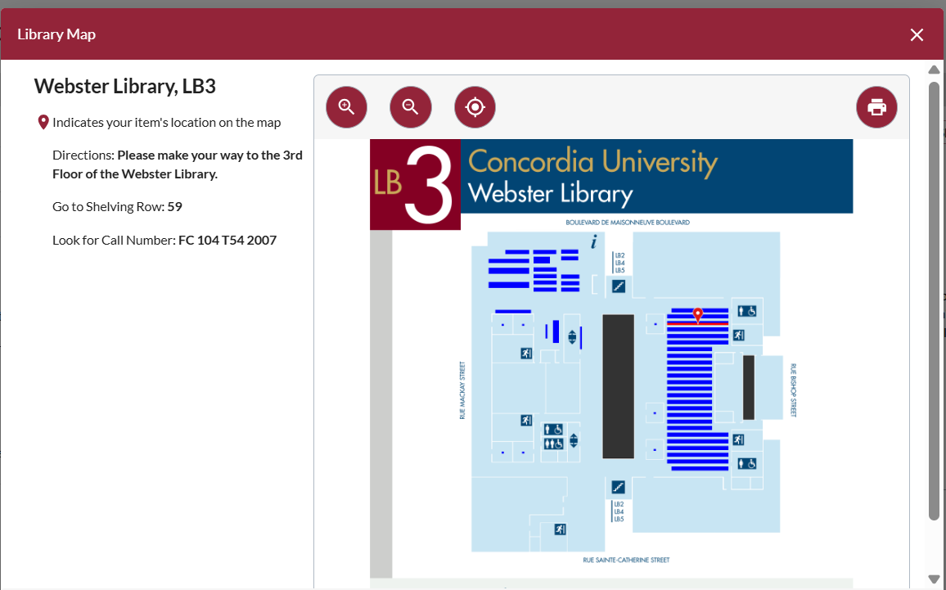
This title is available as an ebook
This title is also available in print, at Webster library

Slide 9
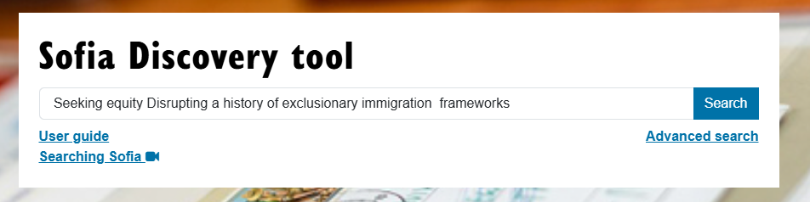
Fernando, S., & Rinaldi, J. (2017). Seeking equity:
Disrupting a history of exclusionary immigration frameworks. Canadian Ethnic Studies, 49(3), 7–26. https://doi.org/10.1353/ces.2017.0019

Slide 10
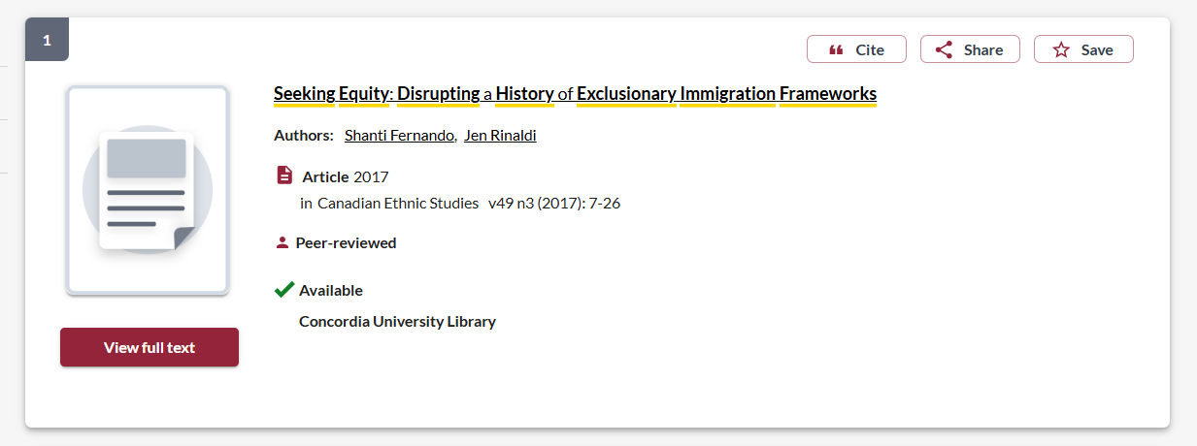
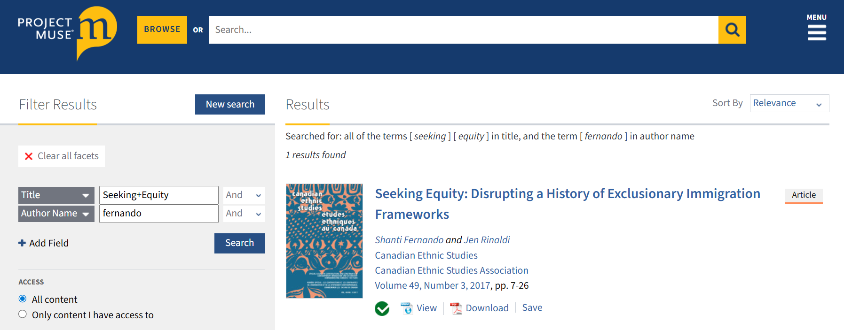
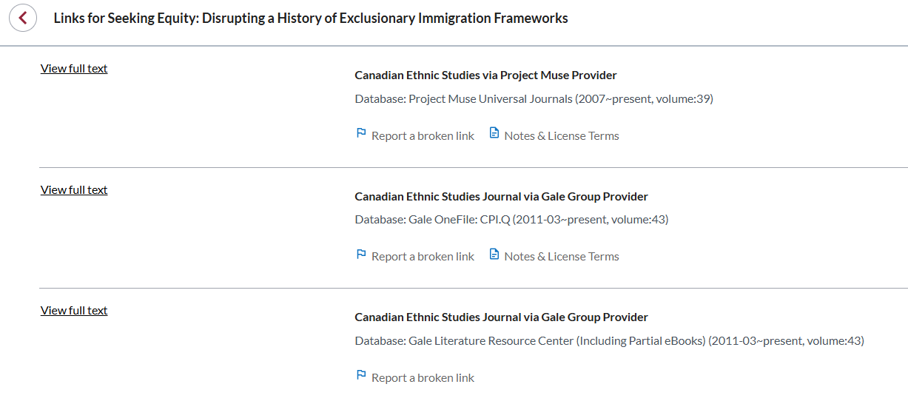

Slide 11

Search strategies

Slide 12
Breaking down a topic
Equitable healthcare access for immigrant populations in Quebec
Main concepts:
  Equitable access
  Healthcare
  Immigrant populations
  Quebec
Synonyms, related terms:
  Accessible, equal
  Health, medical system, hospitals, physicians, clinics, medication
  Immigrants, migrants, refugees
  Canada

Slide 13
How do we combine search words for the best possible results?
AND: combines concepts and limits your results
equity AND policy
state OR government
immigrant OR migrant
OR: allows you to insert synonyms or alternative terms and increases your results

Slide 14
How do we combine search words for the best possible results?
“quotation marks”: If you put two or more words in quotation marks, that exact phrase will be searched and limits your results.
“public policy”
“social movement”
Democra*
Finds: democracy, democracies, democratic, democratically, democratization
* - when you add an asterisk on the end of a word, your results will contain all the words with those endings or suffix

Slide 15
Avoid Searching with linking words
Effects
Impact
Consequences
Influence
Results
Importance
Significance
Response
Emphasis
Causes
Each author may use different linking words when discussing similar topics.
You don’t want your search to be limited to those books and articles that only contain the word “effect” or “consequence”

Slide 16
What will I find in Sofia?
Academic peer reviewed books (ebooks and print books)
Academic textbooks
Non-academic books
Journal articles
Government documents
Theses and dissertations
International Organization publications
Grey literature: reports, publications from non-government organizations, non-profits, etc.
Films

Slide 17
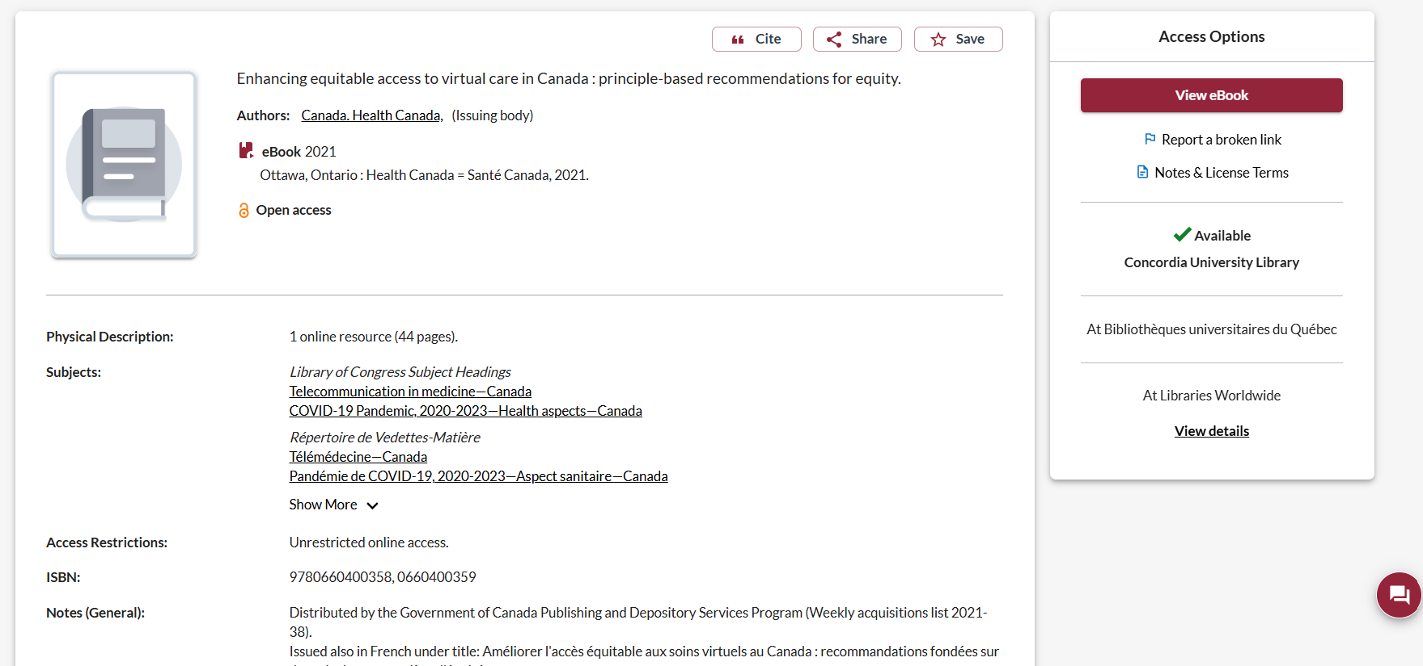


Government Documents: look at the author and publisher

Slide 18
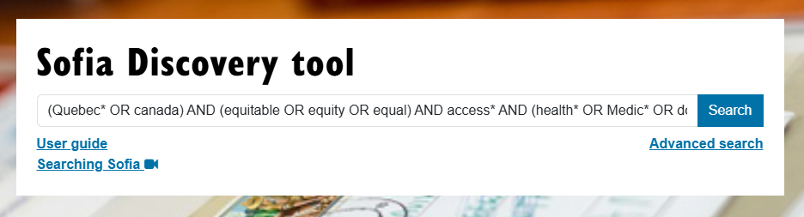
Sofia Search
(Quebec* OR canada) AND (equitable OR equity OR equal* OR inequitable) AND access* AND (healthcare OR health* OR doctors) AND (immigra* OR migrants)

Slide 19
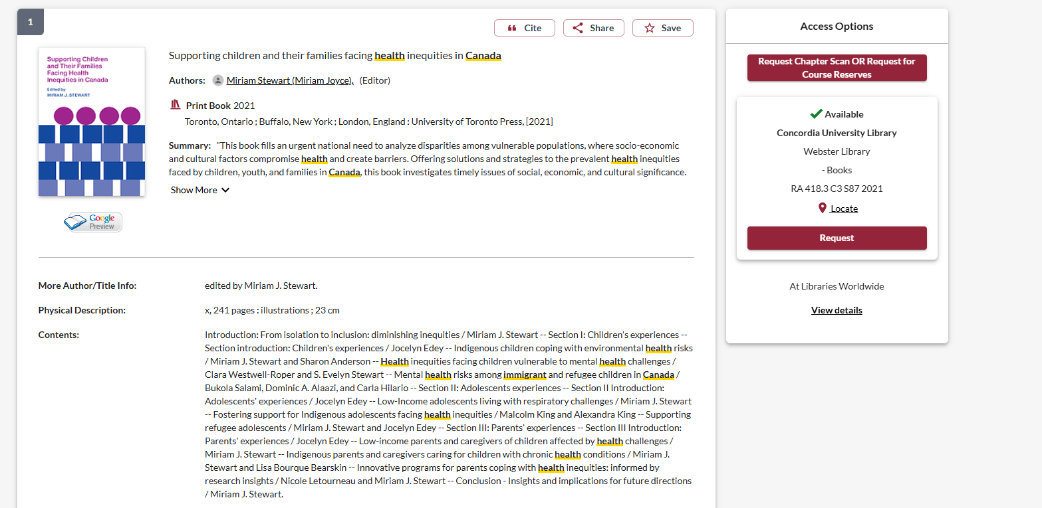
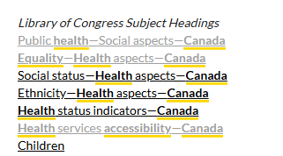
Use the subjects to find other books and articles on your topic

Slide 20
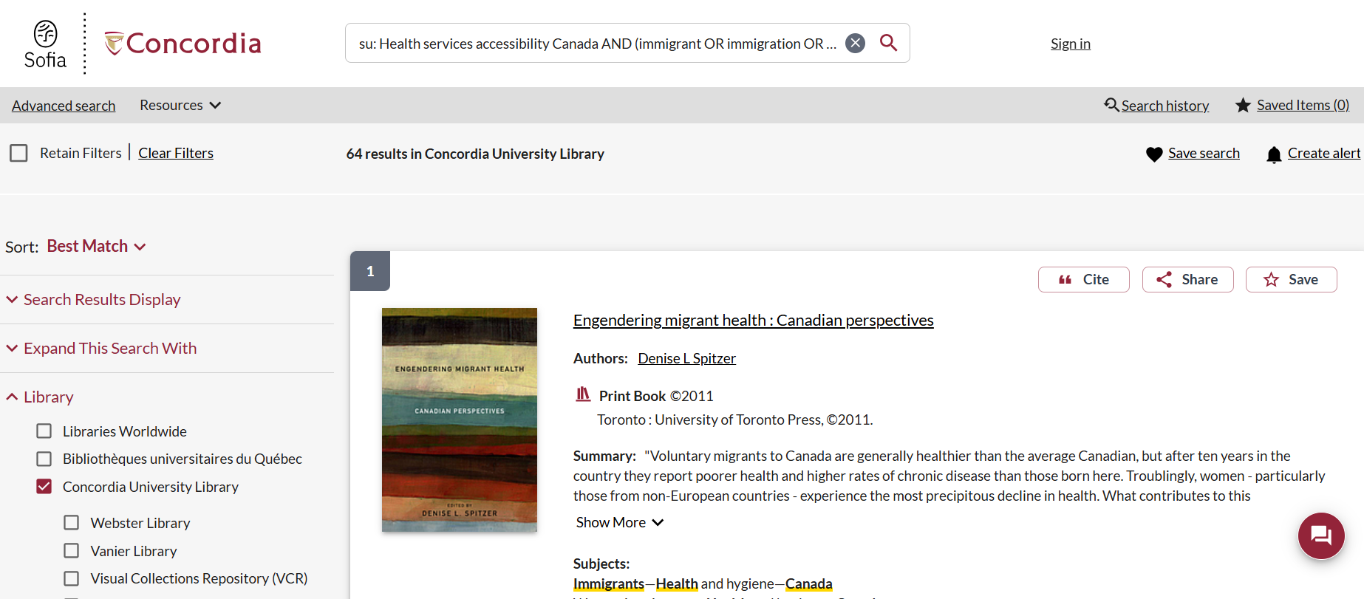
su: Health services accessibility Canada AND (immigrant OR immigration OR migrant)

Slide 21
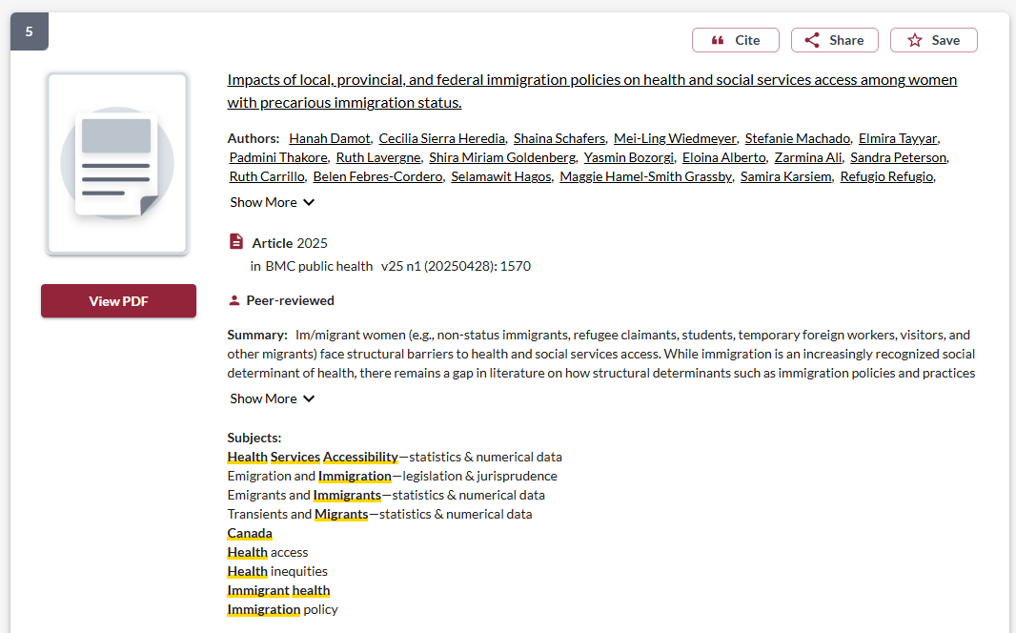
Article in Sofia also have subjects attached to them, which will appear in results of keyword searches

Slide 22

Scholarly sources

Slide 23
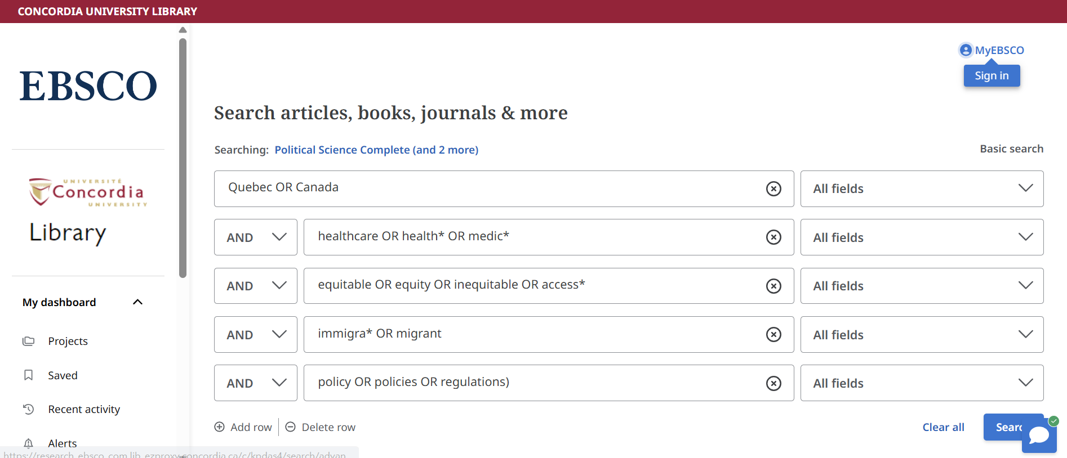
Political Science Complete/SocINDEX: Journal Article Databases
Add more databases to the search

Slide 24
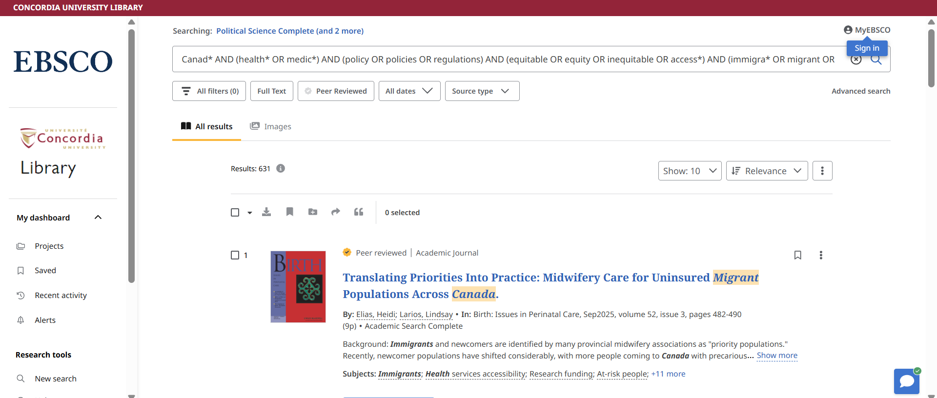
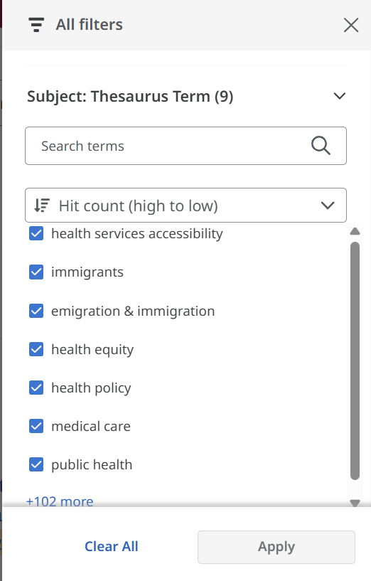
Click on all filters to access subjects

Slide 25
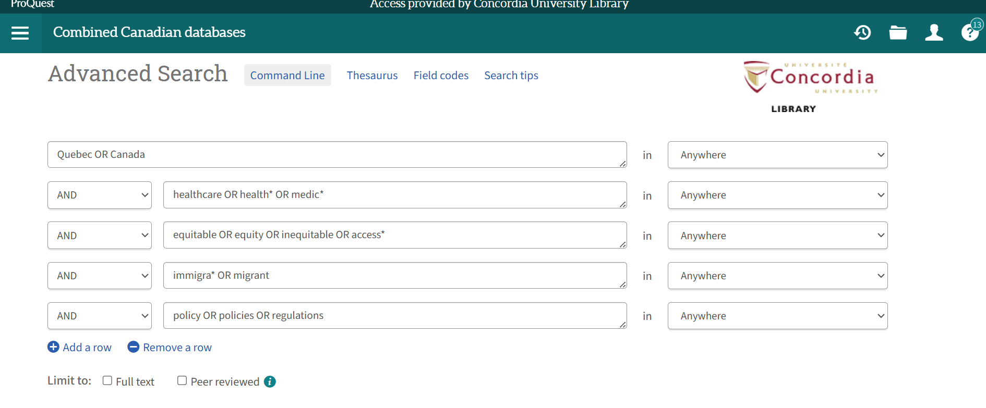
ProQuest Combined Canadian: Journal Articles & Newspaper Articles

Slide 26
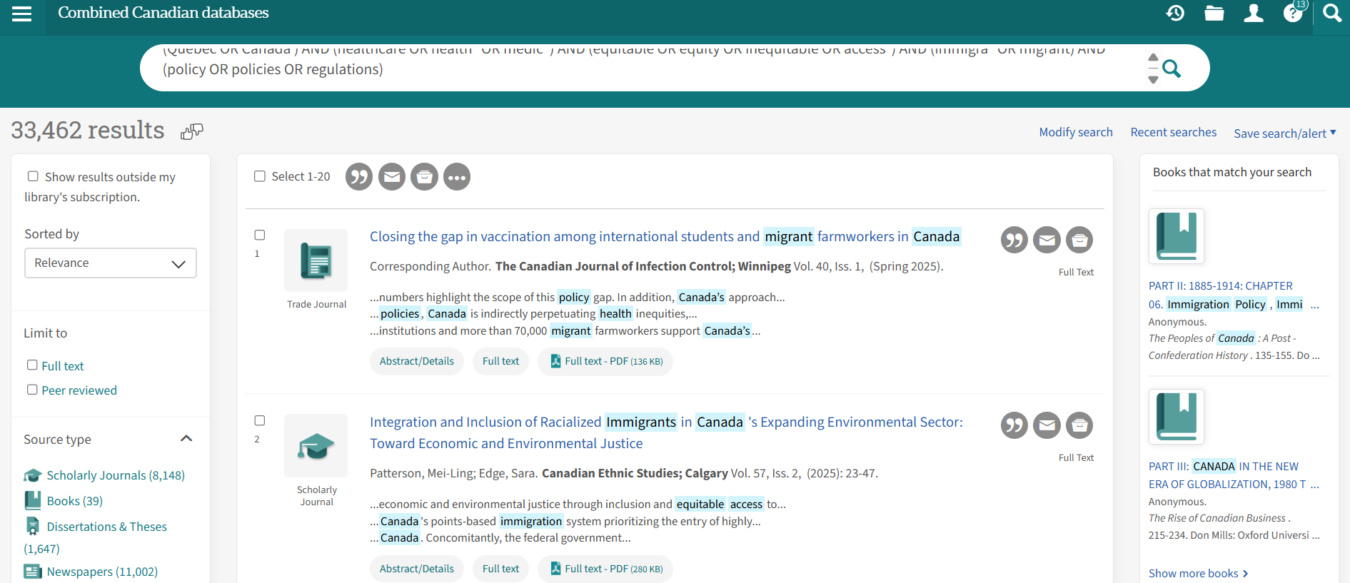
ProQuest Combined Canadian: Journal Articles & Newspaper Articles
Look at the source types, limit to scholarly journals or newspapers

Slide 27
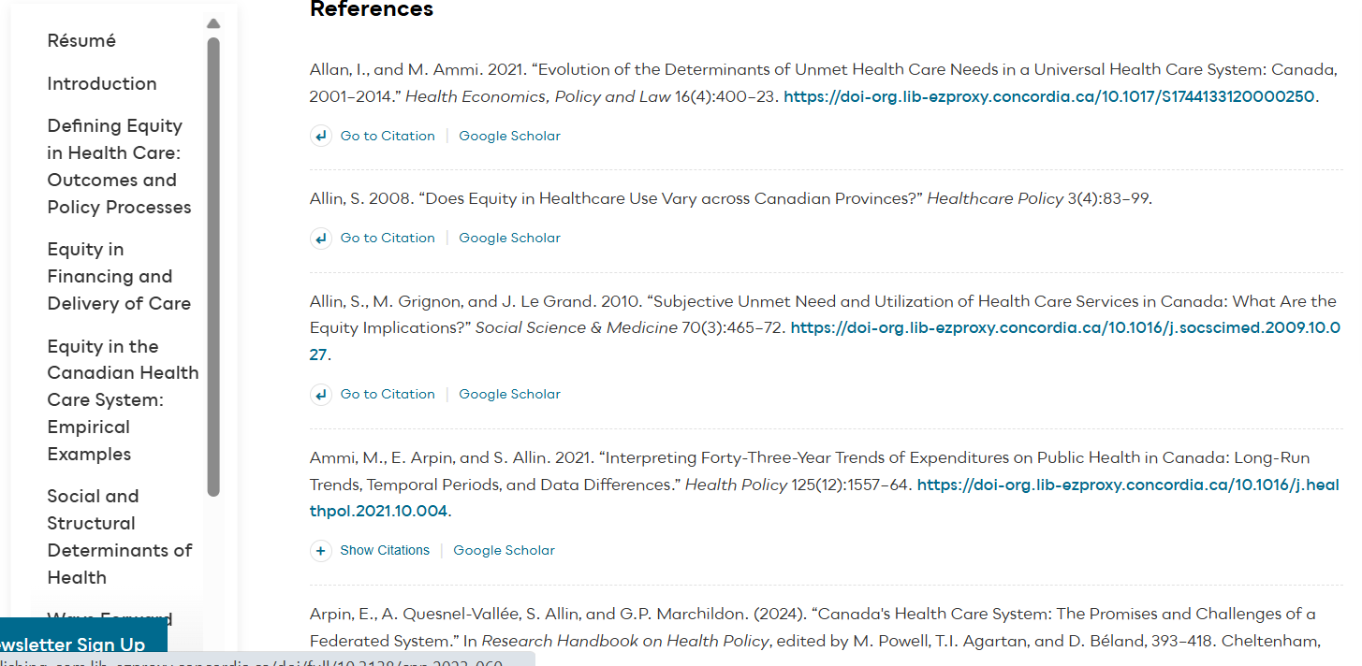
Check the reference lists of articles or books that you find directly related to your topic.
Follow up on the sources used by those scholars to find further research on your topic.

Slide 28
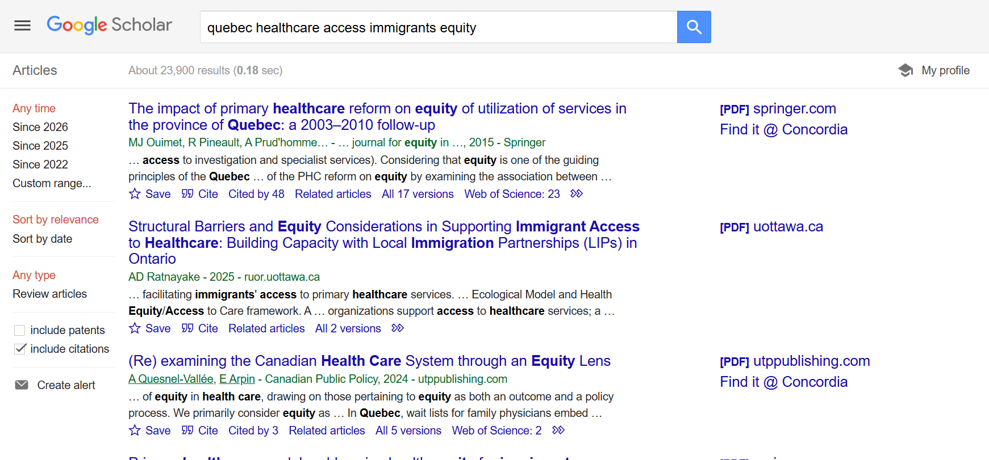
Google Scholar: Journal Articles, Google Books and Theses/Dissertations

Slide 29

Using Google Scholar in 2 ways:
  Setting up Google Scholar to be effective as a Concordia user and use “related articles”
  Using Google Scholar for Reverse Citation Searching

Slide 30
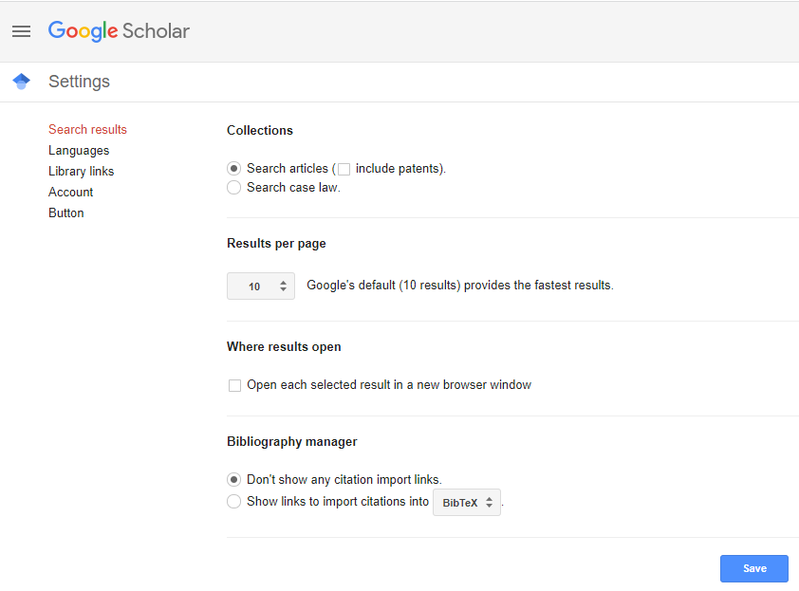
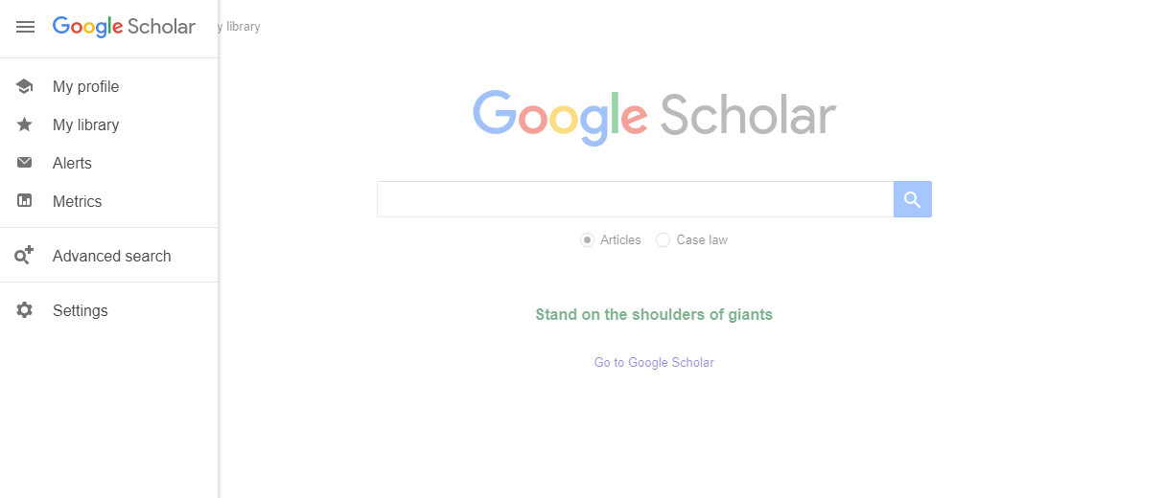

Slide 31
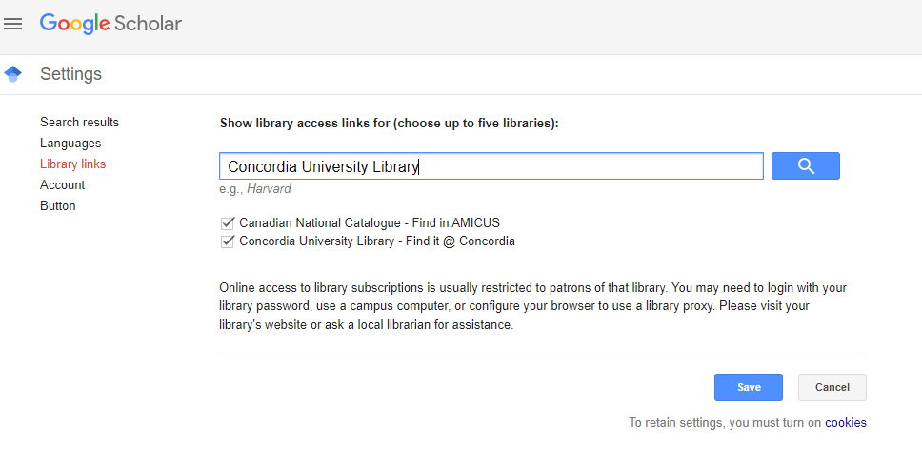
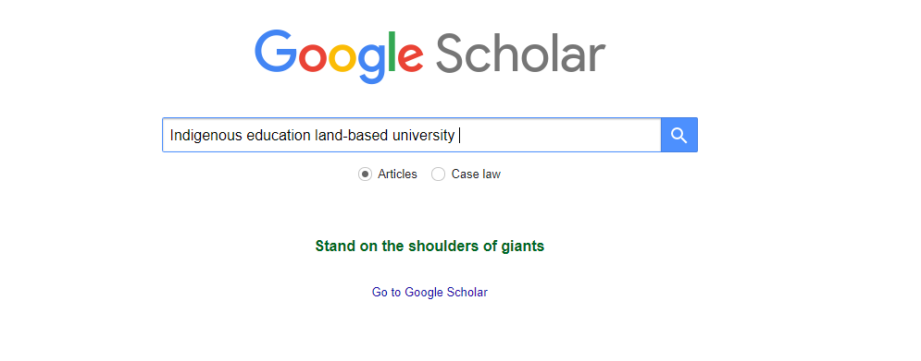

Slide 32
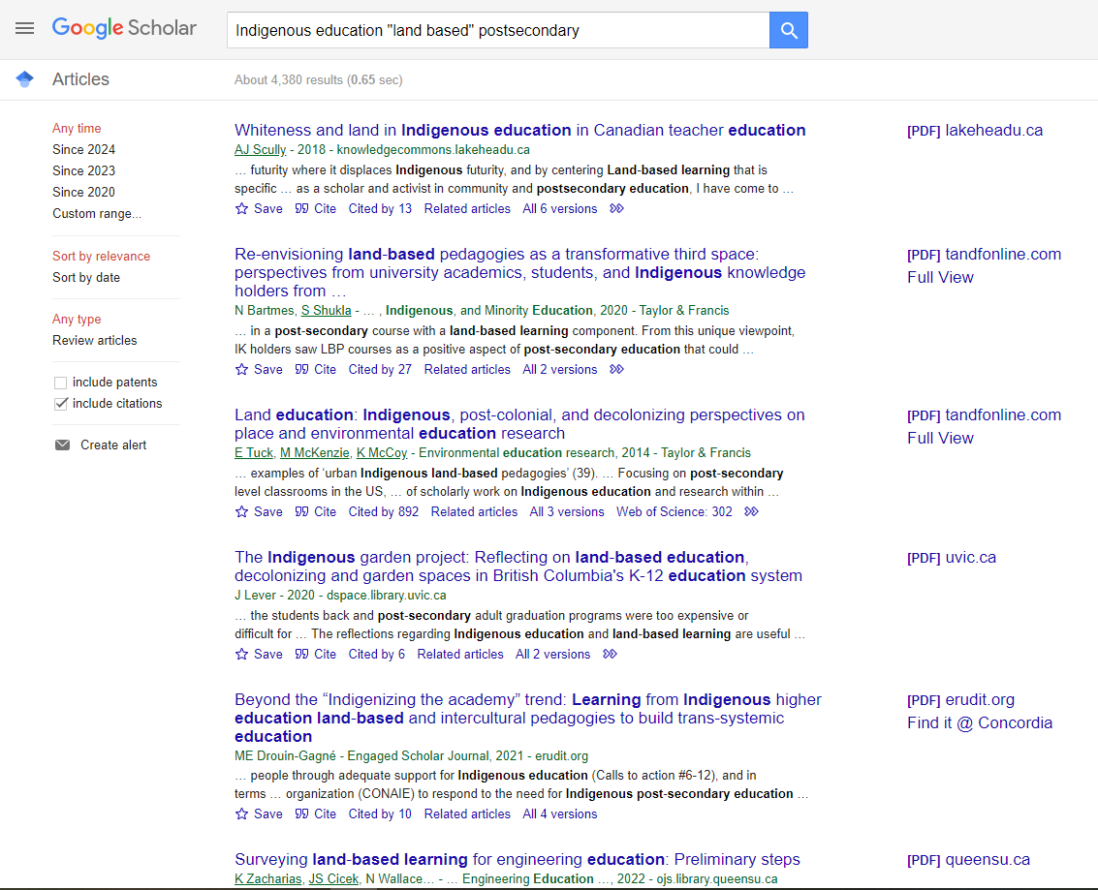
Concordia access
Limit your results by date
Use related articles link

Slide 33
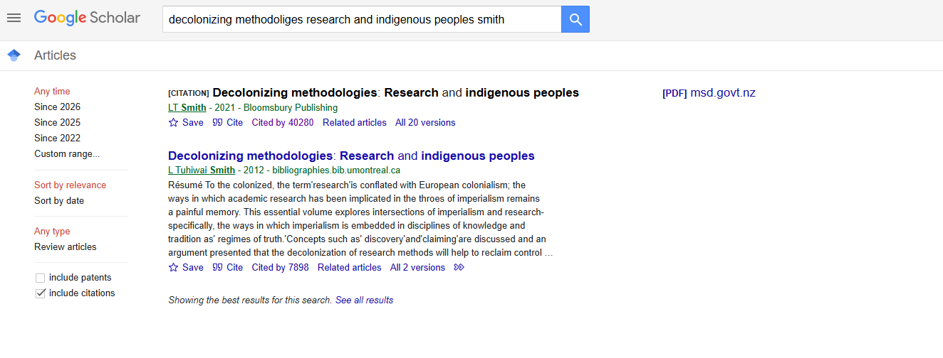
1. You are searching for the citation of your title, to find what other scholars and research have cited it. Click "cited by“ to find resources that cite a specified publication.

Slide 34
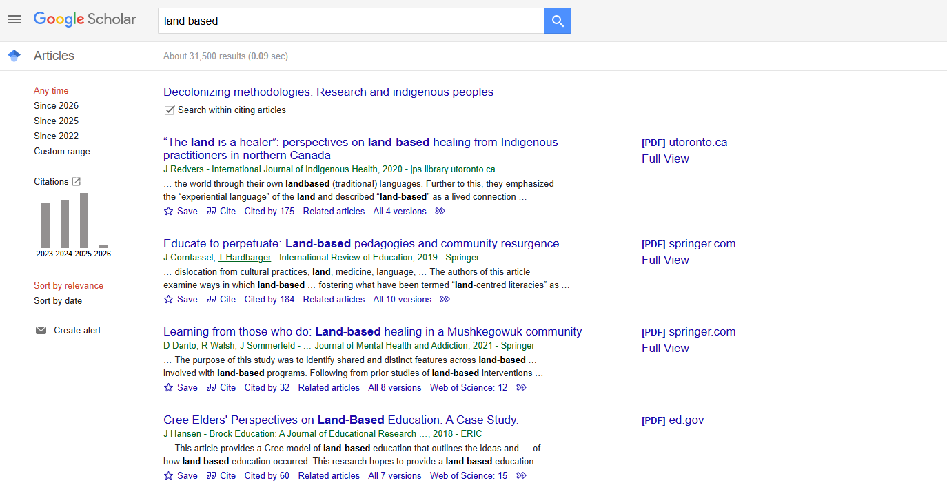
You are looking at books and articles that have cited this book.
2. Now you have a list of books and articles that have cited the title you searched. Select "Search within citing articles" and try performing a keyword search to narrow your results.

Slide 35
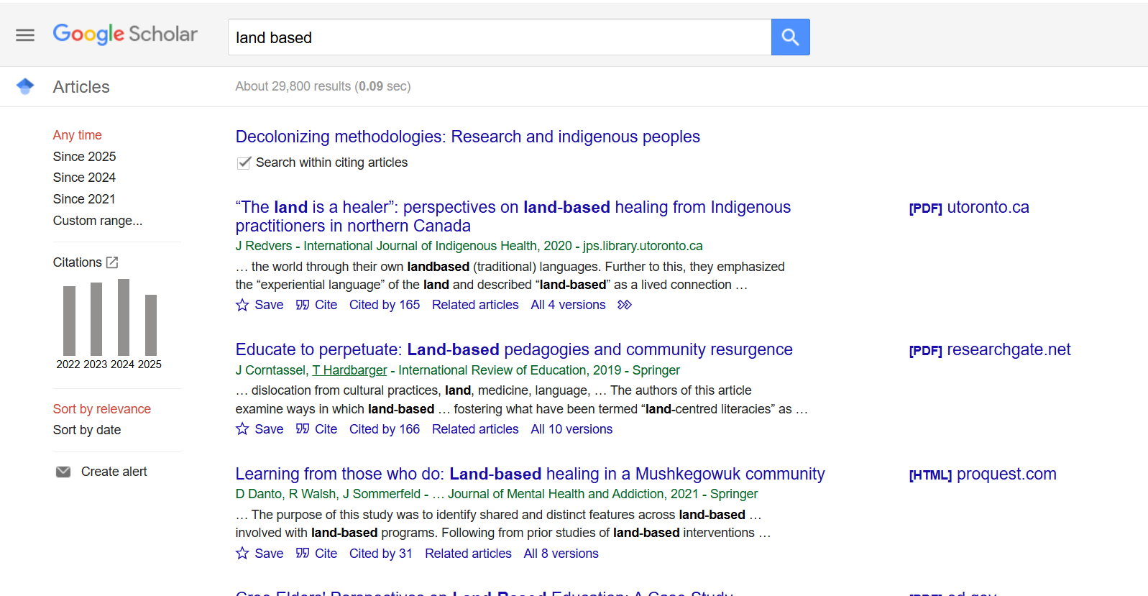
3. Look for author self-identification or biographies which identify authors as Indigenous within articles. Indigenous scholars often cite Indigenous research.

Slide 36

Primary sources

Slide 37
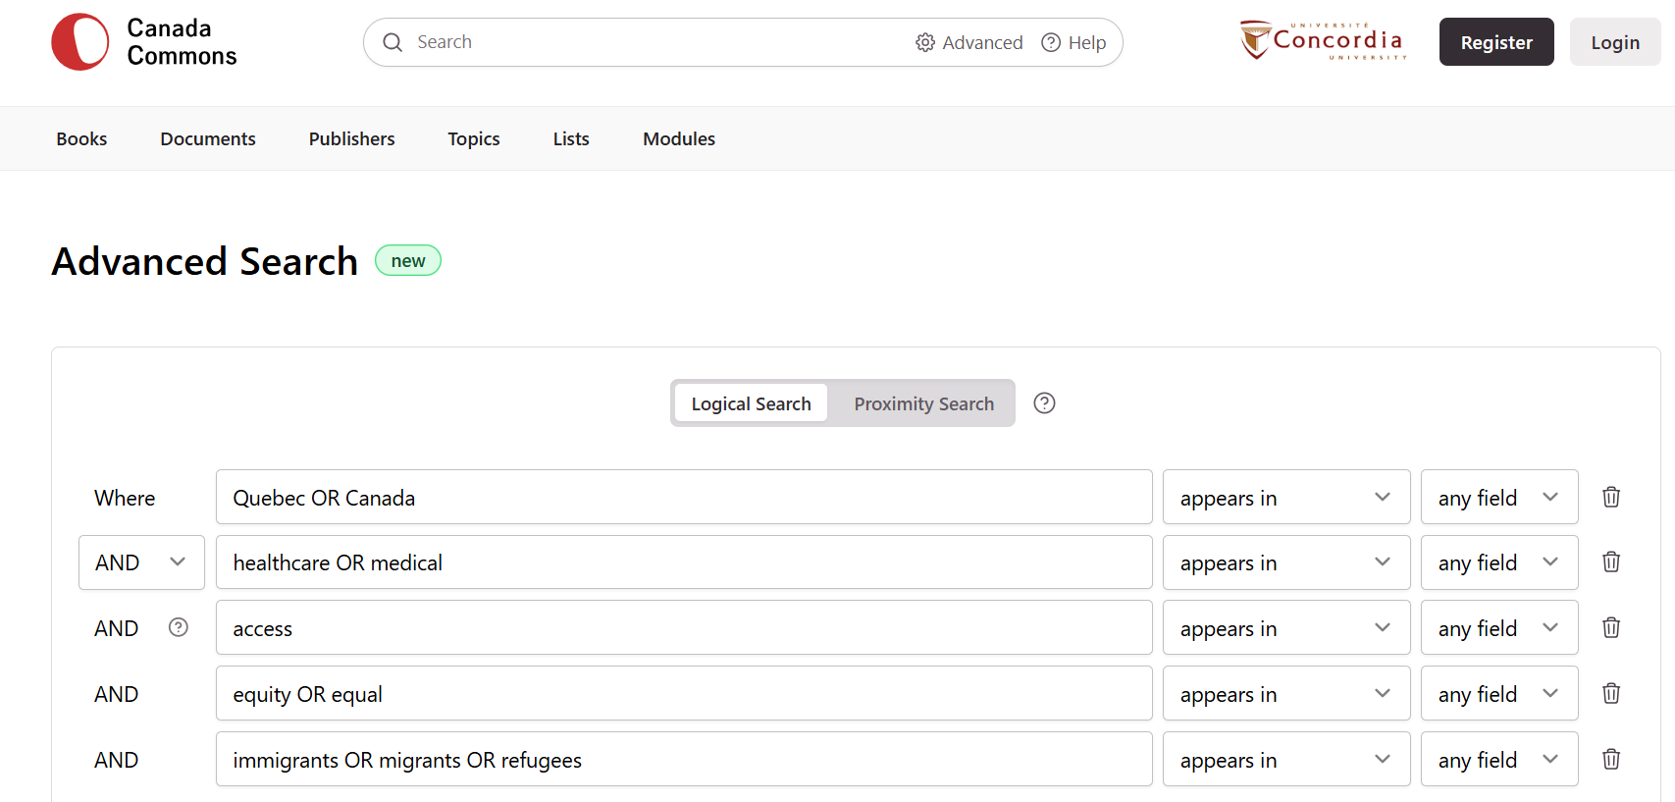
Canada Commons: public policy documents, government documents, publications from think tanks, non-governmental organizations, non-profits, charities
Canada Commons contains government publications, NGO, Non-profit, and Think Tank publications

Slide 38
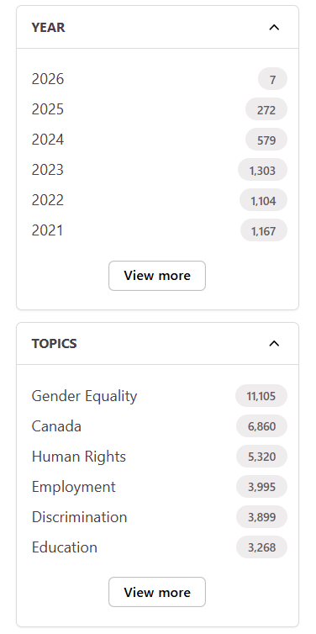
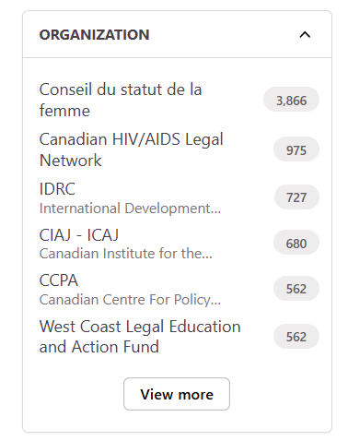
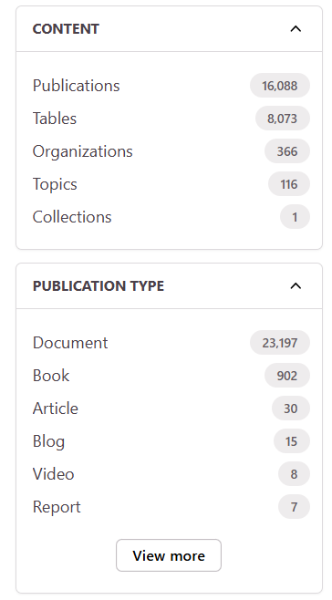
All the limiting options in Canada Commons, to narrow your searches

Slide 39
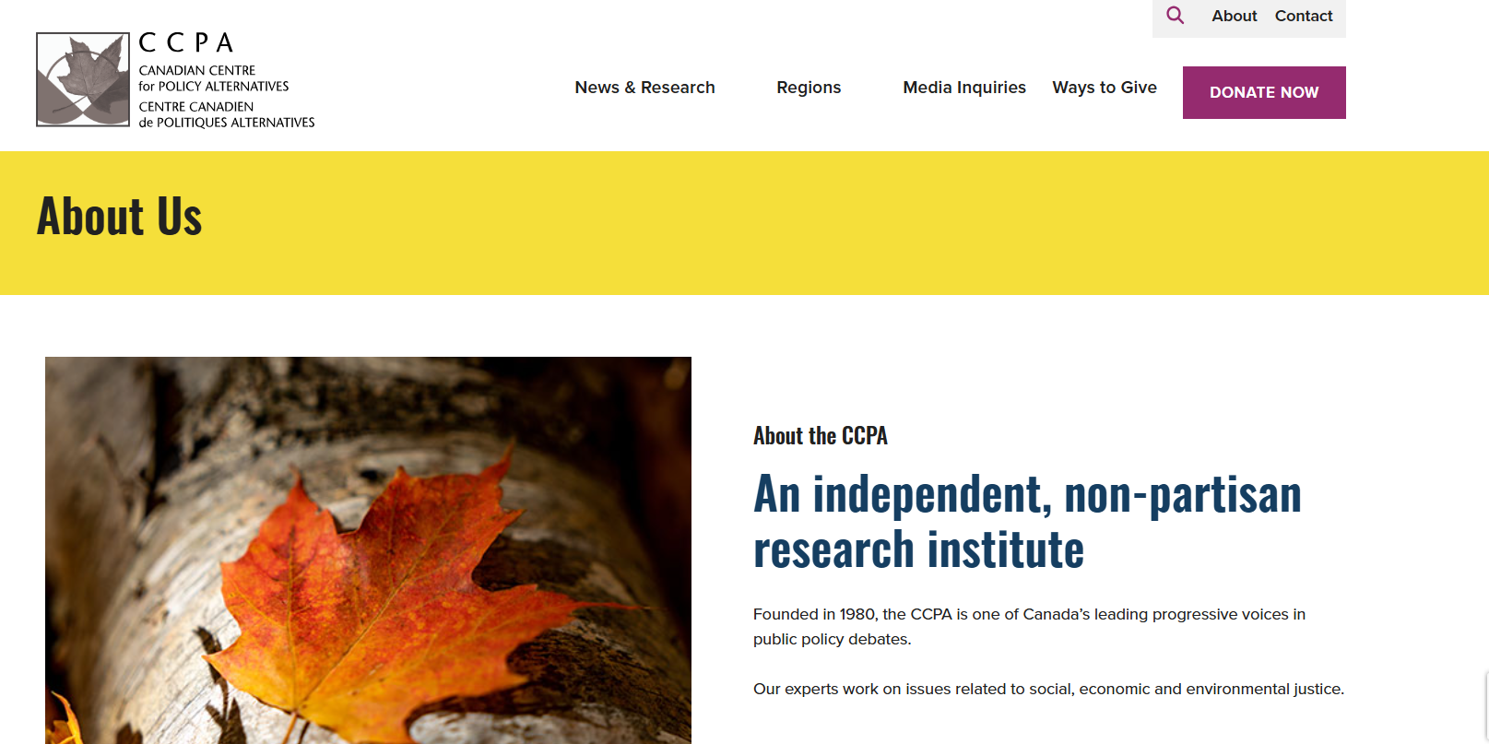
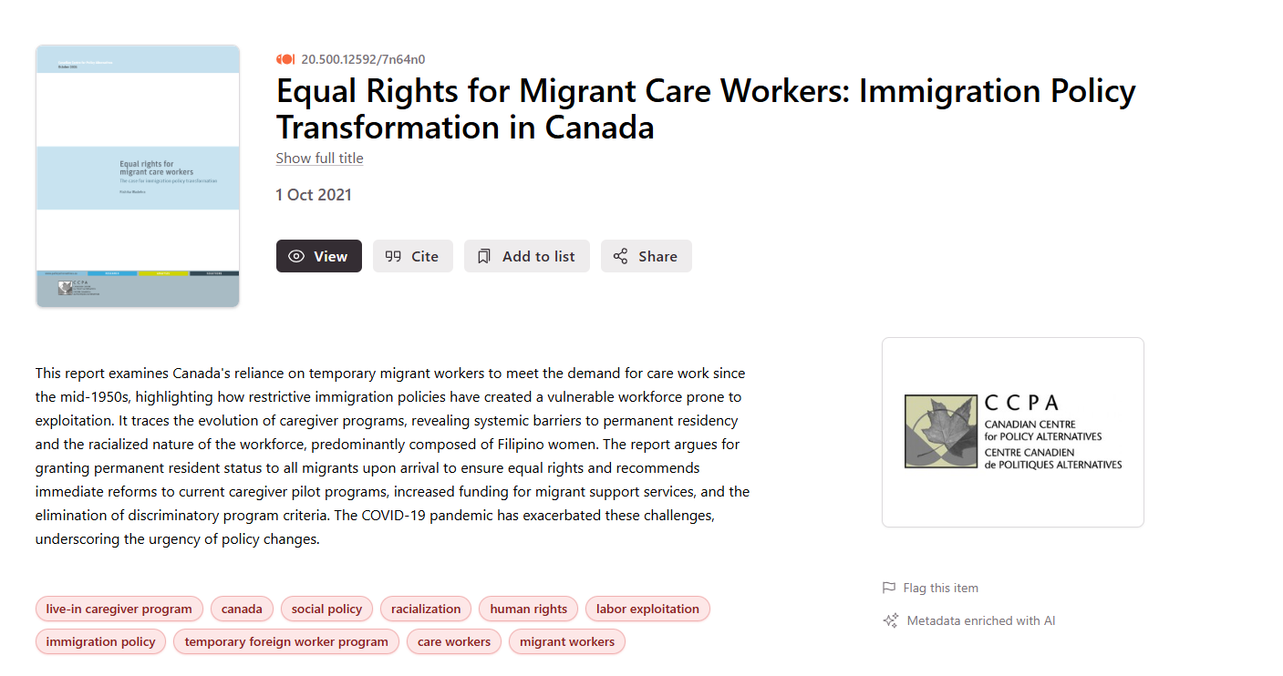
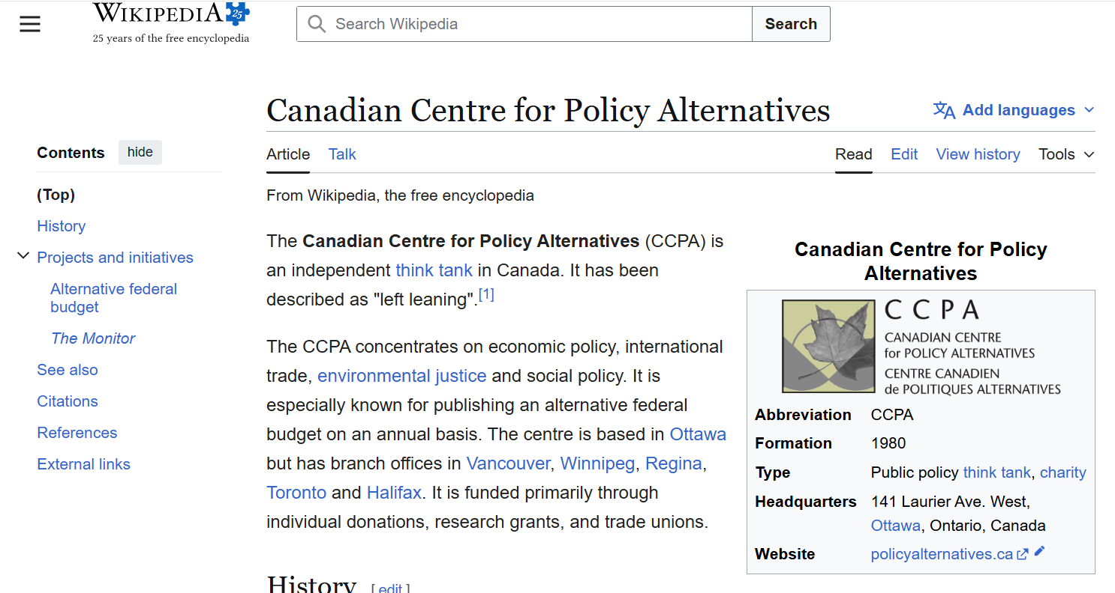
Who is the author? Who is the organization?

Slide 40
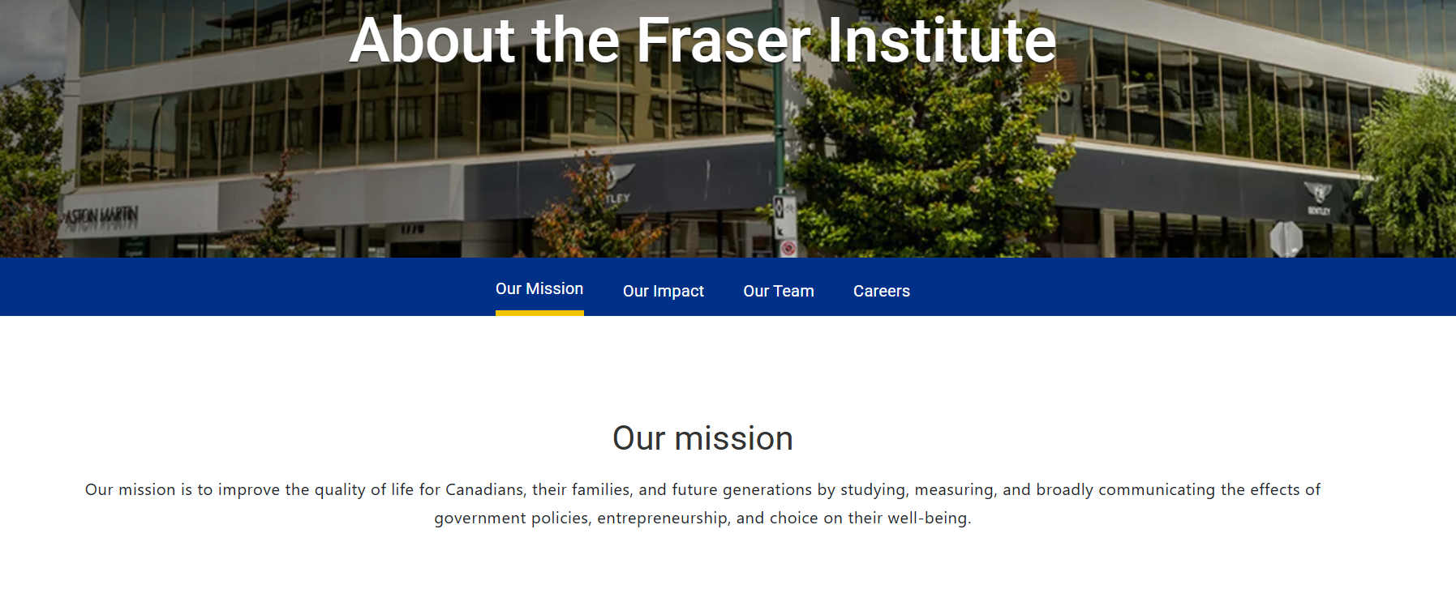
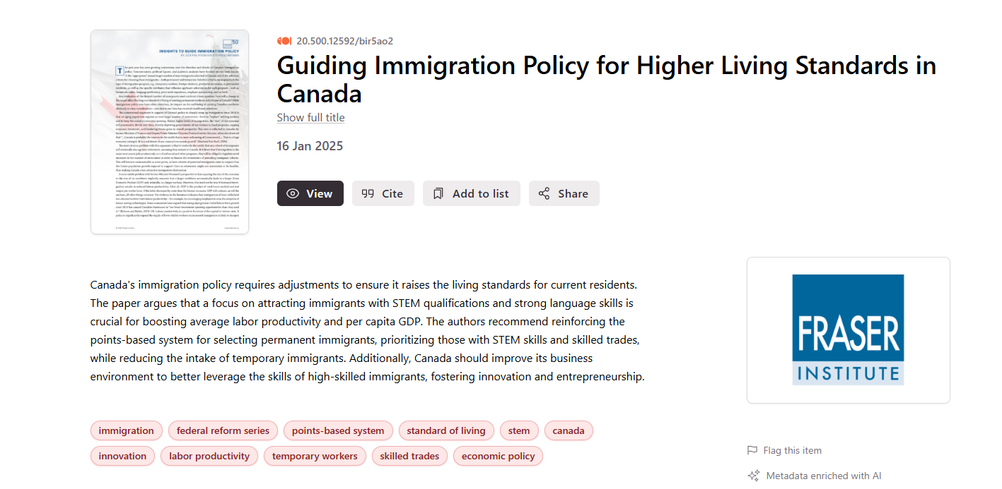
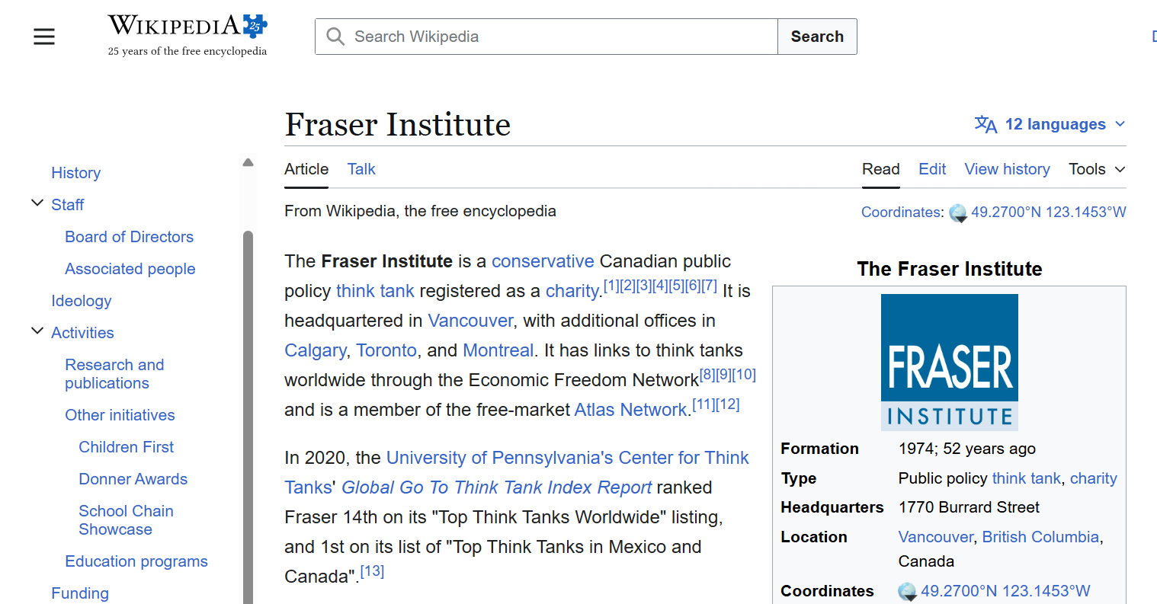
Who is the author? Who is the organization?

Slide 41
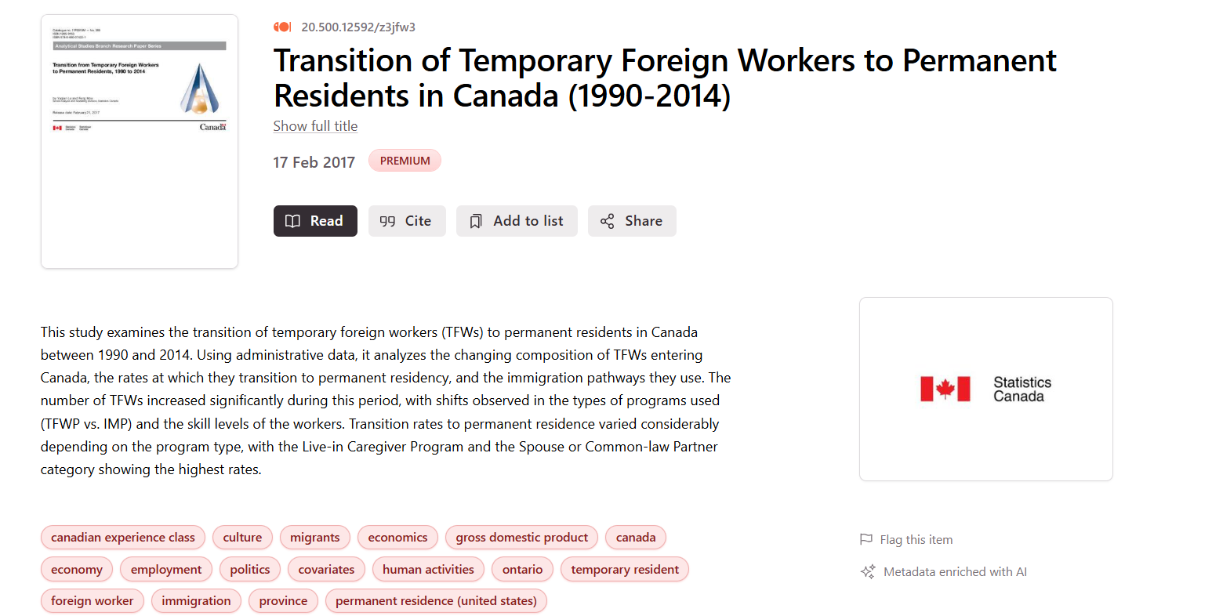
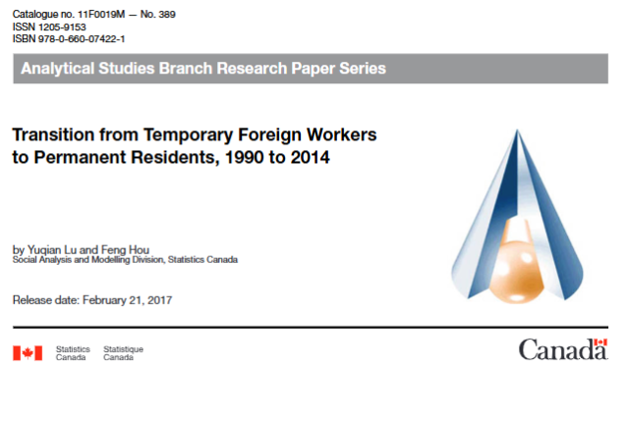
Is a government the publisher/author? Look for official agencies. Government of Canada branding.

Slide 42
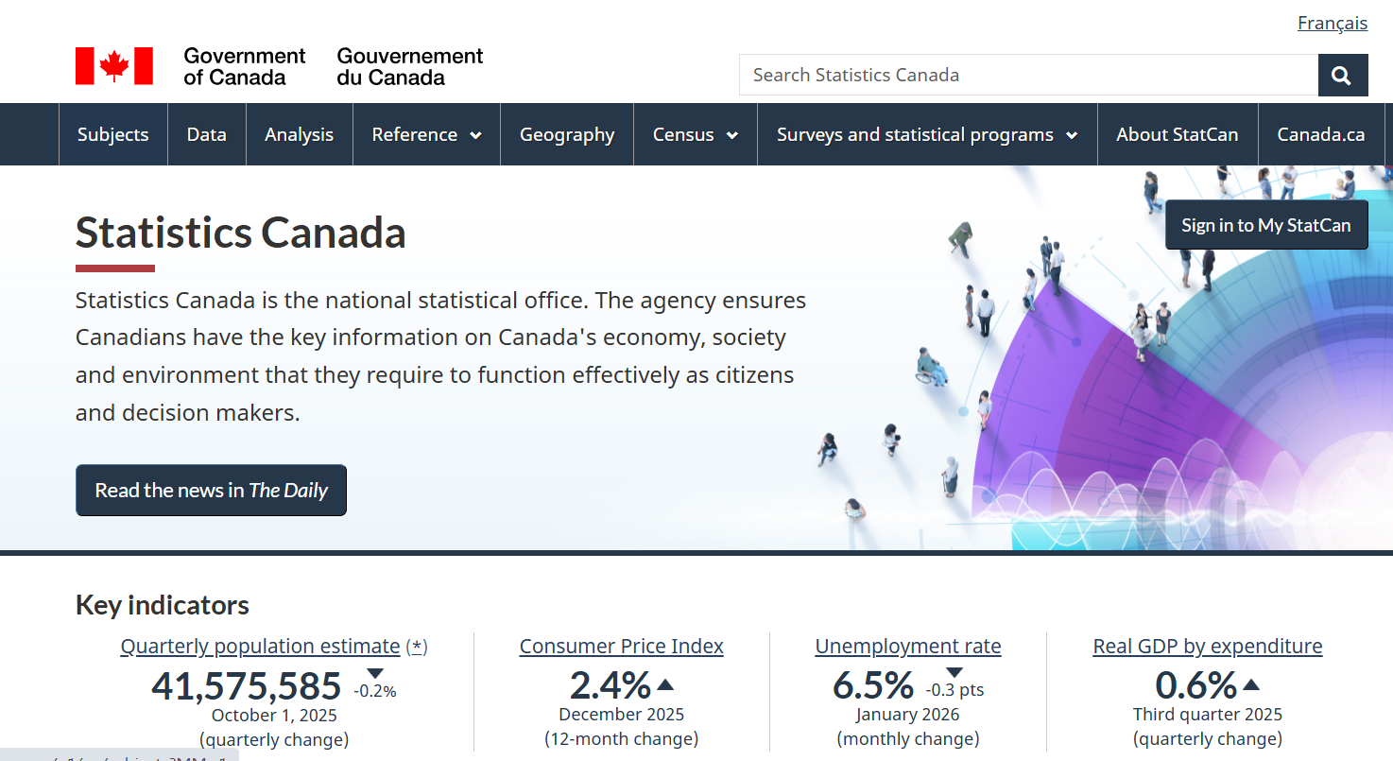
https://www.statcan.gc.ca/en/start Canada’s Statistical Agency

Slide 43
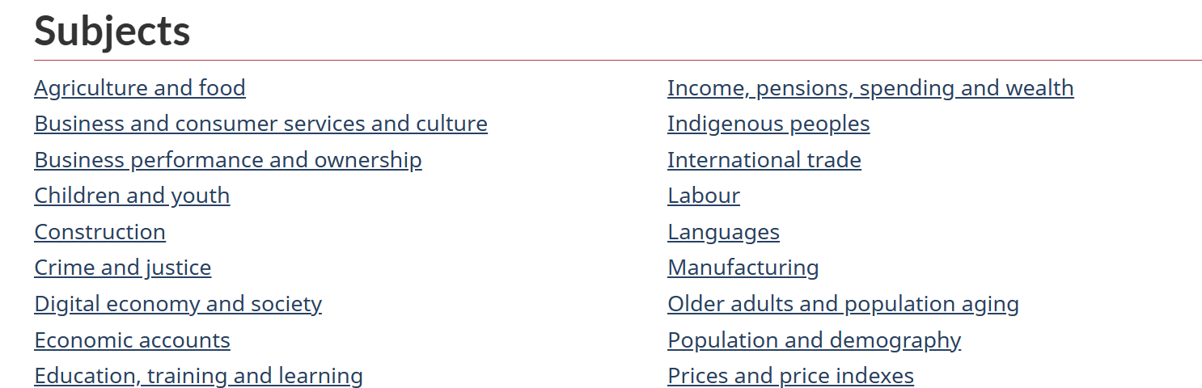
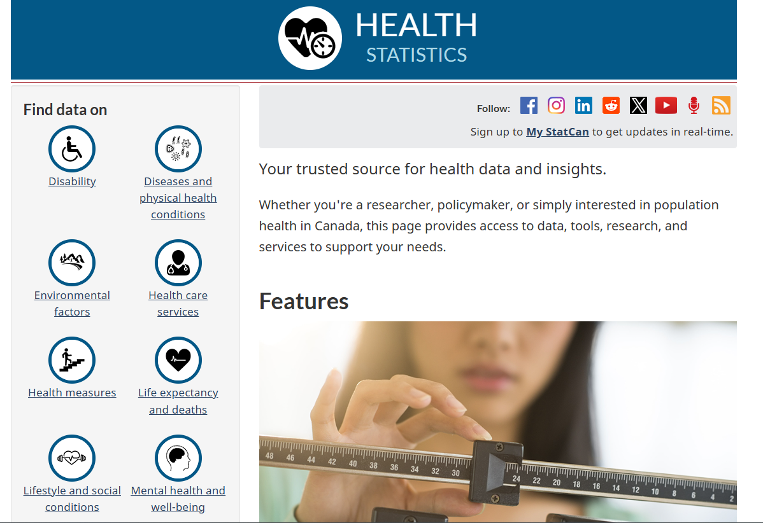
Choose a general subject that is related to your topic
There will be subcategories in which you can locate related data

Slide 44
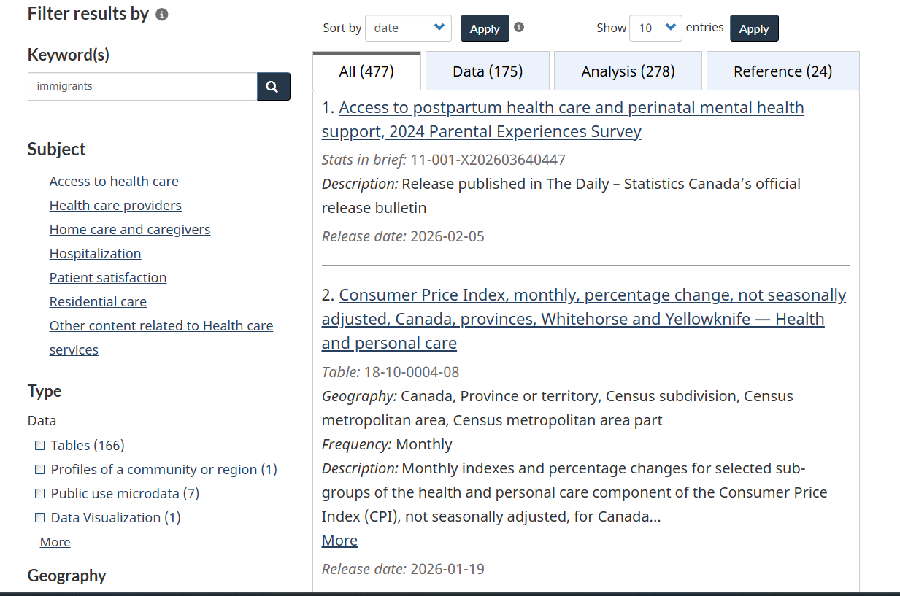


You will find a list of data tables.
Use the subjects to narrow to tables about a specific subtopic.
Or, use the keyword search to find your topic terms in tables

Slide 45
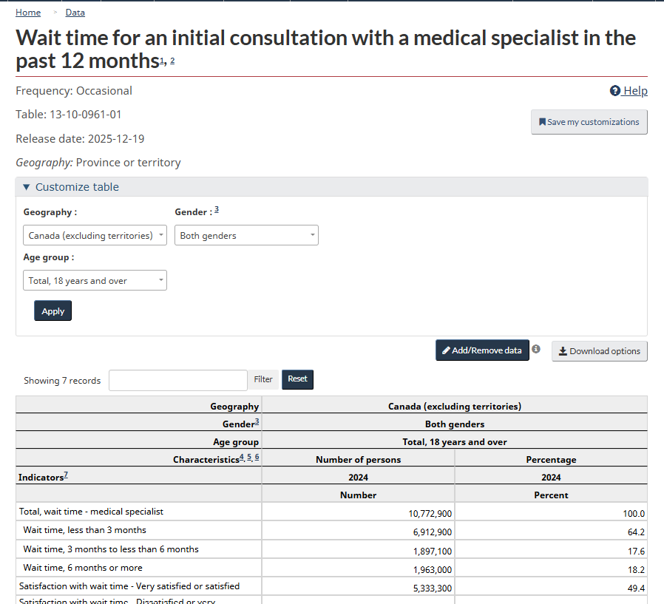
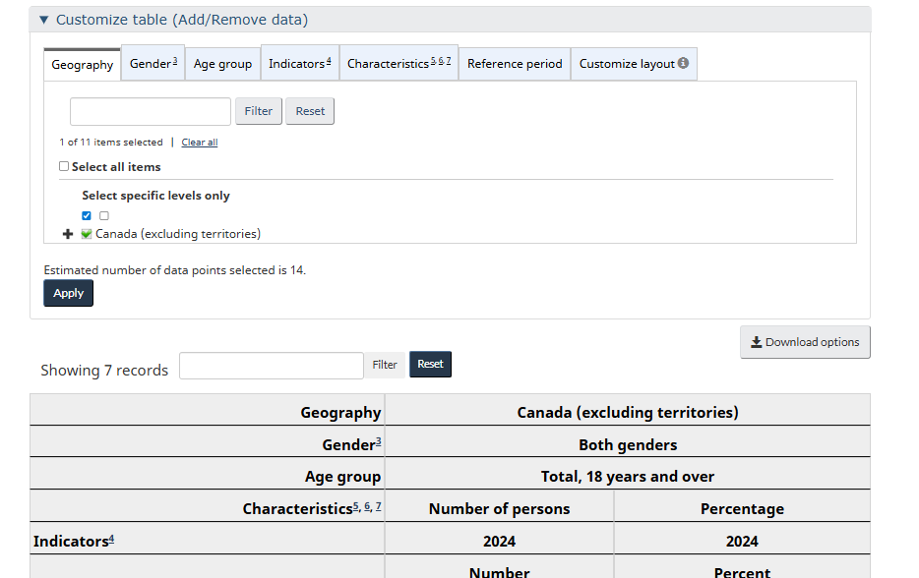

Each tab will give you customization options to add or remove data from the table displayed
If you find a table on your topic, look for the Add/remove data button to customize the table

Slide 46
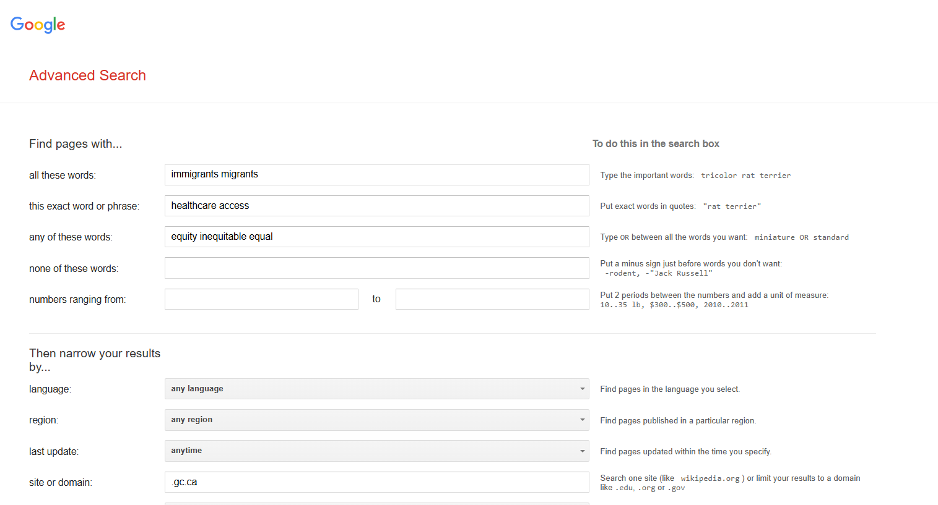




Google Advanced Search: https://www.google.ca/advanced_search
AND
“exact phrase”
OR
This is a domain search for the government of Canada: .gc.ca

Slide 47




A publication from the official government catalogue
Publications from Statistics Canada

Slide 48




Evaluating IGO,NGO and government publications
Who is the publisher? Is it a government or an organization?
What is the date of publication? Is it recent?
What is the source of the statistical information or data?
Are there any official government crests or logos on the publication?
What kind of website is the publication coming from? Is it a recognizable institutional or organization’s domain?

Slide 49

Need help, ask us!
Michelle.Lake@Concordia.ca

