Slide 1
POLI 405: Comparative Electoral Systems Library Workshop
Michelle Lake
Political Science, SCPA, FPST and Government Publications Librarian
Michelle.Lake@concordia.ca

Slide 2
Who am I?
Michelle Lake, librarian for Political Science, the School of Community and Public Affairs, First Peoples Studies, and Government Publications
Michelle.Lake@Concordia.ca / Make an appointment or ask a question
What do I do?
Provide research support, assist with search strategies
Help students navigate library databases, assist with selection and evaluation of sources
Help students find and access materials they need
Build guides, resources and pathfinders to help students locate research materials
Help with citation issues
Choose the books we buy for the above subject areas

Slide 3
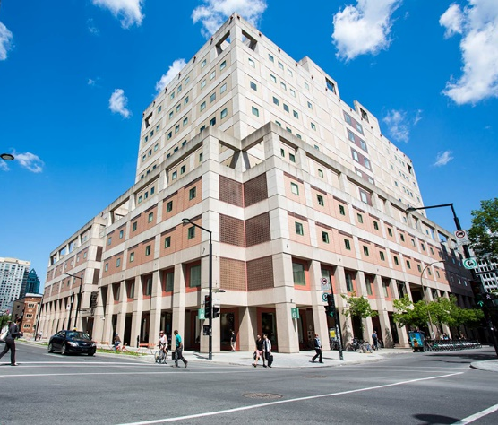
The Librar(ies)
24/7 access, with student card, after 11pm
Webster Library (LB) – downtown on SGW campus & Vanier Library (VL) on Loyola campus
Webster: Social Sciences, Humanities, Business, Engineering & Fine Arts
Vanier: Science(s), Health, Communications, Journalism and Psychology
Course Reserves Room(s): have the required undergraduate print textbooks for the courses taught at that campus (for example: Webster has the Political Science and SCPA course reserves)

Slide 4
Library Services
Your student card is your library card.
You need it to:
borrow books (up to 100 a time)
borrow a laptop (3 day loan) and other technology
print on campus (add money to your Dprint account)
access the library overnight during 24/7 hours.
Webster library has 5 book scanners (And Vanier has 2!) that can be used for free to scan chapters from our print books and email them to yourself as a PDF.
To use Library databases, access online articles and ebooks when you are off campus, login with your MyConcordia Netname and password.

Slide 5
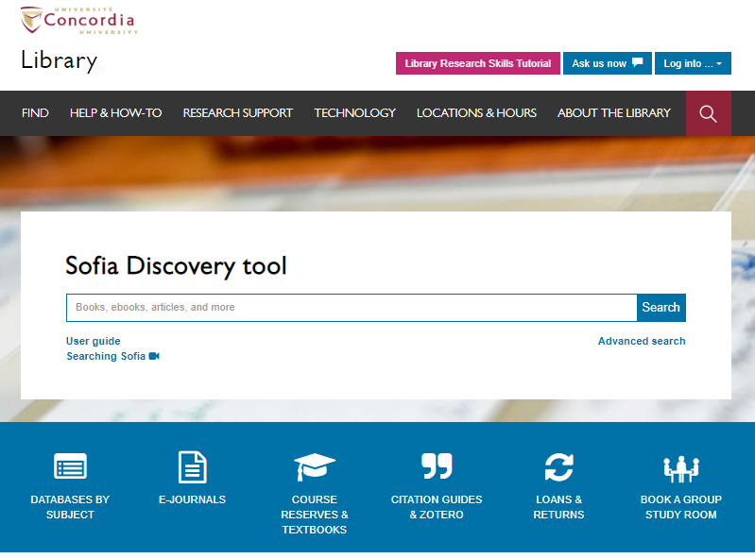
Use the Sofia Discovery tool to find print books, ebooks, and journal articles from the library.

Slide 6
How can I find out if the library has access to an item I’m looking for?

Slide 7
Robinson, Frances. “The Alabama Paradox.” Teaching Mathematics and Its Applications, vol. 1, no. 2, 1982, pp. 69-72.

Slide 8
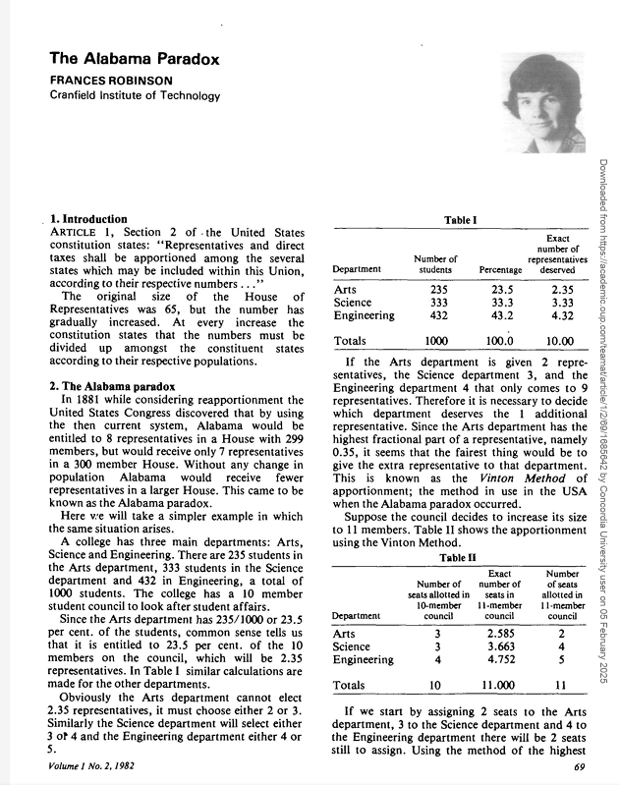
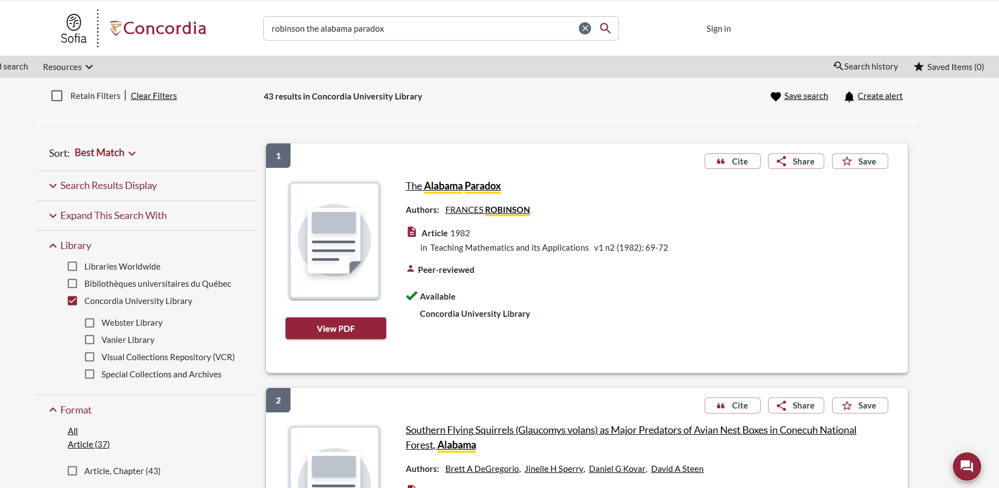

Slide 9
Krook, Mona Lena, ‘Electoral Systems and Women’s representation’, in Erik S. Herron, Robert J. Pekkanen, and Matthew Shugart (eds), The Oxford Handbook of Electoral Systems, Oxford Handbooks (2018).

Slide 10
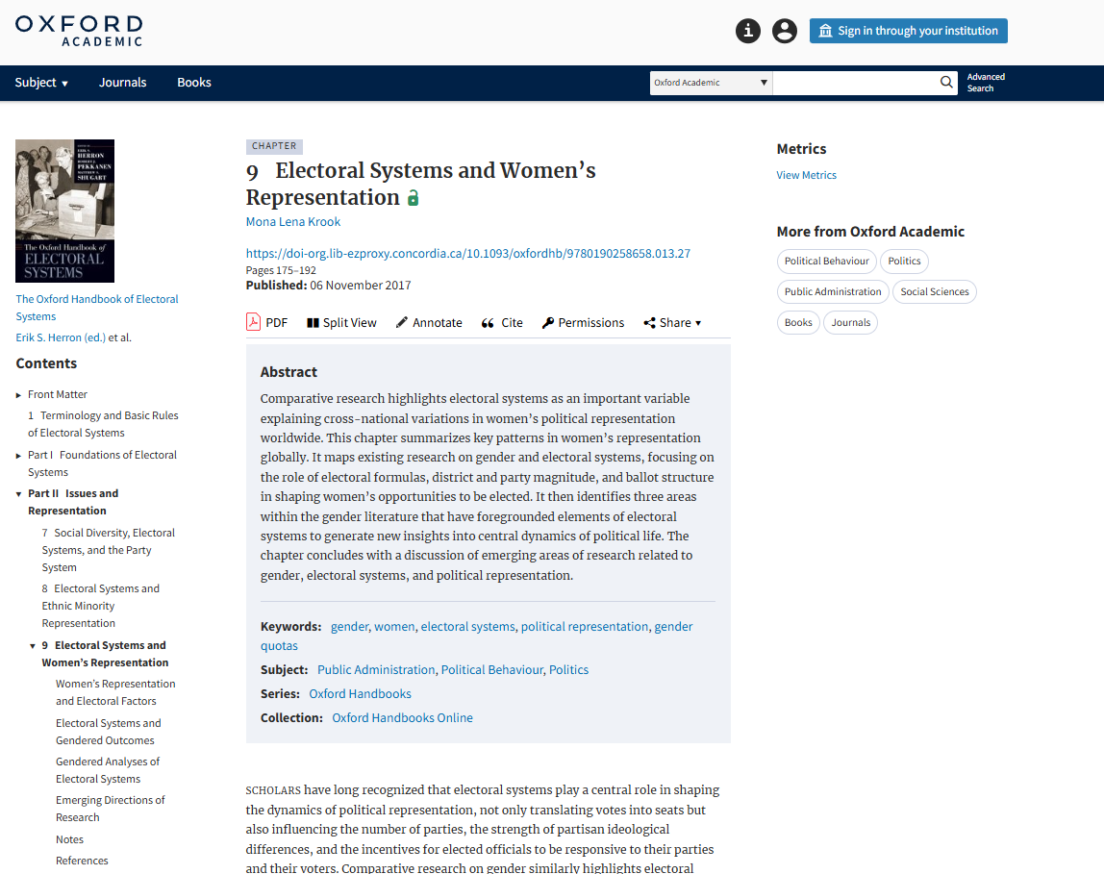
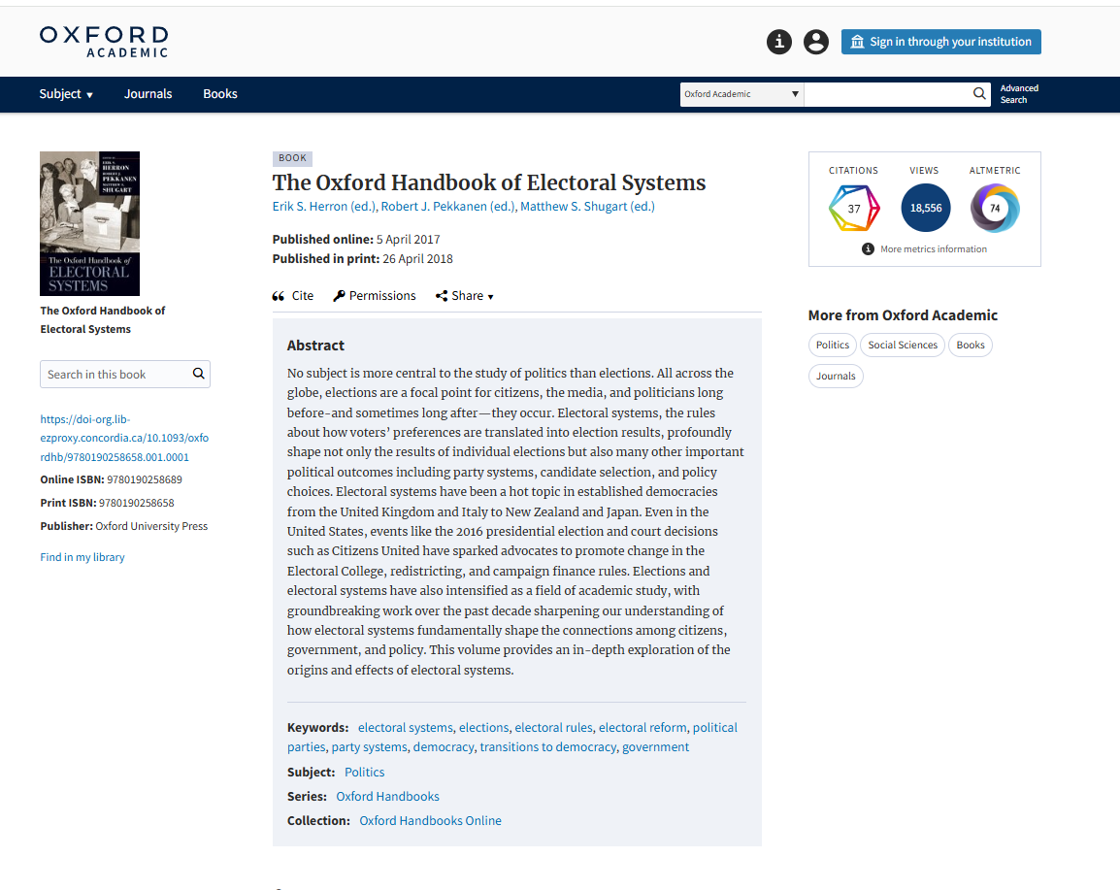
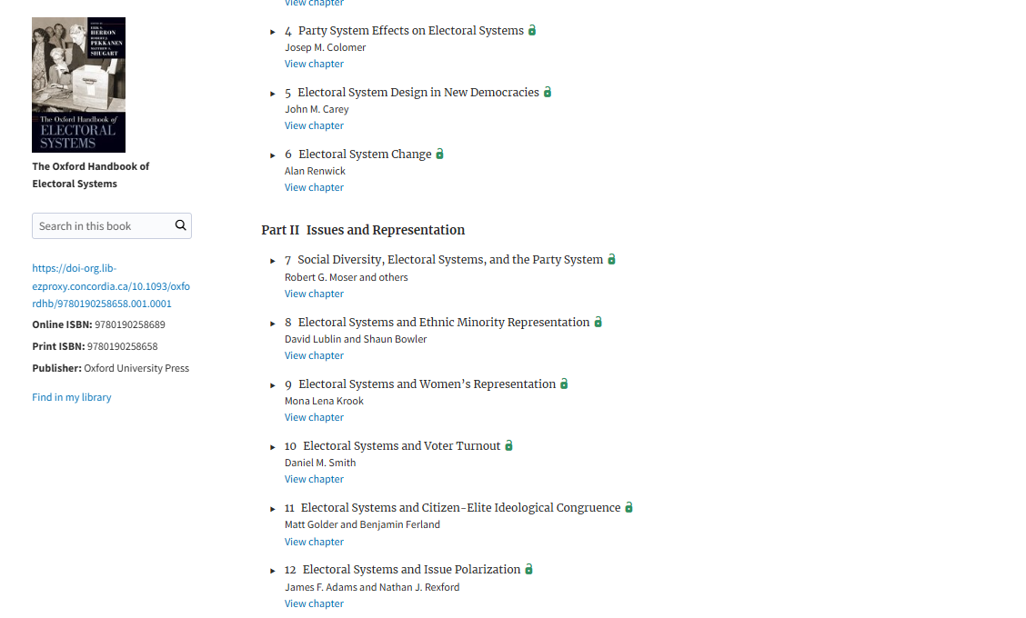
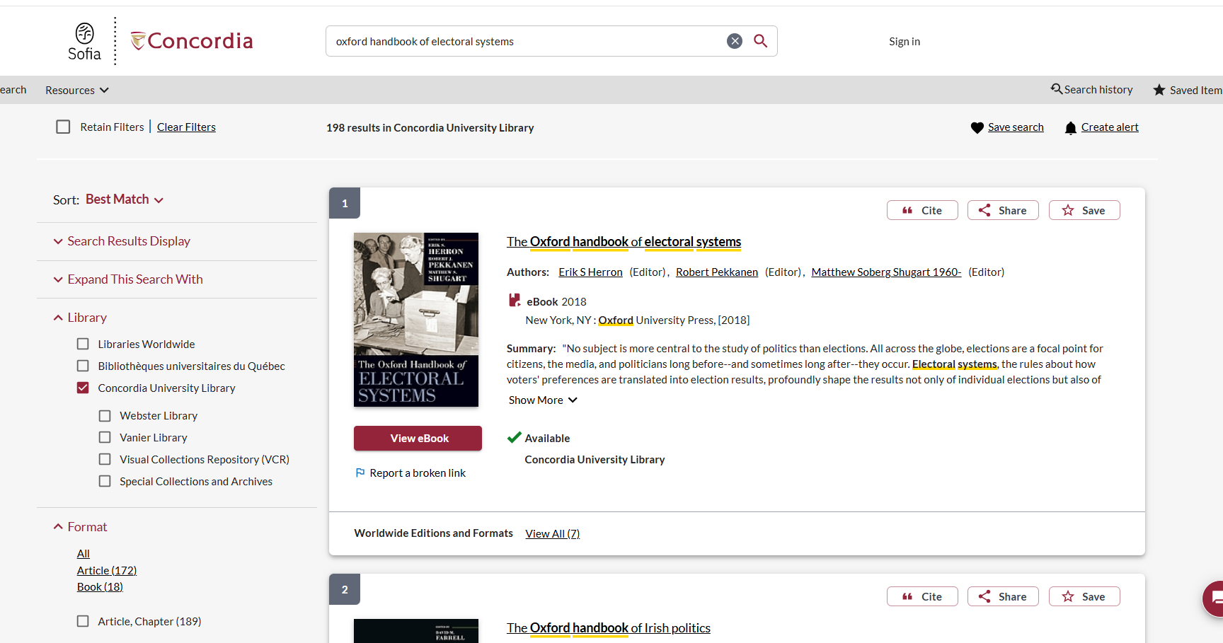

Slide 11
Grossman, E., & Guinaudeau, I. (2021). Do elections (still) matter?: mandates, institutions, and policy in Western Europe. New York: Oxford University Press.

Slide 12
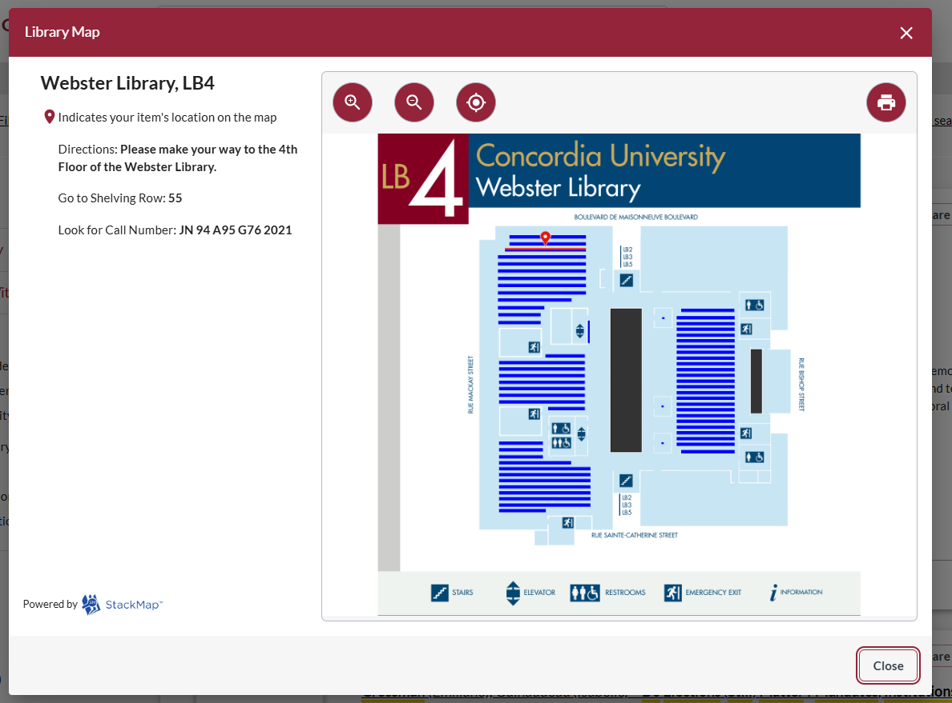
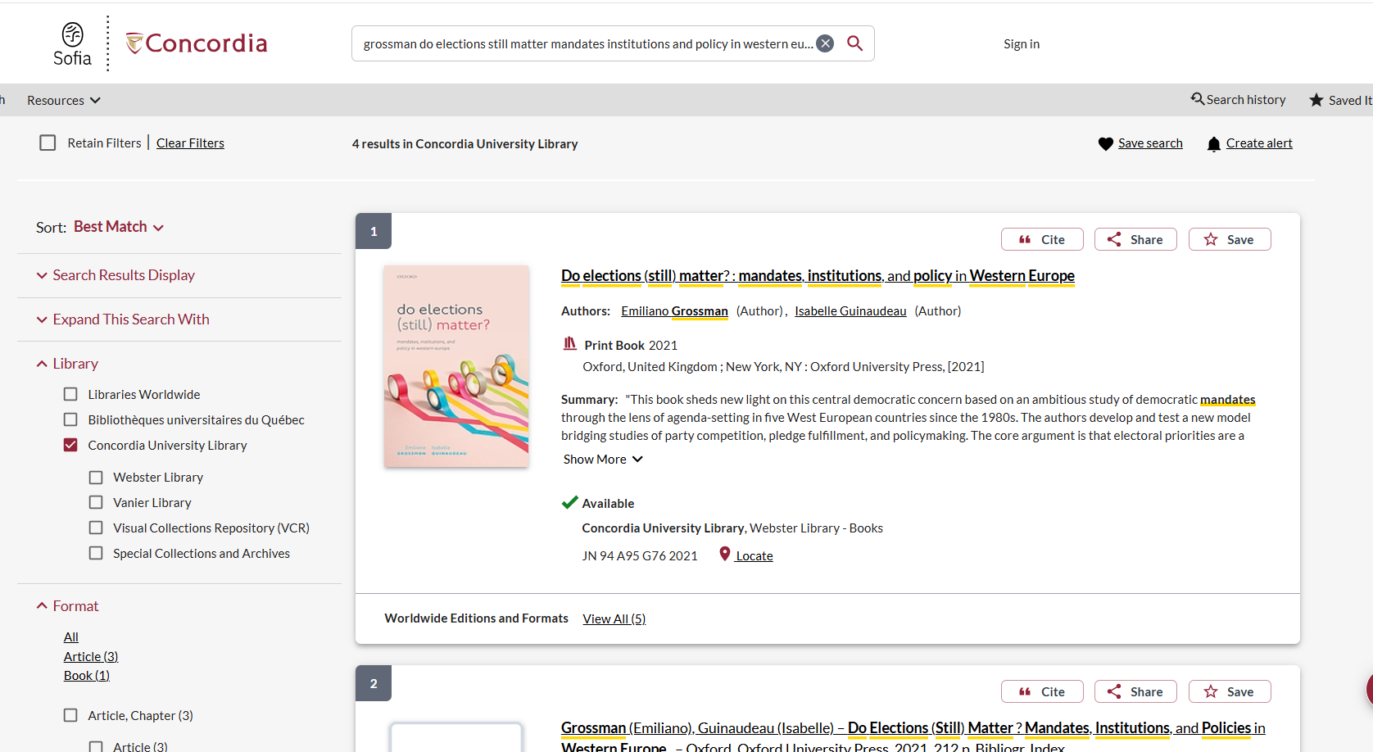

Slide 13
Background Information

Slide 14
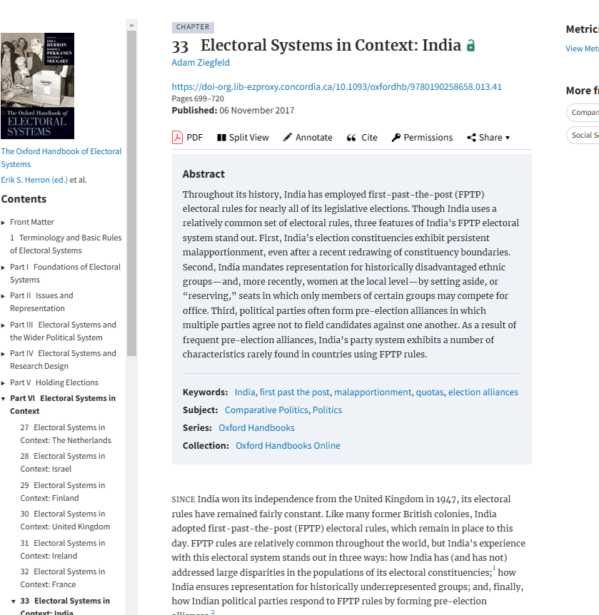
Case study research paper (3500 to 4000 words) that discusses either the origin or the political consequences of the electoral system in a contemporary democracy of their choice.
I’m interested in the electoral system in India
I need to gather some initial information about this system
- > Oxford Handbook of Electoral Systems: Chapter 33 Electoral Systems in Context: India

Slide 15
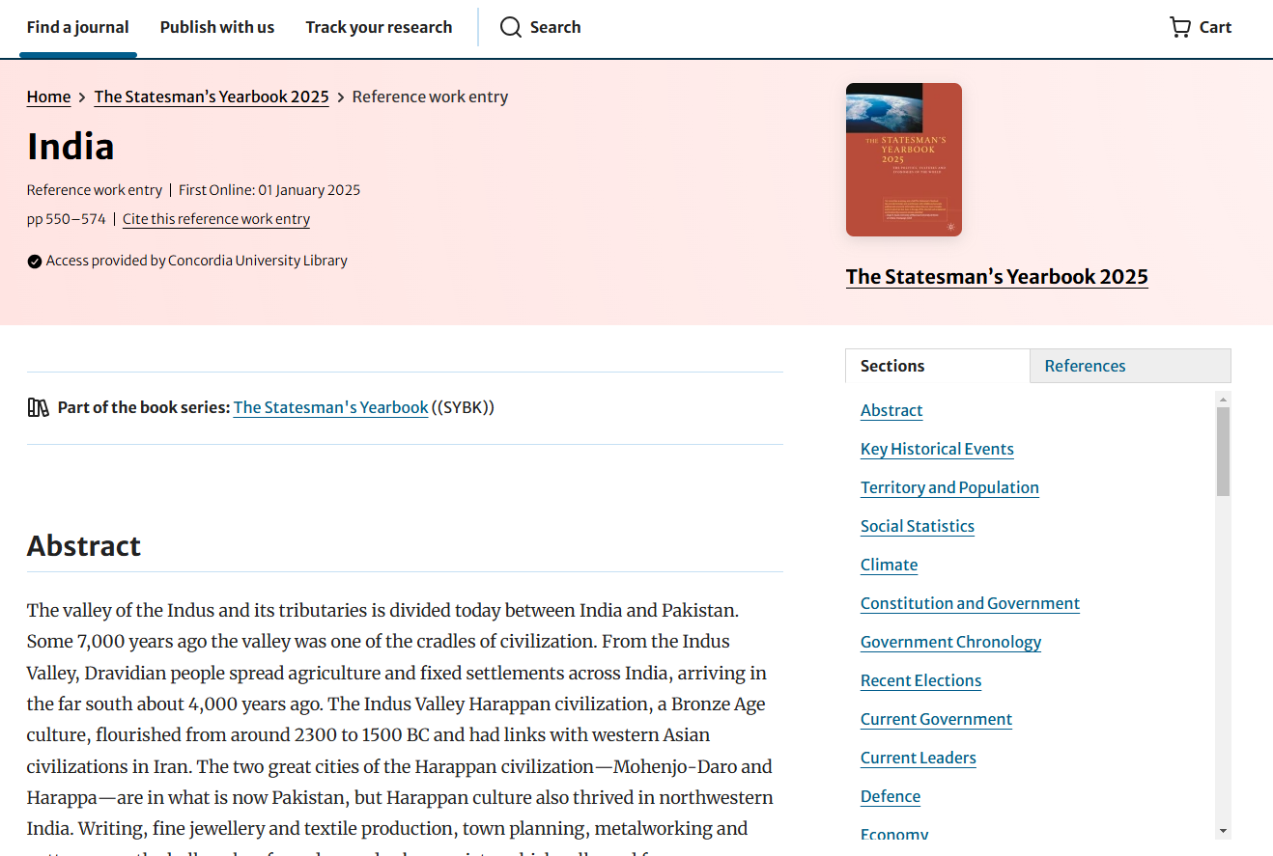

Slide 16
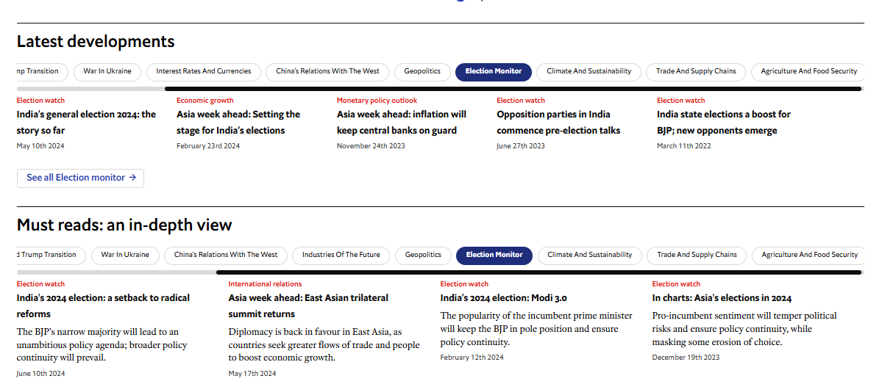
EIU Viewpoint: Country - Politics

Slide 17
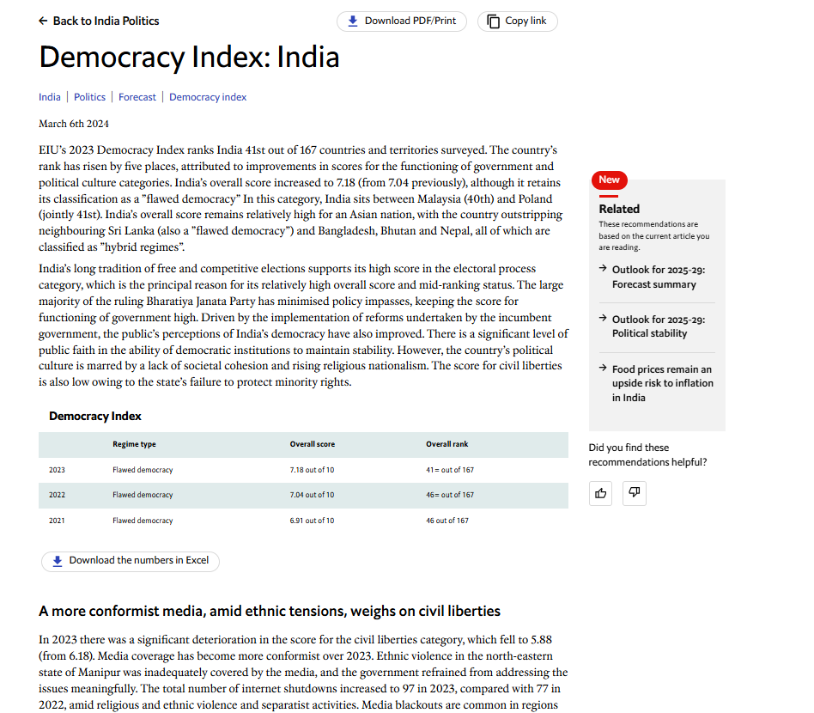
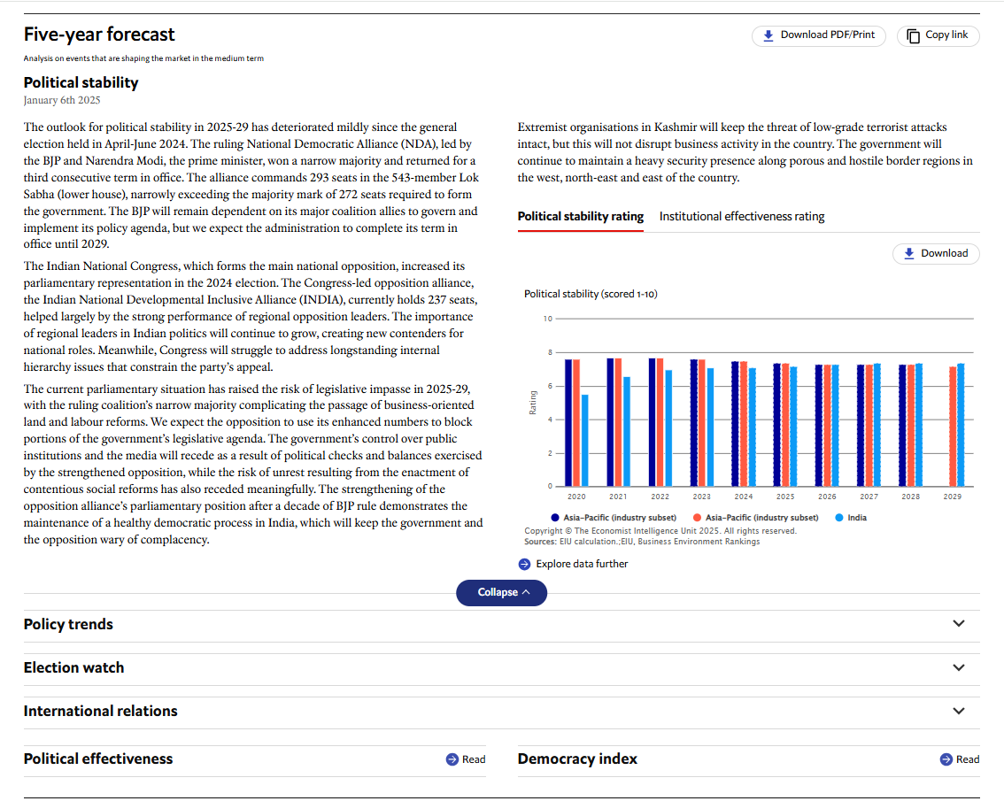

Slide 18
Search strategies

Slide 19
How do we combine search words for the best possible results?
AND: combines concepts and limits your results
politics AND security
state OR government
election OR voting
OR: allows you to insert synonyms or alternative terms and increases your results

Slide 20
How do we combine search words for the best possible results?
“quotation marks”: If you put two or more words in quotation marks, that exact phrase will be searched and limits your results.
“political parties”
“foreign policy”
Democra*
Finds: democracy, democracies, democratic, democratically, democratization
* - when you add an asterisk on the end of a word, your results will contain all the words with those endings or suffix

Slide 21
Avoid Searching with linking words
Effects
Impact
Consequences
Influence
Results
Importance
Significance
Response
Emphasis
Causes
Each author may use different linking words when discussing similar topics.
You don’t want your search to be limited to those books and articles that only contain the word “effect” or “consequence”

Slide 22
Searching in Sofia

Slide 23
What will I find in Sofia?
Academic peer reviewed books (ebooks and print books)
Academic textbooks
Non-academic books
Academic journal articles (peer reviewed and non-peer reviewed)
Government documents
International Organization publications

Slide 24
Why books?
Books can provide comprehensive overviews or background and introductory information that is not covered in journal articles.
Books are much more comprehensive than articles and aim to tell you everything about a topic or in the case of edited books, many perspectives on a topic
Journal articles are much shorter and cover a very specific aspect of a topic.

Slide 25
Why books?
An edited scholarly monograph will have multiple chapters on one broad subject, all by different authors/experts, these chapters can be cited separately; one good book can account for several sources
Using the Index and table of contents, you can navigate through a book to find the exact sections and chapters you need

Slide 26
Library of Congress Classification & Call Numbers
The Library of Congress Classification (LCC) is a classification system that was first developed in the late nineteenth and early twentieth centuries to organize and arrange the book collections of the Library of Congress.
Over the course of the 20th century, the system was adopted by other libraries as well, especially large academic libraries in the United States and Canada.
The system divides all knowledge into twenty-one basic classes, each identified by a single letter of the alphabet.
Most of these alphabetical classes are further divided into more specific subclasses, identified by two-letter, or occasionally three-letter, combinations.

Slide 27
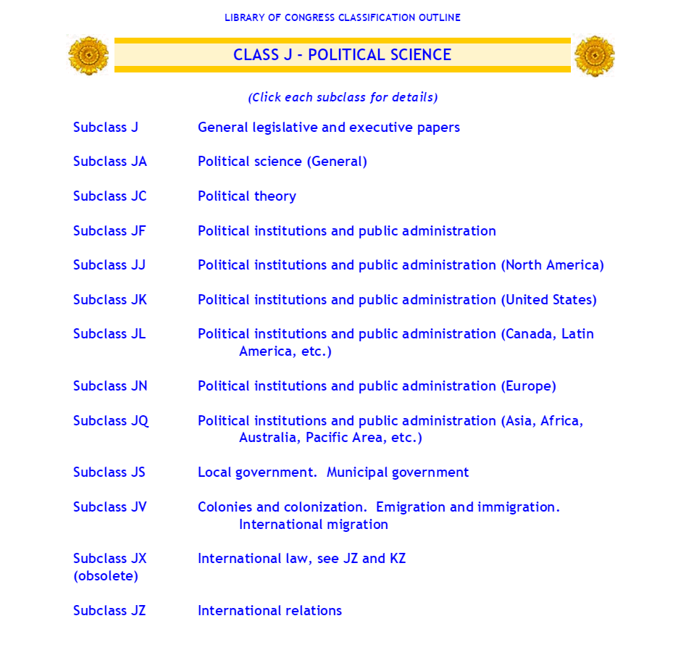
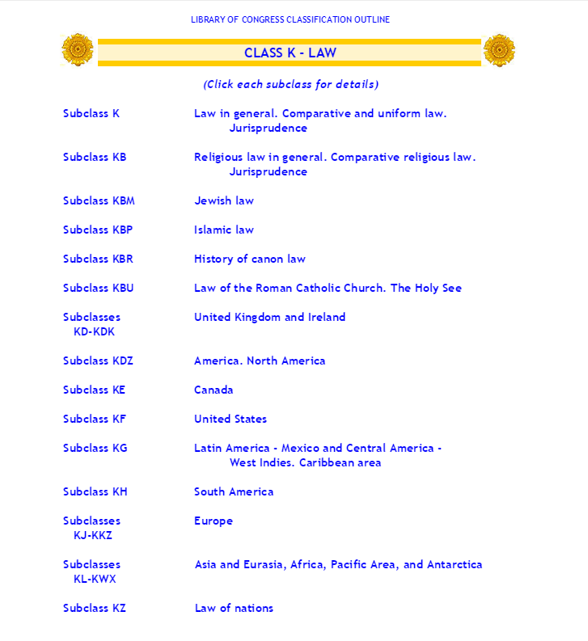
Located in the 4th floor stacks of Webster Library

Slide 28
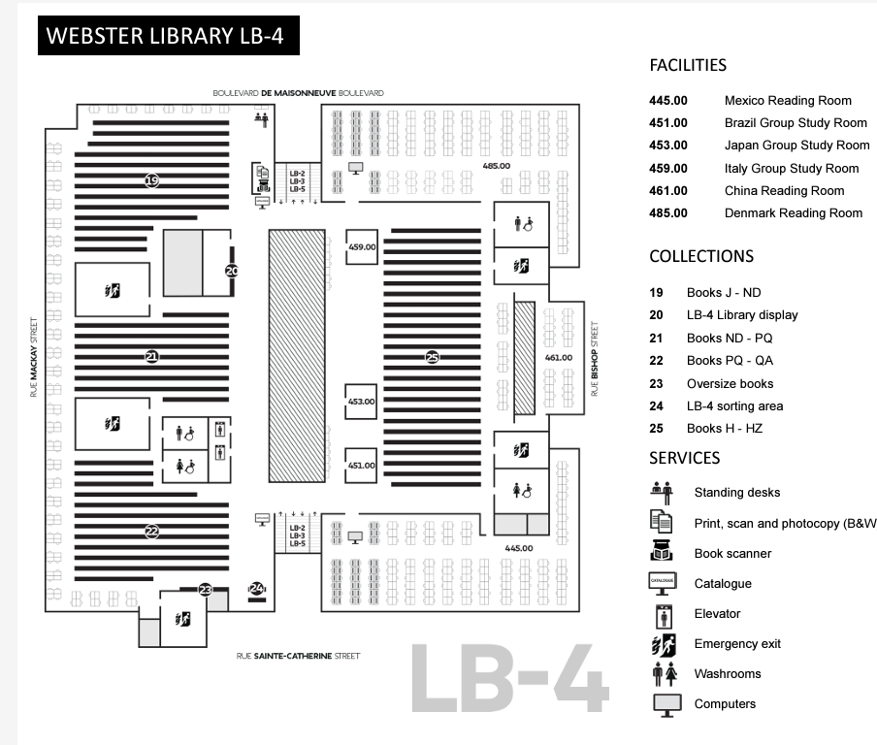

Slide 29
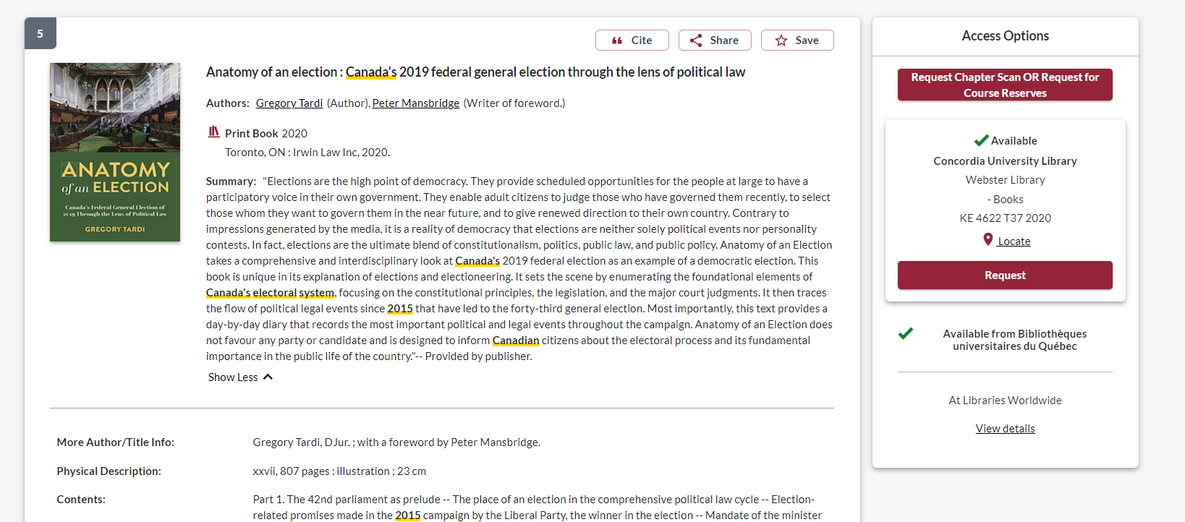
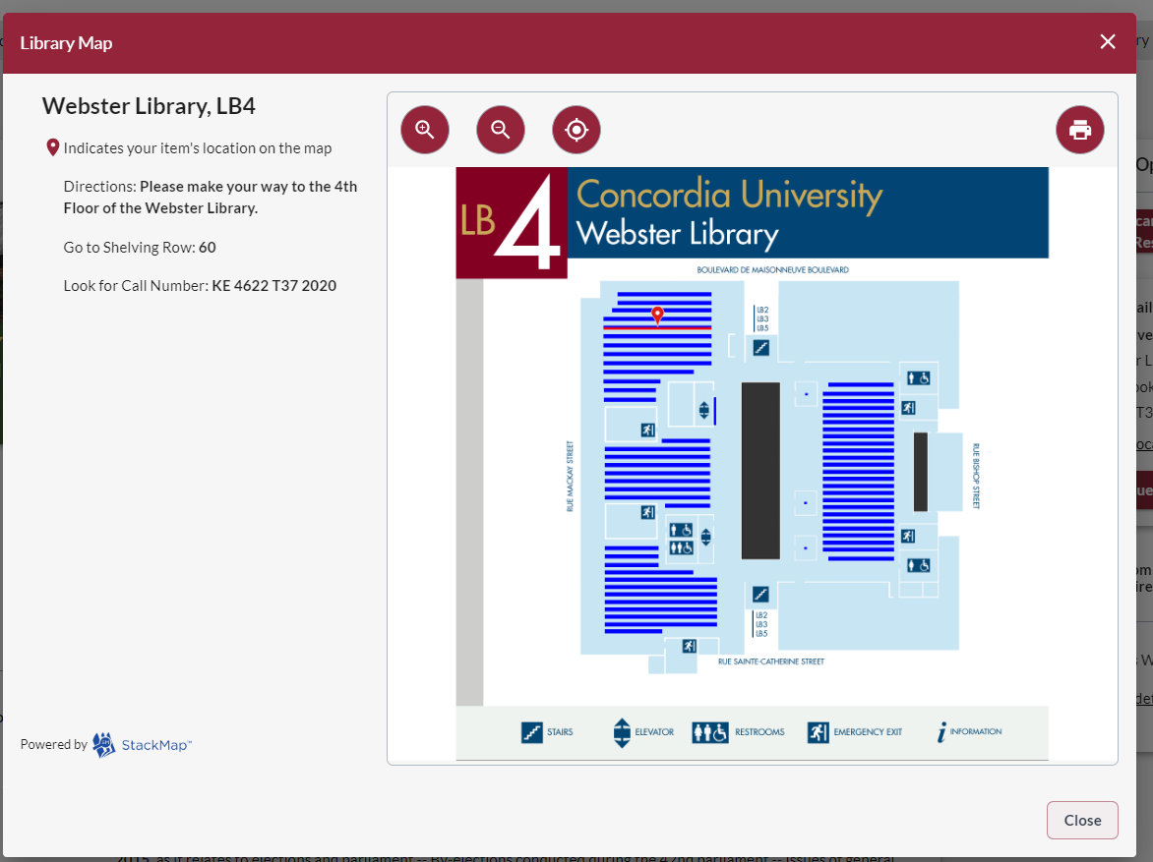

Slide 30
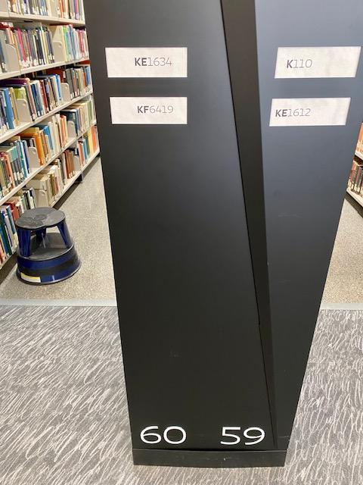
The call number I want to find, KE 4622 T37 2020, will fall in the range on shelf 60: between KE 1634 – KF 6419

Slide 31
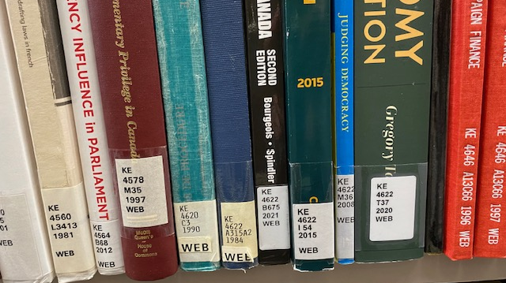

Slide 33
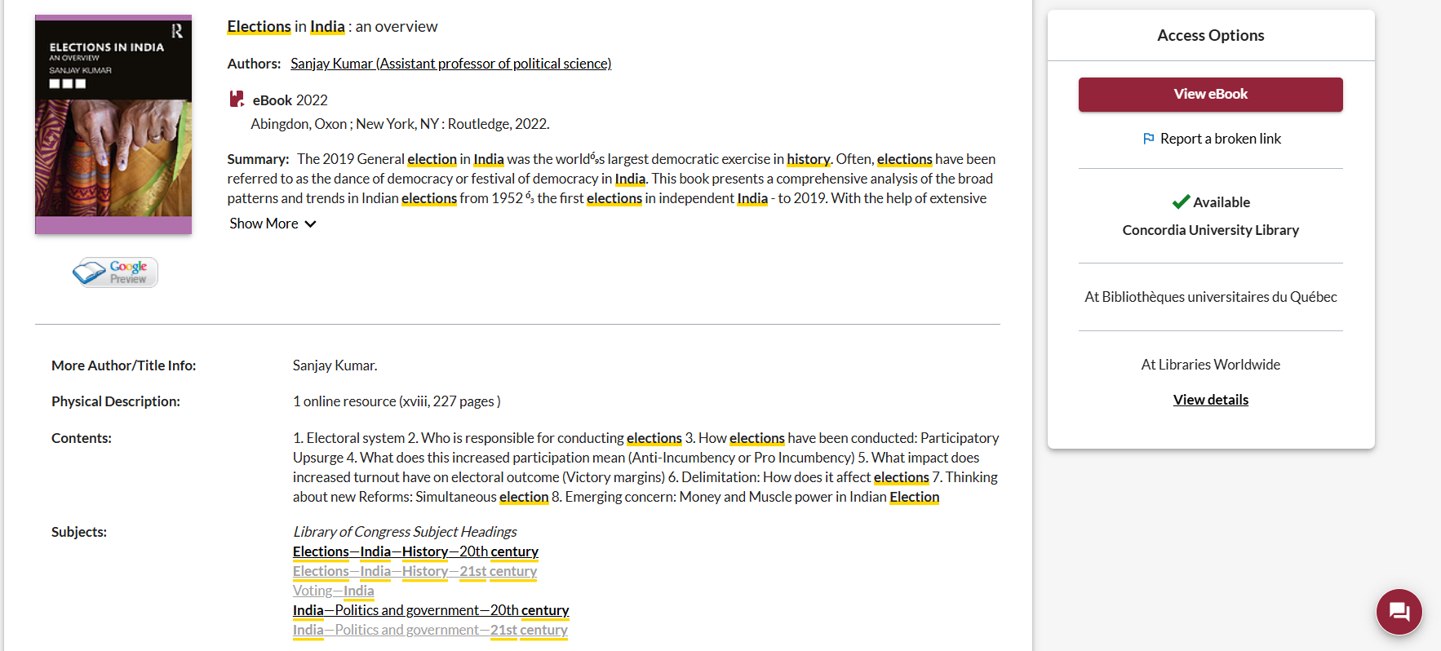
Use the subjects to locate more books and articles on related topics

Slide 34
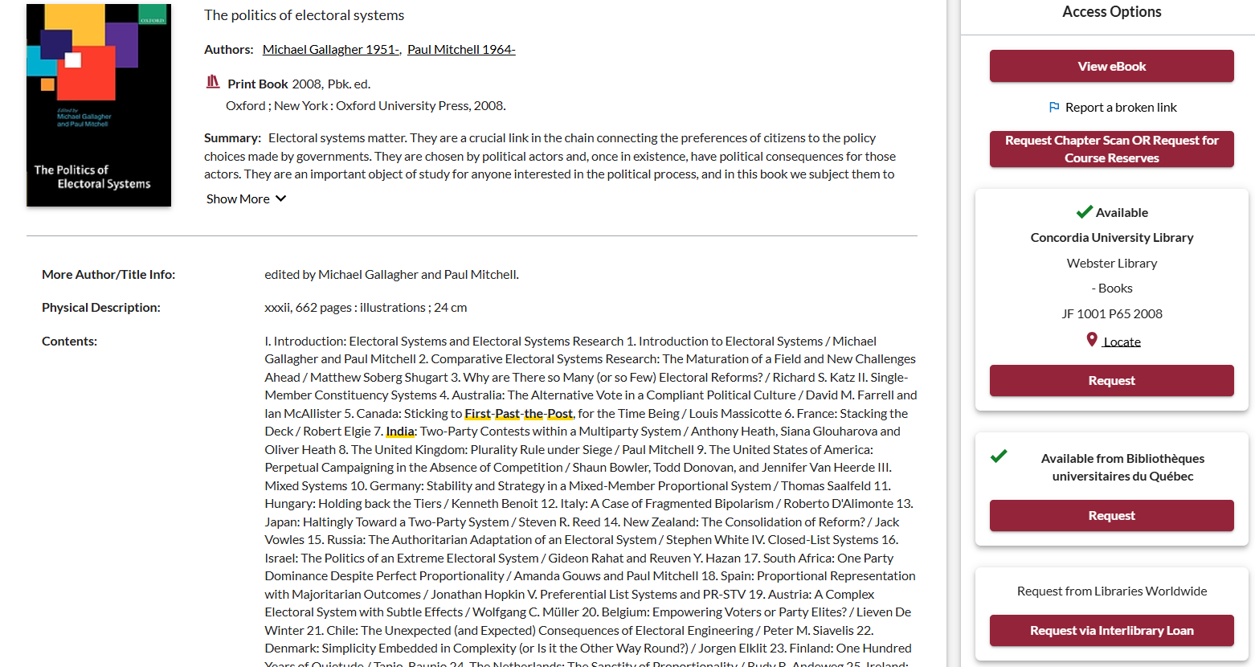
Use chapters from a monograph on your broad topic

Slide 35
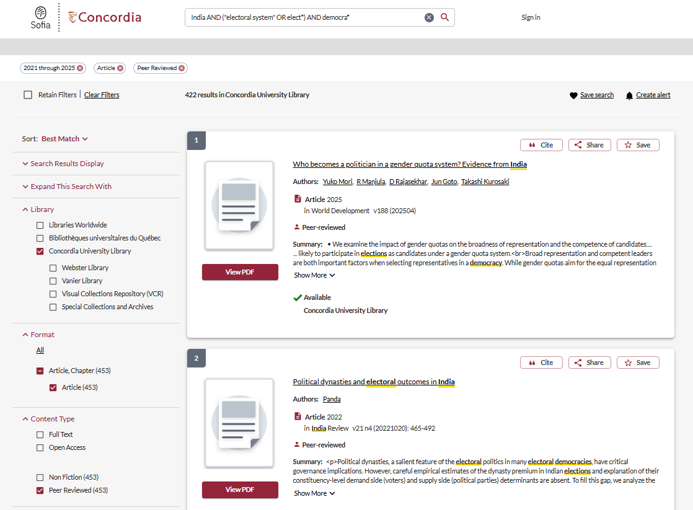
Limit to articles and peer review to access articles through Sofia

Slide 36
Searching for journal articles

Slide 37
Dividing up our search terms into AND/OR
Using quotation marks with phrases: “electoral system”
Adding an asterisk at the end of root words: democra*
Searching for your country name as GE Geographic Terms – this will eliminate articles about a different topic or country, where the author is from the country you are studying

Slide 38
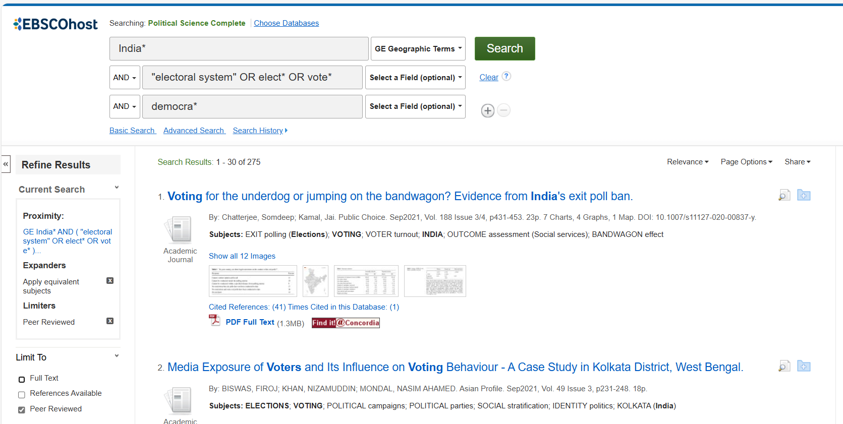

Slide 39
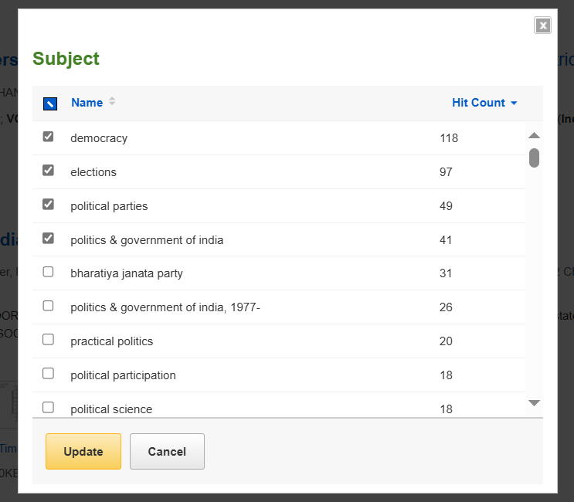
Using subjects to limit search results

Slide 40
Use the subjects to expand your search

Slide 41
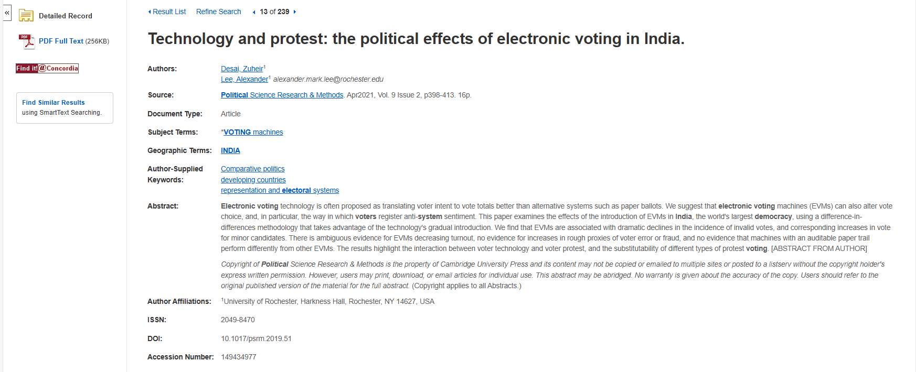
How do I know the article is scholarly?
Scholarly articles should be 10+ pages
Look for scholarly author affiliations

Slide 42
What is peer review? What are peer reviewed, scholarly articles?

Slide 43
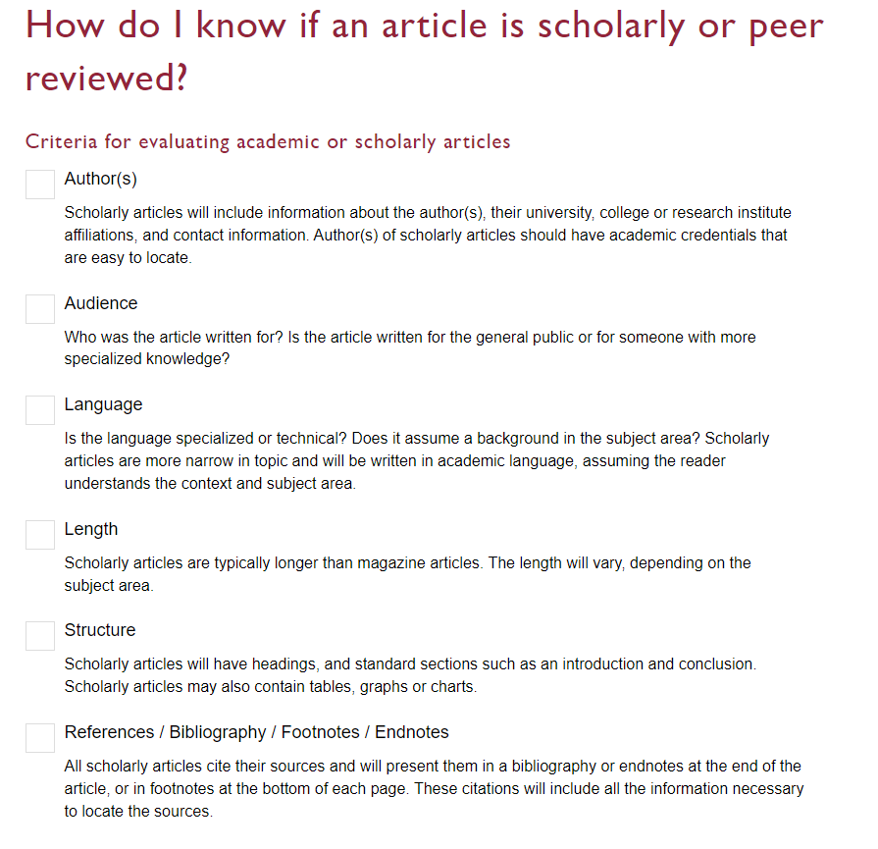

Slide 44
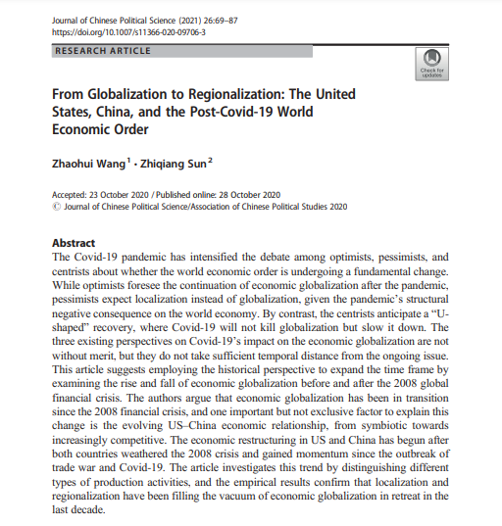
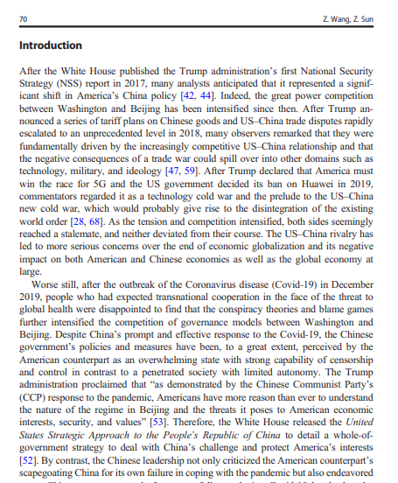
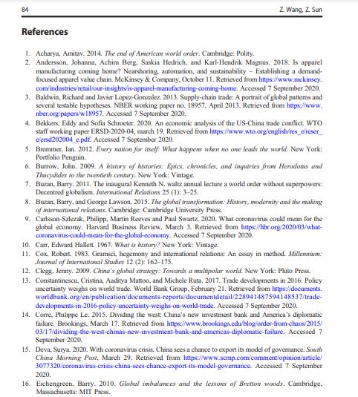
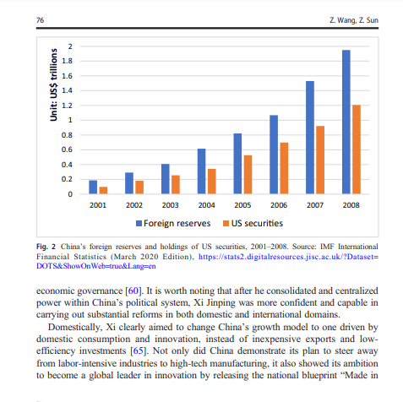
Look for sections, language, charts, tables, graphs and an extensive reference list or bibliography
Specialized language

Slide 45
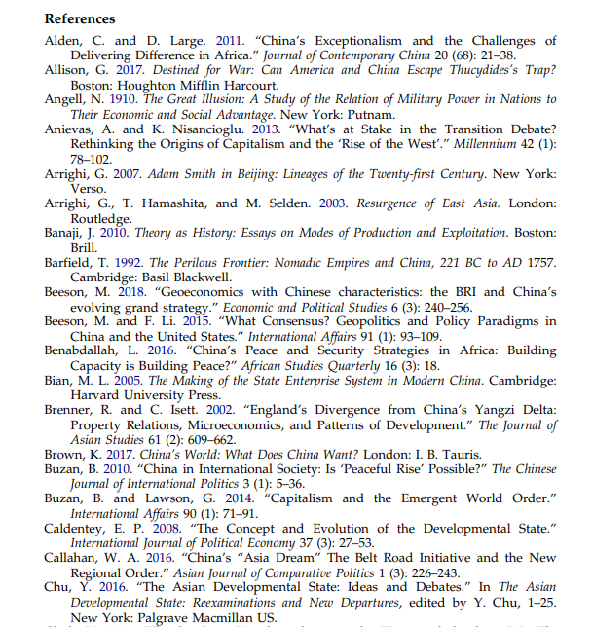
Scholarly articles will always have reference lists/bibliographies/works cited
These are great places to find more sources!
The researcher or research team are experts in the subject area and have already done a lot of research
Use this expertise by looking up the books and articles they cite in Sofia and using them in your own research
This is a commonly used method in academic research

Slide 46
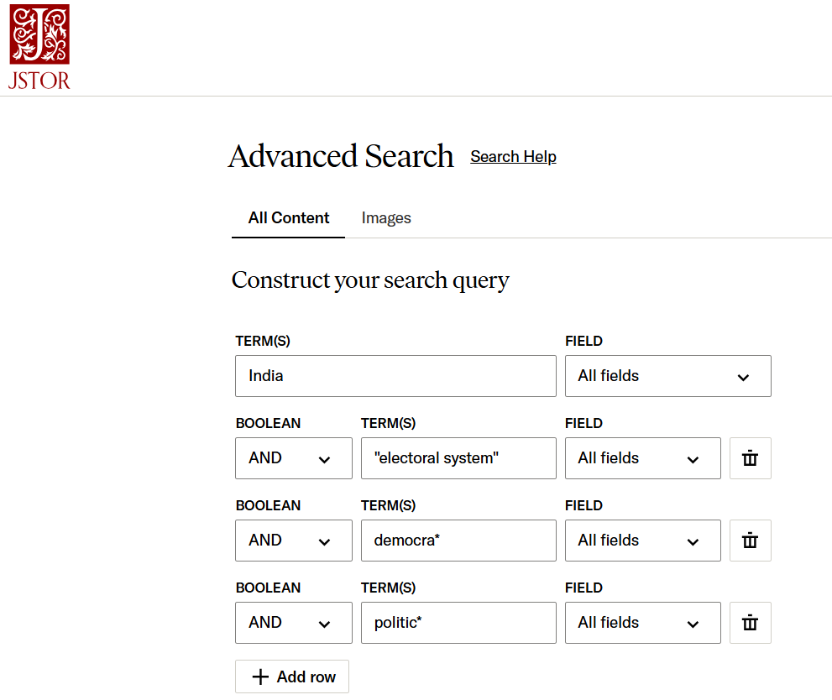
Searching in JSTOR
JSTOR contains a moving wall of archival journals
Multidisciplinary
Search with keywords using AND

Slide 47
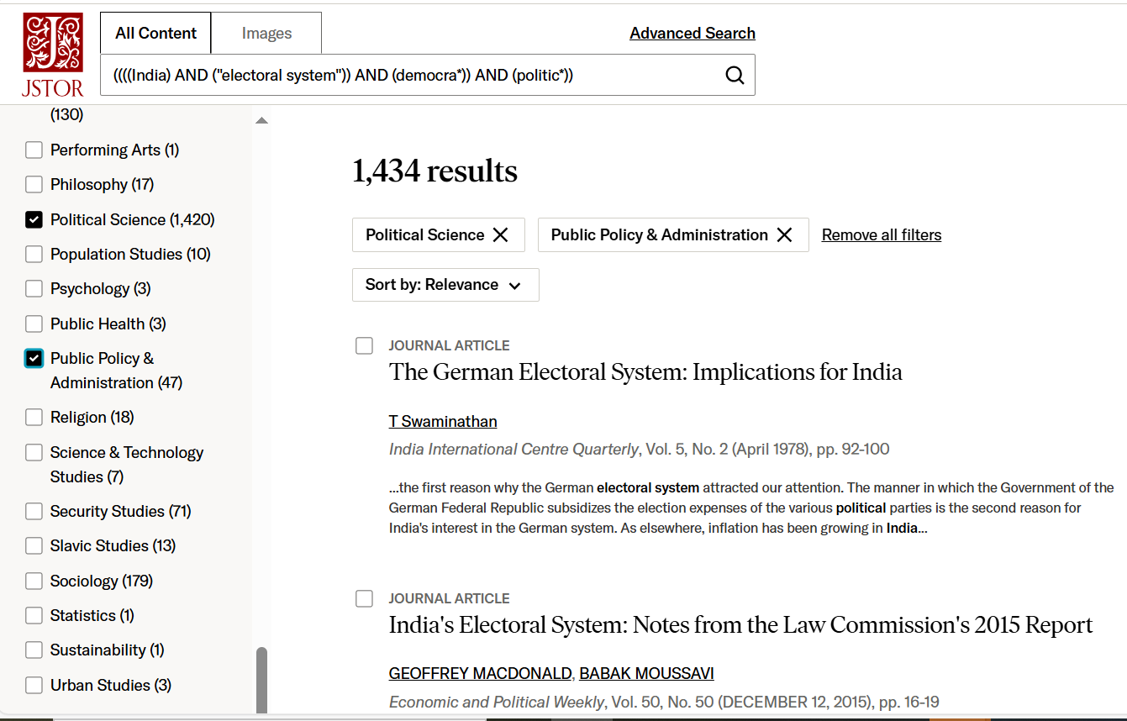
Use the broad subjects on the left hand menu to narrow by discipline

Slide 48
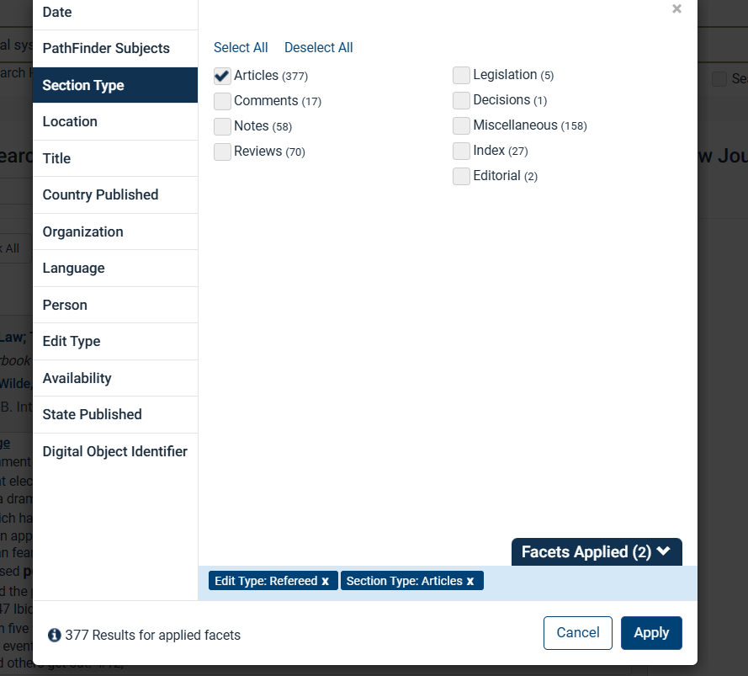
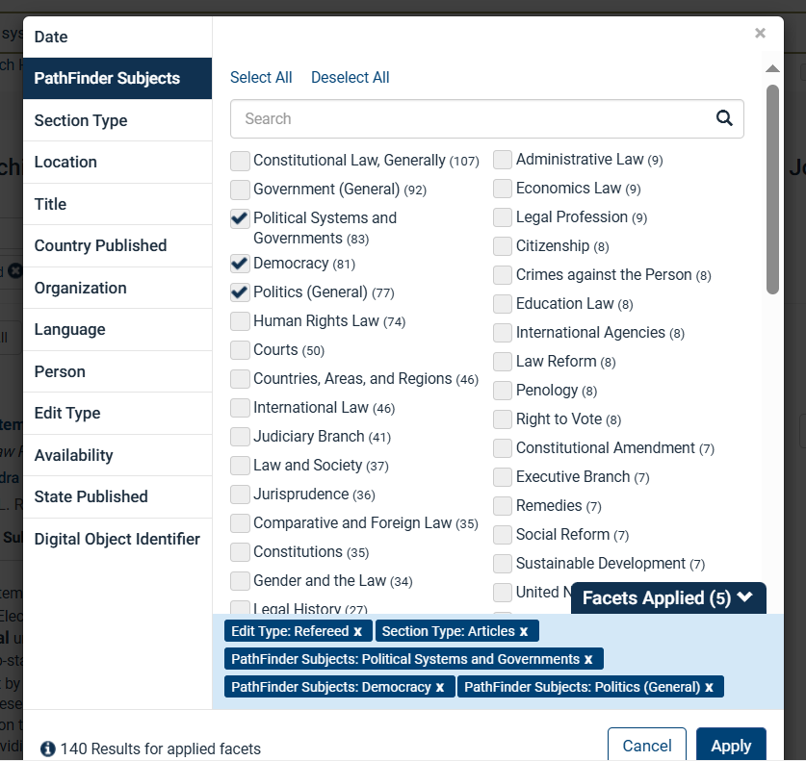
HeinOnline Law Journal Library
Use the limits on the left hand menu to selection section type: Article and to apply subject to your search

Slide 49
Michelle.Lake@Concordia.ca

