Slide 1
POLI 345/4 B: Library Workshop
Michelle Lake
Political Science, SCPA, First Peoples Studies and Government Publications Librarian
Michelle.Lake@Concordia.ca

Slide 2
Who am I?
Michelle Lake, librarian for Political Science, the School of Community and Public Affairs, First Peoples Studies, and Government Publications
Michelle.Lake@Concordia.ca / Make an appointment or ask a question
What do I do?
Provide research support
Help students with library databases
Help students find and access materials they need
Help with citation issues
Choose the books we buy for the above subject areas

Slide 3
Primary sources are immediate, first-hand accounts of a topic, from people who had a direct connection with it.
Types of Sources - Primary
Examples: - Law documents and other government publications - Newspaper articles - Speeches, diaries, letters, interviews - Photos, audio and video from an event - Datasets: census data, economic statistics

Slide 4
Types of Sources - Secondary
Secondary sources are one step removed from primary sources, though they often quote or otherwise use primary sources. They can cover the same topic, but add a layer of interpretation and analysis.
Examples:
Scholarly books about the topic
Data analysis
Scholarly, peer reviewed articles about the topic

Slide 5
Scholarly, peer reviewed journal articles
A scholarly journal article is the best of what we know; it builds on previous research.
The purpose of a scholarly journal is to report on research conducted by scholars, and professionals in the field.
Scholarly journals provide in-depth articles that cover specific issues or research questions, while the language and content is geared toward scholars and professionals in the field.
Some articles contain tables and graphs and most contain bibliographies (or reference lists or works cited)
articles in scholarly journals are peer reviewed.

Slide 6
Has the article gone through the peer review process? What is peer review? Peer review is a system used to decide if an article should be published in a peer-reviewed journal. Each paper submitted to a peer-reviewed journal is read and evaluated by experts in the article’s subject area. The reviewers assess the article’s validity, importance, and originality, and then recommend whether it should be printed in the journal. The reviewers’ suggestions are considered by the journal’s editor, who makes the final decision about whether to accept or reject the article. Criteria for evaluating academic or scholarly articles

Slide 7
Search Strategies to find scholarly journal articles

Slide 8
How do we combine search words for the best possible results?
AND: combines concepts and limits your results
environment AND justice
morality OR ethics
OR: allow you to insert synonyms or alternative terms and increases your results

Slide 9
How do we combine search words for the best possible results?
“quotation marks”: If you put two or more words in quotation marks, that exact phrase will be searched and limits your results.
“political philosophy”
“cultural pluralism”
democra*
Finds: democracy, democracies, democratic, democratically, democratization
* - when you add an asterisk on the end of a word, your results will contain all the words with those endings or suffix

Slide 10
Avoid Searching with Linking words
Each author may use different linking words when discussing similar topics.
Effects
Impact
Consequences
Influence
Results
Importance
Significance
Response
Emphasis
Causes
You don’t want your search to be limited to those books and articles that only contain the word “effect” or “consequence”

Slide 11
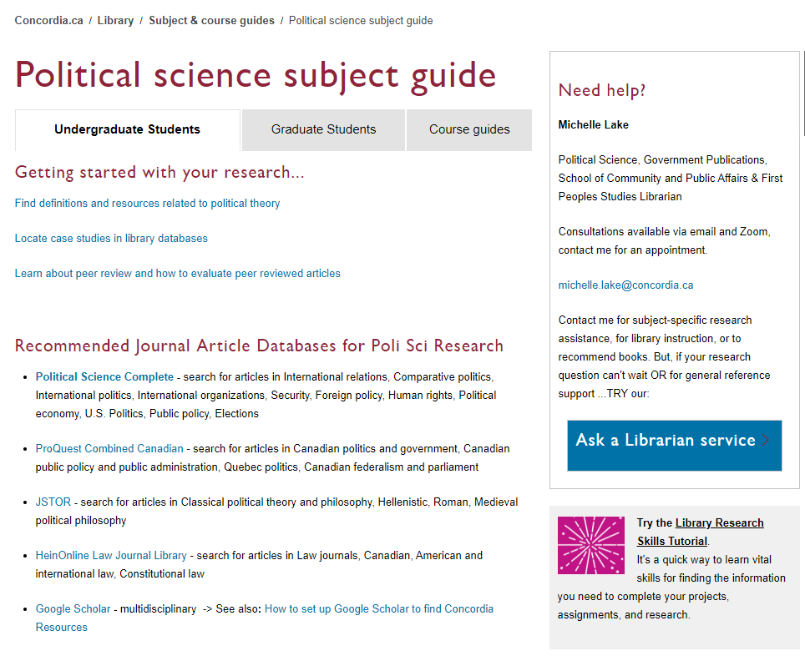

Slide 12
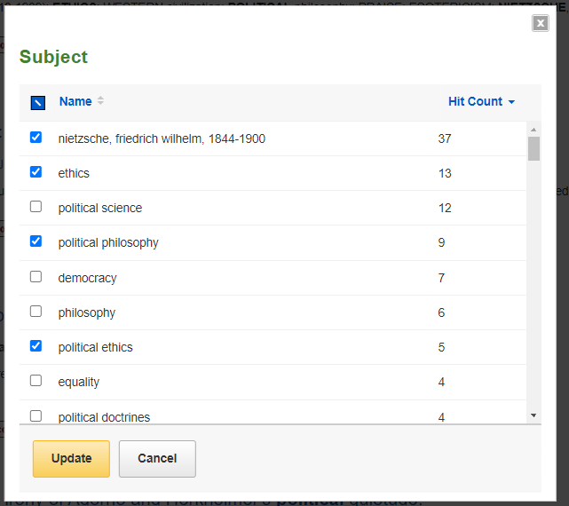
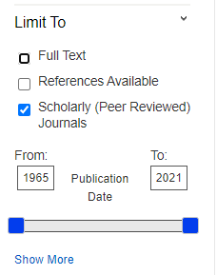
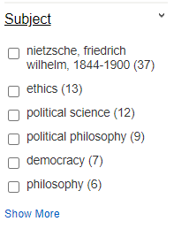

Slide 13
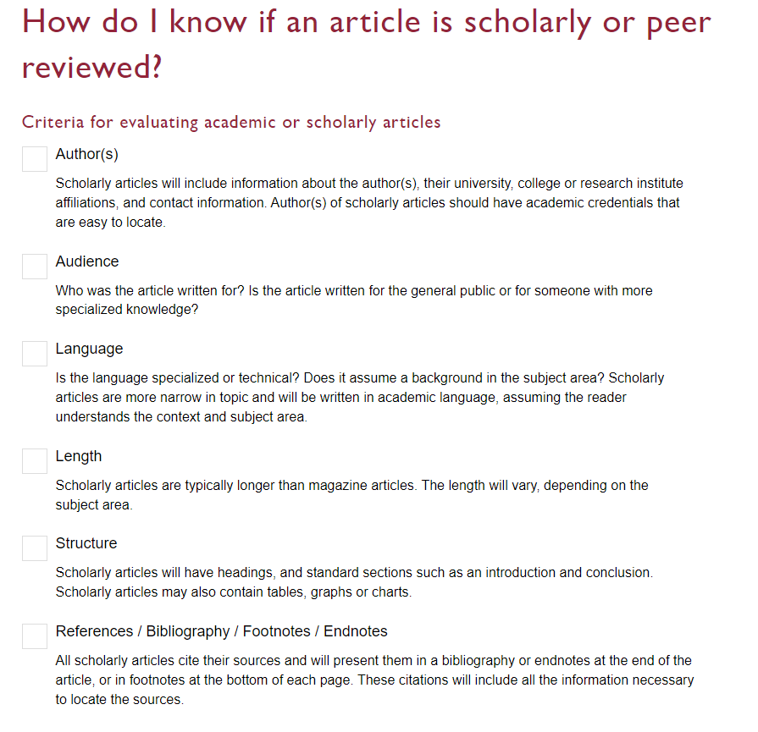

Slide 14
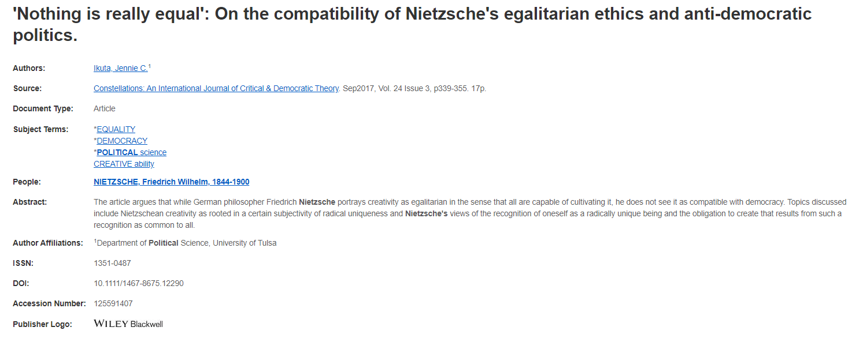
Length: scholarly articles are 10+ pages long
Affiliations: Scholarly article authors will be affiliated with a university or research institute

Slide 15
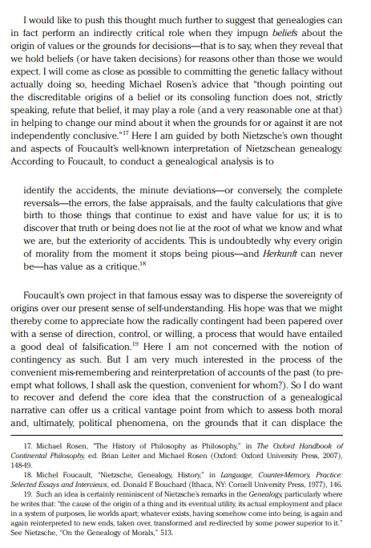
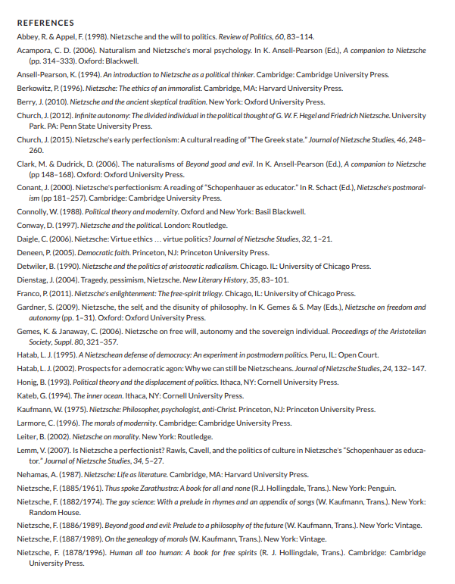
The reference list in scholarly articles can be a great tool, you can find the sourced cited and include them in your own research
Scholarly articles will have extensive reference lists/bibliographies or
footnotes/endnotes
of all the sources cited in the article.

Slide 16
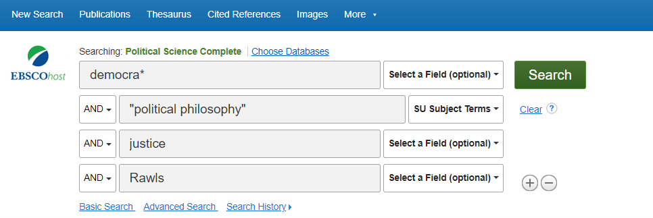
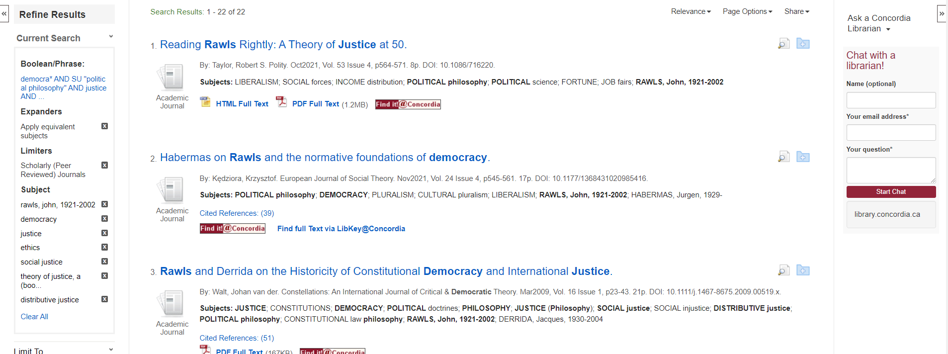
You can use the subject terms in Political Science Complete in a couple different ways
Access options

Slide 17
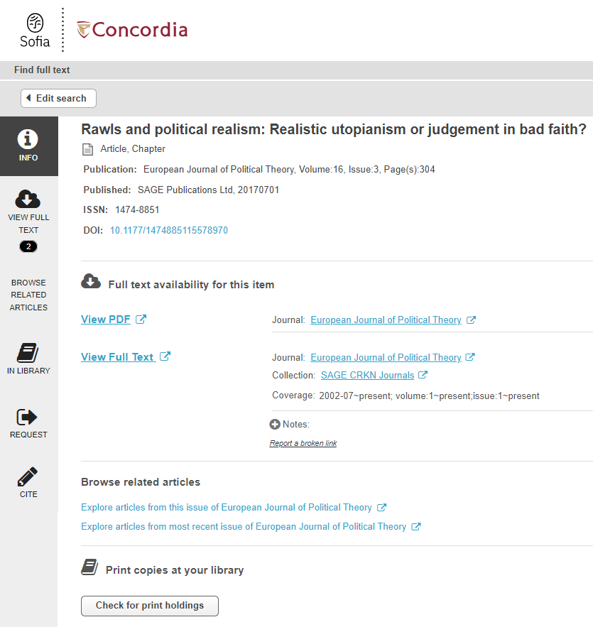
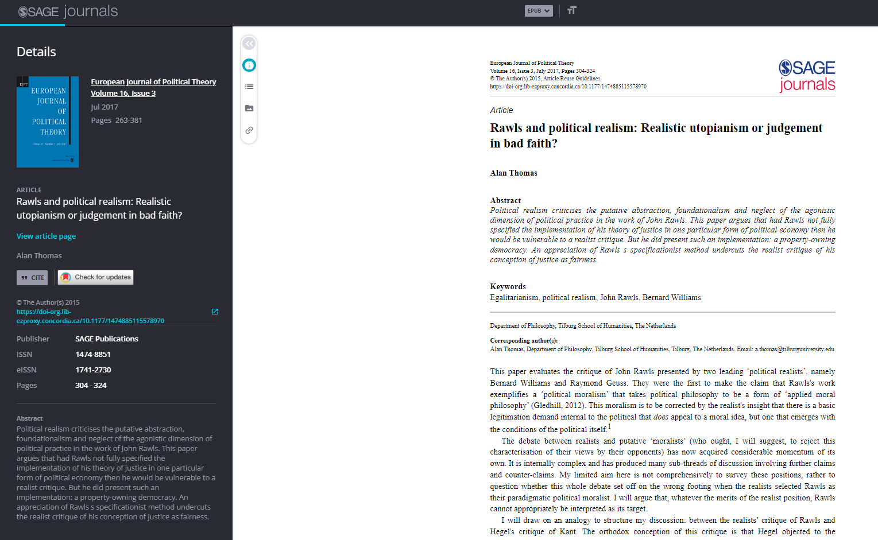

Slide 18
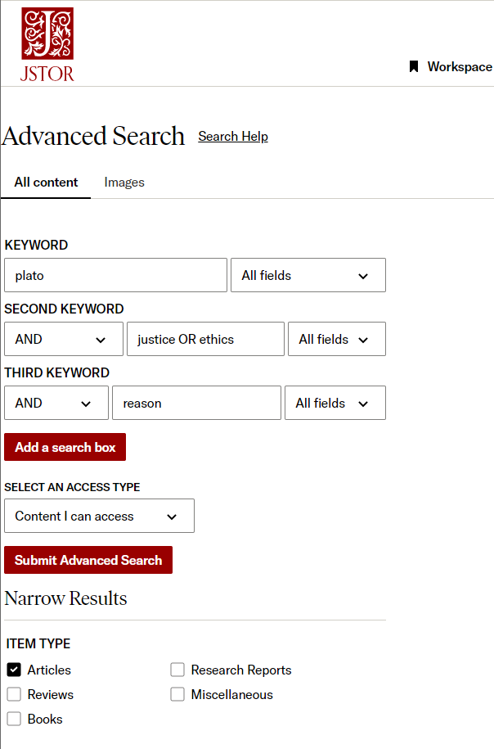
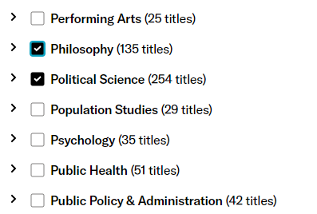
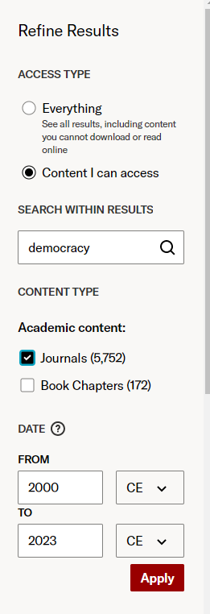
Once you have your initial list of results, there are ways to refine your and limit the articles

Slide 19
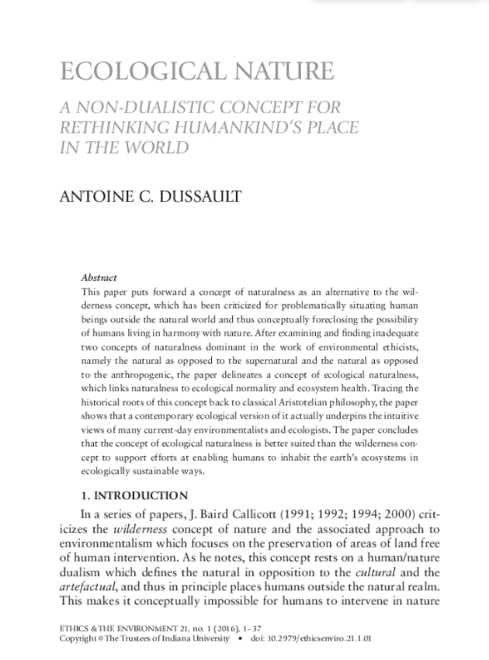
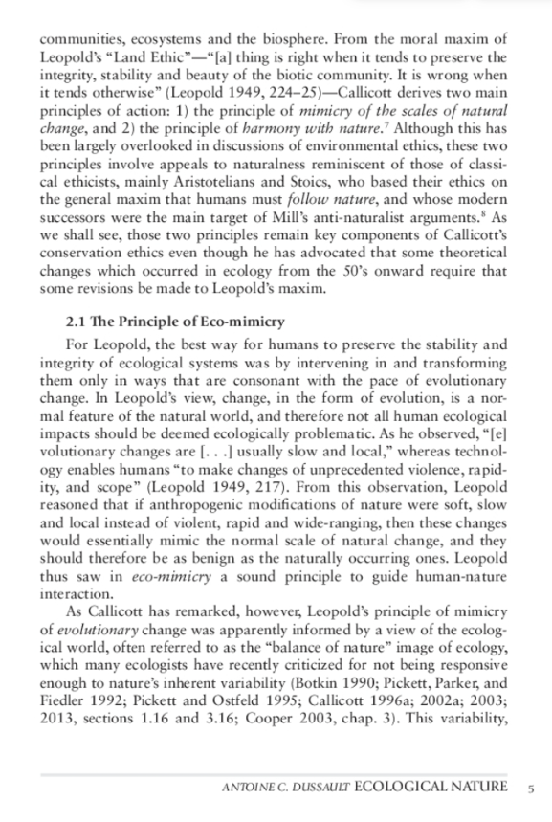
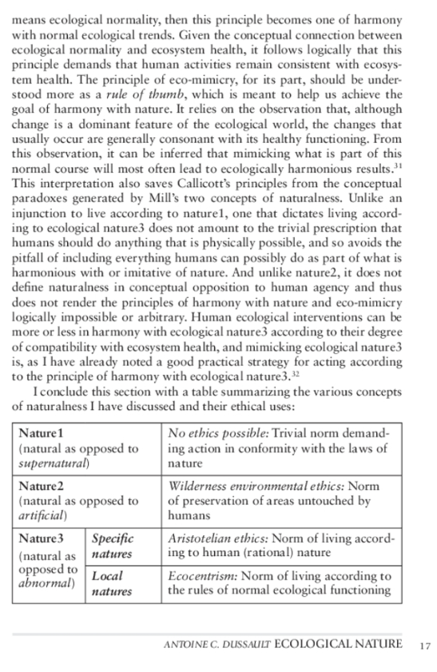
Structure: tables, charts and graphs may be included.
Structure: section headings, abstract, intro, literature review, conclusion.
Language & Audience: specialized vocabulary and knowledge used.
Citations: throughout the text.

Slide 20
Searching in Sofia gives you access to print books, ebooks, and some journal articles
AND /OR should be in ALL CAPS in Sofia, for the database to recognize them as stop/search words
You can keep a Sofia search very high level and general, since it is searching in the titles, table of contents and subjects of books

Slide 21
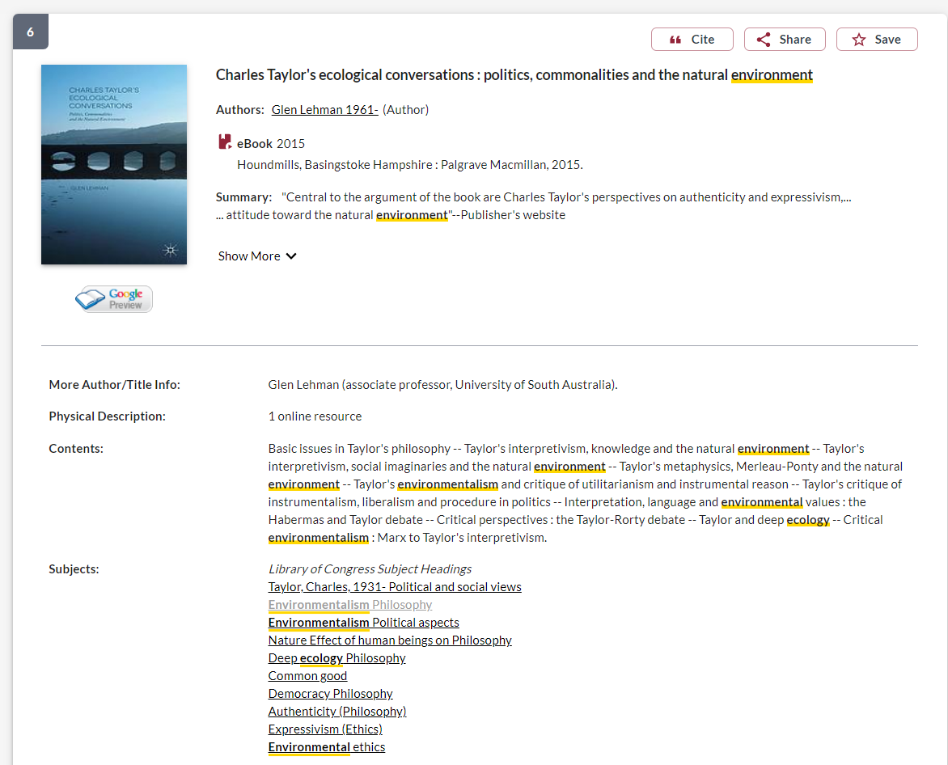
Use the subject headings to narrow down your search.

Slide 22
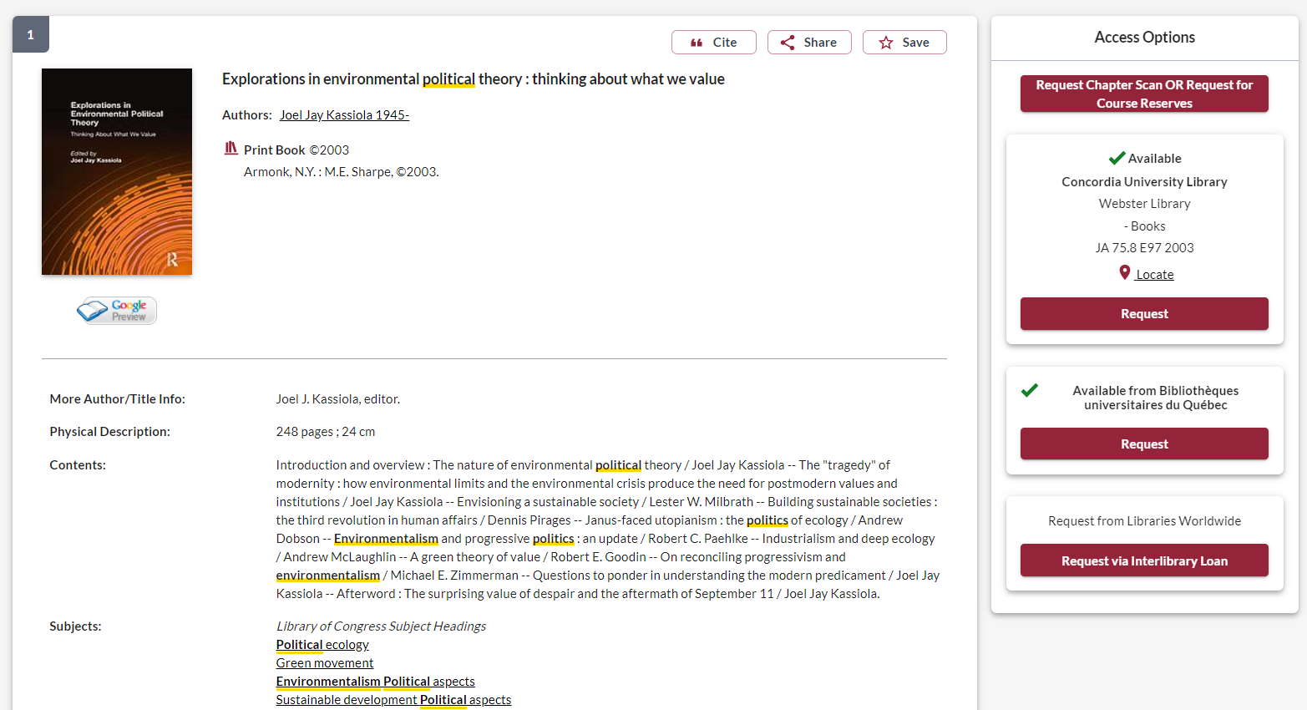
Information to locate the book on the shelves. It is worth going into the stacks and looking at similar books in the same section, as they will all be on the same subject.

Slide 23
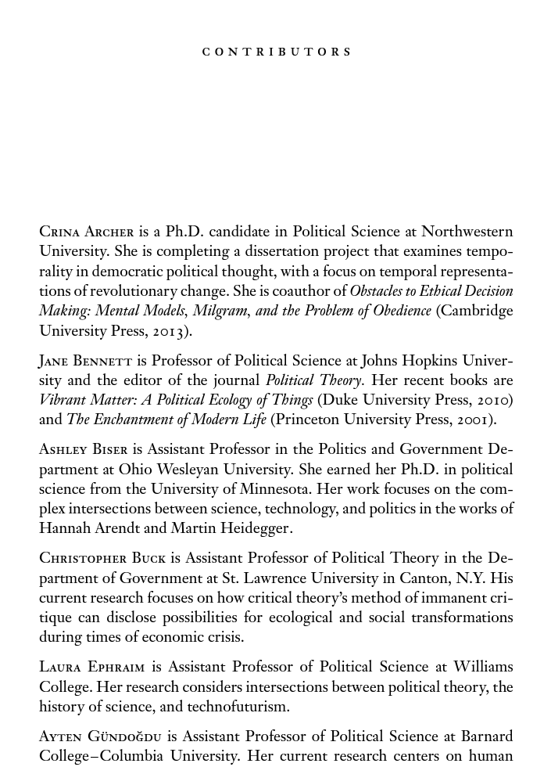
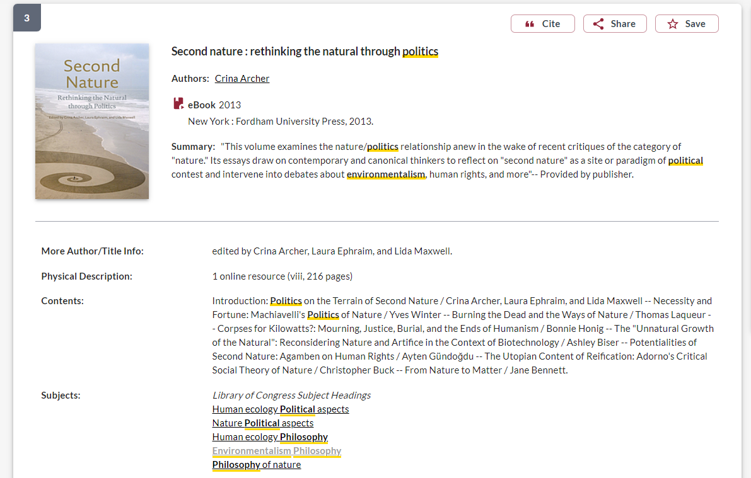
What to look for to identify if a book is scholarly
Look for Contributors sections or about the author, to find the academic affiliations of authors and editors
Scholarly books are published by university presses
Scholarly books are generally 200+ pages

Slide 24
Key points from today’s workshop
Go through the library website to connect to everything we have access to at Concordia
Use a POLI recommended databases to find scholarly, peer reviewed journal articles
Think about and plan your keywords and search strategy
Evaluate all your sources
There is help available at the library!

Slide 25
There is help available!
Michelle.Lake@Concordia.ca

