Slide 1

POLI 331: Comparative party Systems Library Workshop
Michelle Lake
Political Science, SCPA, FPST and Government Publications Librarian
Michelle.Lake@concordia.ca

Slide 2
Who am I?
Michelle Lake, librarian for Political Science, the School of Community and Public Affairs, First Peoples Studies, and Government Publications
Michelle.Lake@Concordia.ca / Make an appointment (on Zoom or in person) or ask a question
What do I do?
Provide research support, assist with search strategies
Help students navigate library databases, assist with selection and evaluation of sources
Help students find and access materials they need
Build guides, resources and pathfinders to help students locate research materials
Help with citation issues
Choose the books we buy for the above subject areas

Slide 3
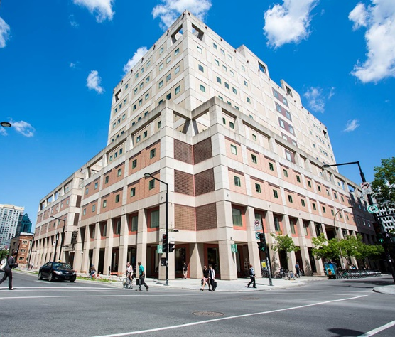

The Librar(ies)
24/7 access, with student card, after 11pm
Webster Library (LB) – downtown on SGW campus & Vanier Library (VL) on Loyola campus
Webster: Social Sciences, Humanities, Business, Engineering & Fine Arts
Vanier: Science(s), Health, Communications, Journalism and Psychology
Course Reserves Room(s): have the required undergraduate print textbooks for the courses taught at that campus (for example: Webster has the Political Science and SCPA course reserves)

Slide 4

Library Services
Your student card is your library card.
You need it to:
borrow books (up to 100 a time)
borrow a laptop (3 day loan) and other technology
print on campus (add money to your Dprint account)
access the library overnight during 24/7 hours.
Webster library has 5 book scanners (And Vanier has 2!) that can be used for free to scan chapters from our print books and email them to yourself as a PDF.
To use Library databases, access online articles and ebooks when you are off campus, login with your Concordia Netname and password.

Slide 5
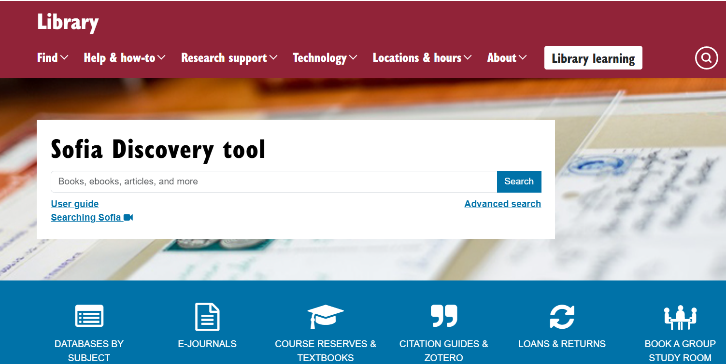
https://library.concordia.ca/
Use the Sofia Discovery tool to find print books, ebooks, and journal articles from the library.

Slide 6
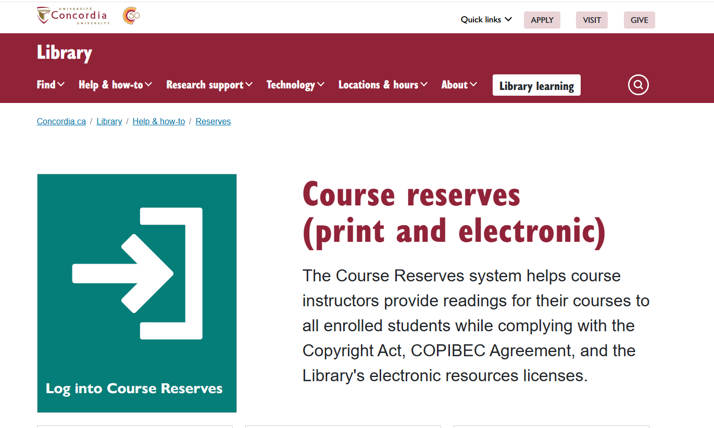

Slide 7
How can I find out if the library has access to an item I’m looking for?

Slide 8
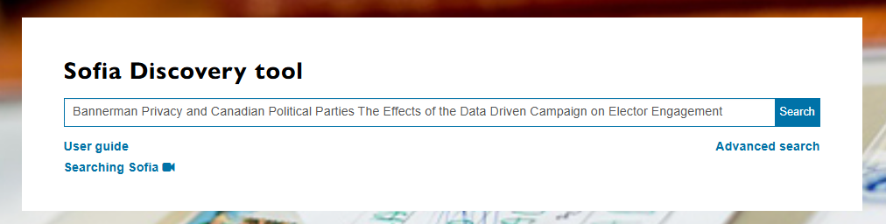
Bannerman, S., Kalinina, J., Dubois, E., & Goodman, N. (2022). Privacy and Canadian Political Parties: The Effects of the Data-Driven Campaign on Elector Engagement. Canadian Journal of Political Science 55(4): 873-896.

Slide 9
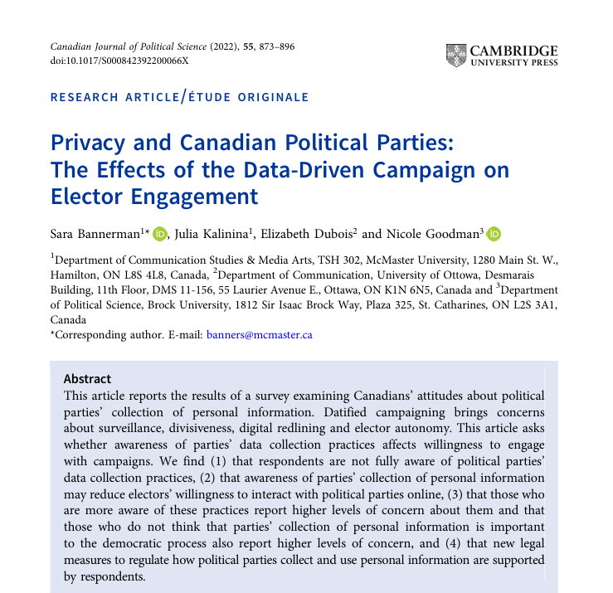
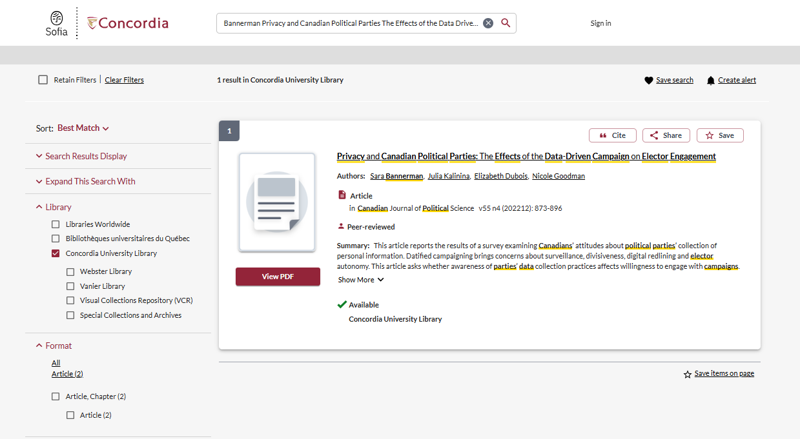
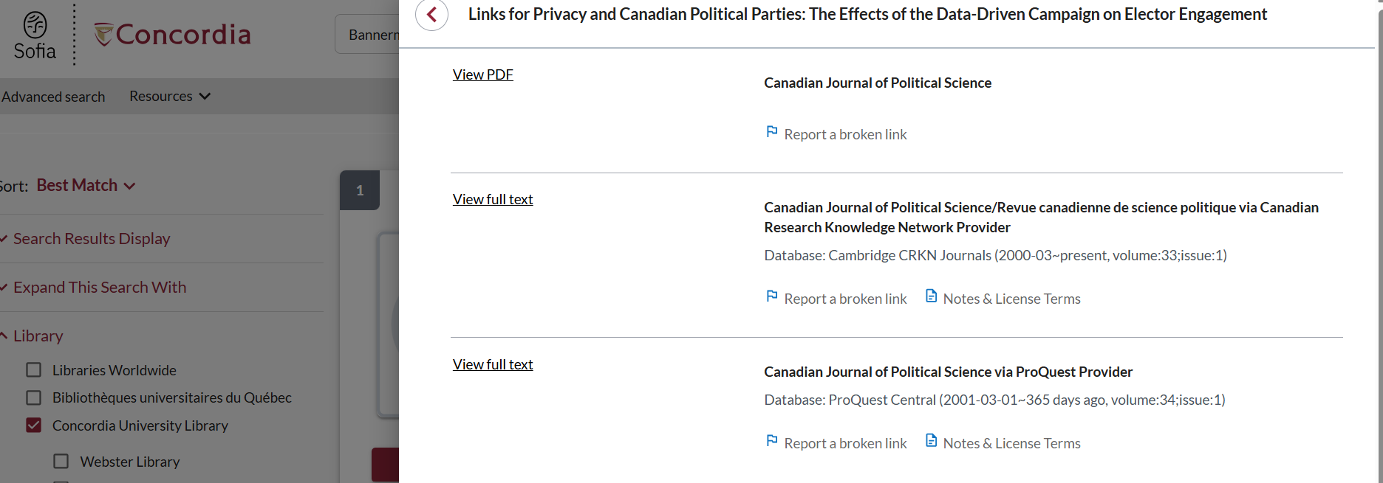

Slide 10
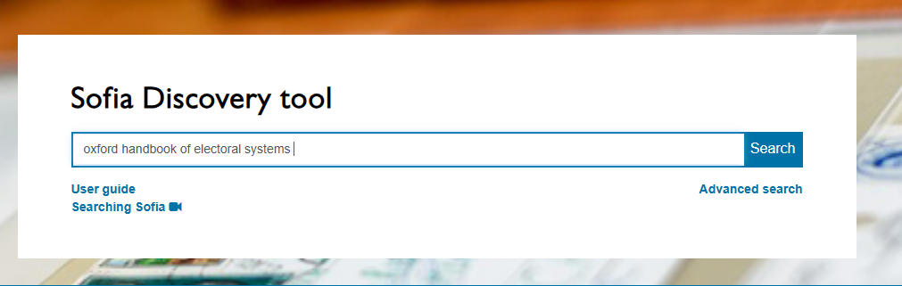
Krook, Mona Lena, ‘Electoral Systems and Women’s representation’, in Erik S. Herron, Robert J. Pekkanen, and Matthew Shugart (eds), The Oxford Handbook of Electoral Systems, Oxford Handbooks (2018).

Slide 11
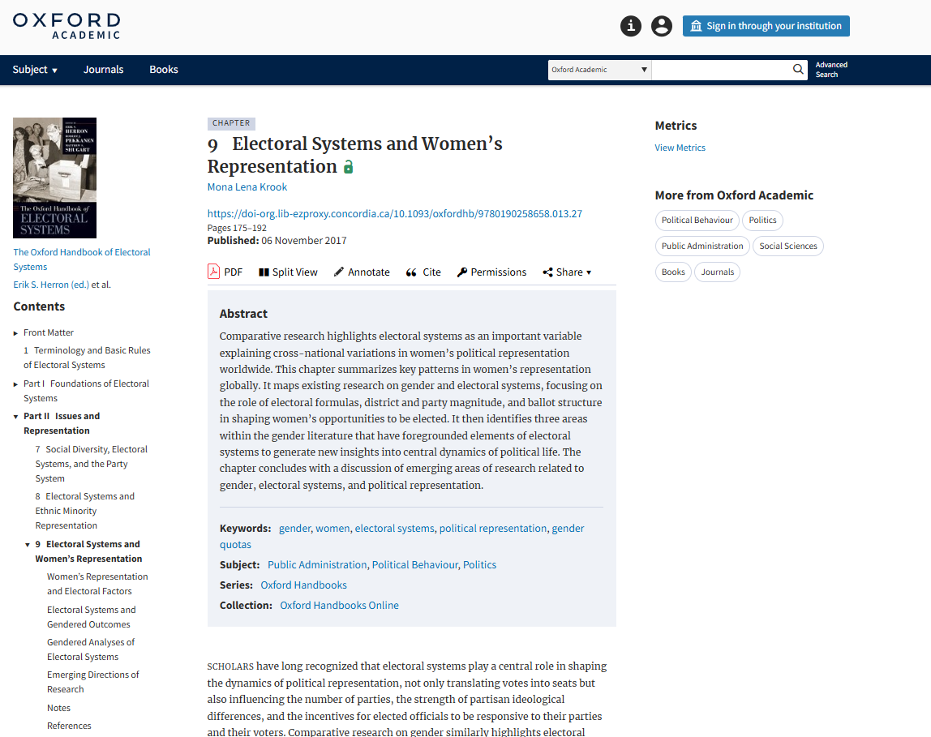
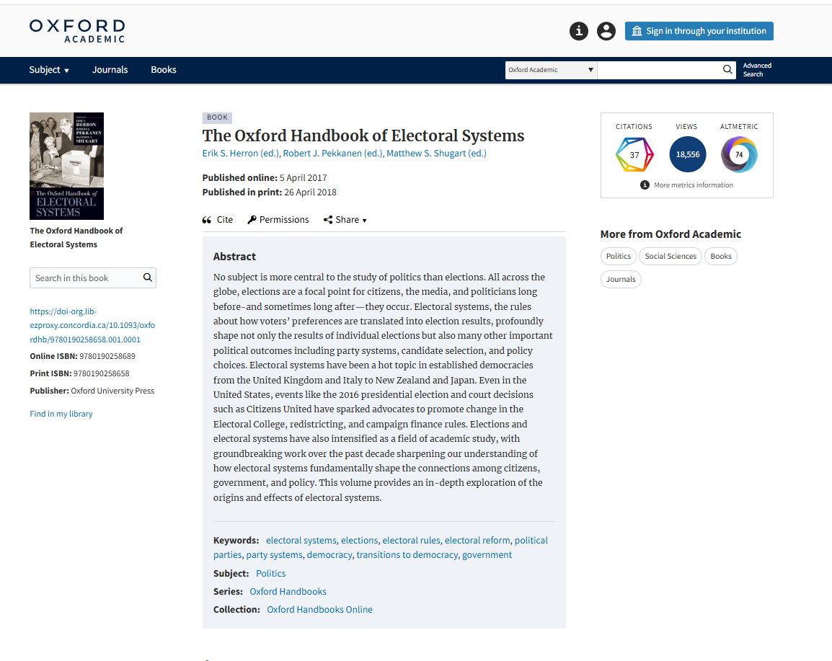
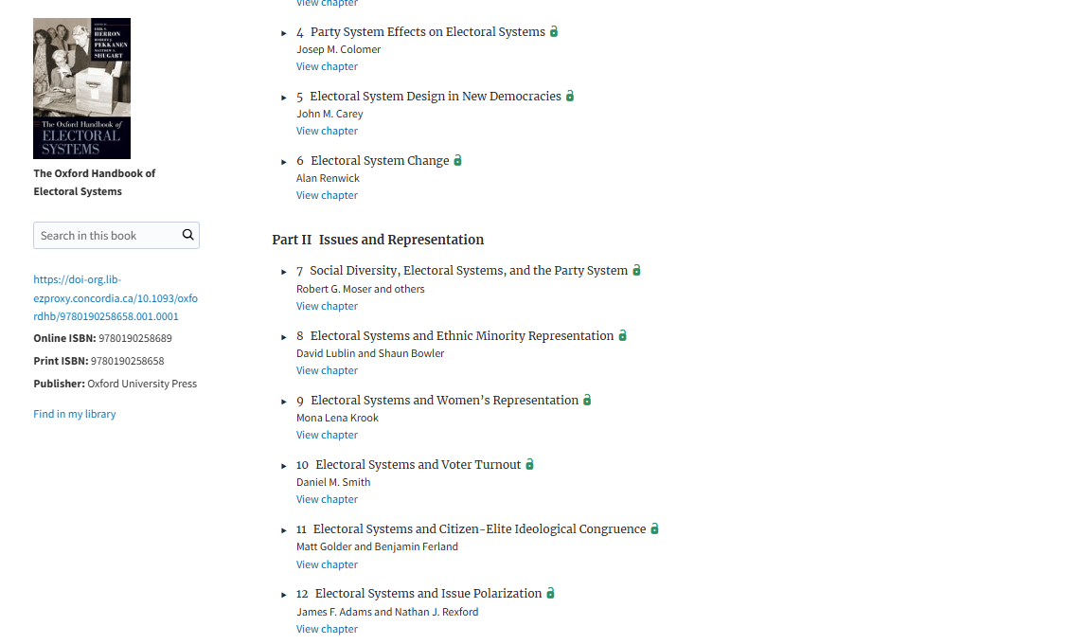
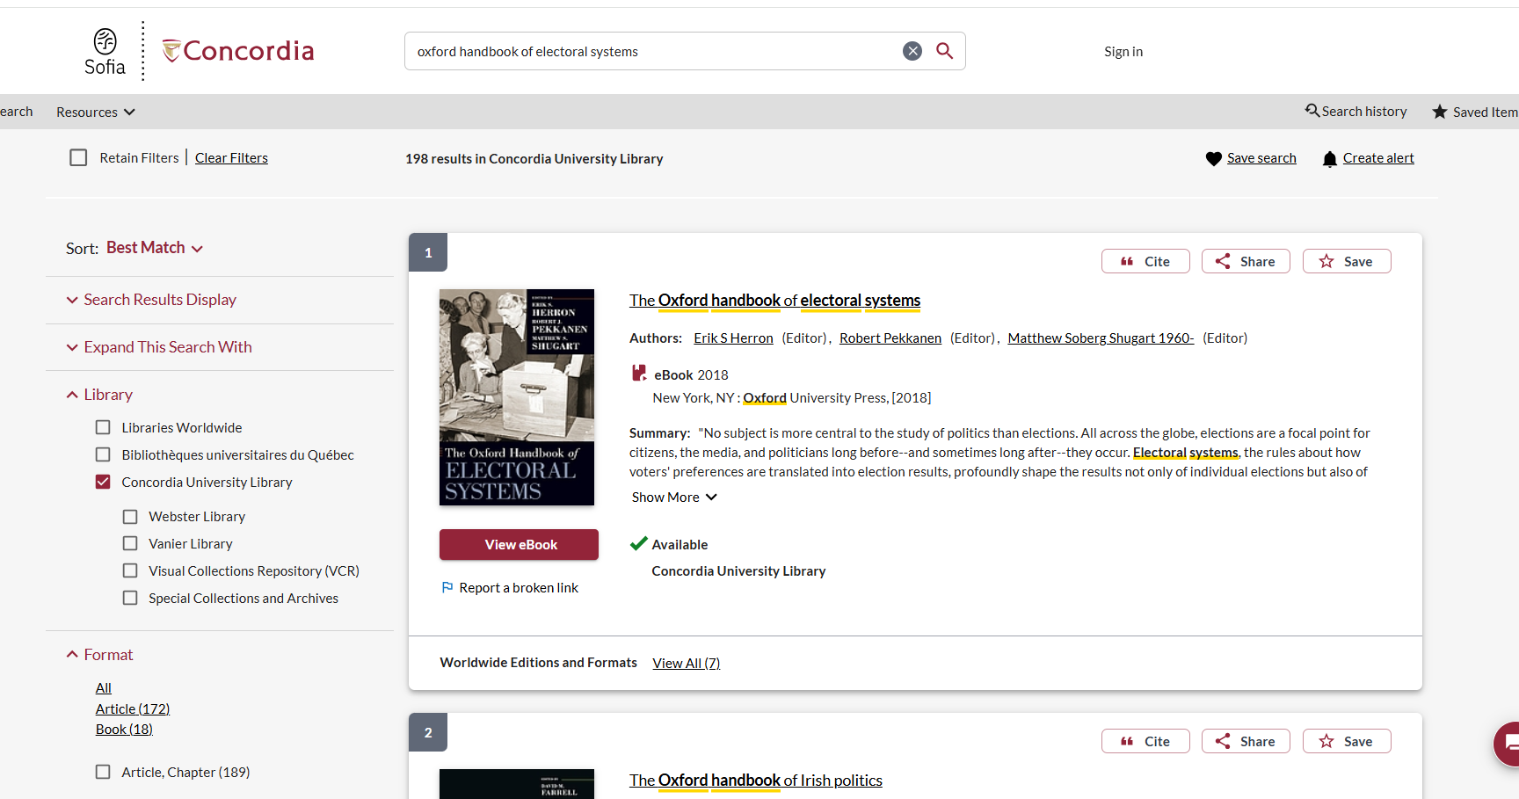

Slide 12
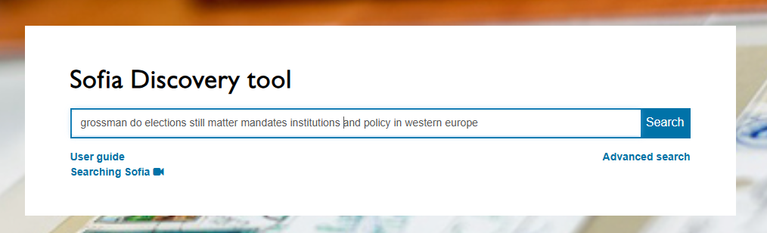
Grossman, E., & Guinaudeau, I. (2021). Do elections (still) matter?: mandates, institutions, and policy in Western Europe. New York: Oxford University Press.

Slide 13
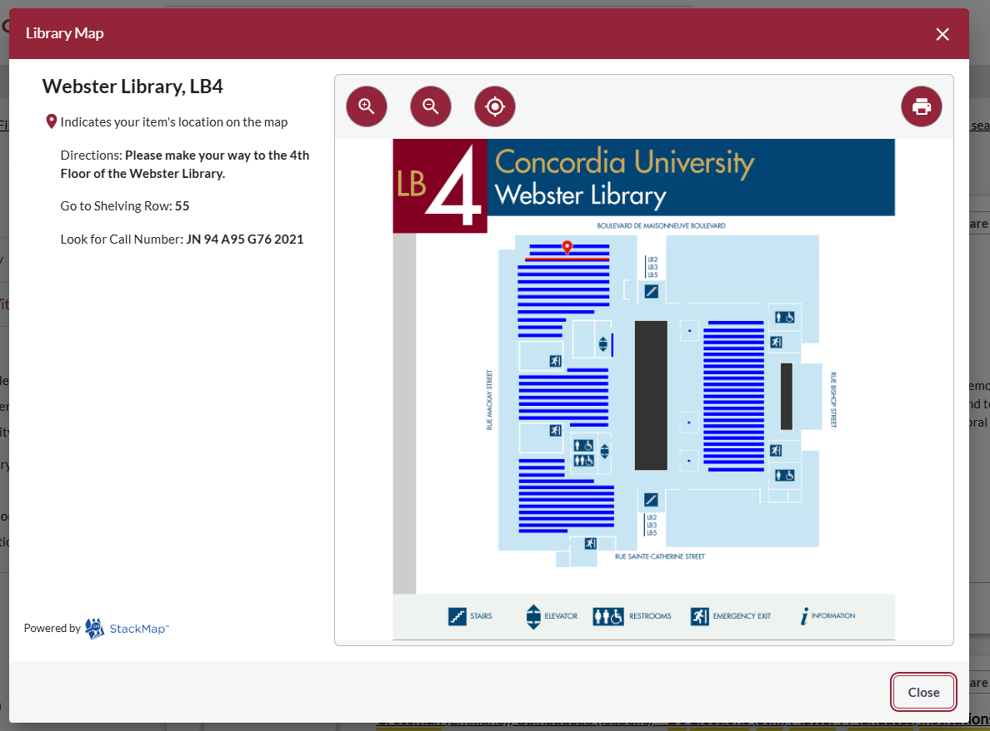
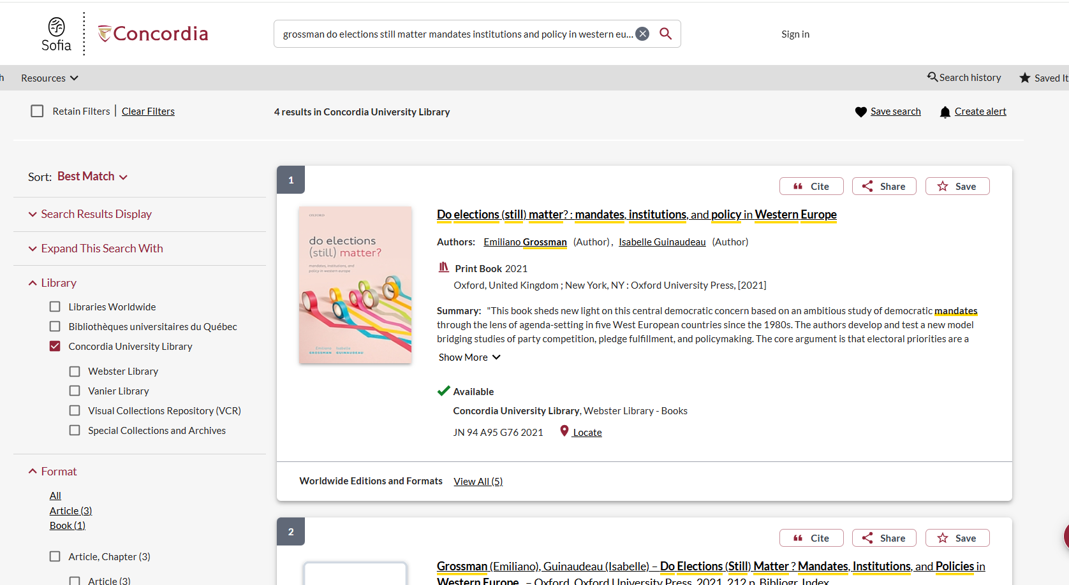

Slide 14
Background Information

Slide 15
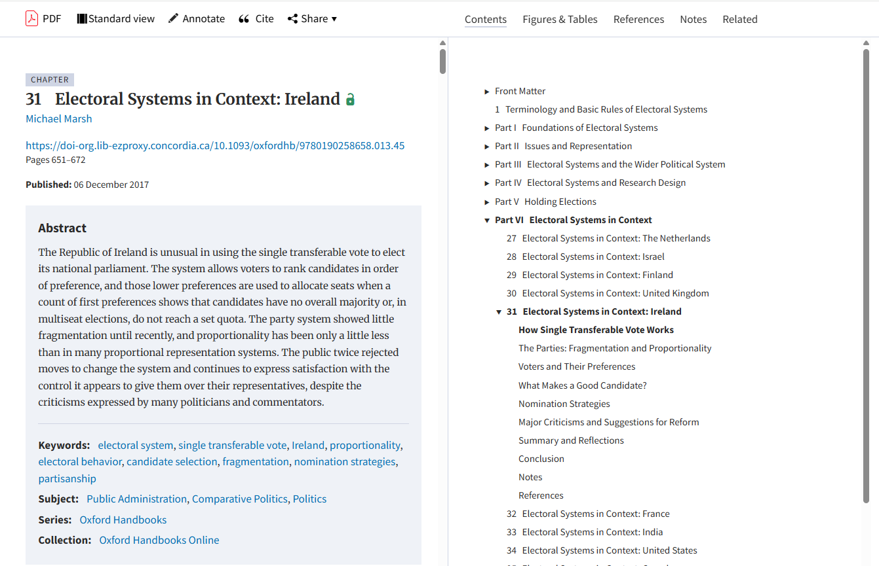
According to Duverger, the single-member simple plurality system favours a two-party system. Do you agree? Answer through comparative analysis of the post-Second World War party systems of *state A* and *state B*.
Main concepts:
Two-party system
Plurality, Duverger
Post WW2
Canada and Ireland
- > Oxford Handbook of Electoral Systems: Chapter 31 Electoral Systems in Context: Ireland
Sources: Your bibliography and your citations must include a minimum of 10 academic (books, book chapters, academic journal articles

Slide 16
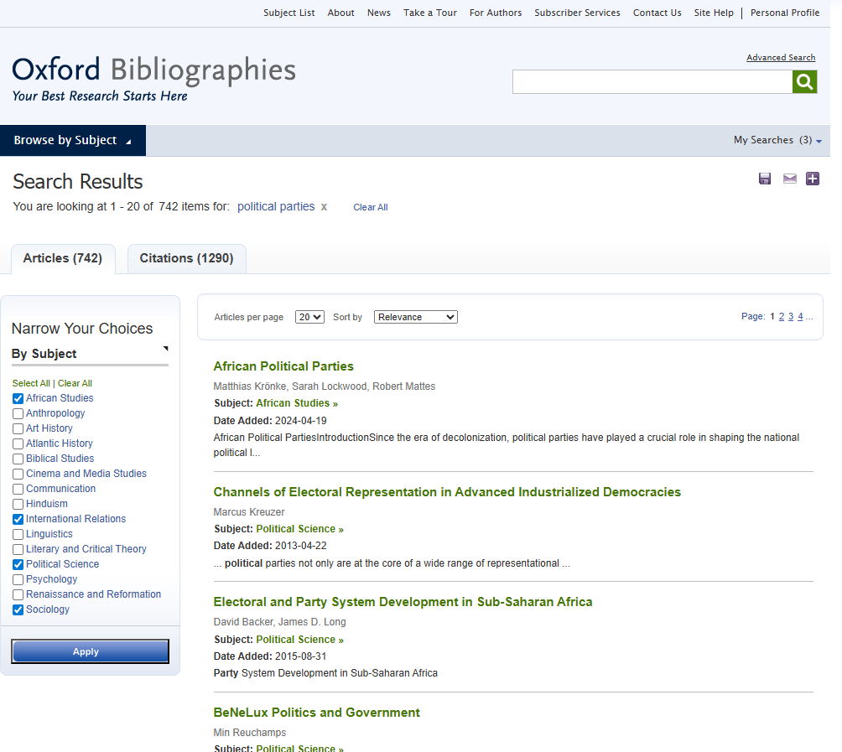
Oxford Bibliographies give high level overviews on a topic. They are useful as breakdown topics into subtopics and recommend related scholarly sources.

Slide 17
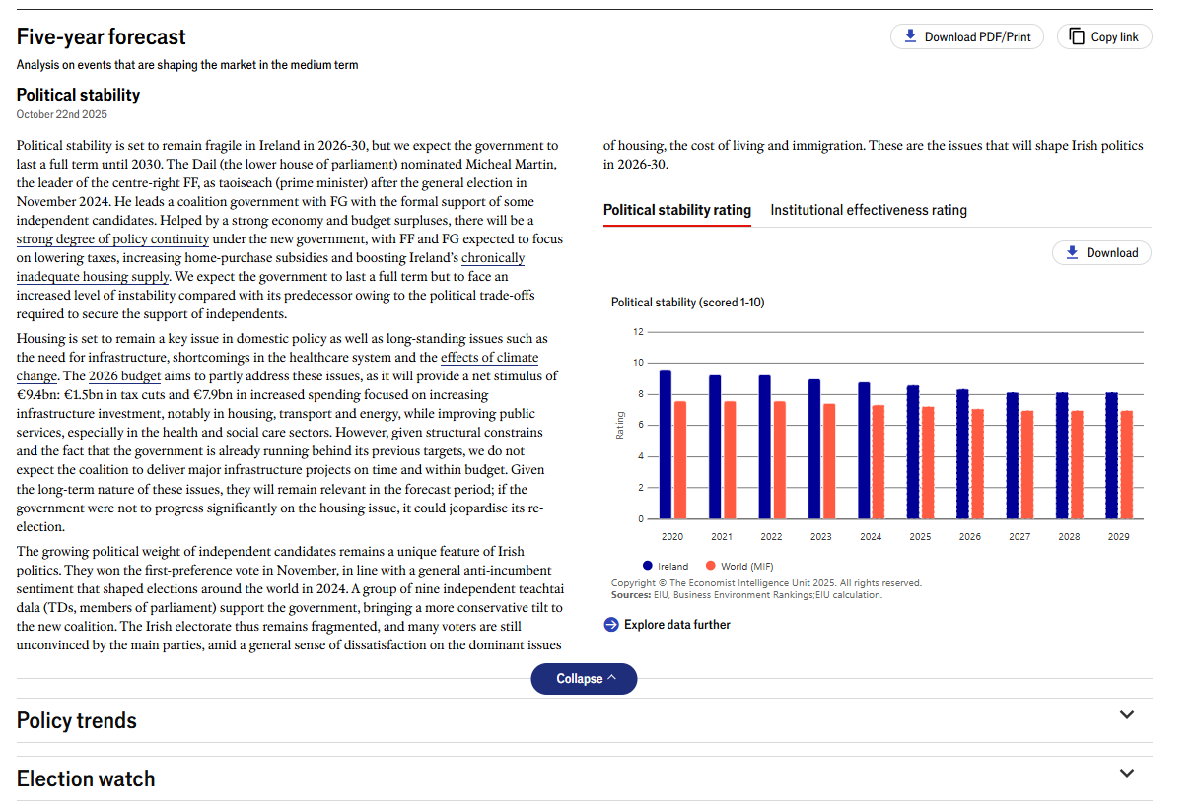
EIU Viewpoint: Country - Politics

Slide 18
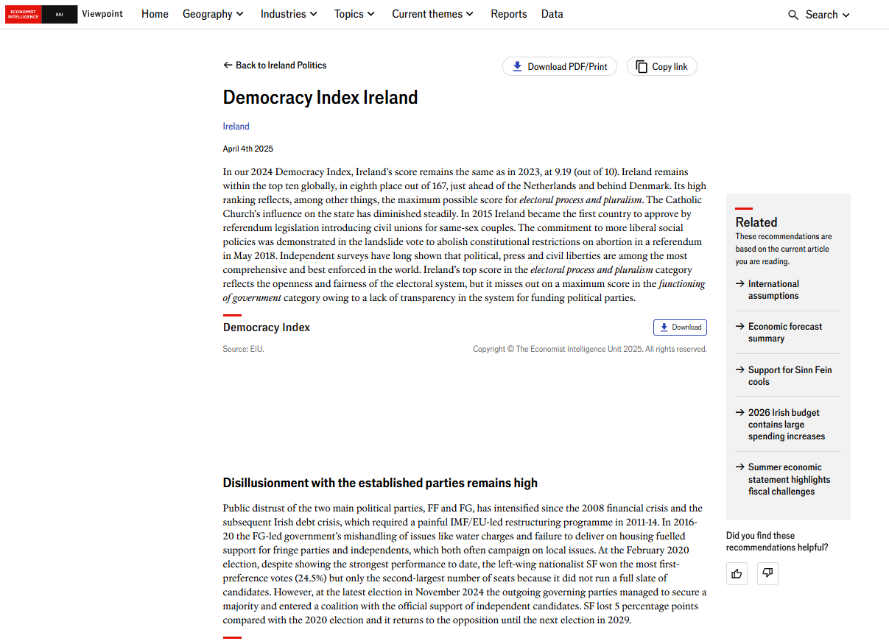

Slide 19
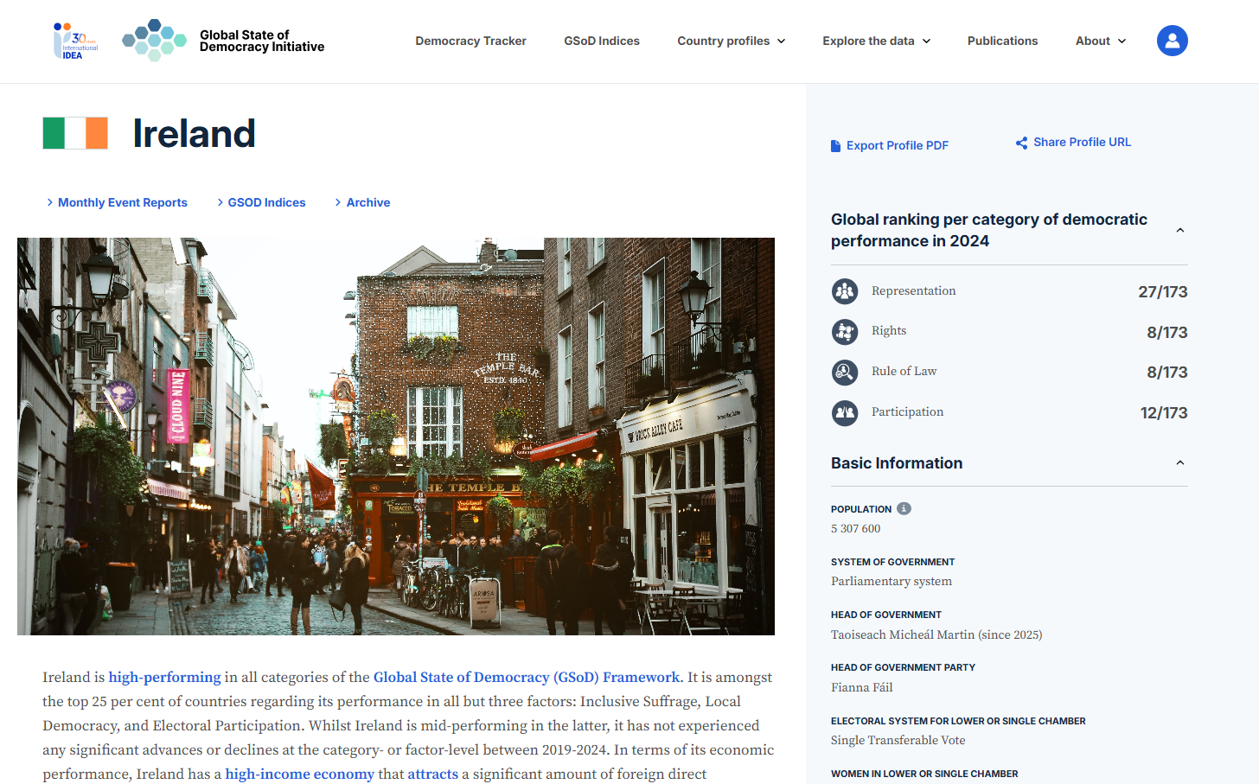

Slide 20

Search strategies

Slide 21
How do we combine search words for the best possible results?
AND: combines concepts and limits your results
politics AND security
state OR government
election OR voting
OR: allows you to insert synonyms or alternative terms and increases your results

Slide 22
How do we combine search words for the best possible results?
“quotation marks”: If you put two or more words in quotation marks, that exact phrase will be searched and limits your results.
“political parties”
“foreign policy”
Democra*
Finds: democracy, democracies, democratic, democratically, democratization
* - when you add an asterisk on the end of a word, your results will contain all the words with those endings or suffix

Slide 23
Avoid Searching with linking words
Effects
Impact
Consequences
Influence
Results
Importance
Significance
Response
Emphasis
Causes
Each author may use different linking words when discussing similar topics.
You don’t want your search to be limited to those books and articles that only contain the word “effect” or “consequence”

Slide 24

Searching in Sofia

Slide 25
What will I find in Sofia?
Academic peer reviewed books (ebooks and print books)
Academic textbooks
Non-academic books
Journal articles (peer reviewed and non-peer reviewed)
Government documents
International Organization publications

Slide 26

Why books?
Books can provide comprehensive overviews or background and introductory information that is not covered in journal articles.
Books are much more comprehensive than articles and aim to tell you everything about a topic or in the case of edited books, many perspectives on a topic
Journal articles are much shorter and cover a very specific aspect of a topic.

Slide 27
Library of Congress Classification & Call Numbers
The Library of Congress Classification (LCC) is a classification system that was first developed in the late nineteenth and early twentieth centuries to organize and arrange the book collections of the Library of Congress.
Over the course of the 20th century, the system was adopted by other libraries as well, especially large academic libraries in the United States and Canada.
The system divides all knowledge into twenty-one basic classes, each identified by a single letter of the alphabet.
Most of these alphabetical classes are further divided into more specific subclasses, identified by two-letter, or occasionally three-letter, combinations.

Slide 28
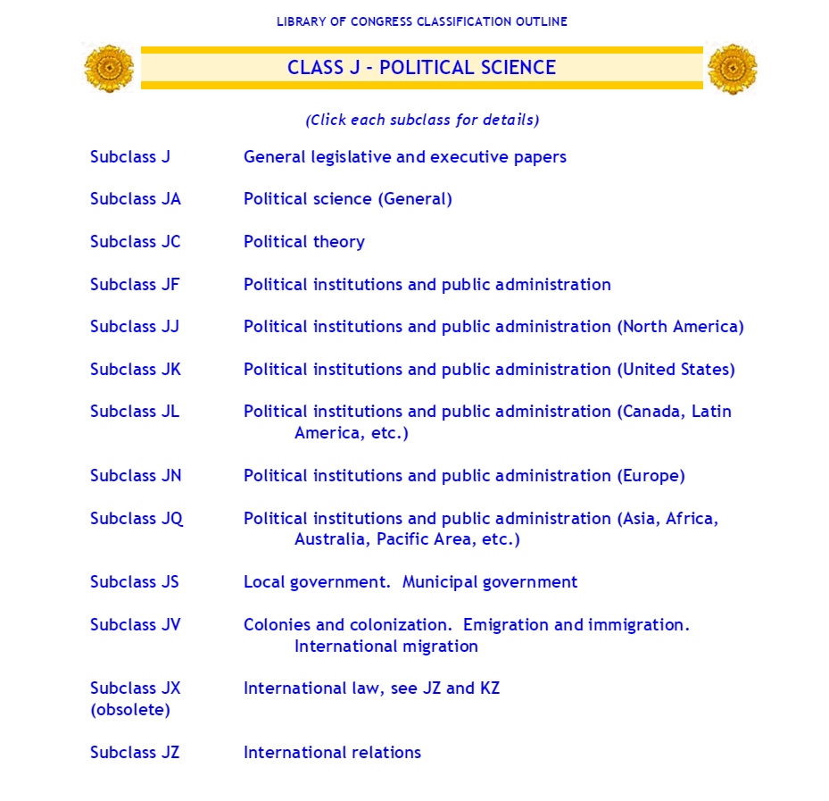
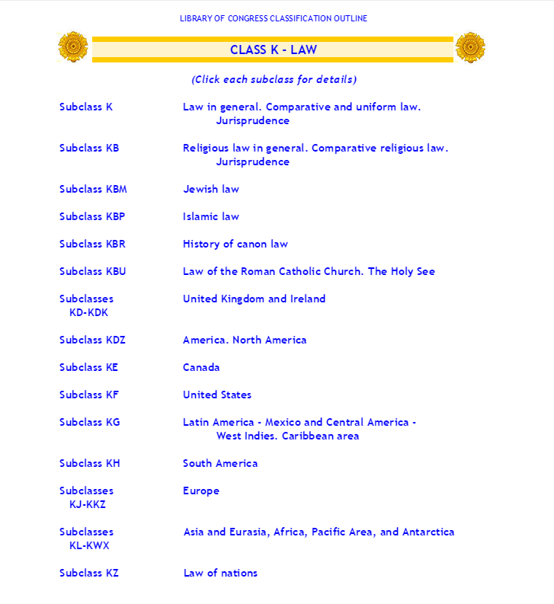
Located in the 4th floor stacks of Webster Library

Slide 29
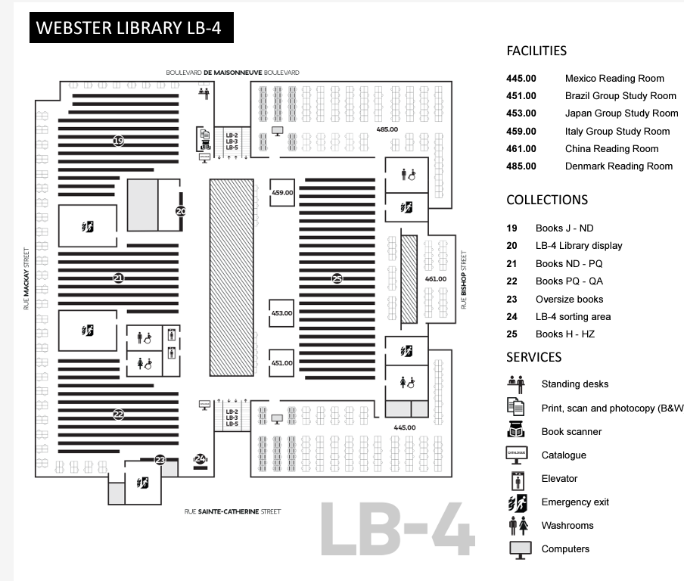

Slide 30
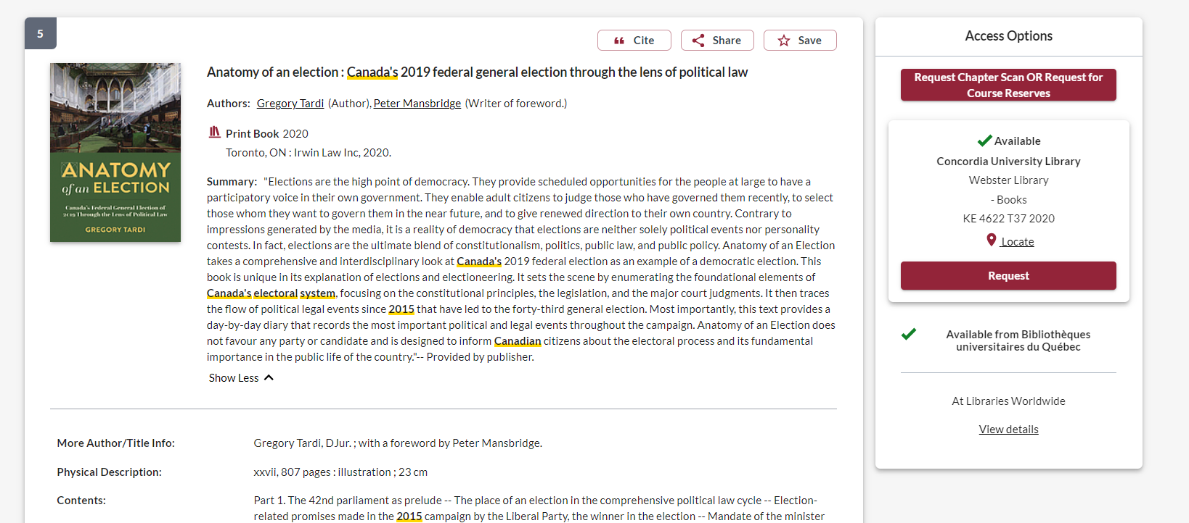
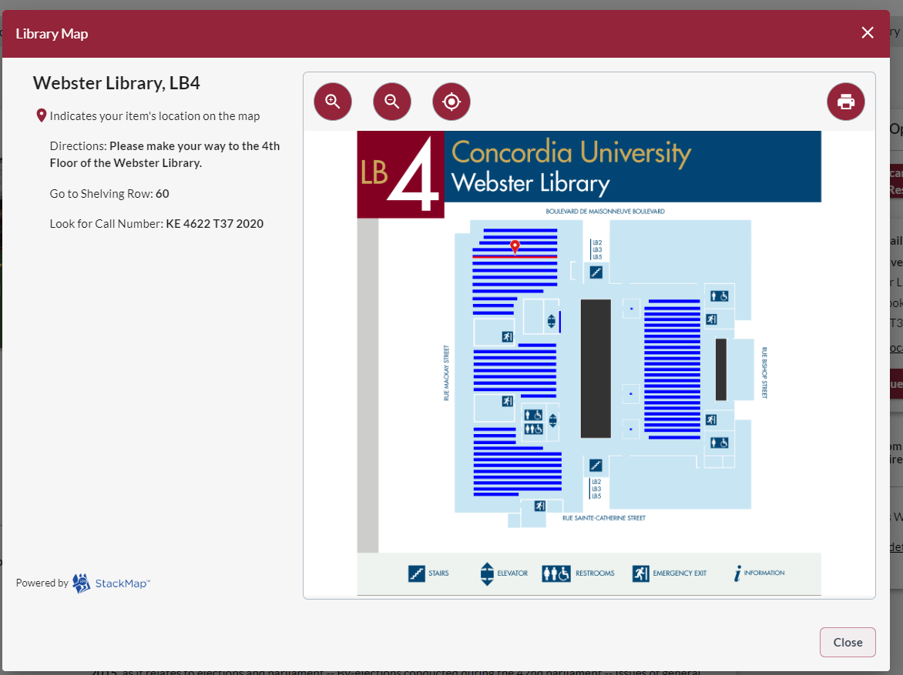


Slide 31
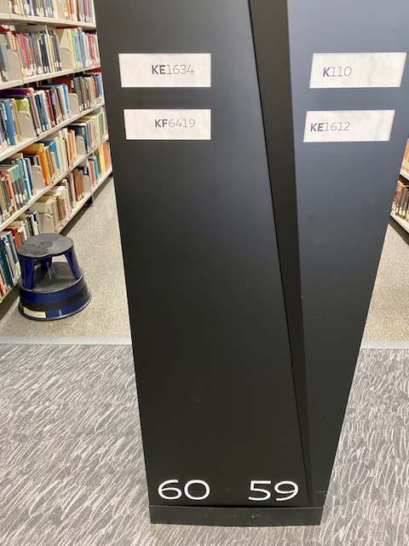
The call number I want to find, KE 4622 T37 2020, will fall in the range on shelf 60: between KE 1634 – KF 6419

Slide 32
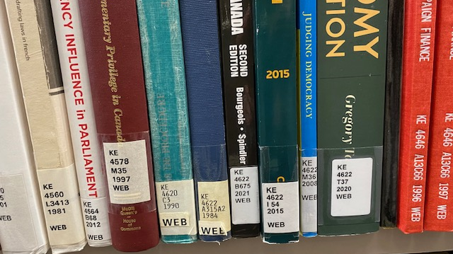

Slide 33
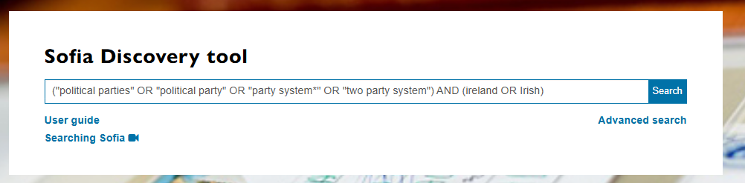

Slide 34
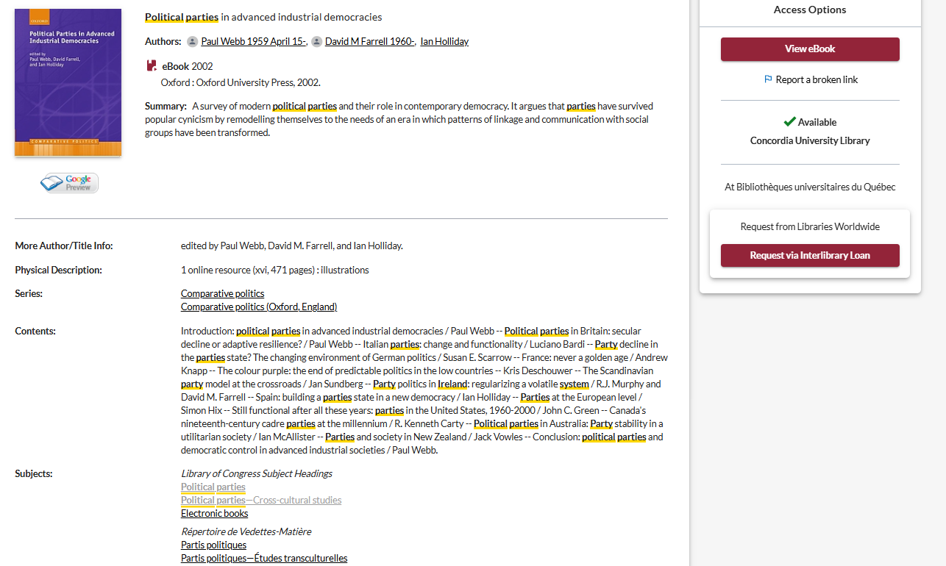
Use the subjects to locate more books and articles on related topics

Slide 35
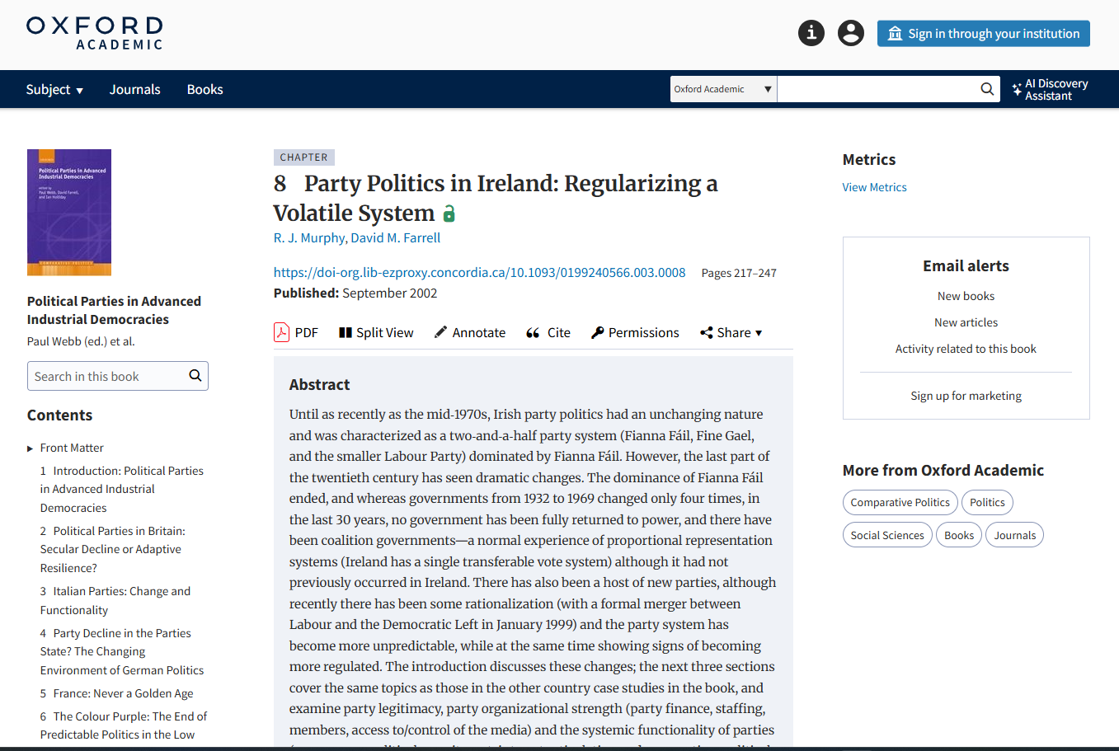

Slide 36
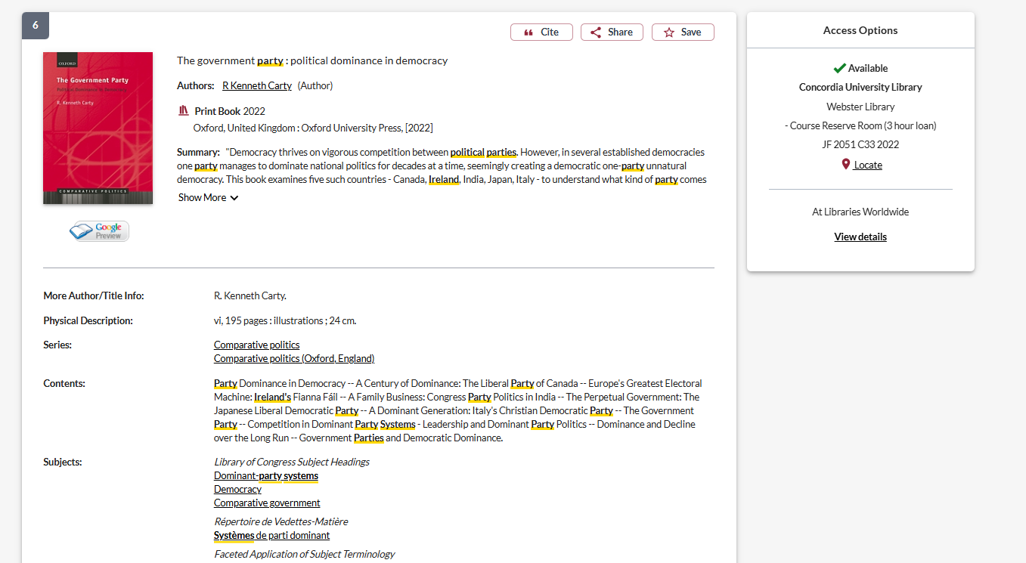
Check out the subjects

Slide 37
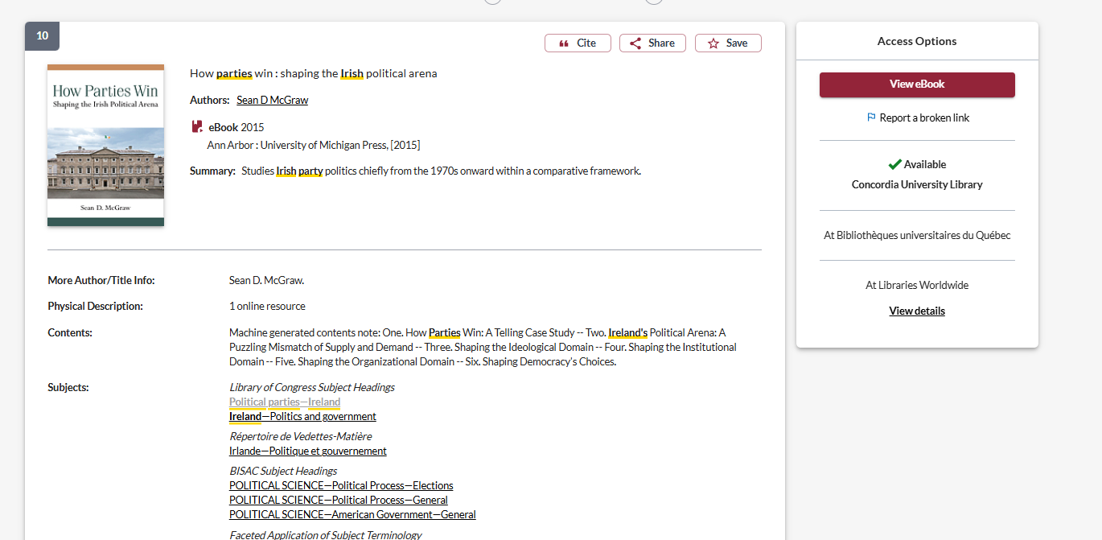

Slide 38
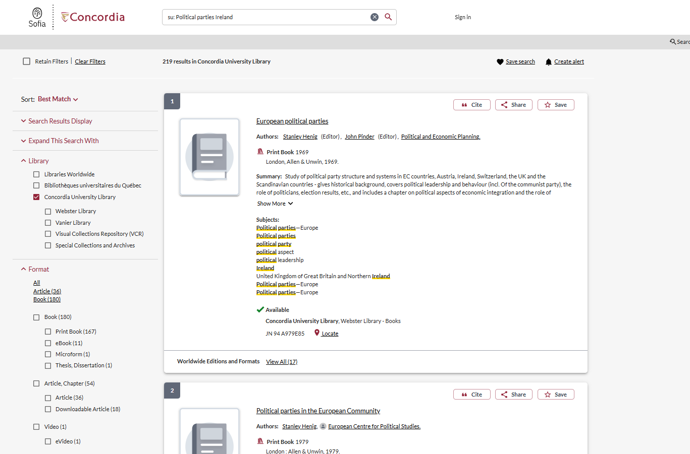
Limit by format to ebooks or articles

Slide 39
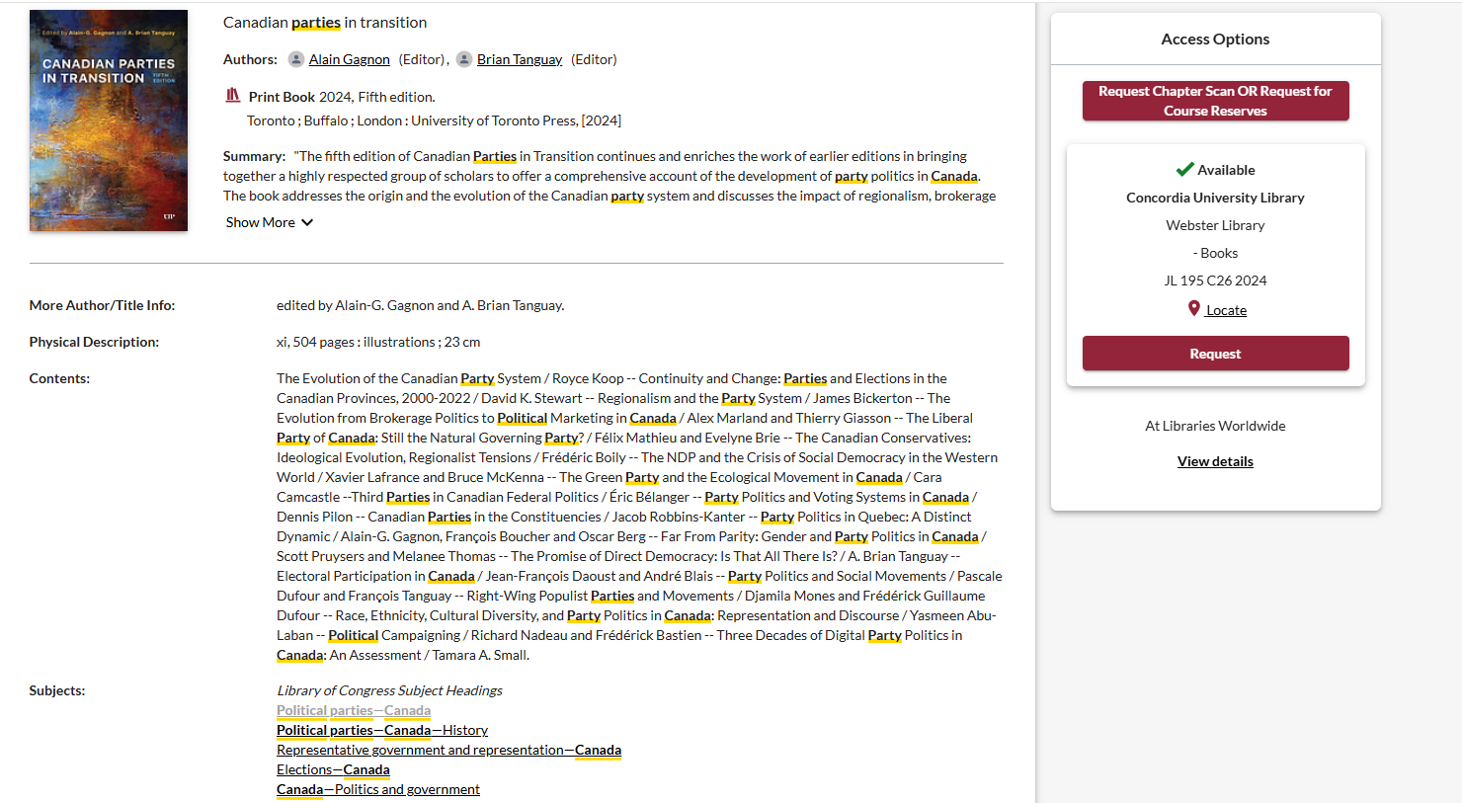
Subject headings can help you locate other books

Slide 40
Searching for journal articles

Slide 41
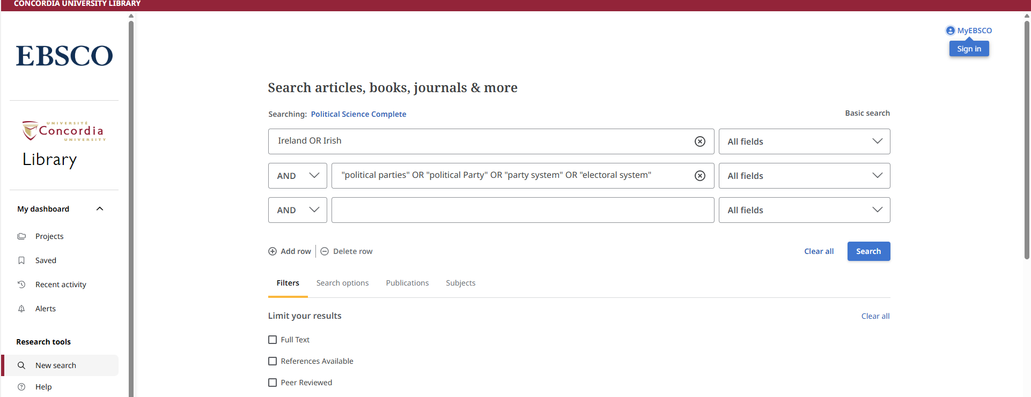
Dividing up our search terms into AND/OR
Using quotation marks with phrases: “electoral system”

Slide 42
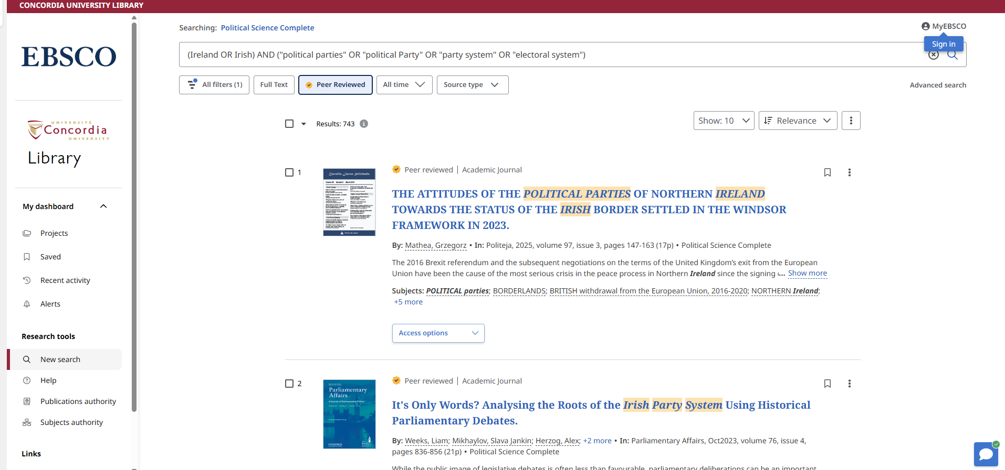

Slide 43
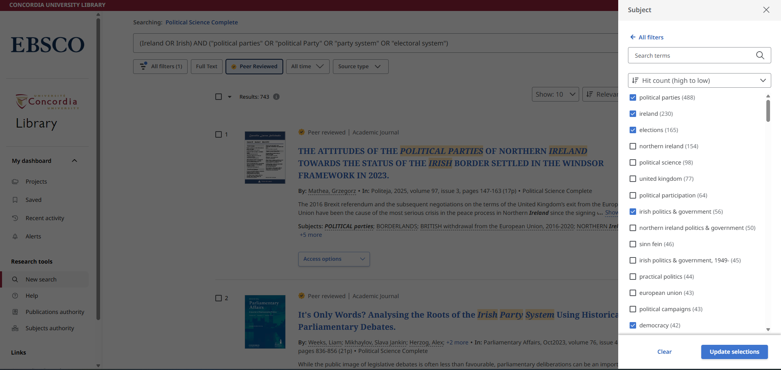
Using subjects to limit search results

Slide 44
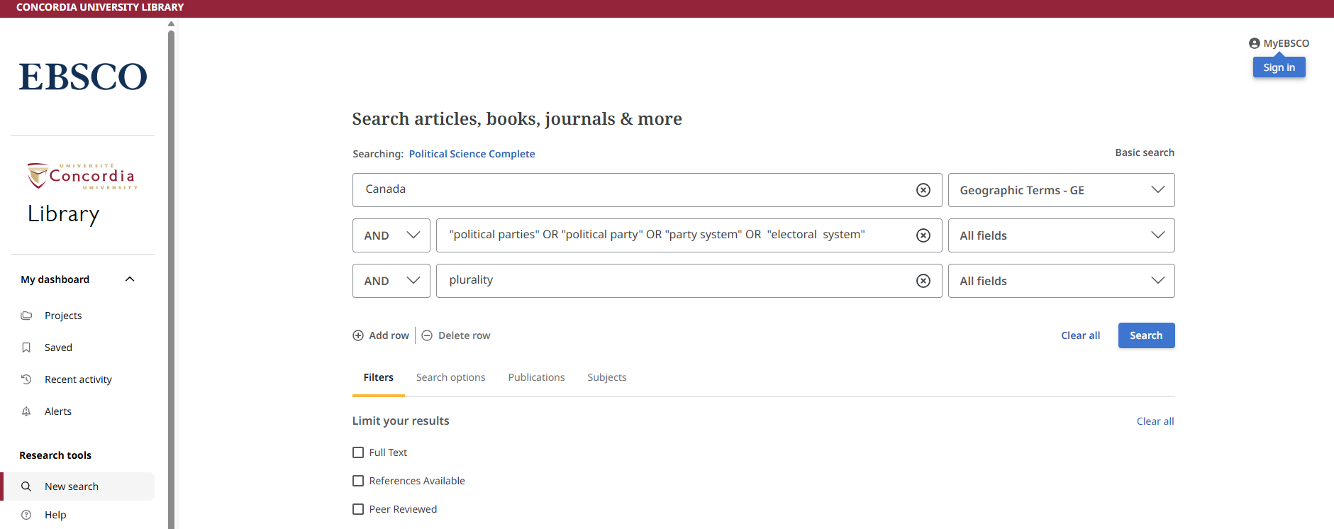
Using Geographic Terms in search

Slide 45
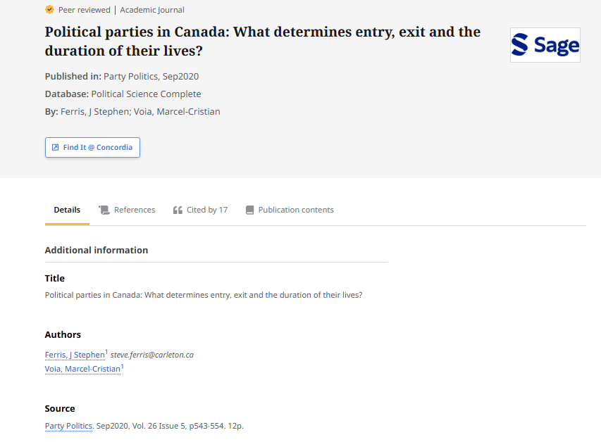
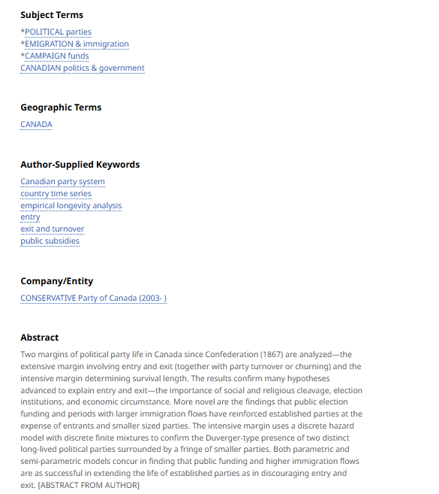
Examine the subject terms, author-supplied keywords and abstract for more key terms to expand you search

Slide 46
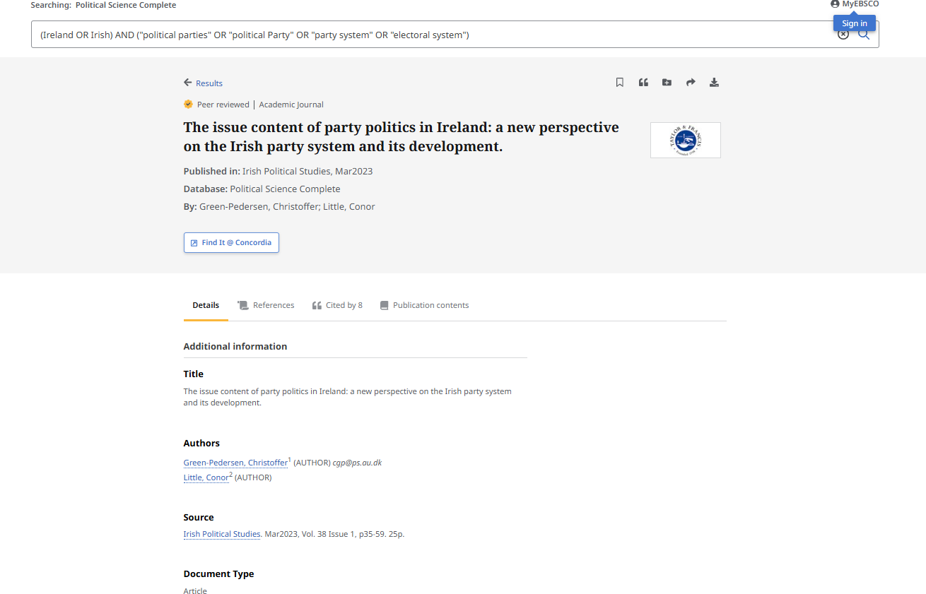
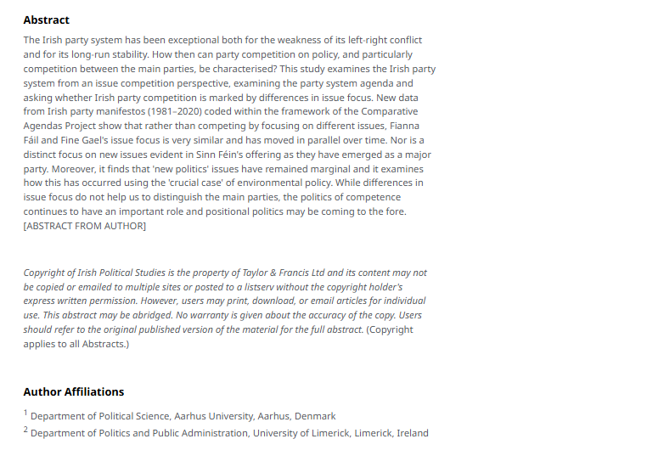
How do I know the article is scholarly?
Look for scholarly author affiliations
Scholarly articles should be 10+ pages

Slide 47

What is peer review? What are peer reviewed, scholarly articles?

Slide 48
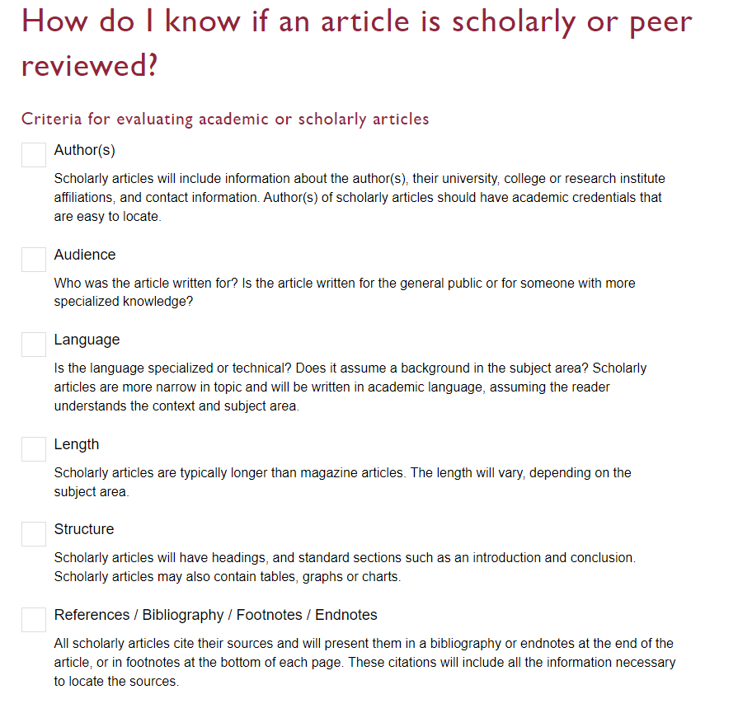

Slide 49
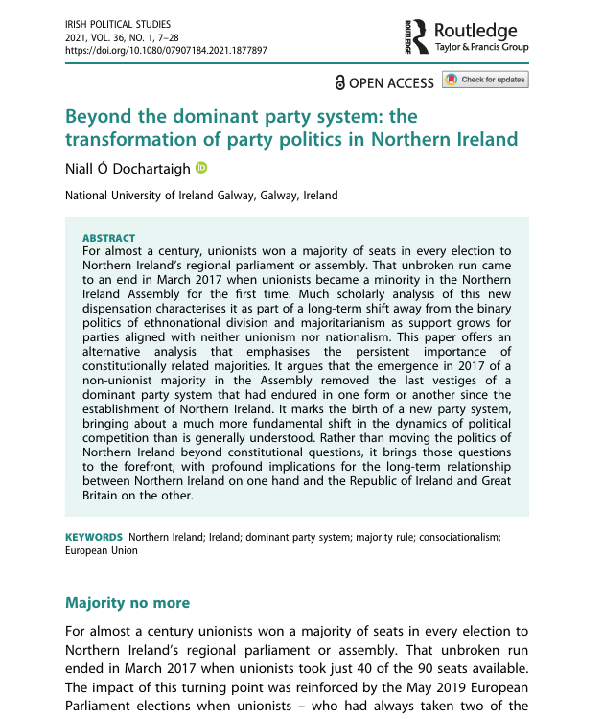
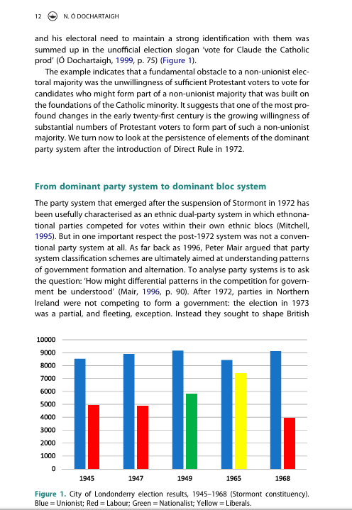
Look for sections, language, charts, tables, graphs, and citations throughout the article
Specialized language

Slide 50
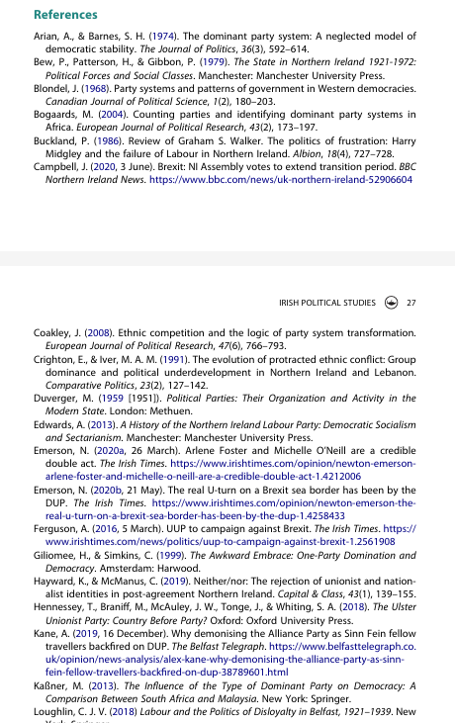
Scholarly articles will always have reference lists/bibliographies/works cited
These are great places to find more sources!
The researcher or research team are experts in the subject area and have already done a lot of research
Use this expertise by looking up the books and articles they cite in Sofia and using them in your own research
This is a commonly used method in academic research

Slide 51
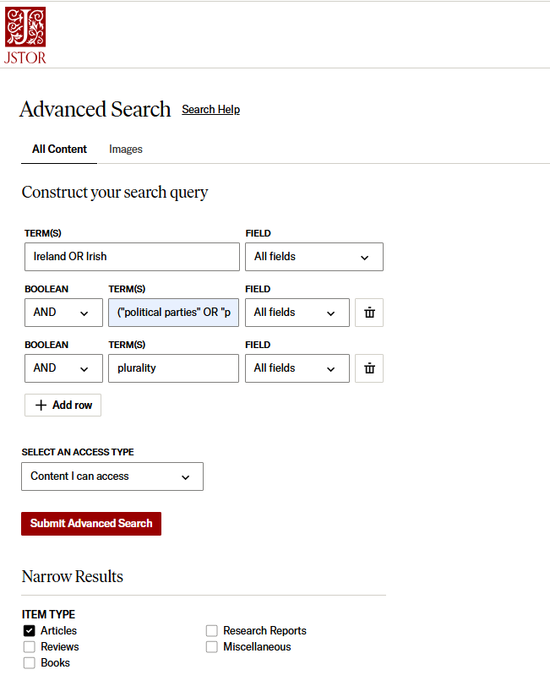
Searching in JSTOR
JSTOR contains a moving wall of archival journals
Multidisciplinary
Search with keywords using AND

Slide 52
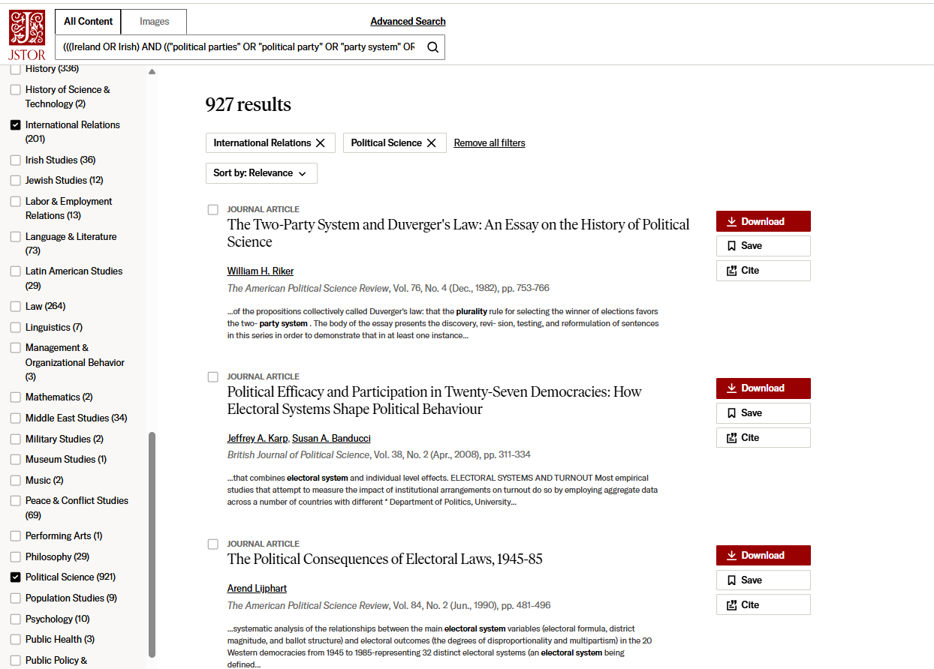
Use the broad subjects on the left hand menu to narrow by discipline

Slide 53
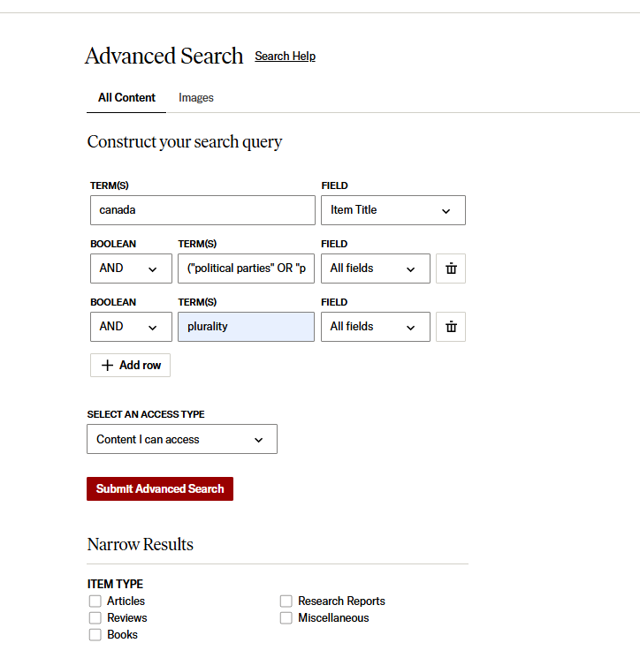
Searching with country names in JSTOR – Item Title

Slide 54
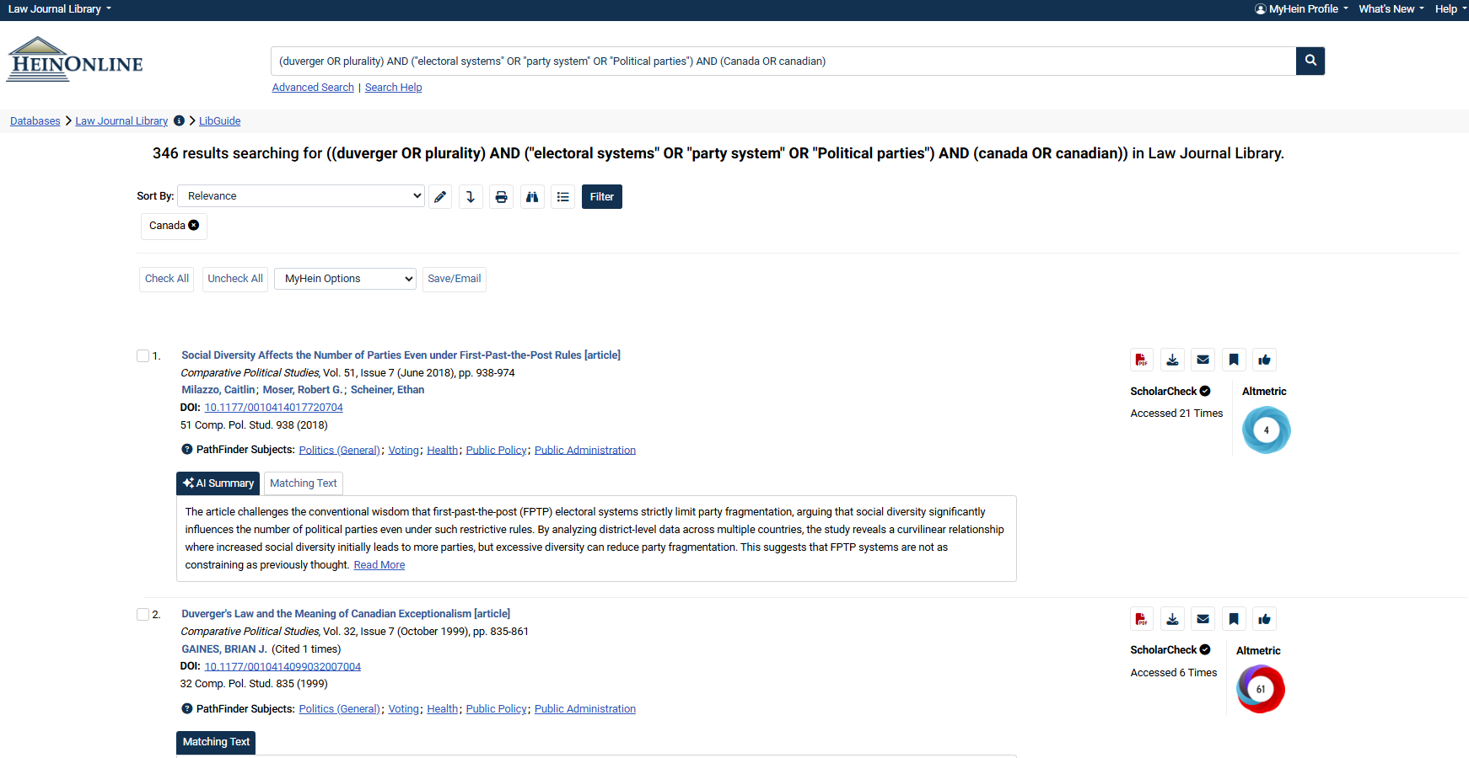
HeinOnline Law Journal Library

Slide 55

Michelle.Lake@Concordia.ca

