Slide 1

Poli 487E:
Gender and Politics in the People’s Republic of China
Library Workshop
Michelle Lake
Political Science, SCPA, First Peoples Studies and Government Publications Librarian
Michelle.Lake@Concordia.ca

Slide 2

Who am I?
Michelle Lake, librarian for Political Science, the School of Community and Public Affairs, First Peoples Studies, and Government Publications
Michelle.Lake@Concordia.ca / Make an appointment or ask a question
What do I do?
  Provide research support
  Help students with library databases
  Help students find and access materials they need
  Help with citation issues
  Choose the books we buy for the above subject areas

Slide 3


The Librar(ies)
24/7 access, with student card, after 11pm
Webster Library (LB) – downtown on SGW campus & Vanier Library (VL) on Loyola campus
Webster: Social Sciences, Humanities, Business, Engineering & Fine Arts
Vanier: Science(s), Health, Communications, Journalism and Psychology
Course Reserves Room(s): have the required undergraduate print textbooks for the courses taught at that campus (for example: Webster has the Political Science and SCPA course reserves)

Slide 4

Library Services
Your student card is your library card.
You need it to:
borrow books (up to 100 a time)
borrow a laptop and other technology
print on campus (add money to your Dprint account)
access the library overnight during 24/7 hours.
Webster library has 5 book scanners (And Vanier has 2!) that can be used for free to scan chapters from our print books and email them to yourself as a PDF.
To use Library databases, access online articles and ebooks when you are off campus, login with your MyConcordia Netname and password.

Slide 5

How can I find out if the library has access to an item I’m looking for?

Slide 6
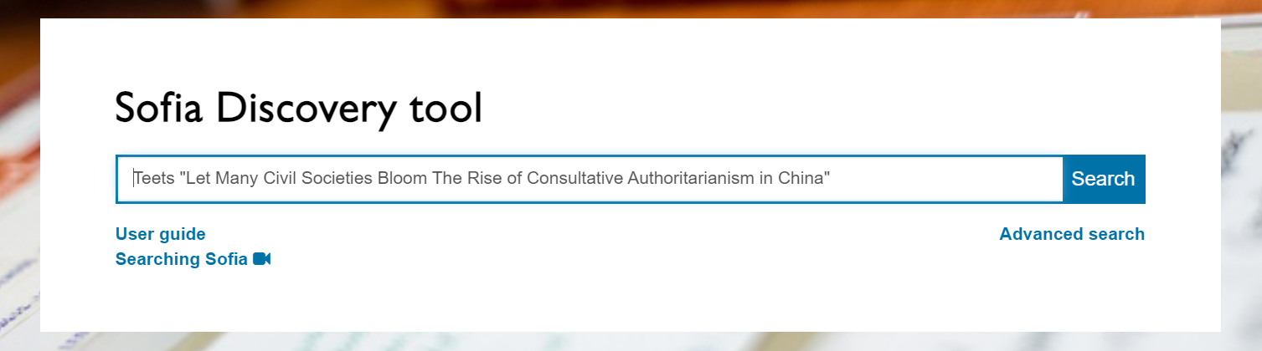
Teets, Jessica C. "Let Many Civil Societies Bloom: The Rise of Consultative Authoritarianism in China." The China Quarterly, no. 213 (2013): 19-38.

Slide 7
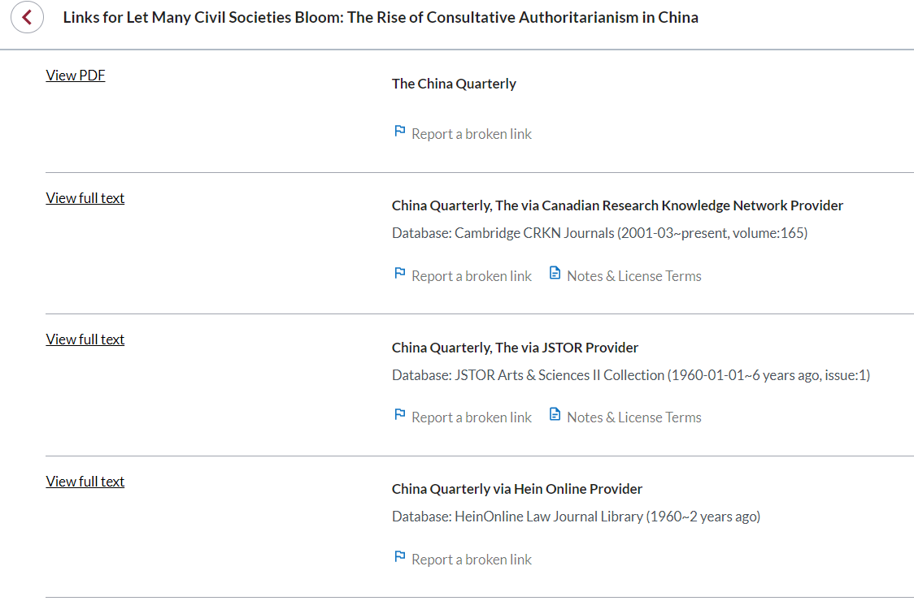
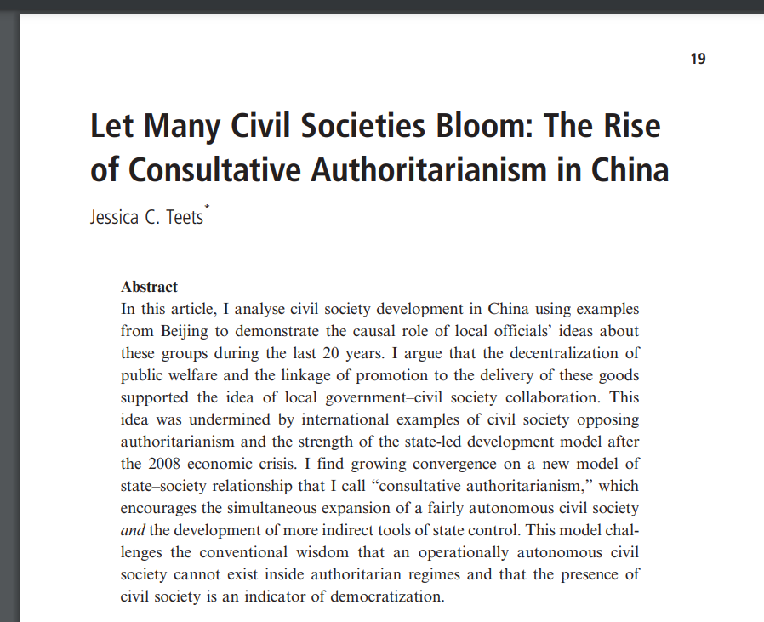
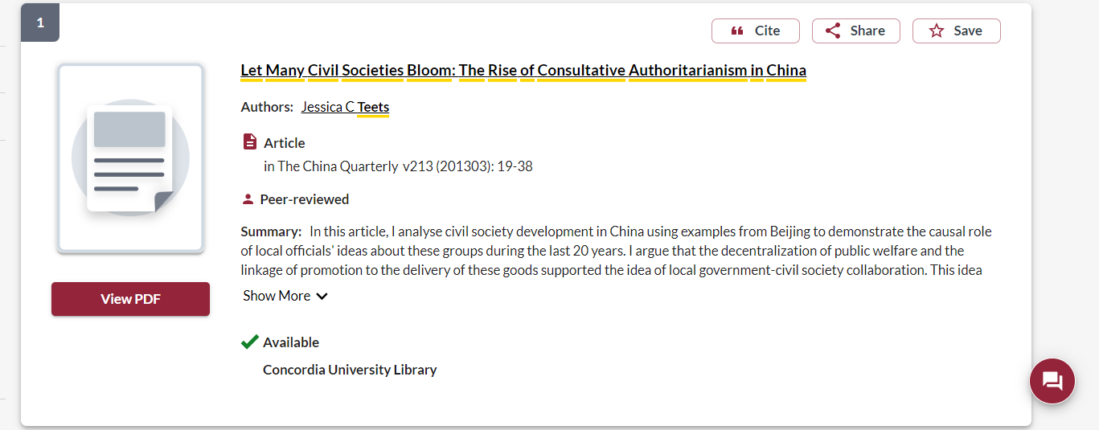

Slide 8
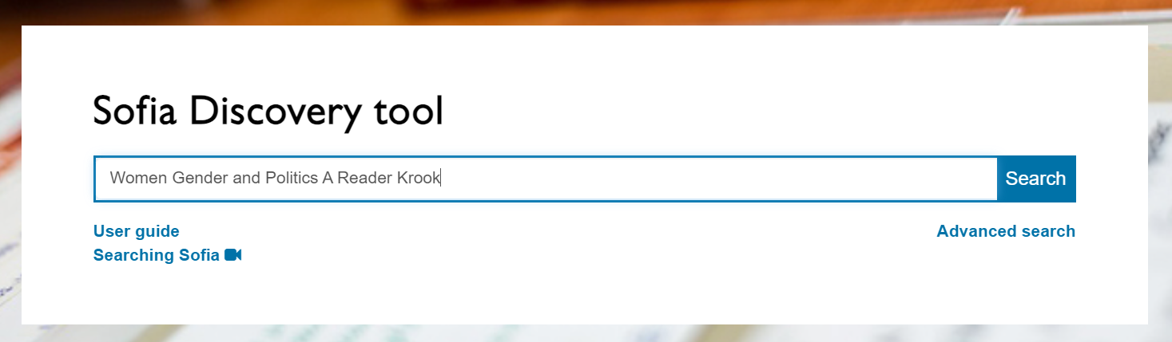
Chappell, Louise. 2010. “Interacting with the State: Feminist Strategies and Political Opportunities.” In Women, Gender, and Politics: A Reader, edited by Mona Lena Krook and Sarah Childs. New York: Oxford University Press, 313-318.

Slide 9
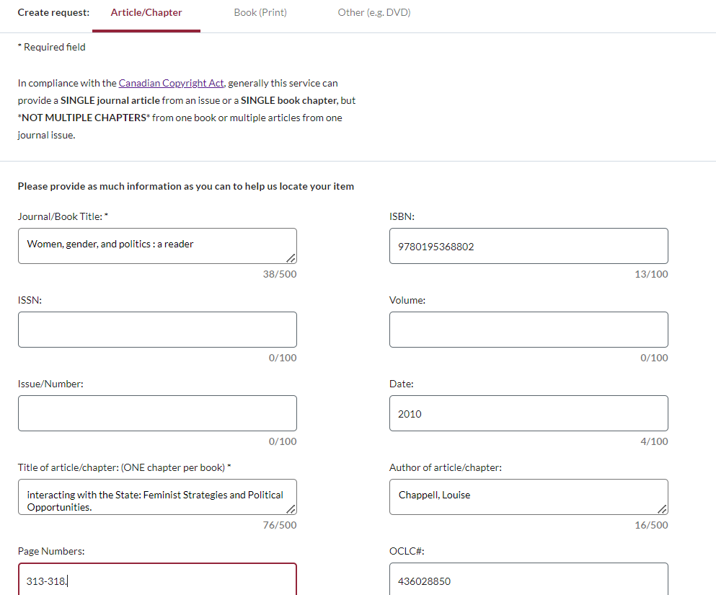
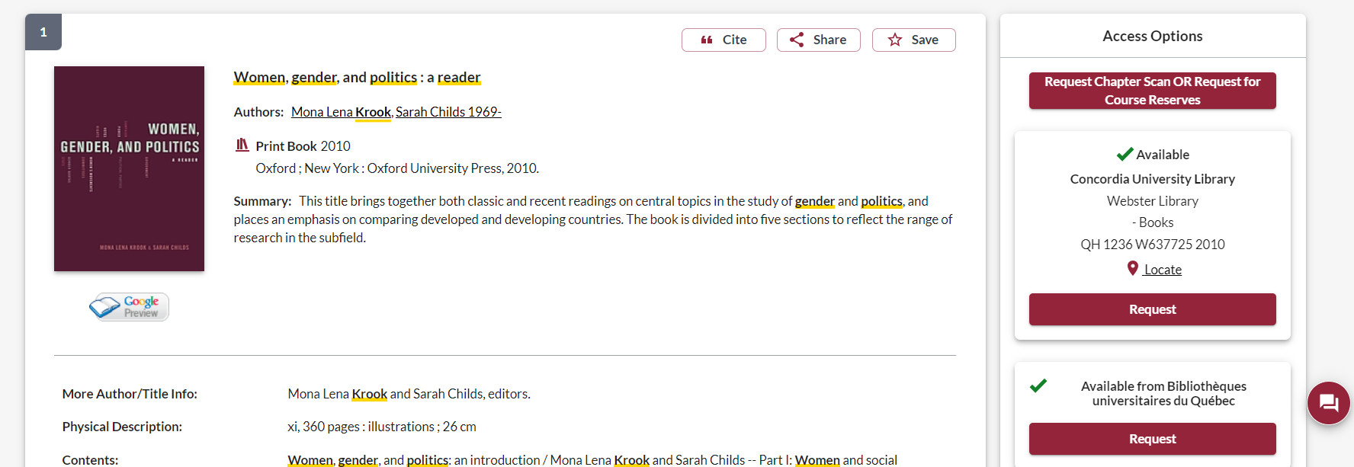
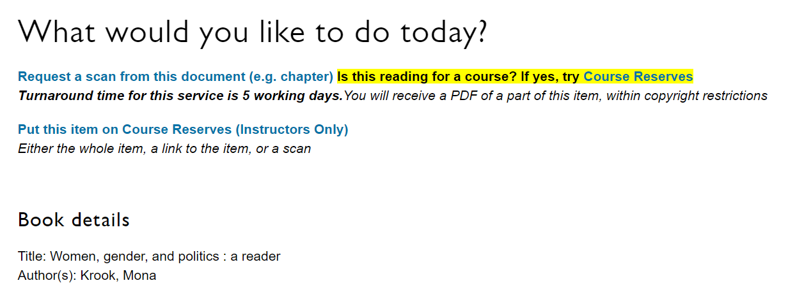
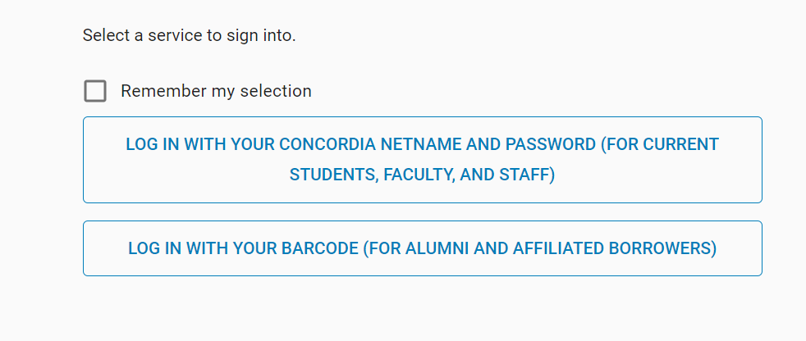

Slide 10
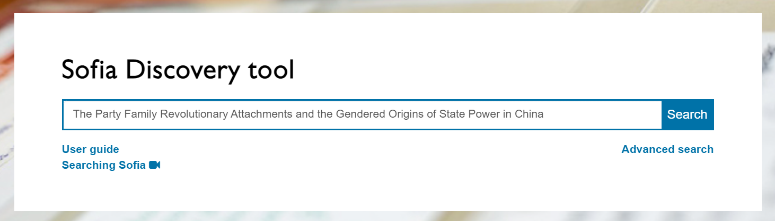
Manning, Kimberley. 2023. The Party Family: Revolutionary Attachments and the Gendered Origins of State Power in China. Ithica, NY: Cornell University Press, pp. 131-155; 318-321.

Slide 11
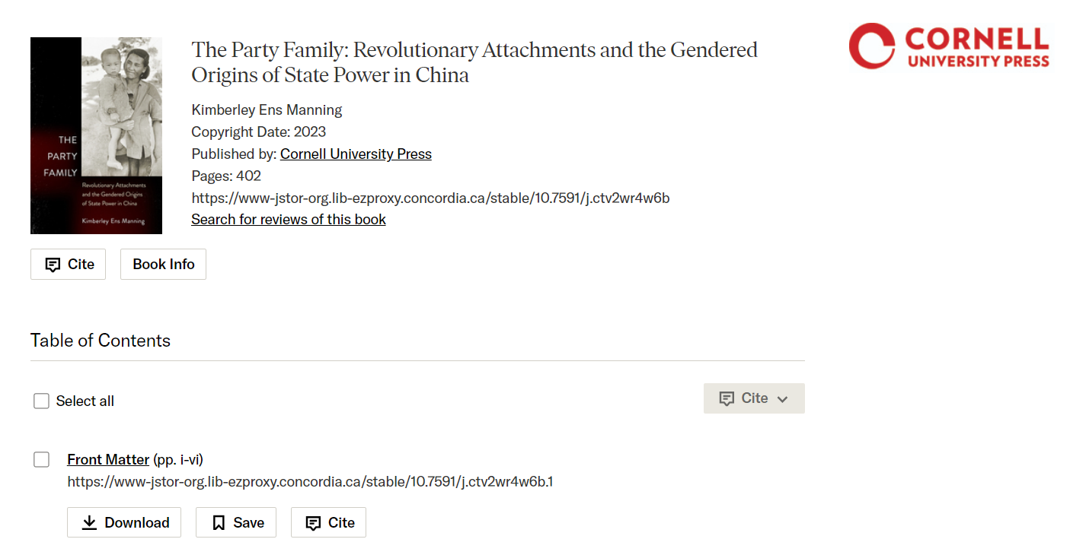
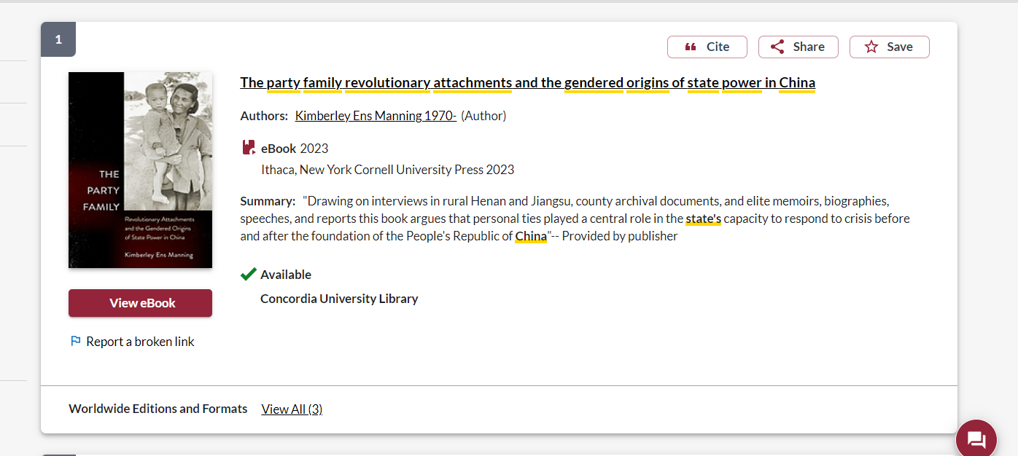
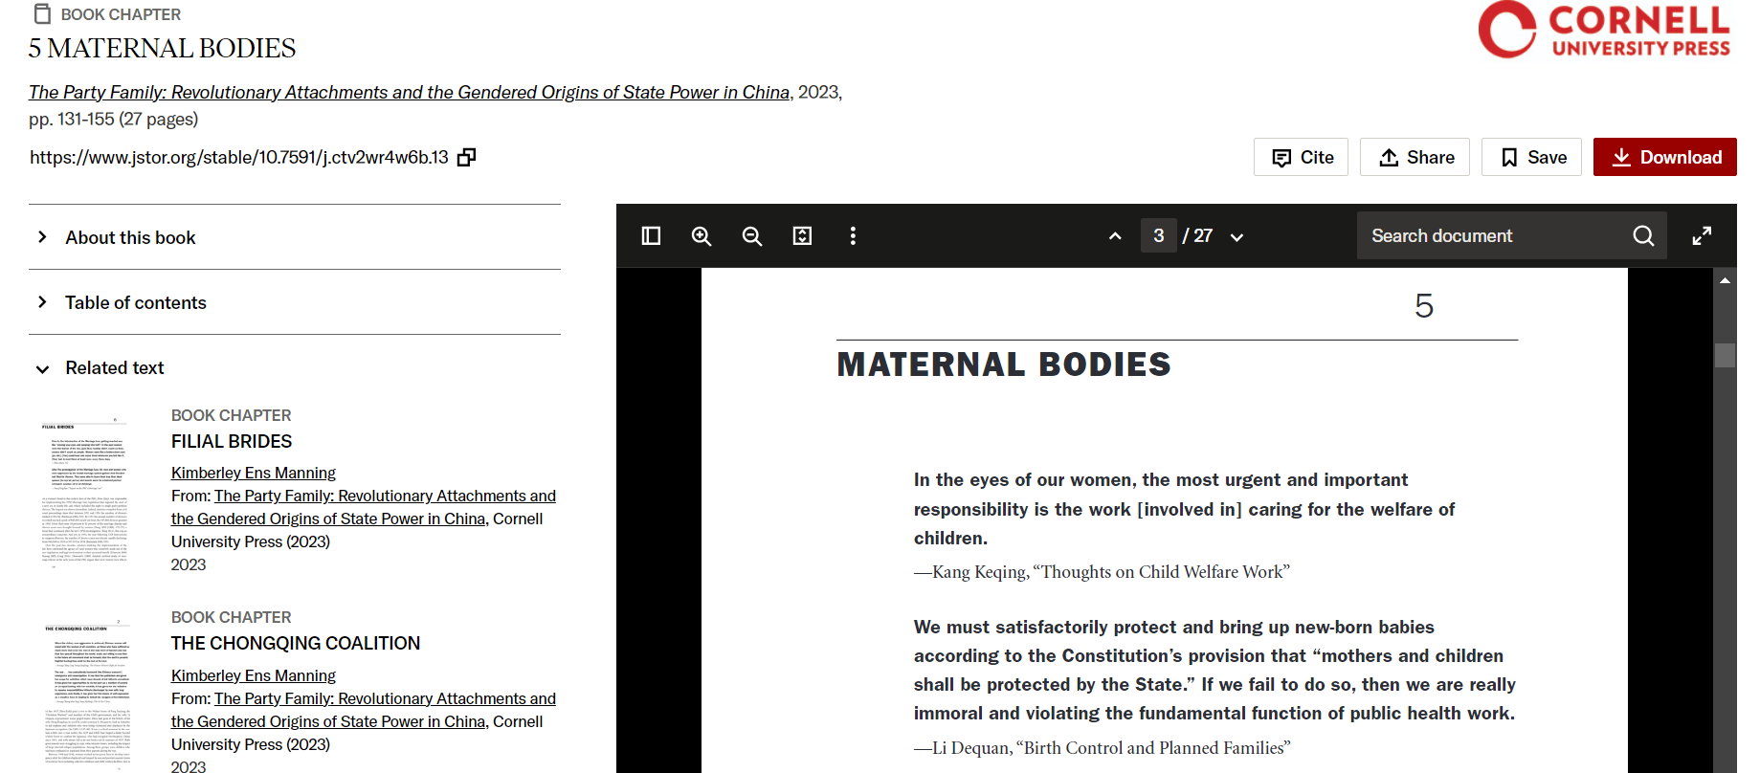
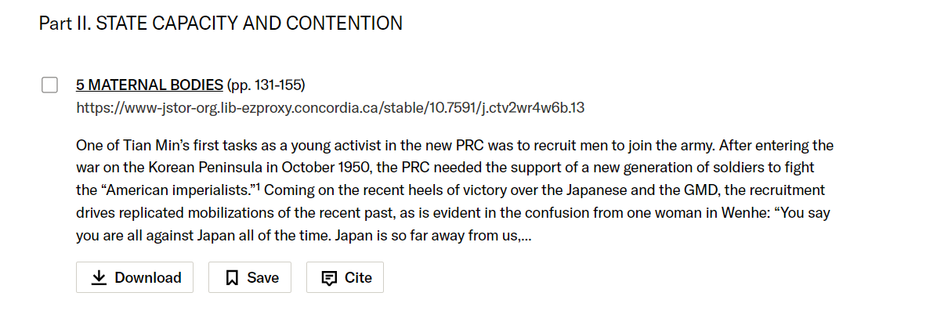

Slide 12
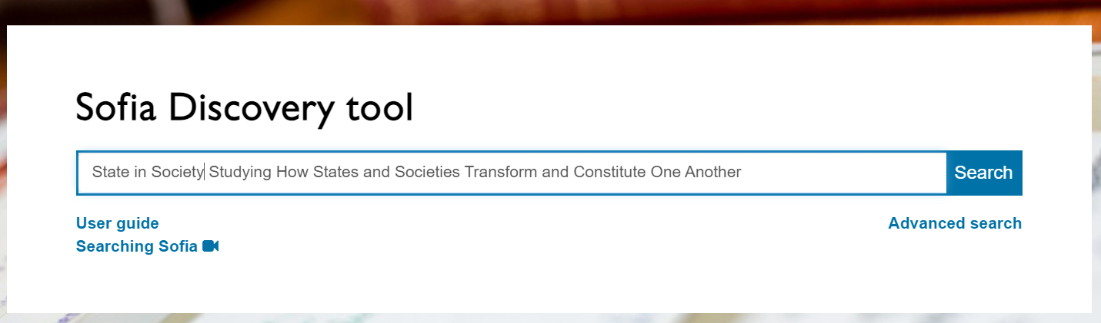
Migdal, Joel. 2001. State in Society: Studying How States and Societies Transform and Constitute One Another. New York: Cambridge University Press, 97-134.

Slide 13
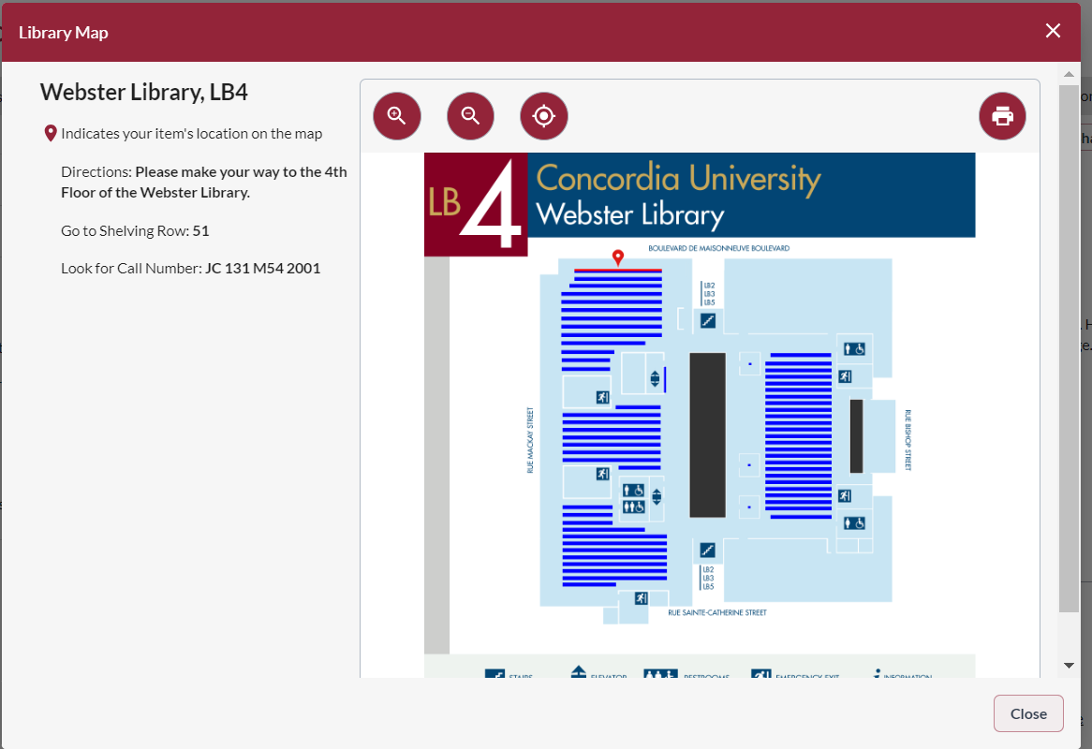
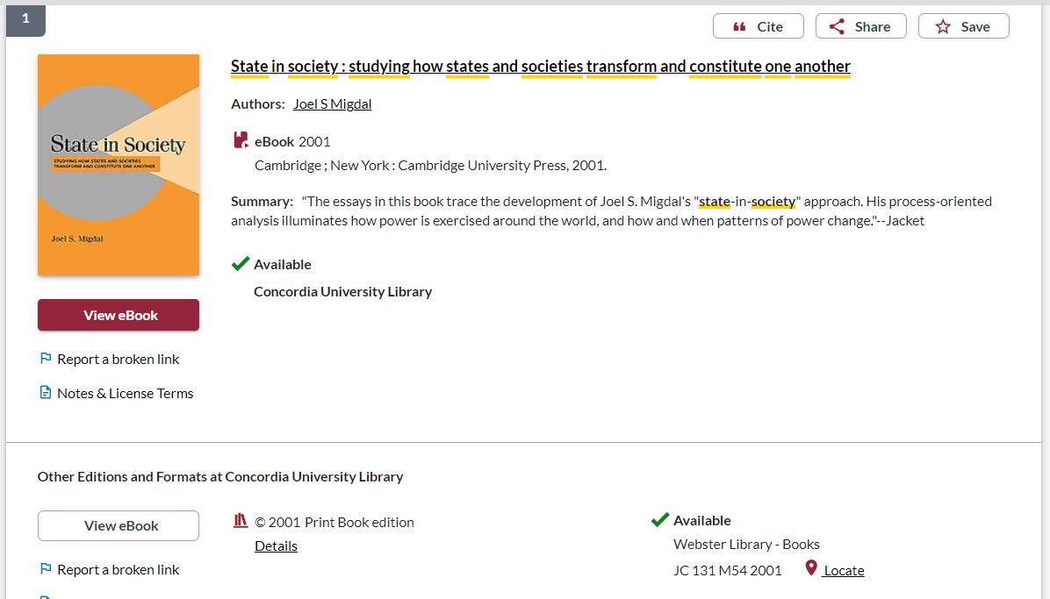

Slide 14

Search Strategies

Slide 15
How do we combine search words for the best possible results?
AND: combines concepts and limits your results
politics AND gender
state OR government
OR: allows you to insert synonyms or alternative terms and increases your results

Slide 16
How do we combine search words for the best possible results?
“quotation marks”: If you put two or more words in quotation marks, that exact phrase will be searched and limits your results.
“cultural revolution”
“one-child policy”
econom*
Finds: economy, economies, economic, economics, economically
* - when you add an asterisk on the end of a word, your results will contain all the words with those endings or suffix

Slide 17
Avoid Searching with Linking words
Each author may use different linking words when discussing similar topics.
Effects
Impact
Consequences
Influence
Results
Importance
Significance
Response
Emphasis
Causes
You don’t want your search to be limited to those books and articles that only contain the word “effect” or “consequence”

Slide 18

Scholarly Sources: Books and Articles

Slide 19
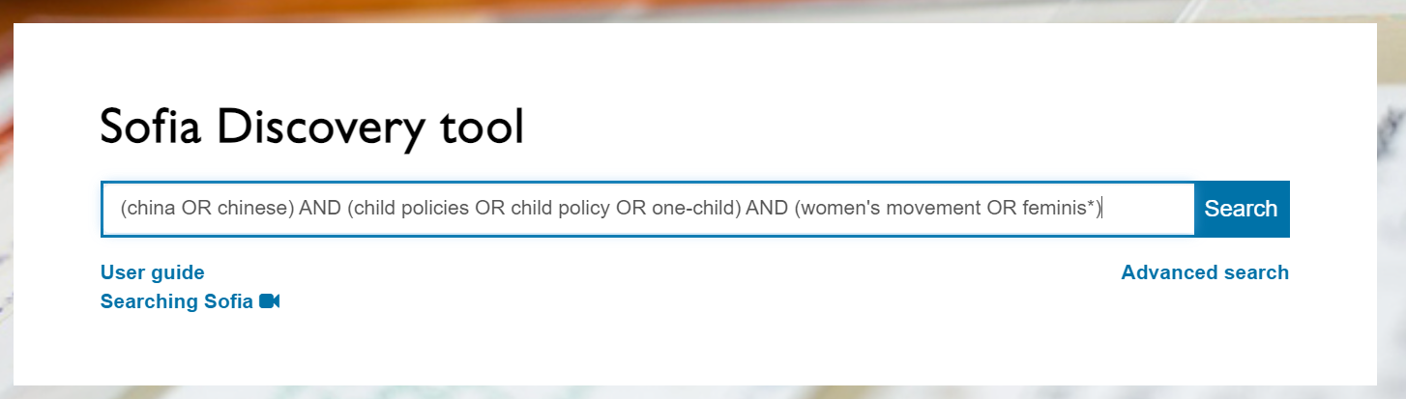
How have the child policies of the PRC government impacted or contributed to the Chinese women’s movement?
Child policies, child policy, one-child policy
Women’s movement, feminism, feminist movement
China, Chinese

Slide 20
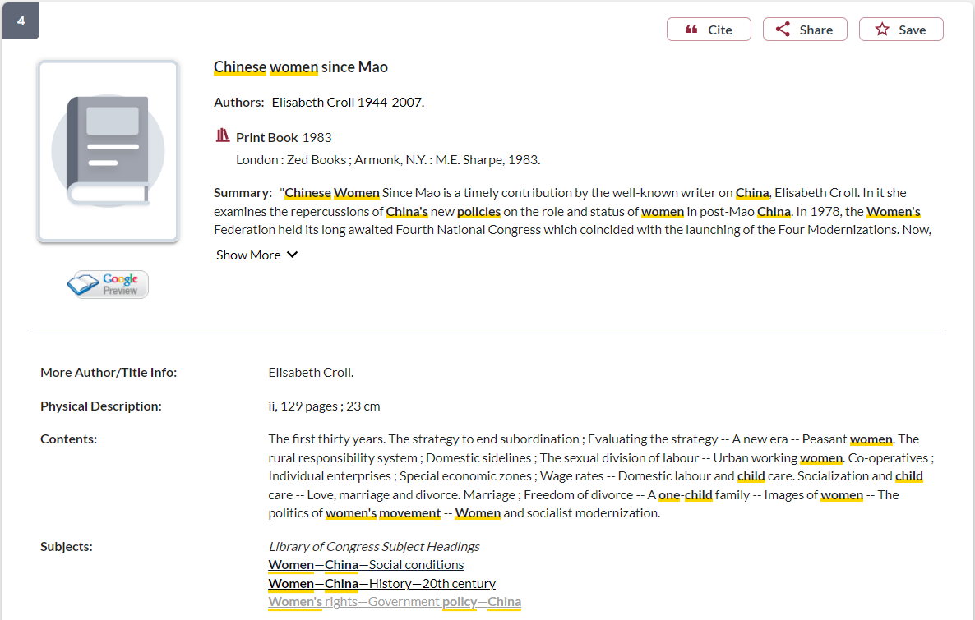
Subject headings will lead to more books on the topic

Slide 21
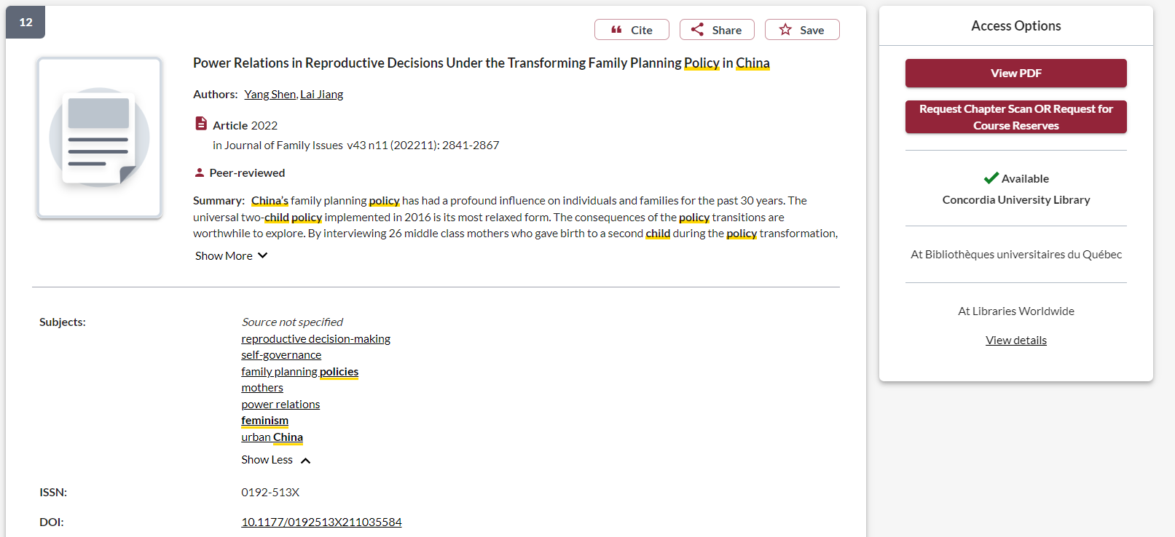
Take a look at the subjects or keywords attached to articles of interest, they will provide additional search words

Slide 22
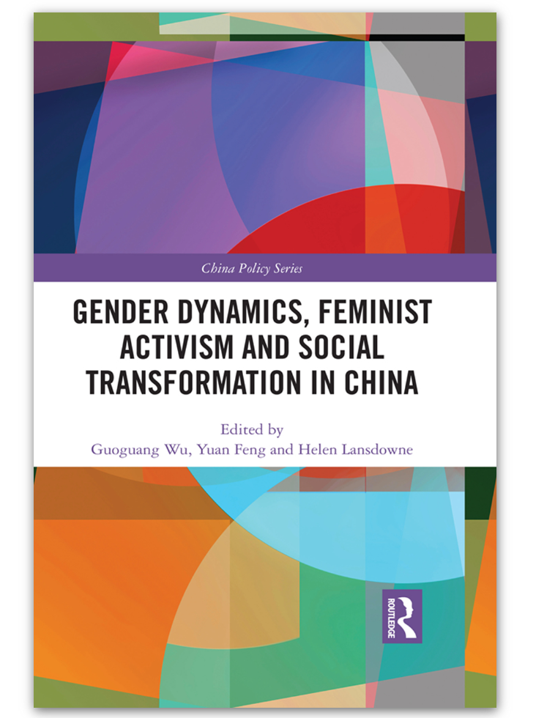
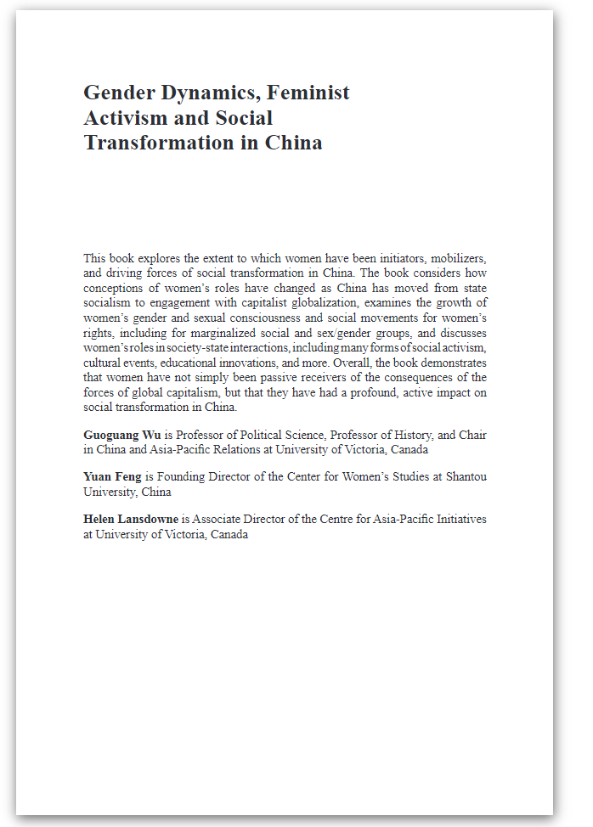
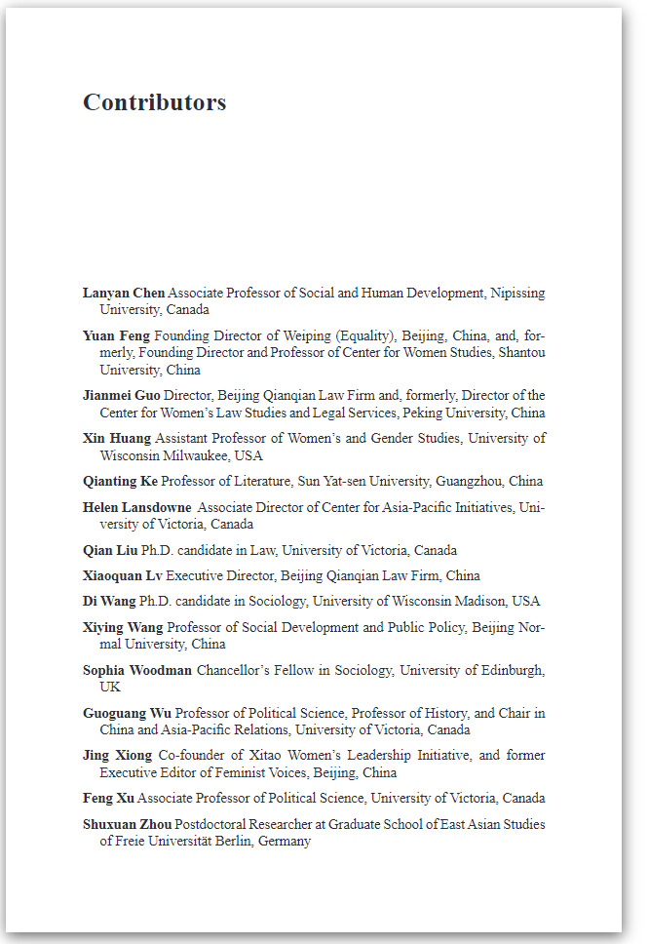
Look for author and editor affiliations in the books you find, contributor lists will also cover the academic credentials of the chapter authors

Slide 23
Scholarly articles

Slide 24
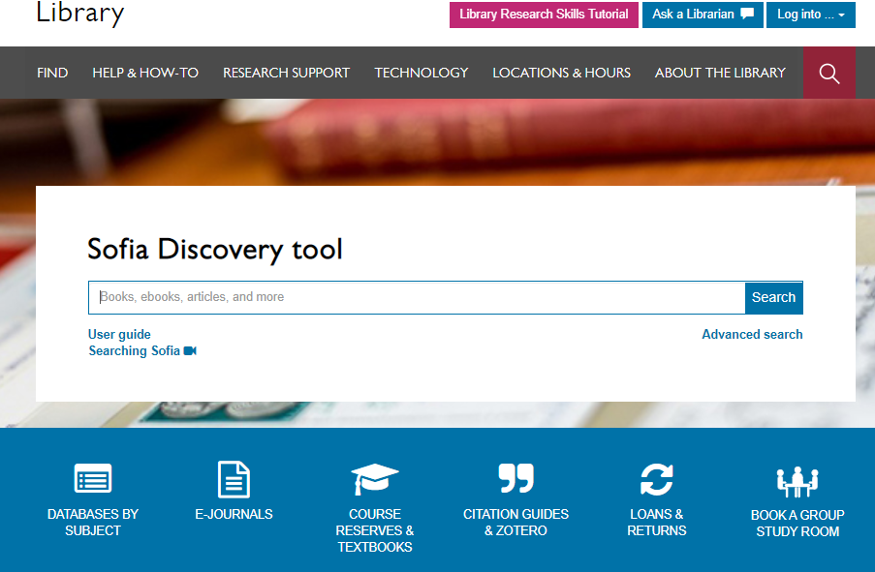
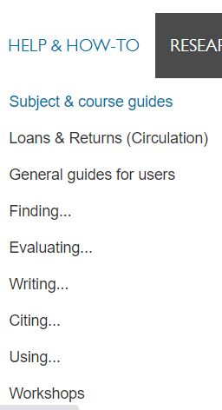

Slide 25
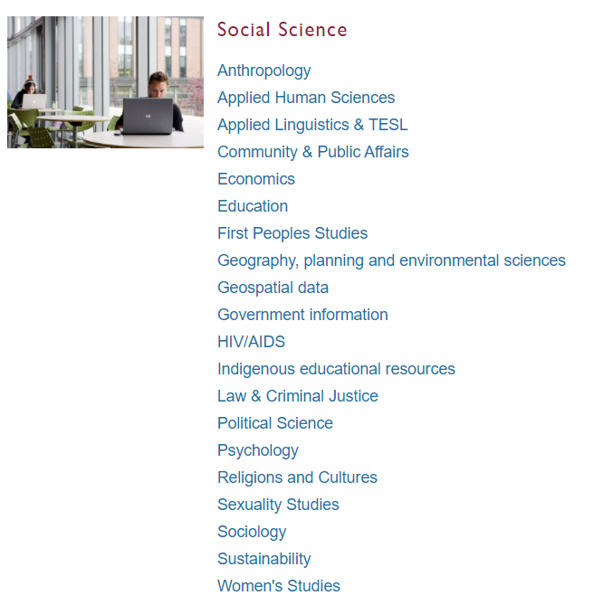
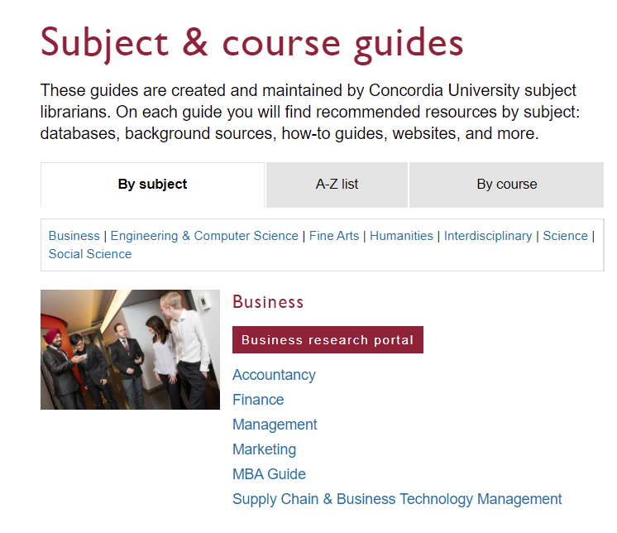
Subject Guide: Political Science

Slide 26
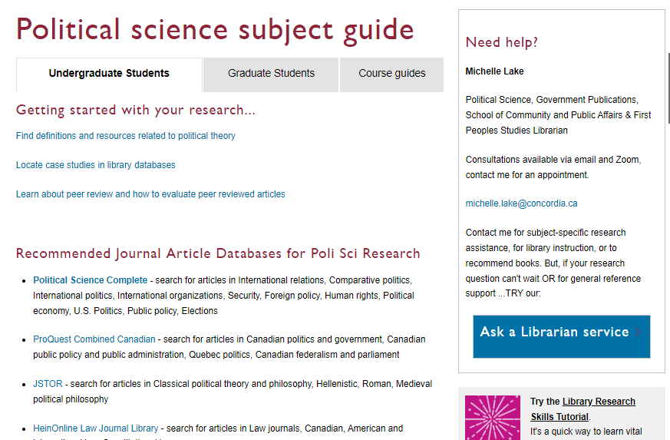

Slide 27
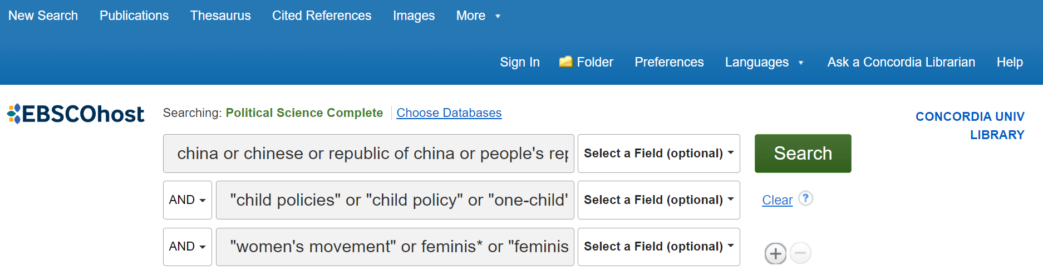
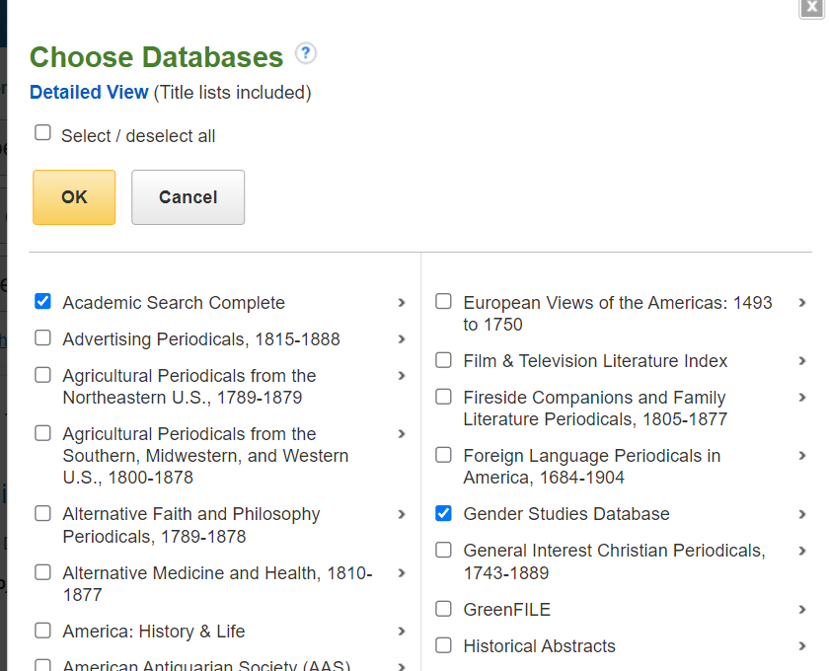
You can search several databases at once.
I selected:
Academic Search Complete
Gender Studies Database
Political Science Complete
SocIndex

Slide 28
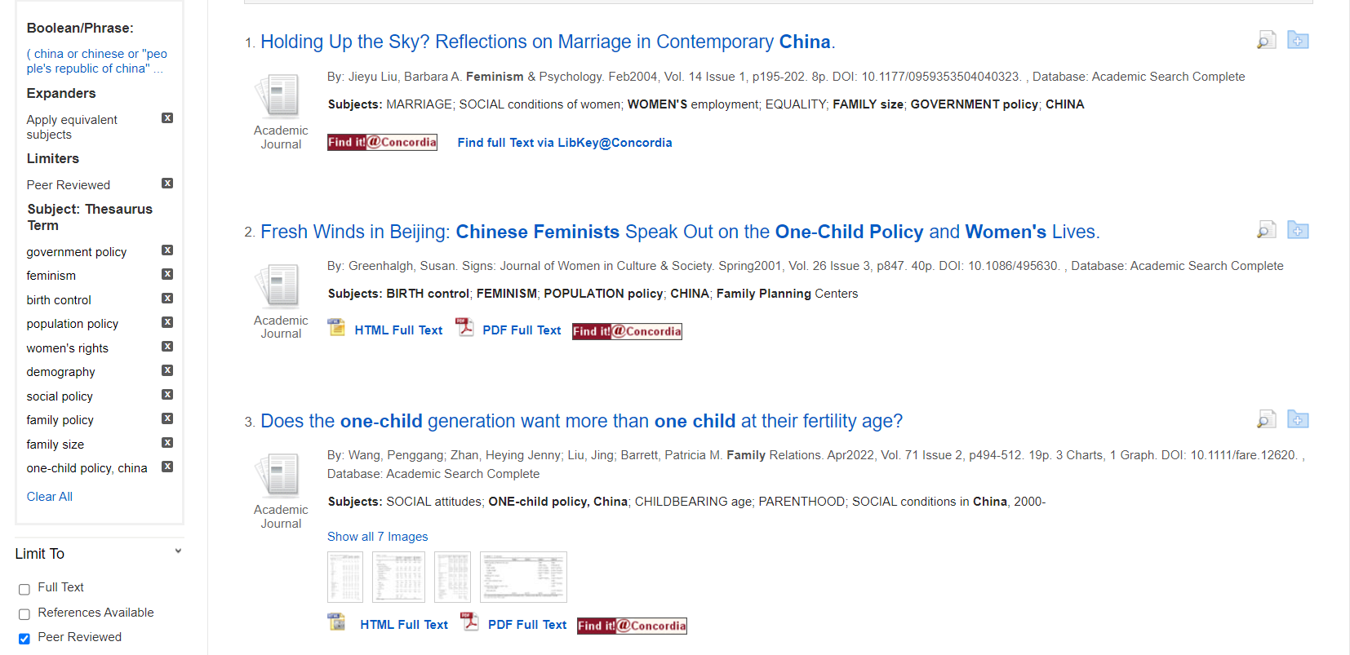
All the subjects applied to the results

Slide 29
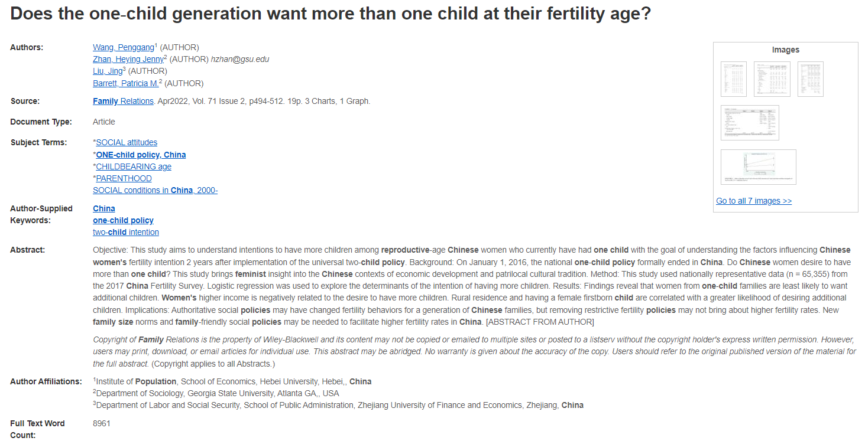
Features of a scholarly article:
Length: 10-30 pages
Author affiliations: universities, research institutes

Slide 30
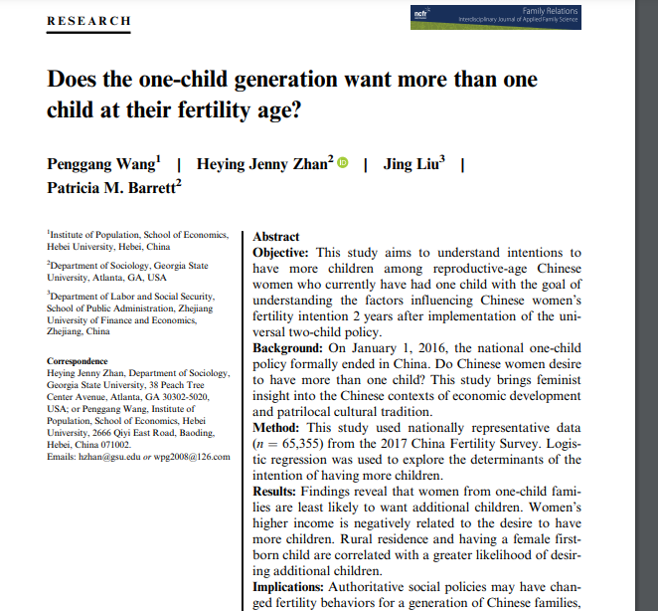
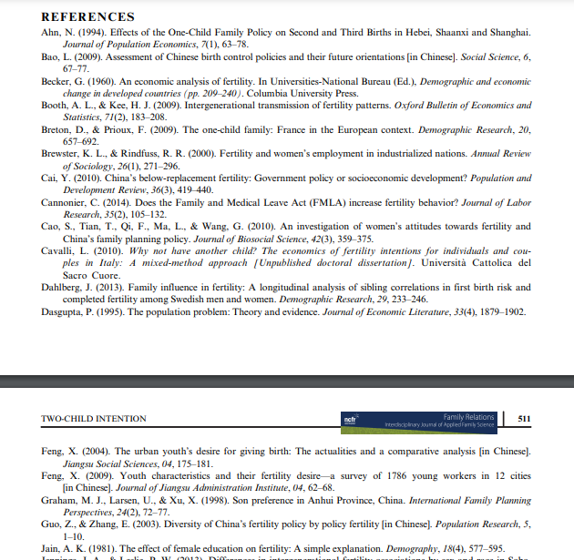
Features of a scholarly article:
Distinct sections: intro, lit search, methodology, results, discussion, conclusion
May include tables, graphs or figures
Extensive reference lists

Slide 31

What is peer review?
What are peer reviewed, scholarly articles?

Slide 32
Has the article gone through the peer review process?
What is peer review?
Peer review is a system used to decide if an article should be published in a peer-reviewed journal. Each paper submitted to a peer-reviewed journal is read and evaluated by experts in the article’s subject area.
The reviewers assess the article’s validity, importance, and originality, and then recommend whether it should be printed in the journal.
The reviewers’ suggestions are considered by the journal’s editor, who makes the final decision about whether to accept or reject the article.
Criteria for evaluating academic or scholarly articles

Slide 33
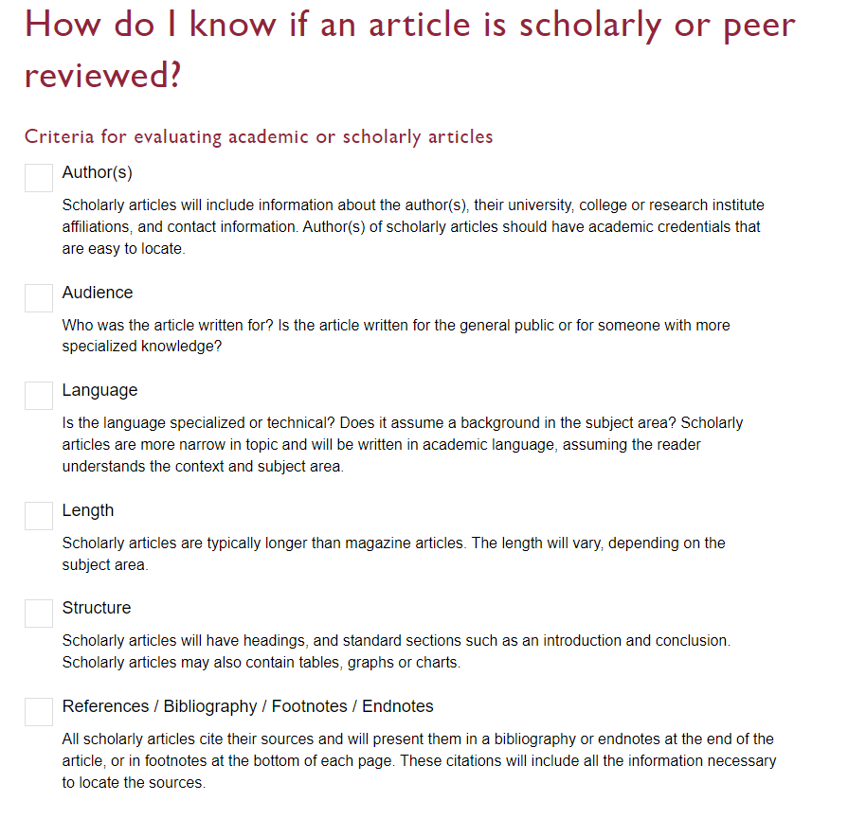

Slide 34
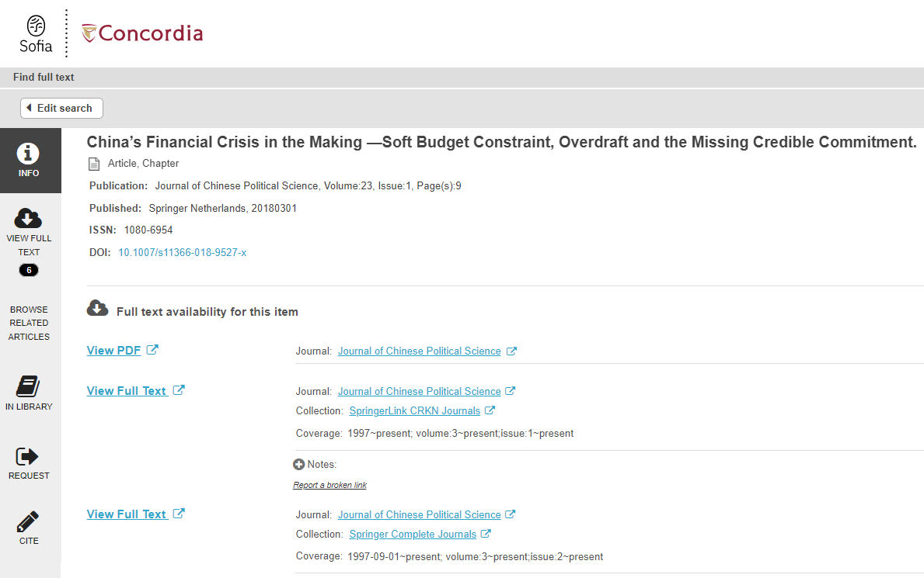
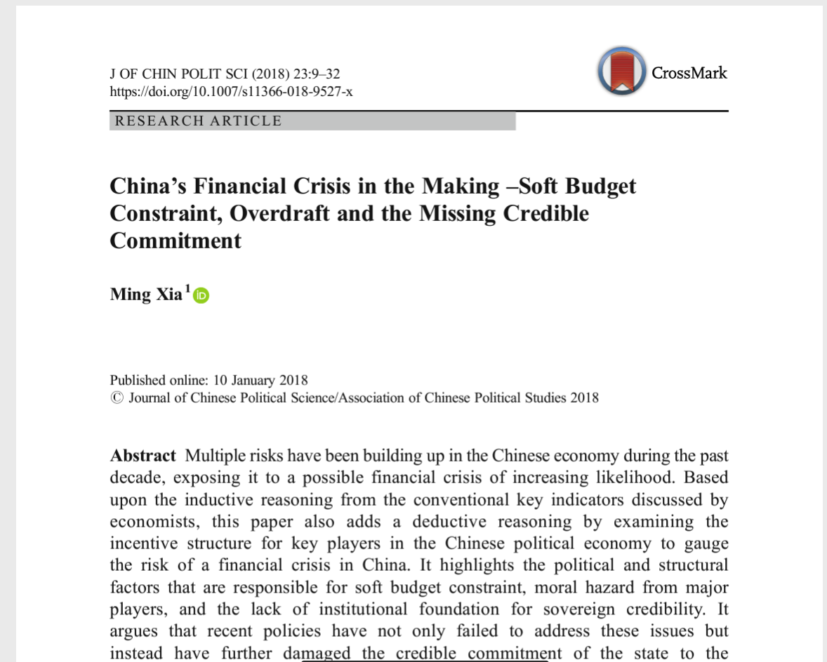
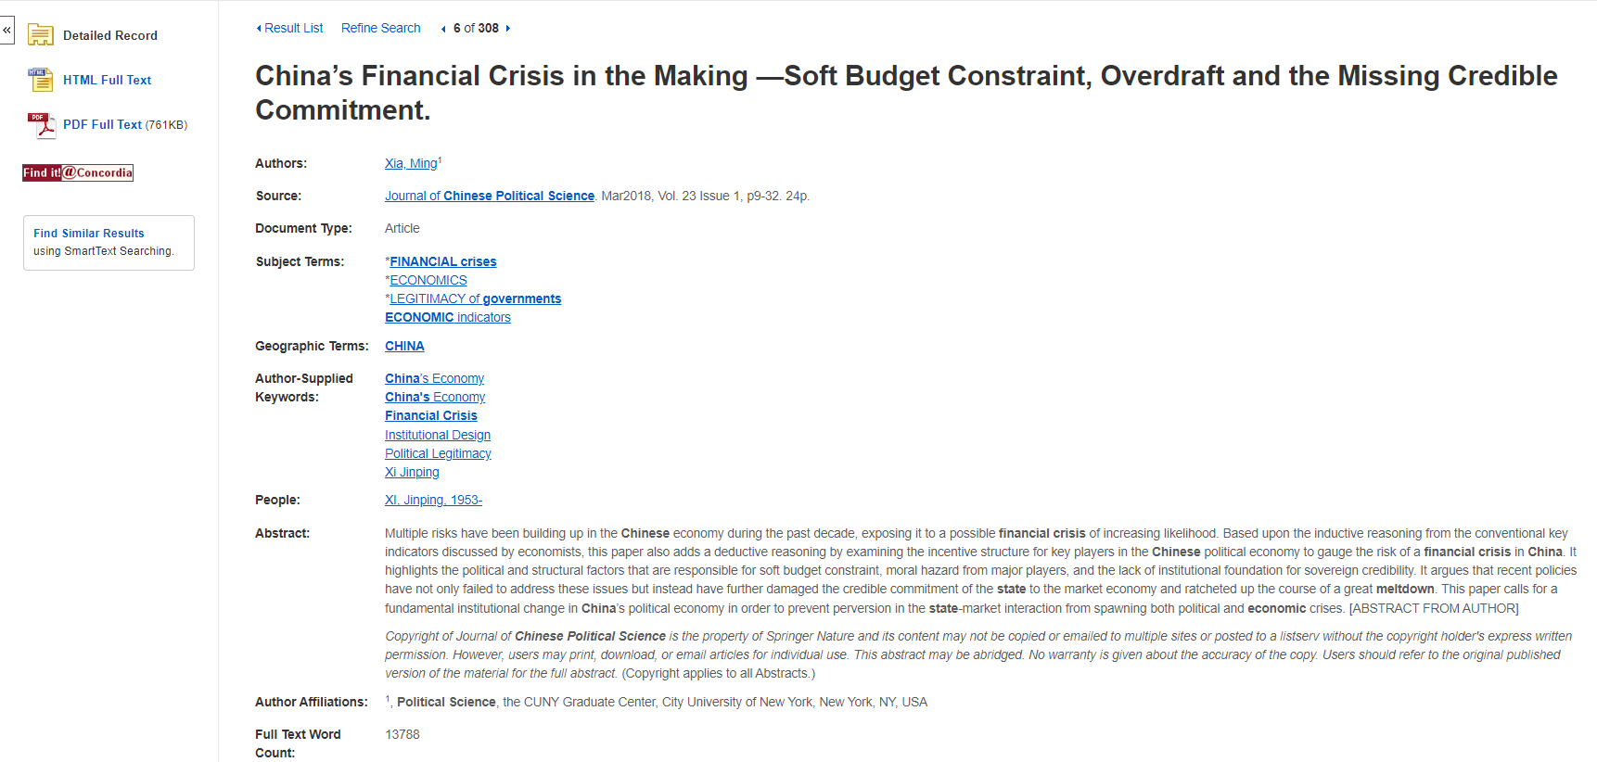
Find it @ Concordia
How to access articles.
Look for PDF or HTML full text options, if neither is available, use the Find it @ Concordia to access the article.

Slide 35
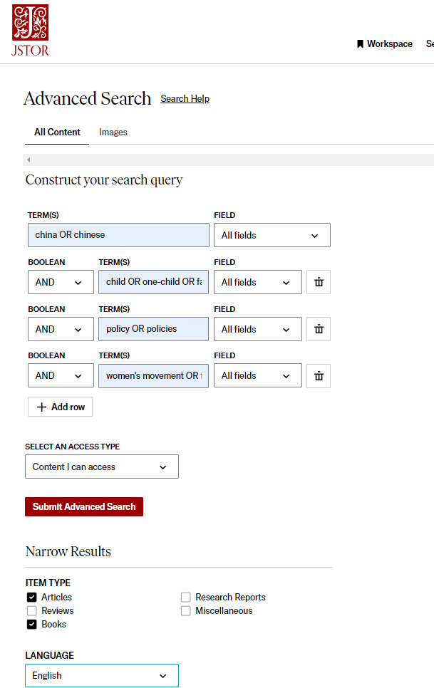
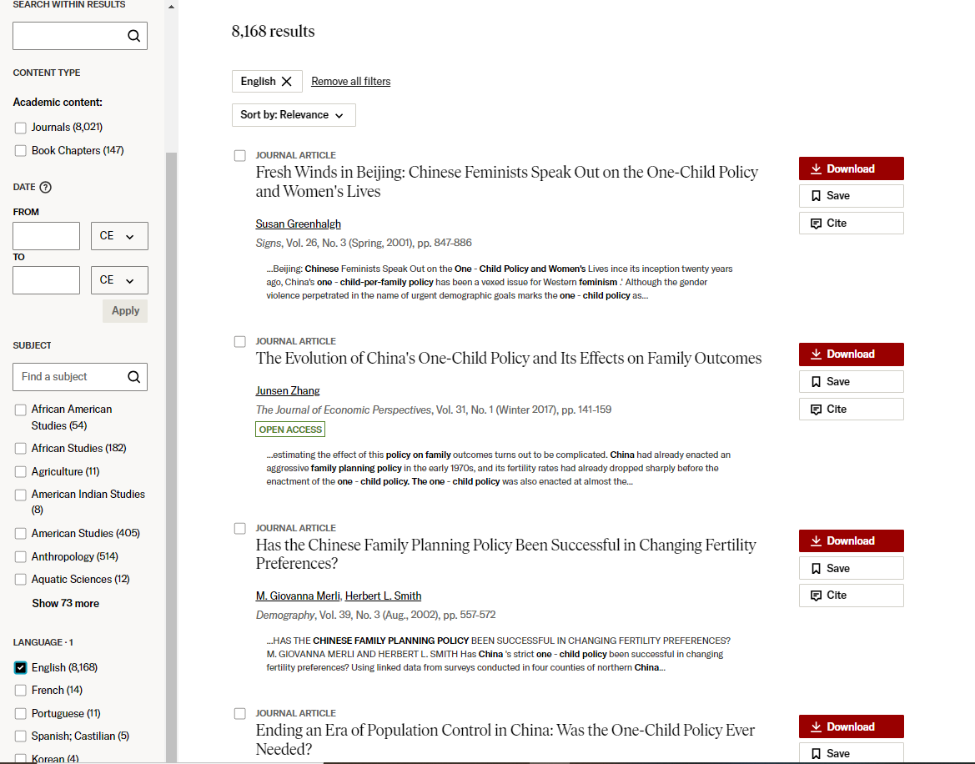

Slide 36
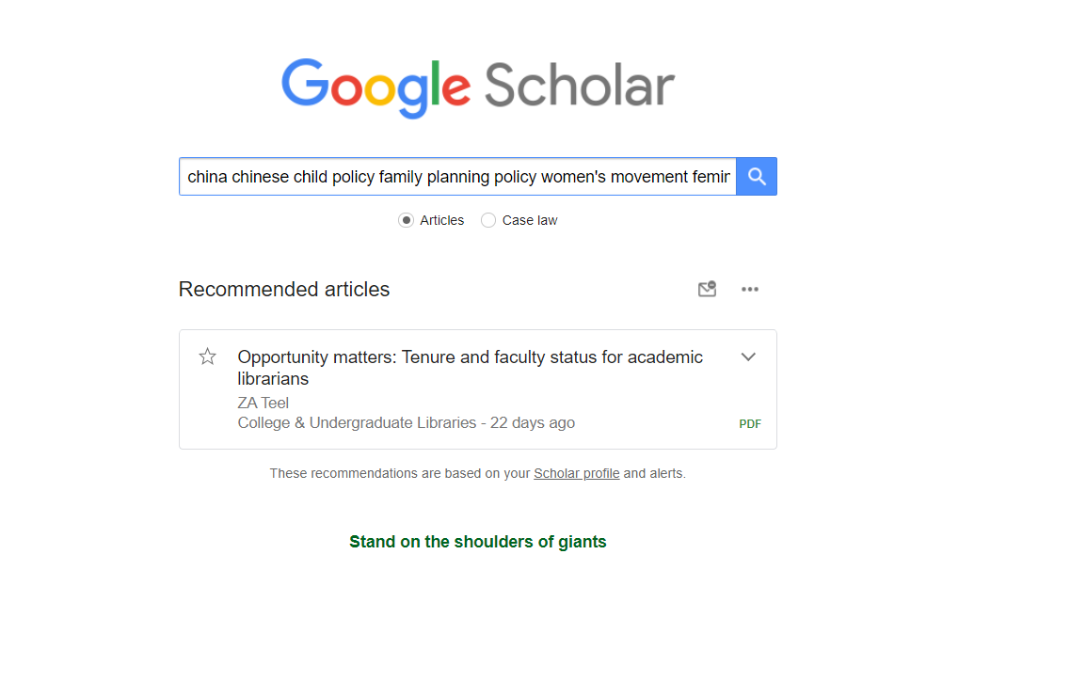
Sample search:
china chinese child policy family planning policy women's movement feminism

Slide 37
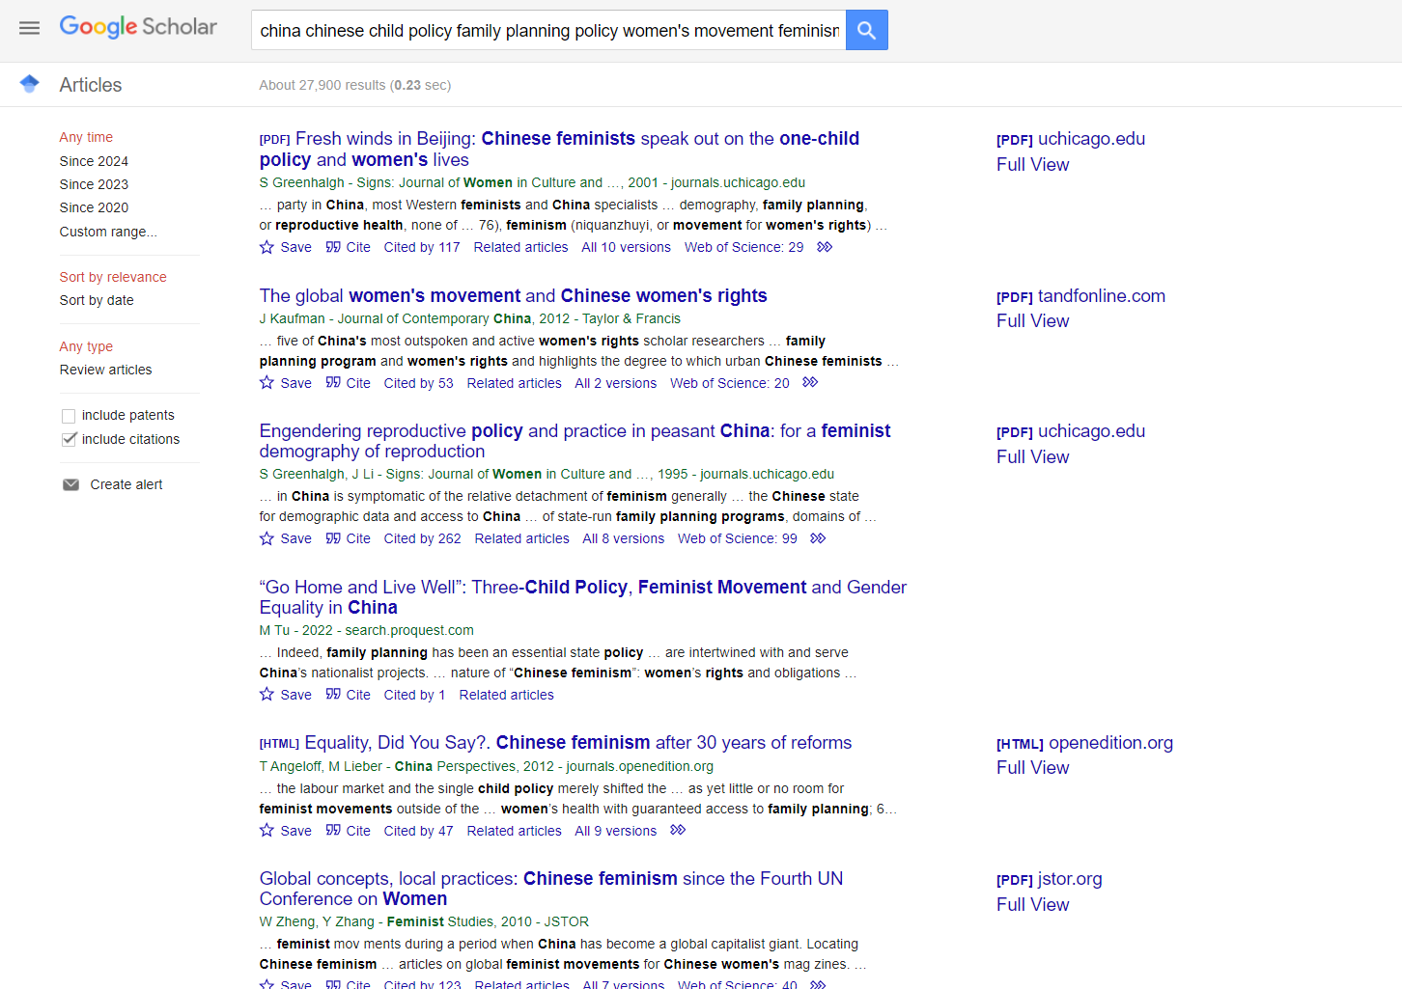
Limit by date
Access Concordia resources by setting up your profile

Slide 38
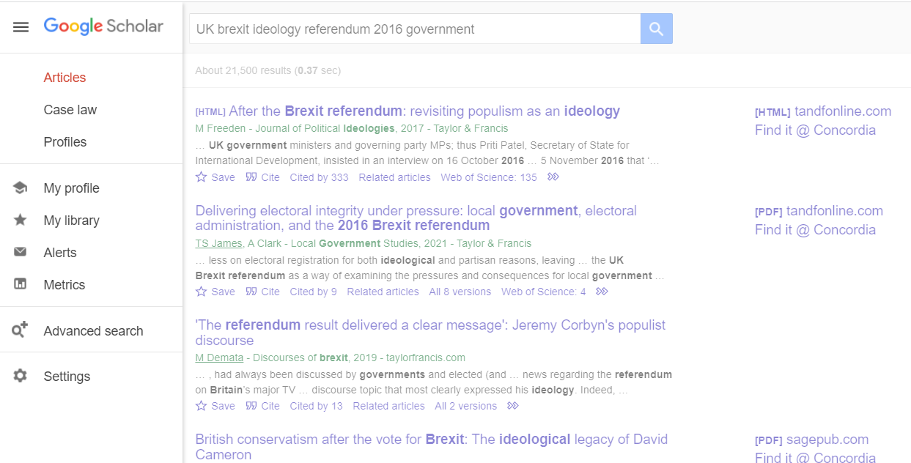
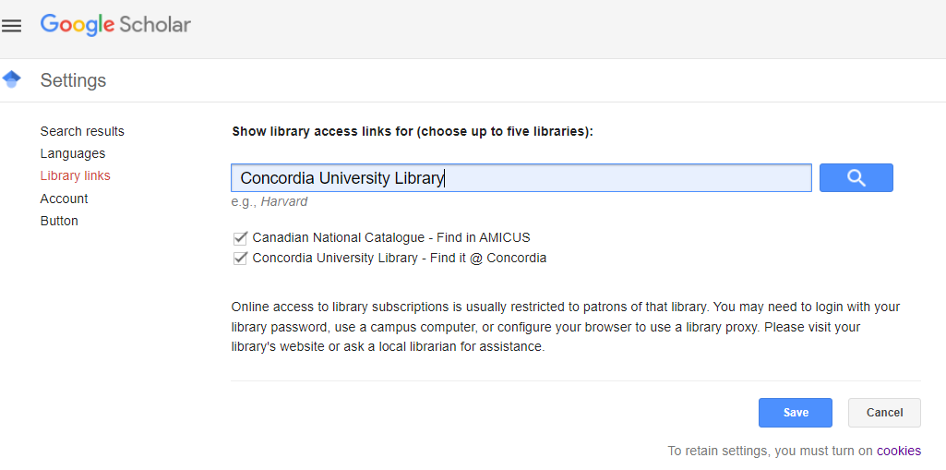

Slide 39
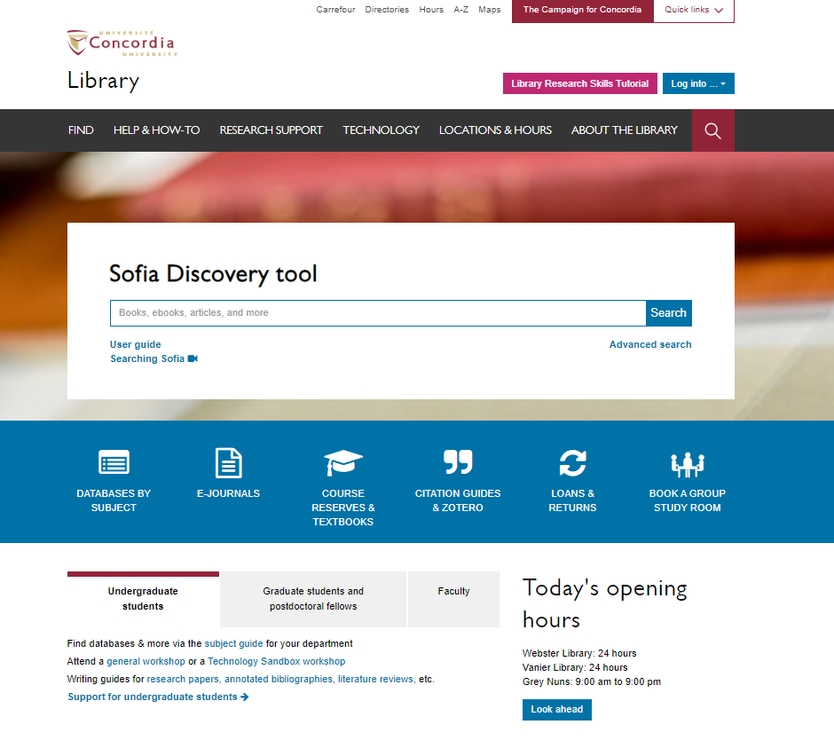
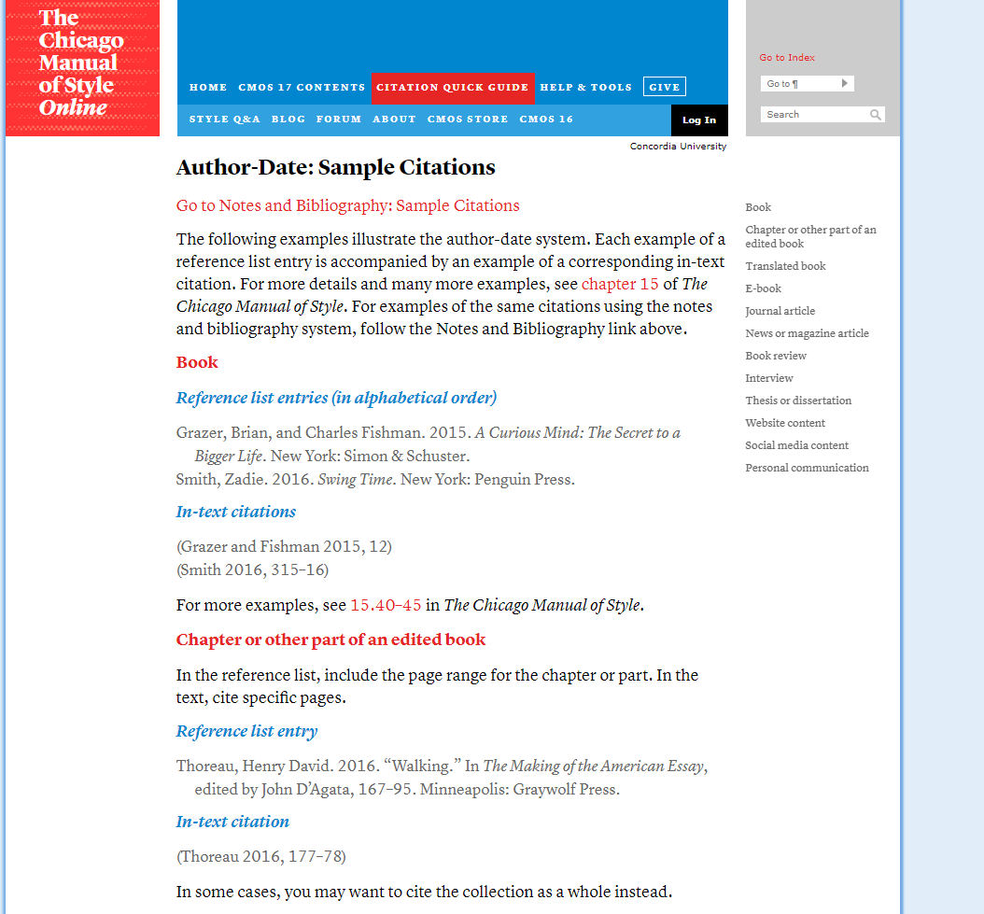
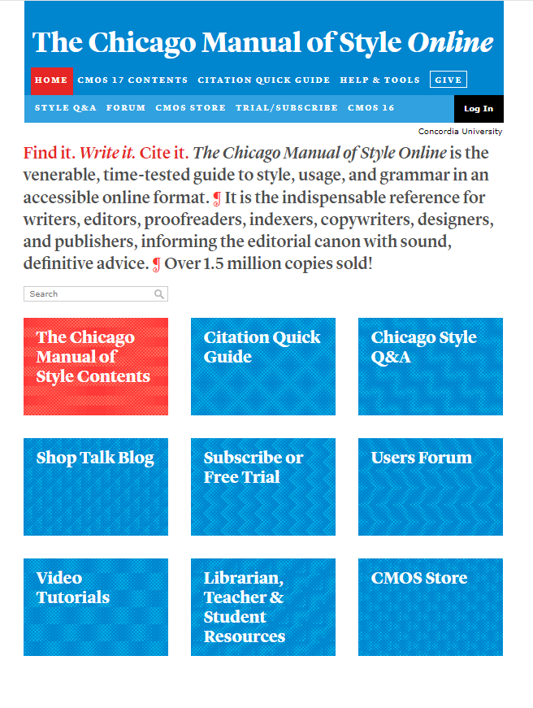
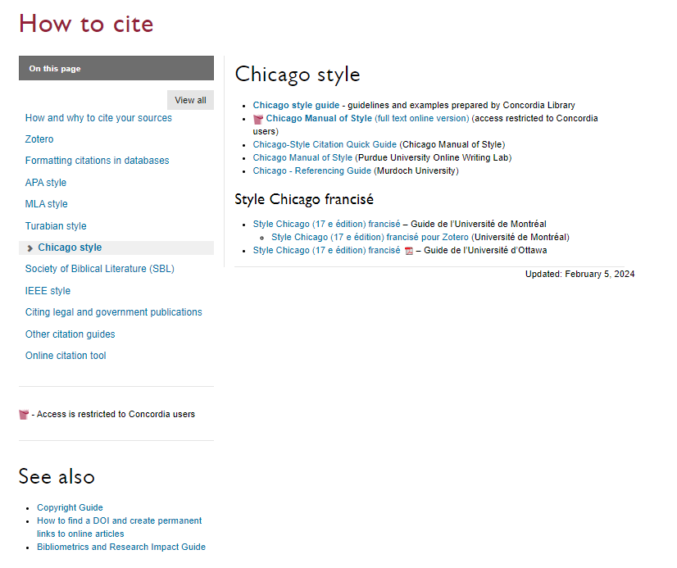
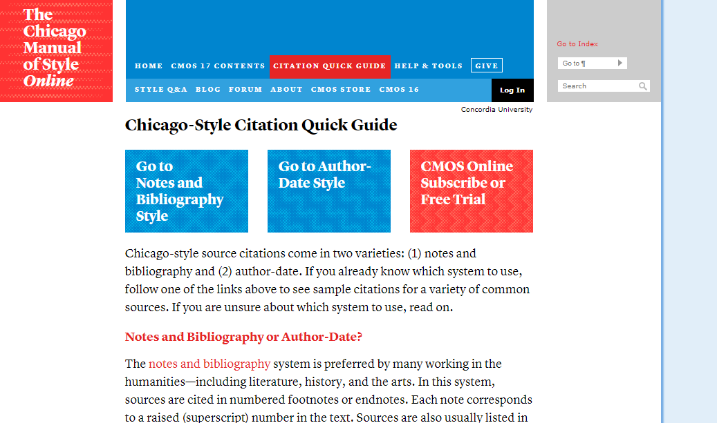

Slide 40
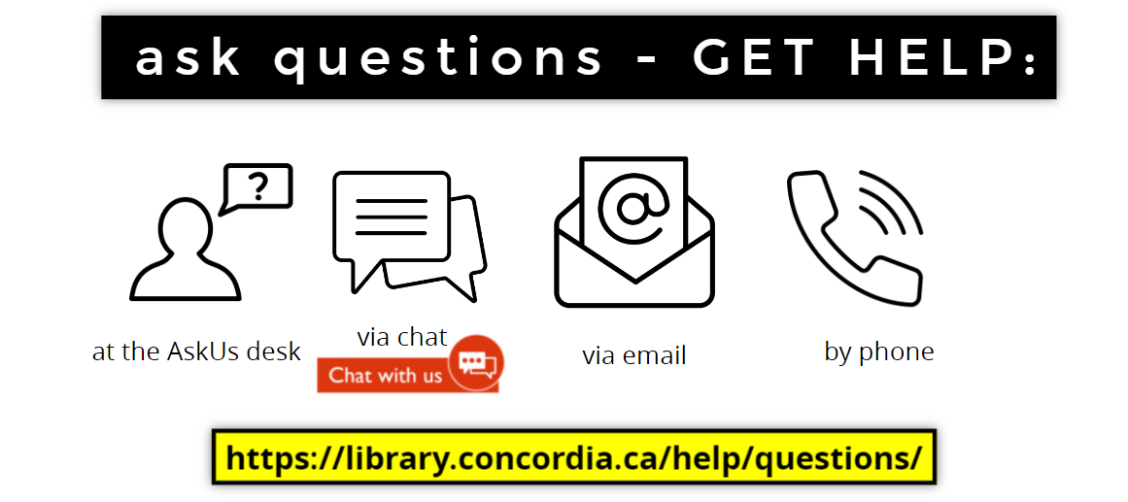
michelle.lake@concordia.ca

Slide 41

Questions?

