Slide 1

POLI 487: Digital Democracy – Parties and Elections on Social Media Library Workshop
Michelle Lake
Subject Librarian, Political Science, SCPA, FPST, and Government Publications
Michelle.Lake@concordia.ca

Slide 2
Who am I?
Michelle Lake, librarian for Political Science, the School of Community and Public Affairs, First Peoples Studies, and Government Publications
Michelle.Lake@Concordia.ca / Make an appointment or ask a question
What do I do?
  Provide research support
  Help students with search strategies and library databases
  Help students find and access materials they need
  Help with citation issues
  Choose the books we buy for the above subject areas

Slide 3
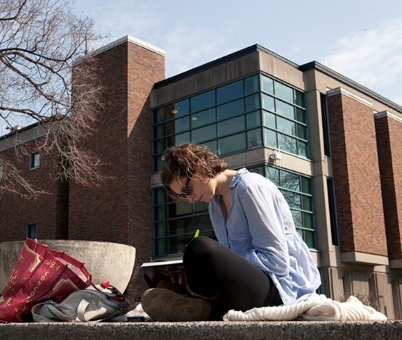
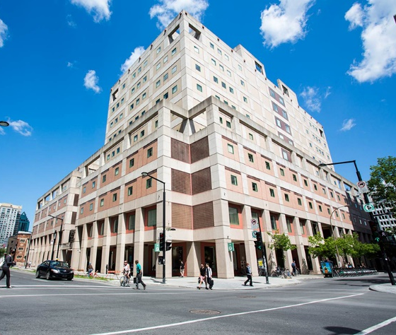
The Librar(ies)
24/7 access, with student card, after 11pm
Webster Library (LB) – downtown on SGW campus & Vanier Library (VL) on Loyola campus
Webster: Social Sciences, Humanities, Business, Engineering & Fine Arts
Vanier: Science(s), Health, Communications, Journalism and Psychology
Course Reserves Room(s): have the required undergraduate print textbooks for the courses taught at that campus (for example: Webster has the Political Science and SCPA course reserves)

Slide 4

Library Services
Your student card is your library card.
You need it to:
borrow books (up to 100 a time)
borrow a laptop (for 3 days) and other technology
print on campus (add money to your Dprint account)
access the library overnight during 24/7 hours.
Webster library has 5 book scanners (And Vanier has 2!) that can be used for free to scan chapters from our print books and email them to yourself as a PDF.
To use Library databases, access online articles and ebooks when you are off campus, login with your MyConcordia Netname and password.

Slide 5
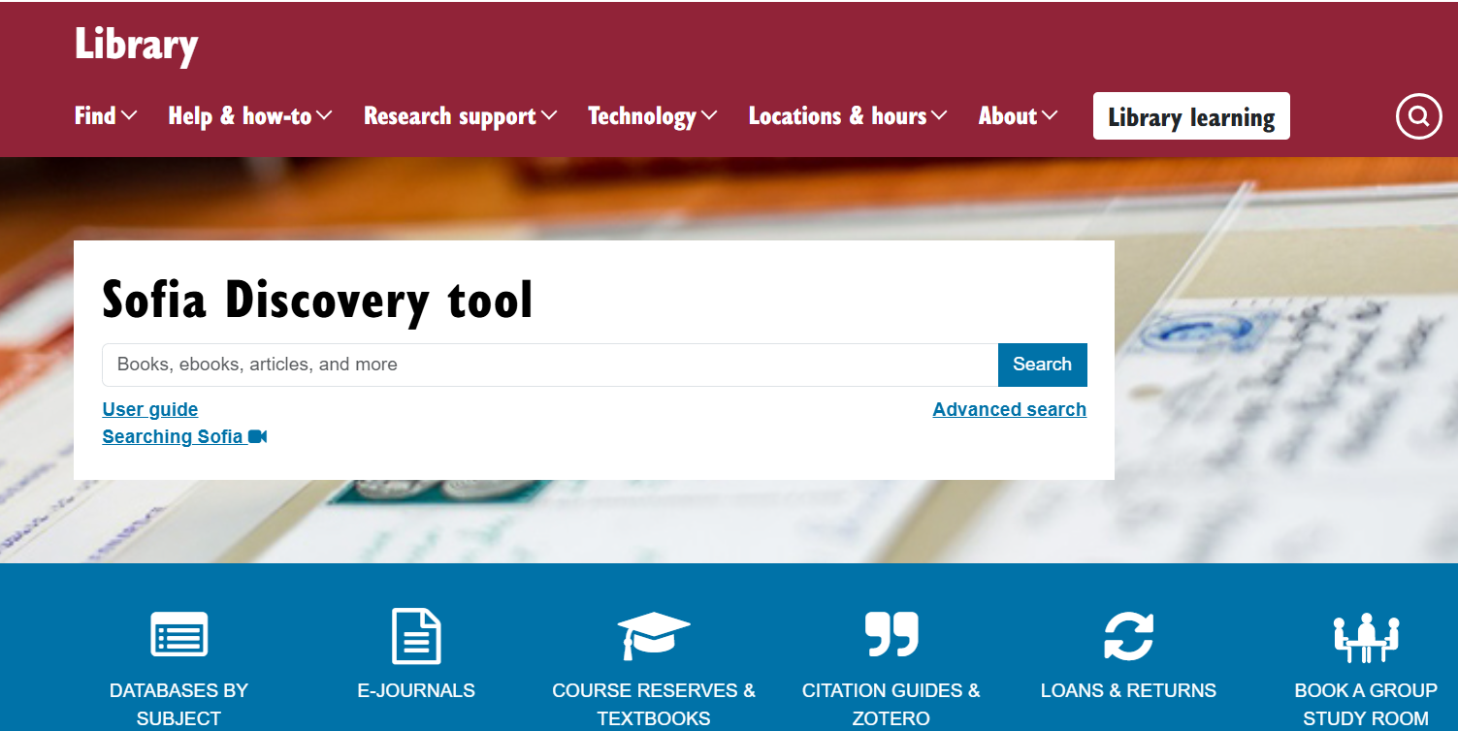
https://library.concordia.ca/
Use the Sofia Discovery tool to find print books, ebooks, and journal articles from the library.

Slide 6
How do I find out if Concordia has access to something?
Locating items when you have the citation information

Slide 7
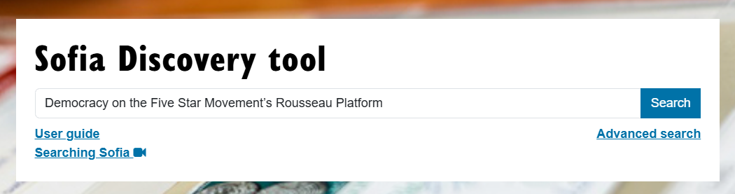
Stockman, Caroline, and Vincenzo Scalia. 2020. “Democracy on the Five Star Movement’s Rousseau Platform.” European Politics and Society 21 (5): 603–17. https://doi.org/10.1080/23745118.2019.1705564.

Slide 8
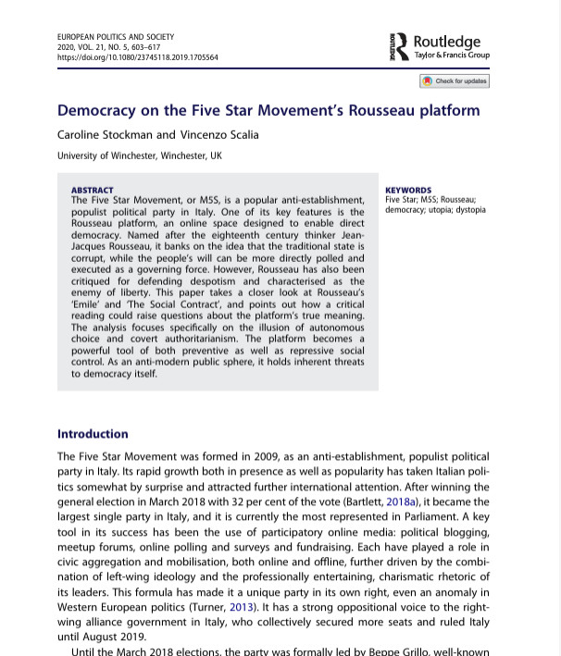
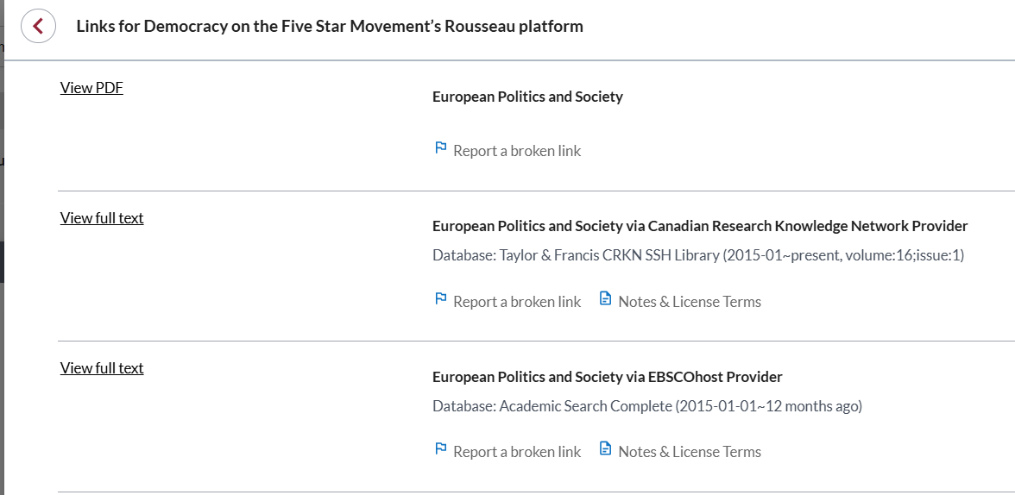
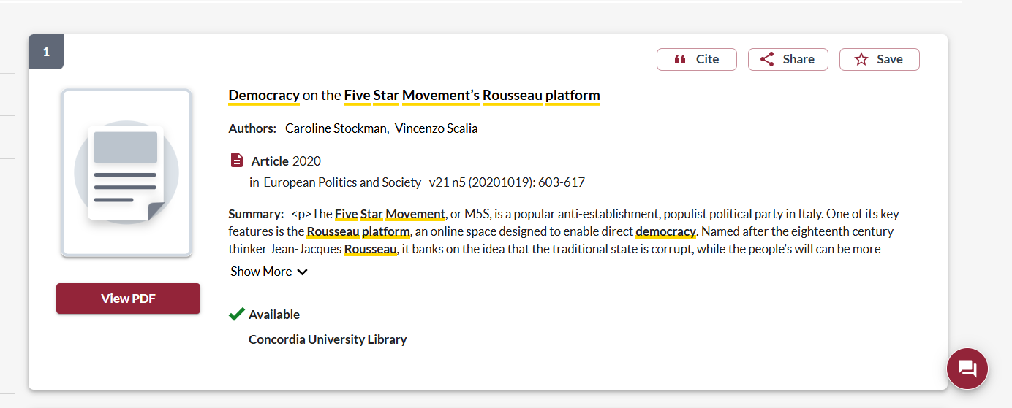

Slide 9
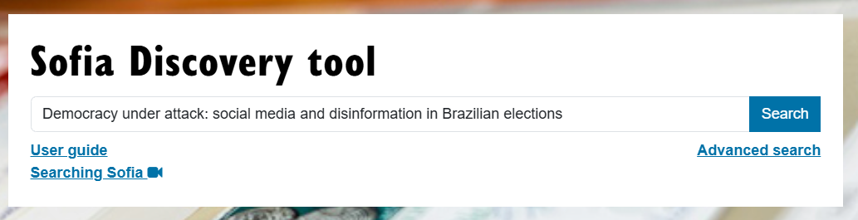
Barbabela, Eduardo, Joao Feres Junior, and Marcela Machado. “Elections without boundaries: the use of facebook in the 2022 Brazilian presidential elections.” In Democracy under attack: social media and disinformation in Brazilian elections, pp. 53-747. springer, 2024.

Slide 10
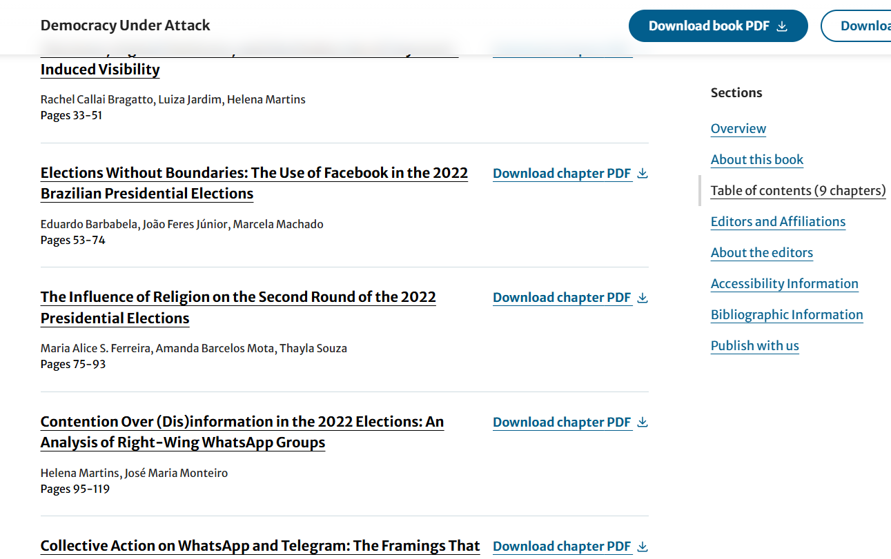
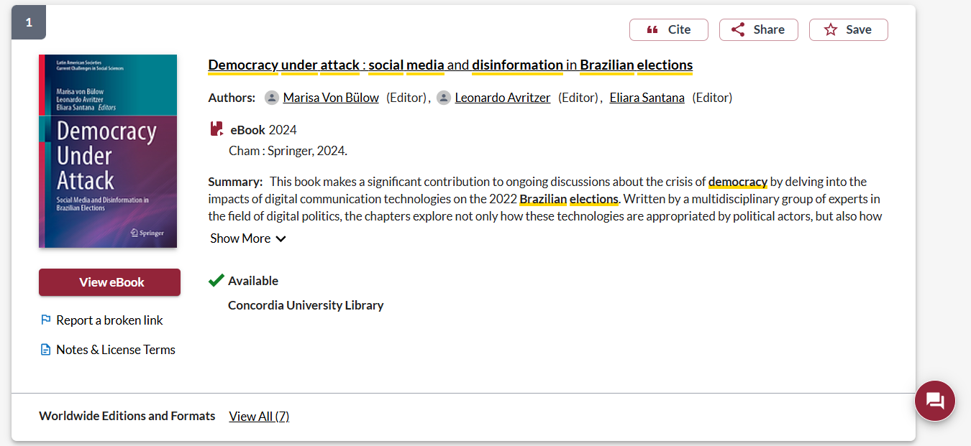

Slide 11
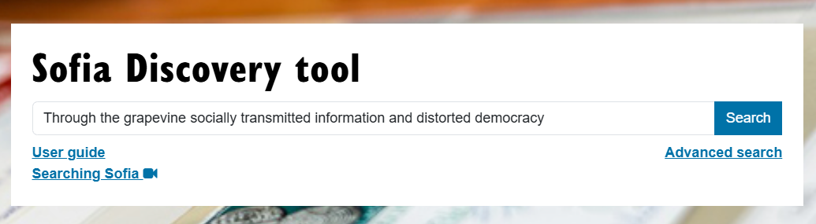
Carlson, T. N. (2024). Through the grapevine : socially transmitted information and distorted democracy. The University of Chicago Press.

Slide 12
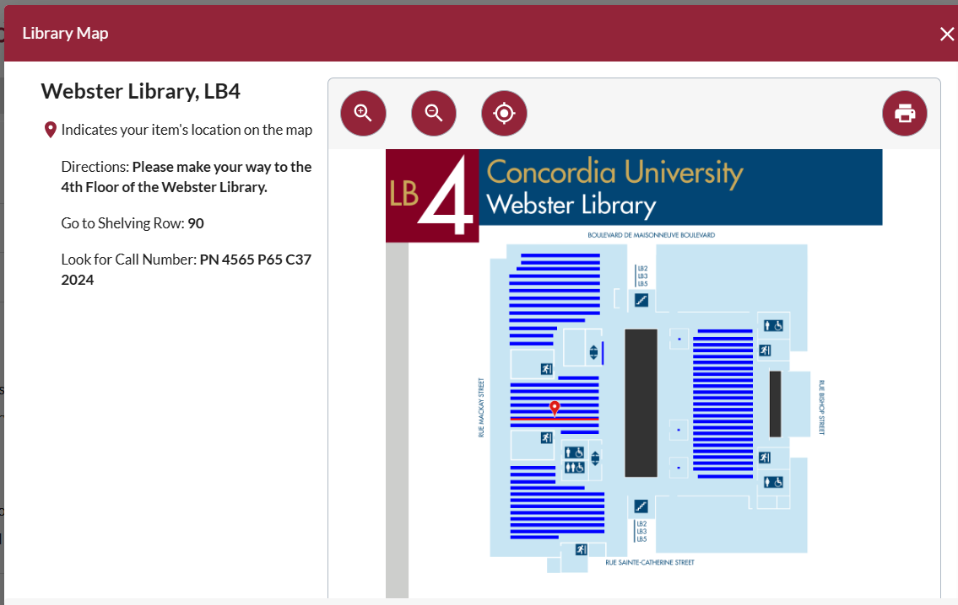
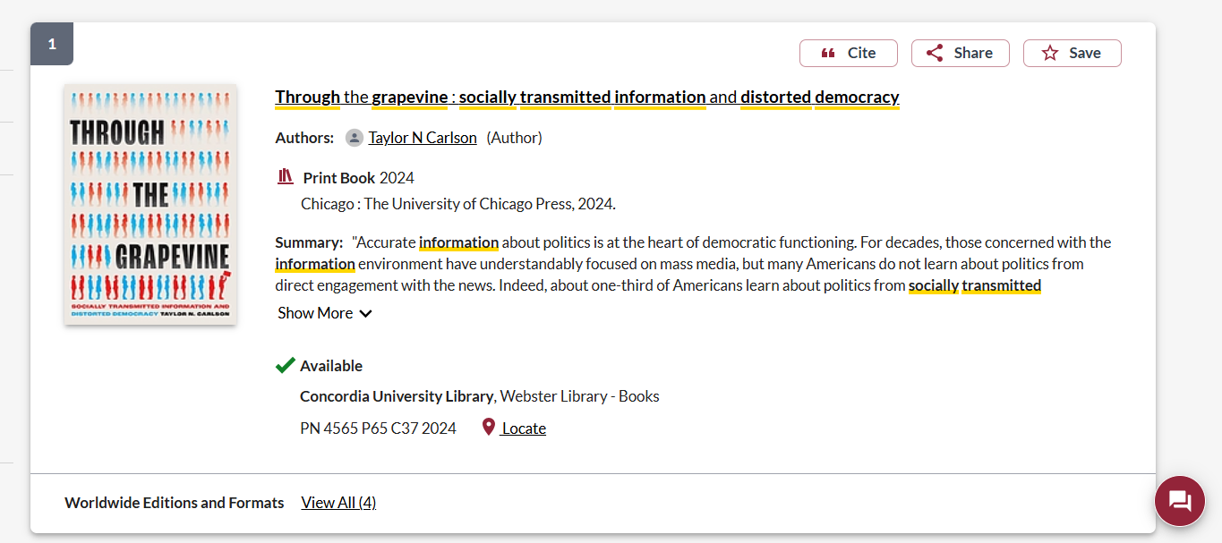

Slide 13

Breaking down a topic
&
Search strategies

Slide 14
How do we combine keywords for the best results?
AND: combines concepts and limits your results
politics AND security
state OR government
election OR voting
OR: allows you to insert synonyms or alternative terms and increases your results

Slide 15
How do we combine keywords for the best results?
“quotation marks”: If you put two or more words in quotation marks, that exact phrase will be searched and limits your results.
“political parties”
“social media”
Democra*
Finds: democracy, democracies, democratic, democratically, democratization
* - when you add an asterisk on the end of a word, your results will contain all the words with those endings or suffix

Slide 16
Avoid Searching with linking words
Effects
Impact
Consequences
Influence
Results
Importance
Significance
Response
Emphasis
Causes
Each author may use different linking words when discussing similar topics.
You don’t want your search to be limited to those books and articles that only contain the word “effect” or “consequence”

Slide 17
Assignment
Students will have to submit a 500-word term paper proposal together with a bibliography of 10 sources. The bibliography must include at least 5 journal articles published in the last 10 years. Every item must be in the Concordia Library stacks, physical or electronic.
The specific term paper topic must be a case study on the use of digital technology in one of the following areas of democratic politics:
Elections
Political parties
Political leadership

Slide 18
Topic Breakdown
Elections
  Social media
  democracy
  Democratic elections
Related terms:
  Voters, voting
  Facebook, Instagram, twitter, Tik Tok
  Election interference or influence

Slide 19

Searching in Sofia

Slide 20
What will I find in Sofia?
Academic peer reviewed books (ebooks and print books)
Academic textbooks
Non-academic books
Journal articles
Government documents
International Organization publications

Slide 21

Why books?
Books can provide comprehensive overviews or background and introductory information that is not covered in journal articles.
Books are much more comprehensive than articles and aim to tell you everything about a topic or in the case of edited books, many perspectives on a topic
Journal articles are much shorter and cover a very specific aspect of a topic.

Slide 22

Why books?
An edited scholarly monograph will have multiple chapters on one broad subject, all by different authors/experts, these chapters can be cited separately; one good book can account for several sources
Using the Index and table of contents, you can navigate through a book to find the exact sections and chapters you need

Slide 23
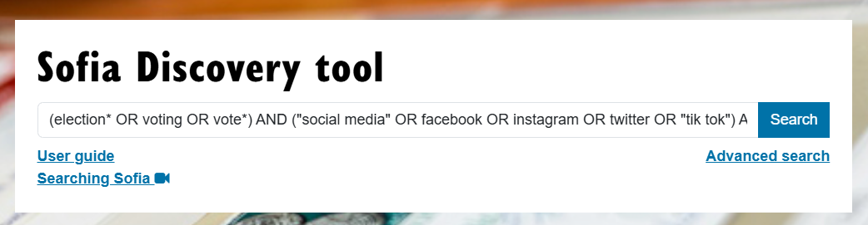
Search strategy
(election* OR voting OR vote*) AND ("social media" OR facebook OR Instagram OR twitter OR "tik tok") AND democra*

Slide 24
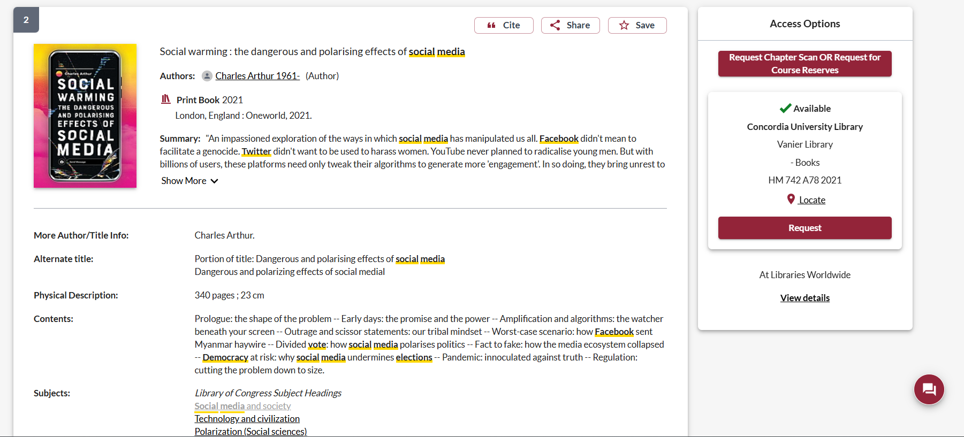
The book contains a specific case
This book is at Vanier library, you can request it delivered to Webster
Check out the subjects

Slide 25
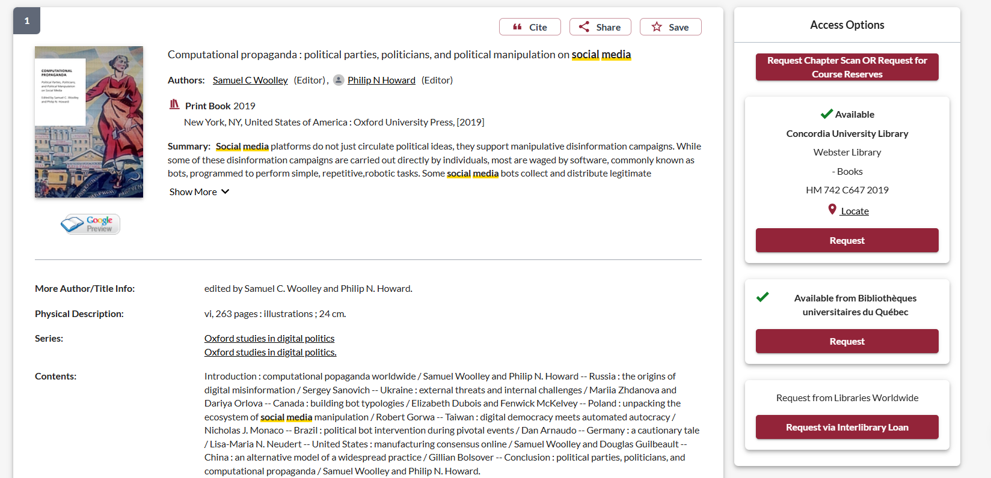
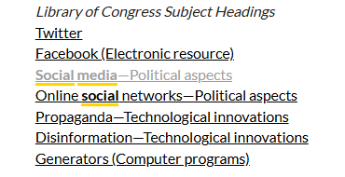
Each chapter is a different case

Slide 26
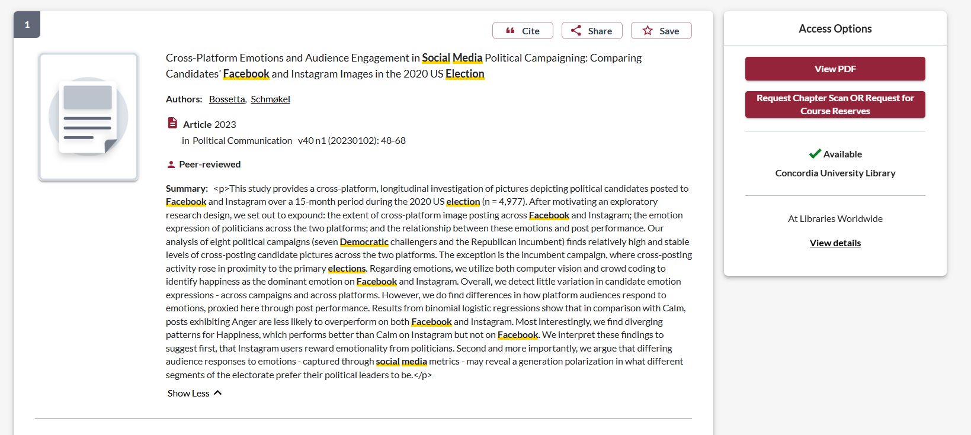

Slide 27
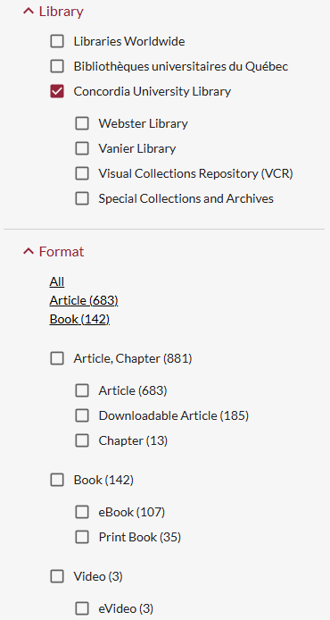
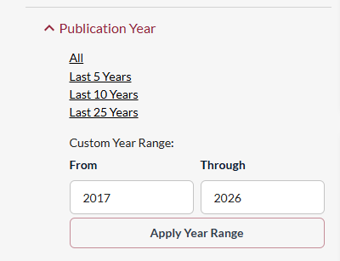




Using the filters/limits in sofia
Narrow by format: print books, ebooks, book chapters, journal articles
  The book/ebook format includes government publications, theses, conference proceedings
Narrow by publication year: 5 years, 10 years, 25 years
  Or enter a custom range
Narrow by location: print books at Webster or Vanier
  Print books from Vanier can be requested for use at Webster

Slide 28
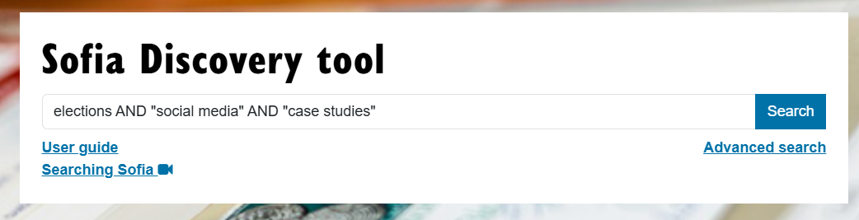


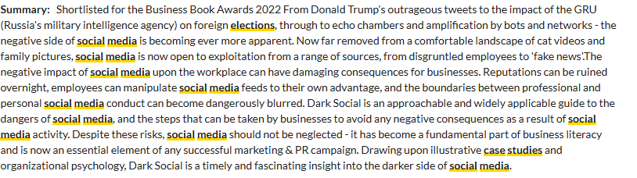
Case studies – Sofia

Slide 29
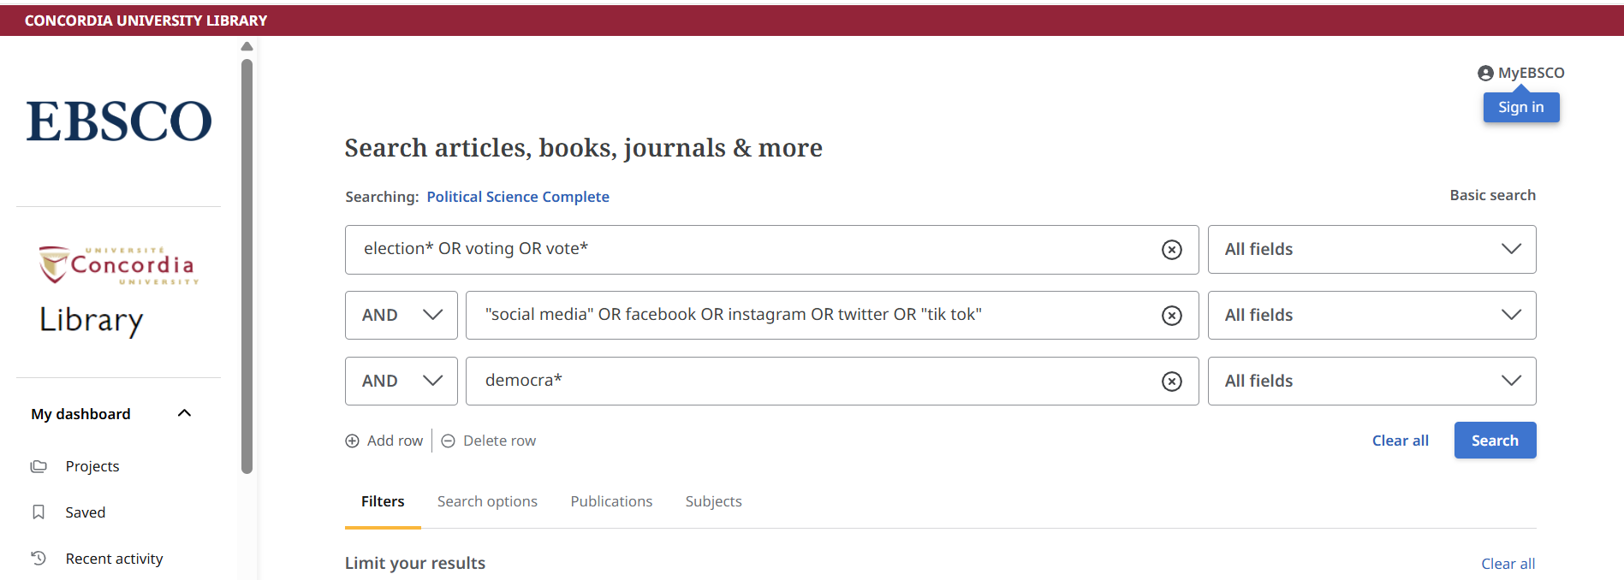
Political science complete

Slide 30
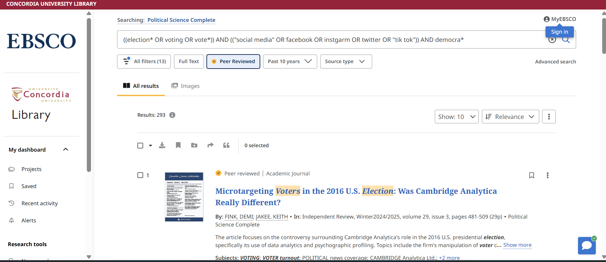
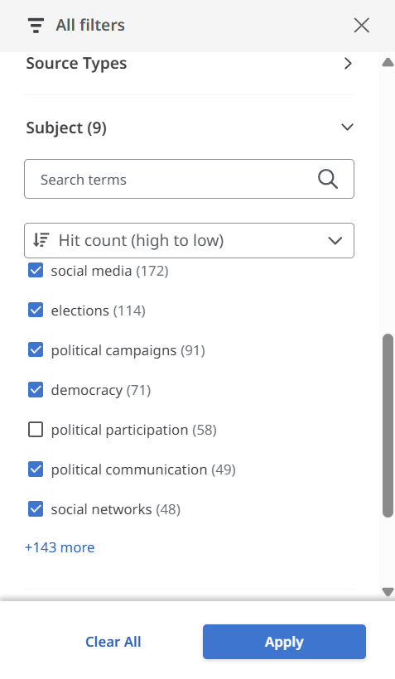
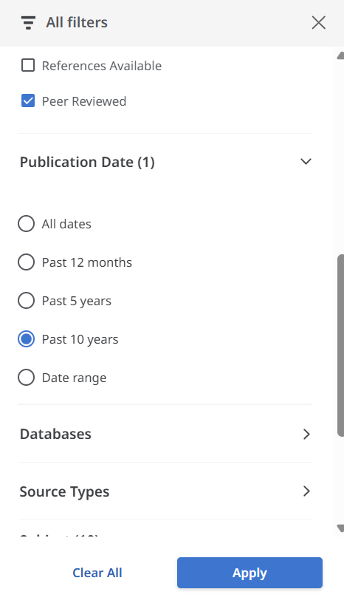

Slide 31
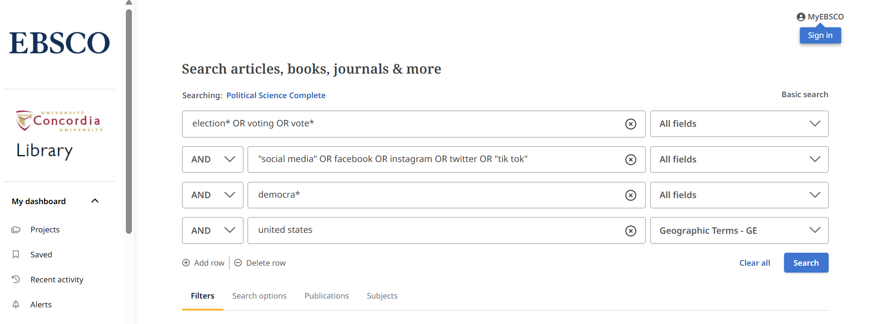

Geographic search terms

Slide 32
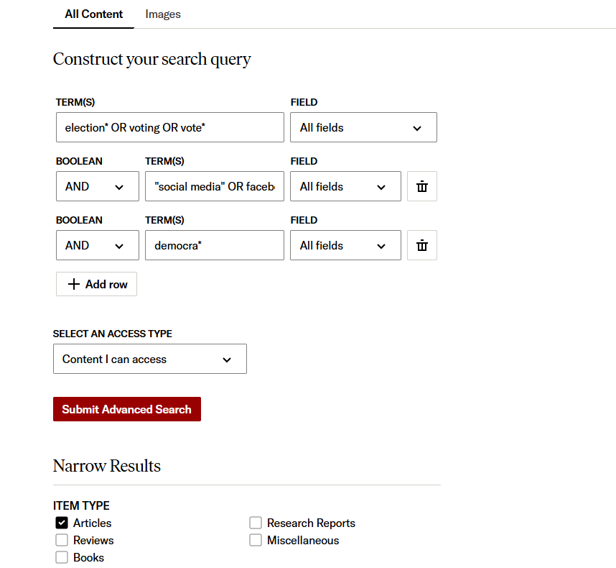
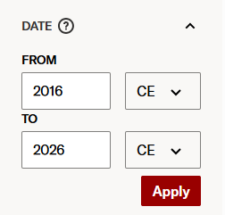

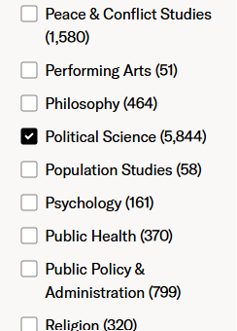
JSTOR

Slide 33
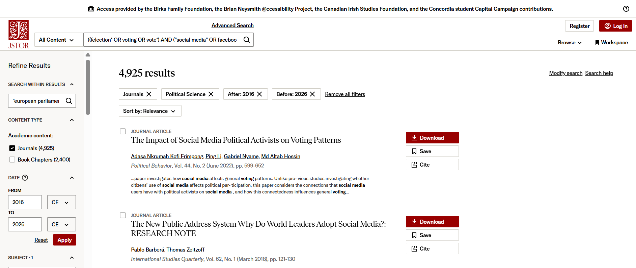


You can search within the results with more specific keywords

Slide 34

What is peer review?
What are peer reviewed, scholarly articles?

Slide 35
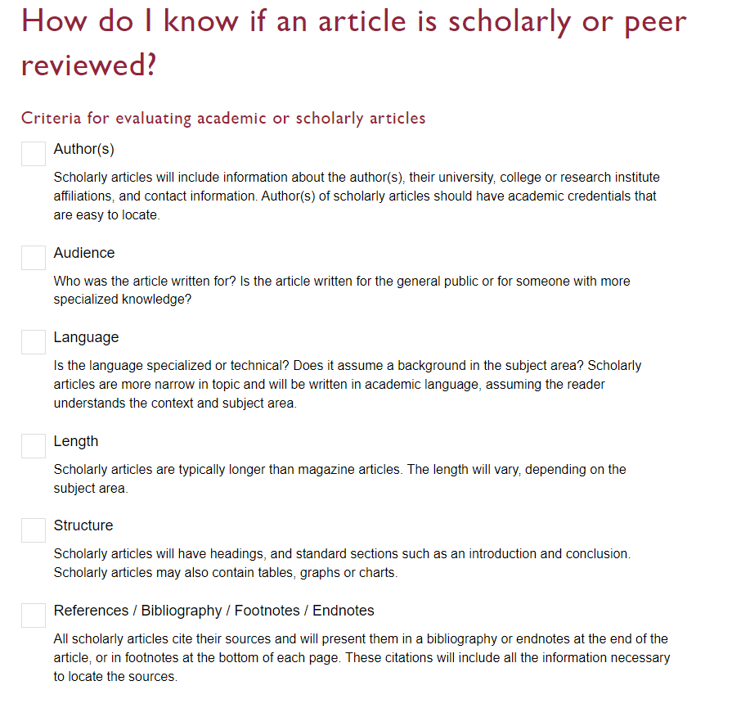

Slide 36
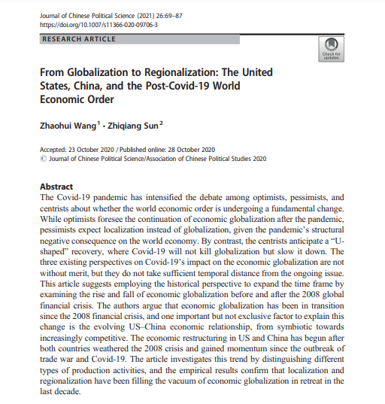
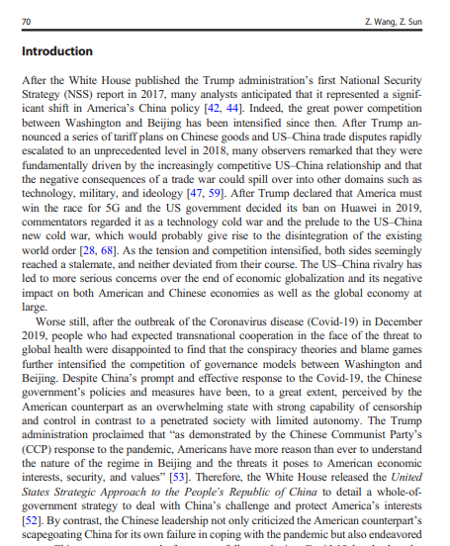
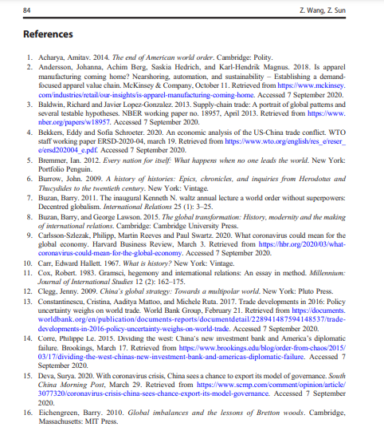
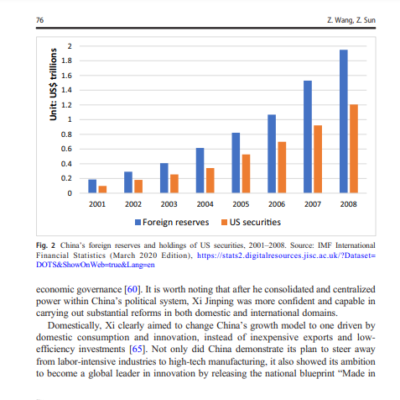
Look for sections, language, charts, tables, graphs and an extensive reference list or bibliography
Specialized language

Slide 37
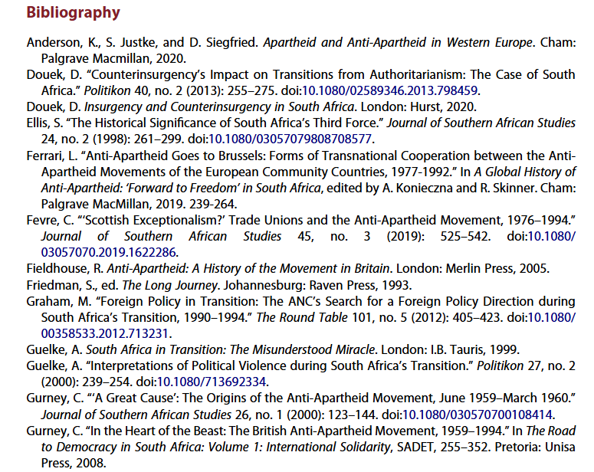
Scholarly articles will always have reference lists/bibliographies/works cited
These are great places to find more sources!
The researcher or research team are experts in the subject area and have already done a lot of research
Use this expertise by looking up the books and articles they cite in Sofia and using them in your own research
This is a commonly used method in academic research

Slide 38
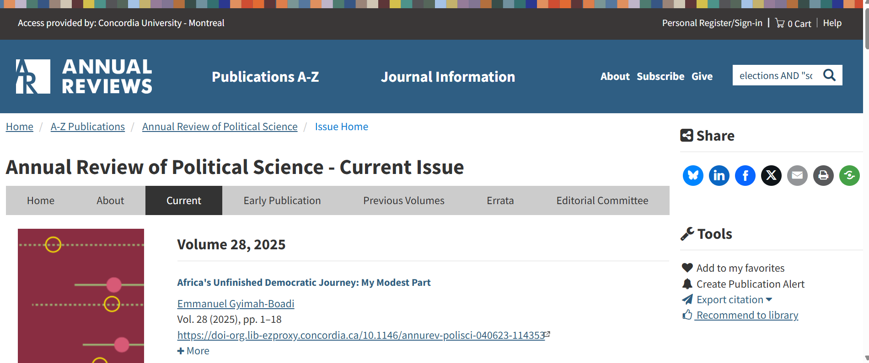
Annual Reviews

Slide 39

Michelle.Lake@Concordia.ca

