Slide 1
POLI 486 International Relations: The Global and Regional Governance of Human Rights Library Workshop
Michelle Lake
Political Science, SCPA, First Peoples Studies and Government Publications Librarian
Michelle.Lake@Concordia.ca

Slide 2
Who am I?
Michelle Lake, librarian for Political Science, the School of Community and Public Affairs, First Peoples Studies, and Government Publications
Michelle.Lake@Concordia.ca / Make an appointment or ask a question
What do I do?
Provide research support, assist with and teach search strategies
Help students navigate library databases, books, journals, and other sources
Help students find and access materials they need
Assist with evaluation of sources
Build guides, resources and pathfinders to help students locate research materials
Help with citation issues
Choose the books we buy for my subject areas: political science, public policy, community and public affairs, First Peoples studies and government information

Slide 3
Library Services
Your student card is your library card.
You need it to:
borrow books (up to 100 a time)
borrow a laptop and other technology (for 24 hours)
print on campus (add money to your Dprint account)
access the library overnight during 24/7 hours.
Webster library has 5 book scanners (And Vanier has 2!) that can be used for free to scan chapters from our print books and email them to yourself as a PDF.
To use Library databases, access online articles and ebooks when you are off campus, login with your MyConcordia Netname and password.

Slide 4
Breaking down a topic, search strategies and answering a research question

Slide 5
Has the Council of Europe (and the various bodies within it) done enough to address the human rights of refugees and asylum-seekers in Europe?
Key Ideas:
Council of Europe
Human rights
Refugees
Asylum-seekers
Europe

Slide 6
Council of Europe
Human Rights
Refugees & asylum-seekers
Parliamentary Assembly of the Council of Europe (PACE)
Life & liberty
Migrants
Freedom from slavery and torture
Internally displaced
European Court of Human Rights
Freedom of opinion and expression
Stateless person
Commissioner for Human Rights
Right to work and education

Slide 7
How have advances in digital technology influenced international human rights monitoring? (You can focus on monitoring by international organizations, NGOs or both)
Key Ideas:
Digital technology
International Human rights monitoring
International organizations
NGOs

Slide 8
Digital technology
International Human rights monitoring
International Organizations & NGOs
Smartphones
United Nations monitoring
Special Rapporteur (UN), UNHCR
Social media: Facebook, Instagram, Twitter, etc
International treaties and treaty bodies (UN)
ILO, WHO, UNESCO, UNDP
What’s App, text, Google chat, Zoom, etc
Human Rights Council (UN) Charter based monitoring
OAS, African Union, Council of Europe
Fact Finding
Advocacy
Amnesty International, Human Rights Watch, Anti-Slavery International

Slide 9
Search strategies

Slide 10
How do we combine search words for the best possible results?
AND: combines concepts and limits your results
politics AND development
migrant OR refugee
OR: allow you to insert synonyms or alternative terms and increases your results

Slide 11
How do we combine search words for the best possible results?
“quotation marks”: If you put two or more words in quotation marks, that exact phrase will be searched and limits your results.
“human rights”
“International organizations”
democra*
Finds: democracy, democracies, democratic, democratically, democratization
* - when you add an asterisk on the end of a word, your results will contain all the words with those endings or suffix

Slide 12
Avoid Searching with Linking words
Each author may use different linking words when discussing similar topics.
Effects
Impact
Consequences
Influence
Results
Importance
Significance
Response
Emphasis
Causes
You don’t want your search to be limited to those books and articles that only contain the word “effect” or “consequence”

Slide 13
Course guide link
https://tinyurl.com/POLI486

Slide 14
Academic Books

Slide 15
When searching in Sofia, I’m searching at a higher level, with a few of the main ideas from my topic. This is because I’m searching through the titles, table of contents and subject attached to academic books, which will be broader than articles.
You will find some articles in your Sofia results, but it is a search well designed for books. Article searching should continue in subject-specific databases.

Slide 16
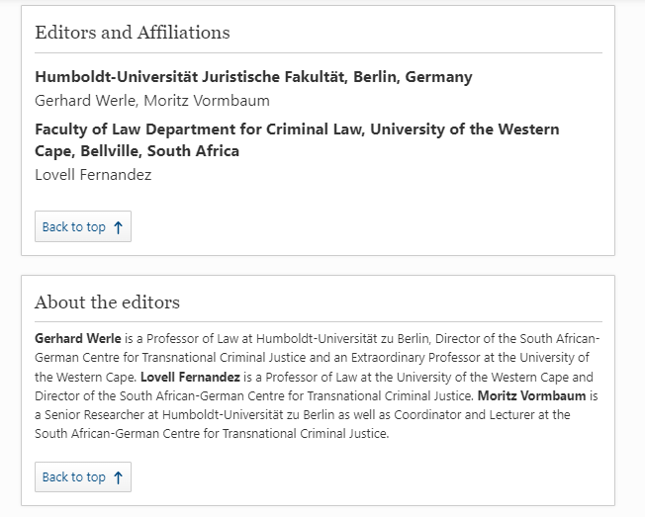
Assessing what you discover in Sofia
In books, the academic affiliations of editors and authors should be easy to locate

Slide 17
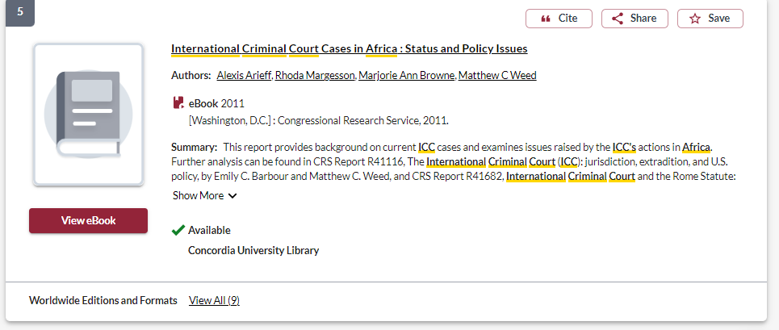
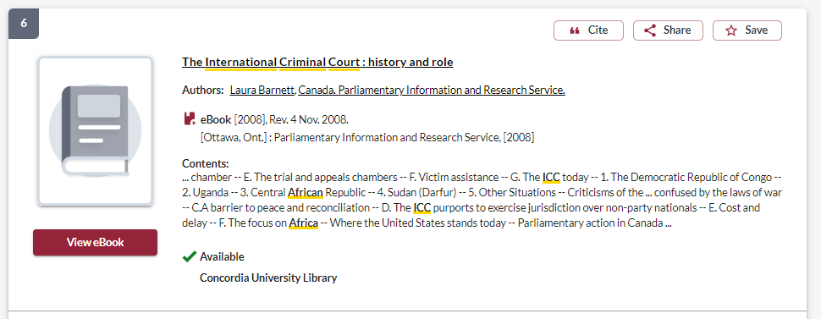
Assessing what you discover in Sofia
These are both government publications, although they are classified as ebooks. Pay attention to the publishers.
Government publications are generally reliable sources, but they are primary sources, not secondary, academic sources.

Slide 18
Assessing what you discover in Sofia
Books from university presses are academic sources

Slide 19
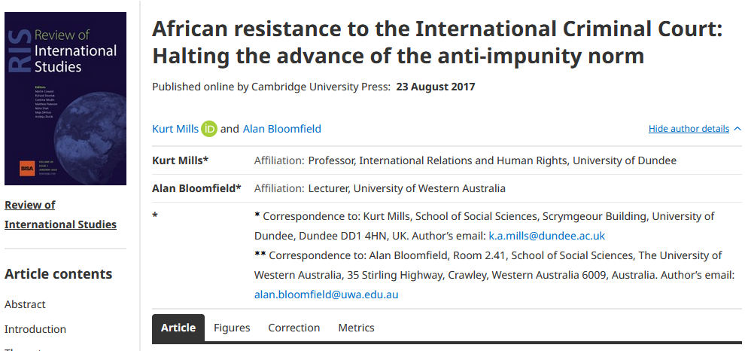
Assessing what you discover in Sofia
You will sometimes find author affiliations in the article record

Slide 20
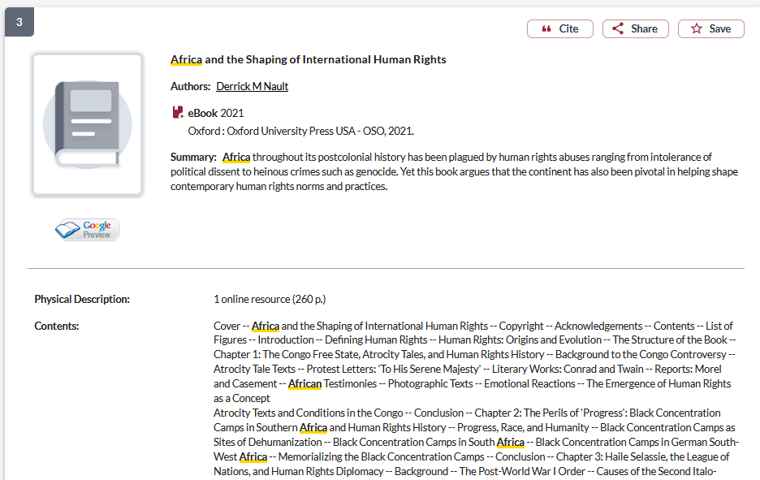
Use the subject headings to find books on similar topics

Slide 21
Expanding your search to other libraries
Selecting Libraries Worldwide, will show you other library collections
Select print books only, as we cannot borrow ebooks from other libraries

Slide 22
Request the book from interlibrary loan, comes from Canada, US & Intl libraries
Request the book from a Quebec university library, this will be faster than ILL

Slide 23
Academic journal articles & database searching

Slide 24
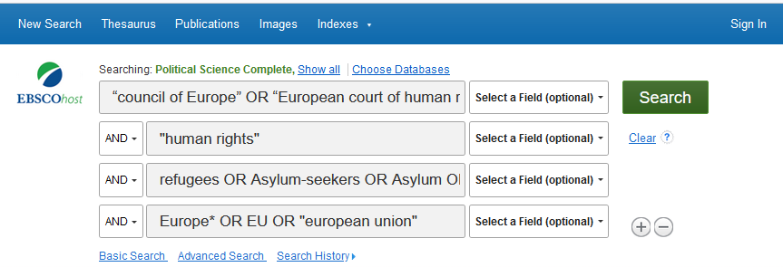
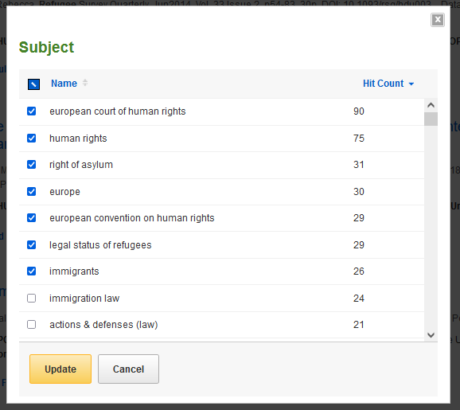
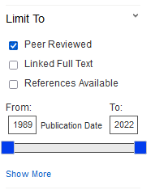
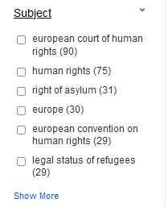

Slide 25
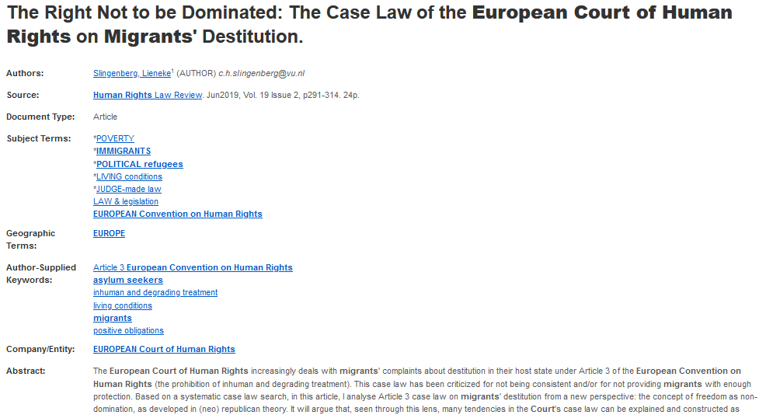
Things to look for: the journal/source title.
Length of the article, 15+ pages long generally.
Subjects, which could help shape your search
Author affiliations

Slide 26
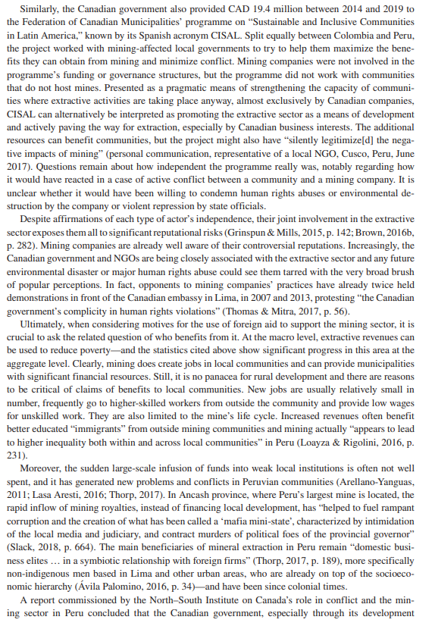
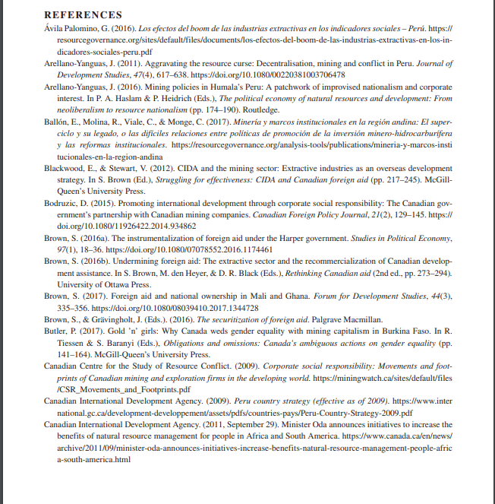
Scholarly articles will have citations/footnotes throughout the text and an extensive reference list/works cited/bibliography/endnotes.

Slide 27
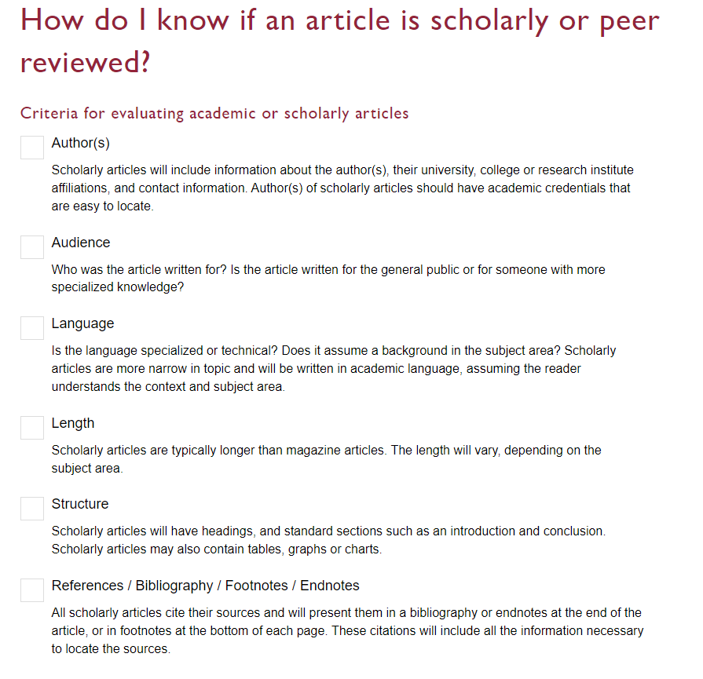

Slide 28
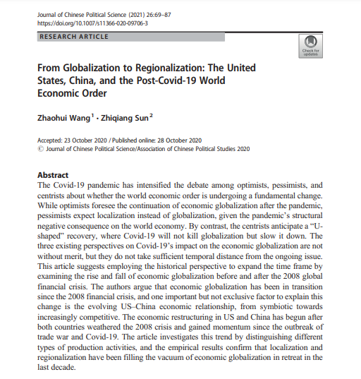
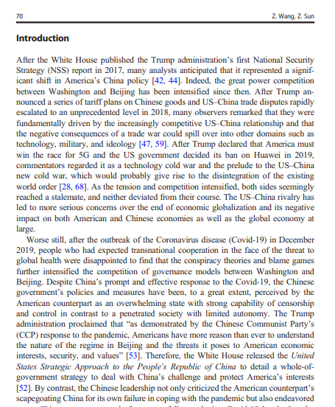
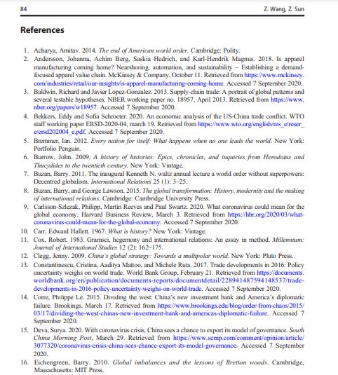
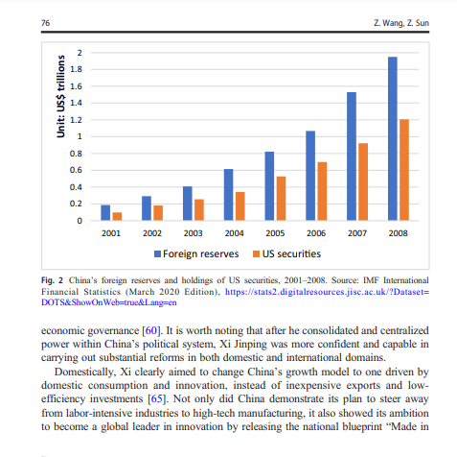
Look for sections, use of specialized language, charts, tables, and graphs
Specialized language

Slide 29
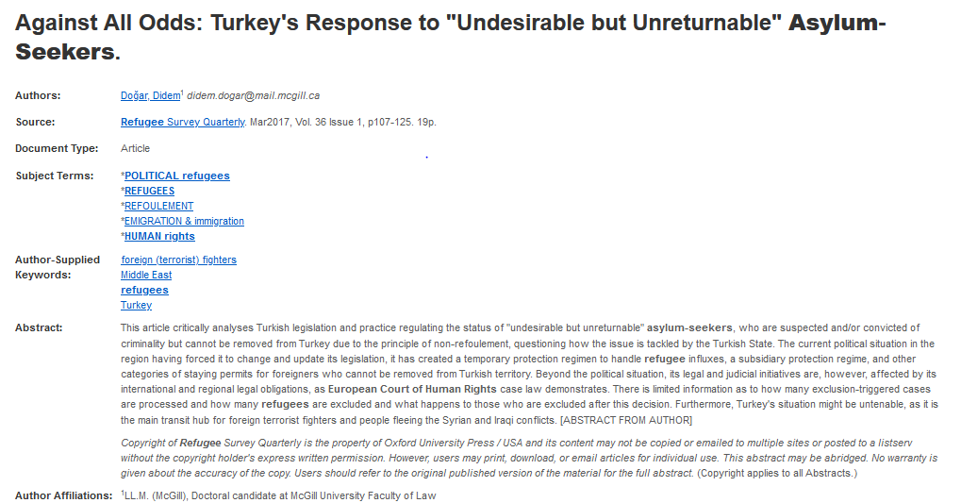
If you identify a journal publishing on your topic, you can search the journal indivudally

Slide 30
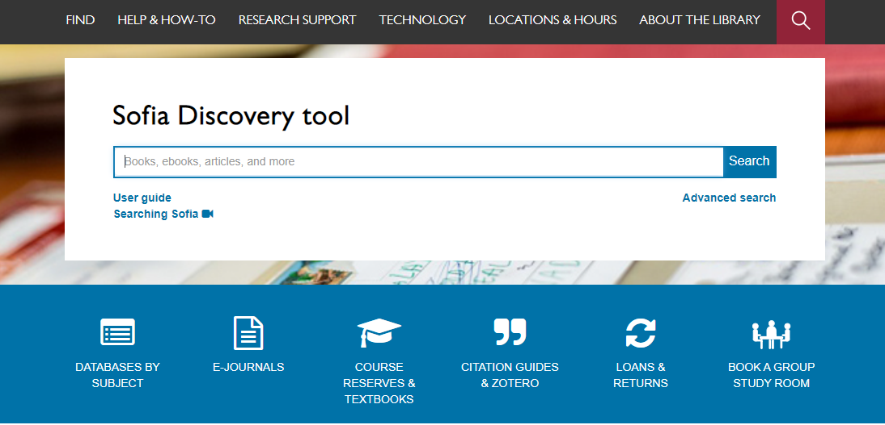
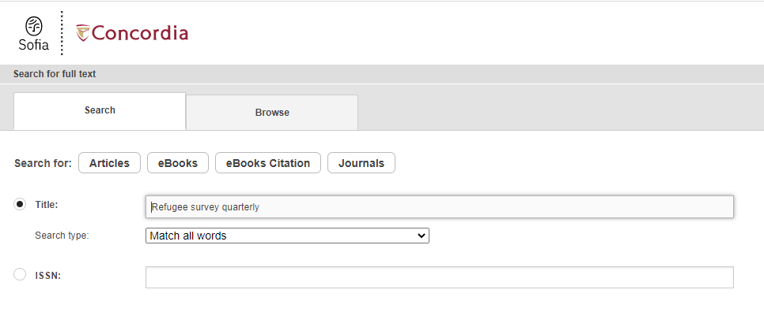

Slide 31
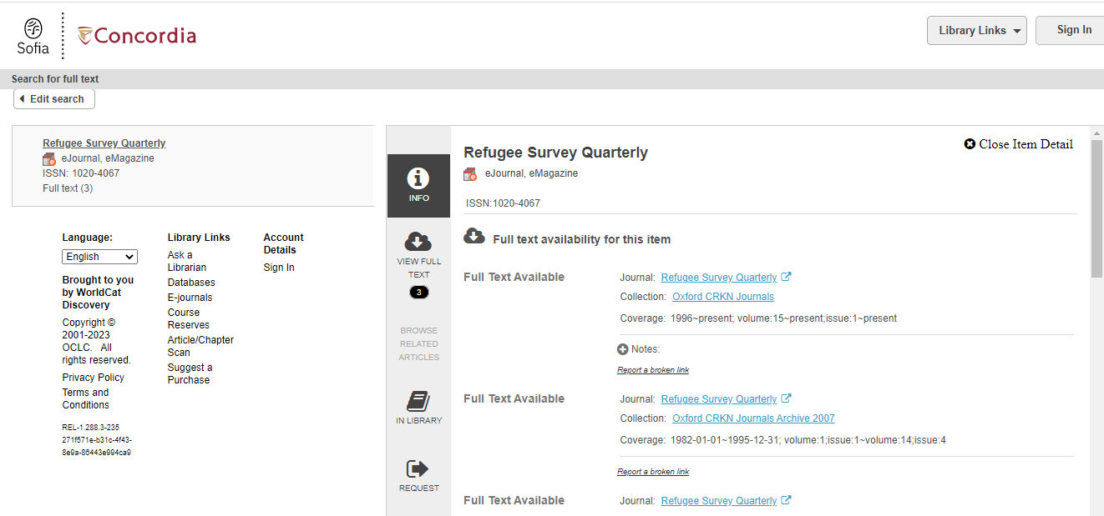
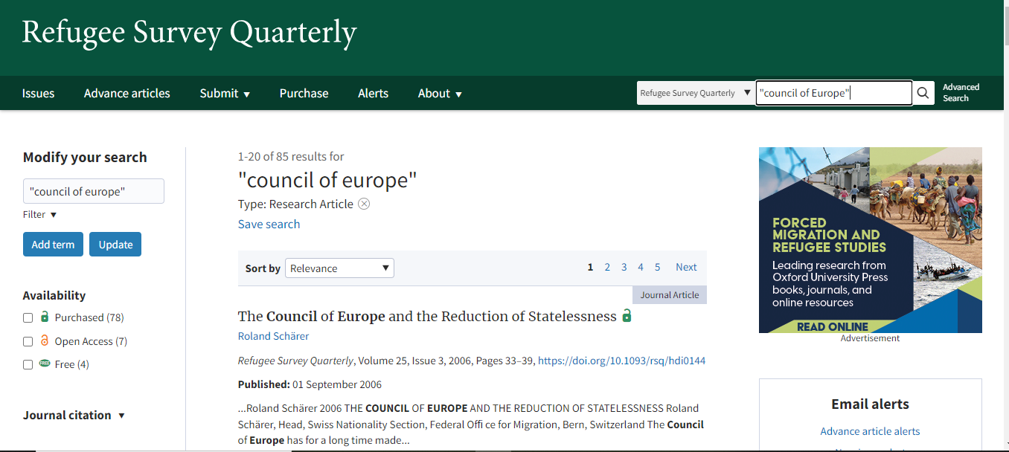

Slide 32
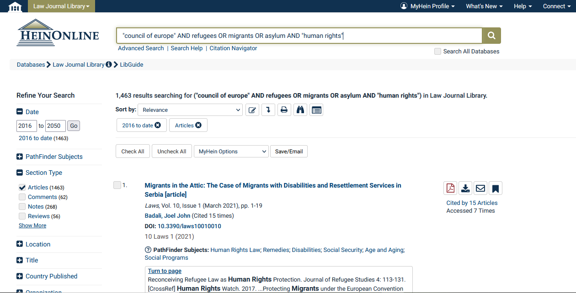

Slide 33
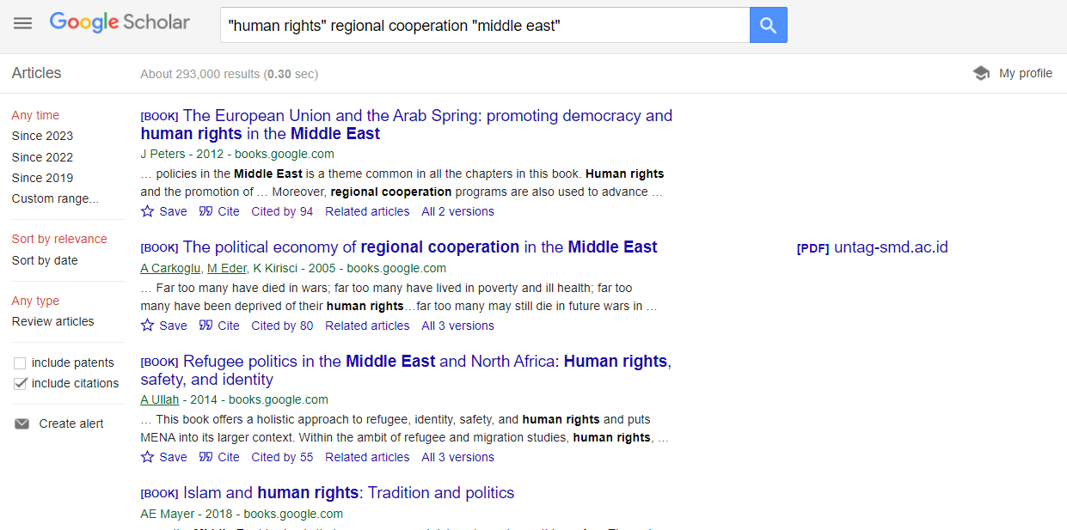
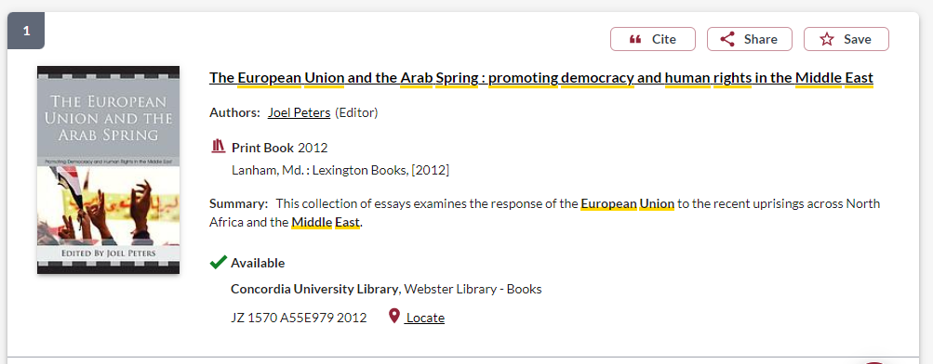

Slide 34
Non-academic sources: IGO,NGO, and government publications

Slide 35
Government Information Search
To search for information from a specific organization, put the name quotation marks, followed by your other search words
Select Intergovernmental organizations from the drop down menu

Slide 36
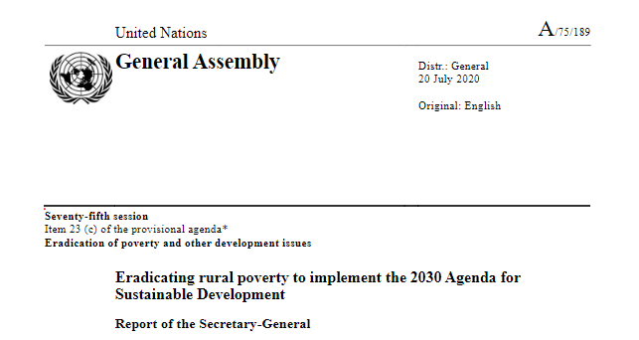
Evaluating IGO,NGO and government publications
Who is the publisher? Is it a government or an organization?
What is the date of publication? Is it recent?
What is the source of the statistical information or data?
Are there any official government crests or logos on the publication?
What kind of website is the publication coming from? Is it a recognizable institutional or organization’s domain?

Slide 37
Annotated Bibliography & Citation

Slide 38
Annotated Bibliographies ( adapted from OWL at Purdue)
A bibliography is a list of sources (books, journals, Web sites, periodicals, etc.) one has used for researching a topic. Bibliographies are sometimes called "References" or "Works Cited" depending on the style format you are using. A bibliography usually just includes the bibliographic information (i.e., the author, title, publisher, etc.).
An annotation is a summary and evaluation. Therefore, an annotated bibliography includes a summary and evaluation of each of the sources.

Slide 39
Annotations should…
1. Summarize: What are the main arguments? What is the point of this book or article? What topics are covered? If someone asked what this article/book is about, what would you say? The length of your annotations will determine how detailed your summary is.
2. Assess: You should also evaluate the source. Is it a useful source? How does it compare with other sources in your bibliography? Is the information reliable? Is this source biased or objective? What is the goal of this source?
3. Reflect: Once you've summarized and assessed a source, you need to ask how it fits into your research. Was this source helpful to you? How does it help you shape your argument? How can you use this source in your research project? Has it changed how you think about your topic?

Slide 40
From your assignment..
The annotated bibliography should contain all the literature (books, articles, documents) you are planning on using. Your sources should be primarily academic, i.e. academic books, and journal articles. List all your citations (in Chicago style) with an annotation (usually a few sentences) that describes/evaluates the relevance of the source for your essay.
For your essay: Citations and bibliography (complete and in Chicago Style). There is no ideal number of sources, but if you have less than a dozen, you probably have not done enough research.

Slide 41
Book Chapter in Chicago style
Du Plessis, Max and Christopher Gevers. 2018. “South Africa’s Foreign Policy and the International Criminal Court: Of African Lessons, Security Council Reform and Possibilities for an Improved ICC.” In African Foreign Policies in International Institutions, edited by Jason Warner and Timothy M. Shaw, 199-214. New York: Palgrave Macmillan. https://link-springer-com.lib-ezproxy.concordia.ca/book/10.1057/978-1-137-57574-6

Slide 42
Book in Chicago style
Clarke, Kamari Maxine. 2019. Affective Justice: the International Criminal Court and the Pan-Africanist Pushback. Durham: Duke University Press. https://muse.jhu.edu/book/72001
Mendes, Errol. 2010. Peace and Justice at the International Criminal Court: a Court of Last Resort. Northhampton: Edward Elgar.

Slide 43
Journal article in Chicago Style
Mills, Kurt and Alan Bloomfield. 2018. “African Resistance to the International Criminal Court: Halting the Advance of the Anti-impunity Norm.” Review of International Studies 44 (1): 101-127. https://doi.org/10.1017/S0260210517000407

Slide 44
Government Publication
Barnett, Laura. 2008. The International Criminal Court: History and Role. Ottawa: Canada. Parliamentary Information and Research Service. Library of Parliament. https://central.bac-lac.gc.ca/.item?id=prb0211-1e&op=pdf&app=Library

Slide 45
NGO website/publication
Amnesty International. March 2023. “Inequality of Pandemic Proportions: State and Pharma Failures not to be Repeated.” POL 30/6518/2023. Accessed March 13, 2023. https://www.amnesty.org/en/documents/pol30/6518/2023/en/

Slide 46
Need help, ask us!
Michelle.Lake@Concordia.ca

