Slide 1
POLI 327: Comparative Democratization Library Workshop
Michelle Lake
Political Science, SCPA, First Peoples Studies and Government Publications Librarian

Slide 2
Who am I?
Michelle Lake, librarian for Political Science, the School of Community and Public Affairs, First Peoples Studies, and Government Publications
Michelle.Lake@Concordia.ca / Make an appointment or ask a question
What do I do?
Provide research support
Help students with search strategies, and navigating library databases
Help students find and access materials they need
Help with citation issues
Choose the books we buy for the above subject areas

Slide 3
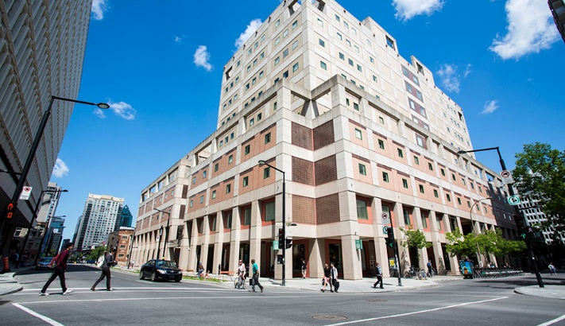
The Librar(ies)
24/7 access, with student card, after 11pm
Webster Library (LB) – downtown on SGW campus & Vanier Library (VL) on Loyola campus
Webster: Social Sciences, Humanities, Business, Engineering & Fine Arts
Vanier: Science(s), Health, Communications, Journalism and Psychology
Course Reserves Room(s): have the required undergraduate print textbooks for the courses taught at that campus (for example: Webster has the Political Science and SCPA course reserves)

Slide 4
Library Services
Your student card is your library card.
You need it to:
borrow books (up to 100 a time)
borrow a laptop and other technology
print on campus (add money to your Dprint account)
access the library overnight during 24/7 hours.
Webster library has 5 book scanners (And Vanier has 2!) that can be used for free to scan chapters from our print books and email them to yourself as a PDF.
To use Library databases, access online articles and ebooks when you are off campus, login with your MyConcordia Netname and password.

Slide 5
How do I find books and articles if I have the citation information?

Slide 6
Dahlum, Sirianne, Carl Henrik Knutsen, and Tore Wig. 2019. “Who Revolts? Empirically Revisiting the Social Origins of Democracy,” The Journal of Politics 81, no. 4 (October): 1494-1499.

Slide 7
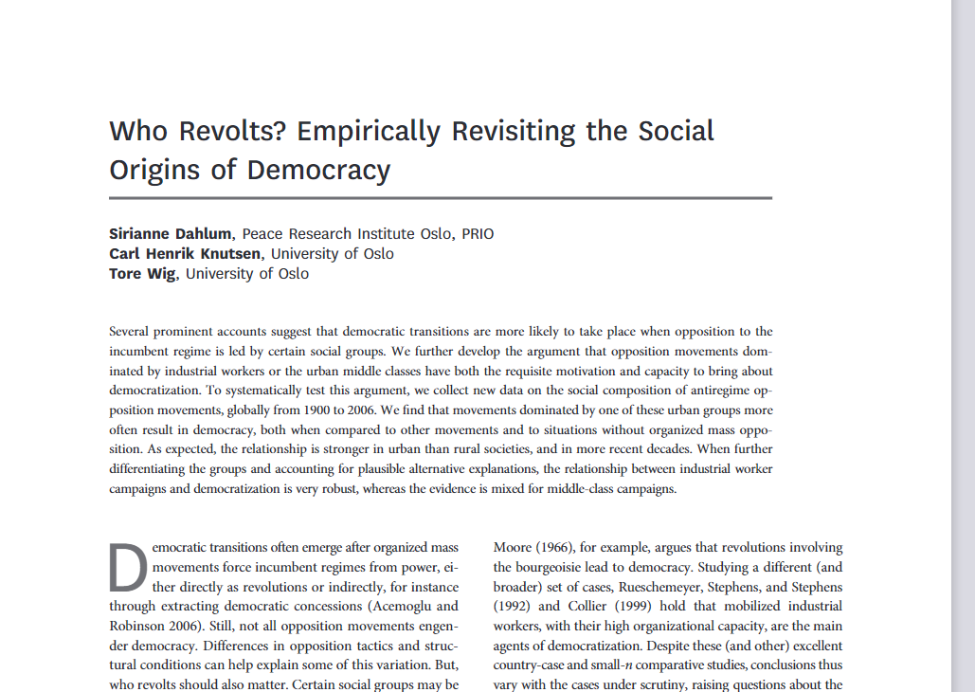
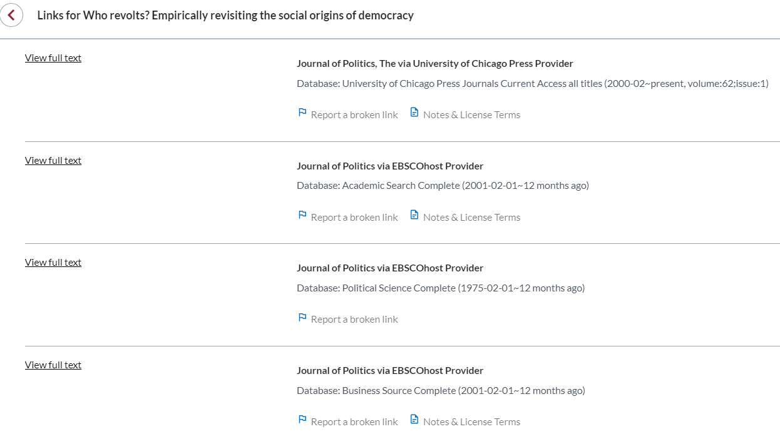
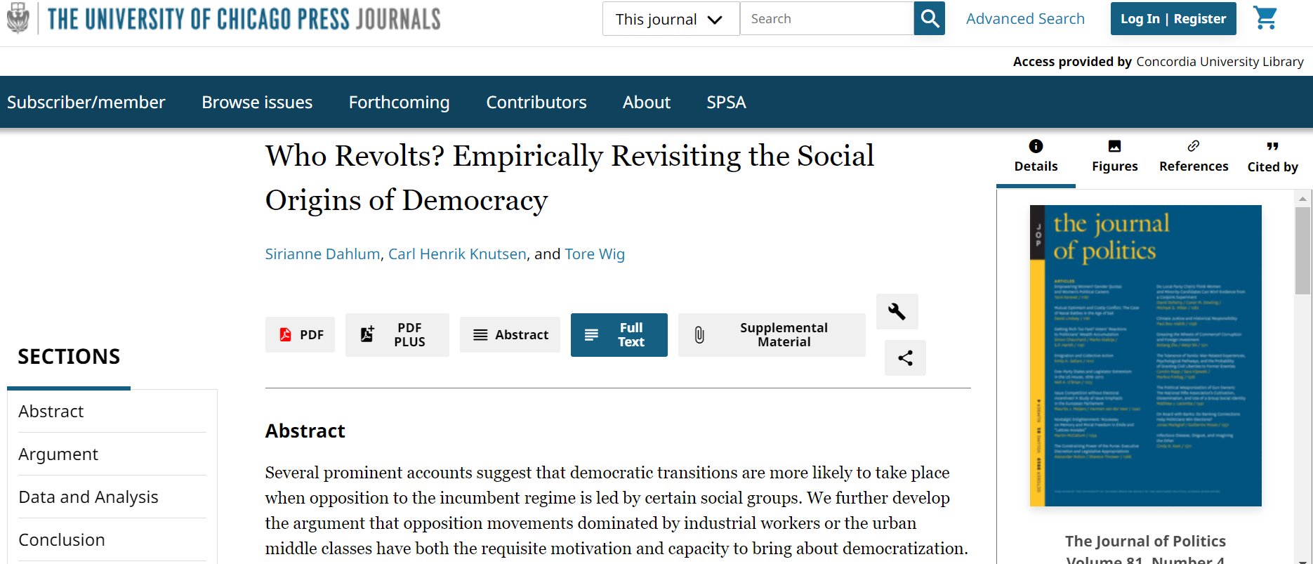
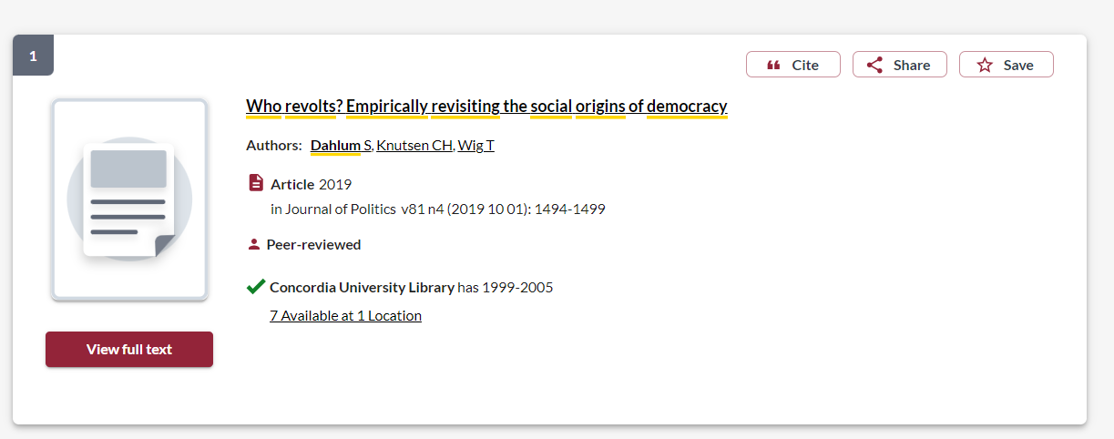

Slide 8
Albertus, Michael and Victor Menaldo. 2018. Authoritarianism and the Elite Origins of Democracy. New York: Cambridge University Press.

Slide 9
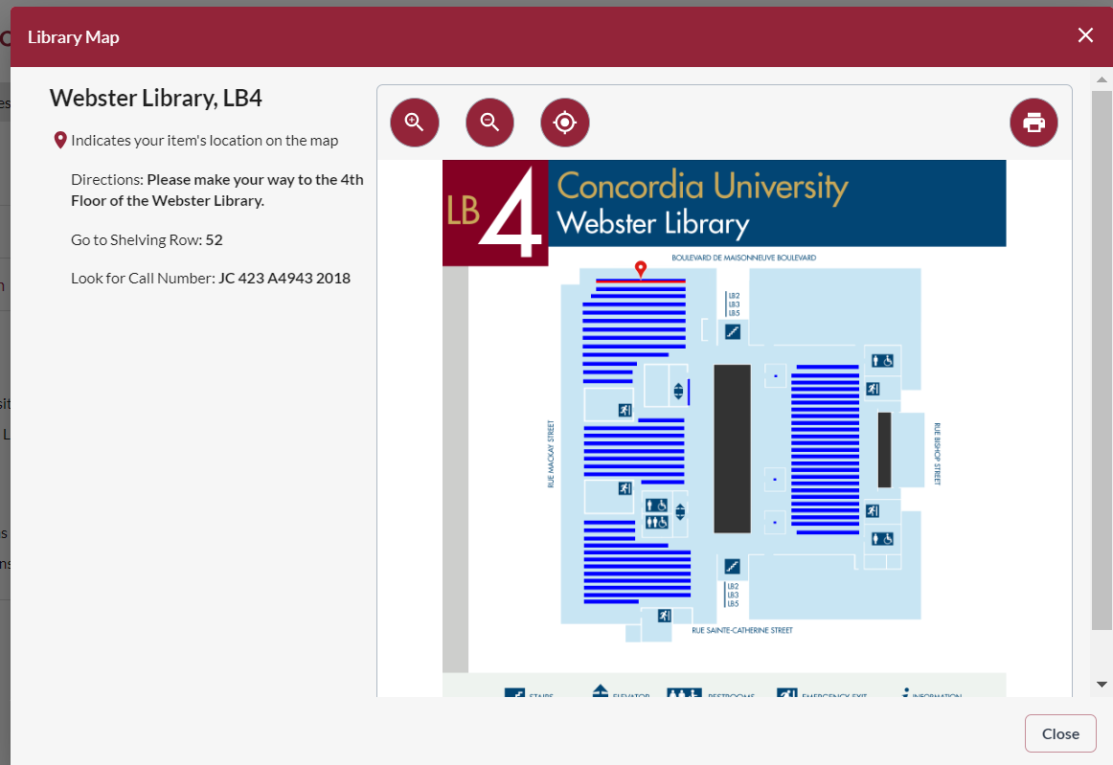
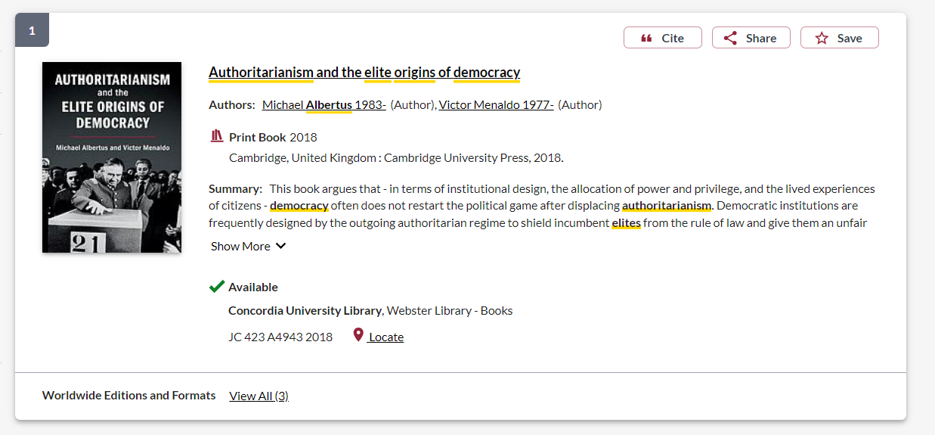

Slide 10
Linz, Juan J. and Alfred Stepan. 1996. Problems of Democratic Transition and Consolidation: Southern Europe, South America, and Post-Communist Europe. Baltimore: John Hopkins University Press.

Slide 11
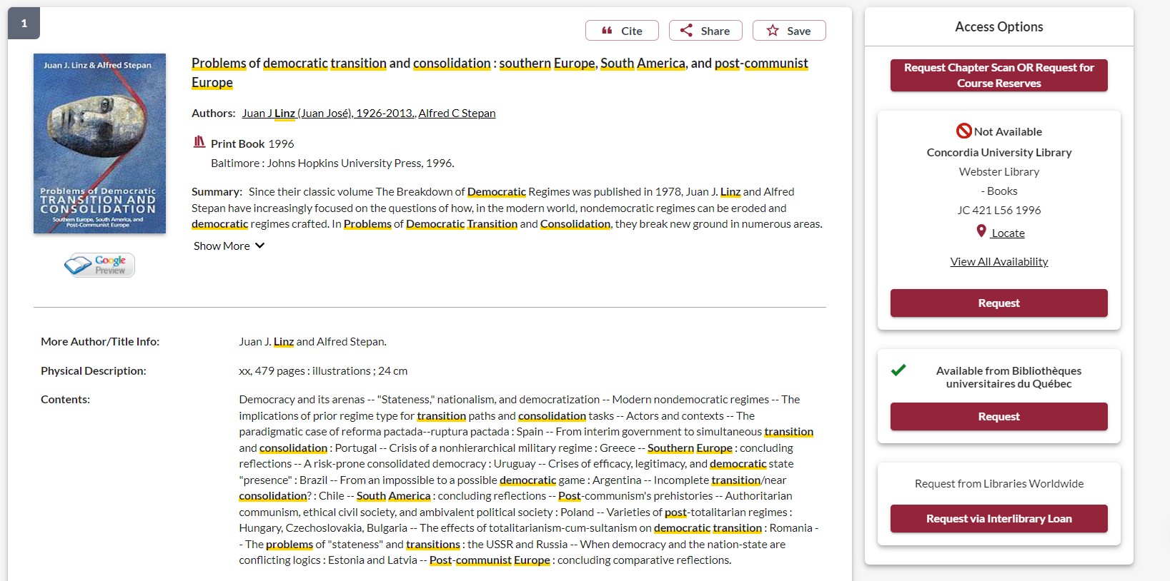
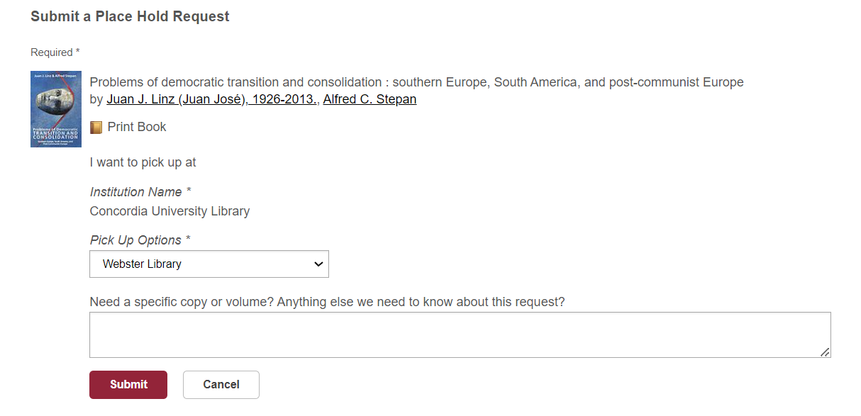
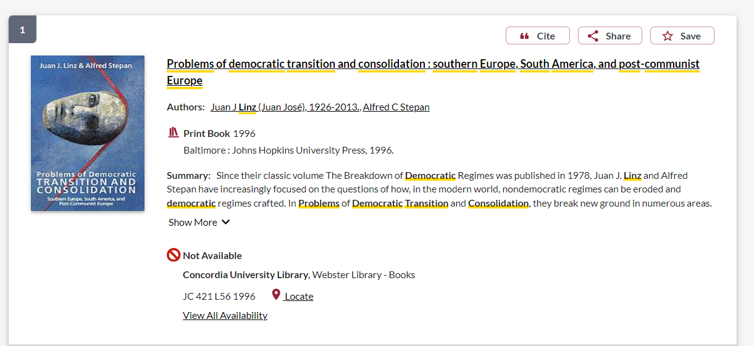
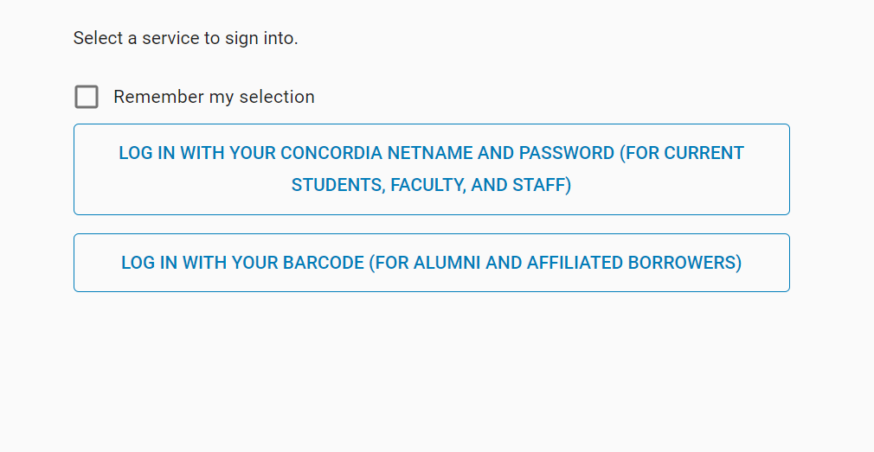

Slide 12
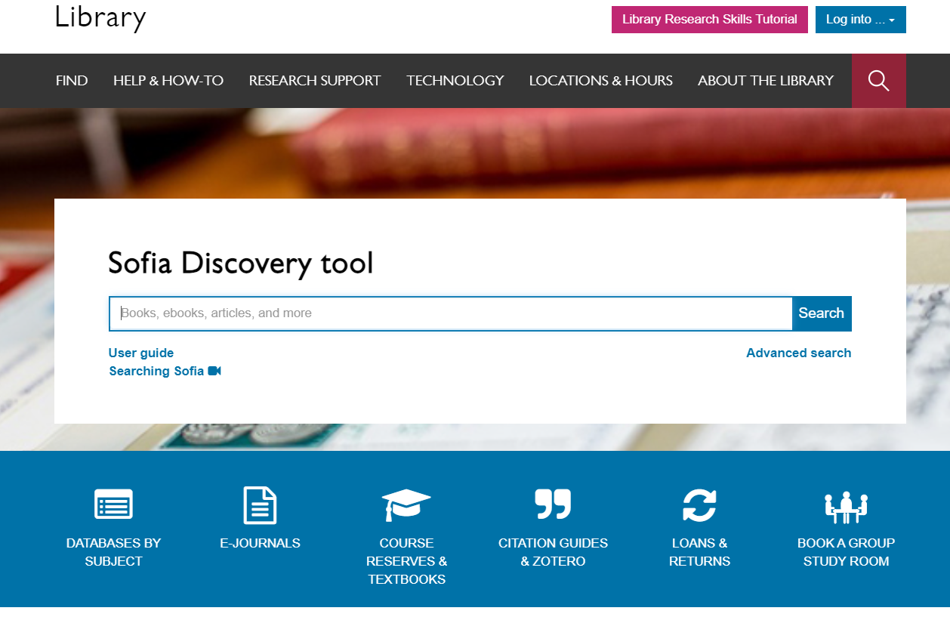
McCoy, Jennifer, and Murat Somer, eds. 2019. “Polarizing and the Global Crisis of Democracy,” special issue of The Annals of the American Academy of Political and Social Science 681, no.1 (January): 8-271. [14 articles]

Slide 13
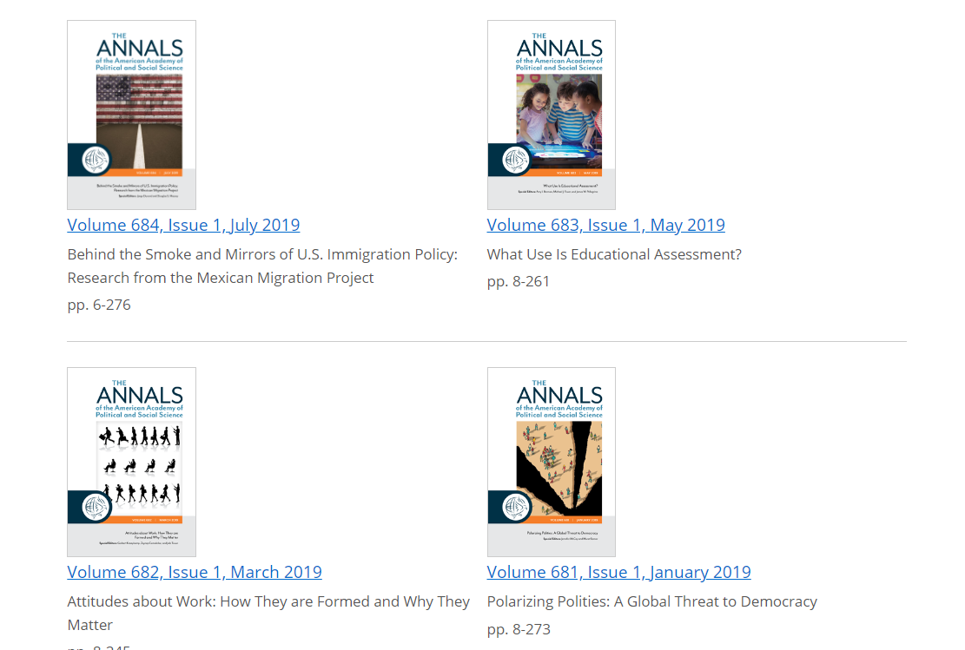
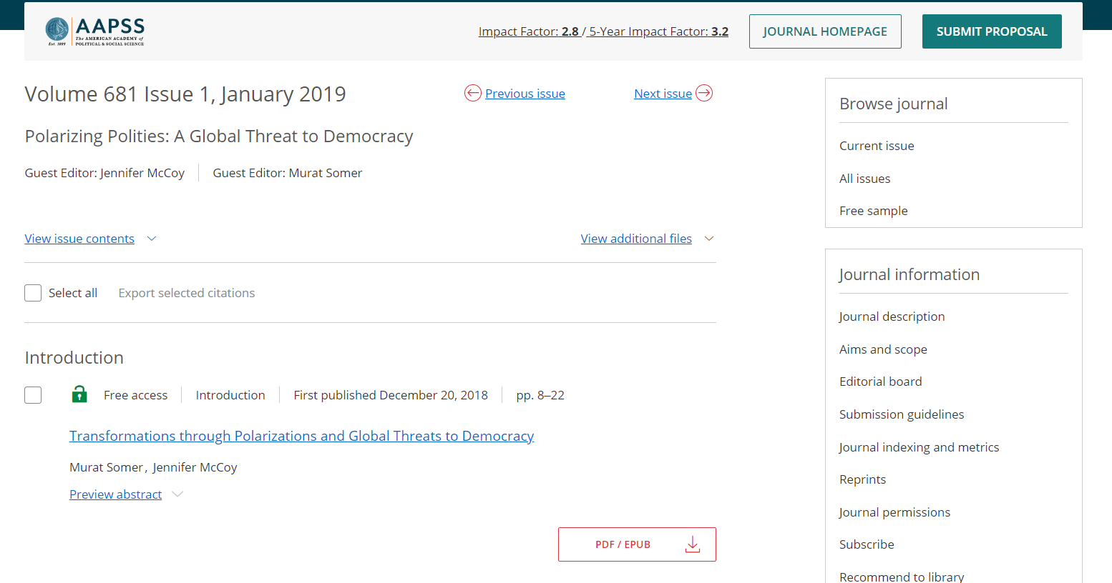
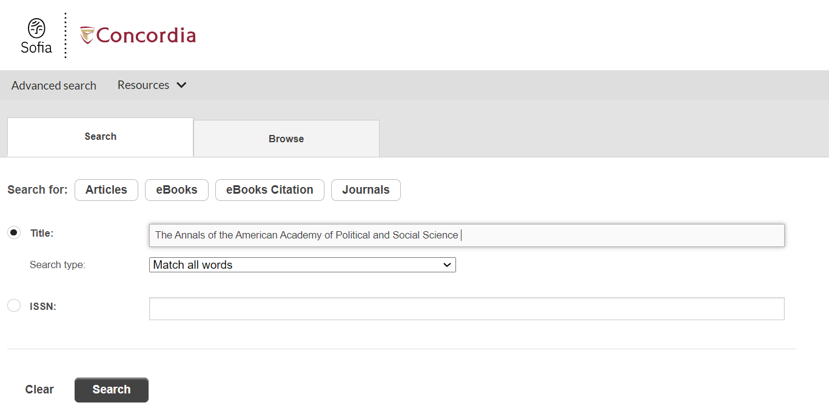
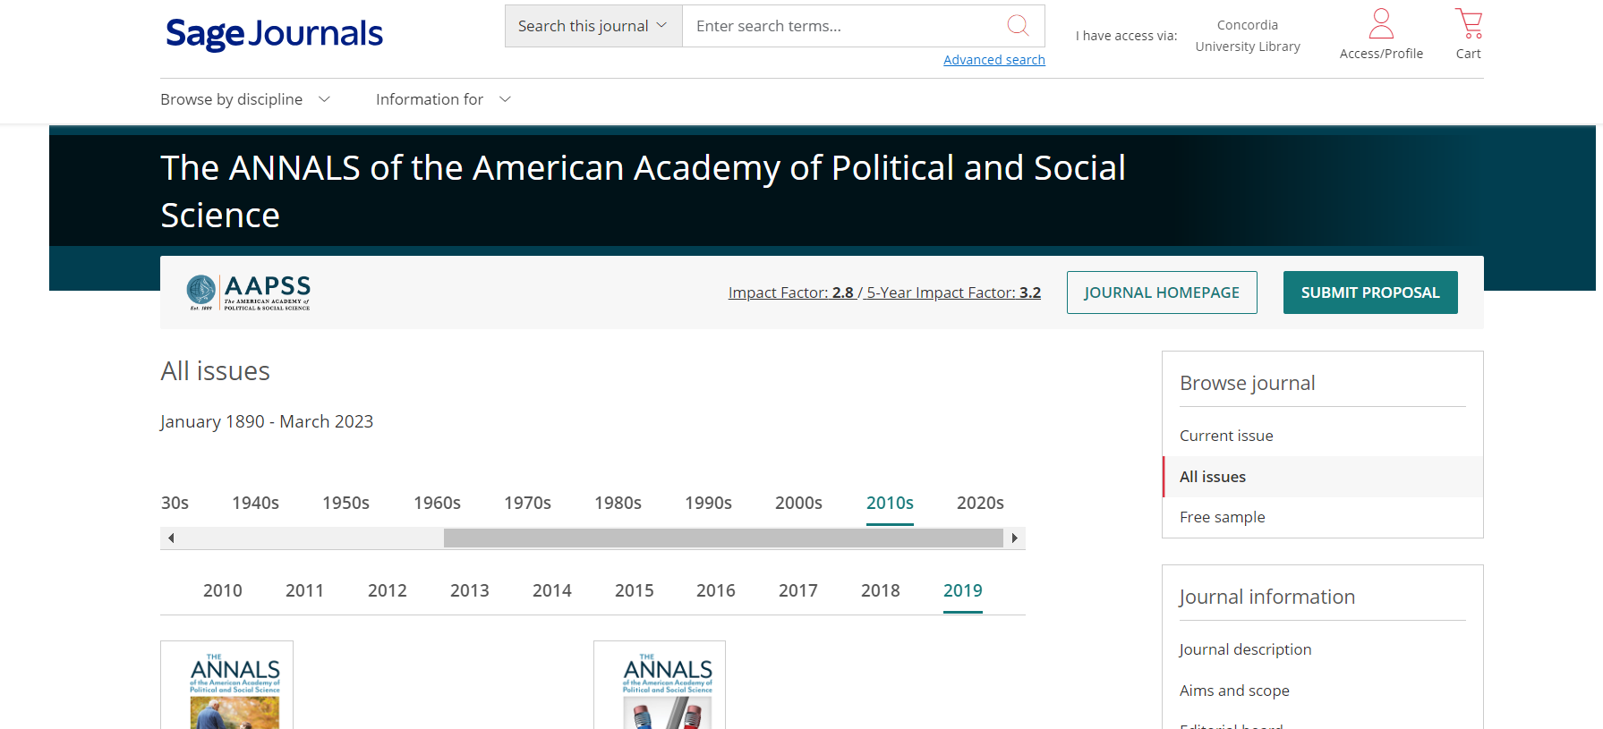
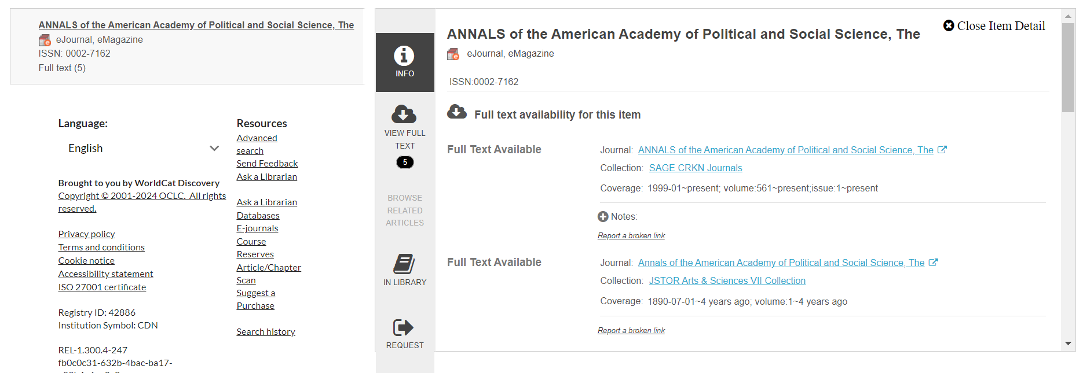
Access all 14 articles below
1
2

Slide 14
Types of sources

Slide 15
Primary sources & supplementary sources
> Primary sources provide first-hand testimony or direct evidence concerning a topic under investigation. They are created by witnesses or recorders who experienced the events or conditions being documented.
News articles and media
Government documents and information
International organization or NGO reports, and publications
data sources (e.g., Freedom House. V-DEM, World Bank)
Information gleaned from websites of government agencies or international organizations
Textbooks
*These sources are not peer reviewed, but represent reliable information

Slide 16
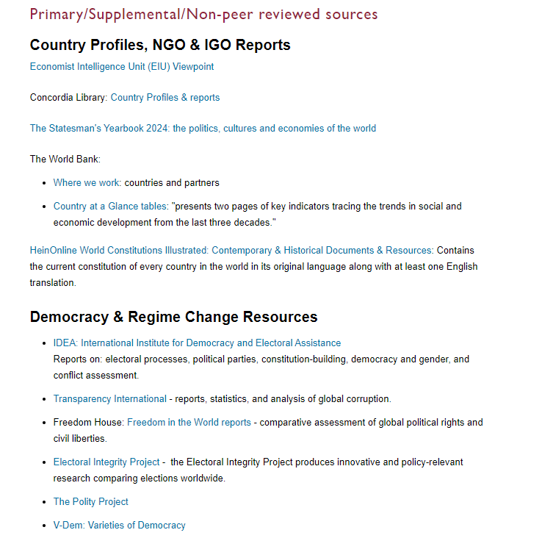

Slide 17
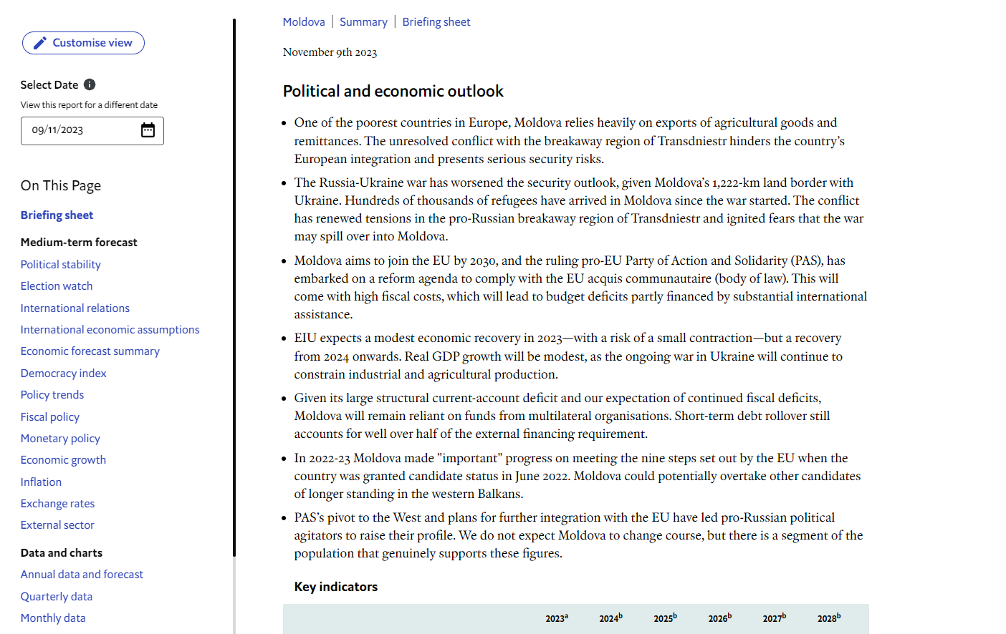
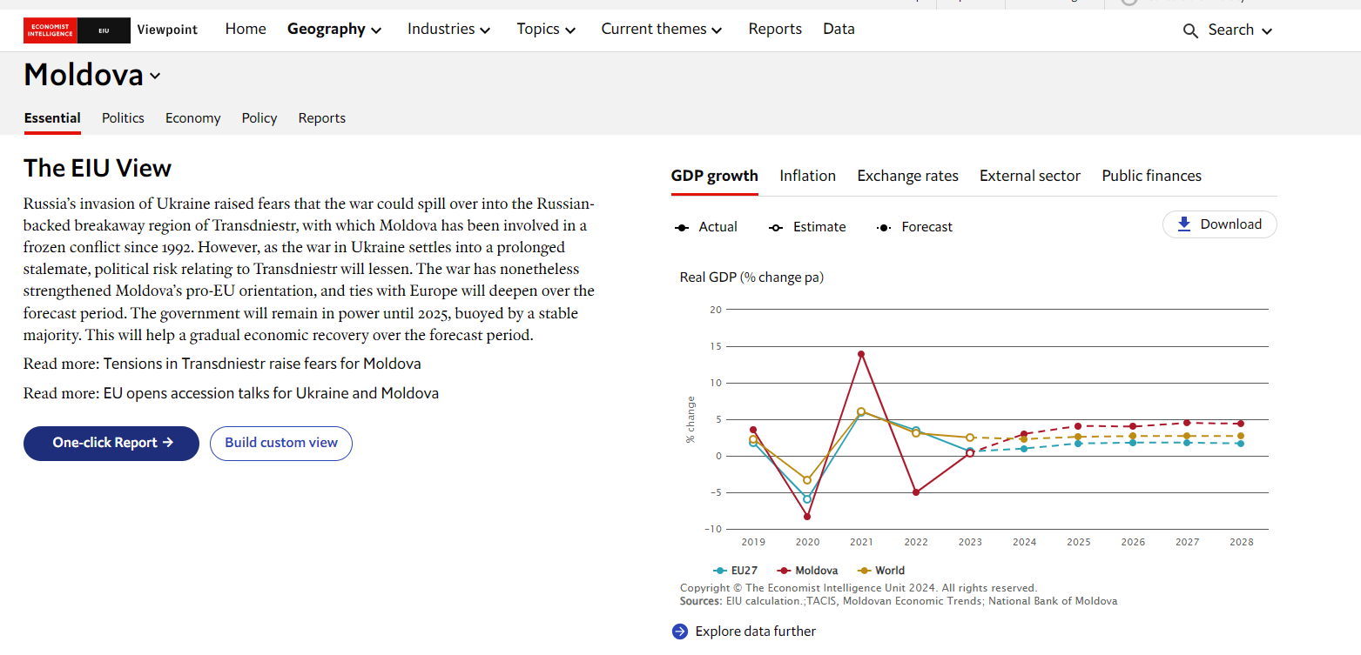
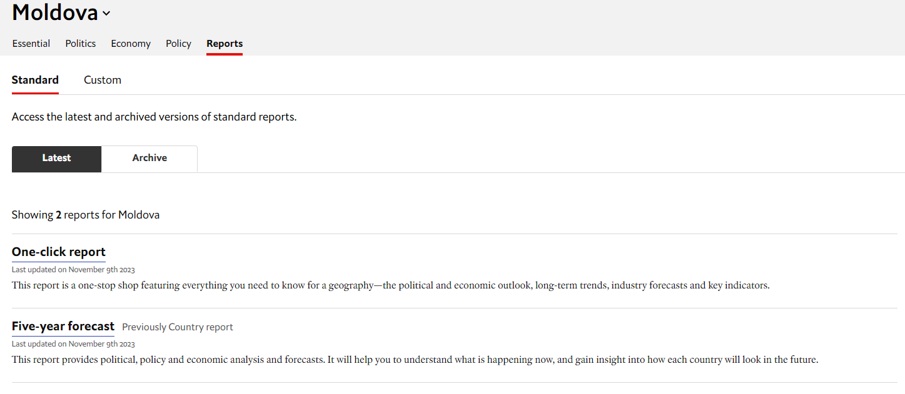
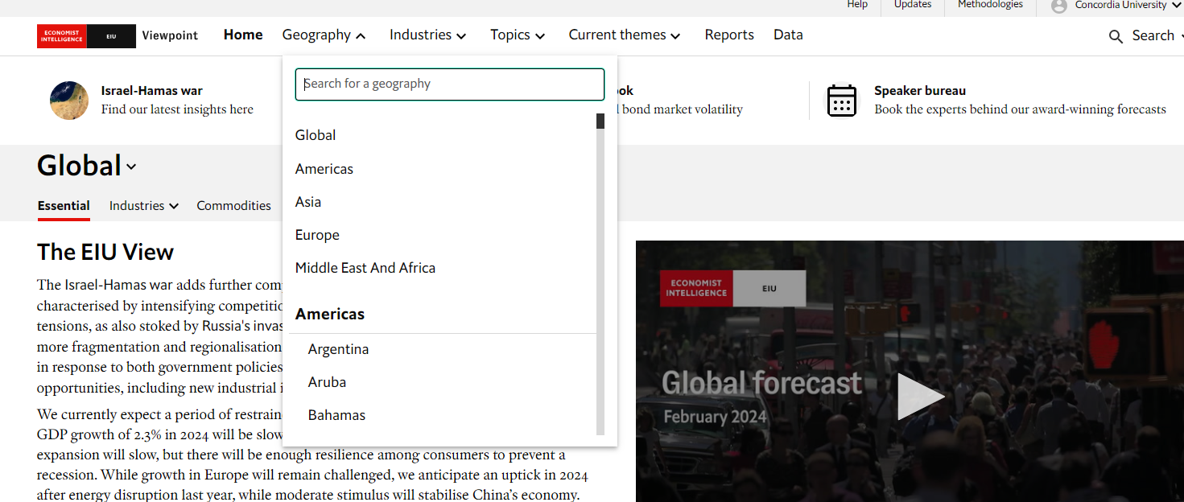

Slide 18
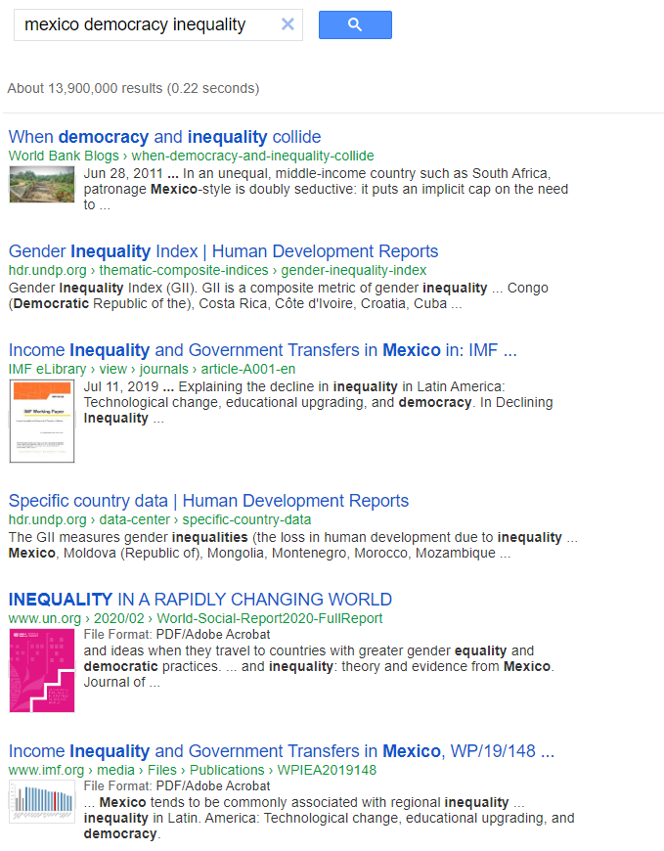
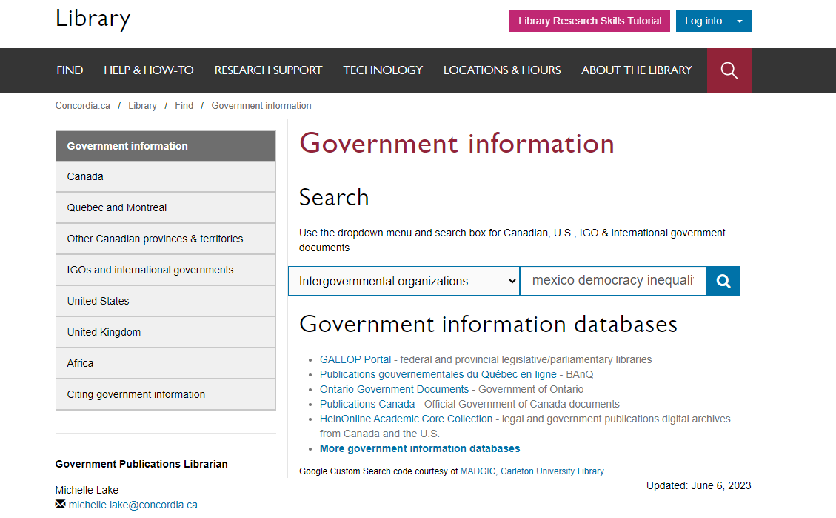
You’ll find publications from various international organizations

Slide 19
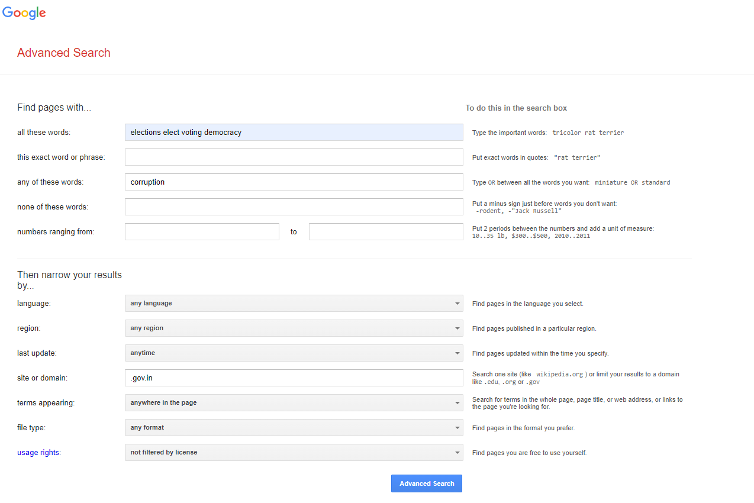
Combining with AND
OR
Gov domain

Slide 20
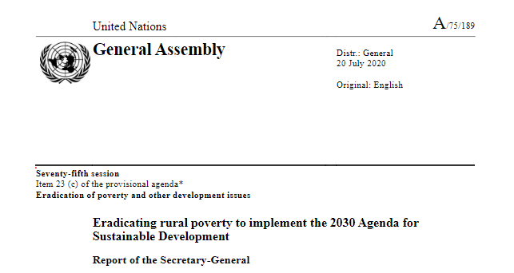
Evaluating IGO,NGO and government publications
Who is the publisher? Is it a government or an organization?
What is the date of publication? Is it recent?
What is the source of the statistical information or data?
Are there any official government crests or logos on the publication?
What kind of website is the publication coming from? Is it a recognizable institutional or organization’s domain?

Slide 21
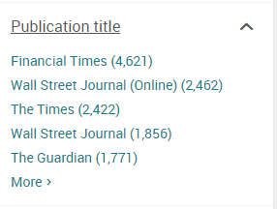
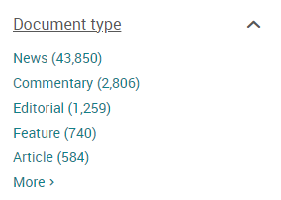
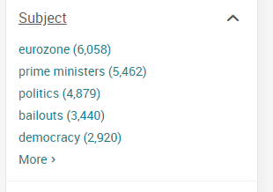
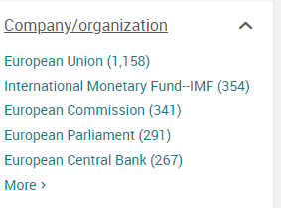
Newspapers

Slide 22
Blinded peer reviewed sources
Peer review is a process through which academic articles are read and evaluated by experts in the article’s subject area. The reviewers assess the article’s validity, importance, and originality, and then recommend whether it should be published.
Academic books go through a peer review process, which can be single or double blind. This peer review process usually happens at university presses. The book will also go through editorial approval before it is published.

Slide 23
Blinded peer reviewed sources
Blinded Peer reviewed journal articles can be:
single blind, which means the authors do not know who the reviewers are
double-blind which means neither the authors or the reviewers know who each other are. Only the editor knows the identity of all parties involved.
This systems helps reduce bias in the review process

Slide 24
Search Strategies

Slide 25
How do we combine search words for the best possible results?
AND: combines concepts and limits your results
India AND elections
state OR government
OR: allows you to insert synonyms or alternative terms and increases your results

Slide 26
How do we combine search words for the best possible results?
“quotation marks”: If you put two or more words in quotation marks, that exact phrase will be searched and limits your results.
“regime change”
“economic development”
democra*
Finds: democracy, democracies, democratic, democratically, democratization
* - when you add an asterisk on the end of a word, your results will contain all the words with those endings or suffix

Slide 27
Avoid searching with linking or unnecessary words
Each author may use different linking words when discussing similar topics.
Effects
Impact
Consequences
Influence
Results
Importance
Significance
Response
Emphasis
Causes
You don’t want your search to be limited to those books and articles that only contain the word “effect” or “consequence”

Slide 28
Developing your topic
Democratization: regime change, democracy promotion, authoritarianism
Country: singular and plural, e.g. Greece, Greek/Brazil, Brazilian/Nepal, Nelpalese, Nepali, etc.
Theme: socio-economic inequality and social mobility
Economic development
Socioeconomic status
Wealth
Educational attainment
Class
Poverty

Slide 29
Topic: Prospects for democracy in Kenya, based on political agency
Kenya* AND democra* AND politic*

Slide 30
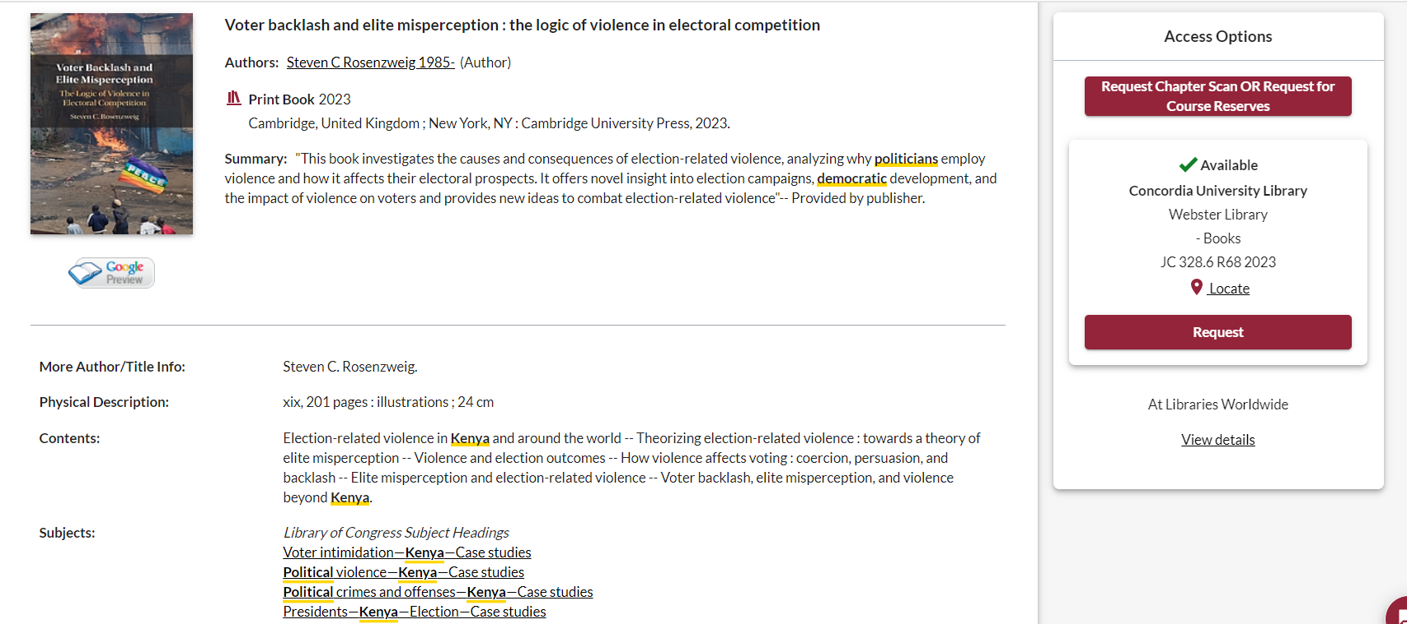
This book is published by a university press, and is academic
Use the subject headings to find books on similar topics

Slide 31
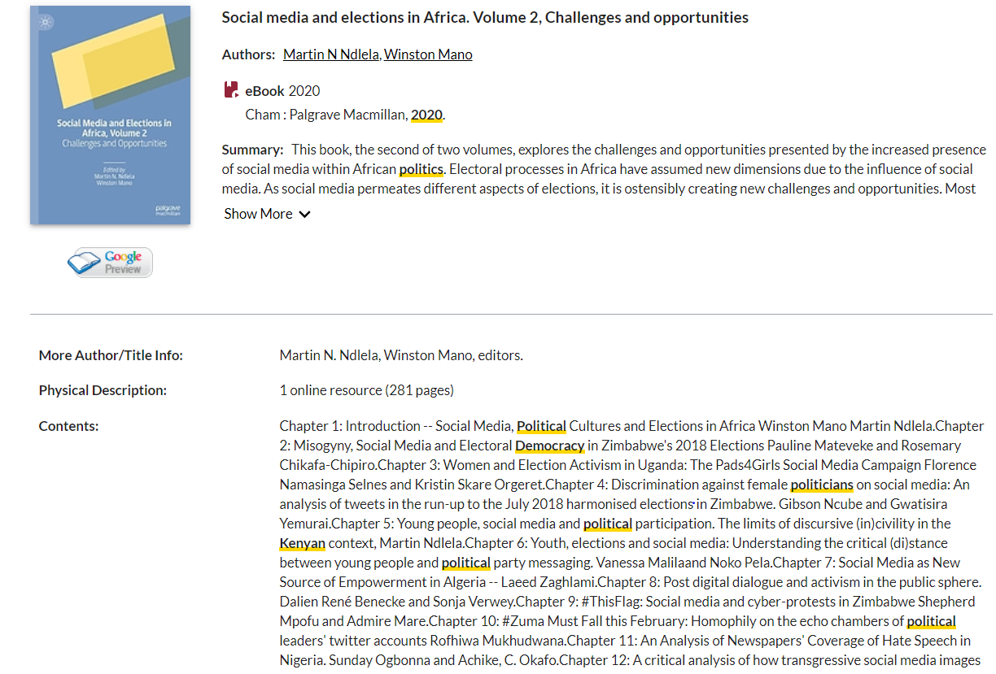
Is this book academic?
Length: academic books are generally 200+ pages

Slide 32
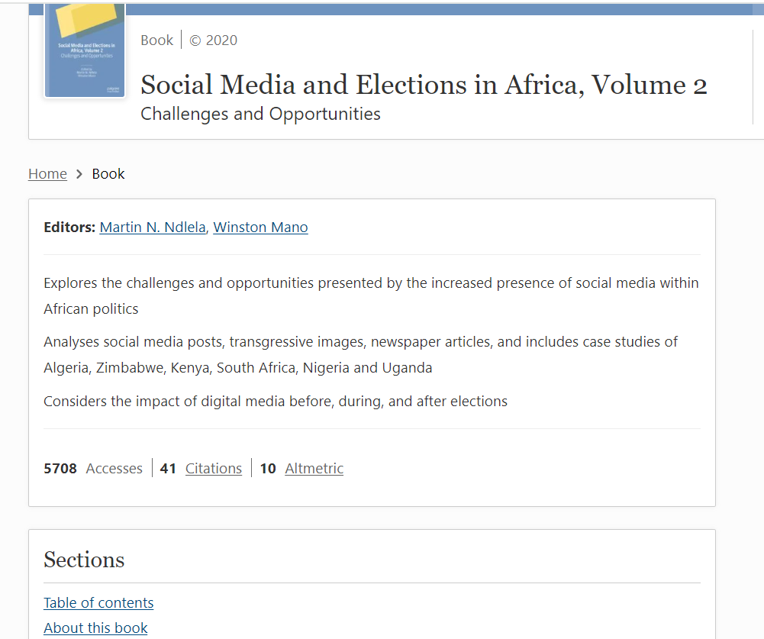
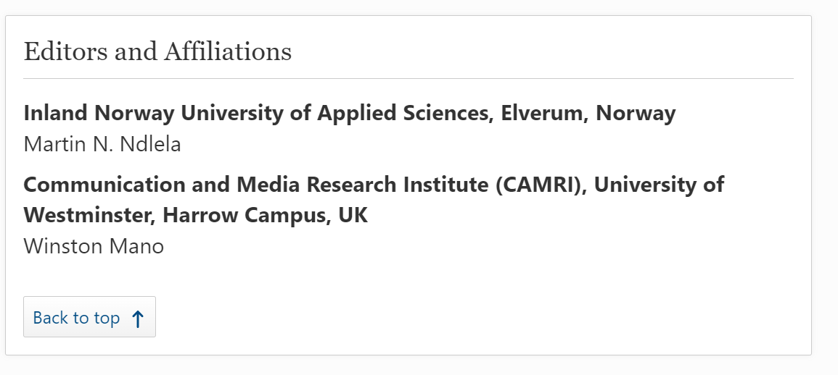

Slide 33
Academic Publishers – Peer reviewed
University presses, [university name] + Press​
Cambridge University Press, McGill-Queen’s University Press, University of Toronto Press, Duke University Press, etc​
Routledge
Palgrave MacMillian
Taylor & Francis
Springer
And more…

Slide 34
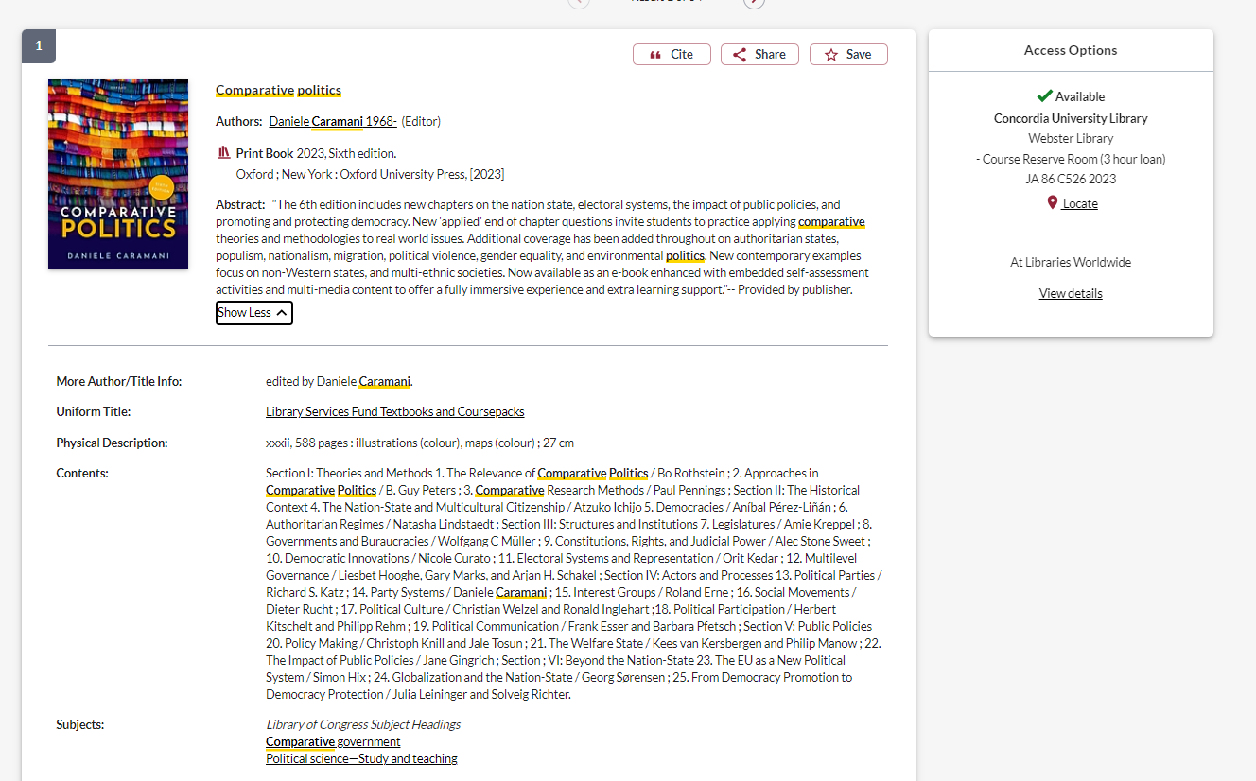
Academic Publishers – Textbooks (not peer reviewed)
Academic publisher
How to identify a textbook:
Book’s topic is very general and high level
Multiple editions: 4th, 6th, 12th, etc.
Mentions what the new edition contains, “new chapters”
Library services fund textbooks
“study and teaching “in the subject heading
Located in the course reserve room

Slide 35
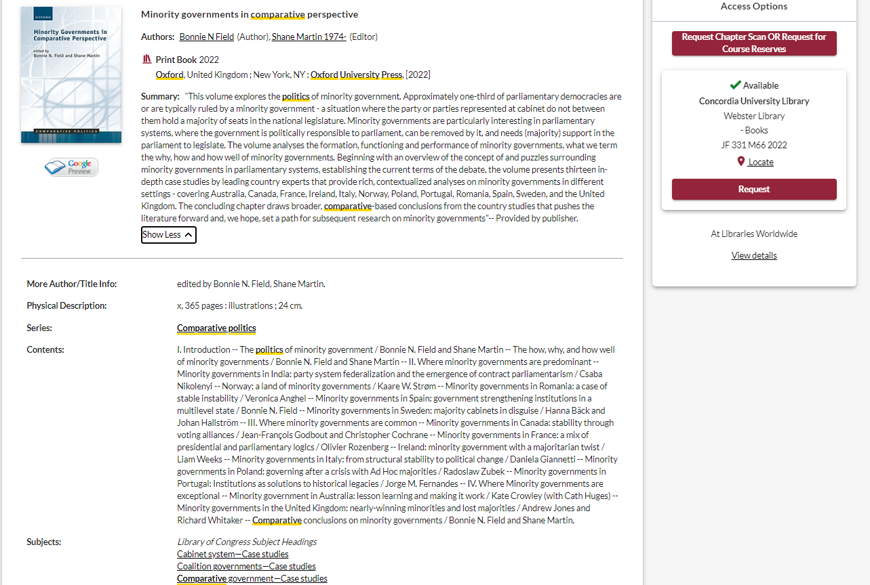
Academic publisher
Academic peer reviewed book:
Book’s topic is more specific, with collected essays/chapters on different aspects of the topic
Single edition
Case studies
Located in the regular collection

Slide 36
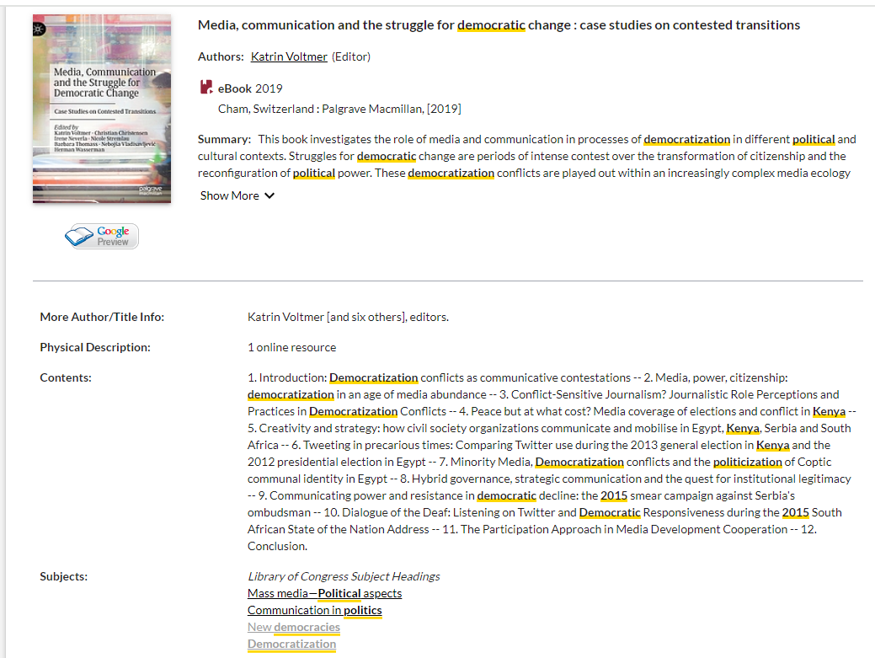
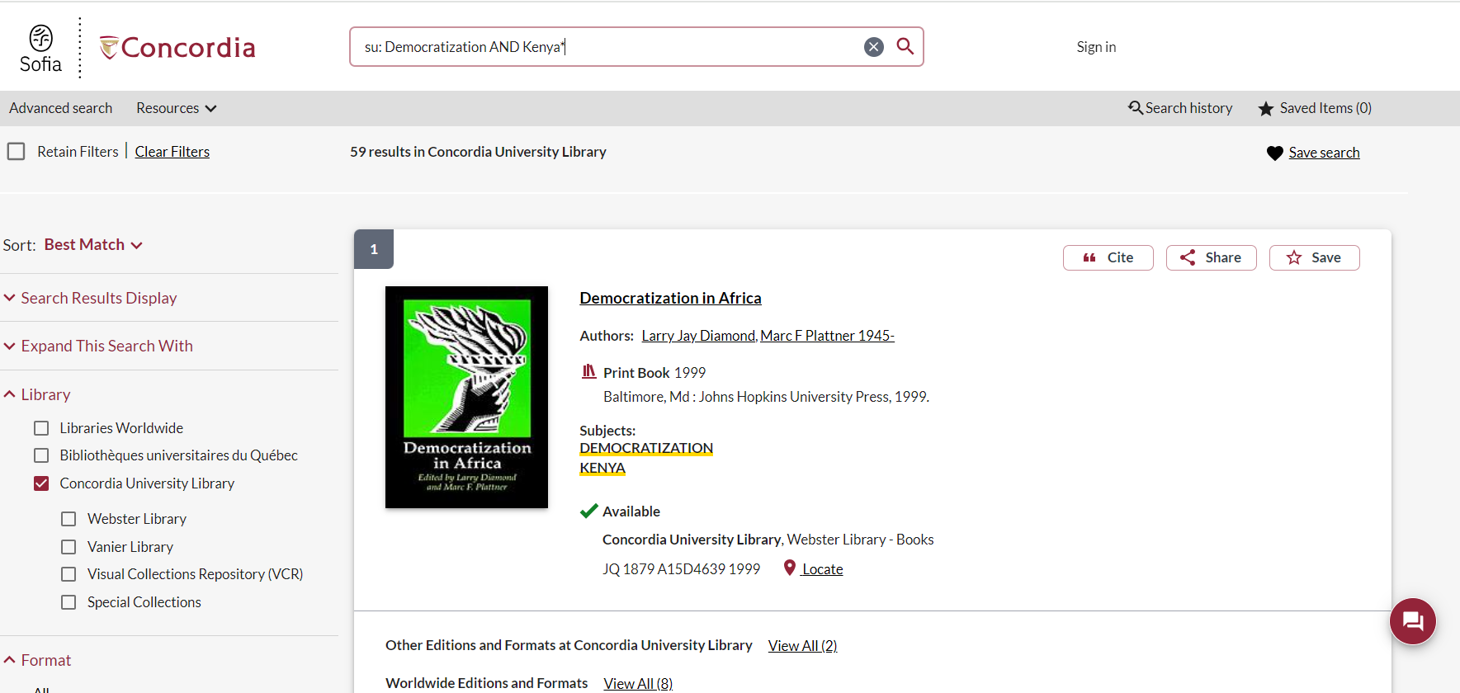
Add focal country with AND

Slide 37
Author affiliations
Length: academic articles should be 15+ pages

Slide 38
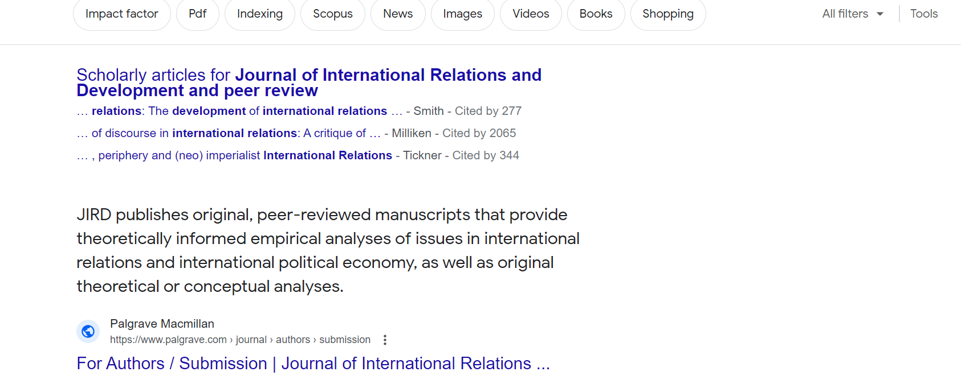
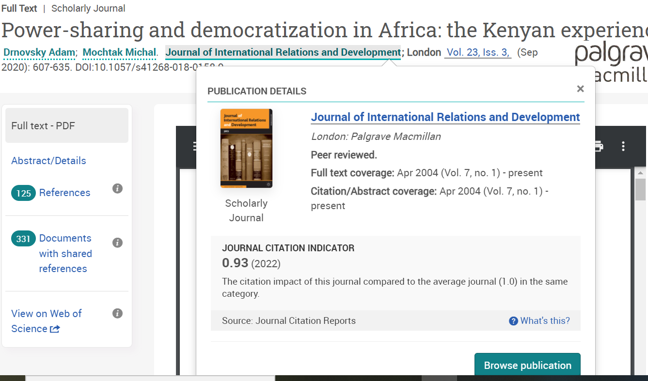
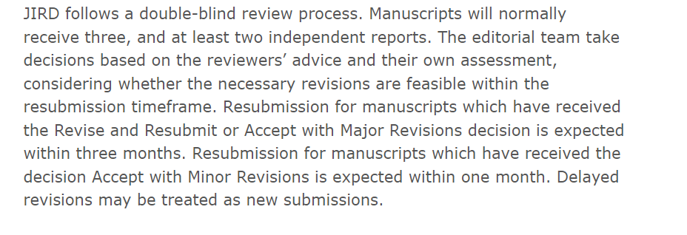
Checking peer review status

Slide 39
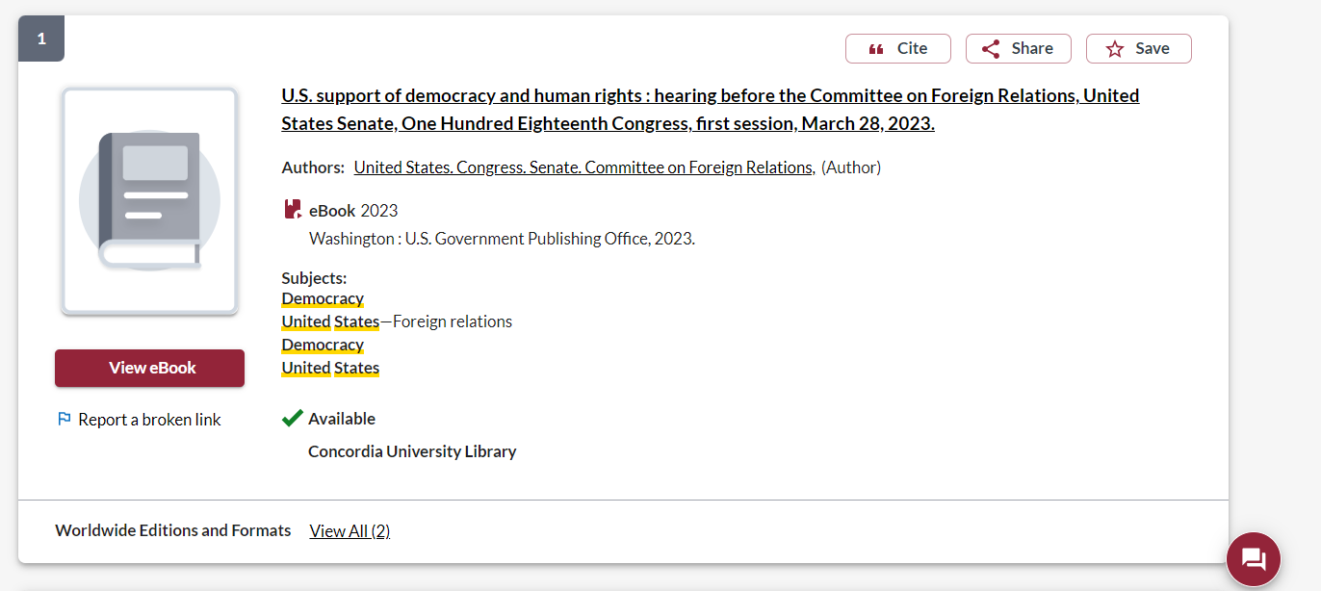
What else will I find in Sofia?
Sofia will provide format information, to tell you the type of container the item is in: print book, ebook, article, etc.
Pay close attention to the authors and publishers.
This is a government document

Slide 40
What else will I find in Sofia?

Slide 41
OECD publications (available through Sofia and OECD iLibrary)
What is the OECD?
Organisation for Economic Co-operation and Development is an intergovernmental organisation with governments of 38 democracies with market-based economies collaborate to develop policy standards to promote sustainable economic growth. A reliable source of evidence-based policy analysis and economic data.
OCED reports and publications are a type of grey literature; this information is reliable, but not scholarly or peer reviewed.

Slide 42
What will I find in Sofia?
Academic peer reviewed books (ebooks and print books)
Academic textbooks
Non-academic books
Academic journal articles (peer reviewed and non-peer reviewed)
Government documents
International Organization publications

Slide 43
Journal Article Database Searching

Slide 44
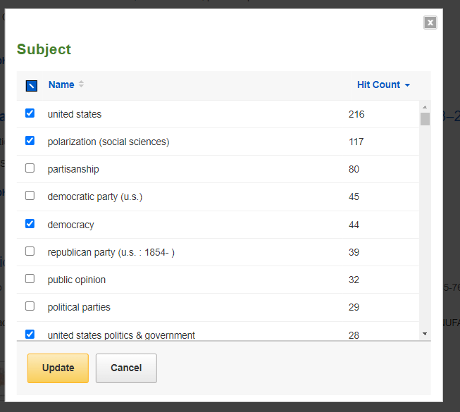
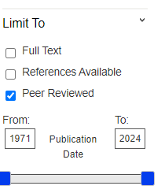
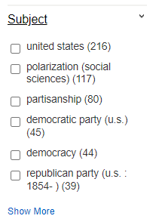
Political Science Complete

Slide 45
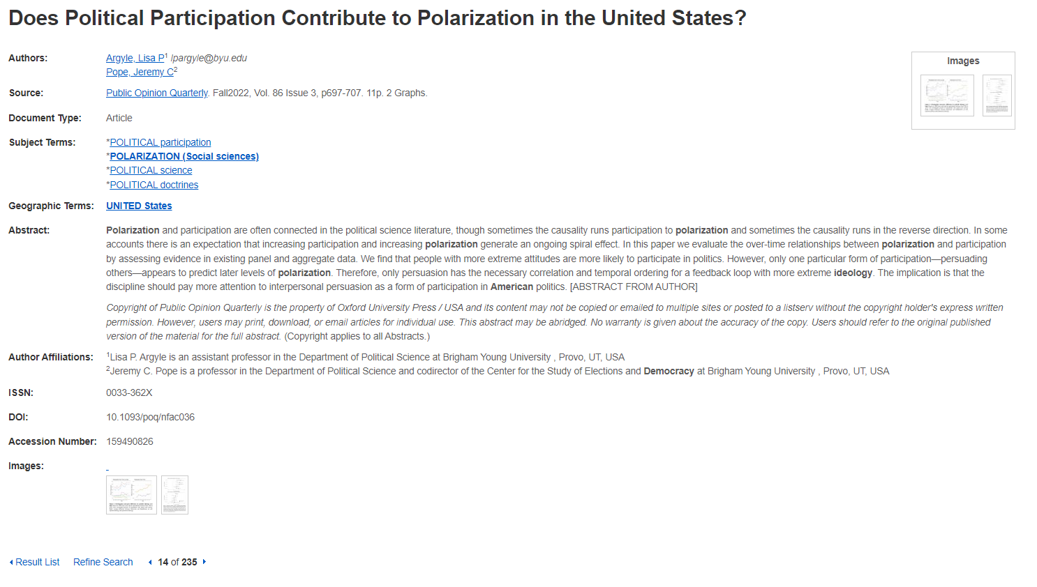
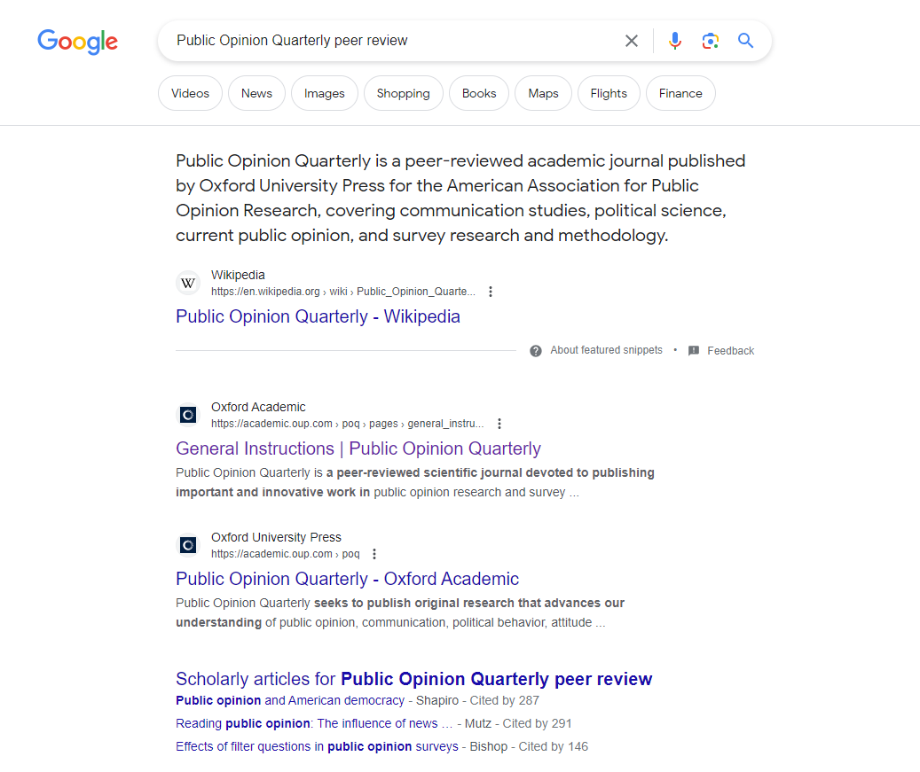
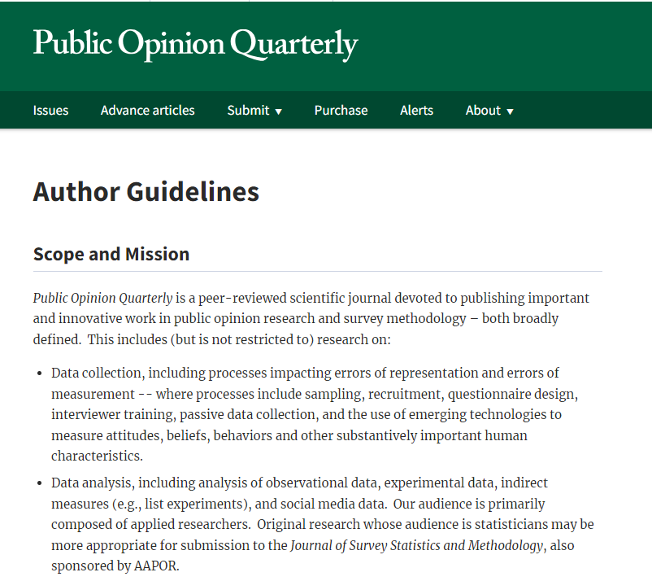
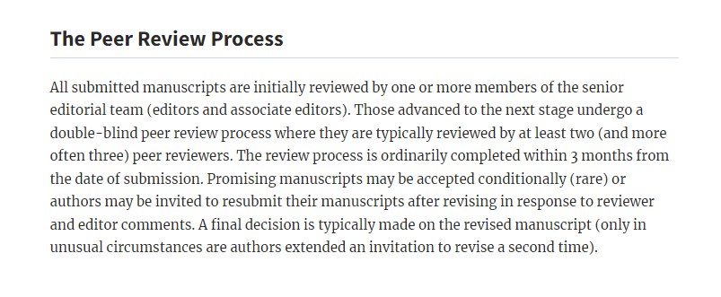
Academic affiliations

Slide 46
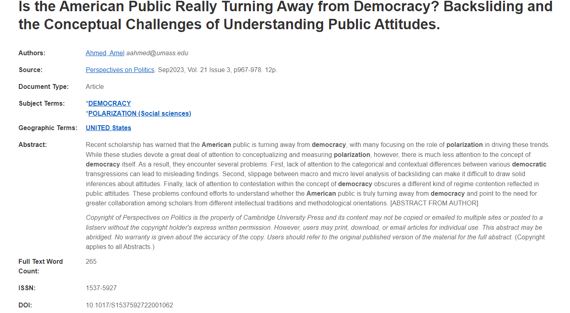

Slide 47
Look for: “Journal information” or “about this journal” or submission instructions

Slide 49
Search Google Scholar, Google’s academic database.
Set up Google Scholar to access Concordia resources.

Slide 50
Academic book
Double blind peer reviewed article
Academic book chapter, available through ILL
Single blind peer reviewed article

