Slide 1
POLI 327: Comparative Democratization Library Workshop
Michelle Lake
Political Science, SCPA, FPST and Government Publications Librarian

Slide 2
Who am I?
Michelle Lake, librarian for Political Science, the School of Community and Public Affairs, First Peoples Studies, and Government Publications
Michelle.Lake@Concordia.ca / Make an appointment or ask a question
What do I do?
Provide research support, assist with search strategies
Help students navigate library databases, assist with selection and evaluation of sources
Help students find and access materials they need
Build guides, resources and pathfinders to help students locate research materials
Help with citation issues
Choose the books we buy for the above subject areas

Slide 3
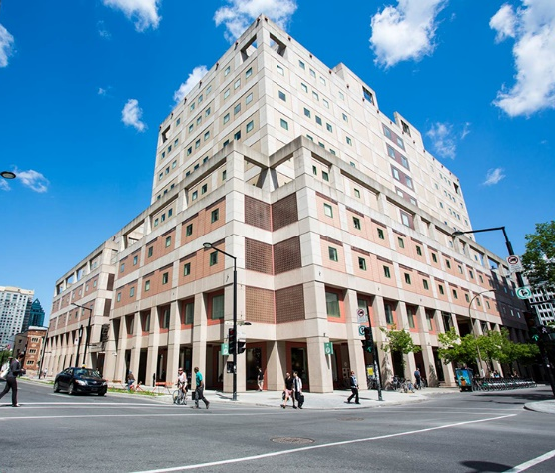
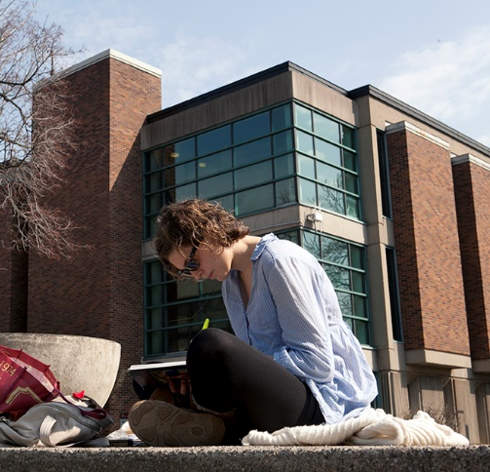
The Librar(ies)
24/7 access, with student card, after 11pm
Webster Library (LB) – downtown on SGW campus & Vanier Library (VL) on Loyola campus
Webster: Social Sciences, Humanities, Business, Engineering & Fine Arts
Vanier: Science(s), Health, Communications, Journalism and Psychology
Course Reserves Room(s): have the required undergraduate print textbooks for the courses taught at that campus (for example: Webster has the Political Science and SCPA course reserves)

Slide 4
Library Services
Your student card is your library card.
You need it to:
borrow books (up to 100 a time)
borrow a laptop (3 day loan) and other technology
print on campus (add money to your Dprint account)
access the library overnight during 24/7 hours.
Webster library has 5 book scanners (And Vanier has 2!) that can be used for free to scan chapters from our print books and email them to yourself as a PDF.
To use Library databases, access online articles and ebooks when you are off campus, login with your MyConcordia Netname and password.

Slide 5
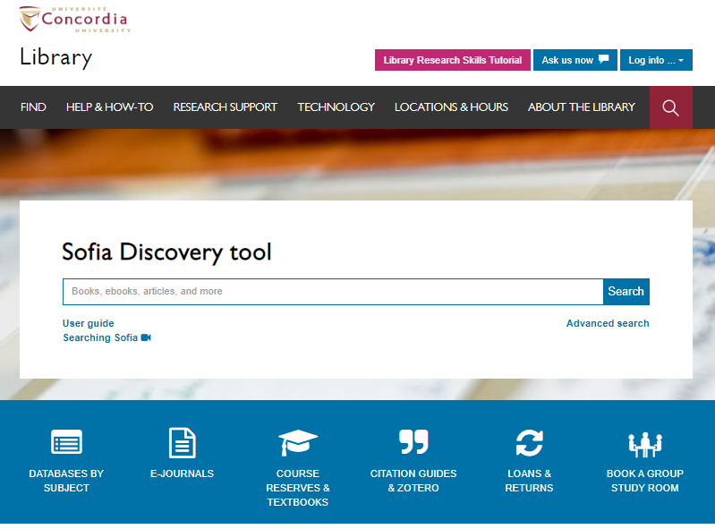
Use the Sofia Discovery tool to find print books, ebooks, and journal articles from the library.

Slide 6
How can I find out if the library has access to an item I’m looking for?

Slide 7
Linz, Juan J. “The perils of presidentialism”. Journal of Democracy , vol. 1, no. 1, Winter 1990, pp. 51-69.

Slide 8
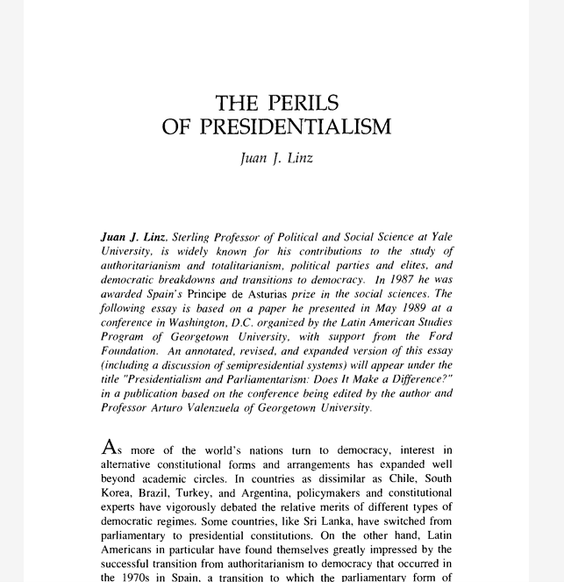
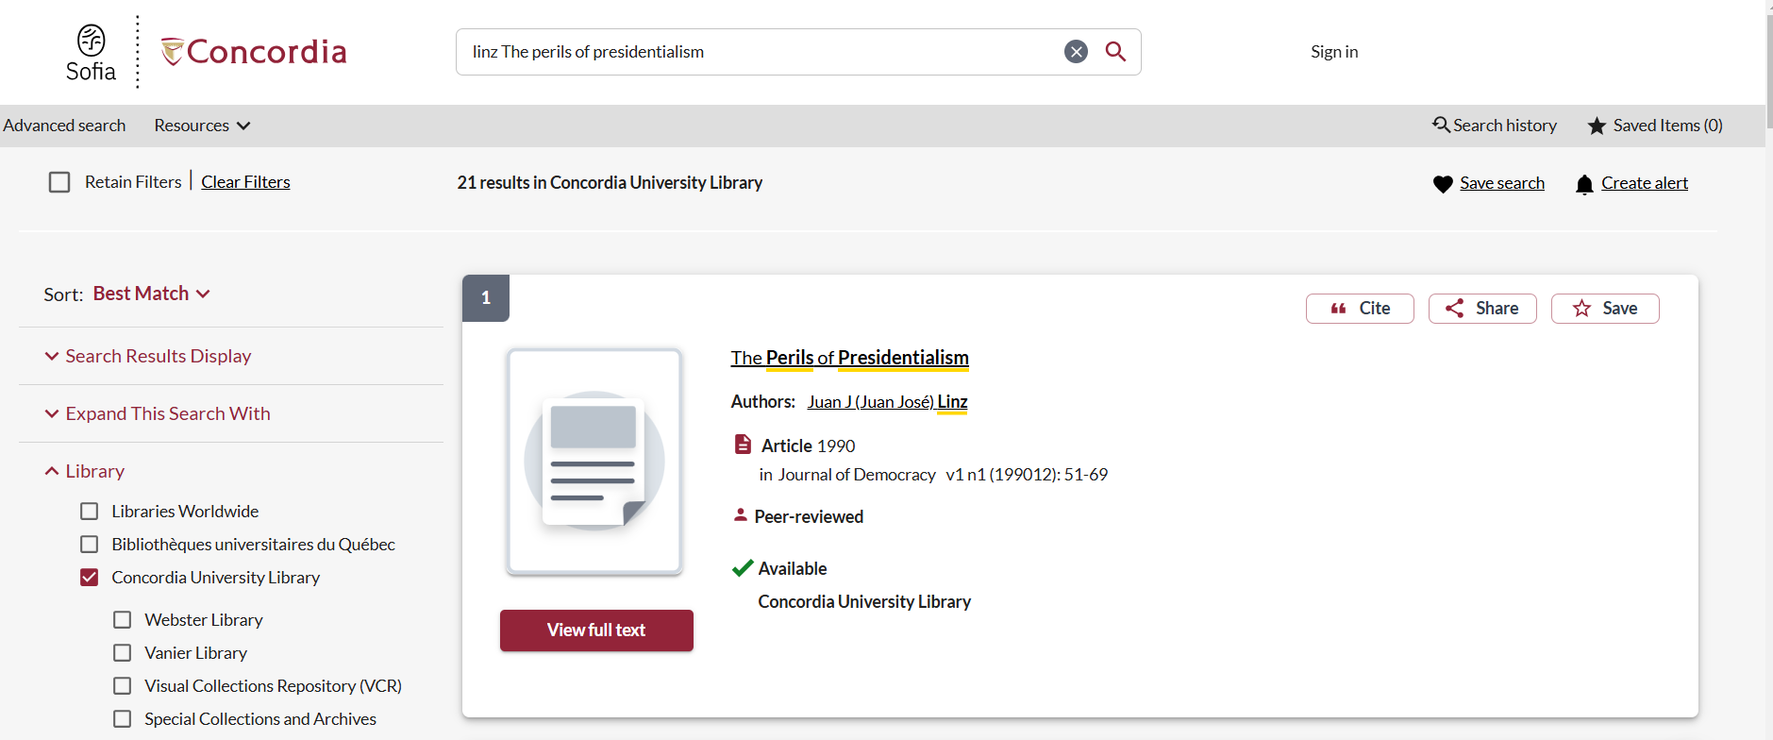

Slide 9
Howard, Philip N., and Muzammil M. Hussain, ‘Digital media and the Arab spring’, Democracy’s Fourth Wave? Digital media and the Arab Spring (new work, 2013 Oxford Academic)

Slide 10
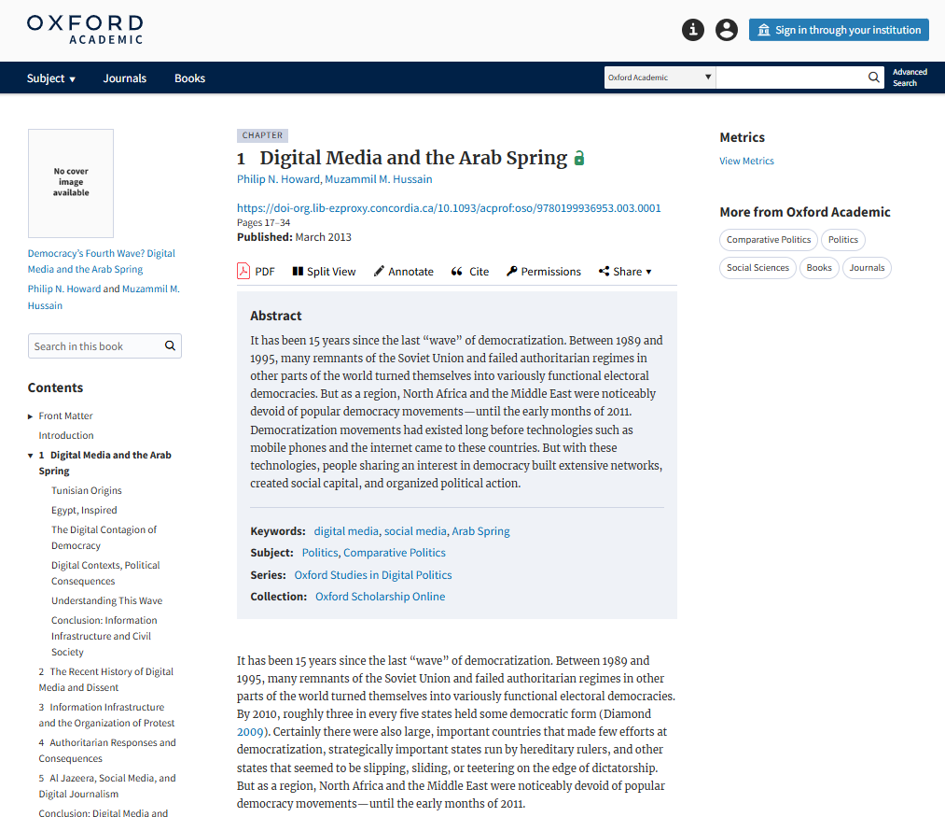
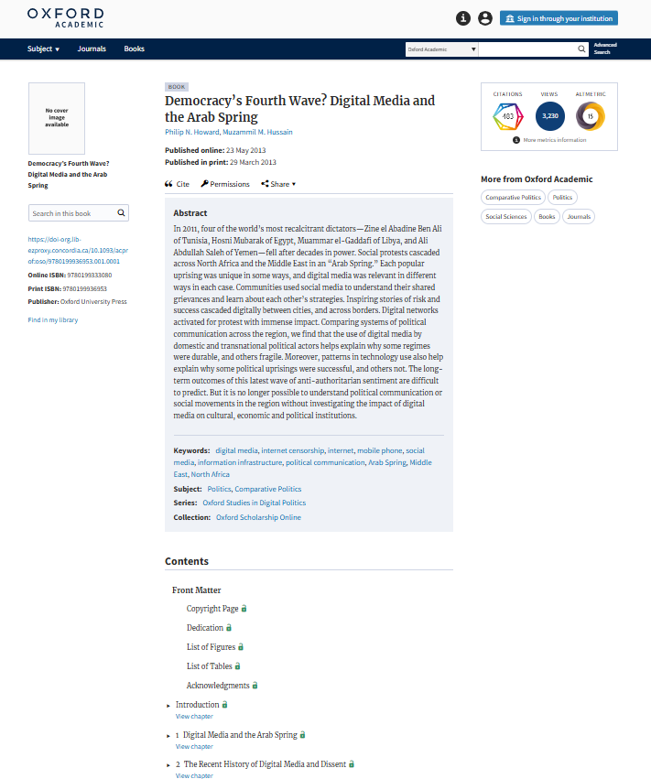
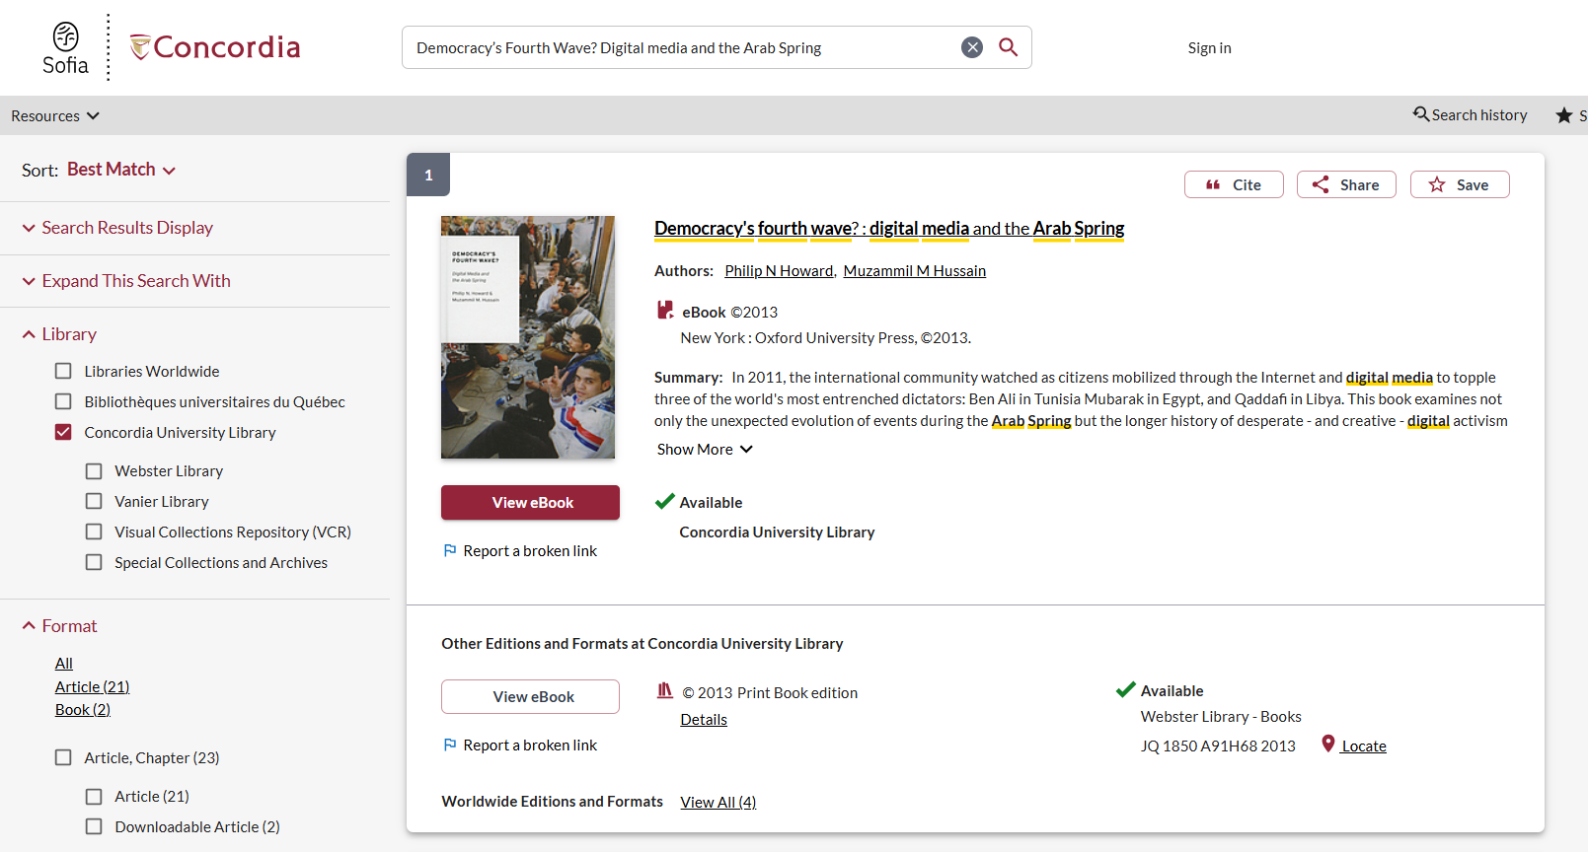

Slide 11
Albertus, Michael and Victor Menaldo. 2018. Authoritarianism and the Elite Origins of Democracy. New York: Cambridge University Press.

Slide 12
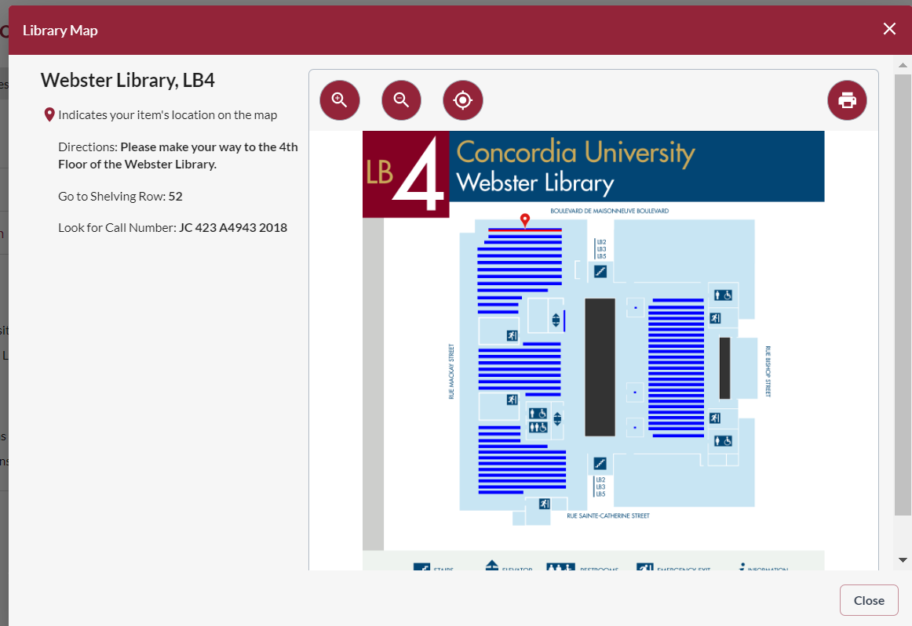
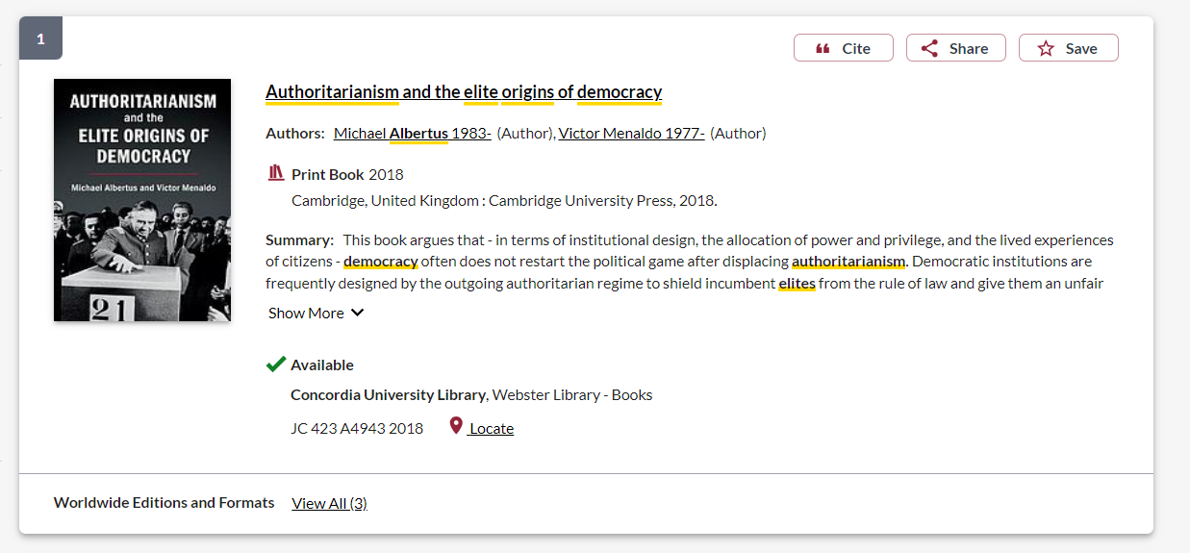

Slide 13
Research paper assignment
Students will write a case study research paper about the success, failure, or an attempt to establish a democratic political system in a country at a historical moment of their choice.
10 sources located in either the physical or digital collections of the University Library

Slide 14
Topic
Country: South Africa
Historical moment: 1948-1994
Related keywords and key concepts: democracy, democratization, democratisation, apartheid, post-apartheid, African National Congress (ANC)

Slide 15
Background and primary sources

Slide 16
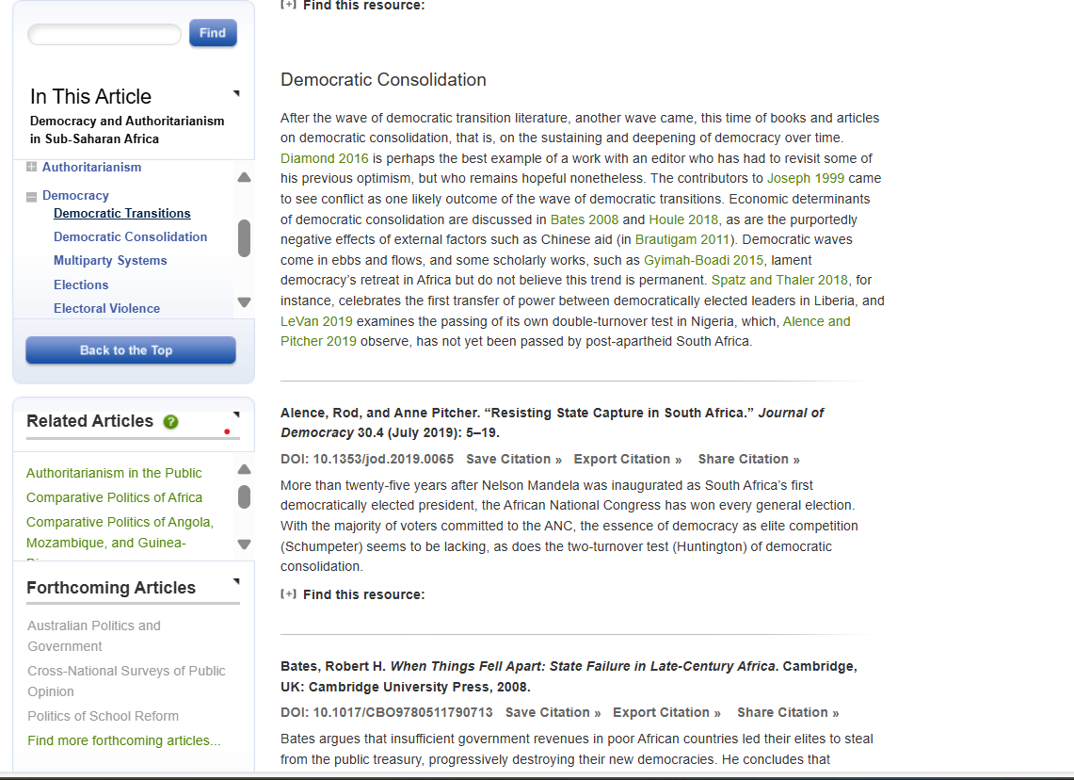

Slide 17
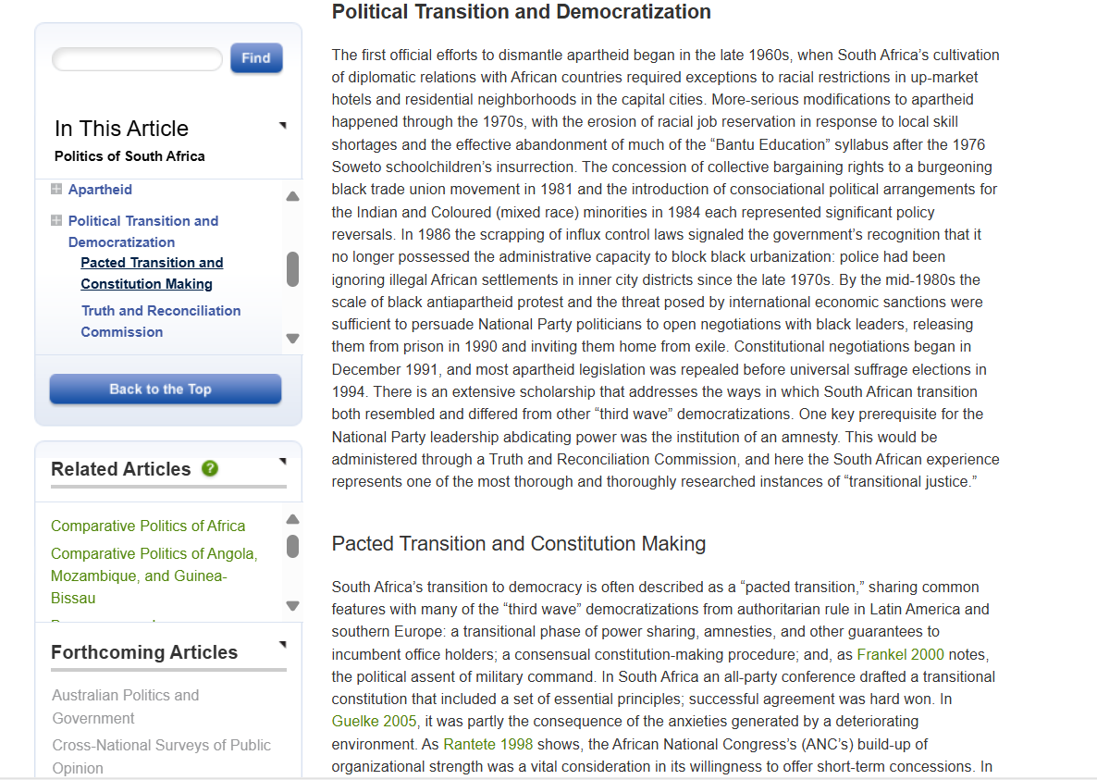
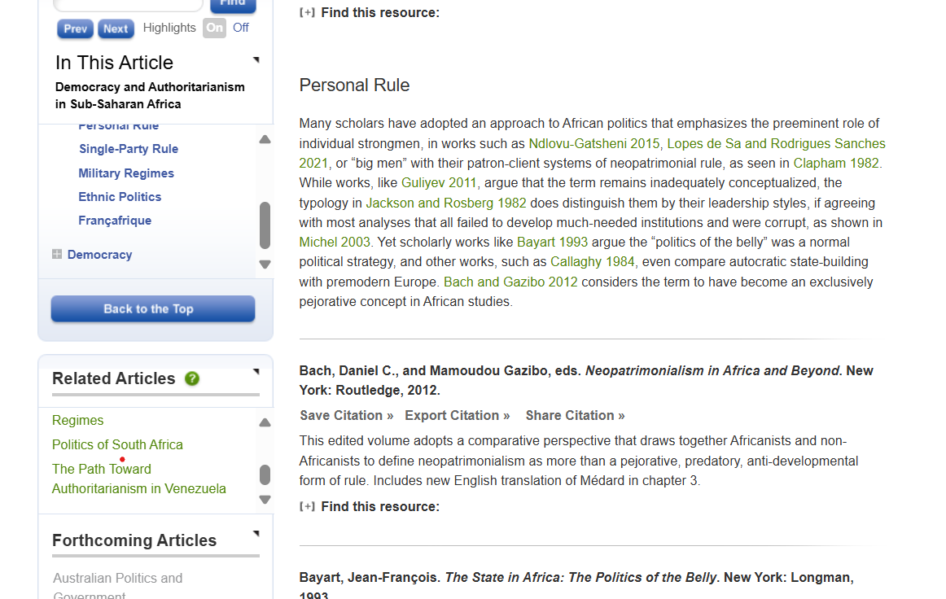

Slide 18
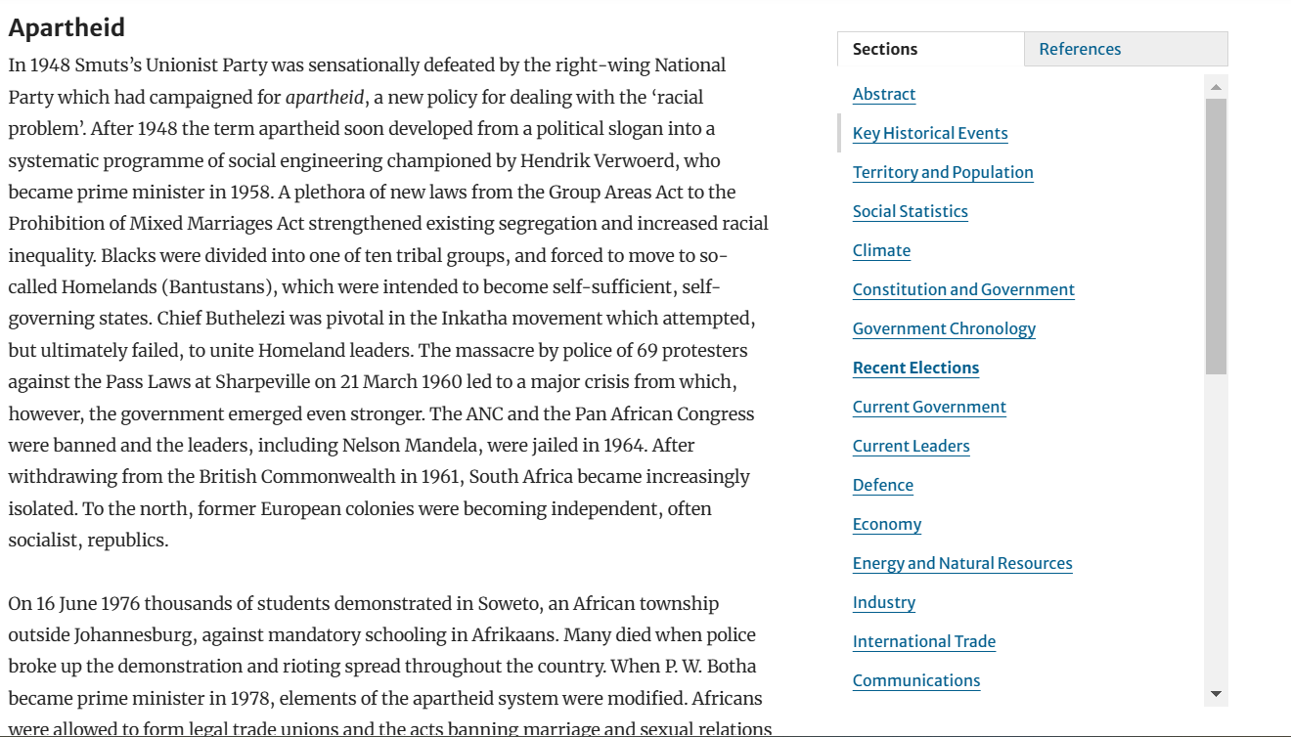
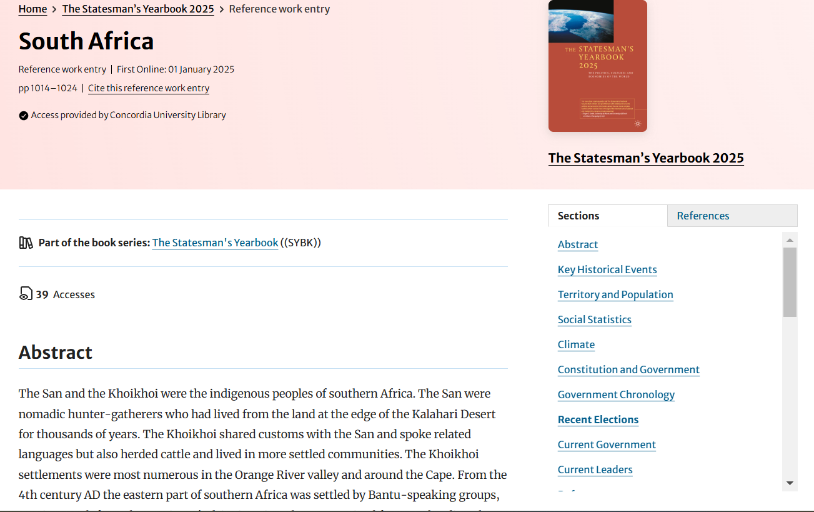
Select which sections might be relevant to your topic: key historical events, constitution and government, government chronology, etc.

Slide 19
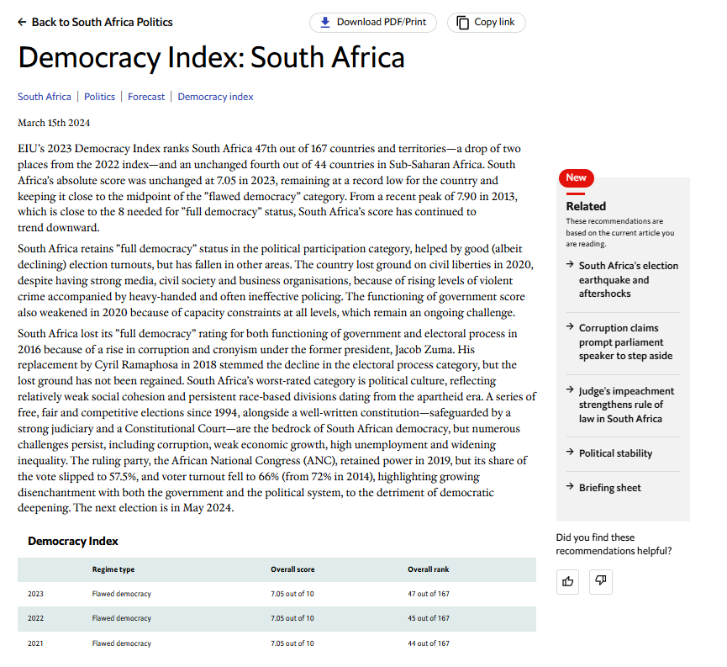
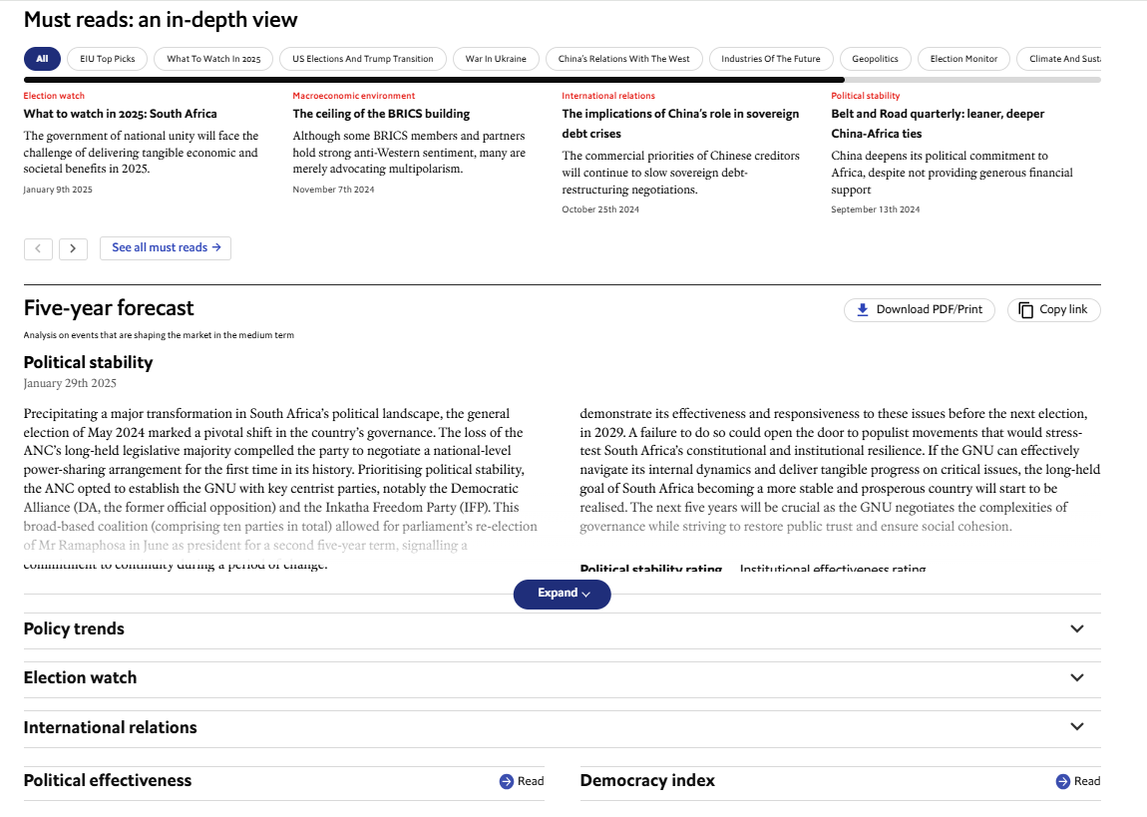
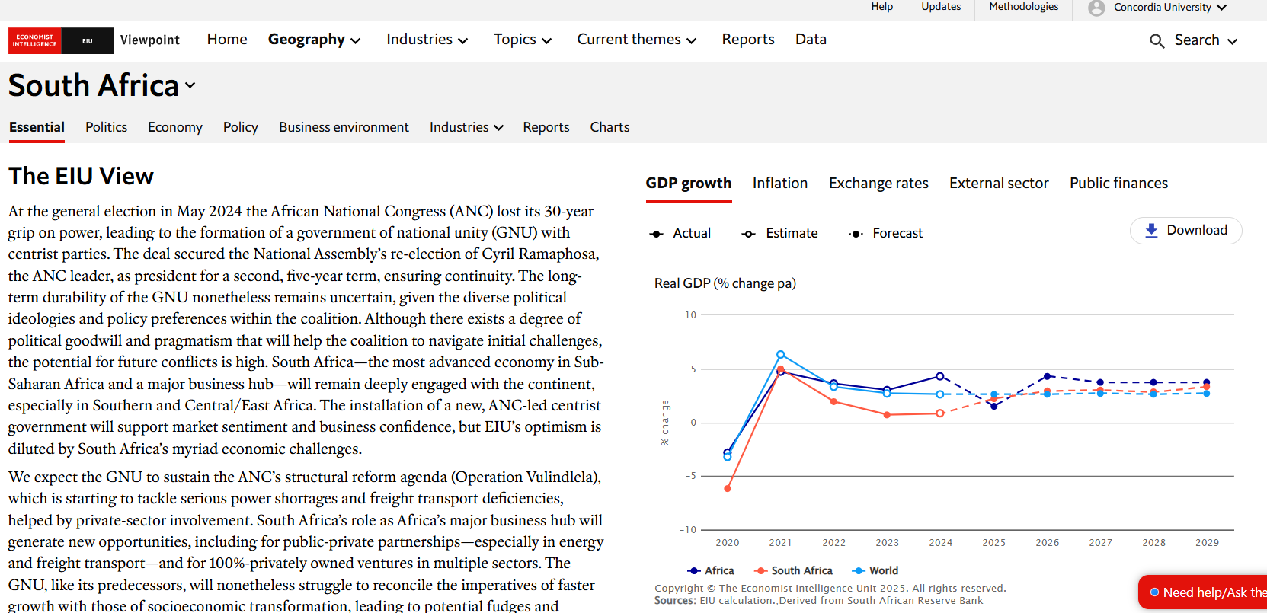

Slide 20
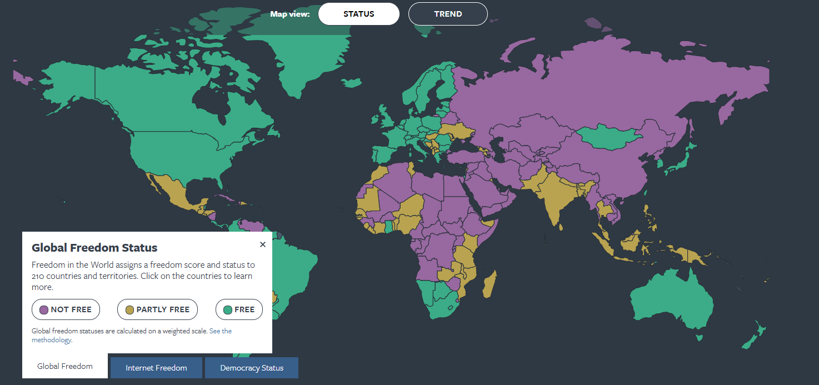
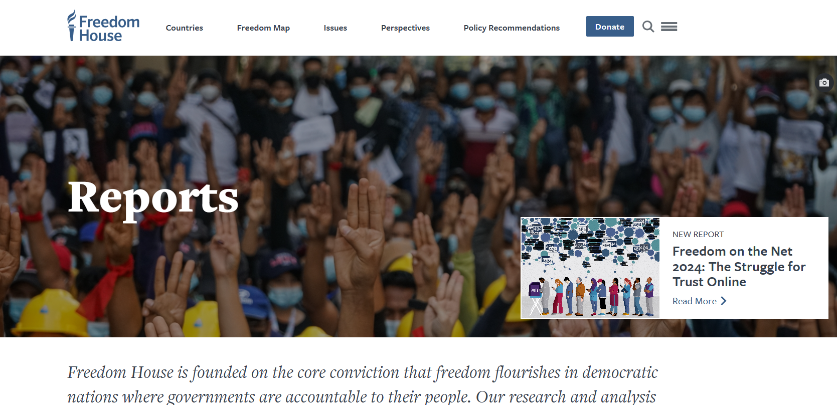
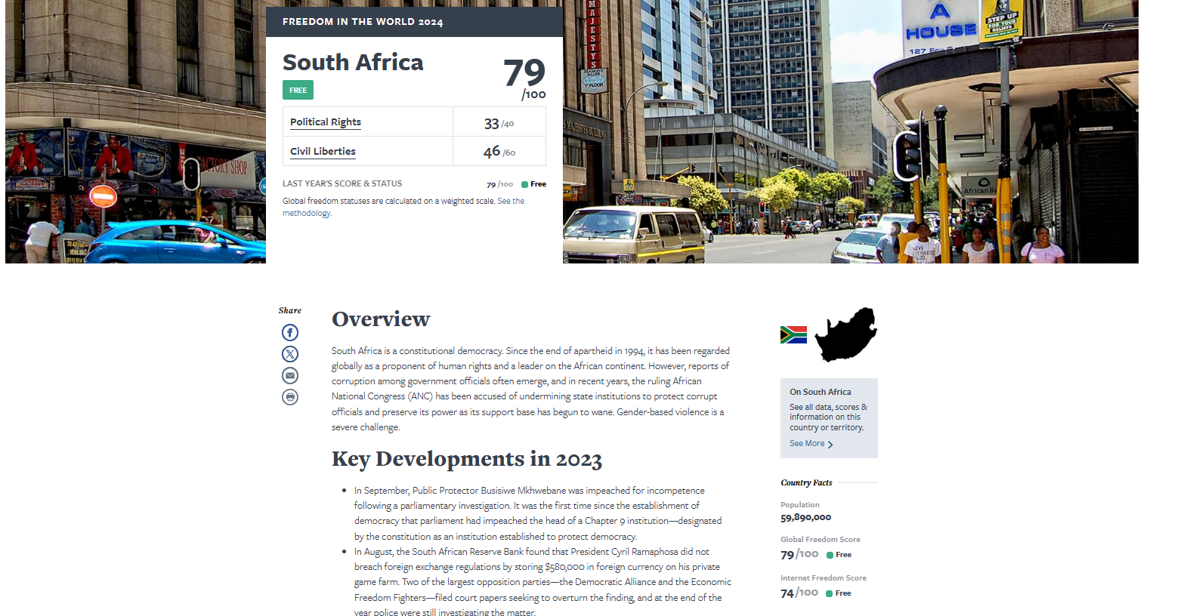
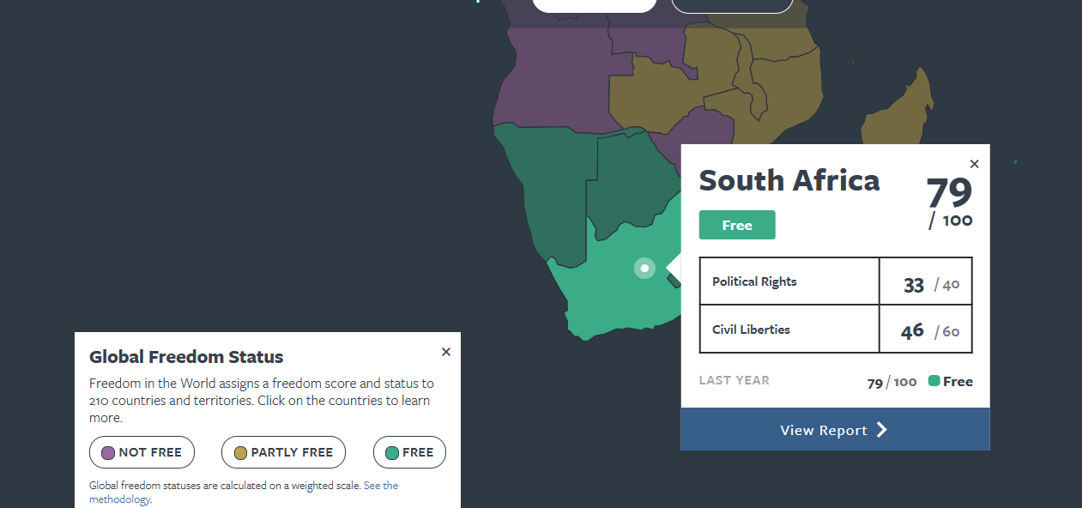

Slide 21
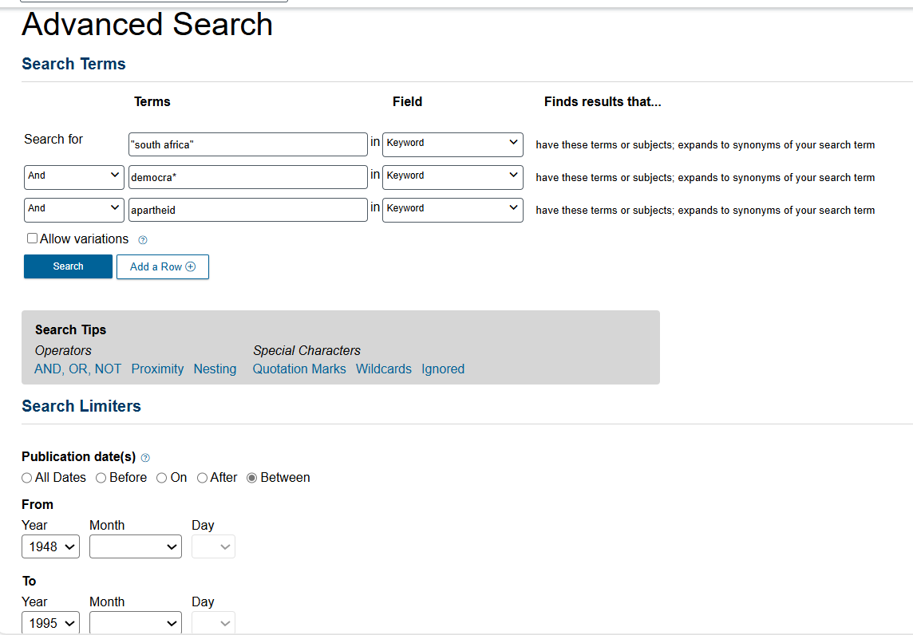
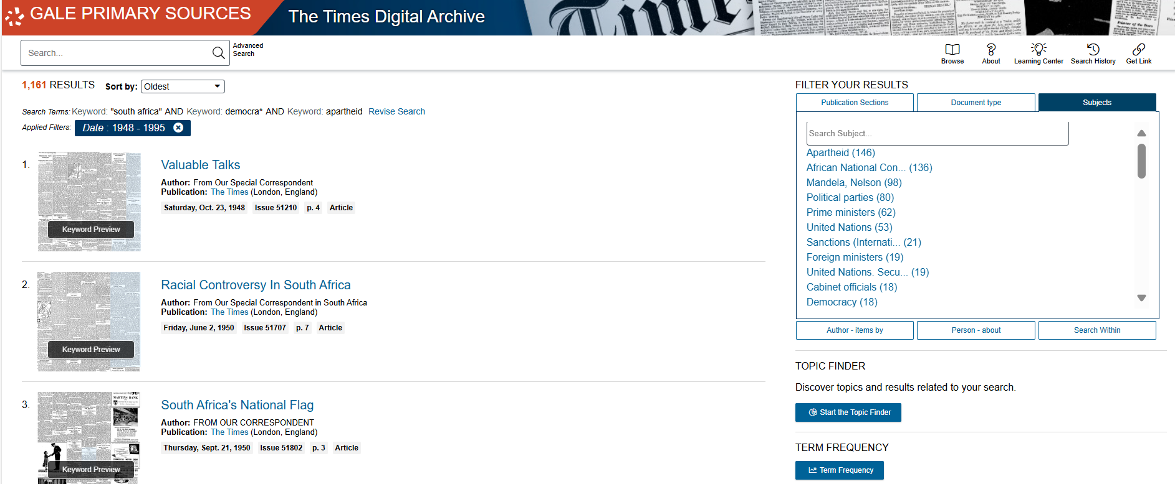
Select subjects to narrow down your results list
Select your date range

Slide 22
Search strategies

Slide 23
How do we combine search words for the best possible results?
AND: combines concepts and limits your results
politics AND security
state OR government
election OR voting
OR: allows you to insert synonyms or alternative terms and increases your results

Slide 24
How do we combine search words for the best possible results?
“quotation marks”: If you put two or more words in quotation marks, that exact phrase will be searched and limits your results.
“political parties”
“foreign policy”
Democra*
Finds: democracy, democracies, democratic, democratically, democratization
* - when you add an asterisk on the end of a word, your results will contain all the words with those endings or suffix

Slide 25
Avoid Searching with linking words
Each author may use different linking words when discussing similar topics.
Effects
Impact
Consequences
Influence
Results
Importance
Significance
Response
Emphasis
Causes
You don’t want your search to be limited to those books and articles that only contain the word “effect” or “consequence”

Slide 26
Searching in Sofia

Slide 27
What will I find in Sofia?
Academic peer reviewed books (ebooks and print books)
Academic textbooks
Non-academic books
Academic journal articles (peer reviewed and non-peer reviewed)
Government documents
International Organization publications

Slide 28
Why books?
Books can provide comprehensive overviews or background and introductory information that is not covered in journal articles.
Books are much more comprehensive than articles and aim to tell you everything about a topic or in the case of edited books, many perspectives on a topic
Journal articles are much shorter and cover a very specific aspect of a topic.

Slide 29
Why books?
An edited scholarly monograph will have multiple chapters on one broad subject, all by different authors/experts, these chapters can be cited separately; one good book can account for several sources
Using the Index and table of contents, you can navigate through a book to find the exact sections and chapters you need

Slide 30
“South Africa” & “democratic transition” are in quotation marks because they are phrases, two or more words that I want Sofia to search together
Using AND/OR both should be in ALL CAPS
Group your synonyms/related words together with OR in brackets

Slide 31
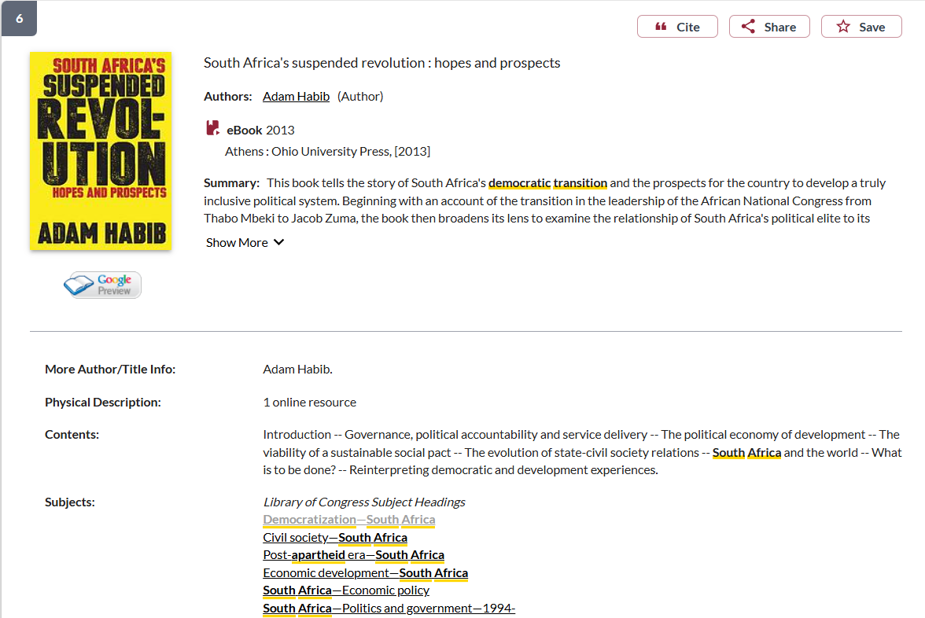
Use the subject headings to find books and articles on the same subject area

Slide 32
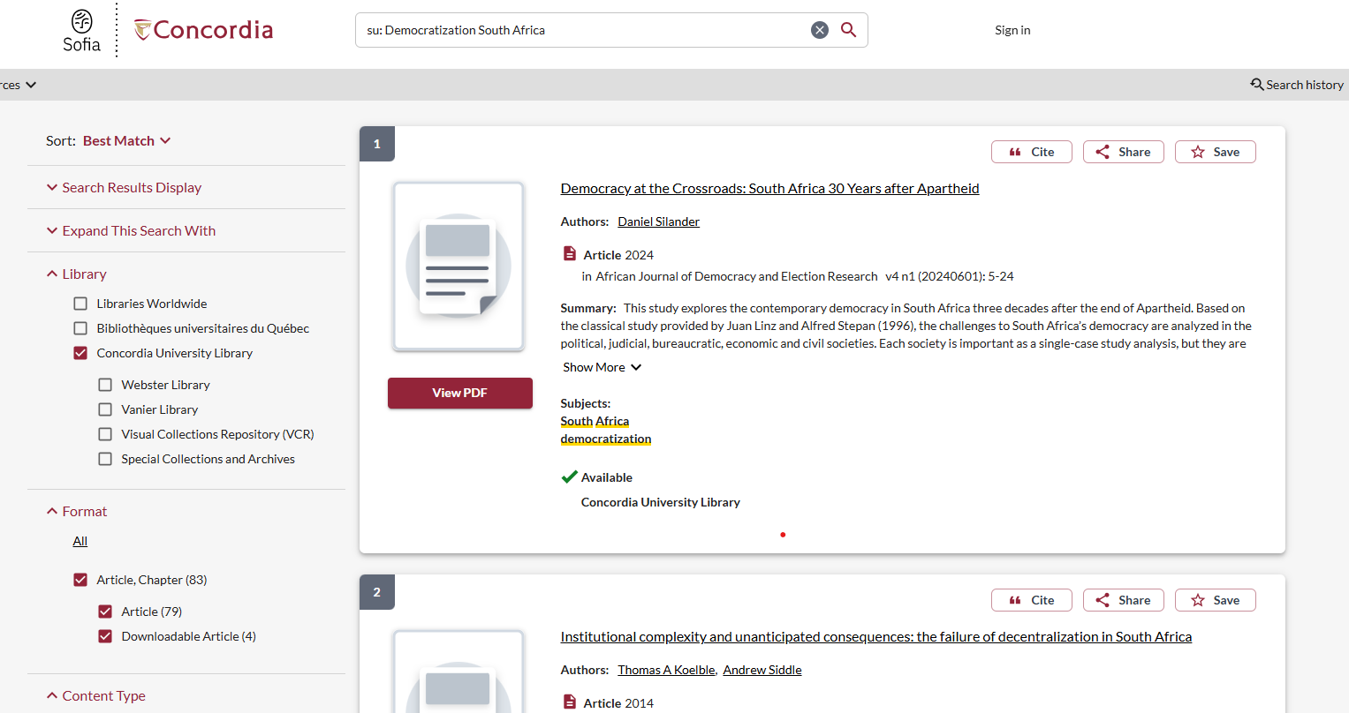
Limit your search to different formats, like journal articles

Slide 33
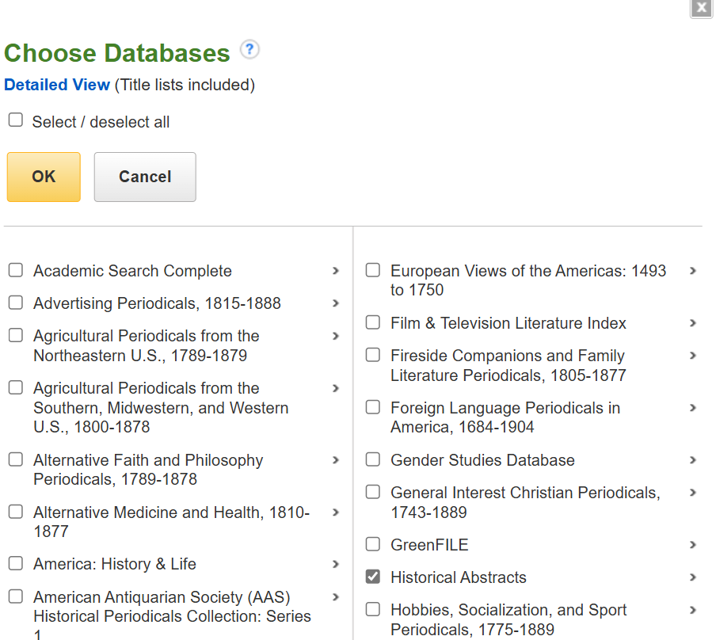
Journal Article Searching: Political Science Complete

Slide 34
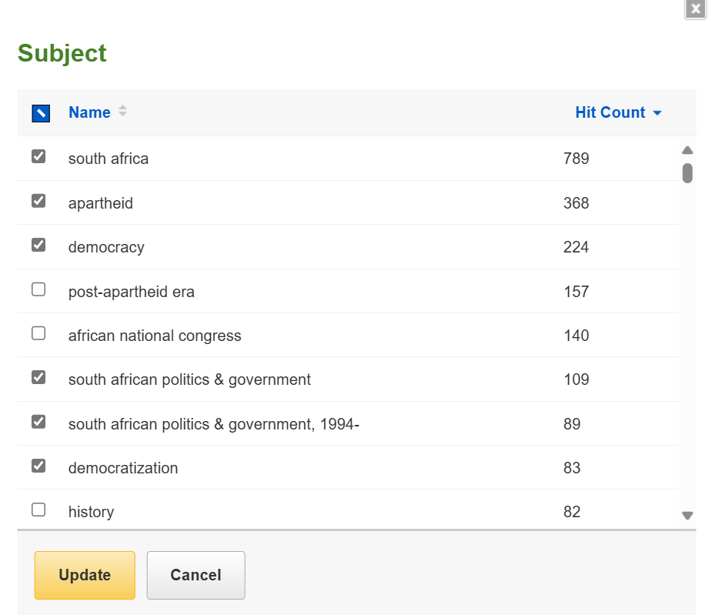
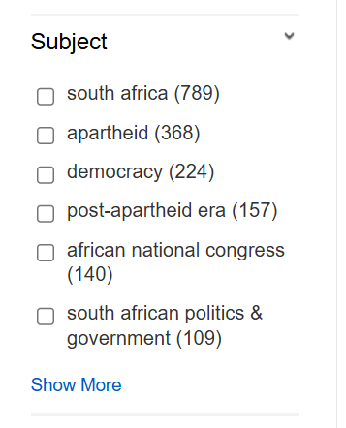
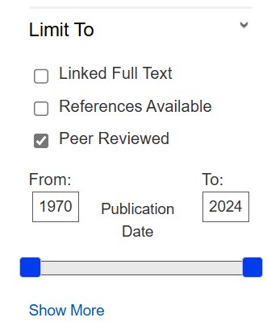

Slide 35
Scholarly journals: 10+ pages
Academic affliation

Slide 36
What is peer review? What are peer reviewed, scholarly articles?

Slide 37
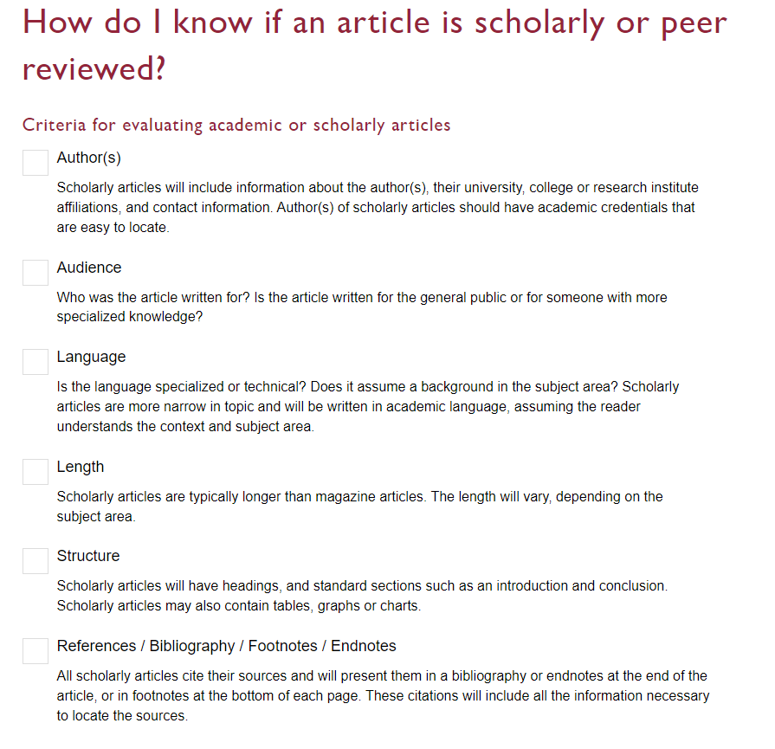

Slide 38
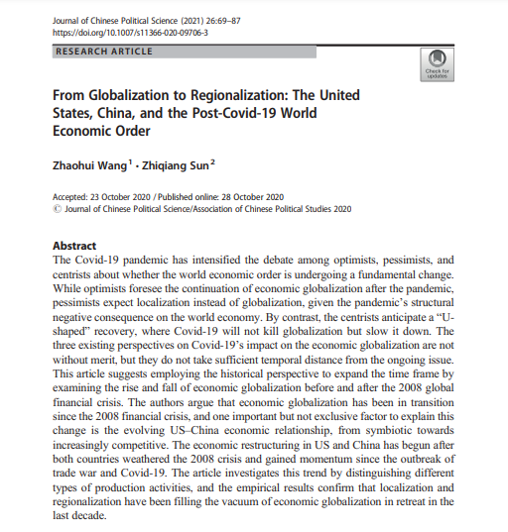
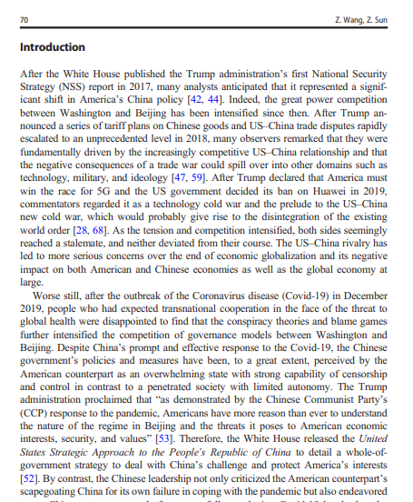
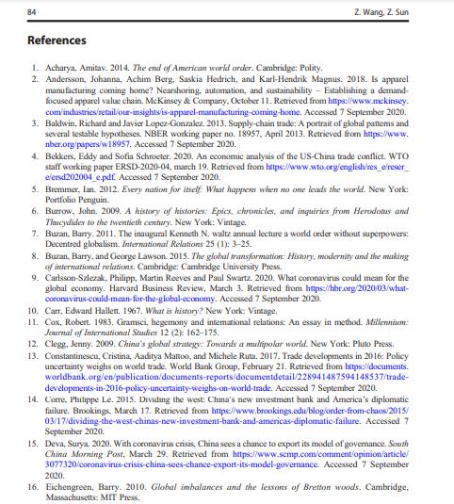
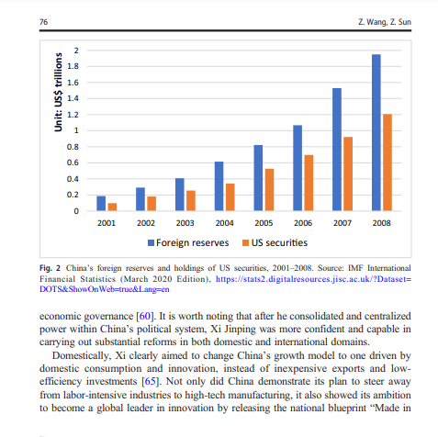
Look for sections, language, charts, tables, graphs and an extensive reference list or bibliography
Specialized language

Slide 39
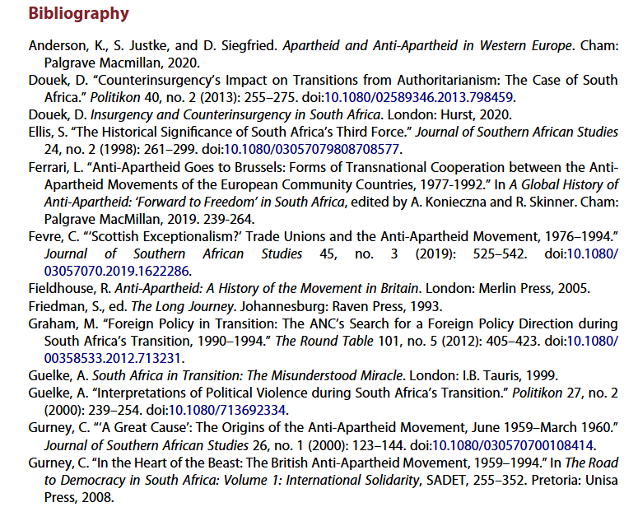
Scholarly articles will always have reference lists/bibliographies/works cited
These are great places to find more sources!
The researcher or research team are experts in the subject area and have already done a lot of research
Use this expertise by looking up the books and articles they cite in Sofia and using them in your own research
This is a commonly used method in academic research

Slide 40
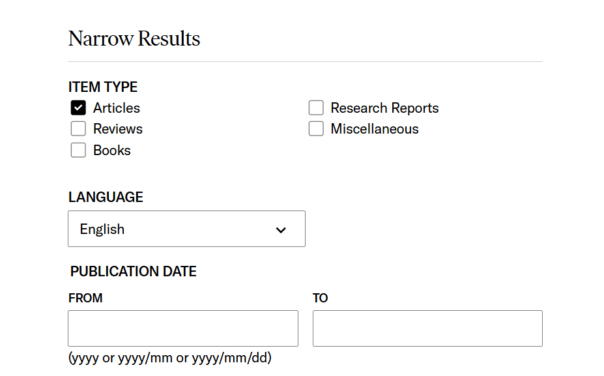
JSTOR

Slide 41
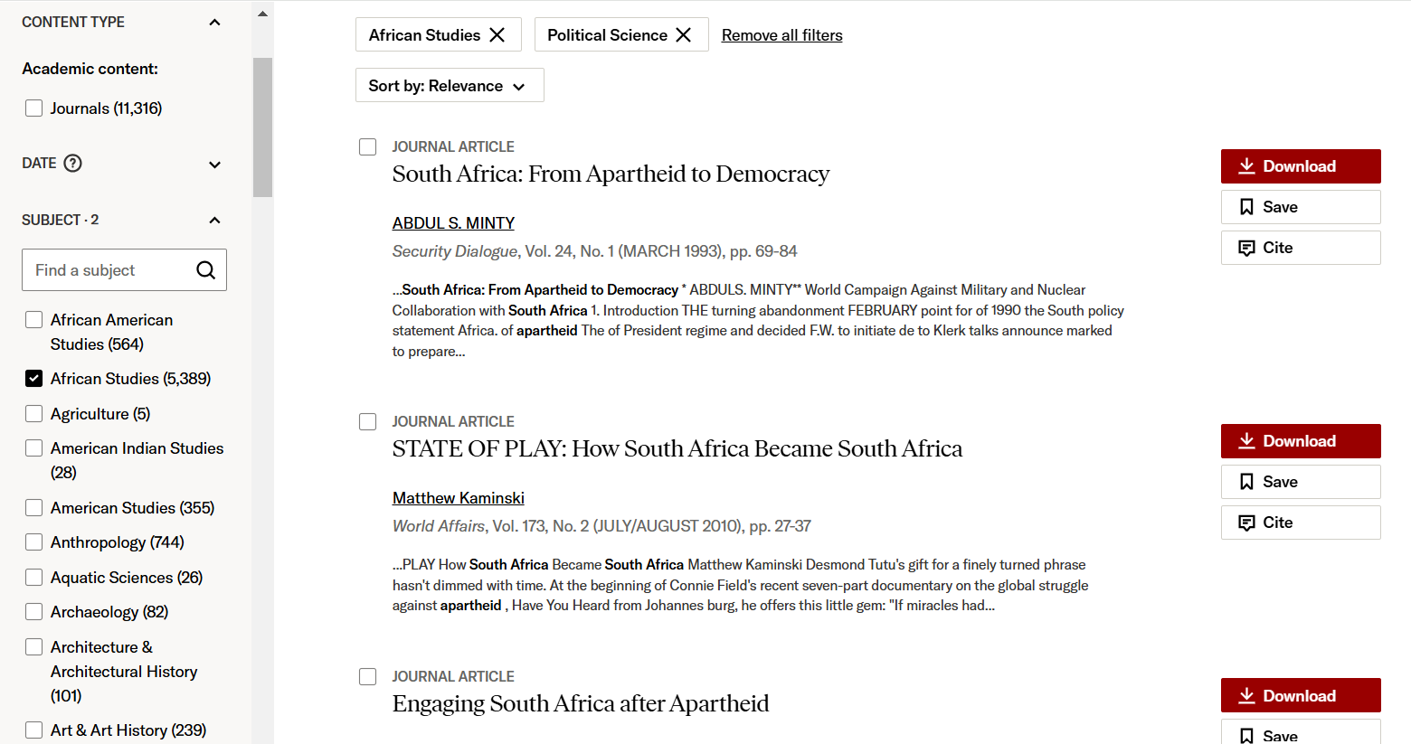
Narrow by subject area

Slide 42
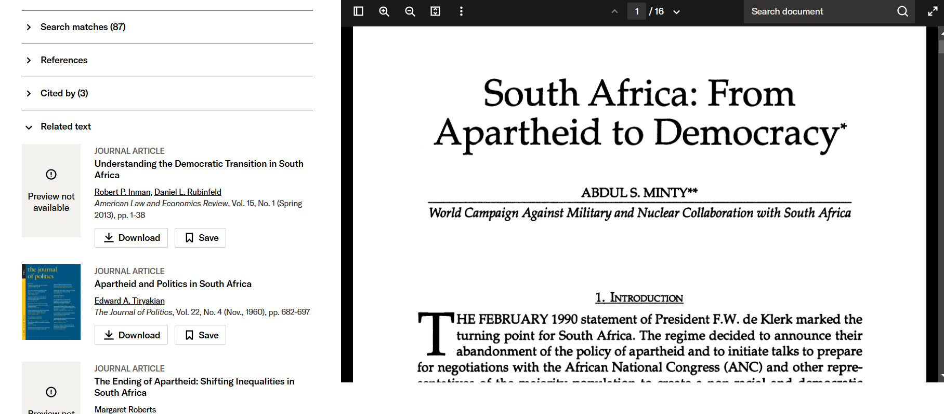
Check out the related articles

Slide 43
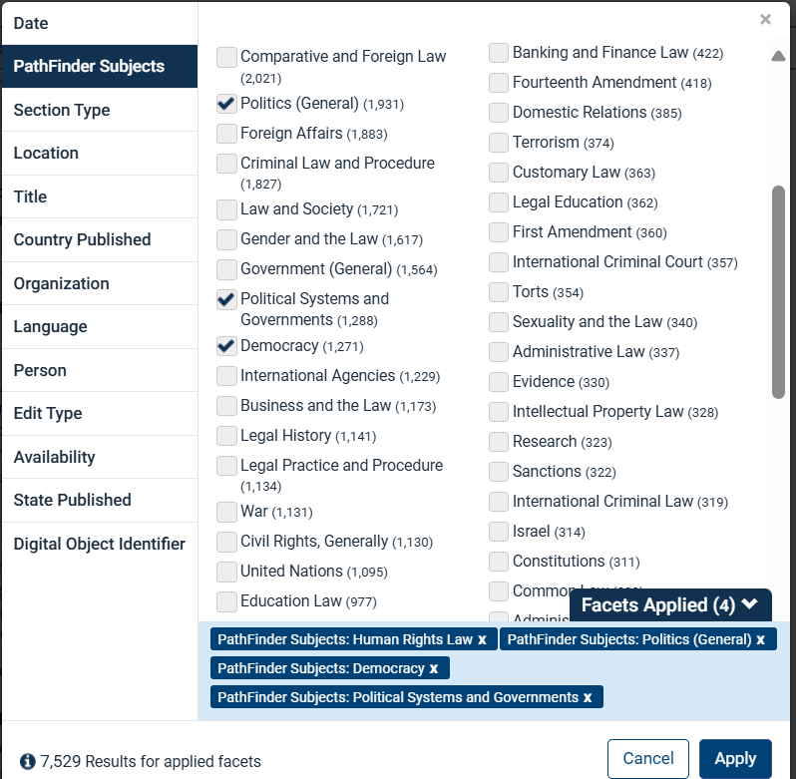
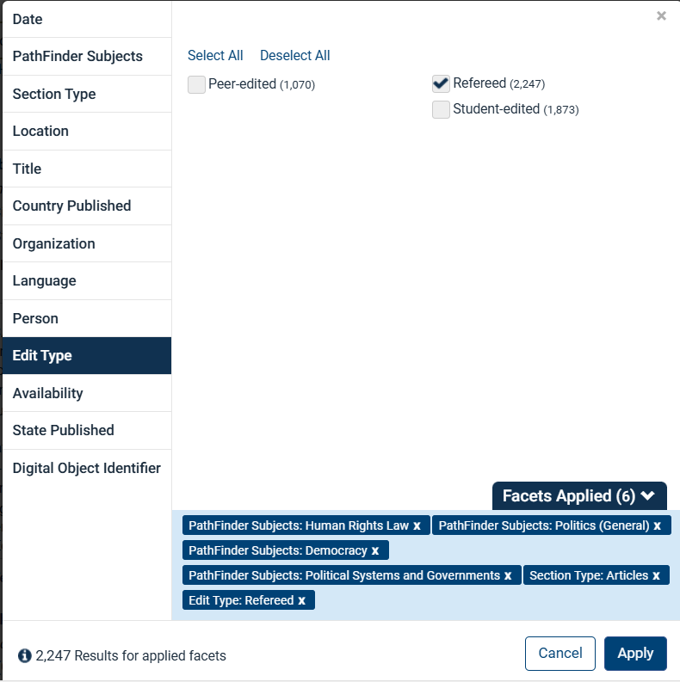

Slide 44
Michelle.Lake@Concordia.ca

