Slide 1

POLI 322: Israeli Political System
Library Workshop
Michelle Lake
Political Science, SCPA, FPST and Government Information Librarian
Michelle.Lake@Concordia.ca

Slide 2
Who am I?
Michelle Lake, librarian for Political Science, the School of Community and Public Affairs, First Peoples Studies, and Government Publications
Michelle.Lake@Concordia.ca / Make an appointment (Zoom or in person) or ask a question
What do I do?
  Provide research support
  Help students with library databases and search strategies
  Help students find and access materials they need
  Help with citation issues
  Choose the books we buy for the above subject areas

Slide 3
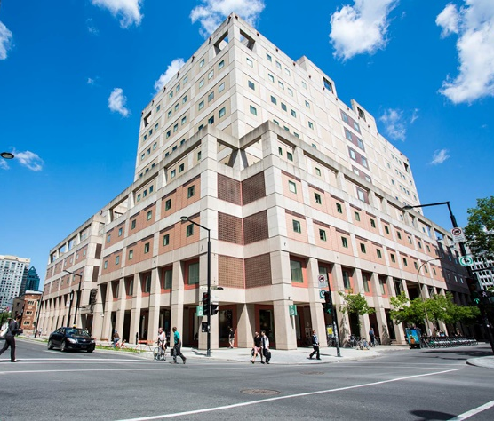
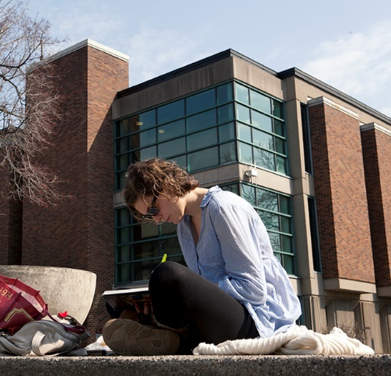
The Librar(ies)
24/7 access, with student card, after 11pm
Webster Library (LB) – downtown on SGW campus & Vanier Library (VL) on Loyola campus
Webster: Social Sciences, Humanities, Business, Engineering & Fine Arts
Vanier: Science(s), Health, Communications, Journalism and Psychology
Course Reserves Room(s): have the required undergraduate print textbooks for the courses taught at that campus (for example: Webster has the Political Science and SCPA course reserves)

Slide 4

Library Services
Your student card is your library card.
You need it to:
borrow books (up to 100 a time)
borrow a laptop and other technology (for 24 hours)
print on campus (add money to your Dprint account)
access the library overnight during 24/7 hours.
Webster library has 5 book scanners (And Vanier has 2!) that can be used for free to scan chapters from our print books and email them to yourself as a PDF.
To use Library databases, access online articles and ebooks when you are off campus, login with your Concordia Netname and password.

Slide 5
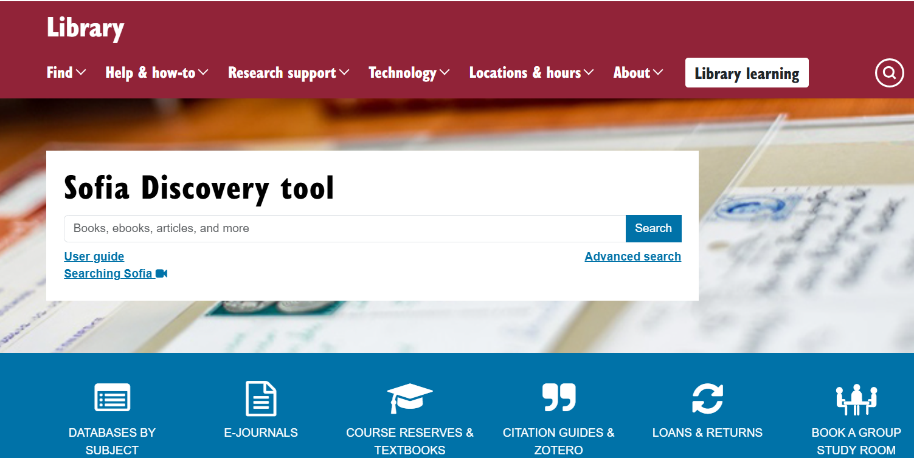
https://library.concordia.ca/
Use the Sofia Discovery tool to find print books, ebooks, and journal articles from the library.

Slide 6
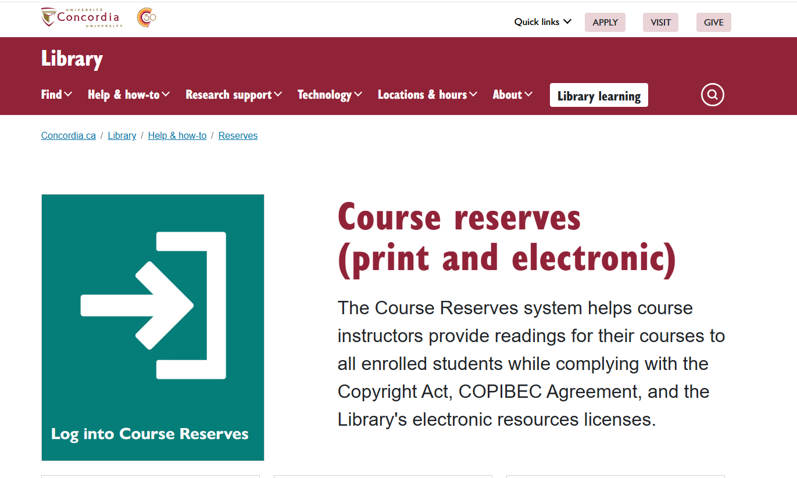

Slide 7
How can I find out if the library has access to an item I’m looking for?

Slide 8
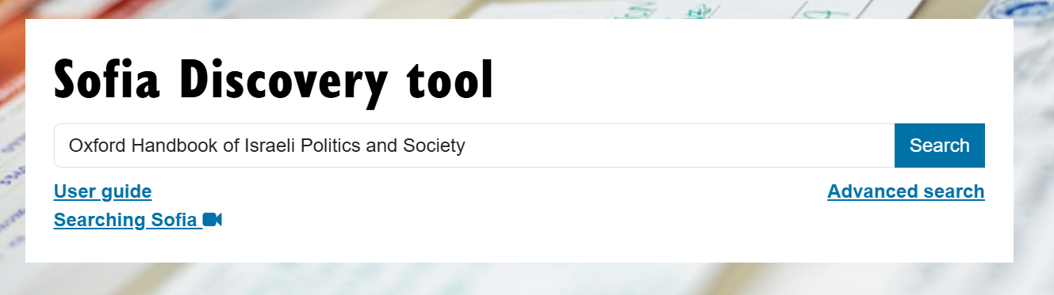
The Oxford Handbook of Israeli Politics and Society edited by Reuven Y. Hazan, et al., Oxford University Press, 2021.

Slide 9
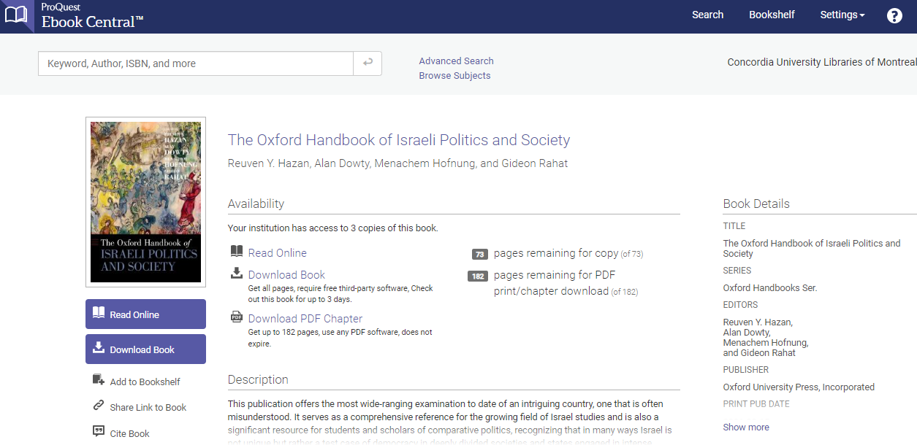
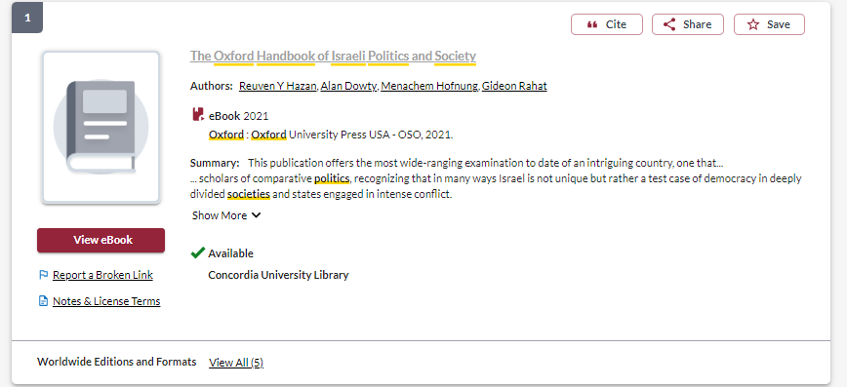

Slide 10
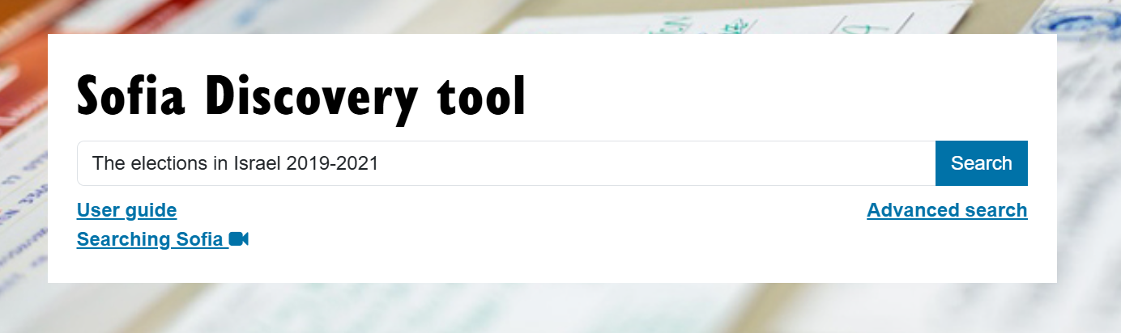
Shamir, M., & Rahat, G. (2023). The elections in Israel 2019-2021. Routledge.

Slide 11
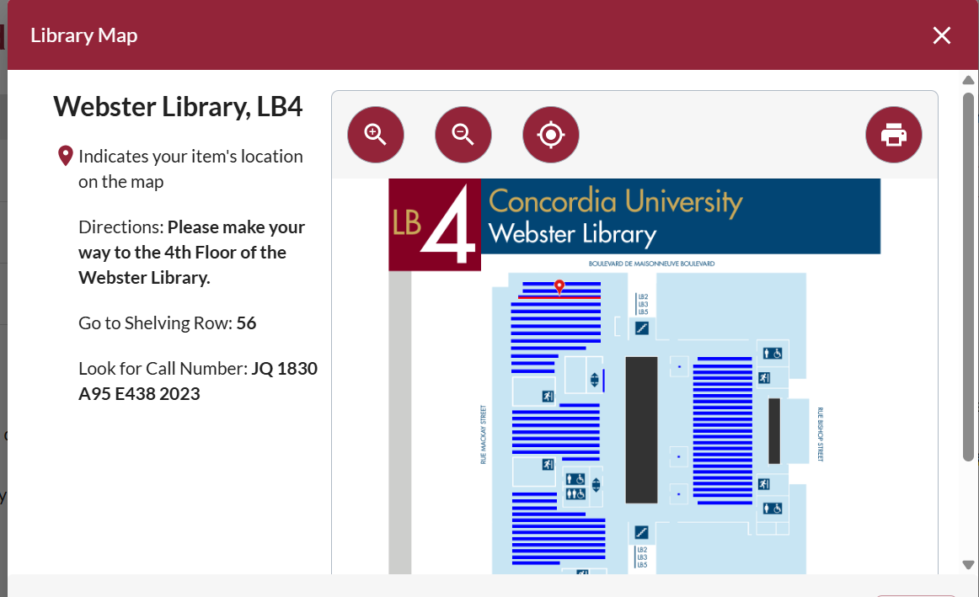
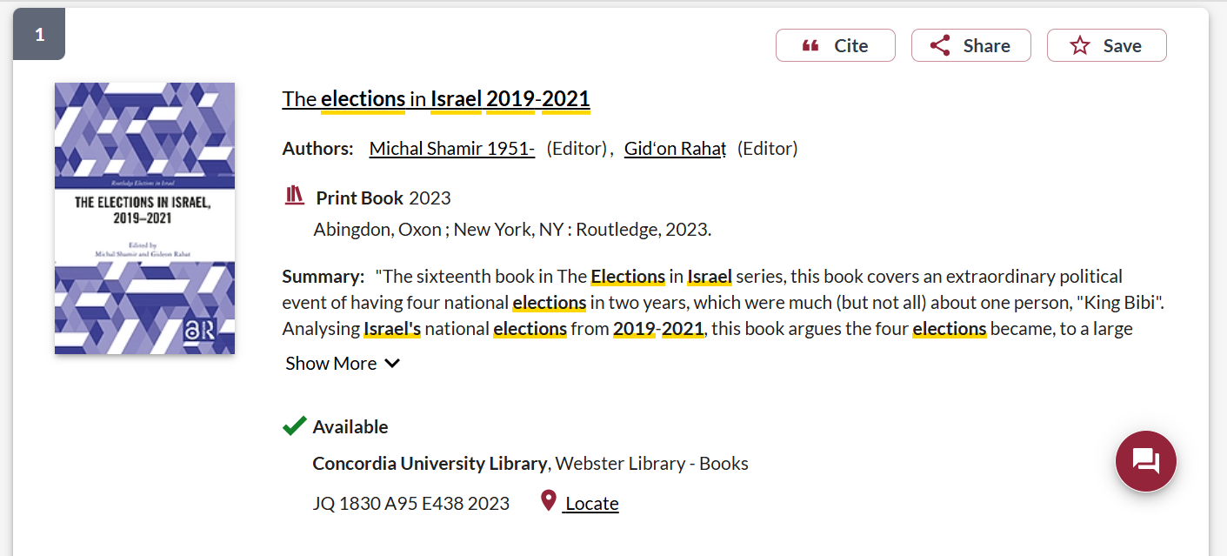

Slide 12
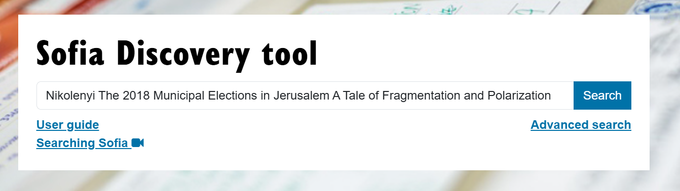
Nikolenyi, C. (2020). The 2018 Municipal Elections in Jerusalem: A Tale of Fragmentation and Polarization. Contemporary Review of the Middle East, 71(1): pp. 6-24.

Slide 13
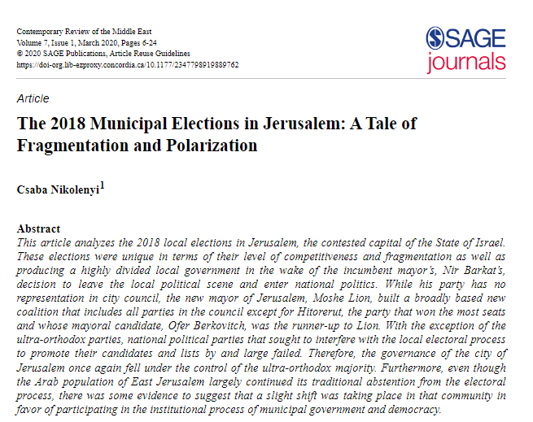
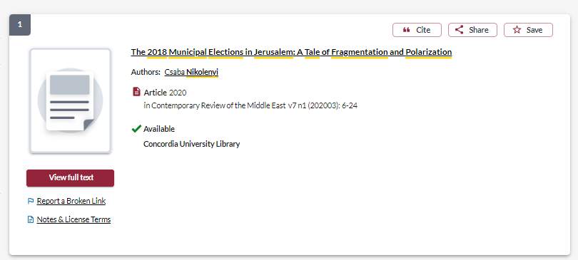
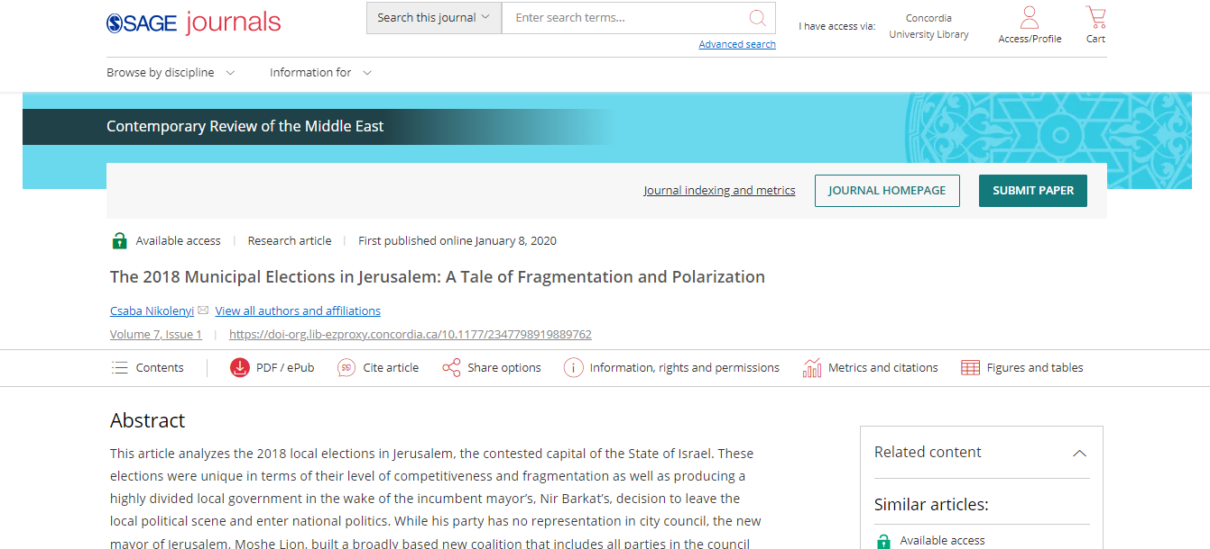

Slide 14
Political Science Subject Guide
https://www.concordia.ca/library/guides/political-science.html

Slide 15
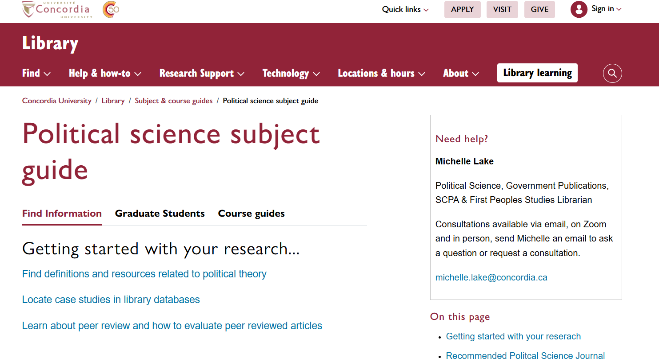
Subject Guide: Political Science

Slide 16
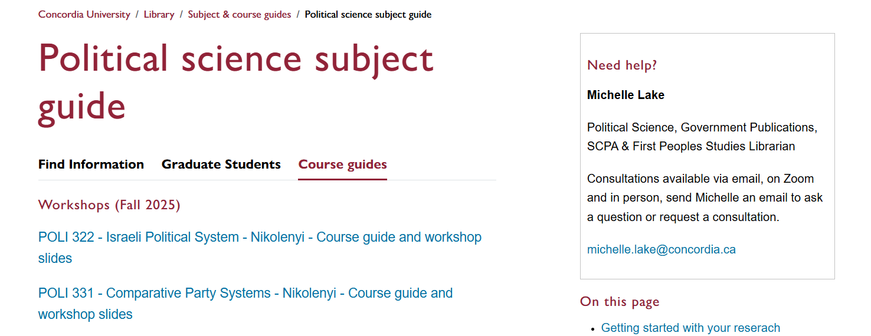

Slide 17
https://www.concordia.ca/library/guides/political-science/poli-322.html

Slide 18
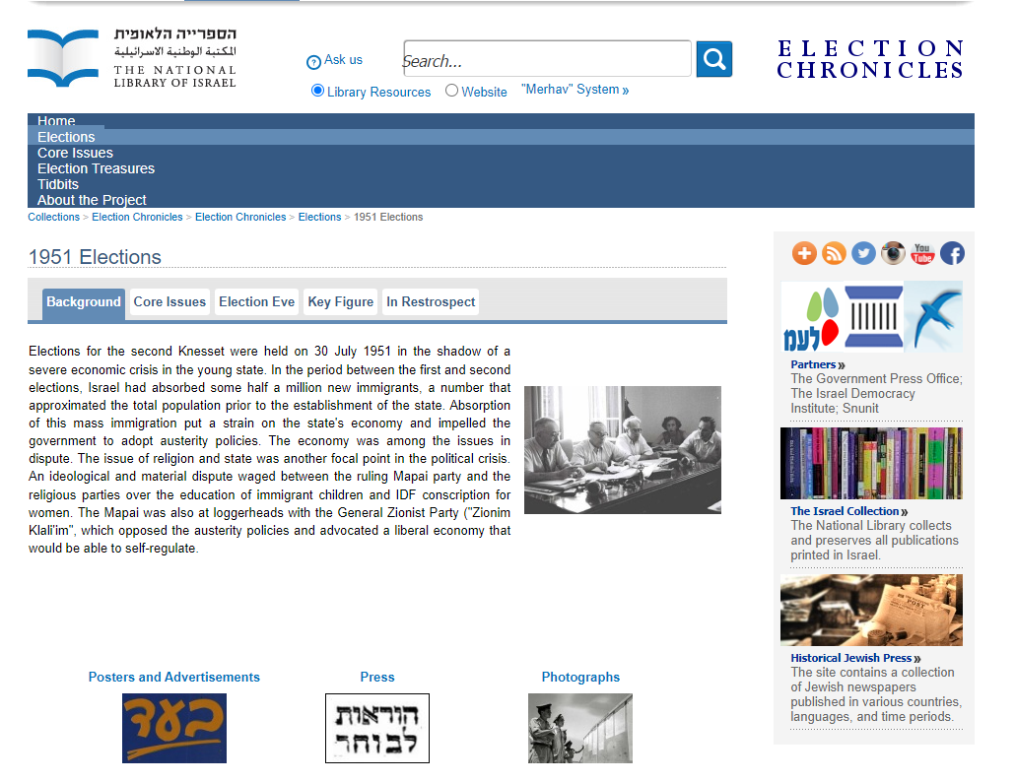
National Library of Israel: Primary Sources & Election Chronicles

Slide 19
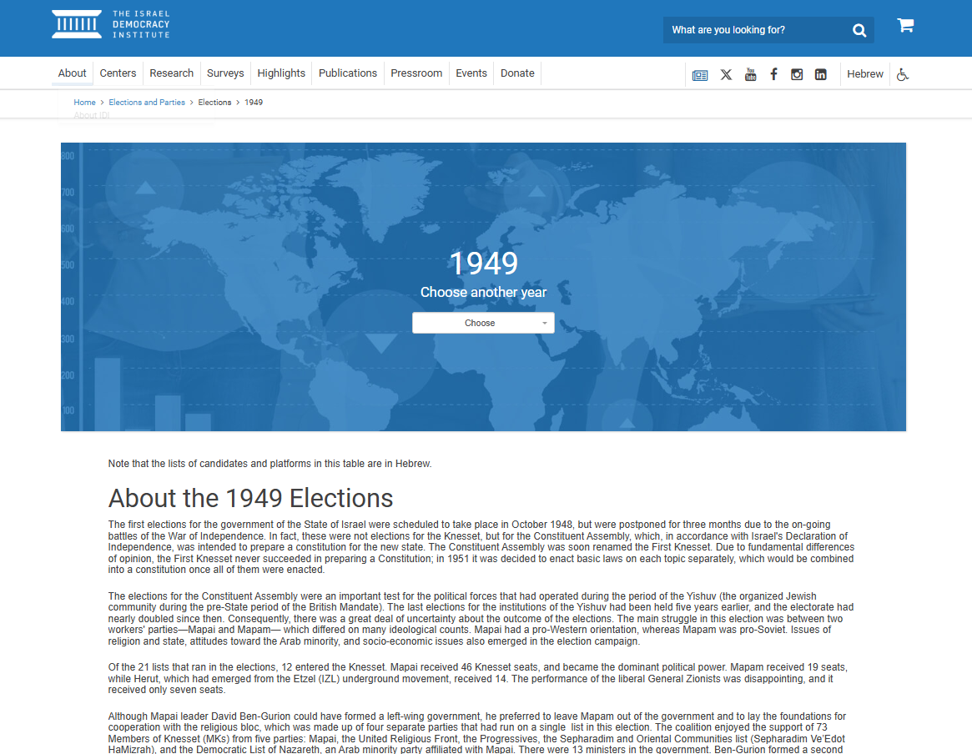
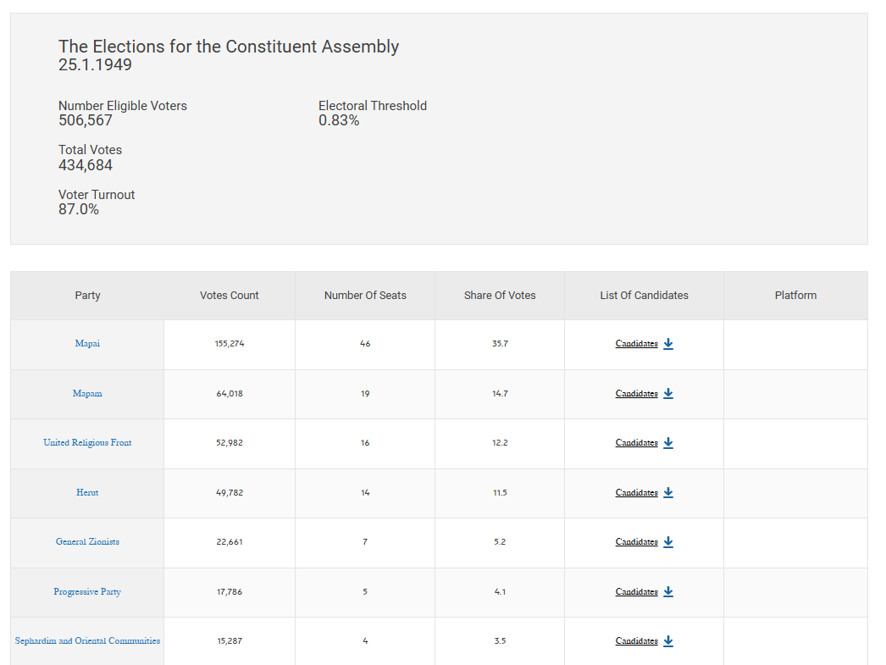
Israel Democracy Institute

Slide 20
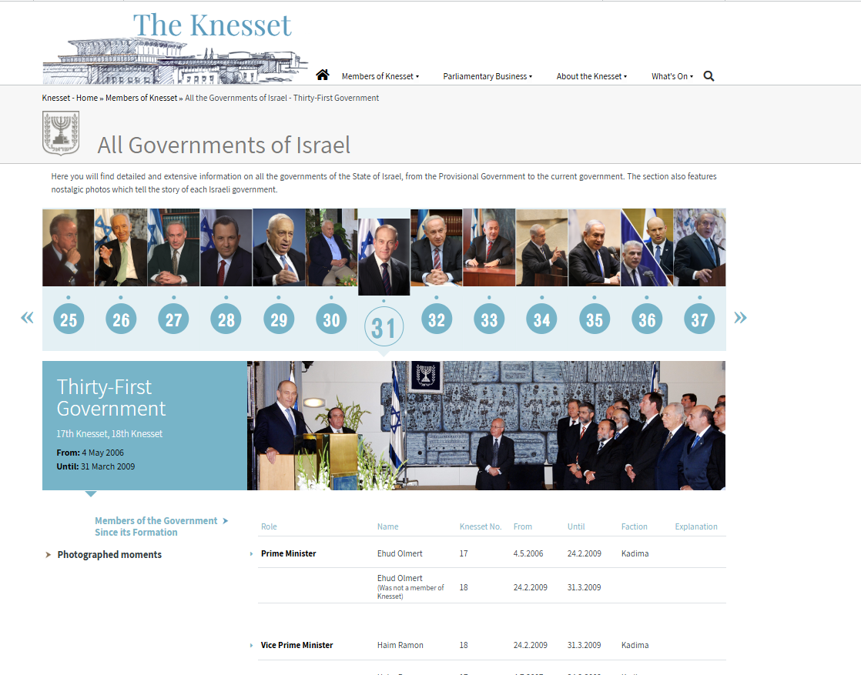

Slide 21
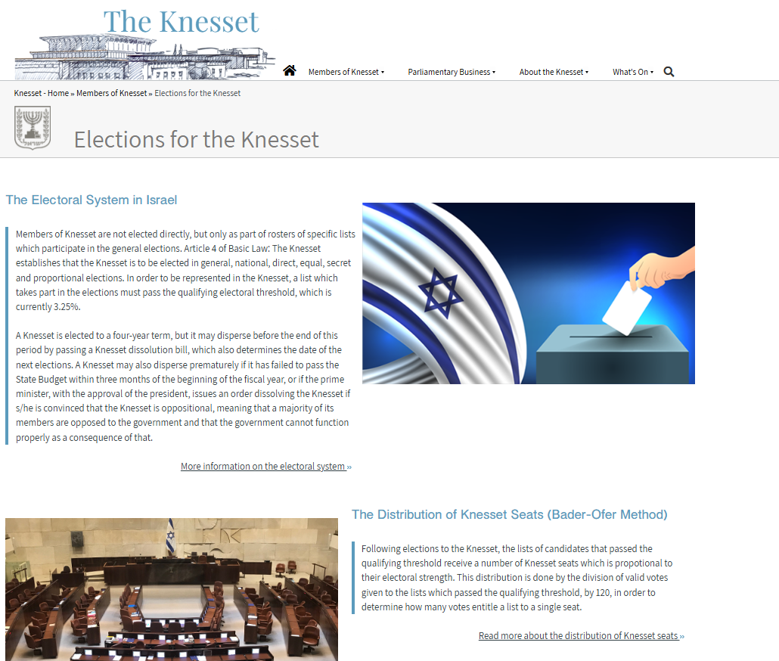
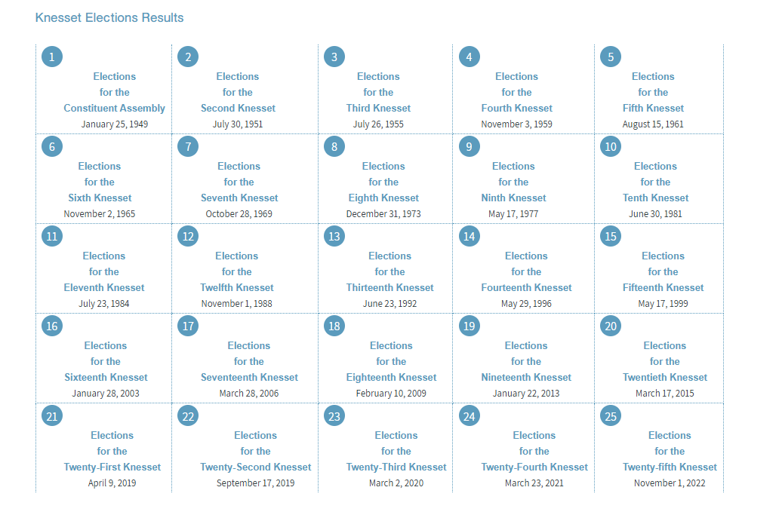

Slide 22
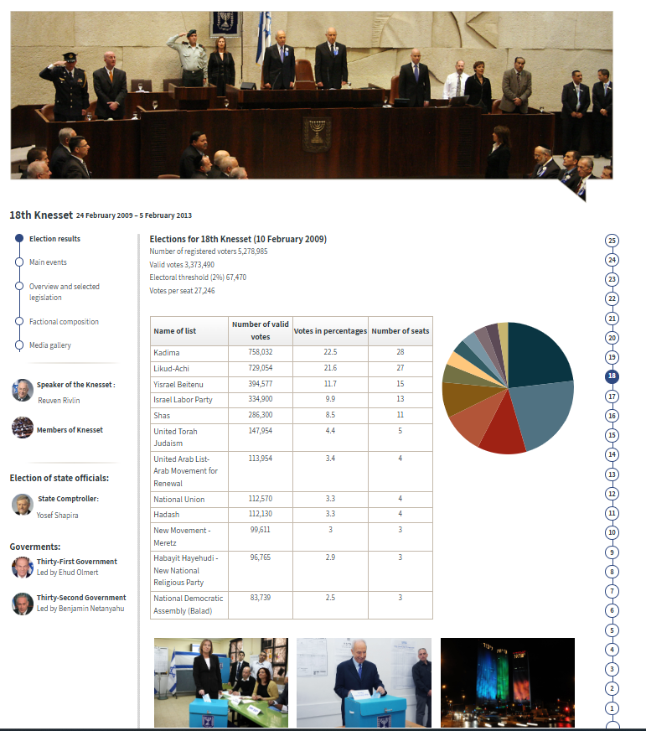
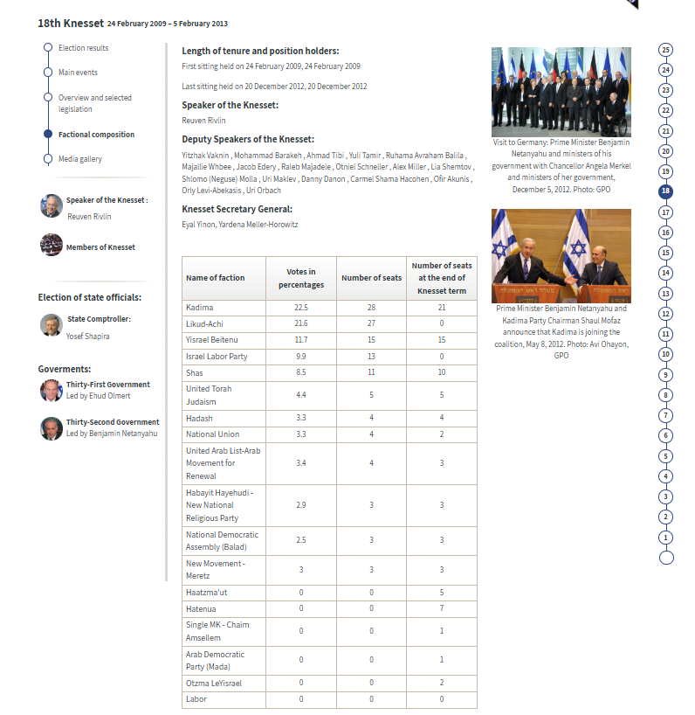

Slide 23
How do we combine search words for the best possible results?
AND: combines concepts and limits your results
politics AND security
state OR government
election OR voting
OR: allows you to insert synonyms or alternative terms and increases your results

Slide 24
How do we combine search words for the best possible results?
“quotation marks”: If you put two or more words in quotation marks, that exact phrase will be searched and limits your results.
“political parties”
“foreign policy”
Democra*
Finds: democracy, democracies, democratic, democratically, democratization
* - when you add an asterisk on the end of a word, your results will contain all the words with those endings or suffix

Slide 25
Avoid Searching with Linking words
Effects
Impact
Consequences
Influence
Results
Importance
Significance
Response
Emphasis
Causes
Each author may use different linking words when discussing similar topics.
You don’t want your search to be limited to those books and articles that only contain the word “effect” or “consequence”

Slide 26
Topic: Israel Votes: the elections of *enter year*
Key Concepts | Related terms/Synonyms
Israel | Israeli
Election | Elect, election, electoral, voting, voters, parliament, Knesset
Political Parties | Party members, candidates
*Year* | 1988, or parliamentary number “12th Knesset” / “twelfth Knesset”

Slide 27
Newspaper articles: Jerusalem Post
The Palestine Bulletin (1925-1932), The Palestine Post (1932-1950), The Jerusalem Post (1950-present)

Slide 28
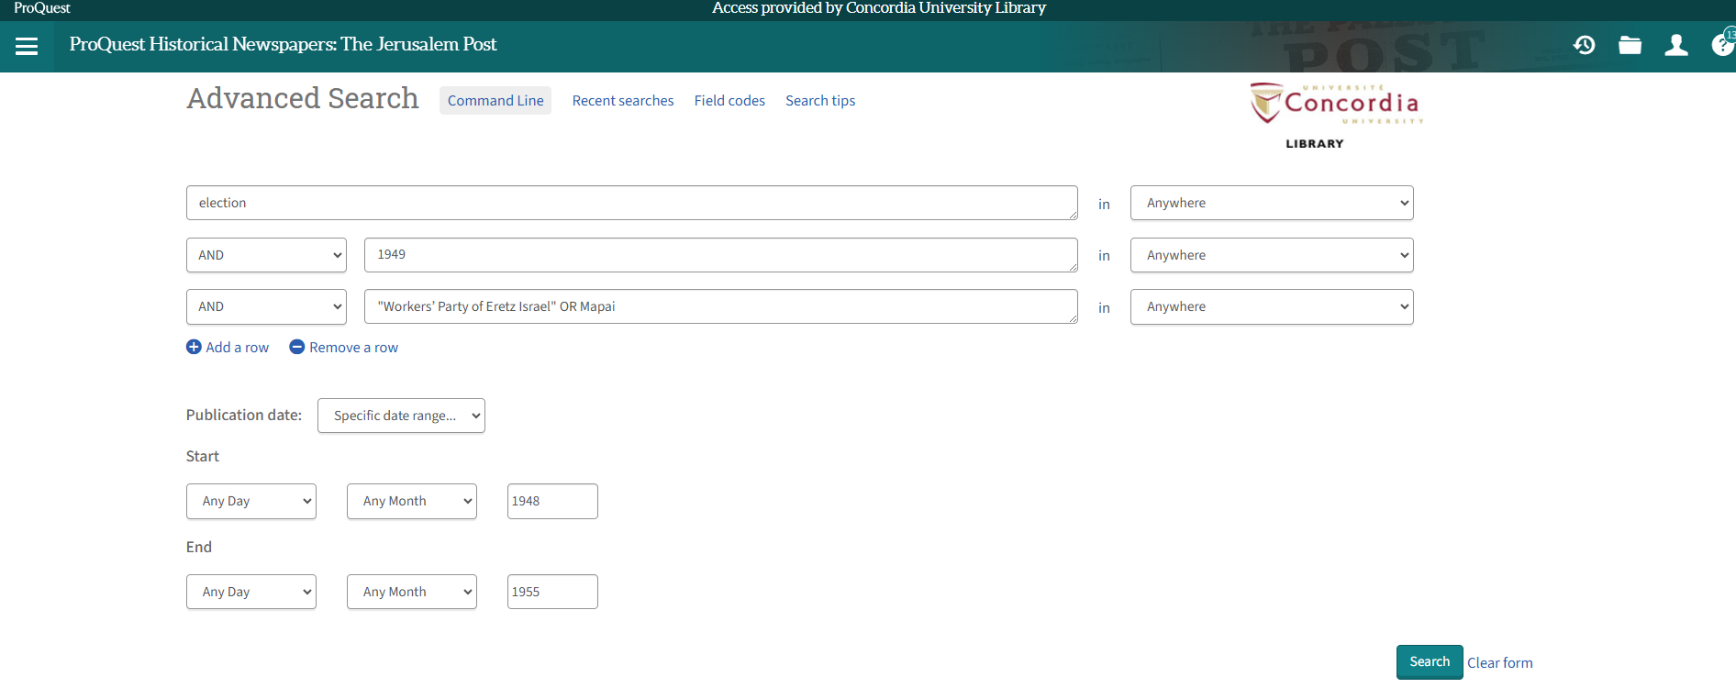
Searching news sources: Historical Jerusalem Post

Slide 29
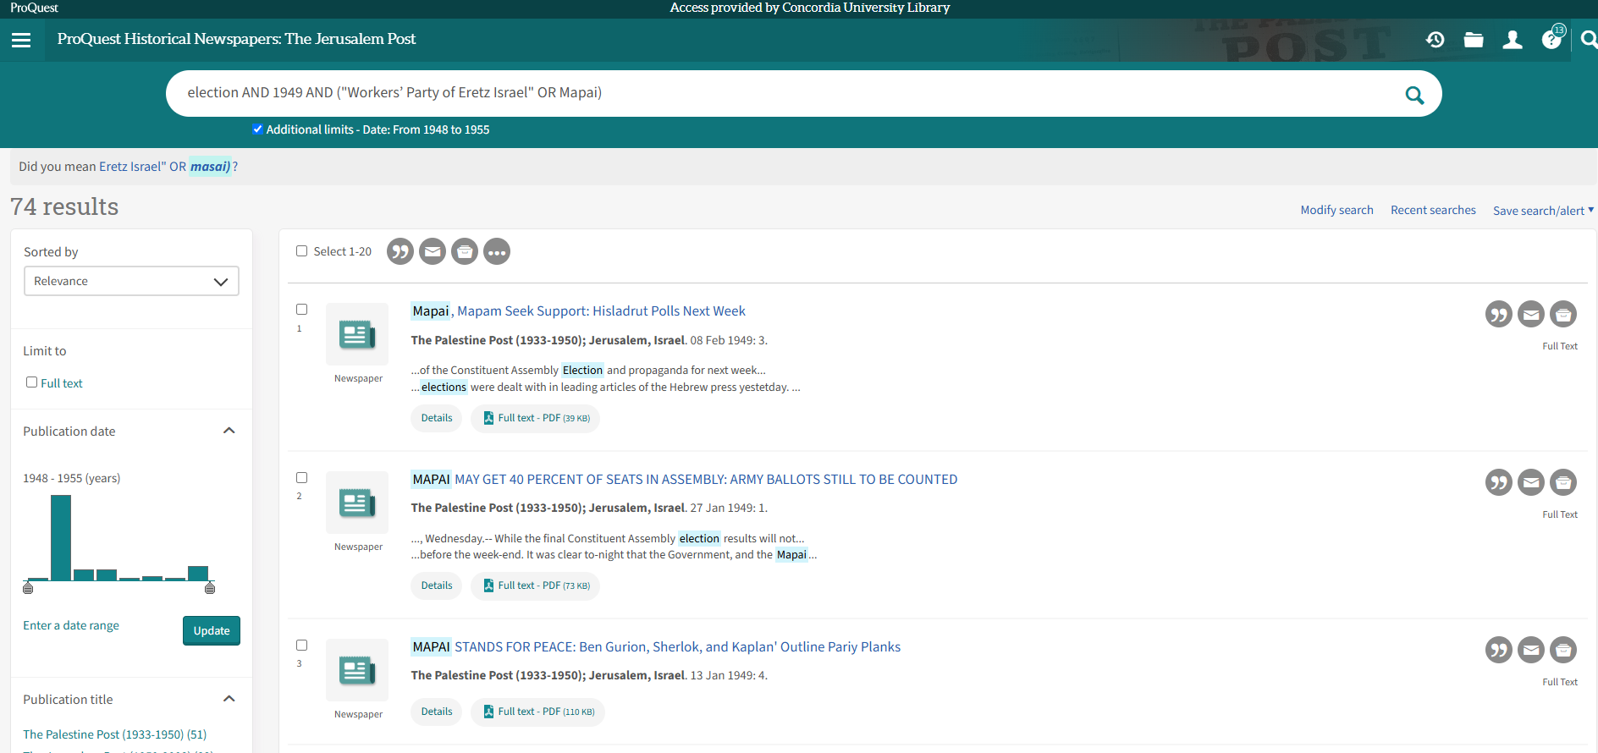
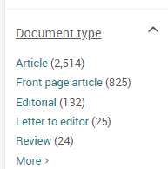

Slide 30
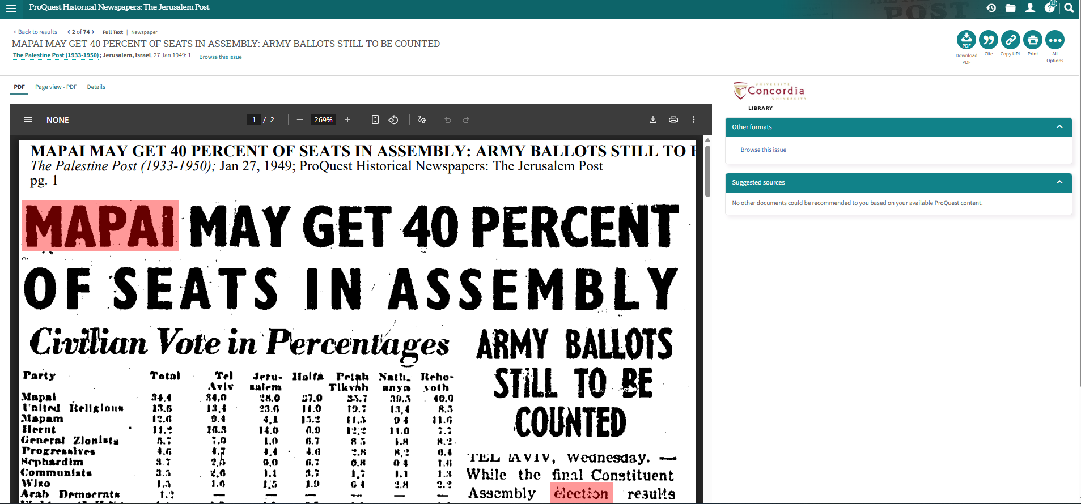
Searching news sources: Jerusalem Post
This database is an online archive and all the historical newspaper images have been scanned as PDFs.
When you search for keywords, they will be highlighted throughout the scanned image.
You can download and save the PDF images of the newspaper.

Slide 31
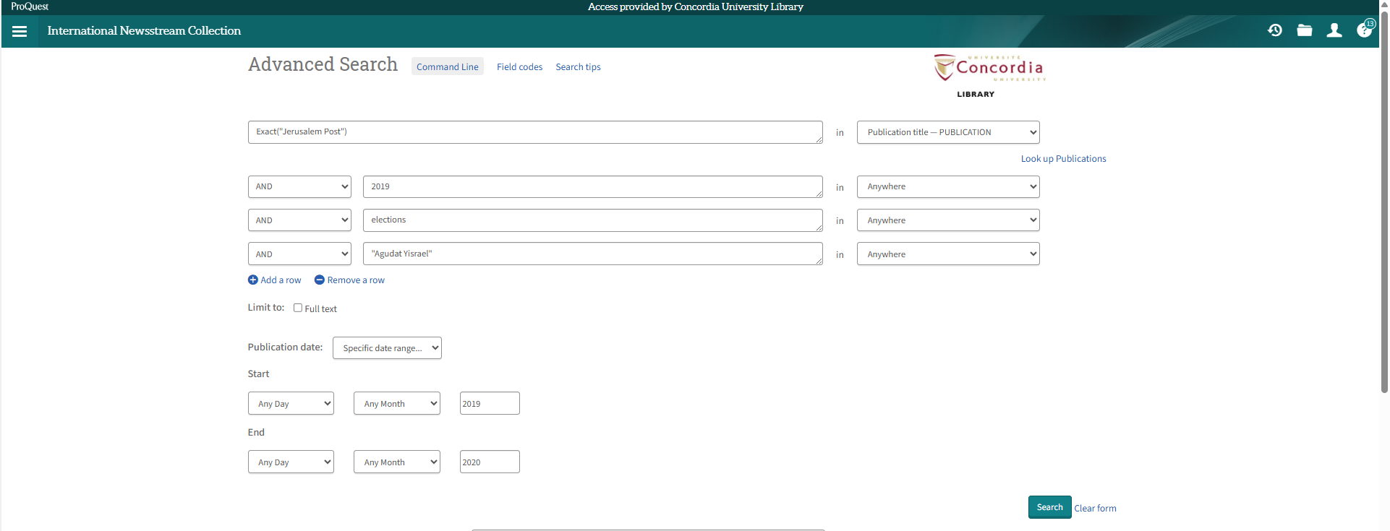
International Newsstream: Jerusalem Post (2011-present)
In International Newsstream, select Publication, then ‘Look up Publication’, then select Jerusalem Post

Slide 32
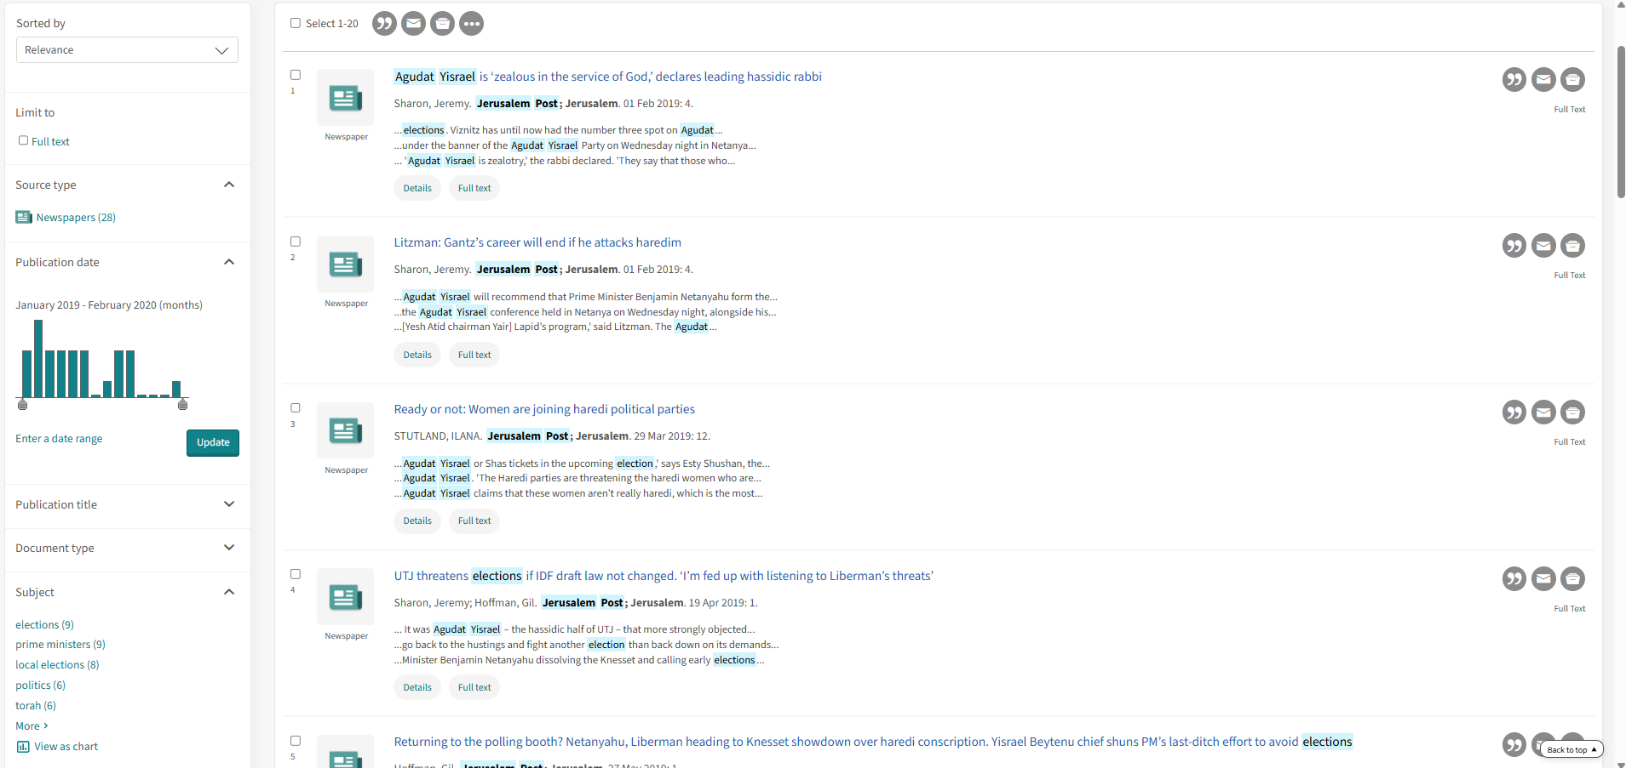
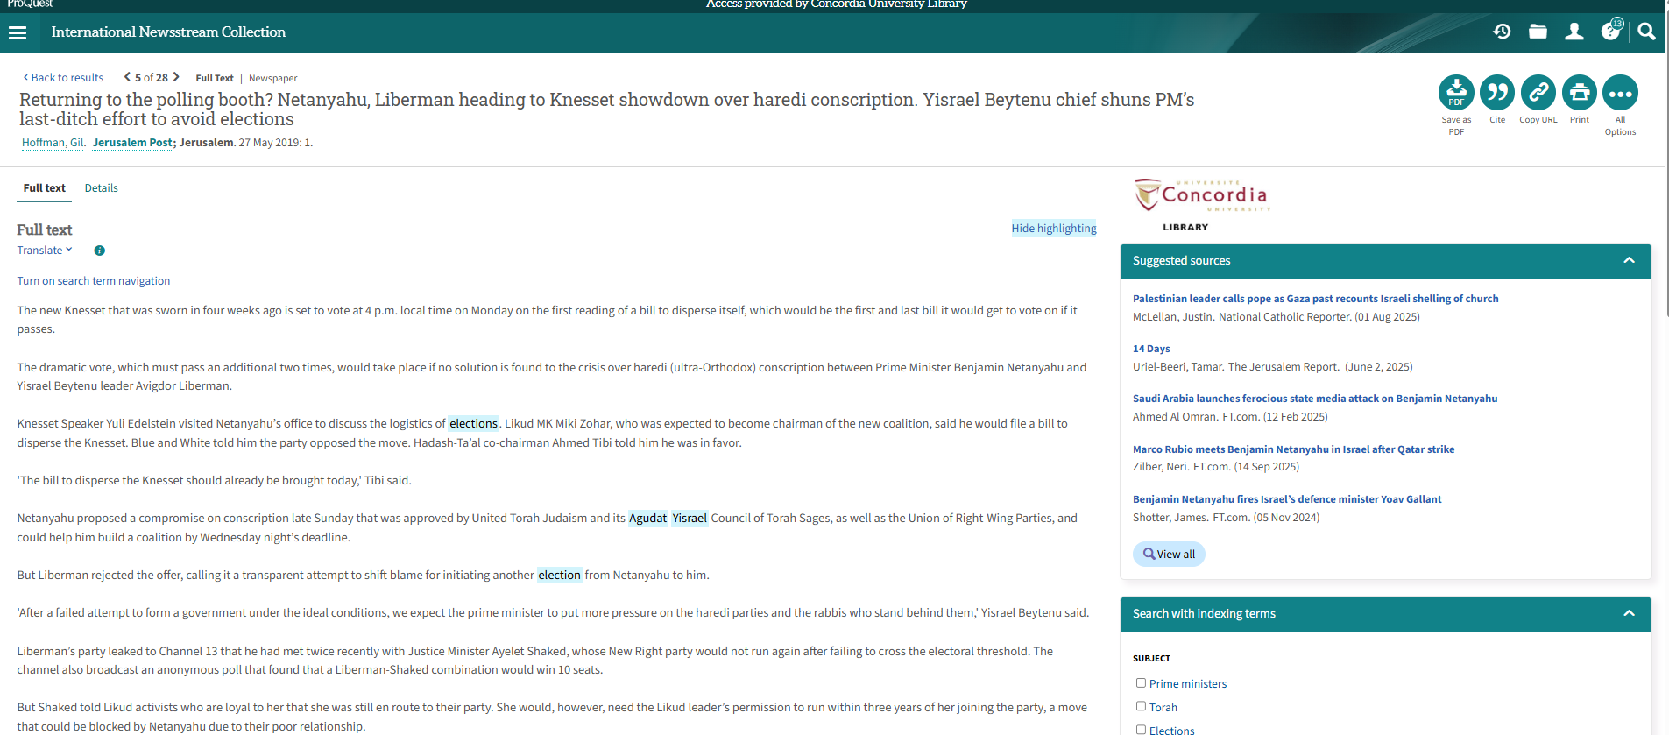

Slide 33

Scholarly Sources: Books and Articles

Slide 34
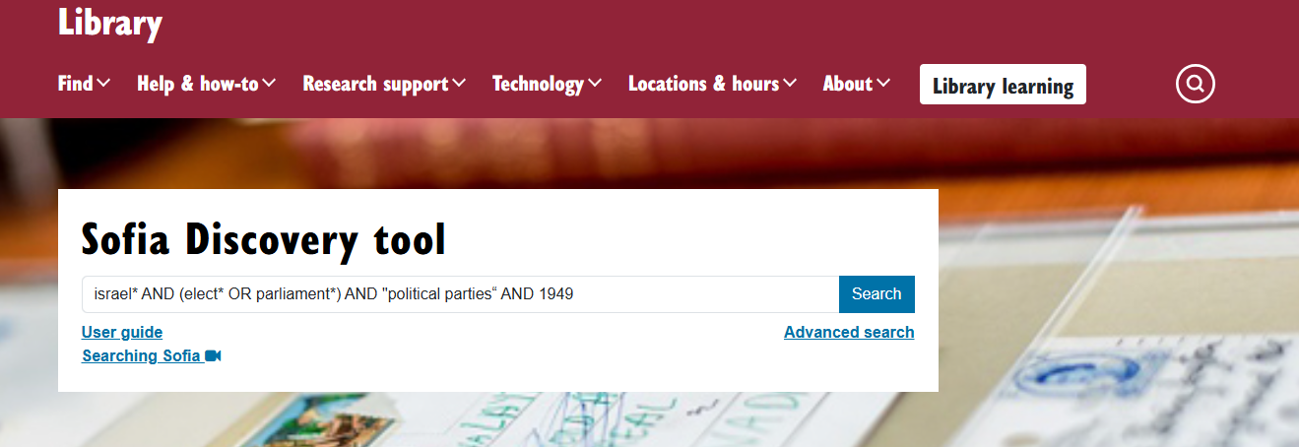
israel* AND (elect* OR parliament*) AND "political parties“ AND 1949

Slide 35
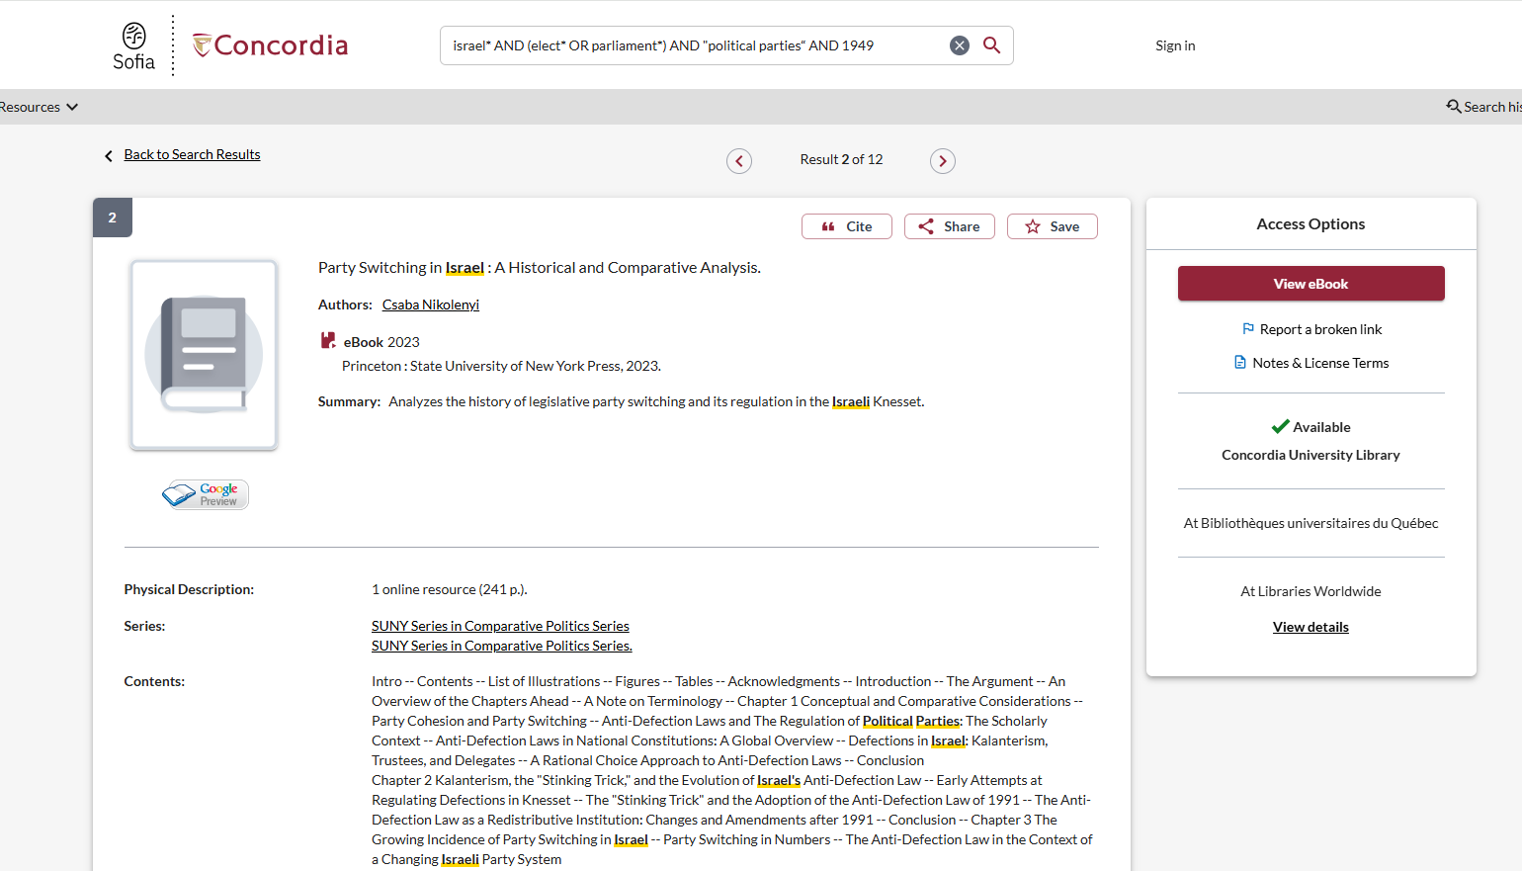
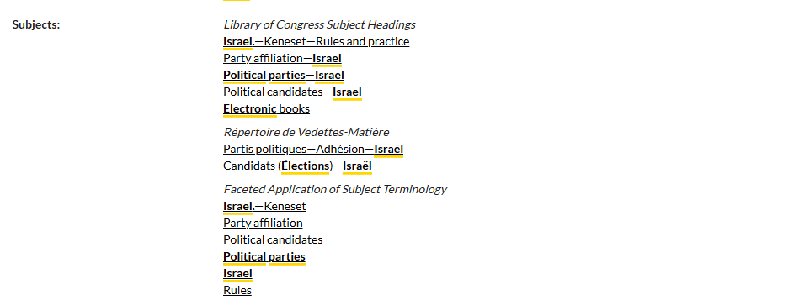
Use the subjects to find more books on the topic

Slide 36
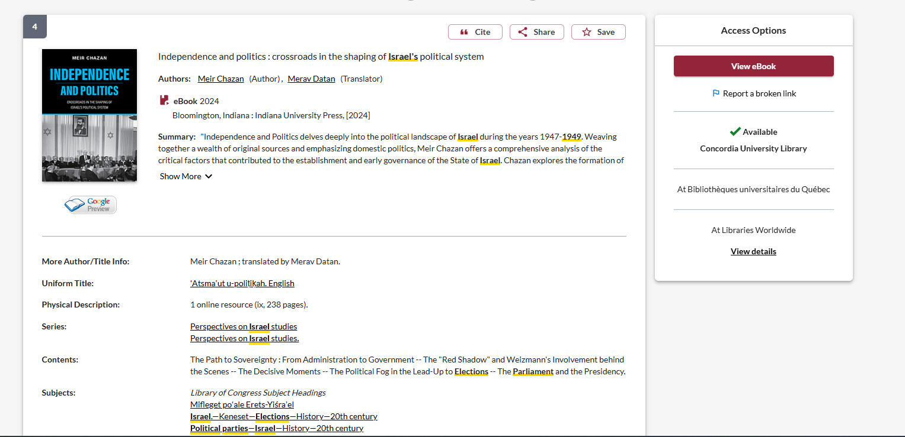

Slide 37
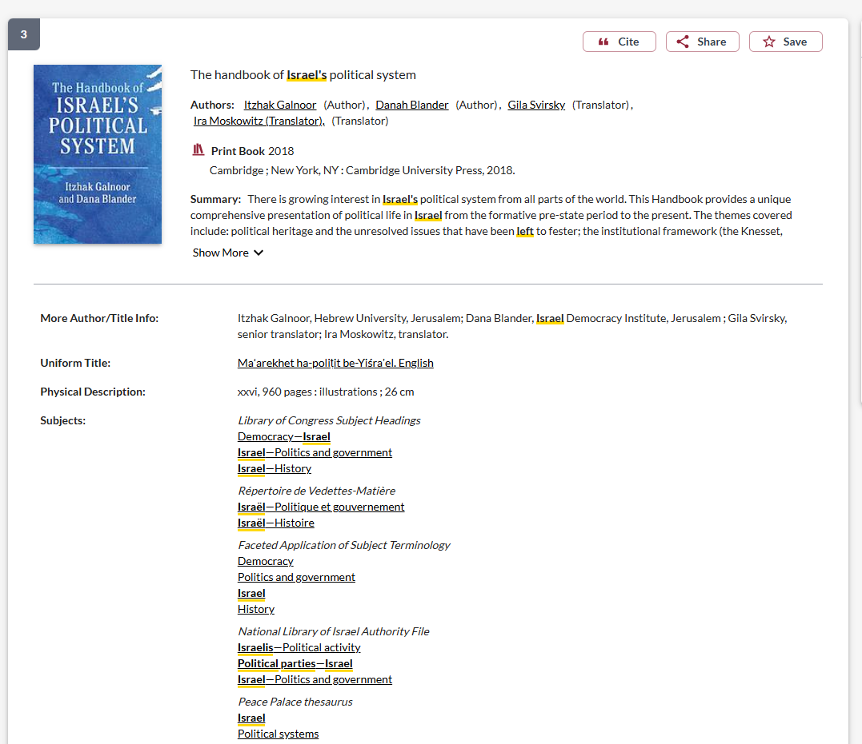
Use the subject headings to find books in these subject areas

Slide 38
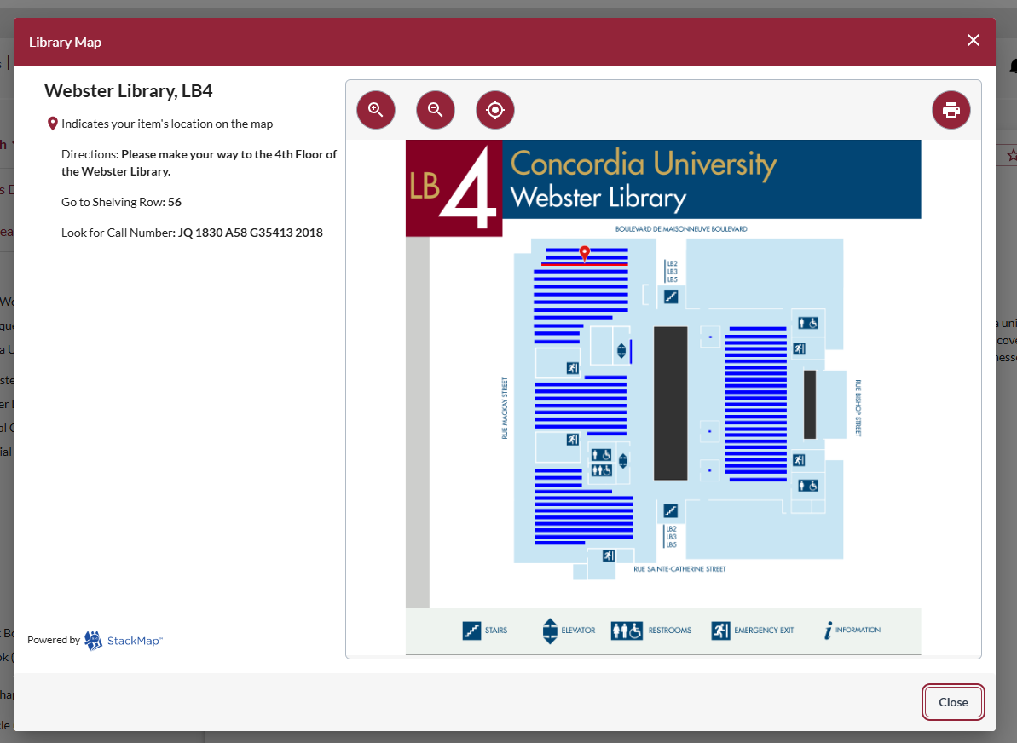
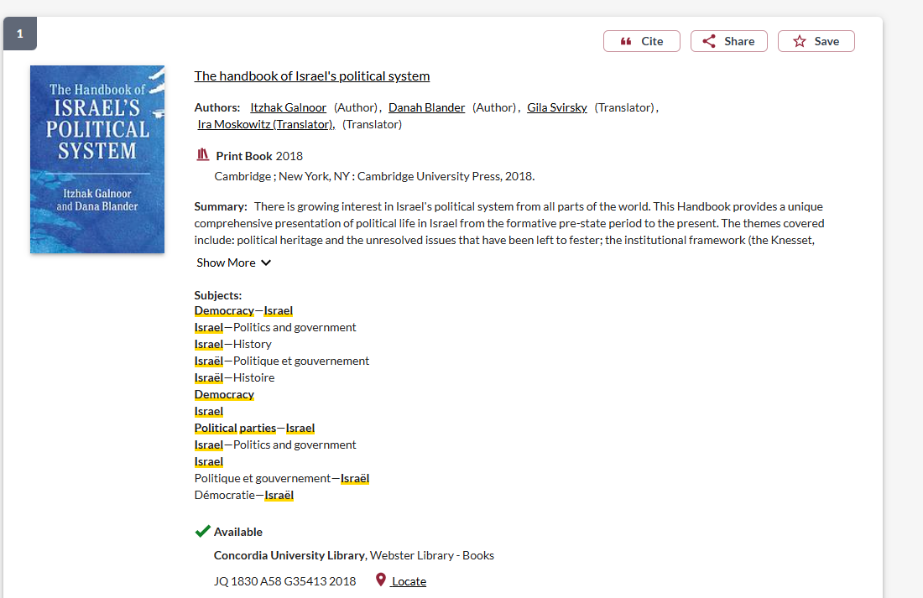

Slide 39
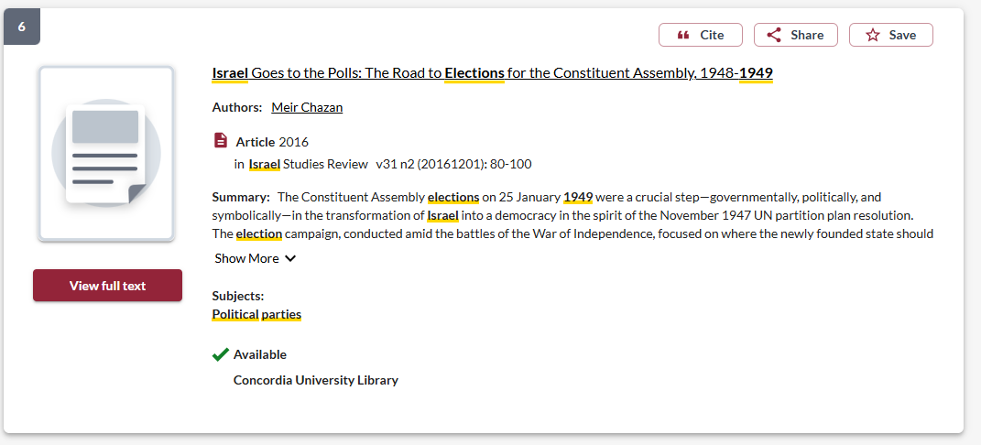
Journal articles from Sofia

Slide 40
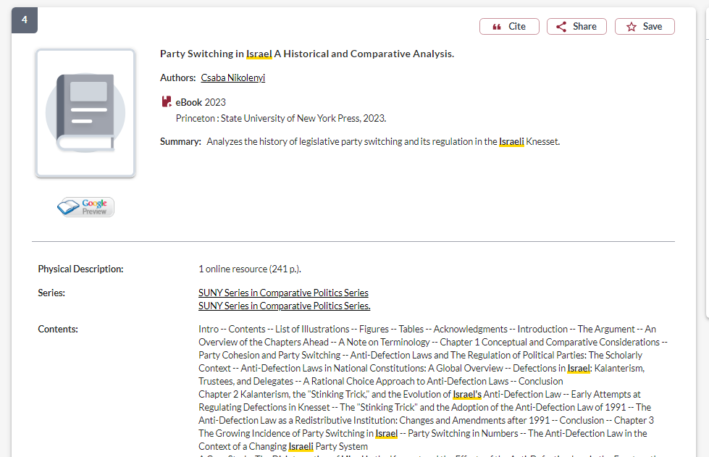
How do I know if a book is academic?
If the book is published by a university press, it is an academic book

Slide 41
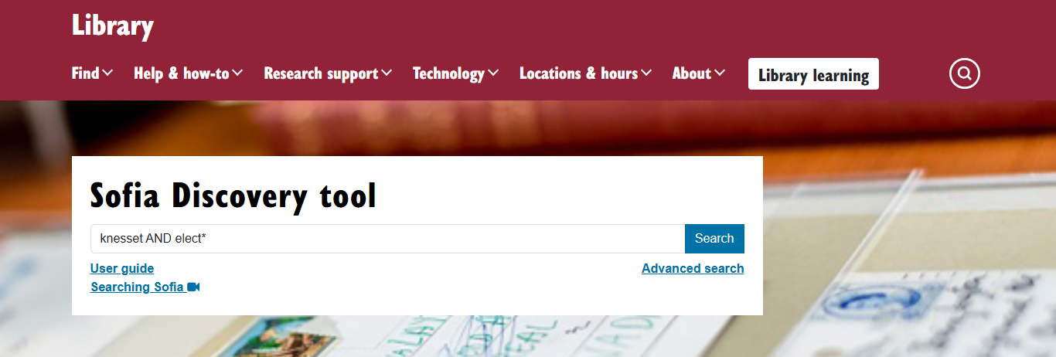

Slide 42
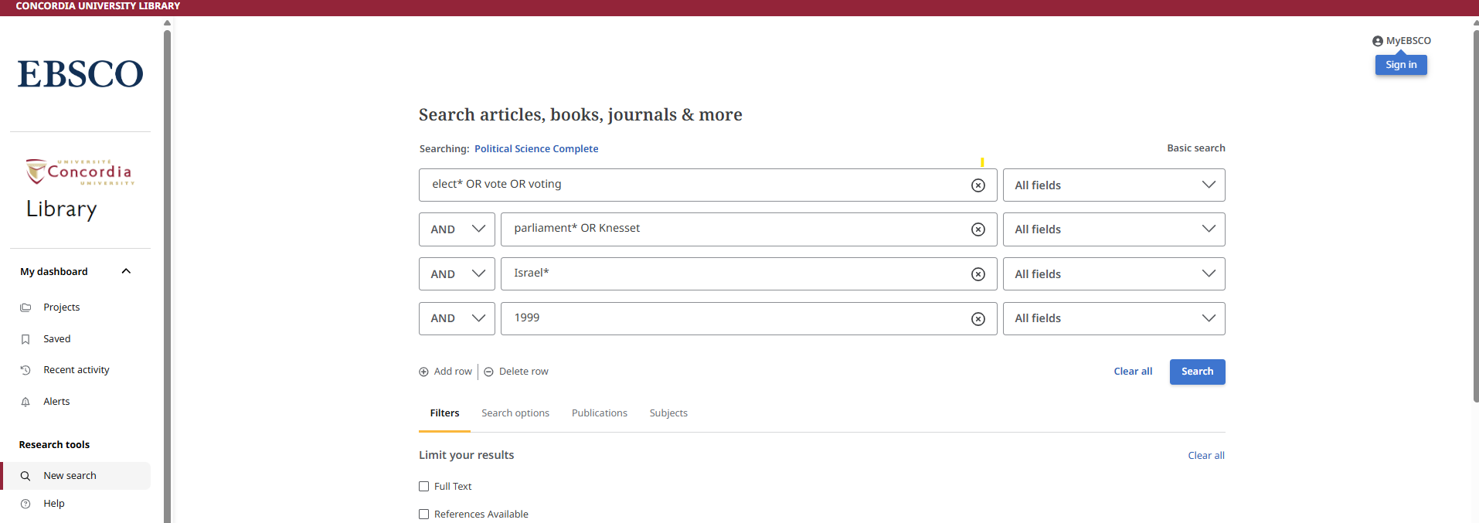
Political Science Complete: Articles

Slide 43
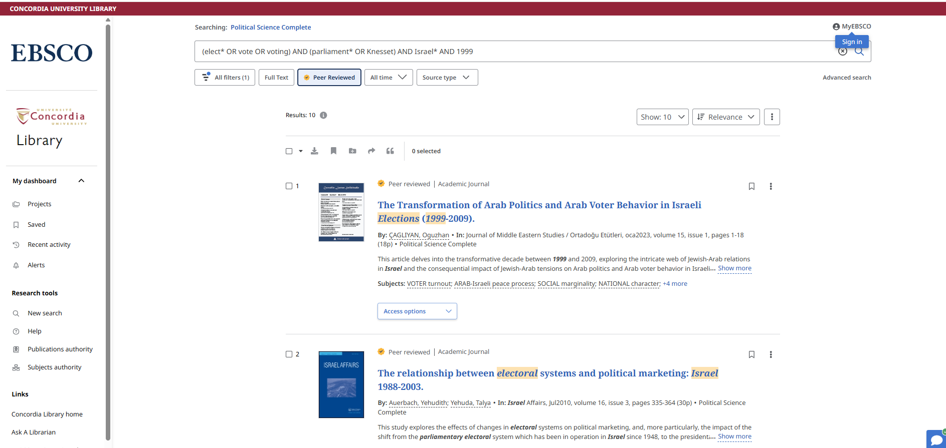

Slide 44
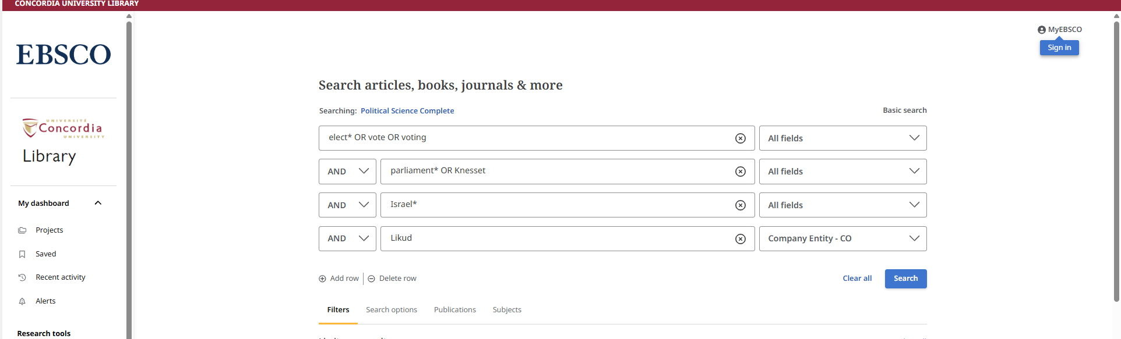
You can search for a political party name as a company entity

Slide 45
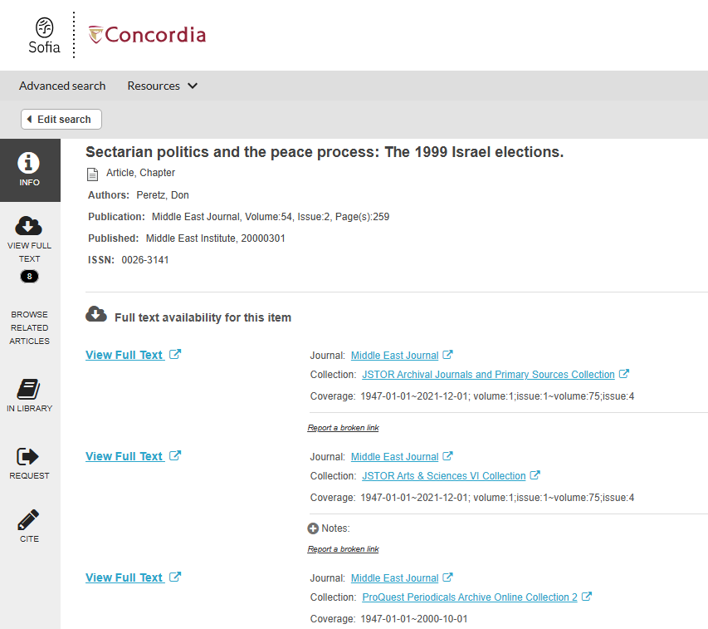
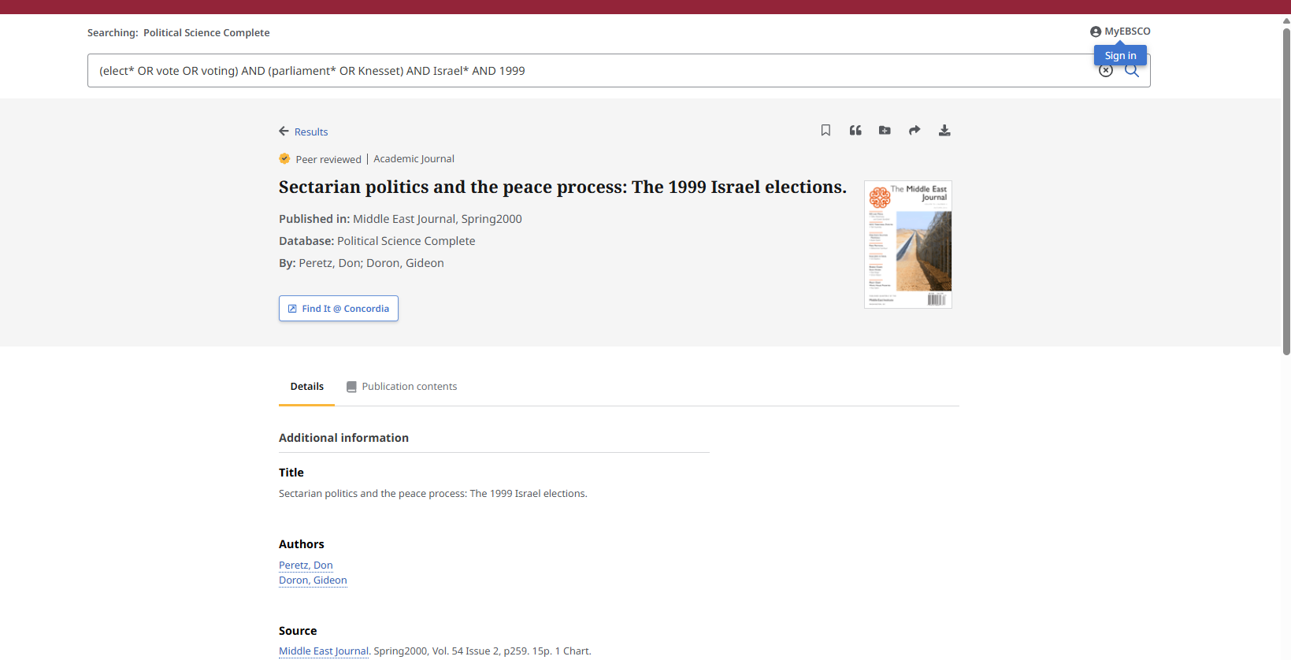
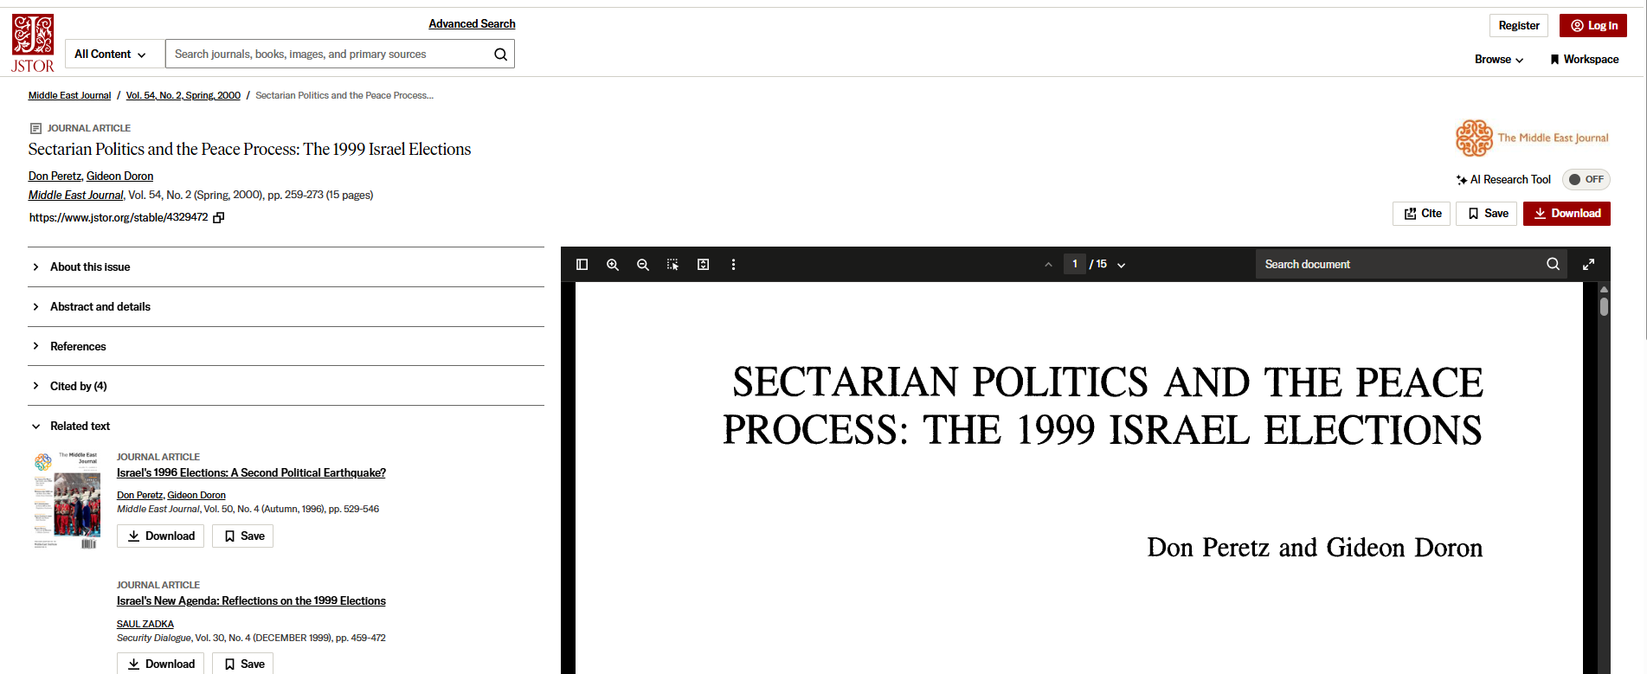

Slide 46
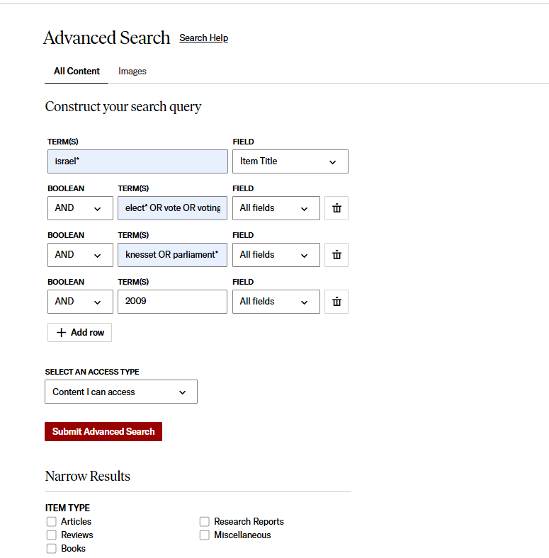
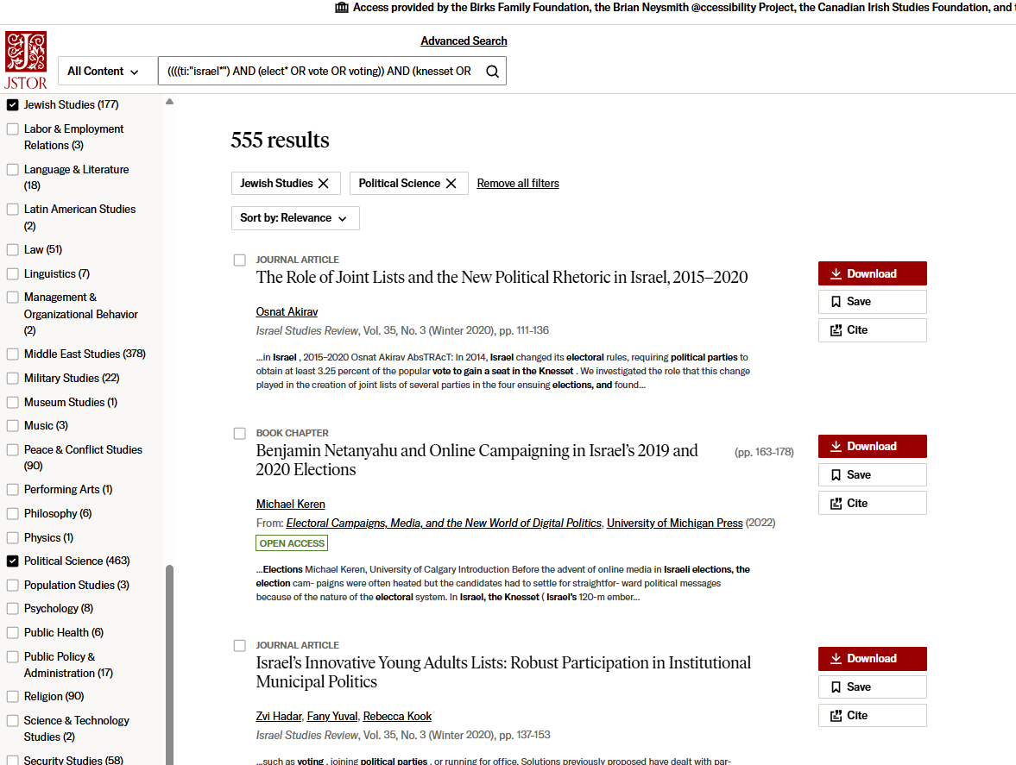
JSTOR: Articles

Slide 47
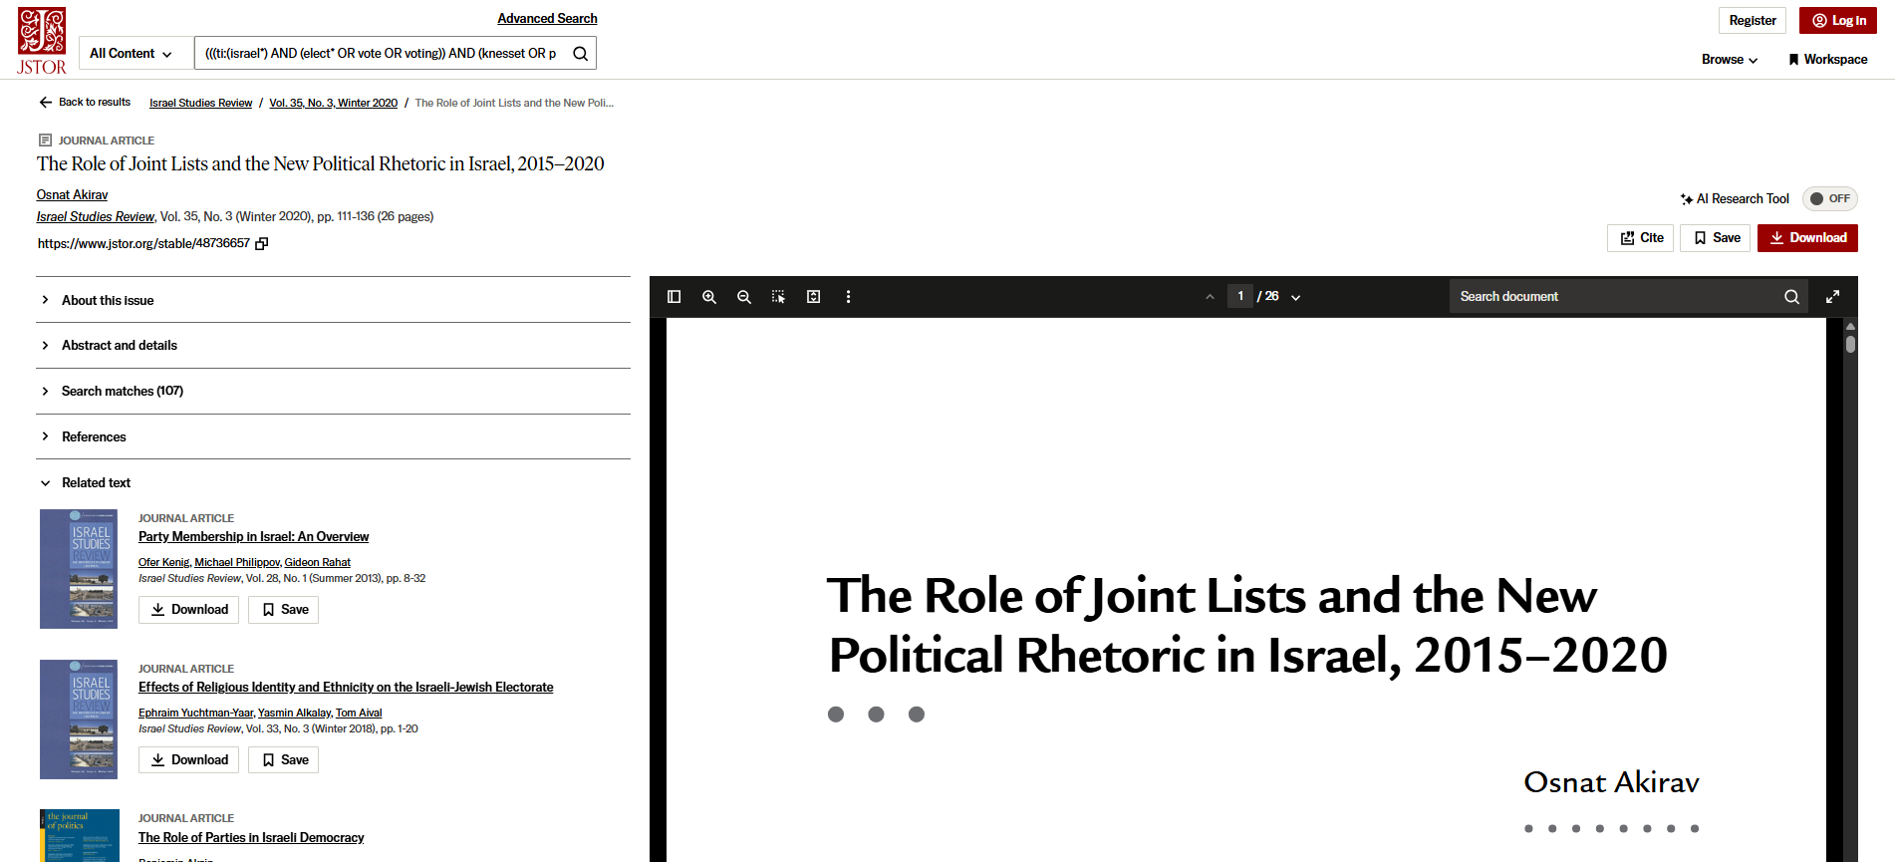
Check out the related texts, these articles will be on the same subject

Slide 48

Google Scholar
You can narrow your search results by date, but you cannot narrow down to peer reviewed journal articles only in Google Scholar

Slide 49



Slide 50

What is peer review?
What are peer reviewed, scholarly articles?

Slide 51
Has the article gone through the peer review process?
What is peer review?
Peer review is a system used to decide if an article should be published in a peer-reviewed journal. Each paper submitted to a peer-reviewed journal is read and evaluated by experts in the article’s subject area.
The reviewers assess the article’s validity, importance, and originality, and then recommend whether it should be printed in the journal.
The reviewers’ suggestions are considered by the journal’s editor, who makes the final decision about whether to accept or reject the article.
Criteria for evaluating academic or scholarly articles

Slide 52


Slide 53




Citations throughout the article and an extensive reference list/bibliography/endnotes/footnotes is available at the end of the article.

Slide 54

Citing your sources

Slide 55
Citation Resources
Help and How to: How to Cite
Chicago (Author-Date) style guide

Slide 56
Wrap up
Political Science subject guide - POLI 322 Course guide provides quick access to key resources
The poli subject librarian (Michelle) is here to help
Your sources must collectively answer your research question
Evaluate everything you cite in your assignments
Properly cite all your sources!

Slide 57

Need help, ask us!
Michelle.Lake@Concordia.ca

