Slide 1
POLI 305 International Political Economy Library Workshop
Michelle Lake
Political Science, SCPA, First Peoples Studies and Government Publications Librarian
Michelle.Lake@Concordia.ca

Slide 2
Who am I?
Michelle Lake, librarian for Political Science, the School of Community and Public Affairs, First Peoples Studies, and Government Publications
Michelle.Lake@Concordia.ca / Make an appointment or ask a question
What do I do?
Provide research support
Help students with library databases
Help students find and access materials they need
Help with citation issues
Choose the books we buy for the above subject areas

Slide 3
John Ravenhill, ed. Global Political Economy. Sixth Edition. Oxford University Press, 2020.

Slide 4
Breaking down a topic

Slide 5
A country’s openness to international trade has different effects on different actors and entities
within a country (workers, consumers, firms, etc.) Trade policy is sometimes understood to be
the outcome of interest group pressure.
Analyzing a specific example of trade policy (e.g. preferential trade agreement; a regional free trade area, a specific set of WTO commitments), answer the following: What evidence is there of lobbying by different interest groups? Do provisions of the trade policy reflect lobbying by affected interest groups, if so, how?
(international) Trade policy
Economy
Actors (workers, consumers, firms, etc)
Design of policy
Lobbying
Interest groups
Lobbying
Persuasion, influence
Lobbyists
Interest groups
Advocacy group, pressure group

Slide 6
There continues to be considerable variety in countries’ exchange rate policies, with some pursuing monetary union, others fixing their exchange rate to the dollar or euro, and others letting their currency float.
Analyzing a specific country’s exchange rate policies, answer the following: What are the
consequences of exchange rate policy choices for the government’s other economic policy objectives? On balance, does the exchange rate policy choice constrain or enable economic policymaking?
Exchange rate policies
Monetary union
Fixed exchange rate (dollar to euro)
Floating currency
Government
Economic policy objectives
Constrain or enable
Economic policymaking
Monetary union
Currency union, single currency
Government
State
Policymaking
Policy formulation

Slide 7
Globalization can offer opportunities and constraints for developing countries, allowing them to enter globalized supply chains and access to international finance, but also leaving them vulnerable to financial volatility and the pressures of multinational corporations. International organizations recognize the particular position of developing countries in different ways.
Analyzing a specific international organization (e.g. WTO, IMF, UNCTAD, World Bank), answer the following questions: How does the organization acknowledge developing countries’ position in the international economy? What reforms have developing countries advocated at the organization? Have they been successful?
Globalization
Globalisation
Interaction and integration
Developing countries
Developing nations
Low to middle income countries
Financial volatility
Variations
Globalization
Developing countries
Globalized supply chains
International finance
Global trade
Financial volatility
Economic globalization

Slide 8
Greater economic interdependence creates incentives for cooperation, but it also allows some states to use economic relationships as a tool for influencing other states, playing into geopolitical competition.
Analyzing a specific country’s policies, answer the following questions: How has the government used economies policy to achieve foreign policy goals vis-à-vis other countries? Were these influence attempts successful? Why or why not?
Economic interdependence
Cooperation
Geopolitical competition
Economic policy
Government/state
Foreign policy
Policy
Law
Regulation
Procedure
Fiscal or monetary
Foreign policy
External policy
Security
Diplomacy

Slide 9
Search Strategies

Slide 10
How do we combine search words for the best possible results?
AND: combines concepts and limits your results
politics AND development
state OR government
OR: allow you to insert synonyms or alternative terms and increases your results

Slide 11
How do we combine search words for the best possible results?
“quotation marks”: If you put two or more words in quotation marks, that exact phrase will be searched and limits your results.
“foreign aid”
“international cooperation”
econom*
Finds: economy, economies, economic, economics, economically
* - when you add an asterisk on the end of a word, your results will contain all the words with those endings or suffix

Slide 12
Avoid Searching with Linking words
Each author may use different linking words when discussing similar topics.
Influence
Effects
Impact
consequences
Results
Importance
Significance
Response
Emphasis
Causes
You don’t want your search to be limited to those books and articles that only contain the word “effect” or “consequence”

Slide 13
Scholarly sources
8 sources of which 5 must be scholarly sources from outside the reading list…
Scholarly sources include:
Scholarly books
Scholarly book chapters
Scholarly, peer reviewed articles

Slide 14
Scholarly Books

Slide 15
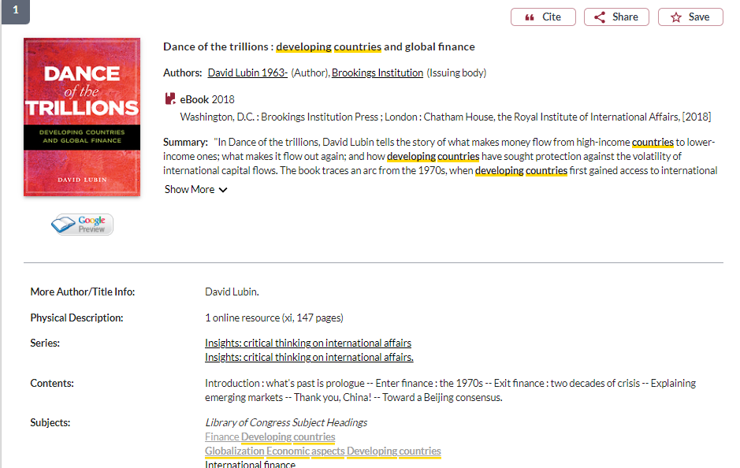
Use the subject headings to narrow your search

Slide 16
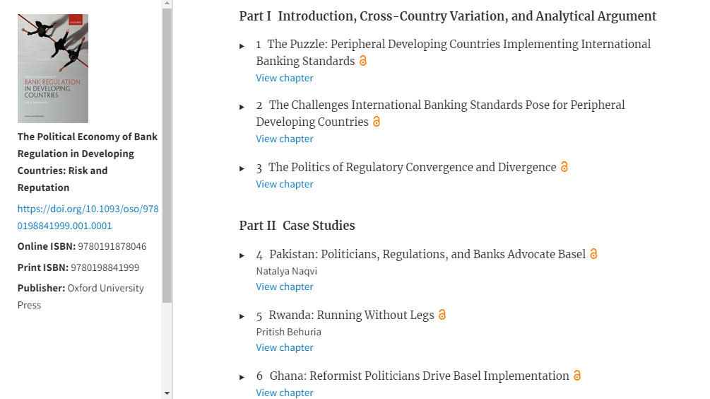
Use the table of contents to locate chapters that will be of use.
This book has country case studies

Slide 17
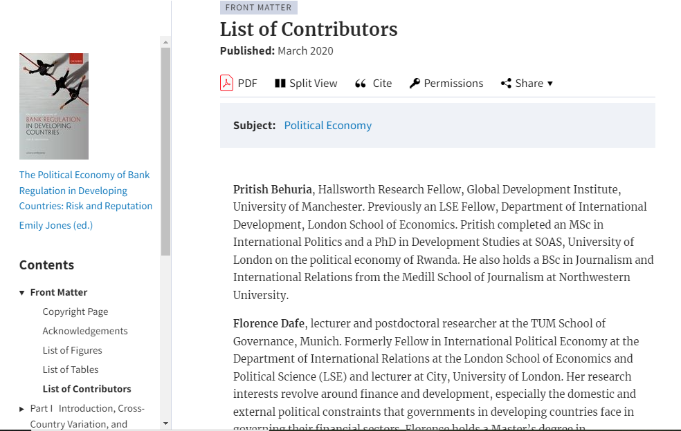
Look at contributor lists in books to find academic affiliations of authors

Slide 18
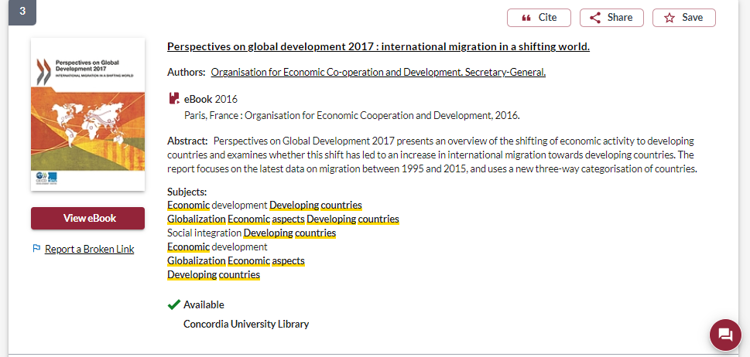
OECD publication

Slide 19
OECD publications (available through Sofia and OECD iLibrary)
What is the OECD?
Organisation for Economic Co-operation and Development is an intergovernmental organisation with governments of 38 democracies with market-based economies collaborate to develop policy standards to promote sustainable economic growth. A reliable source of evidence-based policy analysis and economic data.
OCED reports and publications are a type of grey literature; this information is reliable, but not scholarly or peer reviewed.
Series The Development Dimension
Books and policy papers on the theme of Development

Slide 20
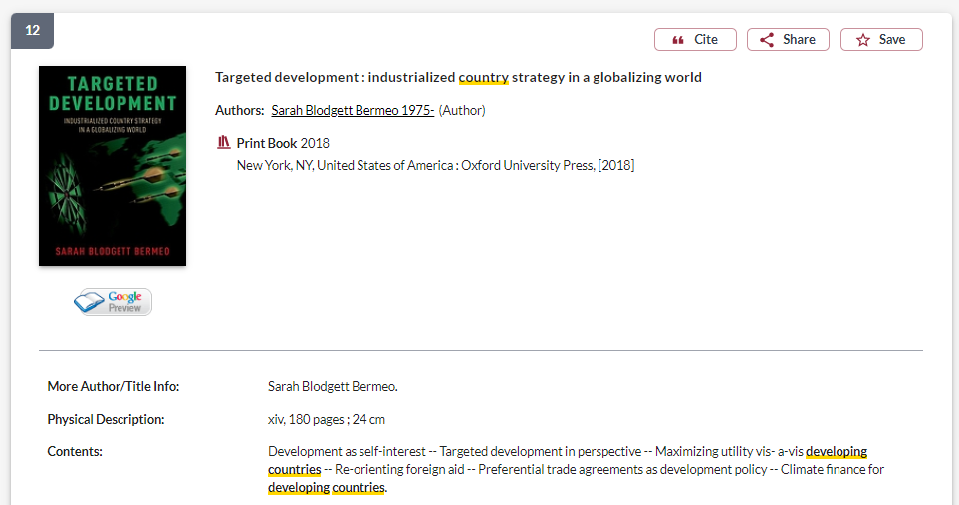
If a book is published by a university press, it is a scholarly book

Slide 21
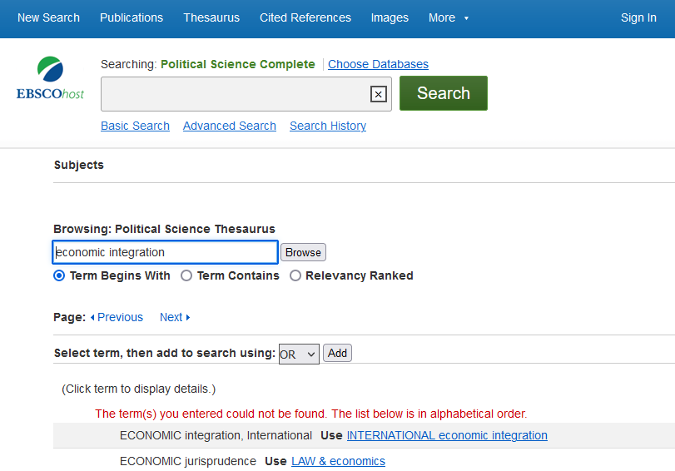
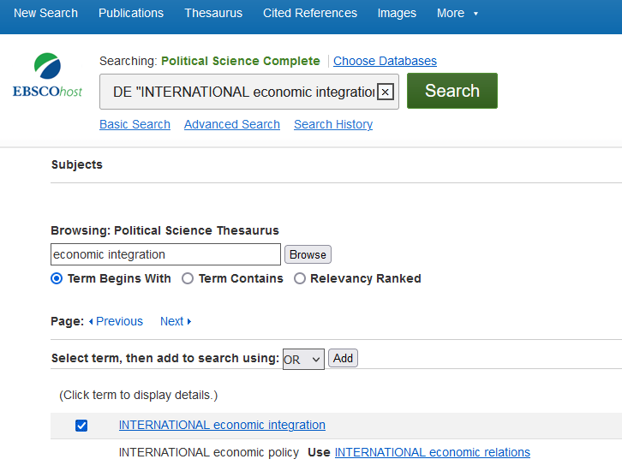

Slide 22
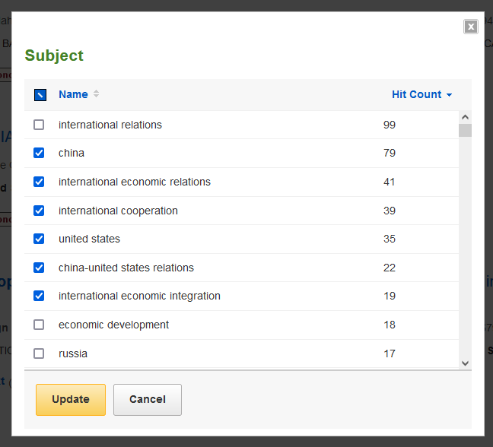
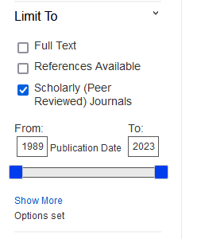
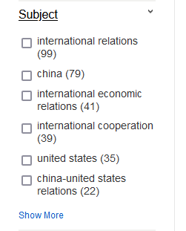

Slide 23
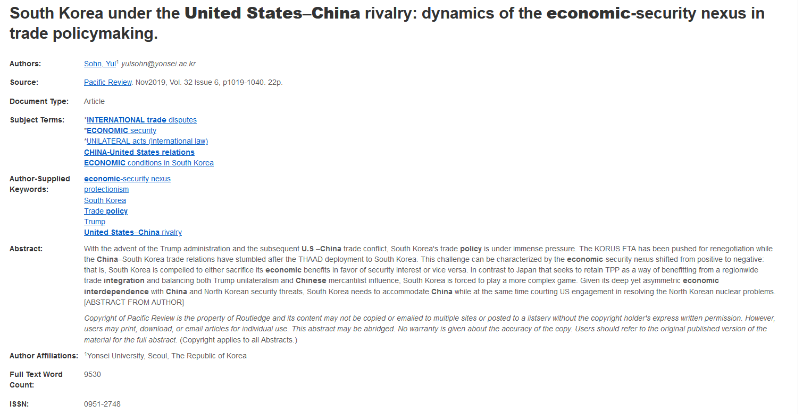
Length: scholarly articles will be 15+ pages long
Find the author’s academic affiliations

Slide 24
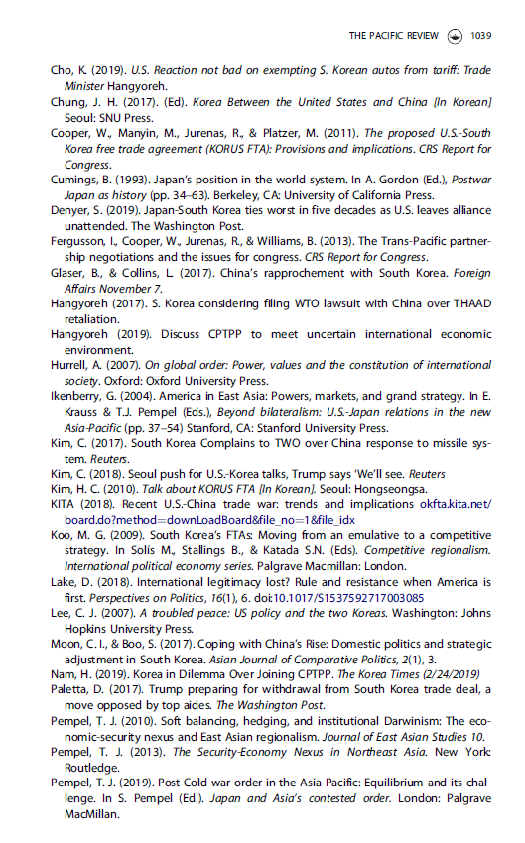
The article should citations throughout (in-text, footnotes, endnotes)
Scholarly articles will have extensive reference lists/bibliographies
These are great places to find more sources
The researcher or research team are experts in the subject area and have already done a lot of research
Use this expertise by looking up the books and articles they cite in Sofia and using them in your own research
This is a commonly used method in academic research

Slide 25
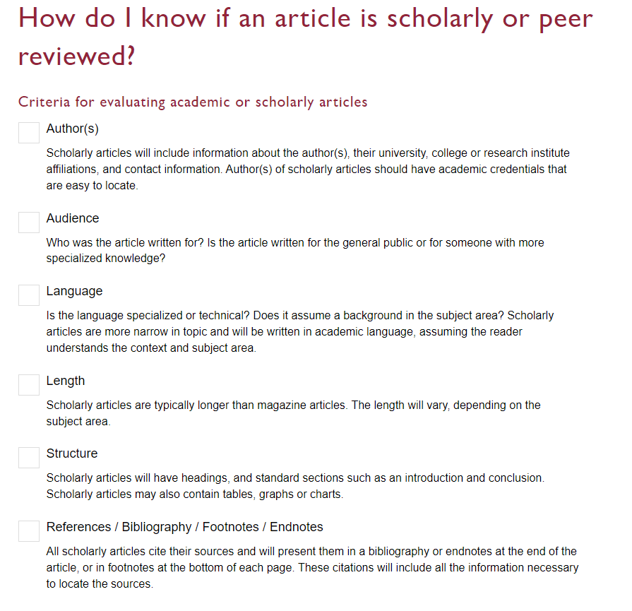

Slide 26
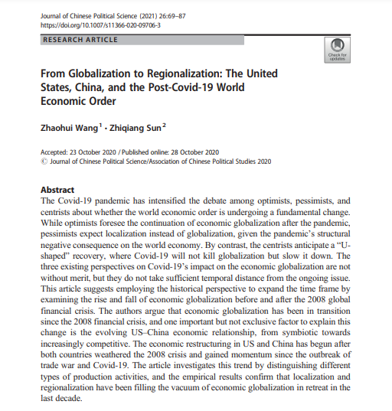
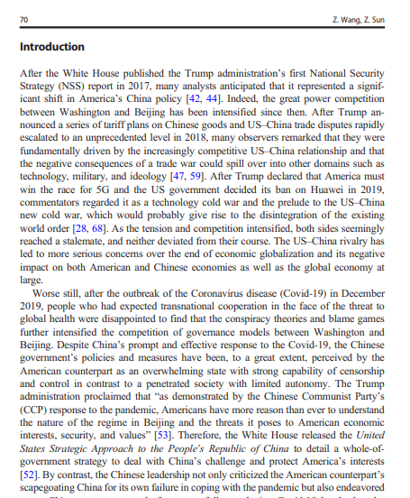
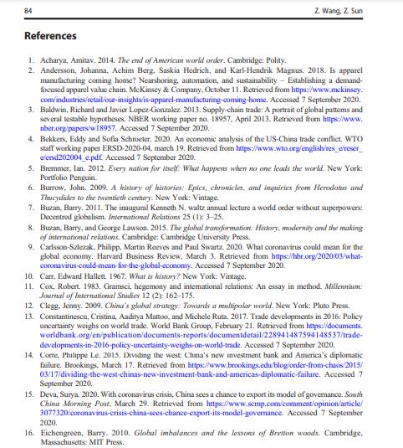
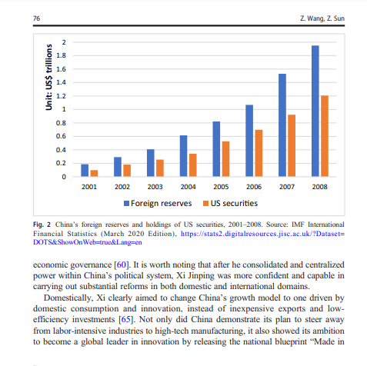
Look for sections, use of specialized language, charts, tables, and graphs
Specialized language

Slide 27
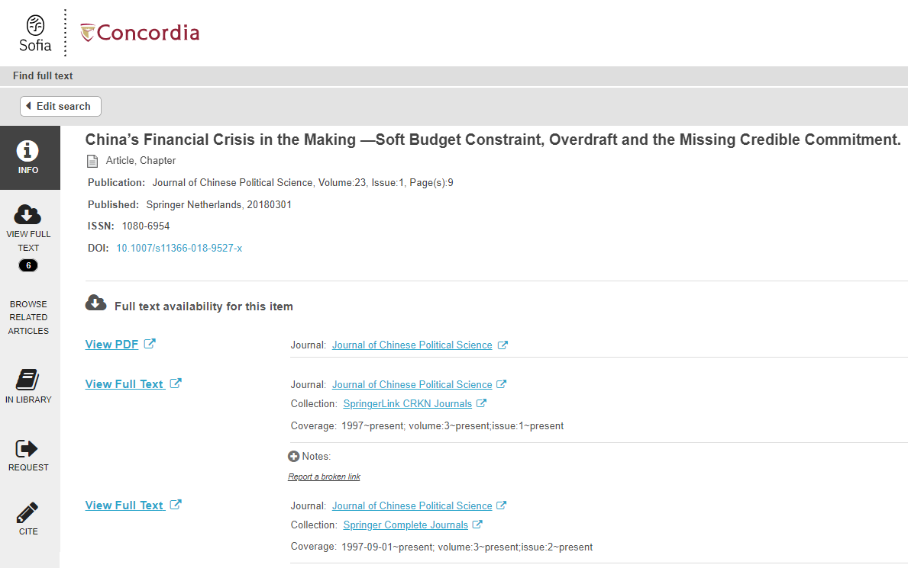
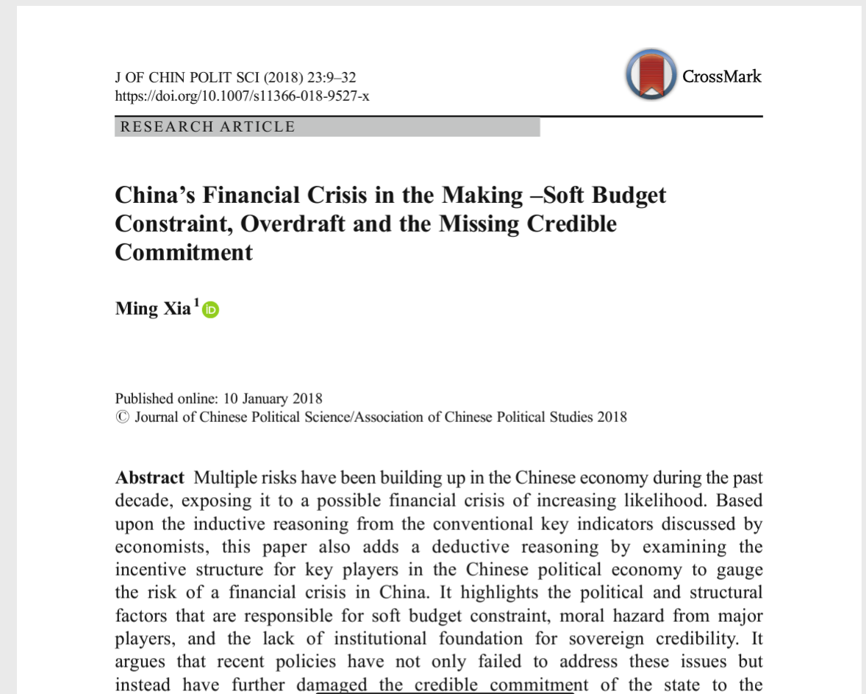
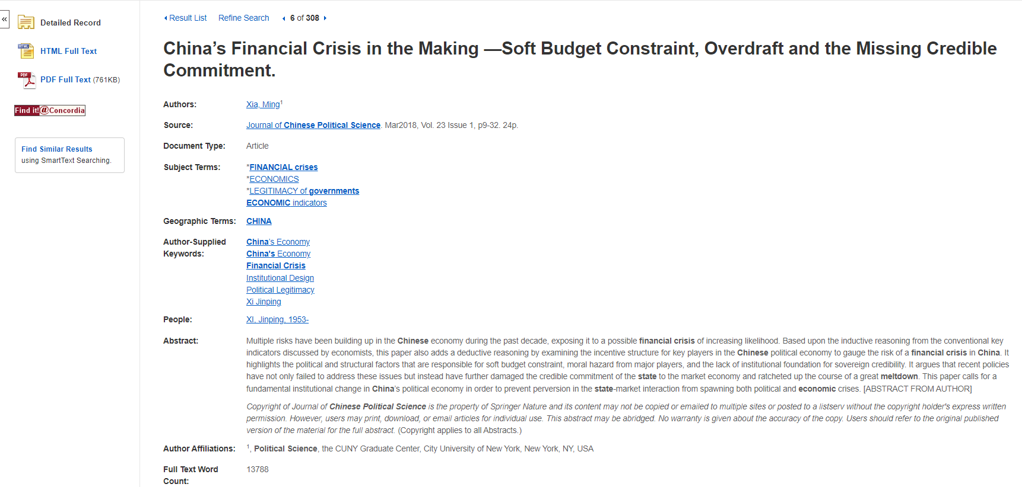
Find it @ Concordia
How to access articles.
Look for PDF or HTML full text options, if neither is available, use the Find it @ Concordia to access the article.

Slide 28
Using Google Scholar in 2 ways:
Setting up Google Scholar to be effective as a Concordia user
Using Google Scholar for Reverse Citation Searching

Slide 29
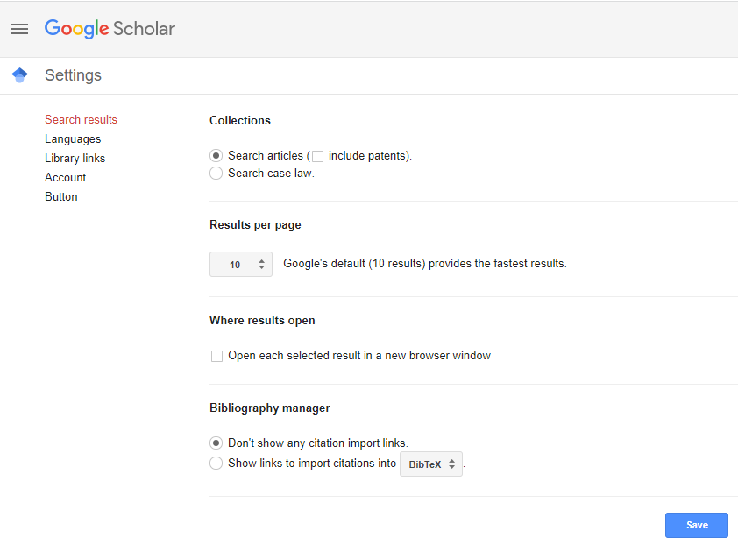
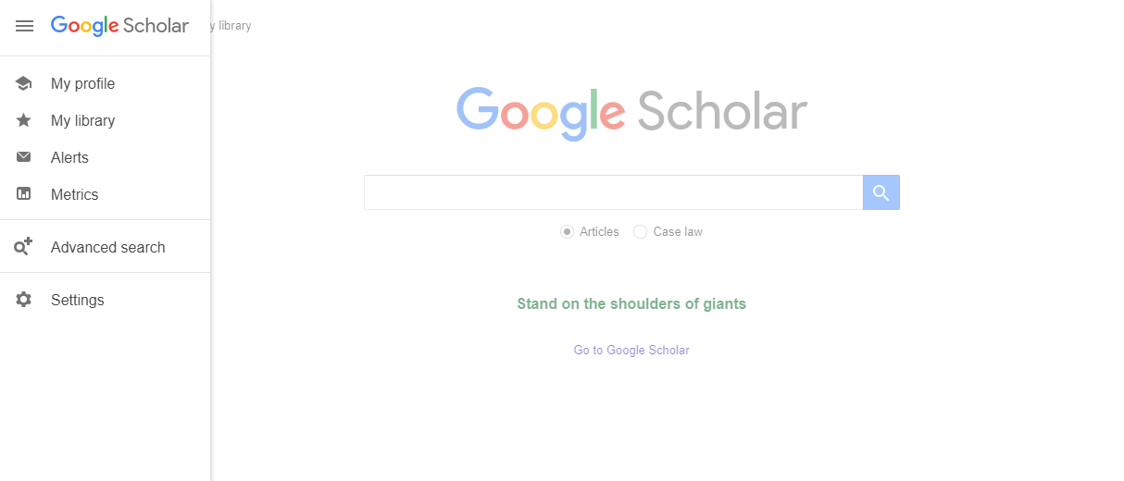

Slide 30
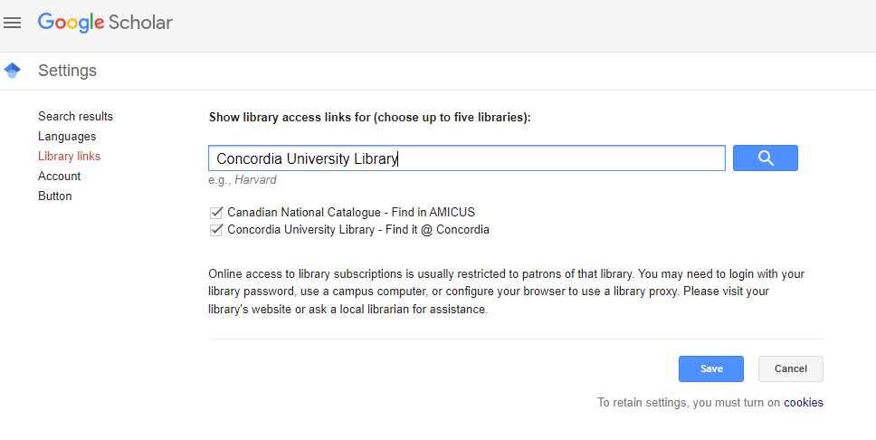
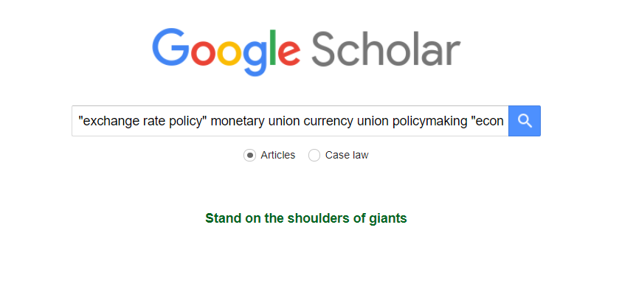

Slide 31
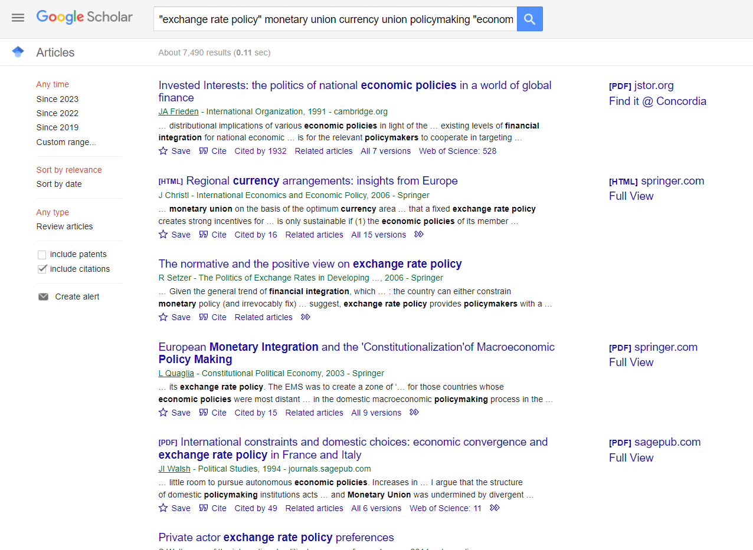
Find related articles

Slide 32
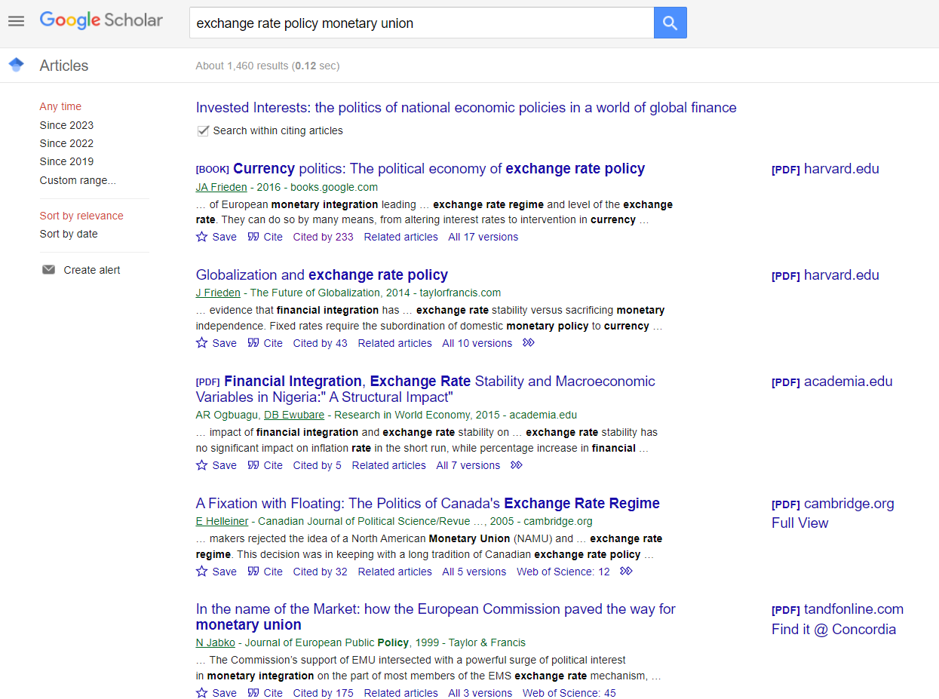
The cited article is from 1991 and has been cited by over 1900 other sources.
Search through those citing articles, with your keywords

Slide 33
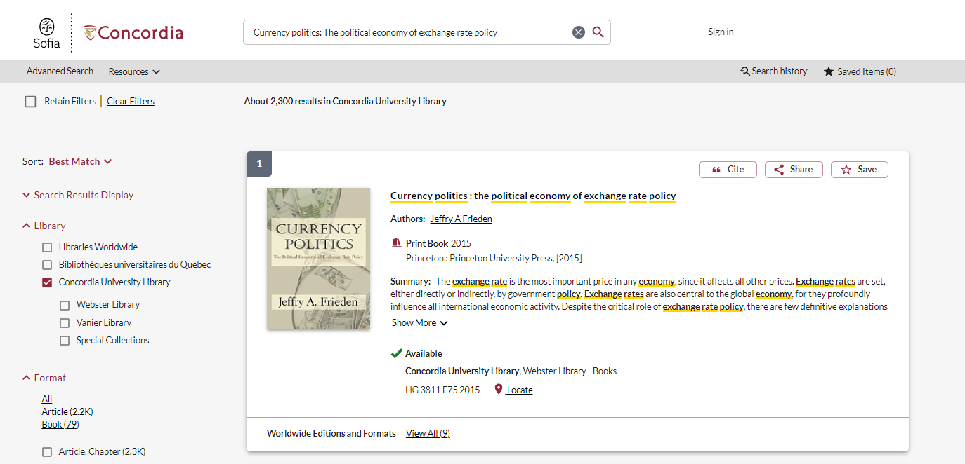

Slide 34
Government Information Search
To search for information from a specific organization, put the name quotation marks, followed by your other search words
Select Intergovernmental organizations from the drop down menu

Slide 35
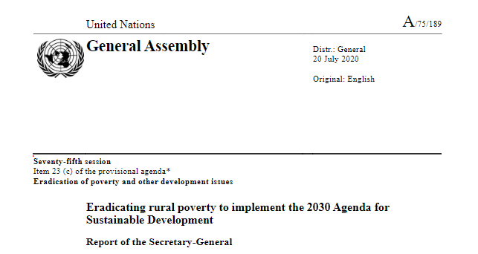
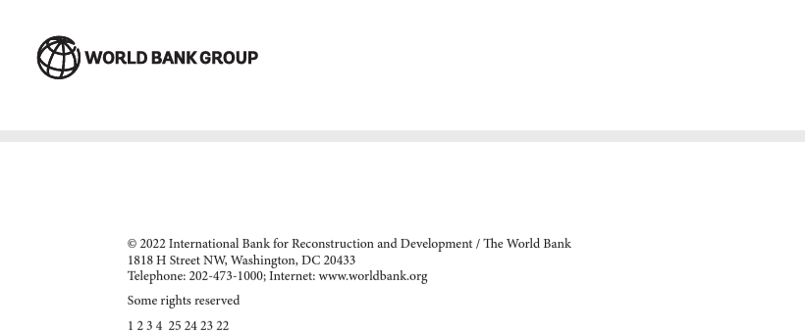
Evaluating IGO,NGO and government publications
Who is the publisher? Is it a government or an organization?
What is the date of publication? Is it recent?
What is the source of the statistical information or data?
Are there any official government crests or logos on the publication?
What kind of website is the publication coming from? Is it a recognizable institutional or organization’s domain?

Slide 36
Questions?

Slide 37
Need help, ask us!
Michelle.Lake@Concordia.ca

