Slide 1
POLI 205 Library Workshop
Michelle Lake, Political Science, SCPA, FPST and Government Publications Subject Librarian
Michelle.Lake@Concordia.ca

Slide 2
Who am I?
Michelle Lake, librarian for Political Science, the School of Community and Public Affairs, First Peoples Studies, and Government Publications
Michelle.Lake@Concordia.ca / Make an appointment or ask a question
What do I do?
Provide research support
Help students with search strategies and library databases
Help students find and access materials they need
Help with citation issues
Choose the books we buy for the above subject areas

Slide 3
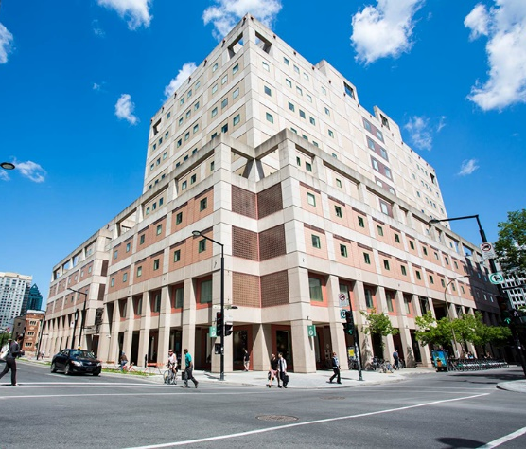

The Librar(ies)
24/7 access, with student card, after 11pm
Webster Library (LB) – downtown on SGW campus & Vanier Library (VL) on Loyola campus
Webster: Social Sciences, Humanities, Business, Engineering & Fine Arts
Vanier: Science(s), Health, Communications, Journalism and Psychology
Course Reserves Room(s): have the required undergraduate print textbooks for the courses taught at that campus (for example: Webster has the Political Science and SCPA course reserves)

Slide 4

Library Services
Your student card is your library card.
You need it to:
borrow books (up to 100 a time)
borrow a laptop (for 3 days) and other technology
print on campus (add money to your Dprint account)
access the library overnight during 24/7 hours.
Webster library has 5 book scanners (And Vanier has 2!) that can be used for free to scan chapters from our print books and email them to yourself as a PDF.
To use Library databases, access online articles and ebooks when you are off campus, login with your MyConcordia Netname and password.

Slide 5
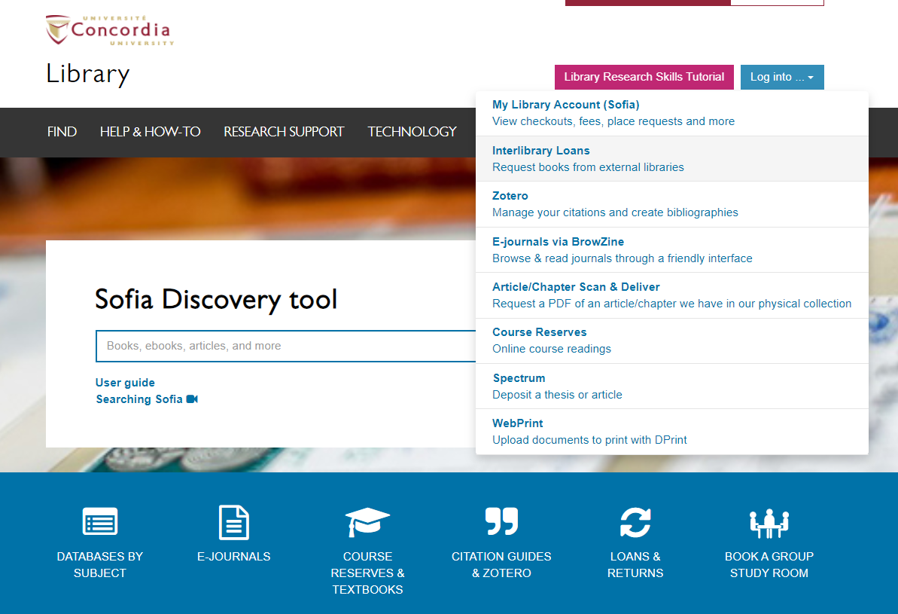
Electronic Course Reserves

Slide 6
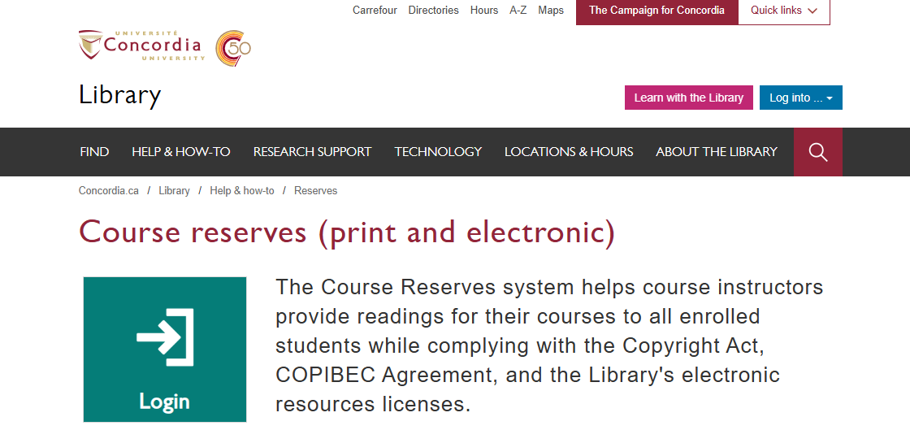

Slide 7
Locating items when you have the citation information

Slide 8
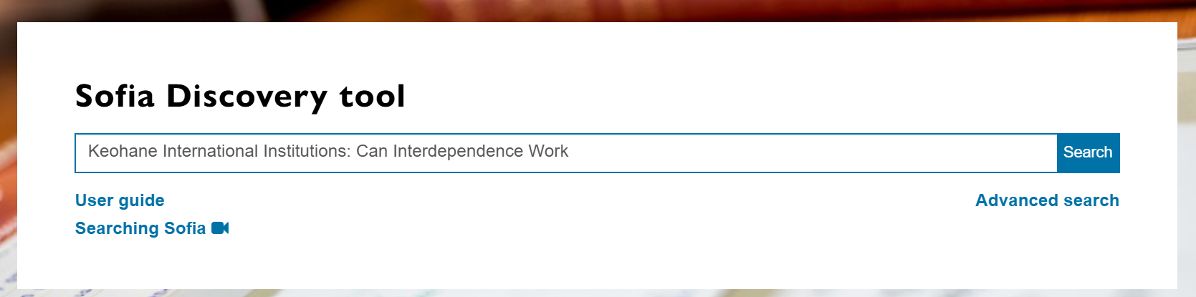
Robert O. Keohane, “International Institutions: Can Interdependence Work?” Foreign Policy 110 (Spring 1998): 82-96.

Slide 9
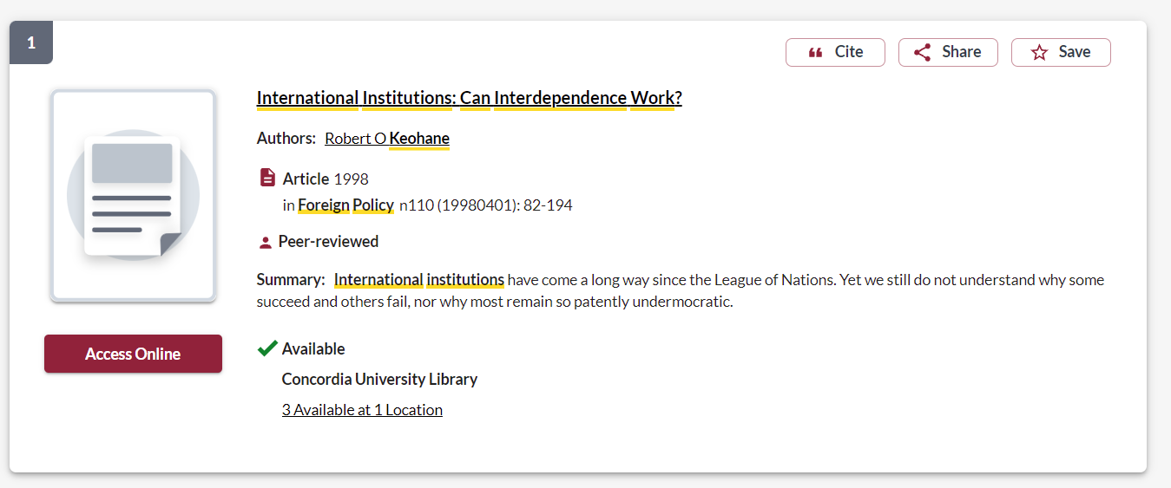
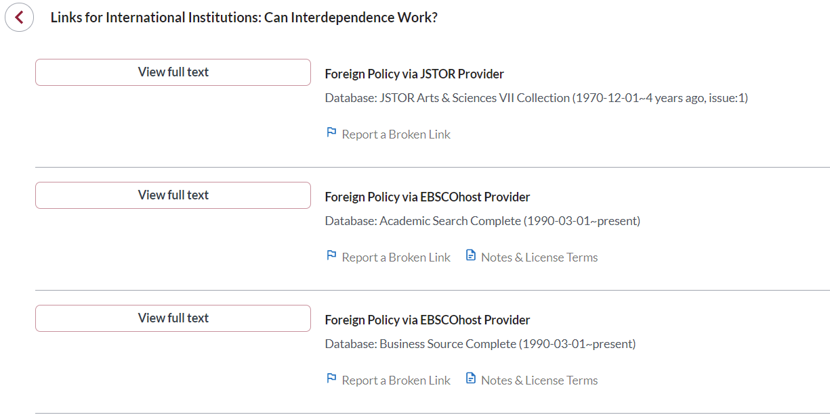
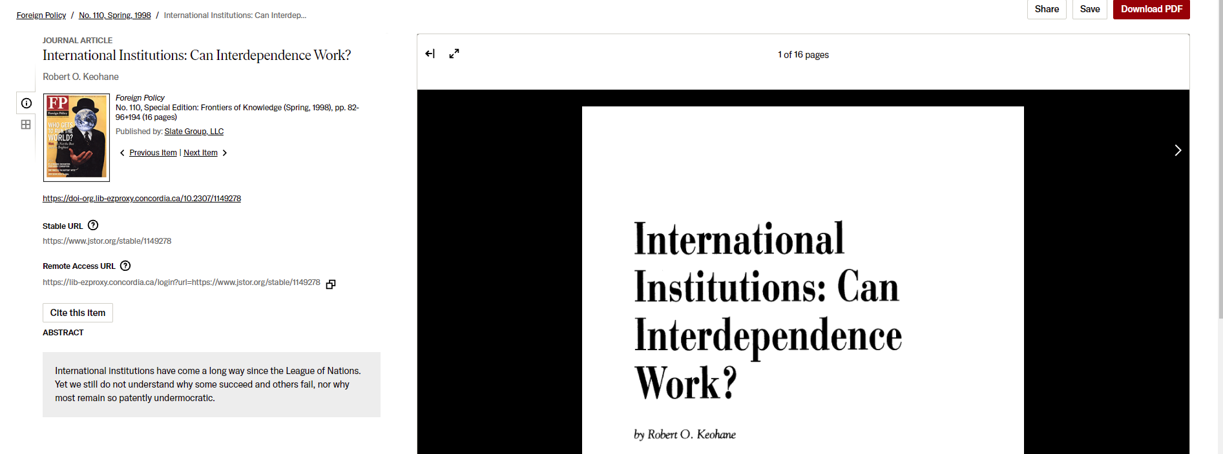

Slide 10
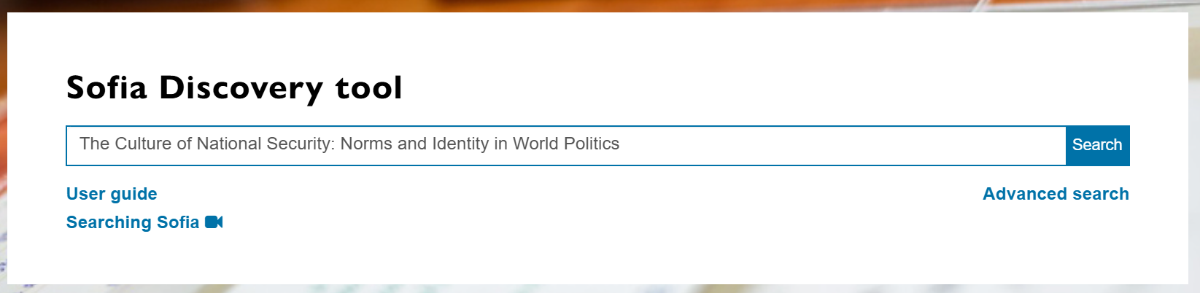
Martha Finnemore, “Constructing Norms of Humanitarian Intervention,” in Peter J. Katzenstein, ed., The Culture of National Security: Norms and Identity in World Politics (New York: Columbia University Press, 1996), 153-185.

Slide 11
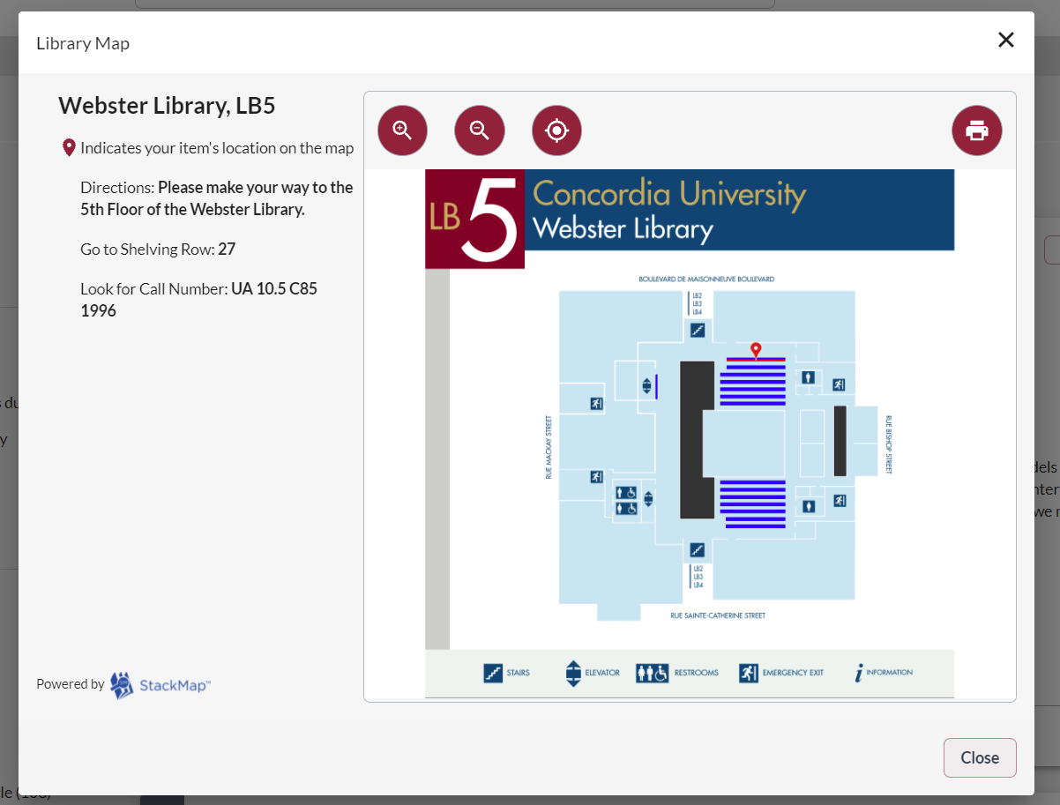
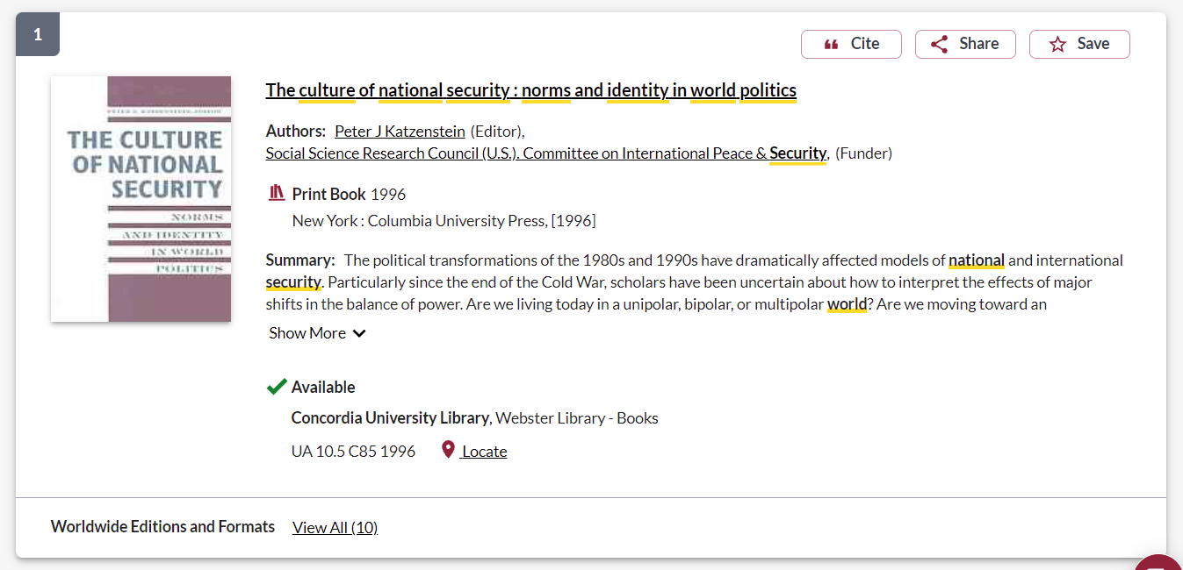

Slide 12
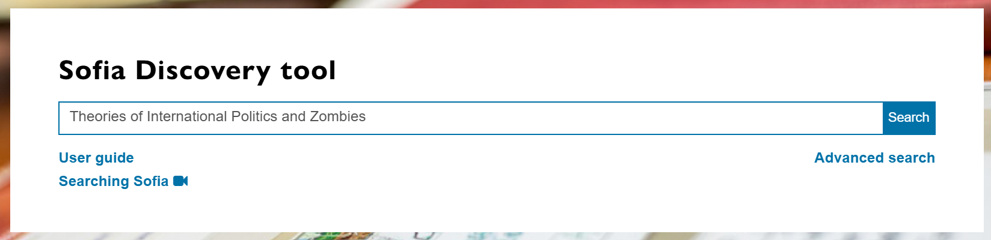
Daniel W. Drezner. Theories of International Politics and Zombies. Princeton, NJ: Princeton University Press.

Slide 13
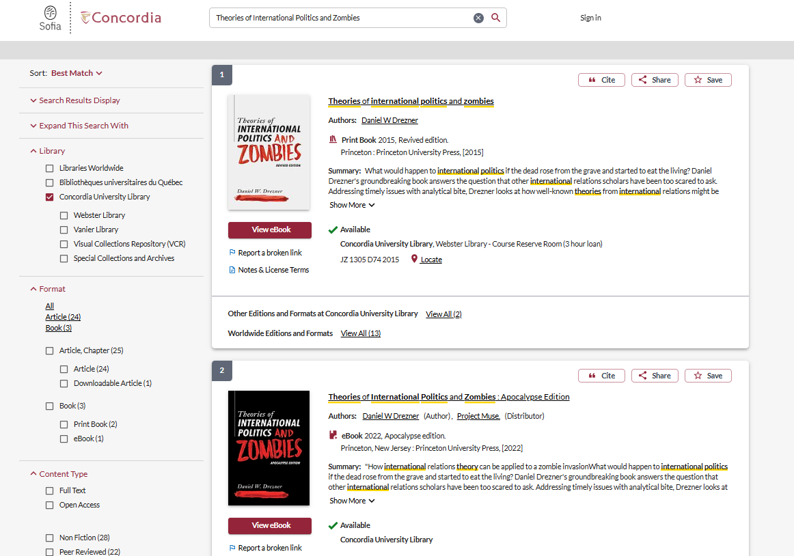

Slide 14
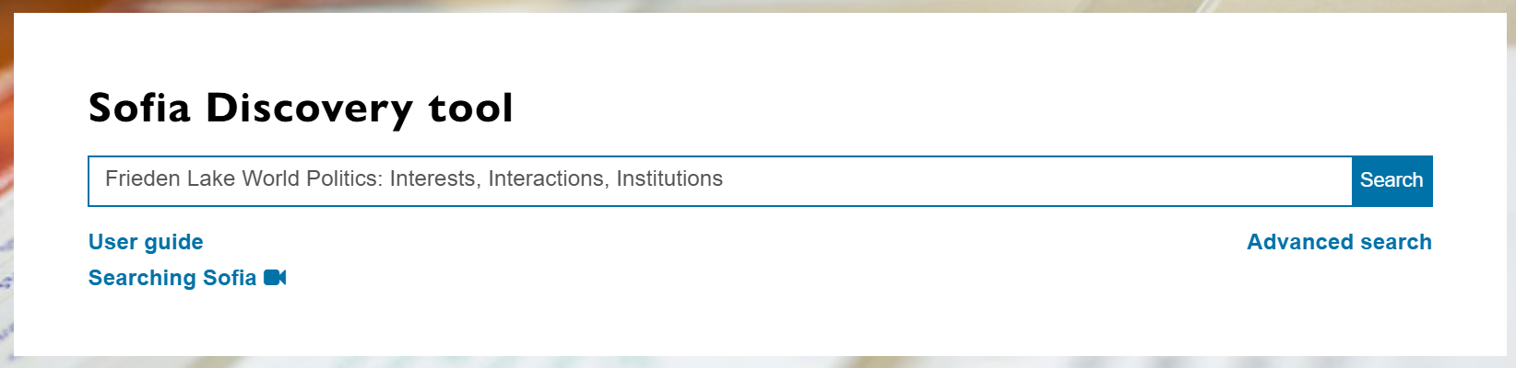
Jeffry A. Frieden, David A. Lake and Kenneth A. Schultz, World Politics: Interests, Interactions, Institutions, 5th edition. (New York: W.W. Norton & Company, 2022).

Slide 15
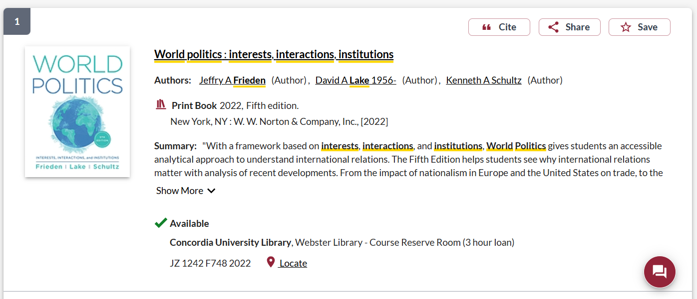
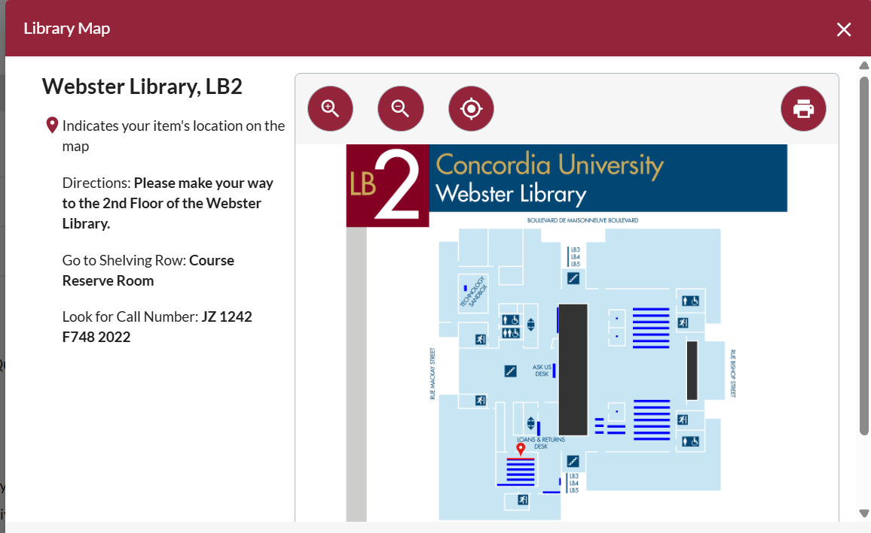
Available to borrow for 3 hours, from the Webster Library Course Reserves Room

Slide 16

Breaking down a topic & Search strategies

Slide 17
Library research assignment Identify five peer reviewed journal articles relevant to a chosen topic and found in Concordia’s online library resources and to format them in a reference list following Chicago author-date style.
Topics (or an alternative approved by Dr. Lipson):
Russia’s 2022 Invasion of Ukraine
U.S. Tariffs under President Trump
The United Kingdom’s withdrawal from the European Union (“Brexit”)
The Paris Agreement on Climate Change
China’s Belt and Road Initiative

Slide 18
Limits
Identify 5 peer reviewed articles in published scholarly journals available online through Concordia’s Library that address your topic
No “opinion” or “editorial” or “book review” articles from peer reviewed journals
Ensure the articles are peer reviewed, do not include the formats above and are directly relevant to your topic
Use Chicago Author-Date citation style, with a hanging indent and including a DOI or web address of the article

Slide 19

What is peer review? What are peer reviewed, scholarly articles?

Slide 20
Has the article gone through the peer review process? What is peer review? Peer review is a system used to decide if an article should be published in a peer-reviewed journal. Each paper submitted to a peer-reviewed journal is read and evaluated by experts in the article’s subject area. The reviewers assess the article’s validity, importance, and originality, and then recommend whether it should be printed in the journal. The reviewers’ suggestions are considered by the journal’s editor, who makes the final decision about whether to accept or reject the article. Criteria for evaluating academic or scholarly articles

Slide 21
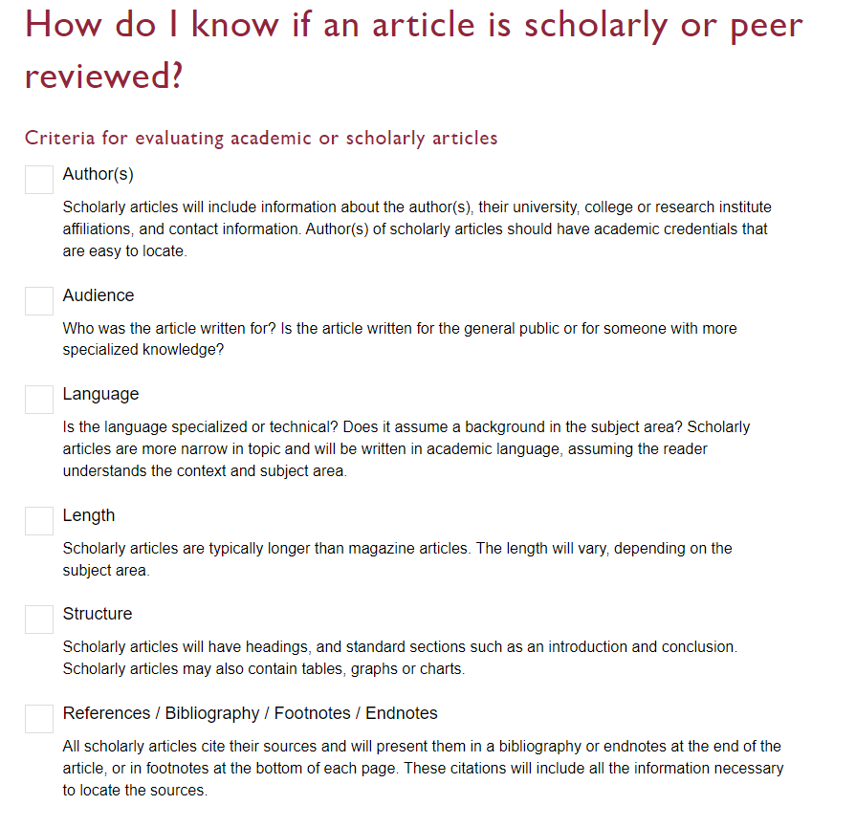

Slide 22
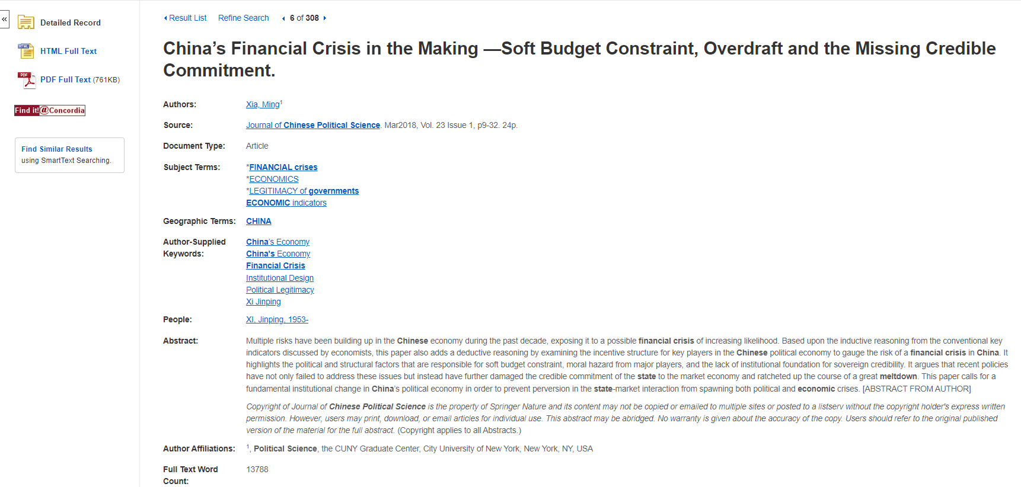
Page length: Scholarly journal articles are 10+ pages long
Author
Is this a scholarly, peer reviewed article?

Slide 23
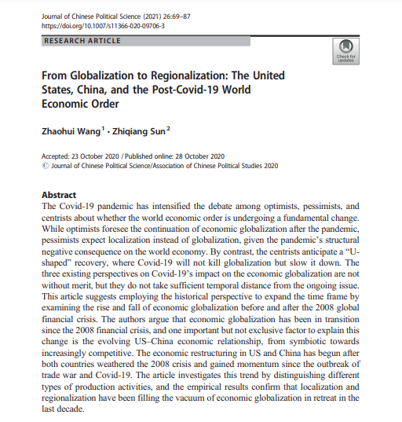
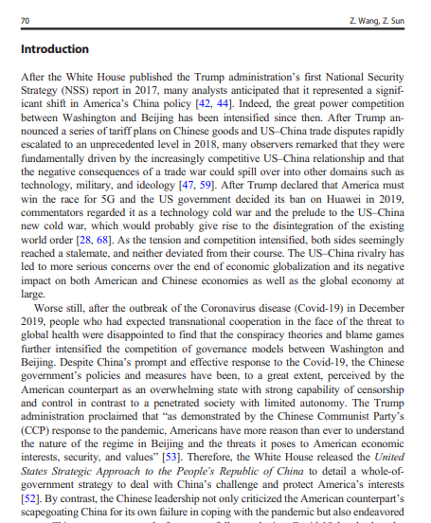
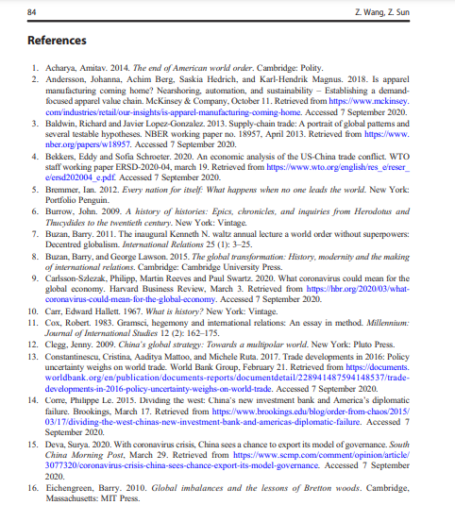
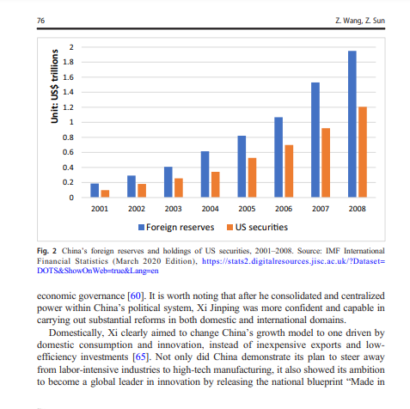
Look for sections, language, charts, tables, graphs and an extensive reference list or bibliography
Specialized language

Slide 24
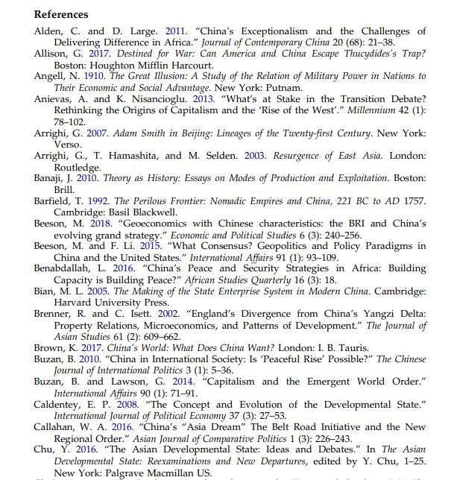
Scholarly articles will always have extensive reference lists/bibliographies/works cited
These are lists of other scholarly journal articles, books and primary sources that support the research topic of the article
The researcher or research team are experts in the subject area and have completed an extensive amount of research
You can find related articles by examining the reference lists of articles on your topic
This is a commonly used method in academic research

Slide 25
How to find peer reviewed articles in library sources

Slide 26
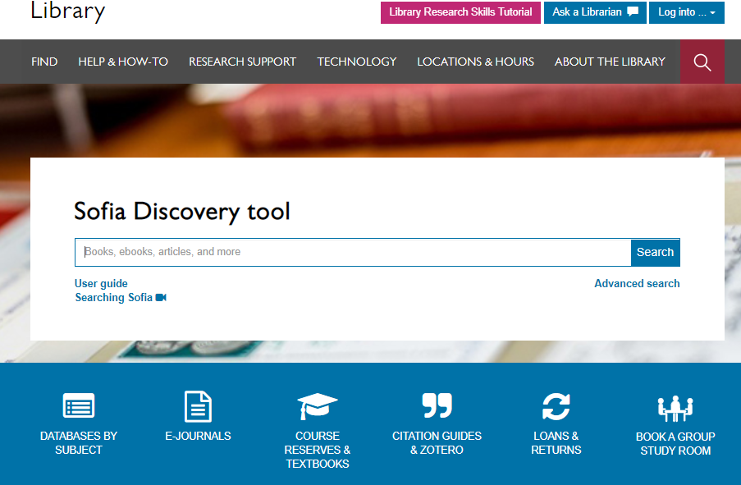
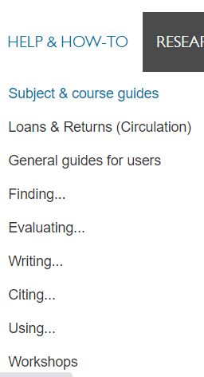

Slide 27
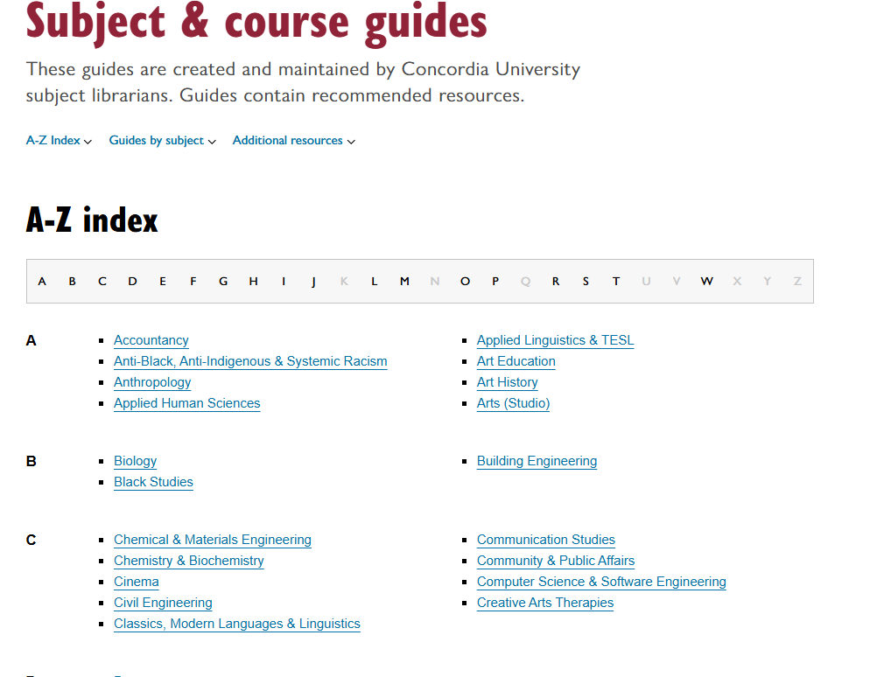
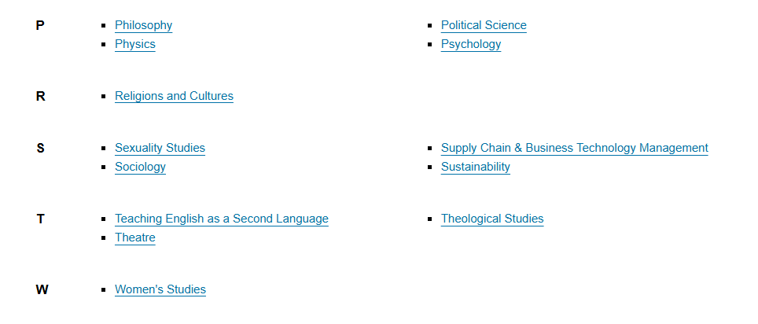
Subject Guide: Political Science

Slide 28
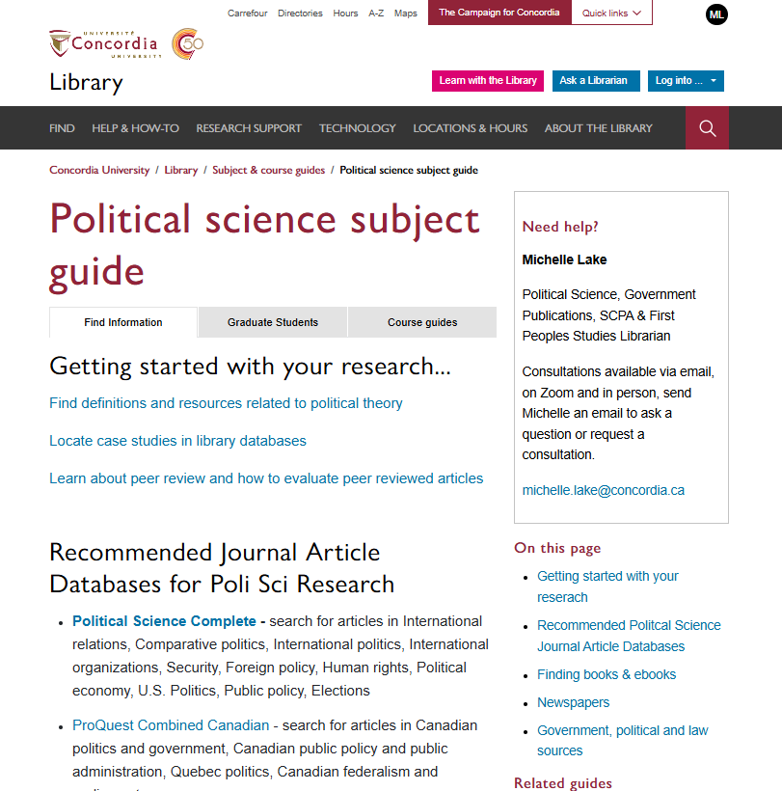
The Political Science Subject Guide is the best place to start your research
There is a list of recommended journal article databases that contain peer reviewed journal articles

Slide 29
Breaking down a topic into a search
The Covid-19 pandemic and its effects on global trade and international relations
Global trade
International trade
World trade
Globalization
Covid-19
Coronavirus
Covid
SARS-CoV-2
International relations
Foreign relations
International borders
Travel restrictions
International politics
Pandemic
Epidemic
Infectious disease

Slide 30
Search Tips
AND –limits how many results your search produces
Example: security AND politics
OR –increases the number of results your search produces
Example: state OR government
“ ” -exact phrase, limits your search results
Example: “international cooperation”
*- truncation: retrieves all words that start with the letters entered and expands search results
Example: peace* finds peace, peacebuilding, peacemaking, peacekeeping

Slide 31
Avoid Searching with Linking words
Effects
Impact
Consequences
Influence
Results
Importance
Significance
Response
Emphasis
Each author may use different linking words when discussing similar topics.
You don’t want your search to be limited to those books and articles that only contain the word “effect” or “consequence”

Slide 32
Breaking down your topic
(Covid-19 OR Coronavirus)
AND (pandemic OR epidemic)
AND (“global trade” OR “international trade” OR “world trade”)
AND (politic* OR “foreign relations” OR “international borders”)

Slide 33
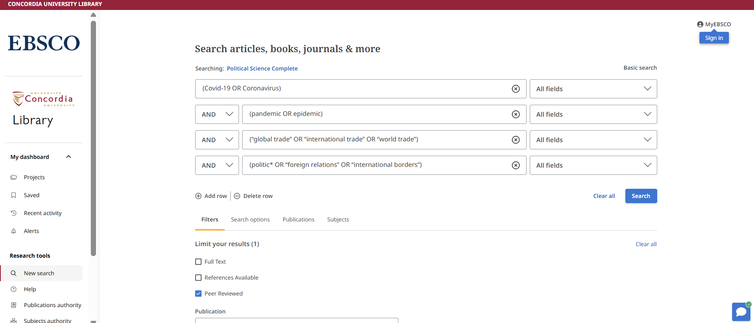
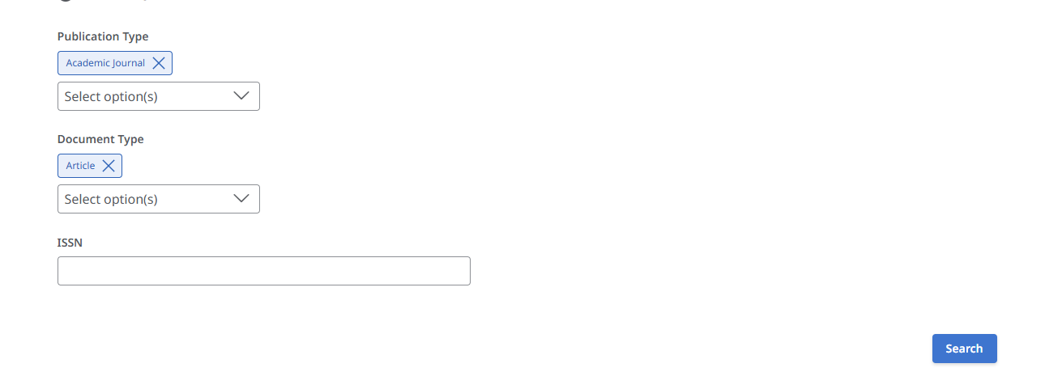
Divide up your keywords by AND/OR in different boxes
Check off the peer reviewed option to only see peer reviewed articles
There are options to choose Academic Journal and Articles only

Slide 34
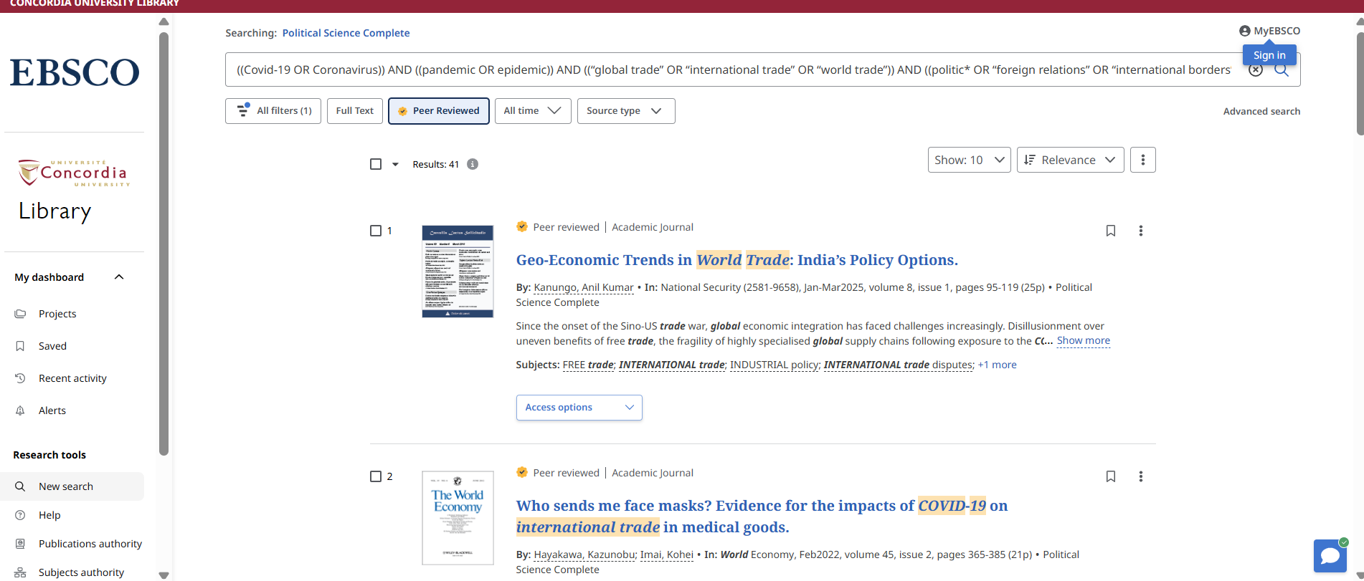
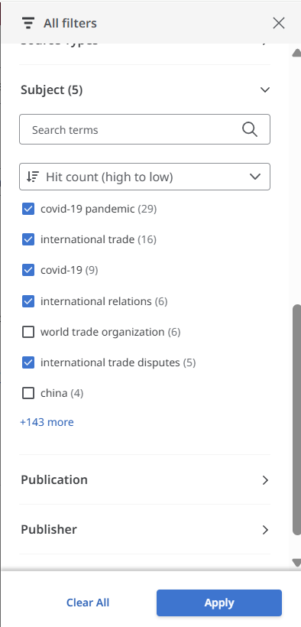

Slide 35
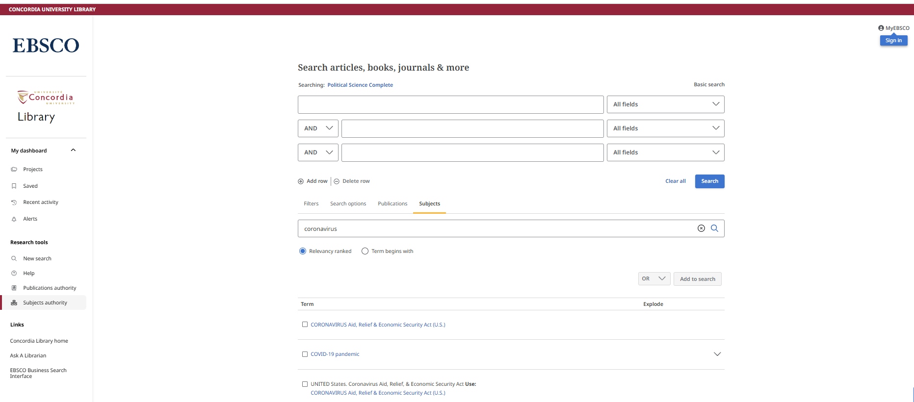
Using the subject authority
Search for terms related to events, agreements, subjects related to political science

Slide 36
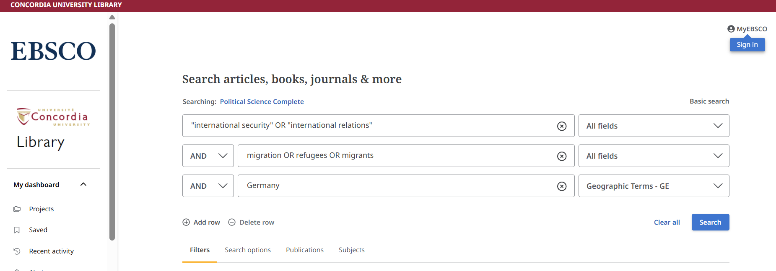

Searching with geographic terms

Slide 37
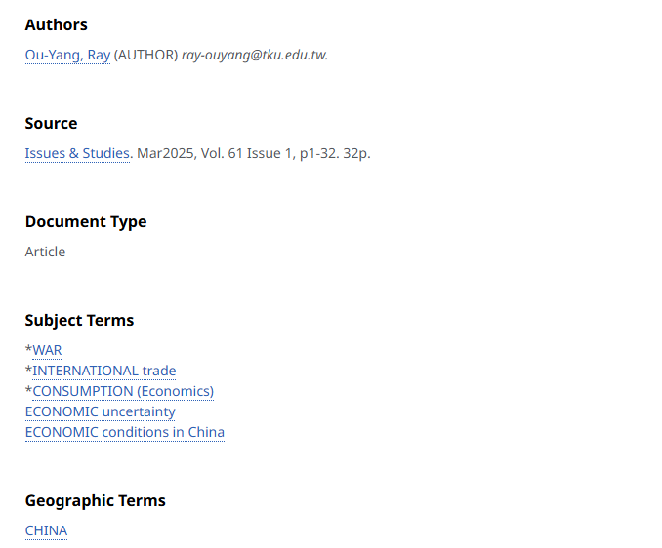
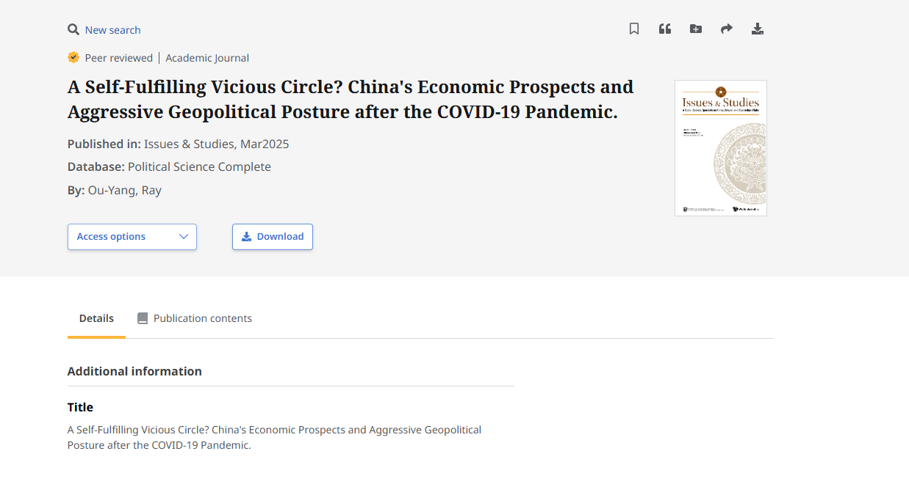
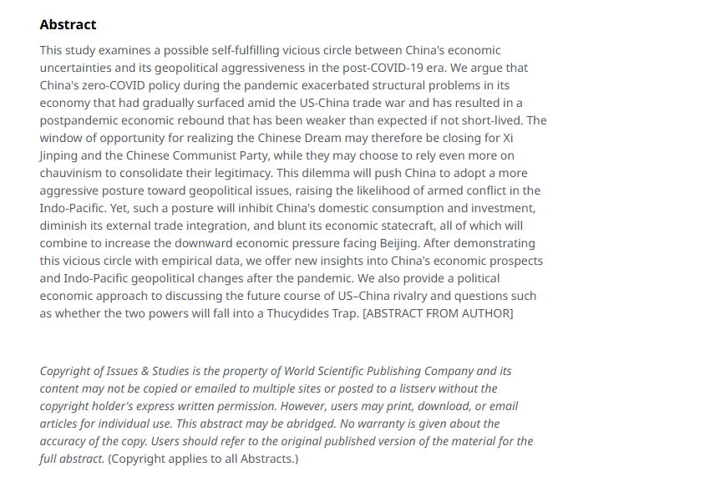
Is it a peer reviewed article? Page length, author affiliations, abstract

Slide 38
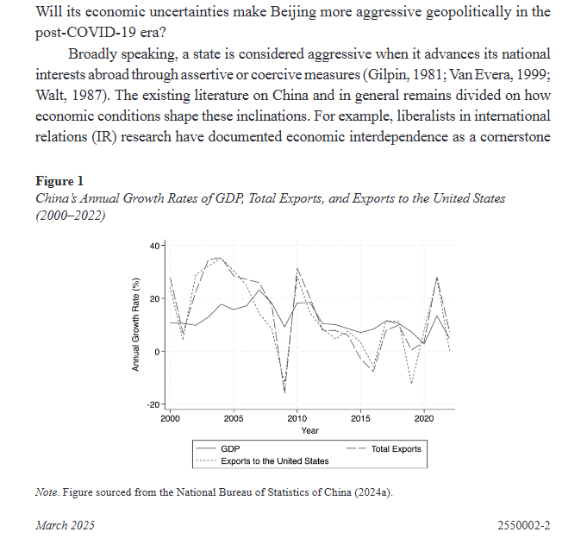
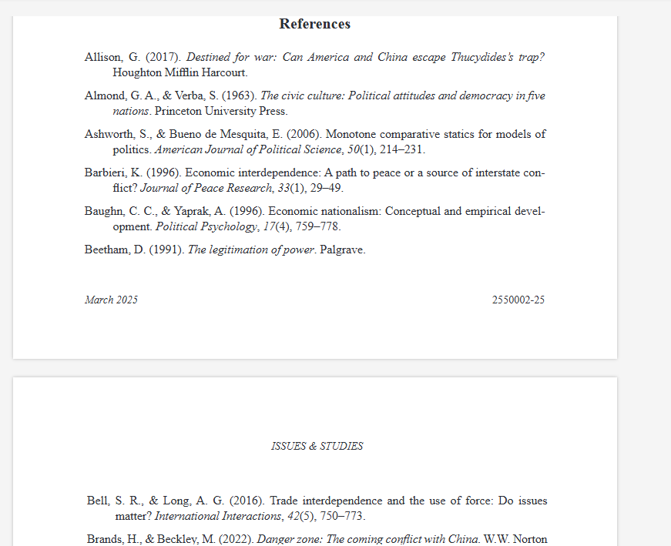
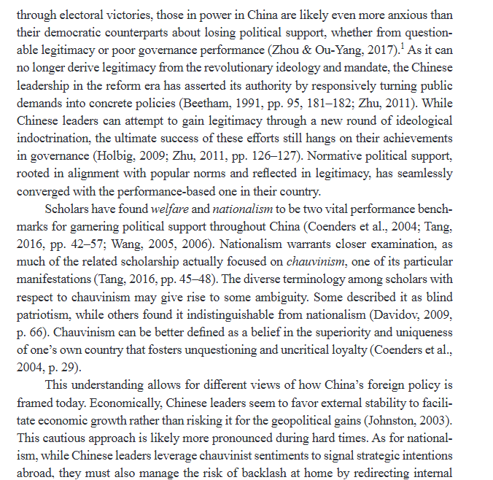










Figures/tables, citations throughout the article, reference list

Slide 39
Is it peer reviewed? Is it relevant to your topic?
Read the Abstract: does it describe the article as a study? An analysis or assessment? Does it describe a methodology? Or a political theory?
AVOID: commentary, editorial, opinion
Read the introduction & conclusion, review the headings of article, does the article seem relevant to your topic?
One final check, search for the name of the journal + peer review to find journal’s policy

Slide 40
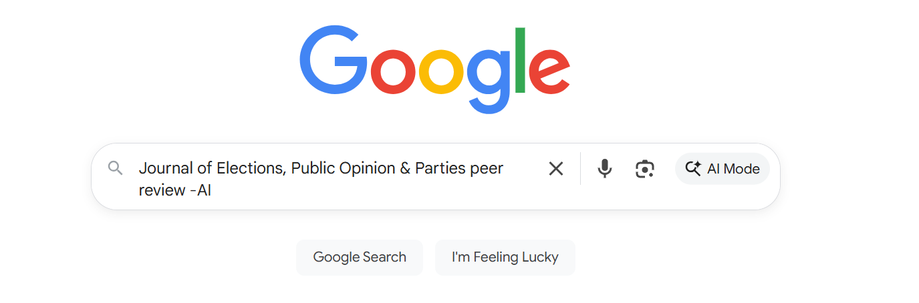
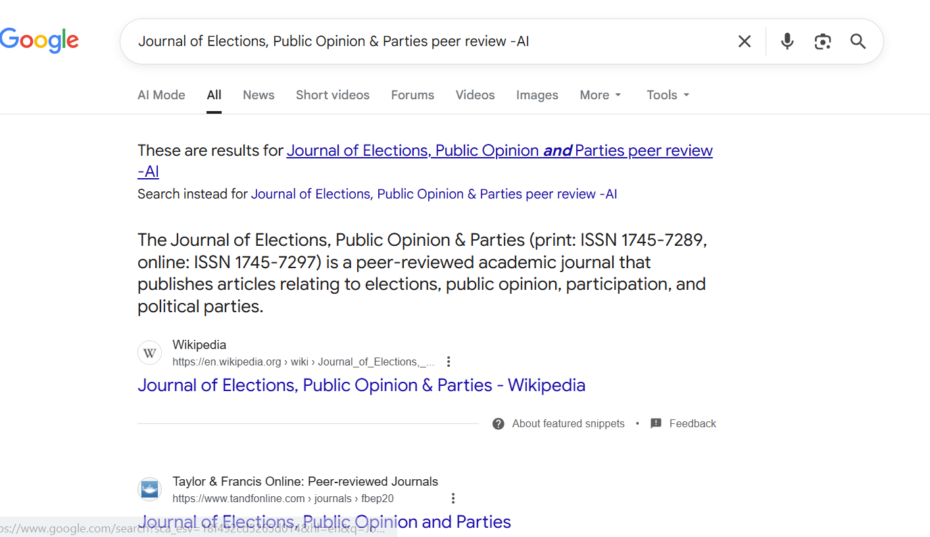
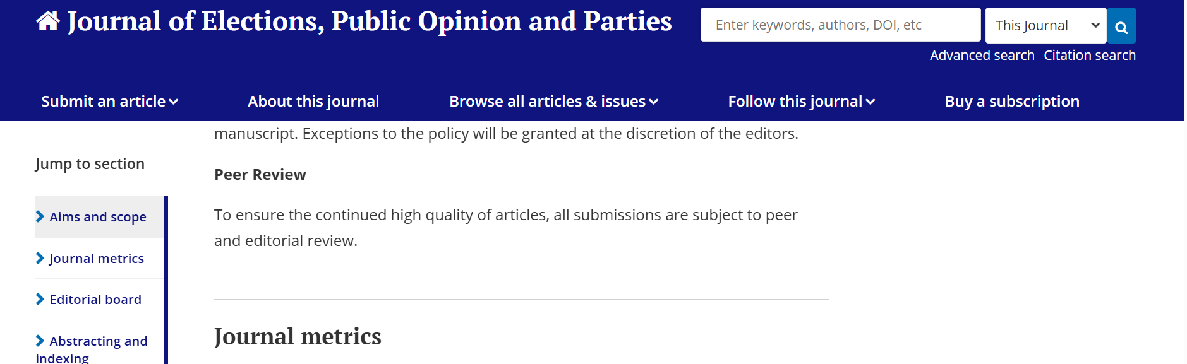

Slide 41
Citing your sources

Slide 42
Citation Resources
On Chicago author-date format, see: https://www.chicagomanualofstyle.org/tools_citationguide/citation-guide-2.html.
For more specific guidelines, see: https://www-chicagomanualofstyle-org.lib-ezproxy.concordia.ca/book/ed18/part3/ch13/psec110.html. (You will need to log in with Concordia credentials)
See the example of a Chicago author-date formatted reference list at: https://www-chicagomanualofstyle-org.lib-ezproxy.concordia.ca/book/ed18/part3/ch13/psec112.html
The DOI or web address should appear at the end of the reference list entry for the article (followed by a period – all reference list entries end with a period), as in the Dittmar and Schemske example in the “journal article” section at: https://www.chicagomanualofstyle.org/tools_citationguide/citation-guide-2.html

Slide 43
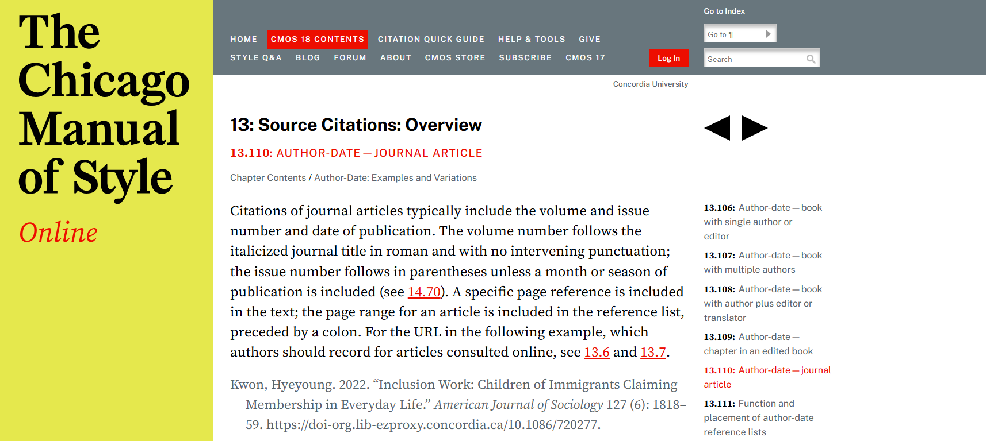

Slide 44
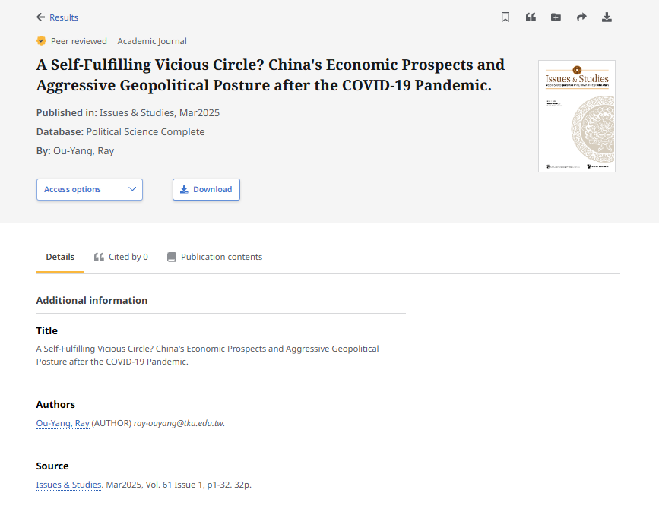
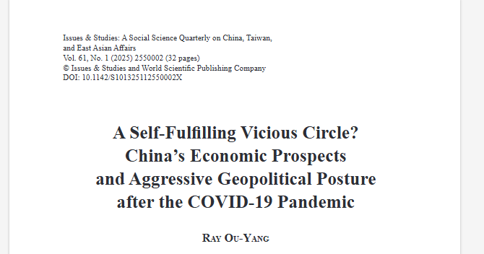
What are the parts of a citation?
Author: Ou-Yang, Ray.
Year: 2025
Article title: “A Self-Fulfilling Vicious Circle? China’s Economic Prospects and Aggressive Geopolitical Posture after the COVID-19 Pandemic.”
Journal title: Issues & Studies
Volume: 61
Issue: (1)
Pages: 1-32.
DOI:10.1142/S101325112550002X.

Slide 45

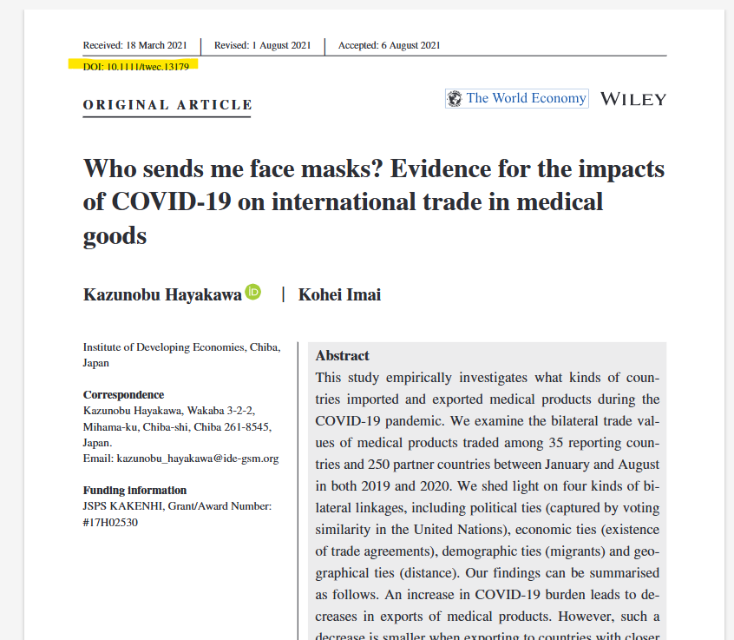
Where to find the DOI?

Slide 46
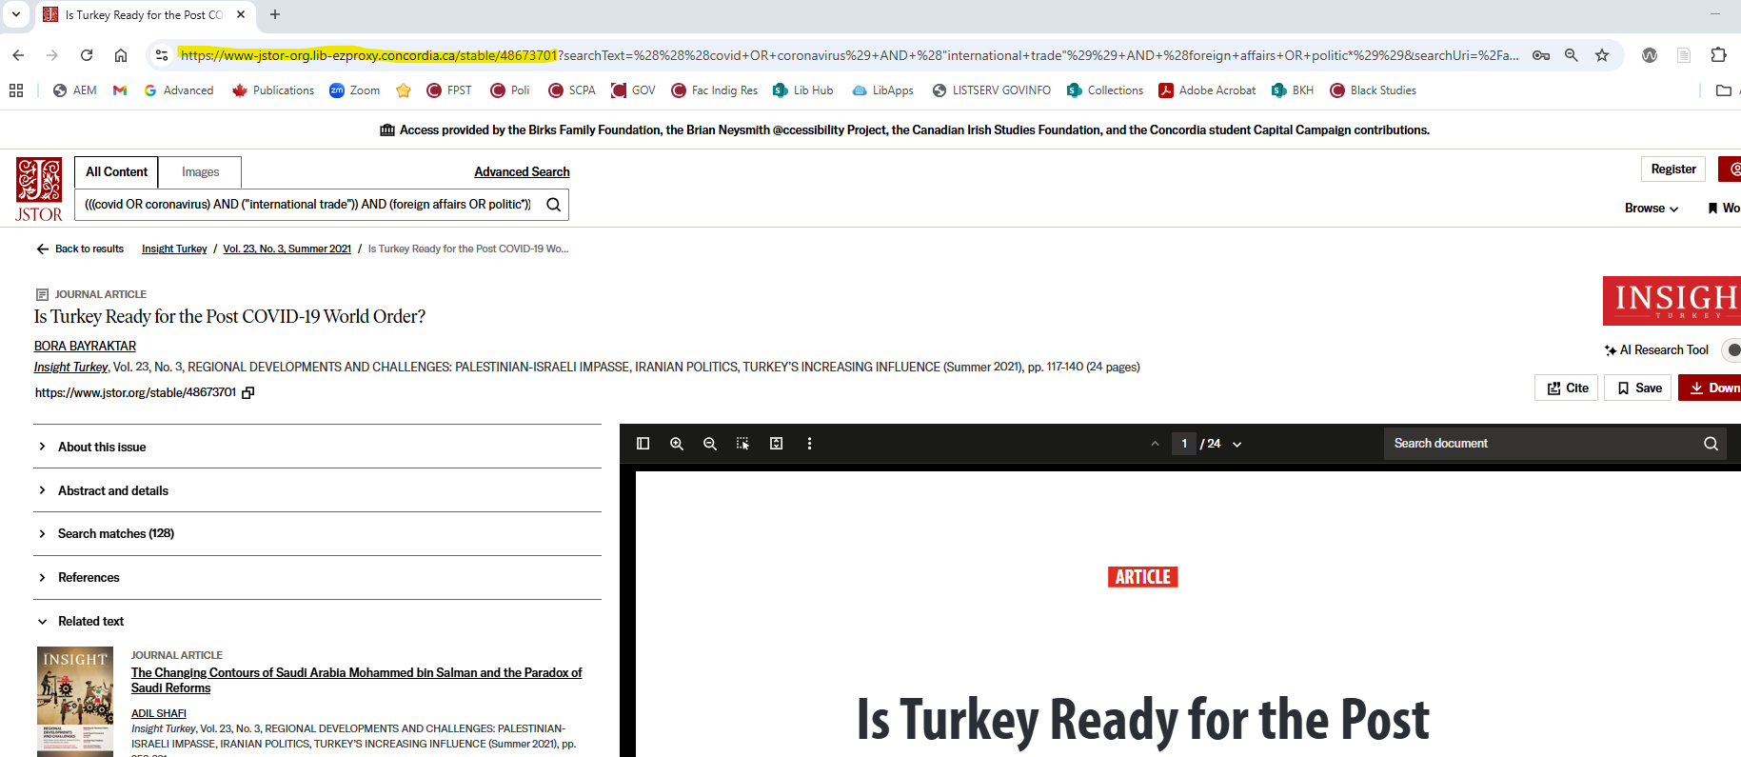
Where to find the DOI or URL?

Slide 47
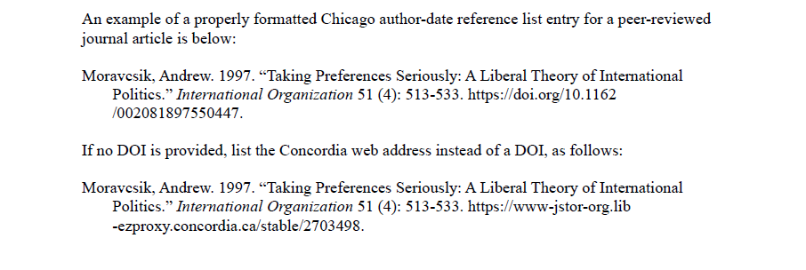

Slide 48

Need help, ask us!
Michelle.Lake@Concordia.ca

