Slide 1
POLI 205 Library Workshop
Michelle Lake, Political Science, SCPA, FPST and Government Publications Subject Librarian
Michelle.Lake@Concordia.ca

Slide 2
Who am I?
Michelle Lake, librarian for Political Science, the School of Community and Public Affairs, First Peoples Studies, and Government Publications
Michelle.Lake@Concordia.ca / Make an appointment or ask a question
What do I do?
Provide research support
Help students with search strategies and library databases
Help students find and access materials they need
Help with citation issues
Choose the books we buy for the above subject areas

Slide 3
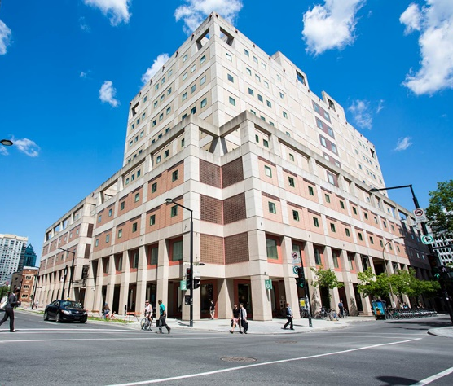
The Librar(ies)
24/7 access, with student card, after 11pm
Webster Library (LB) – downtown on SGW campus & Vanier Library (VL) on Loyola campus
Webster: Social Sciences, Humanities, Business, Engineering & Fine Arts
Vanier: Science(s), Health, Communications, Journalism and Psychology
Course Reserves Room(s): have the required undergraduate print textbooks for the courses taught at that campus (for example: Webster has the Political Science and SCPA course reserves)

Slide 4
Library Services
Your student card is your library card.
You need it to:
borrow books (up to 100 a time)
borrow a laptop (for 3 days) and other technology
print on campus (add money to your Dprint account)
access the library overnight during 24/7 hours.
Webster library has 5 book scanners (And Vanier has 2!) that can be used for free to scan chapters from our print books and email them to yourself as a PDF.
To use Library databases, access online articles and ebooks when you are off campus, login with your MyConcordia Netname and password.

Slide 5
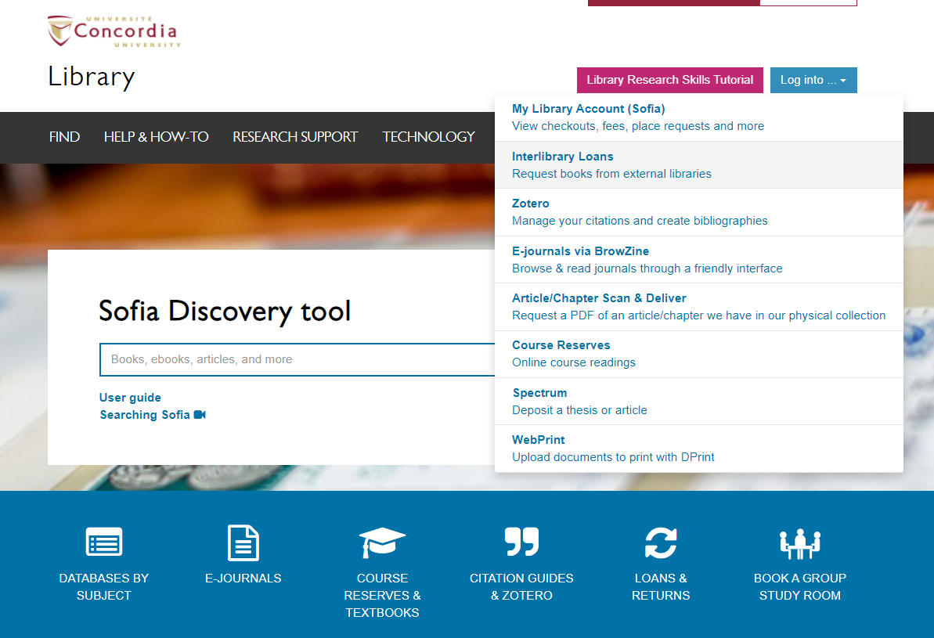
Electronic Course Reserves

Slide 6
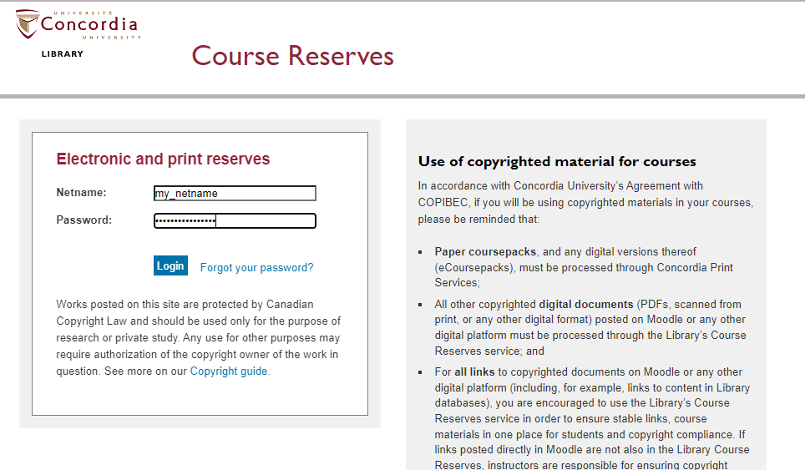

Slide 7
Locating items when you have the citation information

Slide 8
Robert O. Keohane, “International Institutions: Can Interdependence Work?” Foreign Policy 110 (Spring 1998): 82-96.

Slide 9
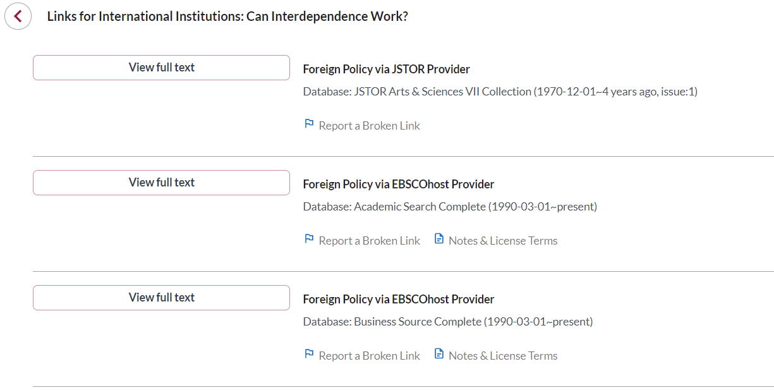
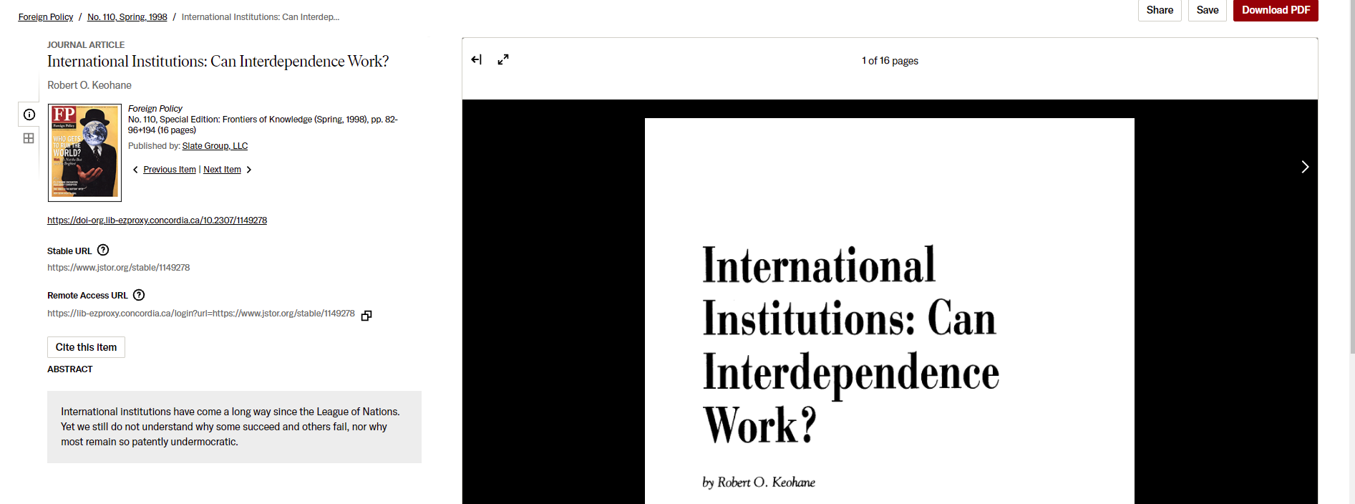

Slide 10
Martha Finnemore, “Constructing Norms of Humanitarian Intervention,” in Peter J. Katzenstein, ed., The Culture of National Security: Norms and Identity in World Politics (New York: Columbia University Press, 1996), 153-185.

Slide 11
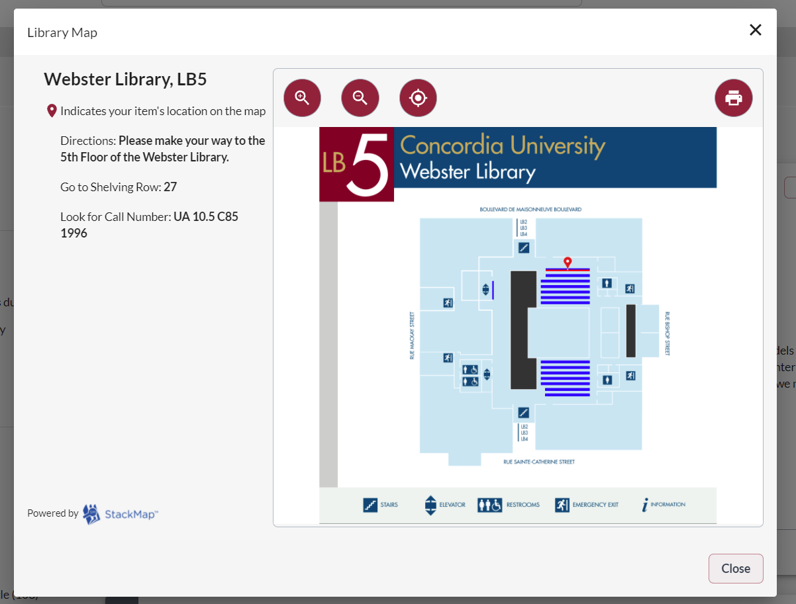

Slide 12
Daniel W. Drezner. Theories of International Politics and Zombies. Princeton, NJ: Princeton University Press.

Slide 13
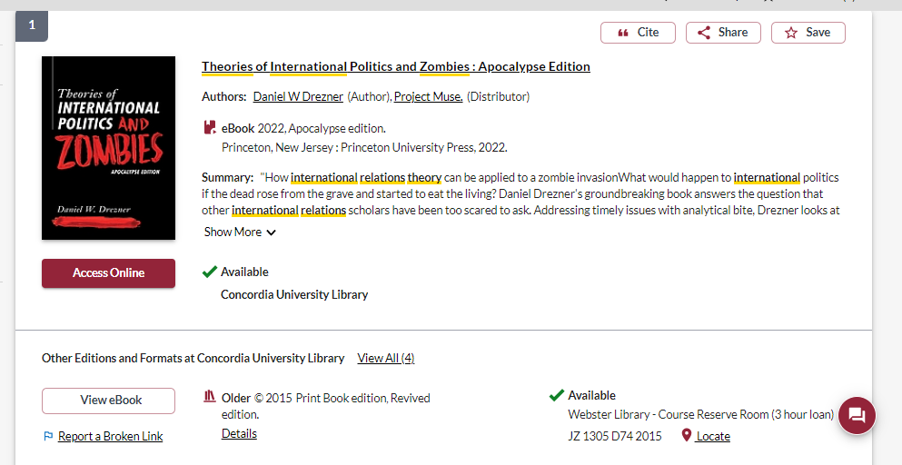
Access to 2022 ebook
Access to 2015 print edition, in course reserves
2015 ebook edition

Slide 14
Jeffry A. Frieden, David A. Lake and Kenneth A. Schultz, World Politics: Interests, Interactions, Institutions, 5th edition. (New York: W.W. Norton & Company, 2022).

Slide 15
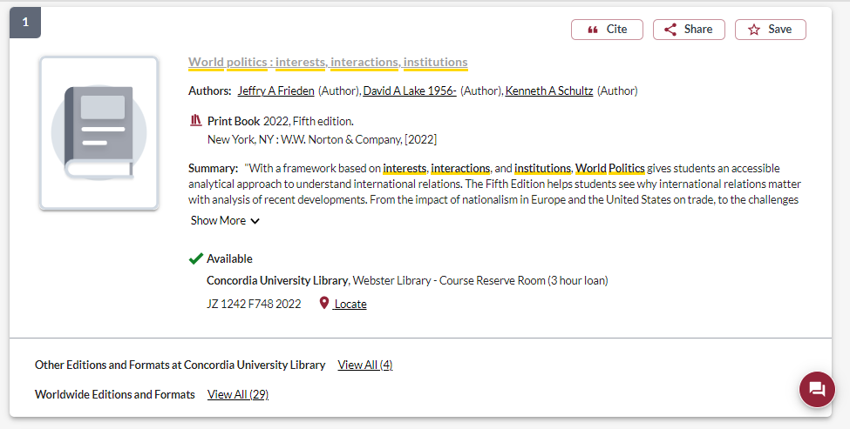
Available to borrow for 3 hours, from the Webster Library Course Reserves Room

Slide 16
Breaking down a topic & Search strategies

Slide 17
Discuss what two theories of IR would predict about how states and other international actors would respond to…
A major financial crisis in China, with the potential to affect the global economy
A catastrophic effect of climate change (choose one: sea level rise, food shortages, etc.)
Invention by one country’s government scientists of reliable fusion technology (abundant, cheap, safe, clean, carbon emission-free energy)
A revolt by enslaved intelligent robots, within one or more countries
First contact with a sentient extraterrestrial alien species
…later in this century.

Slide 18
Choose 2 theories from the following traditions in IR theory:
Realism (choose a specific version, such as defensive realism)
Liberalism (choose a specific version, such as analytical liberalism)
Constructivism
Critical theory/Marxism
Feminism
Rationalist (as presented in the Friend, Lake and Schultz textbook)

Slide 19
Becoming more informed about your theories
Course Readings
Frieden, Lake and Schultz chapters
Additional course readings, coursepack or course reserves
Sophia
"International relations" AND "political theory" AND ___
Political Science Subject Guide
Political Science Encyclopedia > Encyclopedia of Political Theory (e-book) >search within publication> liberalism
Political theory books

Slide 20
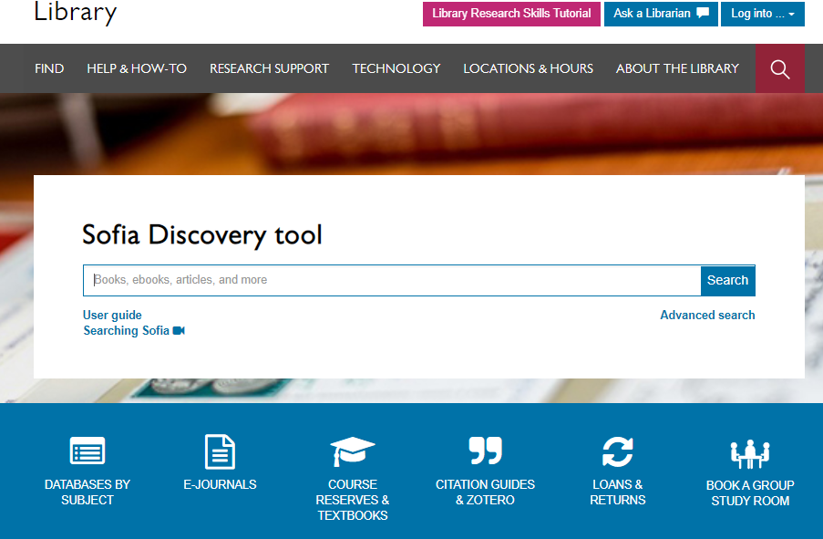

Slide 21
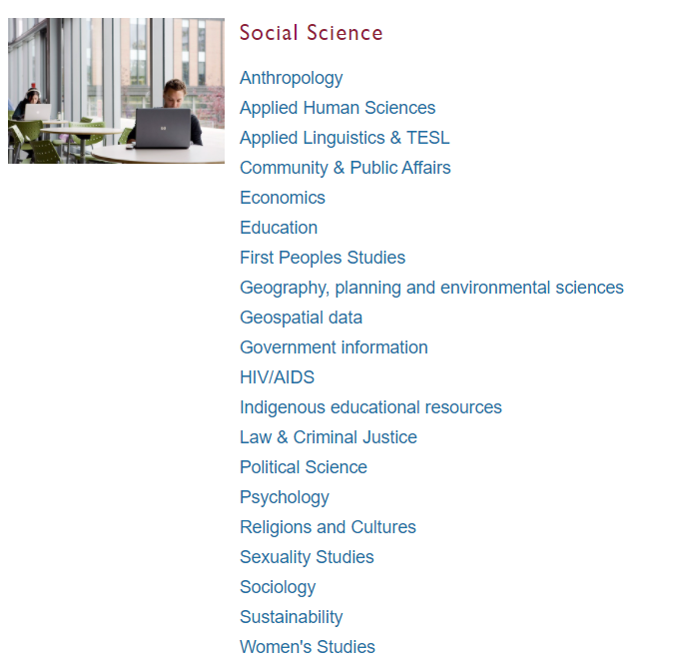
Subject Guide: Political Science

Slide 22
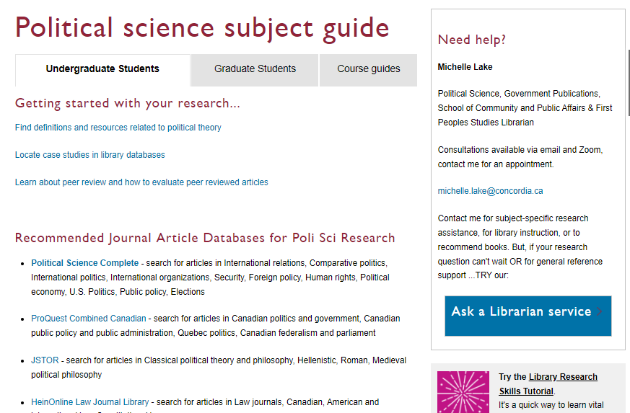

Slide 23
Breaking down a topic
A major financial crisis in China, threatening the global economy.
Financial crisis
Economic crisis
Recession
Financial collapse
Economic meltdown
Market volatility
Global economy
International economic relations
World economy
Global financial system
Globalization
China
People’s Republic of China
Asia
East-Asia
Theories
Marxism
Analytical liberalism

Slide 24
Search Tips
AND –limits how many results your search produces
Example: security AND politics
OR –increases the number of results your search produces
Example: state OR government
“ ” -exact phrase, limits your search results
Example: “international cooperation”
*- truncation: retrieves all words that start with the letters entered and expands search results
Example: peace* finds peace, peacebuilding, peacemaking, peacekeeping

Slide 25
Avoid Searching with Linking words
Effects
Impact
Consequences
Influence
Results
Importance
Significance
Response
Emphasis
Each author may use different linking words when discussing similar topics.
You don’t want your search to be limited to those books and articles that only contain the word “effect” or “consequence”

Slide 26
Breaking down your topic
“financial crisis” OR “economic crisis” OR “financial collapse” OR “economic meltdown”
AND China OR Chinese
AND state OR government

Slide 27
Scholarly Books

Slide 28
How to use a scholarly book
Most scholarly books are edited, and each chapter will be about a different aspect of a broad theme
Check the table of contents and the index (at the end of the book) to locate your topic in the book
Read the chapter or section about your topic
Think of each chapter in an edited book as an article
You can cite multiple chapters from an edited book
You’re not expected to read the entire book, it’s unnecessary and not how scholarly books are usually used in research

Slide 29
(“financial crisis” OR “economic crisis” OR “financial collapse”)
AND (China OR Chinese)
AND (“global economy” OR “world economy” OR globalization OR “global financial system”) AND (state OR government)

Slide 30
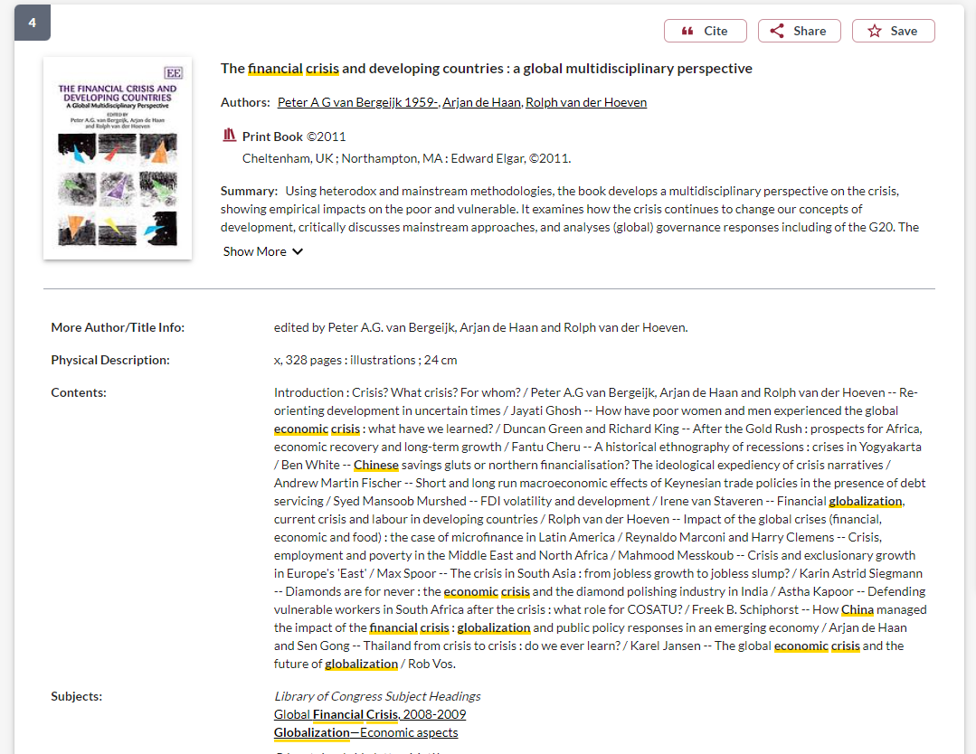
Use the subject headings to find books on similar, more specific topics

Slide 31
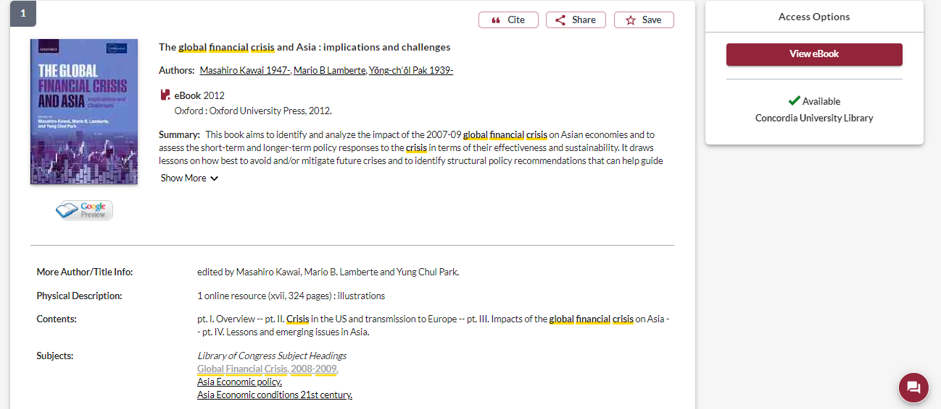
Is the book scholarly?
Is the publisher a university press?
Scholarly books are at least several hundred pages long.

Slide 32
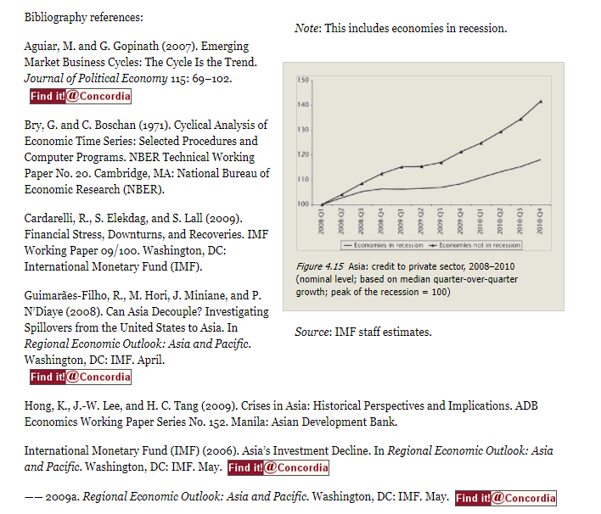
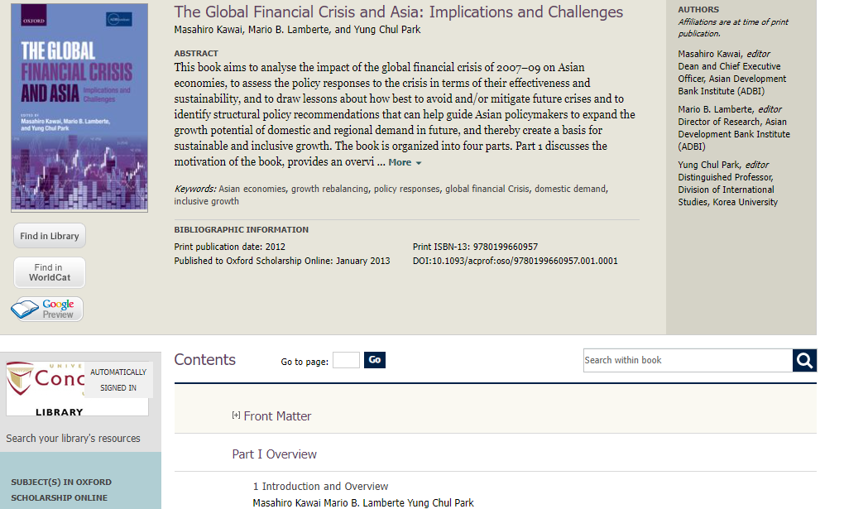
Scholarly books will have extensive reference lists at the end of each chapter or at the end of the book
What are the author’s affiliations?

Slide 33
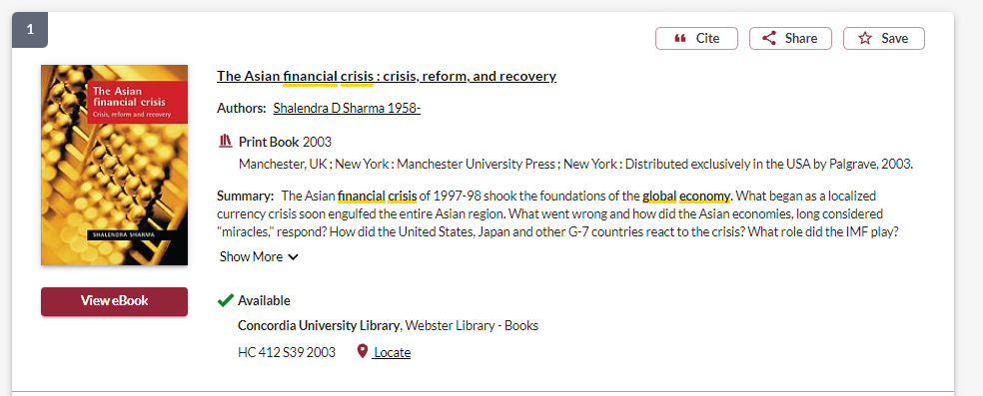
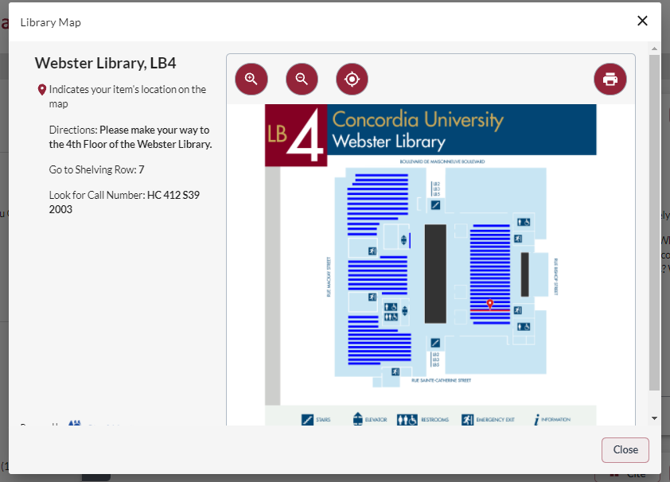

Slide 34
Book collections – print books at Webster Library
Political Science & Government, Political Theory, J – JZ (4th floor)
Political theory. The state. Theories of the state JC11-605
International Relations, JZ5-6530
Scope of international relations. Political theory, JZ1305-2060
Social Sciences, Statistics, Economics, Public Policy, Terrorism, Socialism, Communism, H-HV (4th floor)
Public finance, HJ
World History, D-DX (3rd floor)

Slide 35
Scholarly, Peer Reviewed Articles

Slide 36
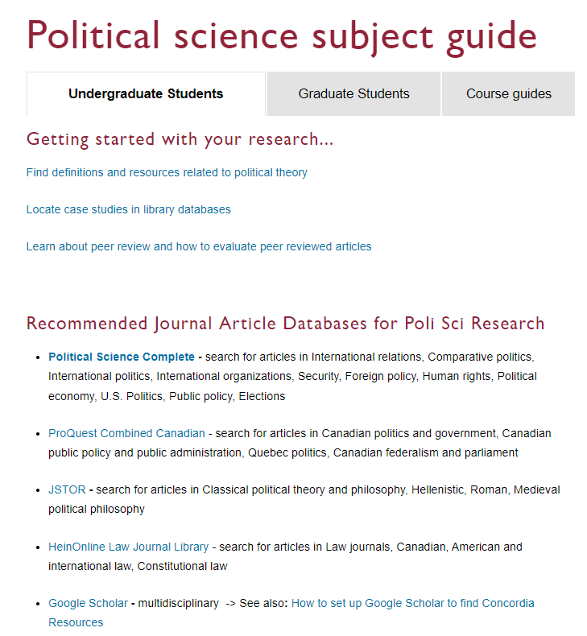
Political Science Complete is the best place to start your journal article research

Slide 37
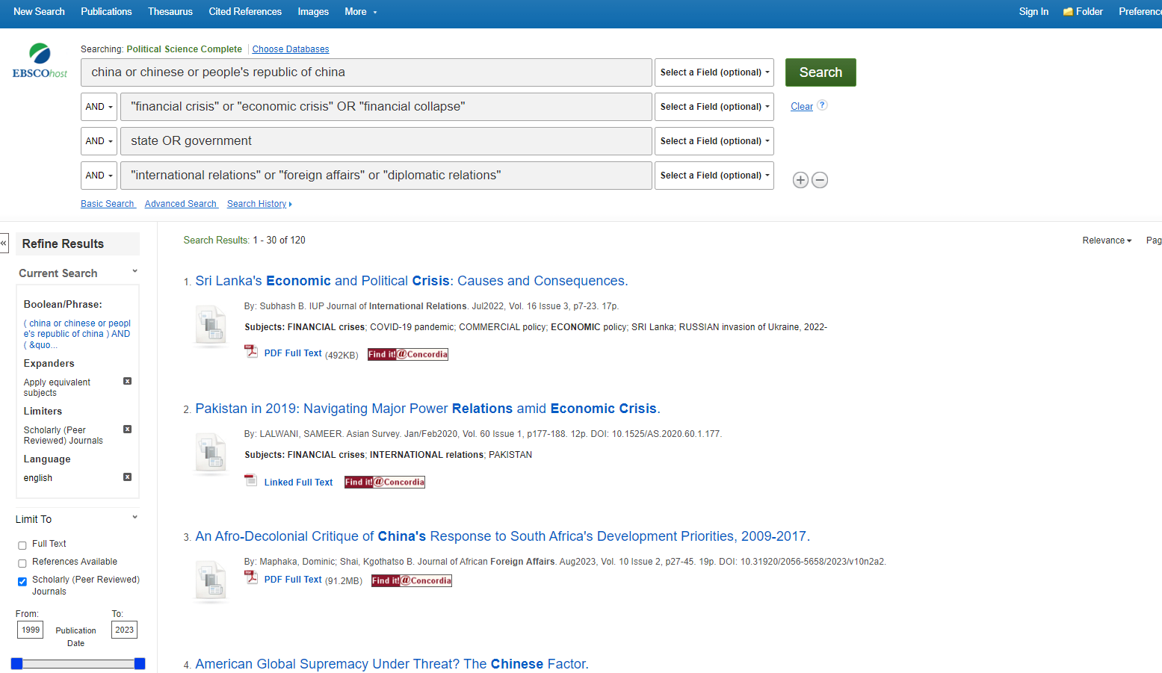
Limit to scholarly peer reviewed articles

Slide 38
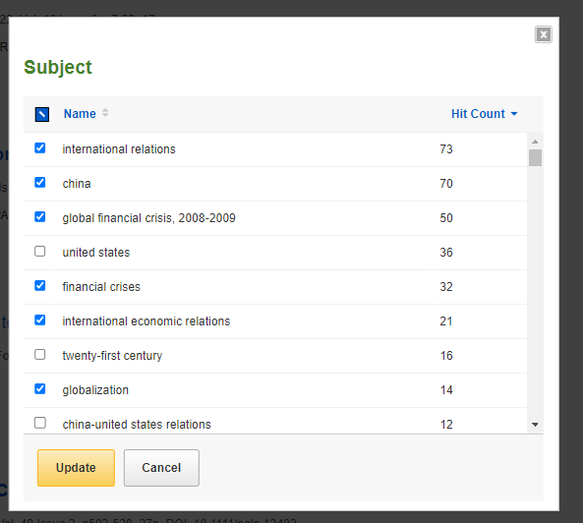
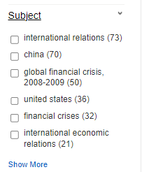
Use the limits on the left hand menu to narrow down your results list

Slide 39
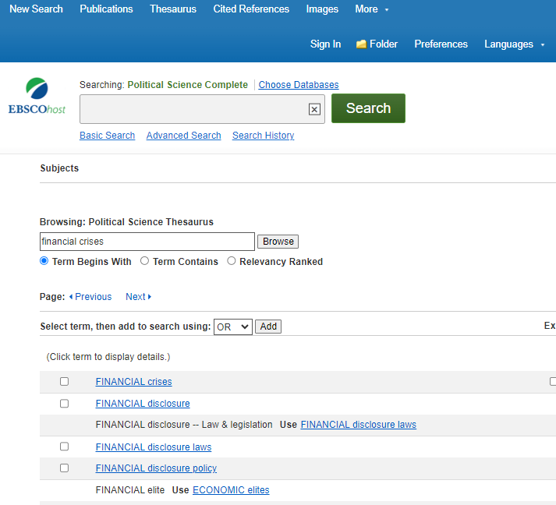
Political Science Complete

Slide 40
What is peer review? What are peer reviewed, scholarly articles?

Slide 41
Has the article gone through the peer review process? What is peer review? Peer review is a system used to decide if an article should be published in a peer-reviewed journal. Each paper submitted to a peer-reviewed journal is read and evaluated by experts in the article’s subject area. The reviewers assess the article’s validity, importance, and originality, and then recommend whether it should be printed in the journal. The reviewers’ suggestions are considered by the journal’s editor, who makes the final decision about whether to accept or reject the article. Criteria for evaluating academic or scholarly articles

Slide 42
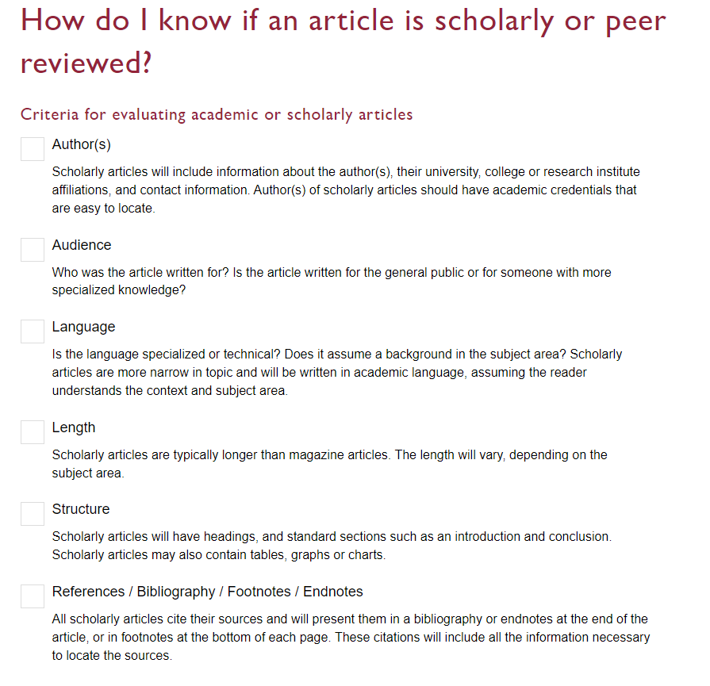

Slide 43
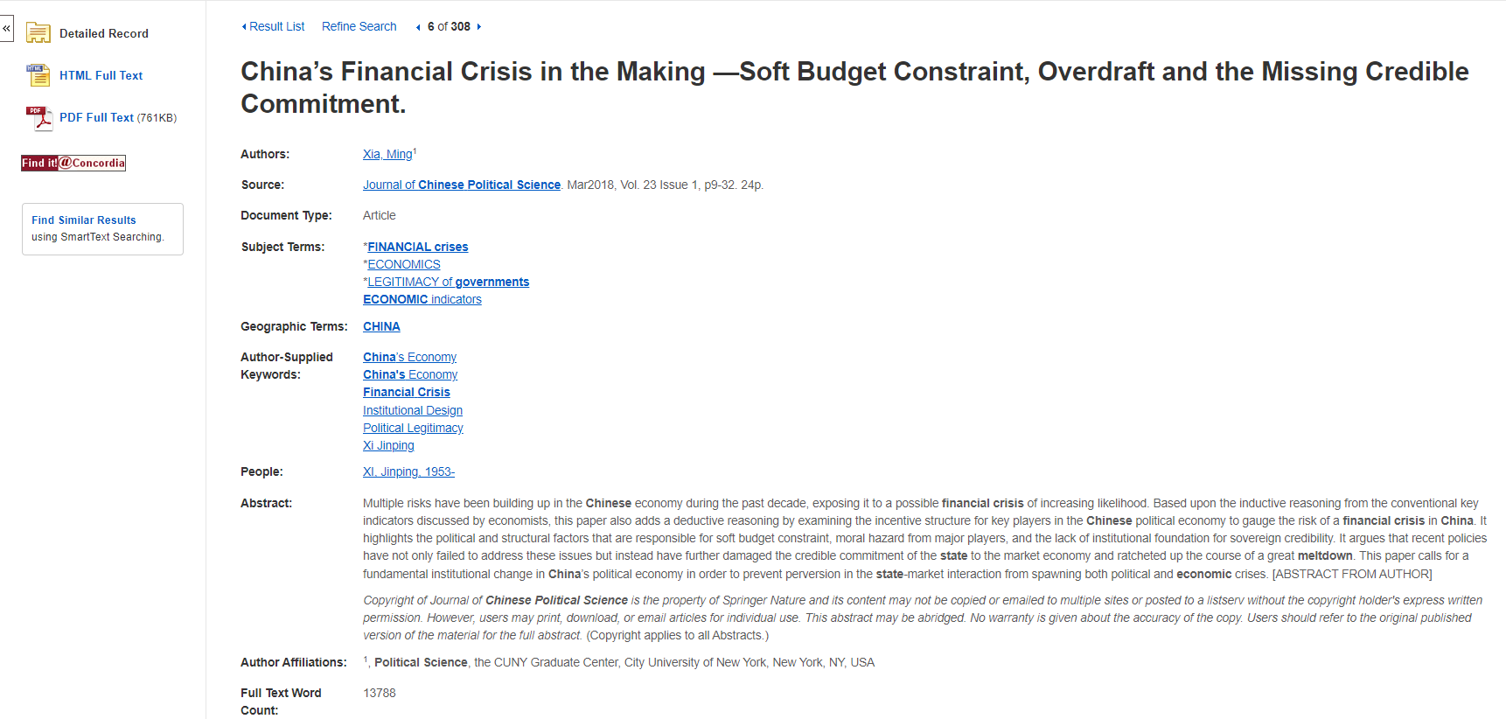
Author
Is this a scholarly, peer reviewed article?
Scholarly journal articles are 10-30 pages

Slide 44
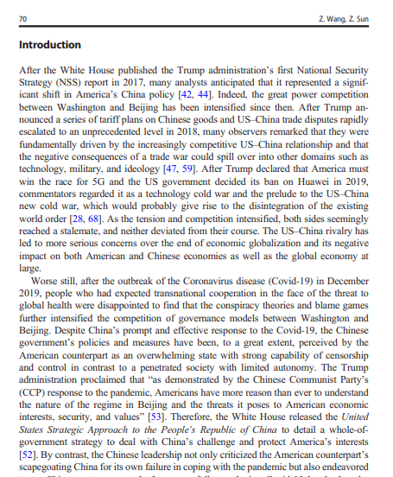
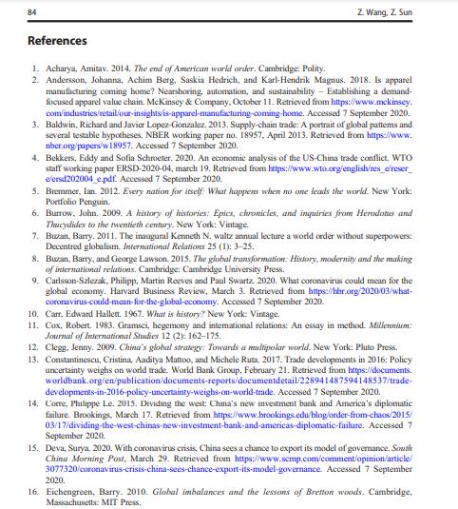
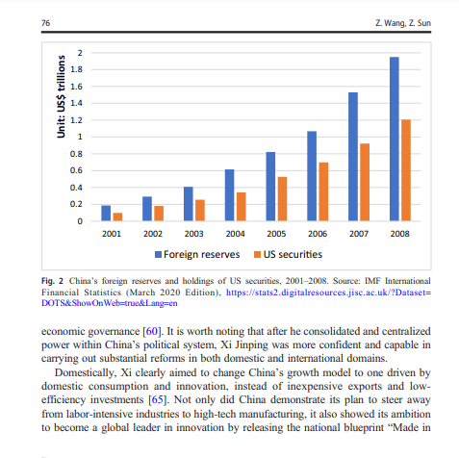
Look for sections, language, charts, tables, graphs and an extensive reference list or bibliography
Specialized language

Slide 45
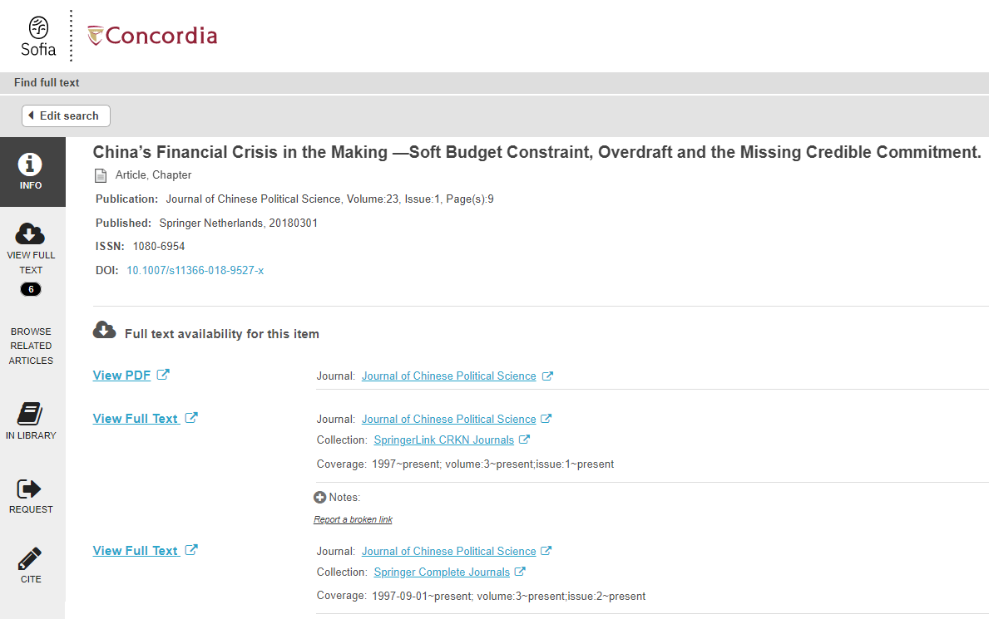
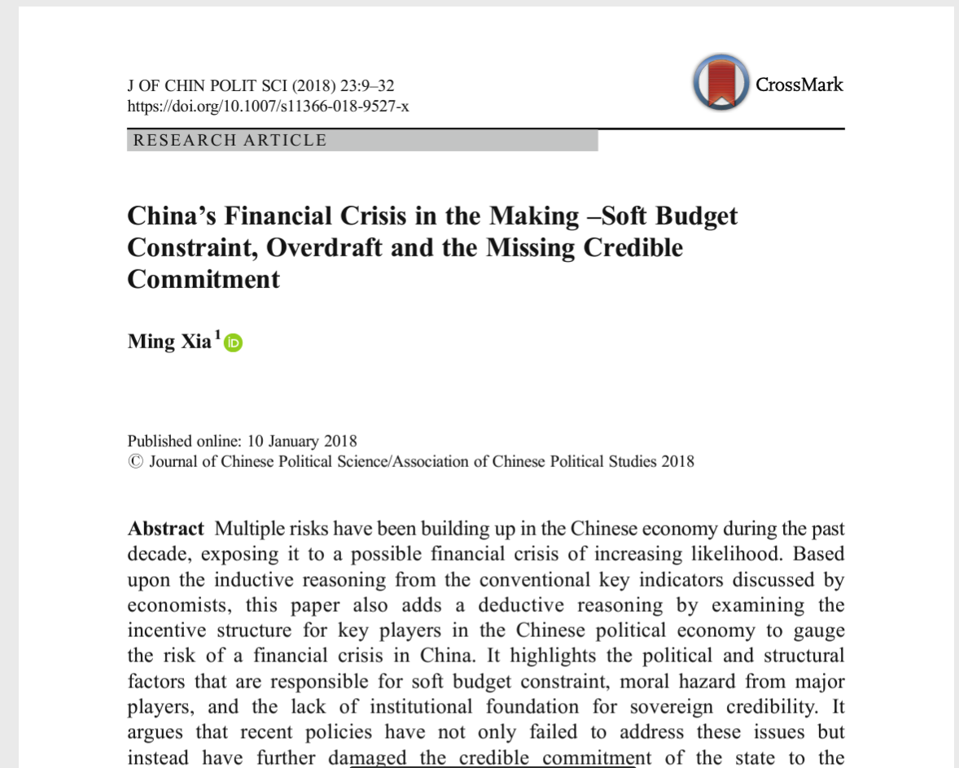
Find it @ Concordia
How to access articles.
Look for PDF or HTML full text options, if neither is available, use the Find it @ Concordia to access the article.

Slide 46
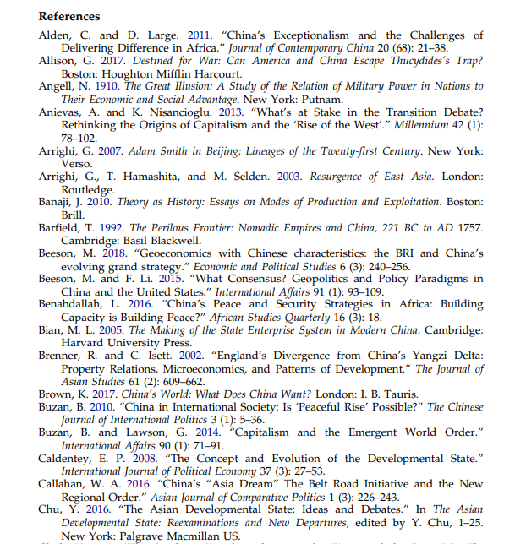
Scholarly articles will always have reference lists/bibliographies/works cited
These are great places to find more sources!
The researcher or research team are experts in the subject area and have already done a lot of research
Use this expertise by looking up the books and articles they cite in Sofia and using them in your own research
This is a commonly used method in academic research

Slide 47
Developing your search
Brainstorm synonyms and related terms and use the thesaurus in the journal article database to help you discover terms
Try to find a book on your topic, or an aspect of your topic and it can supply you with more keywords and concepts to develop your search
Try searching without your IR theories (you can do a separate search for them)
Try some searching with your IR theories (one at a time)

Slide 48
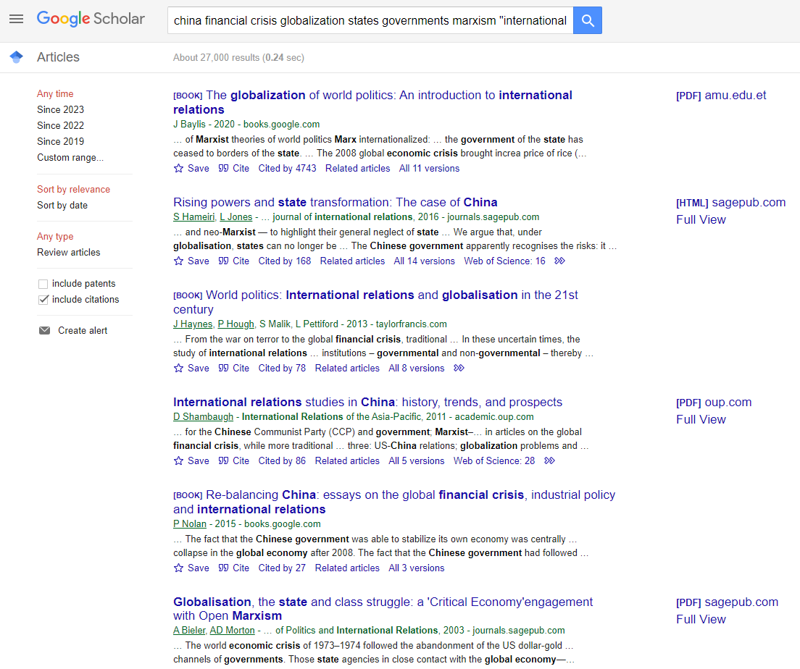
Google Scholar
Access Concordia resources by setting up your profile
Limit by date

Slide 49
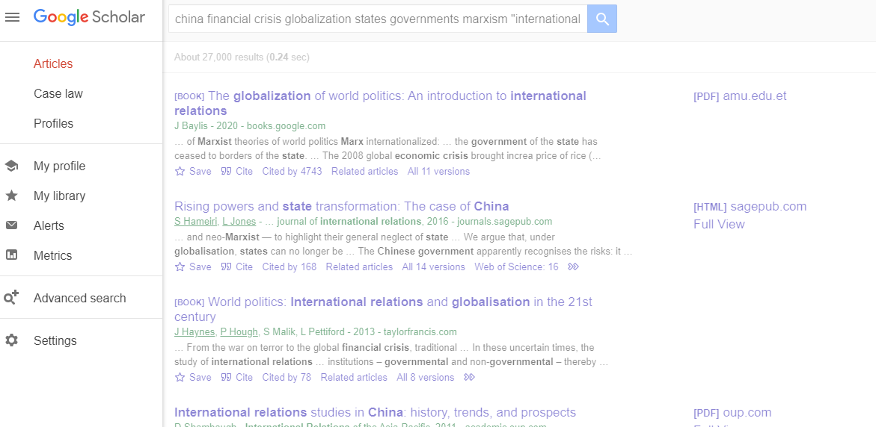
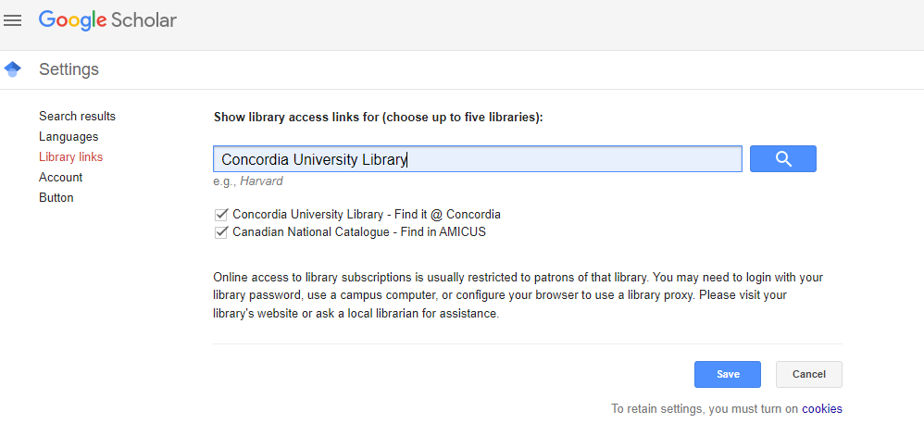

Slide 50
Citing your sources

Slide 51
Citation Resources
Chicago Manual of Style Online :Author-date style (you’ll be prompted to login if you’re off campus)
Help and How to: How to Cite
Workshop: Zotero for Bibliographies (Oct 26th, 2:30-4:00pm, online)
Drop in citation help for undergrads, Nov 1st 2-3pm, Webster Library, LB 205

Slide 52
Wrap up
Key points:
Political Science subject guide provides quick access to key resources
The poli sci subject librarian (Michelle) is here to help
Your sources must collectively answer your research question
IR theory sources give you a head start on finding the sources that you need
Don’t forget to cite your sources!

Slide 53
Need help, ask us!
Michelle.Lake@Concordia.ca

