Slide 1
POLI 204 Library Workshop
Michelle Lake, Subject Librarian
Michelle.Lake@Concordia.ca
Winter 2022

Slide 2
Who am I?
Michelle Lake, librarian for Political Science, the School of Community and Public Affairs, First Peoples Studies, and Government Publications
Michelle.Lake@Concordia.ca / For assistance via email, or to make a Zoom appointment
What do I do?
Provide research support
Help students with library databases
Help students find and access materials they need
Help with citation issues
Choose the books we buy for the above subject areas

Slide 3
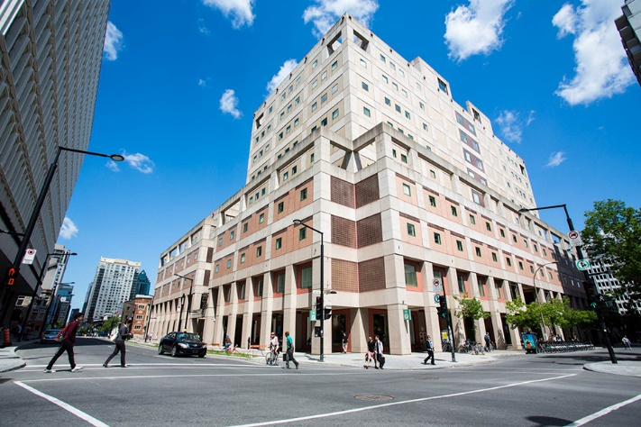
The Librar(ies)
Webster Library – SGW Campus
24/7 access, with student card, after 11pm
2nd, 3rd, 4th, and 5th floor of LB - “Library Building”
Poli Sci, Government Info, Maps, History, Social Sciences, Humanities, Engineering & Fine Arts
Interlibrary Loans
Current Print Journals
Vanier Library – Loyola Campus
24/7 access, with student card, after 11pm
1st, 2nd, and 3rd floor VL – “Vanier Library”
Sciences, Psychology, Communications & Journalism
Special Collections
Print Journal Archive

Slide 4
Library: in person
Services such as the loans desk, Ask Us desk and chat help are not open 24/7, check the library website for hours if you need a particular service.
Course Reserves room is open - you will need to use the call number of a book to locate them in course reserves
Procedural masks need to be worn at all times in the library.

Slide 5
Library Services
Your student card is your library card. You need it to borrow books, borrow a laptop, print and access the library during 24/7 hours.
You can borrow up to 100 print items at a time and renew them online, if no one else requests them. Borrow a laptop for 24 hours or a tablet for 3 days.
Webster library has 5 book scanners that can be used for free to scan chapters from our print books and email them to yourself as a PDF.
To use Library databases, access online articles and ebooks when you are off campus, login with your MyConcordia Netname and password.

Slide 6
Course Reserves via the Library - library.concordia.ca
many ways to access:

Slide 7
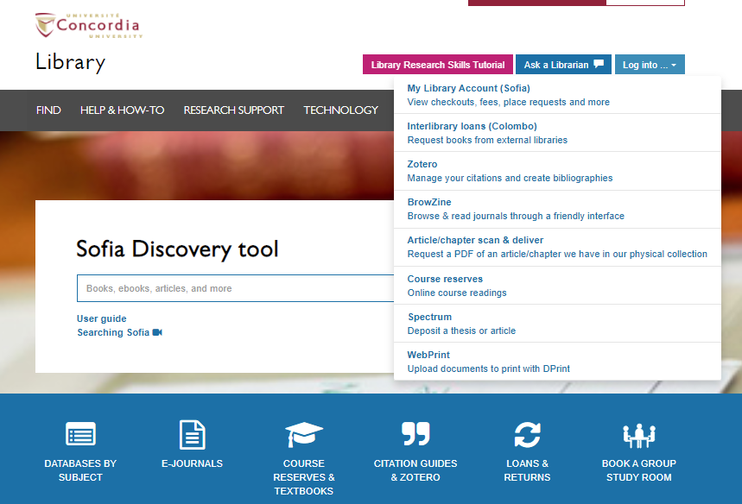

Slide 8
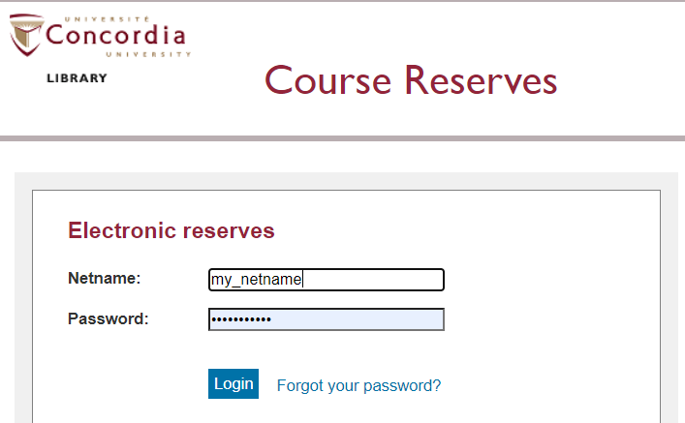

Slide 9
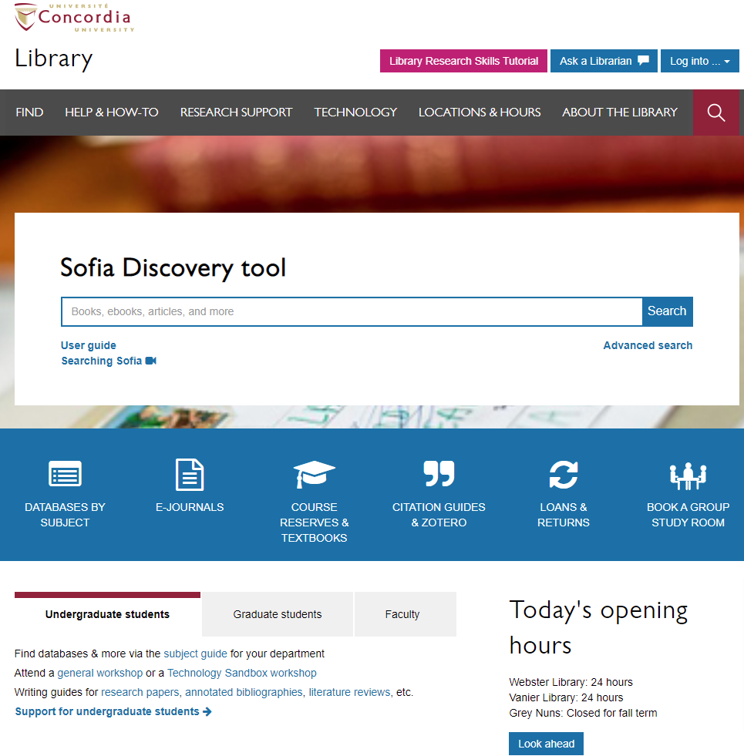
Library website: https://library.concordia.ca/
Use the Sofia Discovery tool to find print books, ebooks, and journal articles from the library.
Find your subject guide for your topic area

Slide 10
To find your textbook…
James Bickerton and Alain-G. Gagnon. Eds. 2020. Canadian Politics, Seventh Edition. Toronto: University of Toronto Press.

Slide 11
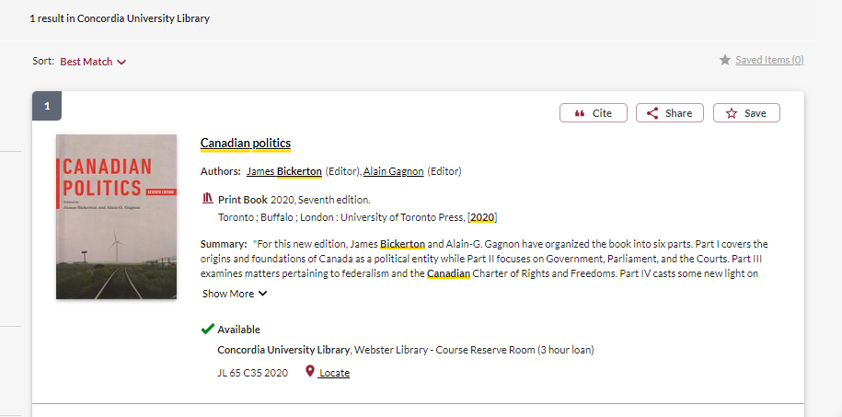
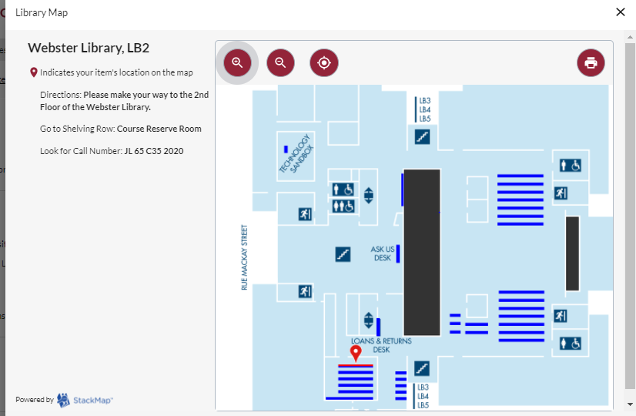
Your textbook is located in the Course Reserves room. All required undergraduate print textbooks can be found here.

Slide 12
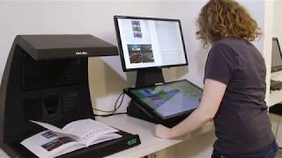
Book Scanners – Course Reserves Room
There are book scanners located in the course reserves room and on the 3rd and 4th floors of Webster library, that you can use to scan chapters from any print book in the library.
The scanners are free and easy to use, and allow you to scan multiple pages and email them to yourself as a PDF.

Slide 13
Locating items when you have the citation information

Slide 14
Donald Savoie. 1999. Governing from the Centre: The Concentration of Power in Canadian Politics. Toronto: University of Toronto Press.

Slide 15
Use the table of contents to navigate through the ebook

Slide 16
Patrice Dutil. 2018. Prime Ministerial Power: Its Origins Under Macdonald, Laurier and Borden. Vancouver: UBC Press.

Slide 17
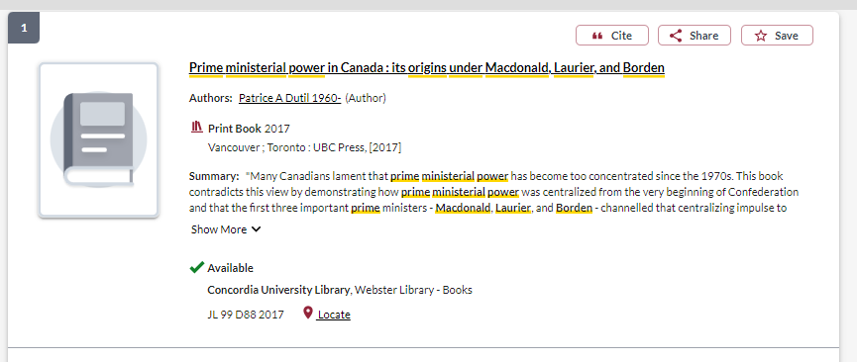
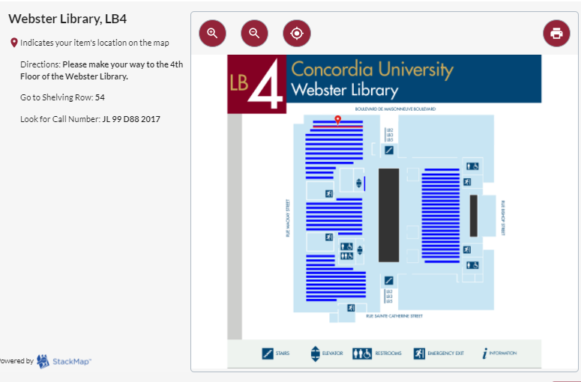
All the information you need to locate the book on the shelf.

Slide 18
Linda A. White. 2014. “Federalism and Equality Rights Implementation in Canada”, Publius: The Journal of Federalism 44(1): 157-182.

Slide 19
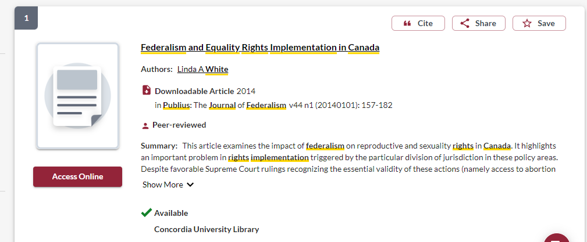
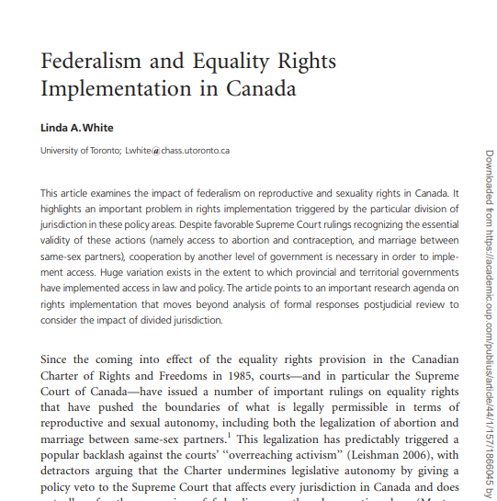
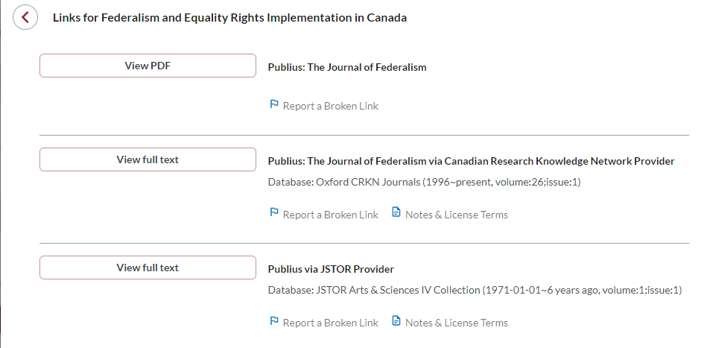

Slide 20
Ian Stewart. 2002. “Vanishing points: Three paradoxes of political culture research.” In Joanna Everitt and Brenda O’Neill, Eds., Citizen Politics: Research and Theory in Canadian Political Behavior. Toronto: Oxford University Press, pp. 21-39.

Slide 21
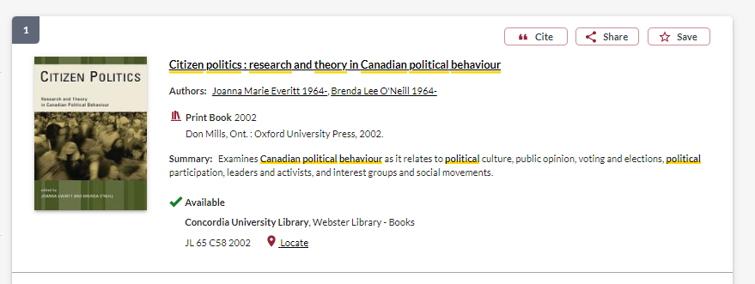
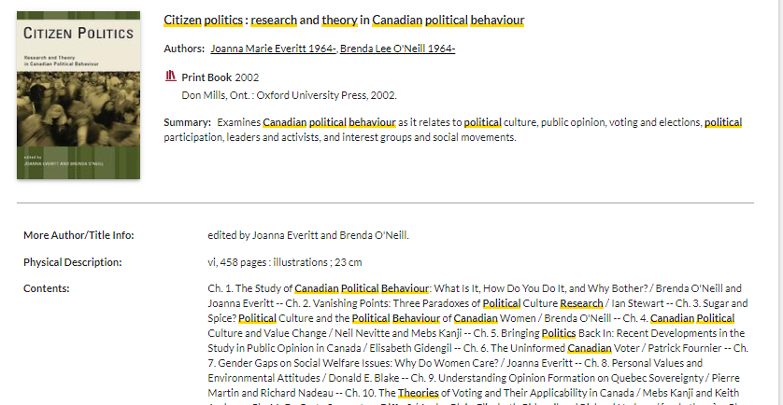

Slide 22
Breaking down a topic & Search strategies

Slide 23
AND –limits how many results your search produces
Example: nationalism AND politics
OR –increases the number of results your search produces
Example: elect OR vote
“ ” -exact phrase, searches for an exact phrase only, rather than each keyword, limits your search results
Example: “political parties”
*- truncation: retrieves all words that start with the letters entered and expands search results
Example: democra* finds democracy, democracies, democratic, democratization

Slide 24
Avoid Searching with Linking words
Effects
Impact
Consequences
Influence
Results
Cause
Importance
Significance
Response
Emphasis
Each author may use different linking words when discussing similar topics.
You don’t want your search to be limited to those books and articles that only contain the word “effect” or “consequence”

Slide 25
What are the causes of women’s underrepresentation in Canadian legislatures?
Key Idea | Keywords
Women | woman, female
Underrepresentation | marginalization, gender inequality, gender gap
Canadian | Canada, provincial, federal
Legislatures | politicians, elected representatives, elections, parliament, legislature, government, politics

Slide 26
Academic Sources: Books

Slide 27
Using Sofia Advanced Search

Slide 28
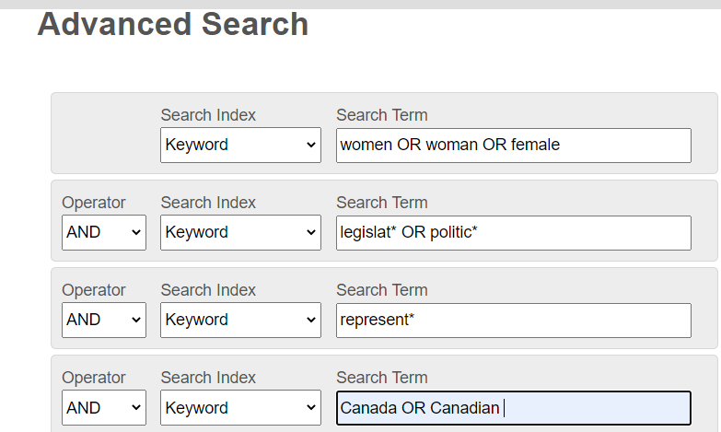
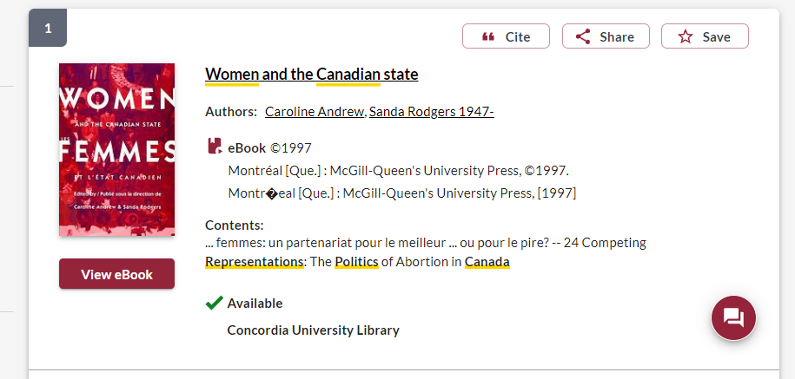
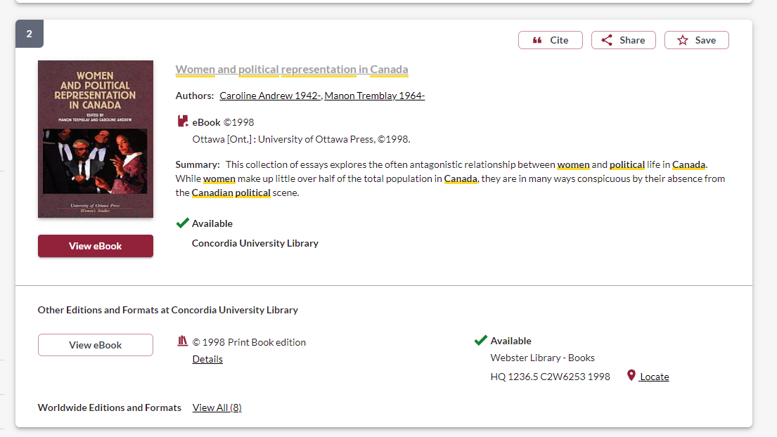

Slide 29
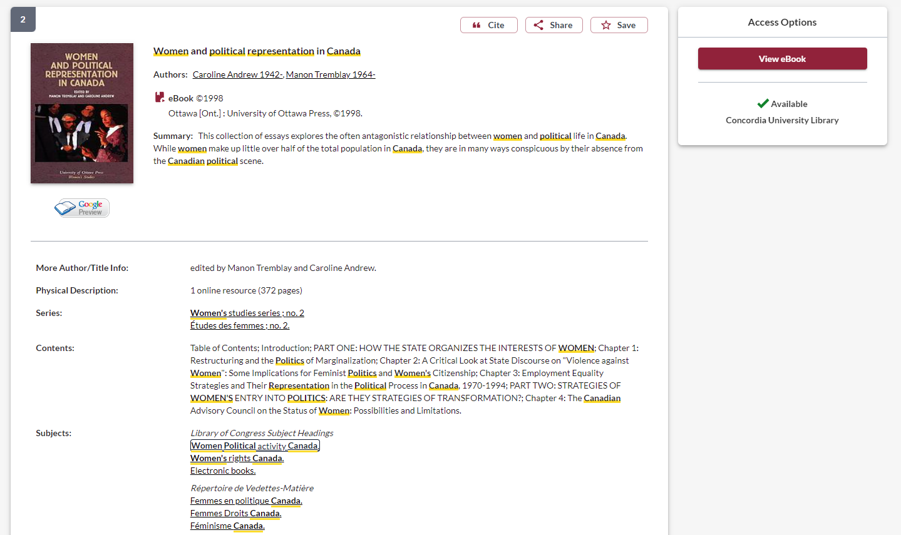
Click on related subject headings to see all the books in this subject area

Slide 30
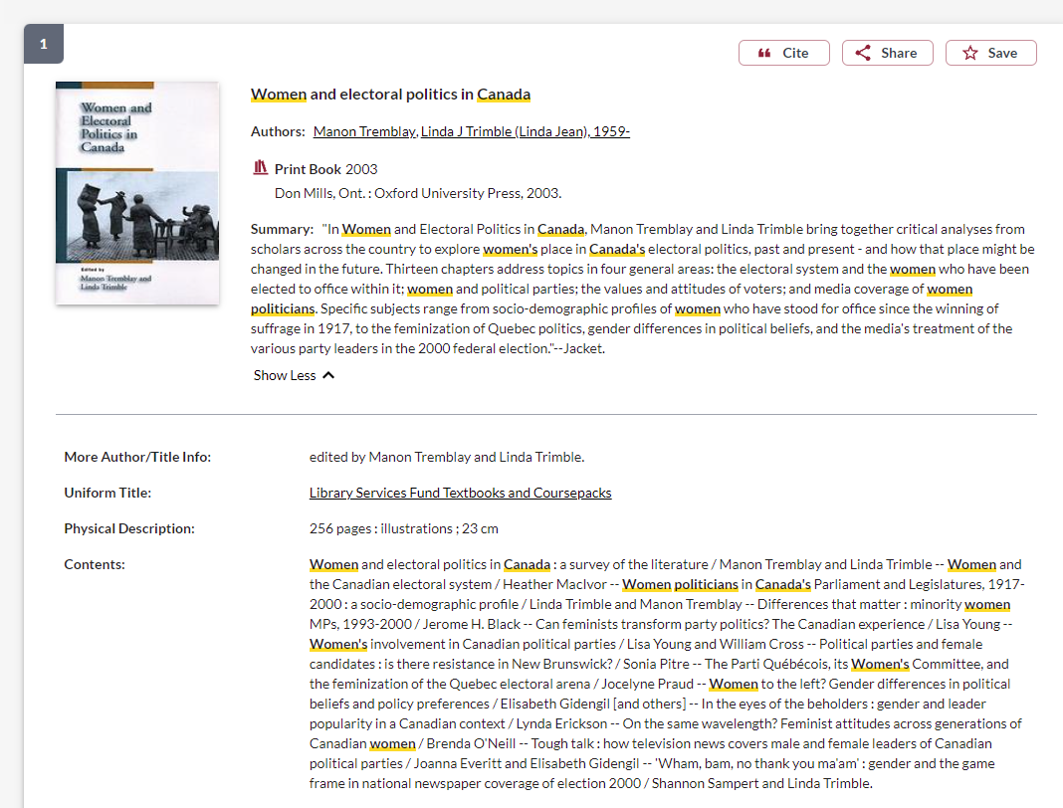
How do I know this is an academic book?
If the publisher is a university press, it is an academic book
Academic books will be at least a couple hundred pages

Slide 31
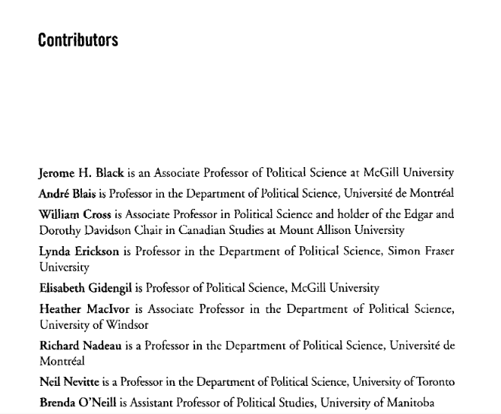
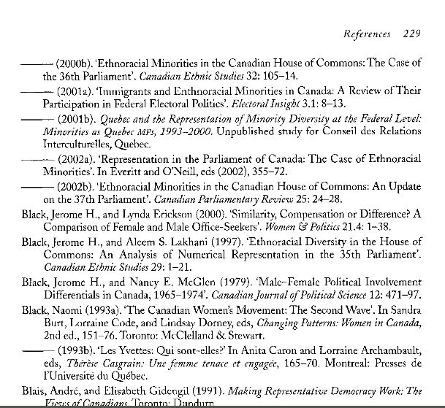
How do I know this is an academic book?
In the book itself look for author affiliations or information about the book’s contributors, are they faculty members at universities?
Academic books will always have a reference list/bibliography/footnotes/endnotes of their sources

Slide 32
Print books at Webster Library
Political Science & Government: J – JZ (4th floor)
Political institutions and public administration (Canada): JL 1 – JL 500
Law, K-KZ (4th floor)
Canadian Law: KE
Social Sciences: Public Policy, Economics, Social welfare: H-HV (4th floor)
Women, Feminism: HQ
History of North and South America (Canadian history), First peoples and Indigenous studies: E-FC (3rd floor)

Slide 33
Academic Sources: Peer reviewed journal articles

Slide 34
go the Library website under:
HELP & HOW-TO
Subject & Course Guides
Social Science
Political Science

Slide 35
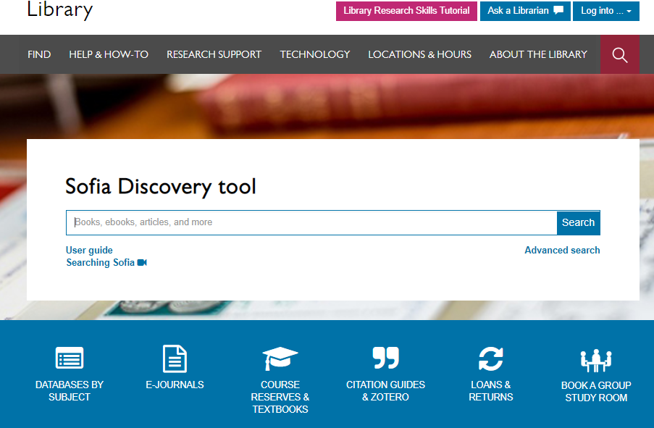

Slide 36
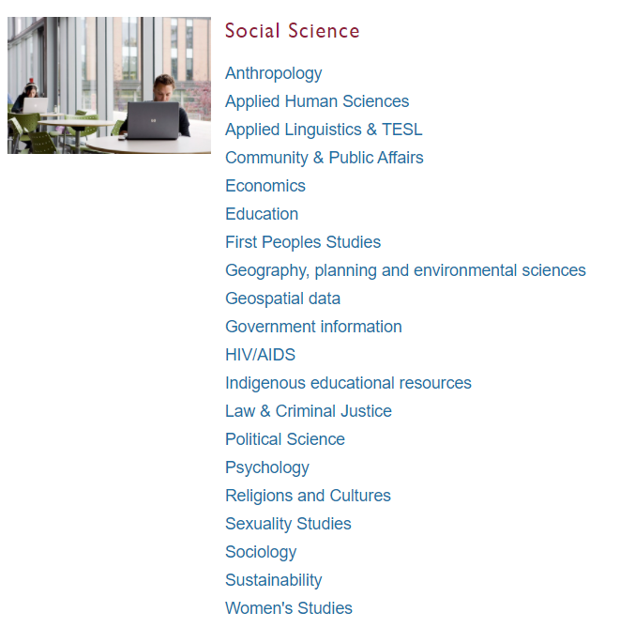
Subject Guide: Political Science

Slide 37
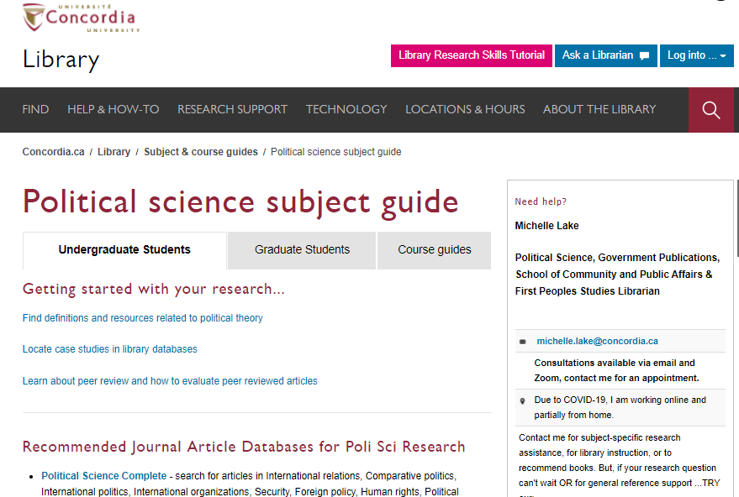
Scroll down to locate the database list

Slide 38
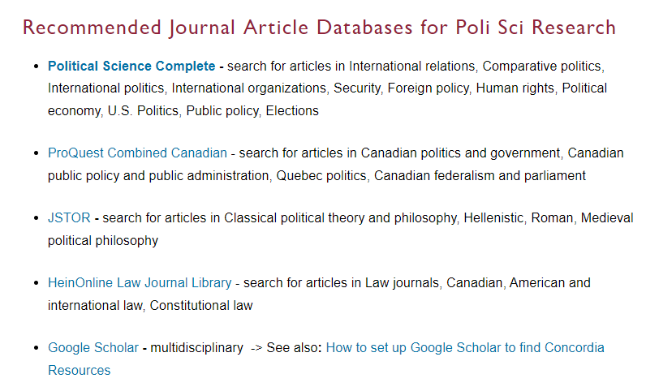
1. Start here: Largest POLI database
1
2. Good Canadian database, social science journals
2
3. Ensure Google Scholar is set up to provide you with Concordia sources
3

Slide 39
What are the challenges of Indigenous self-government in Canada, and how can be overcome?
Key Idea | Keywords
Indigenous | Aboriginal, First Nations, Inuit Metis, First Peoples
Self-Government | self-determination, Indigenous government, Indigenous governance, land claims, land tenure
Canada | Canadian

Slide 40
Indigenous OR Aboriginal OR "First Nations" OR Inuit OR Metis AND self-government OR self-determination OR "Indigenous governance" OR "Indigenous government" OR "land tenure“ AND Canad*

Slide 41
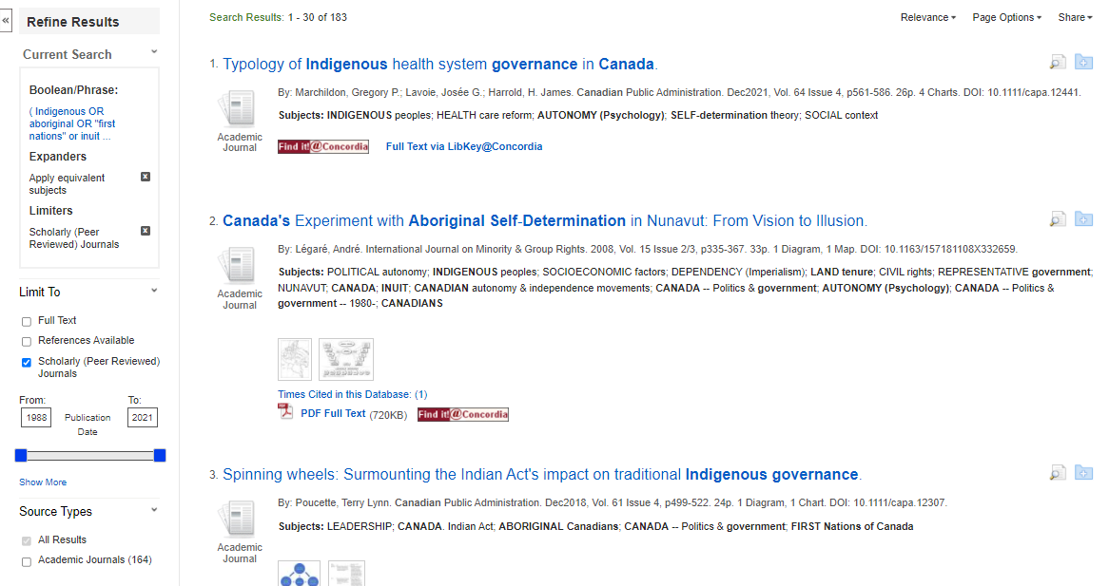
183 results
Limit to Scholarly (peer reviewed) journals right away

Slide 42
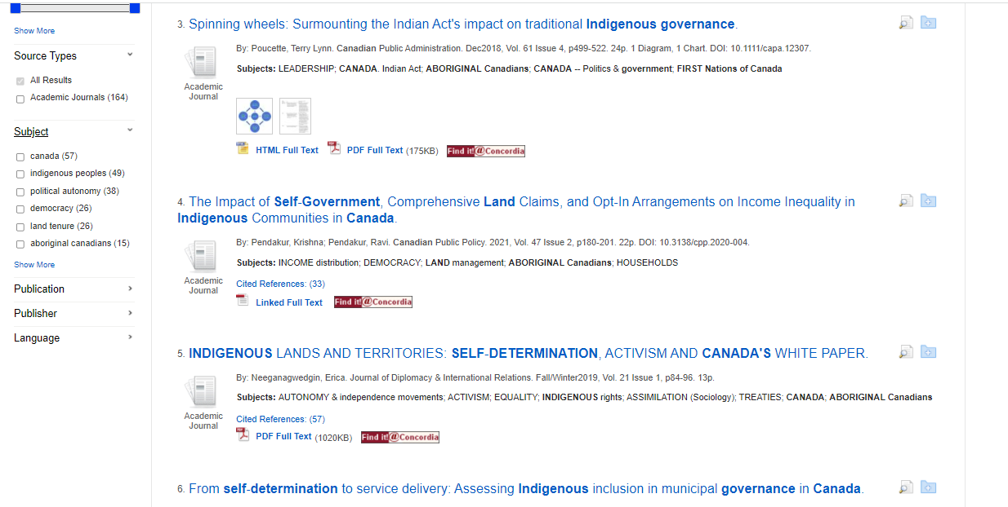
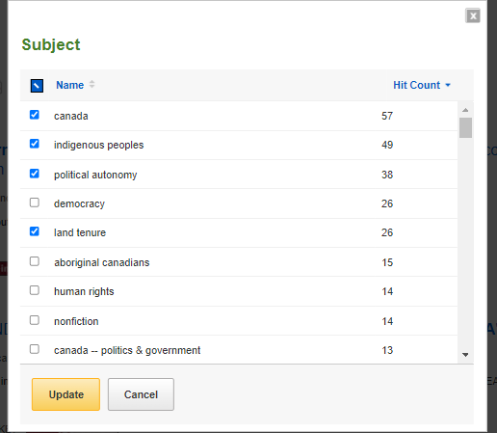
A pop window will open, where you can select narrower subject terms to add to your search
Open up the Subject options, and click on ‘Show More’

Slide 43
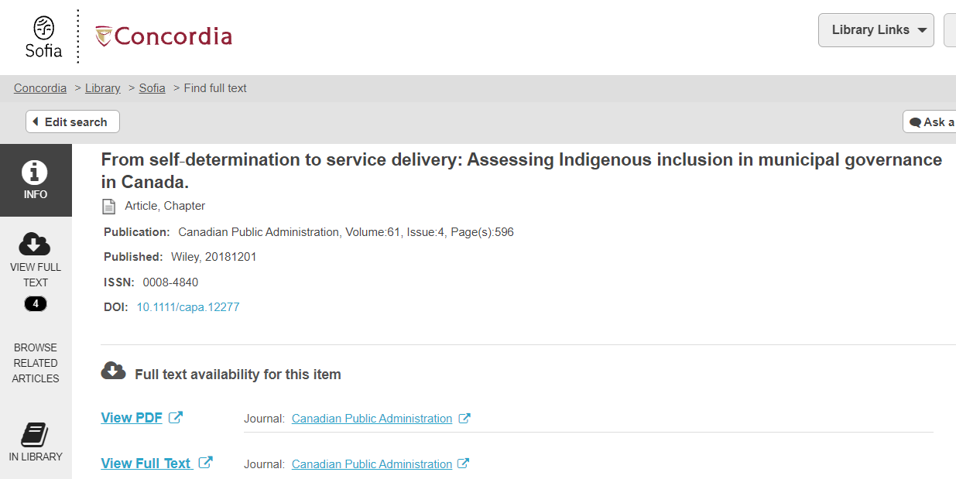
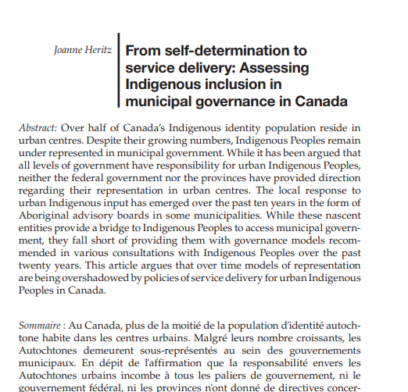
Find it @ Concordia window
Article title
Author
Journal title, date, volume, issue, and pages

Slide 44
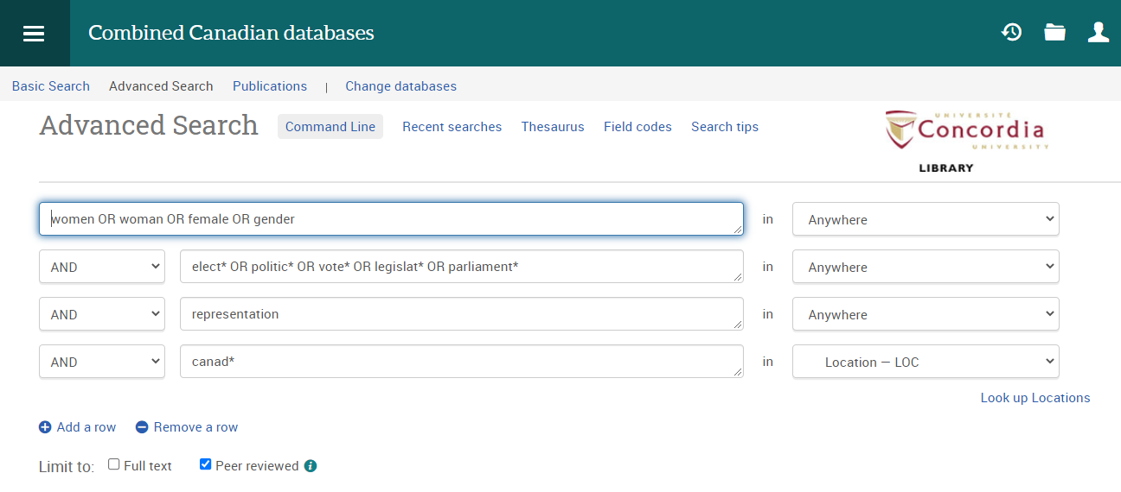
Always select the option for peer reviewed, to avoid newspaper articles in your results
Search for Canada as a “Location”, for articles about Canada, rather than articles written by authors from Canada

Slide 45
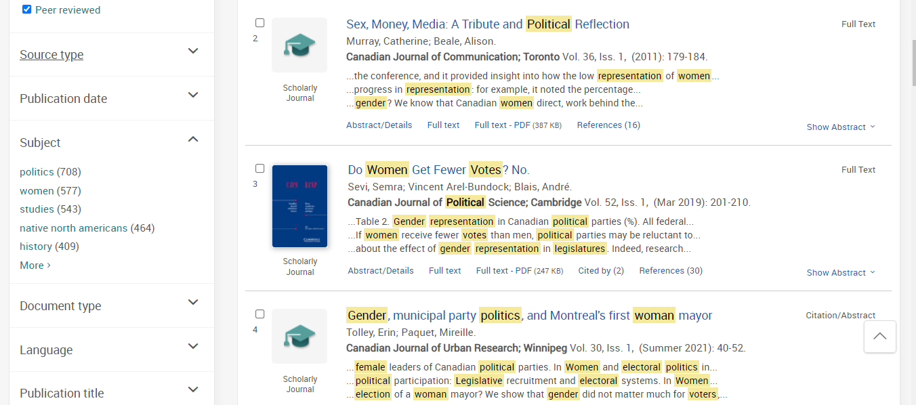
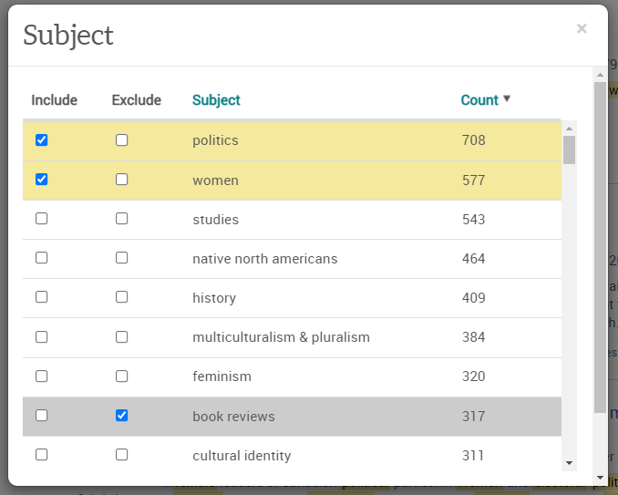
A window will pop open from which you can include or exclude subject terms in your search

Slide 46
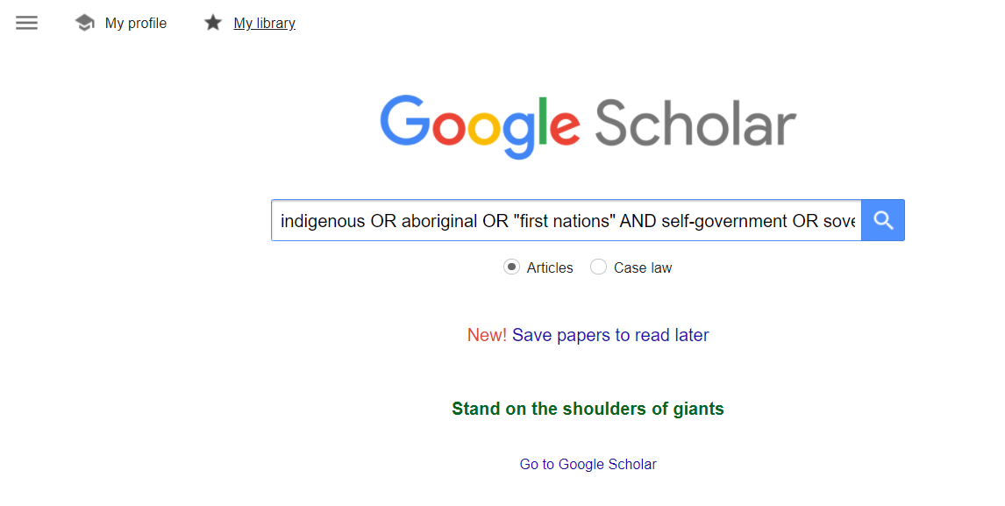
indigenous OR aboriginal OR "first nations" AND self-government OR sovereignty AND Canada
Google Scholar allows you to broadly search for scholarly literature across many disciplines and types of sources.

Slide 47
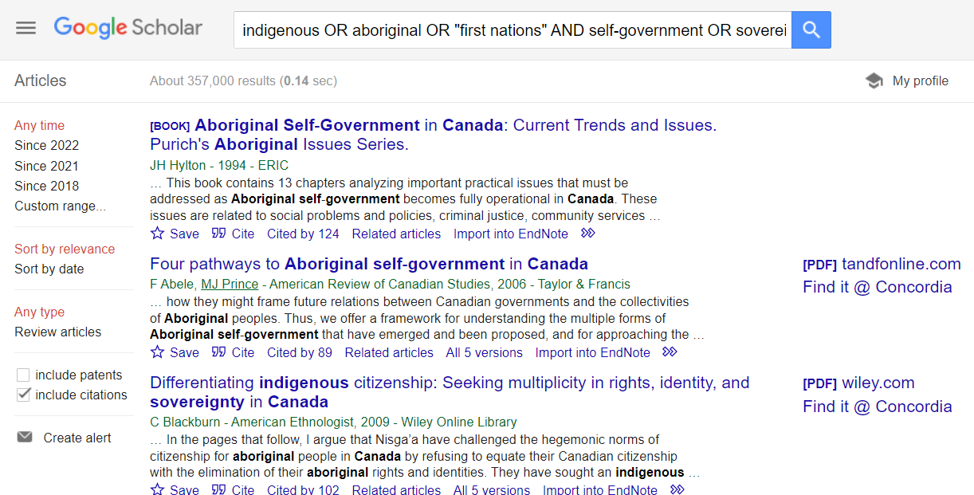
If you have “library links” set-up on your Google profile, you will be able to access journal articles through the library’s subscriptions
Note: Google Scholar provides fewer options to limit your search and does not have the option to narrow to scholarly (peer reviewed) articles only.

Slide 48
How do I know if an article is academic?
Has the article gone through the peer review process?
What is peer review?
Peer review is a system used to decide if an article should be published in a peer-reviewed journal. Each paper submitted to a peer-reviewed journal is read and evaluated by experts in the article’s subject area.
The reviewers assess the article’s validity, importance, and originality, and then recommend whether it should be printed in the journal.
The reviewers’ suggestions are considered by the journal’s editor, who makes the final decision about whether to accept or reject the article.
Criteria for evaluating academic or scholarly articles

Slide 49
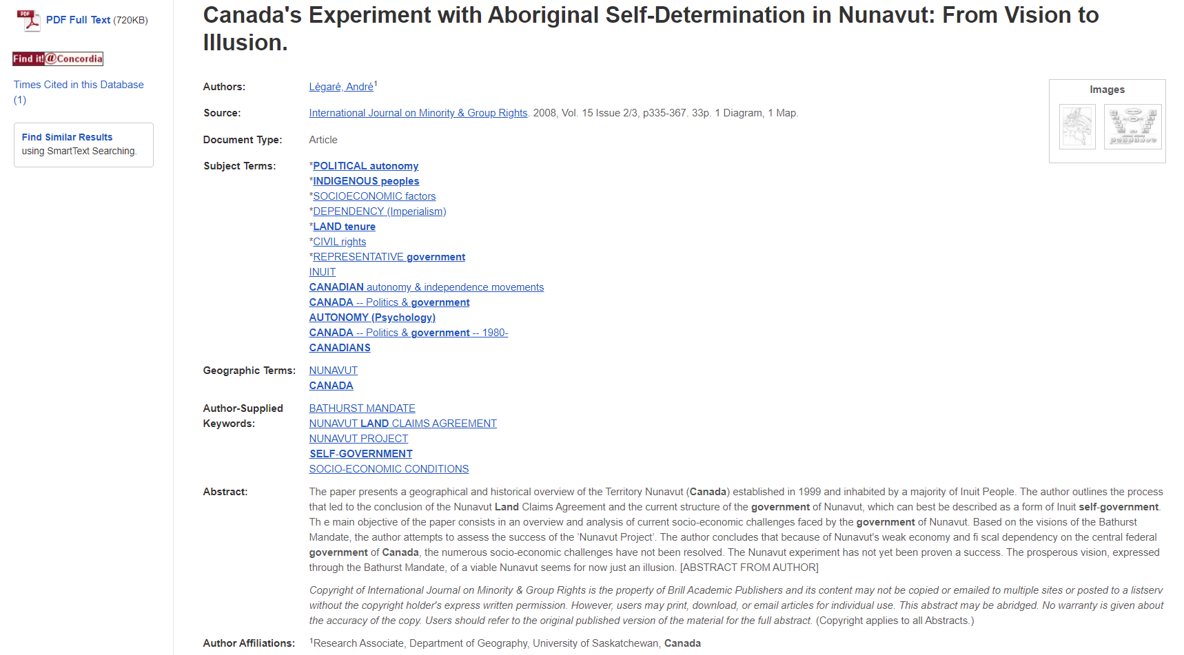
Scholarly articles trend to be 10+ pages long.
Author affiliations

Slide 50
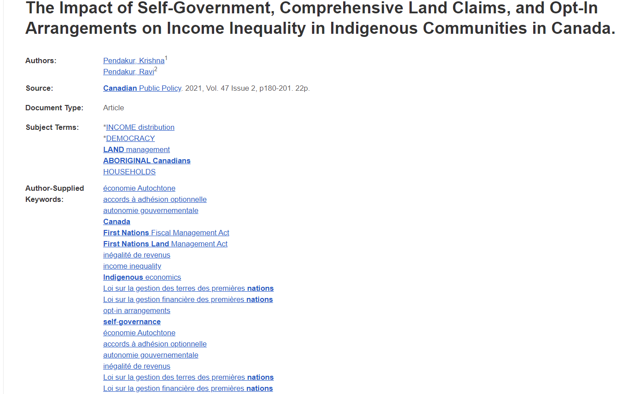
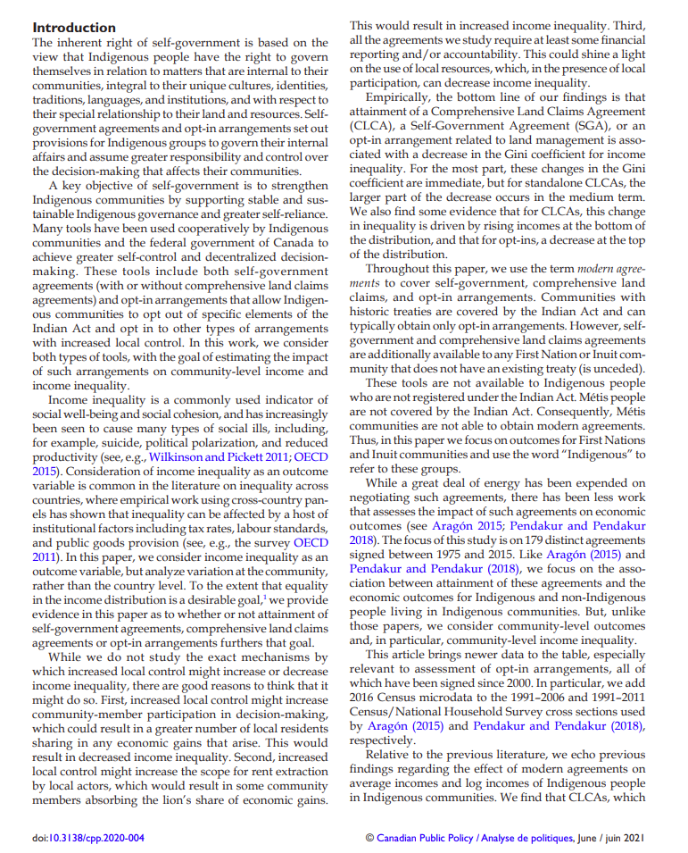
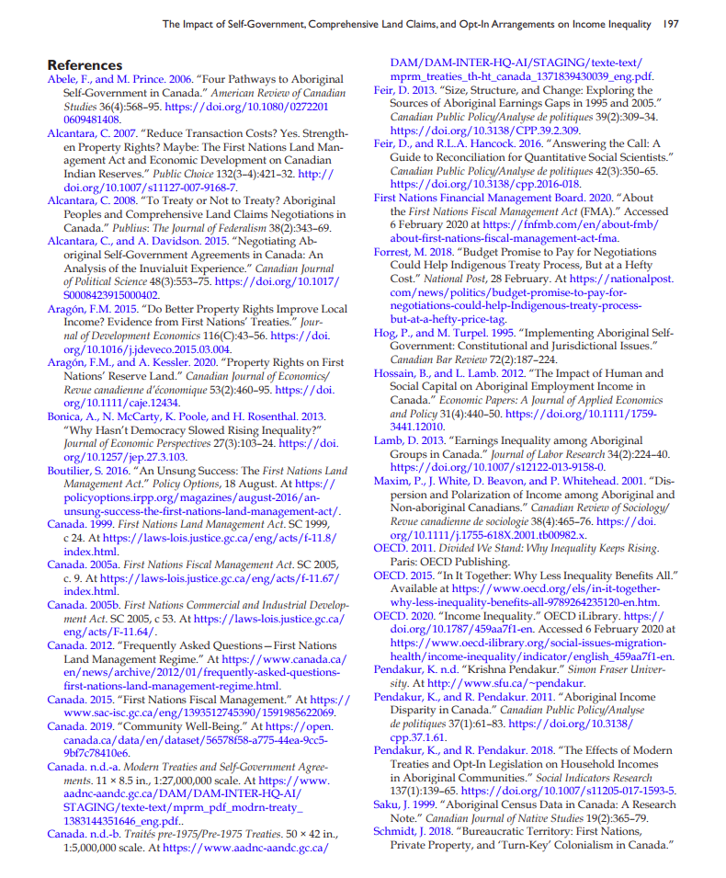
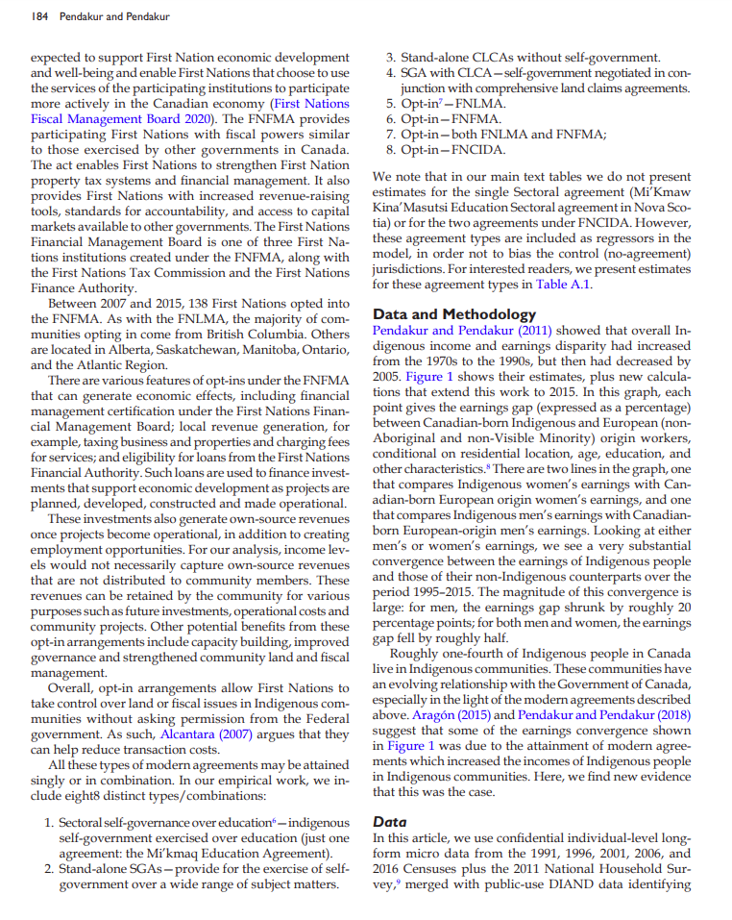
Extensive reference list
Sections
Citations

Slide 51
Elements of a scholarly article to look for:
Length: scholarly articles are longer, usually between 10-30 pages, including a reference list
Credentials/affiliations: authors university departments should be listed, along with contact information
Sections: Many scholarly articles will have similar parts and headings like an abstract, introduction, methodology, literature review and conclusion
Citations: Scholarly articles always cite their sources either with in-text citations or footnotes/endnotes
Reference list: Scholarly articles always provide an extensive reference list/bibliography/works cited list or endnotes, which is a list of sources at the end of the article

Slide 52
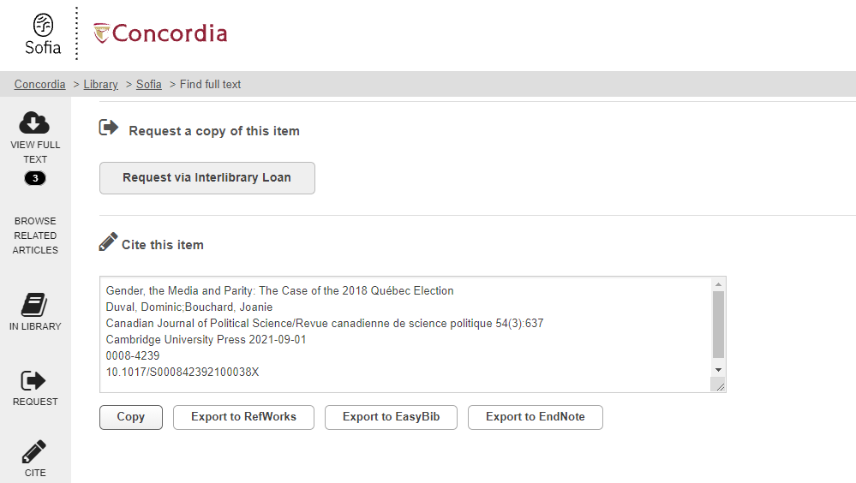
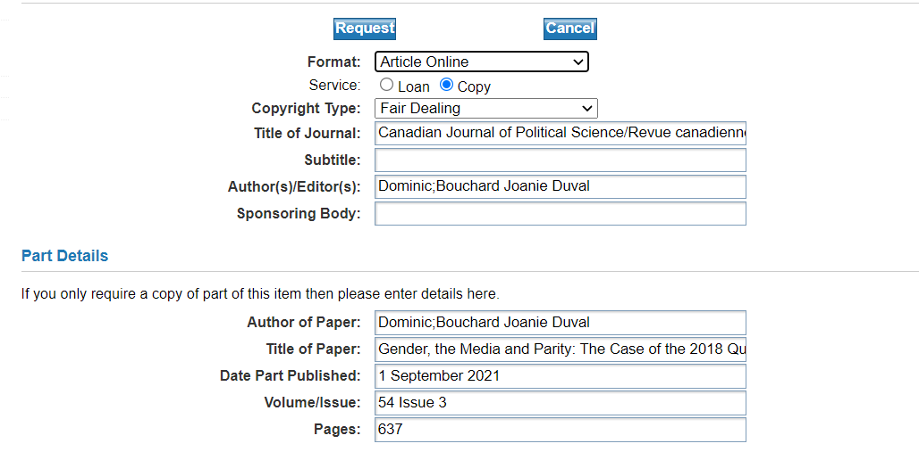
What if Concordia doesn’t have the journal article?

Slide 53
COLOMBO – Interlibrary Loans
Interlibrary loans/COLOMBO
E-Journal Articles
Request e-journal articles from other libraries and a PDF copy will be delivered to your email within a week.
Use the ‘Request via Interlibrary loan’ button in the Find it @ Concordia page to request a specific article.

Slide 54
Citation guides

Slide 55
Need help, ask us!

