Slide 1

POLI 203: Introduction to Comparative Politics Library Workshop
Michelle Lake
Subject Librarian, Political Science, SCPA, FPST, and Government Publications
Michelle.Lake@concordia.ca

Slide 2
Who am I?
Michelle Lake, librarian for Political Science, the School of Community and Public Affairs, First Peoples Studies, and Government Publications
Michelle.Lake@Concordia.ca / Make an appointment or ask a question
What do I do?
  Provide research support
  Help students with search strategies and library databases
  Help students find and access materials they need
  Help with citation issues
  Choose the books we buy for the above subject areas

Slide 3

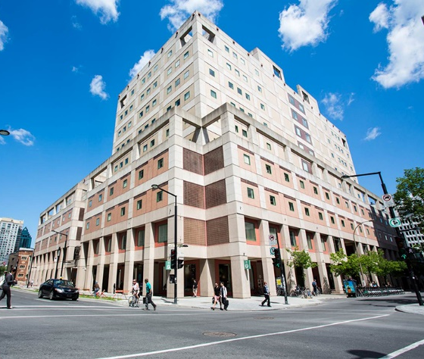
The Librar(ies)
24/7 access, with student card, after 11pm
Webster Library (LB) – downtown on SGW campus & Vanier Library (VL) on Loyola campus
Webster: Social Sciences, Humanities, Business, Engineering & Fine Arts
Vanier: Science(s), Health, Communications, Journalism and Psychology
Course Reserves Room(s): have the required undergraduate print textbooks for the courses taught at that campus (for example: Webster has the Political Science and SCPA course reserves)

Slide 4

Library Services
Your student card is your library card.
You need it to:
borrow books (up to 100 a time)
borrow a laptop (for 3 days) and other technology
print on campus (add money to your Dprint account)
access the library overnight during 24/7 hours.
Webster library has 5 book scanners (And Vanier has 2!) that can be used for free to scan chapters from our print books and email them to yourself as a PDF.
To use Library databases, access online articles and ebooks when you are off campus, login with your MyConcordia Netname and password.

Slide 5
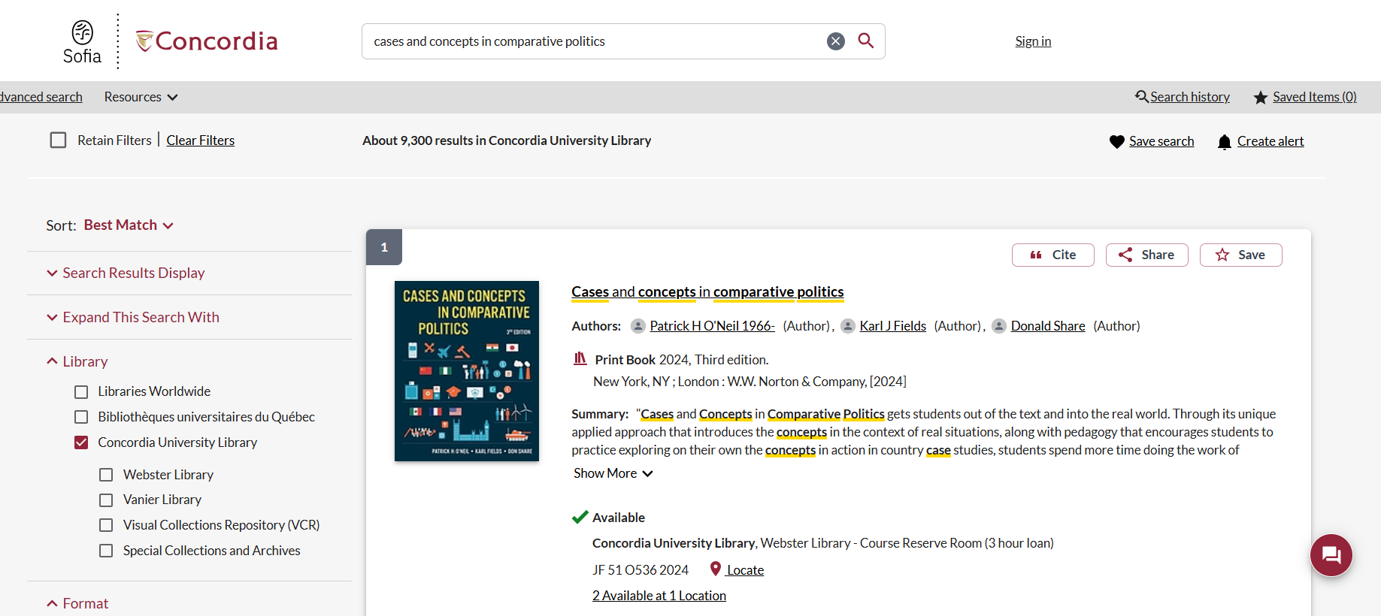
Course reserves

Slide 6
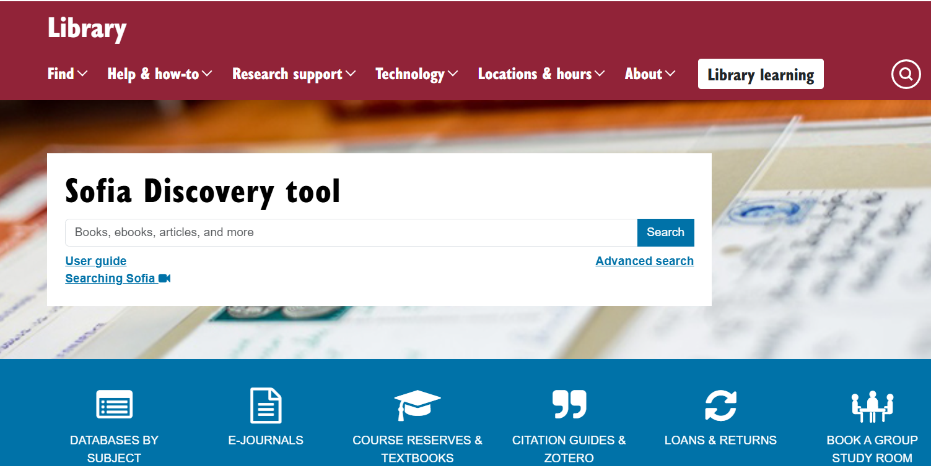
https://library.concordia.ca/
Use the Sofia Discovery tool to find print books, ebooks, and journal articles from the library.

Slide 7
How do I find out if Concordia has access to something?
Locating items when you have the citation information

Slide 8
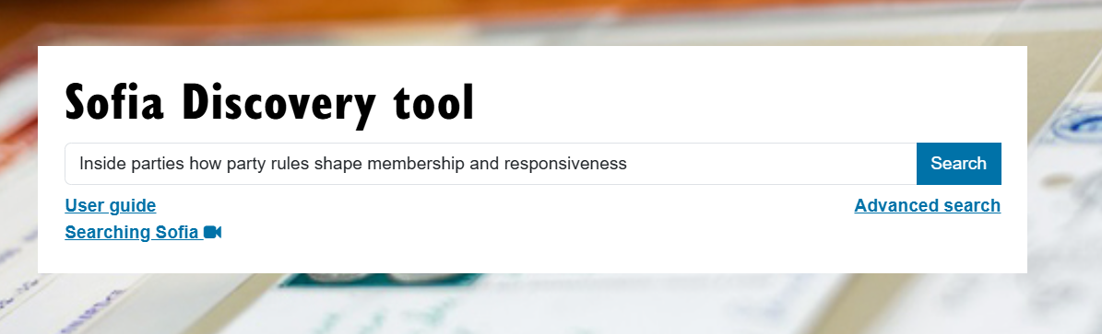
Kernell, G. (2025). Inside parties: how party rules shape membership and responsiveness. Cambridge University press.

Slide 9
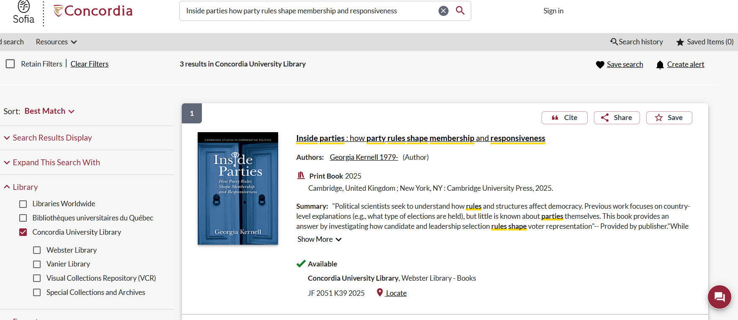
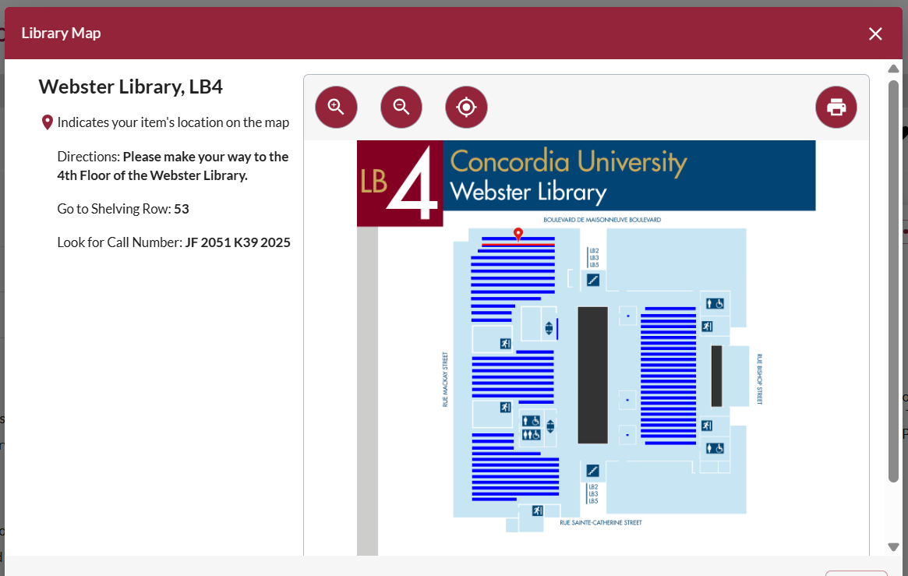

Slide 10
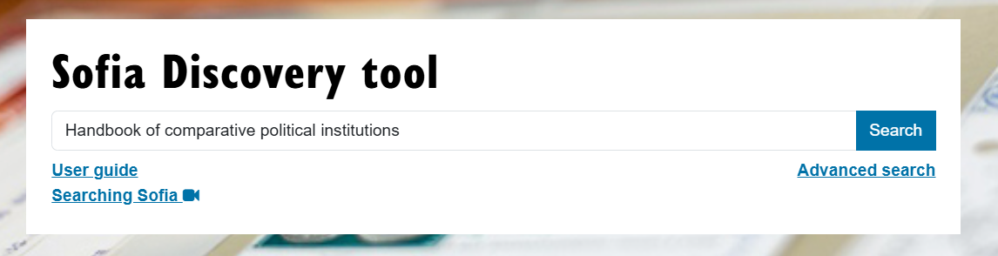
Peters, B. G. (2024). Is there an institutional theory of comparative politics? (pp. 501-513). IN vatter, A. & Freiburghaus, R. (Eds.). Handbook of Comparative political institutions. Edward Elgar publishing.

Slide 11
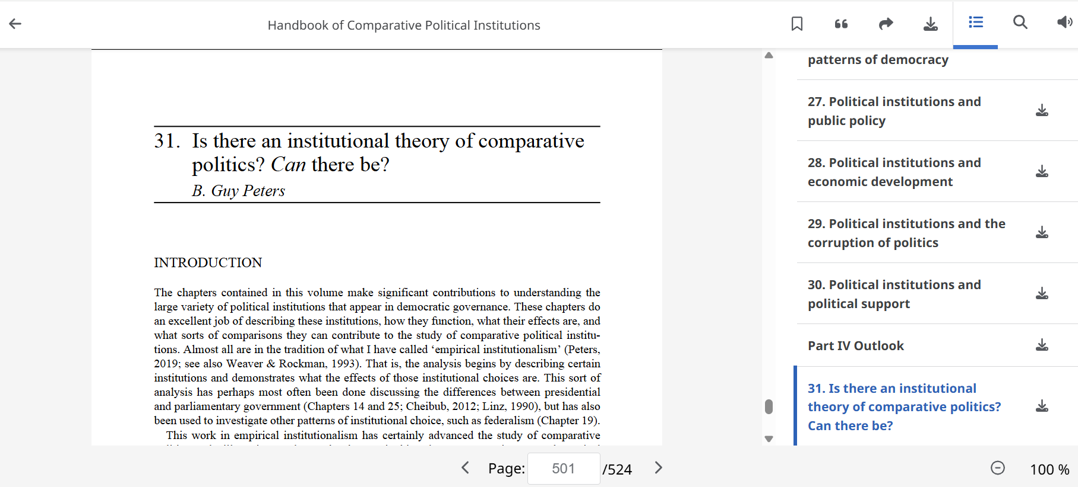
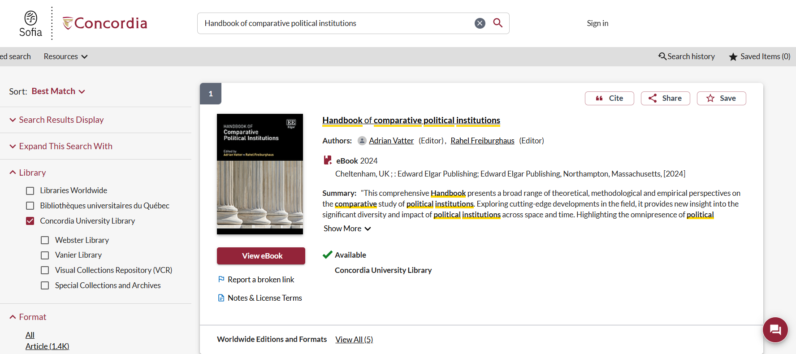

Slide 12
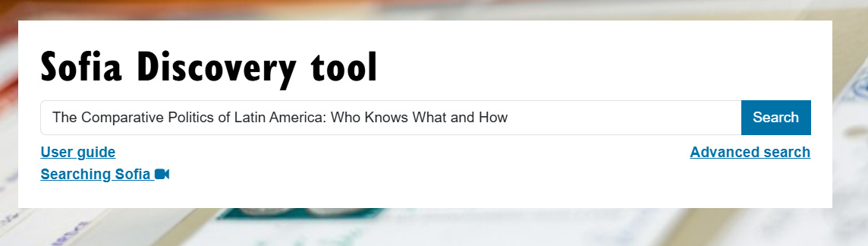
Munck, g.l. (2025). The comparative politics of latin America: who knows what and how? Latin American politics and society 67(2), 124-130.

Slide 13
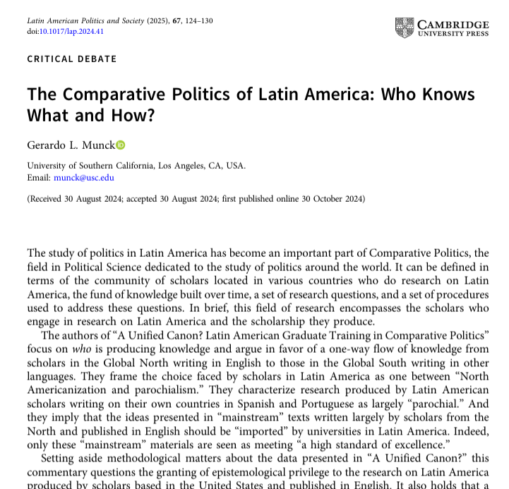
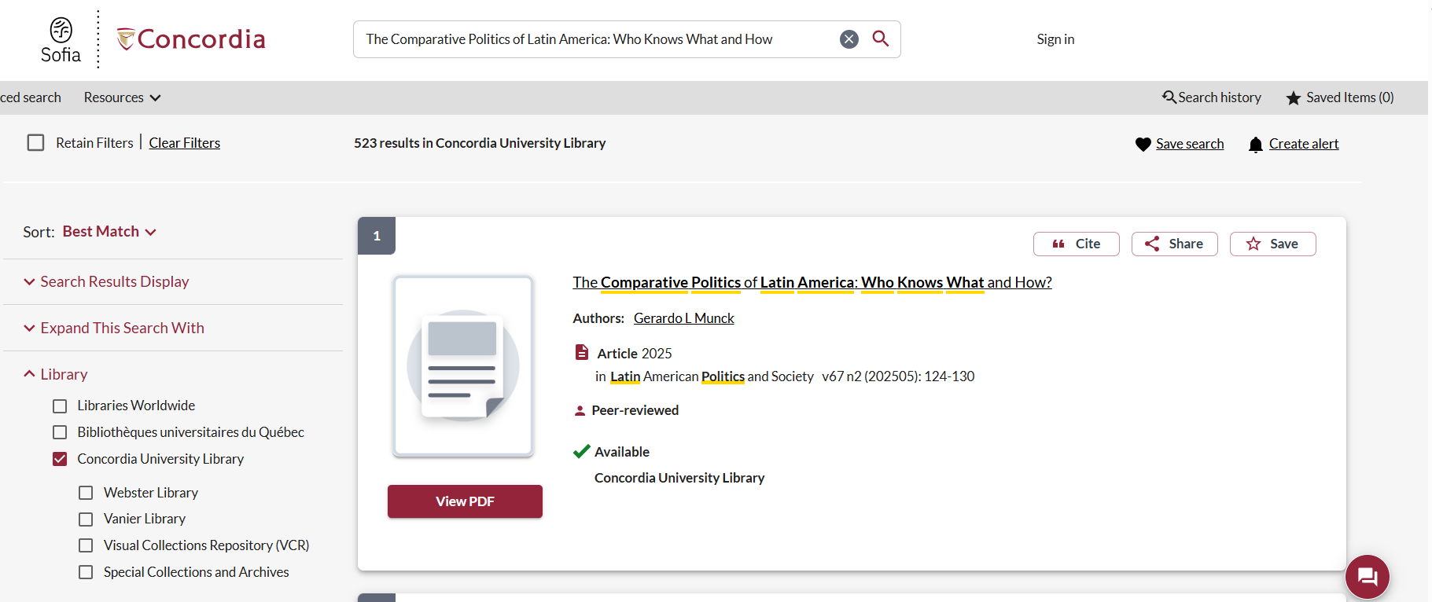
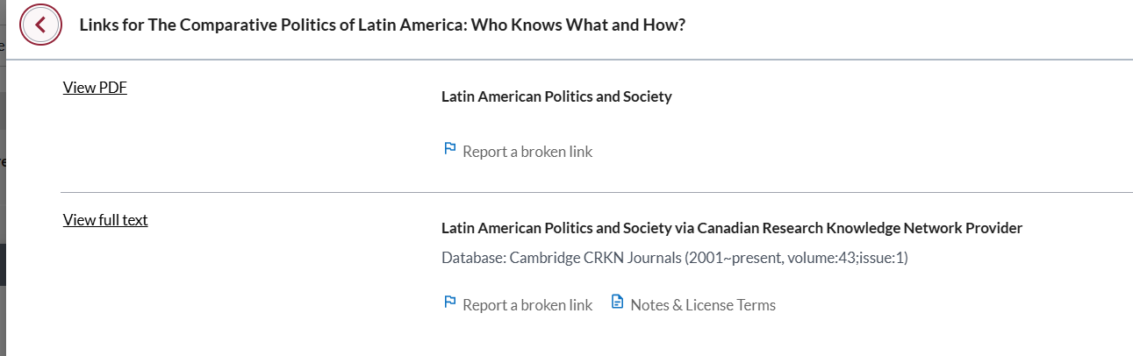

Slide 14

Breaking down a topic
&
Search strategies

Slide 15
How do we combine search words for the best possible results?
AND: combines concepts and limits your results
politics AND security
state OR government
election OR voting
OR: allows you to insert synonyms or alternative terms and increases your results

Slide 16
How do we combine search words for the best possible results?
“quotation marks”: If you put two or more words in quotation marks, that exact phrase will be searched and limits your results.
“political parties”
“foreign policy”
Democra*
Finds: democracy, democracies, democratic, democratically, democratization
* - when you add an asterisk on the end of a word, your results will contain all the words with those endings or suffix

Slide 17
Avoid Searching with linking words
Effects
Impact
Consequences
Influence
Results
Importance
Significance
Response
Emphasis
Causes
Each author may use different linking words when discussing similar topics.
You don’t want your search to be limited to those books and articles that only contain the word “effect” or “consequence”

Slide 18
Breaking down topics
Is the free market the “best” method of economic organization?
  free market, economic systems, economic organization
Is democracy superior to other types of political regimes?
  Democracy, political regimes, authoritarianism
Is nationalism a harmful or a beneficial force?
  Nationalism, sovereignty, populism

Slide 19
Bibliography Assignment
Prepare a bibliography of five (5) sources related to your assigned topic. These sources will be the only materials you are permitted to use and cite in your final term paper. For this reason, it is strongly recommended that you select your sources carefully before including them in your bibliography.
Important:
Final papers that include sources not listed in the approved bibliography will not be accepted and will not be eligible for resubmission.
Your bibliography must meet the following requirements:
A minimum of two (2) journal articles
At least one (1) book or book chapter
At least one (1) source published within the last five (5) years
No more than two (2) sources published within the last twenty-five (25) years
All sources must be available through the Concordia University Library, either electronically or in print

Slide 20

Searching in Sofia

Slide 21
What will I find in Sofia?
Academic peer reviewed books (ebooks and print books)
Academic textbooks
Non-academic books
Journal articles
Government documents
International Organization publications

Slide 22

Why books?
Books can provide comprehensive overviews or background and introductory information that is not covered in journal articles.
Books are much more comprehensive than articles and aim to tell you everything about a topic or in the case of edited books, many perspectives on a topic
Journal articles are much shorter and cover a very specific aspect of a topic.

Slide 23

Why books?
An edited scholarly monograph will have multiple chapters on one broad subject, all by different authors/experts, these chapters can be cited separately; one good book can account for several sources
Using the Index and table of contents, you can navigate through a book to find the exact sections and chapters you need

Slide 24
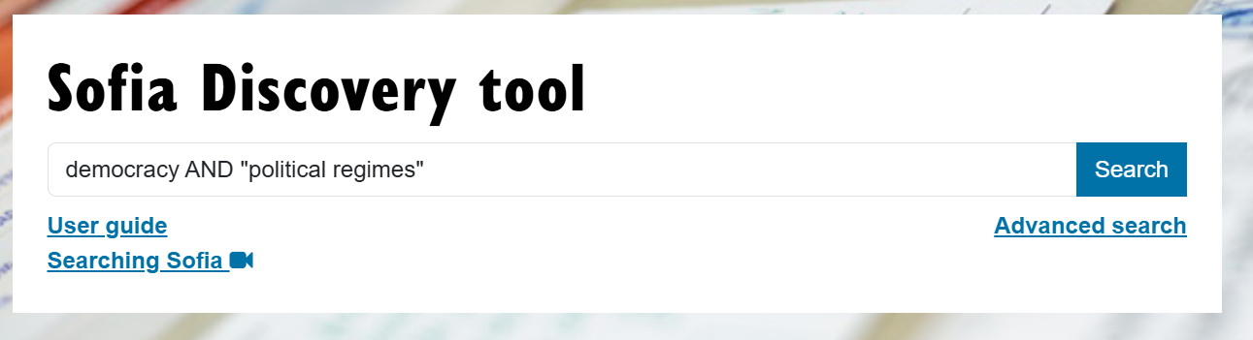

Slide 25
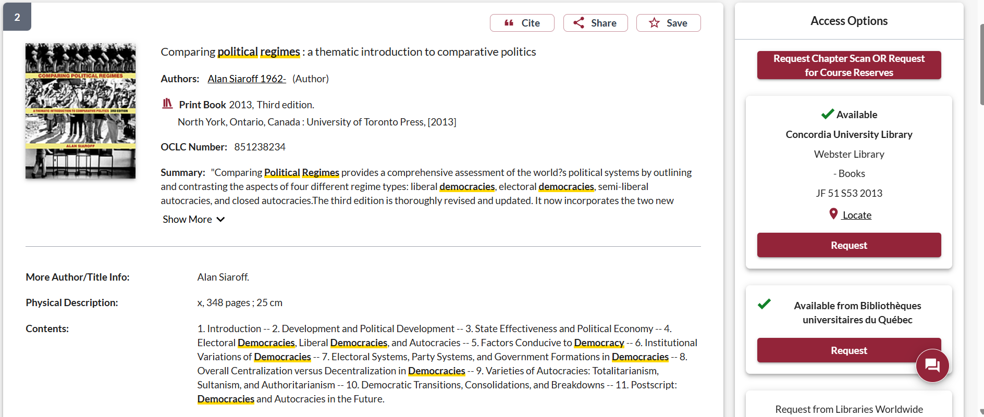
13 years old

Slide 26
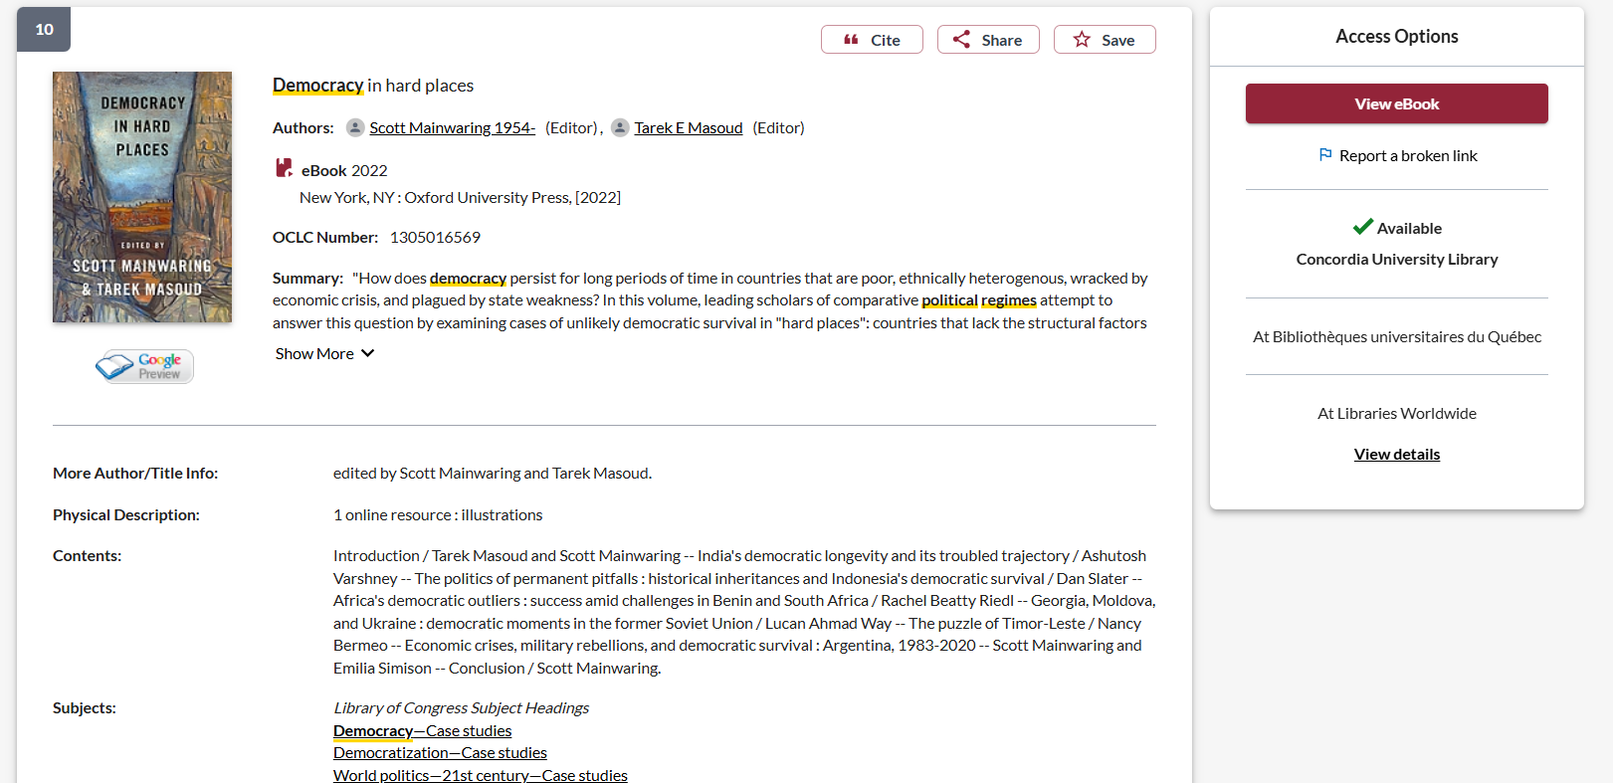
4 years old
Use the subject headings to find more related books and articles

Slide 27
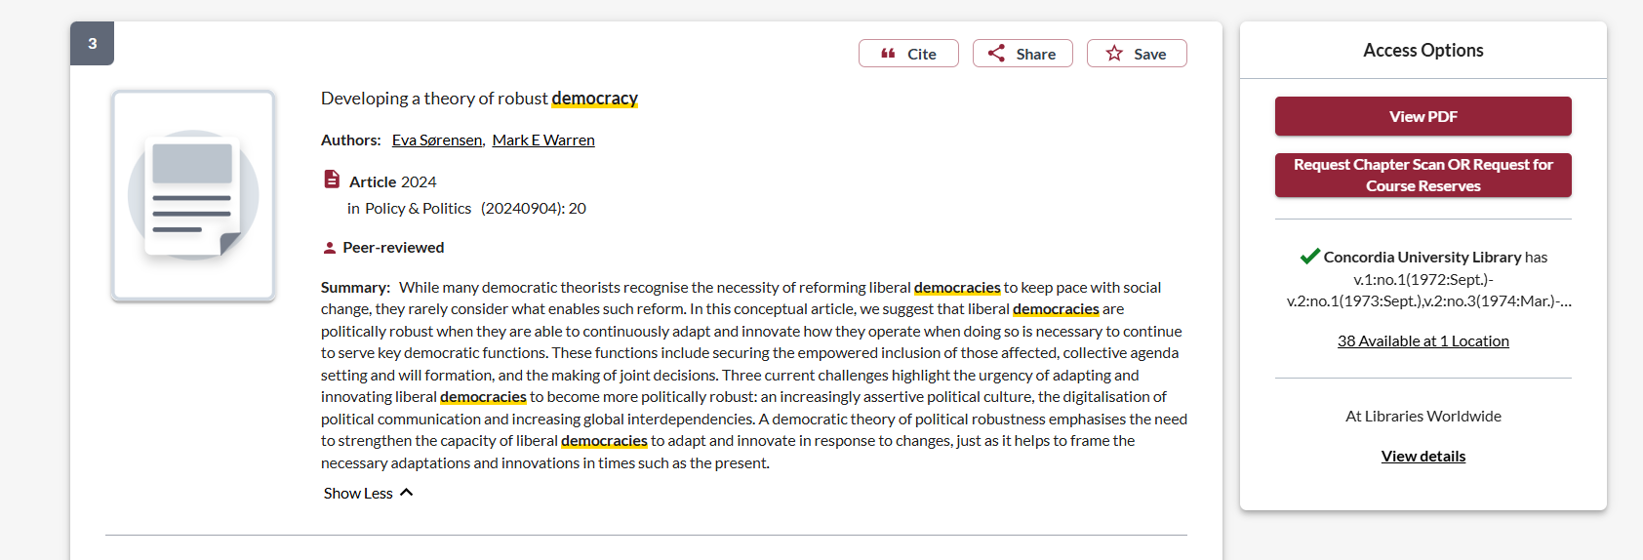
2 years old

Slide 28
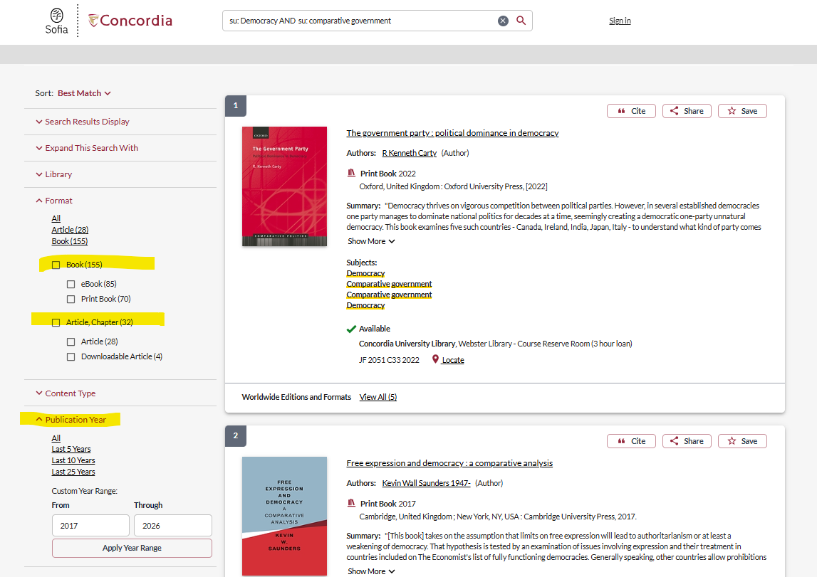
Use the limits on the left panel of Sofia to narrow down by format: books, articles, chapters and by date: 5, 10 or 25 years

Slide 29
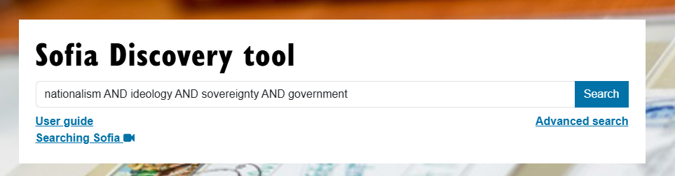

Slide 30
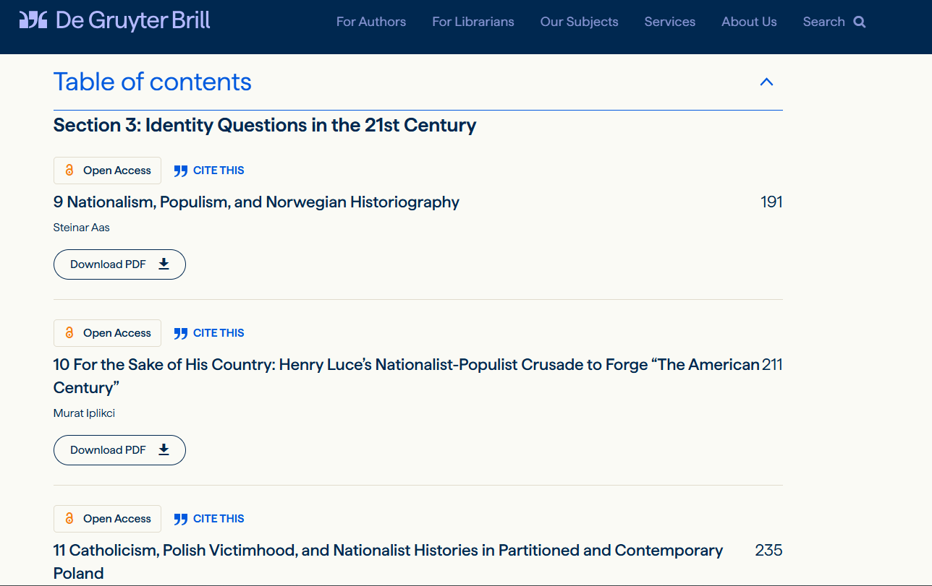
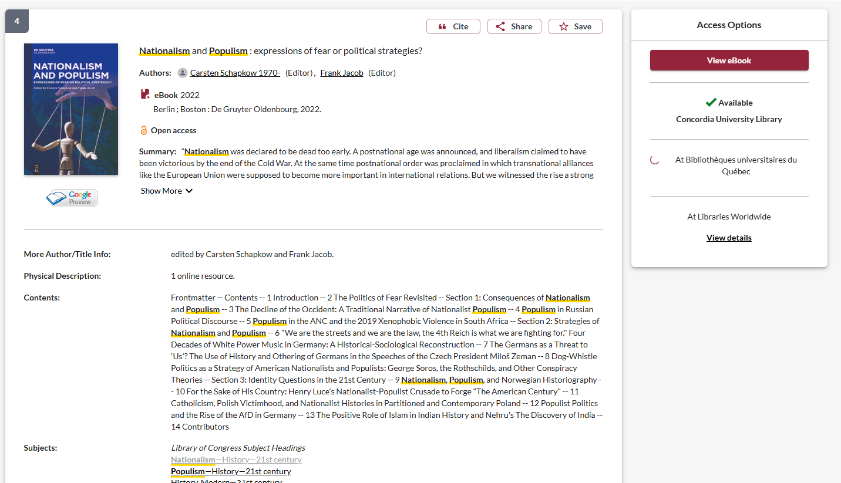
This is an example of edited book, where all the chapters are about different aspects of the larger topic

Slide 31
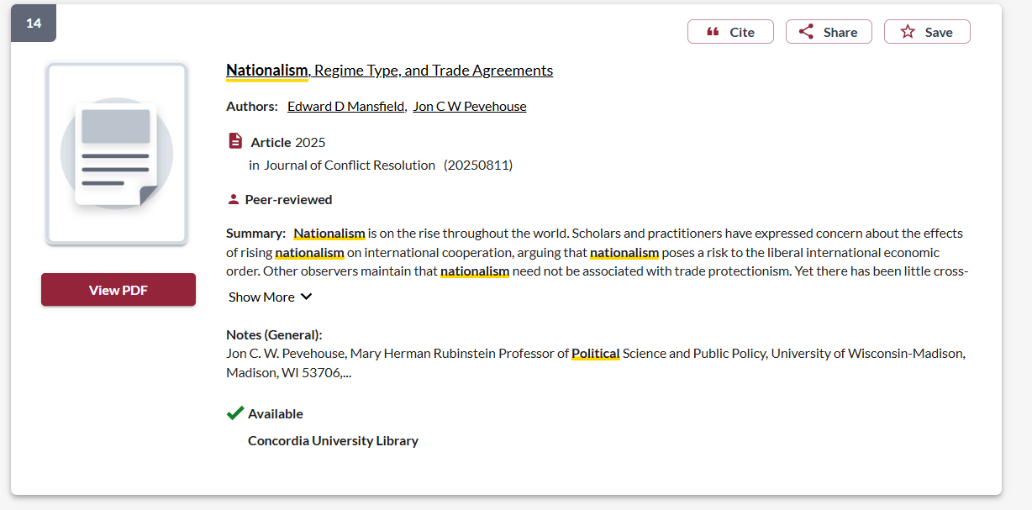

Slide 32
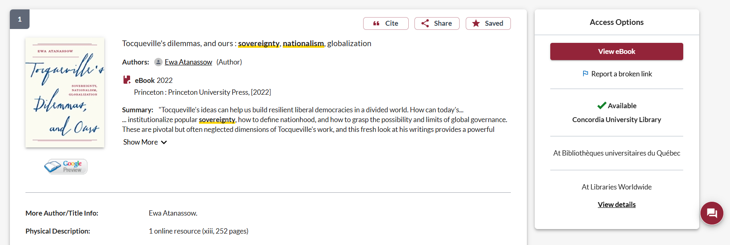
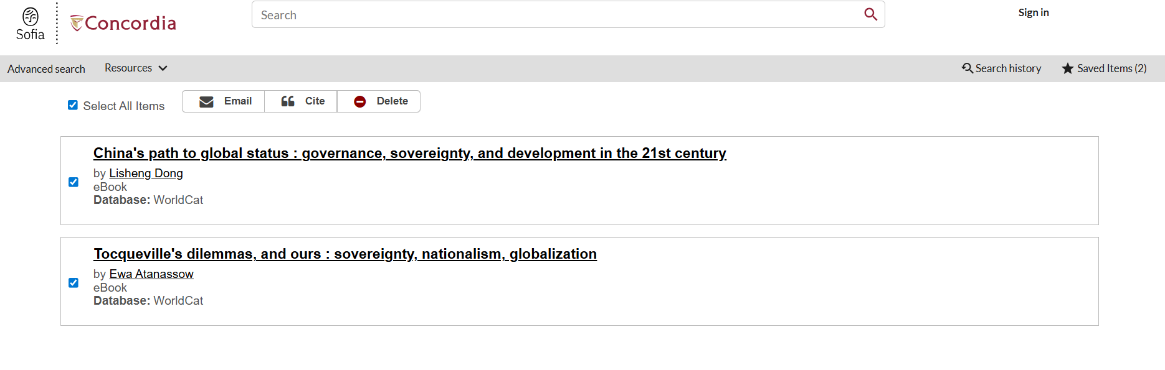
Share: send yourself the URL/Sofia record
Save – add to a list, email entire list to yourself

Slide 33
Journal article databases

Slide 34
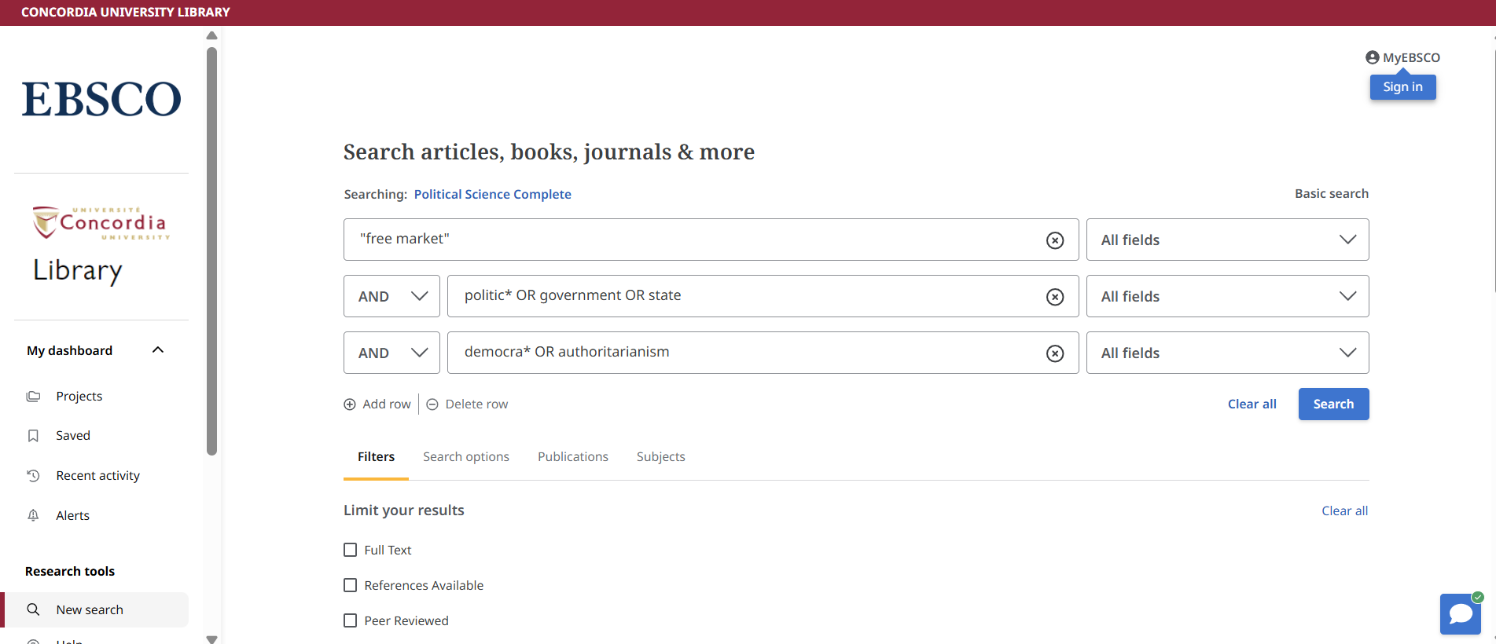
Political Science Complete

Slide 35
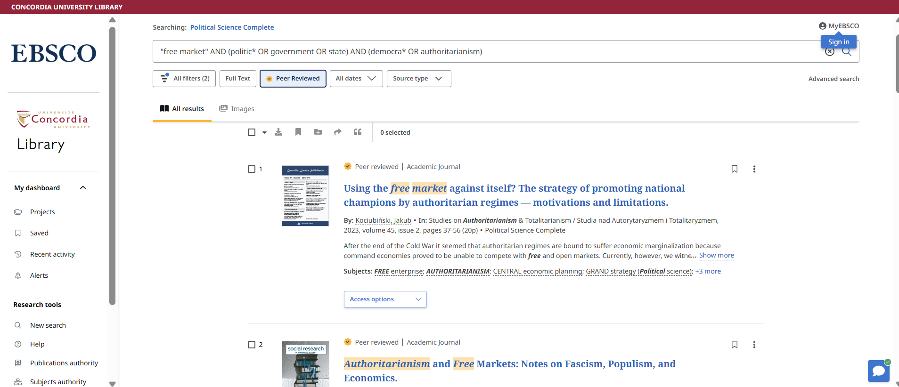
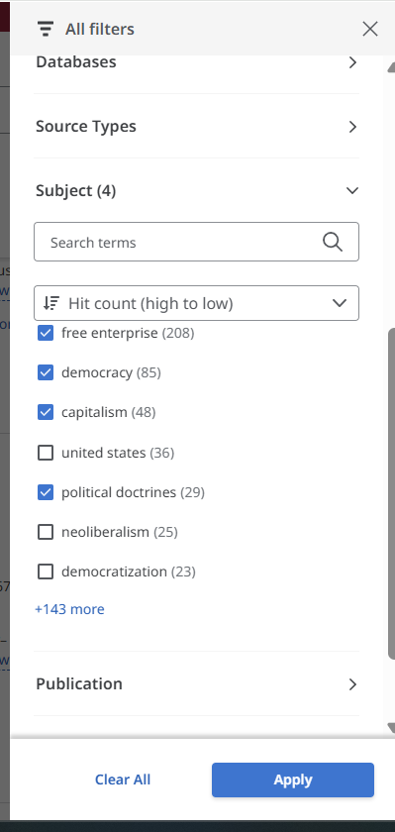
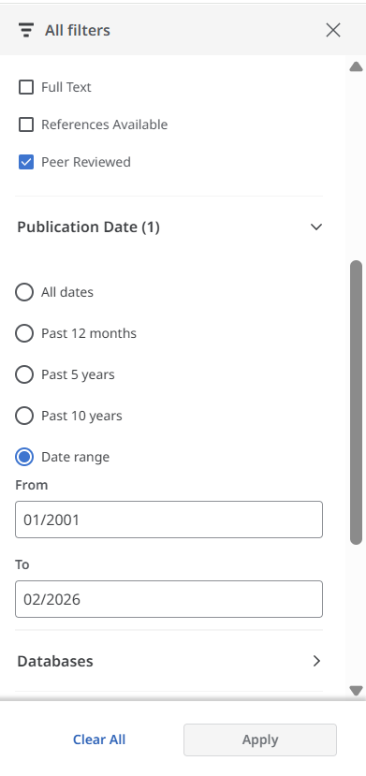



Slide 36
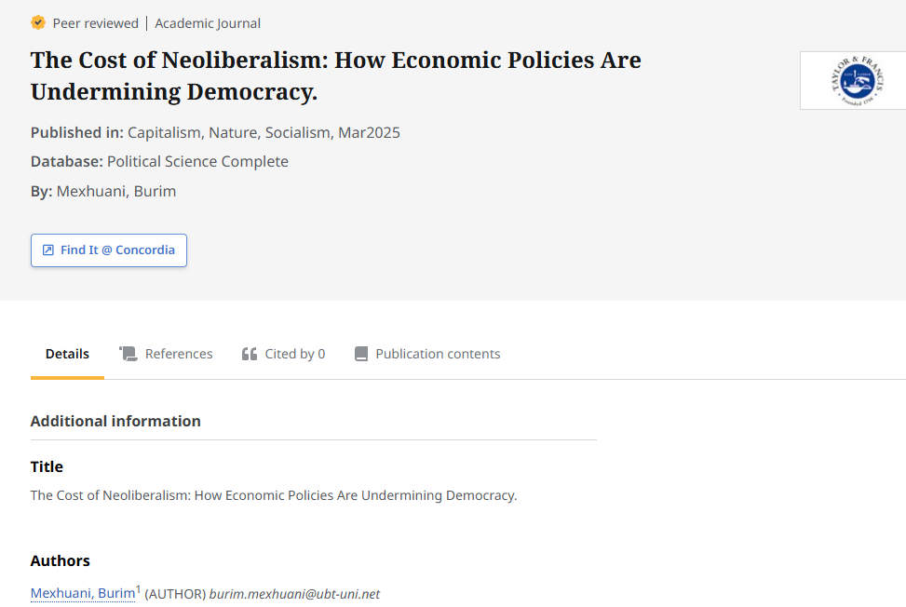
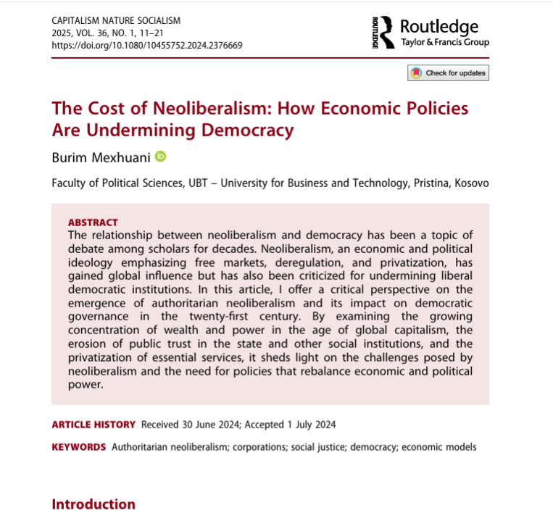
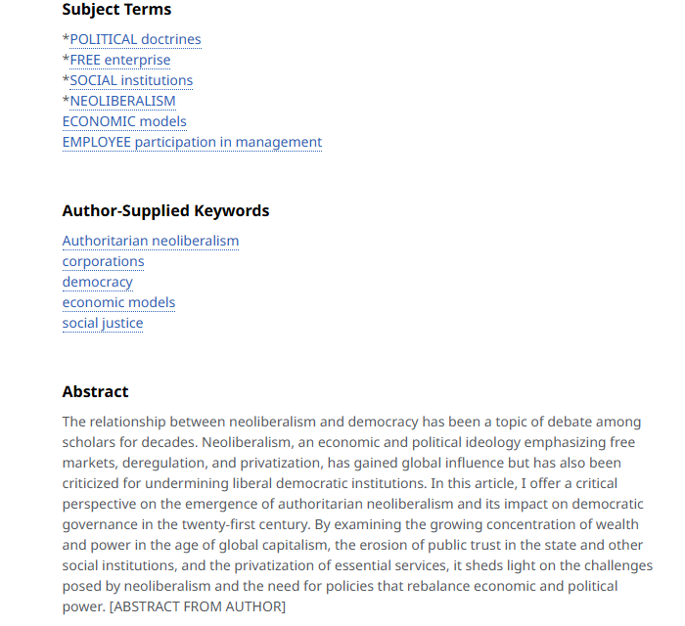

Slide 37
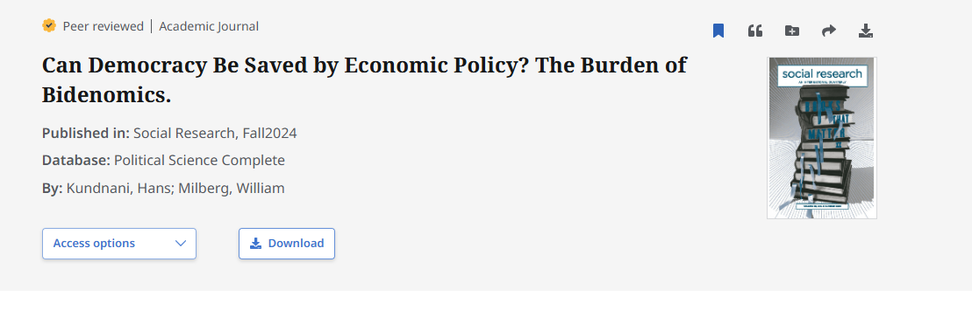
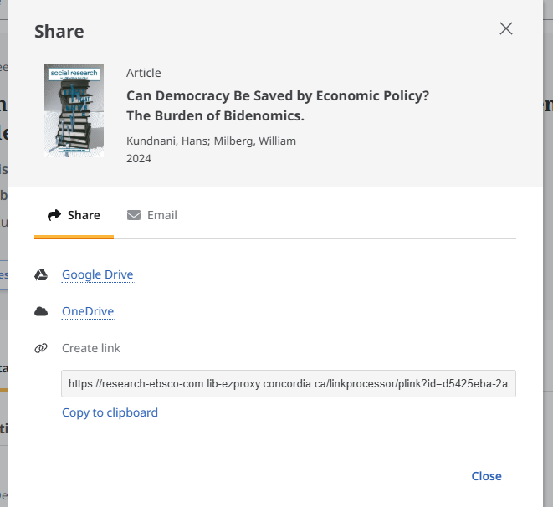
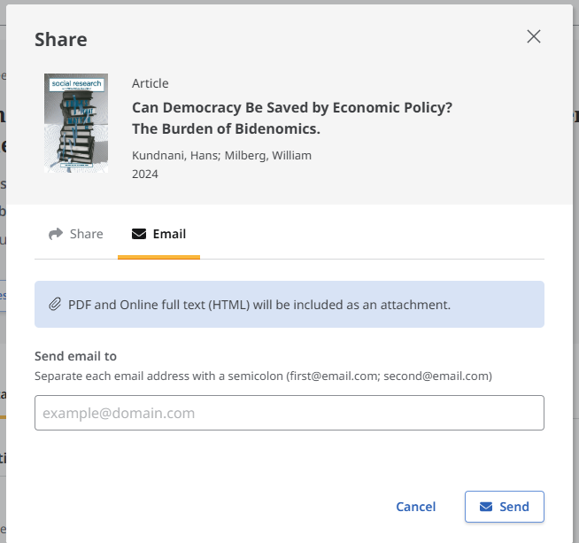
Share and download options

Slide 38

What is peer review?
What are peer reviewed, scholarly articles?

Slide 39
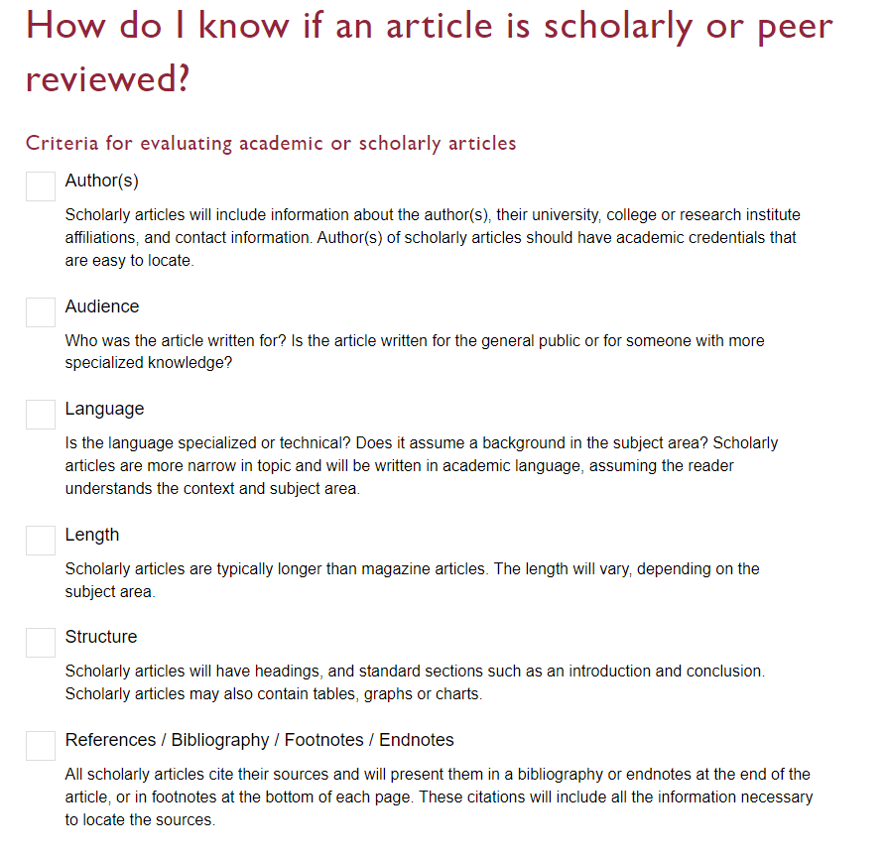

Slide 40
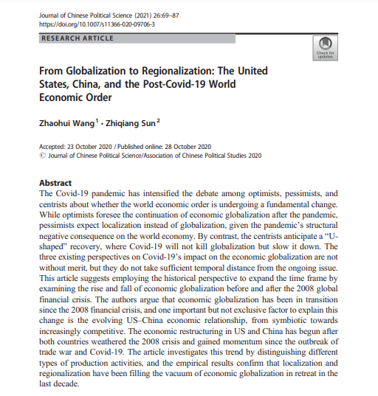
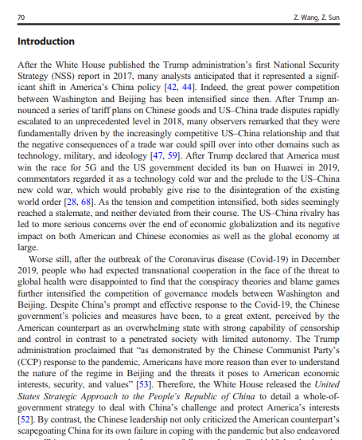
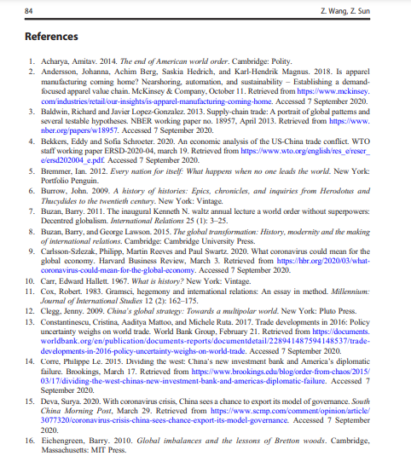
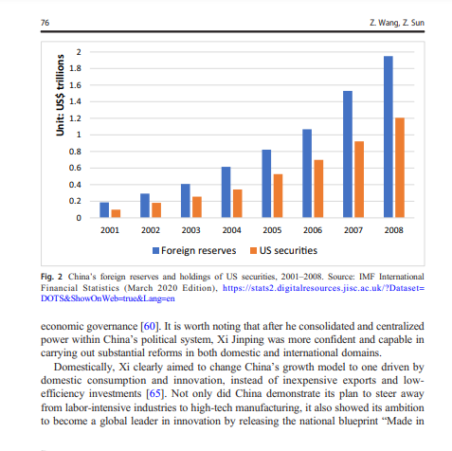
Look for sections, language, charts, tables, graphs and an extensive reference list or bibliography
Specialized language

Slide 41
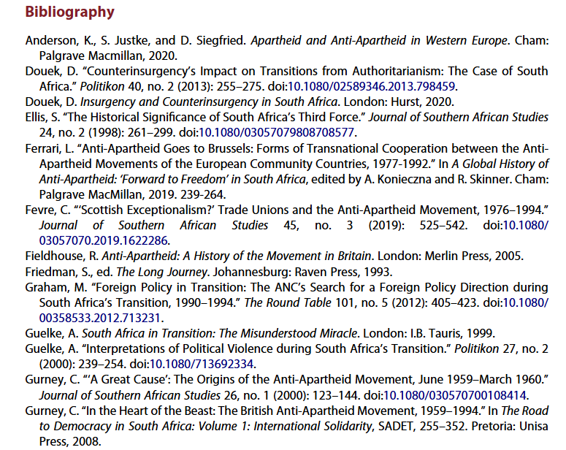
Scholarly articles will always have reference lists/bibliographies/works cited
These are great places to find more sources!
The researcher or research team are experts in the subject area and have already done a lot of research
Use this expertise by looking up the books and articles they cite in Sofia and using them in your own research
This is a commonly used method in academic research

Slide 42
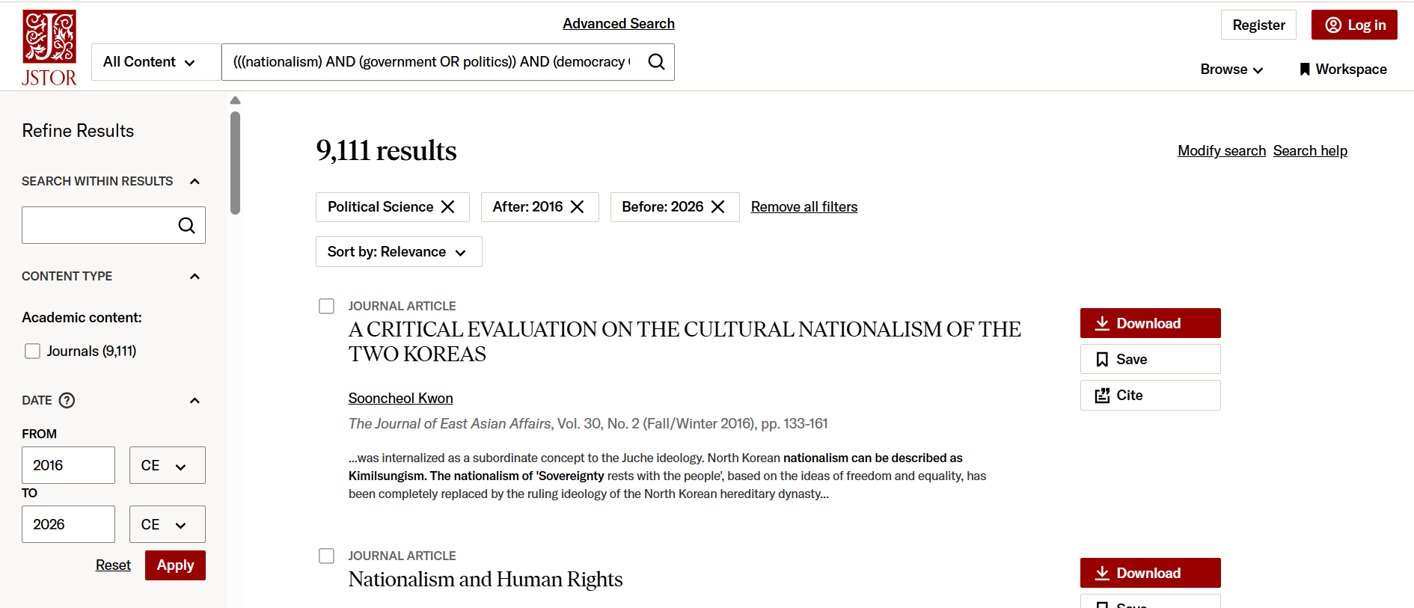
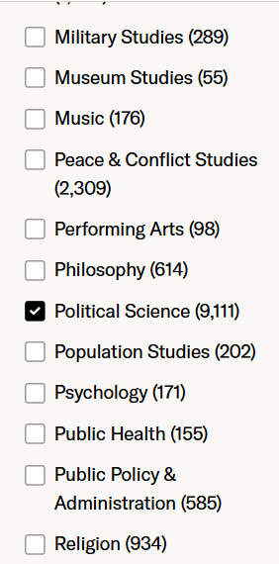
JSTOR

Slide 43
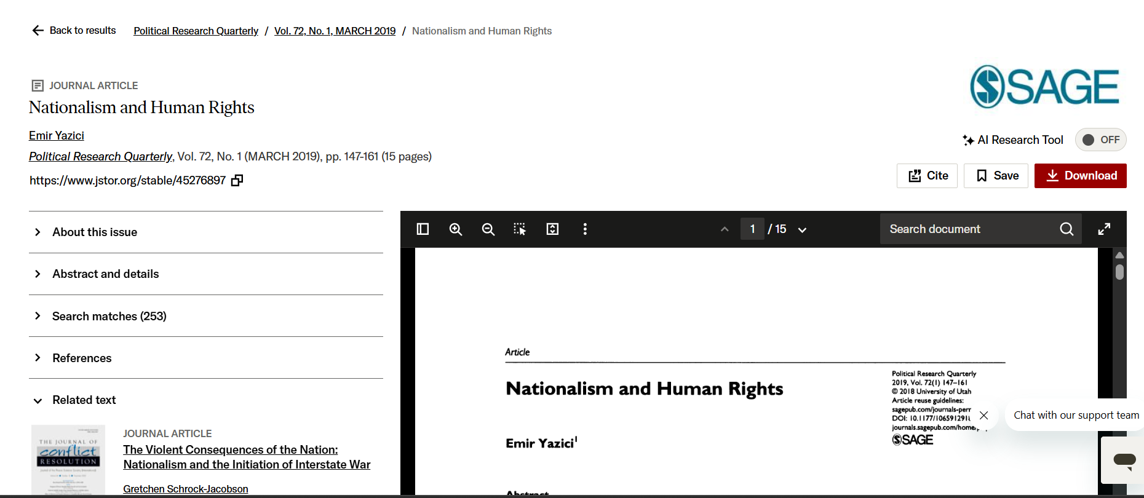

Stable URL to copy/paste to keep track of the article

Slide 44
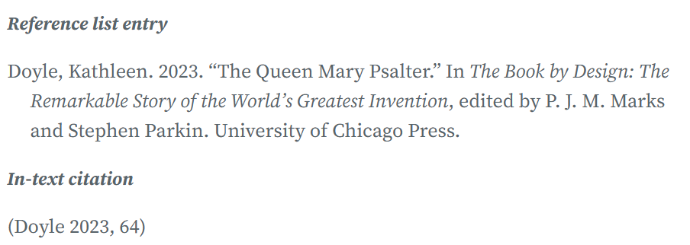
Chicago manual of style citation: author-date
Chicago Guide Online: Author-Date
  Book chapter:

Slide 45
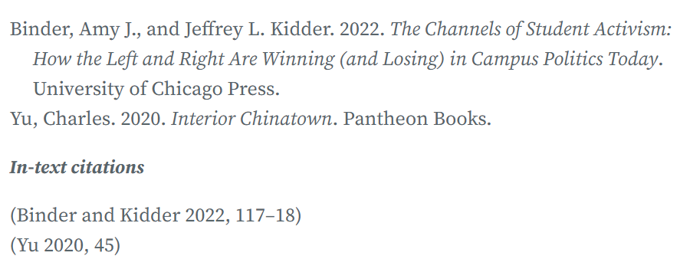
Chicago manual of style citation: author-date
Chicago Guide Online: Author-Date
  Book:

Slide 46
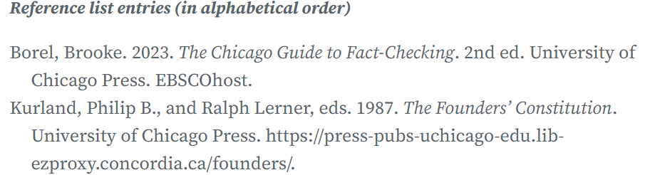
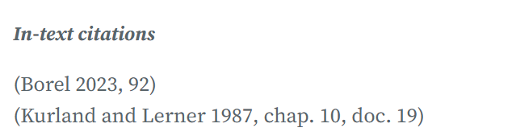
Chicago manual of style citation: author-date
Chicago Guide Online: Author-Date
  E-Book:

Slide 47
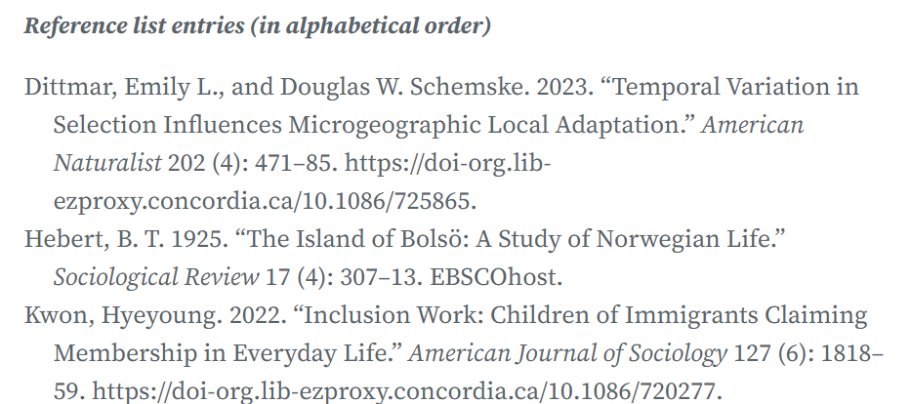
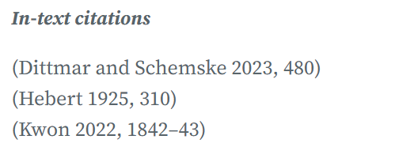
Chicago manual of style citation: author-date
Chicago Guide Online: Author-Date
  Journal Article:

Slide 48
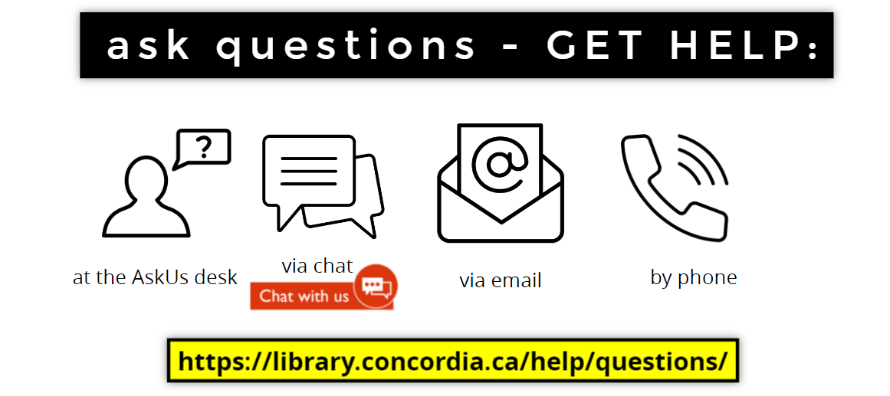
Michelle.Lake@Concordia.ca

