Slide 1

POLI 486
International Relations: The Politics of International Development
Library Workshop
Michelle Lake
Political Science, SCPA, First Peoples Studies and Government Publications Librarian
Michelle.Lake@Concordia.ca

Slide 2
Course guide with links and powerpoint slides
https://www.concordia.ca/library/guides/political-science/poli-486.html

Slide 3
Who am I?
Michelle Lake, librarian for Political Science, the School of Community and Public Affairs, First Peoples Studies, and Government Publications
Michelle.Lake@Concordia.ca / Make an appointment or ask a question
What do I do?
  Provide research support
  Help students with library databases
  Help students find and access materials they need
  Help with citation issues
  Choose the books we buy for the above subject areas

Slide 4
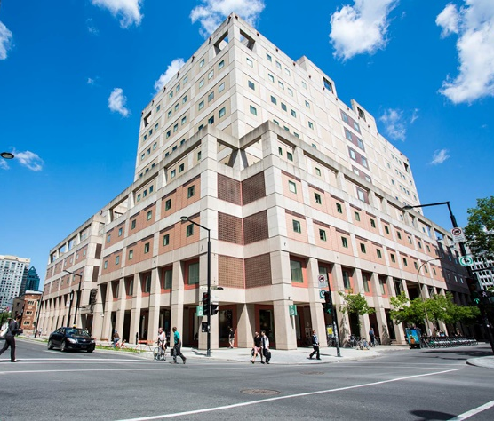
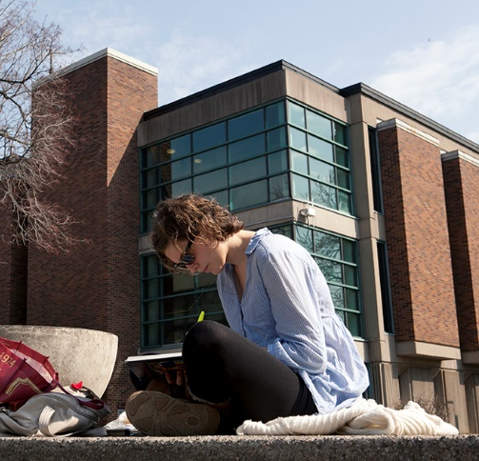
The Librar(ies)
24/7 access, with student card, after 11pm
Webster Library (LB) – downtown on SGW campus & Vanier Library (VL) on Loyola campus
Webster: Social Sciences, Humanities, Business, Engineering & Fine Arts
Vanier: Science(s), Health, Communications, Journalism and Psychology
Course Reserves Room(s): have the required undergraduate print textbooks for the courses taught at that campus (for example: Webster has the Political Science and SCPA course reserves)

Slide 5

Library Services
Your student card is your library card.
You need it to:
borrow books (up to 100 a time)
borrow a laptop and other technology (for 24 hours)
print on campus (add money to your Dprint account)
access the library overnight during 24/7 hours.
Webster library has 5 book scanners (And Vanier has 2!) that can be used for free to scan chapters from our print books and email them to yourself as a PDF.
To use Library databases, access online articles and ebooks when you are off campus, login with your MyConcordia Netname and password.

Slide 6

How can I find out if the library has access to an item I’m looking for?

Slide 7
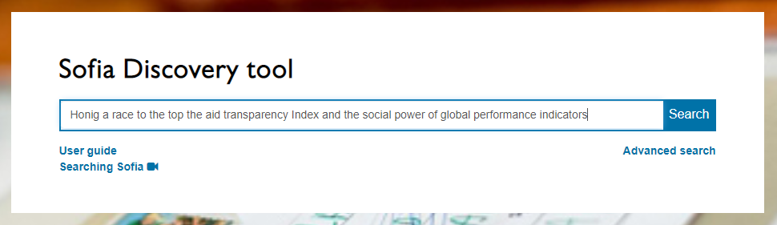
Dan Honig and Catherine Weaver. “A race to the Top? The Aid Transparency Index and the Social Power of Global Performance Indicators.” International Organization 73.03(2019), pp. 579-610

Slide 8
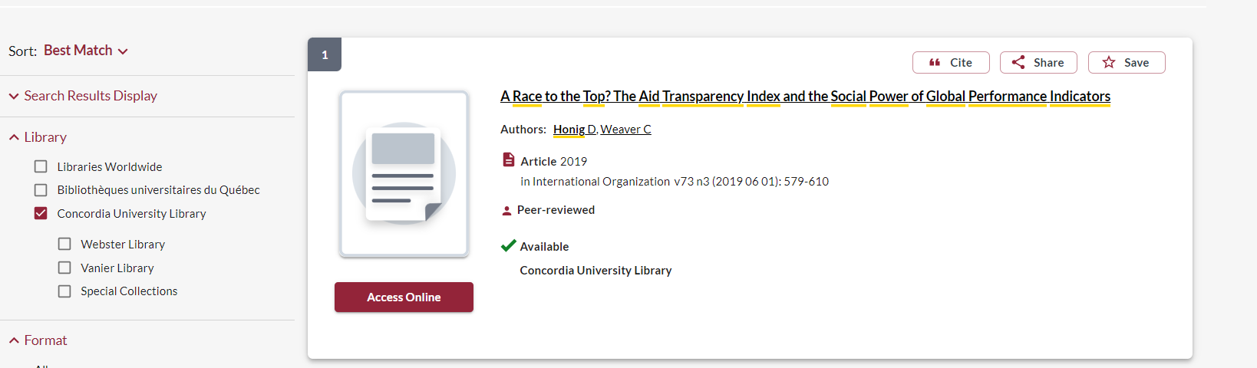
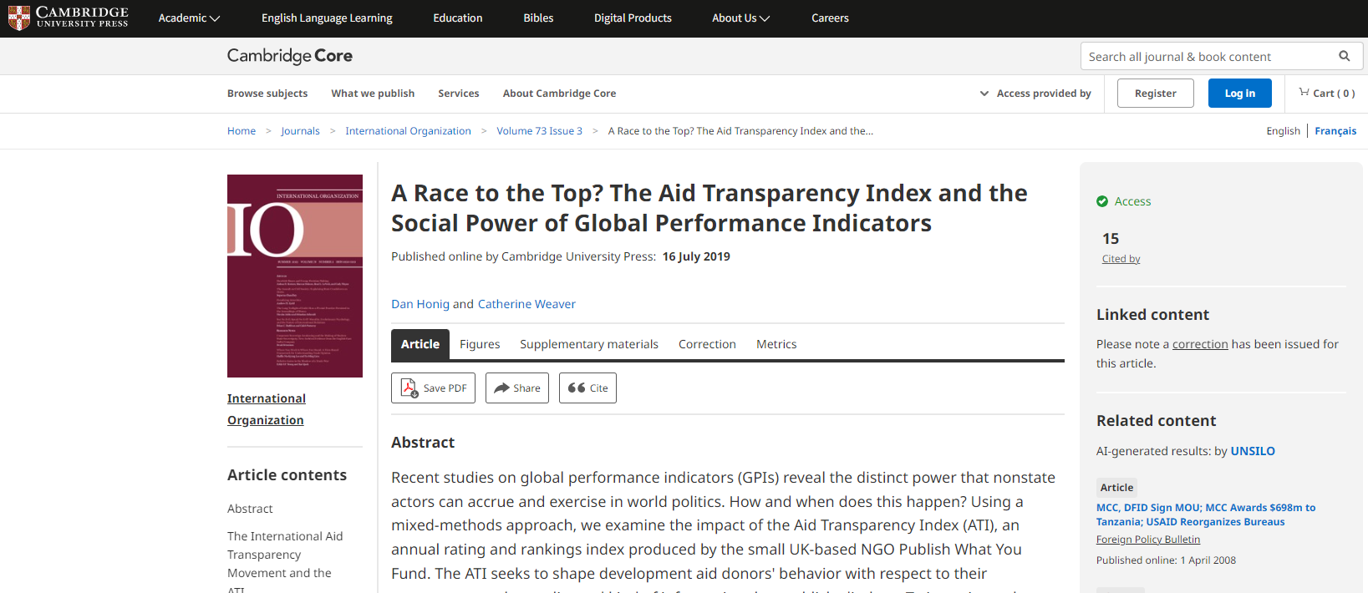
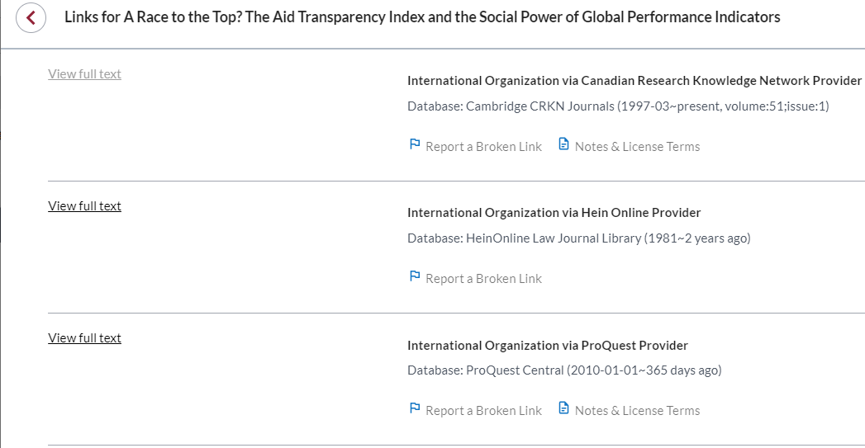

Slide 9
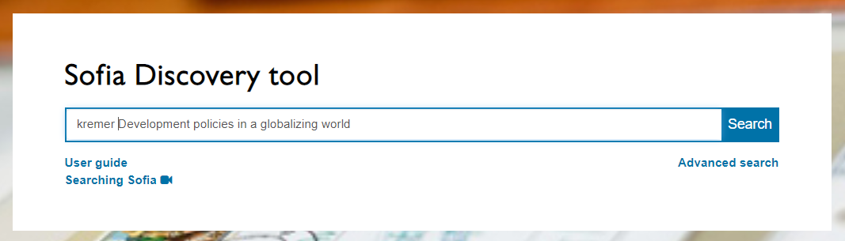
Michael Edwards. “Why ‘Philanthrocapitalism’ is not the answer: Private initiatives and international development.” Doing Good or Doing Better: Development policies in a globalizing world. Ed. By Monique Kremer, et al. Amsterdam University Press, 2009. Chap. 10, pp. 237-254.

Slide 10
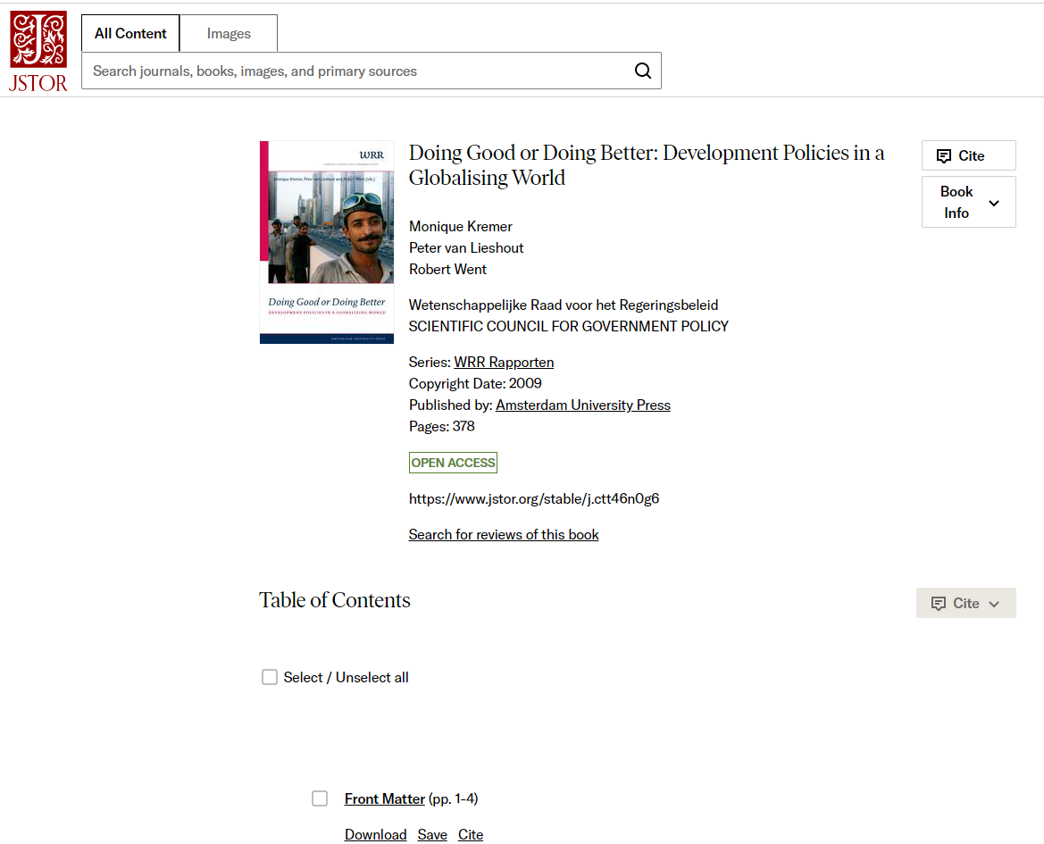
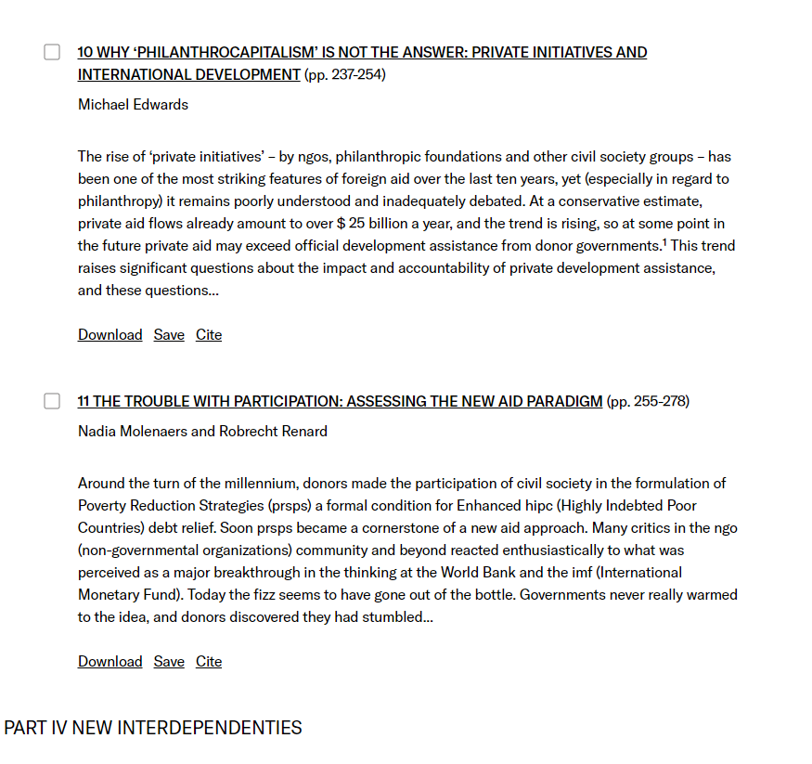
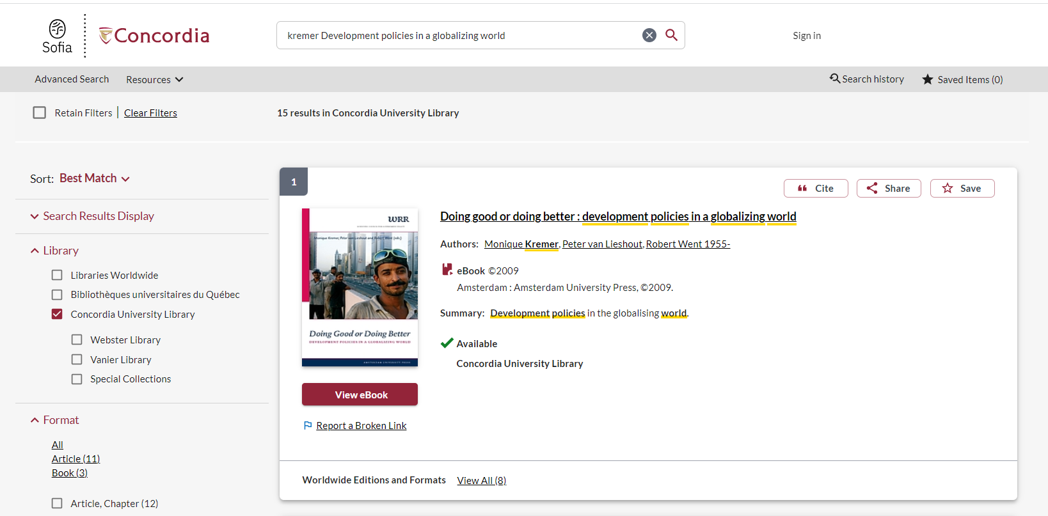
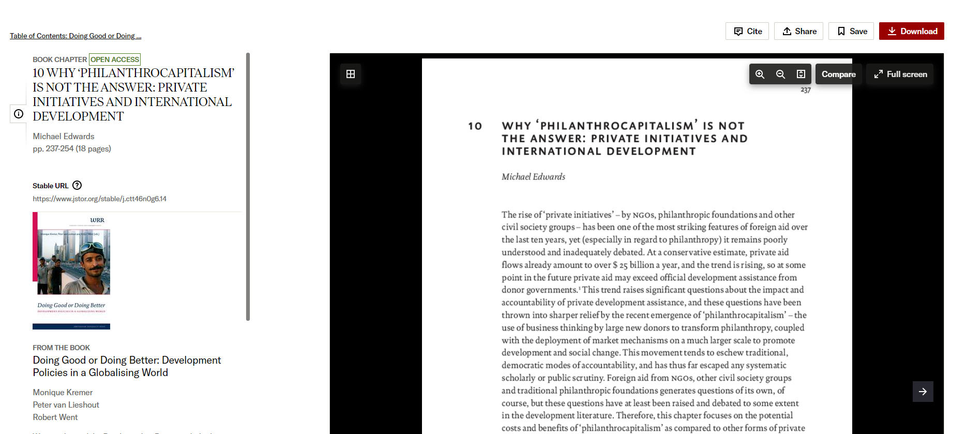
Scroll down to view the chapters

Slide 11
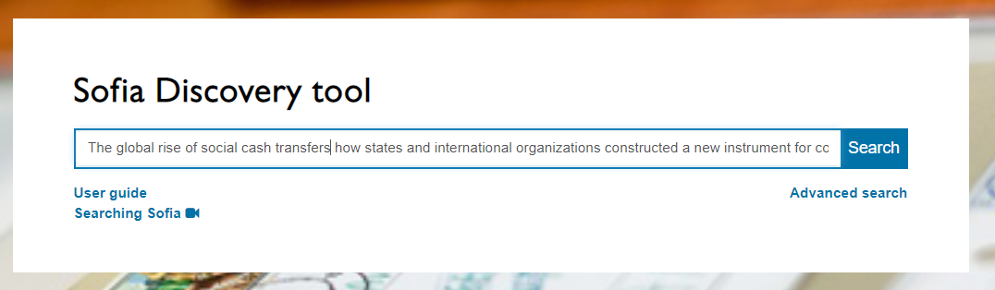
Lutz Leisering. The global rise of social cash transfers: how states and international organizations constructed a new instrument for combating poverty. Oxford University Press, 2019.

Slide 12
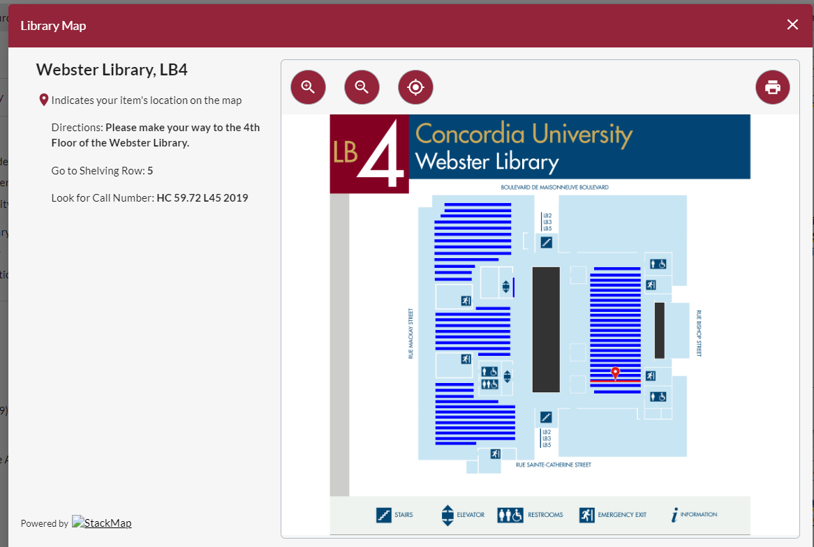
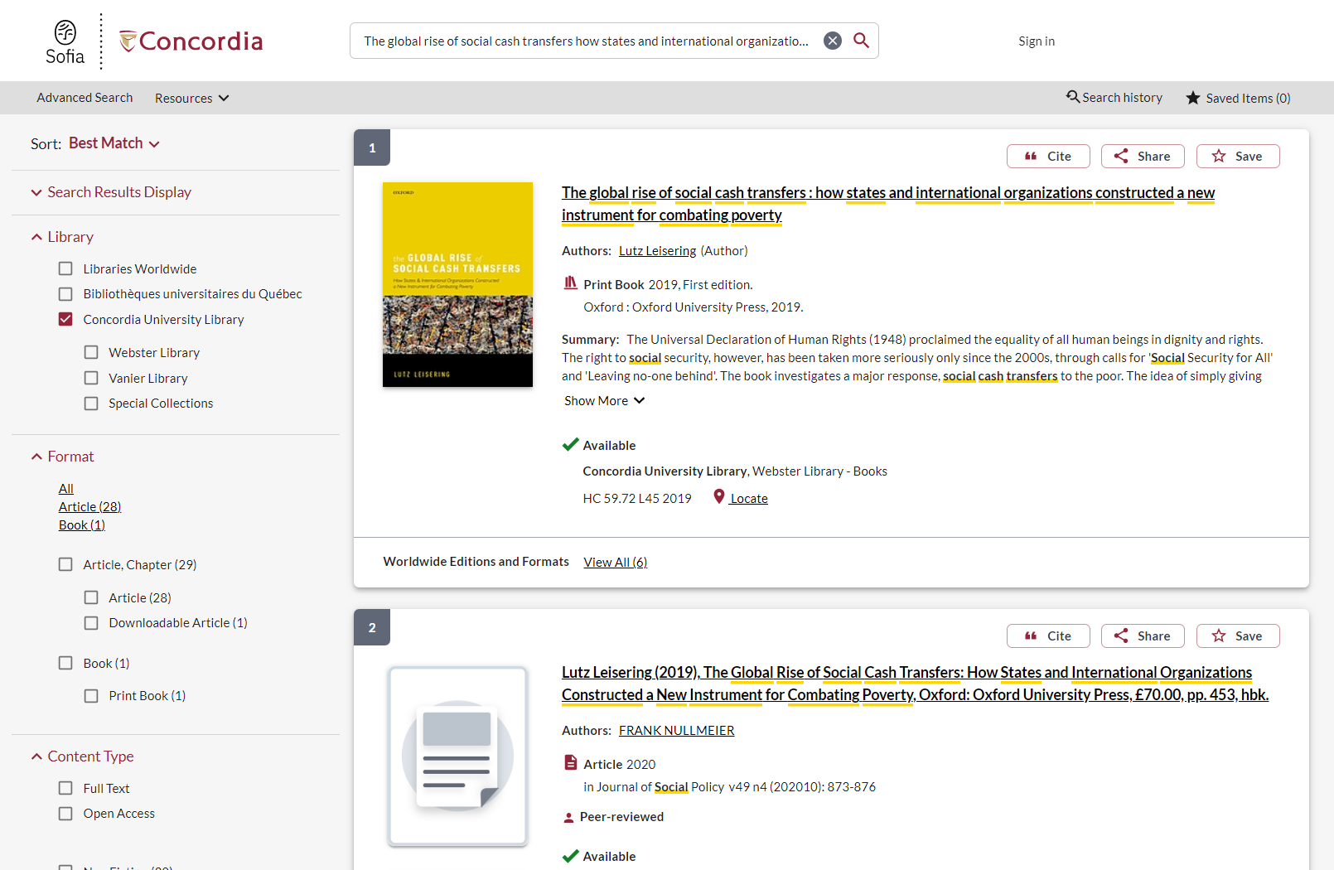
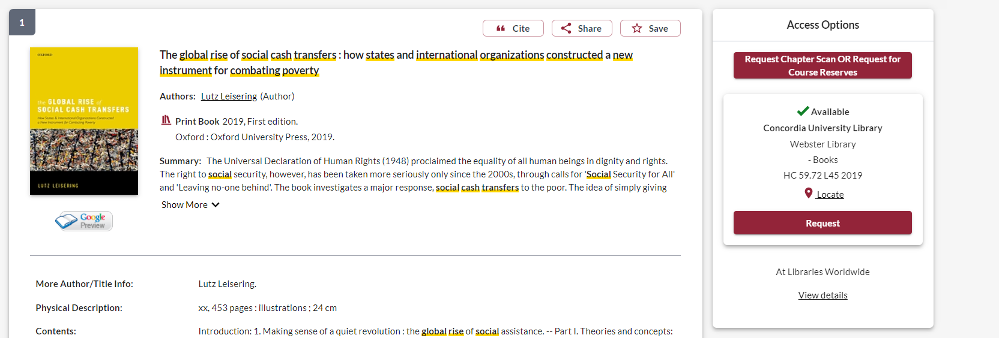
You can use this button to request one chapter from the book, to be scanned and emailed to you, within 5 days.
The book
This is the information to find the book on the shelf yourself
A book review

Slide 13
Scholarly Sources

Slide 14
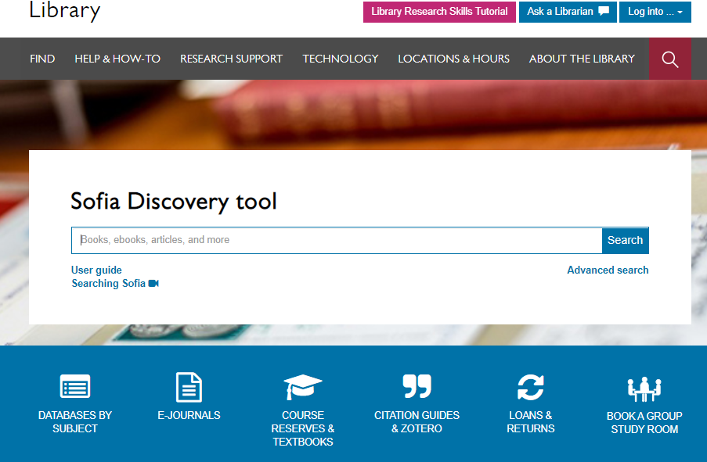
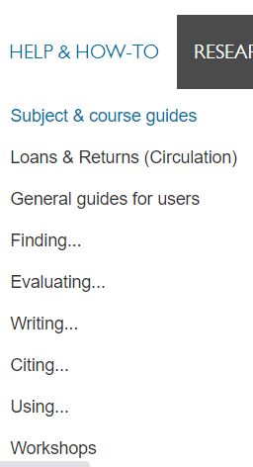

Slide 15
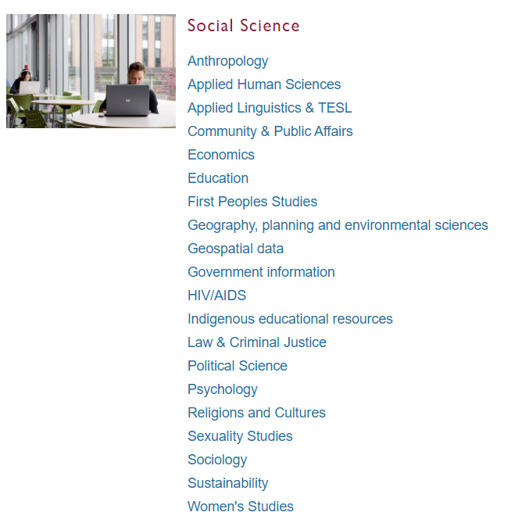
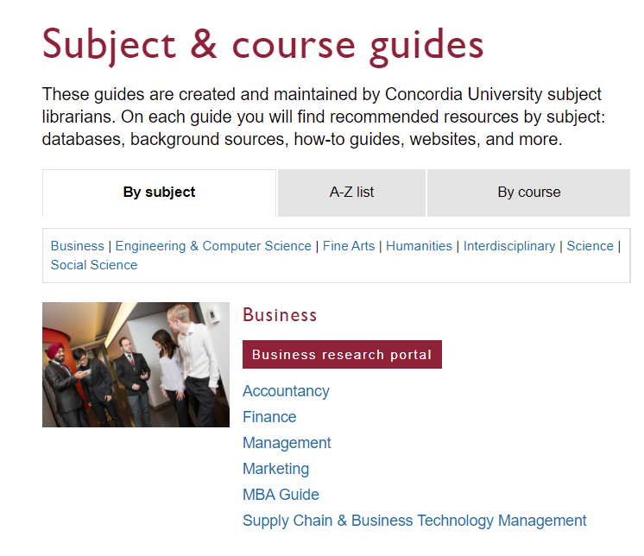
Subject Guide: Political Science

Slide 16
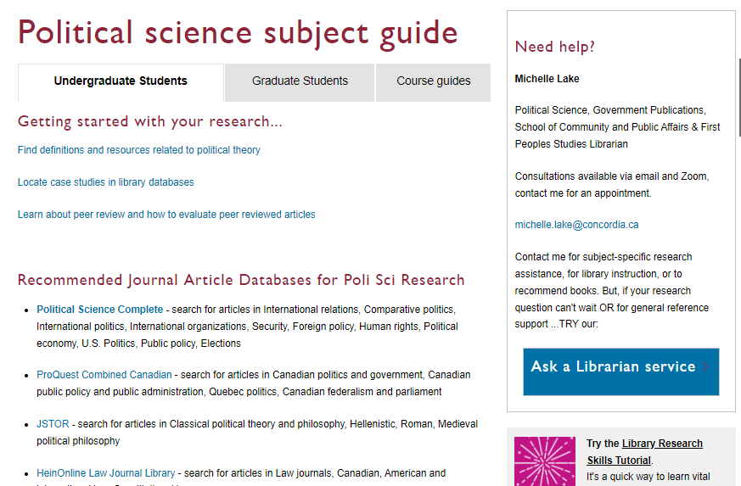

Slide 17

Search Strategies

Slide 18
How do we combine search words for the best possible results?
AND: combines concepts and limits your results
politics AND development
state OR government
OR: allows you to insert synonyms or alternative terms and increases your results

Slide 19
How do we combine search words for the best possible results?
“quotation marks”: If you put two or more words in quotation marks, that exact phrase will be searched and limits your results.
“foreign aid”
“international cooperation”
econom*
Finds: economy, economies, economic, economics, economically
* - when you add an asterisk on the end of a word, your results will contain all the words with those endings or suffix

Slide 20
Avoid Searching with Linking words
Each author may use different linking words when discussing similar topics.
Effects
Impact
Consequences
Influence
Results
Importance
Significance
Response
Emphasis
Causes
You don’t want your search to be limited to those books and articles that only contain the word “effect” or “consequence”

Slide 21

Scholarly Sources: Books and Articles

Slide 22
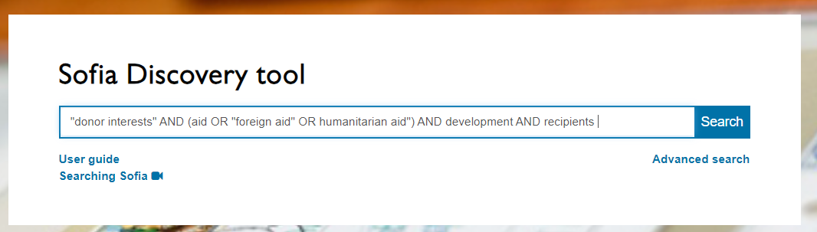
“Even if decisions about aid are determined by donors’ interests, aid can still be effective in recipient countries”.
Do you agree?
Main concepts:
Aid, foreign aid
Donor interests
Effectiveness
recipients
+ development
Tip: When using AND / OR in any databases, type them in ALL CAPS, this is especially important in Sofia.

Slide 23
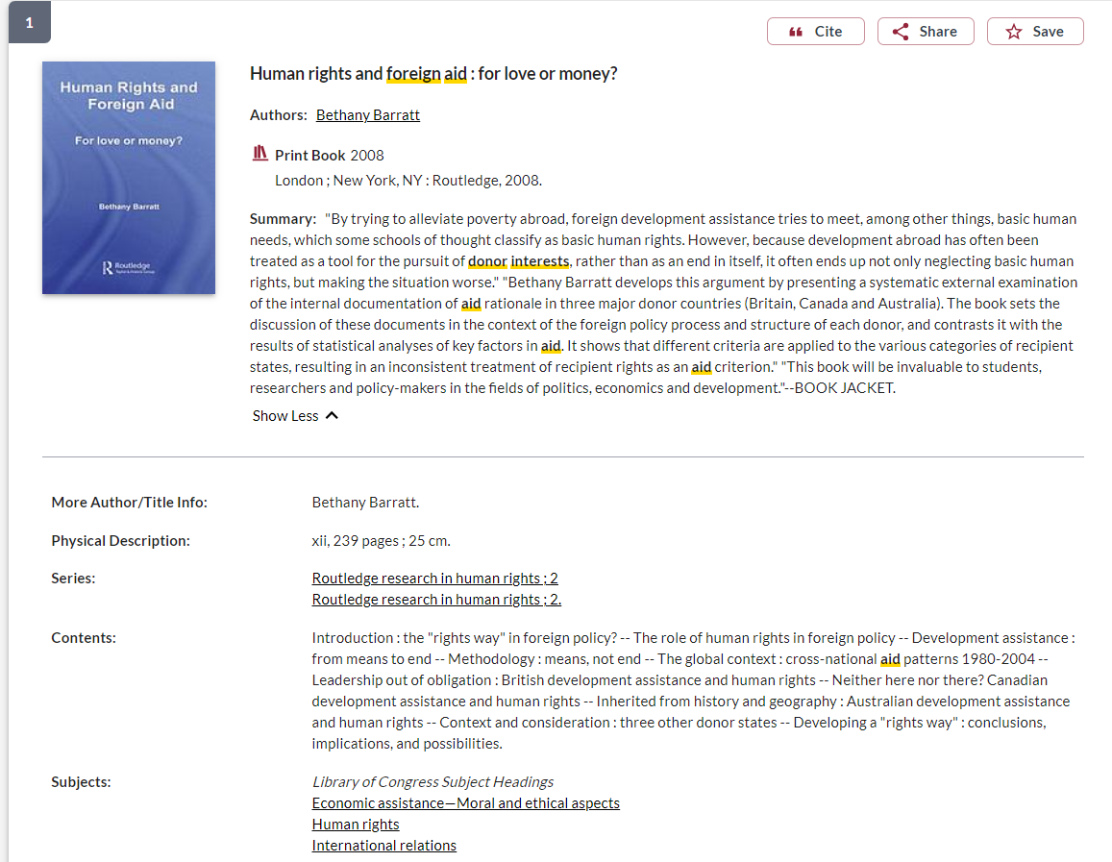
Subject headings can lead to a more focused search

Slide 24
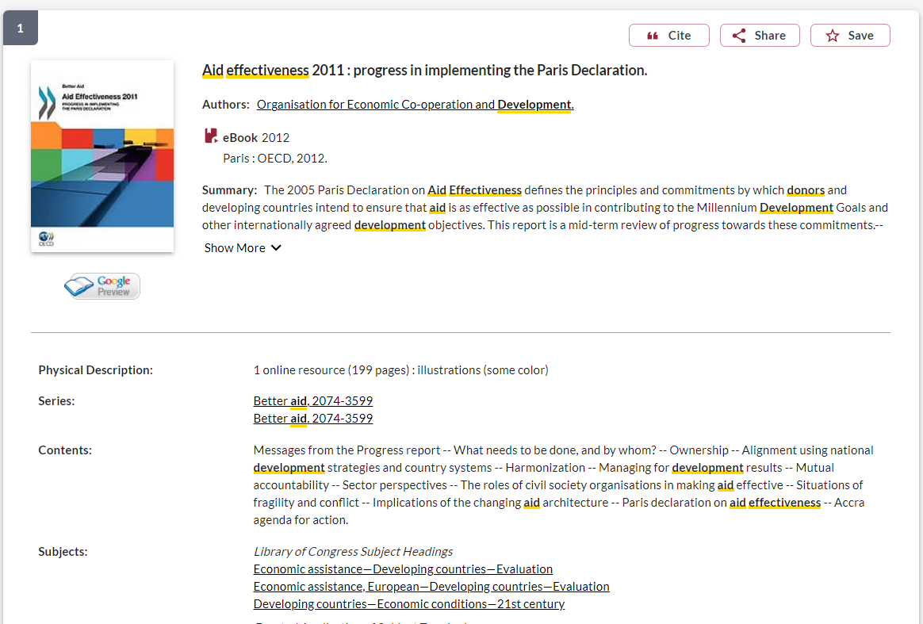
OECD publication

Slide 25
OECD publications (available through Sofia and OECD iLibrary)
What is the OECD?
Organisation for Economic Co-operation and Development is an intergovernmental organisation with governments of 38 democracies with market-based economies collaborate to develop policy standards to promote sustainable economic growth. A reliable source of evidence-based policy analysis and economic data.
  OCED reports and publications are a type of grey literature; this information is reliable, but not scholarly or peer reviewed.
  Series The Development Dimension
  Books and policy papers on the theme of Development

Slide 26
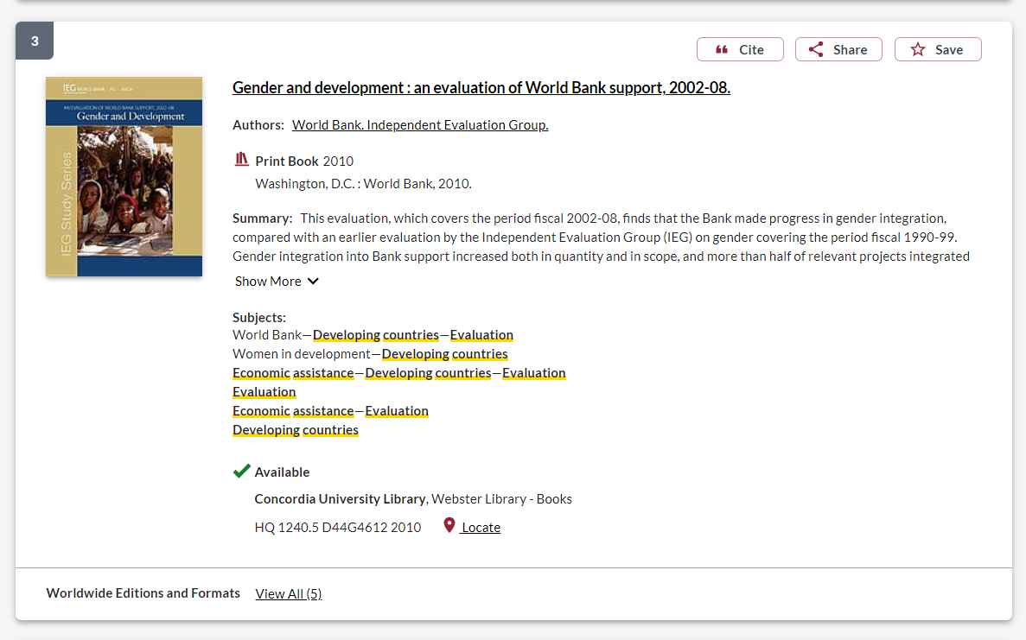
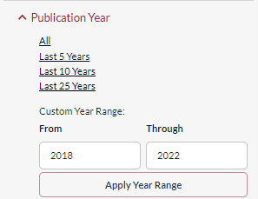
More grey literature, from the World Bank

Slide 27
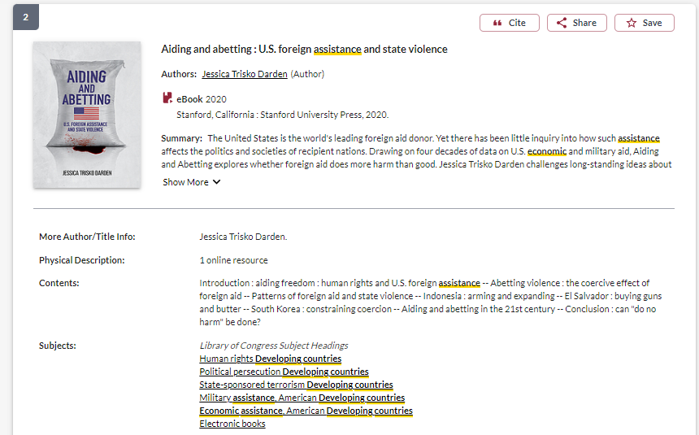
Books published by University Presses are scholarly books

Slide 28
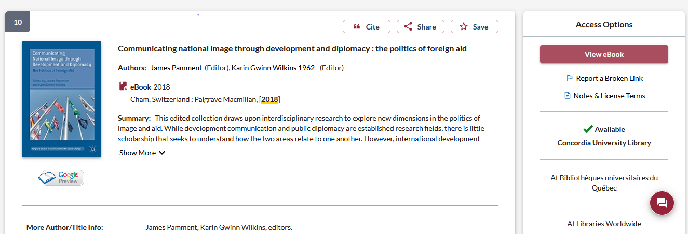
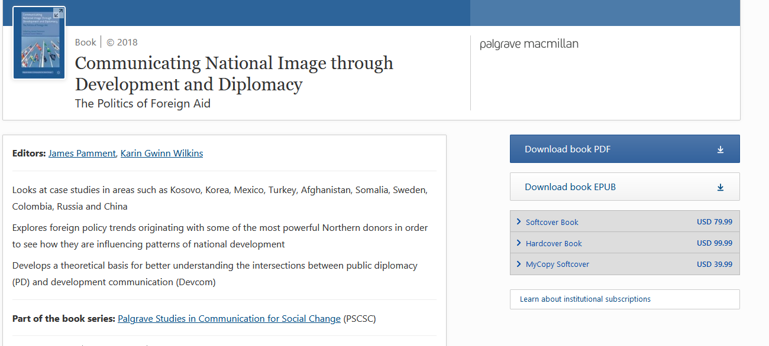
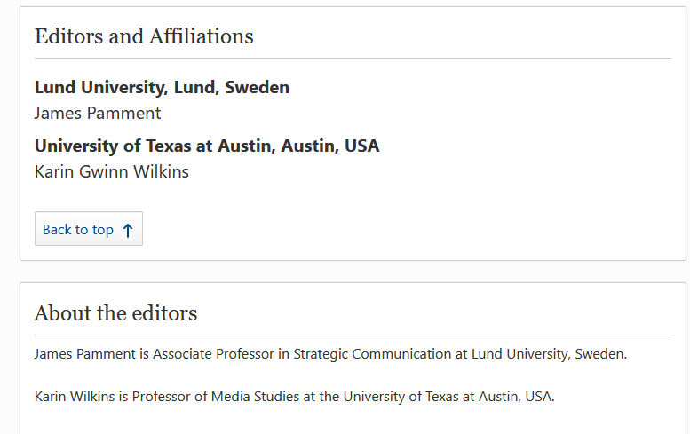
Look for author/editor affiliations, ‘about’ sections, and contributors sections. Scholarly books are written and edited by faculty and researchers from universities

Slide 29
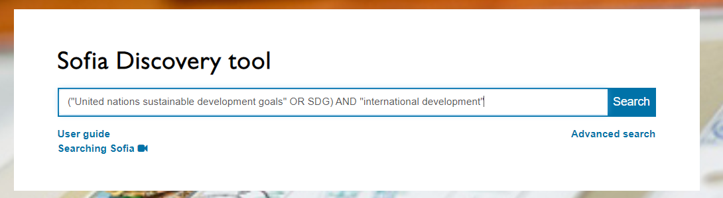
Topic: What are the main impacts of the Sustainable Development Goals (SDGs) on contemporary international development cooperation

Slide 30
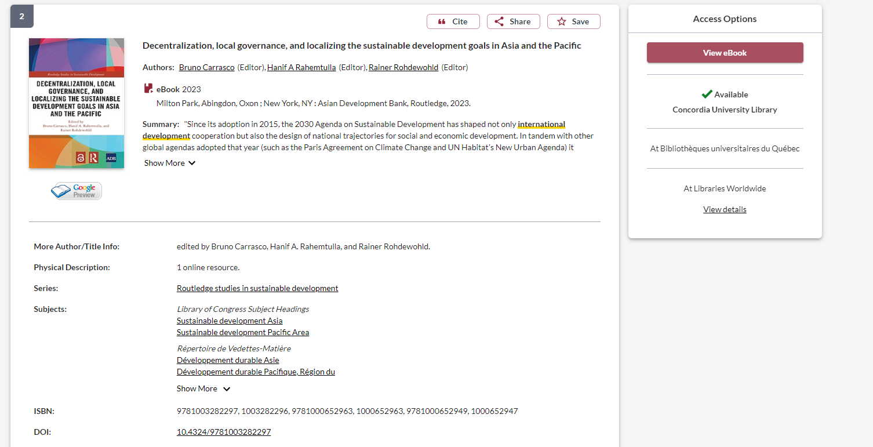

Slide 31
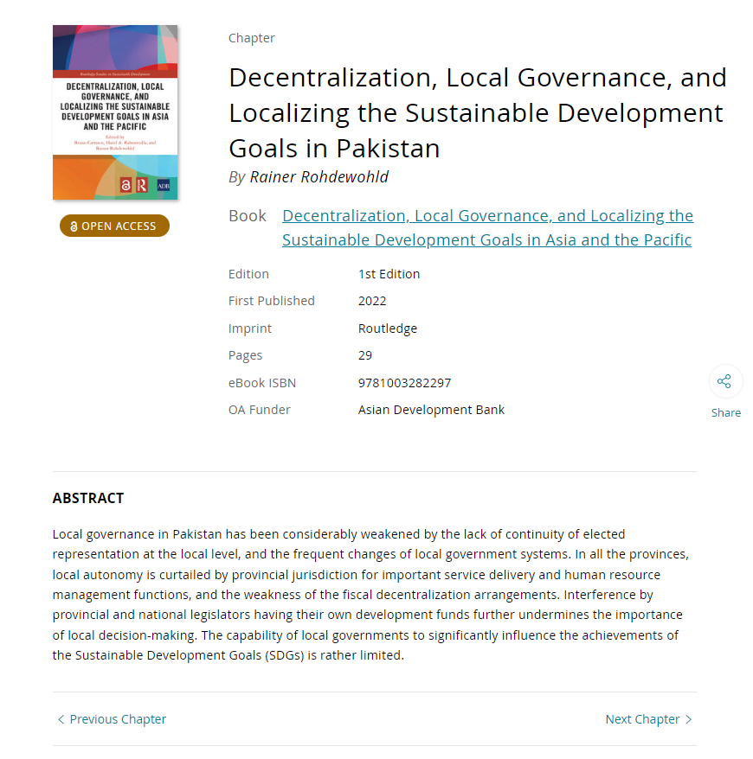
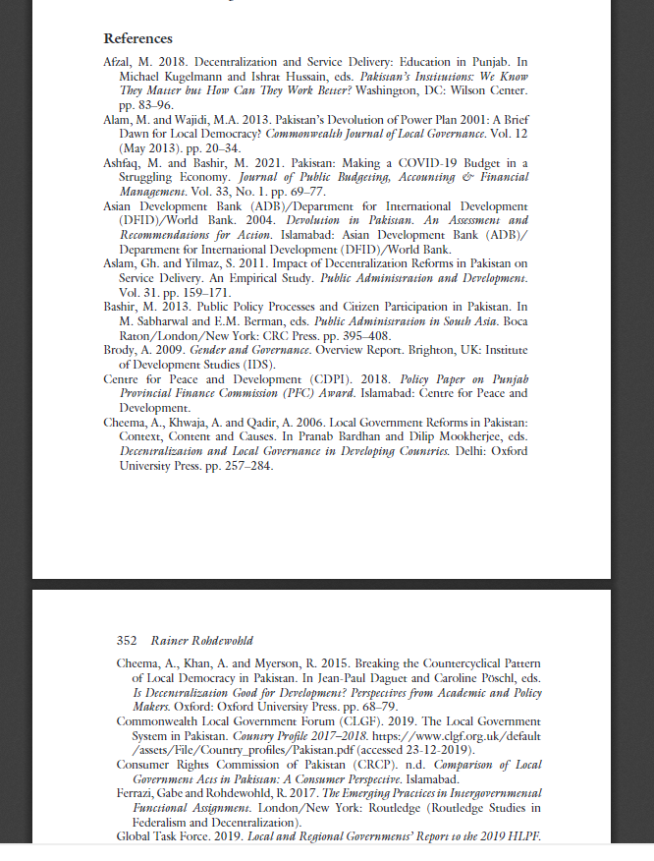
In scholarly books, there will be extensive reference lists and citations, either at the end of each chapter or the end the book.

Slide 32
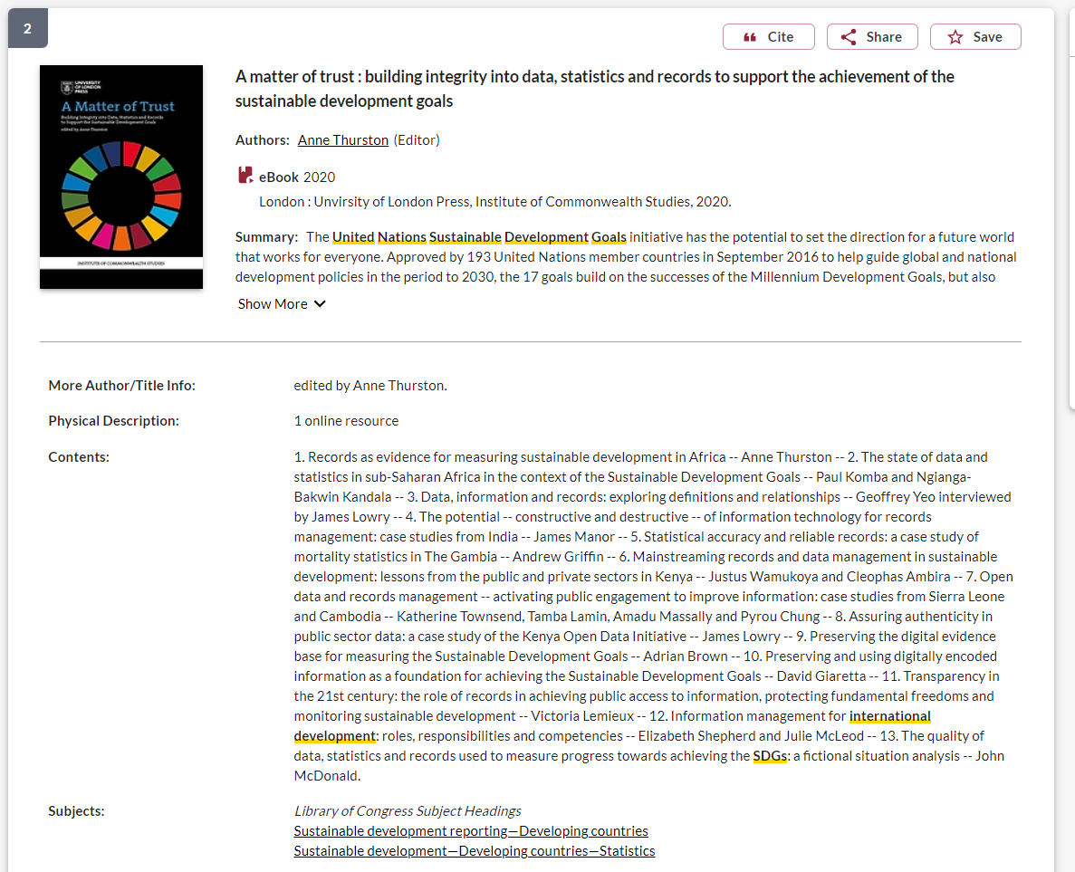

Slide 33
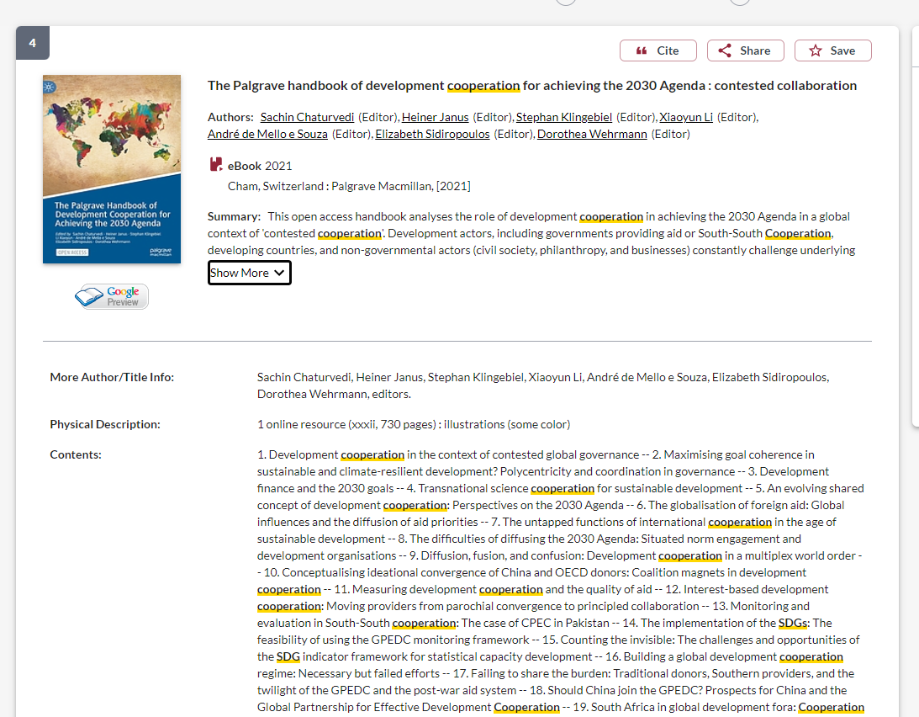
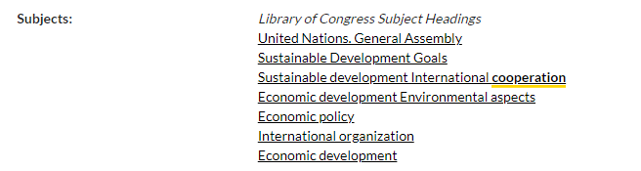

Slide 34
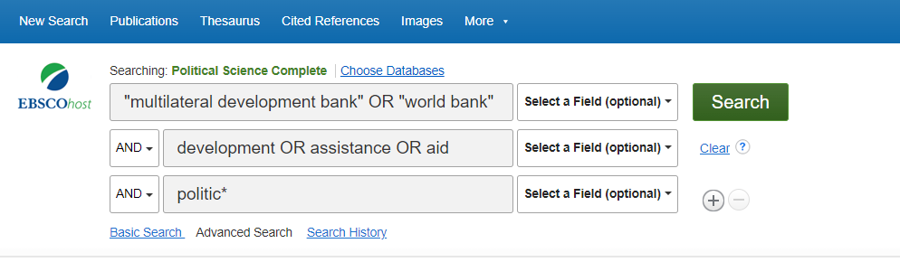
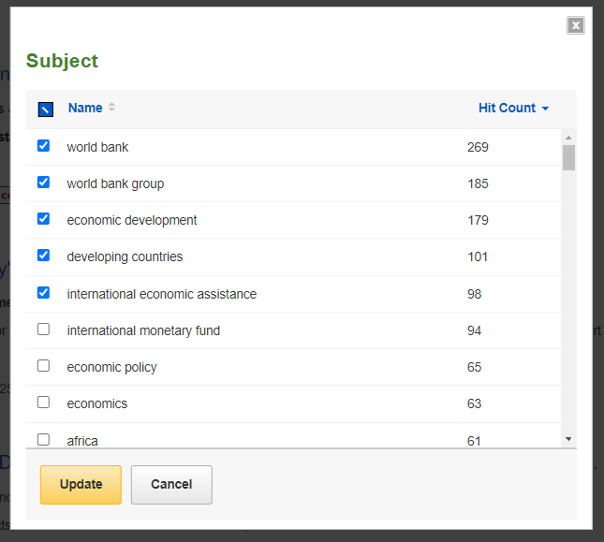
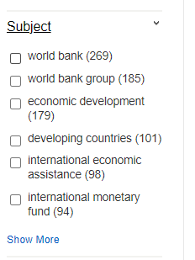
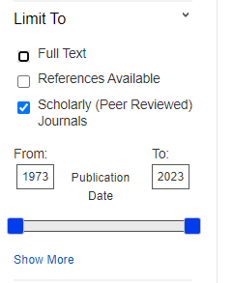
Topic: Choose one type of non-state actor involved in international development: either NGOs or multilateral development bank. Is development assistance provided by this actor less politicized than bilateral aid?

Slide 35
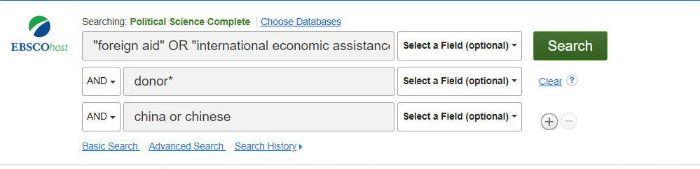
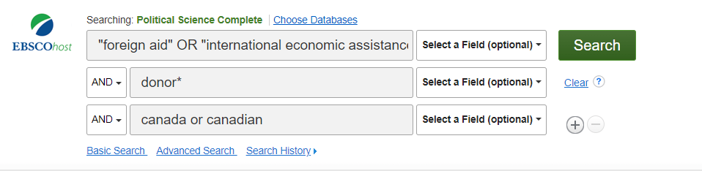
Topic: Are ‘new’ donors like China a threat to established donors like Canada? Why or why not?

Slide 36

What is peer review?
What are peer reviewed, scholarly articles?

Slide 37
Has the article gone through the peer review process?
What is peer review?
Peer review is a system used to decide if an article should be published in a peer-reviewed journal. Each paper submitted to a peer-reviewed journal is read and evaluated by experts in the article’s subject area.
The reviewers assess the article’s validity, importance, and originality, and then recommend whether it should be printed in the journal.
The reviewers’ suggestions are considered by the journal’s editor, who makes the final decision about whether to accept or reject the article.
Criteria for evaluating academic or scholarly articles

Slide 38
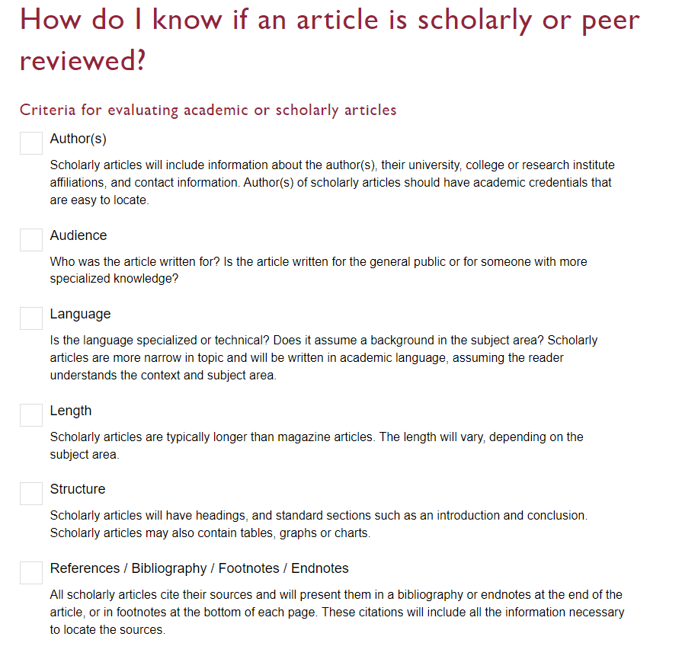

Slide 39
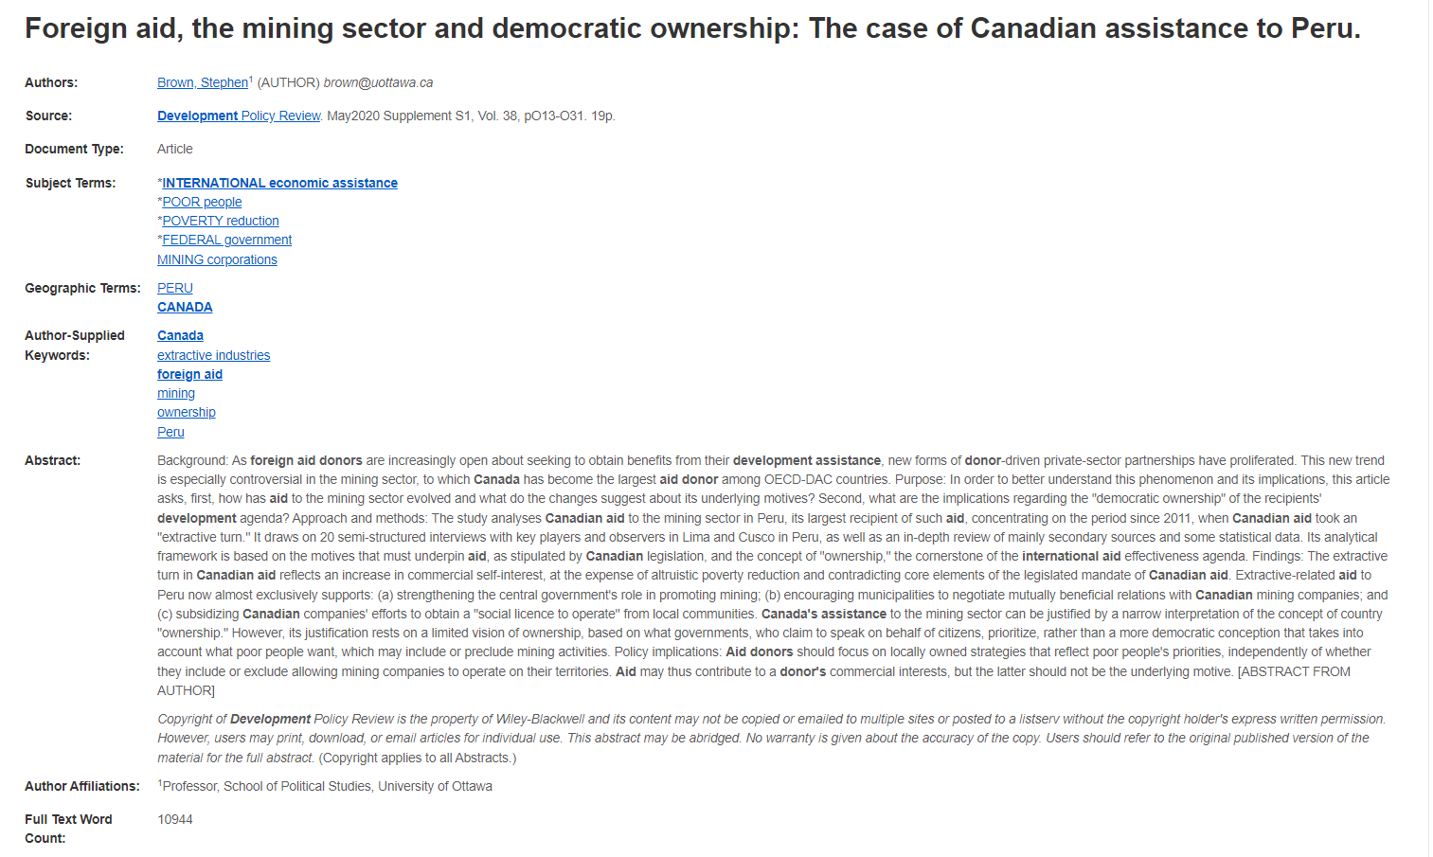
Scholarly articles are generally between 10-30 pages
Authors: scholarly articles are written by faculty and researchers at universities and academic institutions

Slide 40
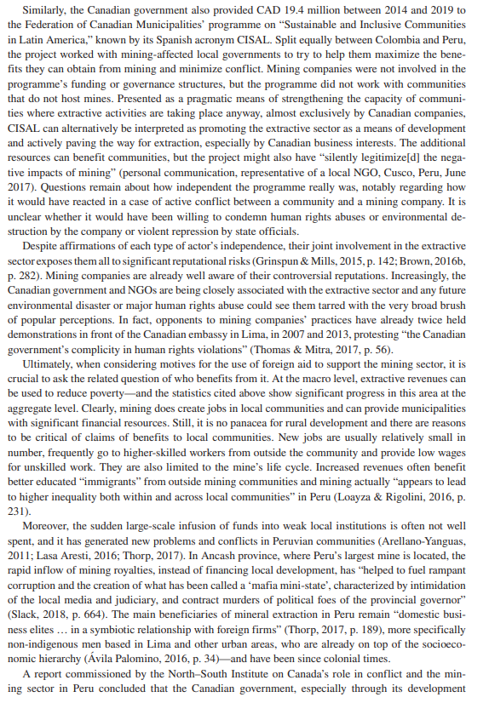
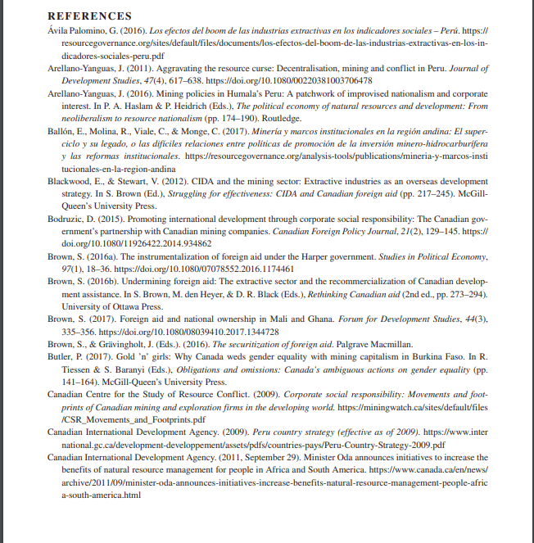
Scholarly articles will have citations/footnotes throughout the text and an extensive reference list/works cited/bibliography/endnotes.

Slide 41
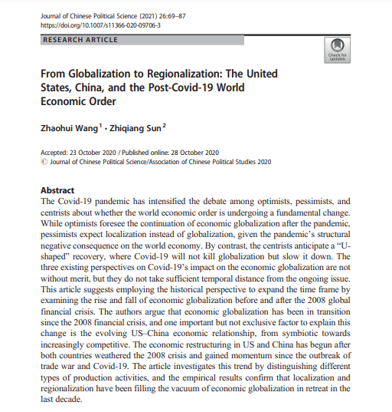
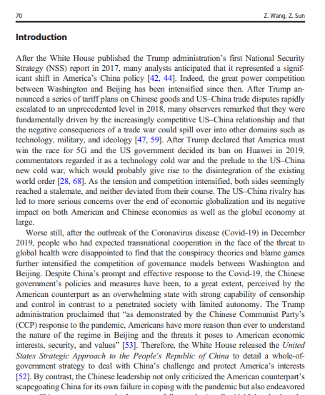
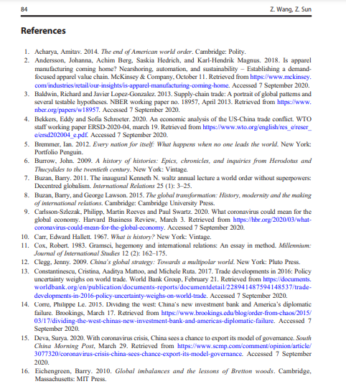
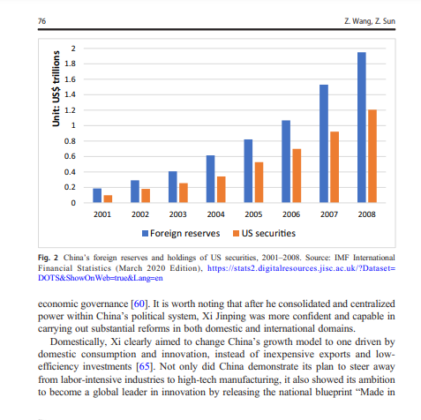
Look for sections, use of specialized language, charts, tables, and graphs
Specialized language

Slide 42



Find it @ Concordia
How to access articles.
Look for PDF or HTML full text options, if neither is available, use the Find it @ Concordia to access the article.

Slide 43

Google Scholar
Limit by date
Access Concordia resources by setting up your profile

Slide 44



Slide 45

Government Information Search
To search for information from a specific organization, put the name quotation marks, followed by your other search words
Select Intergovernmental organizations from the drop down menu

Slide 46






Evaluating IGO,NGO and government publications
Who is the publisher? Is it a government or an organization?
What is the date of publication? Is it recent?
What is the source of the statistical information or data?
Are there any official government crests or logos on the publication?
What kind of website is the publication coming from? Is it a recognizable institutional or organization’s domain?

Slide 47
Citation management

Slide 48
What is Zotero?
Management software for:
References
Research documents
Notes
but not to find new things...
Notes:
2023-11-15
48
48

Slide 49

1. Register for an account
2. Download and install the Zotero desktop software and the Zotero connector

Slide 50



How do I access Zotero?
Desktop application
Web browser version
Web browser
extension
Add-on for writing software
Notes:
2023-11-15
50
50

Slide 51

Zotero Web Interface
Personal library with collections organized as you like.
References (journal articles, books, videos, etc.) & research documents (PDFs), and notes

Slide 52

Zotero Desktop Interface
Personal library with collections organized as you like.
References (journal articles, books, videos, etc.) & research documents (PDFs), and notes
Bibliographic information about the reference

Slide 53

Folder/Library Overview
Personal library contains collections
Drag and drop references into collections to organize them
Collections group references
Click on the
symbol to create a new collection

Slide 54


Introduction to Zotero for desktop
1
2
4
3
2
Notes:
2023-11-15
54
54

Slide 55


Introduction to Zotero for desktop
2
4
3
1
55 /
Notes:
2023-11-15
55
55

Slide 56
Some highlights and comparisons
Desktop version
Web version
Import references from web browser
Create a bibliography
Add/edit/remove references from a shared library
Insert citations in LibreOffice, Microsoft Office or Google Docs
Add features (e.g. auto-capture PDF annotations)
Import references from a web browser
Create a bibliography
Add/edit/remove references from a shared library
Create a shared library
Access from any computer
Requires Internet connection
300 MB free storage
56 /
Notes:
2023-11-15
56
56

Slide 57

Building your personal Database of References : importing from Google Scholar
57 /
Notes:
2023-11-15
57
57

Slide 58

Building your personal Database of References: importing from Google Scholar
58 /
Notes:
2023-11-15
58
58

Slide 59


Building your personal Database of References: saving a list of references
59 /
Notes:
2023-11-15
59
59

Slide 60


Building your personal Database of References: saving one item
60 /
Notes:
2023-11-15
60
60

Slide 61

Zotero Web Interface, Editing a Reference
Click the edit icon to change bibliographic information about a reference

Slide 62

Building your personal Database of References: citation button
62 /
Notes:
2023-11-15
62
62

Slide 63

Zotero Web Interface, Making a Bibliography/Citation
Select citation style you want to use (APA, MLA, Chicago, etc.)

Slide 64

Zotero Web Interface, Making a Bibliography/Citation
Zotero produces the bibliography (or a single citation). Copy this text and paste it into a Word Processor.

Slide 65


Word processors
Microsoft Word
Google Docs
LibreOffice Writer
65 /
Notes:
2023-11-15
65
65

Slide 66

Questions?

Slide 67

Need help, ask us!
Michelle.Lake@Concordia.ca

