Slide 1
Legislative Process in Canadian Parliament
Michelle Lake
Government publications, Political science, SCPA & First Peoples studies Librarian

Slide 2
Agenda
1) The legislative process in Canada
2) Hansard & Standing Committees
3) Parliamentarian information

Slide 3
The legislative process in Canada
A bill (formal legislative proposal) must pass through a number of very specific stages in the House of Commons and the Senate before it becomes law. In parliamentary terminology, these stages make up what is called “the legislative process”.
The passage of a bill by the House of Commons and the Senate is effectively a request that the Crown proclaim its text as the law of the land. Once it has received Royal Assent, it is transformed from a bill into a statute.
Because the process whereby a legislative proposal becomes first a bill, and then a law, takes place in Parliament, the end product—the statute—is often called an “Act of Parliament”.
⁽https://www.ourcommons.ca/About/ProcedureAndPractice3rdEdition/ch_16-e.html)

Slide 4
The Canadian Constitution
A constitution provides the fundamental rules and principles that govern a country. It creates many of the institutions and branches of government, and defines their powers.
Canada was created by an act of the Parliament of the United Kingdom called the British North America Act, 1867 (now known as the Constitution Act, 1867) uniting the British colonies of the United Province of Canada, Nova Scotia, and New Brunswick.
The Constitution of Canada includes the Constitution Act, 1867, and the Constitution Act, 1982. It is the supreme law of Canada. It reaffirms Canada's dual legal system and also includes Aboriginal rights and treaty rights.
What does our Constitution say?
The Constitution sets out the basic principles of democratic government in Canada when it defines the powers of the three branches of government:
the executive
the legislative
the judiciary
The Constitution was "patriated" from the United Kingdom in 1982.
When Canada was created, it was a self-governing British colony. The British North America Act, 1867, codified many constitutional rules for Canada, but major changes to the Constitution could only be made by the United Kingdom Parliament.
In 1982, the Charter of Rights and Freedoms was enacted as part of Canada's Constitution along with a set of procedures allowing the Constitution to be amended in Canada.

Slide 5
System of Government

Slide 6
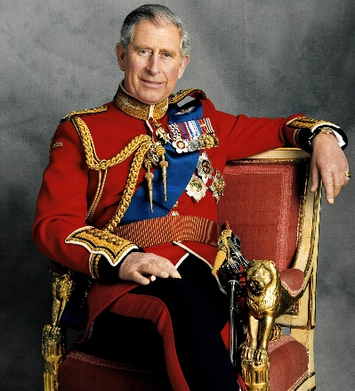

Slide 7
Bills – proposed legislation
Bills can be introduced into one of the 2 chambers, House of Commons or the Senate
Bills are usually introduced in House of Commons, by a Minister
Bills calling for the spending of public revenue or imposing taxes must originate in the House of Commons
Once introduced, bills are subjected to a detailed process of review, debate, examination and amendment through both chambers before final approval
House of Commons also considers Private Member’s bills by members who are not cabinet ministers in the executive
To become law all legislation must be adopted by both chambers in identical form and receive royal assent
House of Commons – Procedural Info: Canadian Parliamentary System

Slide 8
LEGISinfo
The primary source of information regarding legislation before Parliament.
The full text of the most recent version of a bill and any previous versions of the bill.
The bill's life cycle, from the day it is introduced for first reading until it receives royal assent.
Links to the relevant content in official parliamentary publications associated with the passage of a bill.
Browse all bills from previous sessions going back to the 37th Parliament in 2001.

Slide 9
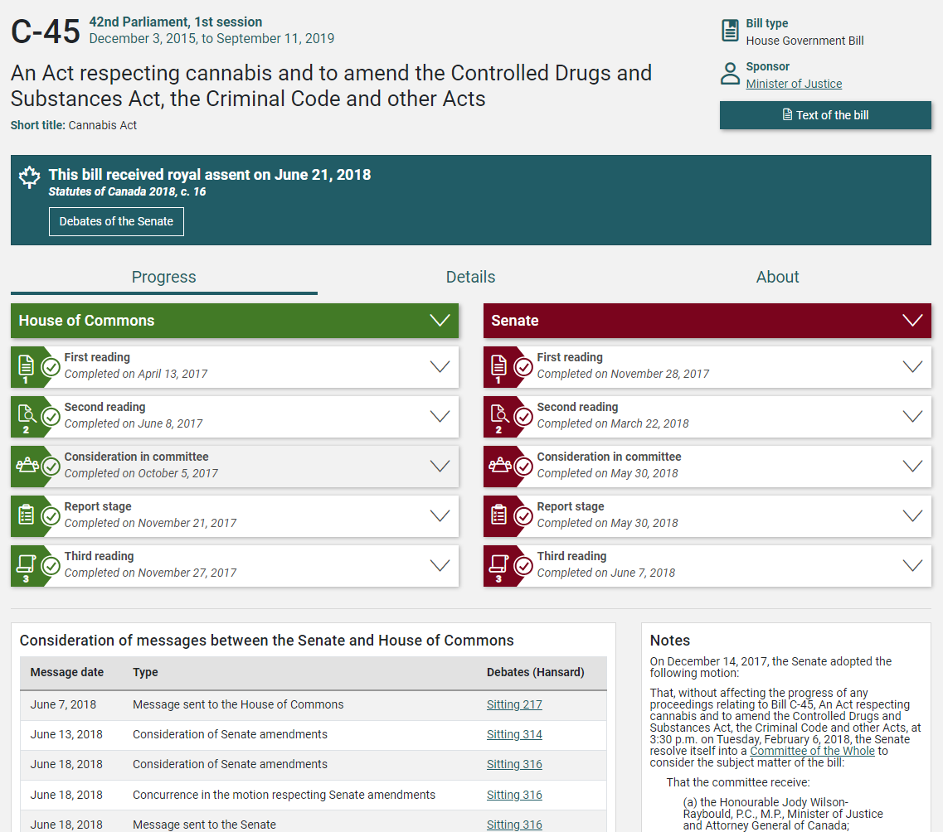
Bill C-45 Short title: Cannabis Act

Slide 10
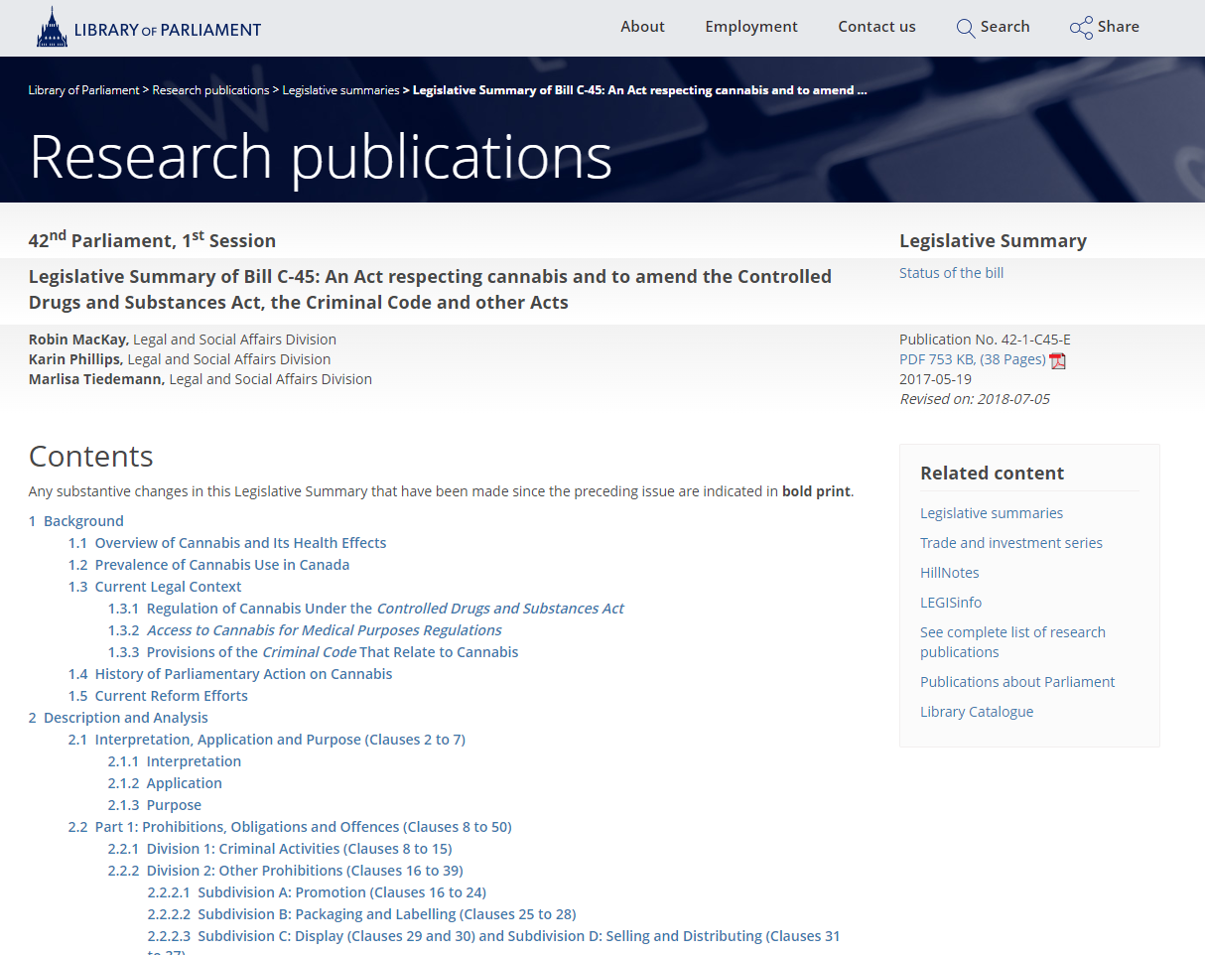
Legislative Summaries (Library of Parliament):
Concise analyses of certain bills before Parliament

Slide 11
Legislative process
Notice:
A member or a minister who intends to introduce a public bill in the House of Commons must first give 48-hours’ written notice to the Clerk of the House. The title of the bill to be introduced is then placed on the Notice Paper.
The day after it appears on the Notice Paper, the title of the bill will appear in the Order Paper, making it ready for introduction in the House.

Slide 12
Legislative process
Bills originating in the House are labelled with the letter ‘C’, government/public bills, sponsored by Ministers of the Government are numbed C-1 to C-200. Private Members bills, sponsored by a private member or MP and deal with public policy are numbered C-201 to C-1000.
Senate government/public bills are numbered S-1 to S-200, are sponsored by the government, but first introduced in the Senate. Private Senator Public bills, numbered S-201 to S-1000 are sponsored by a private senator and deal with public policy.
Bills are published on LEGISinfo, historically bills were also published in the Journals, the official record of decisions and other transactions of the House.
Step 1, First Reading: A bill (proposed law) is introduced in either the House of Commons or the Senate.
This is the ‘First Reading’ of the bill and also represents the first time the bill is printed and made available publically.
It is assigned a bill number. There is no discussion of the bill at this stage.
Published
Documents

Slide 13
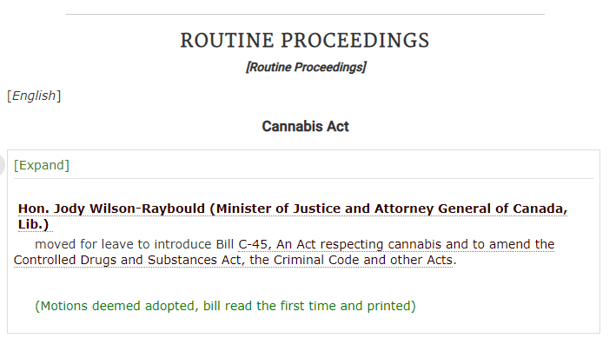
Bill C-45 Short title: Cannabis Act

Slide 14
Legislative process
The debates are recorded in the Hansard, which is available online, and contain everything that is said, verbatim in the House or Senate chamber. (1994 – present)
Historical Hansard debates are also available in the Canadian Parliamentary Historical Resources database. (1867-1994)online.
Step 2, Second reading: Parliamentarians (MPs in the House or Senators in the Senate), debate on the main ideas or principles of the bill and vote to decide whether it should be studied further.
This is known as the ‘Second reading.’
Published
Documents

Slide 15
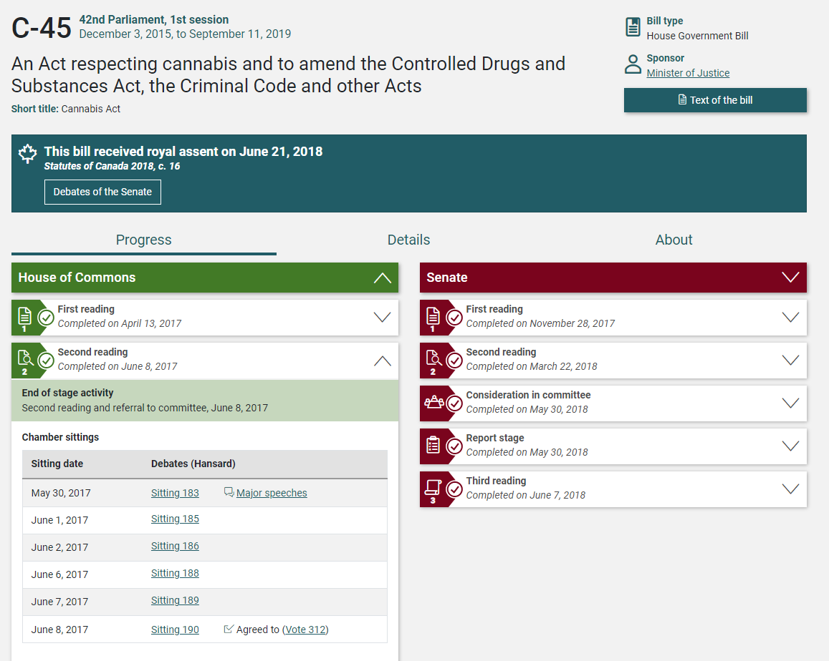

Slide 16
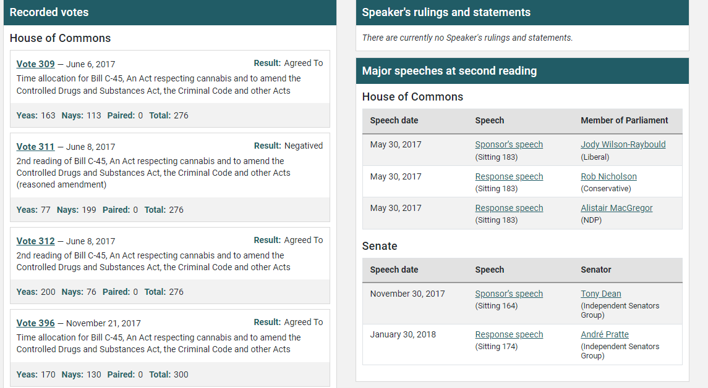

Slide 17
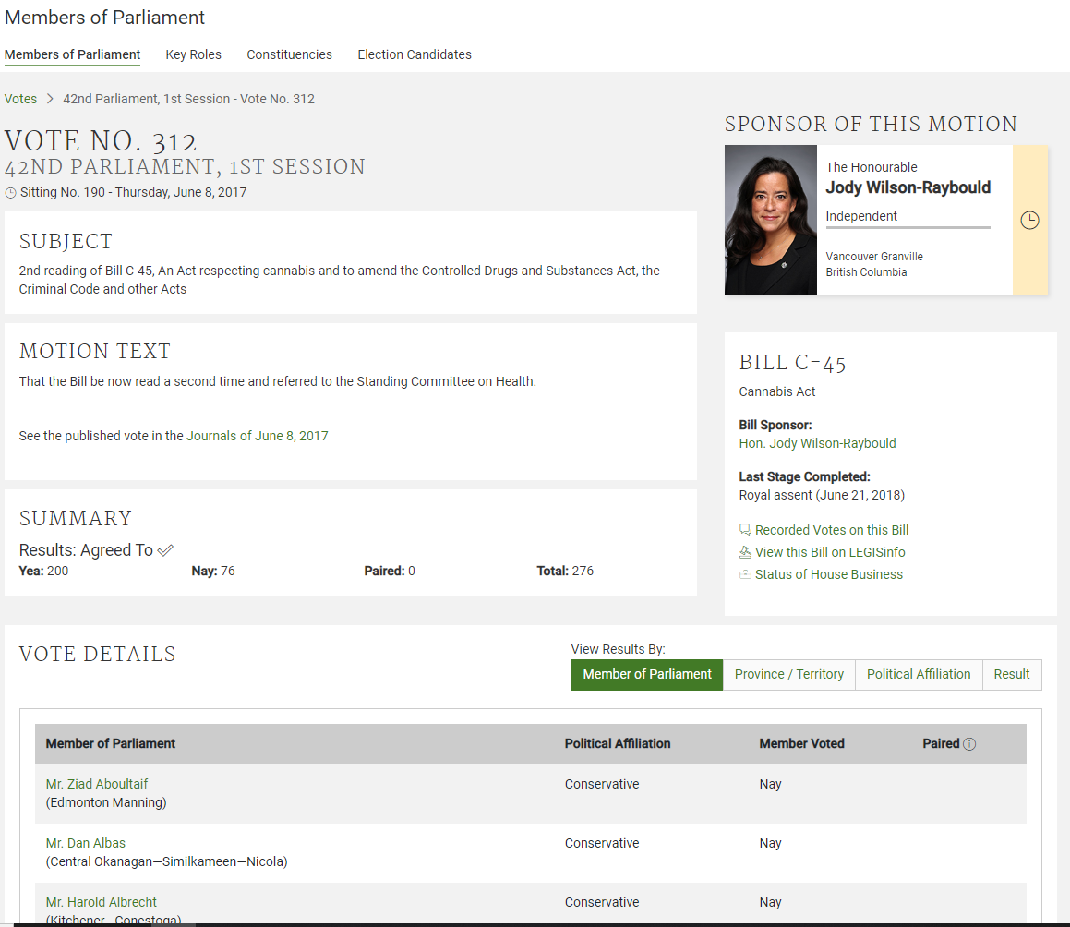
Votes:
Explore motion text, sponsor of the motion and vote details, including MP votes

Slide 18
Legislative process
Committee Minutes are a brief synopsis of proceedings. Evidence consists of a verbatim transcript of public meetings, including witness testimony. Briefs are written submissions that provide opinions, comments and recommendations, individuals or organizations may submit briefs.
Final Reports are presented to the House and most often appear in Committee proceedings.
They may also appear in House Journals, Debates, Votes and Proceedings and Parliamentary Sessional Papers.
Step 3, Committee stage: If the bill passes debate, it is then referred to a Standing Committee/Parliamentary Committee who studies it in depth and may suggest changes. There may be Witness hearings.
Standing Committees are permanent and review matters under their jurisdiction. Special and select committees are appointed on a temporary basis, to examine specific bills in detail. Joint committees are composed of members of the House and Senate.
Published
Documents

Slide 19
Standing/Parliamentary Committees
In Canada, a standing committee is a permanent committee established by Standing Orders of the House of Commons or the Senate.
It may study matters referred to it by special order or, within its area of responsibility in the Standing Orders, may undertake studies on its own initiative.
Committee roles and responsibilities include:
Studying bills, in detail, analyze and vote on each clause
Listening to opinions; listen to and gather information from groups and individuals (witnesses), they also gather information (evidence), from written briefs, from individual and organizations
Travelling; committees will meet in Ottawa and other locations to hear evidence or hold consultations
Suggest amendments; committees can suggest changes to bills, and the bill with its amendments will return to the chamber for further debate
Writing reports; once a committee has concluded its work with a bill, they write a report which makes recommendations

Slide 20
Committee Membership
Committees are designed to be smaller-scale versions of the Senate and the House of Commons. This format allows parliamentarians to discuss proposed laws and study important issues while maintaining representation ratios similar to those seen in the chambers.
For example, a political party or group with 20% of the seats in the chamber will hold roughly 20% of the seats on a given committee.
Similarly, a majority government will hold a majority of seats in a House of Commons committee
At the beginning of each session of Parliament, both the Senate and the House of Commons create selection committees to choose which parliamentarians will be members of each committee.
All officially recognized parties and groups (a group or party with at least nine seats in the Senate or 12 seats in the House of Commons) are represented in the committees.

Slide 21
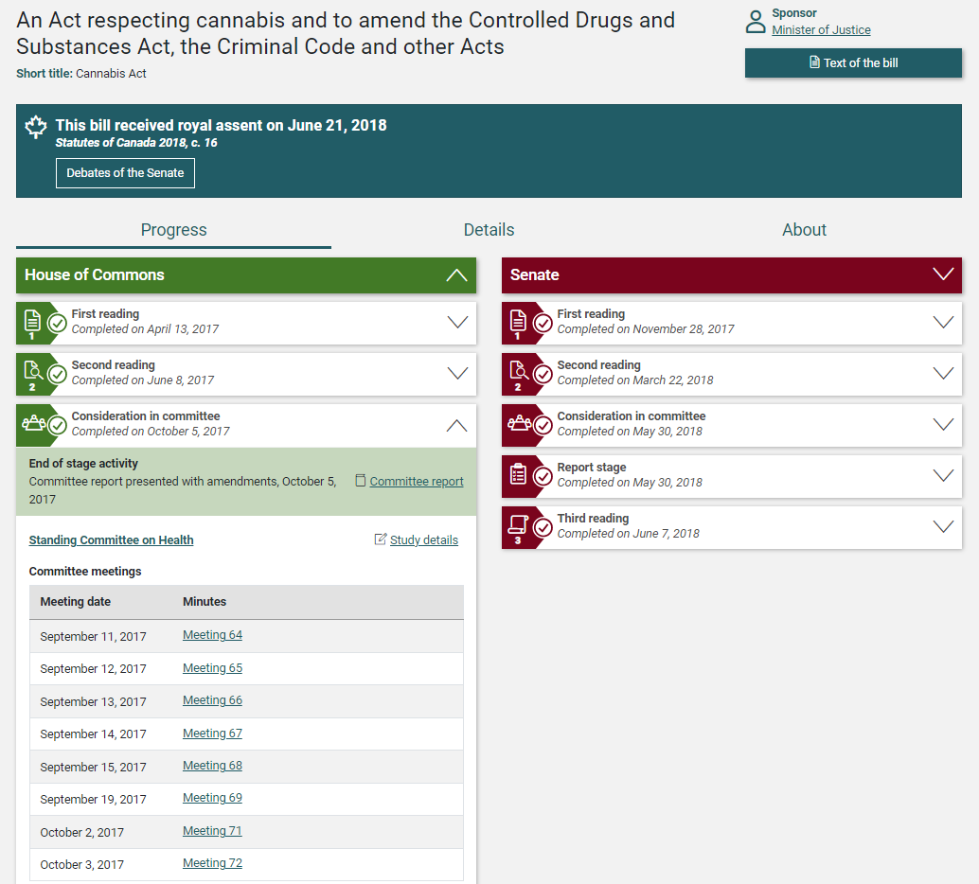
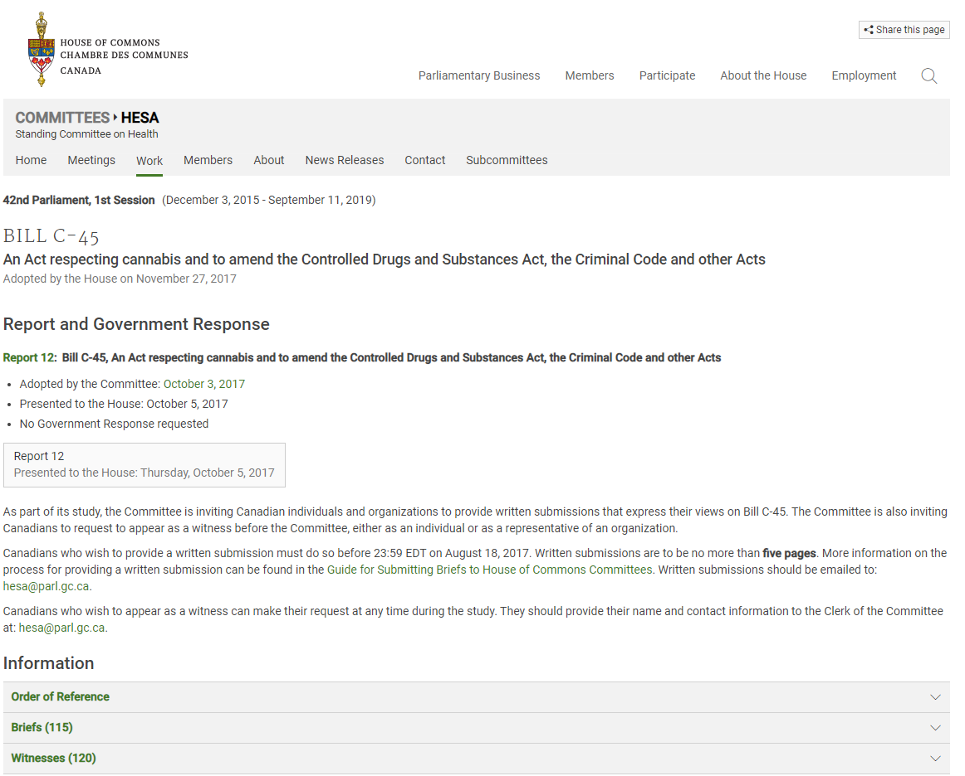

Slide 22
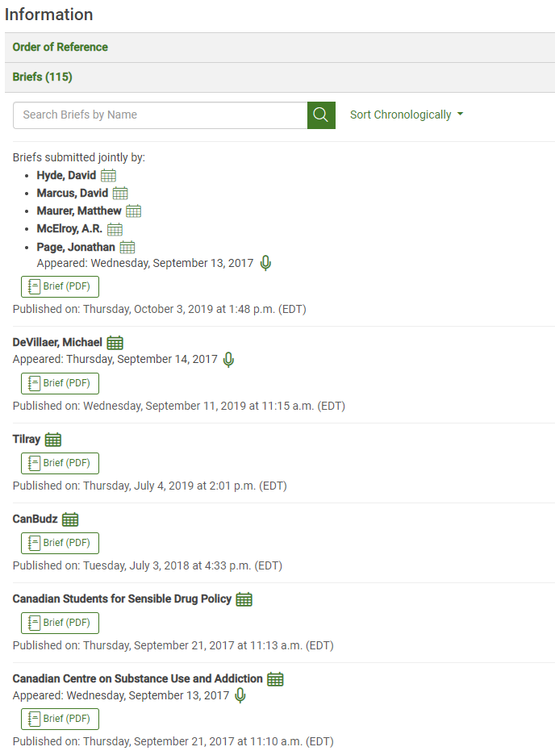
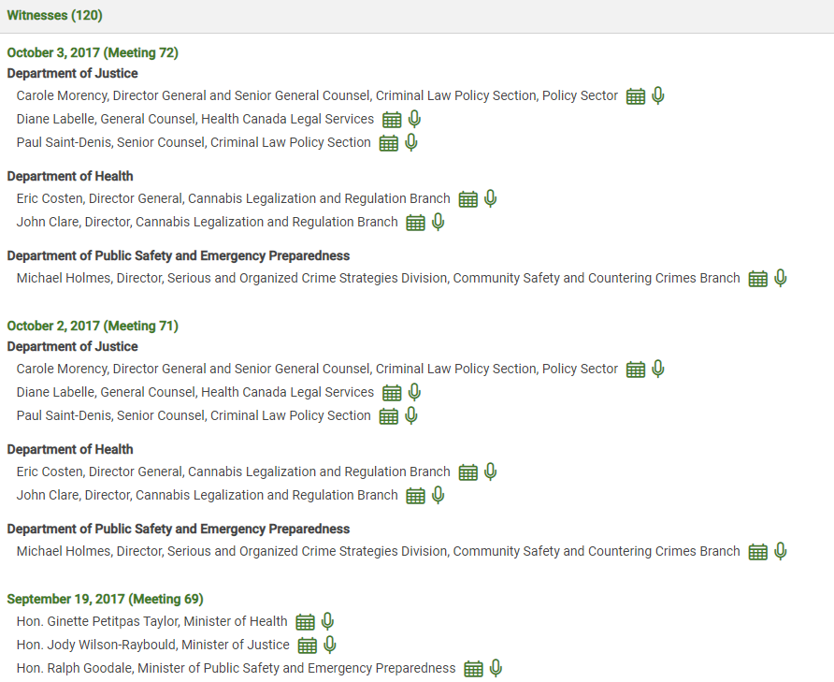
You can view transcripts by witness
Microphone icon indicates a transcript of testimony from a witness who appeared in person
Evidence, including testimony and briefs can be from individuals or organizations
A brief is a written opinions submitted, maximum of 10 pages
Or you can watch recordings of the entire meetings, with all witnesses

Slide 23
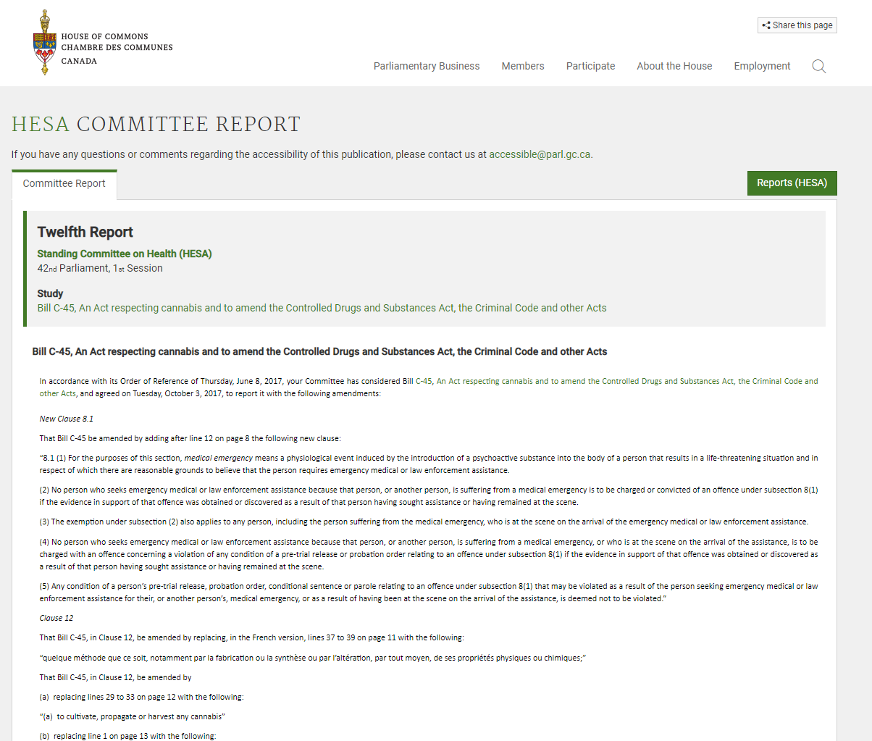
Final report
Presenting a report to the House is the way a committee makes public its findings and recommendations on a particular topic.
The committee can ask the government to respond to its recommendations within 120 calendar days after the presentation of the report.
Dissenting or supplementary opinions (i.e., a brief text providing additional comment) may be attached to subject-matter reports.

Slide 24
Legislative process
The debates are recorded in the Hansard, which is available online, and contain everything that is said, verbatim in the House or Senate chamber. (1994 – present)
Historical Hansard debates are also available in the Canadian Parliamentary Historical Resources database. (1867-1994)online.
Step 4, Report stage: The bill returns to the chamber where it originated, either the House or the Senate, for a final debate and vote. This is known as the ‘Report stage’.
Published
Documents

Slide 25
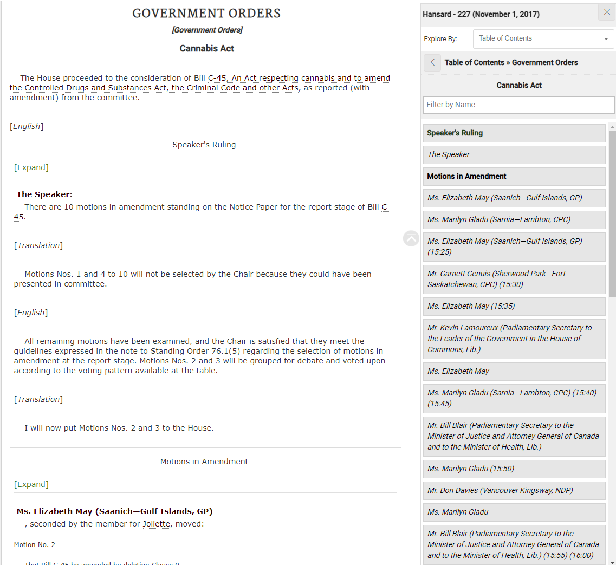
Use the Publication Explorer to access the Table of Contents, under “Government Orders”, which includes bills under
consideration

Slide 26
Legislative process
What is said in the Senate chamber is published in the Debates of the Senate of Canada (Hansard).of
Committee Minutes are a brief synopsis of proceedings. Evidence contains a verbatim transcript of public meetings and includes witness testimony and briefs.
Final reports are presented to the Senate and most often appear in Committee proceedings. Canada (Hansard).
Step 5, Third reading: If the bill passes the vote, it goes to the other chamber, where it goes through the same process as it did in the first chamber.
Published
Documents

Slide 27
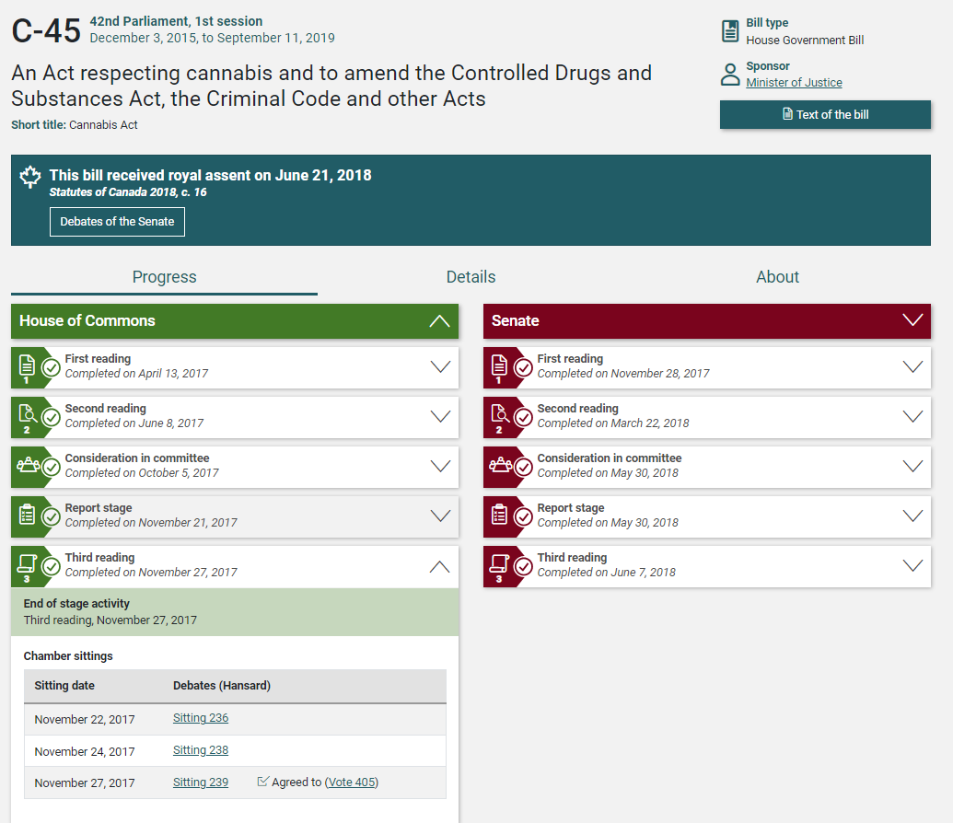
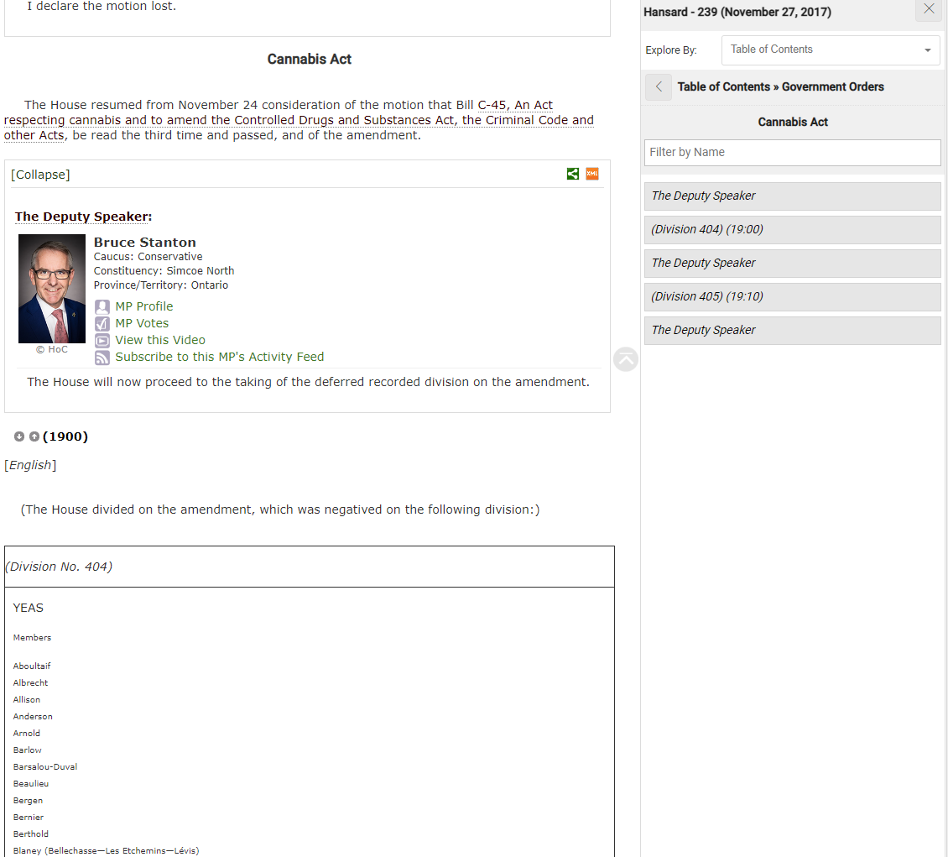

Slide 28
Legislative Process: Sent to the other chamber
Most bills begin in the House of Commons and are sent to the Senate for review.
Bills can also start in the Senate and then go to the House of Commons for review.
When a bill is sent from one chamber to the other, the bill is read again for the first time and goes through the same steps.
If the reviewing chamber makes any changes, the bill gets sent back to the initial chamber for further review. Messages may go back and forth between the chambers as amendments are debated. Most amendments are intended to clarify, simplify or improve a bill.

Slide 29
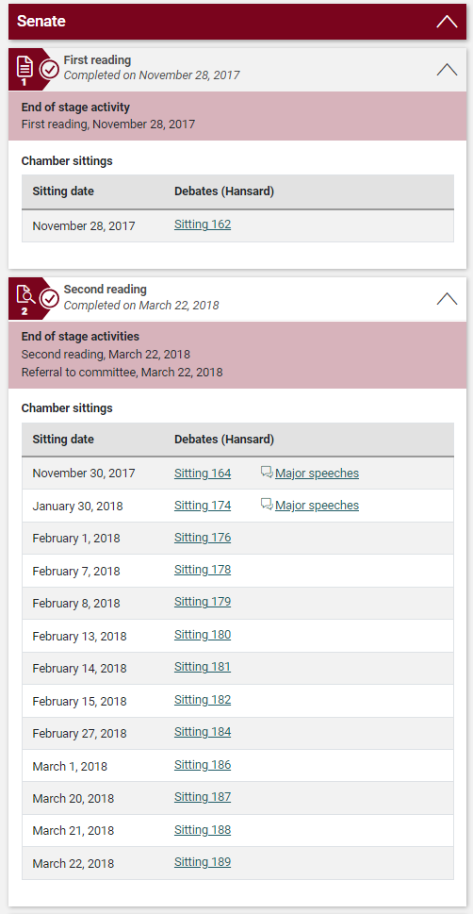
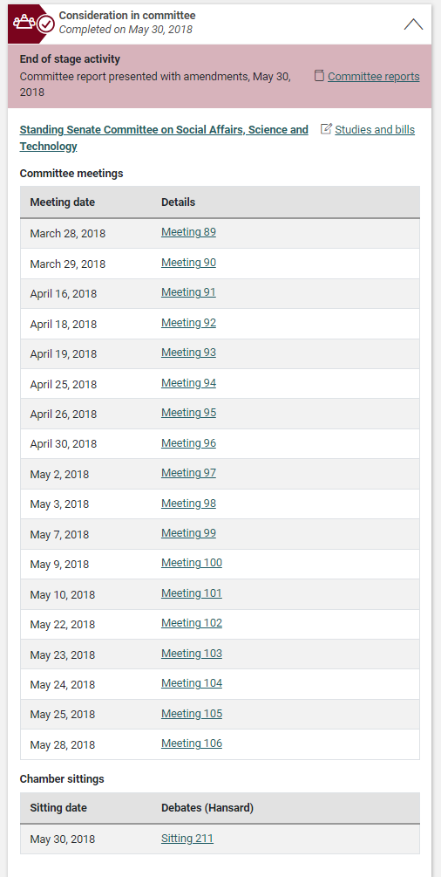
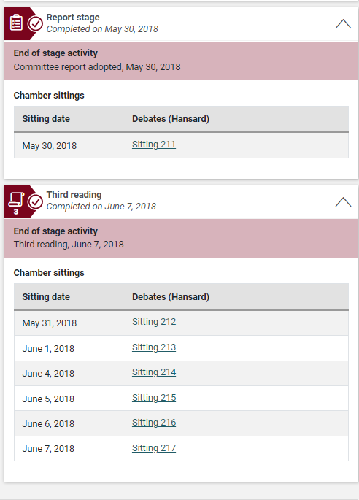

Slide 30
Legislative process
When a bill successfully passes through the legislative process and receives Royal Assent, it becomes an Act.
Each Act is assigned a chapter number coupled with the name of the reigning sovereign and the regnal year(s) of the session, (eg. 40-41-42 Elizabeth II, c.44). In bound form, these Acts are commonly known as Statutes.
The most recent Public Acts and their enactment proclamations are available in the Canada Gazette, Part III.
The Canada Gazette is the official news bulletin of the Government of Canada. It includes new statutes and regulation, proposed regulations, decisions of administrative boards, and notices, as required by Statute.
Step 6, Royal Assent – Becoming a Law: Once the bill has been passed by both chambers in identical form, it goes to the Governor General for Royal Assent, comes into force and becomes Canadian law.
Published
Documents

Slide 31
Legislative process: Royal Assent
Royal Assent may be granted by a nod of the head in a traditional Royal Assent ceremony in the Senate Chamber or by the Governor General signing the bill.
Once the bill receives Royal Assent, it officially becomes a law.
Royal Assent has never been refused to a federal bill in Canada.
Canada is a constitutional monarchy. The Monarch (the King or Queen) is the Head of State, whose powers are defined by the Constitution and constitutional conventions.
These responsibilities are carried out by the Governor General (the Monarch’s representative in Canada). Currently, her Excellency the Right Honourable Mary Simon, is the Governor General of Canada.
The positions of Head of State and Head of Government are held by separate people. The Prime Minister is the Head of Government, and the Monarch – currently His Majesty King Charles III – is the Head of State.

Slide 32
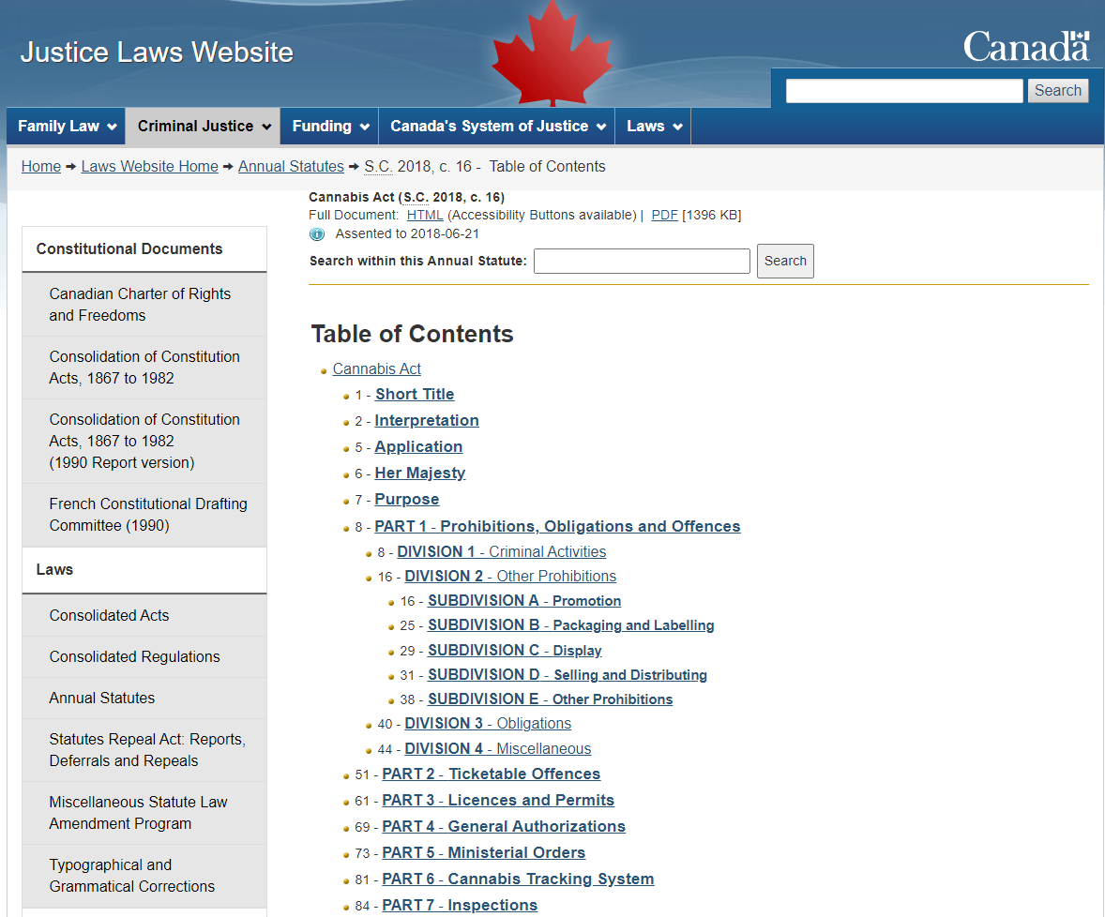
Justice Laws – Statutes:
The Annual Statutes accessible on the Justice Laws Website are a collection of the Public General Acts in the form in which they were originally enacted by Parliament in a given calendar year.
They include new Acts as well as Acts and provisions that amend existing Acts.

Slide 33
Parliamentarians - Parlinfo

Slide 34
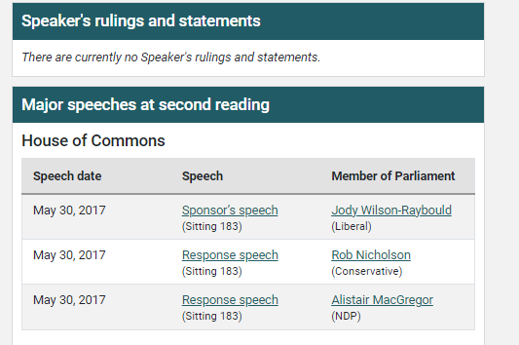
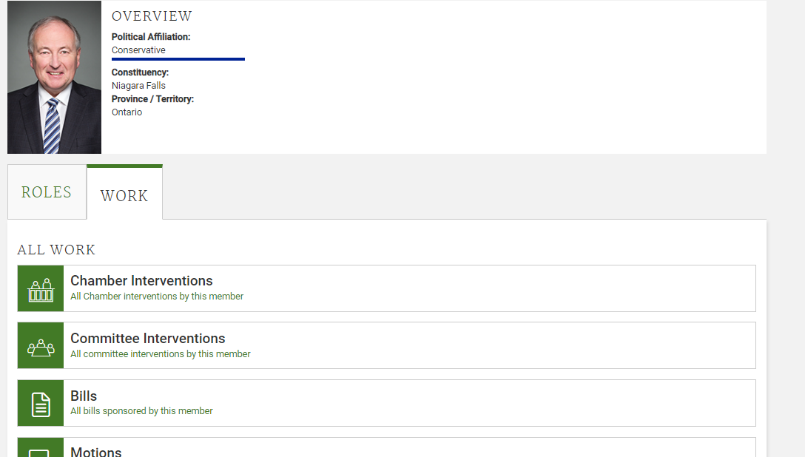
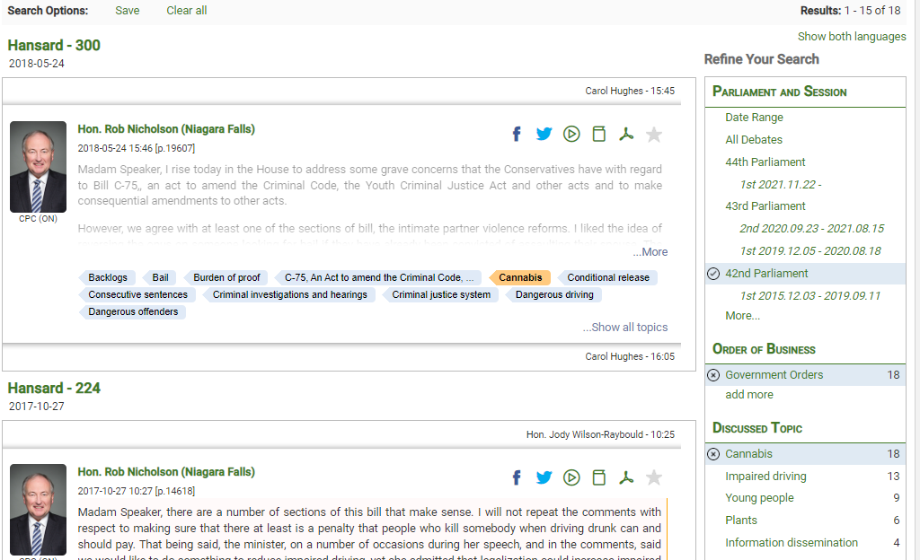

Slide 35
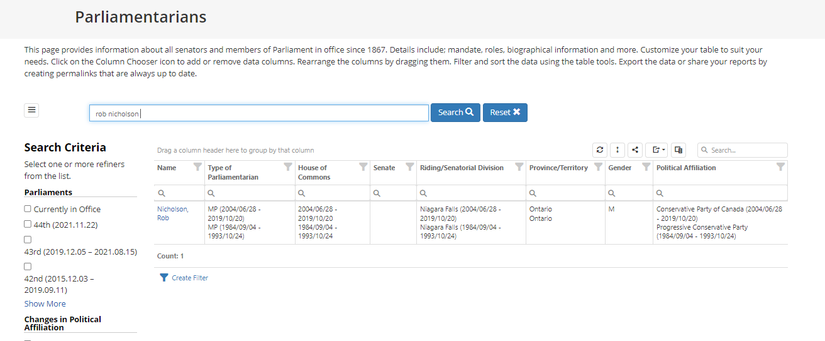
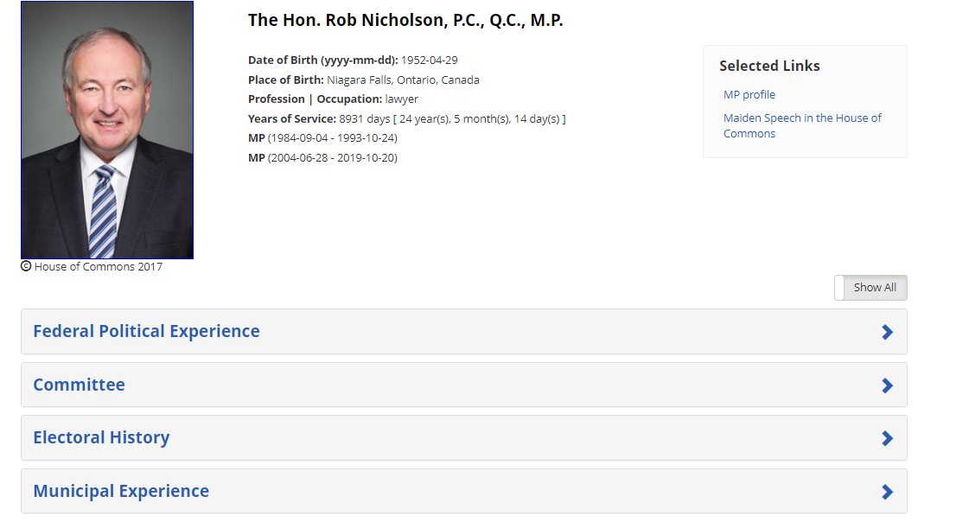

Slide 36
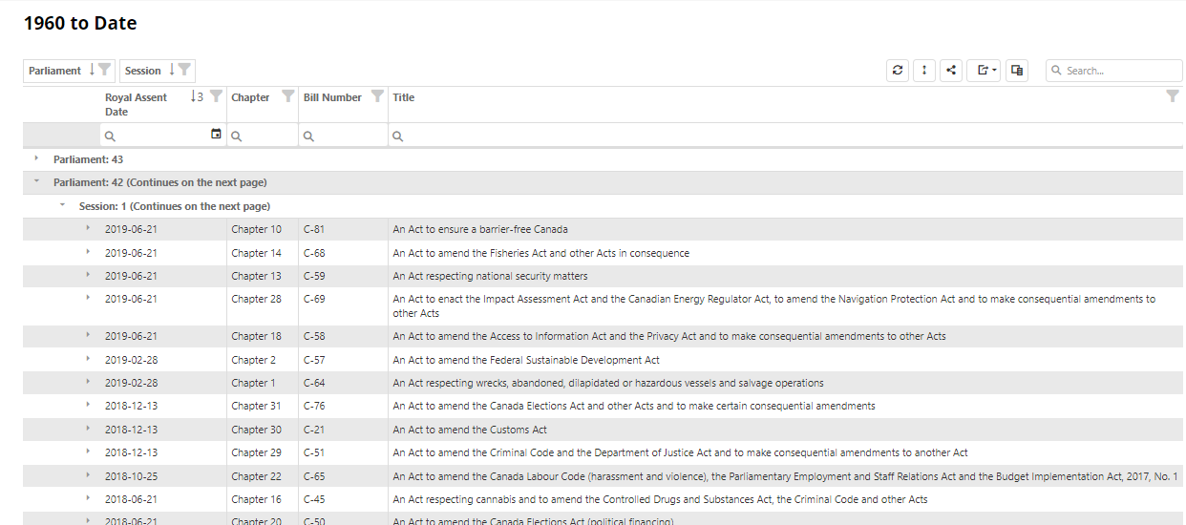

Slide 37
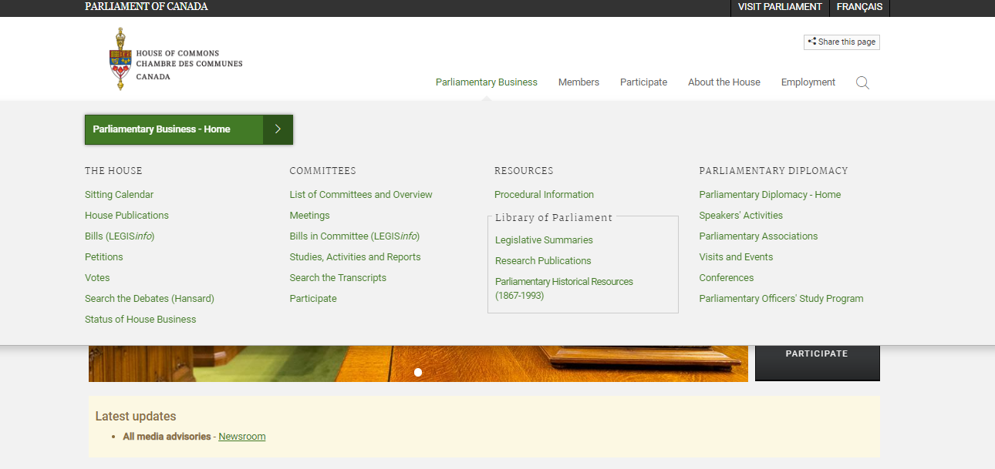

Slide 38
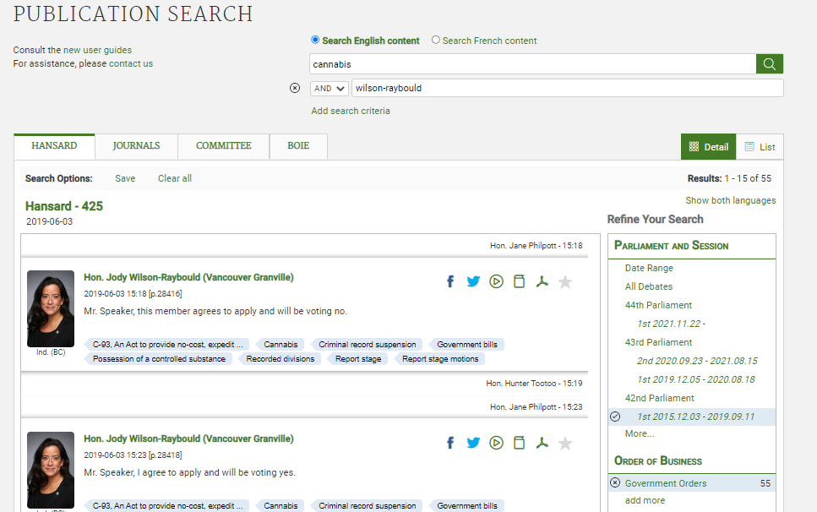
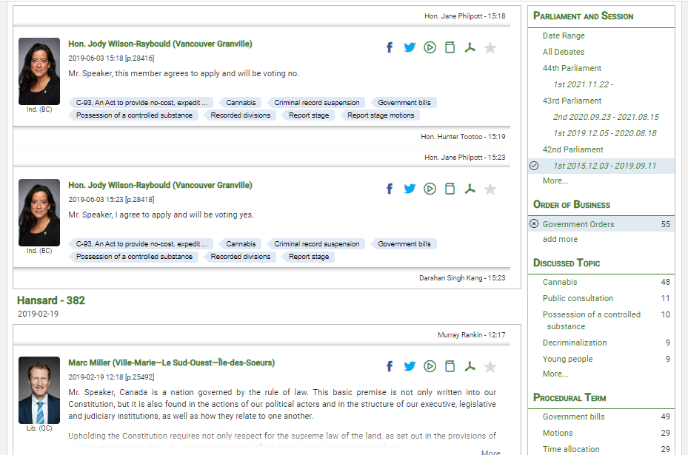
Use the menu options to narrow down results

Slide 39
Historical parliamentary research

Slide 40
Indian Act
The Indian Act is the principal statute through which the federal government administers Indian status, local First Nations governments and the management of reserve land and communal monies.
It was first introduced in 1876 as a consolidation of previous colonial ordinances that aimed to eradicate First Nations culture in favour of assimilation into Euro-Canadian society.
The Act has been amended several times, most significantly in 1951 and 1985…
(Canadian Encyclopedia – Indian Act)

Slide 41
Indian Act - 1951
Between 1946 and 1948, a special joint committee of the Senate and House of Commons examined the operation of the Indian Act and Indian administration. Witnesses were called, including government officials, select native groups, and interested parties.
From 1948 to 1950, government officials considered the special joint committee's proposals and rejected most of them: the federal vote, the claims commission, and the notion of Indian band constitutions and incorporation. In June 1950, revised Indian Act legislation was presented to the House of Commons. It was soon withdrawn because Indigenous people and their supporters claimed they had not been formally consulted.
A revised bill was reintroduced in the fall of 1950 and was reviewed by select Indigenous leaders in a five-day session in Ottawa in the winter of 1951. A new Indian Act, the one currently in force, was proclaimed in September 1951.
(STANDING COMMITTEE ON ABORIGINAL AFFAIRS, NORTHERN DEVELOPMENT AND NATURAL RESOURCES – Committee evidence, 37th parl, 1st session, 2002)

Slide 43
Thank you!
Michelle.Lake@Concordia.ca

