Slide 1

Introduction to Black Studies in the Canadian Context Library Workshop
Michelle Lake
Subject Librarian: Political Science, SCPA, First Peoples Studies, Government Information and Black Studies

Slide 2
Who am I?
Michelle Lake, librarian for Political Science, the School of Community and Public Affairs, First Peoples Studies, Government Publications and Black Studies
Michelle.Lake@Concordia.ca / Make an appointment or ask a question
What do I do?
  Provide research support, assist with search strategies
  Help students navigate library databases, assist with selection and evaluation of sources
  Help students find and access materials they need
  Build guides, resources and pathfinders to help students locate research materials
  Help with citation issues
  Choose the books we buy for the above subject areas

Slide 3
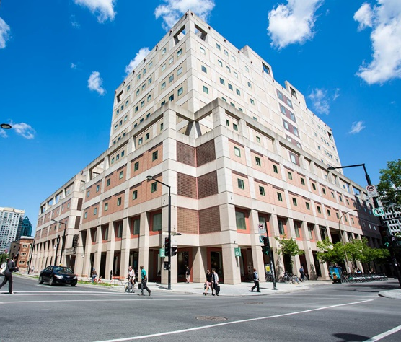
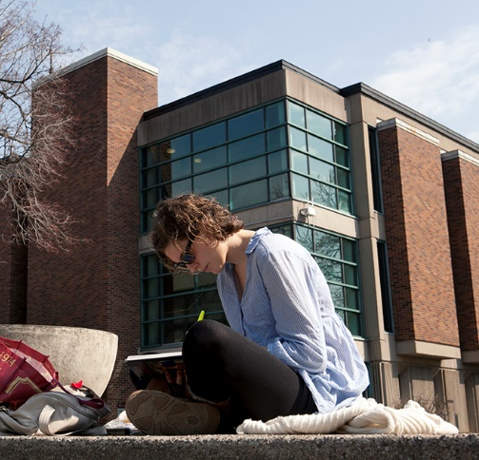
The Librar(ies)
24/7 access, with student card, after 11pm
Webster Library (LB) – downtown on SGW campus & Vanier Library (VL) on Loyola campus
Webster: Social Sciences, Humanities, Business, Engineering & Fine Arts
Vanier: Science(s), Health, Communications, Journalism, Psychology and Special Collections
Course Reserves Room(s): have the required undergraduate print textbooks for the courses taught at that campus

Slide 4

Library Services
Your student card is your library card.
You need it to:
borrow books (up to 100 a time)
borrow a laptop (3 day loan) and other technology
print on campus (add money to your Dprint account)
access the library overnight during 24/7 hours.
Webster library has 5 book scanners (And Vanier has 2!) that can be used for free to scan chapters from our print books and email them to yourself as a PDF.
To use Library databases, access online articles and ebooks when you are off campus, login with your MyConcordia Netname and password.

Slide 5
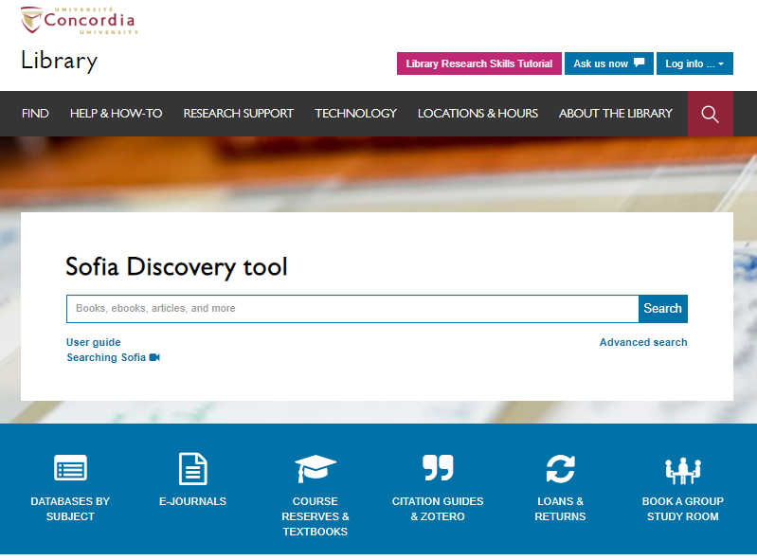
Use the Sofia Discovery tool to find print books, ebooks, and journal articles from the library.

Slide 6
Course Reserves

Slide 7
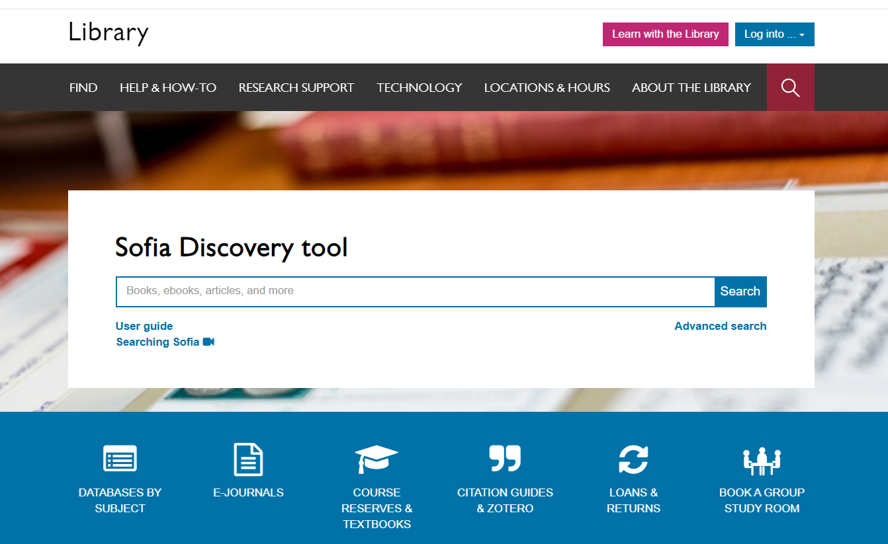
Click here to login to eReserves!

Slide 8
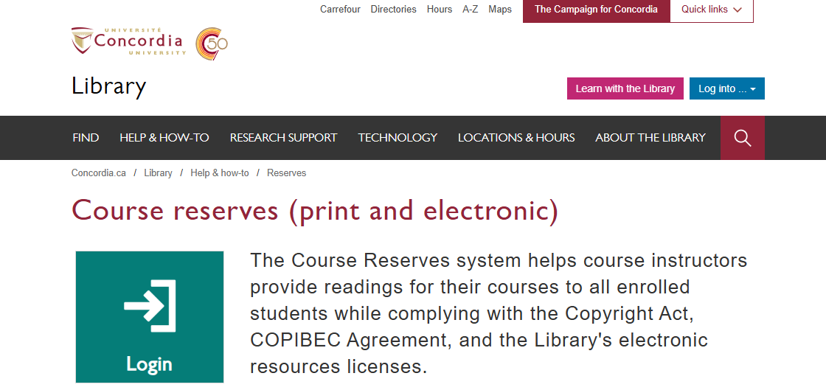

Slide 9
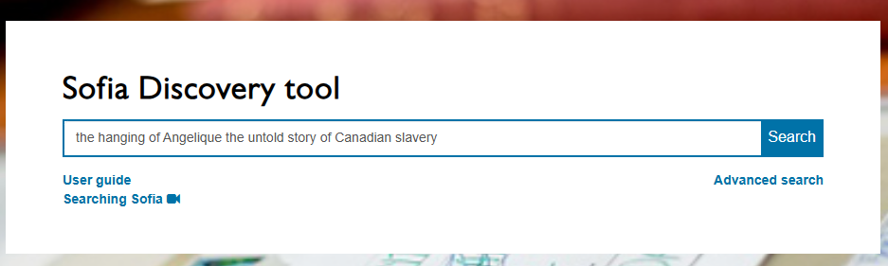
Afua Cooper, (2006) The Hanging of Angelique: The Untold Story of Canadian Slavery and the burning of Old Montreal. University of Georgia Press.

Slide 10
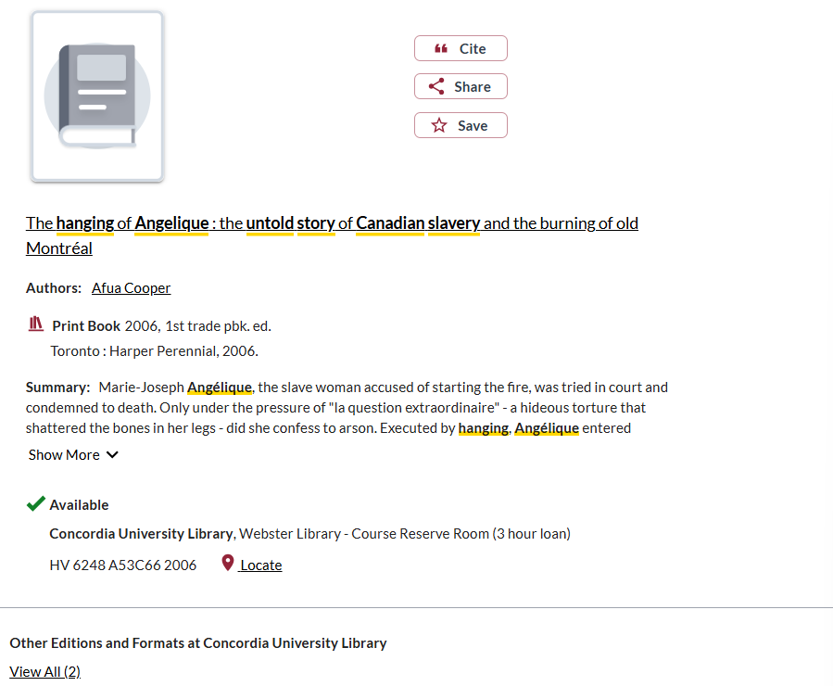
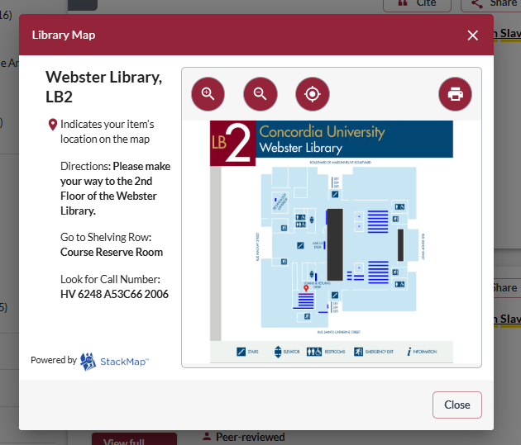

Slide 11
How can I find out if the library has access to an item I’m looking for?

Slide 12
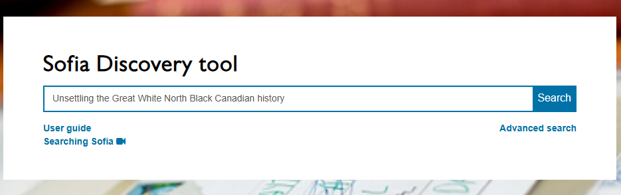
Johnson, M. , & Aladejebi, F. (Eds). (2022). Unsettling the Great White North: Black Canadian History. University of Toronto Press.

Slide 13
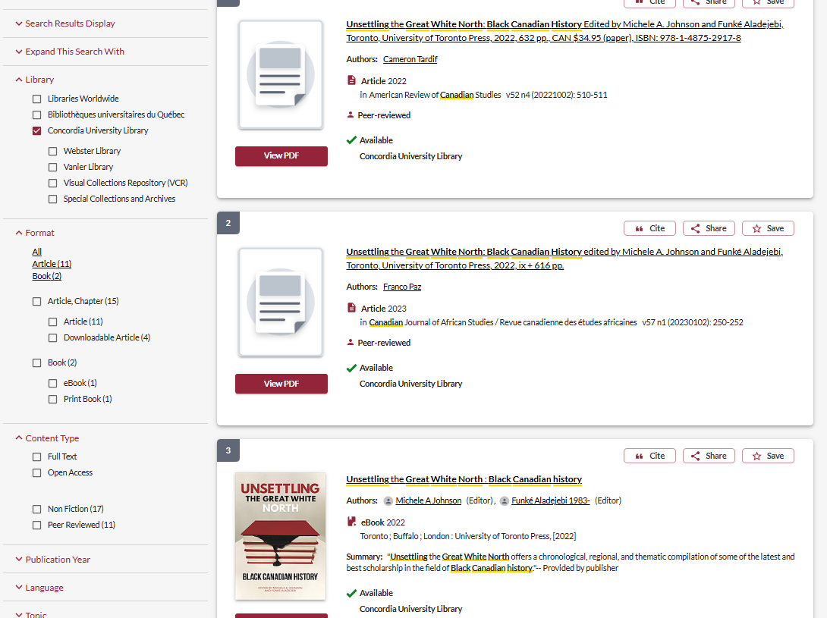
Book review
Book review
The book

Slide 14
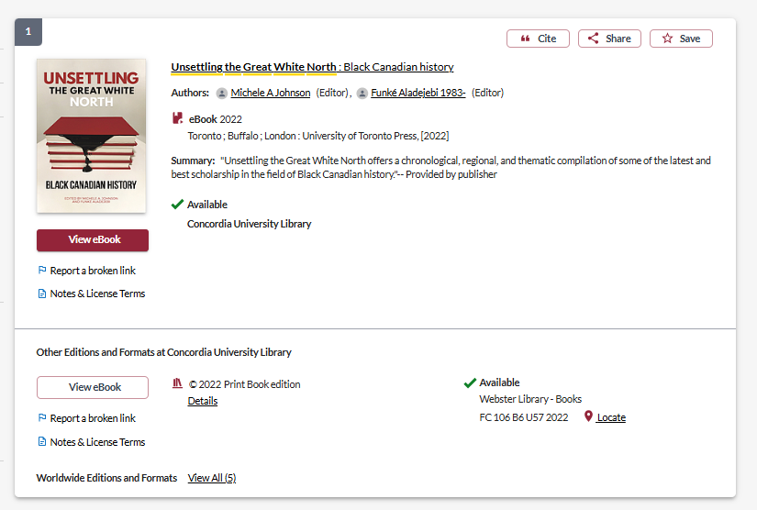

Slide 15
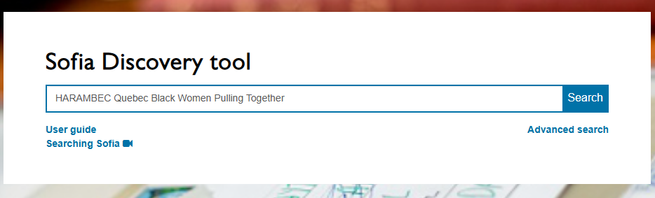
Small, S., & Thornhill E. M. A. (2008). HARAMBEC! Quebec Black Women Pulling Together. Journal of Black Studies 38(3): 427-442.

Slide 16
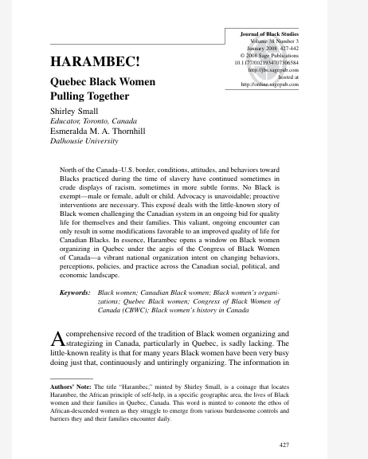
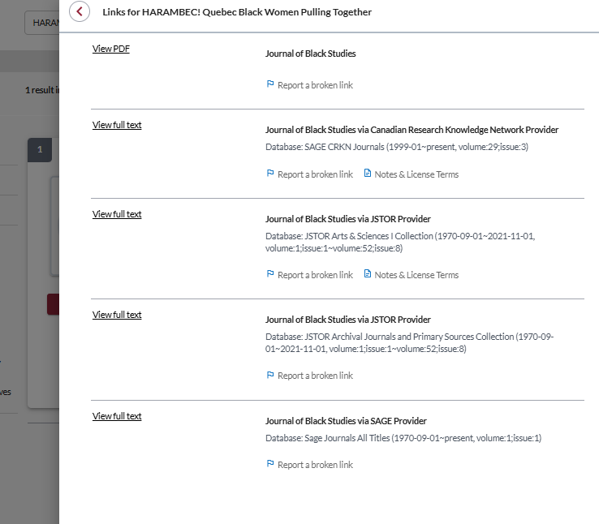
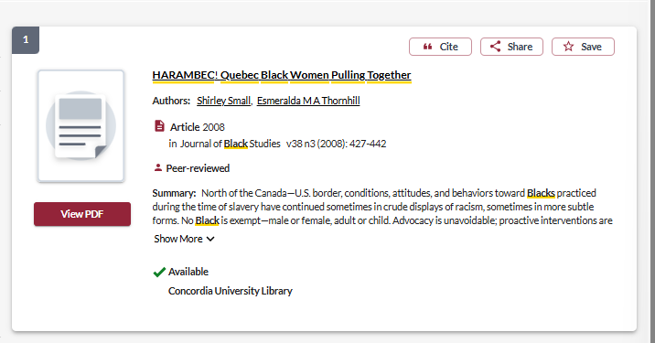

Slide 17
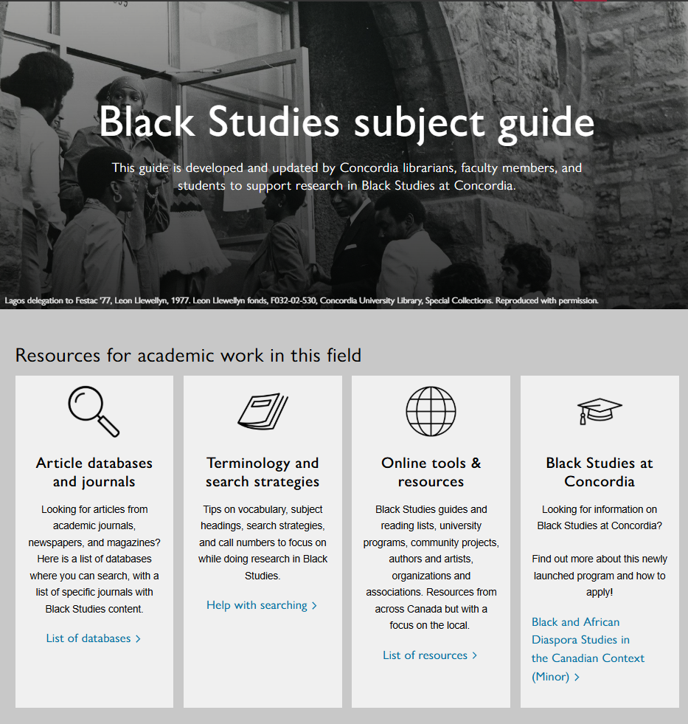

Slide 18
Libraries as colonial institutions
“The library is always an ideological structure. It’s not just what goes into the library that matters, but how it’s organized and under which norms.”
Daniel Heath Justice, Ph.D, ACRL Choice Webinar: Indigenous Literatures, social justice and the decolonial library (2019)
“When we look at collections, the actual ‘information’ contained in libraries and how it is organized, we can see that it (surely by accident) somehow manages to construct a reality wherein whiteness is default, normal, civilized and everything else is Other.”
nina de jesus, Locating the library in institutional oppression, In the library with the lead pipe (Sept 24, 2014)

Slide 19

Search strategies

Slide 20
How do we combine search words for the best possible results?
AND: combines concepts and limits your results
activism AND education
state OR government
OR: allows you to insert synonyms or alternative terms and increases your results

Slide 21
How do we combine search words for the best possible results?
“quotation marks”: If you put two or more words in quotation marks, that exact phrase will be searched and limits your results.
“Black Canadians”
“Black lives matter”
Music*
Finds: music, musician, musicians, musical
* - when you add an asterisk on the end of a word, your results will contain all the words with those endings or suffix

Slide 22
Avoid Searching with linking words
Each author may use different linking words when discussing similar topics.
Effects
Impact
Consequences
Influence
Results
Importance
Significance
Response
Emphasis
Causes
You don’t want your search to be limited to those books and articles that only contain the word “effect” or “consequence”

Slide 23

Searching in Sofia

Slide 24
What will I find in Sofia?
Academic peer reviewed books (ebooks and print books)
Academic textbooks
Non-academic books
Academic journal articles (peer reviewed and non-peer reviewed)
Government documents
International Organization publications
Films

Slide 25
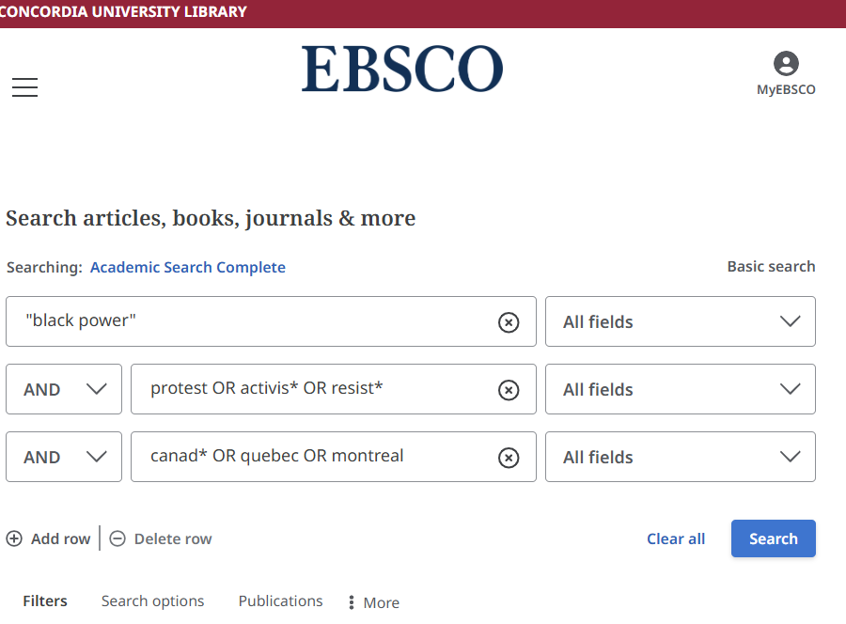

Slide 26
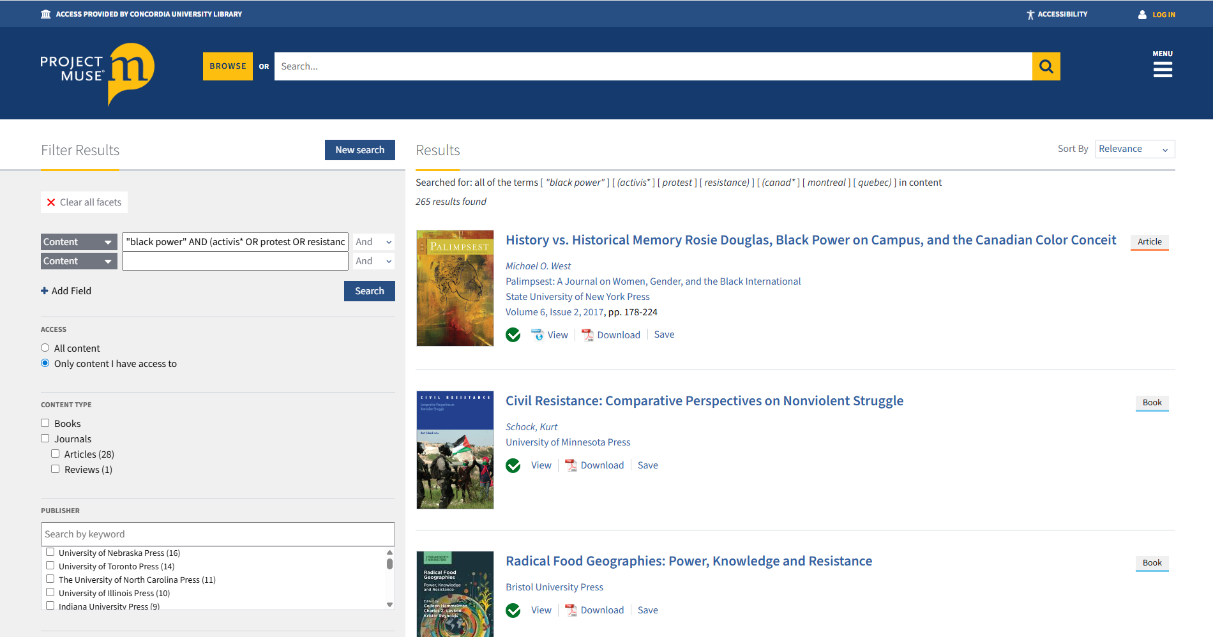

Slide 27
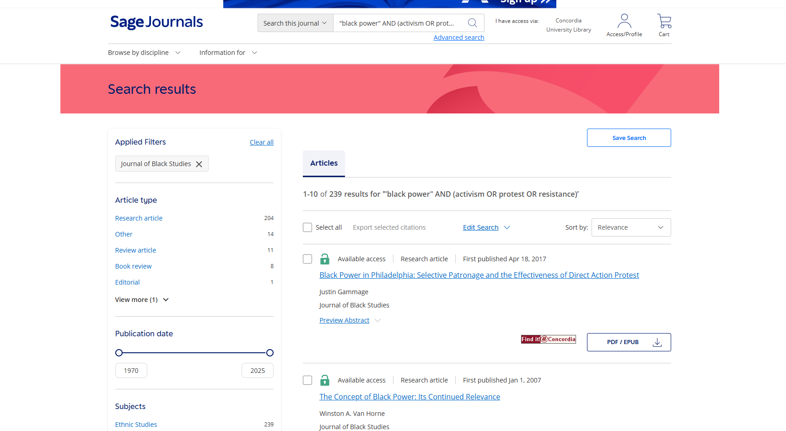
Searching directly in individual journals

Slide 28
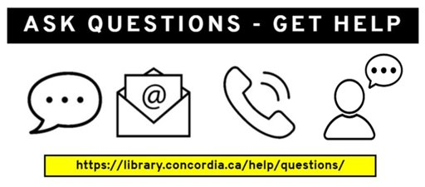
Need help, ask us!
Michelle.Lake@concordia.ca

