Slide 1

Political Science Graduate Library Orientation
Michelle Lake
Subject Librarian for Political Science, School of Community and Public Affairs, First Peoples Studies and Government Publications
Michelle.Lake@concordia.ca

Slide 2
Your Subject Librarian
Who am I?
Michelle Lake, librarian for Political Science, the School of Community and Public Affairs, First Peoples Studies and Government Publications
Michelle.Lake@Concordia.ca / Book a one-on-one Zoom consultation or an in-person appointment
What do I do?
  Provide research support
  Teach and assist with library databases and search strategies
  Help you find and access materials, including scholarly materials, government documents, grey literature, etc.
  Assist with citation issues
  Choose the books we buy for the above subject areas

Slide 3
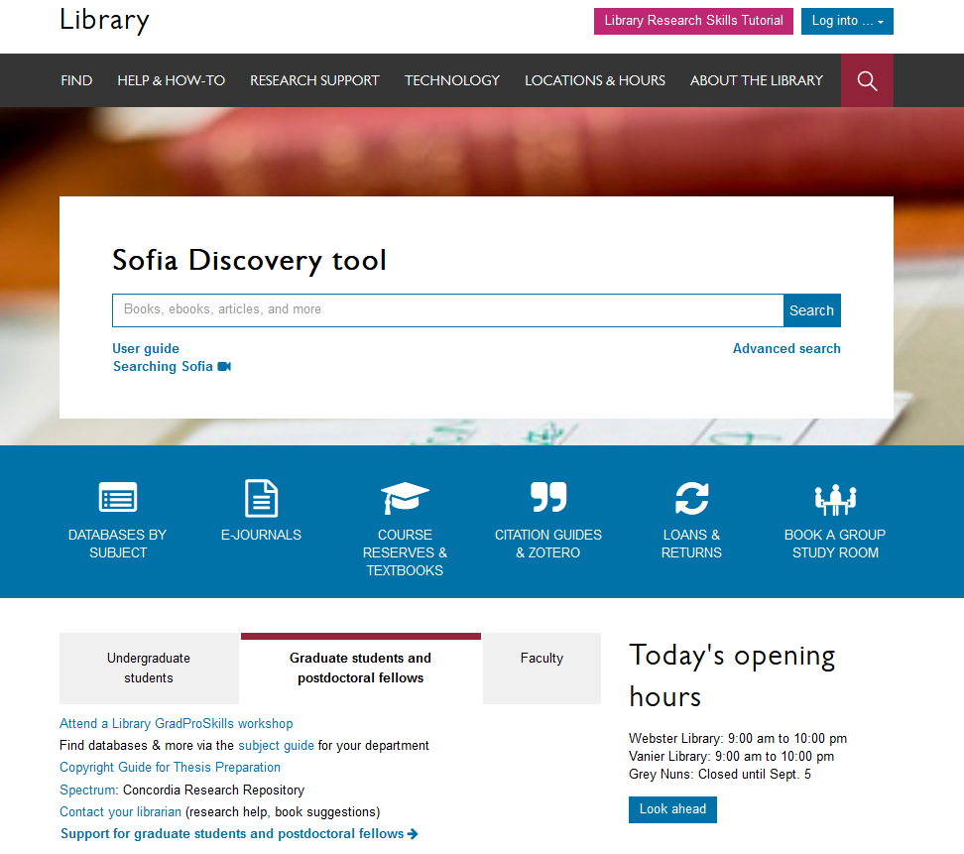

Locations & Hours
Library homepage: library.concordia.ca
Notes:
Next we’ll take a look at some of the library’s spaces. Clicking on “Locations and hours” will give you more information about the Concordia library spaces, including opening hours and floor plans.

Slide 4
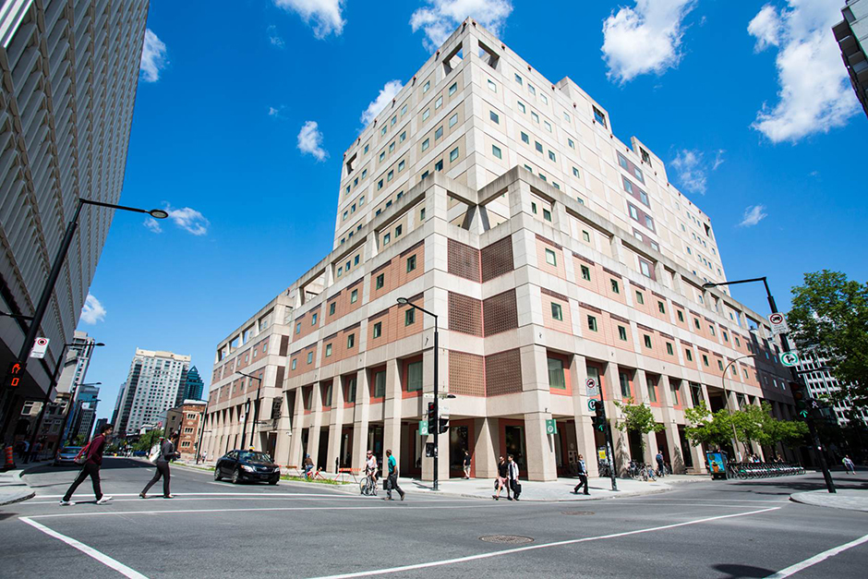
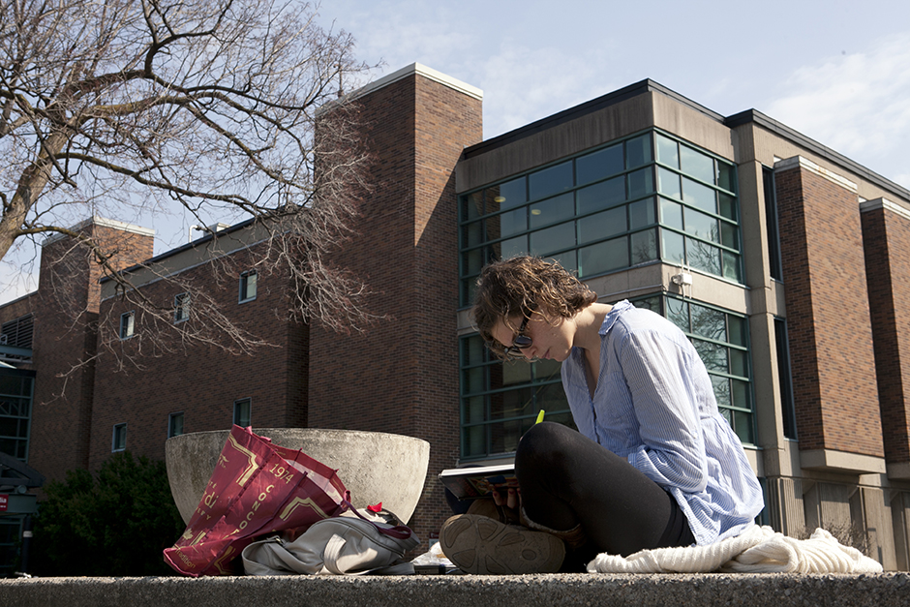
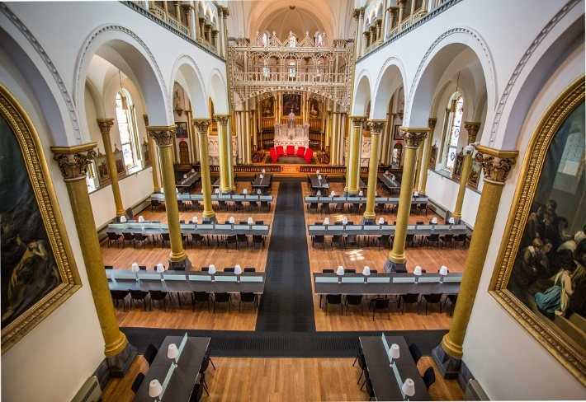
Webster Library (LB) – SGW Campus
24/7 access - between 11pm – 7am access with your student card
2nd, 3rd, 4th, and 5th floor of LB - “Library Building”
Poli Sci, Government Info, Maps, History, Social Sciences, Humanities, Engineering & Fine Arts
Interlibrary Loans
Current Print Journals
Dissertation Writer’s Rooms – LB5
24/7 hours for both libraries begins Tues, Sept 3, 2024
Vanier Library (VL) – Loyola Campus
24/7 access - between 11pm – 7am access with your student card
1st, 2nd, and 3rd floor VL – “Vanier Library”
Sciences, Psychology, Communications & Journalism
Special Collections
Print Journal Archive
Graduate Study Carrels
Grey Nuns (GN) – SGW Campus
(1190 Guy St.)
Mon-Thurs 9am-9pm, Fri 9-5pm, Sat & Sun 10am-5pm
Access with student card
Group Study Rooms
Quiet Study
Bring your own device
Outlets/Wifi
No collections
Reopens Sept 3rd

Slide 5
Library Services
Your student card is your library card.
You need it to:
borrow books (up to 100 a time)
borrow a laptop (for 3 days) & other technology (tablets, headsets, charger cables, DVD drives, media equipment)
print on campus (add money to your Dprint account)
access the library overnight during 24/7 hours.
Webster library has 5 book scanners (And Vanier has 2!) that can be used for free to scan chapters from our print books and email them to yourself as a PDF.
The Technology Sandbox has equipment that can be borrowed and used on site, workshops on various technologies are also offered
Access from home: To use Library databases, access online articles and ebooks when you are off campus, login with your Concordia Netname and password and access electronic materials the library website.

Slide 6

Technology sandbox
Notes:
In addition to letting you borrow cool tech, the technology sandbox is also a community space that encourages everyone to learn by doing, making, playing and sharing knowledge with each other. It’s in the Webster library and has a drop in space with regular hours and staff, and also hosts workshops that you can attend to learn new skills. Some of the technology available in the sandbox includes virtual reality headsets, 3d printers, a knitting machine, a button maker and more.

Slide 7
Library Resources

Slide 8

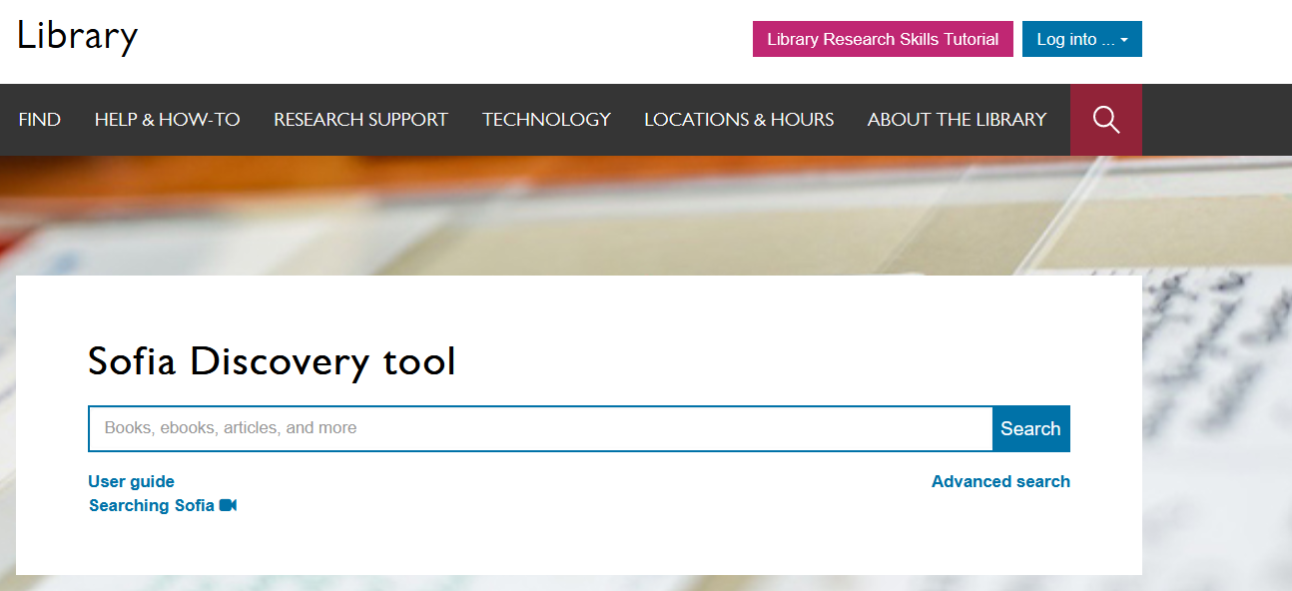
Sofia Discovery Tool, your library catalogue+
A general search across library resources
Good for getting started
Notes:
The Sophia discovery tool is Concordia library's main search tool, and you can find it in the middle of the main library web page. You can use Sophia to find a wide range of physical and digital items, such as books, journal articles, videos, and much more. Sofia is the best place to start you research, and has handy filtering tools, including a “peer-reviewed” check box.

Slide 9
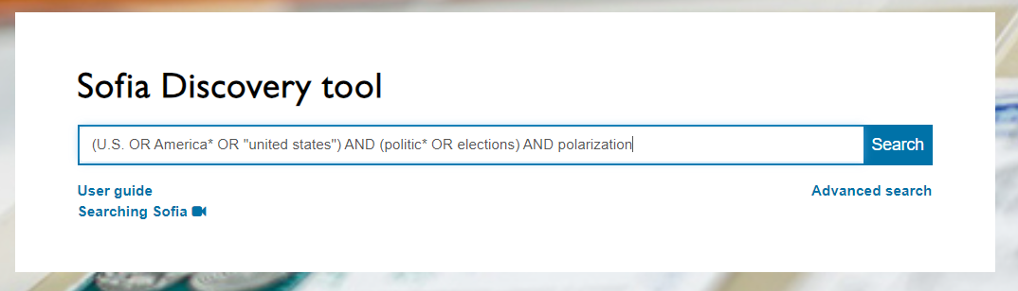
Searching Sofia with a topic/keywords
Search Tip: In Sofia, AND/OR must be in ALL CAPS to be recognized as stop words in the search

Slide 10
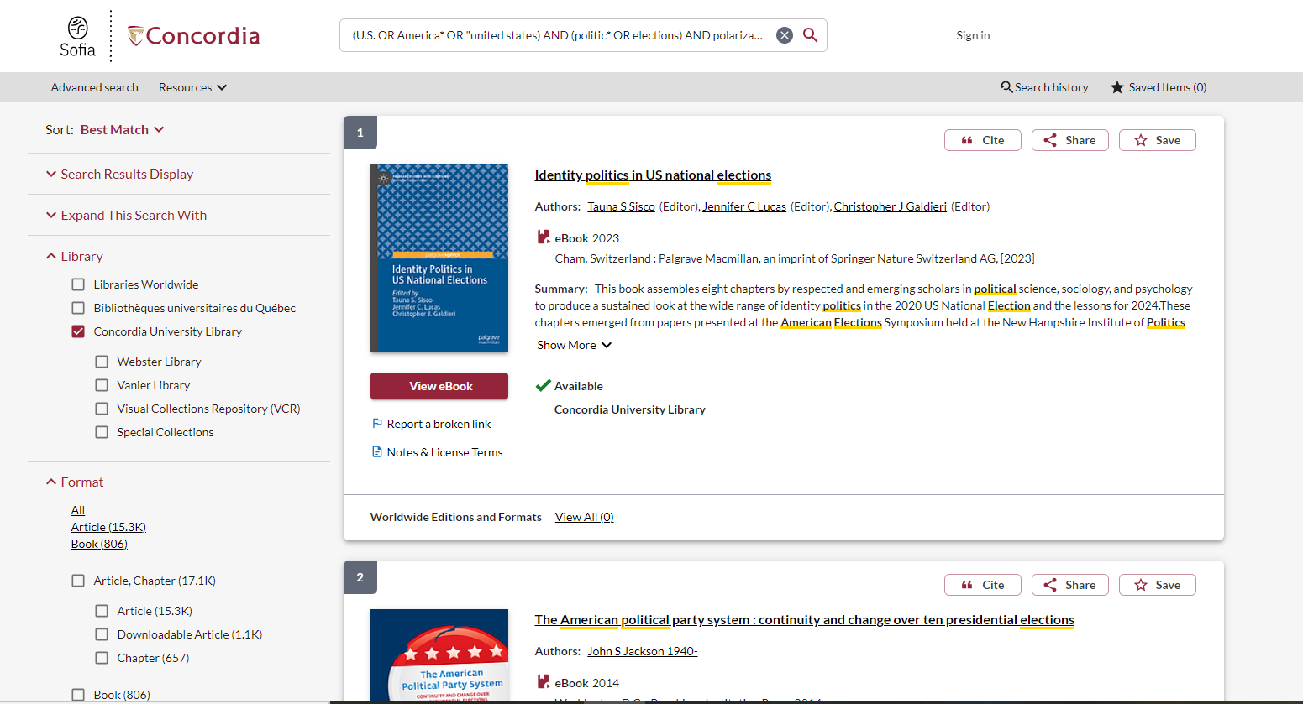
Use the menu to narrow to a location or format

Slide 11
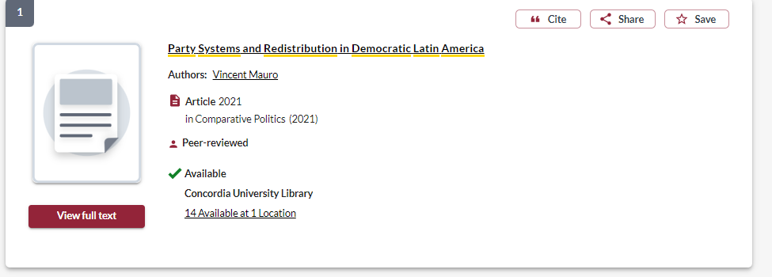
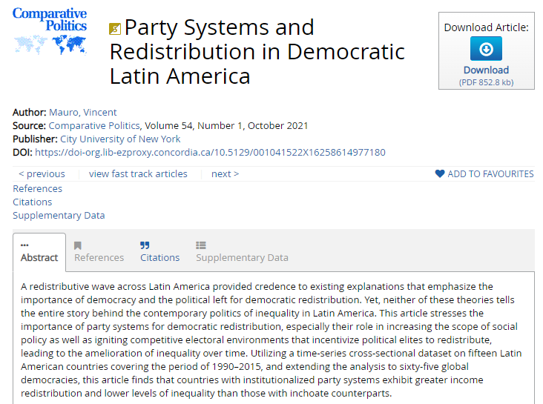
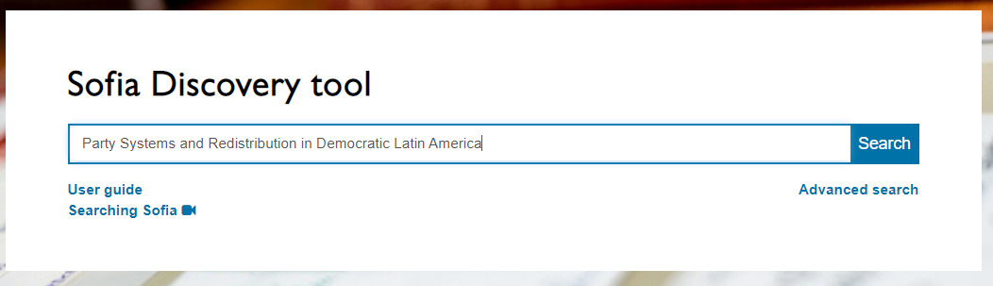
Mauro, V. (2021). Party systems and redistribution in democratic Latin America. Comparative Politics 54(1): 1-23.
Using Sofia to locate known items

Slide 12
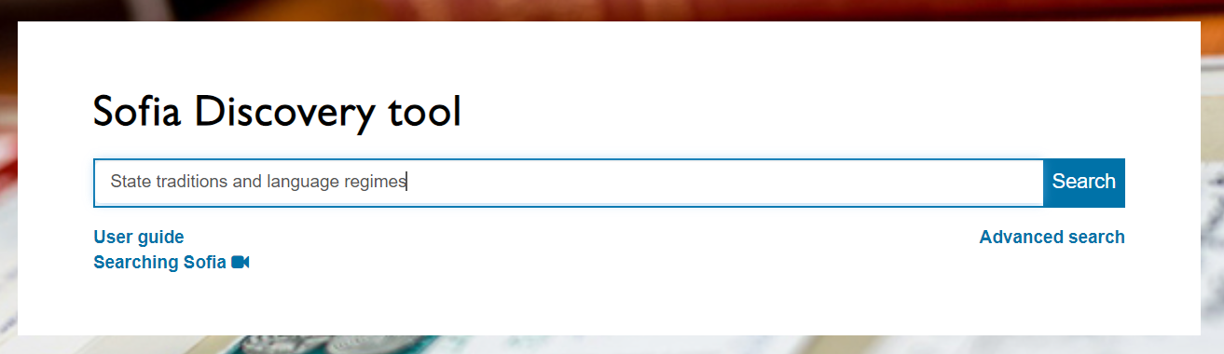
Using Sofia to locate known items

Slide 13
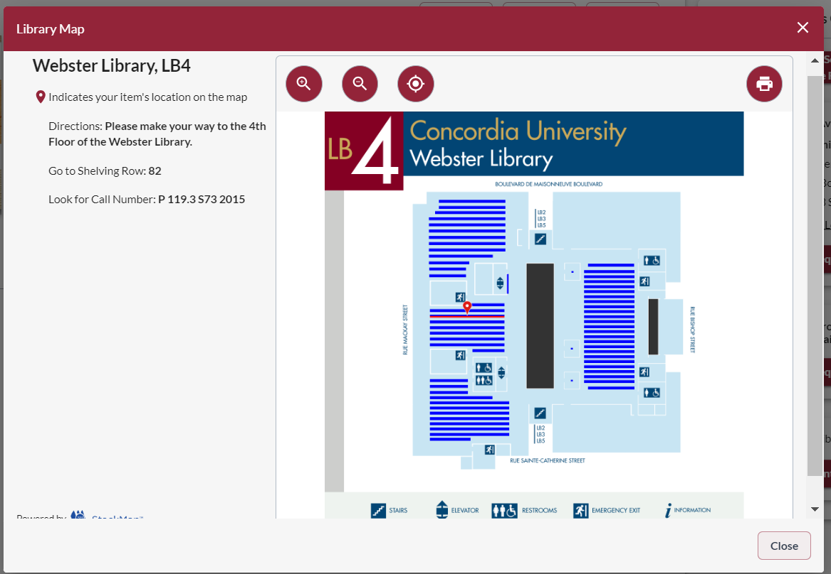
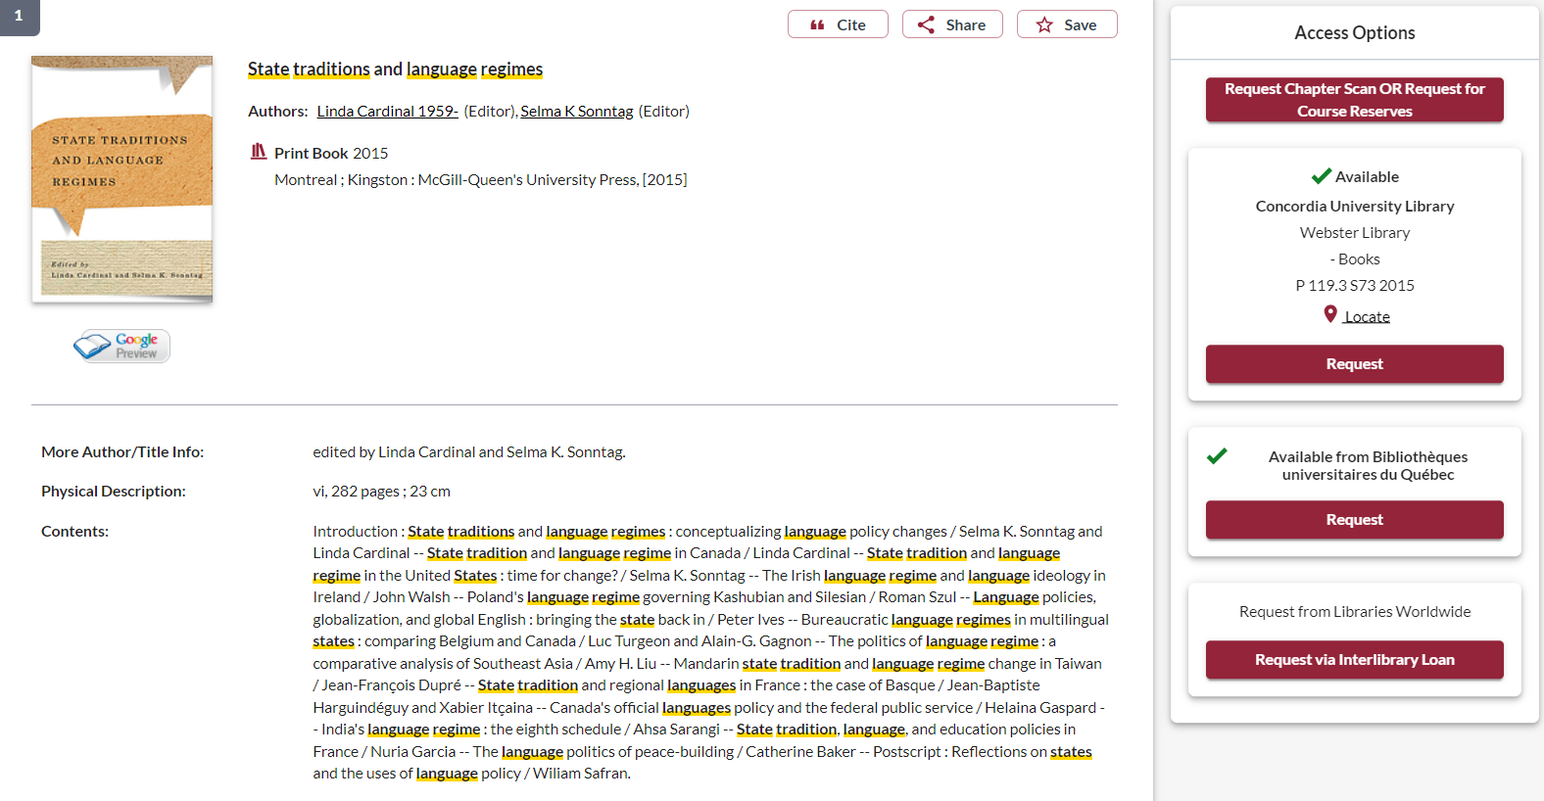

Slide 14
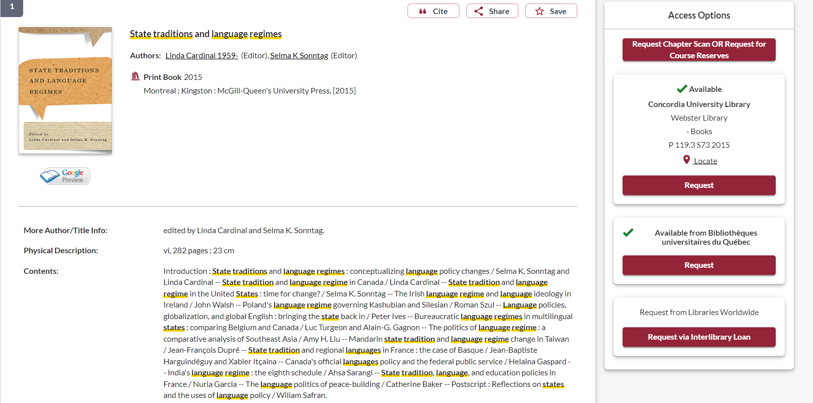
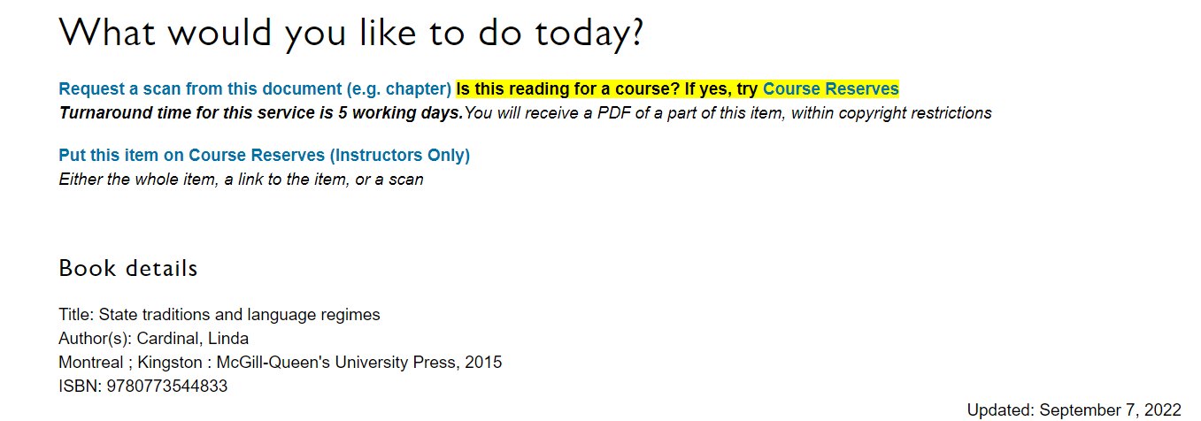
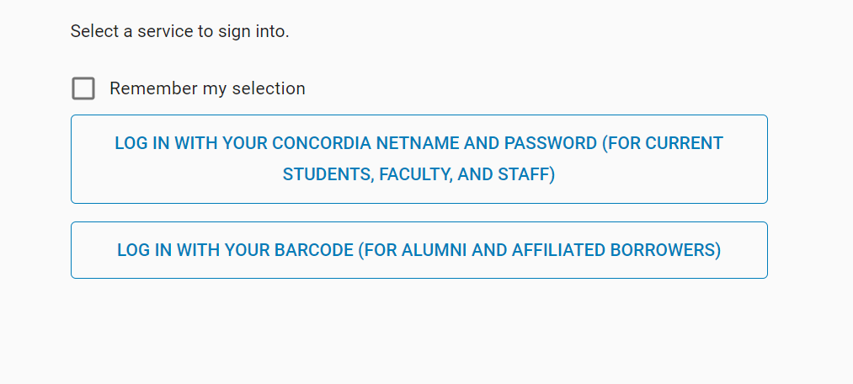
To request a scan of one chapter from the print book, click this button

Slide 15
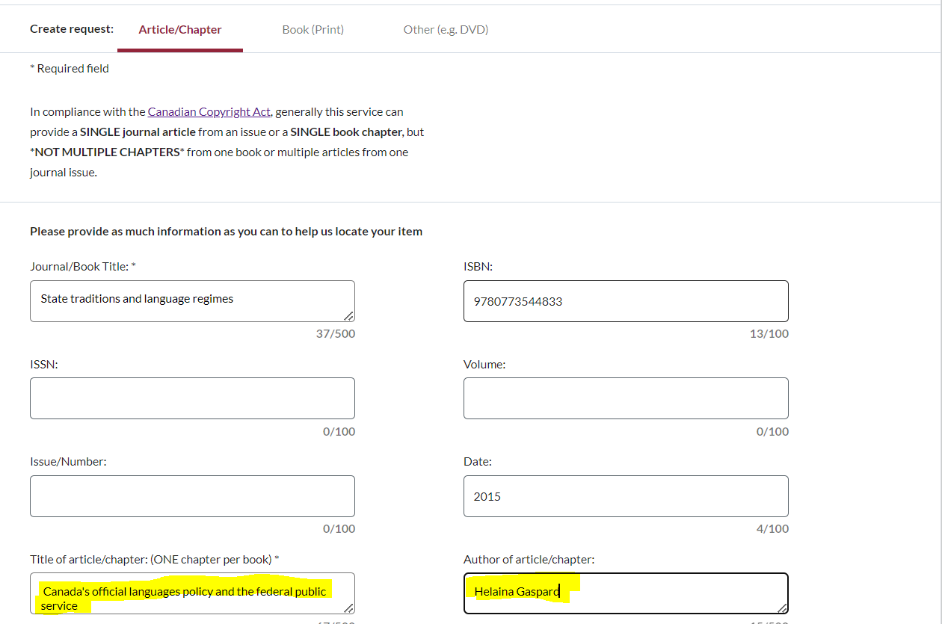
The book’s title and ISBN will be automatically filled in, you just need to provide the chapter title and author of the chapter.

Slide 16
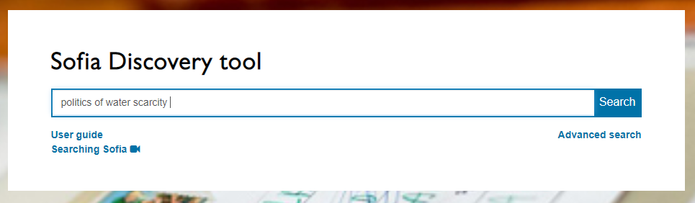
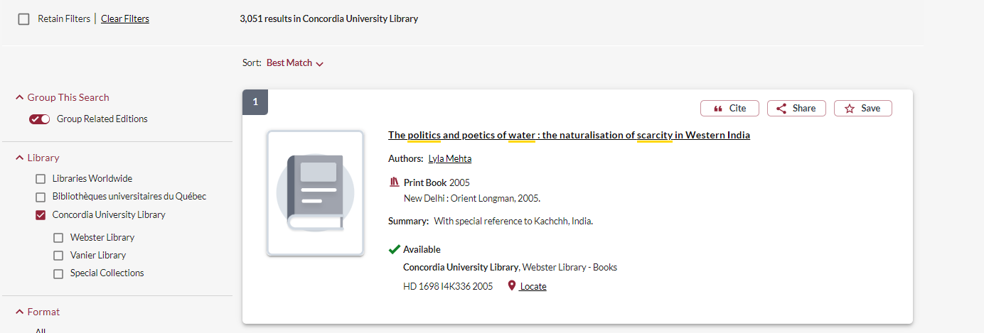
Borrowing from other libraries

Slide 17
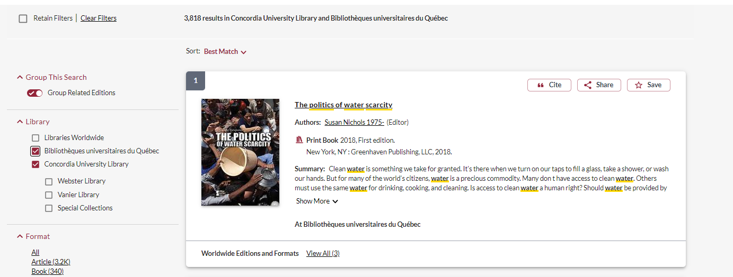
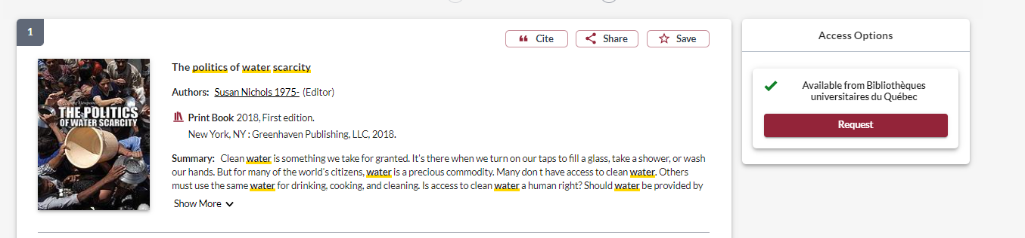
Request the book and it will be delivered to Concordia for your use

Slide 18
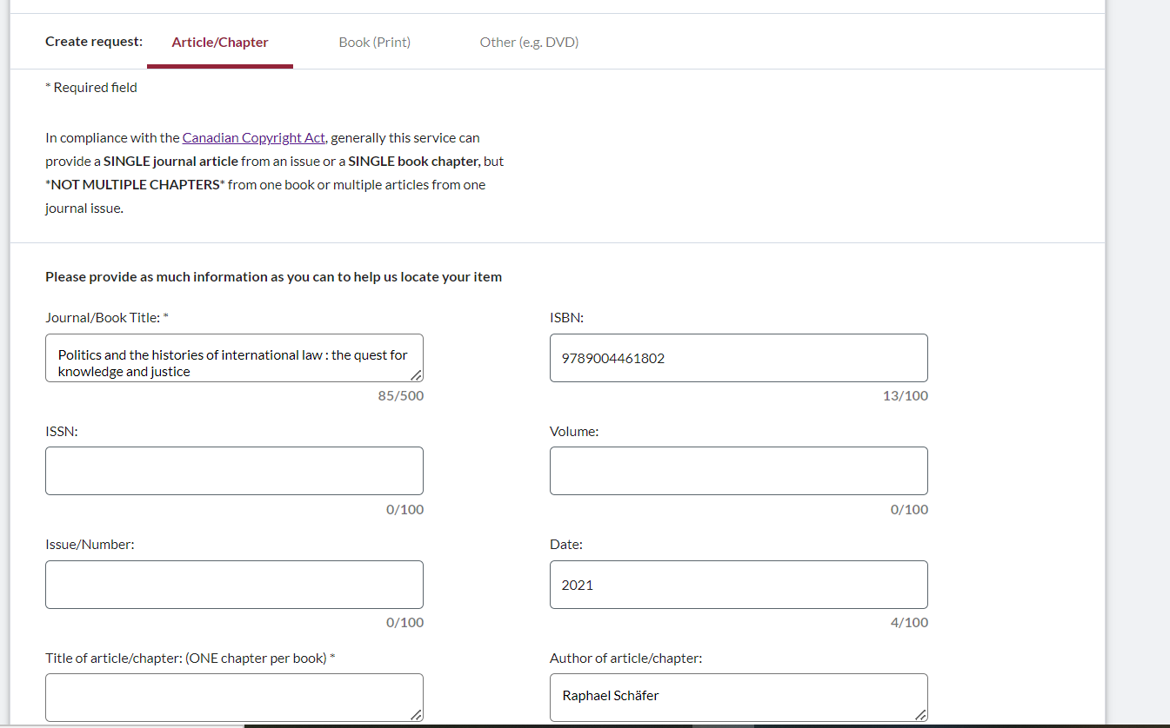
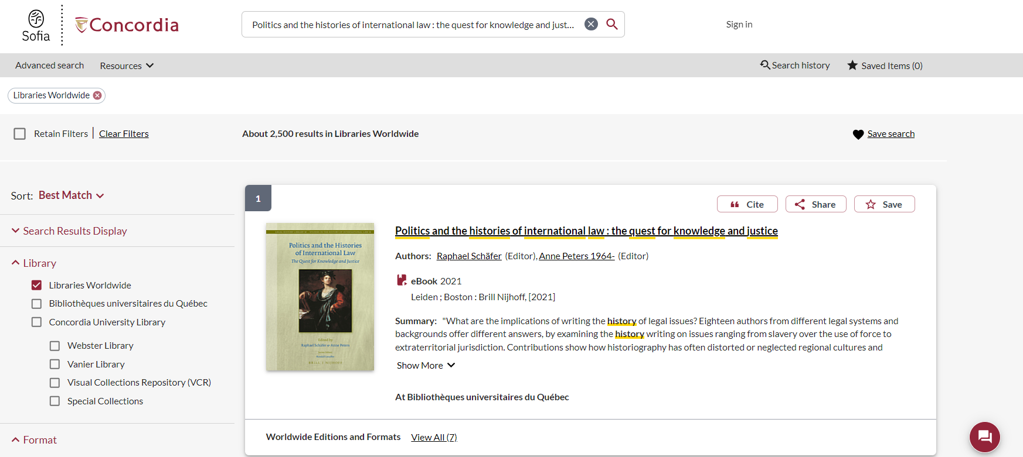
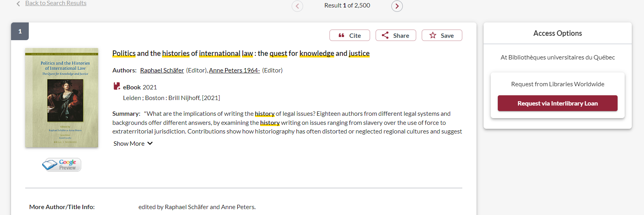

Slide 19
Interlibrary Loans
You will receive email notifications when your ILL request is available for pickup or download.
Physical items can be picked up at the Circulation/Loans desks at either Vanier or Webster Library.
ILL requests can be borrowed for 30 days, with up to 4 automatic renewals, or until item is recalled.
Notes:
When your loan is ready, you will get a notification by email and you can retrieve your ILL from the loans desk of the library you set as your pickup point. The default loan period for ILLs is 30 days, and that loan will renew automatically up to 4 times, unless another user requests the book.
Article or chapter scan requests will be delivered as PDF files and you will be notified by email when they are ready for download.

Slide 20
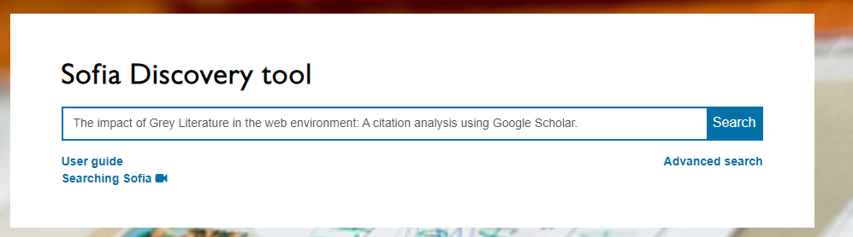
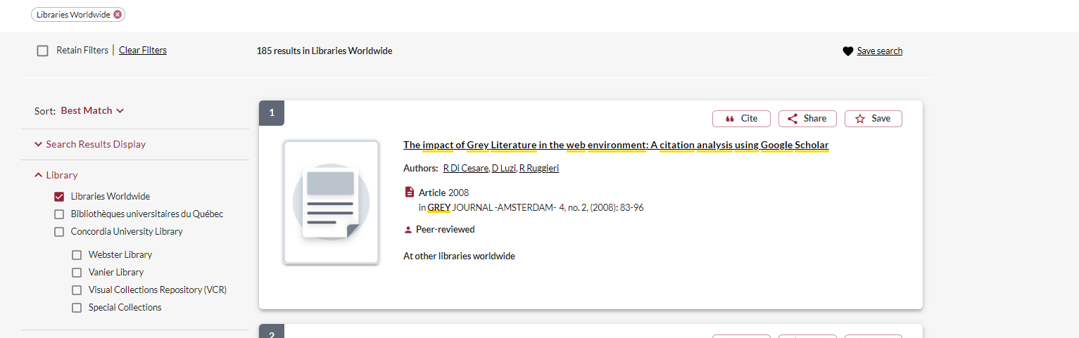
Interlibrary loans for journal articles

Slide 21
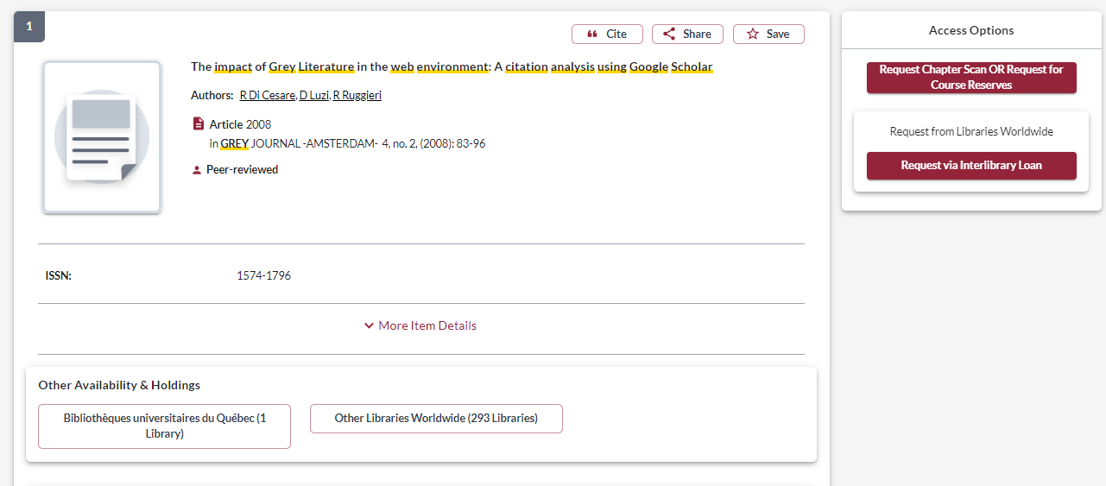

Slide 22
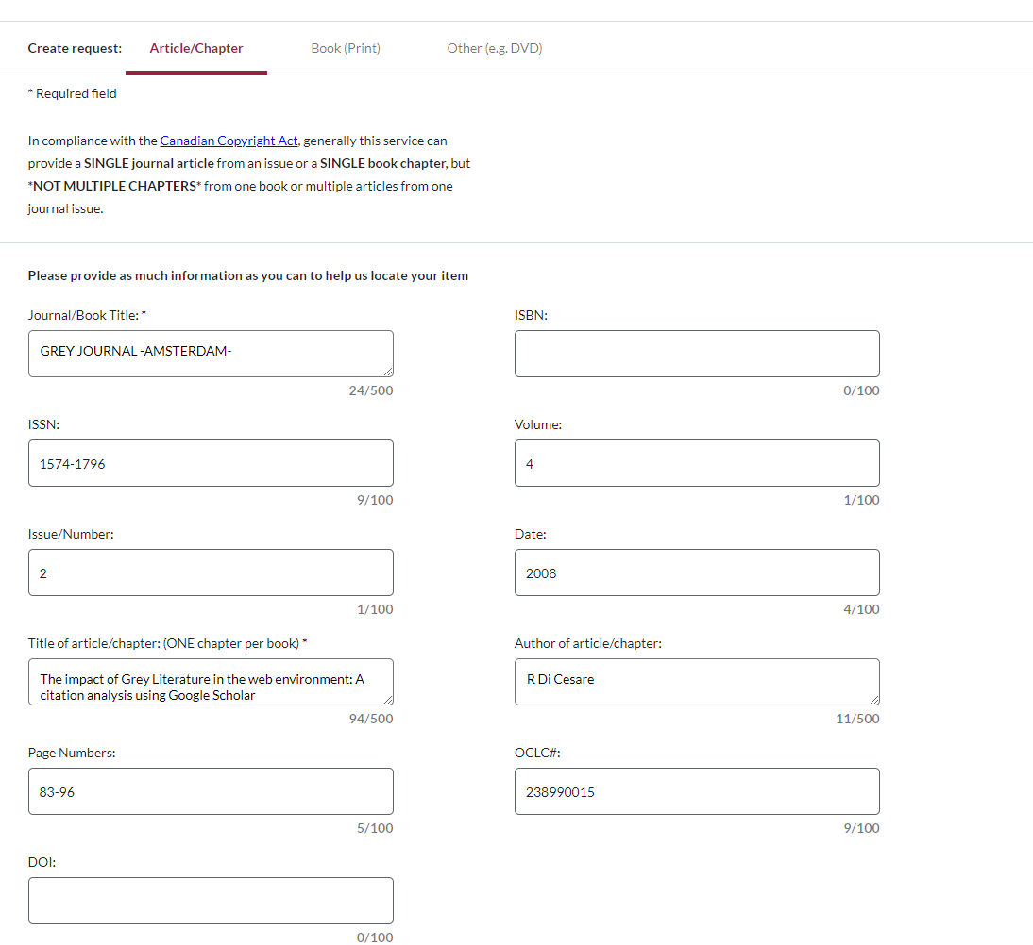

Slide 23
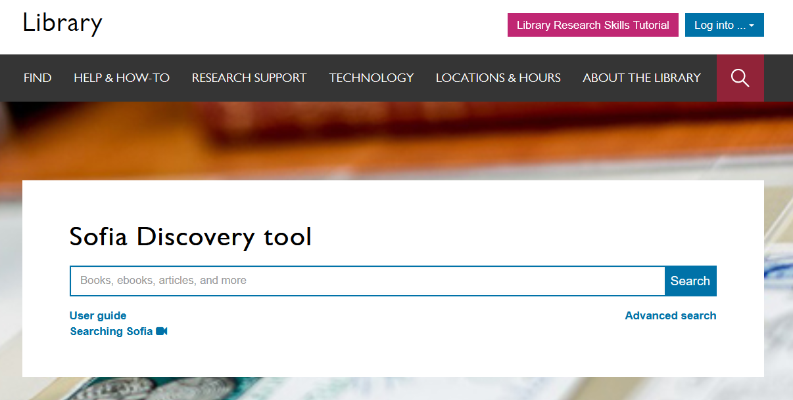
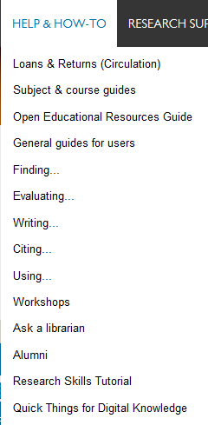
Notes:
You can also access these guides from the main library homepage by clicking on the help and how to menu and then select subject and course guides. These are great place to start for finding databases and other information for your discipline.

Slide 24
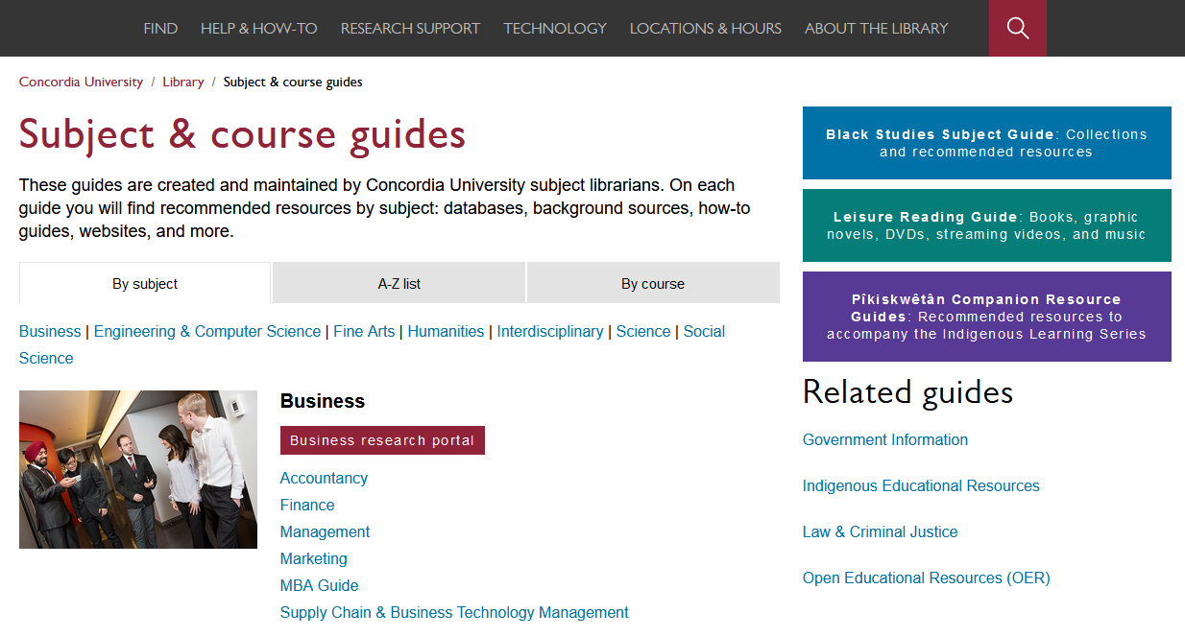
Subject and course guides
Notes:
The subject and course guides are some of the most helpful guides. They are created and maintained by the library’s subject librarians – librarians who are experts at supporting research in your field. The guides contain recommended resources for each subject, including the best databases to use, background sources like encyclopedias and handbooks, how-to guides for finding trickier resources like primary sources, lists of useful websites and online tools. The guides also have links you can use to contact your subject librarians if you have any questions or need help working on a project.

Slide 25
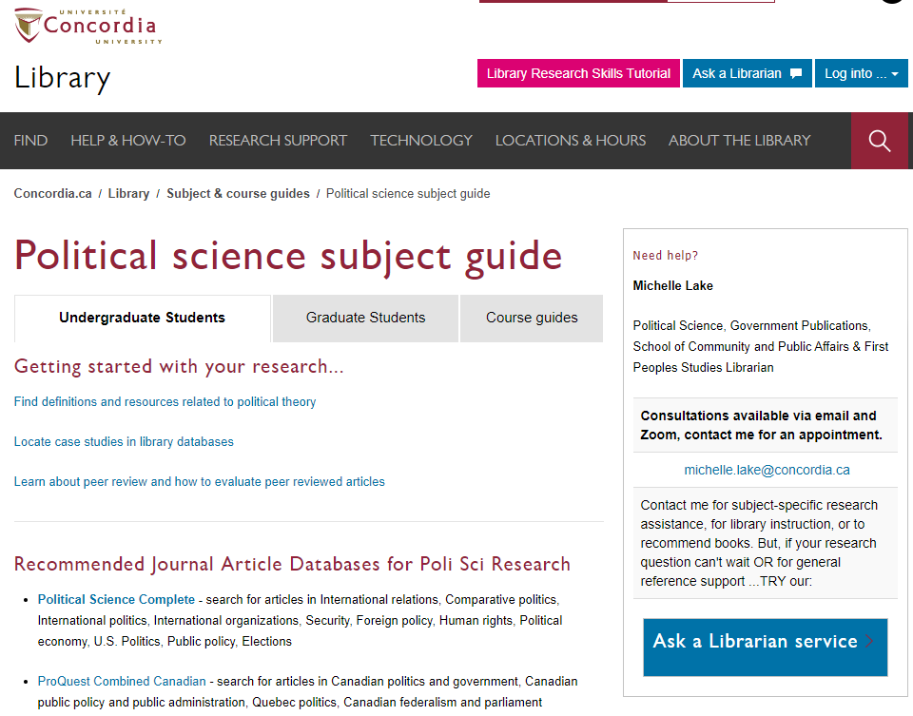
The political science subject guide is a great place to start your research and find recommended resources.

Slide 26
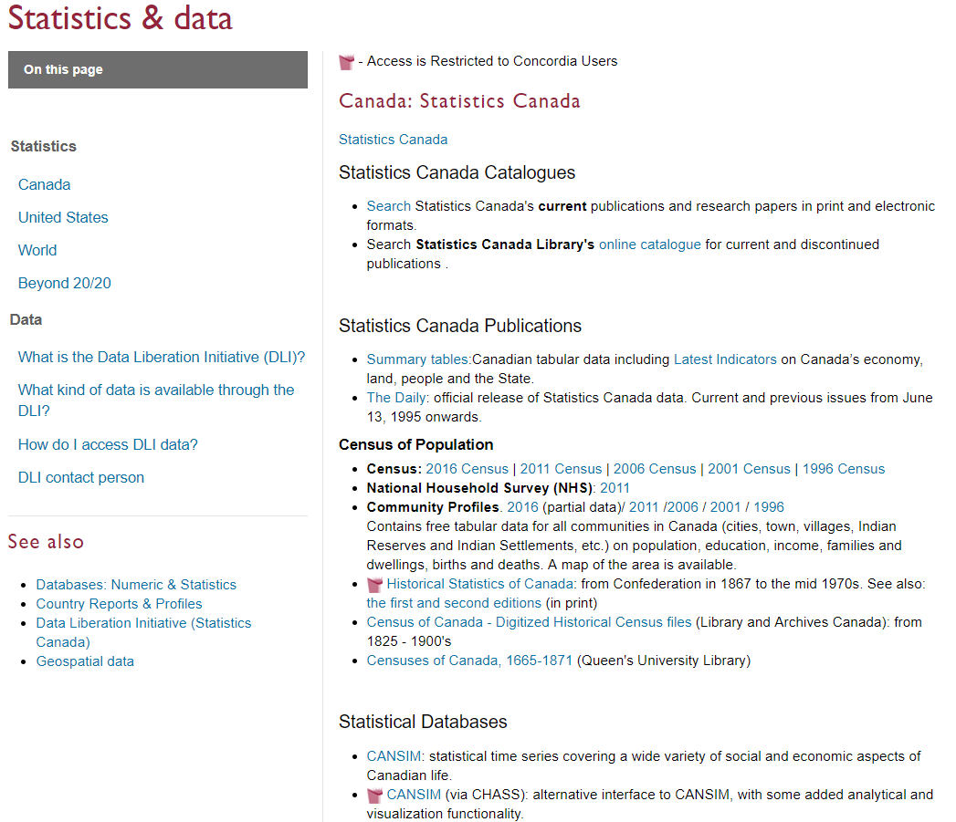
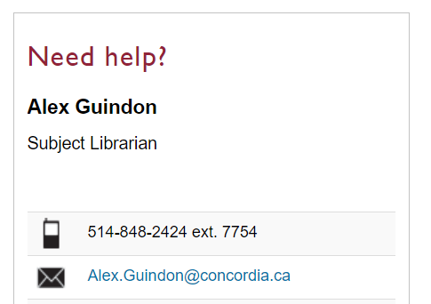
Help with stats & data
Consult with the data librarian or get started with data and statistics using the help guides.

Slide 27

How do you keep track of all the great articles and documents you find? How do you cite them?
Zotero GradProSkills workshops
  Sept 25, 10:30-12:00 in person
  Oct 1, 2:00-3:30 online
Zotero library help page
Bibliographic management software
Notes:
Once you’ve started finding really good sources to support your research project, how do you keep track of them all? And how should you cite them? These are some of the most common questions we get at the library. There are a bunch of tools you can use to help you manage your sources and reading notes, but one that I would highly recommend is Zotero. It's a free bibliographic management software that integrates well with the Sofia discovery tool, and has plugins for your browser and your word processing software. It helps you manage your sources, organize reading notes, and will automatically generate lists of references in different citation styles. If you’re interested, we provide workshops, guides, and help through the library for using Zotero.

Slide 28
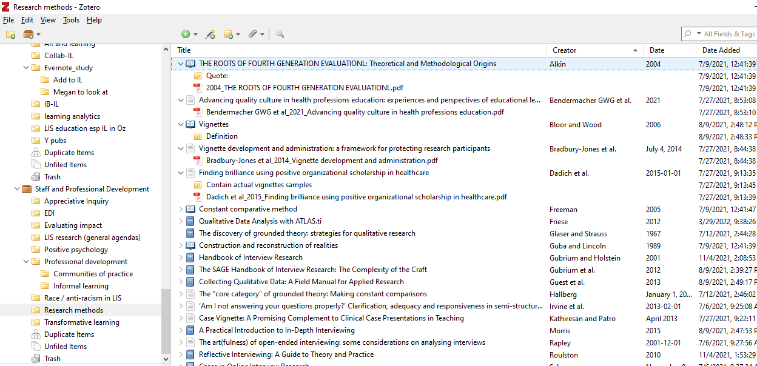
Notes:
This is just an example screenshot from a Zotero library, to give you a sense of what a powerful tool it is. On the left side of the screen, there are lots of folders with labels, divided by research project. In the center, you see the titles of different resources that I found with different icons, these represent books, articles, dissertations, and more. These records include the bibliographic information for these resources like the author, and the publication date and so on. You can also see the little notes with the yellow post-it icon, these are reading notes I’ve added, as well as some PDF files that I've attached.
Zotero is a really powerful tool for organizing your information, allowing you to take notes, highlight PDFS, and keep track of references as you're writing. So I highly recommend learning more about Zotero for your research and your studies.

Slide 29
GradProSkills Library Workshops
Workshop title | Date, time & location
Library Skills & Resources: Maximize your Graduate Research Potential | Sept 12, 2024, 11:00am-1:00pm (Webster Library, LB 205), & Oct 10, 2024, 1:00-3:00pm (online)
Researching Indigenous Topics - Instructor: Michelle Lake | Sept 24, 2024, 1:00-3:00pm (online)
Using Zotero for Grads | Sept 25, 2024, 10:30-12pm (Webster Library, LB 207), & Oct 1, 2024, 2:00-3:30pm (online)
Interdisciplinary Scholarship: Advanced Bibliographic Searching | Oct 24, 2024, 11:00am-1:00pm (Webster Library, LB 207)
Introduction to Zettelkasten note-taking and tools for writing research | Oct 31, 2024, 9:00am-11:00am (Webster Library, LB 207)

Slide 30

Graduate Students tab
Support for graduate students page
Notes:
You can also find space specifically for graduate students by clicking the Graduate students and postdoctoral fellows tab under the Sofia Discovery Tool. There’s a link here to the “Support for graduate students and postdoctoral fellows” page. That page is a hub for grad students and has links to the resources that we're going to talk about today, as well as other useful information. So it’s a good page to have bookmarked and to spend some time exploring on your own. We’ll come back to some of the other resources there, but let’s start with grad student spaces.

Slide 31
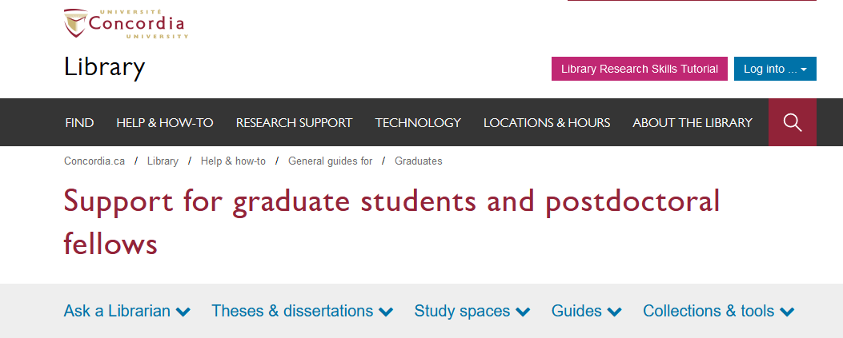
Support for graduate students
Graduate Students library page: https://library.concordia.ca/help/users/graduates/index.php
Notes:
Click the “Study spaces” tab near the top of the “Support for graduate students” page.

Slide 32
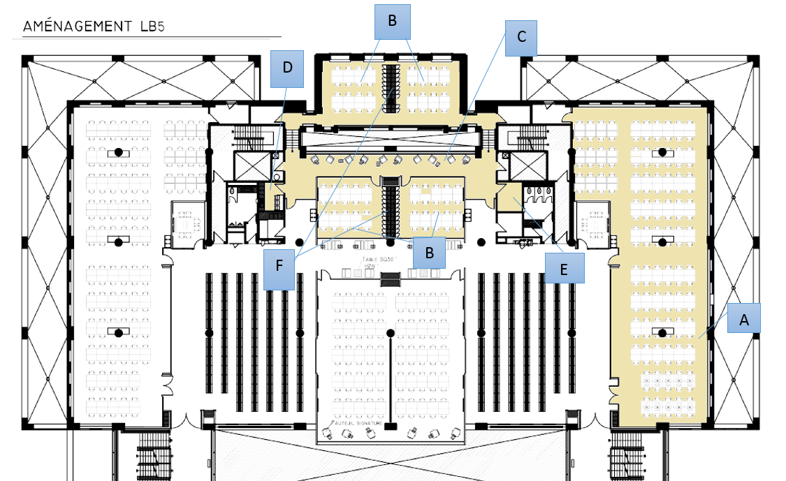
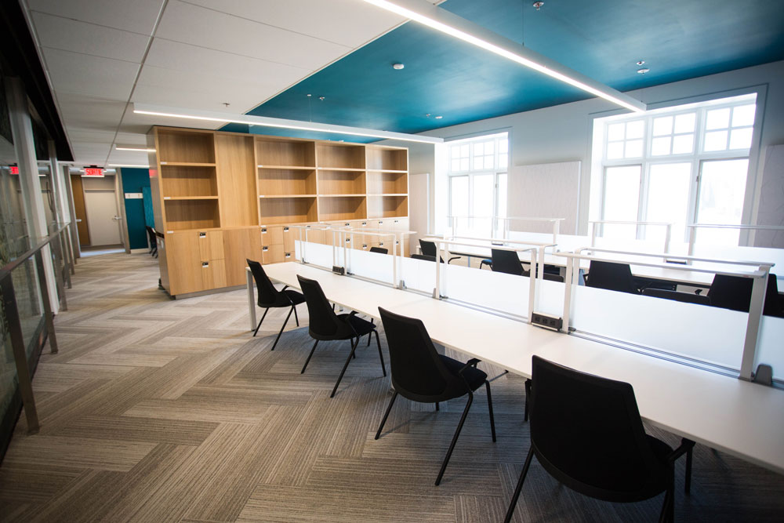
Graduate spaces - SWG
Webster 5th Floor
Quiet reading room
Four dissertation writing rooms
Lounge
Kitchenette
Dedicated printer/copier/scanner
Lockers & Shelves
Notes:
At the Webster library, on the downtown campus, all of the grad space is on the fifth floor, with the exception of the seminar room and a thesis defense room which are on the third floor. On the fifth floor, you'll find reading rooms and writing rooms that are reserved only for graduate students, and you need your Concordia ID card to be able to enter these rooms. There's also a lounge with comfortable seating and a small kitchenette with a microwave where you can heat up food or eat your lunch.

Slide 33
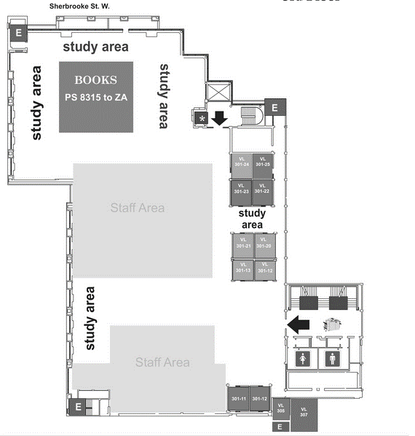
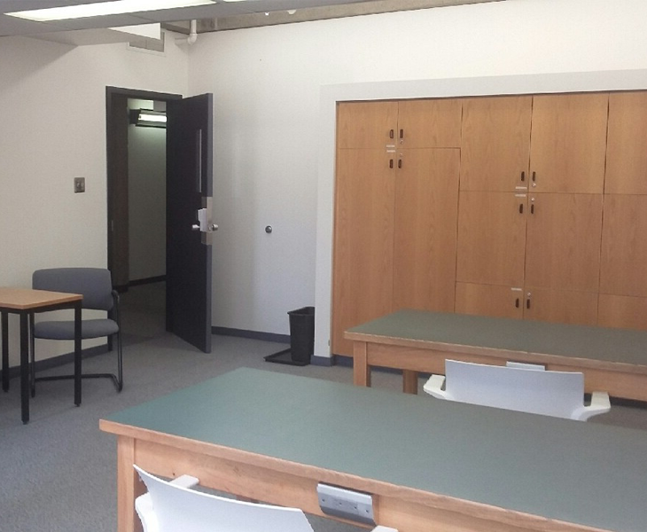
Graduate spaces - Loyola
Vanier Library 3rd Floor
Obtain access codes when you arrive
Graduate study room (VL-307)
  Assigned shelves
Graduate group study room (VL-305)
B
A
Notes:
At the Vanier library on the Loyola campus, the third floor has a room, room 307, which is reserved for graduate students. To get an access code for the room, you need to show your valid Concordia student ID at the Ask us Desk. You'll be assigned individual code for accessing the room. There’s quiet reading space in the room and assigned shelves where you can leave your books throughout the semester. There’s also a group study room for grad students next door in room 305.

Slide 34
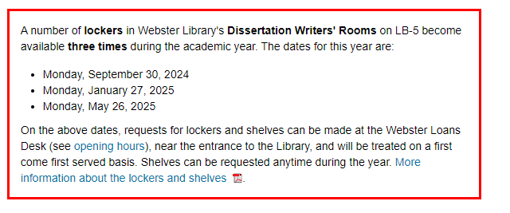
Webster Library – Graduate student spaces
To request a shelf or locker, you must be a currently registered graduate student:
Only one shelf or locker can be assigned to each student
Shelves and lockers are assigned to an individual student and must not be shared with others
Library books that you want to keep on a shelf must be checked out at the Loans Desk

