Slide 1

Writing the thesis proposal
–
Library Resources
Éthel Gamache
Philosophy Subject Librarian
ethel.gamache@concordia.ca

Slide 2
Ice-breaker Activity
I use or have used online library services.
I know how to apply boolean logic to searching.
When I search for articles, I often find what I’m looking for.
I prefer to use Google / Scholar to find scholarly articles.
I have attended a library workshop before.
I’ve met with a librarian to find relevant sources for an assignment.
Move your fingers
Touch your head
Play air piano
Wave
Take a bow
Clap your hands
This activity was created by K-Lee Fraser, University of Toronto Scarborough, K-Lee's Remixed Information Literacy Games. (unpublished)

Slide 3
Who Am I?
Éthel Gamache, M.A., M.S.I., Philosophy Subject Librarian
ethel.gamache@concordia.ca: email me a question, make an appointment to meet and discuss your research
What do I do?
  Provide research support, assist with search strategies.
  Help students navigate library databases, assist with selection and evaluation of sources.
  Help students find and access materials (primary, secondary) they need.
  Build guides and resources to help students locate research materials.
  Buy books and ebooks for the Philosophy, Classics, Modern Languages and Linguistics, Études françaises, Religions and Cultures, and Theological Studies departments.

Slide 4
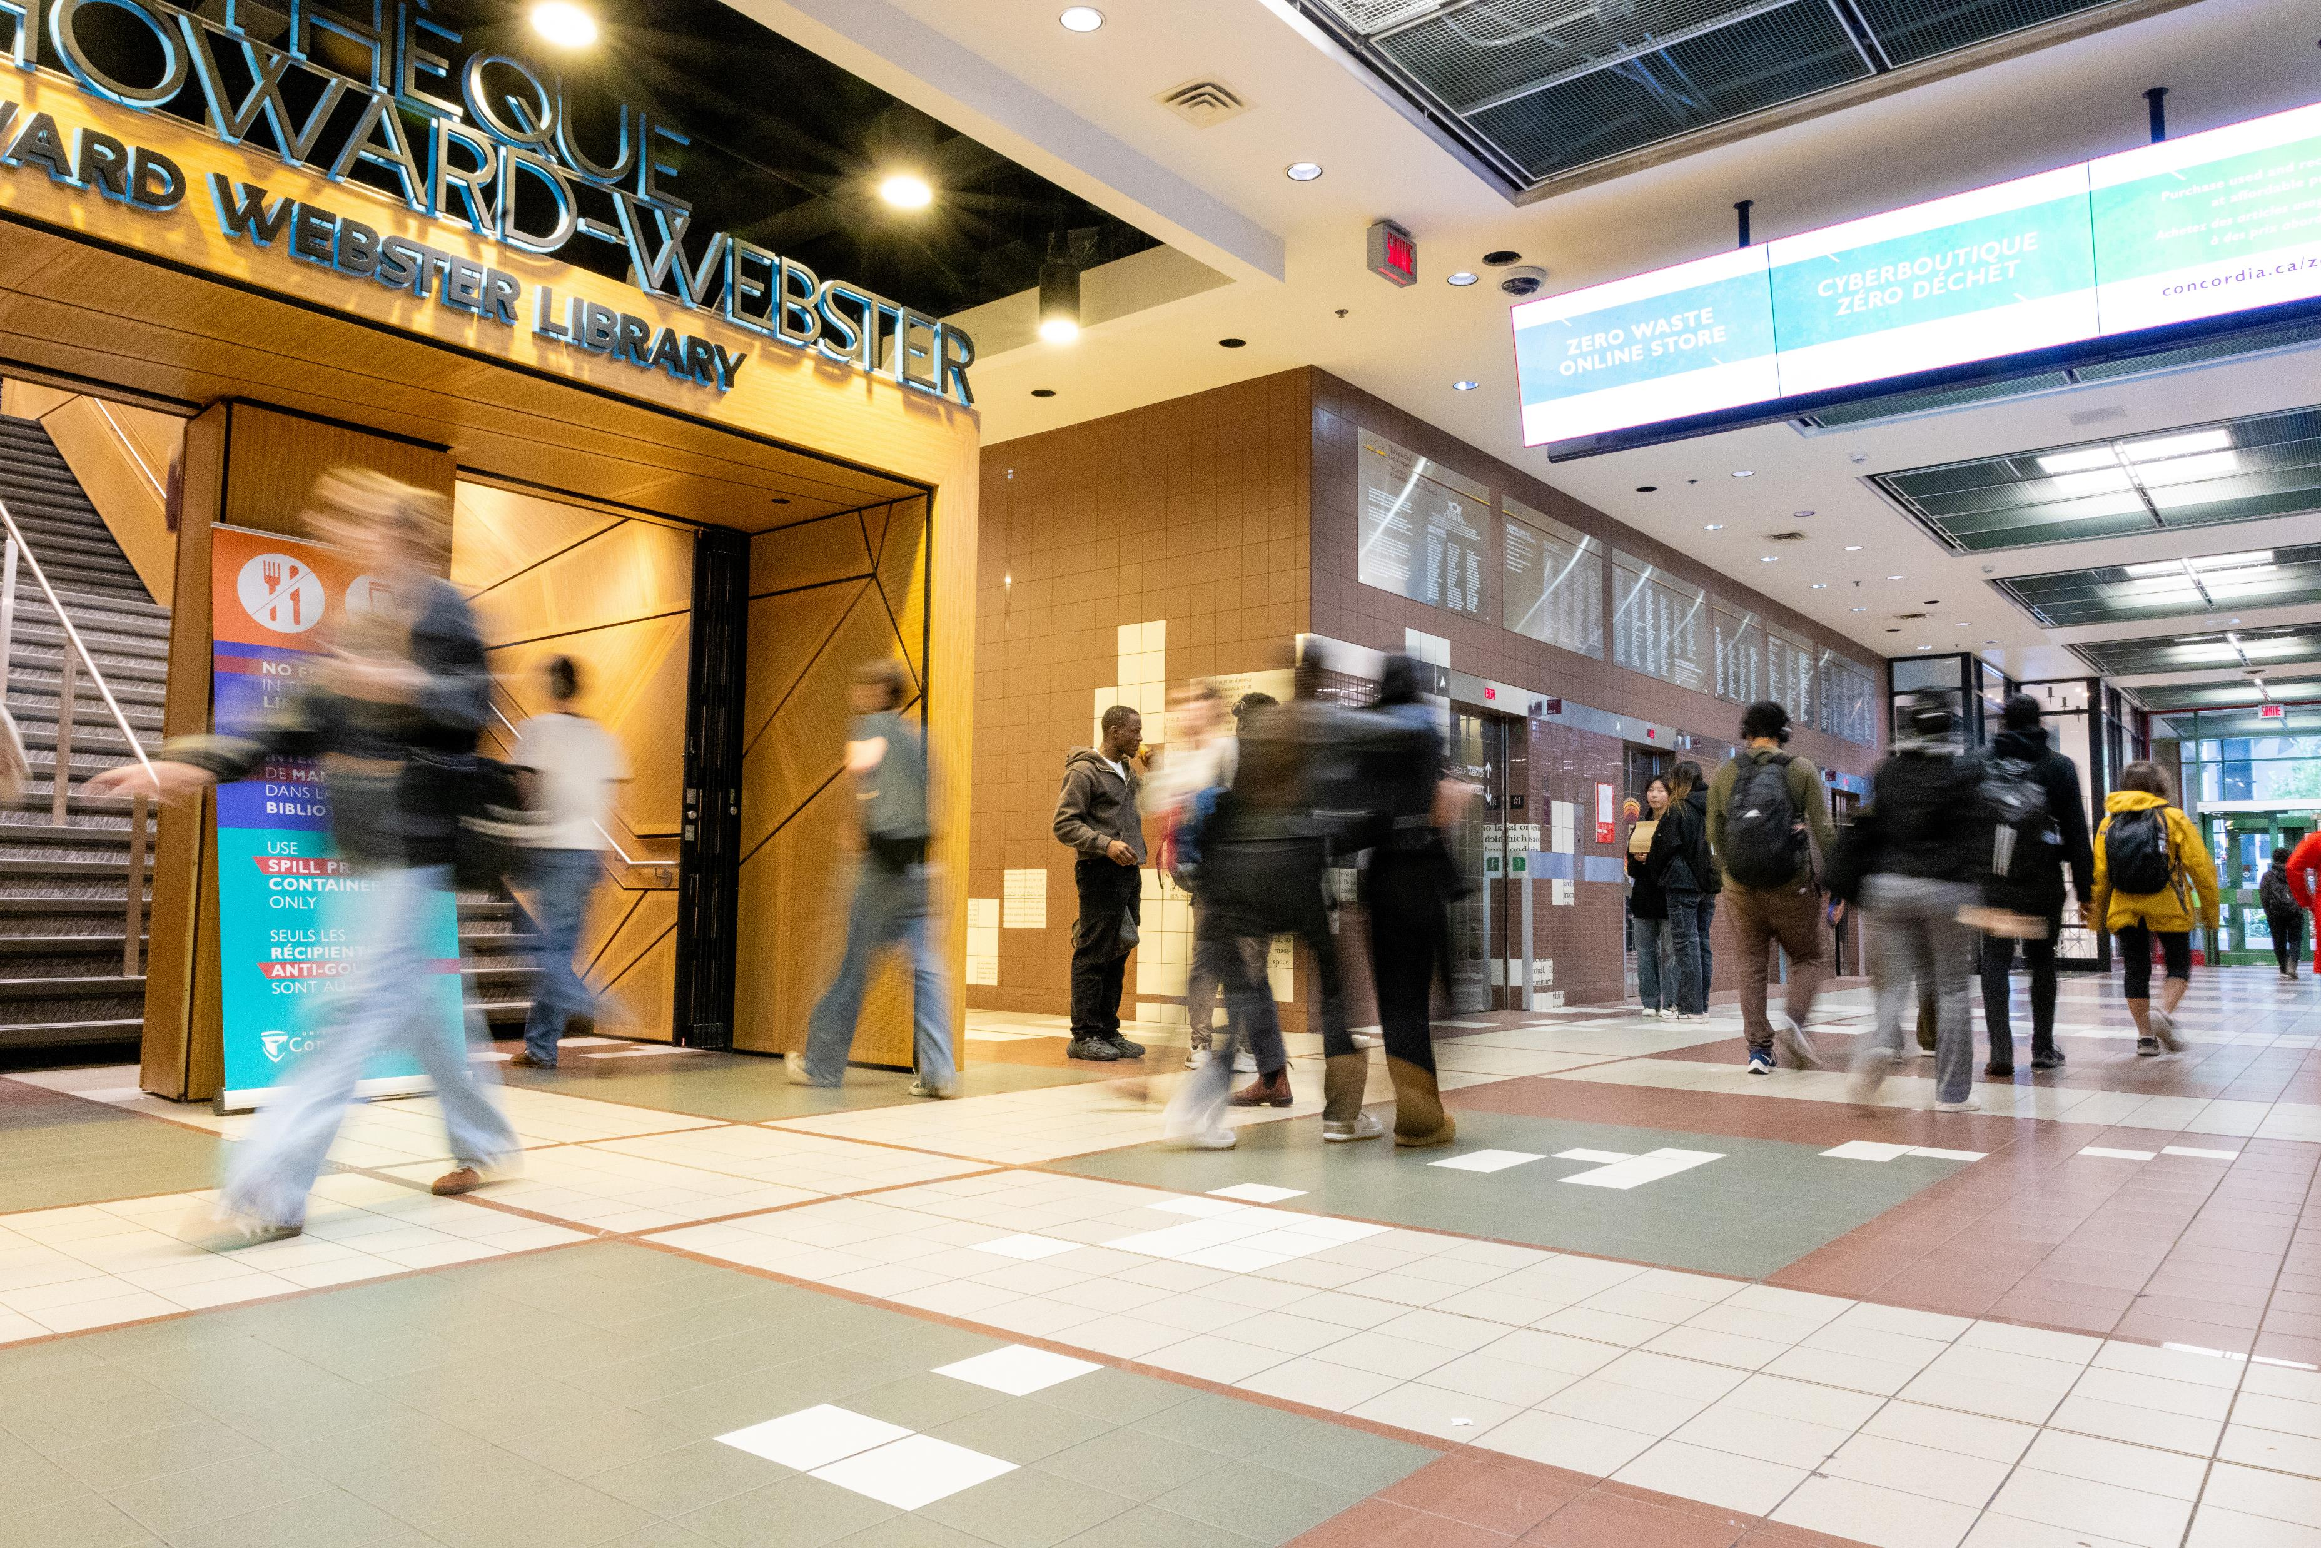
What does the Library do?
Curates access to resources: databases, journals and ejournals, books and ebooks, archival material, films, …
Manages Spectrum, Concordia Research Repository
Offers spaces, including dissertation writing spaces for graduate students
Teach workshops
Supports research

Slide 5
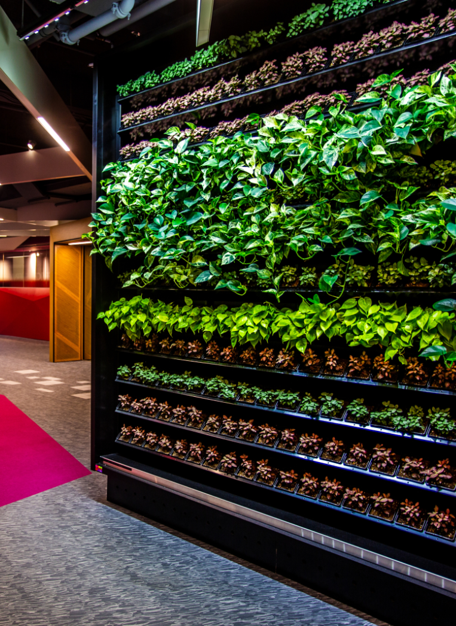
What does the Library offer?
24/7 access for Concordia students in the Fall and Winter terms
2 libraries:
  Webster Library (LB) – downtown on SGW campus &
  Vanier Library (VL) on Loyola campus
  One reading room – Grey Nuns (GN)
Bookable Group Study Rooms (3 locations)
Course Reserves: required textbooks
Desktop computers or borrow a laptop
Technology Sandbox (LB-211: maker space, 3D printing, VR, workshops and more) and a Visualization Studio (LB-314)

Slide 6
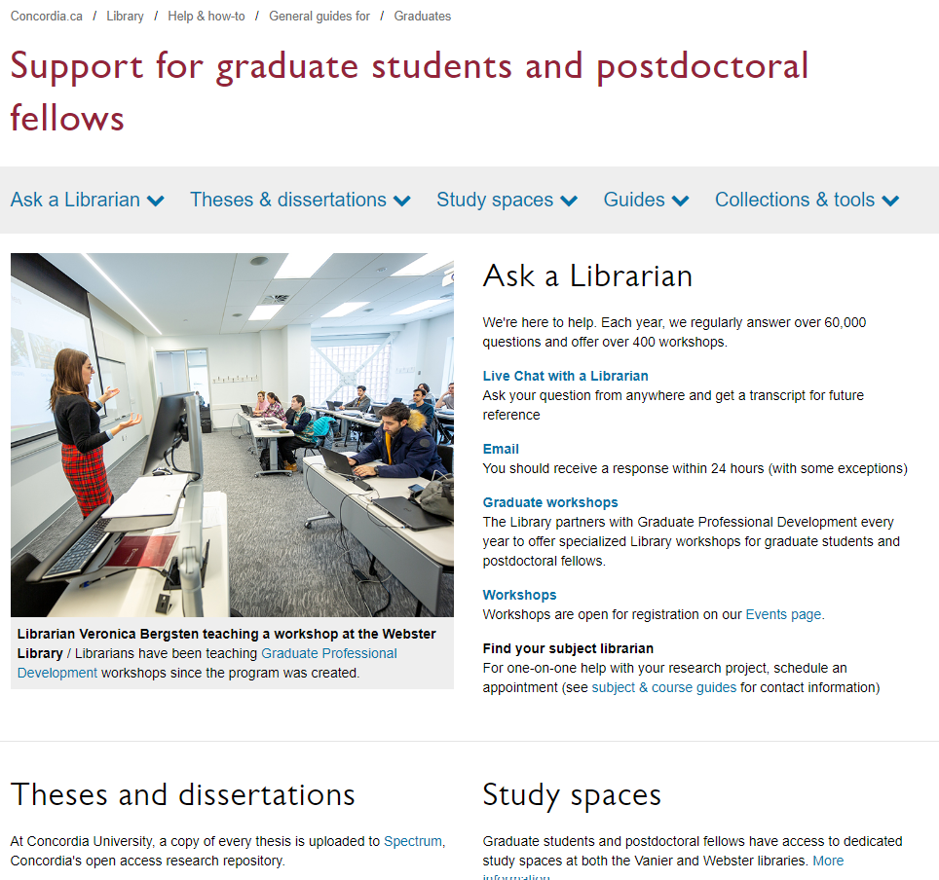
Services
Ask a Librarian
Interlibrary loans
Data visualization
Theses and dissertations (Copyright guide for Thesis preparation, Spectrum Research Repository)
Dedicated study spaces (with small lockers, shelves, kitchenette)
Researcher support: ORCID Id, research data management
Guides for finding an array of different material
Technology Sandbox
https://library.concordia.ca/help/users/graduates/

Slide 7
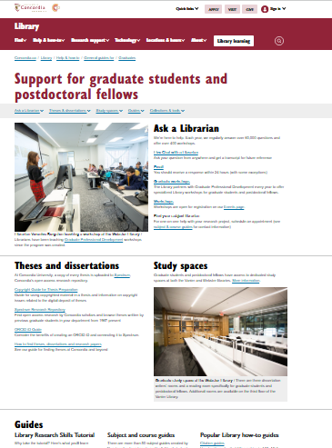
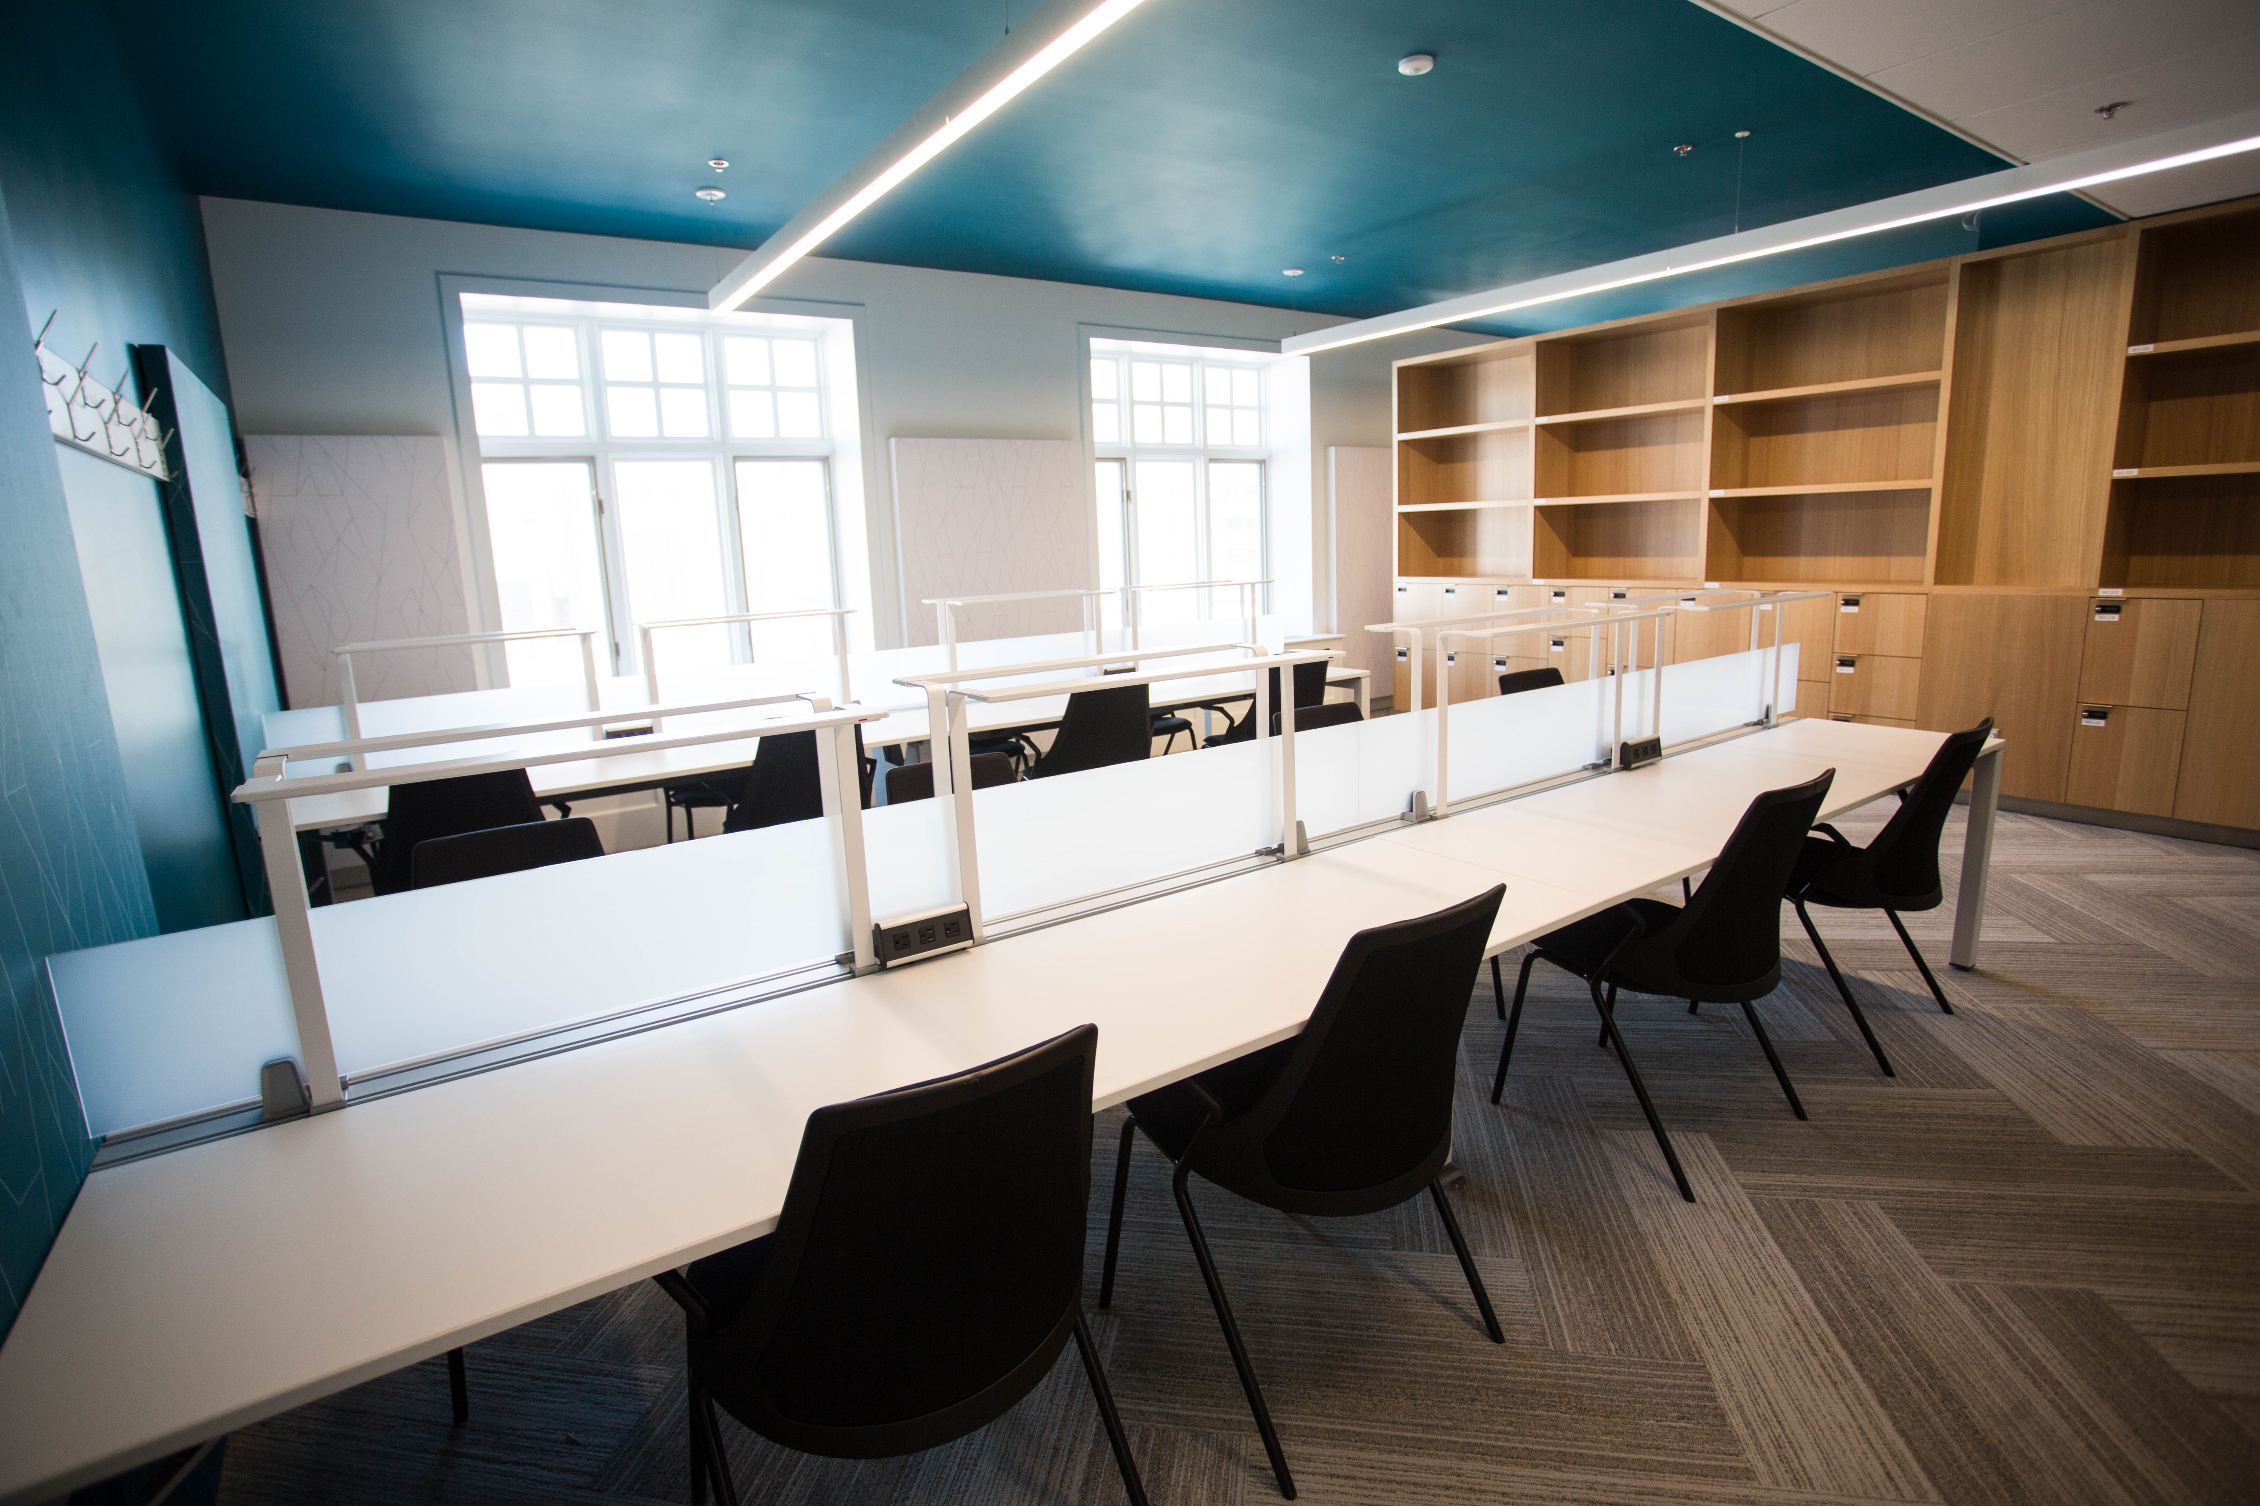
For graduate students https://library.concordia.ca/help/users/graduates/

Slide 8

Contact the library if you need help
https://library.concordia.ca/help/questions/

Slide 9
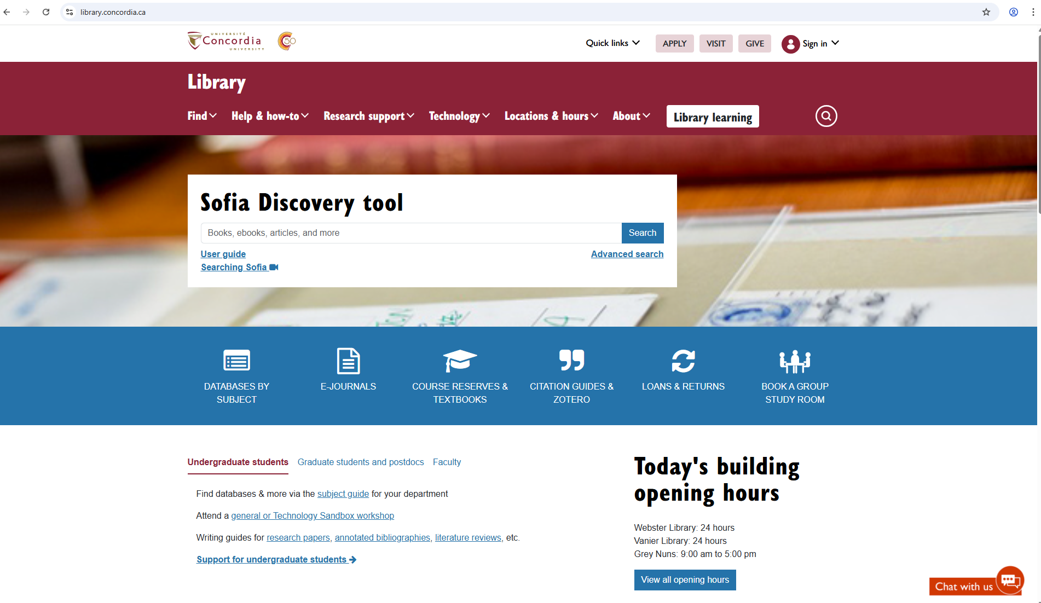
The Library website, library.concordia.ca, is the key access point to the collection.
The Collection has print books/ ebooks, articles, journals/ejournals, databases, films, art books, plays, theatre, newspapers, curated open access content, archives, theses, government and legal information, images, maps, geospatial data, encyclopedias, handbooks, policy and grey literature, …
What we don’t have? You can request via interlibrary loans.
https://library.concordia.ca/find/

Slide 10
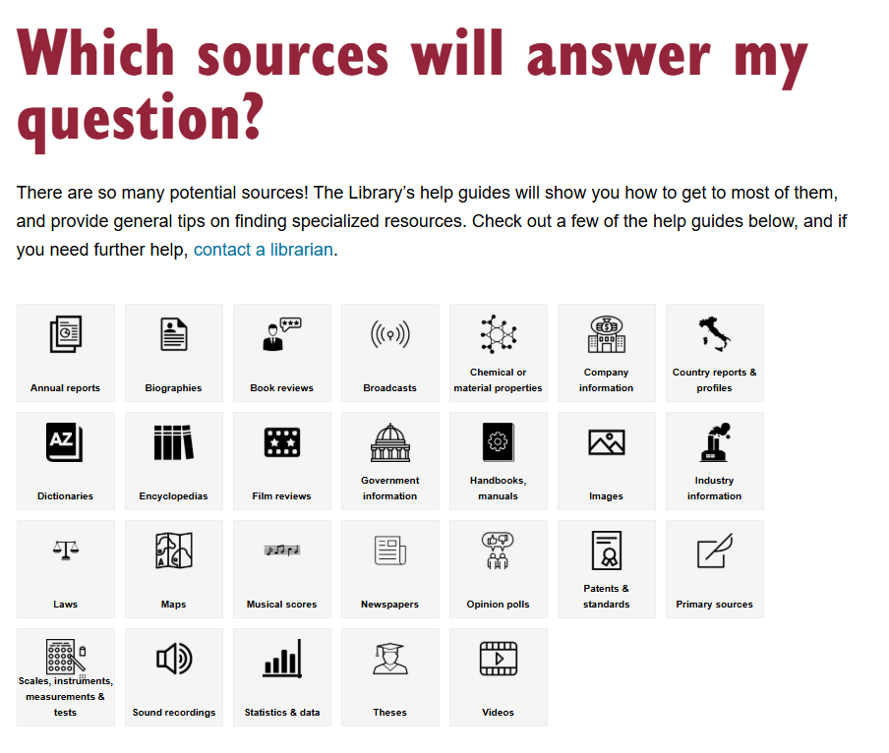
Resources
You have access to everything in the Library
Sofia, the Library Discovery tool
Databases
Special Collections
Learn with the Library (online learning modules)
Help and How to guides
Citation guides
https://library.concordia.ca/learn/finding-other-sources/which-sources/

Slide 11

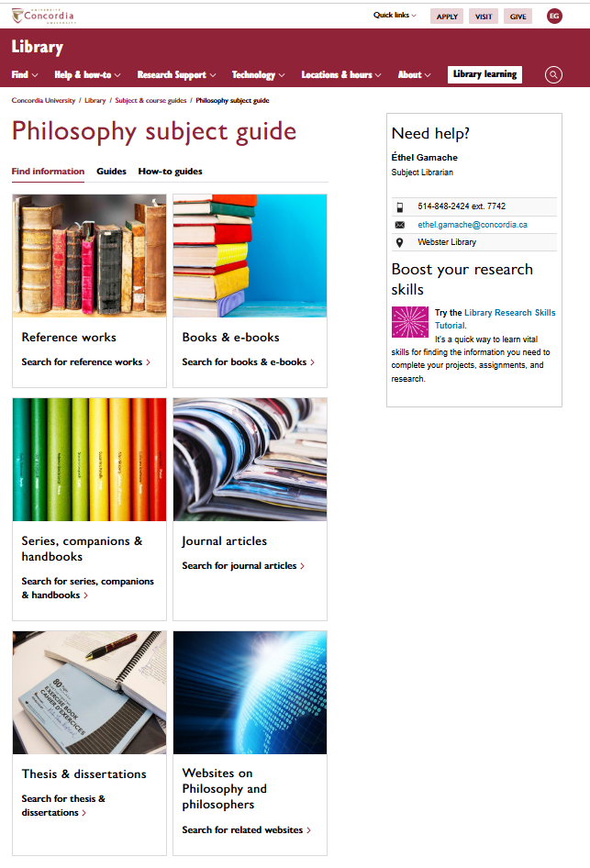
https://www.concordia.ca/library/guides/philosophy.html

Slide 12
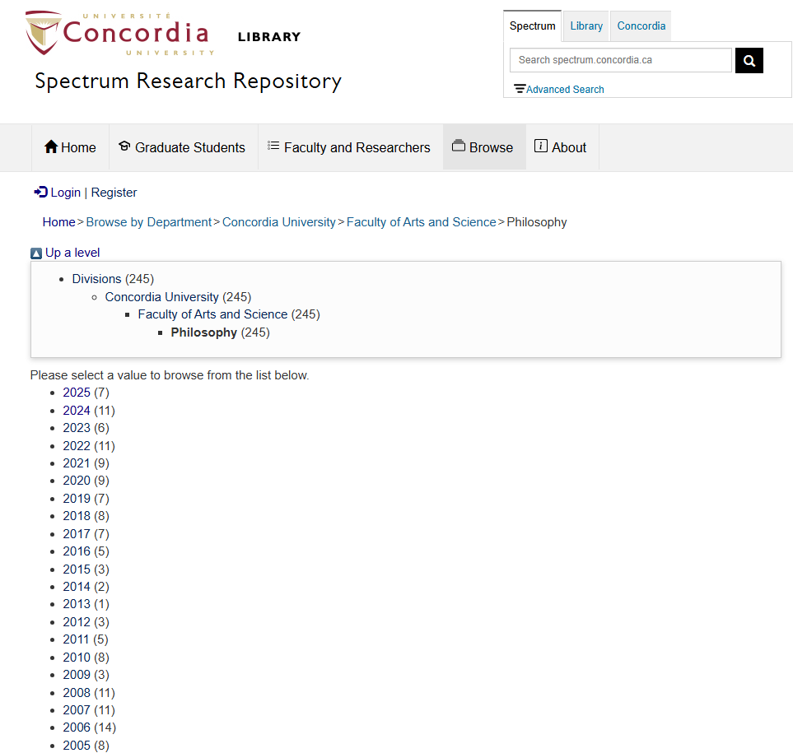
Spectrum https://spectrum.library.concordia.ca/

Slide 13
Activity
Talk to your neighbour about your thesis, research project or a specific interest in philosophy.
Discuss 3 keywords that describe it.

Slide 14
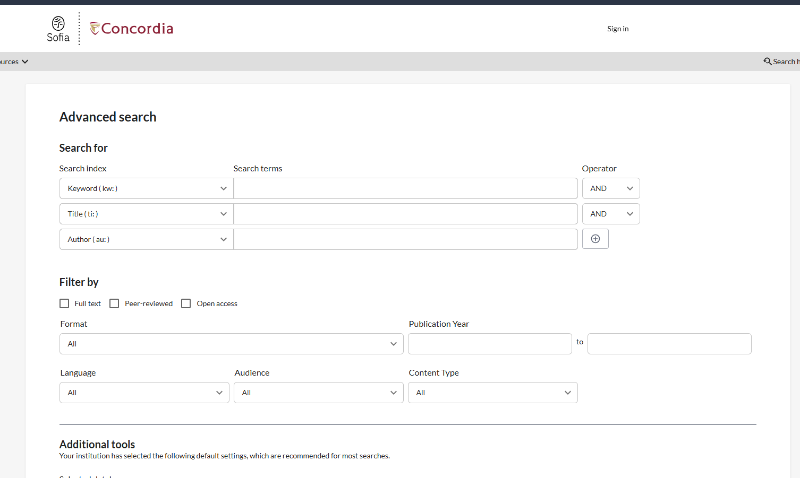
Use the Sofia Discovery Tool to explore the collections.
https://concordiauniversity.on.worldcat.org/discovery

Slide 15
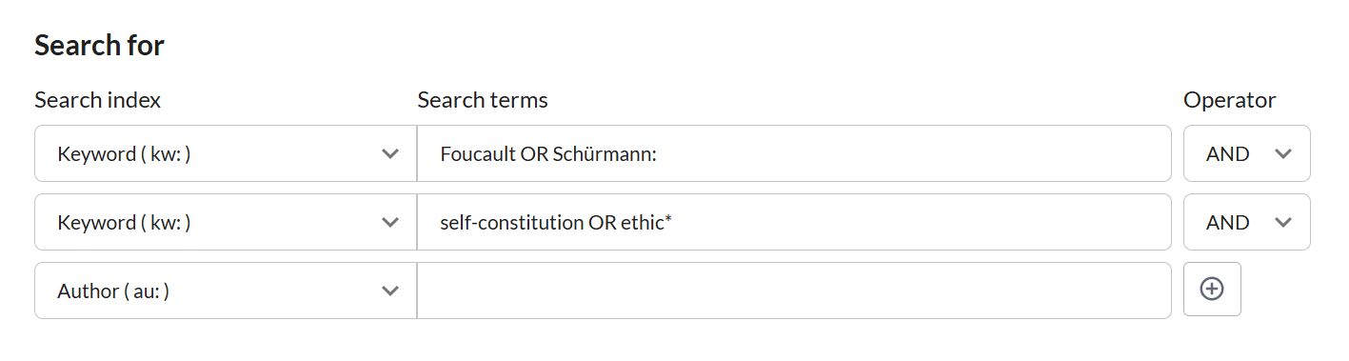
What is this research equation looking for?
Link to the results

Slide 16
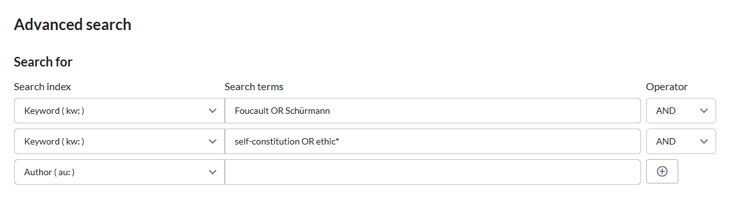
What is this research equation looking for?
Link to the results

Slide 17
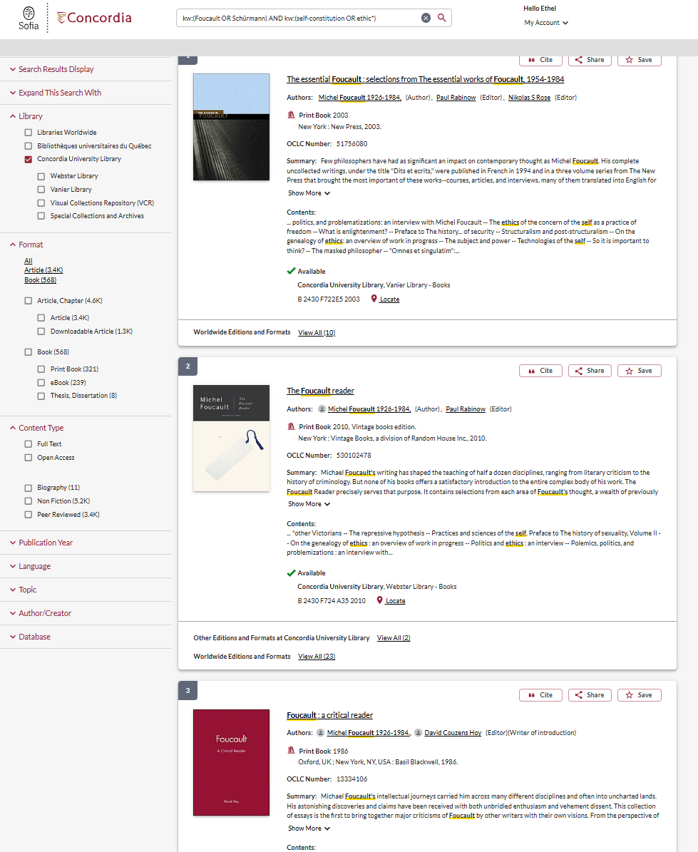
Let’s explore Sofia - demonstration

Slide 18
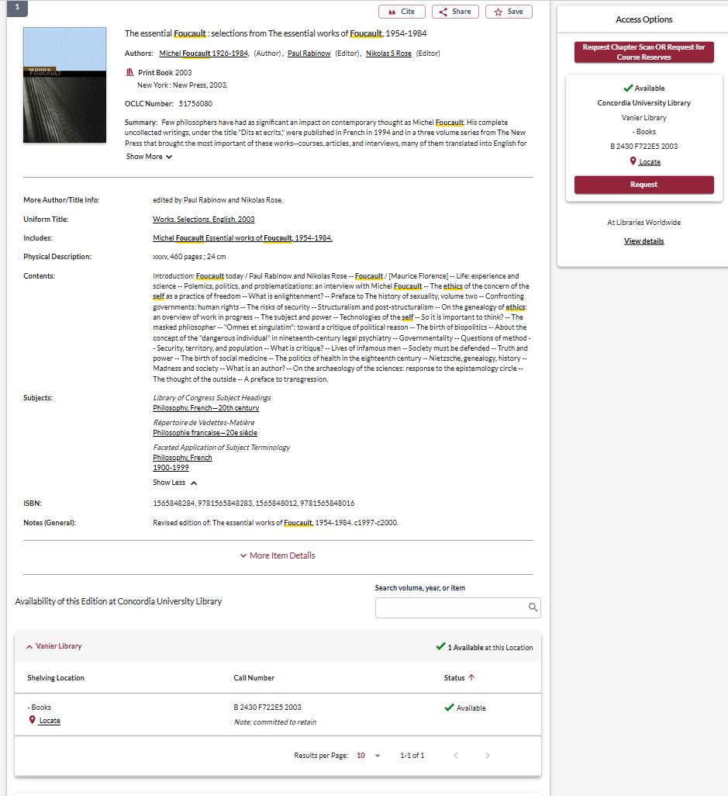
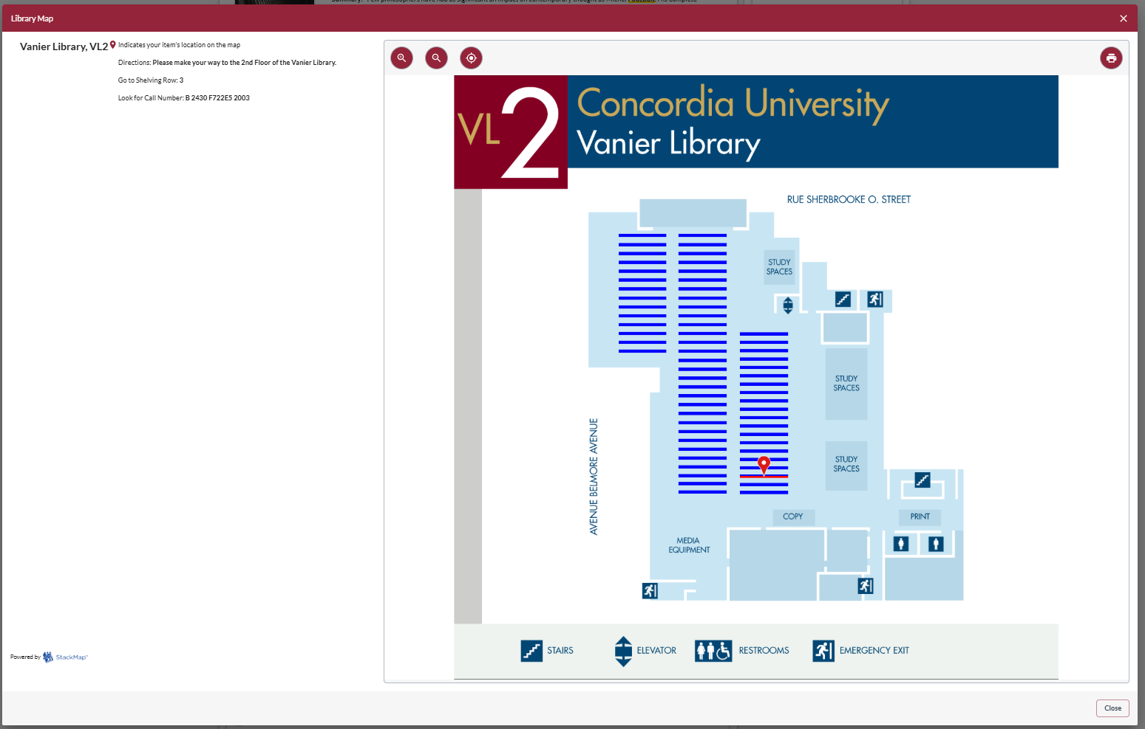

Slide 19
More books and ebooks
E-book Collections
Cambridge Companions Complete Collection
Oxford Scholarship Online
Past Masters (InteLex)
More e-books
Series, Companions & Handbooks
Cambridge Companions Complete Collection
No-Nonsense Guides
Routledge Key Guides
Continuum Guides for the Perplexed
Starting With...
Cambridge Critical guides
Blackwell Companions to Philosophy
Very Short Introduction
Oxford Companion to...
Oxford Handbooks of...
Critical Lives
Johns Hopkins Guide to Literary Theory and Criticism

Slide 20
Reference works
Stanford Encyclopedia of Philosophy
Oxford Reference Premium Online
Dictionary of Philosophical Terms and Names
Dictionary of Philosophy of Mind
Oxford English Dictionary
The Internet Encyclopedia of Philosophy - IEP
The Philosophical Lexicon

Slide 21

Requesting a document via Interlibrary loans (ILL)

Slide 22


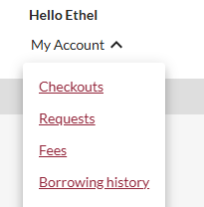
What is the new Interlibrary Loans (ILL) service?
ILL requests are made directly in the Sofia Discovery tool:
“Request via Interlibrary Loan” button
Form available under the “Requests” tab in "My Account".

Slide 23

Concordia article/chapter scan & deliver service
Book chapter and journal article scans from Concordia’s print collection can now be requested and tracked in Sofia.
Look for the “Chapter Scan” button in the Access Options panel.

Slide 24

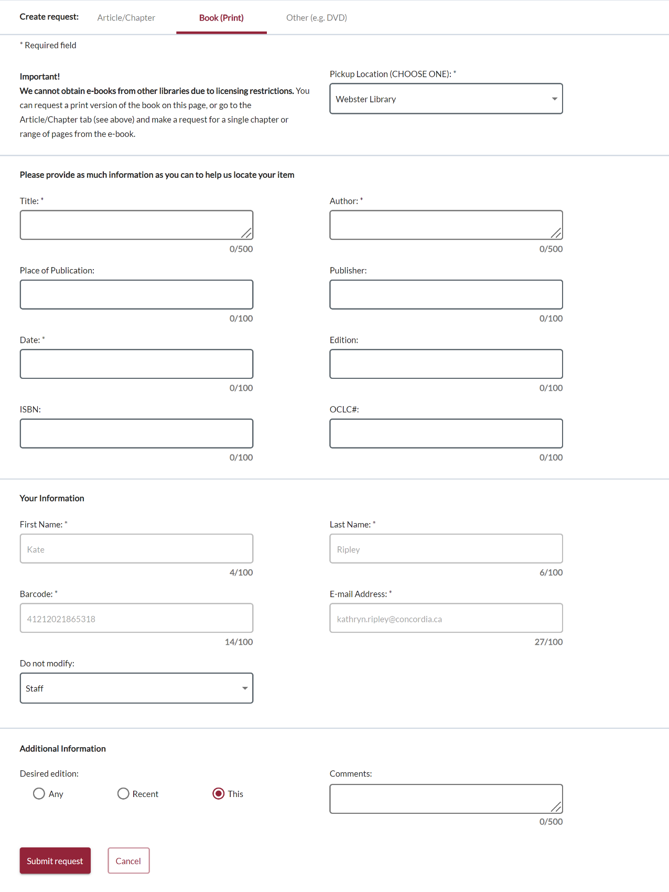
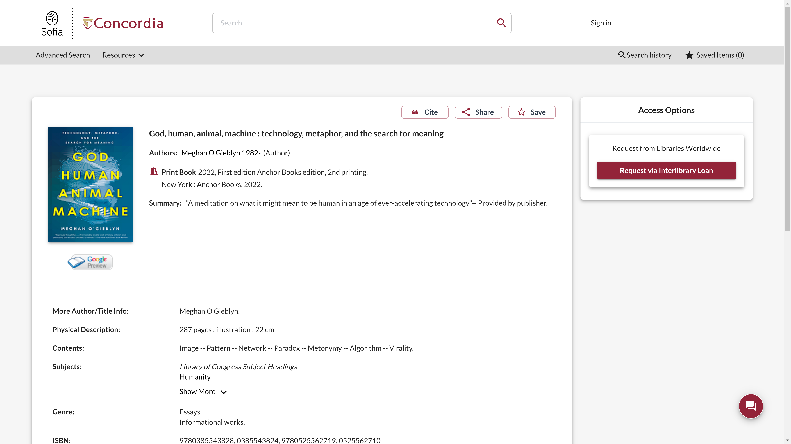
Sofia Discovery Tool request via Interlibrary loan

Slide 25
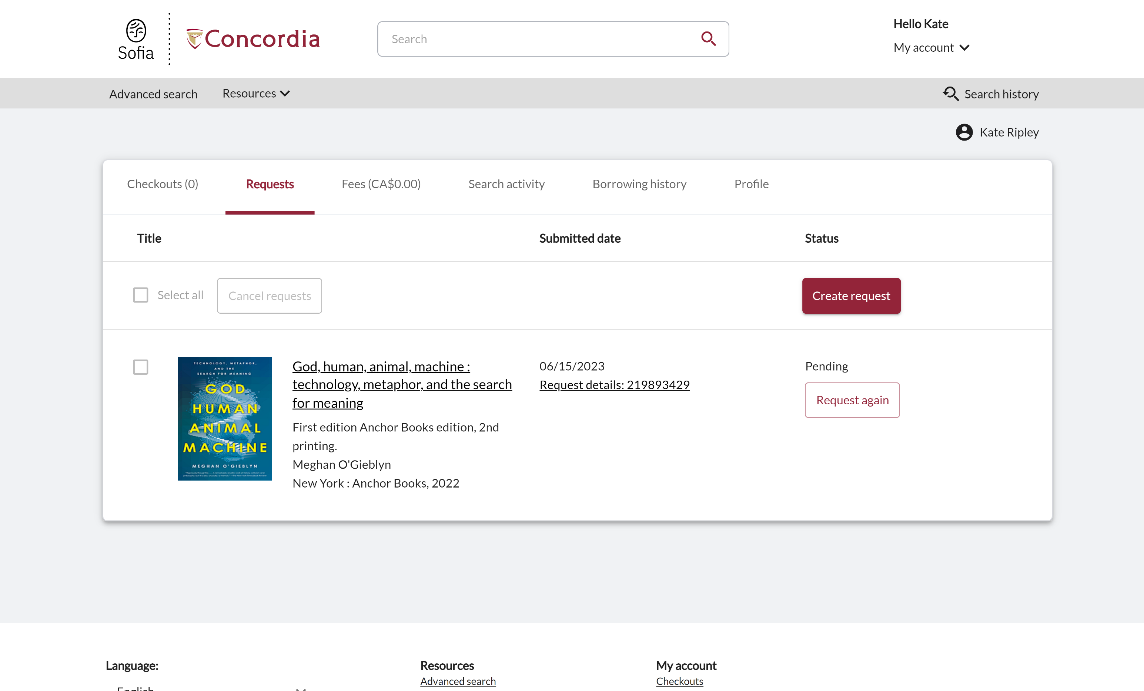
Check the status of your request under the "Requests" tab.

Slide 26
About
Interlibrary loan
You will receive email notifications when your ILL request is available for pickup or download.
Physical items can be picked up at the Circulation/Loans desks at either Vanier or Webster Library.
ILL requests can be borrowed for 30 days, with up to 4 automatic renewals, or until item is recalled.

Slide 27

The peer-review process
-
Being a part of the scholarly conversation

Slide 28
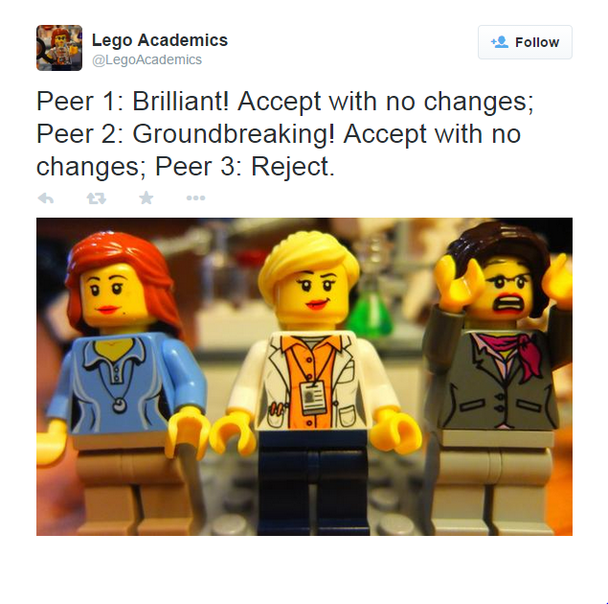
The peer-review process
Image source:
Yates, D. [@LegoAcademics]. (2014, August 12). Peer 1: Brillant! Accept with no changes; Peer 2: Groundbreaking! Accept with no changes; Peer 3: Reject. [Tweet]. Twitter. https://twitter.com/LegoAcademics/status/499205005468262400/photo/1

Slide 29
Databases – for scholarly articles and more
Disciplinary: Philosophy
PhilPapers: Online Research in Philosophy
Année philologique
Arts & Humanities Database (ProQuest)
Thesaurus Linguae Graecae (TLG)
Multidisciplinary (within the Humanities and more)
Academic Search Complete (EBSCO)
JSTOR
Google scholar

Slide 30

Let’s explore
PhilPapers: Online Research in Philosophy
Academic Search Complete (EBSCO)

Slide 31
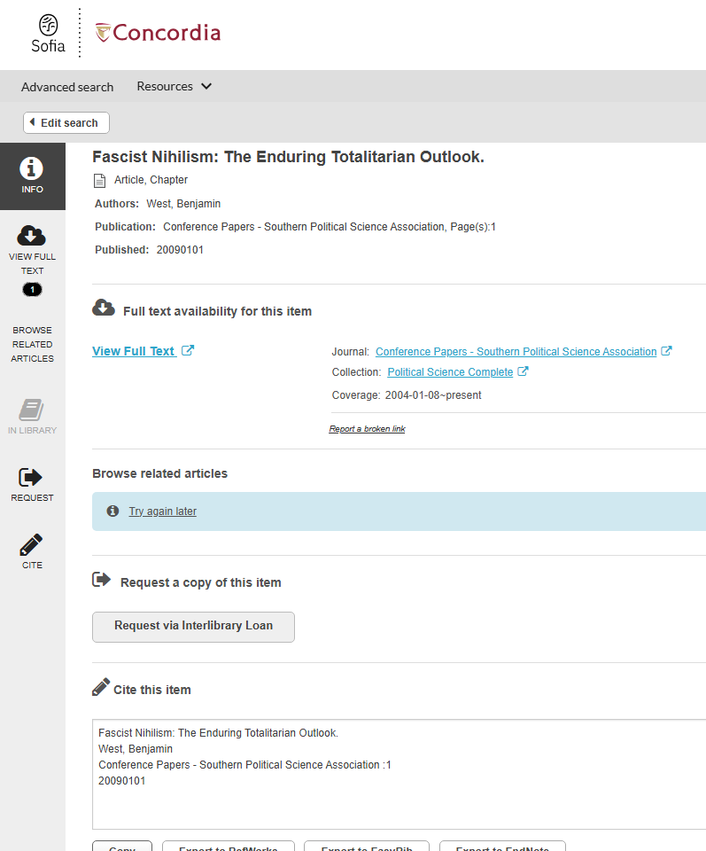
Link resolver – Find it @Concordia

Slide 32

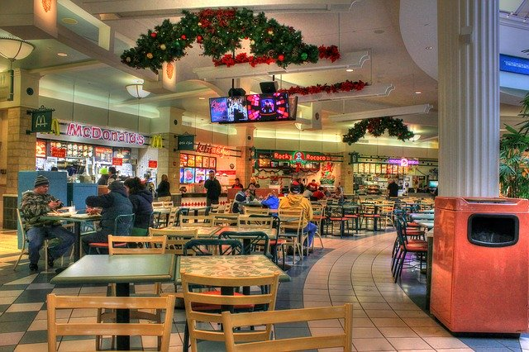

On using Google Scholar
Google scholar
Library databases
Volume | Quantity | Quick
Depth | Quality | Thorough
Left image: Yinan Chen, Dining Court, public domain, https://pixabay.com/photos/dining-court-shopping-mall-corridor-347314/
Right image: Jason Briscoe, Cooking, public domain, https://unsplash.com/photos/VBsG1VOgLIU

Slide 33
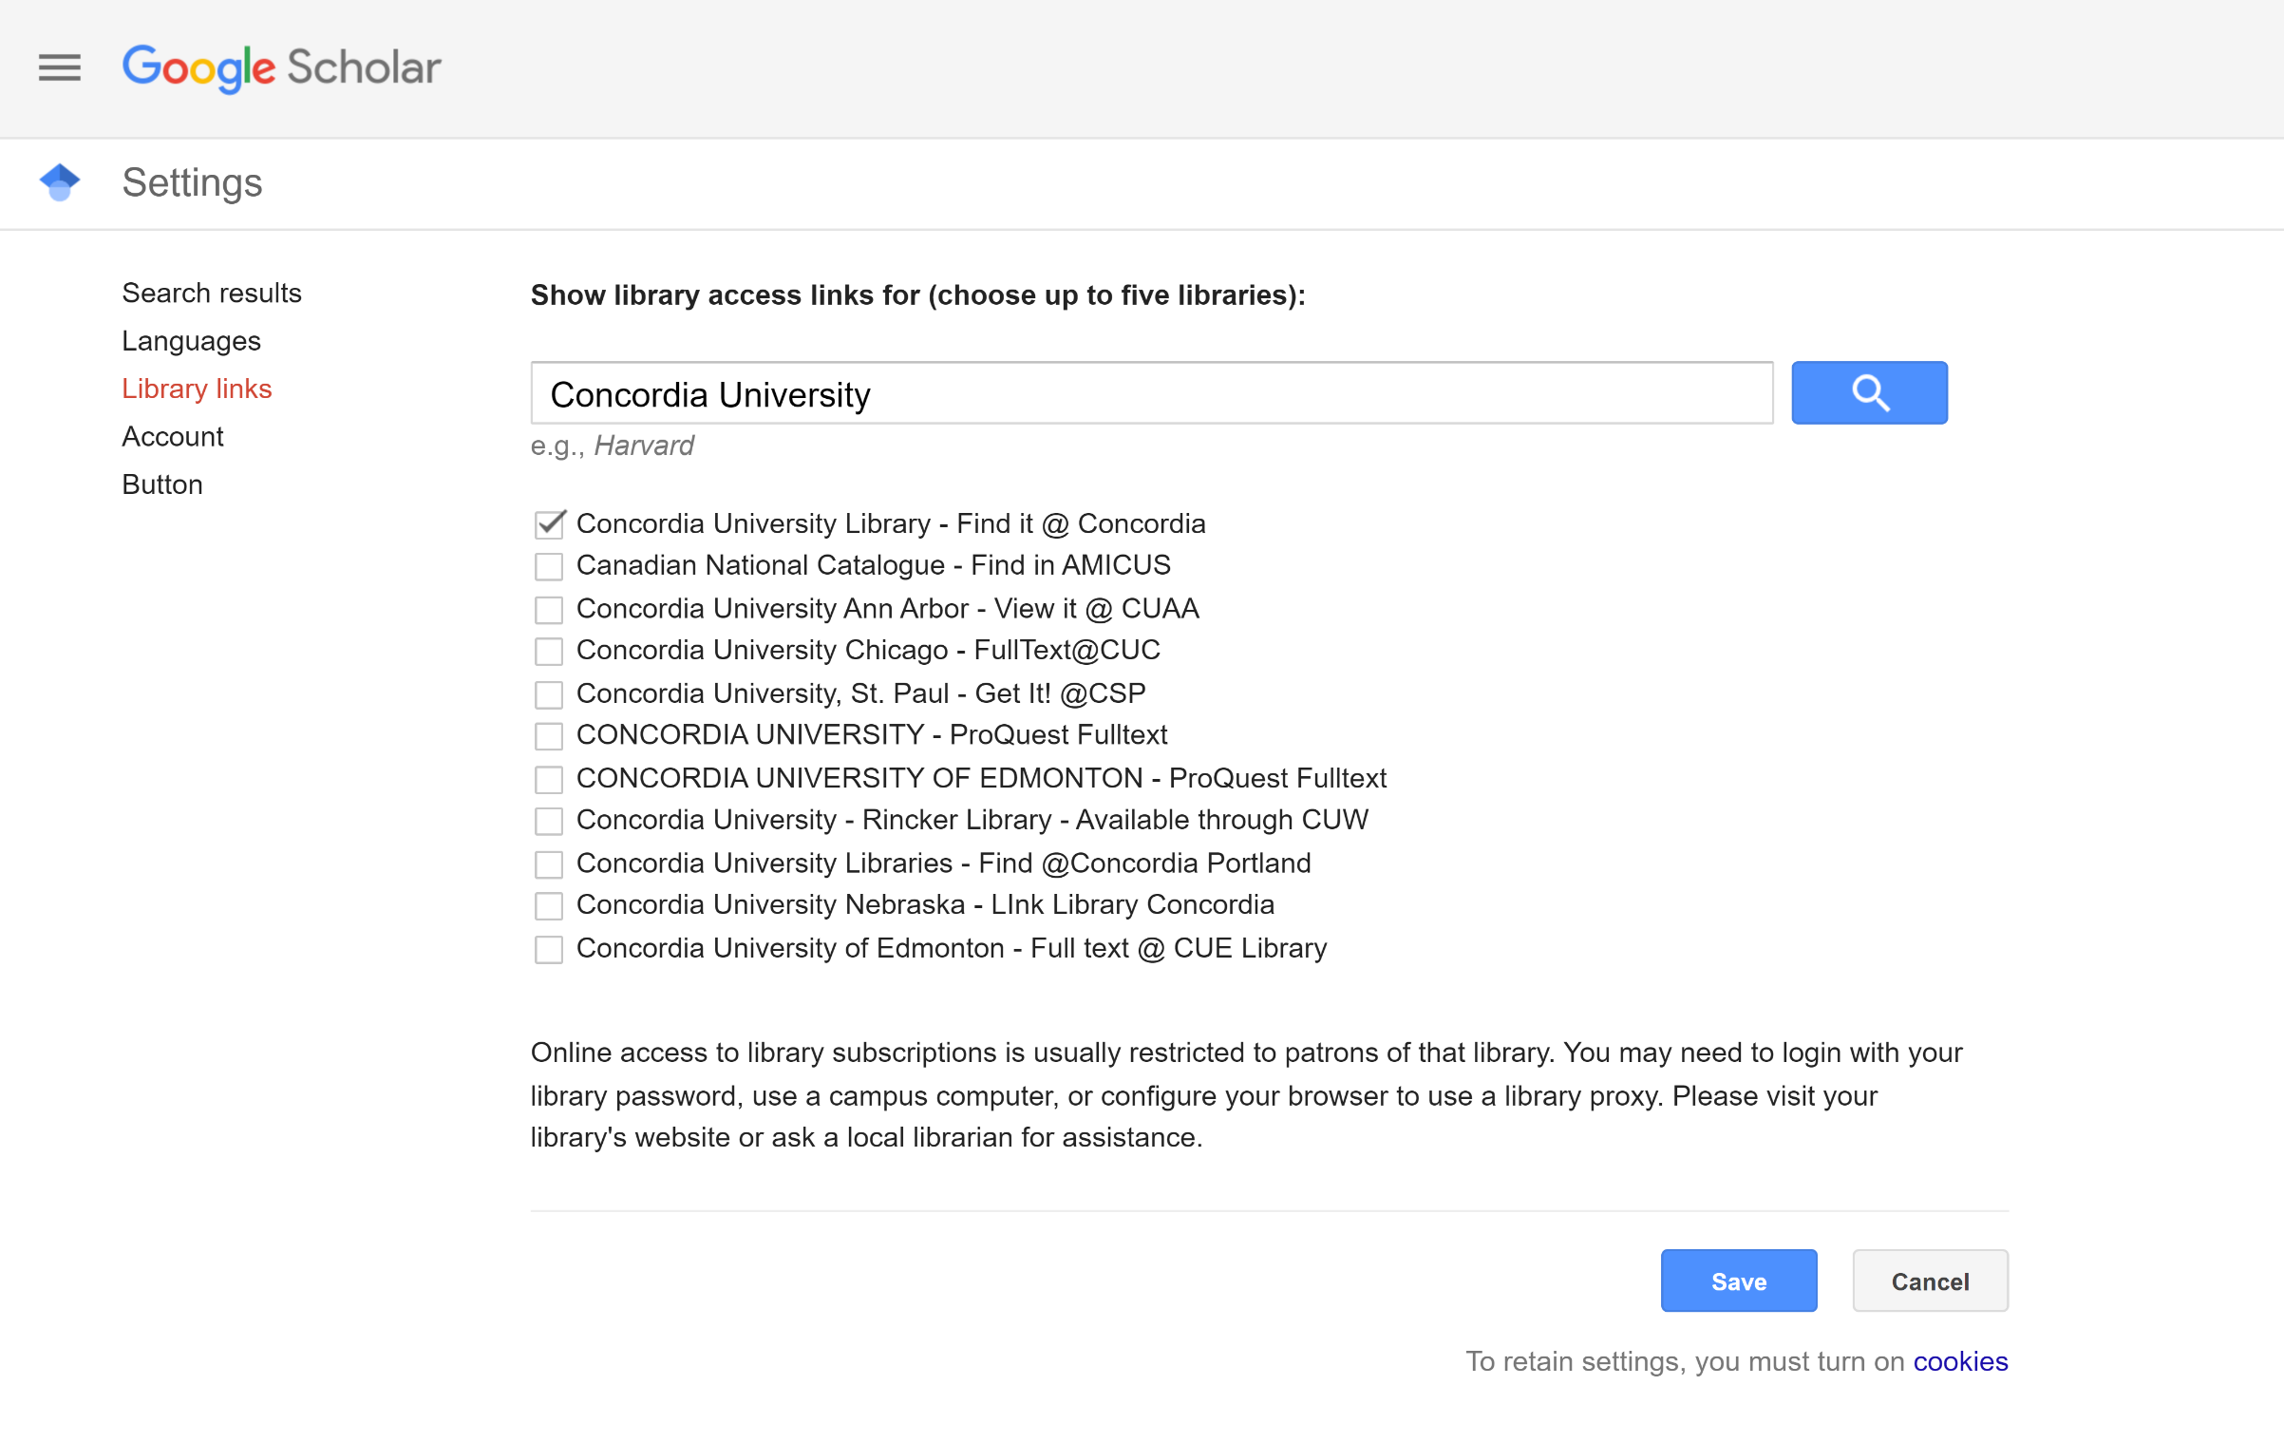
Google Scholar – select a library access link

Slide 34

Citing, bibliographies and Zotero

Slide 35
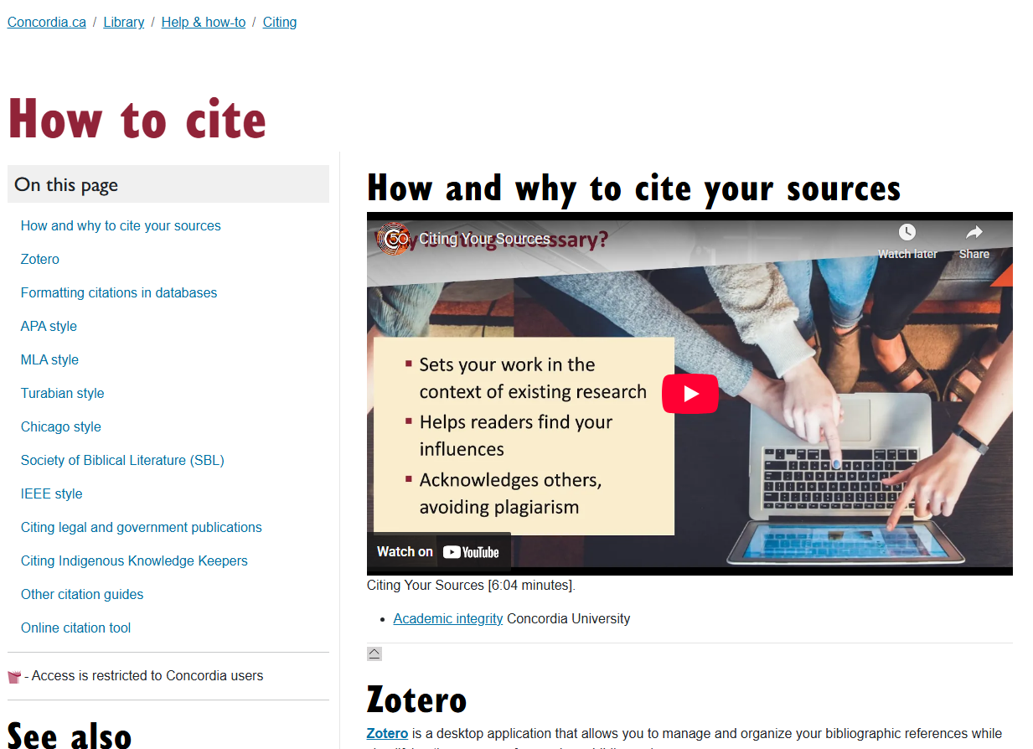
Citing https://library.concordia.ca/help/citing/

Slide 36
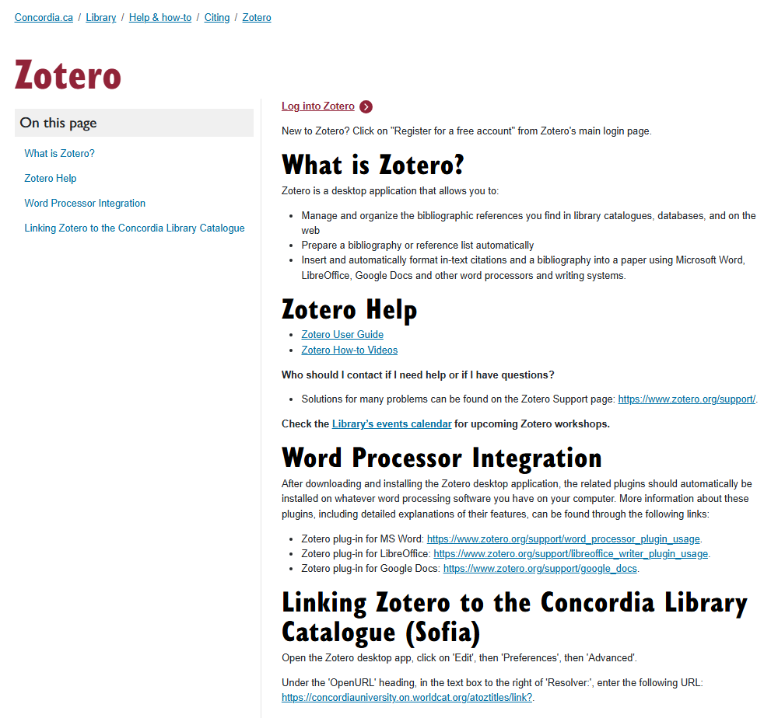
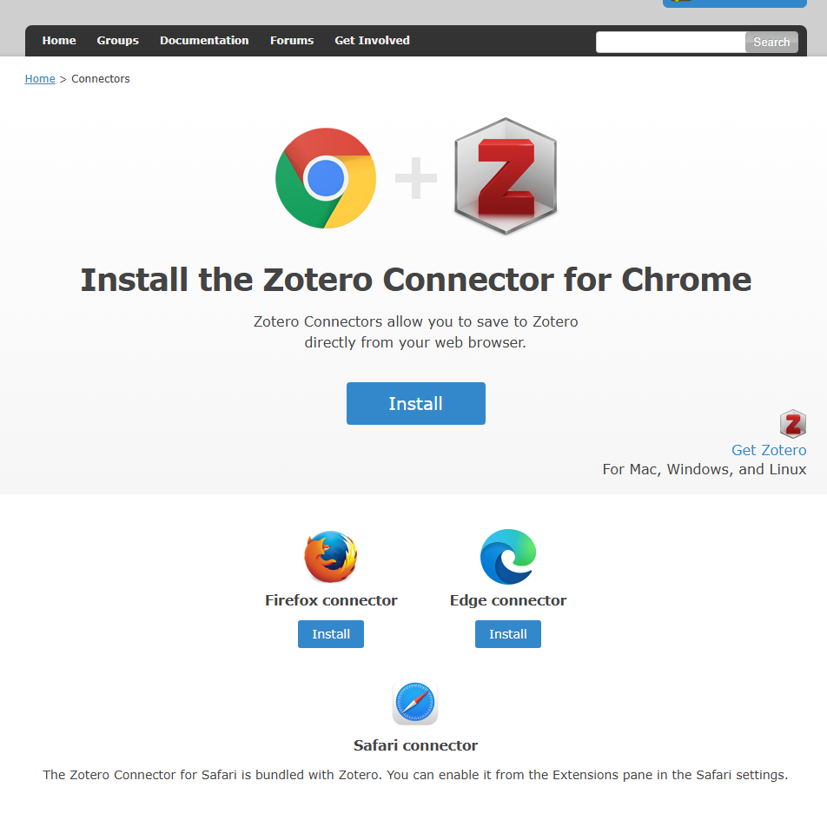
Zotero – to manage your bibliographic references https://library.concordia.ca/help/citing/zotero/

Slide 37

Evaluating resources

Slide 38
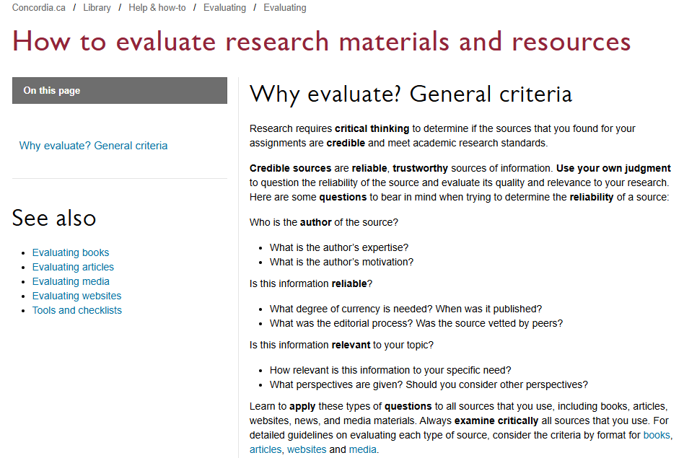
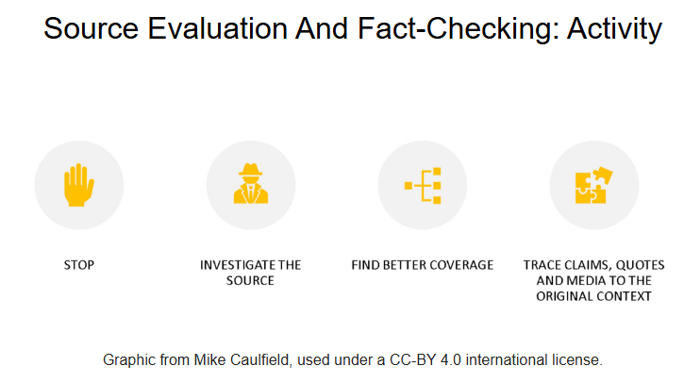
Evaluating resources
https://library.concordia.ca/help/evaluating/evaluating.php
https://library.concordia.ca/apps/critical-toolkit/course.html?courseID=27406

Slide 39
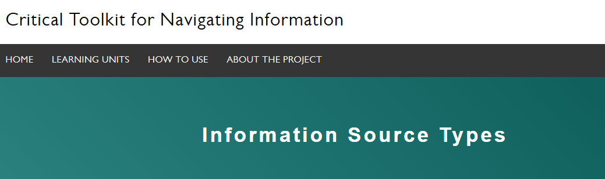
Activity (self-standing module)
https://library.concordia.ca/apps/critical-toolkit/course.html?courseID=27594
Notes:
https://library.concordia.ca/apps/critical-toolkit/course.html?courseID=27594

Slide 40

Key take-aways

Slide 41


You are welcome at the library.

Slide 42
Contact the library if you need help – we are here for you.
https://library.concordia.ca/help/questions/

Slide 43

Questions?
Discussion points?

Slide 44
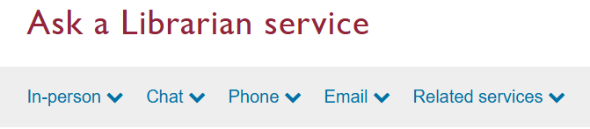
Thank you for your participation!
Please don’t hesitate to contact me.
Your librarian:
Éthel Gamache
ethel.gamache@concordia.ca
https://library.concordia.ca/help/questions/

