Slide 1
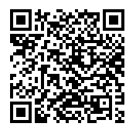
Éthel Gamache, Librarian | ethel.gamache@concordia.ca
Philosophy MA Student Orientation
LIBRARY PRESENTATION
Welcome!

Slide 2
HOW TO FIND AND ACCESS RESOURCES NAVIGATING THE LIBRARY WEBSITE

Slide 3
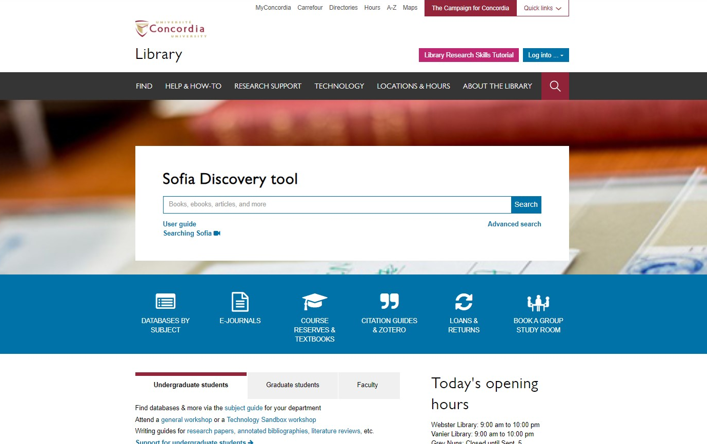
Concordia Library Website
library.concordia.ca

Slide 4
Concordia Library Website “FIND” dropdown menu
library.concordia.ca

Slide 5
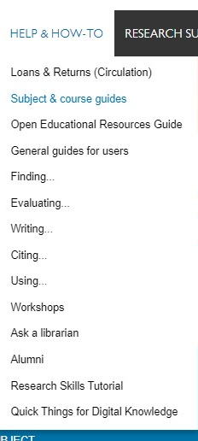
Concordia Library “Help & How To” dropdown menu
library.concordia.ca

Slide 6
HOW TO FIND AND ACCESS RESOURCES YOUR SUBJECT GUIDE

Slide 7
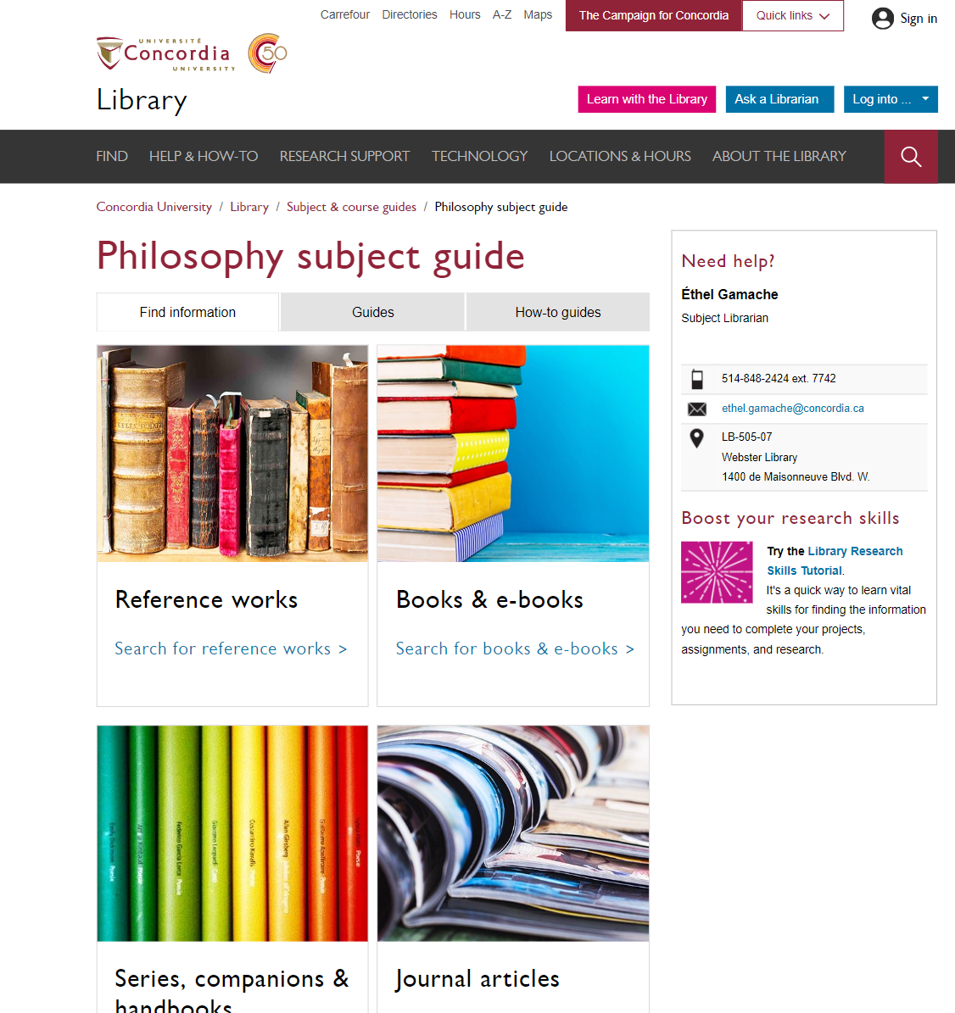
Religions and Cultures Subject Guides

Slide 8
SUPPORT FOR GRADUATE STUDENTS

Slide 9
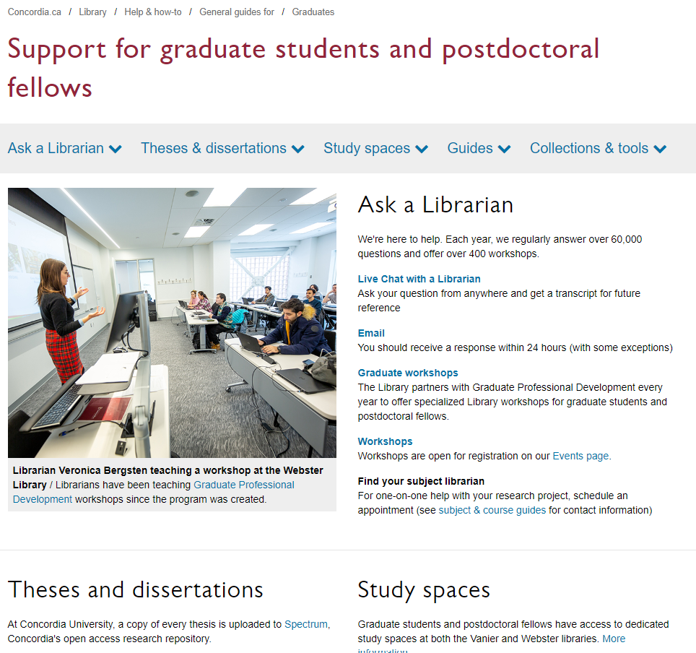
Services
Ask a Librarian
Interlibrary loans
Data visualization
Theses and dissertations (Copyright guide for Thesis preparation, Spectrum Research Repository)
Dedicated study spaces (with small lockers, shelves, kitchenette)
Researcher support: ORCID Id, research data management
Guides for finding an array of different material
Technology Sandbox
https://library.concordia.ca/help/users/graduates/

Slide 10
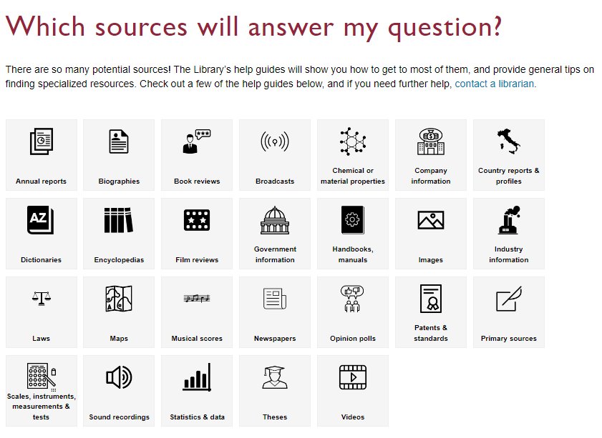
Resources - You have access to everything in the Library
Sofia, the Library Discovery tool
Databases (Philosopher’s Index, PhilPapers, Academic Search Complete, JSTOR, Oxford Handbooks Online, Arts & Humanities Database, DOAJ Free Journals, Google Scholar, …)
Special Collections
Learn with the Library (online learning modules)
Help and How to guides
Citation guides

Slide 11
You do have access to many resources!

Slide 12
The Library is there to support you with your research too.

Slide 13
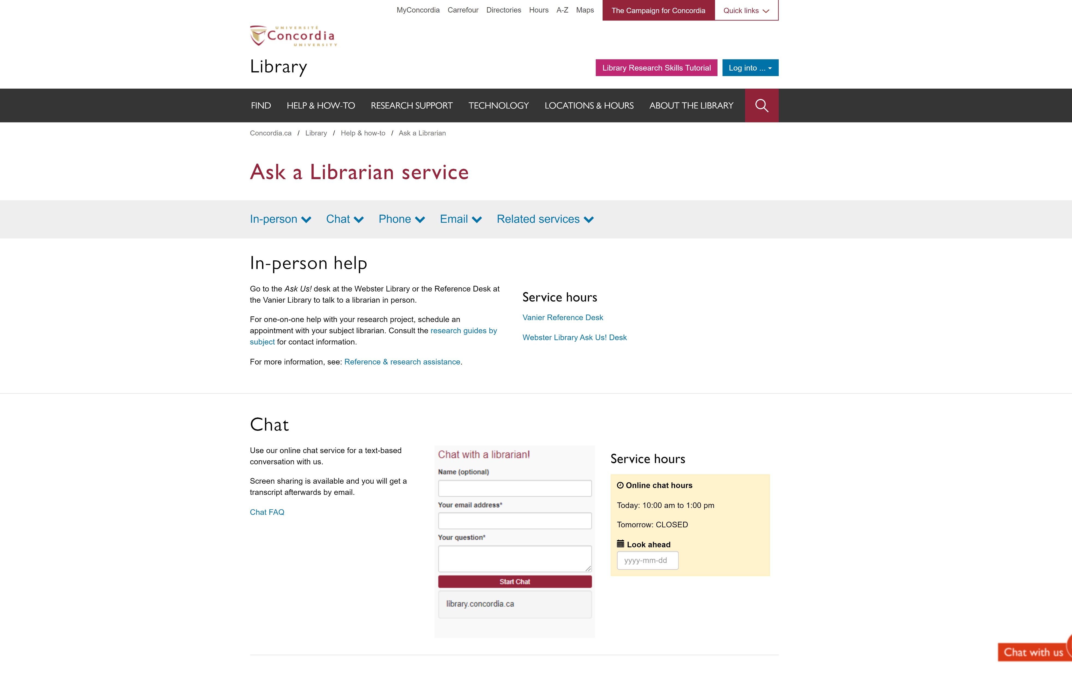
Concordia Library Website – Ask a Librarian

Slide 14
The Library is yours!
ÉTHEL GAMACHE
ethel.gamache@concordia.ca

Slide 15
HOW TO FIND AND ACCESS RESOURCES USING SOFIA, THE DISCOVERY TOOL

Slide 16
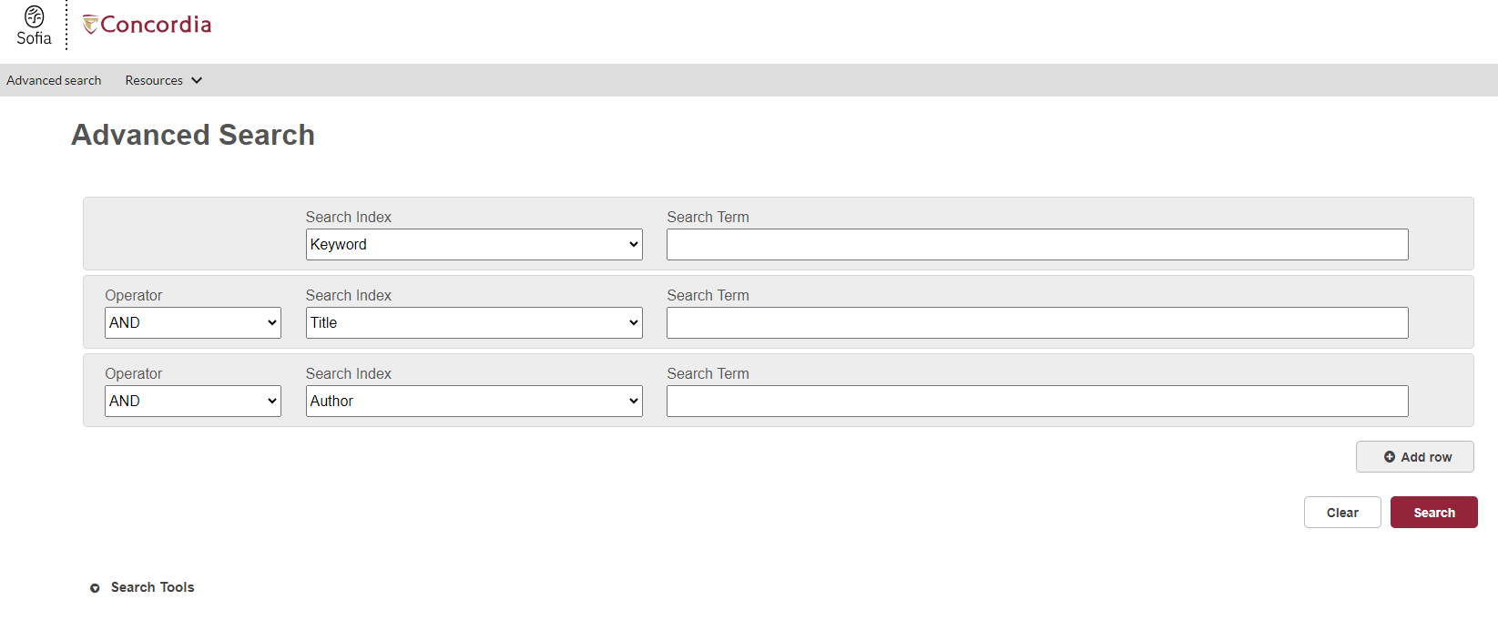
Sofia Discovery Took Advanced Search

Slide 17
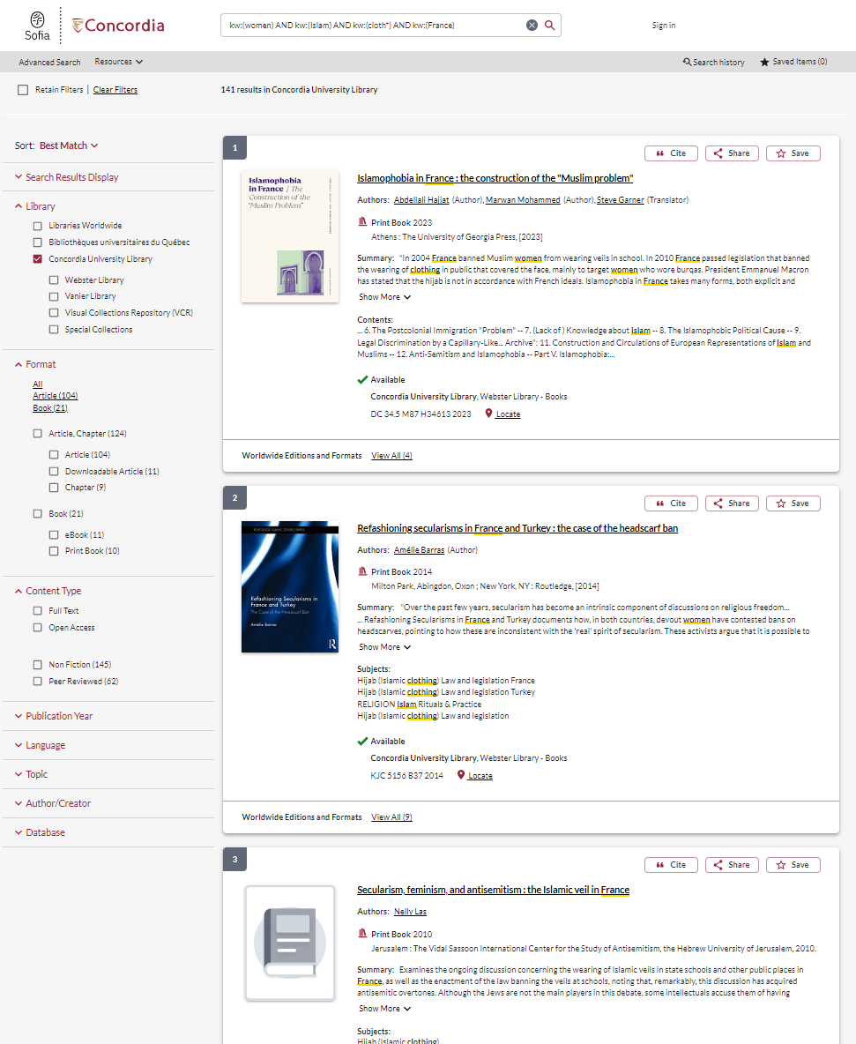
Sofia Discovery Tool search limiters

Slide 18
If you have any difficulty finding a document, reach out!

Slide 19
USING INTERLIBRARY LOAN WITHIN SOFIA

Slide 20
What is the new Interlibrary Loans (ILL) service?
ILL requests are made directly in the Sofia Discovery tool:
“Request via Interlibrary Loan” button
Form available under the “Requests” tab in "My Account".

Slide 21
Concordia article/chapter scan & deliver service
Book chapter and journal article scans from Concordia’s print collection can now be requested and tracked in Sofia.
Look for the “Chapter Scan” button in the Access Options panel.

Slide 22
REQUEST A BOOK VIA INTERLIBRARY LOAN
EXAMPLE

Slide 23
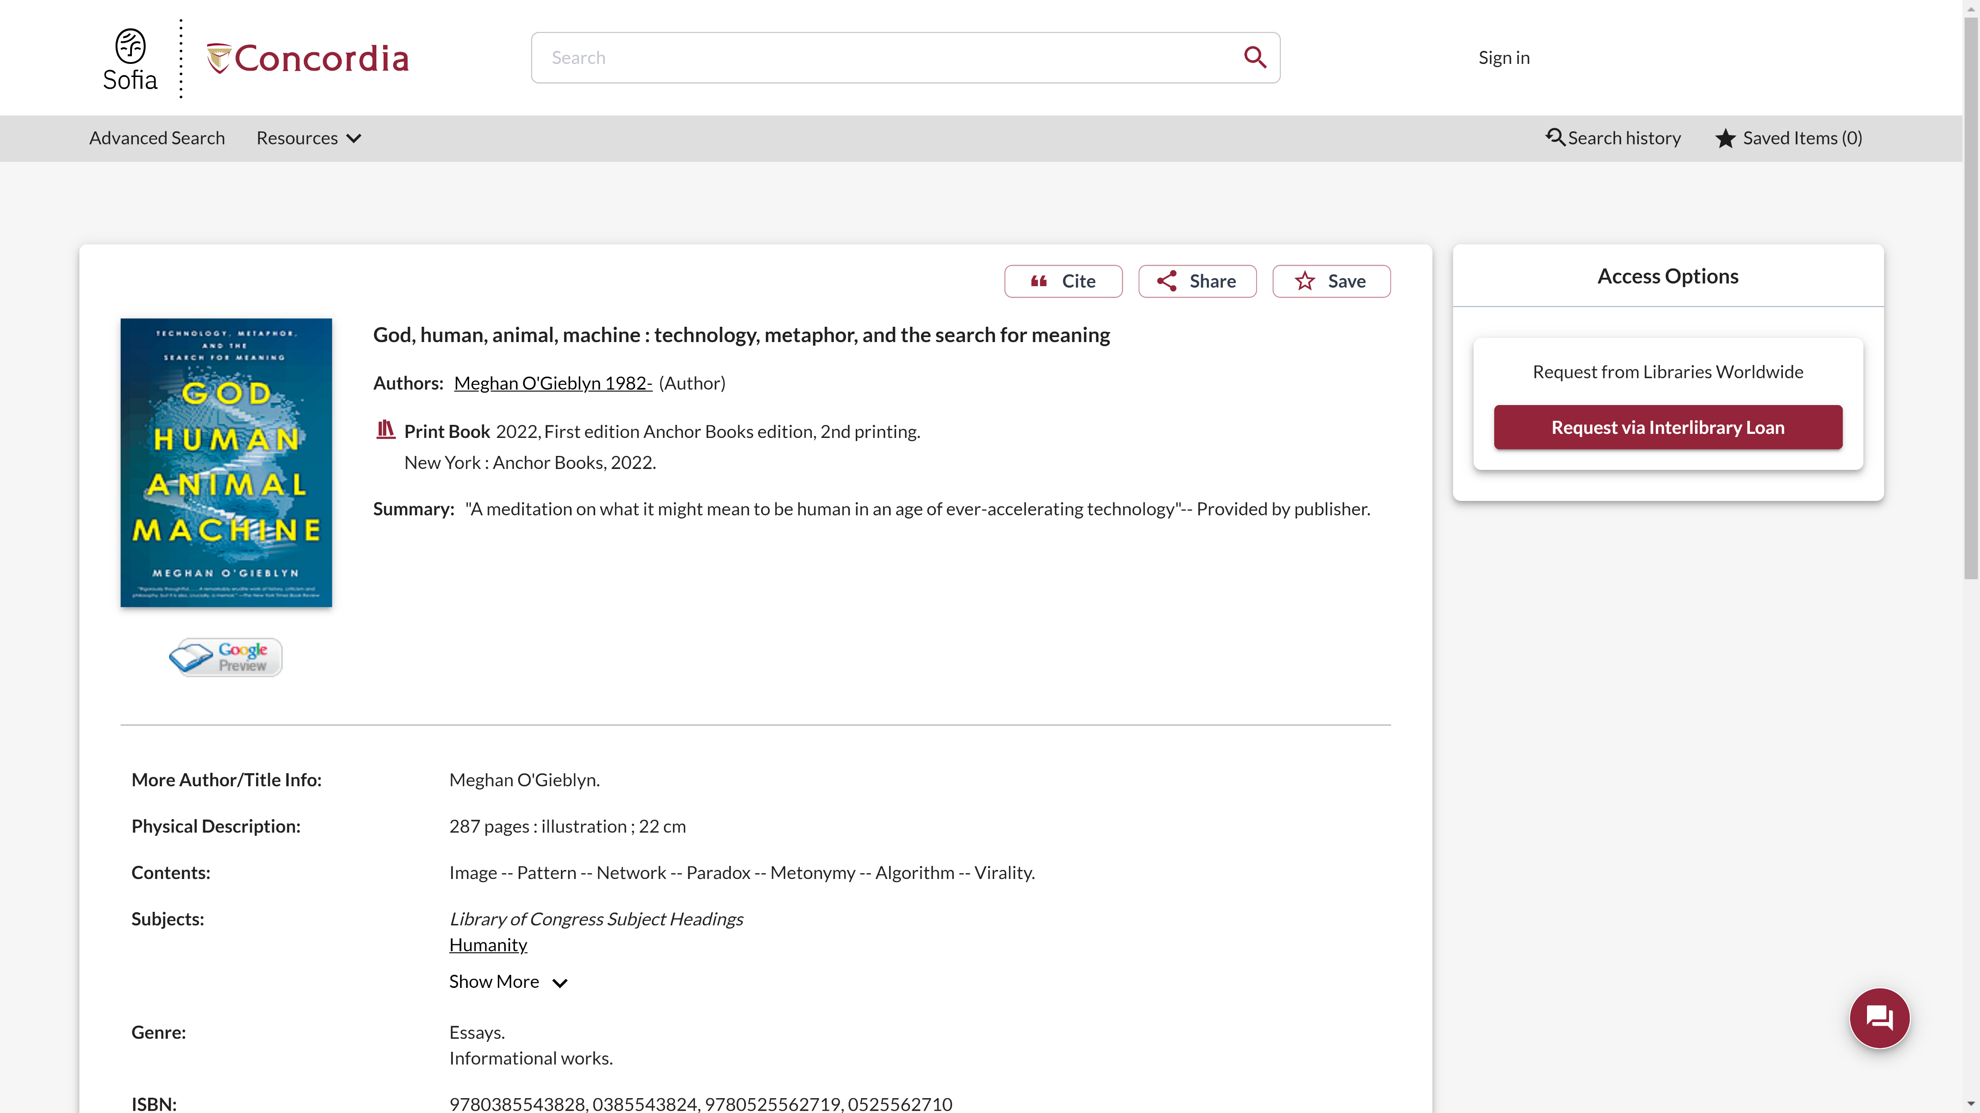
Sofia Discovery Tool request via Interlibrary loan

Slide 24
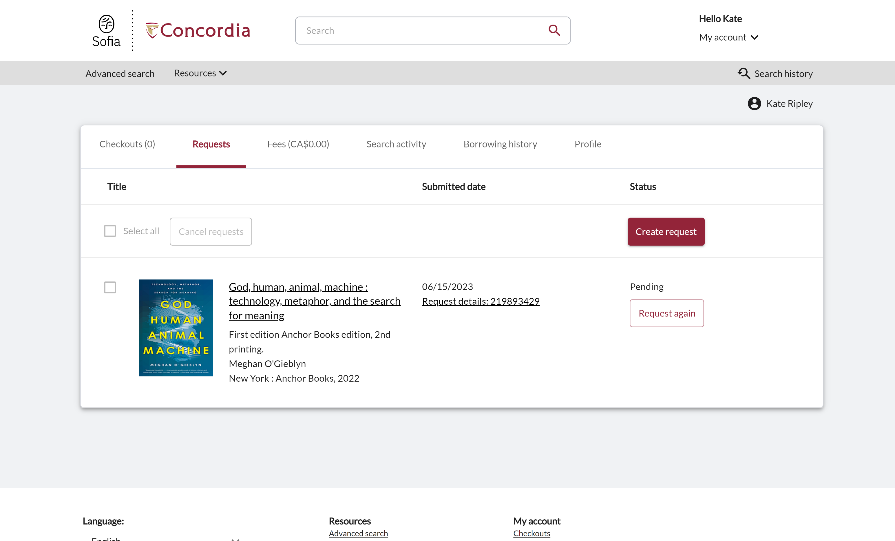
Check the status of your request under the "Requests" tab.

Slide 25
About Interlibrary loan
You will receive email notifications when your ILL request is available for pickup or download.
Physical items can be picked up at the Circulation/Loans desks at either Vanier or Webster Library.
ILL requests can be borrowed for 30 days, with up to 4 automatic renewals, or until item is recalled.

Slide 26
REQUEST A BOOK BLANK FORM
EXAMPLE

Slide 27
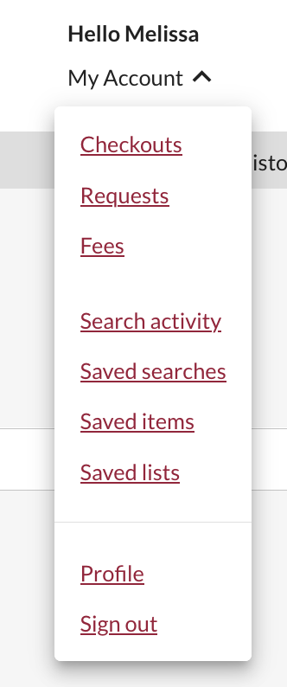
Create an Interlibrary Loan request
Sign in to "My Account" and select "Requests".
Click on "Create request".

Slide 28
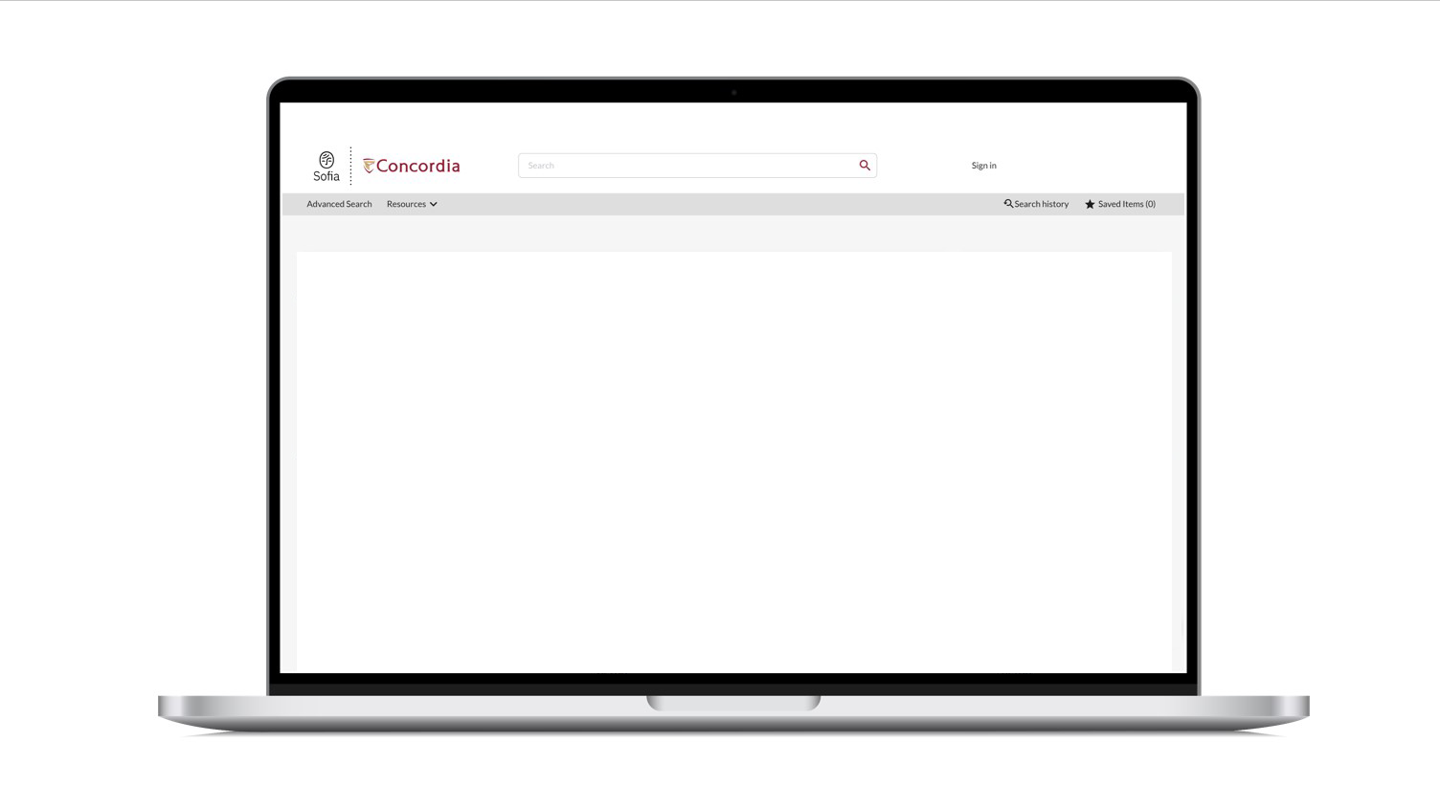
Sofia Discovery Tool – request a book form

Slide 29
SEARCHING FOR ARTICLES WITH GOOGLE SCHOLAR AND THE DATABASE ACADEMIC SEARCH COMPLETE

Slide 30
Where should you search?
Library Discovery Tool
Academic Search Complete
(Library Database)
Google Scholar
Eureka.cc
(Library Database)
Grey literature (e.g. government documents, NGO reports, working papers, newsletters, preprints)

Slide 31
HOW TO FIND AND ACCESS RESOURCES USING GOOGLE SCHOLAR

Slide 32
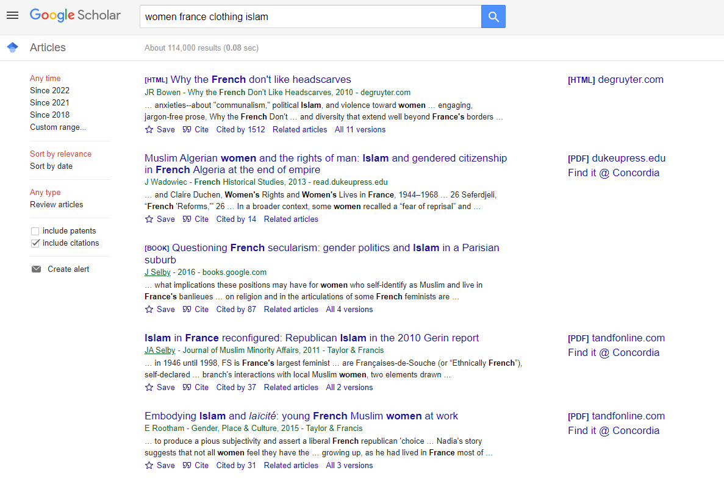
Searching in Google Scholar

Slide 33
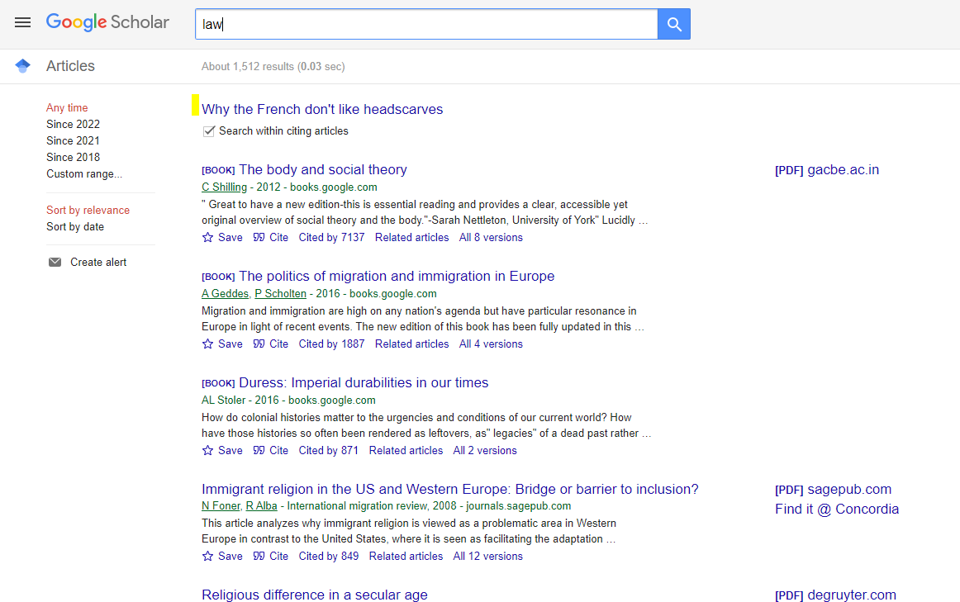
Google Scholar – Searching within a search result

Slide 34
Google Scholar – select a library access link

Slide 35
Concordia Library Website – Ask a Librarian

