Slide 1

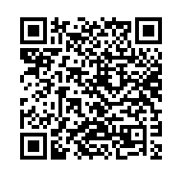
PHIL 236 /2 Environmental Ethics
LIBRARY WORKSHOP
Éthel Gamache ethel.gamache@concordia.ca
Presentation and Resources handout available here:

Slide 2
Objective - locating reviewed journal articles
Plan
Search strategies
Introduction to the Library website & subject guide
What is a peer-reviewed article?
Where to find them?
  Using Sofia, the Library Discovery tool (and Interlibrary loans)
  Using the database Academic Search Complete
  Using the database Philosopher’s Index
  Using Google Scholar
  5. Evaluating and citing sources

Slide 3

Search Strategies

Slide 4
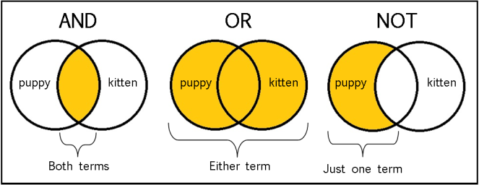
The Concept of a Boolean search illustrated
From: The Library of Antiquity, https://libraryofantiquity.wordpress.com/2016/10/07/forgotten-skills-boolean-searches/

Slide 5

Other search operators
  Searching for an exact phrase (phrase searching): Quotation marks: “ ”, looks for adjacent words
  “rite of passage”, “service desk”
  Truncation: *
  relig*: religion, religions, religare, religious, religieux, religieuse

Slide 6
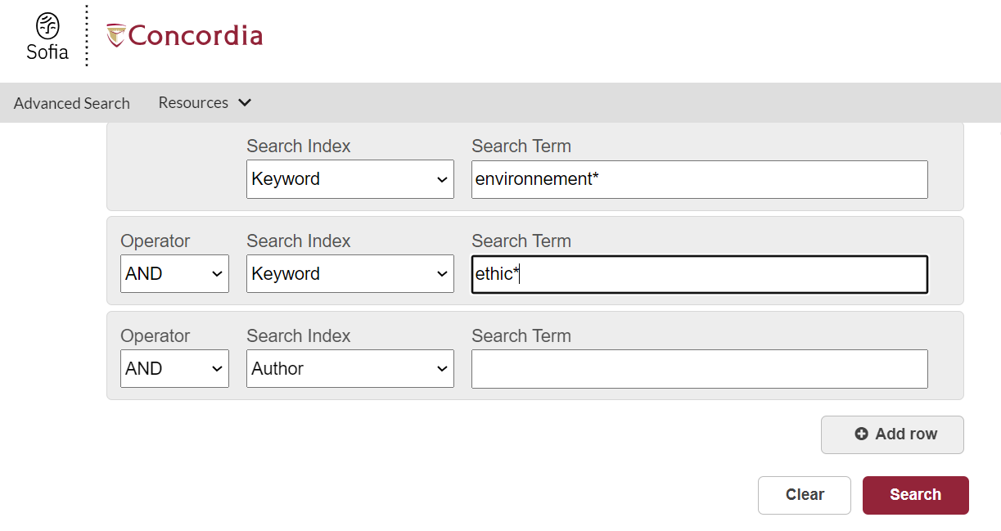

Slide 7
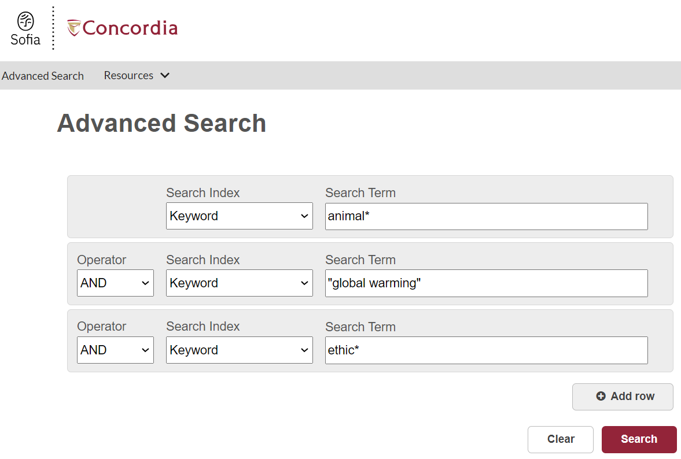

Slide 8

Introduction to the Library website & subject guides

Slide 9
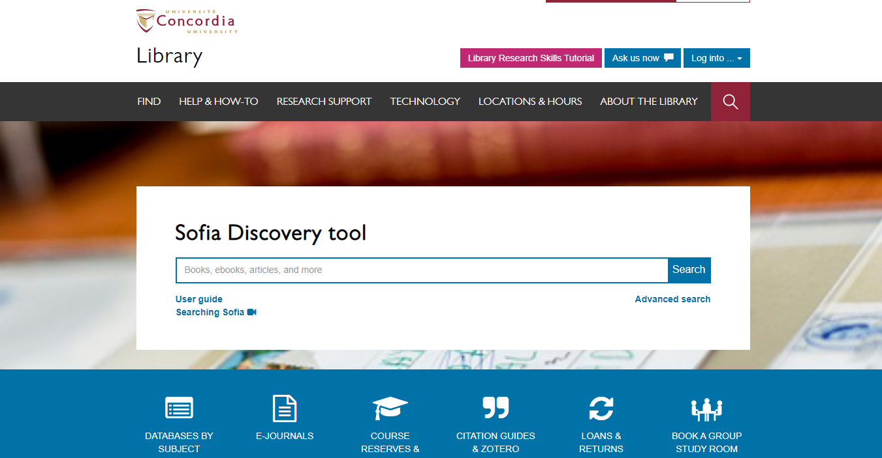

Slide 10

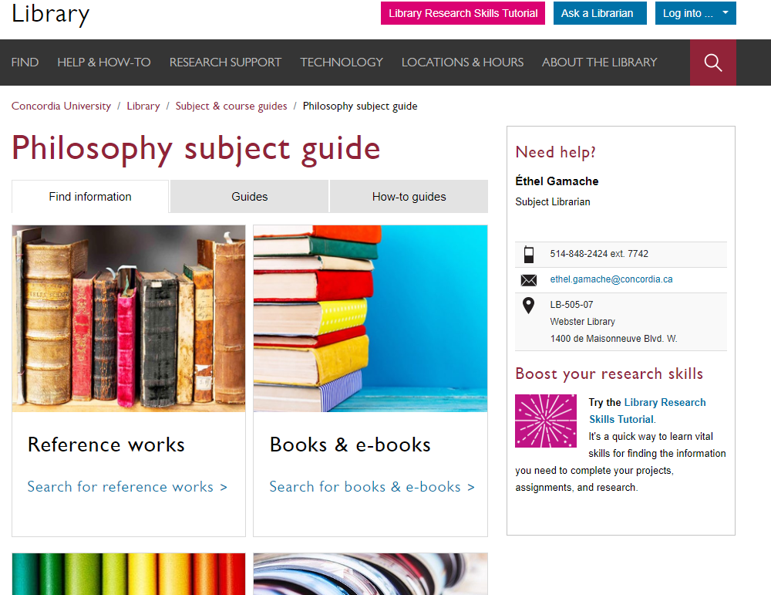
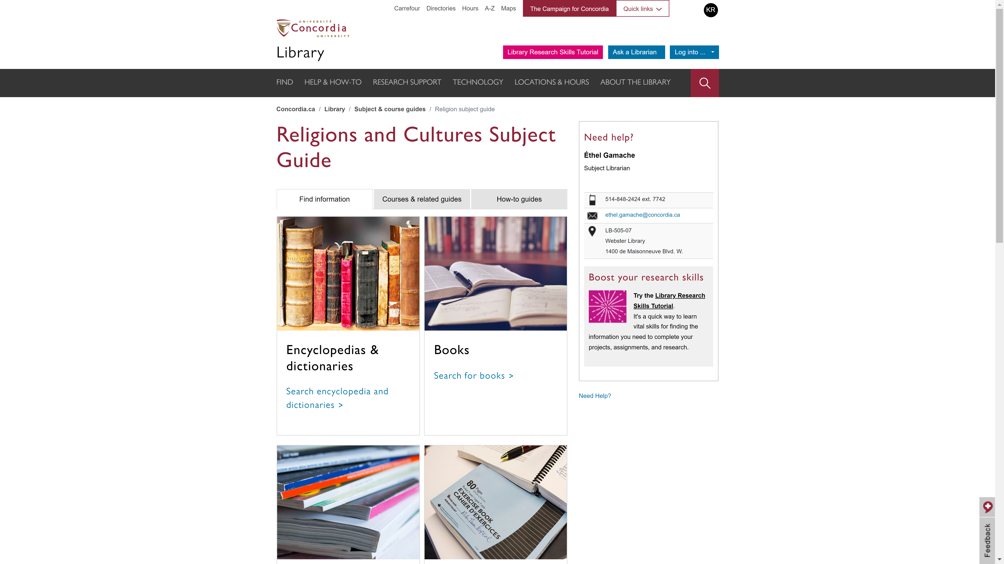
Religions and Cultures Subject Guides
concordia.ca/library/guides/philosophy.html

Slide 11
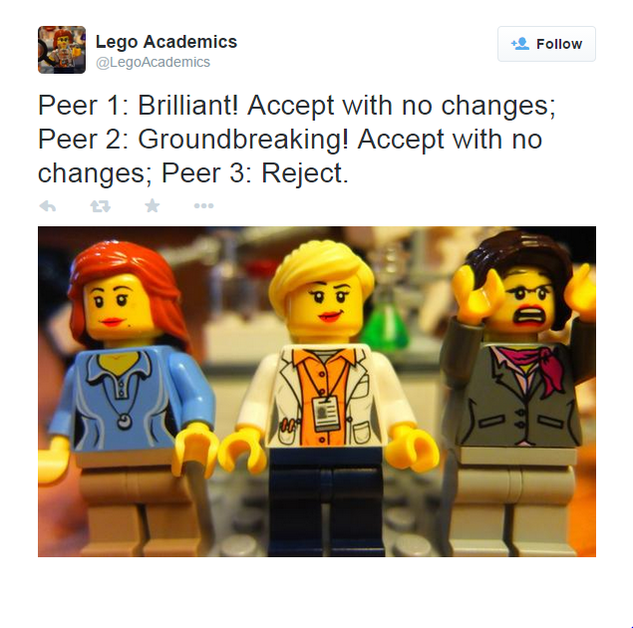
What is a peer-reviewed article?
Yates, D. [@LegoAcademics]. (2014, August 12). Peer 1: Brillant! Accept with no changes; Peer 2: Groundbreaking! Accept with no changes; Peer 3: Reject. [Tweet]. Twitter. https://twitter.com/LegoAcademics/status/499205005468262400/photo/1

Slide 12
Where to find peer-reviewed articles?

Slide 13

Using Sofia and Interlibrary loans

Slide 14
Advanced search in Sofia

Slide 15
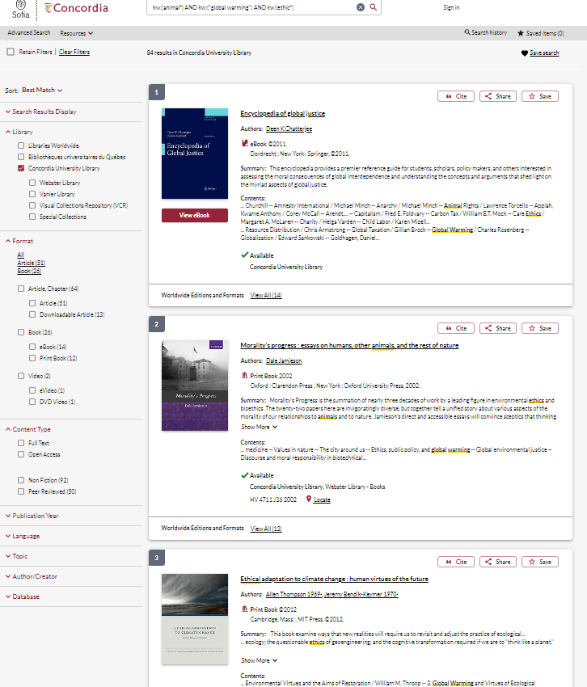
Advanced search in Sofia

Slide 16
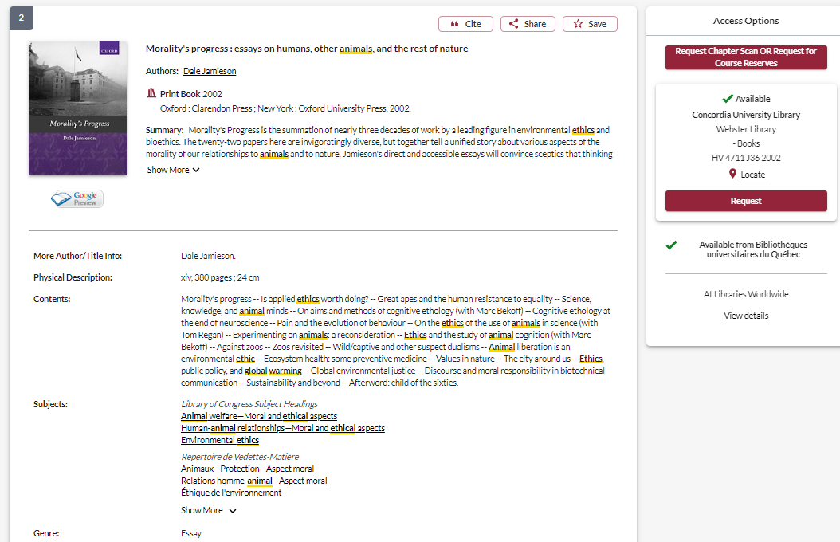

Slide 17

USING INTERLIBRARY LOANS
WITHIN SOFIA

Slide 18
What is the new interlibrary loans (ILL) service?
ILL requests are made directly in the Sofia Discovery tool:
“Request via Interlibrary Loan” button
Form available under the “Requests” tab in "My Account".

Slide 19
Concordia article/chapter scan & deliver service
Book chapter and journal article scans from Concordia’s print collection can now be requested and tracked in Sofia.
Look for the “Chapter Scan” button in the Access Options panel.

Slide 20
REQUEST A BOOK
VIA INTERLIBRARY LOAN
EXAMPLE

Slide 21

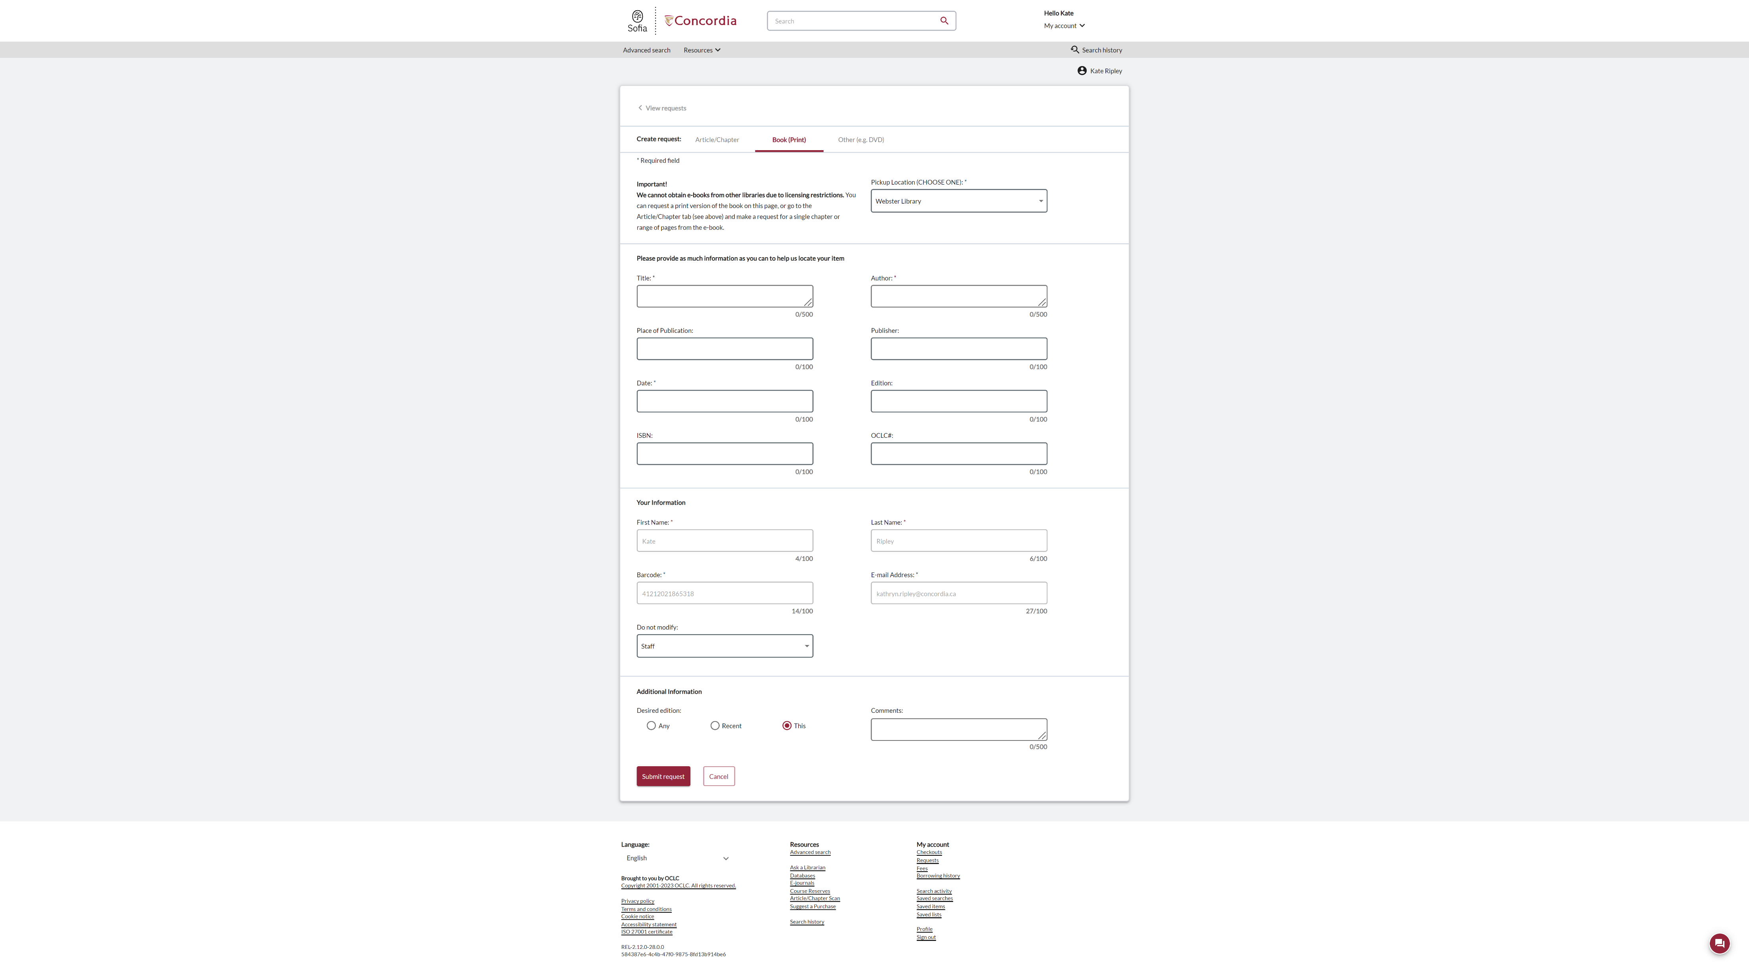
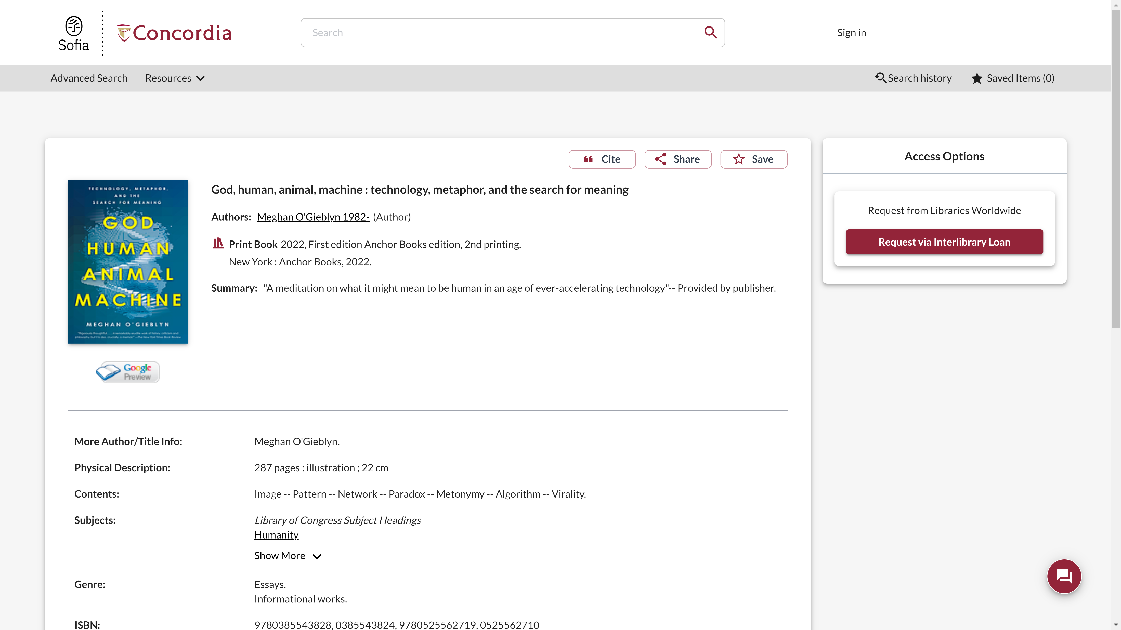
Sofia Discovery Tool request via Interlibrary loan

Slide 22
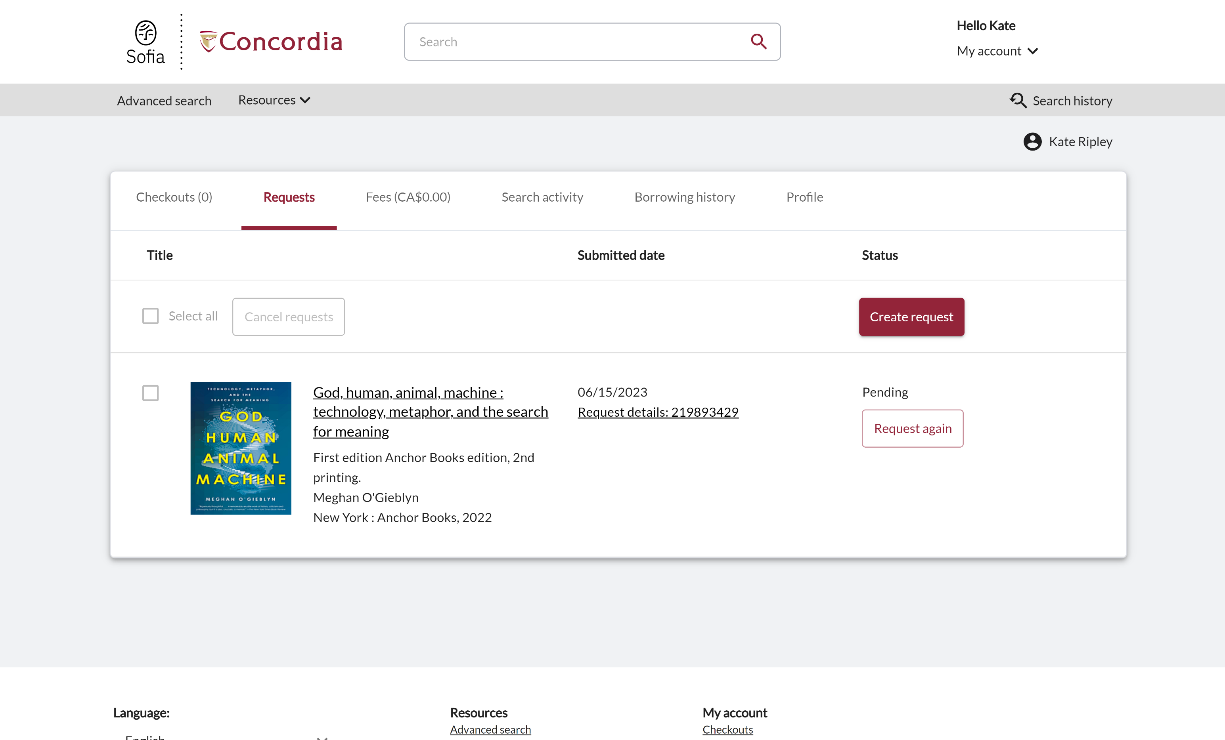
Check the status of your request under the "Requests" tab.

Slide 23
About
Interlibrary loan
You will receive email notifications when your ILL request is available for pickup or download.
Physical items can be picked up at the Circulation/Loans desks at either Vanier or Webster Library.
ILL requests can be borrowed for 30 days, with up to 4 automatic renewals, or until item is recalled.

Slide 24
REQUEST A BOOK
BLANK FORM
EXAMPLE

Slide 25
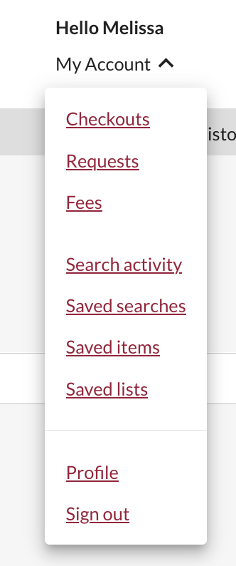
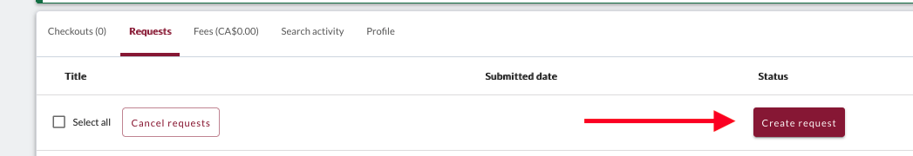
Create an Interlibrary Loan request
Sign in to "My Account" and select "Requests".
Click on "Create request".

Slide 26
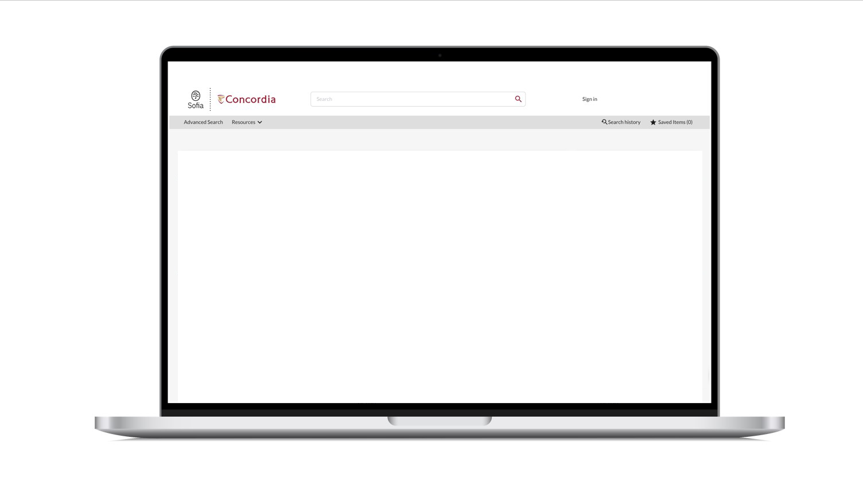
Sofia Discovery Tool – request a book form

Slide 27
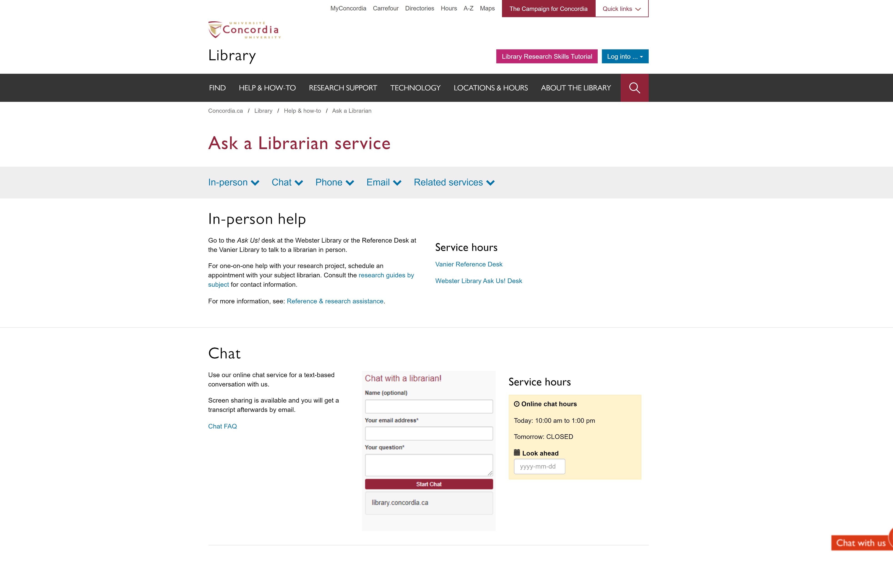
If you have any difficulty finding a document, reach out!

Slide 28

Using the database Academic Search Complete to find academic articles

Slide 29
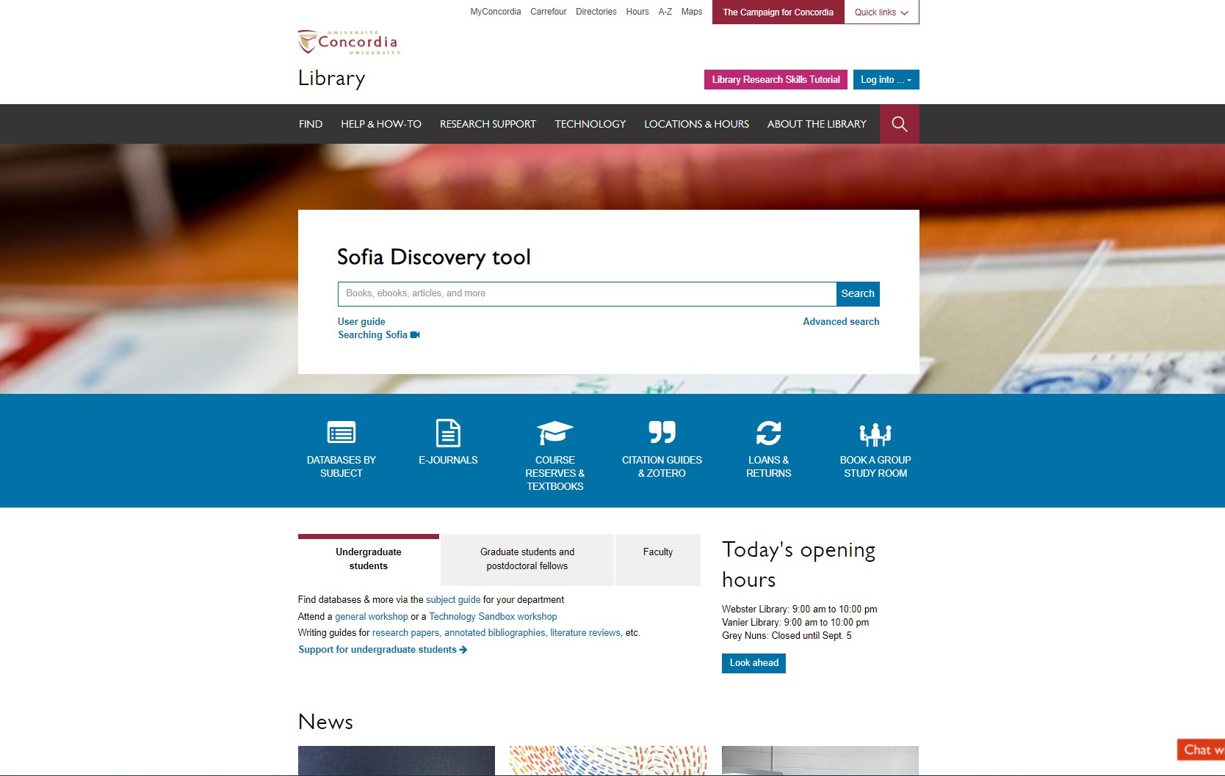
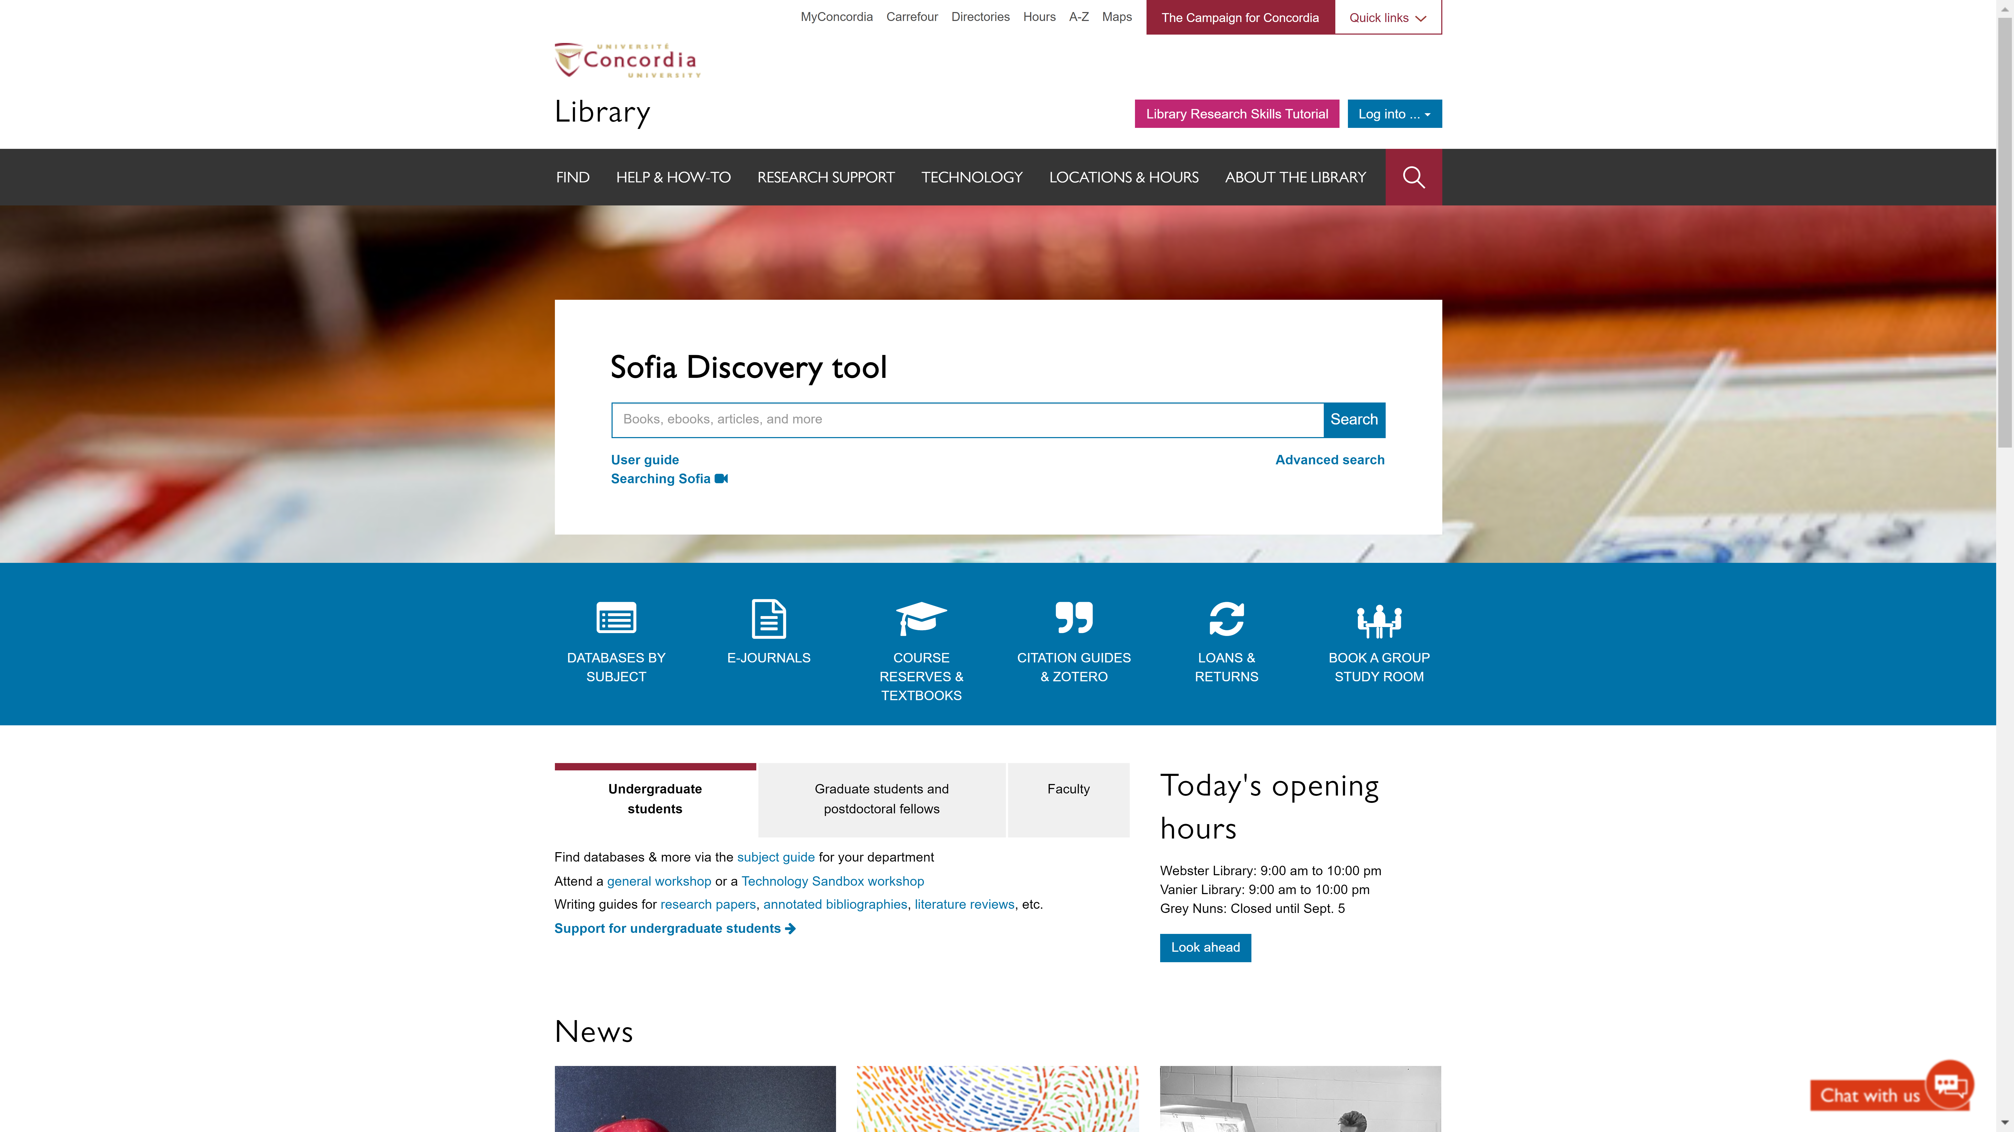
Sofia Discovery Tool – Databases By Subject

Slide 30
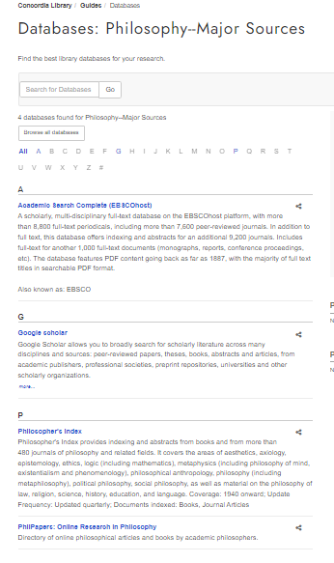
Databases

Slide 31
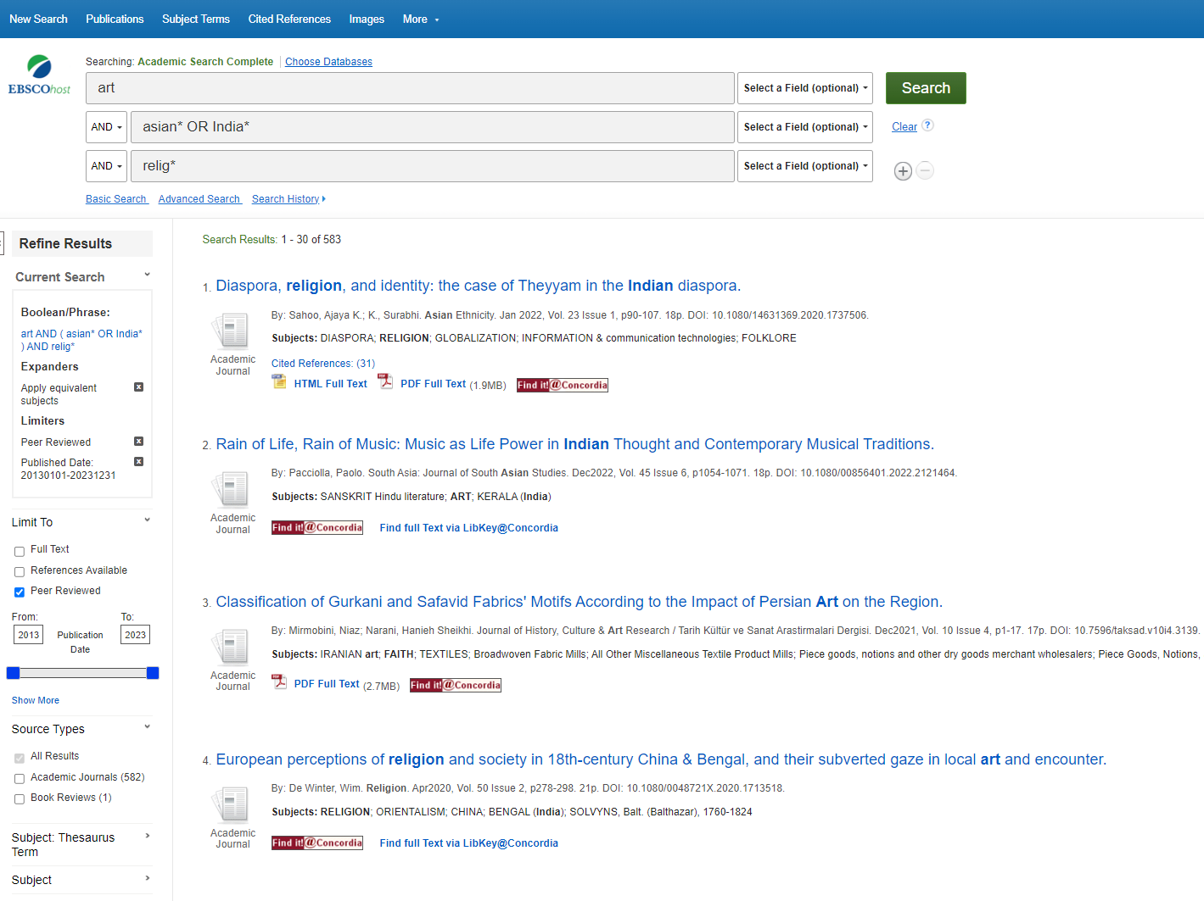
Academic Search COmplete

Slide 32
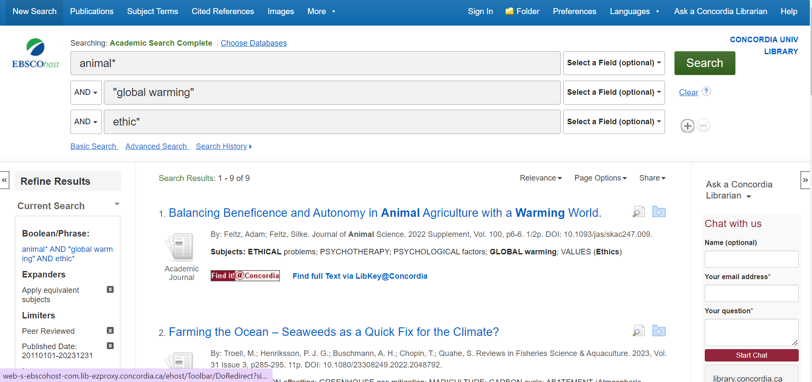
Academic Search COmplete

Slide 33
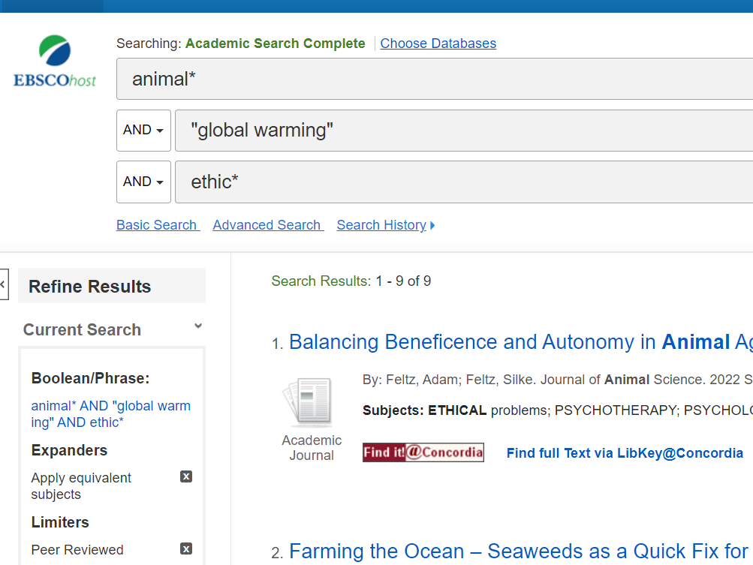
Academic search complete

Slide 35
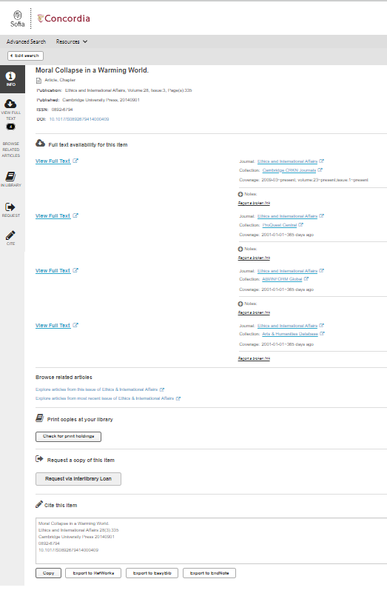
Using the link resolver

Slide 36

Using the database Philosopher’s Index

Slide 37
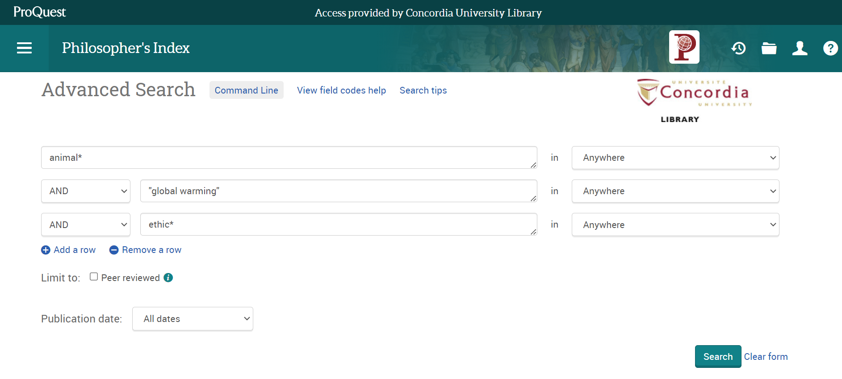


Slide 38
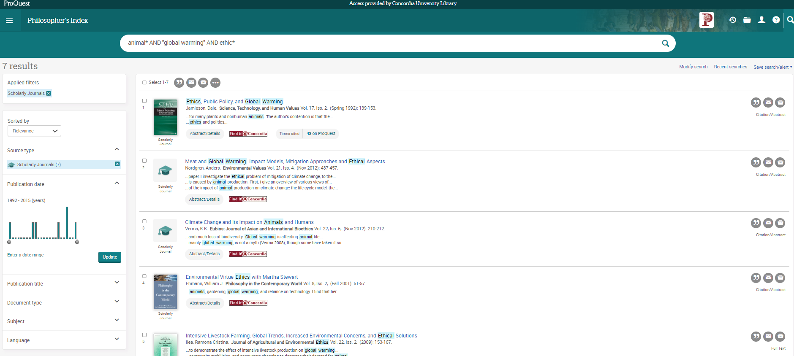

Slide 39
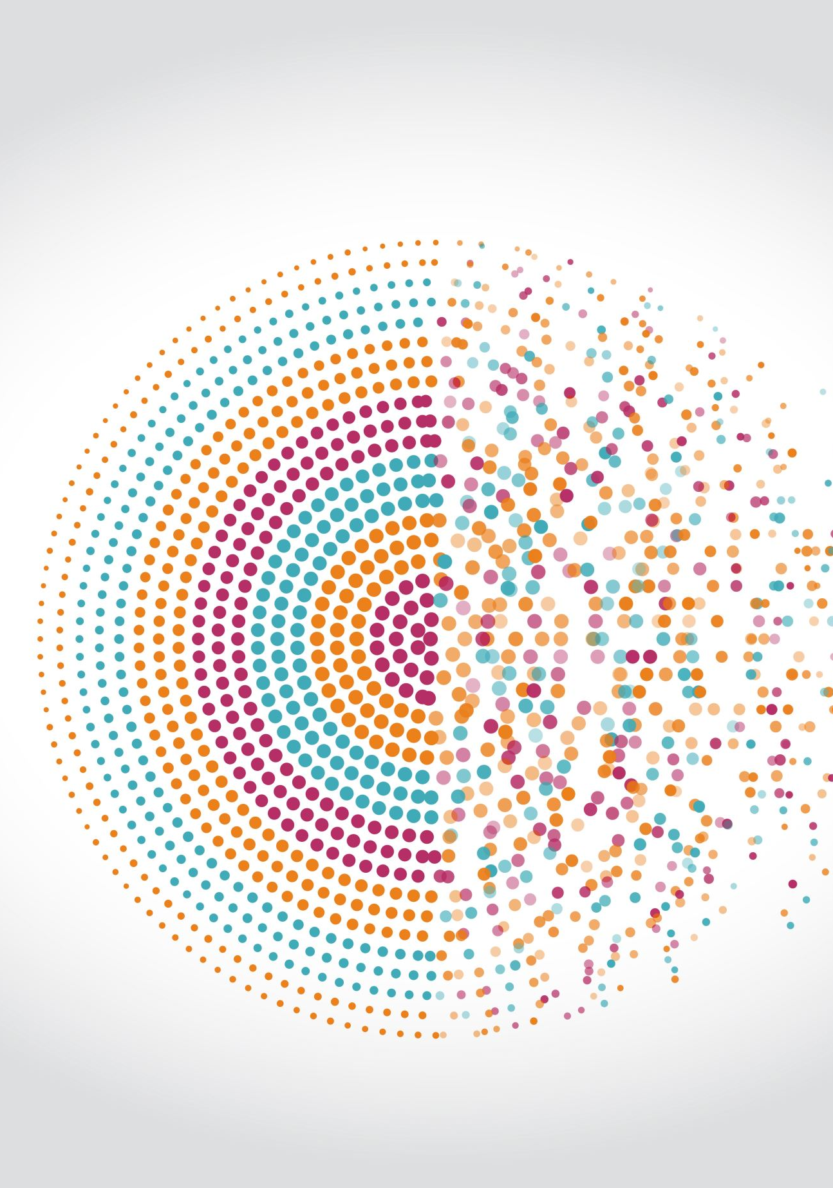
Using Google Scholar
Are the articles really peer-reviewed?

Slide 40
How are Google Scholar and a database different?
Library Databases | Google Scholar
• Provide the ability to focus search by subject area. | • Does not have the ability to focus search by subject area.
• Allow users to sort results according to date and relevance. | • Does not have an easy way to sort articles in your results list.
• Allow users to sort results by type of material (academic journal, magazine, newspaper, etc). | • Does not clearly specify what type of material (academic journal, magazine, newspaper, etc) is in the results list.
• Contain the ability to limit searches by a variety of criteria | • Does not have full criteria to limit your search results.
• Will never charge you for the full text of an article if the Library has a subscription to that database. | • Provides full text of some electronic articles, but is not as helpful in tracking down print articles. Some articles may be available for a fee.
How Google Scholar Can Help You
Source: “Library Resources & Services: Use Google Scholar: Library Databases vs. Google Scholar.” Library Databases vs. Google Scholar - Use Google Scholar - Library Resources & Services at Howard Community College, Howard Community College, howardcc.libguides.com/c.php?g=52041&p=428654.

Slide 41
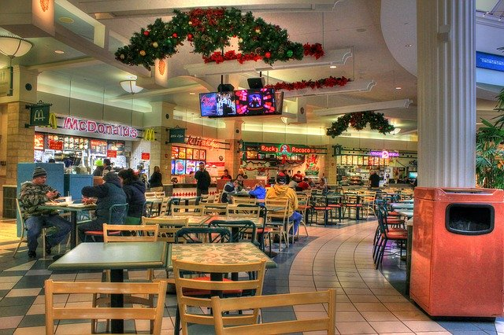

What is the difference?
Google scholar
Library databases
Volume | Quantity | Quick
Depth | Quality | Thorough
Left image: Yinan Chen, Dining Court, public domain, https://pixabay.com/photos/dining-court-shopping-mall-corridor-347314/
Right image: Jason Briscoe, Cooking, public domain, https://unsplash.com/photos/VBsG1VOgLIU
Notes:
Searching in Google Scholar – finding something to eat in a food court
Searching in Library Databases – Cooking at home
Speed vs process

Slide 42
Where should you search?
Library Discovery Tool (Sofia)
Academic Search Complete
(Library Database)
Google Scholar
PhilPapers
(Library Database)
Grey literature (e.g. government documents, NGO reports, working papers, newsletters, preprints)

Slide 43
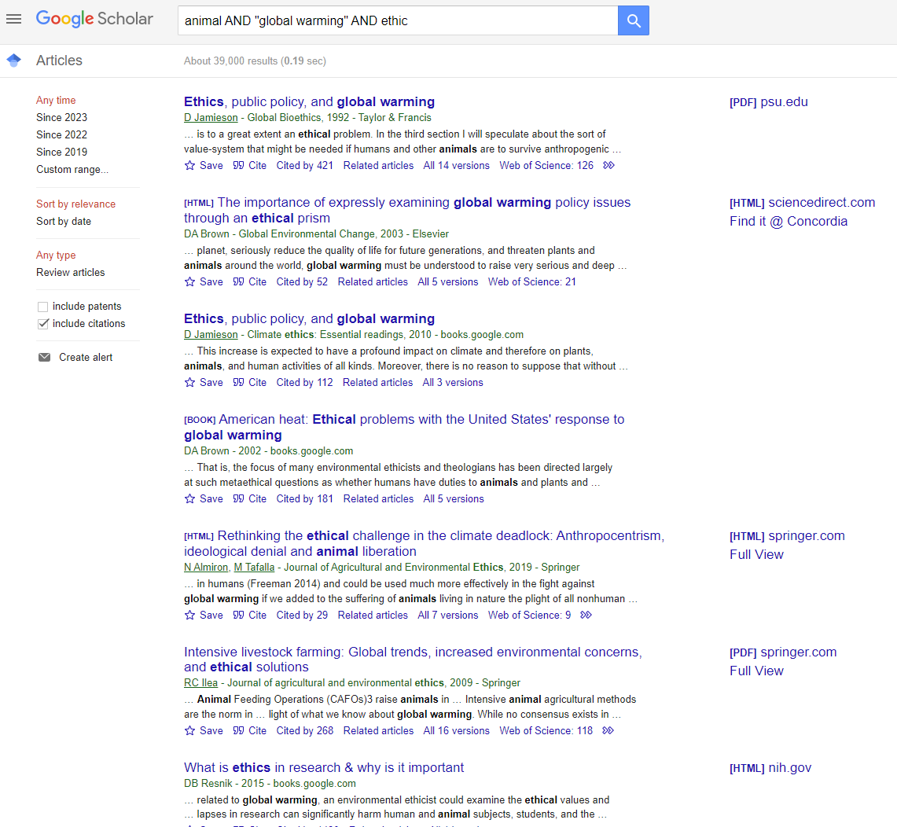

Slide 44
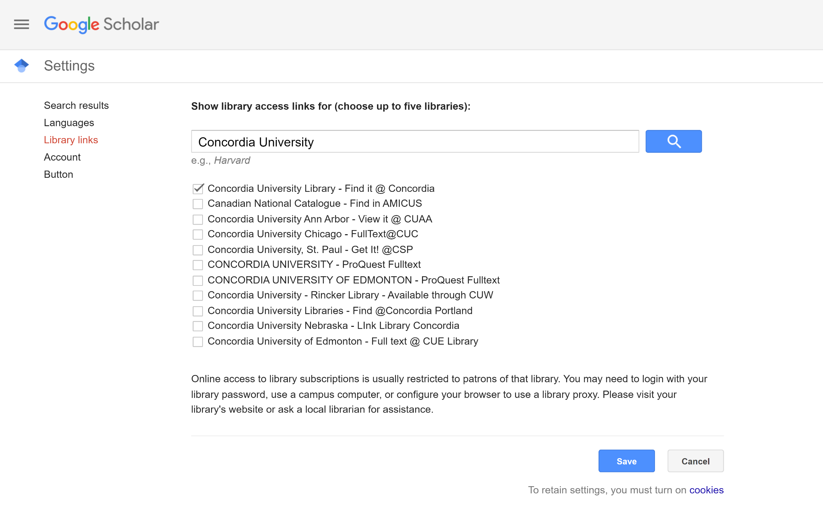
Google Scholar – select a library access link

Slide 45

Evaluating and citing sources

Slide 46
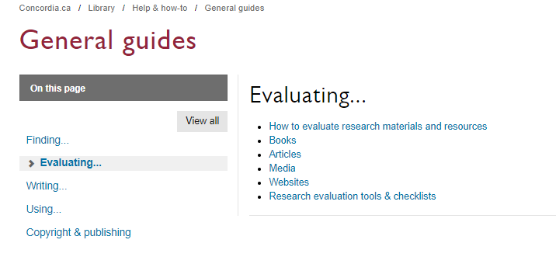

Slide 47
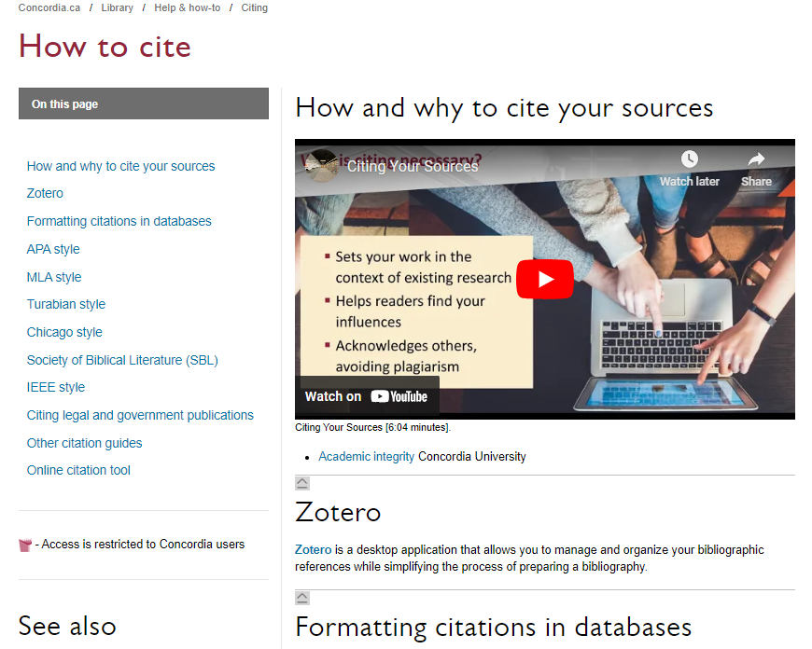
library.concordia.ca/help/citing/

Slide 48

Questions?

Slide 49
Concordia Library Website – Ask a Librarian

Slide 50

Thank you for your attention!
ÉTHEL GAMACHE
ethel.gamache@concordia.ca
Presentation and handouts are on the subject guide, https://www.concordia.ca/library/guides/philosophy/guidesfromyourlibrarian.html

Slide 51
Going further
Search Smarter, Search Faster by Sydney University
Types of Information Sources by CSUN University Library
How do I Select Relevant Web or Online Resources? by Concordia University Library

