Slide 1
FPST 210 Library Workshop
Michelle Lake
First Peoples Studies Librarian
Michelle.Lake@Concordia.ca

Slide 2
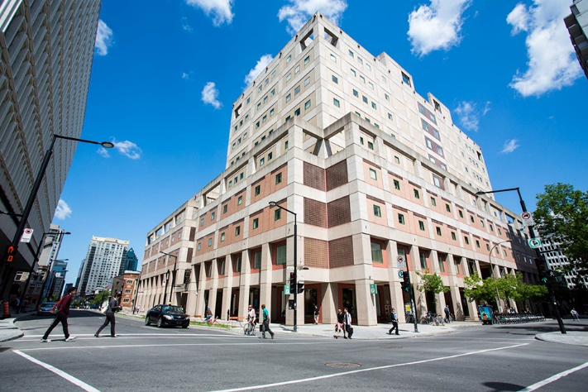
The Librar(ies)
Webster Library – SGW Campus
24/7 access, with student card, after 11pm
2nd, 3rd, 4th, and 5th floor of LB - “Library Building”
Poli Sci, Government Info, Maps, History, Social Sciences, Humanities, Engineering & Fine Arts
Interlibrary Loans
Current Print Journals
Vanier Library – Loyola Campus
24/7 access, with student card, after 11pm
1st, 2nd, and 3rd floor VL – “Vanier Library”
Sciences, Psychology, Communications & Journalism
Special Collections
Print Journal Archive

Slide 3
Library: in person
Course Reserves contains at least one copy of every print required undergraduate textbook (when available) - students need to use the call number of a book to locate them in course reserves
Procedural masks need to be worn at all times in the library.
Your student card is your library card. You need it to borrow books, borrow a laptop, print and access the library during 24/7 hours.
To use Library databases, access online articles and ebooks when you are off campus, login with your MyConcordia Netname and password.

Slide 4
Locating items when you have the citation information

Slide 5
Kimmerer, Robin. Braiding Sweetgrass. Milkweed Editions, 2013.

Slide 6
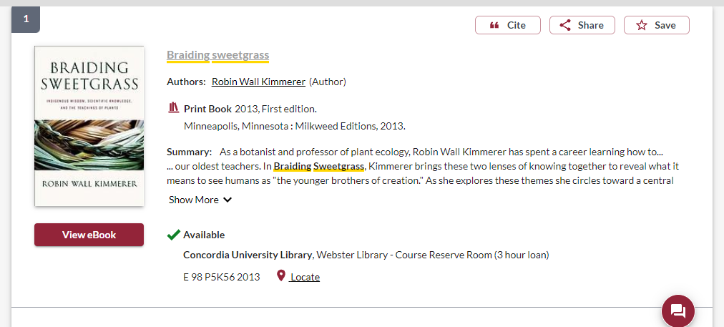
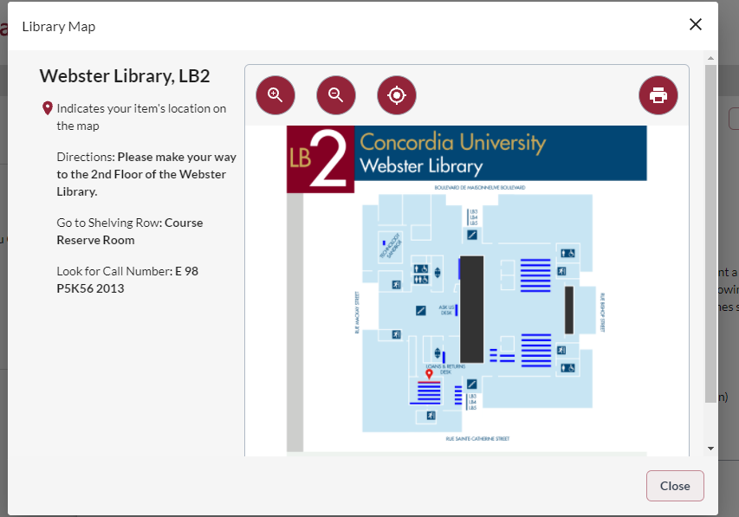

Slide 7
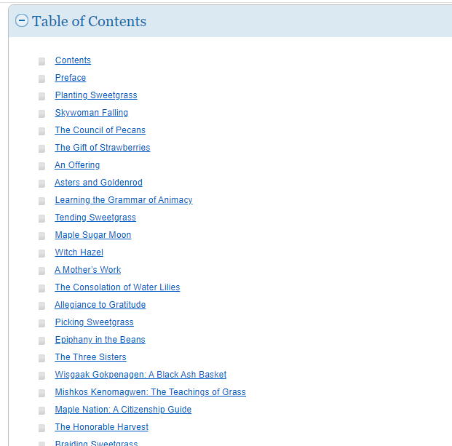
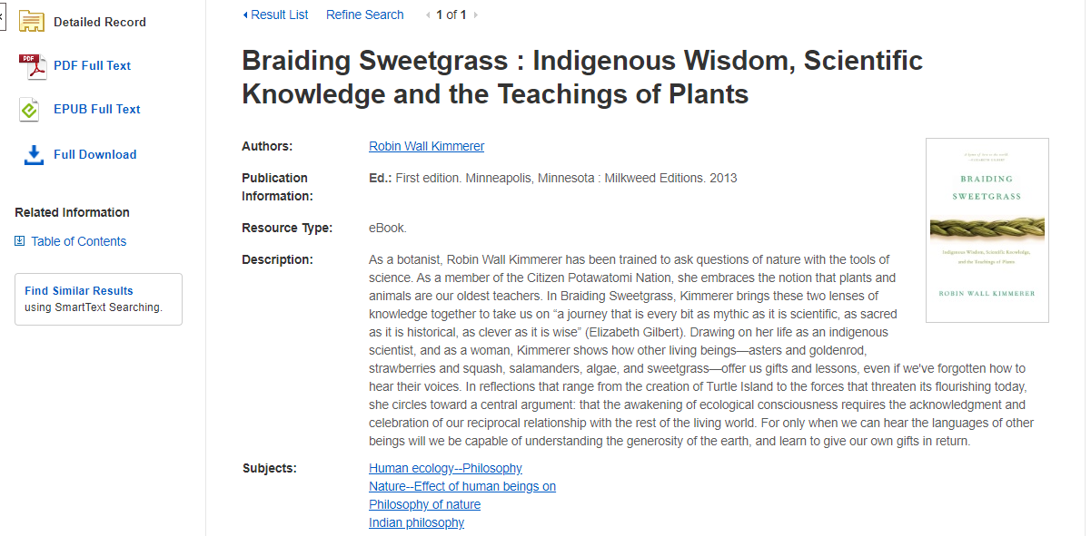

Slide 8
Huaman, E.S. & Martin, D.N. (2020). Indigenous knowledge systems and research methodologies: local solutions and global opportunities. Vancouver: Canadian Scholars Press.

Slide 10
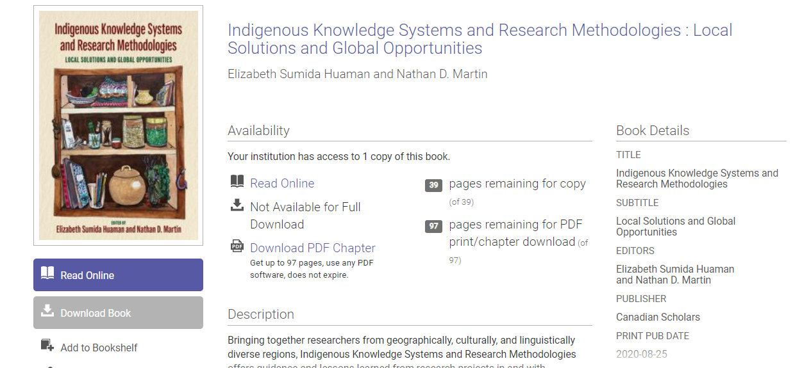
Scroll down to access individual chapters and download PDFs

Slide 11
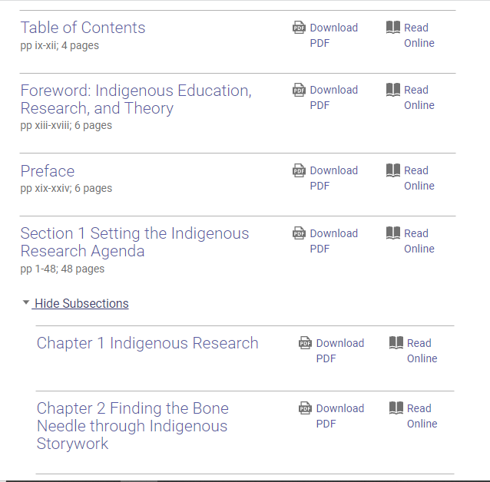

Slide 12
Graeme, C.S. & Mandawe, E. (2017). Indigenous geographies: research as reconciliation. International Policy Journal 8(2): 1-19.

Slide 13
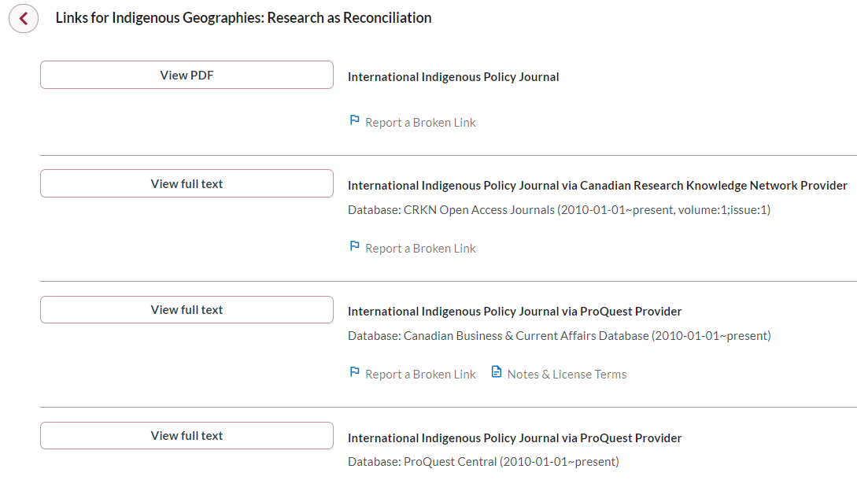
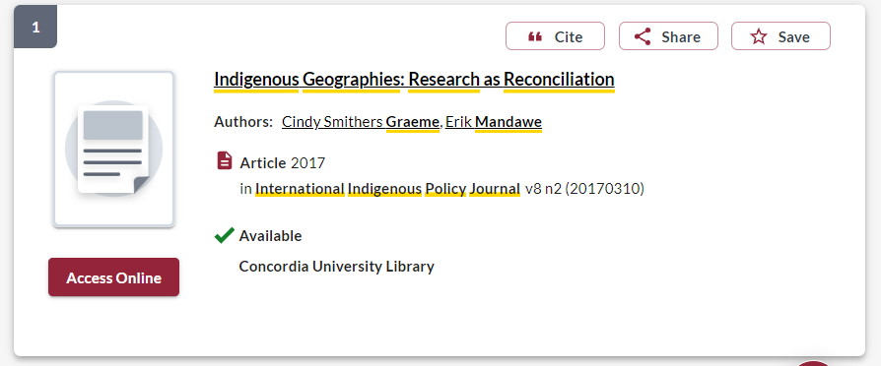
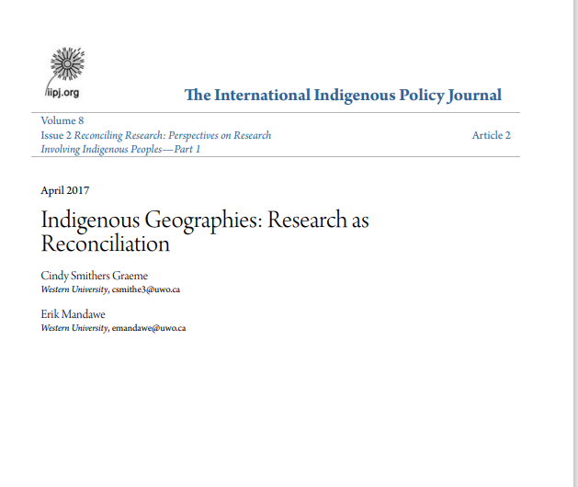

Slide 14
Choosing &
developing a topic

Slide 15
Broad topic: Haudenosaunee Language Revitalization
Mohawk | Kanienʼkéha
Language revitalization | Language revival, language renewal, language preservation
Broad topic: Oka Land Dispute
Oka | Kanehsatake
Crisis | Standoff, blockade, dispute, revolt, uprising
Land | Territory

Slide 16
BEFORE YOU SEARCH: Tips for Library Databases
TIP | WHAT IT DOES | EXAMPLE
AND | Combines concepts. Limits how many results your search produces | Pipelines AND Activism
OR | Lets you insert synonyms or alternative terms. Increases the number of results your search produces | Indigenous OR Aboriginal
* | Near the end of a word, retrieves all words that start with the letters entered. Increases the number of results your search produces. | Environment* (retrieves environment, environmental, environmentalist, environmentalism)
“ ” | For two words or more, searches for an exact phrase only, rather than each keyword. Limits how many results your search produces. | “First Nations” (retrieves First Nations, but not: first there were several nations)
Notes:
So, now we have several possible searches we could try.
Be sure each of your KEY concepts is still in your search and don’t forget the AND!
(have each search appear one at a time, but not too slowly – no need for viewer to read each, just to get the idea)
If you find a few good results, in a few different searches, you will have a good set of resources to support your research question!

Slide 17
Avoid Searching with Linking words
Effects
Impact
Consequences
Influence
Results
Importance
Significance
Each author may use different linking words when discussing similar topics.
You don’t want your search to be limited to those books and articles that only contain the word “effect” or “consequence”

Slide 18
Primary Sources
Primary sources provide first-hand testimony or direct evidence concerning a topic under investigation.
They are created by witnesses or recorders who experienced the events or conditions being documented.
Often these sources are created at the time when the events or conditions are occurring, but primary sources can also include autobiographies, memoirs, and oral histories recorded later.
Some examples of primary sources include:
Letters
Diaries
Interviews
Oral histories
Maps
Proclamations
Treaties
Newspaper and magazine articles
Government documents
Autobiographies and memoirs
Works of art, including plays, poetry, films novels, and paintings
Artefacts, including clothing, furniture, and buildings

Slide 19
Secondary Sources
Secondary sources interpret and analyze primary sources.
These sources are one or more steps removed from the event.
Secondary sources may have pictures, quotes or graphics of primary sources in them. Some types of secondary sources include:
Scholarly Articles
Scholarly Books and book chapters
Textbooks
Encyclopedia or dictionary entries
Documentaries

Slide 20
Secondary sources: Academic Books

Slide 21
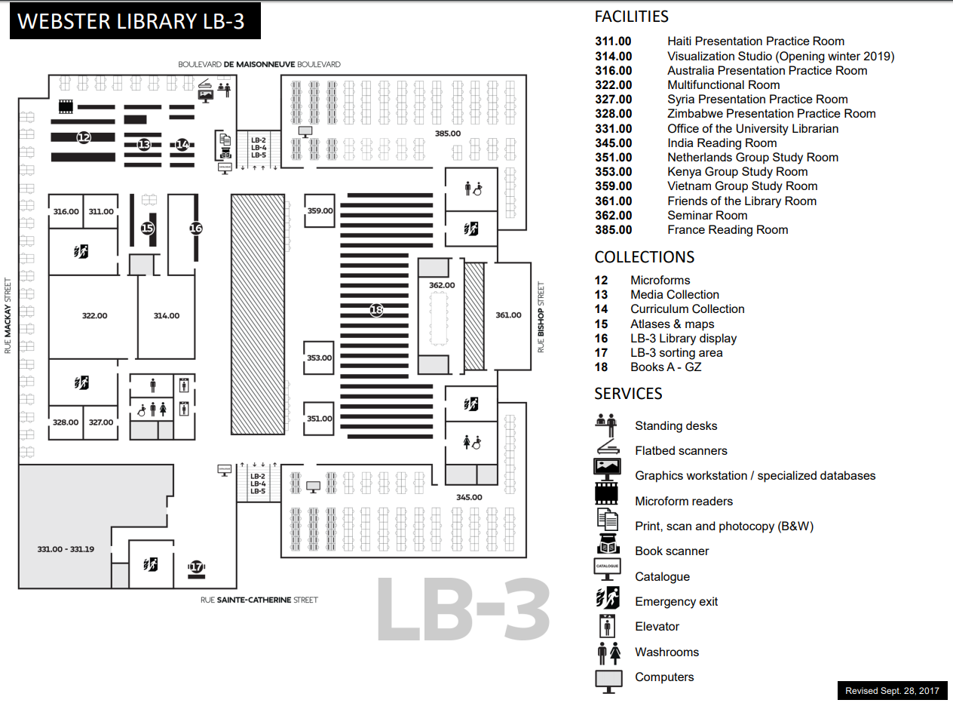
E, F and FC books are here
Call number ranges:
E 75 – E 99 Indigenous Peoples in North America
F 1-1140 History of British America (Canada)
FC 1-4200 Canada

Slide 22
Terminology
In the most common university library classification system, Library of Congress Subject Headings (LCSH), the main subject heading for material about Indigenous peoples in Canada and the United States is “Indians of North America”.
The term Indigenous is still new in these systems.
Though relevant and correct, terms for nations such as the Kanien’kehá:ka or confederacies such as the Haudenosaunee are far less prevalent in our Sofia Discovery tool than terms such as Mohawk or Iroquois.

Slide 23
Terminology
…sometimes you will have to include inappropriate or white-settler terms when searching in library databases and search tools. -- See for example this ready-made search strategy for topics related to residential schools.
but be sure to also learn and include the relevant and specific names or terms related to the Indigenous/First Peoples topics you are researching. See for instance this short guide to names and terminology in the context of Turtle Island / North America.

Slide 24
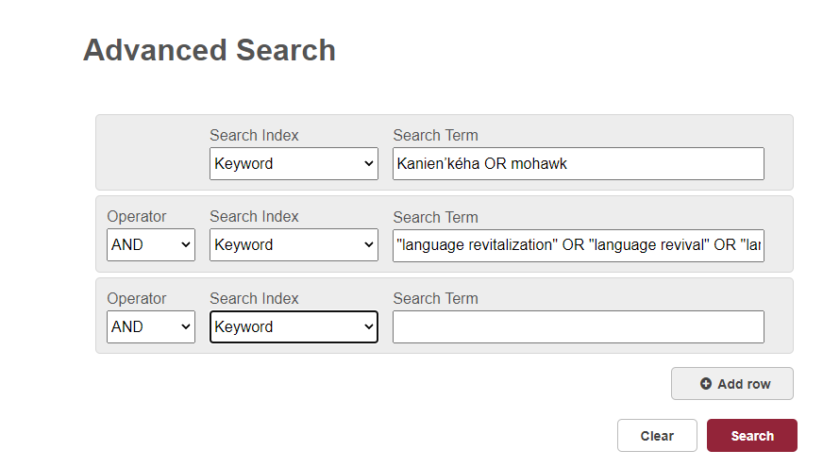
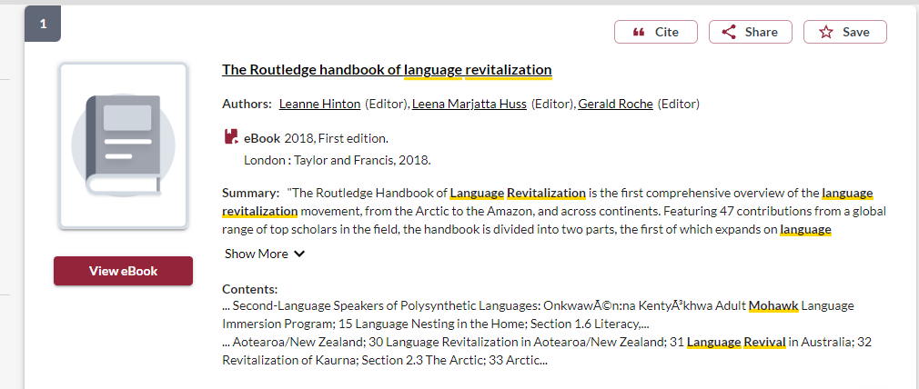
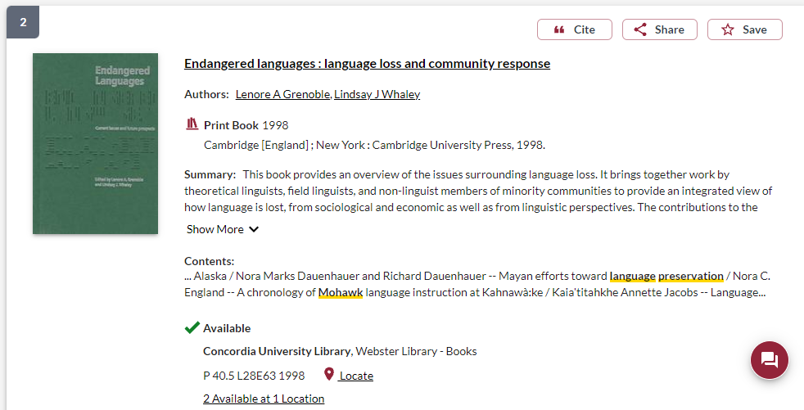
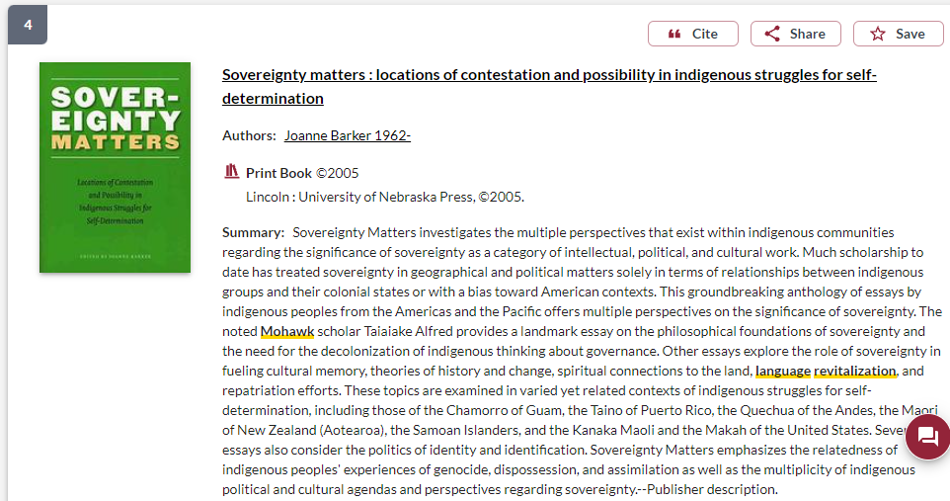

Slide 25
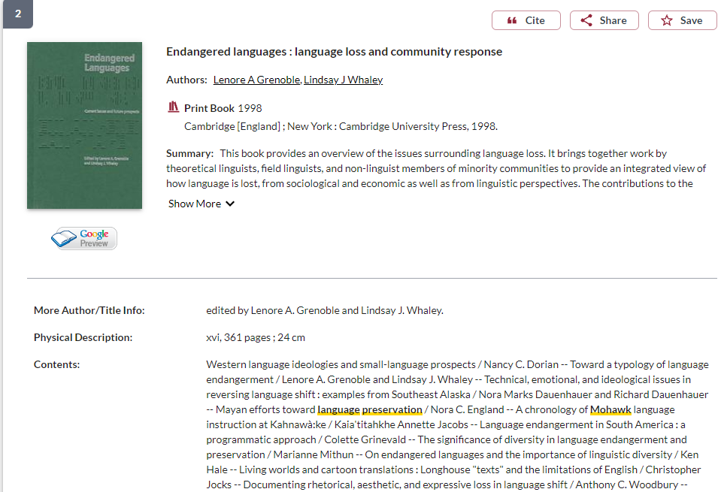
Is the publisher a university press? It is likely a scholarly book.
How long is the book? Scholarly books will be several hundred pages long.

Slide 26
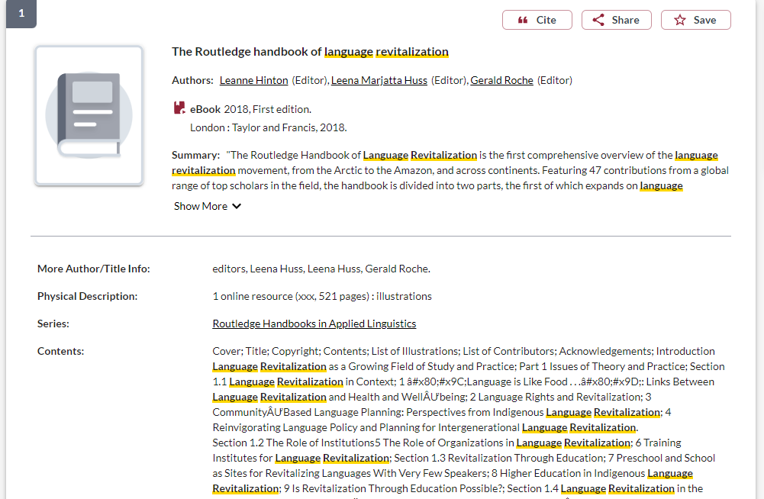
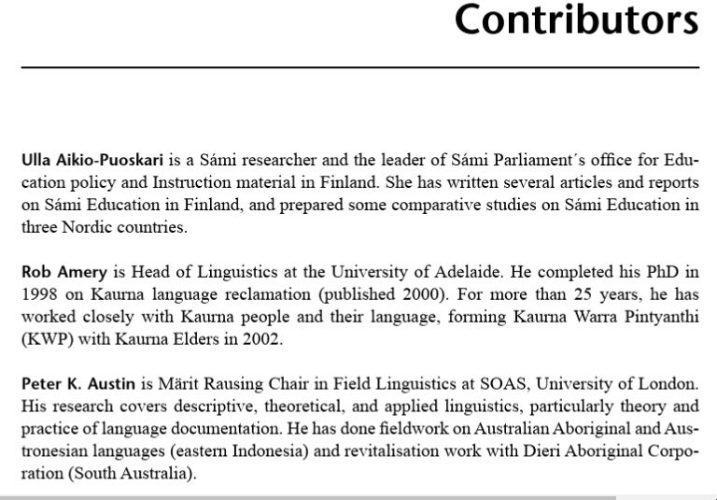
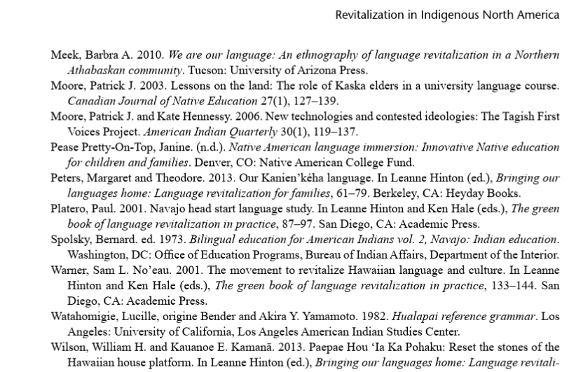
Look for the contributors/author affiliations, are they university faculty members? If so, the book is scholarly. This is also a good place to find out information regarding Indigenous contributors, or any community connections.
All scholarly books will have extensive reference lists either at the end of each chapter or the end of the book.

Slide 27
Using the library databases to find scholarly journal articles for your assignments

Slide 28
go the Library website under:
HELP & HOW-TO
Subject & Course Guides
First Peoples Studies

Slide 29
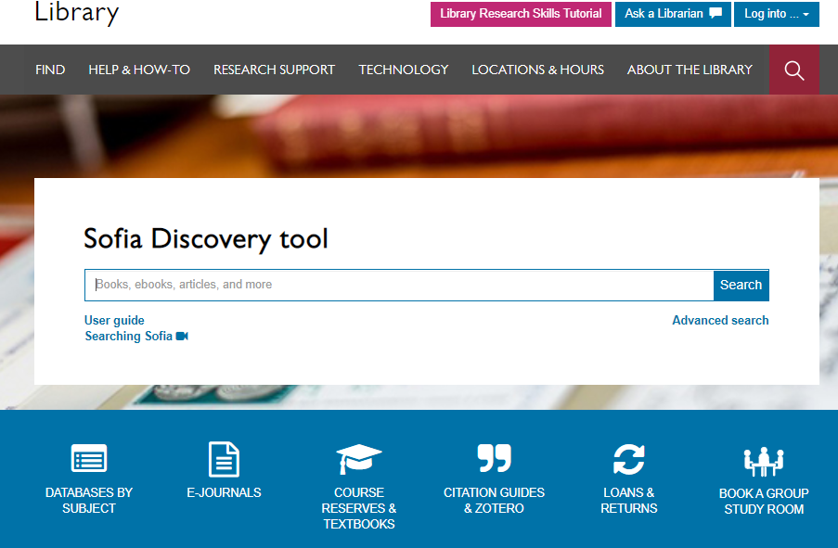

Slide 30
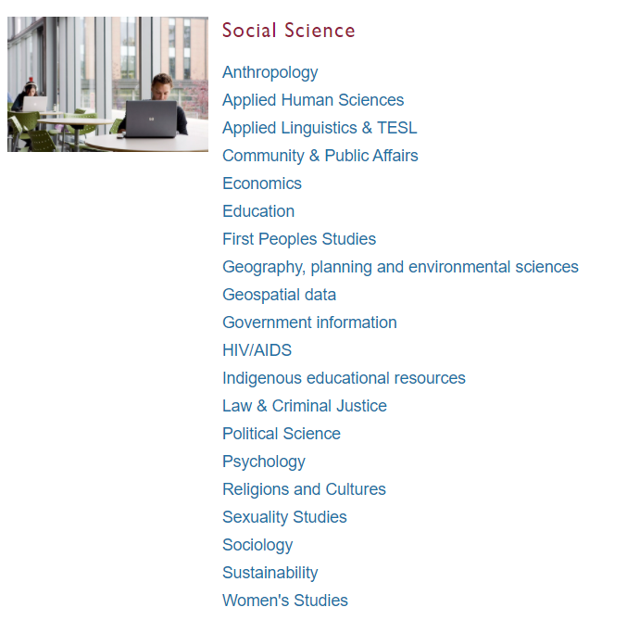
Subject Guide: First Peoples Studies

Slide 31
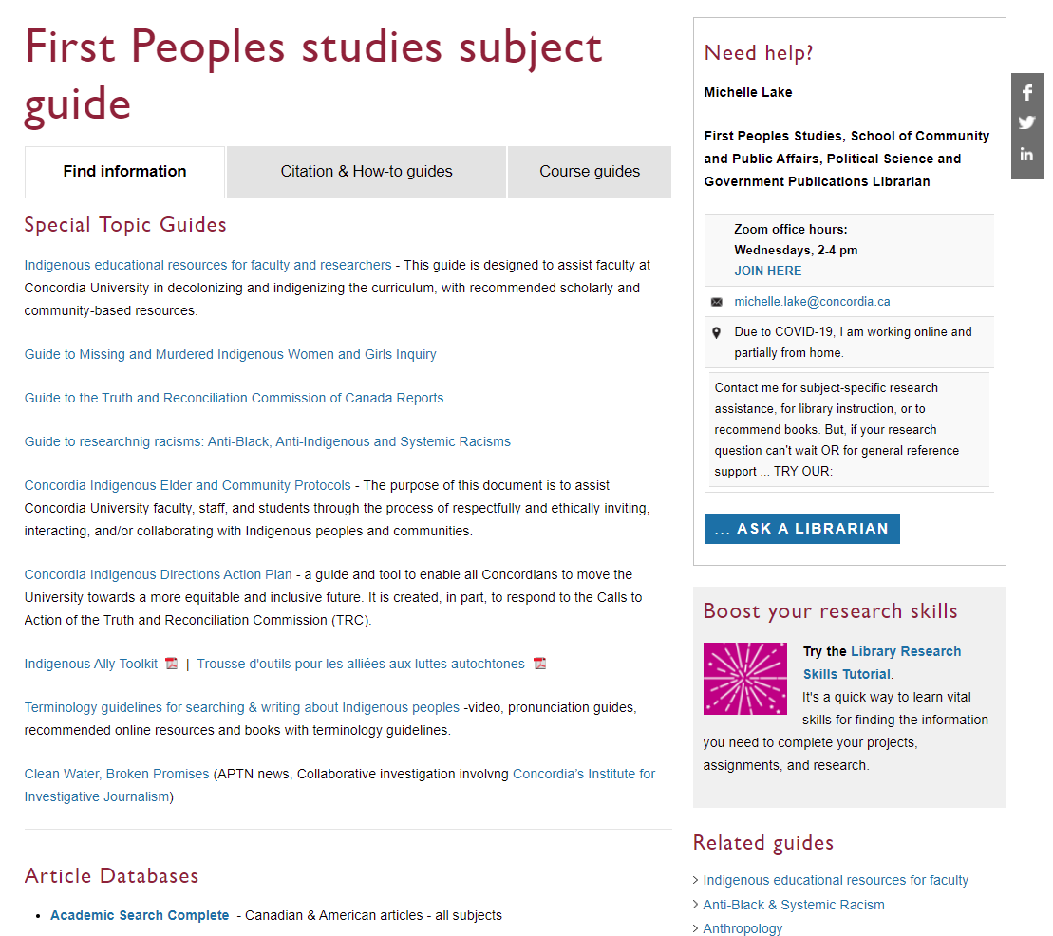
Scroll down for suggested
Article databases

Slide 32
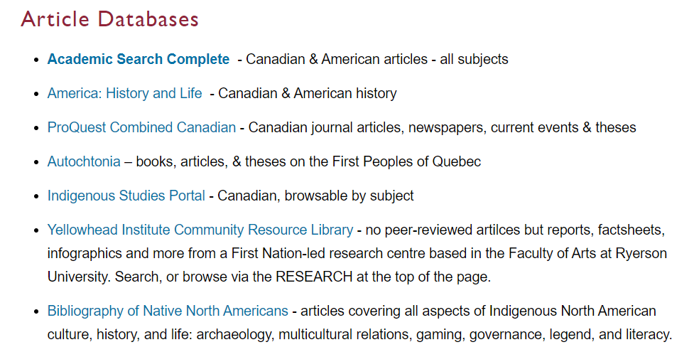

Slide 33
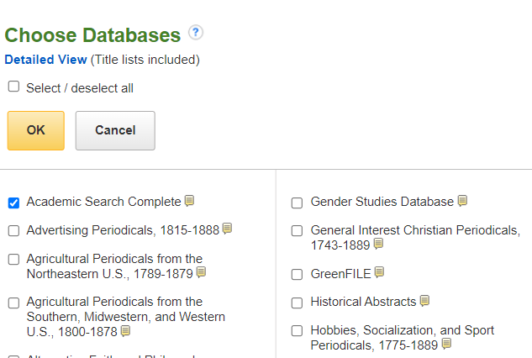
We select both Academic Search Complete and Bibliography of Native North Americans, then click OK.
Choose up to 3 databases maximum to search in at the same time.

Slide 34
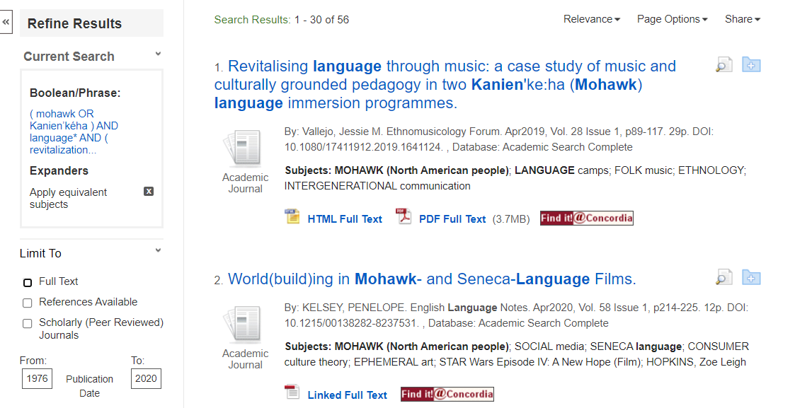

Slide 35
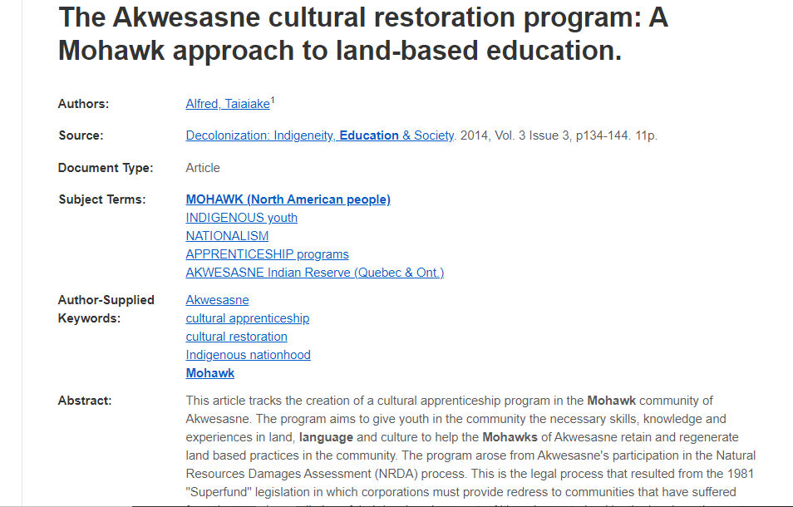
Scholarly journal articles are usually 10+ pages long.
You should be able to locate the author’s affiliations.

Slide 36
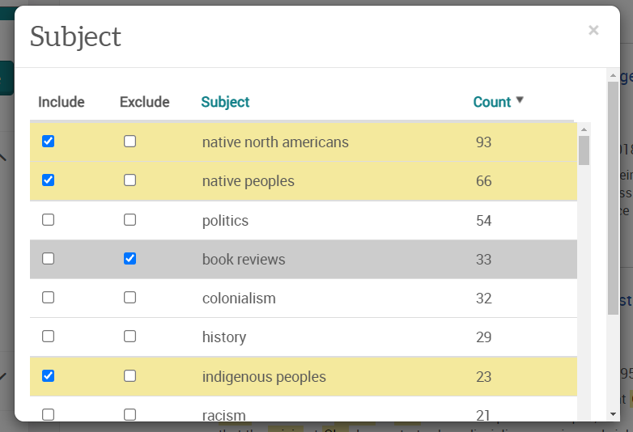
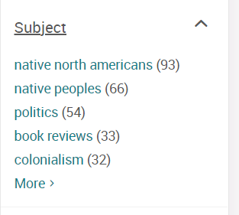

Slide 37
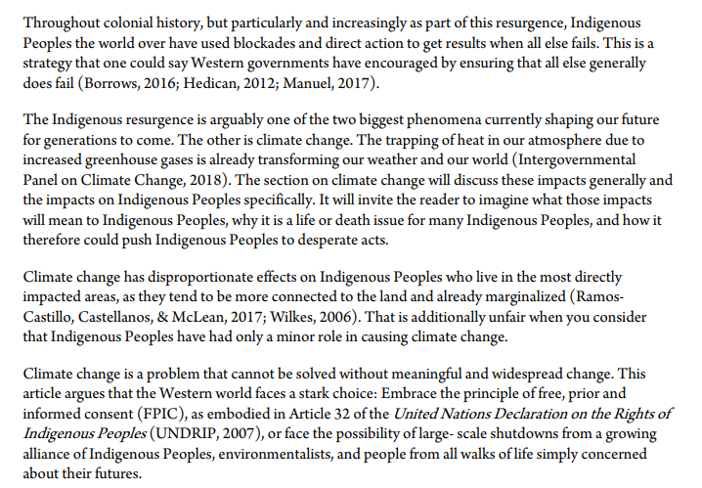
Scholarly articles will feature citations through the text, and have an extensive reference list at the end of the article.

Slide 38
Primary sources

Slide 39
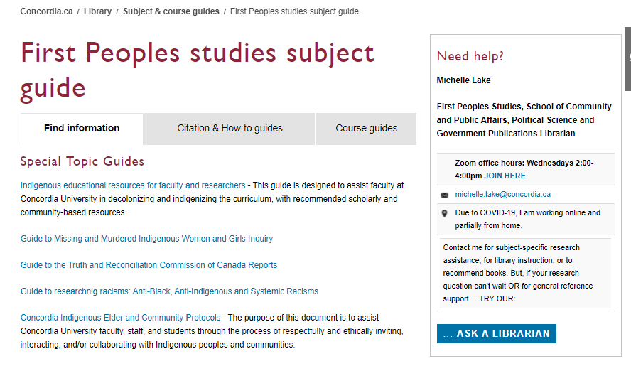

Slide 40
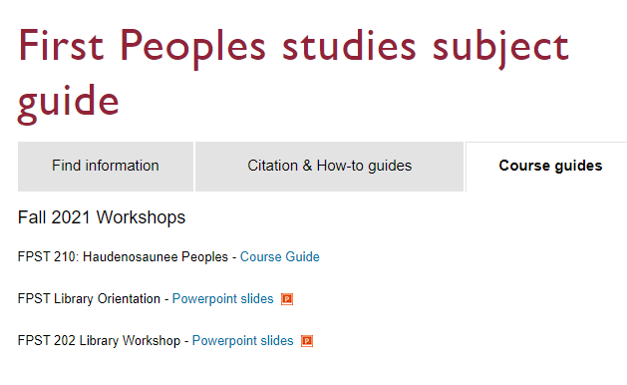
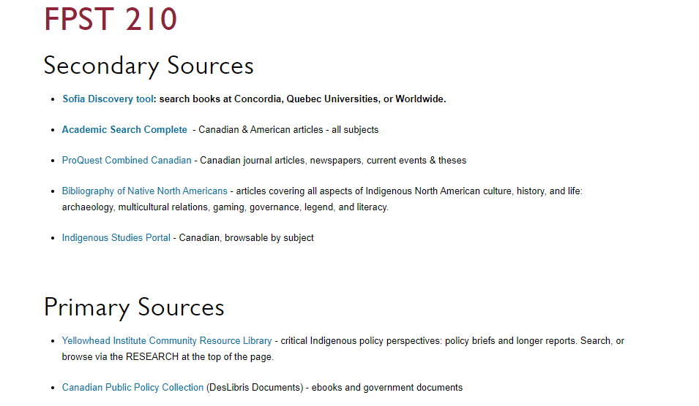

Slide 41
Need help, ask us!
Michelle.Lake@Concordia.ca

