Slide 1

FPST 202: Research Strategies in First Peoples Studies
Library Workshop
Michelle Lake
Subject Librarian for FPST, SCPA, Poli Sci and Government information
Michelle.Lake@Concordia

Slide 2
Who am I?
Michelle Lake, librarian for First Peoples Studies, the School of Community and Public Affairs, Political Science, and Government Publications
Settler, originally from Ontario.
My hometown is located on the traditional territories of the Erie, Neutral, Huron-Wendat, Haudenosaunee and Mississaugas, on land covered by the Dish With One Spoon Wampum Belt Covenant.
I live and work on the unceded Indigenous lands of Tiohtià:ke, where the Kanien’kehá:ka Nation is recognized as the custodians of those lands and waters.

Slide 3
Who am I?
BA, University of Guelph, MLIS Western University
16 years working at Concordia Library
13 years in my current position, Subject librarian for First Peoples Studies, SCPA, Political Science & Government Information
I am still always learning and working to decolonize my own practice as a librarian

Slide 4
What do I do?
  Provide research support, teach and assist with search strategies
  Help students navigate library databases
  Help students find and access materials they need
  Assist with evaluation of sources
  Build guides, resources and pathfinders to help students locate research materials
  Help with citation issues
  Choose the books we buy for my subject areas: First Peoples studies, political science, public policy, community and public affairs and government information

Slide 5
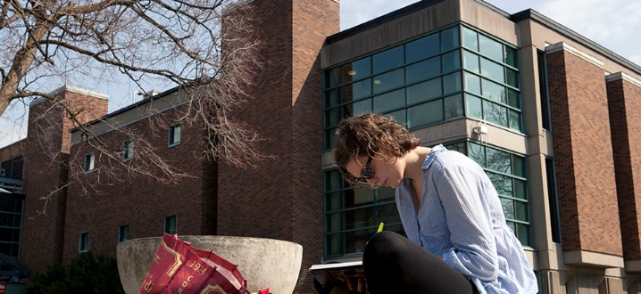
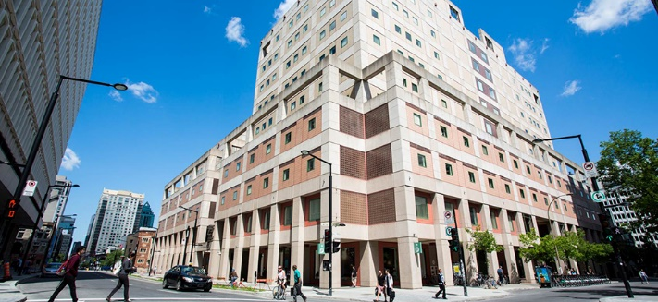
The Librar(ies)
24/7 access, with student card, after 11pm
Webster Library (LB) – downtown on SGW campus & Vanier Library (VL) on Loyola campus
Webster: Social Sciences, Humanities, Business, Engineering & Fine Arts
Vanier: Science(s), Health, Communications, Journalism and Psychology
Course Reserves Room(s): have the required undergraduate print textbooks for the courses taught at that campus (for example: Webster has the FPST, Political Science and SCPA course reserves)

Slide 6

Library Services
Your student card is your library card.
You need it to:
borrow books (up to 100 a time)
borrow a laptop (3 day loan) and other technology
print on campus (add money to your Dprint account)
access the library overnight during 24/7 hours.
Webster library has 5 book scanners (And Vanier has 2!) that can be used for free to scan chapters from our print books and email them to yourself as a PDF.
To use Library databases, access online articles and ebooks when you are off campus, login with your MyConcordia Netname and password.

Slide 7
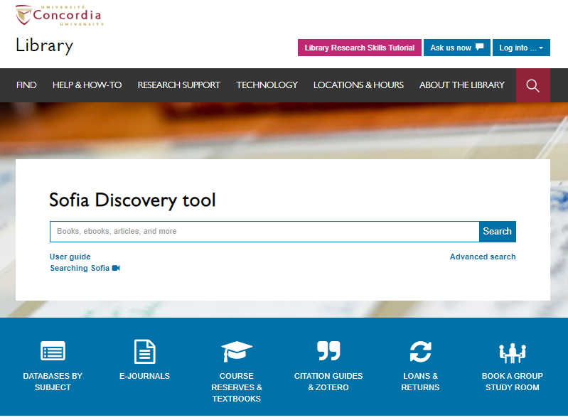
Use the Sofia Discovery tool to find print books, ebooks, and journal articles from the library.

Slide 8
How can I find out if the library has access to an item I’m looking for?

Slide 9
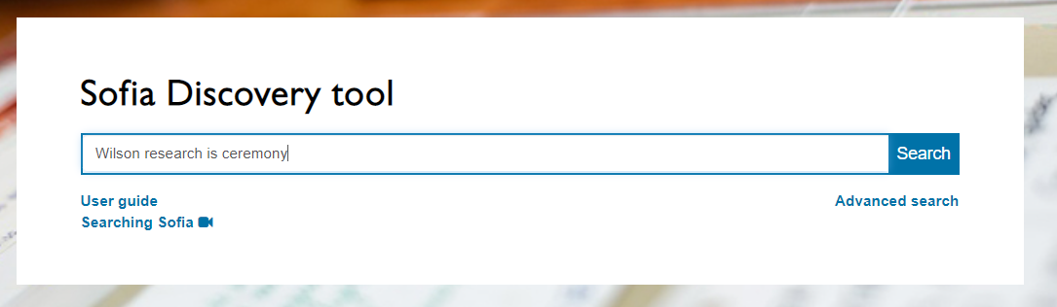
Wilson, S. (2008). Research is ceremony: Indigenous research methods. Halifax: Fernwood Publishing.

Slide 10
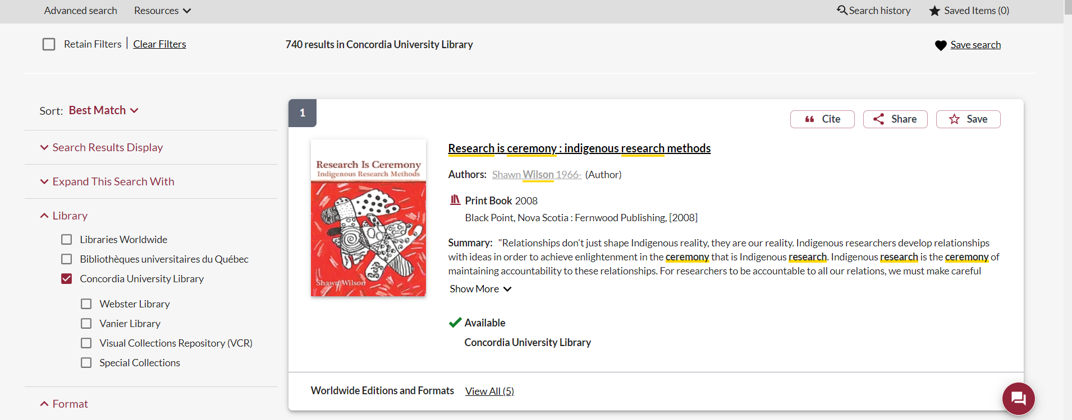
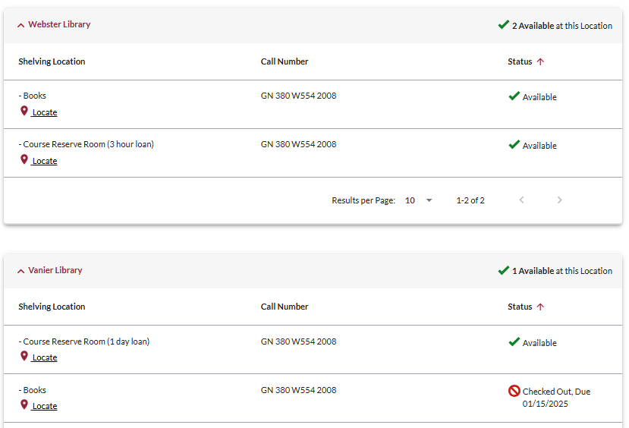
This is a required textbook, so it is found in the course reserves room for a 3 hour loan.
There is a book scanner in the course reserves room, where you can scan chapters and email them to yourself for free.

Slide 11
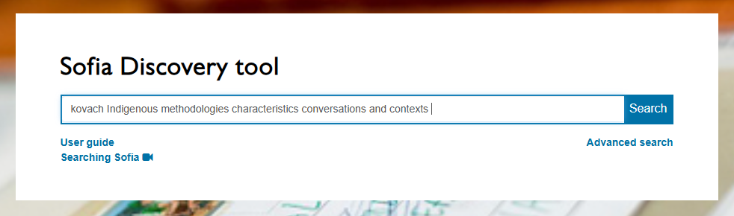
Kovach, M. (2021). Indigenous methodologies: characteristics, conversations, and contexts. (Second edition). University of Toronto Press.

Slide 12
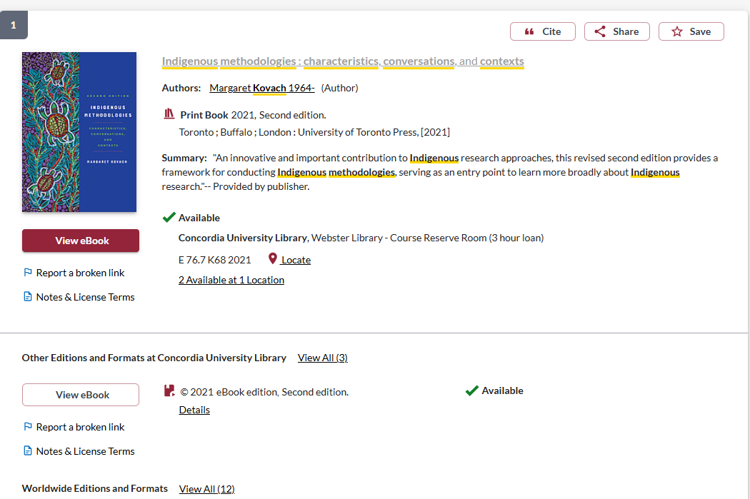
This is available as an ebook, to read online
The print copy is also available in the course reserves room for a limited loan

Slide 13
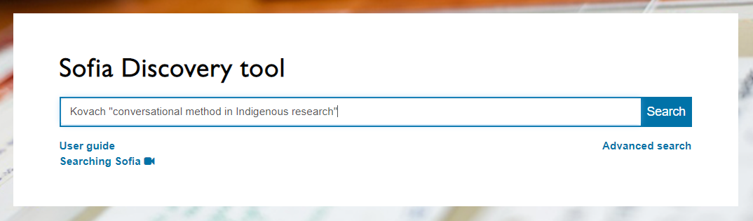
Kovach, M. (2019). Conversational method in Indigenous research. First Peoples Child & Family Review, 14(1), 123-136.

Slide 14
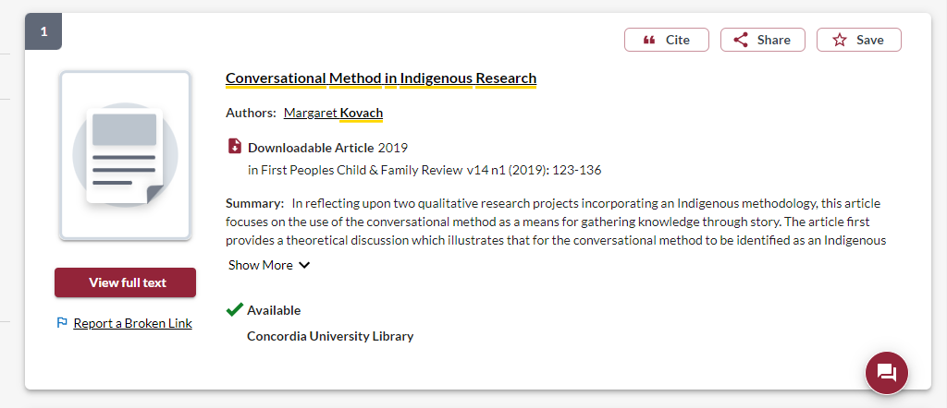
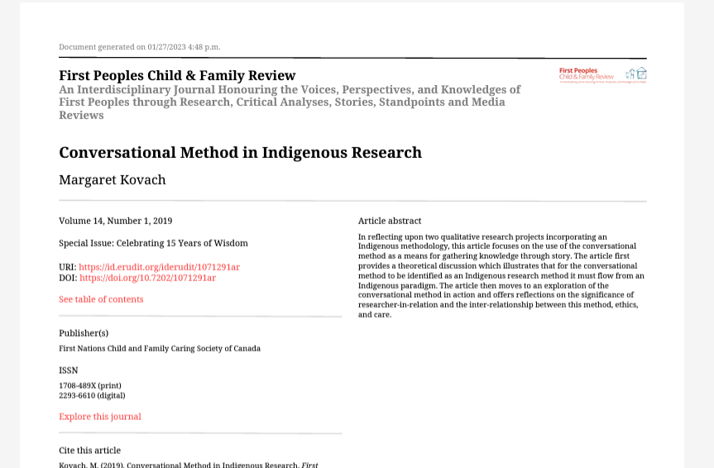

Slide 15
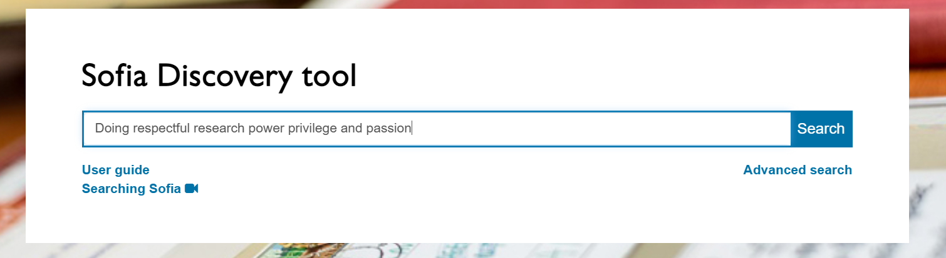
Tilley, Susan A.(2016). Doing respectful research: power, privilege and passion. Winnipeg: Fernwood Publishing

Slide 16
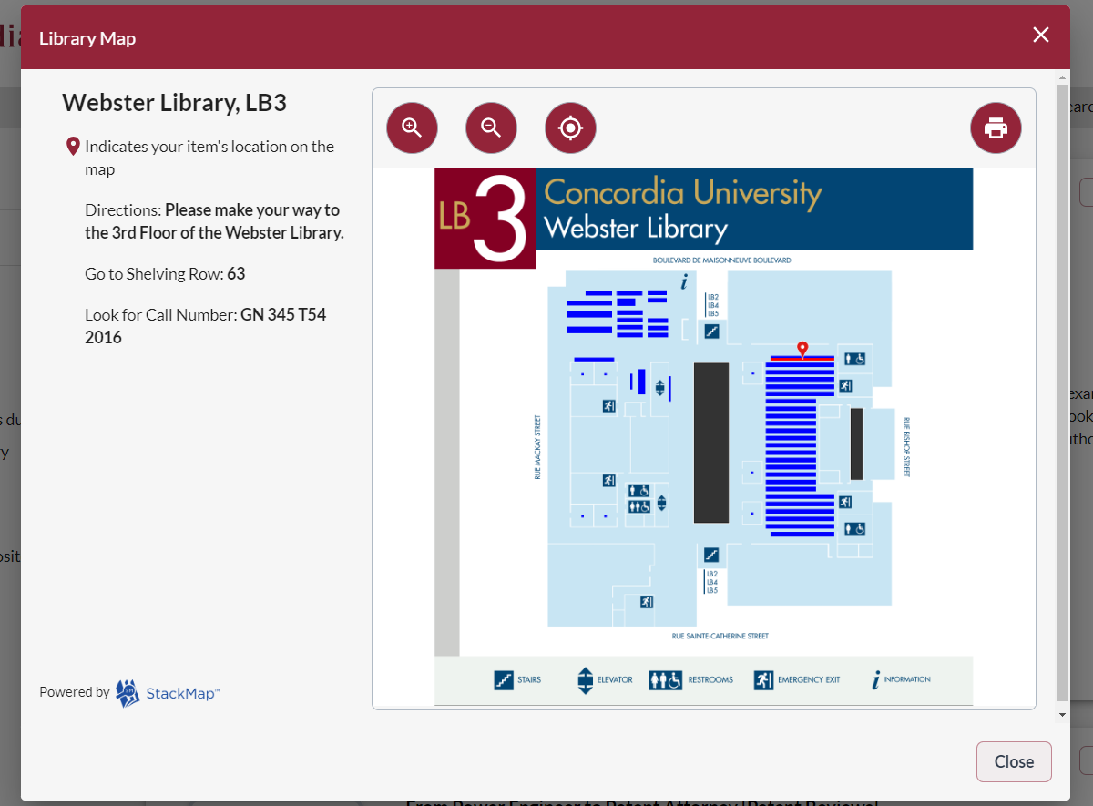
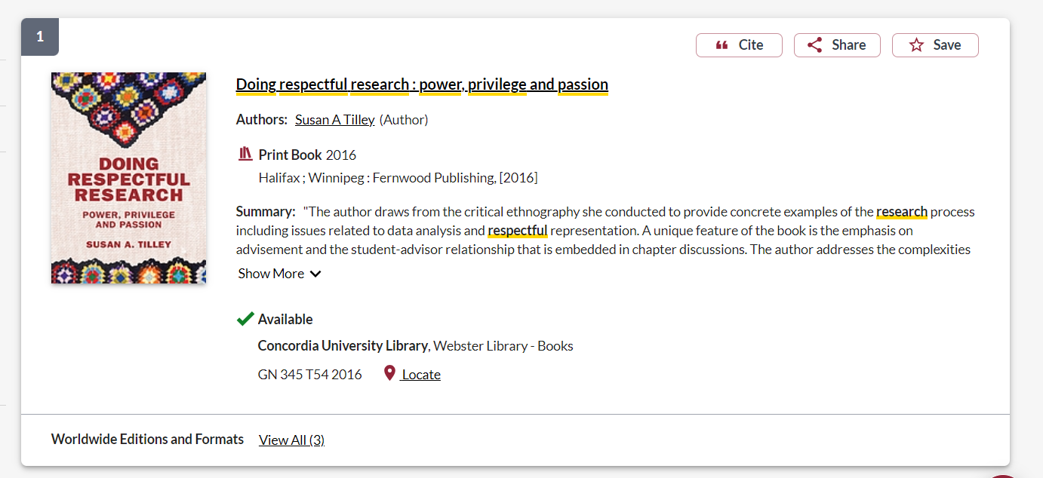

Slide 17
Context – searching for Indigenous scholarship in an academic library

Slide 18
Indigenous Peoples and education in Canada
Education, as controlled and imposed by the church, federal and provincial governments in Canada has been a destructive force in Indigenous communities
Research at the university level, about Indigenous Peoples and communities has been harmful
Libraries, as part of the University and education system, are also colonial institutions, with barriers, biases and impediments to enhancing Indigenous scholarship and voices

Slide 19
Universities & libraries are colonial institutions
“While Indigenous people have necessarily (and effectively) engaged with Western institutions, it is important to remember that this necessity came about largely due to a need to respond to colonial impositions. Colonizers wanted Indigenous lands, and ultimately found imposing institutions to be a most effective way of stealing that land.”
Tuck, E. & Yang, K.W. (2012). Decolonization is not a metaphor. Decolonization: Indigeneity, Education & Society, 1(1), 5-6. https://jps.library.utoronto.ca/index.php/des/article/view/18630/15554

Slide 20
Colonial institutions as ideological structure
“The library is always an ideological structure. It’s not just what goes into the library that matters, but how it’s organized and under which norms.”
Daniel Heath Justice, Ph.D, ACRL Choice Webinar: Indigenous Literatures, social justice and the decolonial library (2019)
“When we look at collections, the actual ‘information’ contained in libraries and how it is organized, we can see that it (surely by accident) somehow manages to construct a reality wherein whiteness is default, normal, civilized and everything else is Other.”
nina de jesus, Locating the library in institutional oppression, In the library with the lead pipe (Sept 24, 2014)

Slide 21
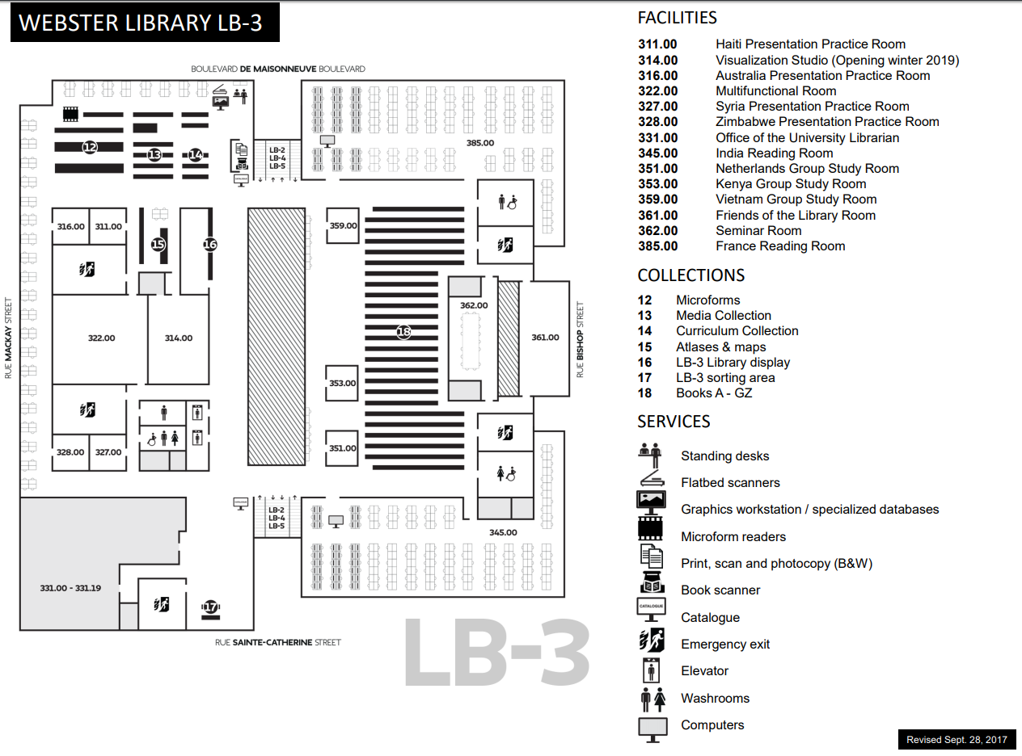
E, F and FC books are here
Call number ranges:
E 75 – E 99 Indigenous Peoples in North America
F 1-1140 History of British America (Canada)
FC 1-4200 Canada

Slide 22
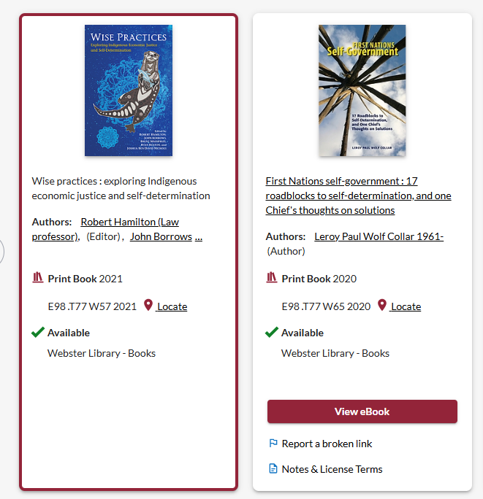
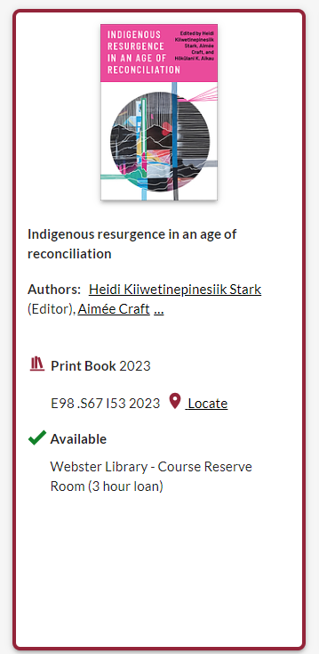
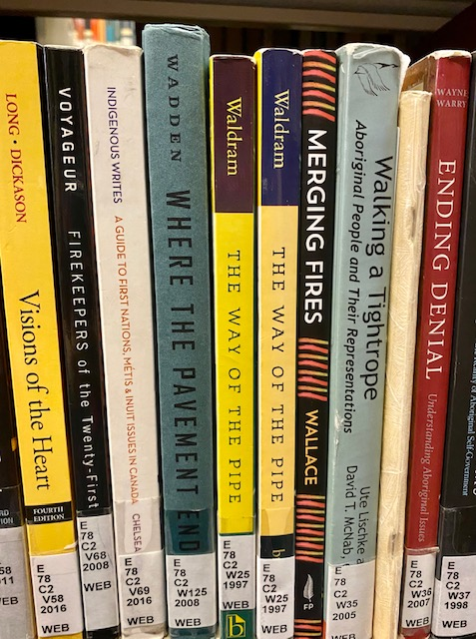
Classification: browse the bookshelves
On the library shelves, most books about First Nations, Inuit, and Métis peoples and thought are found in the E classification area, for “History of North America”. This represents an erasure of living peoples, philosophies, and knowledge.

Slide 23
Terminology
In the most common university library classification system, Library of Congress Subject Headings (LCSH), the main subject heading for material about Indigenous Peoples in Canada and the United States is “Indians of North America”.
The term Indigenous is still new in these systems.
Though relevant and correct, terms for nations such as the Kanien’kehá:ka or confederacies such as the Haudenosaunee are far less prevalent in our Sofia Discovery tool than terms such as Mohawk or Iroquois.

Slide 24
Terminology
  Library of Congress: Subject Headings for Indigenous Peoples - Evaluation
  Libraries in the U.S. and Canada are changing how they refer to Indigenous Peoples – The Conversation (Aug 2022)
  First Nations, Metis and Inuit – Indigenous Ontologies (FNMIIO) – National Indigenous Knowledge and Language Alliance/Alliance nationale des connaissances et des langues autochtones NIKLA-ANCLA (home.blog)
  Respectful Terminology Platform Project | NIKLA-ANCLA

Slide 25
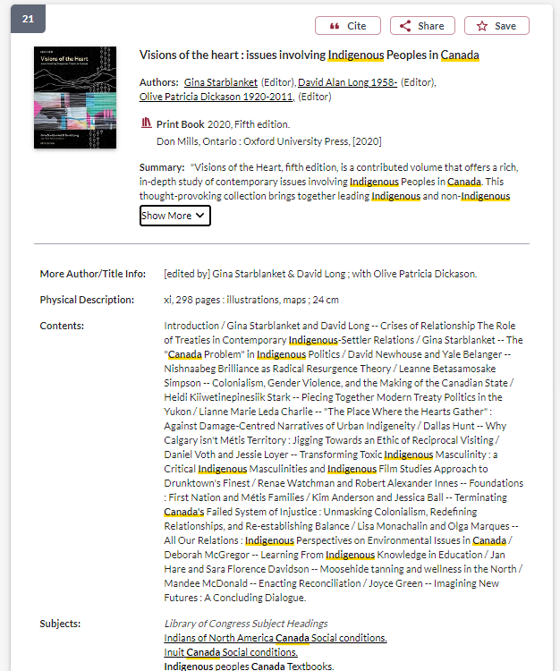
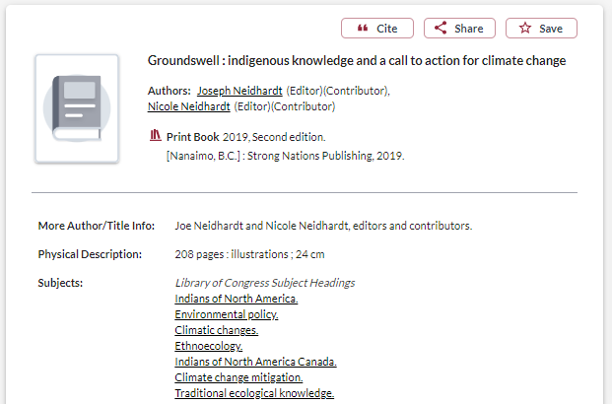
Terminology: what about the subjects?
These books were published in 2019 and 2020 and are about “contemporary issues involving Indigenous peoples in Canada” and Indigenous activism regarding climate change.
However, they are classified within the subject heading: Indians of North America

Slide 26
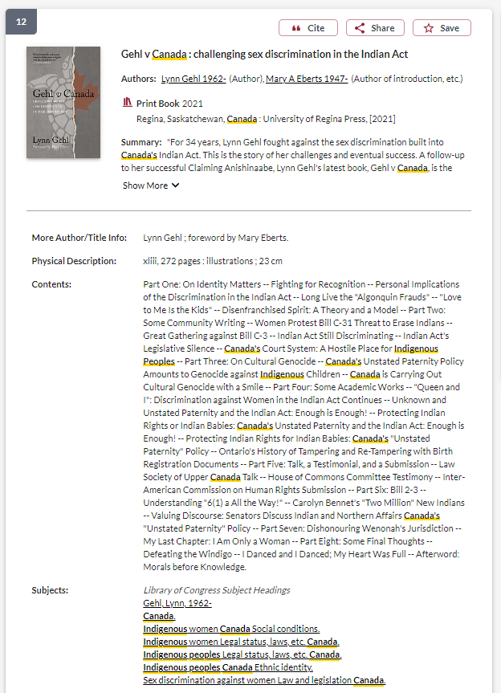
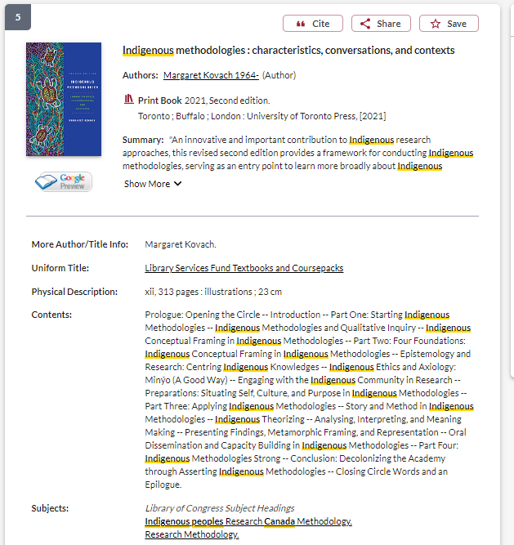
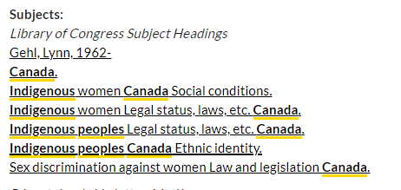

Slide 27
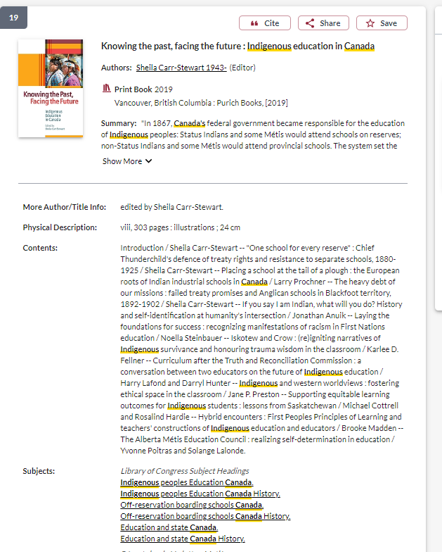
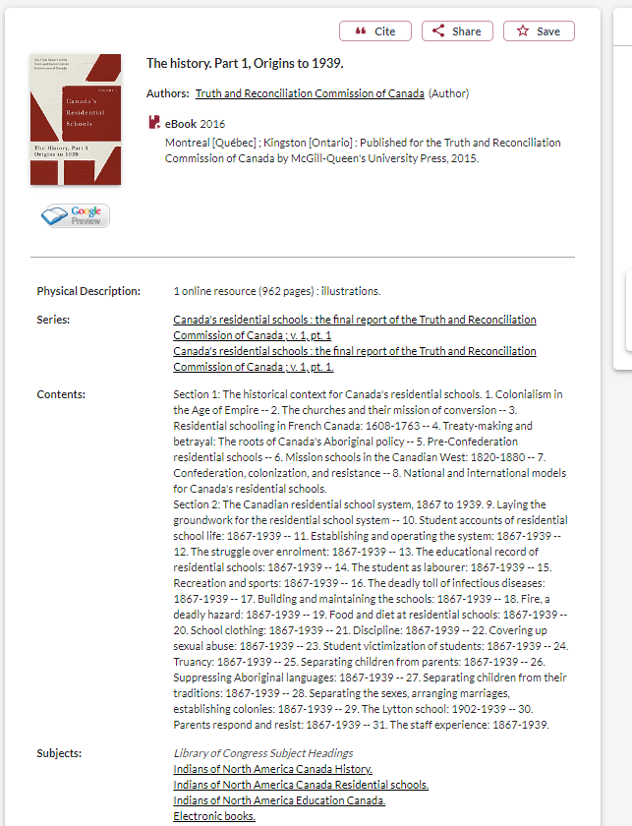
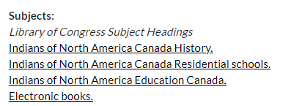
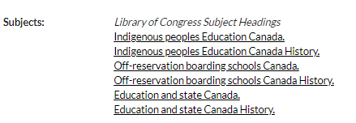
Terminology: what about the subjects?
Until recently, the subject heading “Residential School” was less common than subject headings such as:
“Off-reservation boarding schools - Canada”
“Indians of North America - Education”

Slide 28
Terminology – Government
The government departments responsible for relations with Indigenous Peoples in Canada, has changed 9 times the country’s colonial history.
1860 - Dept of Crown Lands & Hudson's Bay Company,
1873 – Dept of the Interior,
1880 – Dept of Indian Affairs,
1936 – Dept of Mines & resources,
1949 – Citizenship & Immigration,
1965 – Northern Affairs and National resources,
1966 – Indian Affairs and Northern Development
Current departments: 2017- Indigenous Services Canada (ISC) and Crown-Indigenous Relations and Northern Affairs Canada (CIRNAC).

Slide 29
Keywords and subjects for searching scholarly literature
  Indigenous
  Aboriginal
  Indian (legal significance)
  First Nations, Métis, Inuit
  First Peoples
  Autochtones
  Premières Nations
Regional differences:
  Aboriginal: Australia & Canada
  Native American or American Indian: U.S.
  First Nations: Canada
  Indigenous: international

Slide 30
Language matters
Oka Crisis – government, western scholars, and western journalists
Oka resistance, Oka uprising, Oka revolt – Indigenous scholars, Indigenous perspectives
Kanehsatake/Kanehsatà:ke Resistance – specificity

Slide 31
There is a tension between finding keywords and subjects that will result in the most comprehensive search, and the terminology or way of speaking and writing about Indigenous Peoples, knowledges, and worldviews respectfully.
Pause.

Slide 32
Strategies to locate Indigenous Scholars and other research in library databses

Slide 33
Choosing and developing a topic

Slide 34
Possible topics
I’m interested in Indigenous studies in higher education
I’d like to know how land-based education is being incorporated into pedagogy at the university level
I want to know how Indigenizing and decolonizing efforts are being integrated into university curriculum

Slide 35
Identifying keywords
My key concepts
Alternative or related terms
Indigenous studies
Land-based education
Higher education/University
Pedagogy/curriculum
Indigenizing
Decolonizing
First Peoples Studies
Land-based learning/Place based education
Post-secondary
Teaching
Reconciliation

Slide 36
How do we combine keywords for the best possible results?
AND: combines concepts and limits your results
Indigenous AND education
youth OR teens
land OR territory
OR: allow you to insert synonyms or alternative terms and increases your results

Slide 37
How do we combine search words for the best possible results?
“quotation marks”: If you put two or more words in quotation marks, that exact phrase will be searched and limits your results.
“First Nations”
“public policy”
Democra*
Finds: democracy, democracies, democratization, etc.
* - when you add an asterisk on the end of a word, your results will contain all the words with those endings or suffix

Slide 38
Avoid searching with linking or unnecessary words
Effects
Impact
Consequences
Influence
Results
Importance
Significance
Response
Emphasis
Causes
Each author may use different linking words when discussing similar topics.
You don’t want your search to be limited to those books and articles that only contain the word “effect” or “consequence”

Slide 39

How do you start your research?
Where do you look first?

Slide 40
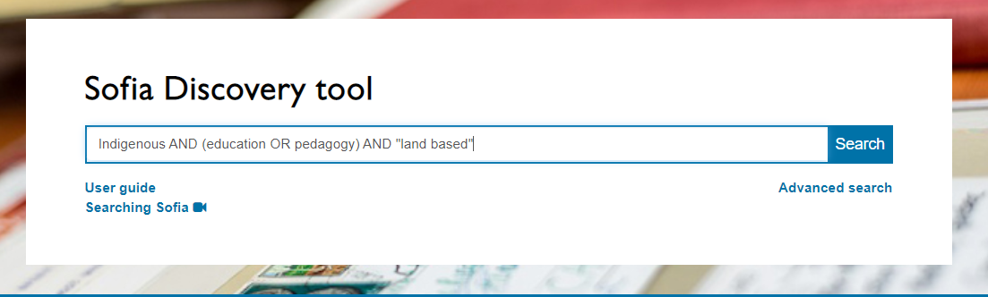
Searching for some of the main concepts I identified
Keeping my search broad, to see what is out there
AND/OR need to be in ALL CAPS in Sofia
I can add concepts, as I develop my search
In Sofia, we are searching through books and articles, books can be searched more broadly because we are searching through titles, subjects and table of contents

Slide 41
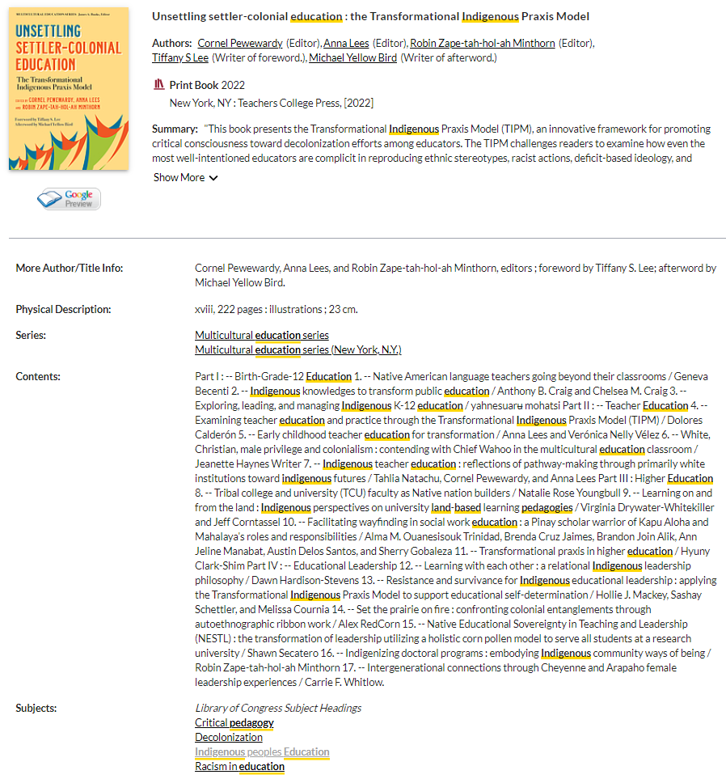
All books in the library are arranged by subject and will have subjects listed in their book record.
Clicking on one of these subjects will find all the books and some articles that have the same subject attached, at the library.

Slide 42
Who wrote the book?
How do we locate Indigenous authors?
Scholarly books often have editors and each chapter will have different authors
You should look for “Contributors”, which will have a list of individual chapter authors, and their biographies either at the beginning or very end of the book
If a book has one author, look for “about the author” section or even skim the introduction, where the author will describe themselves

Slide 43
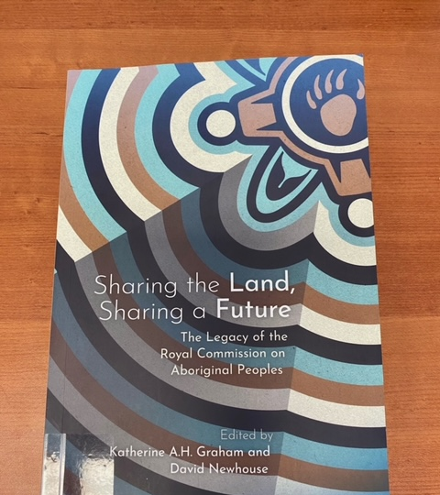
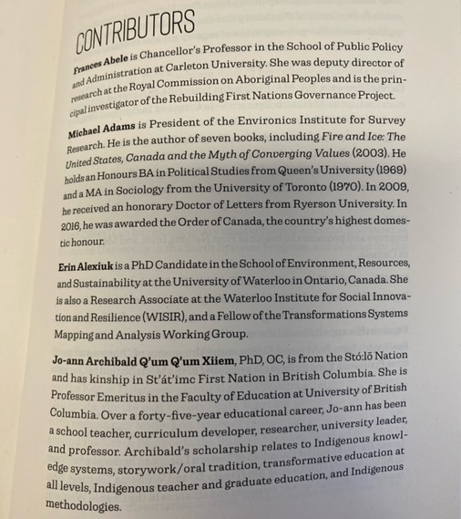

Slide 44
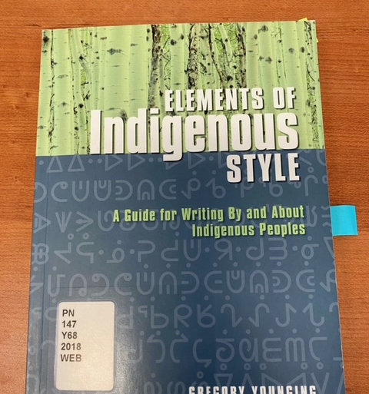
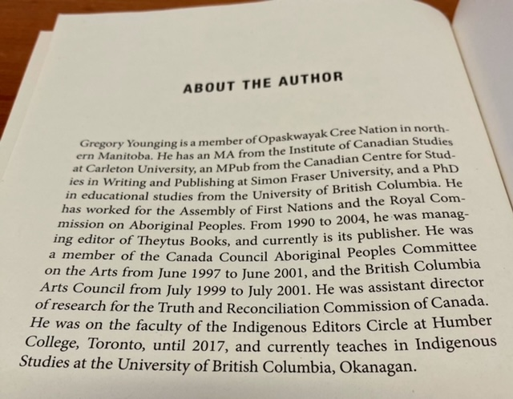

Slide 45
Who wrote the book?
How do we locate Indigenous authors?
The table of contents might also have author information, in the case of Indigenous authors their community or nation may be in brackets following their name
Indigenous scholars and authors are very likely to self-identify, with details about their nation or community in prefaces, introductions, etc.

Slide 46
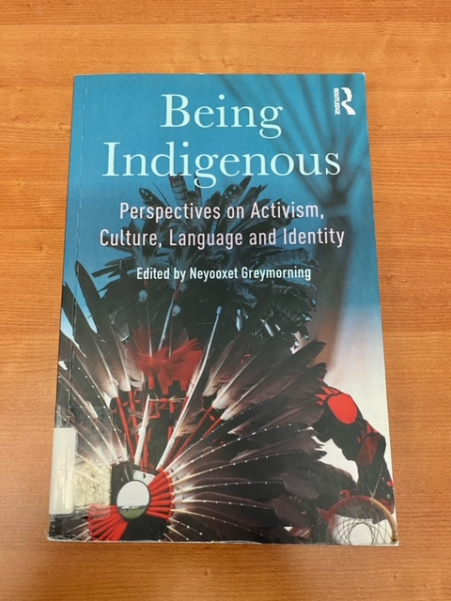
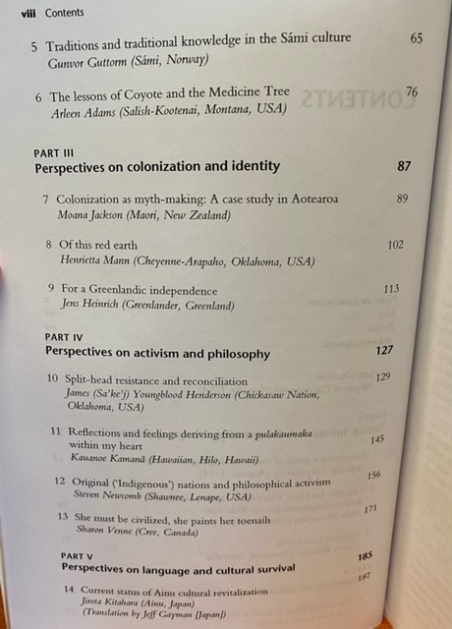

Slide 47
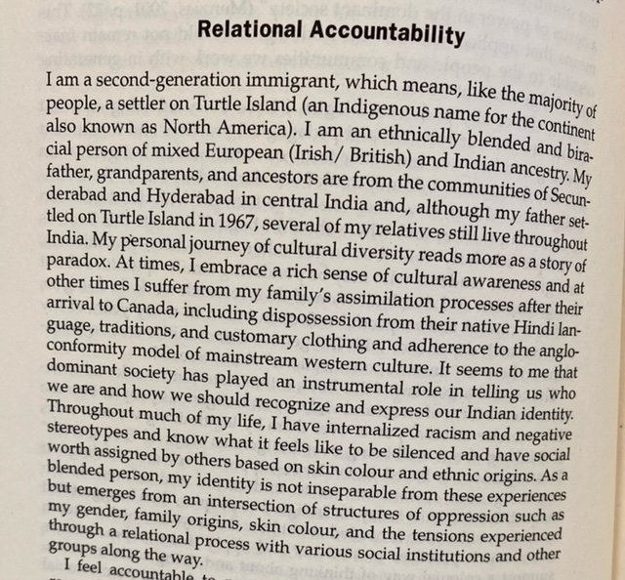
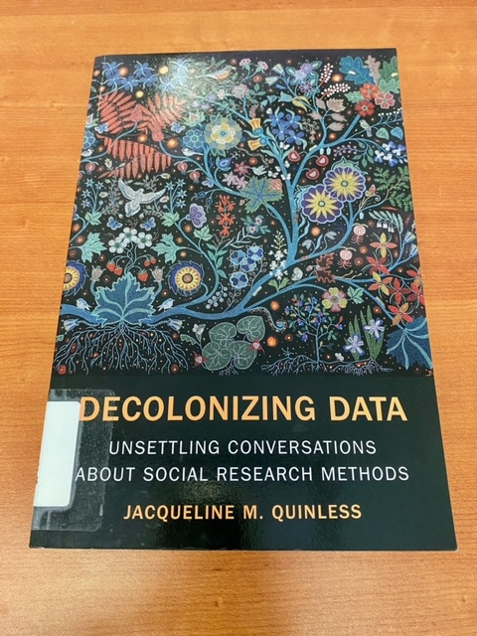

Slide 48
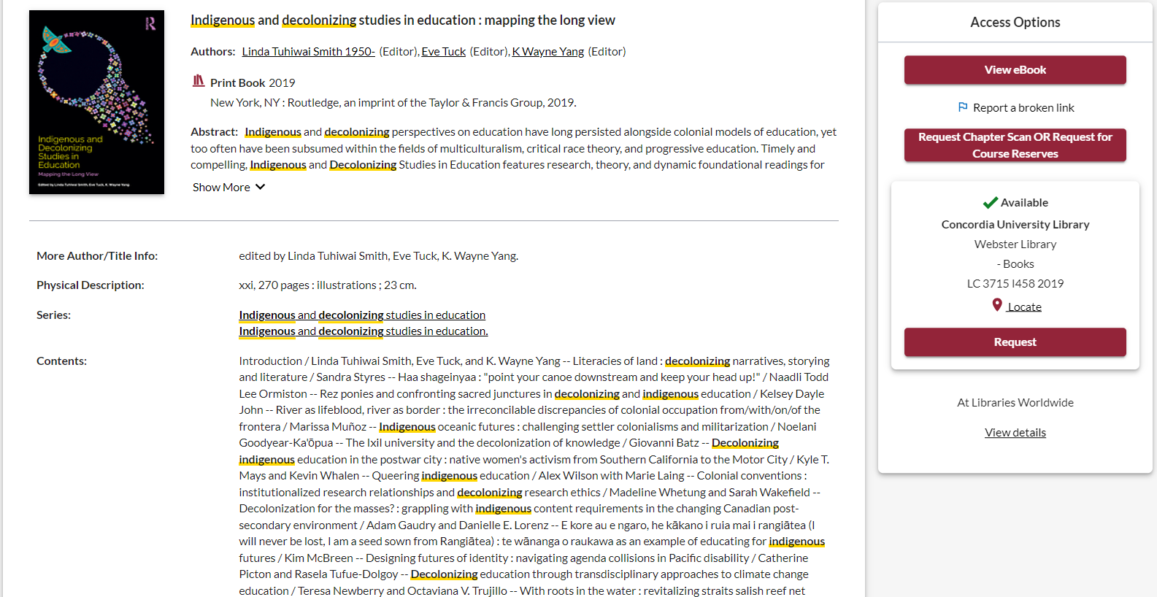
Let’s find out about the contributors

Slide 49

How to use a scholarly book
Most scholarly books are edited, and each chapter will be about a different aspect of a broad theme
Check the table of contents and the index (at the end of the book) to locate your topic in the book
Read the chapter or section about your topic
Think of each chapter in an edited book as an article
You can cite multiple chapters from an edited book
You’re not expected to read the entire book, it’s unnecessary and not how scholarly books are usually used in research

Slide 50
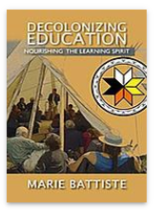
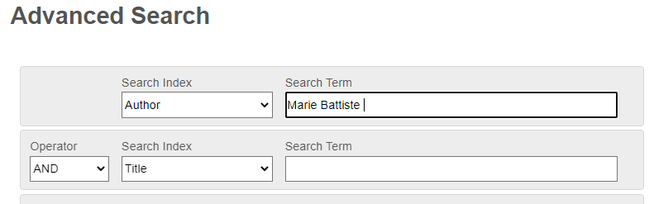
How else can I locate books by Indigenous authors and scholars?
Indigenous Authors in the Spotlight series
Indigenous Resources guide: Knowledges, methods & ethics
Sofia (Advanced) Author search for a known scholar
Marie Battiste is a Mi'kmaw educator from the Potlotek First Nation

Slide 51
Indigenous publishers / organizations / institutes
Publishers:
UBC's list of Indigenous Publishers, Distributors & News Media
UofT's list of First Nations, Inuit, and Métis Publishers and Distributors
GoodMinds: First Nations, Métis and Inuit Books – online bookstore, located at Six Nations of the Grand River
Organizations and institutes - EXAMPLES:
The Yellowhead Institute
Shekon Neetchie: An Indigenous History Site -- see their history bibliography
The Montreal Indigenous Community Network -- see their resources
The Native Women’s Association of Canada – See the Knowledge Centre, Journal and Magazine
.....do YOU have tips to offer?

Slide 52
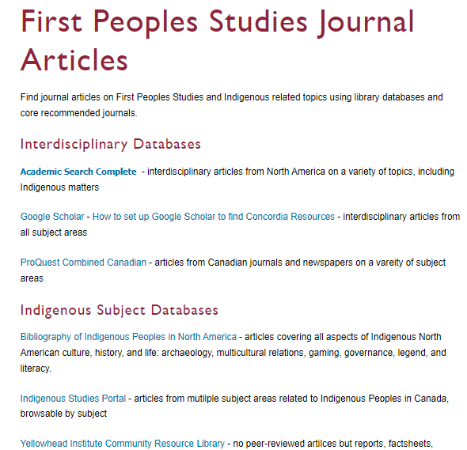
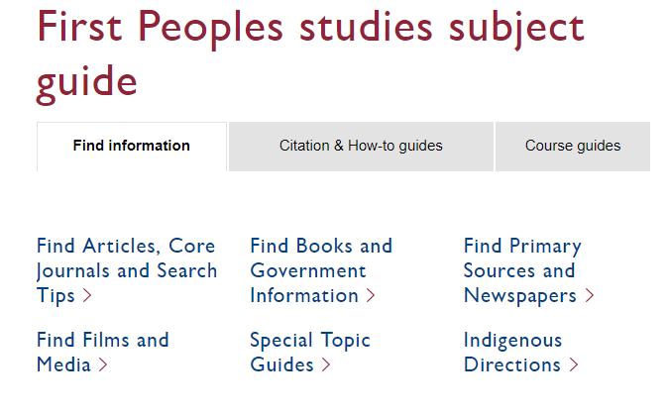
Using databases to search for journal articles

Slide 53
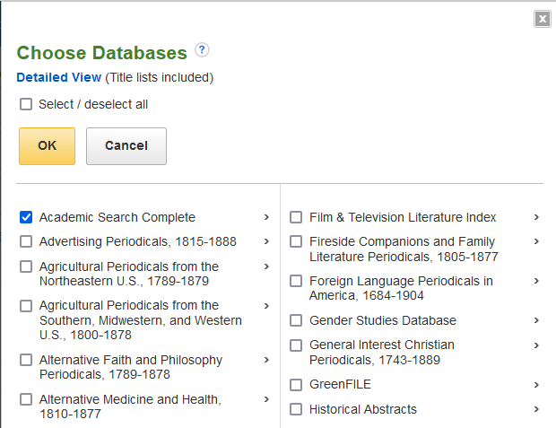
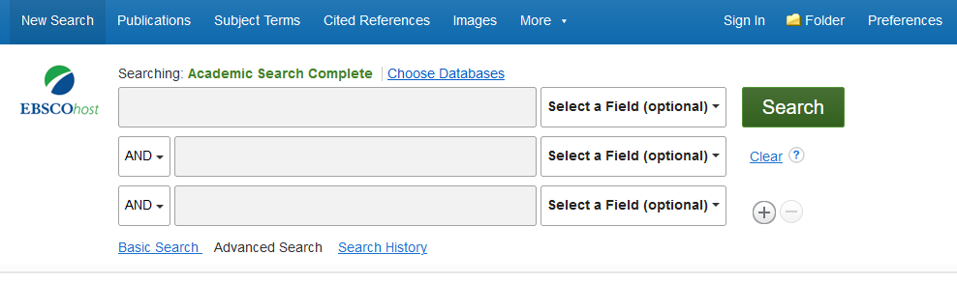

Combining databases in EBSCO
We can combine the large, multidisciplinary database Academic Search Complete with the subject-specific database Bibliography of Indigenous Peoples in North America

Slide 54
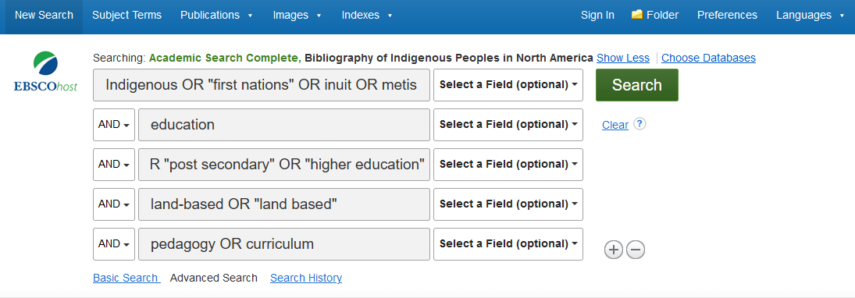
Search:
Indigenous OR "first nations" OR inuit OR metis
AND education
AND university OR "post secondary" OR "higher education“
AND land-based OR "land based“
AND pedagogy OR curriculum

Slide 55
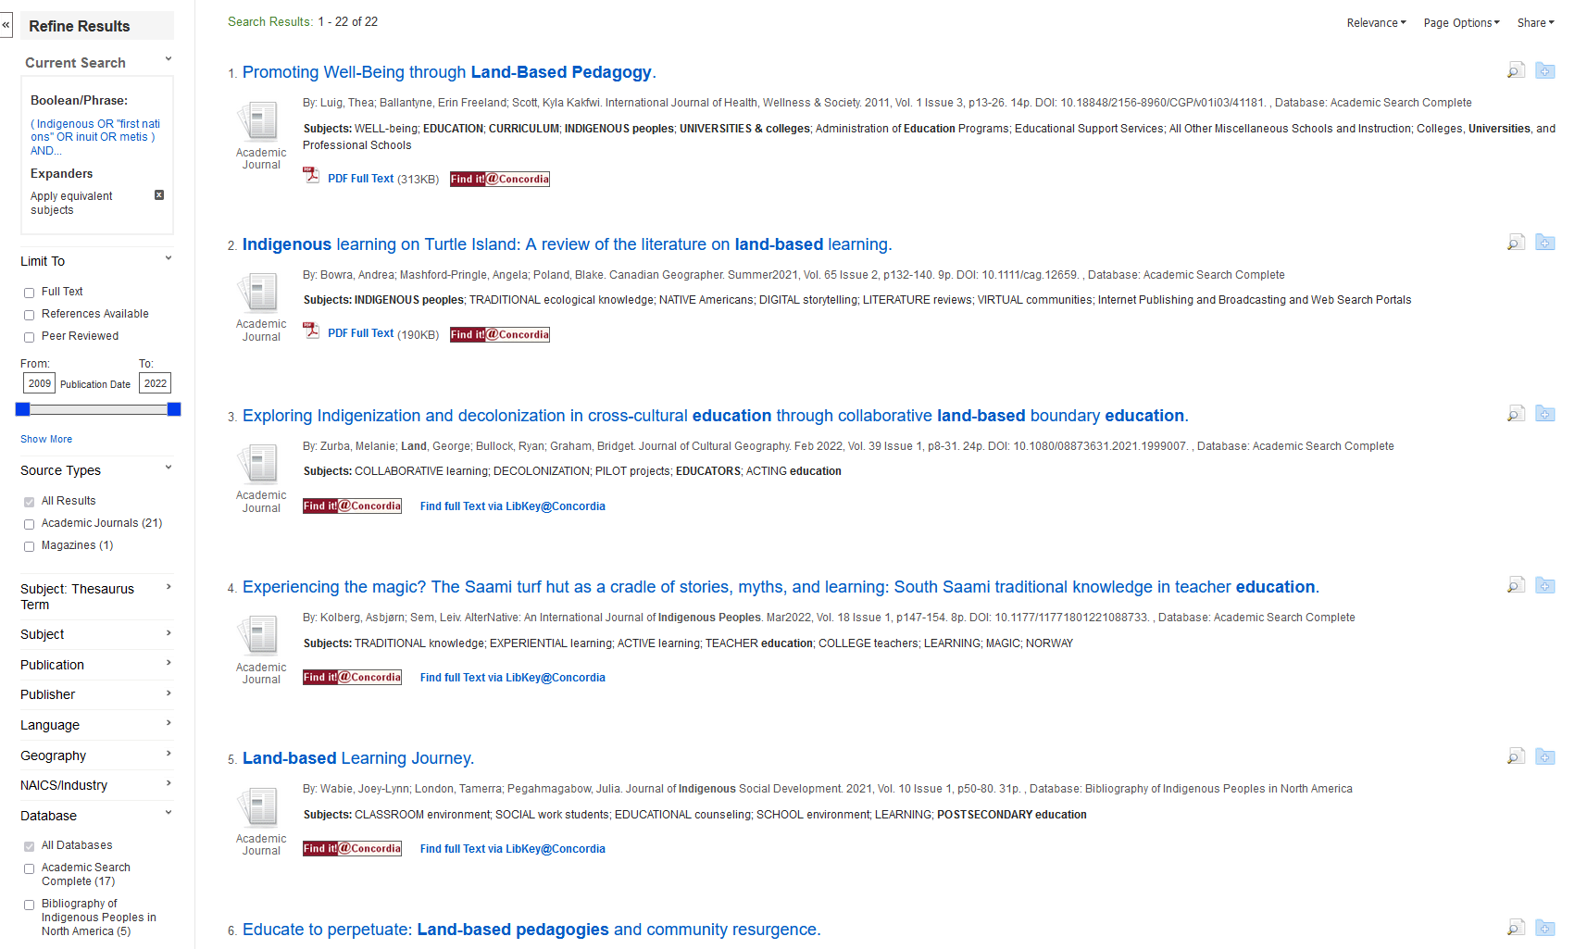
We can narrow down to peer reviewed articles only here
We can save our articles here
We can add subjects here
We can see which database our articles are coming from here

Slide 56
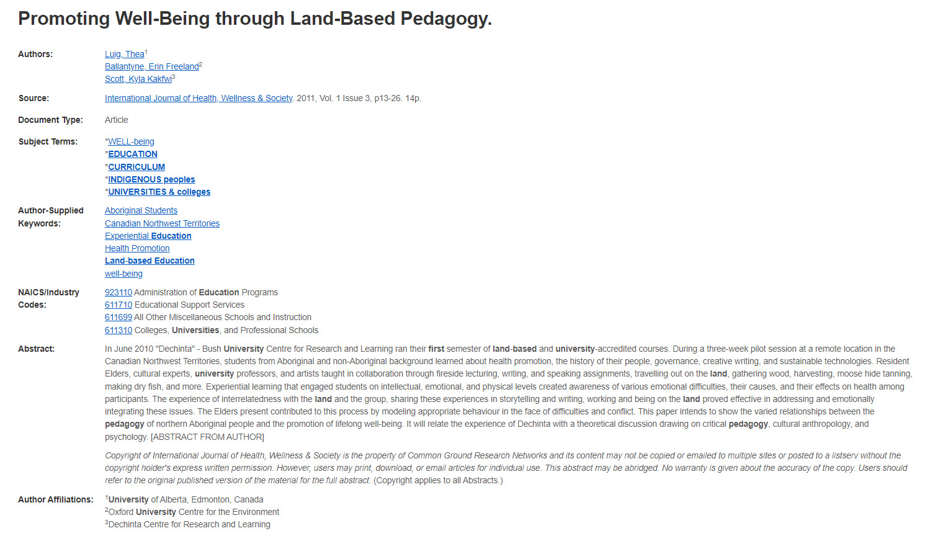
Length: scholarly articles are generally 10+ pages
Read the abstract and the subjects to see if the article will match your topic
Author affiliations will provide which universities researchers are from and, in some cases, identify Indigenous authors and communities

Slide 57
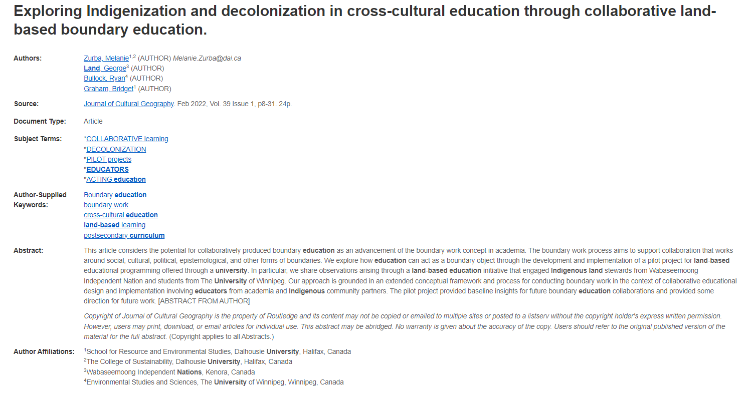
There is an Indigenous author on the research team, affiliations can give this information like “contributors” lists

Slide 58
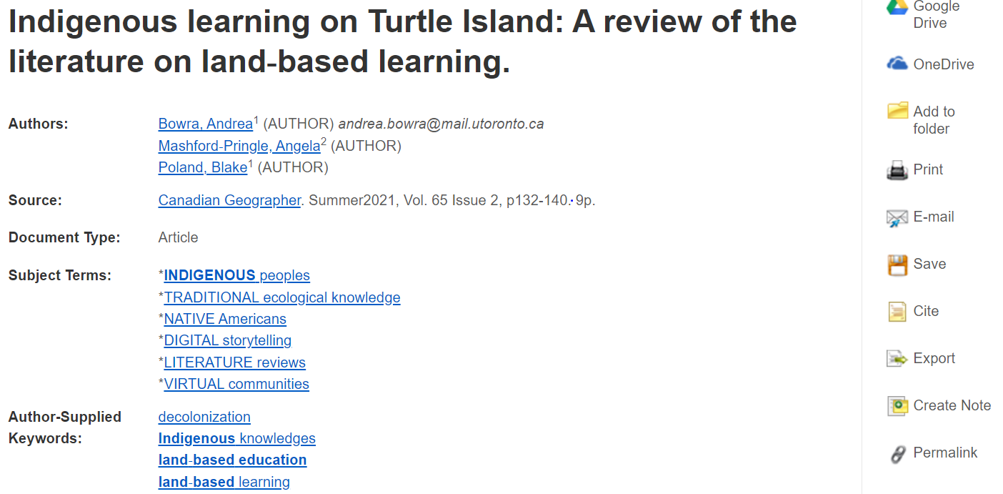
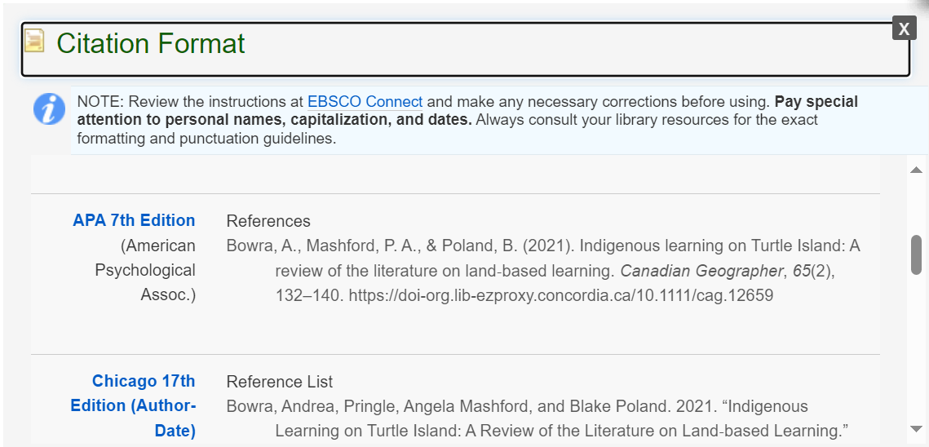
Cite!

Slide 59

Scholarly articles will always have reference lists/bibliographies/works cited
These are great places to find more sources!
The researcher or research team are experts in the subject area and have already done a lot of research
Use this expertise by looking up the books and articles they cite in Sofia and using them in your own research
This is a commonly used method in academic research

Slide 60
Use the reference list or bibliography from a well designed research study or relevant research article, written by Indigenous authors or with Indigenous contributors to find additional Indigenous research
Indigenous scholars often cite each other’s work
Those working with Indigenous research methods and worldviews will build on the previous research
Fits within the concept of Ethical Citation Practices

Slide 61




Slide 62




Slide 63


Slide 64

I-Portal can be browsed by using the Turtle or the list of broad topics

Slide 65

The record will give you a lot of information about the article including the type of source, peer reviewed, and attached subjects

Slide 66

Search in the same way we searched in the Sofia Discovery Tool
Options to narrow down, on the right

Slide 67


Slide 68

Your turn!
Use a database to find an article

Slide 69
Your turn!
Topics and research strategies
Fill in your general topic or research question
Break the topic down into the key concepts or ideas, then brainstorm synonyms and related terms
How will that search strategy look in the Sofia Discovery Tool?
Key Concept | Key Concept | Key Concept | Key Concept
Indigenous | education | Land-based | University
Synonym or related terms | Synonym or related terms | Synonym or related terms | Synonym or related terms
First Nations Metis Inuit First Peoples | Pedagogy Learning Teaching | Placed based | Post-secondary
Sofia Search: Indigenous AND (education OR pedagogy OR learning OR teaching) AND (“land based” OR “place based”) AND (university OR post secondary)

Slide 70

Citation!

Slide 71
Elements of Indigenous Style
The body of literature on Indigenous Peoples in Canada is based on “a colonial practice of transmitting ‘information’ about Indigenous Peoples rather than transmitting Indigenous Peoples’ perspectives about themselves.”
(Younging, 2018, p. 1)

Slide 72
Elements of Indigenous Style
“Many Indigenous Peoples and authors have cited cultural appropriation, misrepresentation, and a lack of respect for Indigenous cultural Protocols as significant problems in Canadian publishing. Indigenous Peoples have frequently taken the stand that they are best capable of, and morally empowered to, transmit information about themselves. They have the right to tell their own story.”
(Younging, 2018, p. 2)

Slide 73
Representations of Indigenous Peoples
(Younging, 2018, pp. 8-10)
Writings about Indigenous Peoples were written by early explorers, missionaries, and anthropologists contained descriptions that are “degrading and offensive” to Indigenous Peoples
1980’s to present a “wave of writing by non-Indigenous academics” at universities, and in governments and were established as “authorities” on Indigenous Peoples
Much of this academic writing has been “observational and analytical” it has not “expressed Indigeneity and Indigenous epistemologies, it has not expressed Indigenous Peoples’ internal unique perspectives on contemporary Indigenous political and cultural issues.”

Slide 74

Principles of Indigenous Style
(Younging, 2018, p. 7)

Slide 75
More Principals of Indigenous style
Recognizing Indigenous identity
Respecting Indigenous cultural property
Collaboration
Elders as authentic sources of Indigenous cultural information
In working with Traditional Knowledge and Oral Traditions, recognizing that these are Indigenous cultural properties, owned and controlled by Indigenous Peoples
Relationship, trust and truth
Avoiding inappropriate terminology
Naming, capitalization, inappropriate possessives or past tenses
Recognizing historical materials may not be appropriate to reuse

Slide 76
Indigenous Data Sovereignty
Movements, guidelines, & protocols
*Indigenous data includes information:
related to resources and environments (land, geology, water)
about demographics and service use (legal, social, health, educational)
produced BY Indigenous communities (stories, archives, traditions).
Lar-Son,Kayla. iassistdata. (2021). Data as Relation: Indigenous Data Sovereignty and Ethic of Care. [SLIDES]

Slide 77
Data Sovereignty
Data sovereignty means “managing information in a way that is consistent with the laws, practices and customs of the nation-state in which it is located”.
[Indigenous Peoples] have an inherent and constitutionally protected right to self-government. This inherent right stems from sovereignty which existed prior to the arrival of European settlers.
This includes jurisdiction over their education, laws, policies, health, and information.
As sovereign nations, First Nations [and other Indigenous Peoples] have the right (inherent and constitutionally-protected) to exercise authority over their data and information...The concept of data sovereignty “is linked with Indigenous peoples’ right to maintain, control, protect and develop their cultural heritage, traditional knowledge and traditional cultural expressions, as well as their right to maintain, control, protect and develop their intellectual property over these”.
First Nations Information Governance Centre. (2019). First Nations data sovereignty. Statistical Journal of the IAOS 35(1), 47-69.

Slide 78

[From Concordia’s Research Data Management guide]
Research with Indigenous Communities:

Slide 79

APA Citation Style – 7th edition
APA Style Blog (2022). Personal Communications. https://apastyle.apa.org/style-grammar-guidelines/citations/personal-communications

Slide 80

APA – Traditional Knowledge or Oral Traditions
APA Style Blog (2022). Personal Communications. https://apastyle.apa.org/style-grammar-guidelines/citations/personal-communications

Slide 81

APA – Traditional Knowledge or Oral Traditions
APA Style Blog (2022). Personal Communications. https://apastyle.apa.org/style-grammar-guidelines/citations/personal-communications

Slide 82
Style guides
SFU - Respectful Research: https://www.lib.sfu.ca/help/cite-write/citation-style-guides/apa/indigenous-elders-knowledge-keepers
NorQuest College Library - Referencing Indigenous Elders and Knowledge Keepers: https://libguides.norquest.ca/apa/references

Slide 83


Slide 84


Slide 85


Slide 86


Slide 87


Slide 88


Slide 89


Slide 90


Slide 91


Slide 92


Slide 93

Need help, ask us!
Michelle.Lake@Concordia.ca

