Slide 1
FPST 202: Research Strategies in First Peoples Studies Library Workshop
Michelle Lake
Subject Librarian for FPST, SCPA, Poli Sci and Government information
Michelle.Lake@Concordia

Slide 2
Who am I?
Michelle Lake, librarian for Political Science, the School of Community and Public Affairs, First Peoples Studies, and Government Publications
Settler, originally from Ontario.
My hometown is located on the traditional territories of the Erie, Neutral, Huron-Wendat, Haudenosaunee and Mississaugas, on land covered by the Dish With One Spoon Wampum Belt Covenant.
I live and work on the unceded Indigenous lands of Tiohtià:ke, where the Kanien’kehá:ka Nation is recognized as the custodians of those lands and waters.

Slide 3
Who am I?
BA, University of Guelph, MA Western University
15 years working at Concordia Library
12 years in my current position, Subject librarian for First Peoples Studies, SCPA, Political Science & Government Information
I am still always learning and working to decolonize my own practice as a librarian

Slide 4
What do I do?
Provide research support, teach and assist with search strategies
Help students navigate library databases
Help students find and access materials they need
Assist with evaluation of sources
Build guides, resources and pathfinders to help students locate research materials
Help with citation issues
Choose the books we buy for my subject areas: First Peoples studies, political science, public policy, community and public affairs and government information

Slide 5
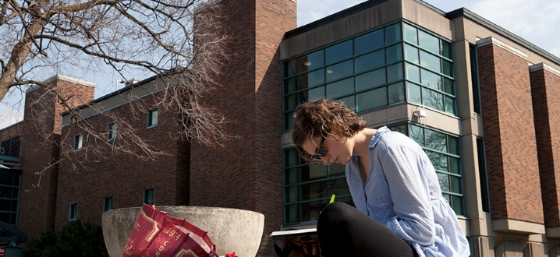
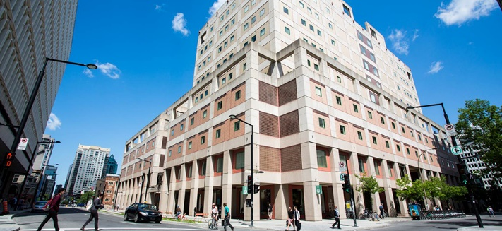
The Librar(ies)
24/7 access, with student card, after 11pm
Webster Library (LB) – downtown on SGW campus & Vanier Library (VL) on Loyola campus
Webster: Social Sciences, Humanities, Business, Engineering & Fine Arts
Vanier: Science(s), Health, Communications, Journalism and Psychology
Course Reserves Room(s): have the required undergraduate print textbooks for the courses taught at that campus (for example: Webster has the FPST, Political Science and SCPA course reserves)

Slide 6
Library Services
Your student card is your library card.
You need it to:
borrow books (up to 100 a time)
borrow a laptop and other technology (for 24 hours)
print on campus (add money to your Dprint account)
access the library overnight during 24/7 hours.
Webster library has 5 book scanners (And Vanier has 2!) that can be used for free to scan chapters from our print books and email them to yourself as a PDF.
To use Library databases, access online articles and ebooks when you are off campus, login with your MyConcordia Netname and password.

Slide 7
Electronic Course Reserves

Slide 8
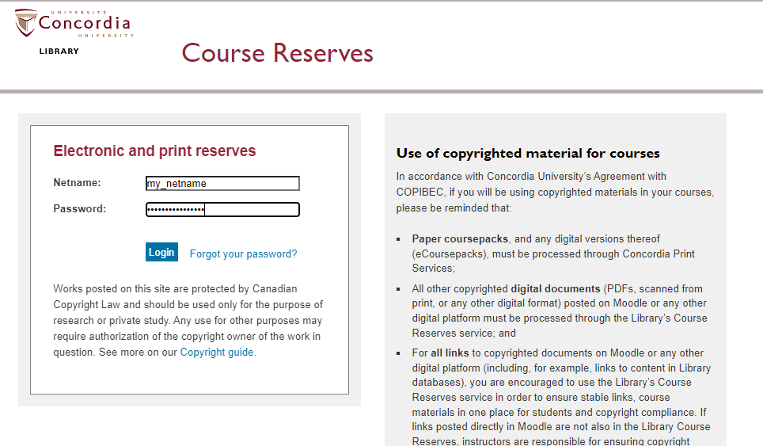

Slide 9
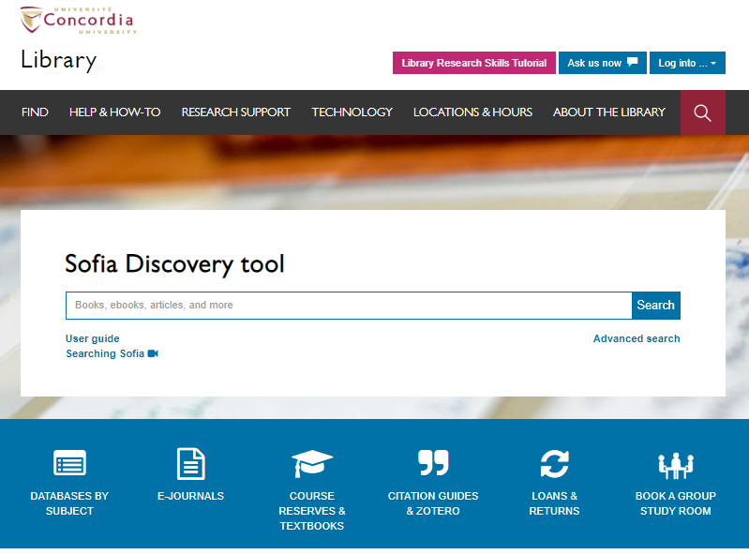
Use the Sofia Discovery tool to find print books, ebooks, and journal articles from the library.

Slide 10
How can I find out if the library has access to an item I’m looking for?

Slide 11
Wilson, S. (2008). Research is ceremony: Indigenous research methods. Halifax: Fernwood Publishing.

Slide 12
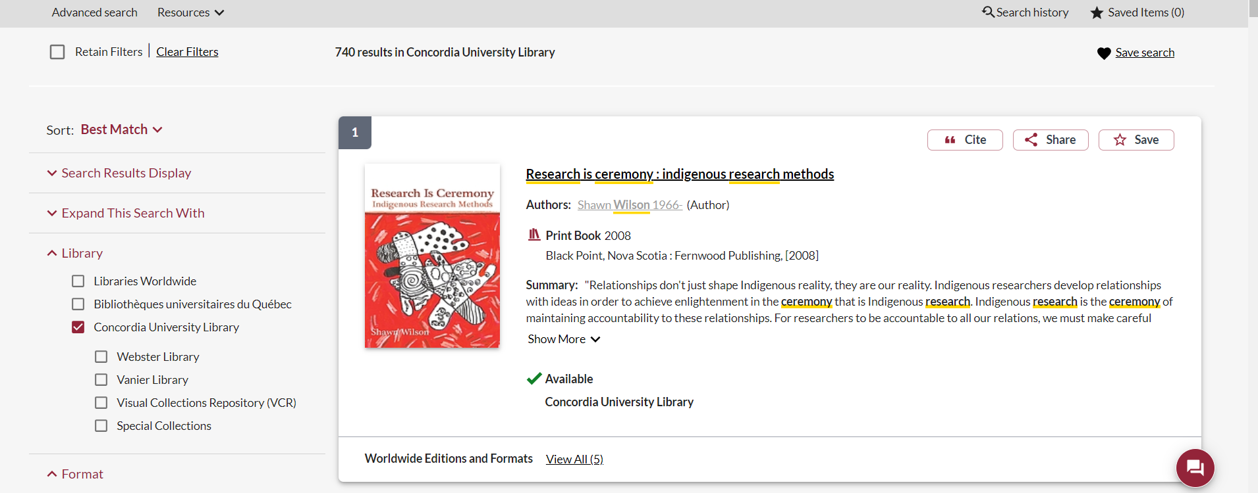
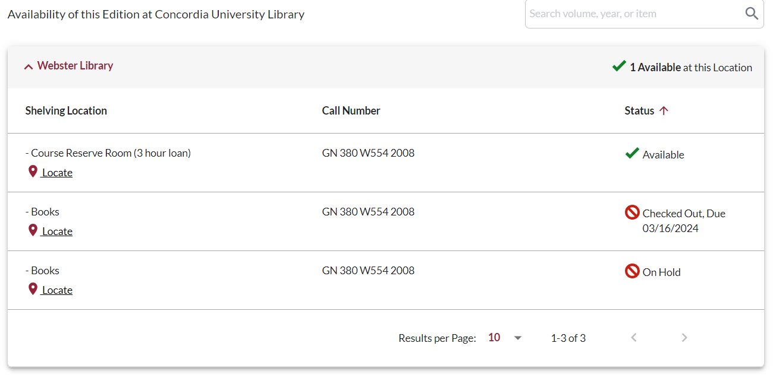
This is a required textbook, so it is found in the course reserves room for a 3 hour loan.
There is a book scanner in the course reserves room, where you can scan chapters and email them to yourself for free.

Slide 13
Kovach, M. (2019). Conversational method in Indigenous research. First Peoples Child & Family Review, 5(1), 40-48.

Slide 14
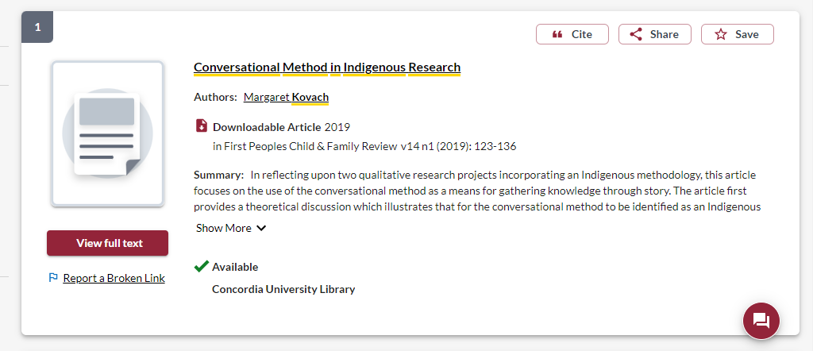
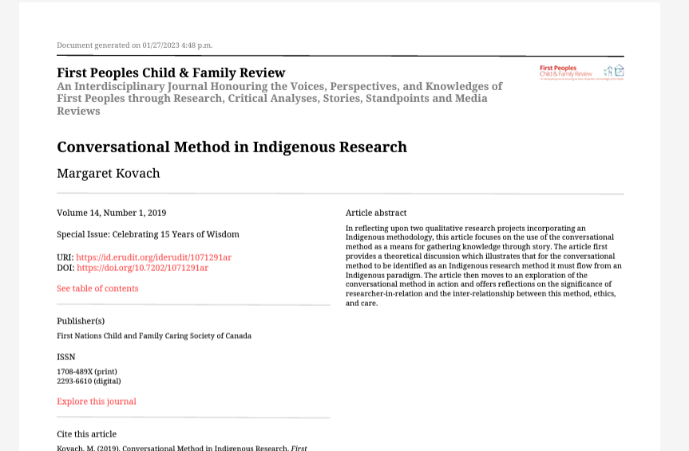

Slide 15
Tenorio, R. (2020). Indigenizing Research Participant Recruitment. In E.S. Huaman & N.D. Martin (Eds). Indigenous Knowledge Systems and Research Methodologies: local solutions and global opportunities. (pp. 145-164). Canadian Scholars.

Slide 16
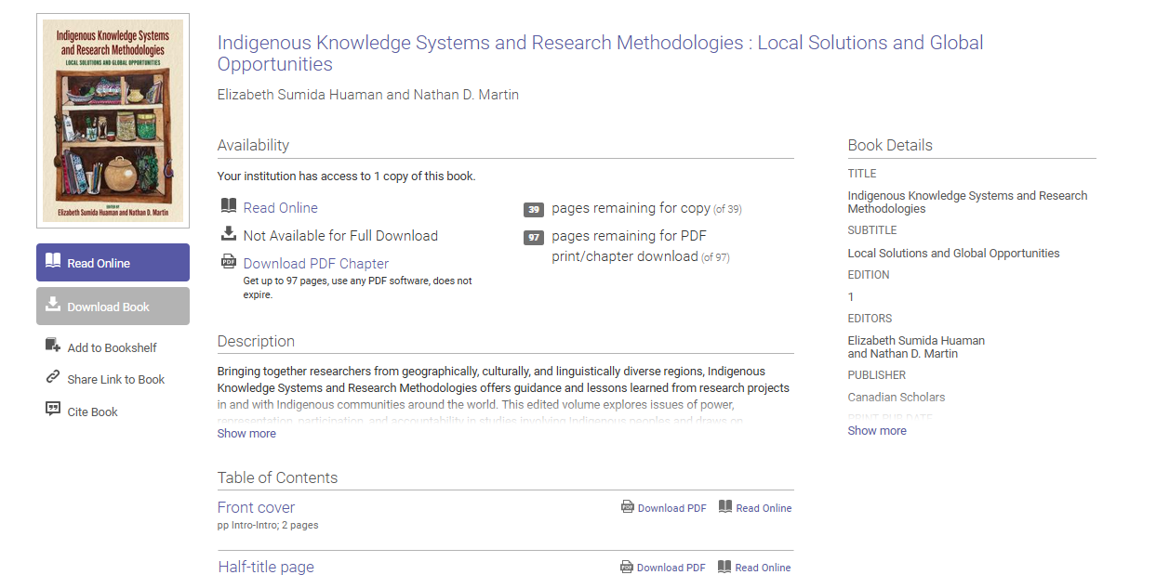

Slide 17
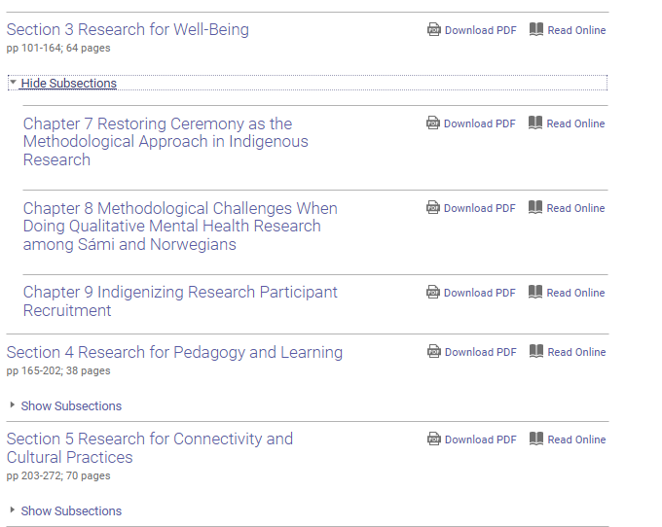
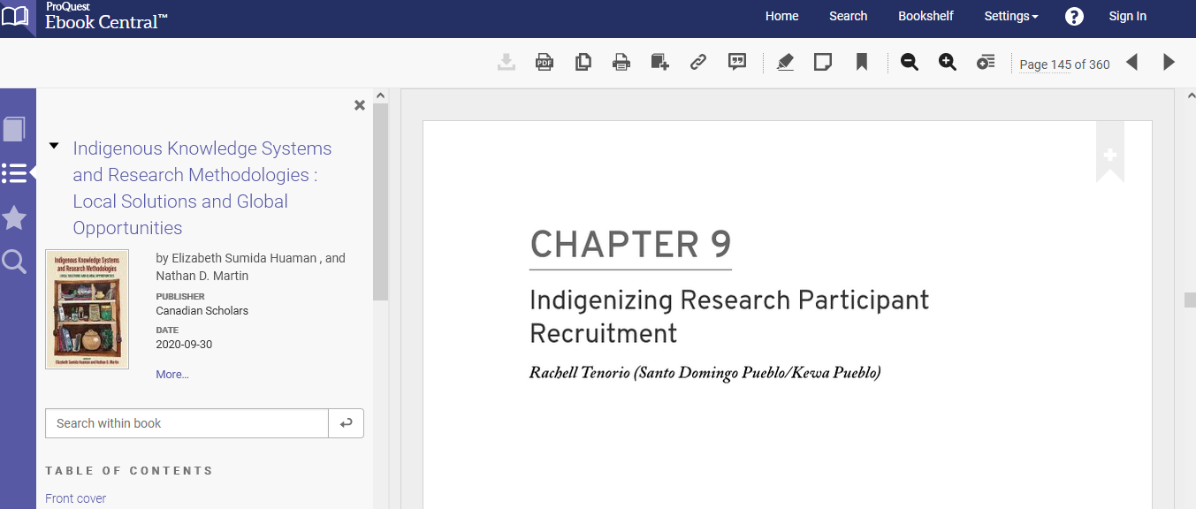

Slide 18
Tilley, Susan A.(2016). Doing respectful research: power, privilege and passion. Winnipeg: Fernwood Publishing

Slide 19
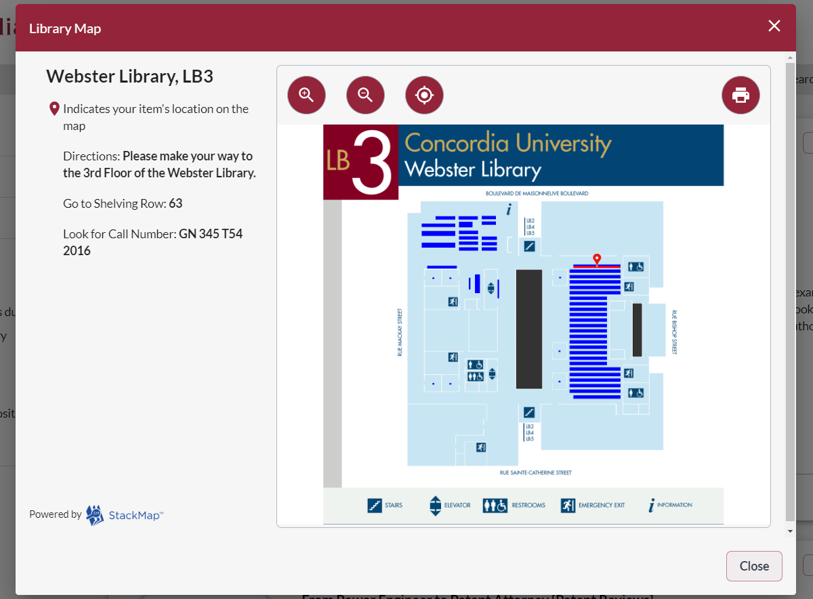
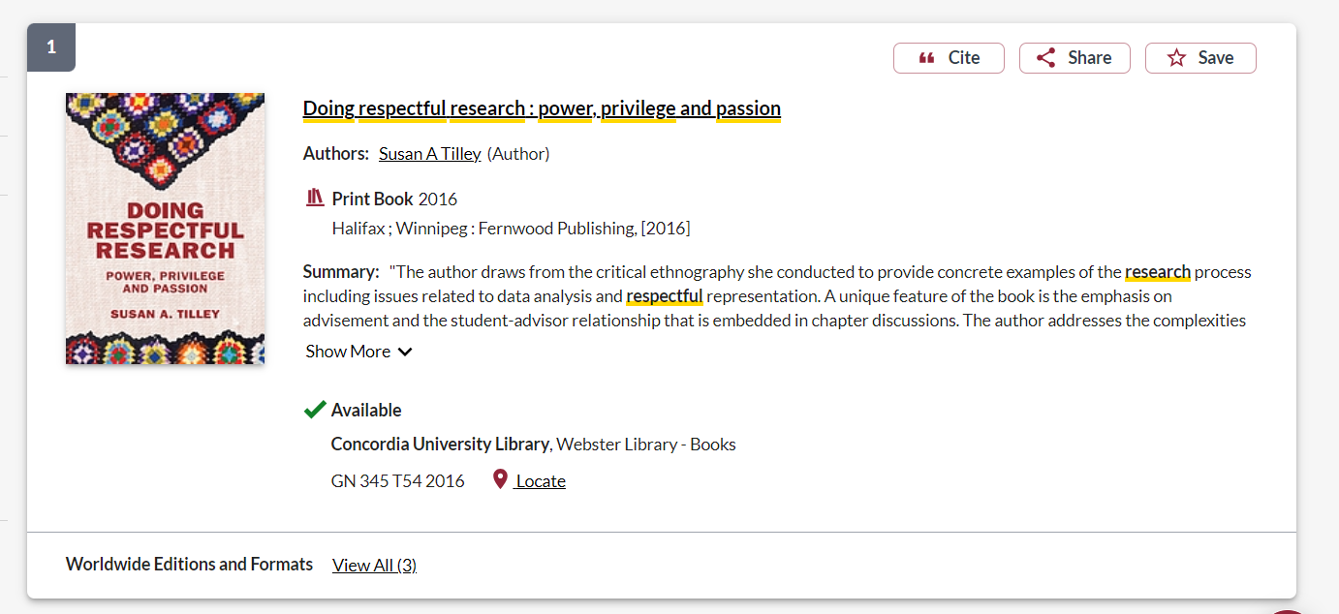

Slide 20
Your Turn! Find and identify the sources. Individually or in pairs
**Hint: Use the Sofia Discovery Tool on the Concordia Library website: https://library.concordia.ca/

Slide 21
Context – searching for Indigenous scholarship in an academic library

Slide 22
Indigenous Peoples and education in Canada
Education, as controlled and imposed by the church, federal and provincial governments in Canada has been a destructive force in Indigenous communities
Research at the university level, about Indigenous Peoples and communities has been harmful
Libraries, as part of the University and education system, are also colonial institutions, with barriers, biases and impediments to enhancing Indigenous scholarship and voices

Slide 23
Universities & libraries are colonial institutions
“While Indigenous people have necessarily (and effectively) engaged with Western institutions, it is important to remember that this necessity came about largely due to a need to respond to colonial impositions. Colonizers wanted Indigenous lands, and ultimately found imposing institutions to be a most effective way of stealing that land.”
Tuck, E. & Yang, K.W. (2012). Decolonization is not a metaphor. Decolonization: Indigeneity, Education & Society, 1(1), 5-6. https://jps.library.utoronto.ca/index.php/des/article/view/18630/15554

Slide 24
Colonial institutions as ideological structure
“The library is always an ideological structure. It’s not just what goes into the library that matters, but how it’s organized and under which norms.”
Daniel Heath Justice, Ph.D, ACRL Choice Webinar: Indigenous Literatures, social justice and the decolonial library (2019)
“When we look at collections, the actual ‘information’ contained in libraries and how it is organized, we can see that it (surely by accident) somehow manages to construct a reality wherein whiteness is default, normal, civilized and everything else is Other.”
nina de jesus, Locating the library in institutional oppression, In the library with the lead pipe (Sept 24, 2014)

Slide 25
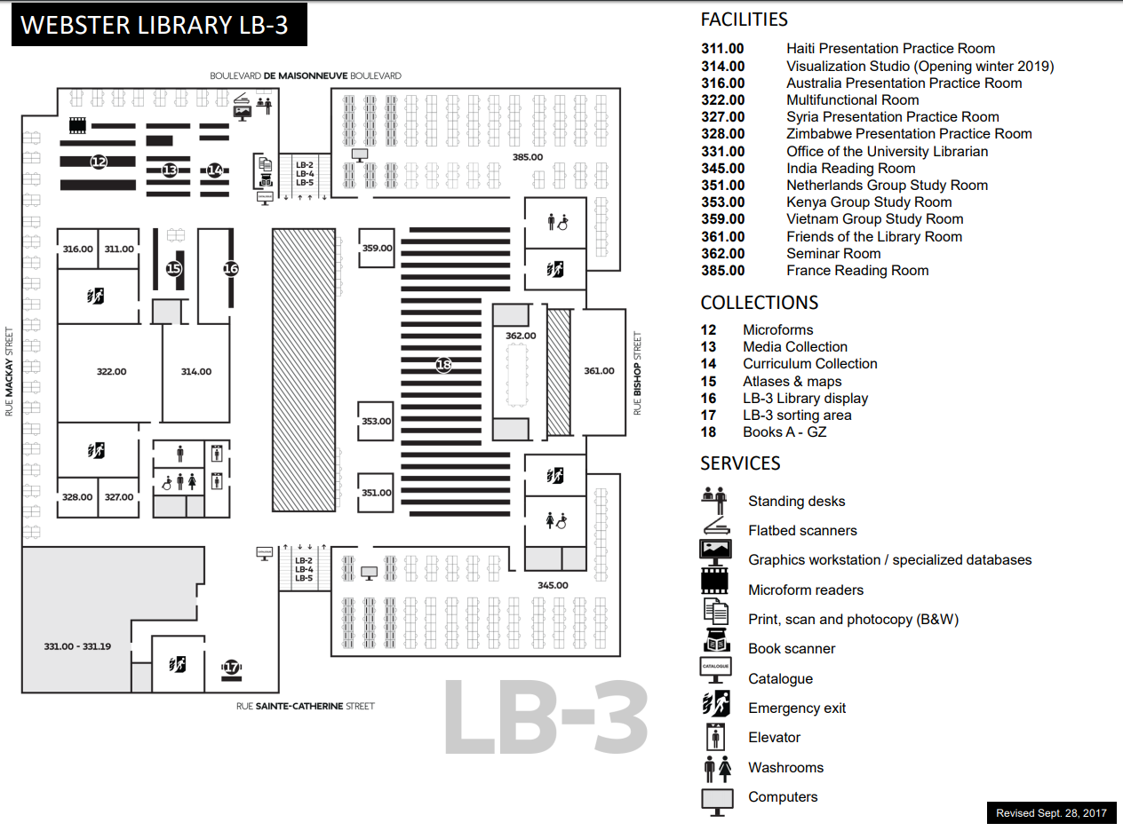
E, F and FC books are here
Call number ranges:
E 75 – E 99 Indigenous Peoples in North America
F 1-1140 History of British America (Canada)
FC 1-4200 Canada

Slide 26
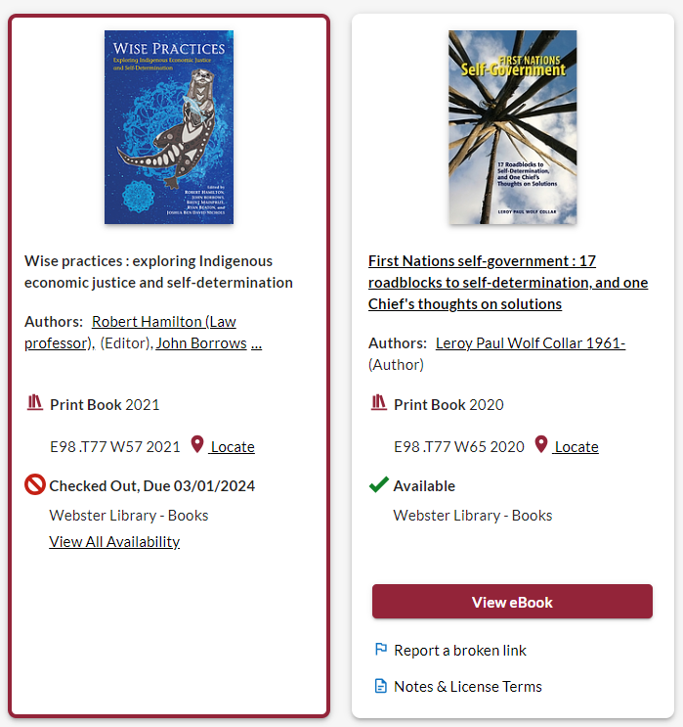
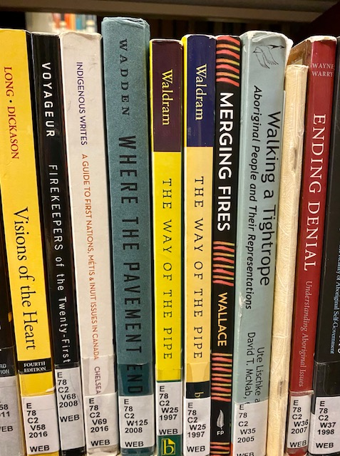
Classification: browse the bookshelves
On the library shelves, most books about First Nations, Inuit, and Métis peoples and thought are found in the E classification area, for “History of North America”. This represents an erasure of living peoples, philosophies, and knowledge.

Slide 27
Terminology
In the most common university library classification system, Library of Congress Subject Headings (LCSH), the main subject heading for material about Indigenous peoples in Canada and the United States is “Indians of North America”.
The term Indigenous is still new in these systems.
Though relevant and correct, terms for nations such as the Kanien’kehá:ka or confederacies such as the Haudenosaunee are far less prevalent in our Sofia Discovery tool than terms such as Mohawk or Iroquois.

Slide 28
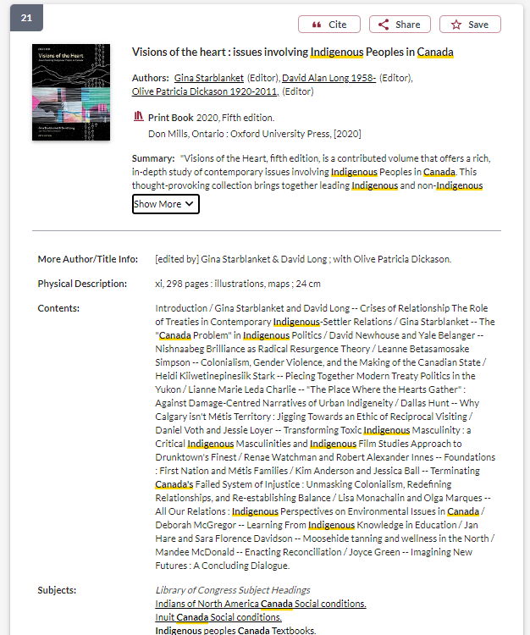
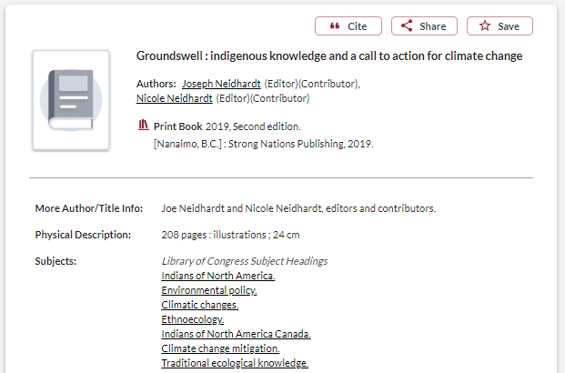
Terminology: what about the subjects?
These books were published in 2019 and 2020 and are about “contemporary issues involving Indigenous peoples in Canada” and Indigenous activism regarding climate change.
However, they are classified within the subject heading: Indians of North America

Slide 29
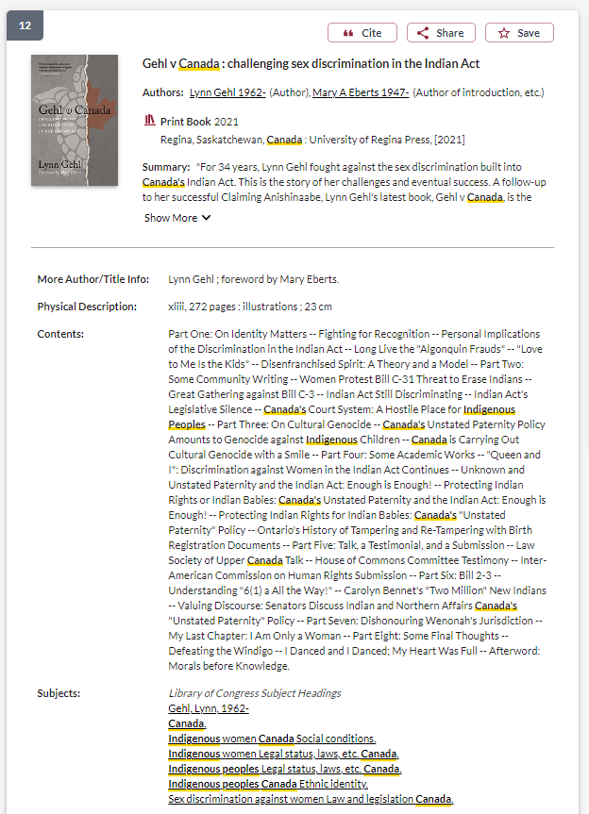
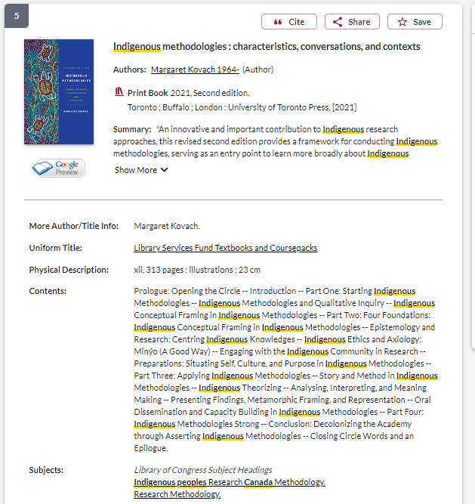
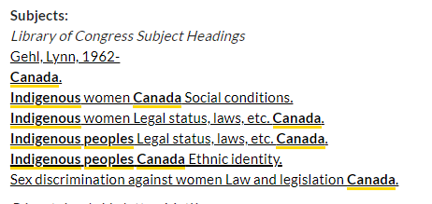

Slide 30
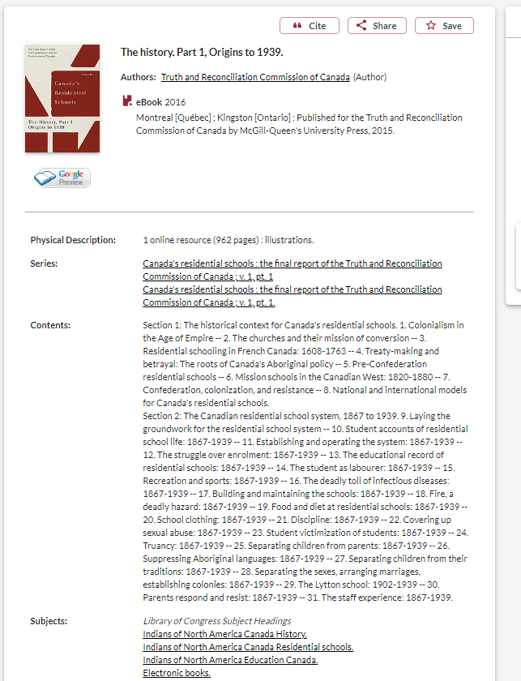
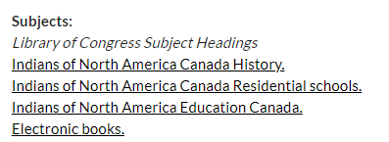
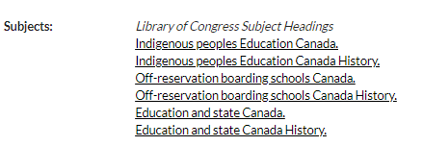
Terminology: what about the subjects?
Until recently, the subject heading “Residential School” was less common than subject headings such as:
“Off-reservation boarding schools - Canada”
“Indians of North America - Education”

Slide 31
Terminology – Government
The government departments responsible for relations with Indigenous peoples in Canada, has changed 9 times the country’s colonial history.
1860 - Dept of Crown Lands & Hudson's Bay Company,
1873 – Dept of the Interior,
1880 – Dept of Indian Affairs,
1936 – Dept of Mines & resources,
1949 – Citizenship & Immigration,
1965 – Northern Affairs and National resources,
1966 – Indian Affairs and Northern Development
Current departments: 2017- Indigenous Services Canada (ISC) and Crown-Indigenous Relations and Northern Affairs Canada (CIRNAC).

Slide 32
Keywords and subjects for searching scholarly literature
Indigenous
Aboriginal
Native**
Indian (legal significance)
First Nations, Métis, Inuit
First peoples
Autochtone (native)
Autochtones (indigenous)
Amérindien (Indian)
Regional differences:
Aboriginal: Australia & Canada
Native American or American Indian: U.S.
First Nations: Canada
Indigenous: international

Slide 33
Language matters
Oka Crisis – government, western scholars, and western journalists
Oka resistance, Oka uprising, Oka revolt – Indigenous scholars, Indigenous perspectives
Kanehsatake Resistance – specificity

Slide 34
There is a tension between finding keywords and subjects that will result in the most comprehensive search, and the terminology or way of speaking and writing about Indigenous Peoples, knowledges, and worldviews respectfully.
Pause.

Slide 35
Reflection
What barriers have you encountered in accessing resources from the library?
How can we address this tension?
What are some strategies you have used to locate resources and materials from Indigenous voices in scholarship?
Thoughts or questions about what we’ve just covered?

Slide 36
Strategies to locate Indigenous Scholars and other research in library databses

Slide 37
Choosing and developing a topic

Slide 38
Possible topics
I’m interested in Indigenous studies in higher education
I’d like to know how land-based education is being incorporated into pedagogy at the university level
I want to know how Indigenizing and decolonizing efforts are being integrated into university curriculum

Slide 39
Identifying keywords
My key concepts
Alternative or related terms
Indigenous studies
Land-based education
Higher education/University
Pedagogy/curriculum
Indigenizing
Decolonizing
First Peoples Studies
Land-based learning/Place based education
Post-secondary
Teaching
Reconciliation

Slide 40
How do we combine keywords for the best possible results?
AND: combines concepts and limits your results
Indigenous AND education
youth OR teens
land OR territory
OR: allow you to insert synonyms or alternative terms and increases your results

Slide 41
How do we combine search words for the best possible results?
“quotation marks”: If you put two or more words in quotation marks, that exact phrase will be searched and limits your results.
“First Nations”
“public policy”
Democra*
Finds: democracy, democracies, democratization, etc.
Canad*
Finds: Canada, Canadian
* - when you add an asterisk on the end of a word, your results will contain all the words with those endings or suffix

Slide 42
Avoid searching with linking or unnecessary words
Effects
Impact
Consequences
Influence
Results
Importance
Significance
Response
Emphasis
Causes
Each author may use different linking words when discussing similar topics.
You don’t want your search to be limited to those books and articles that only contain the word “effect” or “consequence”

Slide 43
How do you start your research? Where do you look first?

Slide 44
Next steps….
Combine the keywords with AND/OR
Search for them in a database to find sources for my research
What’s the best place to search?
Sofia Discovery Tool: all the ebooks and print books at Concordia Library, journal articles from many disciplines, government documents and print books in collections outside of Concordia
Academic Search Complete (EBSCO): a journal article database with articles from multiple disciplines and good limiters, plus the opportunity to combine searches
iPortal: an Indigenous focused research portal with journal articles
Google Scholar: an academic database of journal articles, fewer limiters, wide scope

Slide 45
Searching for some of the main concepts I identified
Keeping my search broad, to see what is out there
AND/OR need to be in ALL CAPS in Sofia
I can add concepts, as I develop my search
In Sofia, we are searching through books and articles, books can be searched more broadly because we are searching through titles, subjects and table of contents

Slide 46
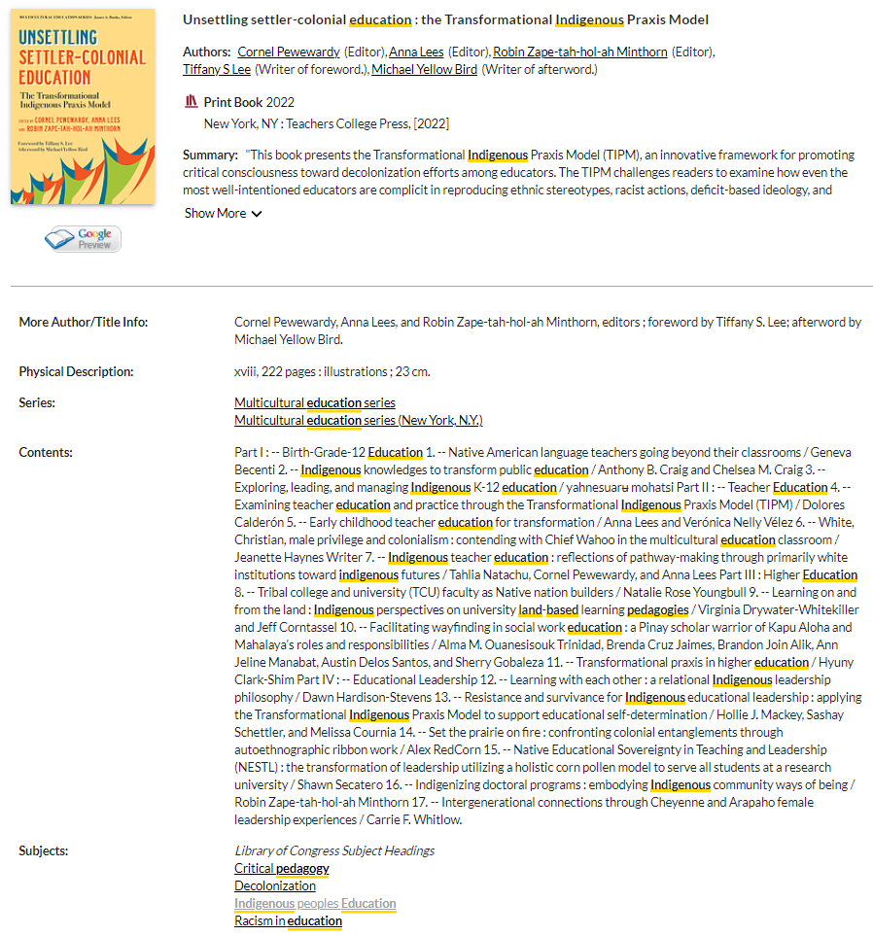
All books in the library are arranged by subject and will have subjects listed in their book record.
Clicking on one of these subjects will find all the books and some articles that have the same subject attached, at the library.

Slide 47
Who wrote the book? How do we locate Indigenous authors?
Scholarly books often have editors and each chapter will have different authors
You should look for “Contributors”, which will have a list of individual chapter authors, and their biographies either at the beginning or very end of the book
If a book has one author, look for “about the author” section or even skim the introduction, where the author will describe themselves

Slide 48
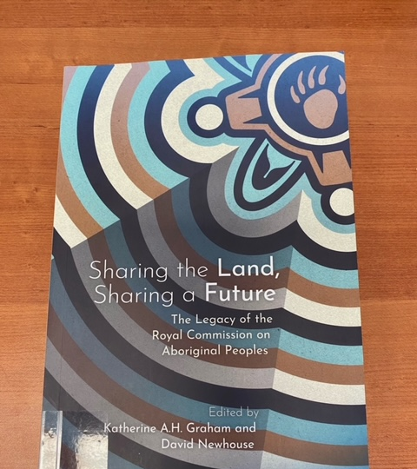
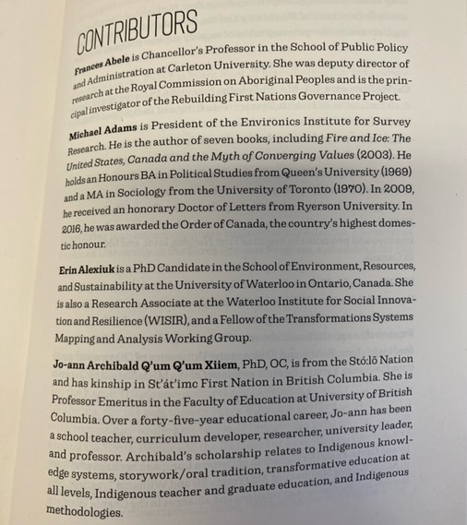

Slide 49
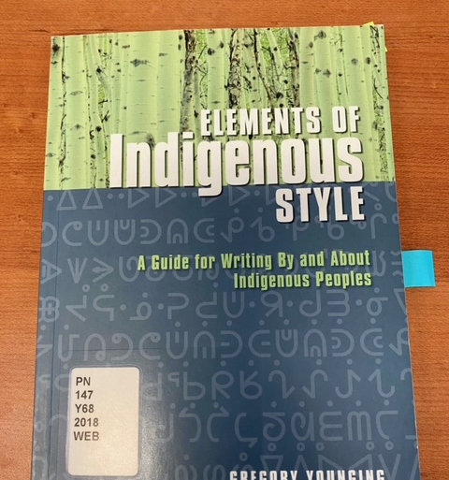
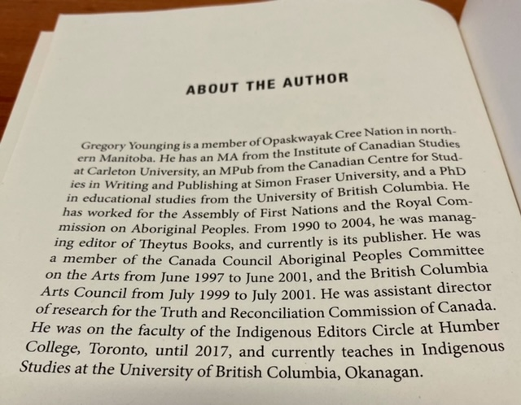

Slide 50
Who wrote the book? How do we locate Indigenous authors?
The table of contents might also have author information, in the case of Indigenous authors their community or nation may be in brackets following their name
Indigenous scholars and authors are very likely to self-identify, with details about their nation or community in prefaces, introductions, etc.

Slide 51
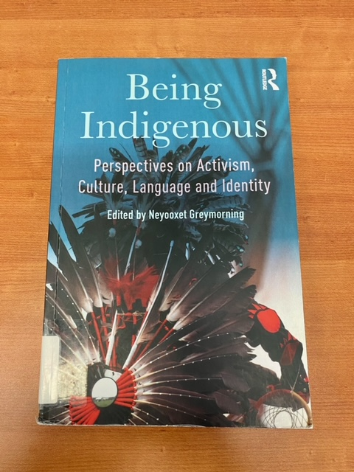
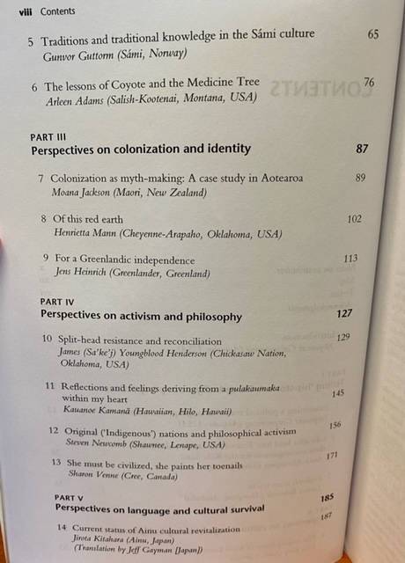

Slide 52
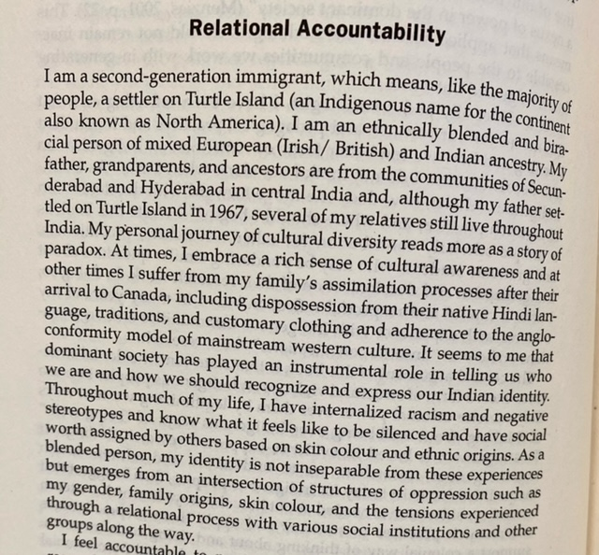
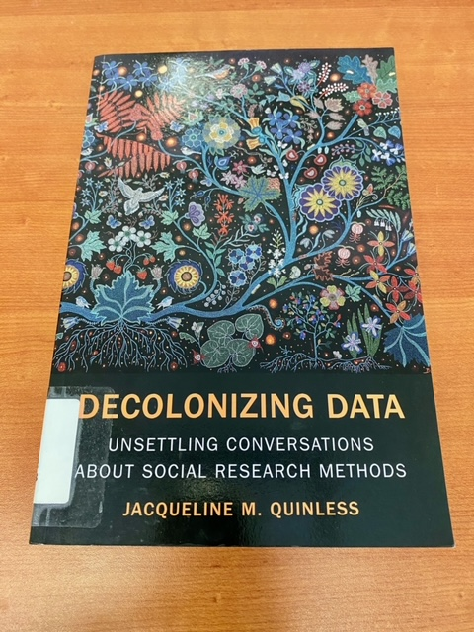

Slide 53
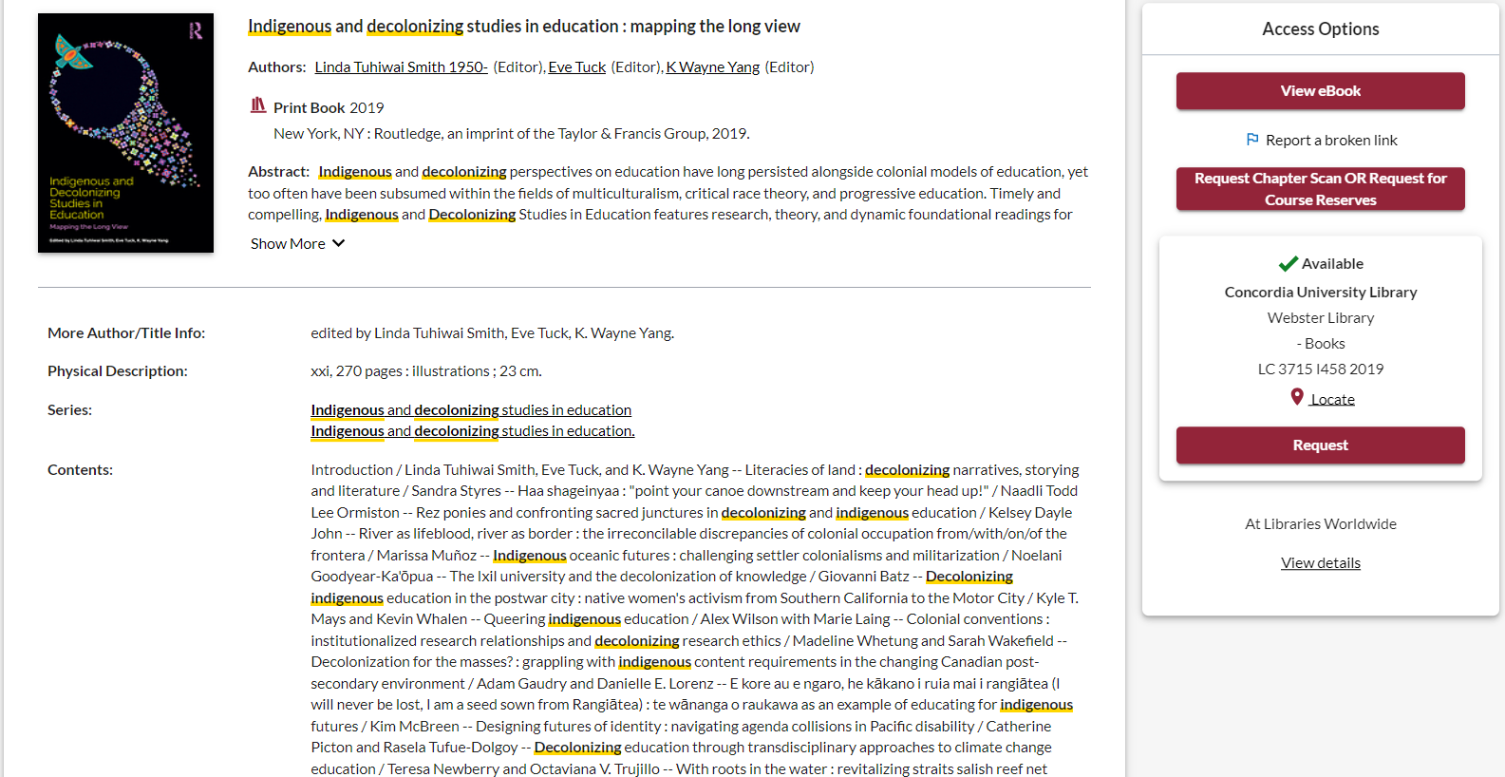
Let’s find out about the contributors

Slide 54
How to use a scholarly book
Most scholarly books are edited, and each chapter will be about a different aspect of a broad theme
Check the table of contents and the index (at the end of the book) to locate your topic in the book
Read the chapter or section about your topic
Think of each chapter in an edited book as an article
You can cite multiple chapters from an edited book
You’re not expected to read the entire book, it’s unnecessary and not how scholarly books are usually used in research

Slide 55
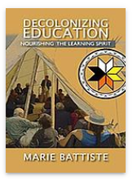
How else can I locate books by Indigenous authors and scholars?
Indigenous Authors in the Spotlight series
Indigenous Resources guide: Knowledges, methods & ethics
Sofia (Advanced) Author search for a known scholar
Marie Battiste is a Mi'kmaw educator from the Potlotek First Nation

Slide 56
Indigenous Authors
Search for Indigenous authors on Google, or stay close to home:
Concordia's Indigenous Futures Research Centre
Indigenous Faculty Members at Concordia
Concordia’s Indigenous Directions Stories & Events
Concordia CTL Decolonization Hub
Concordia Library's Indigenous authors in the spotlight -see for instance: research methods; futurisms; poetry; feminisms
First People’s Studies Subject Guide: Indigenous Newspapers and magazines
watch for affiliations and acknowledgements in the articles you find

Slide 57
Indigenous publishers / organizations / institutes
Publishers:
UBC's list of Indigenous Publishers, Distributors & News Media
UofT's list of First Nations, Inuit, and Métis Publishers and Distributors
GoodMinds: First Nations, Métis and Inuit Books – online bookstore, located at Six Nations of the Grand River
Organizations and institutes - EXAMPLES:
The Yellowhead Institute
Shekon Neetchie: An Indigenous History Site -- see their history bibliography
The Montreal Indigenous Community Network -- see their resources
The Native Women’s Association of Canada – See the Knowledge Centre, Journal and Magazine
.....do YOU have tips to offer?

Slide 58
Your turn! Topics and research strategies
Fill in your general topic or research question
Break the topic down into the key concepts or ideas, then brainstorm synonyms and related terms
How will that search strategy look in the Sofia Discovery Tool?
Key Concept | Key Concept | Key Concept | Key Concept
Indigenous | education | Land-based | University
Synonym or related terms | Synonym or related terms | Synonym or related terms | Synonym or related terms
First Nations Metis Inuit First Peoples | Pedagogy Learning Teaching | Placed based | Post-secondary
Sofia Search: Indigenous AND (education OR pedagogy OR learning OR teaching) AND (“land based” OR “place based”) AND (university OR post secondary)

Slide 59
Scholarly, peer reviewed journal articles
A scholarly journal article is the best of what we know; it builds on previous research.
The purpose of a scholarly journal is to report on research conducted by scholars, and professionals in the field.
Scholarly journals provide in-depth articles that cover specific issues or research questions, while the language and content is geared toward scholars and professionals in the field.
Some articles contain tables and graphs and most contain bibliographies (or reference lists or works cited)
articles in scholarly journals are peer reviewed.

Slide 60
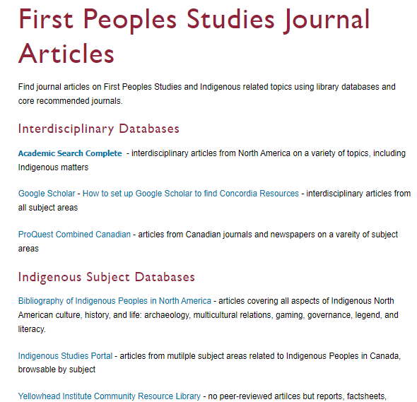
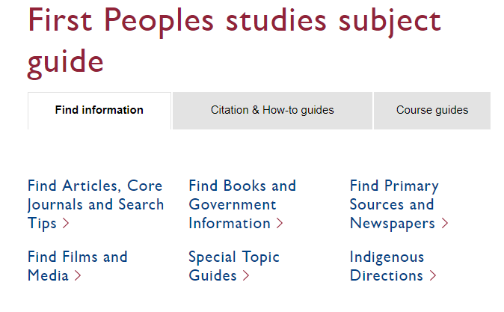
Using databases to search for journal articles

Slide 61
Database: Academic Search Complete
Journal: International Review of Education
Article: Educate to perpetuate: land-based pedagogies and community resurgence

Slide 62
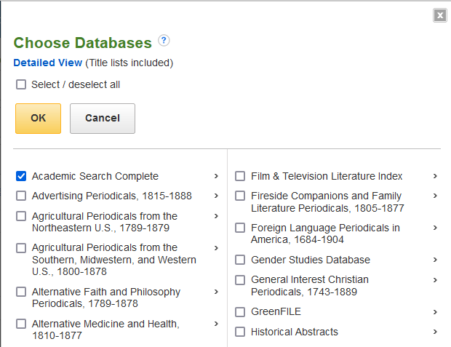
Combining databases in EBSCO
We can combine the large, multidisciplinary database Academic Search Complete with the subject-specific database Bibliography of Indigenous Peoples in North America

Slide 63
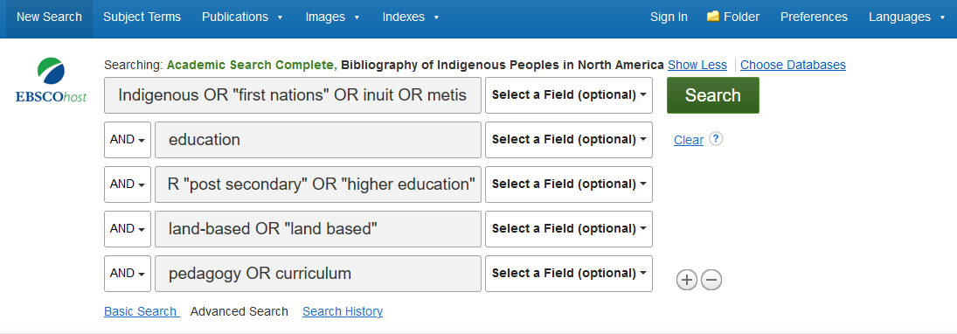
Search:
Indigenous OR "first nations" OR inuit OR metis
AND education
AND university OR "post secondary" OR "higher education“
AND land-based OR "land based“
AND pedagogy OR curriculum

Slide 64
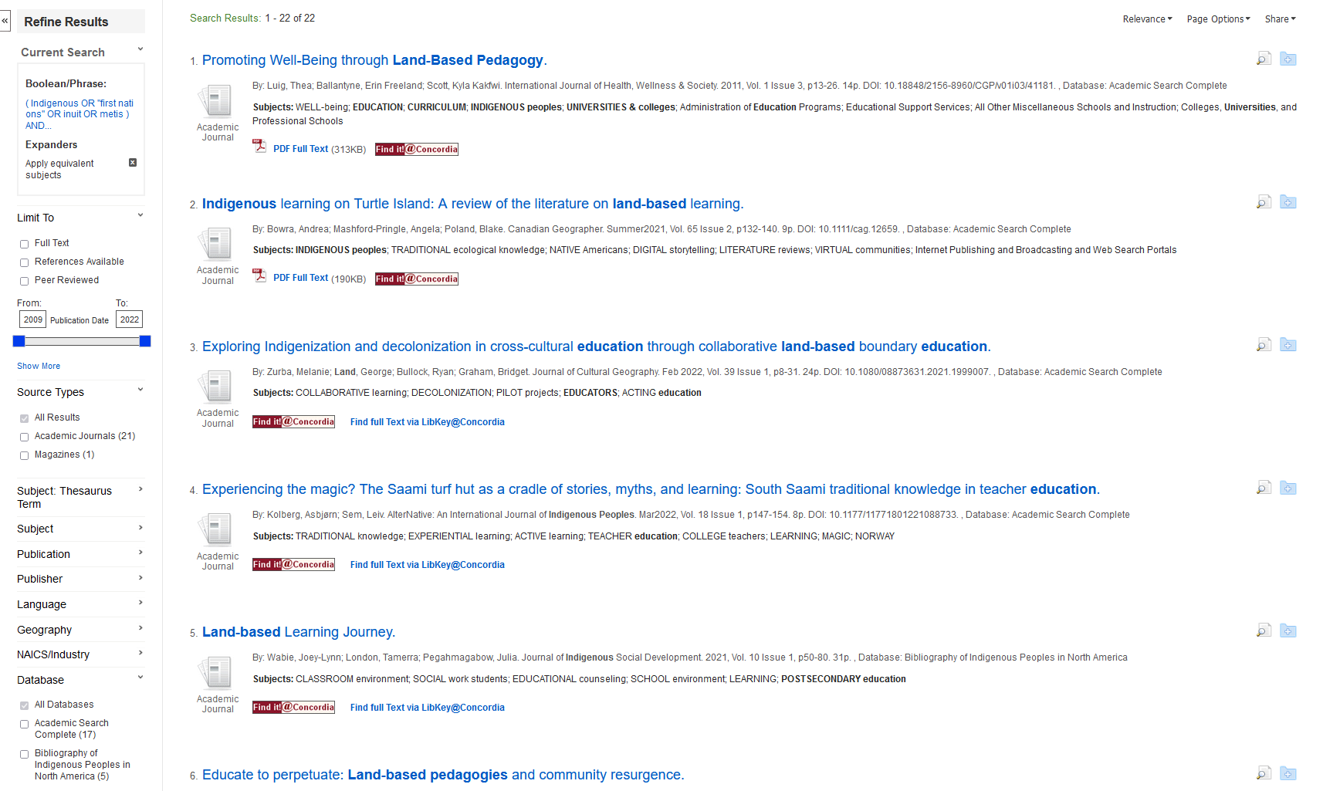
We can narrow down to peer reviewed articles only here
We can save our articles here
We can add subjects here
We can see which database our articles are coming from here

Slide 65
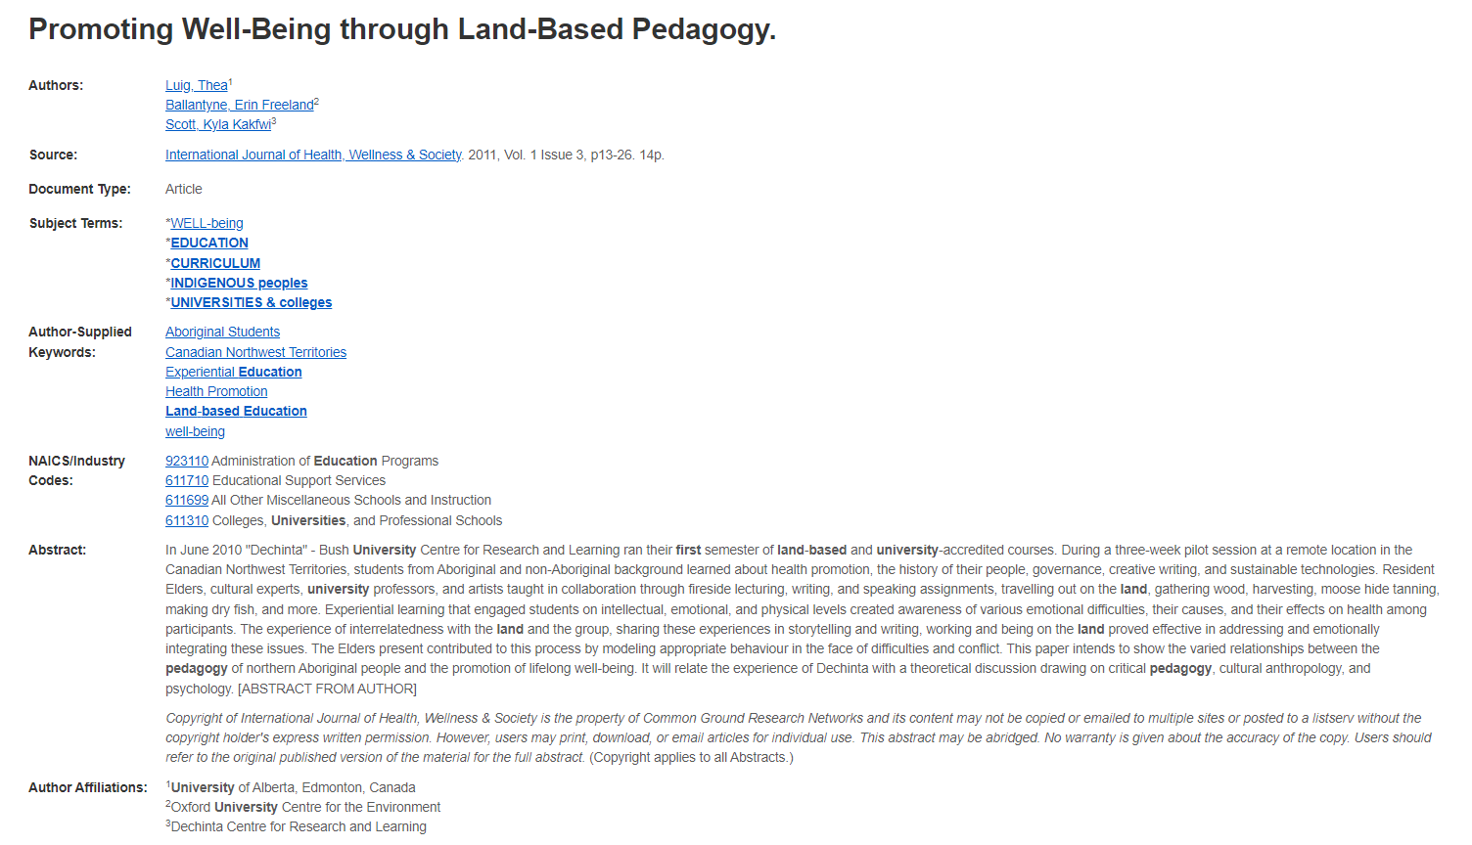
Length: scholarly articles are generally 10+ pages
Read the abstract and the subjects to see if the article will match your topic
Author affiliations will provide which universities researchers are from and, in some cases, identify Indigenous authors and communities

Slide 66
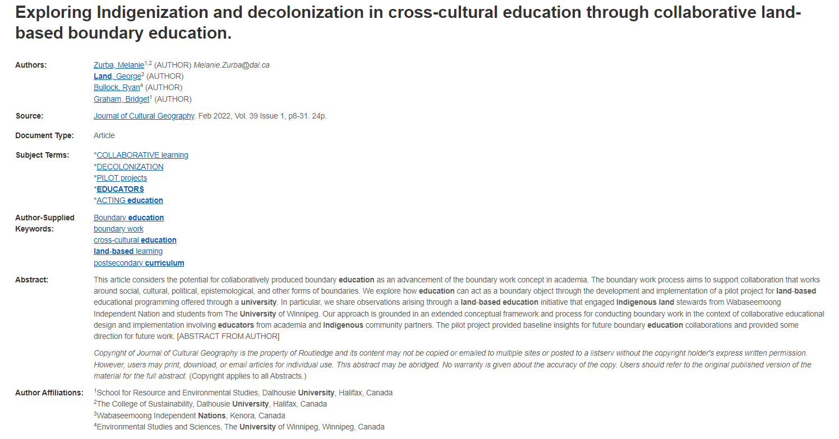
There is an Indigenous author on the research team, affiliations can give this information like “contributors” lists

Slide 67
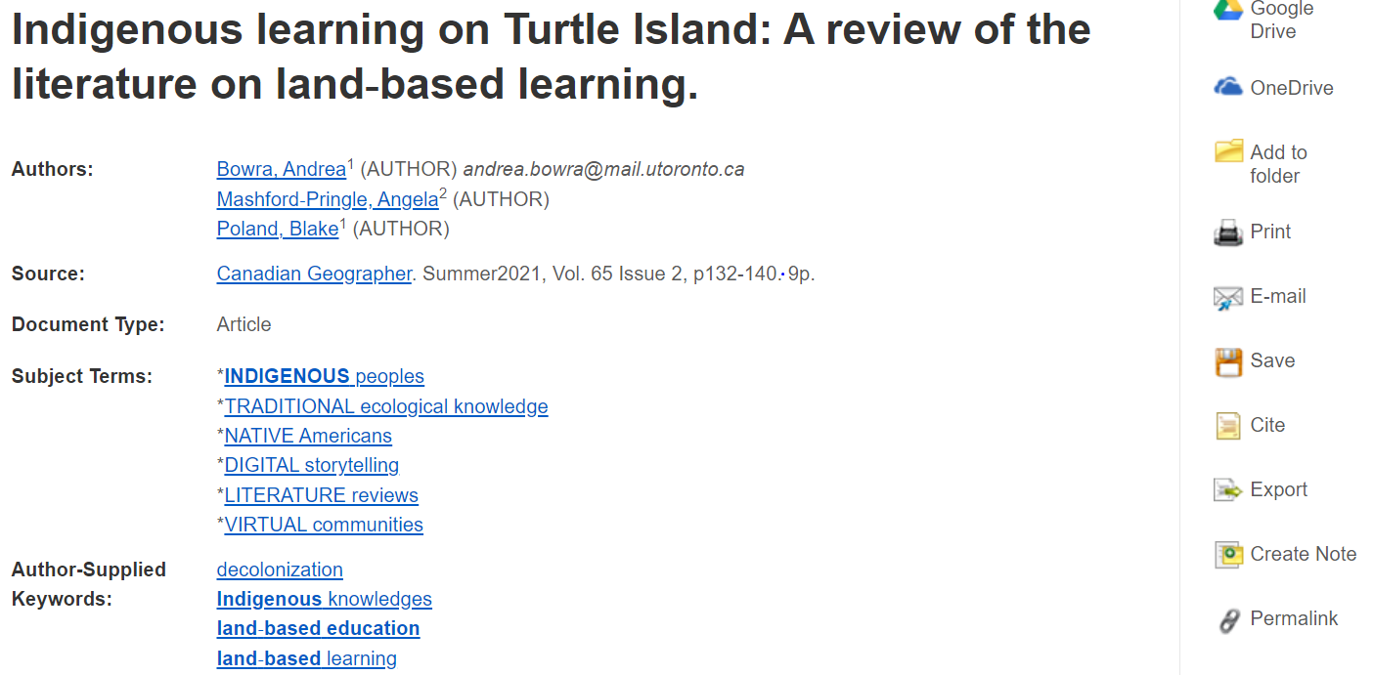
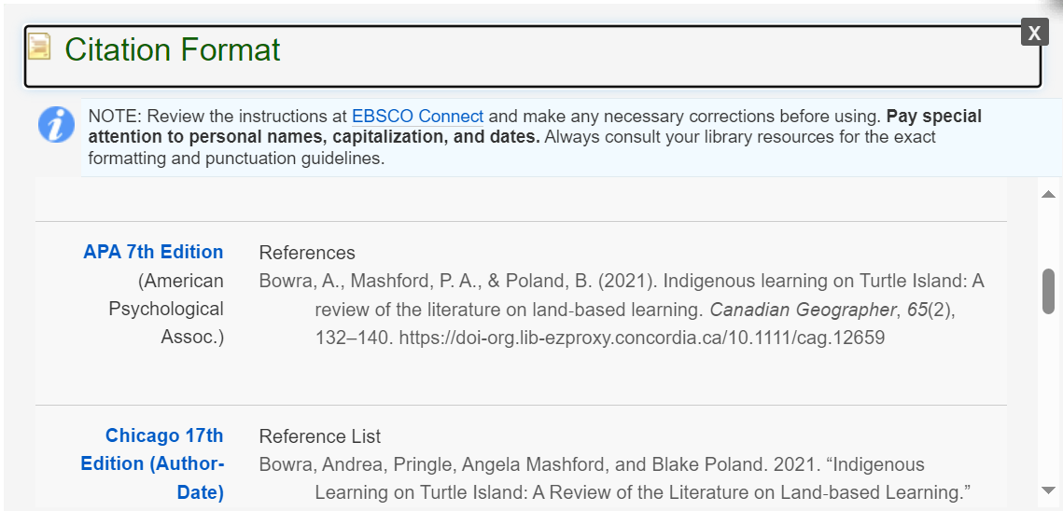
Cite!

Slide 68
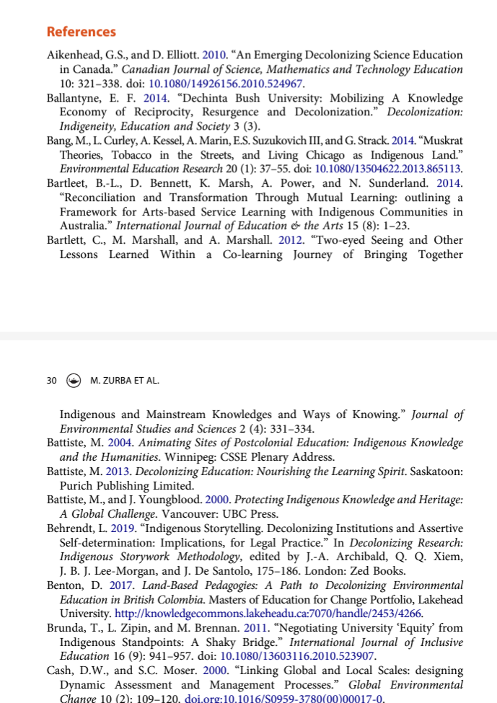
Scholarly articles will always have reference lists/bibliographies/works cited
These are great places to find more sources!
The researcher or research team are experts in the subject area and have already done a lot of research
Use this expertise by looking up the books and articles they cite in Sofia and using them in your own research
This is a commonly used method in academic research

Slide 69
Use the reference list or bibliography from a well designed research study or relevant research article, written by Indigenous authors or with Indigenous contributors to find additional Indigenous research
Indigenous scholars often cite each other’s work
Those working with Indigenous research methods and worldviews will build on the previous research
Fits within the concept of Ethical Citation Practices

Slide 70
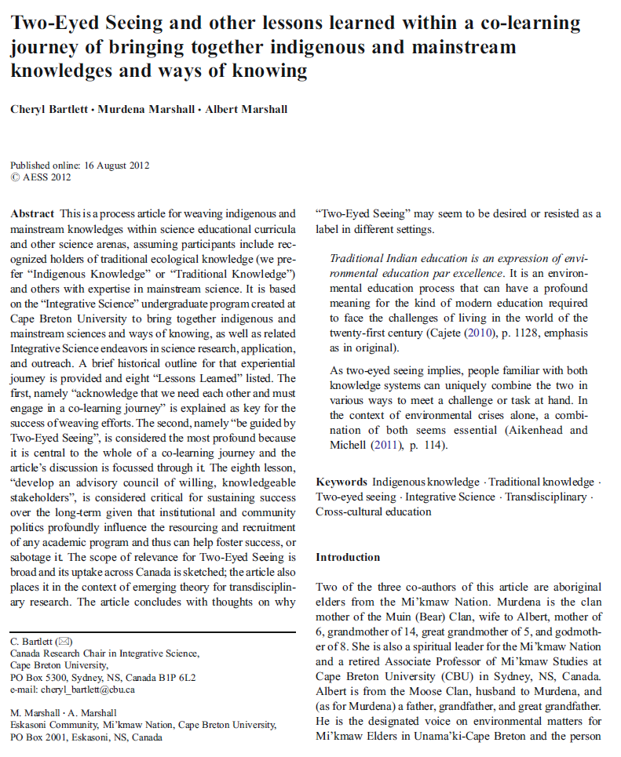
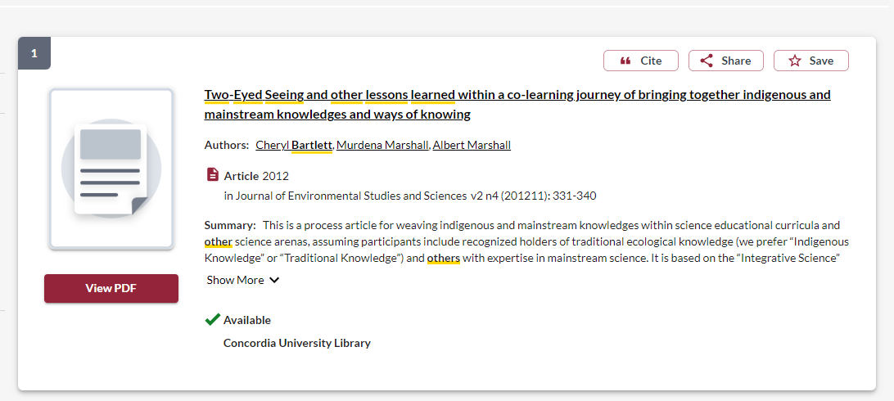

Slide 71
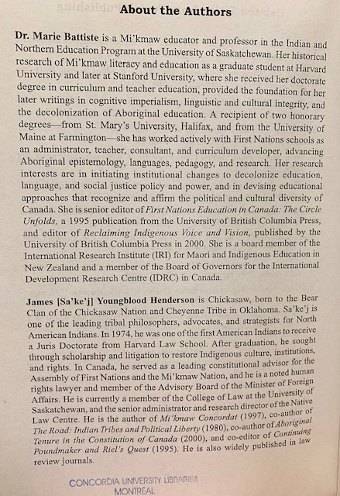
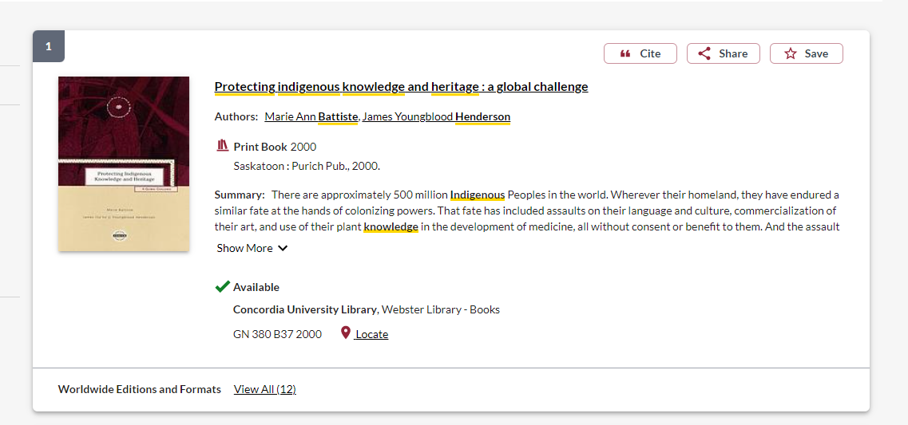

Slide 72
How to read an academic article
Read the abstract to get a broad overview of the topic and to decide if the article is relevant to your research
Read the introduction and discussion/conclusion
Look at the headings of the article sections, is there one or two sections that will be important for your research?
Look at the reference list for further helpful sources, focusing on those cited in the sections that you have selected as most relevant
Use Crtl+F (Windows) or Command+F (Mac) to find a particular name, word or phrase in the text

Slide 73
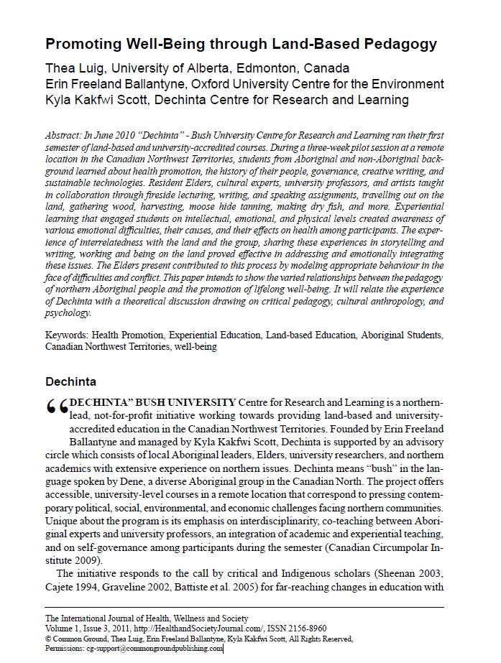
Read the conclusion
I found this section on land-based pedagogy, so I will read this in detail
Read the abstract and introduction

Slide 74
Reading & notetaking
Read actively and selectively. Make decisions about what is essential. Once you’ve read what is most relevant, you may not need to read the rest.
Read to answer your questions. What do you need to find out? Actively look for the evidence that will answer these questions.
Break reading into manageable segments. Read only one chapter, an individual article, or a specific number of pages. Reward yourself with a break once you’ve completed the task.

Slide 75
Reading & notetaking
Try a two-step process: When you first search for books and articles, sort them into folders or piles and take only minimal notes; for example, two or three lines summarizing the key argument.
Flag articles as "high," "medium," or "low" priority. Once you have identified book chapters or articles that are relevant to your assignment, take in-depth notes.
When taking notes, always put quotation marks around direct quotes.
You may want to consider dividing your page into two columns: they say/I say. This way you will always know which words are someone else's, whether it's direct quotes or paraphrases.

Slide 76
Next steps….
Combine the keywords with AND/OR
Search for them in a database to find sources for my research
What’s the best place to search?
Sofia Discovery Tool: all the ebooks and print books at Concordia Library, journal articles from many disciplines, government documents and print books in collections outside of Concordia
Academic Search Complete (EBSCO): a journal article database with articles from multiple disciplines and good limiters, plus the opportunity to combine searches
iPortal: an Indigenous focused research portal with journal articles
Google Scholar: an academic database of journal articles, fewer limiters, wide scope

Slide 78
I-Portal can be browsed by using the Turtle or the list of broad topics

Slide 79
The record will give you a lot of information about the article including the type of source, peer reviewed, and attached subjects

Slide 80
Search in the same way we searched in the Sofia Discovery Tool
Options to narrow down, on the right

Slide 82
Your turn! Use a database to find an article

Slide 83
Using Google Scholar in 2 ways:
Setting up Google Scholar to be effective as a Concordia user
Using Google Scholar for Reverse Citation Searching

Slide 86
Concordia access
Use related articles link
Limit your results by date

Slide 87
Reverse Citation Searching – Google Scholar
Title: Decolonizing Methodologies: Research and Indigenous Peoples
Author: Linda Tuhiwai Smith
Date: 2012*
*When doing a reverse citation search, it is important to pick a title that has been available for several years, as it will have time to have been read and cited.

Slide 88
1. You are searching for the citation of your title, to find what other scholars and research have cited it. Click "cited by“ to find resources that cite a specified publication.

Slide 89
You are looking at books and articles that have cited this book.
2. Now you have a list of books and articles that have cited the title you searched. Select "Search within citing articles" and try performing a keyword search to narrow your results.

Slide 90
3. Look for author self-identification or biographies which identify authors as Indigenous within articles. Indigenous scholars often cite Indigenous research.

Slide 91
What is the muddiest point about the research process? What is unclear or a bit confusing?

Slide 92
Citation!

Slide 106
Need help, ask us!
Michelle.Lake@Concordia.ca

