Slide 1

FPST 202: Research Strategies in First Peoples Studies
Library Workshop
Michelle Lake
Subject Librarian for FPST, SCPA, Poli Sci and Government information
Michelle.Lake@Concordia

Slide 2
Who am I?
Michelle Lake, librarian for Political Science, the School of Community and Public Affairs, First Peoples Studies, and Government Publications
Settler, originally from Ontario.
My hometown is located on the traditional territories of the Erie, Neutral, Huron-Wendat, Haudenosaunee and Mississaugas, on land covered by the Dish With One Spoon Wampum Belt Covenant.
I live and work on the unceded Indigenous lands of Tiohtià:ke, where the Kanien’kehá:ka Nation is recognized as the custodians of those lands and waters.

Slide 3
What do I do?
  Provide research support, assist with search strategies
  Help students navigate library databases
  Help students find and access materials they need
  Assist with evaluation of sources
  Teach research strategies
  Build guides, resources and pathfinders to help students locate research materials
  Help with citation issues
  Choose the books we buy for my subject areas: First Peoples studies, political science, public policy, community and public affairs and government information

Slide 4
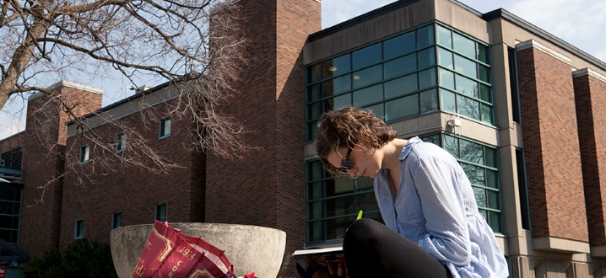
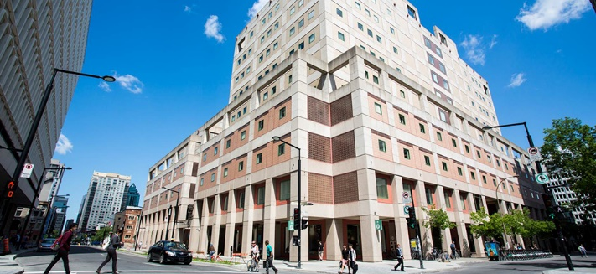
The Librar(ies)
24/7 access, with student card, after 11pm
Webster Library (LB) – downtown on SGW campus & Vanier Library (VL) on Loyola campus
Webster: Social Sciences, Humanities, Business, Engineering & Fine Arts
Vanier: Science(s), Health, Communications, Journalism and Psychology
Course Reserves Room(s): have the required undergraduate print textbooks for the courses taught at that campus (for example: Webster has the Political Science and SCPA course reserves)

Slide 5

Library Services
Your student card is your library card.
You need it to:
borrow books (up to 100 a time)
borrow a laptop and other technology (for 24 hours)
print on campus (add money to your Dprint account)
access the library overnight during 24/7 hours.
Webster library has 5 book scanners (And Vanier has 2!) that can be used for free to scan chapters from our print books and email them to yourself as a PDF.
To use Library databases, access online articles and ebooks when you are off campus, login with your MyConcordia Netname and password.

Slide 6
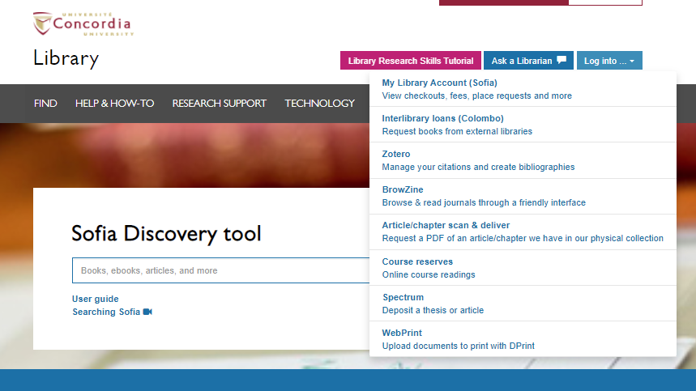
Electronic Course Reserves

Slide 7
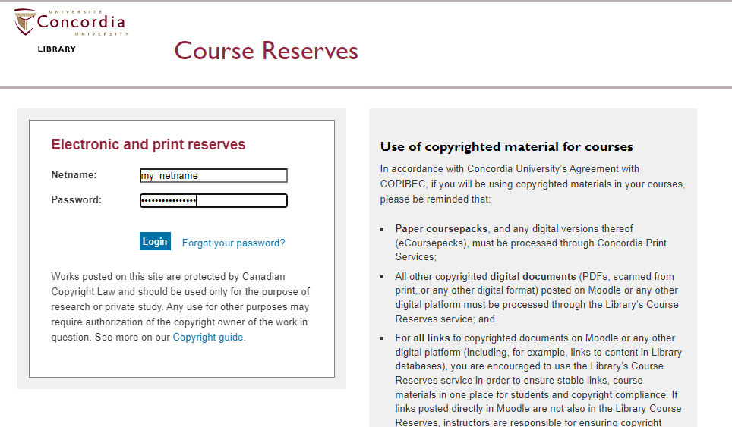

Slide 8
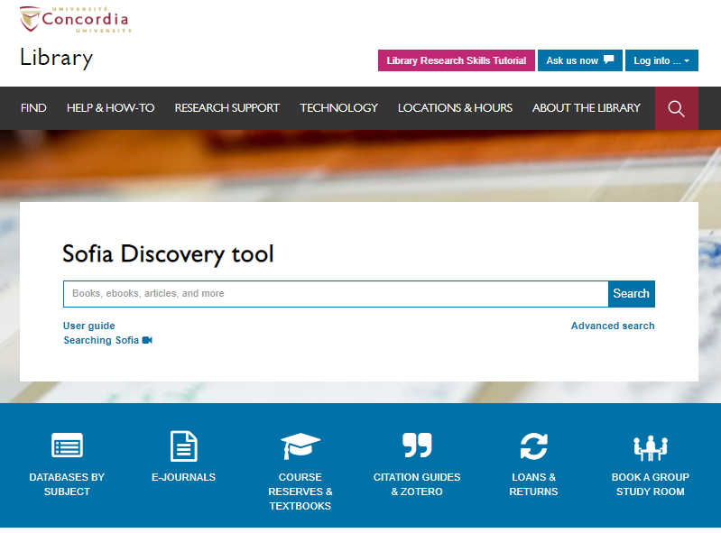
Use the Sofia Discovery tool to find print books, ebooks, and journal articles from the library.

Slide 9
How can I find out if the library has access to an item I’m looking for?

Slide 10
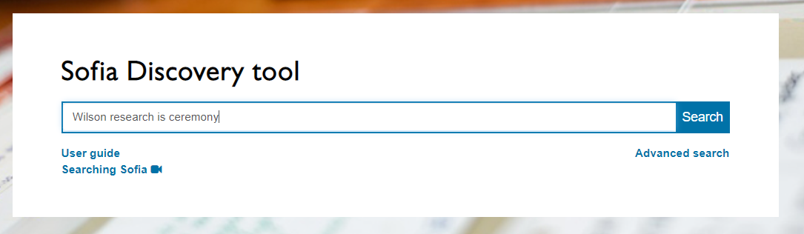
Wilson, S. (2008). Research is ceremony: Indigenous research methods. Halifax: Fernwood Publishing.

Slide 11
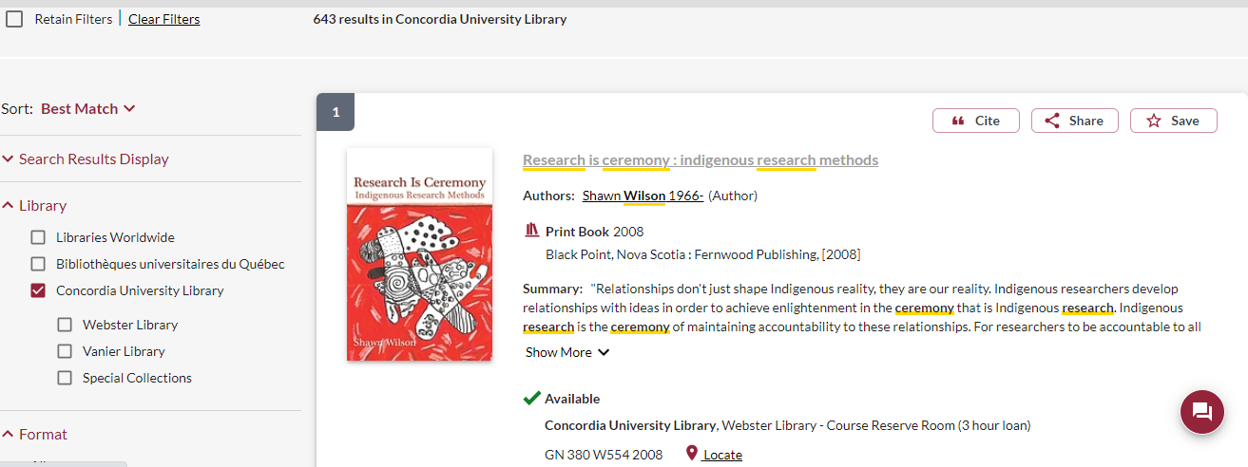
This is a required textbook, so it is found in the course reserves room for a 3 hour loan.
There is a book scanner in the course reserves room, where you can scan chapters and email them to yourself for free.

Slide 12
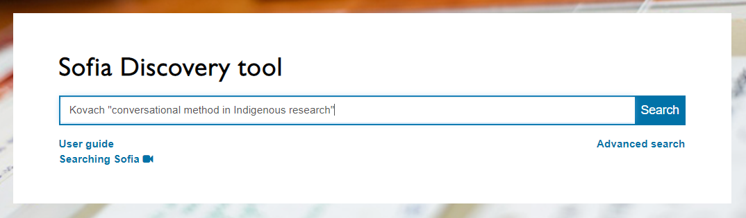
Kovach, M. (2019). Conversational method in Indigenous research. First Peoples Child & Family Review, 5(1), 40-48.

Slide 13
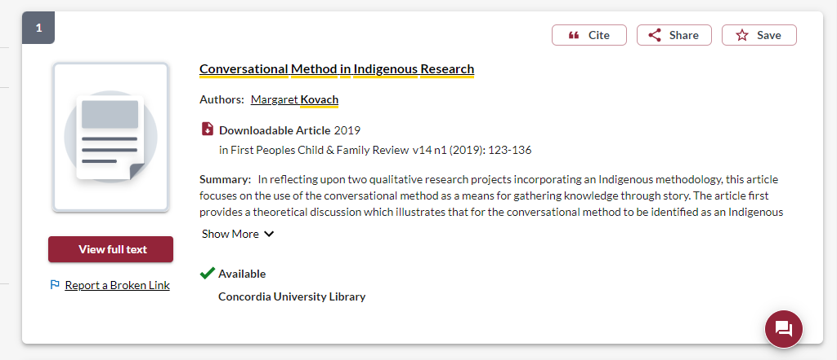
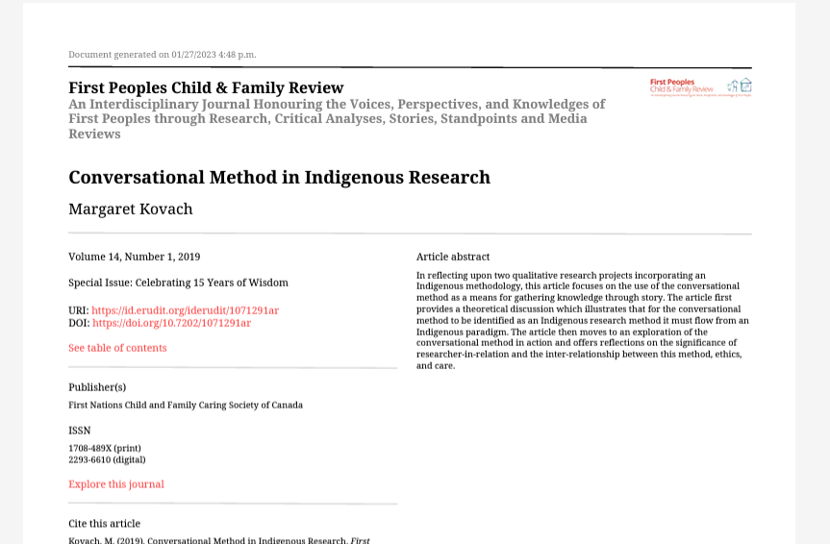

Slide 14
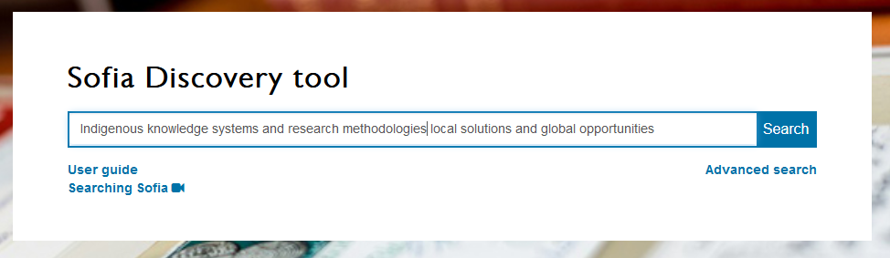
Tenorio, R. (2020). Indigenizing Research Participant Recruitment. In E.S. Huaman & N.D. Martin (Eds). Indigenous Knowledge Systems and Research Methodologies: local solutions and global opportunities. (pp. 145-164). Canadian Scholars.

Slide 15
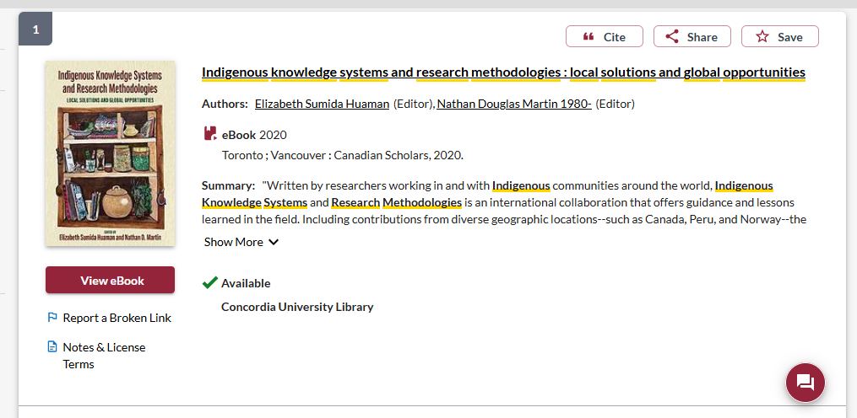
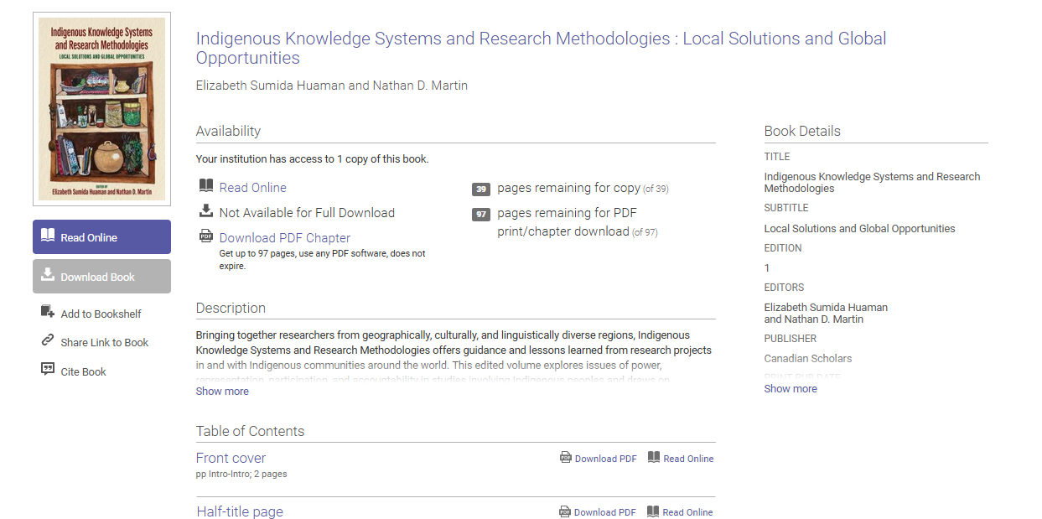

Slide 16
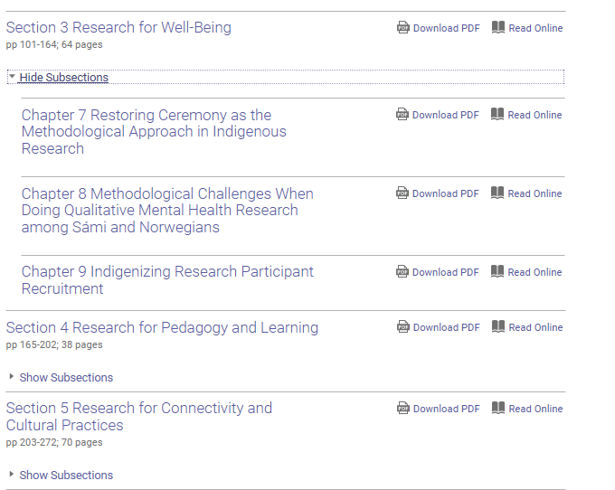
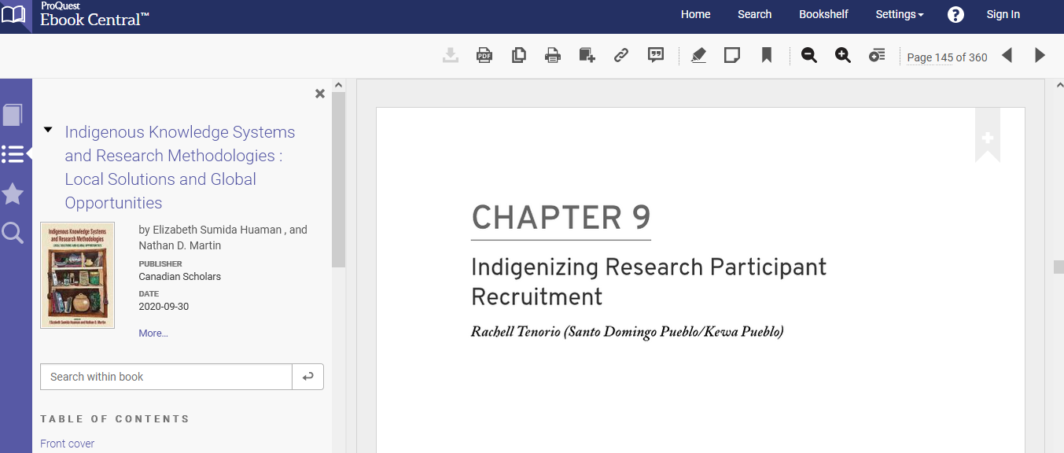

Slide 17
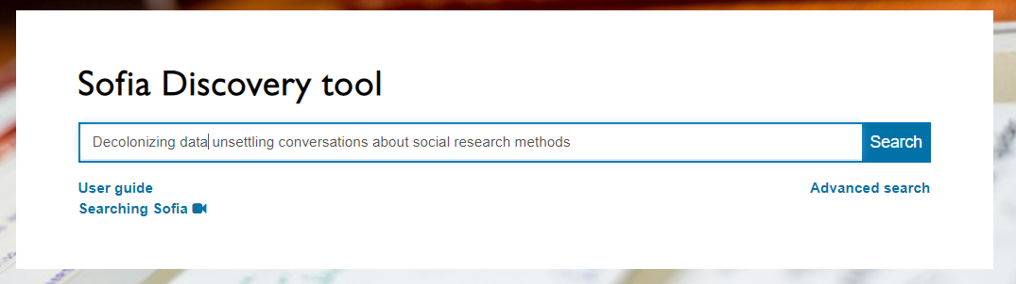
Quinless, J.M. (2022). Decolonizing data: unsettling conversations about social research methods. Toronto: University of Toronto Press.

Slide 18
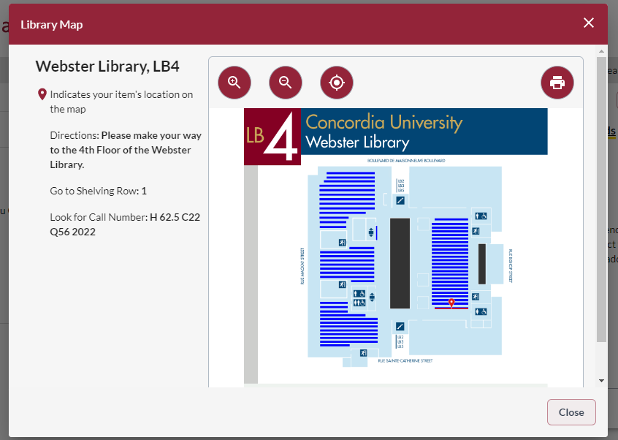
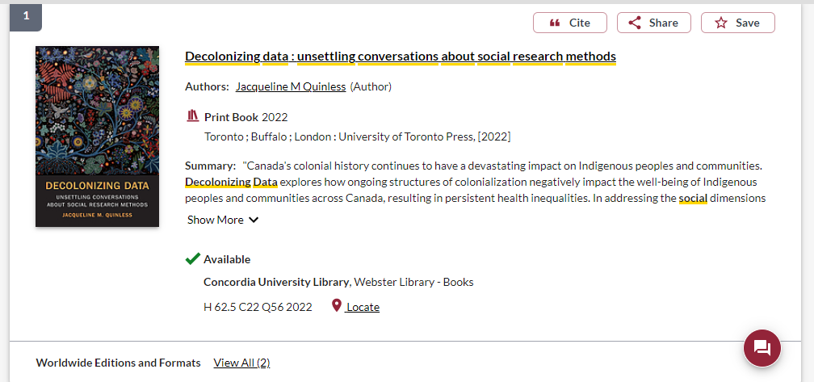

Slide 19
Context – searching for Indigenous scholarship in an academic library

Slide 20
Indigenous Peoples and education in Canada
Education, as controlled and imposed by the church, federal and provincial governments in Canada has been a destructive force in Indigenous communities
Research at the university level, about Indigenous Peoples and communities has been harmful
Libraries, as part of the University and education system, are also colonial institutions, with barriers, biases and impediments to enhancing Indigenous scholarship and voices

Slide 21
Universities & libraries are colonial institutions
“While Indigenous people have necessarily (and effectively) engaged with Western institutions, it is important to remember that this necessity came about largely due to a need to respond to colonial impositions. Colonizers wanted Indigenous lands, and ultimately found imposing institutions to be a most effective way of stealing that land.”
Tuck, E. & Yang, K.W. (2012). Decolonization is not a metaphor. Decolonization: Indigeneity, Education & Society, 1(1), 5-6. https://jps.library.utoronto.ca/index.php/des/article/view/18630/15554

Slide 22
Colonial institutions as ideological structure
“The library is always an ideological structure. It’s not just what goes into the library that matters, but how it’s organized and under which norms.”
Daniel Heath Justice, Ph.D, ACRL Choice Webinar: Indigenous Literatures, social justice and the decolonial library
“When we look at collections, the actual ‘information’ contained in libraries and how it is organized, we can see that it (surely by accident) somehow manages to construct a reality wherein whiteness is default, normal, civilized and everything else is Other.”
nina de jesus, Locating the library in institutional oppression, In the library with the lead pipe (Sept 24, 2014)

Slide 23
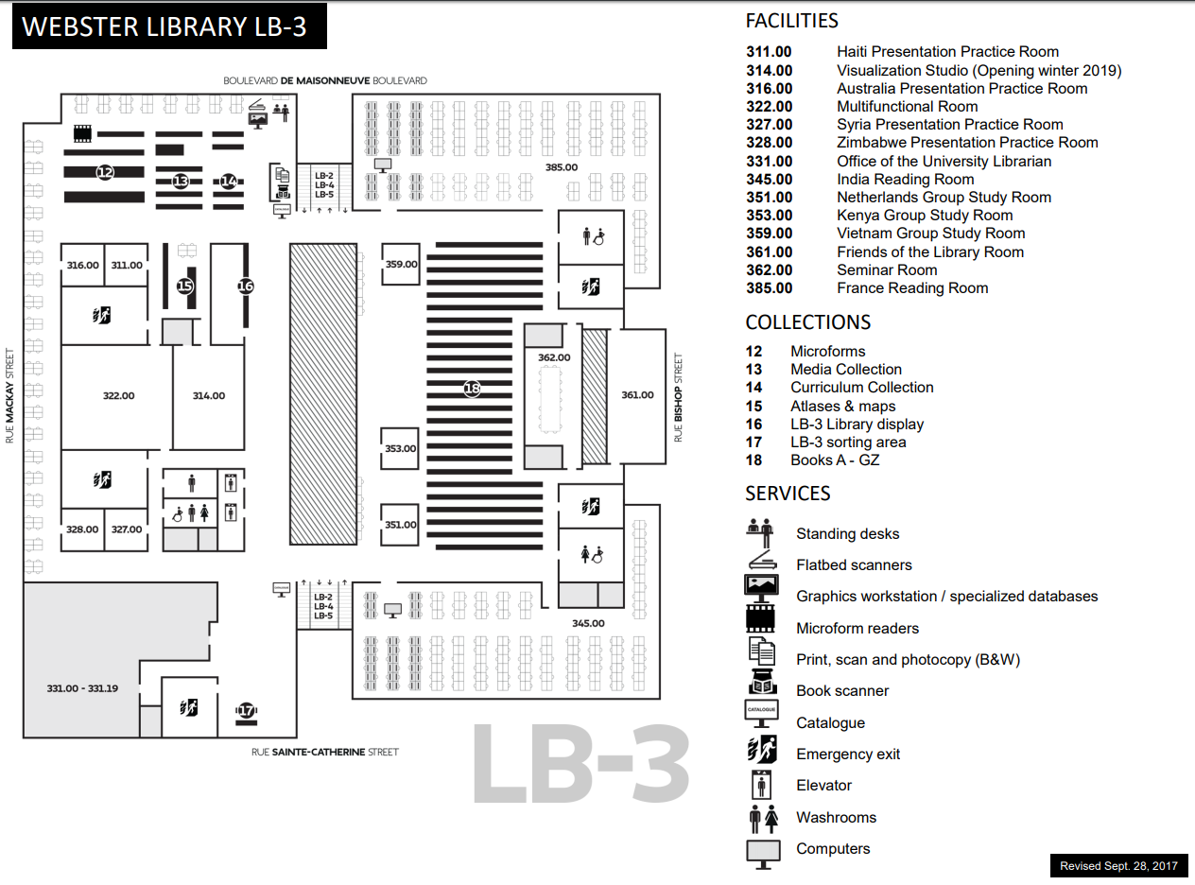
E, F and FC books are here
Call number ranges:
E 75 – E 99 Indigenous Peoples in North America
F 1-1140 History of British America (Canada)
FC 1-4200 Canada

Slide 24
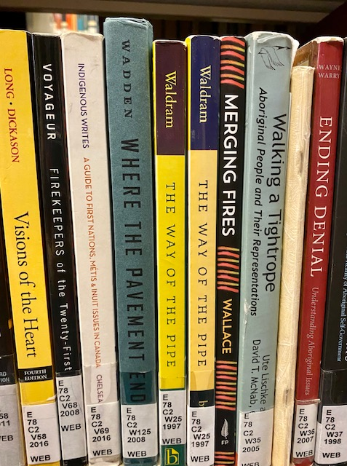
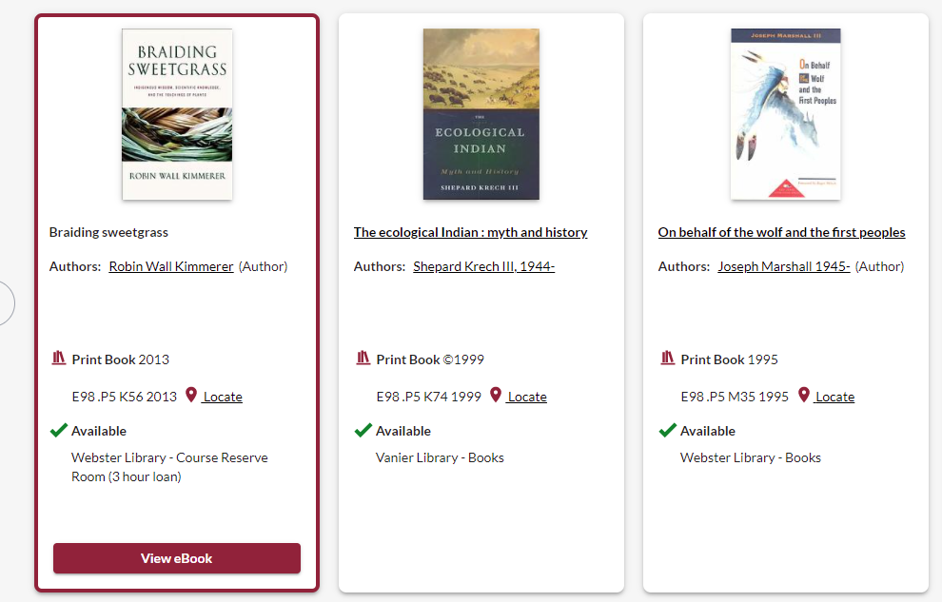
Classification: browse the bookshelves
On the library shelves, most books about First nations, Metis and Inuit peoples and thought are found in the E classification area, for “History of North America”. This represents an erasure of living peoples, philosophies, and knowledge.

Slide 25
Terminology
In the most common university library classification system, Library of Congress Subject Headings (LCSH), the main subject heading for material about Indigenous peoples in Canada and the United States is “Indians of North America”.
The term Indigenous is still new in these systems.
Though relevant and correct, terms for nations such as the Kanien’kehá:ka or confederacies such as the Haudenosaunee are far less prevalent in our Sofia Discovery tool than terms such as Mohawk or Iroquois.

Slide 26
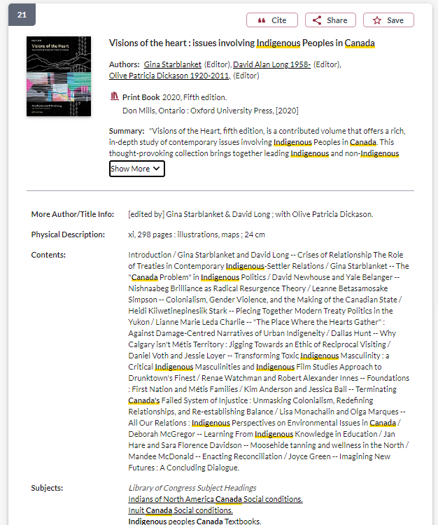
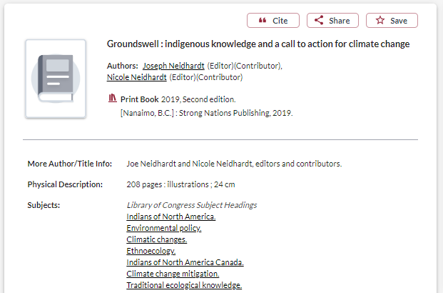
Terminology: what about the subjects?
These books were published in 2019 and 2020 and are about “contemporary issues involving Indigenous peoples in Canada” and Indigenous activism regarding climate change.
However, they are classified within the subject heading: Indians of North America

Slide 27
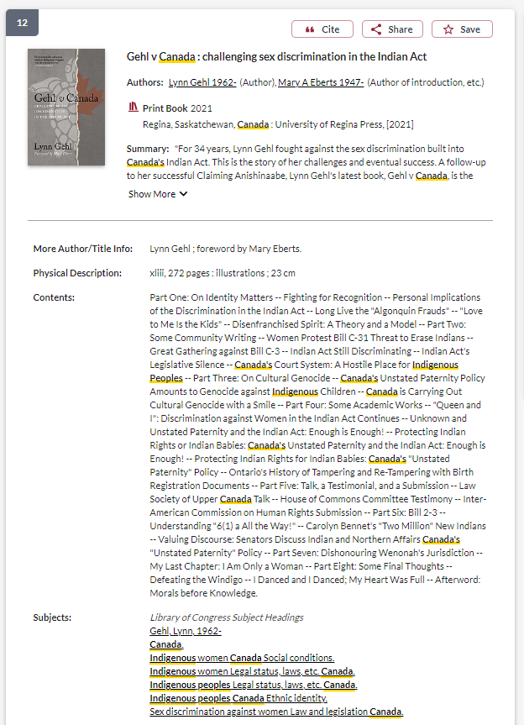
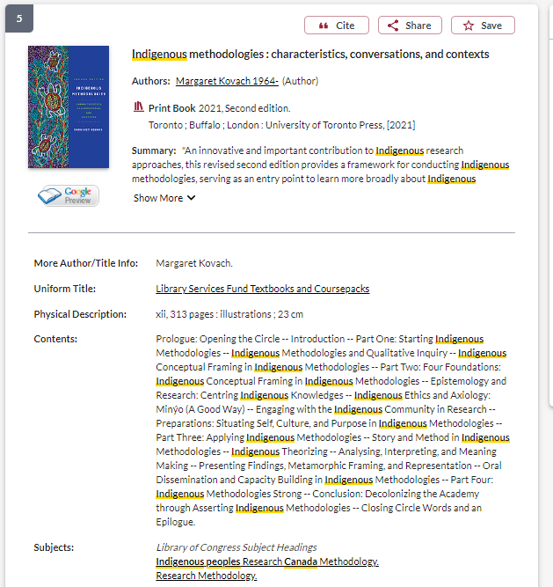
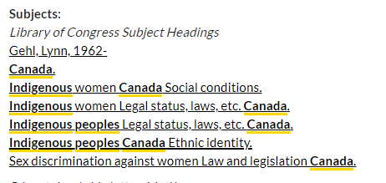

Slide 28
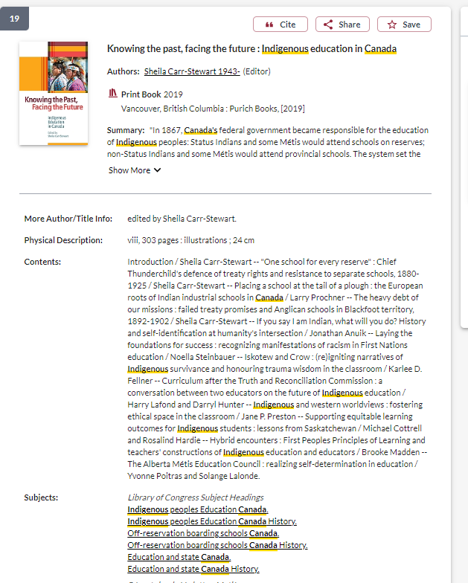
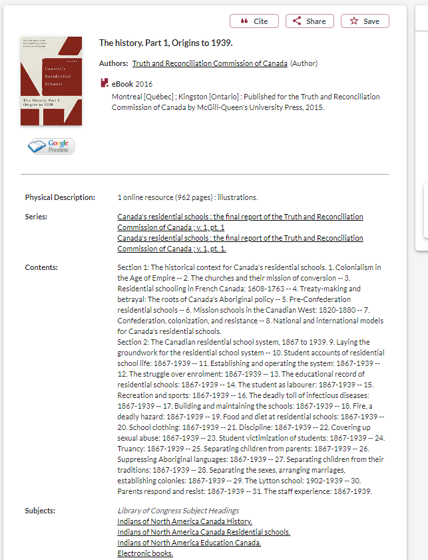
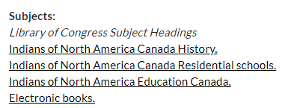
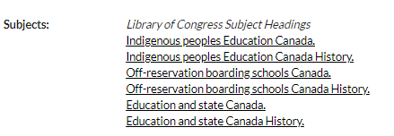
Terminology: what about the subjects?
Until recently, the subject heading “Residential School” was less common than subject headings such as:
“Off-reservation boarding schools - Canada”
“Indians of North America - Education”

Slide 29
Terminology – Government
The government departments responsible for relations with Indigenous peoples in Canada, has changed 9 times the country’s colonial history.
1860 - Dept of Crown Lands & Hudson's Bay Company,
1873 – Dept of the Interior,
1880 – Dept of Indian Affairs,
1936 – Dept of Mines & resources,
1949 – Citizenship & Immigration,
1965 – Northern Affairs and National resources,
1966 – Indian Affairs and Northern Development
Current departments: 2017- Indigenous Services Canada (ISC) and Crown-Indigenous Relations and Northern Affairs Canada (CIRNAC).

Slide 30
Keywords and subjects for searching scholarly literature
  Indigenous
  Aboriginal
  Native**
  Indian (legal significance)
  First Nations, Metis, Inuit
  First peoples
  Autochtone (native)
  Autochtones (indigenous)
  Amérindien (Indian)
Regional differences:
  Aboriginal: Australia & Canada
  Native American or American Indian: U.S.
  First Nations: Canada
  Indigenous: international

Slide 31
There is a tension between finding keywords and subjects that will result in the most comprehensive search, and the terminology or way of speaking and writing about Indigenous Peoples, knowledges, and worldviews respectfully.
Pause.

Slide 32
Strategies to locate Indigenous Scholars and other research in library databses

Slide 33
Choosing and developing a topic

Slide 34
Possible topics
I’m interested in Indigenous studies in higher education
I’d like to know how land-based education is being incorporated into pedagogy at the university level
I want to know how Indigenizing and decolonizing efforts are being integrated into university curriculum

Slide 35
Identifying keywords
My key concepts
Alternative or related terms
Indigenous studies
Land-based education
Higher education/University
Pedagogy/curriculum
Indigenizing
Decolonizing
First Peoples Studies
Land-based learning/Place based education
Post-secondary
Teaching
Reconciliation

Slide 36
How do we combine keywords for the best possible results?
AND: combines concepts and limits your results
Indigenous AND education
youth OR teens
land OR territory
OR: allow you to insert synonyms or alternative terms and increases your results

Slide 37
How do we combine search words for the best possible results?
“quotation marks”: If you put two or more words in quotation marks, that exact phrase will be searched and limits your results.
“First Nations”
“public policy”
Democra*
Finds: democracy, democracies, democratization, etc.
Canad*
Finds: Canada, Canadian
* - when you add an asterisk on the end of a word, your results will contain all the words with those endings or suffix

Slide 38
Avoid Searching with Linking words
Effects
Impact
Consequences
Influence
Results
Importance
Significance
Response
Emphasis
Causes
Each author may use different linking words when discussing similar topics.
You don’t want your search to be limited to those books and articles that only contain the word “effect” or “consequence”

Slide 39

How do you start your research?
Where do you look first?

Slide 40
Next steps….
Combine the keywords with AND/OR
Search for them in a database to find sources for my research
What’s the best place to search?
  Sofia Discovery Tool: all the ebooks and print books at Concordia Library, journal articles from many disciplines, government documents and print books in collections outside of Concordia
  Academic Search Complete (EBSCO): a journal article database with articles from multiple disciplines and good limiters, plus the opportunity to combine searches
  iPortal: an Indigenous focused research portal with journal articles
  Google Scholar: an academic database of journal articles, fewer limiters, wide scope

Slide 41
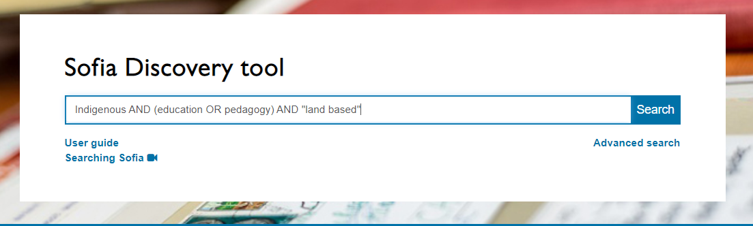
Searching for some of the main concepts I identified
Keeping my search broad, to see what is out there
AND/OR need to be in ALL CAPS in Sofia
I can add concepts, as I develop my search
In Sofia, we are searching through books and articles, books can be searched more broadly because we are searching through titles, subjects and table of contents

Slide 42
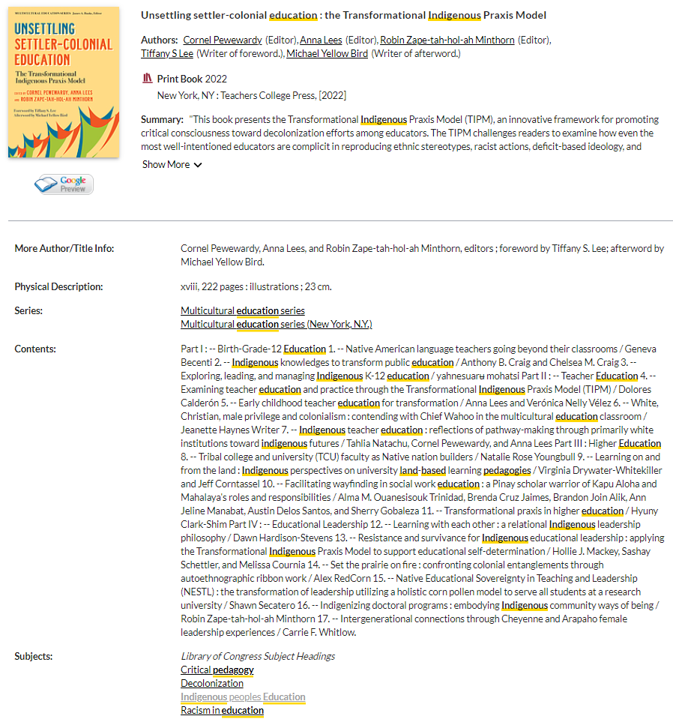
All books in the library are arranged by subject and will have subjects listed in their book record.
Clicking on one of these subjects will find all the books and some articles that have the same subject attached, at the library.

Slide 43
Who wrote the book?
How do we locate Indigenous authors?
Scholarly books often have editors and each chapter will have different authors
You should look for “Contributors”, which will have a list of individual chapter authors, and their biographies either at the beginning or very end of the book
If a book has one author, look for “about the author” section or even skim the introduction, where the author will describe themselves
The table of contents might also have author information, in the case of Indigenous authors their community or nation may be in brackets following their name

Slide 44
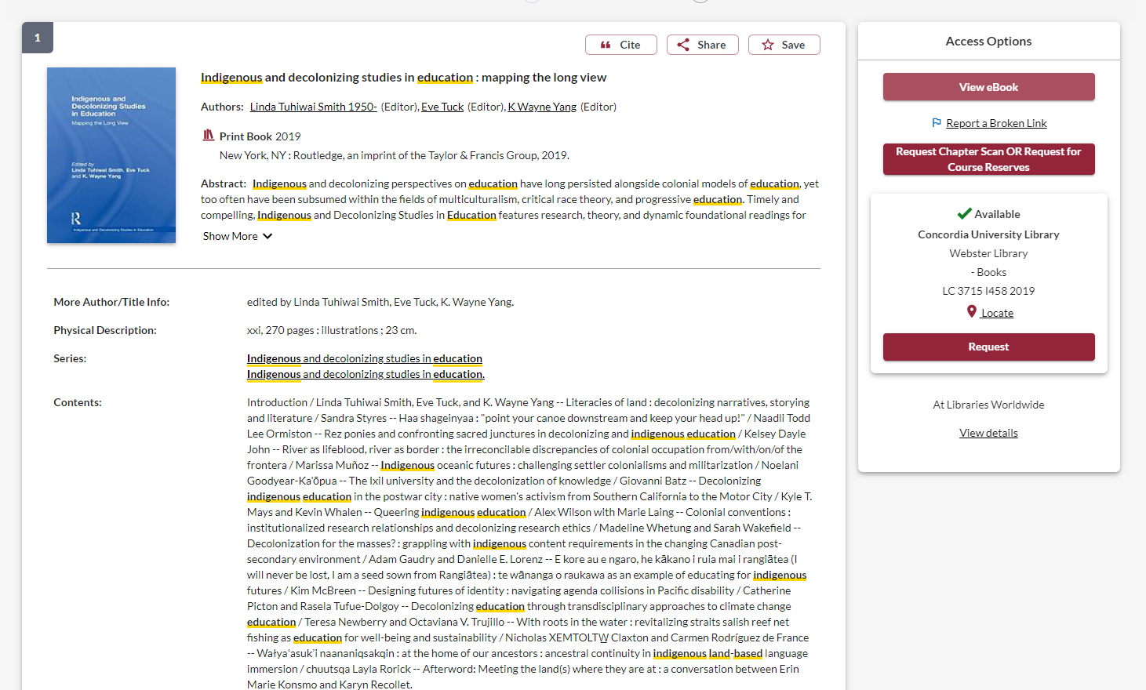
Let’s find out about the contributors

Slide 45

How to use a scholarly book
Most scholarly books are edited, and each chapter will be about a different aspect of a broad theme
Check the table of contents and the index (at the end of the book) to locate your topic in the book
Read the chapter or section about your topic
Think of each chapter in an edited book as an article
You can cite multiple chapters from an edited book
You’re not expected to read the entire book, it’s unnecessary and not how scholarly books are usually used in research

Slide 46
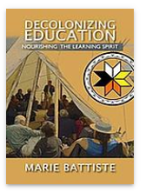
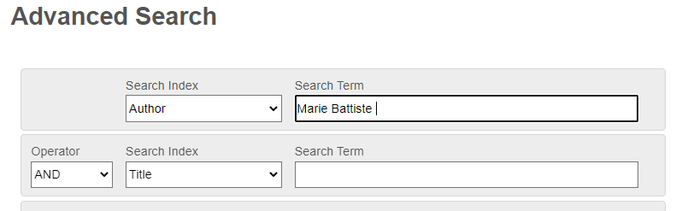
How else can I locate books by Indigenous authors and scholars?
Indigenous Authors in the Spotlight series
Indigenous Resources guide: Knowledges, methods & ethics
Sofia (Advanced) Author search for a known scholar
Marie Battiste is a Mi'kmaw educator from the Potlotek First Nation

Slide 47
Your turn! Find a book in Sofia
Brainstorm a few key concepts from your topic or break a topic you are interested in, into keywords
Using AND/OR, “quotation marks” and the asterisk* (if needed), put together a search
Does the book have a useful subject heading?

Slide 48

Scholarly, peer reviewed journal articles
A scholarly journal article is the best of what we know; it builds on previous research.
The purpose of a scholarly journal is to report on research conducted by scholars, and professionals in the field.
  Scholarly journals provide in-depth articles that cover specific issues or research questions, while the language and content is geared toward scholars and professionals in the field.
  Some articles contain tables and graphs and most contain bibliographies (or reference lists or works cited)
  articles in scholarly journals are peer reviewed.

Slide 49
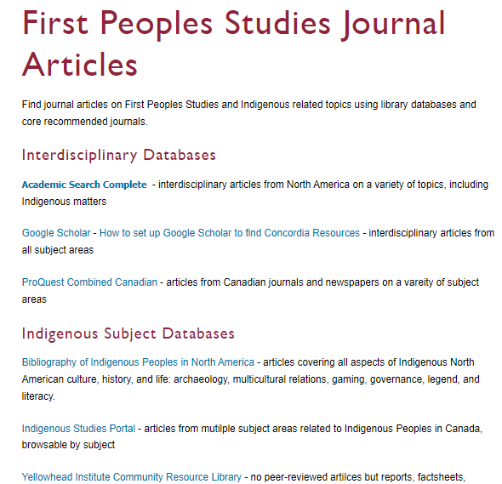
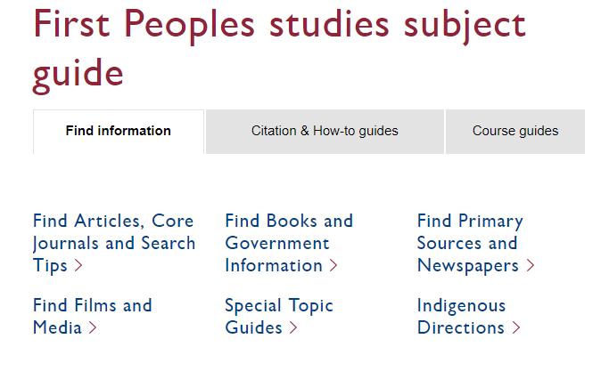
Using databases to search for journal articles

Slide 50
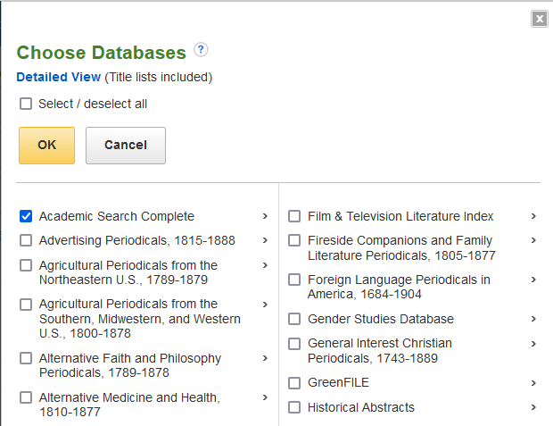
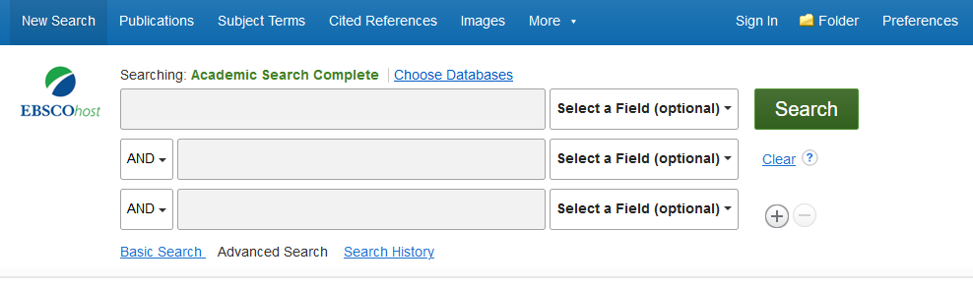

Combining databases in EBSCO
We can combine the large, multidisciplinary database Academic Search Complete with the subject-specific database Bibliography of Indigenous Peoples in North America

Slide 51
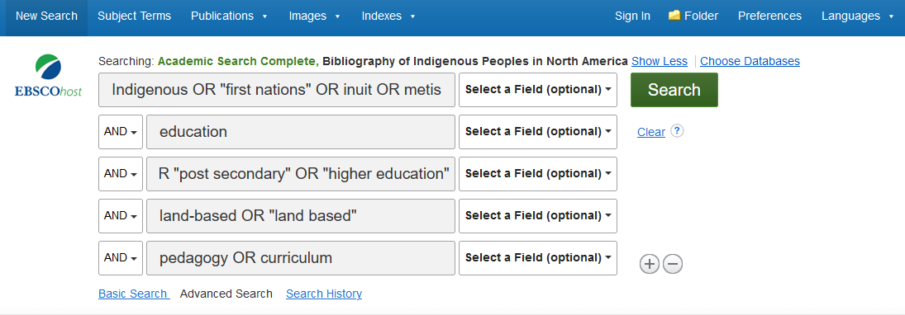
Search:
Indigenous OR "first nations" OR inuit OR metis
AND education
AND university OR "post secondary" OR "higher education“
AND land-based OR "land based“
AND pedagogy OR curriculum

Slide 52
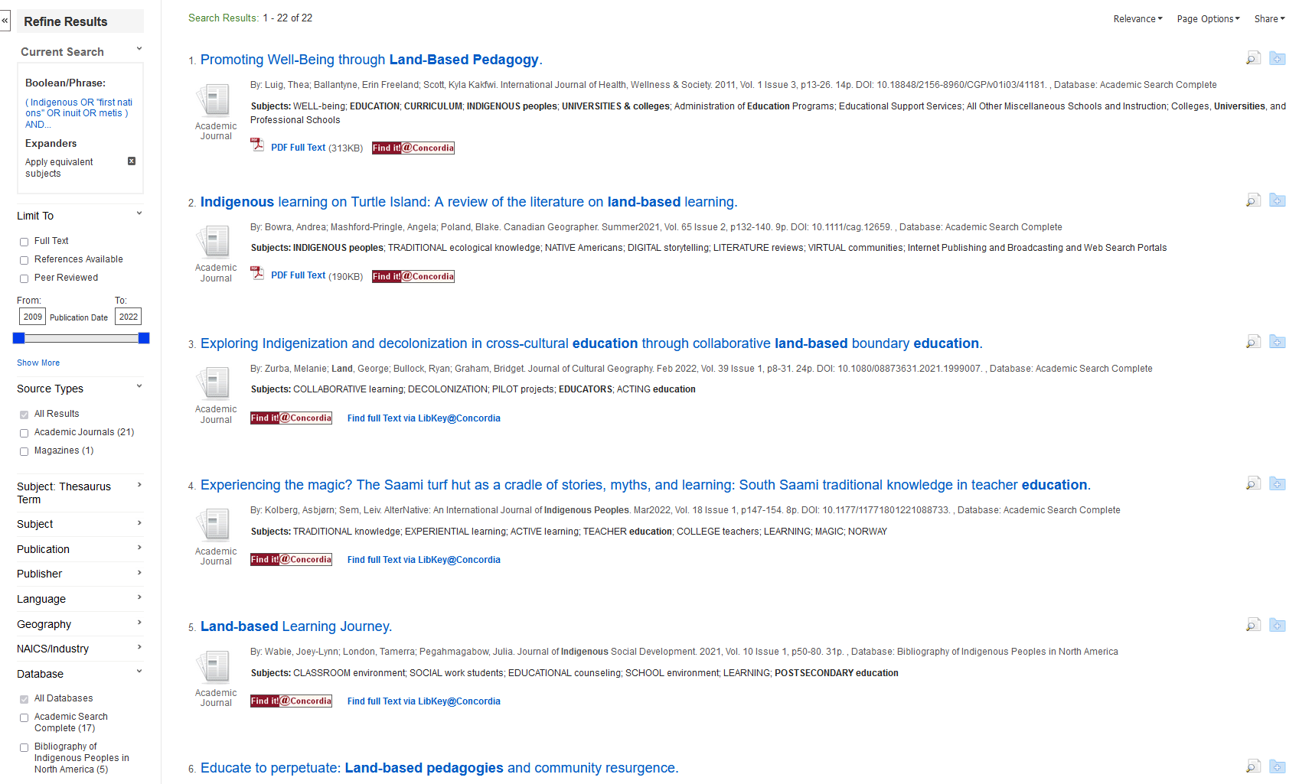
We can narrow down to peer reviewed articles only here
We can save our articles here
We can add subjects here
We can see which database our articles are coming from here

Slide 53
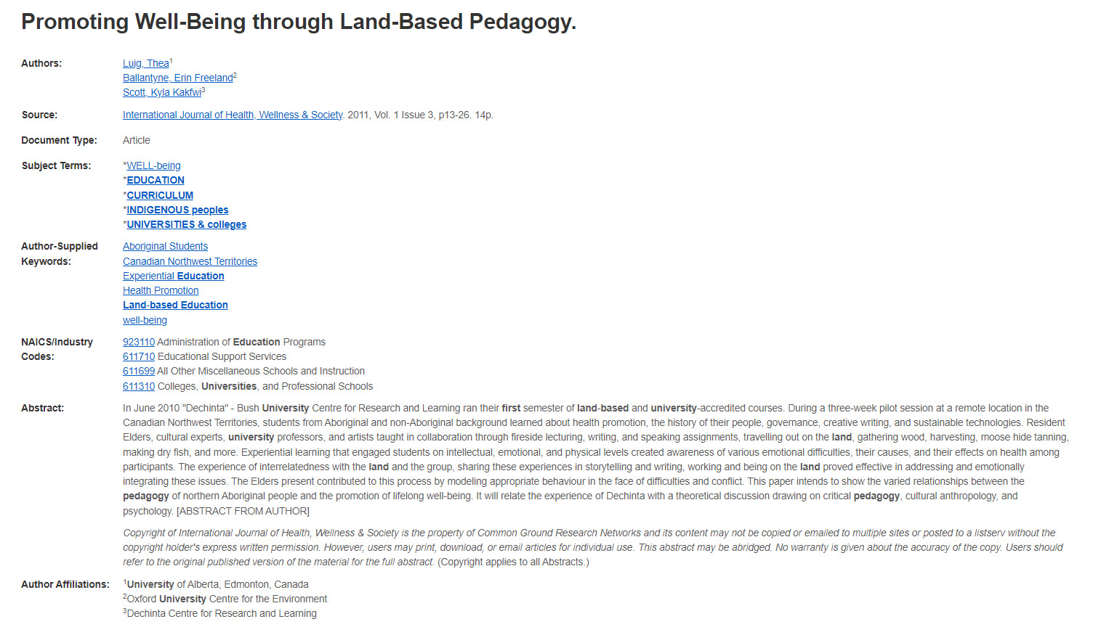
Length: scholarly articles are generally 10+ pages
Read the abstract and the subjects to see if the article will match your topic
Author affiliations will provide which universities researchers are from and, in some cases, identify Indigenous authors and communities

Slide 54
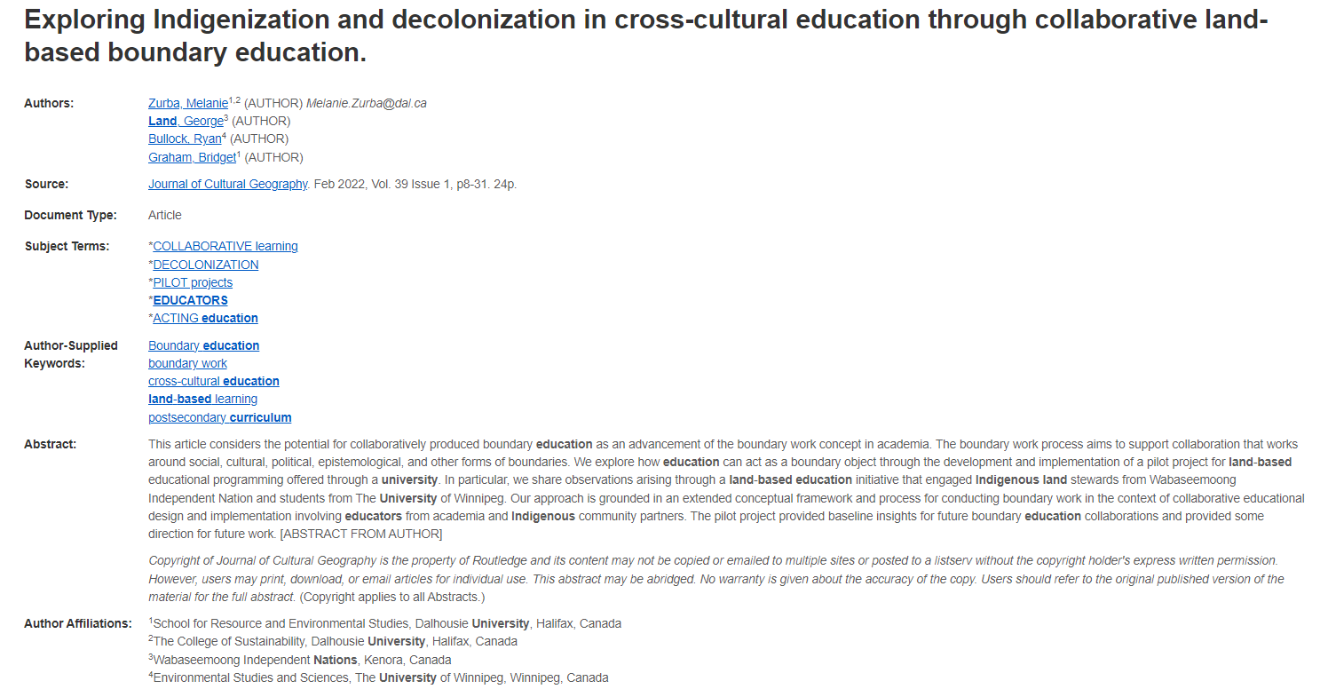
There is an Indigenous author on the research team, affiliations can give this information like “contributors” lists

Slide 55
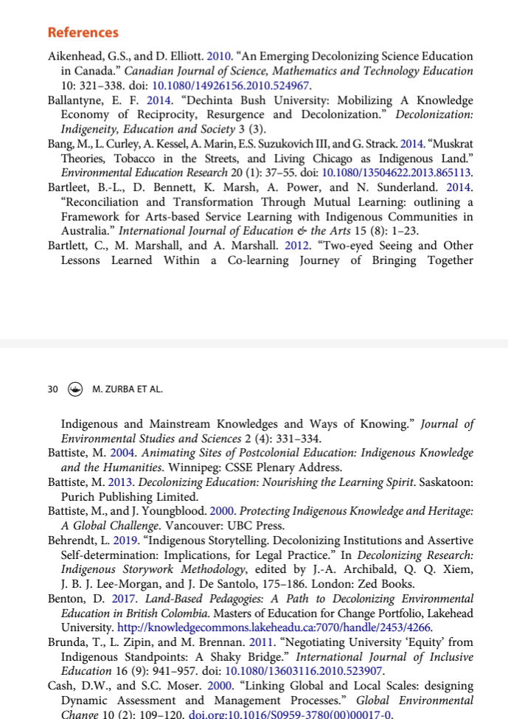
Scholarly articles will always have reference lists/bibliographies/works cited
These are great places to find more sources!
The researcher or research team are experts in the subject area and have already done a lot of research
Use this expertise by looking up the books and articles they cite in Sofia and using them in your own research
This is a commonly used method in academic research

Slide 56
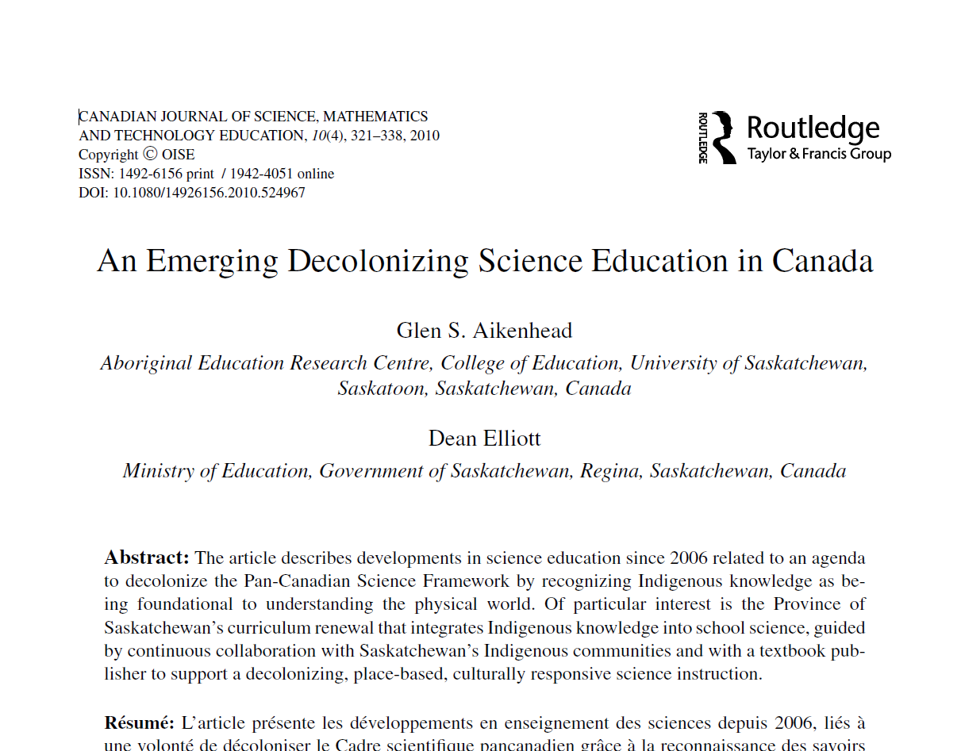
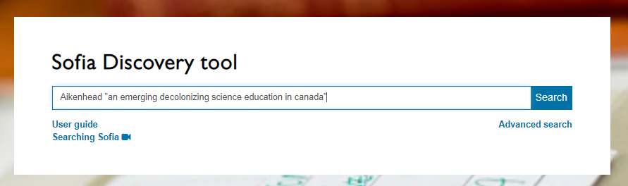
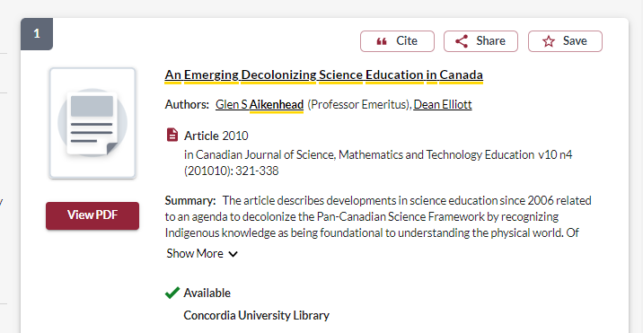

Slide 57
How to read an academic article
Read the abstract to get a broad overview of the topic and to decide if the article is relevant to your research
Read the introduction and discussion/conclusion
Look at the headings of the article sections, is there one or two sections that will be important for your research?
Look at the reference list for further helpful sources, focusing on those cited in the sections that you have selected as most relevant
Use Crtl+F (Windows) or Command+F (Mac) to find a particular name, word or phrase in the text

Slide 58
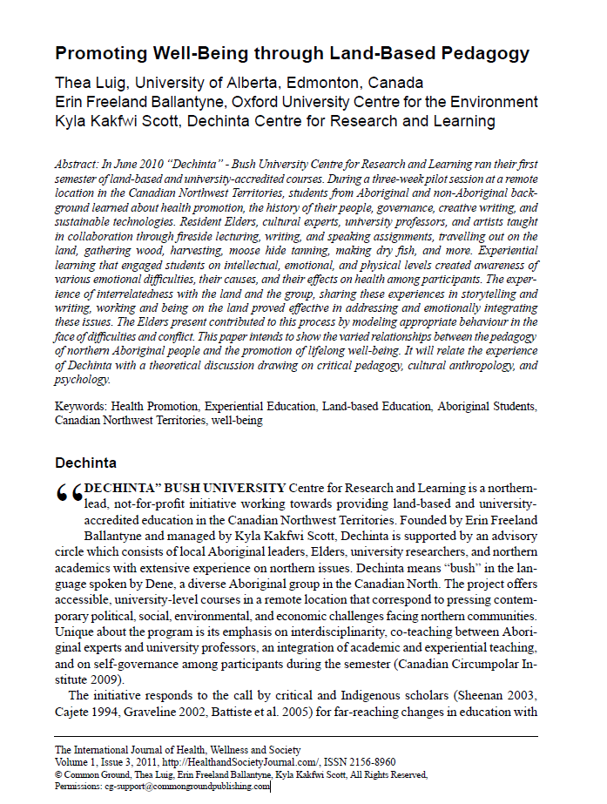
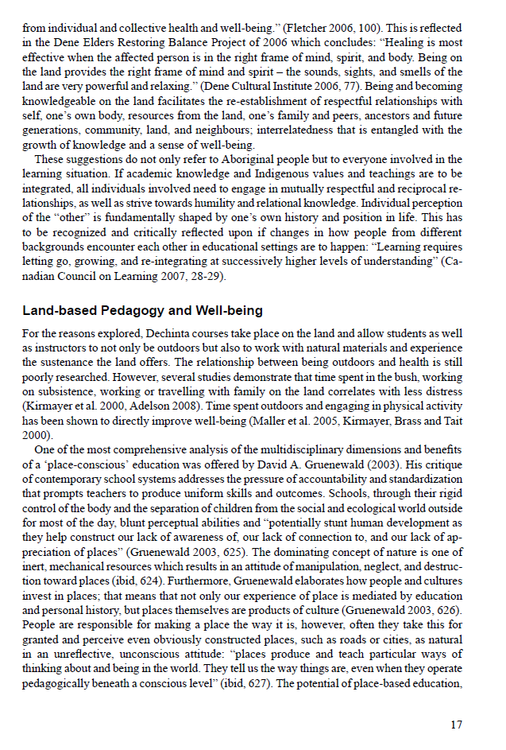
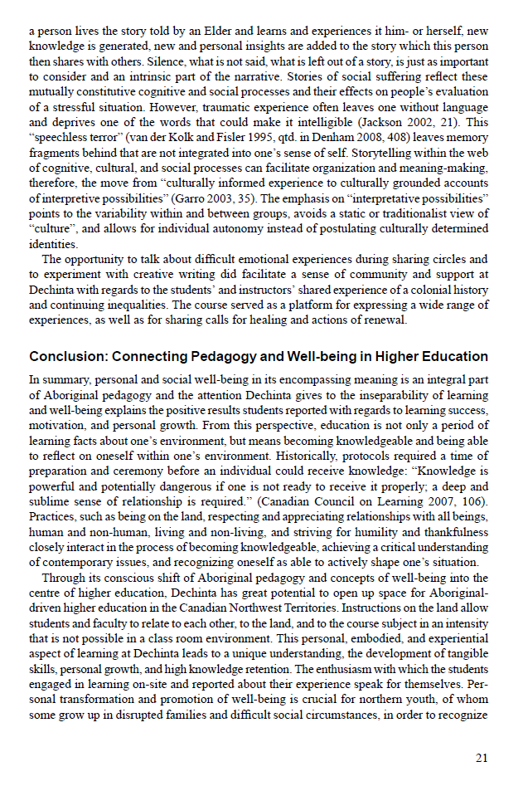
Read the conclusion
I found this section on land-based pedagogy, so I will read this in detail
Read the abstract and introduction

Slide 59

Reading & notetaking
Read actively and selectively. Make decisions about what is essential. Once you’ve read what is most relevant, you may not need to read the rest.
Read to answer your questions. What do you need to find out? Actively look for the evidence that will answer these questions.
Break reading into manageable segments. Read only one chapter, an individual article, or a specific number of pages. Reward yourself with a break once you’ve completed the task.

Slide 60

Reading & notetaking
Try a two-step process: When you first search for books and articles, sort them into folders or piles and take only minimal notes; for example, two or three lines summarizing the key argument.
Flag articles as "high," "medium," or "low" priority. Once you have identified book chapters or articles that are relevant to your assignment, take in-depth notes.
When taking notes, always put quotation marks around direct quotes.
You may want to consider dividing your page into two columns: they say/I say. This way you will always know which words are someone else's, whether it's direct quotes or paraphrases.

Slide 61
Next steps….
Combine the keywords with AND/OR
Search for them in a database to find sources for my research
What’s the best place to search?
  Sofia Discovery Tool: all the ebooks and print books at Concordia Library, journal articles from many disciplines, government documents and print books in collections outside of Concordia
  Academic Search Complete (EBSCO): a journal article database with articles from multiple disciplines and good limiters, plus the opportunity to combine searches
  iPortal: an Indigenous focused research portal with journal articles
  Google Scholar: an academic database of journal articles, fewer limiters, wide scope

Slide 62


Slide 63

I-Portal can be browsed by using the Turtle or the list of broad topics

Slide 64

The record will give you a lot of information about the article including the type of source, peer reviewed, and attached subjects

Slide 65

Search in the same way we searched in the Sofia Discovery Tool
Options to narrow down, on the right

Slide 66


Slide 67

Your turn!
Use a database to find an article

Slide 68

Using Google Scholar in 2 ways:
  Setting up Google Scholar to be effective as a Concordia user
  Using Google Scholar for Reverse Citation Searching

Slide 69



Slide 70



Slide 71

Concordia access
Use related articles link
Limit your results by date

Slide 72


Reverse Citation Searching – Google Scholar
Title: Decolonizing Methodologies: Research and Indigenous Peoples
Author: Linda Tuhiwai Smith
Date: 2012*
*When doing a reverse citation search, it is important to pick a title that has been available for several years, as it will have time to have been read and cited.

Slide 73

1. You are searching for the citation of your title, to find what other scholars and research have cited it. Click "cited by“ to find resources that cite a specified publication.

Slide 74

You are looking at books and articles that have cited this book.
2. Now you have a list of books and articles that have cited the title you searched. Select "Search within citing articles" and try performing a keyword search to narrow your results.

Slide 75

3. Look for author self-identification or biographies which identify authors as Indigenous within articles. Indigenous scholars often cite Indigenous research.

Slide 76
Summary
Break your topic into key ideas and keywords to use them in a search strategy in the databases
Consider the bias and barriers of library tools searching, think about what words you are using and whose voices you are seeking
Use Sofia to find books, look a table of contents and Index in a scholarly book to find your topic and treat each chapter like an article
Look for Contributor lists to find Indigenous scholars and authors
Use the library guides and the Indigenous resources lists to find Indigenous authors
Use the library databases to find journal articles, look for author affiliations to find Indigenous scholars
Use the reference lists from good articles to look for other sources
Skim articles, read the abstract/intro, discussion, conclusion and any sections that look relevant to your topic
Use subject specific databases from the First Peoples Subject Guide
Set up Google Scholar as a Concordia user and do reverse citation searches on notable Indigenous research

Slide 77

Citation!

Slide 78


Slide 79


Slide 80


Slide 81


Slide 82


Slide 83


Slide 84


Slide 85


Slide 86


Slide 87


Slide 88


Slide 89


Slide 90


Slide 91


Slide 92


Slide 93


Slide 94


Slide 95


Slide 96

Gibbs, J. T., & Huang, L. N. (Eds.). (1991). Children of color: Psychological interventions with minority youth. Jossey-Bass.

Slide 97

Robinson, B. (2019). No holds barred: Policing and security in the public library. In the Library with the Lead Pipe. https://www.inthelibrarywiththeleadpipe.org/2019/no-holds-barred
https://jps.library.utoronto.ca/index.php/des/article/view/18630

Slide 98

APA workshop – online: March 13th
https://concordiauniversity.libcal.com/event/3705403

Slide 99

Need help, ask us!
Michelle.Lake@Concordia.ca

