Slide 1
Fpst 202 Library workshop
Michelle Lake
Michelle.Lake@Concordia.ca

Slide 2
Who am I?
Michelle Lake, librarian for First Peoples Studies, Political Science, the School of Community and Public Affairs, and Government Publications
Michelle.Lake@Concordia.ca / Zoom Office Hours – Wednesdays 2-4pm
What do I do?
Provide research support
Help students with library databases
Help students find and access materials they need
Help with citation issues
Choose the books we buy for the above subject areas

Slide 3
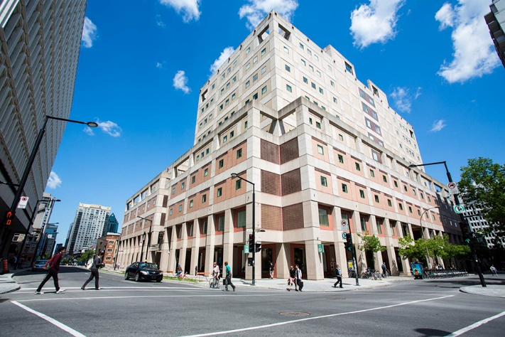
The Librar(ies)
Webster Library – SGW Campus
24/7 access, with student card, after 11pm
2nd, 3rd, 4th, and 5th floor of LB - “Library Building”
Poli Sci, Government Info, Maps, History, Social Sciences, Humanities, Engineering & Fine Arts
Interlibrary Loans
Current Print Journals
Vanier Library – Loyola Campus
24/7 access, with student card, after 11pm
1st, 2nd, and 3rd floor VL – “Vanier Library”
Sciences, Psychology, Communications & Journalism
Special Collections
Print Journal Archive

Slide 4
Library: in person
Services such as the loans desk, Ask Us desk and chat help are not open 24/7, check the library website for hours if you need a particular service.
Course Reserves room is open - need to use the call number of a book to locate them in course reserves
Procedural masks need to be worn at all times in the library.

Slide 5
Library Services
Your student card is your library card. You need it to borrow books, borrow a laptop, print and access the library during 24/7 hours.
You can borrow up to 100 print items at a time and renew them online, if no one else requests them. Borrow a laptop for 24 hours or a tablet for 3 days.
Webster library has 5 book scanners that can be used for free to scan chapters from our print books and email them to yourself as a PDF.
To use Library databases, access online articles and ebooks when you are off campus, login with your MyConcordia Netname and password.

Slide 6
Course Reserves via the Library - library.concordia.ca
many ways to access:

Slide 7
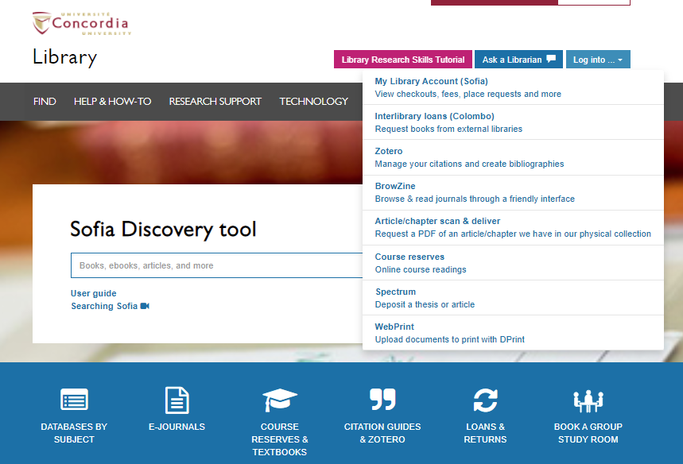

Slide 8
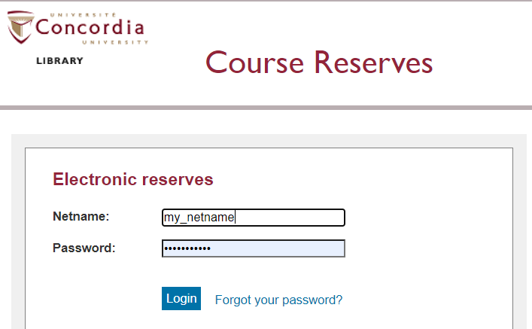

Slide 9
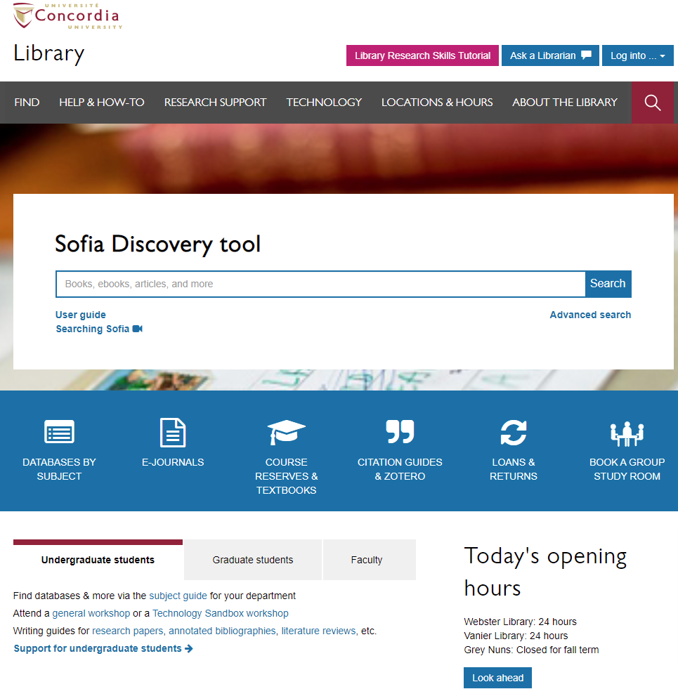
Library website: https://library.concordia.ca/
Use the Sofia Discovery tool to find print books, ebooks, and journal articles from the library.
Book a study room in the library for 2 or more people to use for up to 3 hours
Find your subject guide for your topic area

Slide 10
Locating items when you have the citation information

Slide 11
Minthorn, R.S., Shotton, H.J., Brayboy, B.M. (Eds). (2018). Reclaiming Indigenous research in higher education. New Jersey: Rutgers University Press.

Slide 12
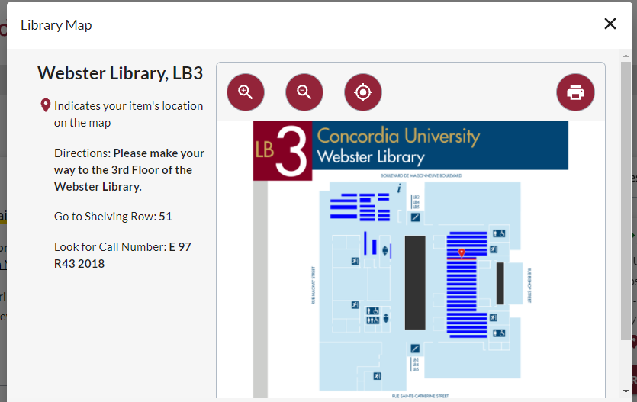

Slide 13
Huaman, E.S. & Martin, D.N. (2020). Indigenous knowledge systems and research methodologies: local solutions and global opportunities. Vancouver: Canadian Scholars Press.

Slide 15
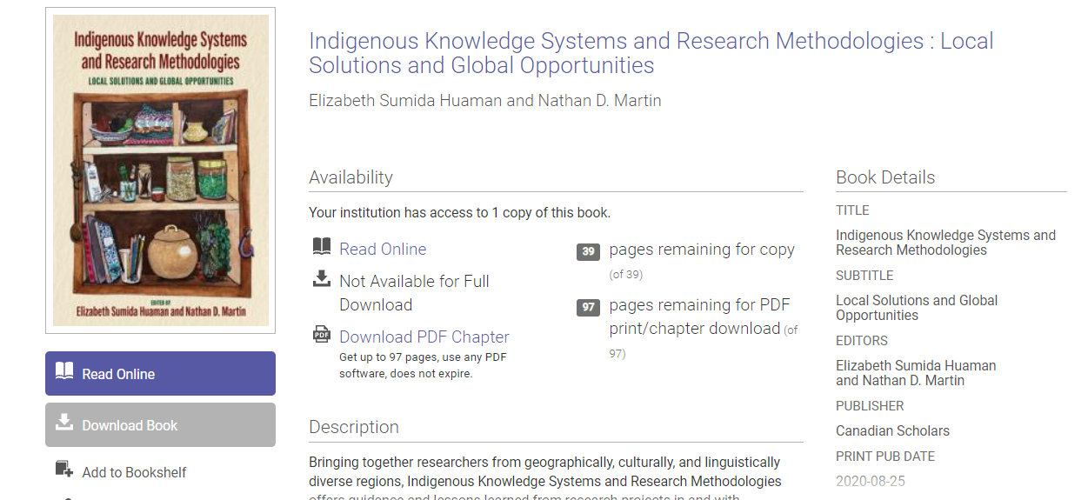
Scroll down to access individual chapters and download PDFs

Slide 16
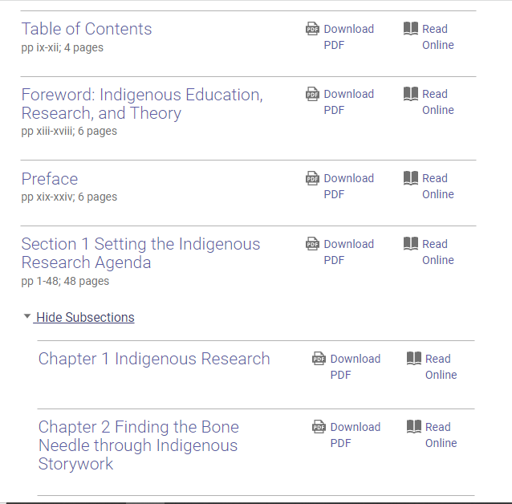

Slide 17
Graeme, C.S. & Mandawe, E. (2017). Indigenous geographies: research as reconciliation. International Policy Journal 8(2): 1-19.

Slide 18
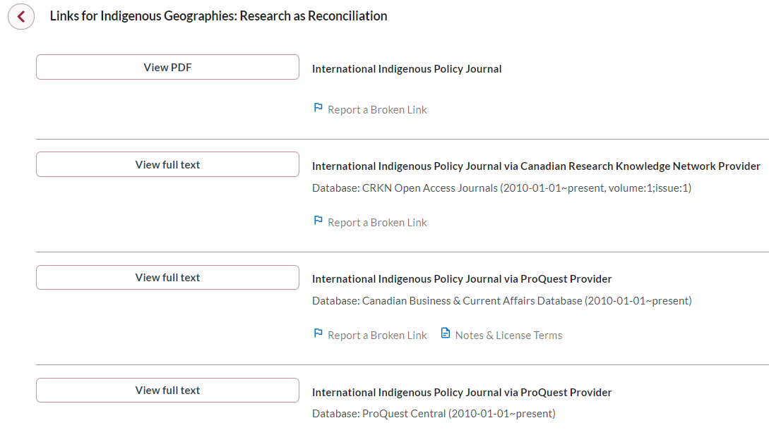
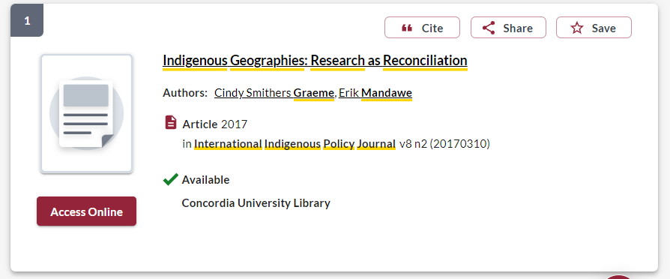
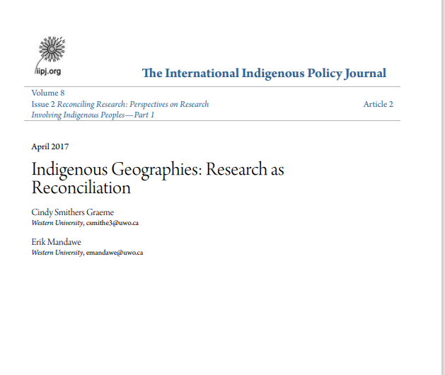

Slide 19
Types of Sources

Slide 20
Primary Sources
Primary sources provide first-hand testimony or direct evidence concerning a topic under investigation.
They are created by witnesses or recorders who experienced the events or conditions being documented.
Often these sources are created at the time when the events or conditions are occurring, but primary sources can also include autobiographies, memoirs, and oral histories recorded later.
Some examples of primary sources include:
Letters
Diaries
Interviews
Maps
Proclamations
Newspaper and magazine articles
Government documents
Autobiographies and memoirs
Works of art, including plays, poetry, films novels, and paintings
Artefacts, including clothing, furniture, and buildings

Slide 21
Secondary Sources
Secondary sources interpret and analyze primary sources.
These sources are one or more steps removed from the event.
Secondary sources may have pictures, quotes or graphics of primary sources in them. Some types of secondary sources include:
Scholarly Articles
Scholarly Books and book chapters
Textbooks
Encyclopedia or dictionary entries
Documentaries

Slide 22
Choosing &
developing a topic

Slide 23
Topics and Keywords
What is your broad topic?
First Peoples studies and Indigenous education in Canadian universities.
What are your research questions?
Are Canadian universities Indigenizing their curriculums?
How are Canadian universities responding to the TRC Calls to Action and implementing educational policies for reconciliation?
Are Indigenous knowledges being incorporated into teacher education programs at Canadian universities?

Slide 24
Topics and Keywords
What are the keywords you can use to search for books and articles?
Indigenous / Education / Universities / Canada / Curriculum / Indigenous knowledge
What are some synonyms or alternative words that you can add to this search?
Indigenous > First peoples, First Nations, Metis, Inuit, Aboriginal
University > post-secondary, higher education, college
Curriculum > educational program, pedagogy, course of study
Indigenous knowledge >Traditional knowledge, Indigenous worldviews, local knowledge, Indigenize, decolonize

Slide 25
Search Strategies

Slide 26
BEFORE YOU SEARCH: Tips for Library Databases
TIP | WHAT IT DOES | EXAMPLE
AND | Combines concepts. Limits how many results your search produces | Pipelines AND Activism
OR | Lets you insert synonyms or alternative terms. Increases the number of results your search produces | Indigenous OR Aboriginal
* | Near the end of a word, retrieves all words that start with the letters entered. Increases the number of results your search produces. | Environment* (retrieves environment, environmental, environmentalist, environmentalism)
“ ” | For two words or more, searches for an exact phrase only, rather than each keyword. Limits how many results your search produces. | “First Nations” (retrieves First Nations, but not: first there were several nations)
Notes:
So, now we have several possible searches we could try.
Be sure each of your KEY concepts is still in your search and don’t forget the AND!
(have each search appear one at a time, but not too slowly – no need for viewer to read each, just to get the idea)
If you find a few good results, in a few different searches, you will have a good set of resources to support your research question!

Slide 27
Avoid Searching with Linking words
Effects
Impact
Consequences
Influence
Results
Importance
Significance
Each author may use different linking words when discussing similar topics.
You don’t want your search to be limited to those books and articles that only contain the word “effect” or “consequence”

Slide 28
Using Sofia to find books and articles (Indigenous OR "First Nations" OR Metis OR Inuit) AND (universit* OR post-secondary) AND (Curriculum OR pedagogy) AND ("Indigenous knowledge" OR "traditional knowledge" OR indigenization OR decolonization) AND Canad*

Slide 29
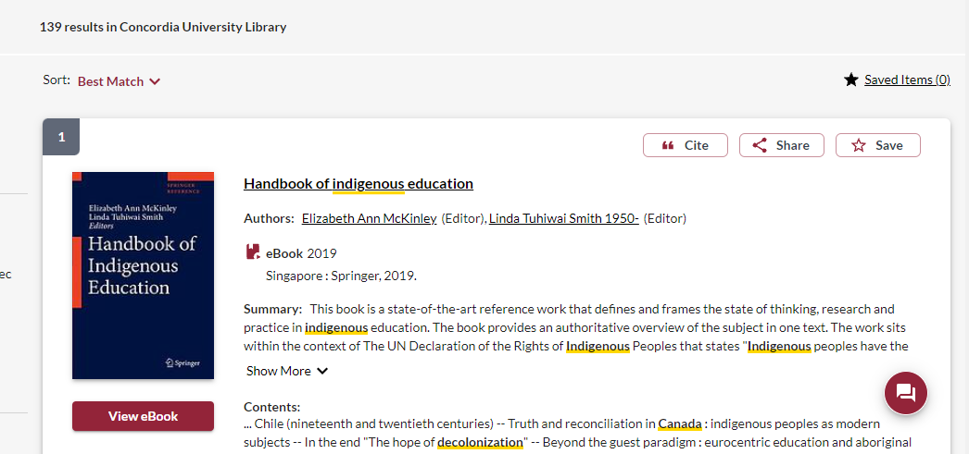
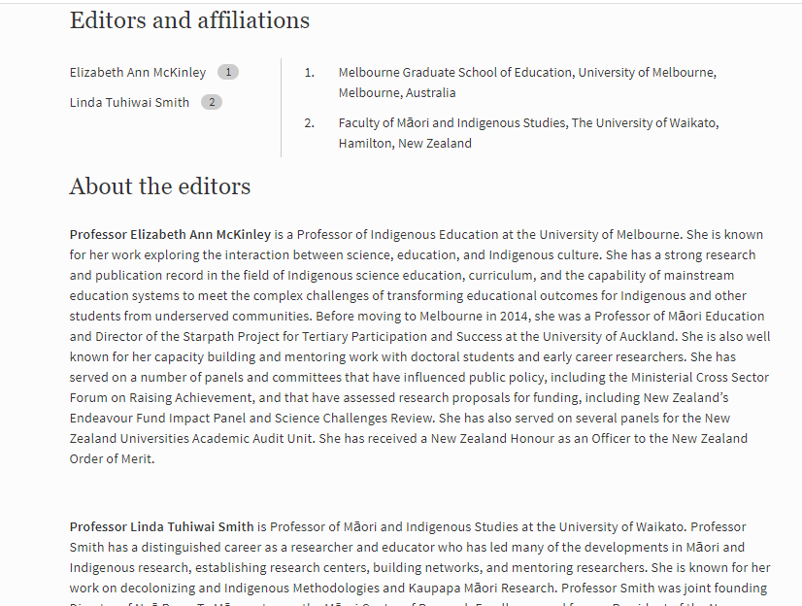
The ebook provides the author’s affiliations, and we can see that they are both university professors and experts in the field

Slide 30
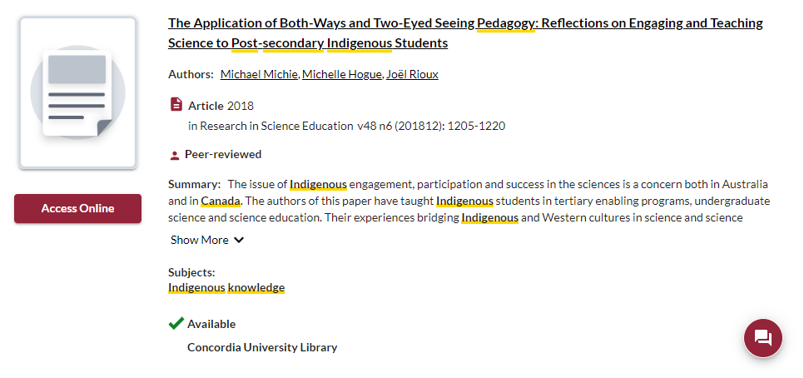
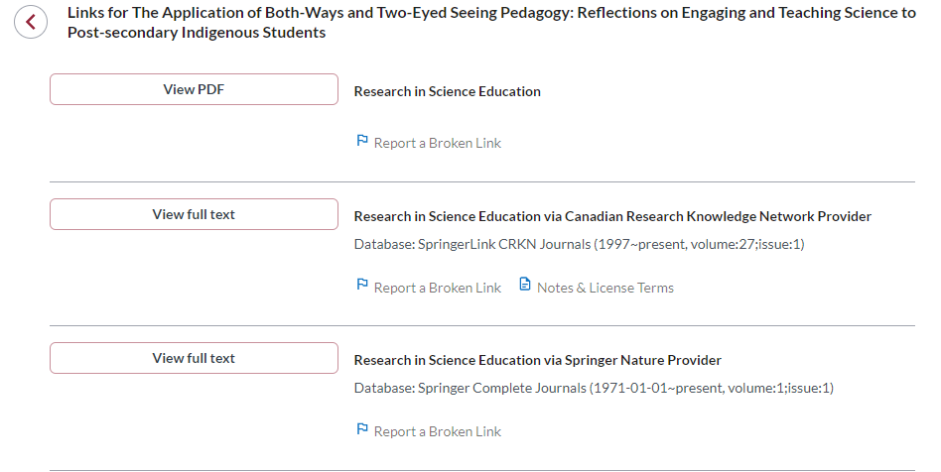
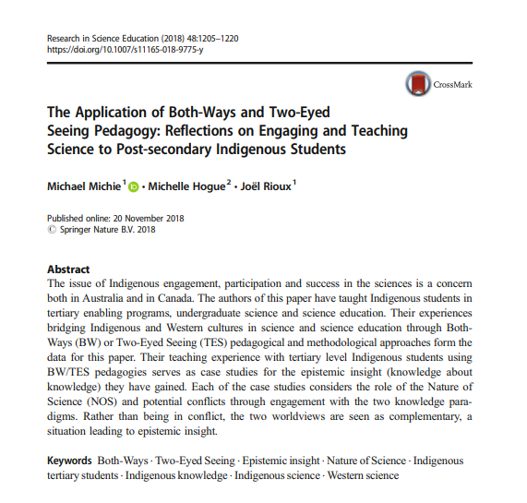

Slide 31
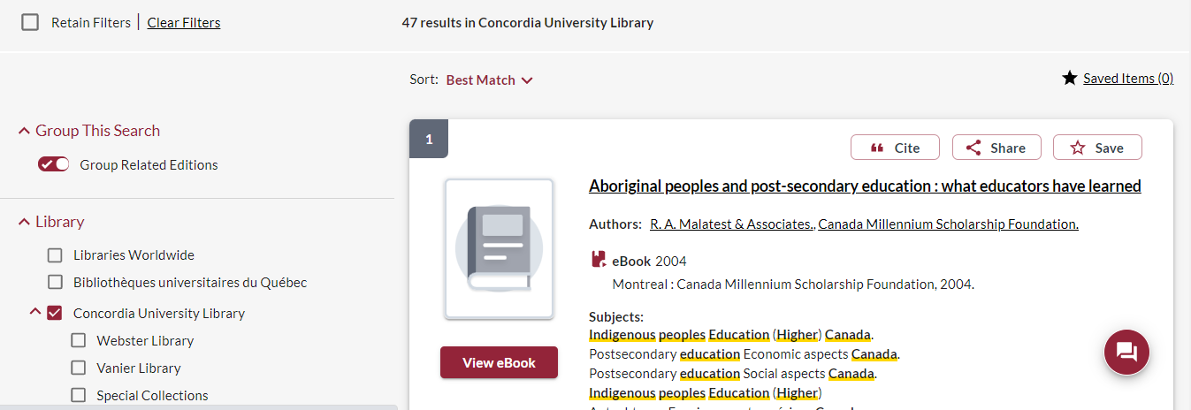
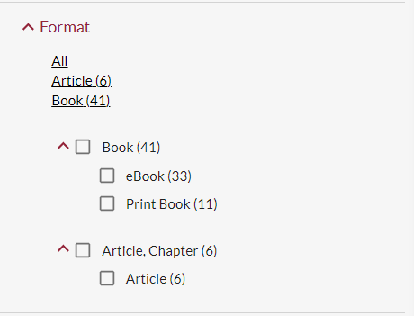

Slide 32
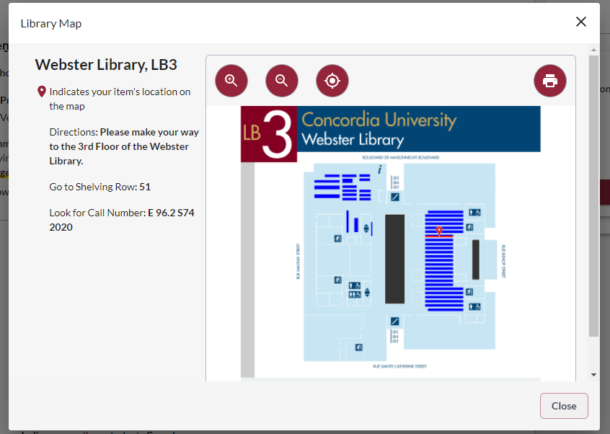
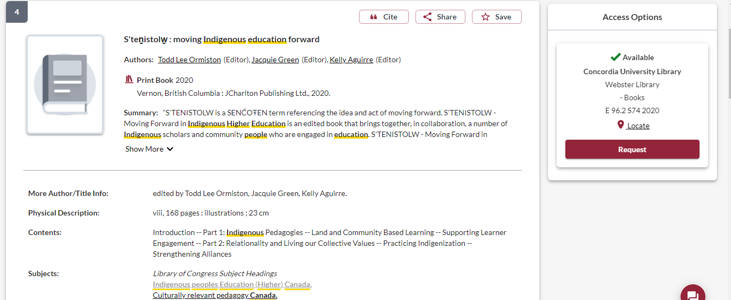

Slide 33
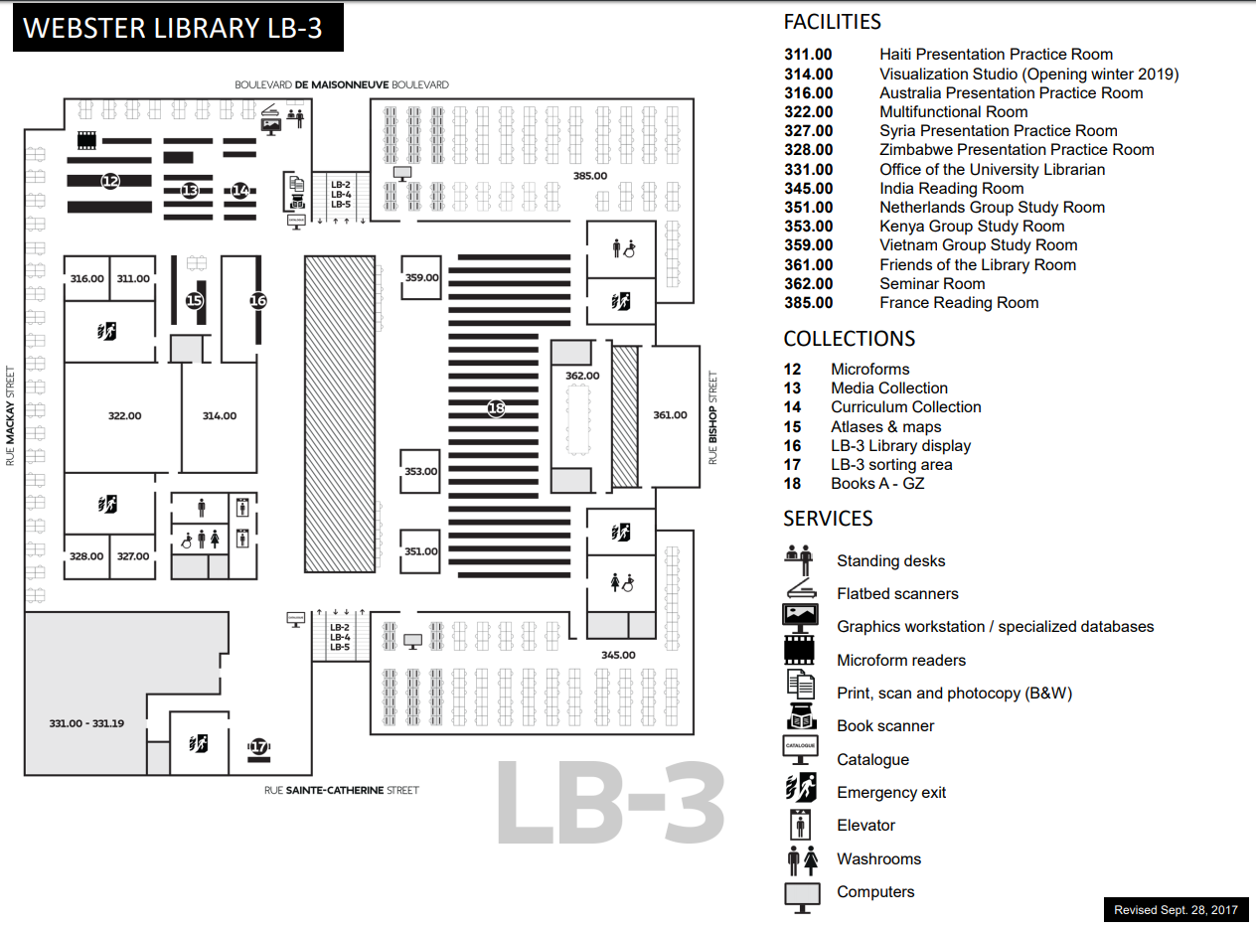
E, F and FC books are here
Call number ranges:
E 75 – E 99 Indigenous Peoples in North America
F 1-1140 History of British America (Canada)
FC 1-4200 Canada

Slide 34
Collections: Print books
Webster Library:
Social Sciences/Sociology/social issues H-HV: 4th floor
Political Science & Government J – JZ: 4th floor
Canadian & Indigenous Law KE: 4th floor
General world history D: 3rd floor
History of the Americas (Canada & U.S.), Indigenous peoples E: 3rd floor
History of South America, Indigenous peoples F: 3rd floor
Canada FC: 3rd floor

Slide 35
Terminology
In the most common university library classification system, Library of Congress Subject Headings (LCSH), the main subject heading for material about Indigenous peoples in Canada and the United States is “Indians of North America”.
The term Indigenous is still new in these systems.
Though relevant and correct, terms for nations such as the Kanien’kehá:ka or confederacies such as the Haudenosaunee are far less prevalent in our Sofia Discovery tool than terms such as Mohawk or Iroquois.

Slide 36
Terminology
sometimes you will have to include inappropriate or white-settler terms when searching in library databases and search tools*. -- See for example this ready-made search strategy for topics related to residential schools.
but be sure to also learn and include the relevant and specific names or terms related to the Indigenous/First Peoples topics you are researching. See for instance this short guide to names and terminology in the context of Turtle Island / North America.

Slide 37
Using the library databases to find scholarly journal articles for your assignments

Slide 38
go the Library website under:
HELP & HOW-TO
Subject & Course Guides
First Peoples Studies

Slide 39
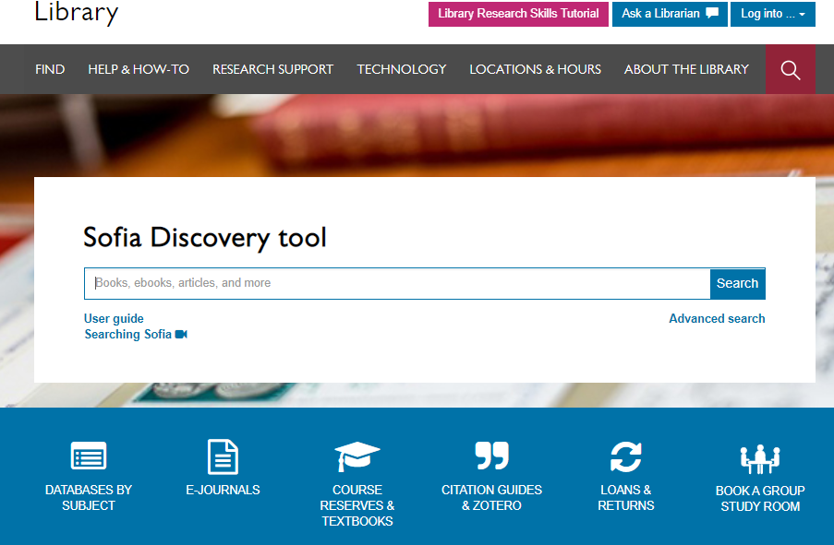

Slide 40
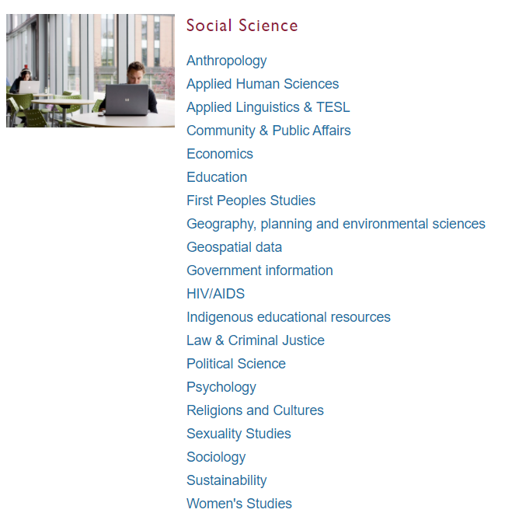
Subject Guide: First Peoples Studies

Slide 41
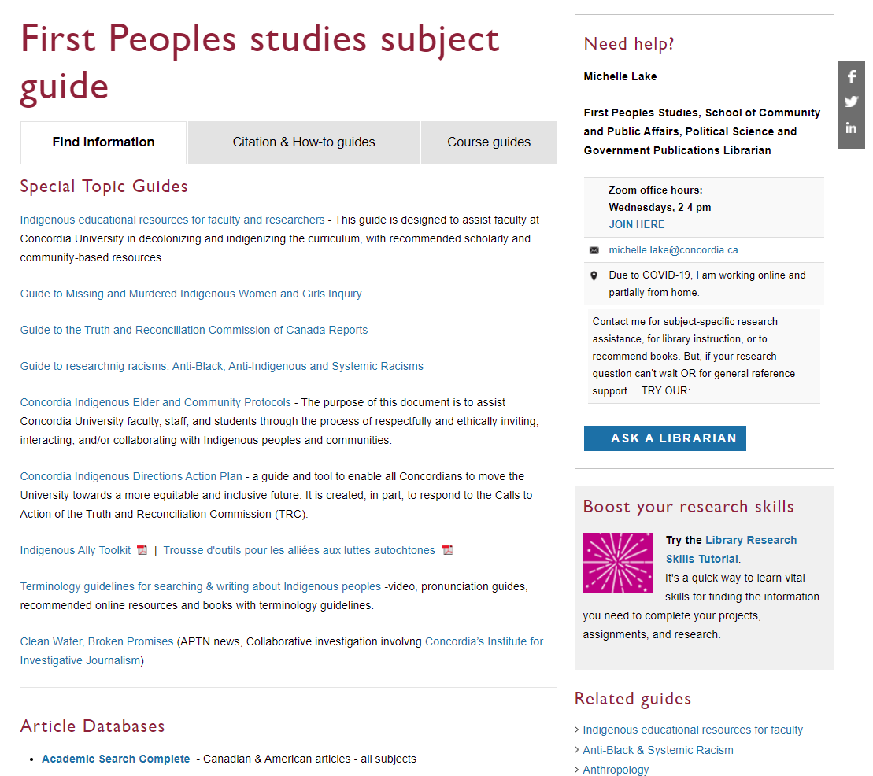
Scroll down for suggested
Article databases

Slide 42
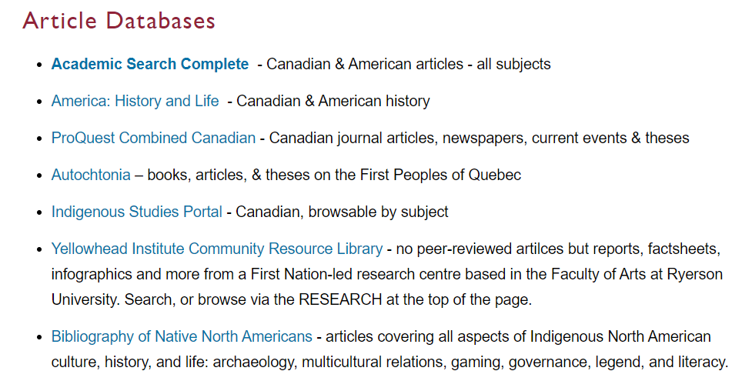

Slide 43
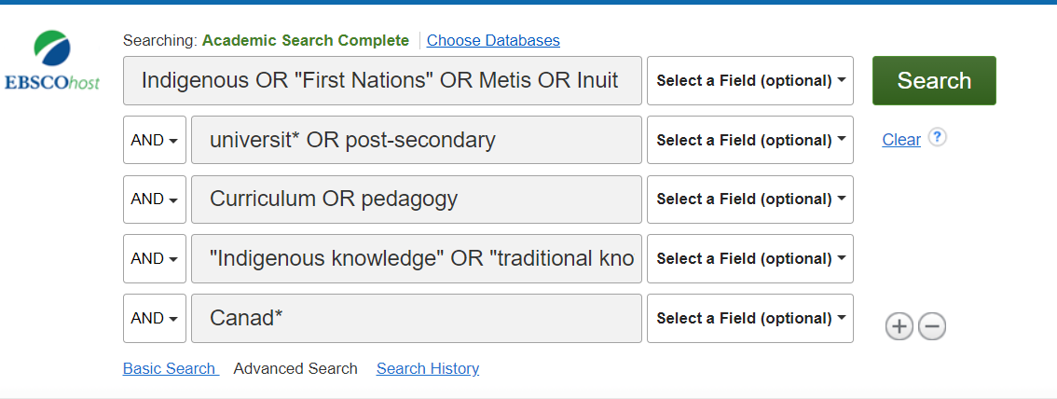

Slide 44
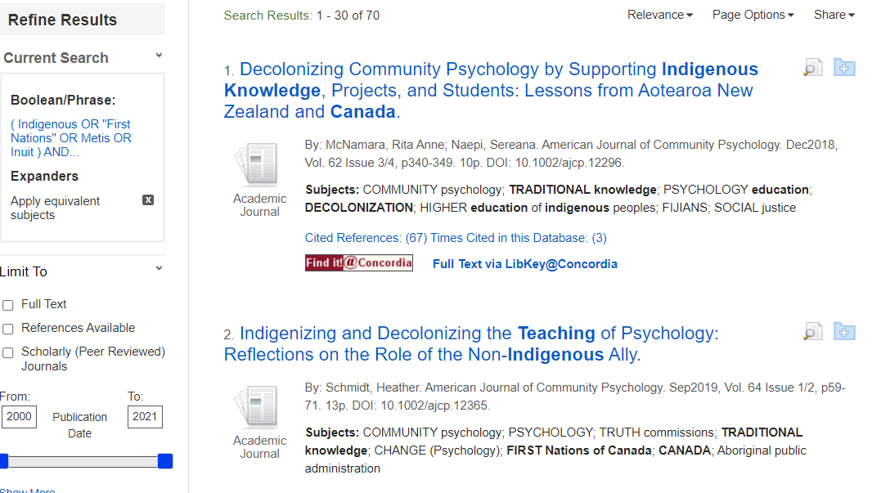

Slide 45
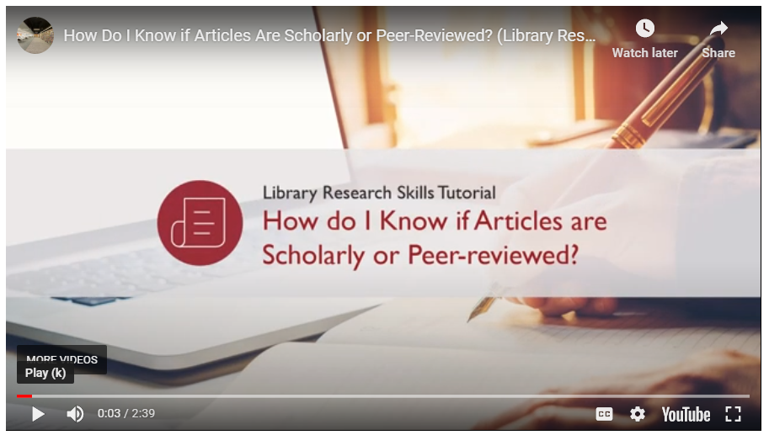

Slide 46
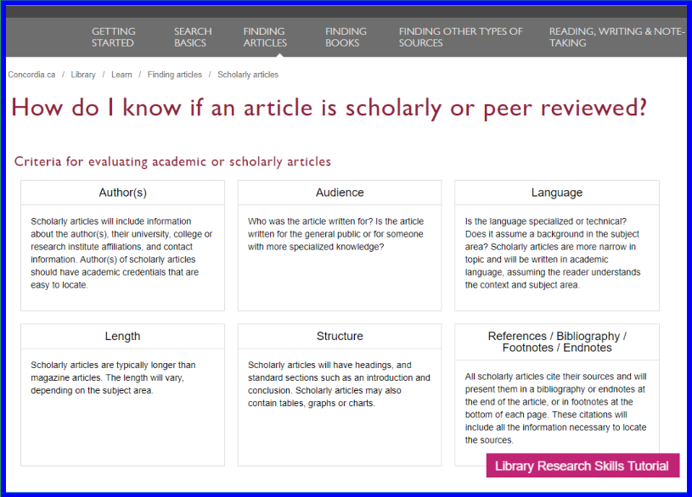

Slide 47
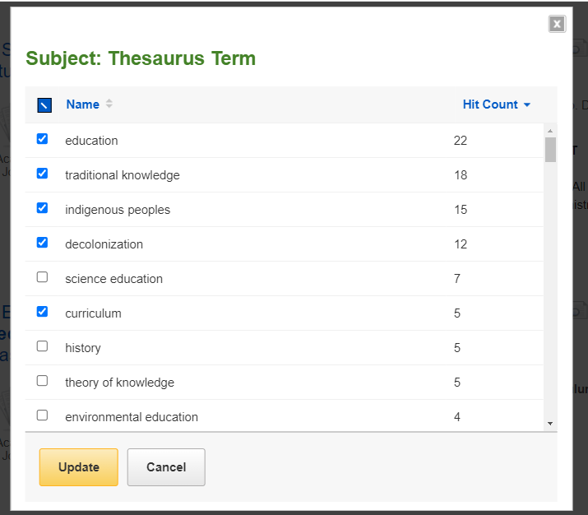
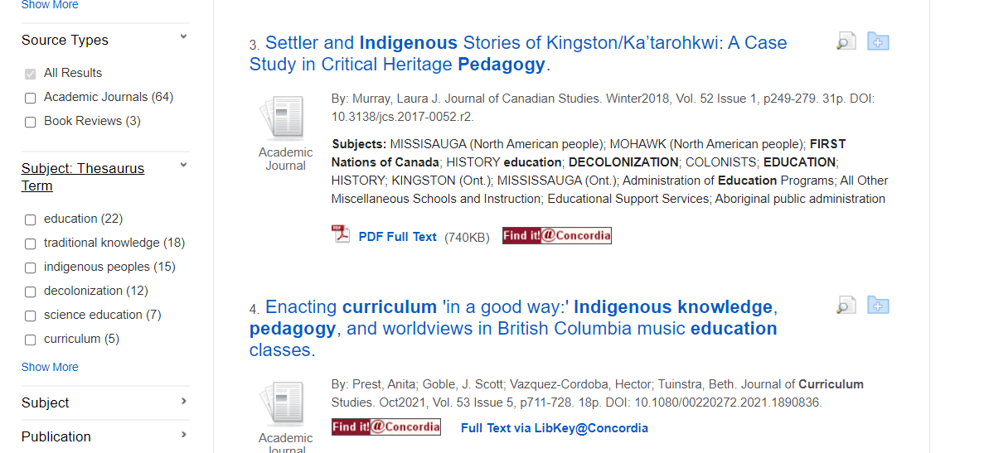
The more subjects you click to include, the narrower and more specific your results become

Slide 48
Scholarly articles trend to be 10+ pages long.

Slide 49
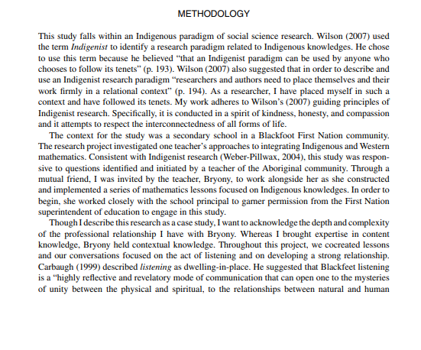
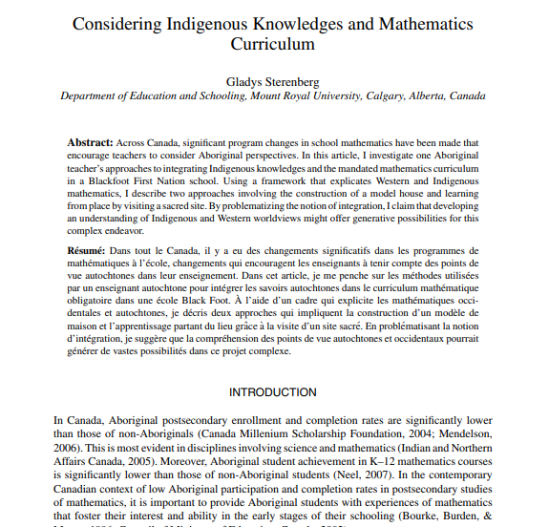
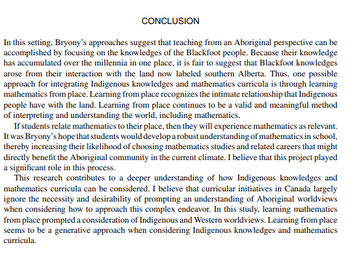
v

Slide 50
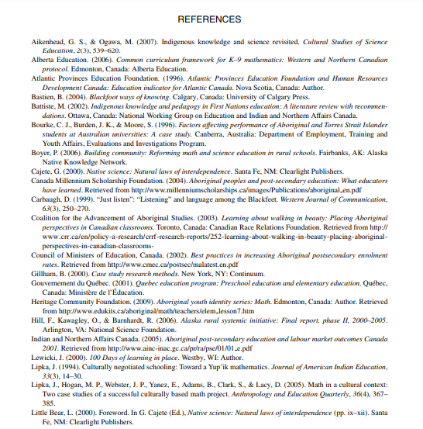
Elements of a scholarly article to look for:
Length: scholarly articles are longer, usually between 10-30 pages, including a reference list
Credentials/affiliations: authors university departments should be listed, along with contact information
Sections: Many scholarly articles will have similar parts and headings like an abstract, introduction, methodology, literature review and conclusion
Citations: Scholarly articles always cite their sources either with in-text citations or footnotes/endnotes
Reference list: Scholarly articles always provide an extensive reference list/bibliography/works cited list or endnotes, which is a list of sources at the end of the article

Slide 52
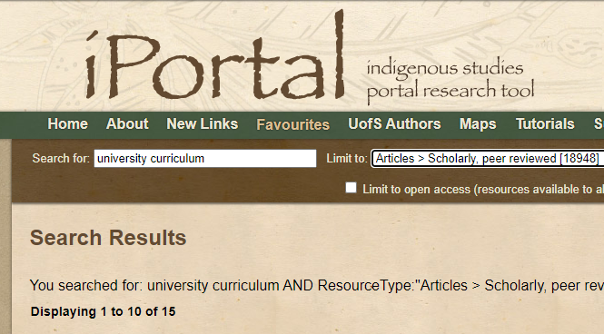
Using a Subject-specific database to browse for article

Slide 53
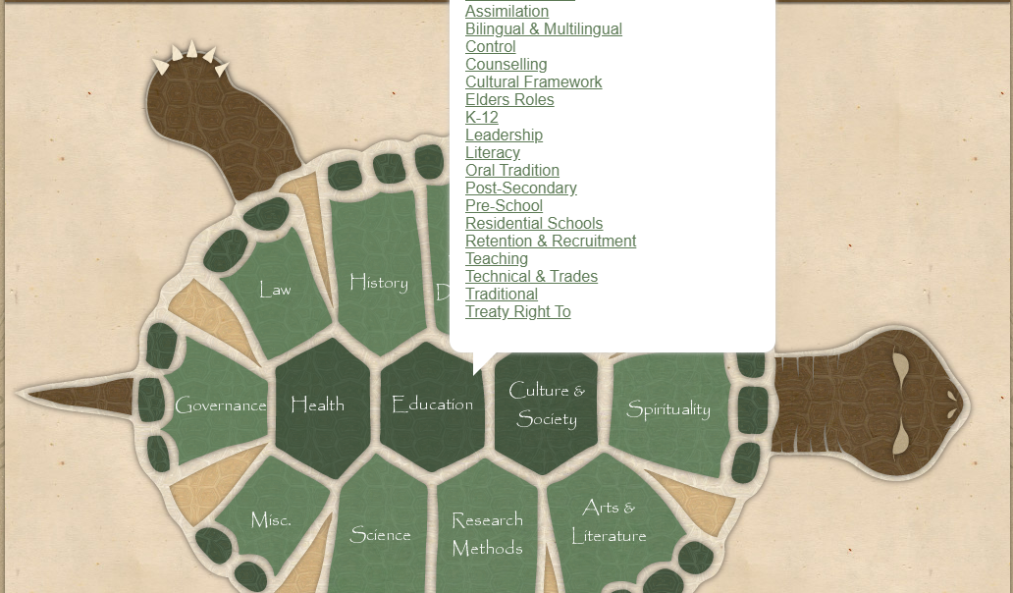

Slide 54
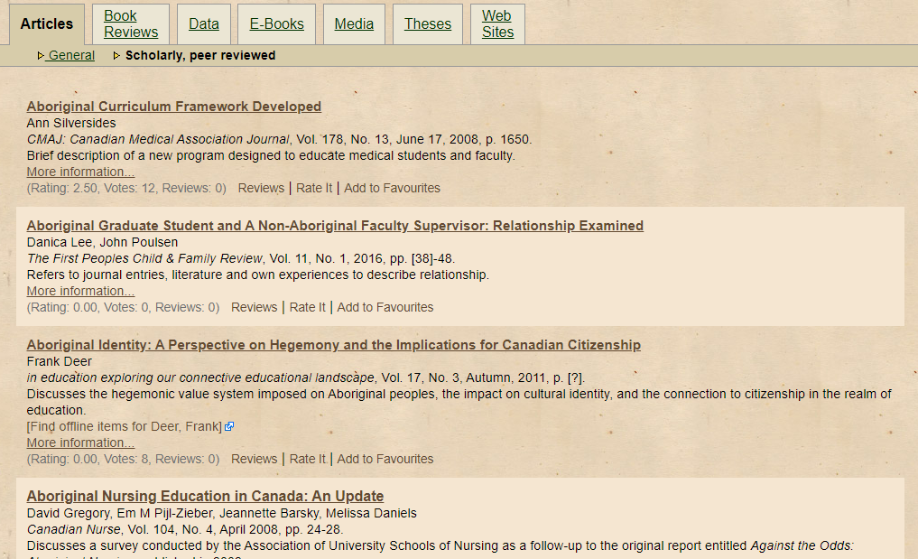

Slide 55
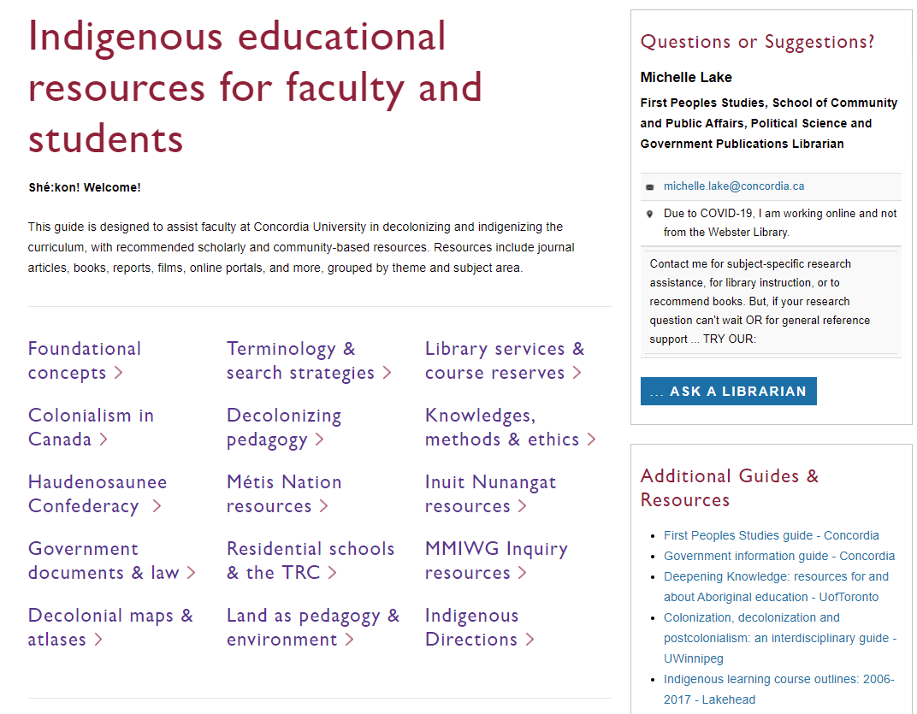
Each of these topic areas has suggested readings, which may include journal articles, books, websites and even films.
Not all of the materials are by Indigenous authors, but again this is a good place to browse.

Slide 56
Citation guides

Slide 57
Need help, ask us!

