Slide 1

FPST 201 Introduction to First Peoples Studies Library Workshop
Michelle Lake
First Peoples Studies, Political Science, SCPA and Government Publications Librarian
Michelle.Lake@concordia.ca

Slide 2
Who am I?
Michelle Lake, librarian for First Peoples Studies, the School of Community and Public Affairs, Political Science, and Government Publications
Settler, originally from Ontario.
My hometown is located on the traditional territories of the Erie, Neutral, Huron-Wendat, Haudenosaunee and Mississaugas, on land covered by the Dish With One Spoon Wampum Belt Covenant.
I live and work on the unceded Indigenous lands of Tiohtià:ke, where the Kanien’kehá:ka Nation is recognized as the custodians of those lands and waters.

Slide 3
What do I do?
Provide research support to students and faculty, teach workshops and assist with search strategies
Help students navigate library databases
Help students find and access materials they need
Assist with evaluation of sources
Build guides, resources and pathfinders to help students locate research materials
Help with citation issues
Choose the books we buy for my subject areas: First Peoples studies, political science, public policy, community and public affairs and government information

Slide 4
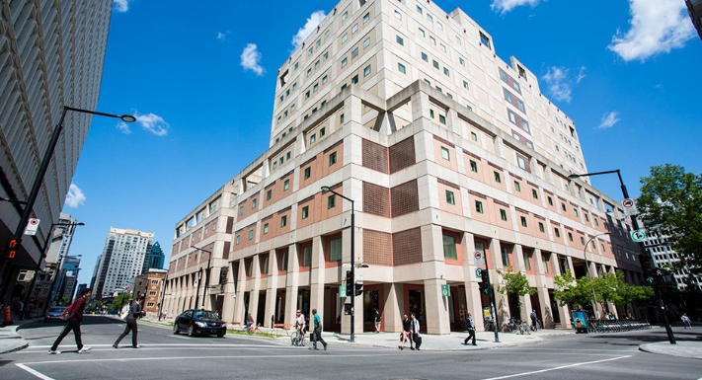
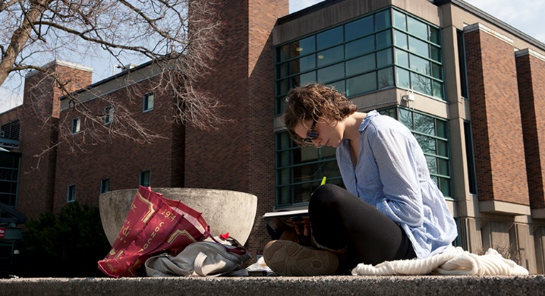
The Librar(ies)
24/7 access, with student card, after 11pm
Webster Library (LB) – downtown on SGW campus & Vanier Library (VL) on Loyola campus
Webster: Social Sciences, Humanities, Business, Engineering & Fine Arts
Vanier: Science(s), Health, Communications, Journalism and Psychology
Course Reserves Room(s): have the required undergraduate print textbooks for the courses taught at that campus (for example: Webster has the FPST, Political Science and SCPA course reserves)

Slide 5

Library Services
Your student card is your library card.
You need it to:
borrow books (up to 100 a time)
borrow a laptop (3 day loan) and other technology
print on campus (add money to your Dprint account)
access the library overnight during 24/7 hours.
Webster library has 5 book scanners (And Vanier has 2!) that can be used for free to scan chapters from our print books and email them to yourself as a PDF.
To use Library databases, access online articles and ebooks when you are off campus, login with your MyConcordia Netname and password.

Slide 6
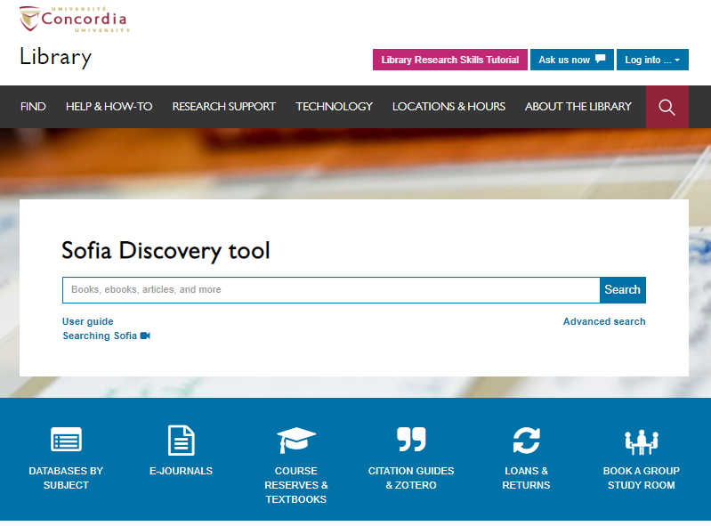
Use the Sofia Discovery tool to find print books, ebooks, and journal articles from the library.

Slide 7
How can I find out if the library has access to an item I’m looking for?

Slide 8
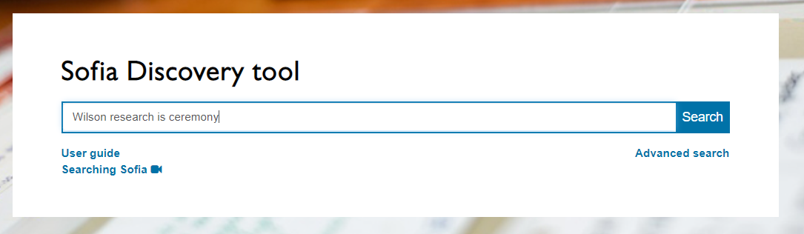
Wilson, S. (2008). Research is ceremony: Indigenous research methods. Halifax: Fernwood Publishing.

Slide 9
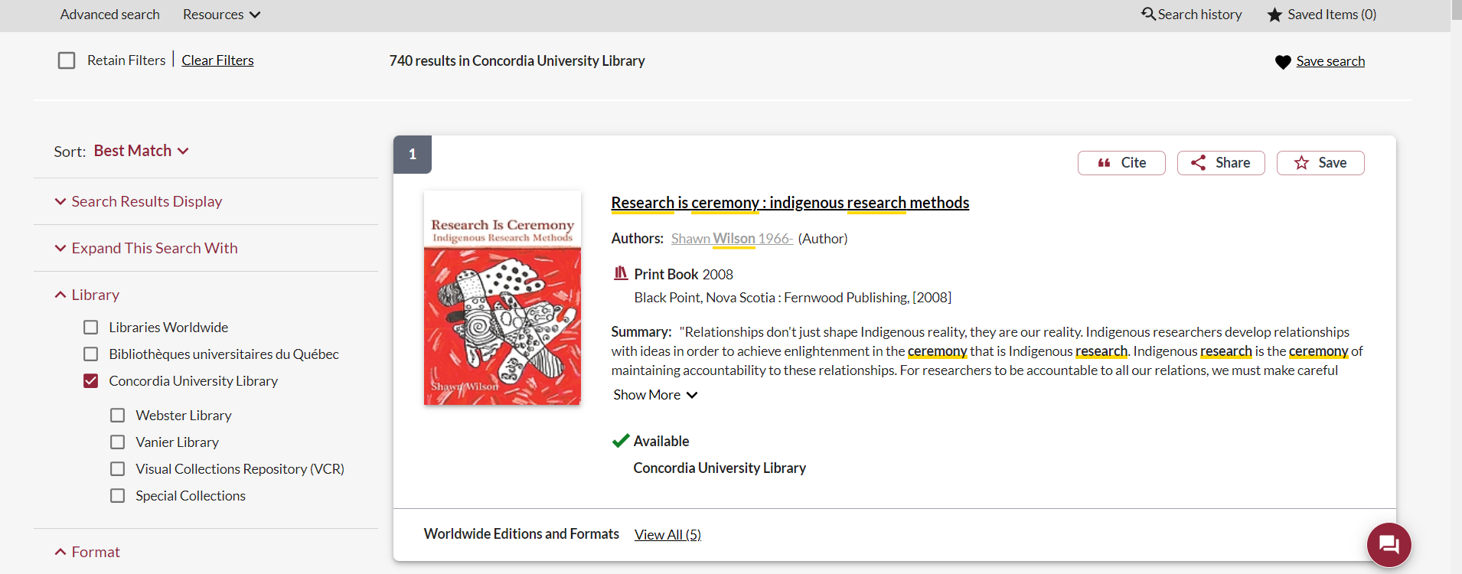
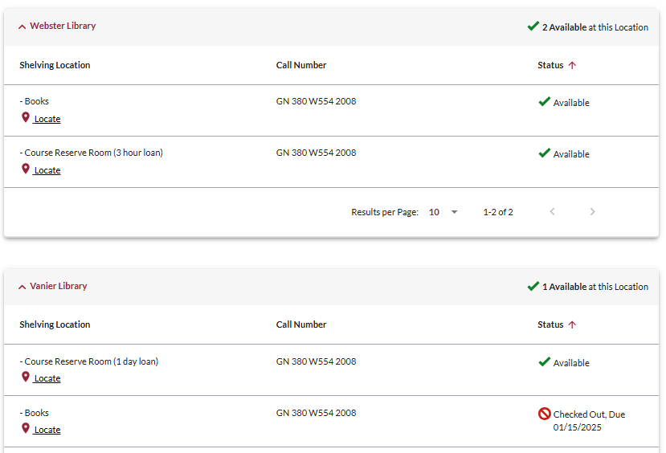
This is a required textbook, so it is found in the course reserves room for a 3 hour loan.
There is a book scanner in the course reserves room, where you can scan chapters and email them to yourself for free.

Slide 10
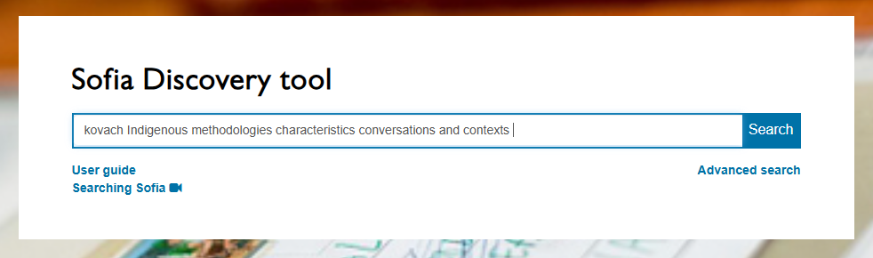
Kovach, M. (2021). Indigenous methodologies: characteristics, conversations, and contexts. (Second edition). University of Toronto Press.

Slide 11
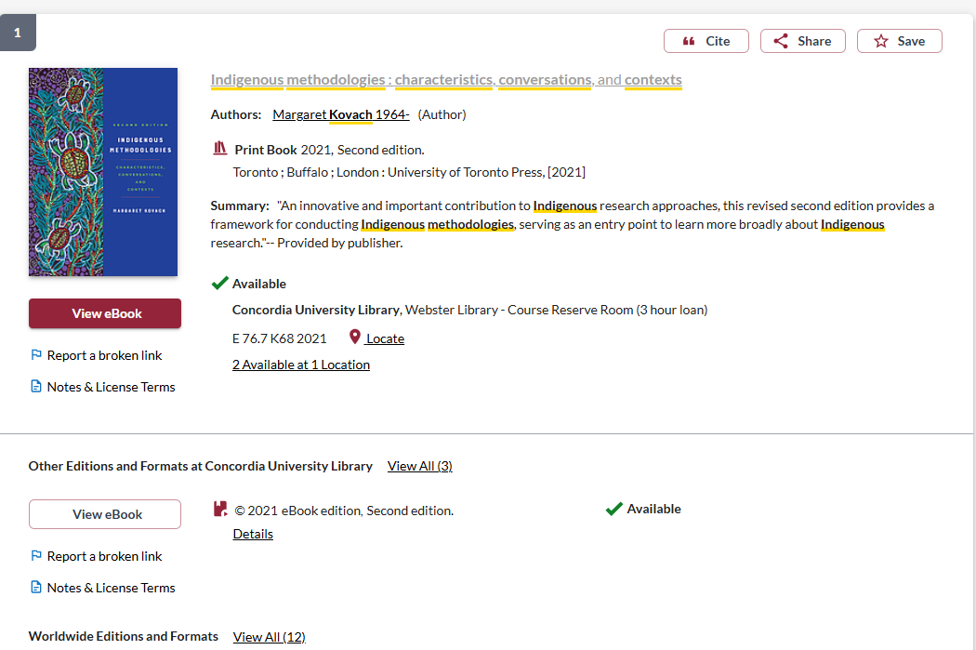
This is available as an ebook, to read online
The print copy is also available in the course reserves room for a limited loan

Slide 12
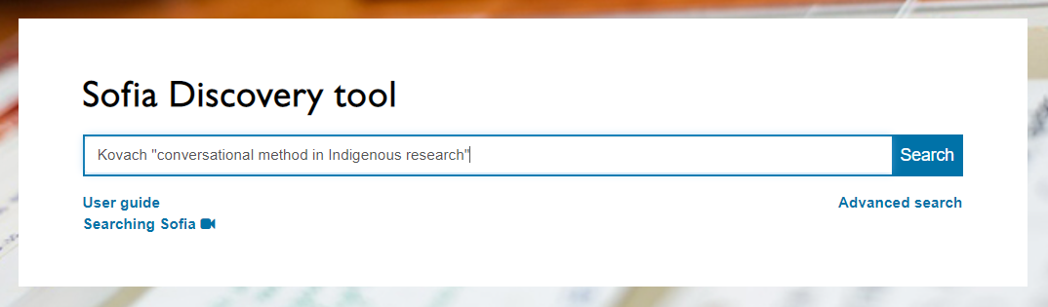
Kovach, M. (2019). Conversational method in Indigenous research. First Peoples Child & Family Review, 14(1), 123-136.

Slide 13
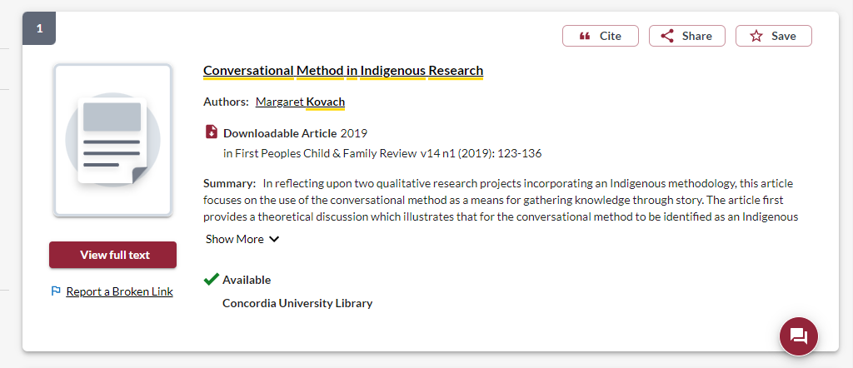
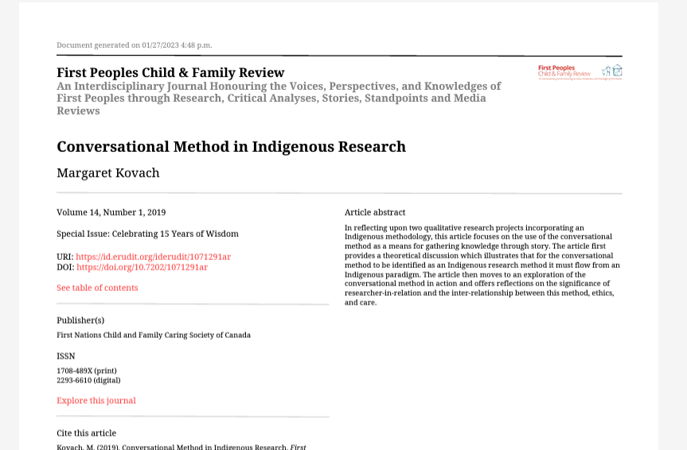

Slide 14
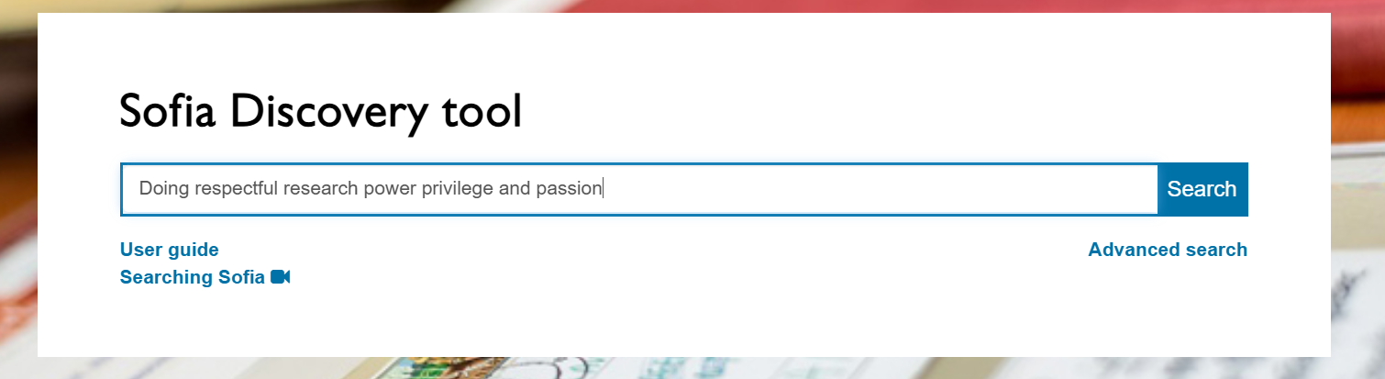
Tilley, Susan A.(2016). Doing respectful research: power, privilege and passion. Winnipeg: Fernwood Publishing

Slide 15
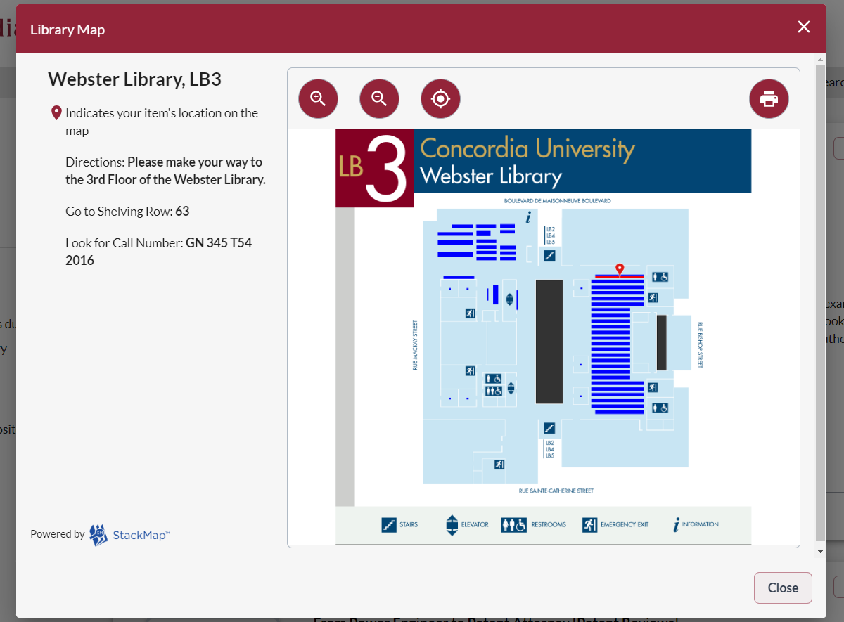
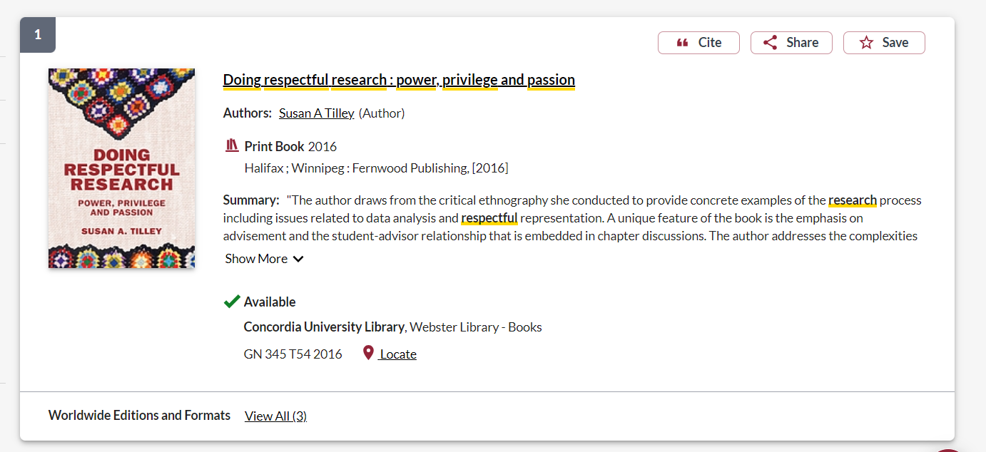

Slide 16
Context – searching for Indigenous scholarship in an academic library

Slide 17
Indigenous Peoples and education in Canada
Education, as controlled and imposed by the church, federal and provincial governments in Canada has been a destructive force in Indigenous communities
Research at the university level, about Indigenous Peoples and communities has been harmful
Libraries, as part of the University and education system, are also colonial institutions, with barriers, biases and impediments to enhancing Indigenous scholarship and voices

Slide 18
Terminology
In the most common university library classification system, Library of Congress Subject Headings (LCSH), the main subject heading for material about Indigenous Peoples in Canada and the United States is “Indians of North America”.
The term Indigenous is still new in these systems.
Though relevant and correct, terms for nations such as the Kanien’kehá:ka or confederacies such as the Haudenosaunee are far less prevalent in our Sofia Discovery tool than terms such as Mohawk or Iroquois.

Slide 19
Language matters
Oka Crisis – government, western scholars, and western journalists
Oka resistance, Oka uprising, Oka revolt – Indigenous scholars, Indigenous perspectives
Kanehsatake/Kanehsatà:ke Resistance – specificity

Slide 20
Strategies to locate Indigenous Scholars and other research in library databases

Slide 21
Choosing and developing a topic

Slide 22
I’m interested in Indigenous and decolonial land based learning in universities

Slide 23
I’m interested in Indigenous and decolonial land-based learning in universities
My key concepts
Alternative or related terms
Indigenous studies
Land-based learning
University
Curriculum
Decolonial
First Peoples Studies
Land-based education
Higher education OR postsecondary
Pedagogy
Indigenizing

Slide 24
How do we combine keywords for the best results?
AND: combines concepts and limits your results
Indigenous AND education
youth OR teens
land OR territory
OR: allow you to insert synonyms or alternative terms and increases your results

Slide 25
How do we combine search words for the best results?
“quotation marks”: If you put two or more words in quotation marks, that exact phrase will be searched and limits your results.
“First Nations”
“public policy”
Democra*
Finds: democracy, democracies, democratization, etc.
* - when you add an asterisk on the end of a word, your results will contain all the words with those endings or suffix

Slide 26
Avoid searching with unnecessary words
Effects
Impact
Consequences
Influence
Results
Importance
Significance
Response
Emphasis
Causes
Each author may use different linking words when discussing similar topics.
You don’t want your search to be limited to those books and articles that only contain the word “effect” or “consequence”

Slide 27

Search Strategies

Slide 28
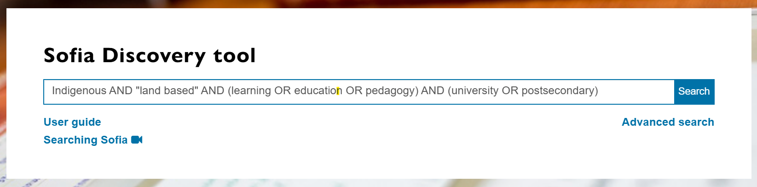
Searching for some of the main concepts I identified
Keeping my search broad, to see what is out there
AND/OR need to be in ALL CAPS in Sofia

Slide 29
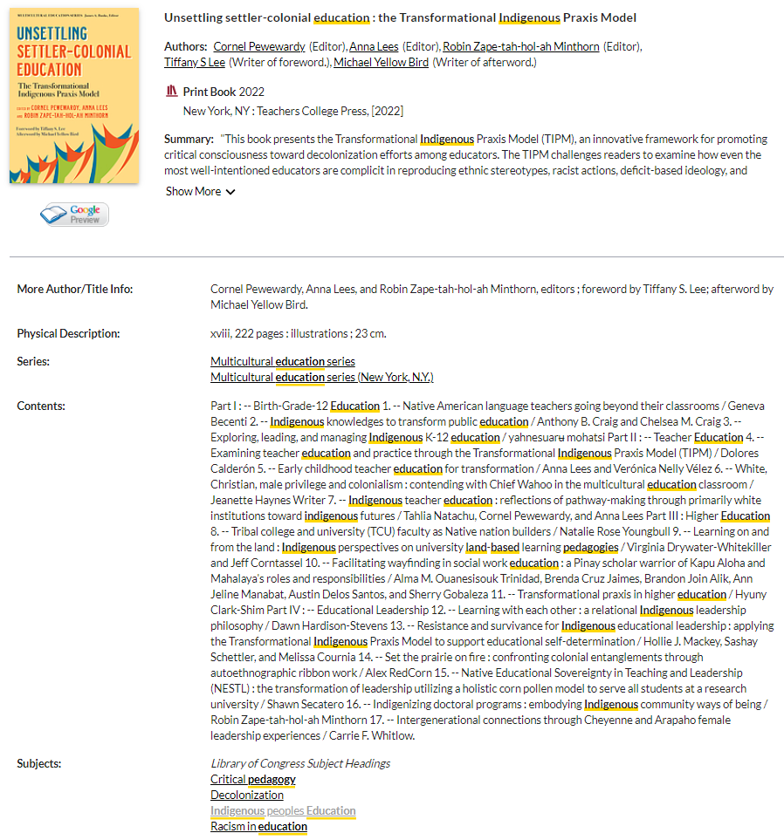
All books in the library are arranged by subject and will have subjects listed in their book record.
Clicking on one of these subjects will find all the books and some articles that have the same subject attached, at the library.

Slide 30
Who wrote the book? How do we locate Indigenous authors?
Scholarly books often have editors and each chapter will have different authors
You should look for “Contributors”, which will have a list of individual chapter authors, and their biographies either at the beginning or very end of the book
If a book has one author, look for “about the author” section or even skim the introduction, where the author will describe themselves

Slide 31
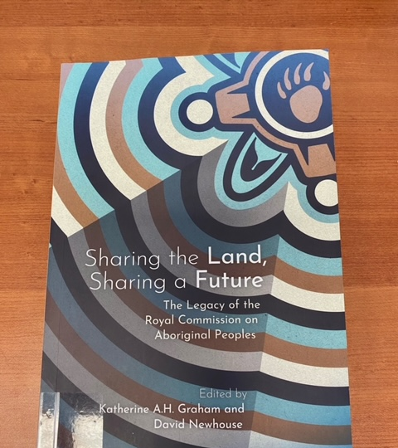
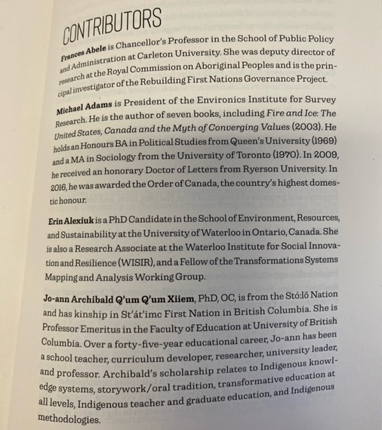

Slide 32
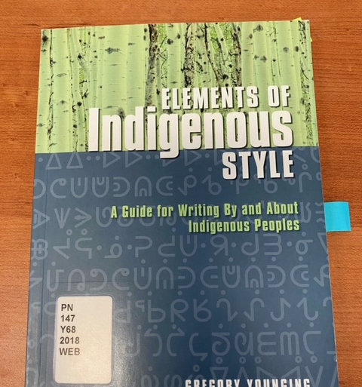
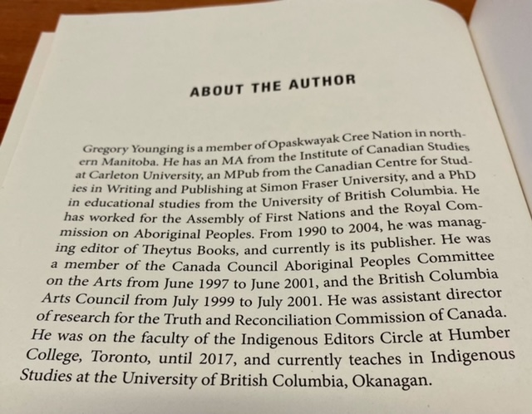

Slide 33
Who wrote the book? How do we locate Indigenous authors?
The table of contents might also have author information, in the case of Indigenous authors their community or nation may be in brackets following their name
Indigenous scholars and authors are very likely to self-identify, with details about their nation or community in prefaces, introductions, etc.

Slide 34
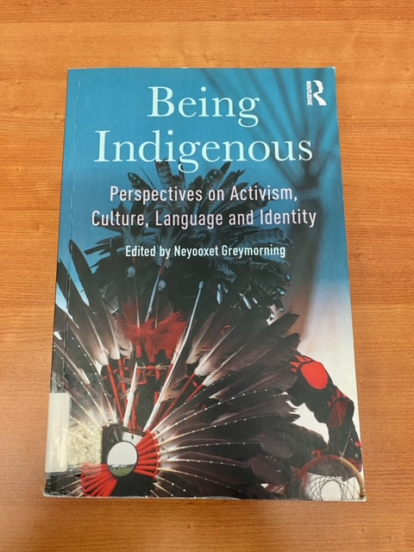
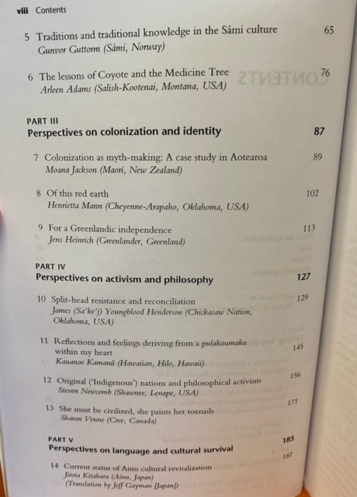

Slide 35
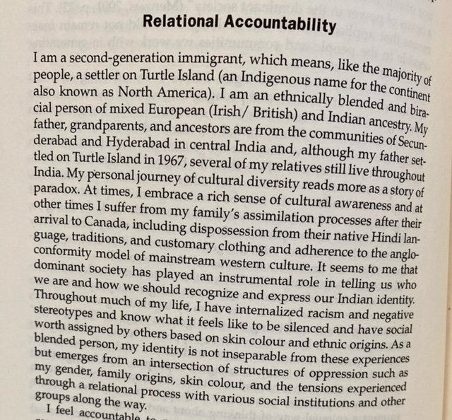
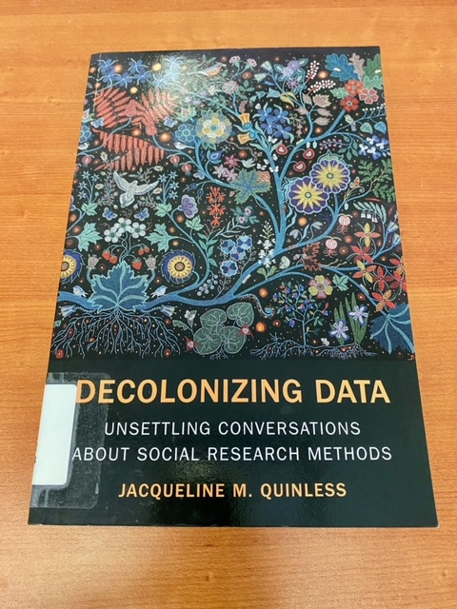

Slide 36
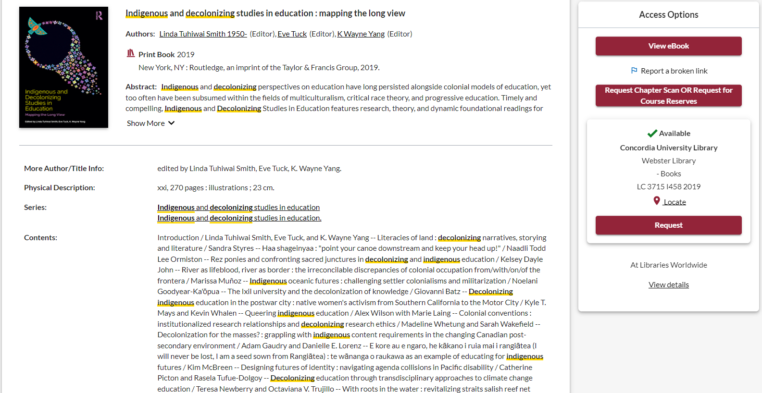
Let’s find out about the contributors

Slide 37
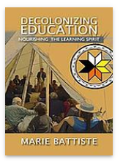
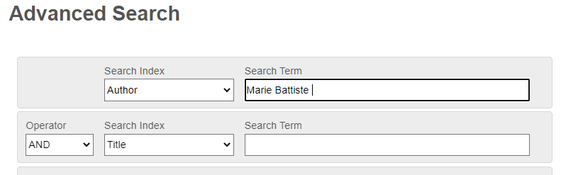
How else can I locate books by Indigenous authors and scholars?
Indigenous Authors in the Spotlight series
Indigenous Resources guide: Knowledges, methods & ethics
Sofia (Advanced) Author search for a known scholar
Marie Battiste is a Mi'kmaw educator from the Potlotek First Nation

Slide 38
How do I locate writing by Indigenous authors?
The Yellowhead Institute
Shekon Neetchie: An Indigenous History Site -- see their history bibliography
The Montreal Indigenous Community Network -- see their resources
The Native Women’s Association of Canada – See the Knowledge Centre.

Slide 39
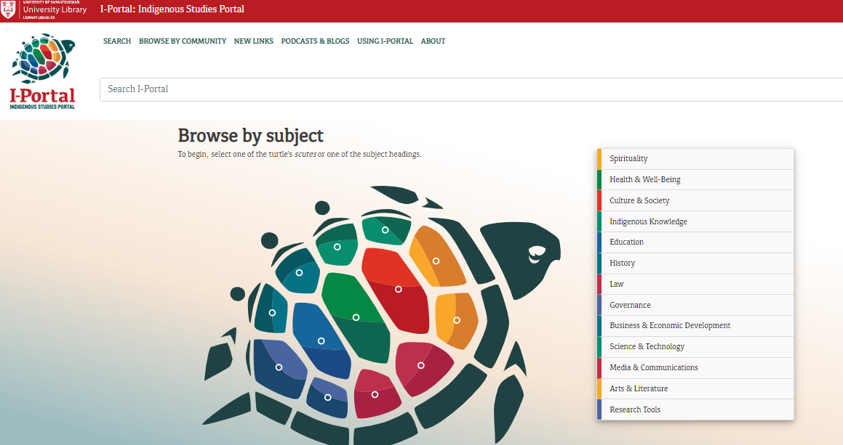
I-Portal can be browsed by using the Turtle or the list of broad topics

Slide 40
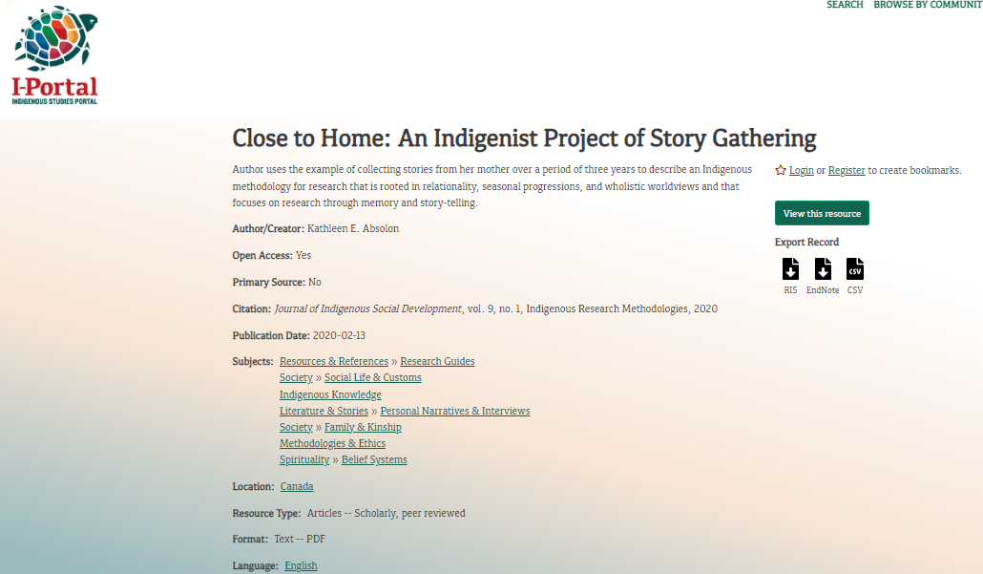
The record will give you a lot of information about the article including the type of source, peer reviewed, and attached subjects

Slide 41
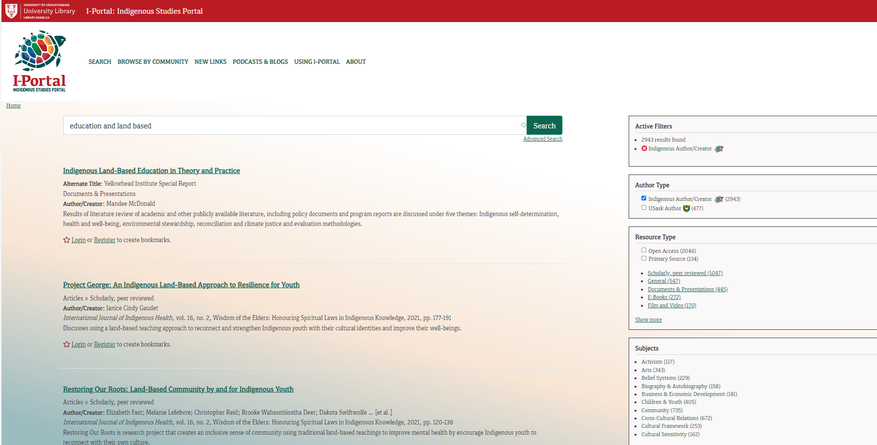
Search in the same way we searched in the Sofia Discovery Tool
Options to narrow down, on the right

Slide 42
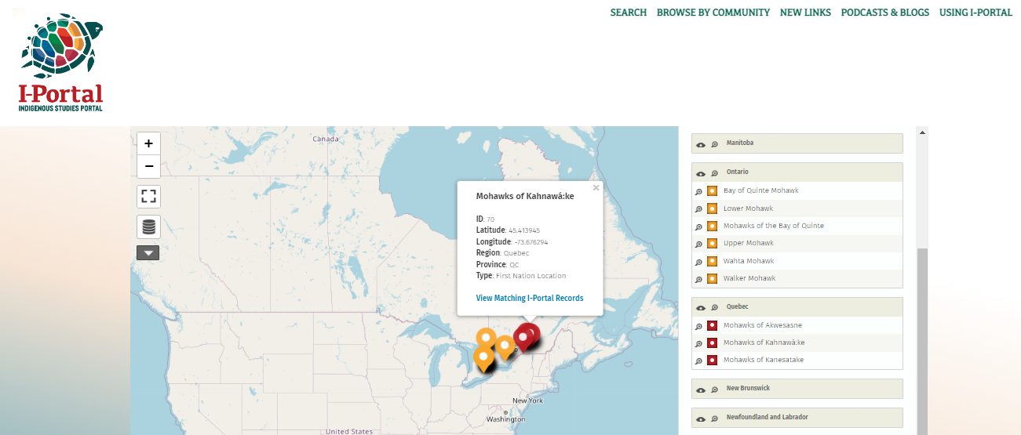

Slide 43
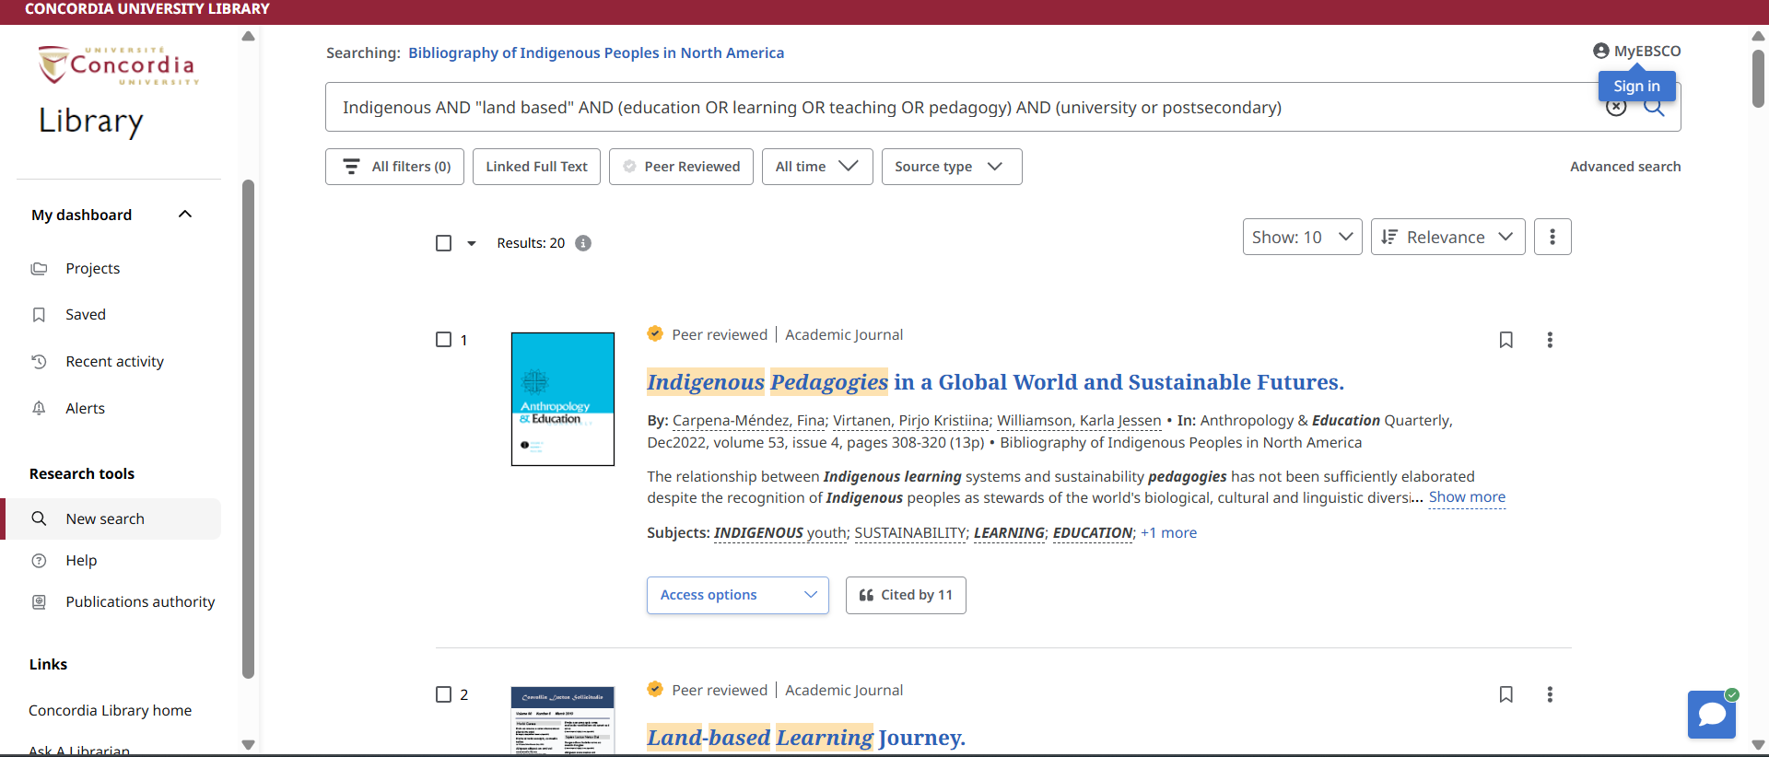
Academic Search Complete/Bibliography of Indigenous Peoples in North America

Slide 44
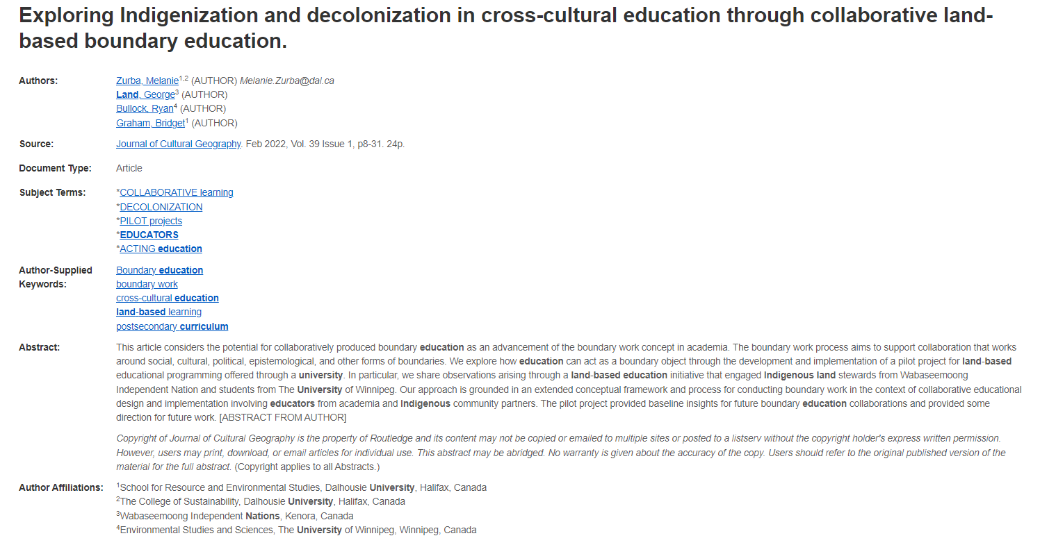
There is an Indigenous author on the research team, affiliations can give this information like “contributors” lists

Slide 45
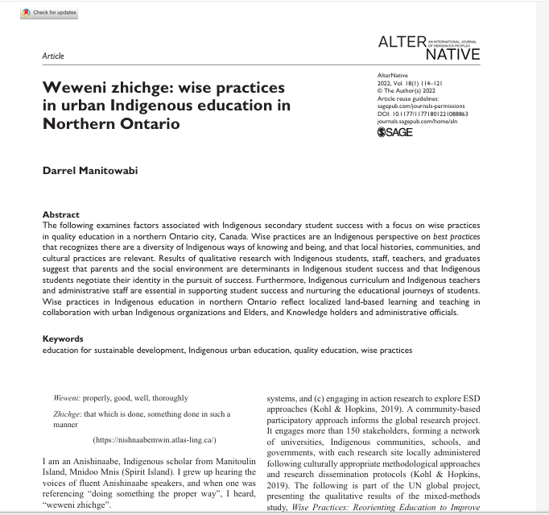
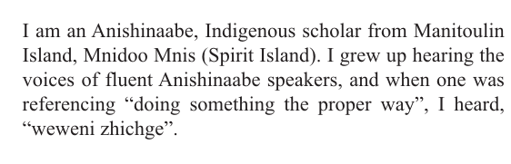

Slide 46
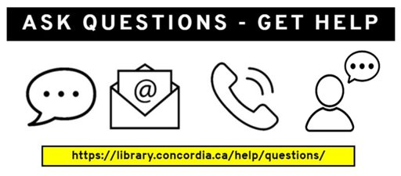
Need help, ask us!
Michelle.Lake@concordia.ca

