Slide 1
FTRA 200 Méthodologie de la traduction Library Workshop Éthel Gamache Librarian ethel.gamache@concordia.ca Thursday, October 3, 2024

Slide 2
Plan
Library: website and services
Search strategies
Sofia and Interlibrary loans (ILL)
Terminological dictionaries
Other reference documents
Databases
Other resources on the web
Assess and cite your sources

Slide 3
The Library

Slide 4
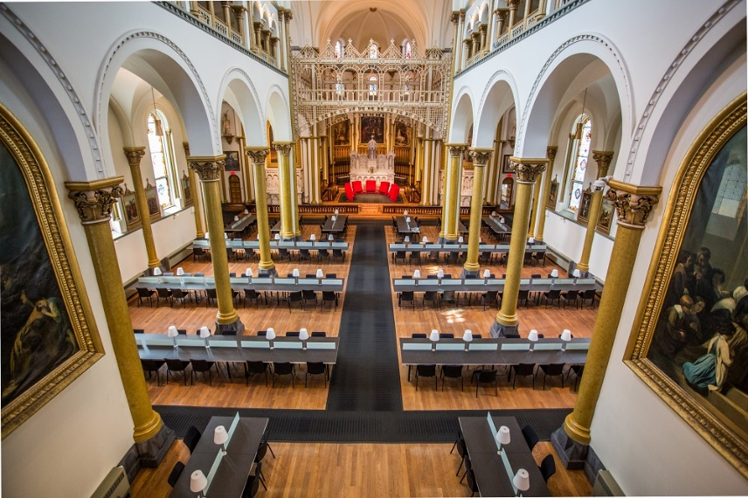
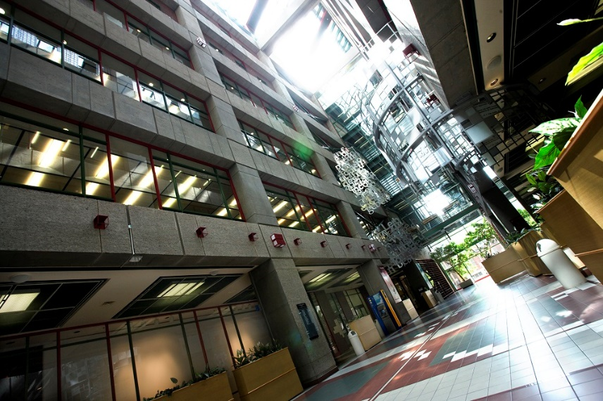
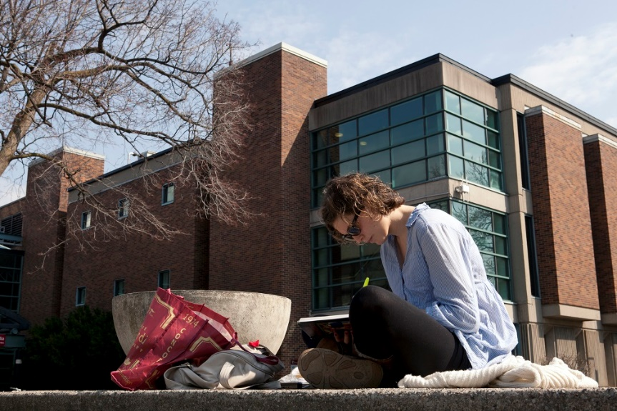
The libraries and reading room
Grey Nuns
Reading room (SGW)
Webster Library
(Sir George Williams campus)
Bibliothèque Vanier
(Loyola campus)
Notes:
Types de documents à la bibliothèque:
Livres (imprimés ou électroniques)
Périodiques (Journals)
Journaux (Newspapers)
Videos (films, théâtre, danse,…)
Musique (partitions, sons)
*En ligne or imprimé*
Équipment: tablette, portables, caméras, et plus
Votre carte étudiante (Concordia ID card) est votre carte de bibliothèque :
Utilisez-la pour emprunter des documents
et de l’équipement du comptoir de
Circulation (Loans & Returns desk).
Soeurs-Grises:https://www.concordia.ca/fr/a-propos/patrimoine-soeurs-grises.html

Slide 5
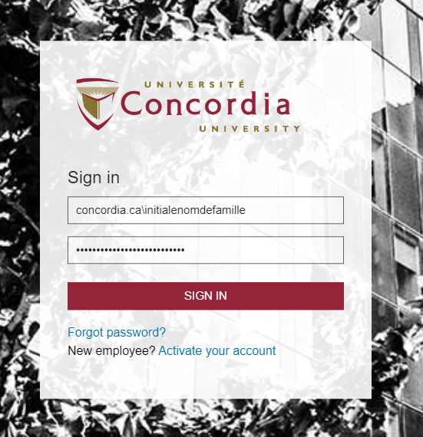
Off CAMpus access
Use your student id (Concordia netname or username ) and your password.
Notes:
Les mêmes que vous utilisez pour Moodle, par exemple.
Votre carte étudiante (Concordia ID card) est votre carte de bibliothèque :
Utilisez-la pour emprunter des documents
et de l’équipement du comptoir de
Circulation (Loans & Returns desk).

Slide 6
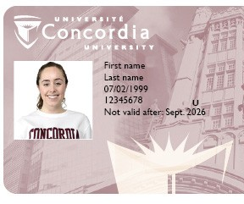
Library card
Your Concordia ID card, or student card, is your library card.
Notes:
Votre carte étudiante (Concordia ID card) est votre carte de bibliothèque :
Utilisez-la pour emprunter des documents
et de l’équipement du comptoir de
Circulation (Loans & Returns desk).

Slide 7
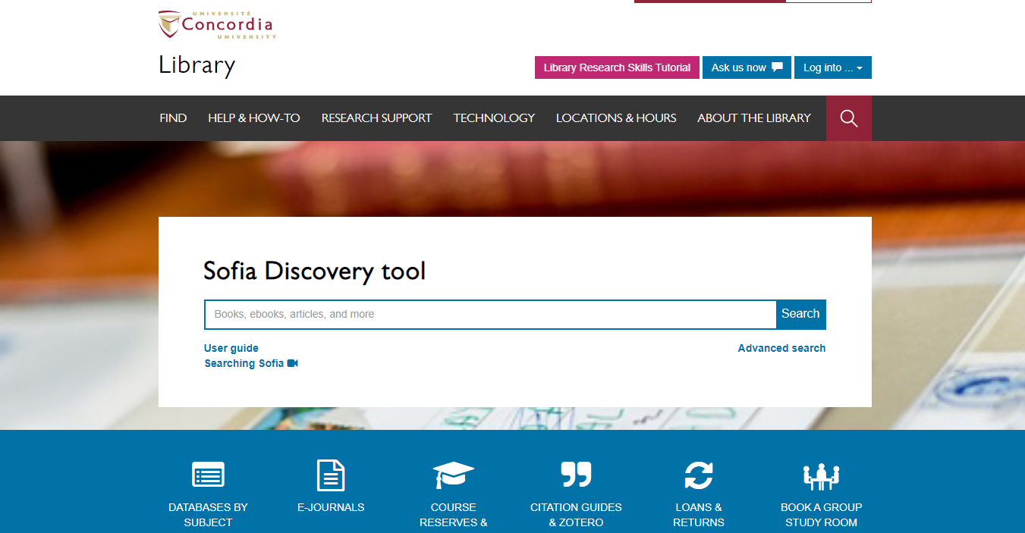

Slide 8
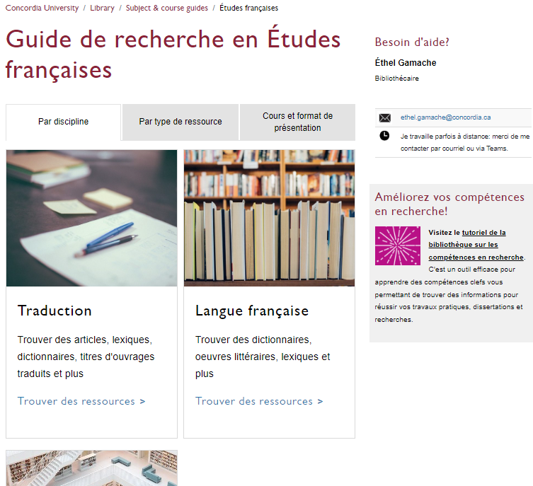
Religions and Cultures Subject Guides
concordia.ca/library/guides/religion.html

Slide 9
Exercises
How do I get a library card?
What if you can't find a document?
Where is the course reserve?

Slide 10
Search Strategies

Slide 11
Video recap
Search Smarter, Search Faster by the University of Sydney

Slide 12
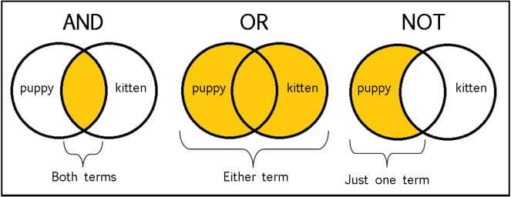
The Concept of a Boolean search illustrated
Source: Library 0f Antiquity. « Forgotten Skills: Boolean Searches ». The Library of Antiquity, 8 octobre 2016. https://libraryofantiquity.wordpress.com/2016/10/07/forgotten-skills-boolean-searches/.
Notes:
library0fantiquity. « Forgotten Skills: Boolean Searches ». The Library of Antiquity, 8 octobre 2016. https://libraryofantiquity.wordpress.com/2016/10/07/forgotten-skills-boolean-searches/.

Slide 13
Other Search operators
Exact phrase searching
Quotation marks (” ”) are used to search for an expression in its exact form (phrase searching). They are useful for expressions containing more than one word.For example, “rite of passage” will find these words written together, without their variants, in that order.
Truncation
The asterisk (*), placed at the end of a word, replaces 0, 1 or more characters. For example, chat* will find chat, chats, chatte, chaton, but also château, Chateaubriand, Châtelaine... It will not, however, find matou, félin, or lynx. Another example: relig*: religion, religions, religare, religious, religieux, religieuse.
Notes:
Exemples tirés de https://www-erudit-org.lib-ezproxy.concordia.ca/public/documents/Guide_recherche.pdf

Slide 14
What is a Boolean Search?
Notes:
Megafauna OR dinosaurs OR prehistoric animal
Ice Age OR Extinction OR Meteorite
Asia-Pacific OR Australia OR Oceania

Slide 15
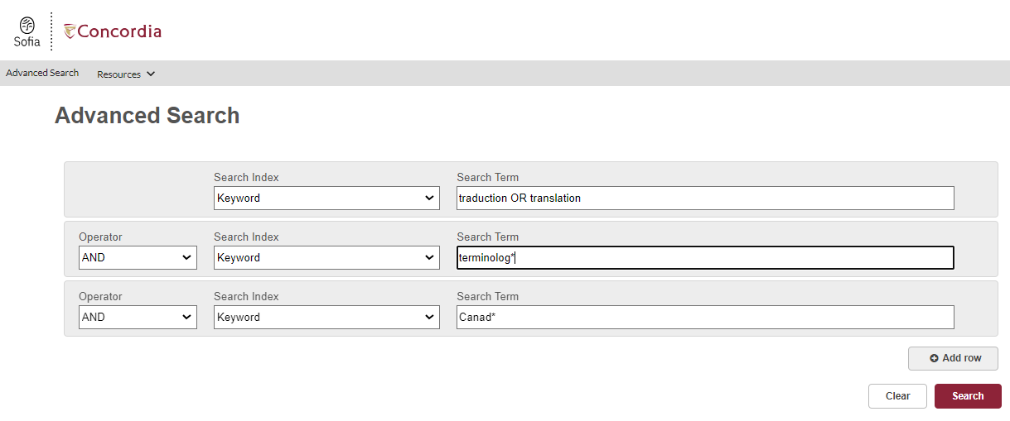
Notes:
Un exemple de recherche avancée utilisant des boîtes de recherche

Slide 16
Sofia and Interlibrary loans (ILL)

Slide 17
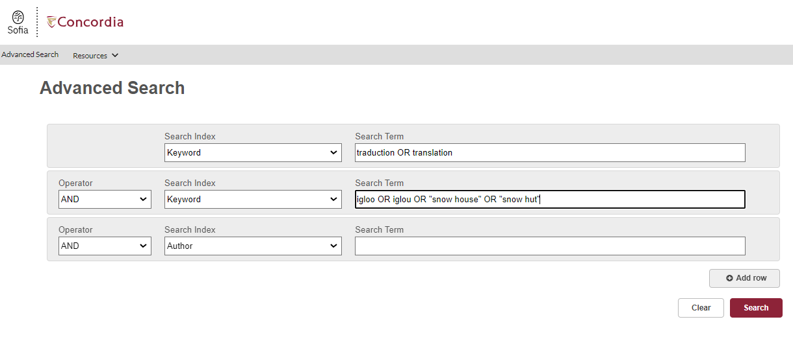

Slide 18
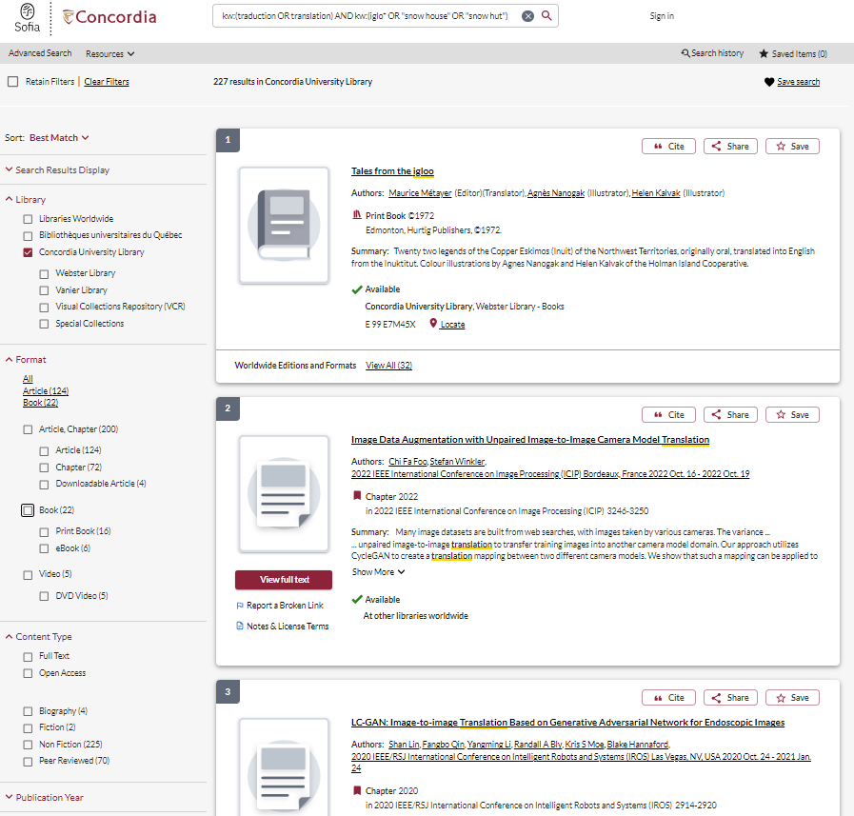

Slide 19
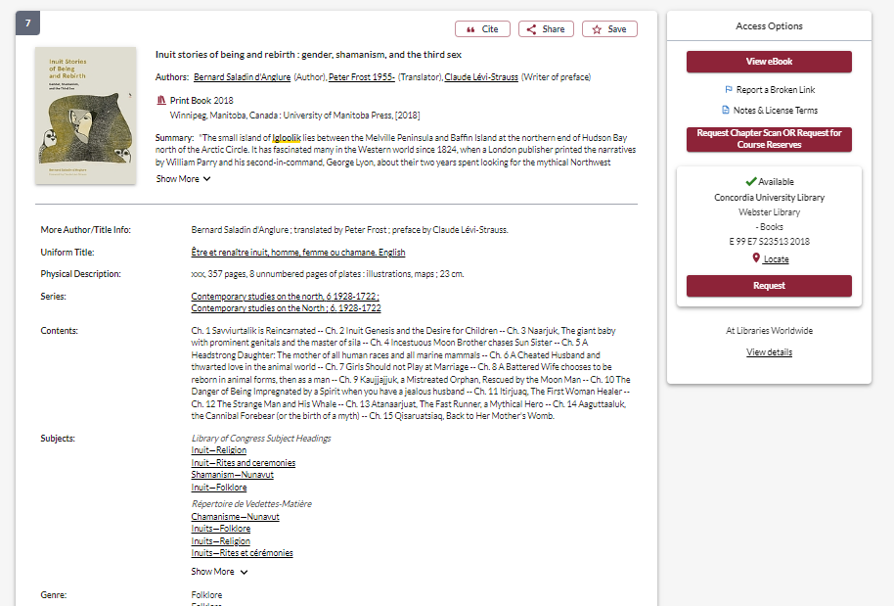

Slide 20
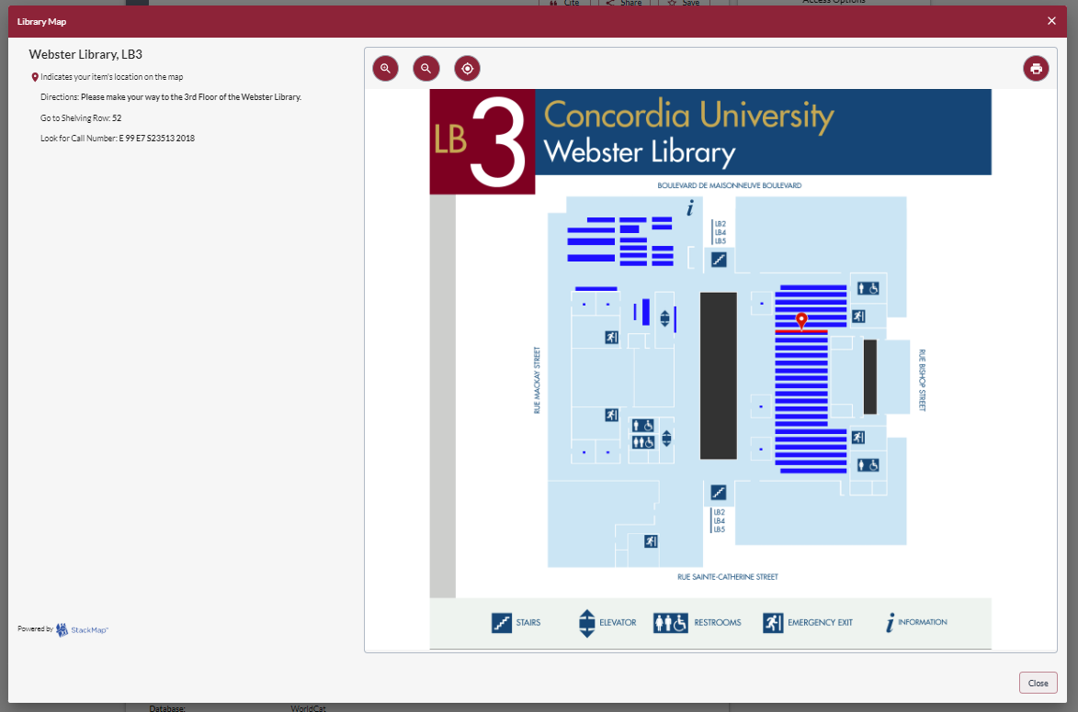

Slide 21
What is the new Interlibrary Loans (ILL) service?
ILL requests are made directly in the Sofia Discovery tool:
“Request via Interlibrary Loan” button
Form available under the “Requests” tab in "My Account".

Slide 22
Concordia article/chapter scan & deliver service
Book chapter and journal article scans from Concordia’s print collection can now be requested and tracked in Sofia.
Look for the “Chapter Scan” button in the Access Options panel.

Slide 23
REQUEST A BOOK VIA INTERLIBRARY LOAN
EXAMPLE

Slide 24
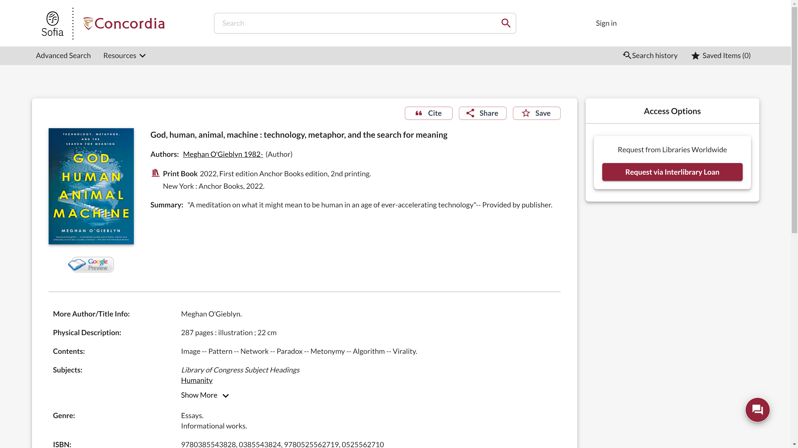
Sofia Discovery Tool request via Interlibrary loan

Slide 25
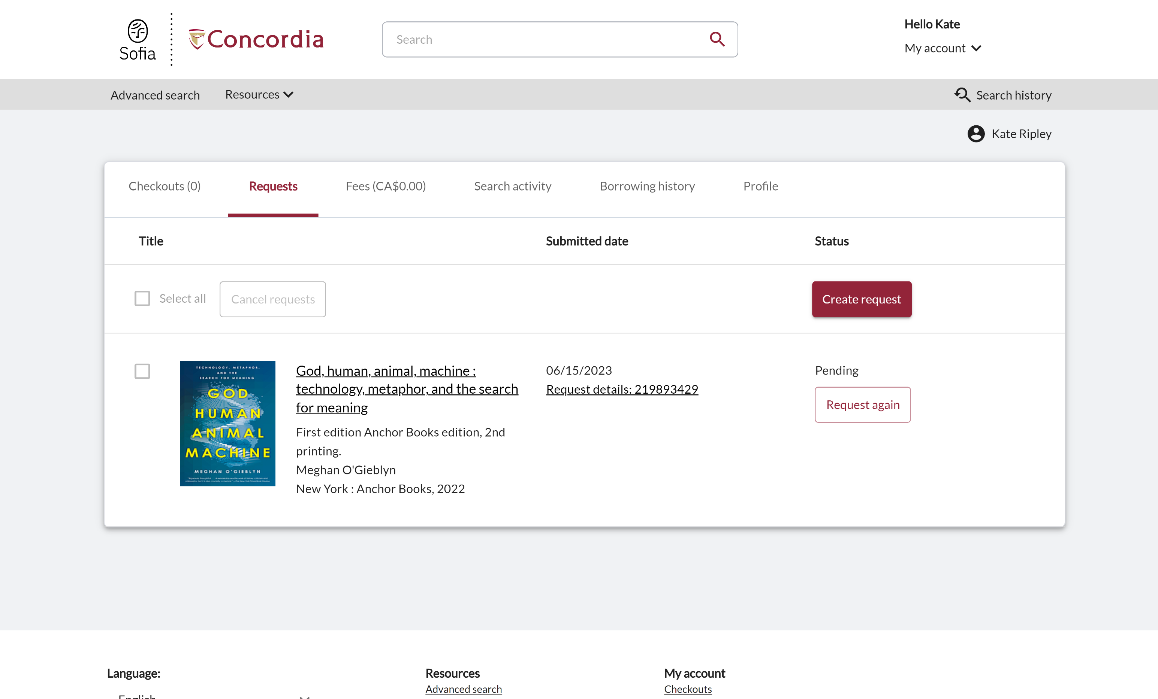
Check the status of your request under the "Requests" tab.

Slide 26
About Interlibrary loan
You will receive email notifications when your ILL request is available for pickup or download.
Physical items can be picked up at the Circulation/Loans desks at either Vanier or Webster Library.
ILL requests can be borrowed for 30 days, with up to 4 automatic renewals, or until item is recalled.

Slide 27
REQUEST A BOOK BLANK FORM
EXAMPLE

Slide 28
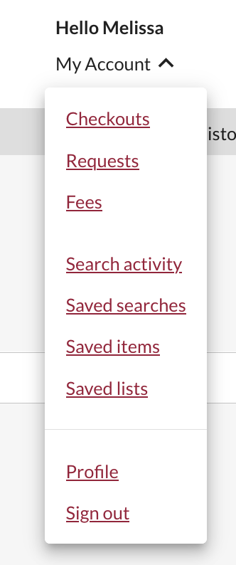
Create an Interlibrary Loan request
Sign in to "My Account" and select "Requests".
Click on "Create request".

Slide 29
Create an Interlibrary Loan request
Sign in to "My Account" and select "Requests".
Click on "Create request".

Slide 30
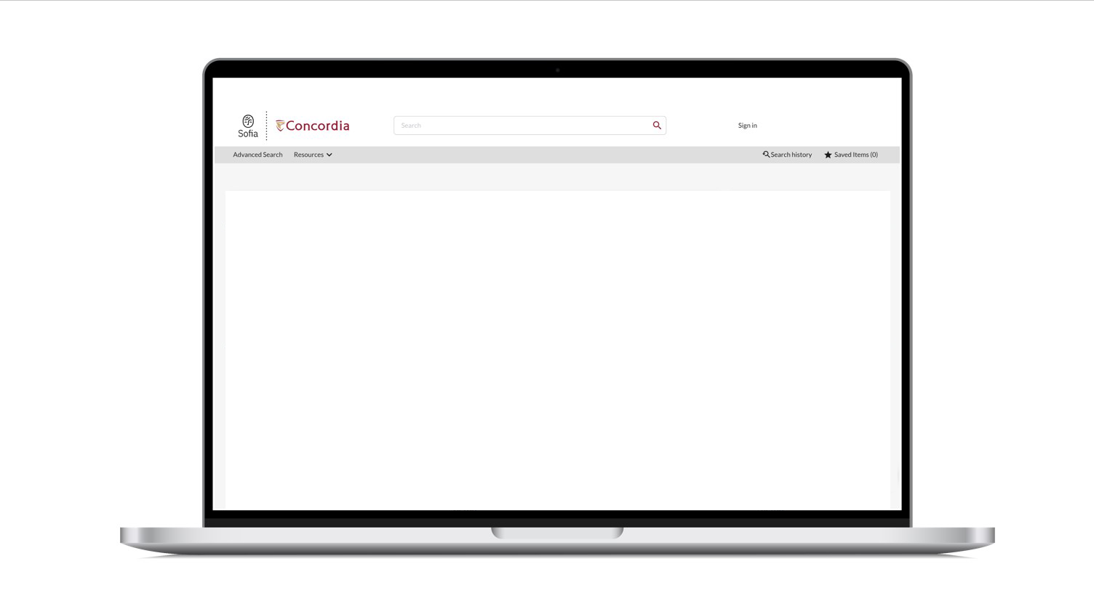
Sofia Discovery Tool – request a book form

Slide 31
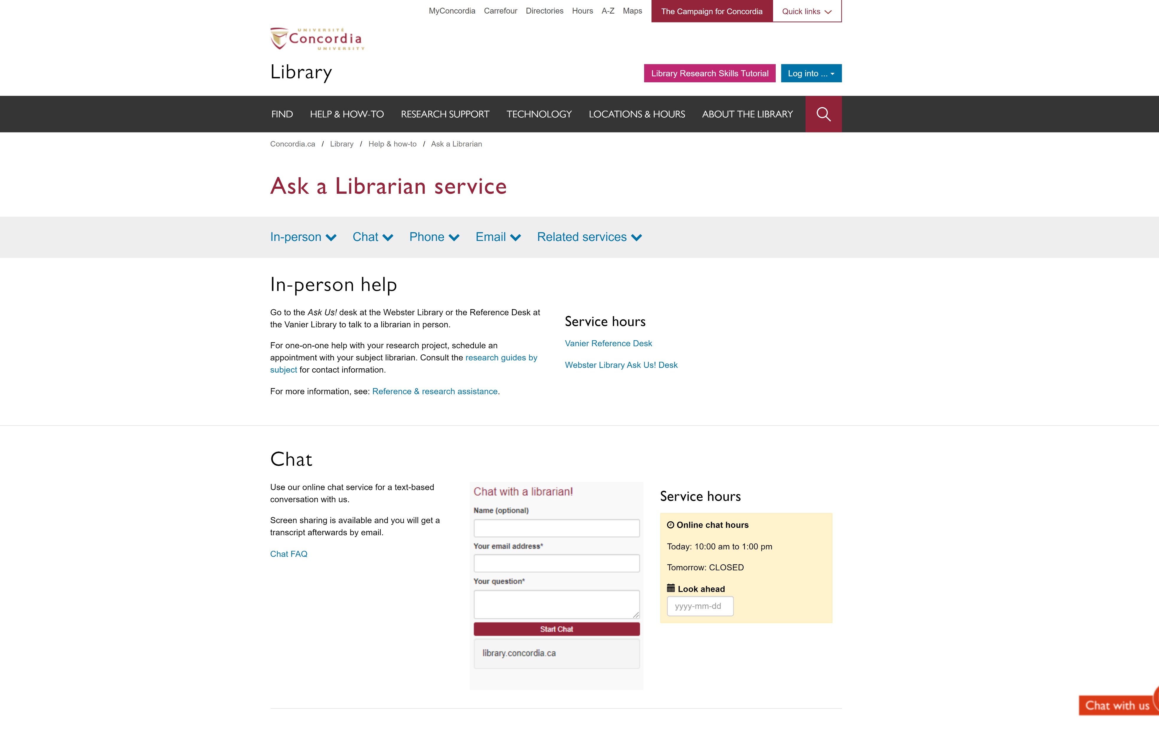
If you have any difficulty finding a document, reach out!

Slide 32
Exercises
How many documents do we have at Concordia under the subject heading “Translating and interpreting”? How do I get a document if it's not available at Concordia?
Does the Library have any book written by Franz Kafka?

Slide 33
Terminological dictionaries

Slide 34
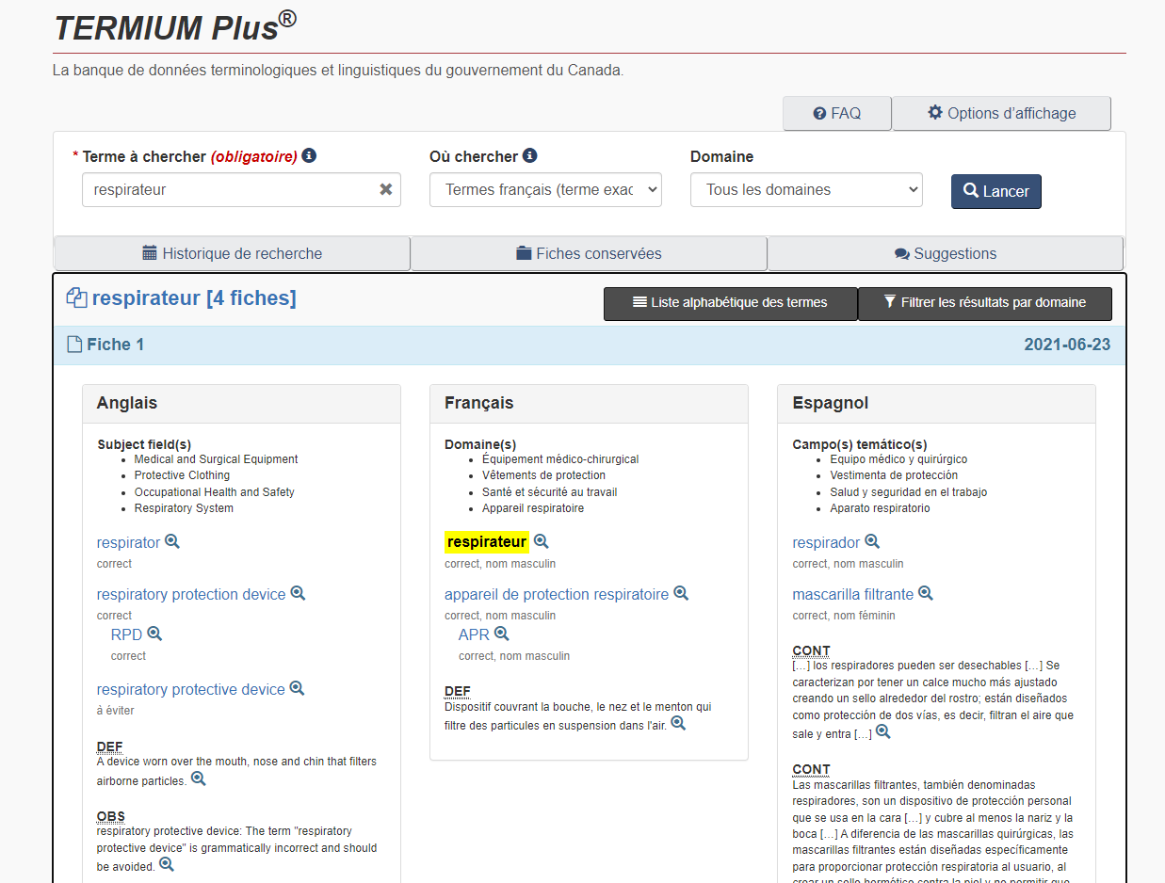
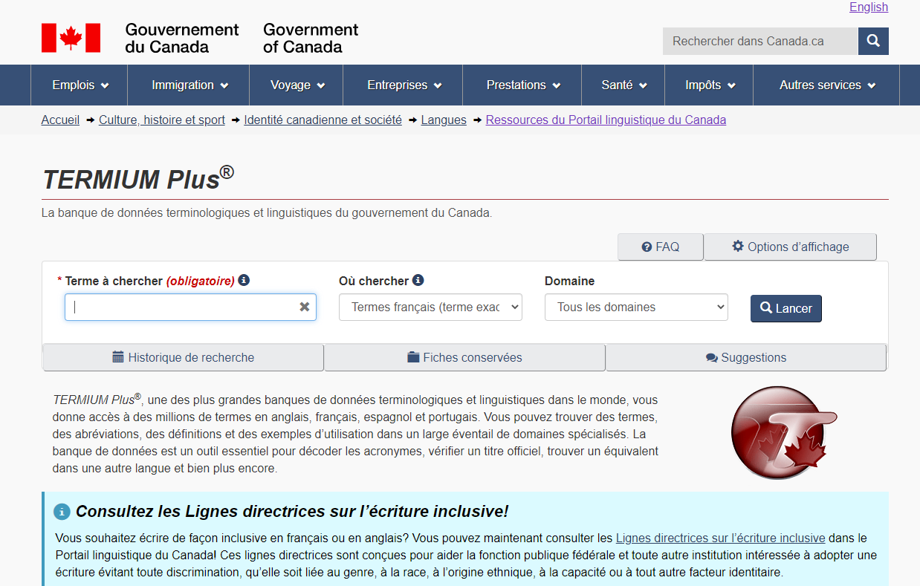
Termium Plus
https://www.btb.termiumplus.gc.ca
Resources of the Language Portal of Canada
Available free online
Notes:
Data farming
Hashtag
ONU

Slide 35
Exercises
What is Benelux?
Find a lexicon to talk about the pandemic that started in 2019.
How would you translate "mot-clic''?

Slide 36
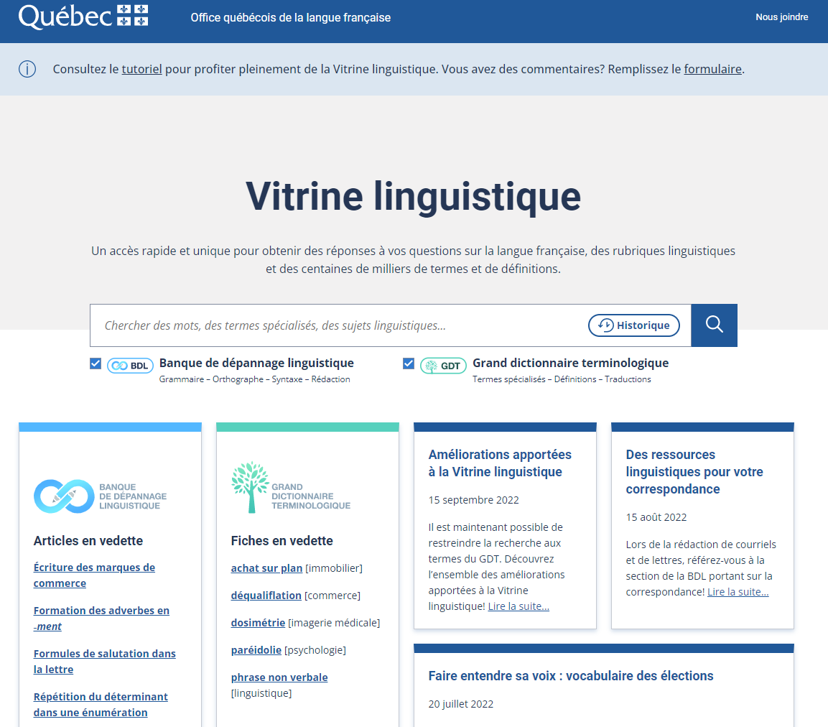
Vitrine linguistique
https://vitrinelinguistique.oqlf.gouv.qc.ca/ from the Office de la langue française
Includes the Grand dictionnaire terminologique
Free available online
Notes:
Hashtag
Communauté de pratiques
Feux de circulation
Carte d’affaires

Slide 37
Exercises
What are the Vitrine Linguistique's suggestions to translate "hashtag"?

Slide 38
Other reference documents
Online language dictionaries
Petit Robert de la langue française
Oxford English Dictionary (OED online)
Lexibase (Collins)
The Canadian Oxford dictionary
Collections d’ouvrages de référence
Oxford Reference
Canadian Oxford Dictionary
Gale ebooks (Encyclopeadias collection)

Slide 39
Different types of reference books
Dictionaries ... for definitions, pronunciation, etymology
Encyclopedias ... to learn more about a subject
Glossaries ... for indexing specialized vocabulary (e.g. dialect, science)
Handbooks ... for specific information

Slide 40
Exercises
Does the Canadian Oxford dictionary recognizes the word "sugar shack"?

Slide 41
Databases
Notes:
Naviguer un océan de données

Slide 42
The Peer-review process
Yates, D. [@LegoAcademics]. (2014, August 12). Peer 1: Brillant! Accept with no changes; Peer 2: Groundbreaking! Accept with no changes; Peer 3: Reject. [Tweet]. Twitter. https://twitter.com/LegoAcademics/status/499205005468262400/photo/1

Slide 43
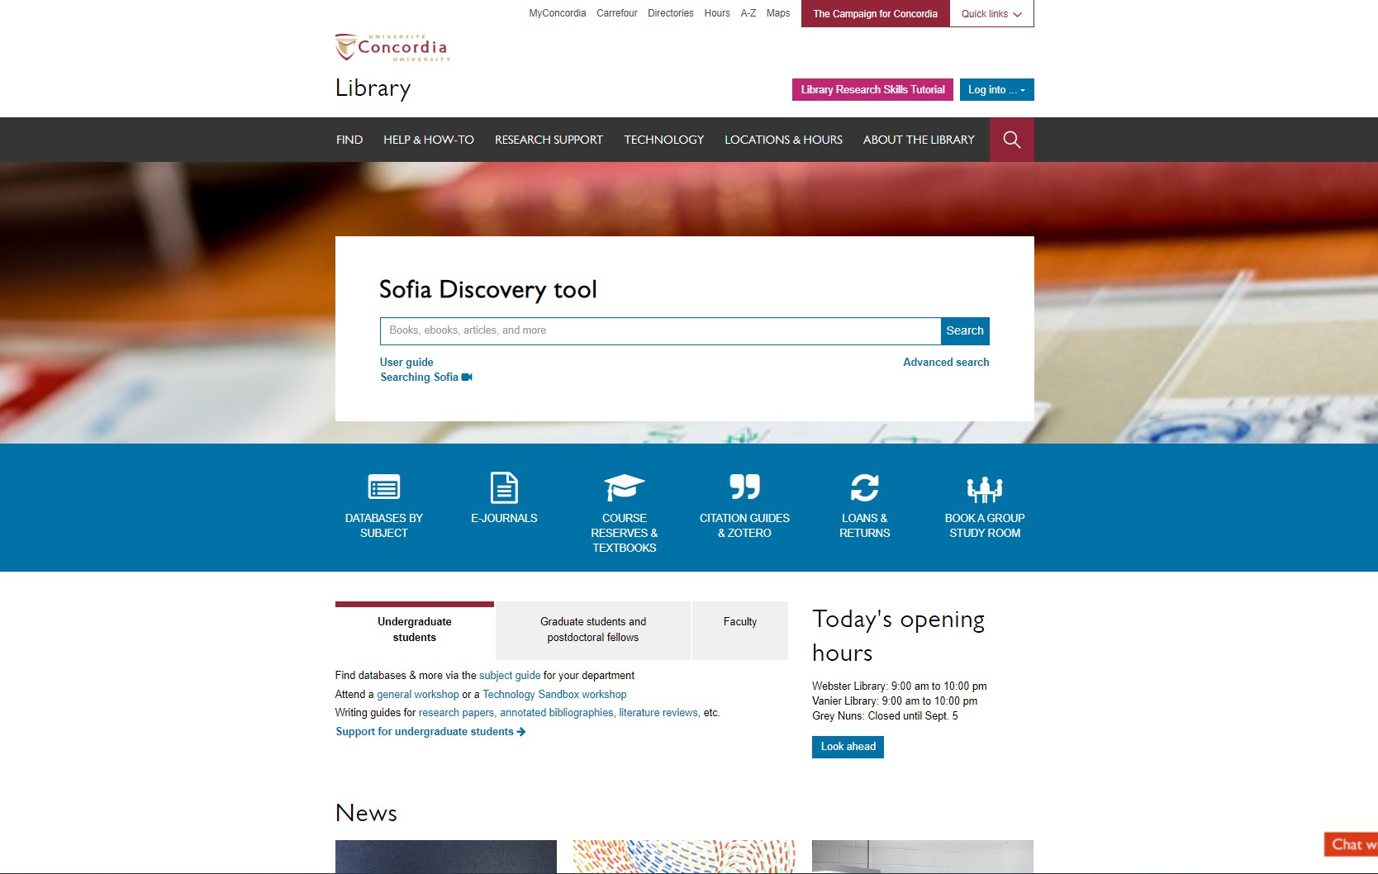
Sofia Discovery Tool – Databases By Subject

Slide 44
DATABASES
Disciplinary
Érudit
CAIRN
Repère
Persée
MLA Directory of Periodicals
Linguistics & language behavior abstracts (LLBA)
MLA International Bibliography

Slide 45
Multidisciplinary
Academic Search Complete
JSTOR
News and other
Eureka.cc
Google News (Archives) (journaux et revues)
Canadian Newsstream
Factiva

Slide 46
HOW TO FIND AND ACCESS RESOURCES USING ACADEMIC SEARCH COMPLETE

Slide 47
Sofia Discovery Tool – Databases By Subject

Slide 48
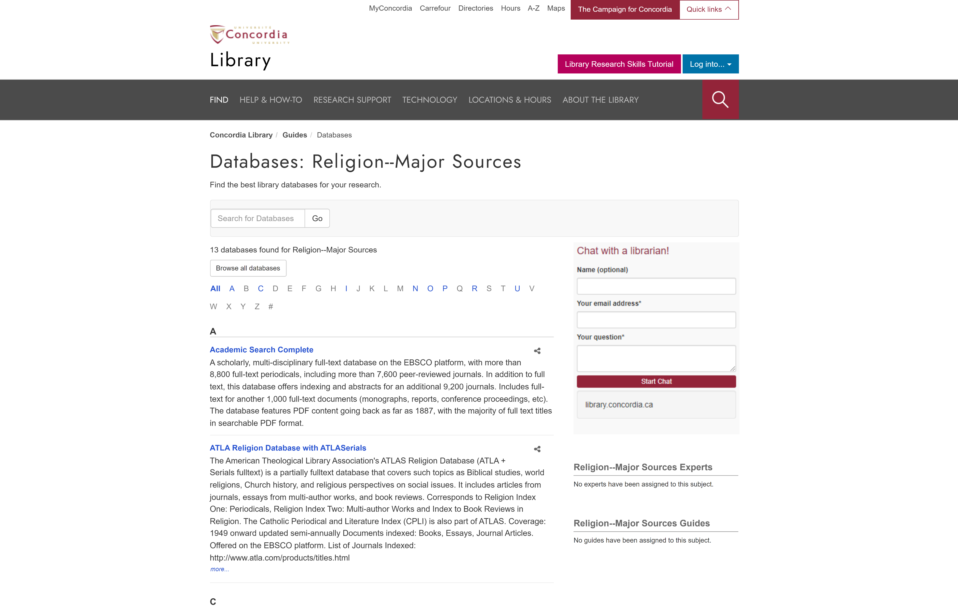
library.concordia.ca/find/databases/index.php

Slide 49
library.concordia.ca/find/databases/index.php

Slide 50
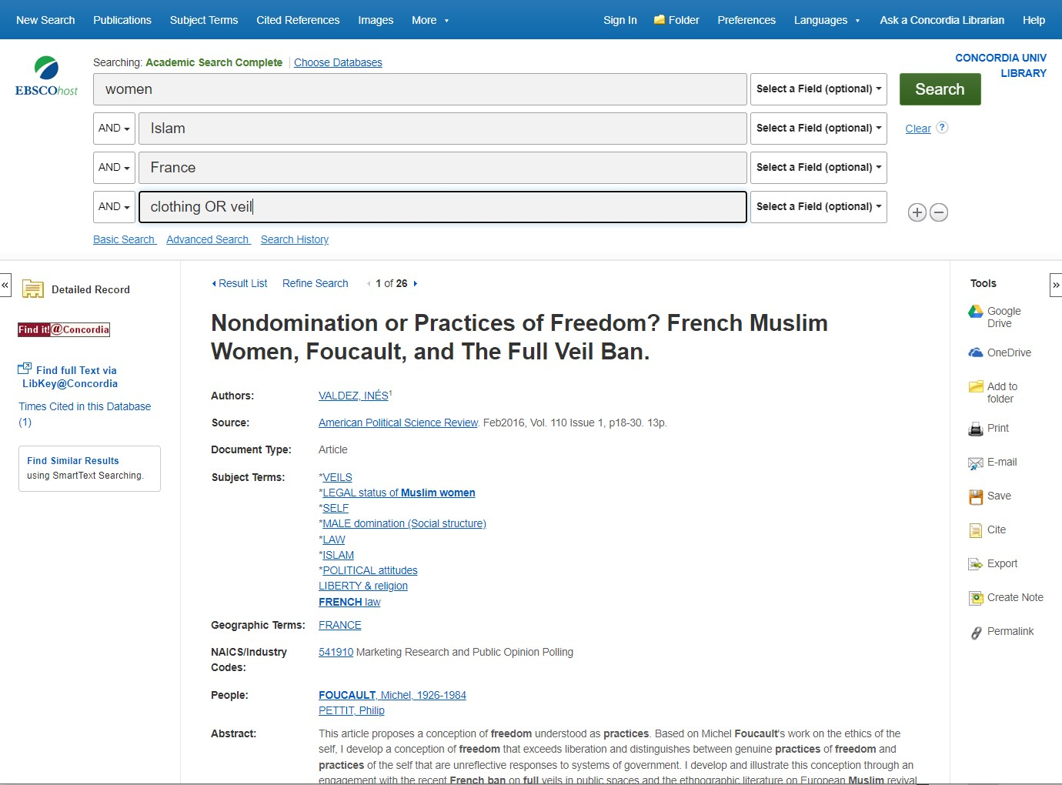
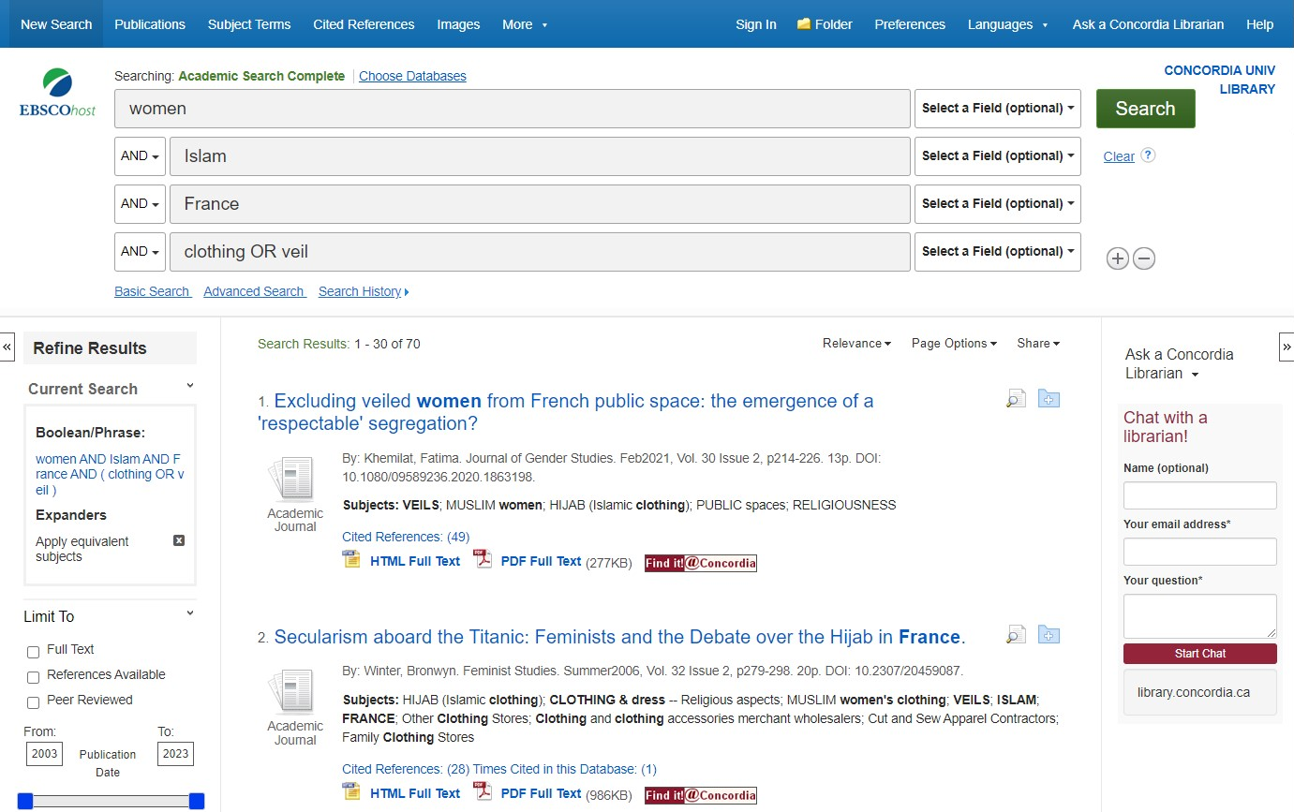
Database Boolean Search

Slide 51
View full article via Find it@Concordia button

Slide 52
Find it@Concordia results webpage

Slide 53
Find it@Concordia results webpage

Slide 54
Database tools

Slide 55
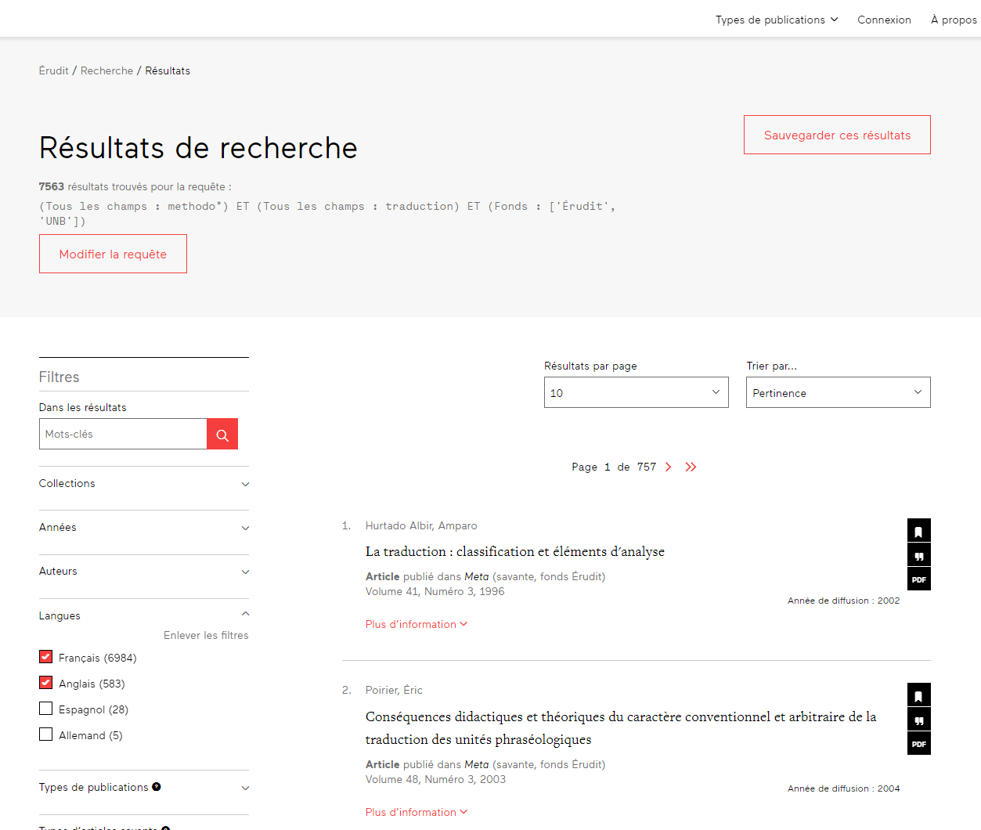
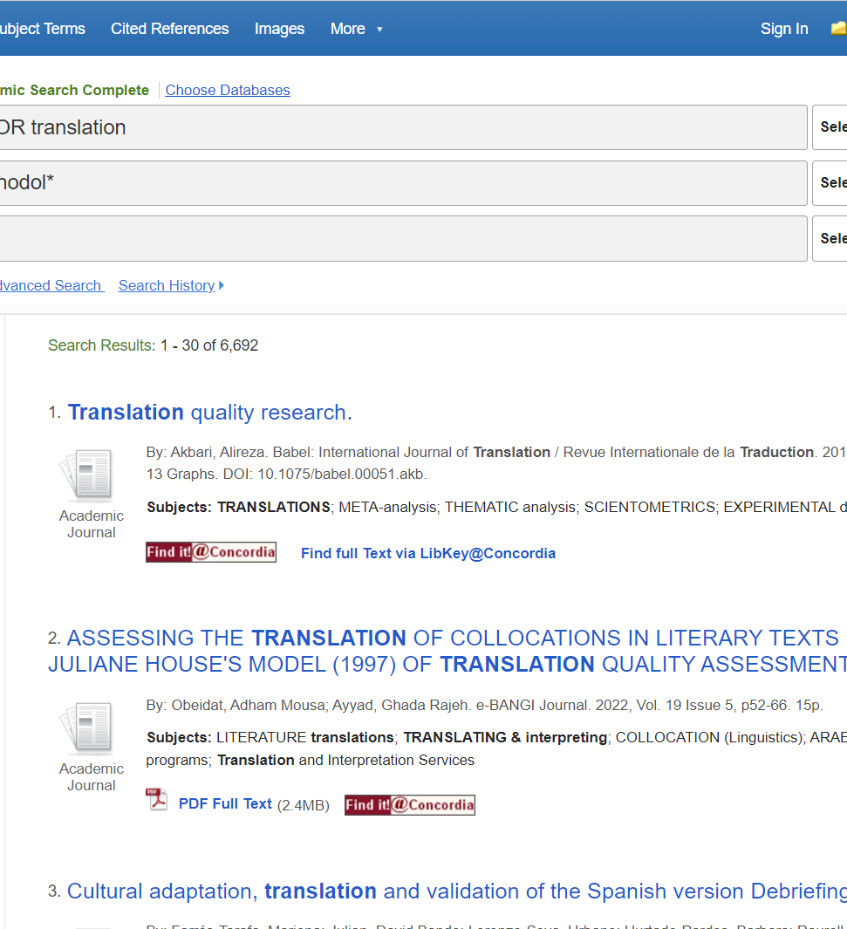
Démonstrations
Notes:
Academic Search Complete
Érudit
Eureka.cc

Slide 56
Exercises
Explain to me the peer-review process.
Find on peer-reviewed article about women in politics in Canada.

Slide 57
Other resources on the web

Slide 58
Useful websites
Federal government web pages (.ca)
Other governments or international organizations (UN, UNESCO)
Universities or research or teaching institutions

Slide 59
Lexicons and other online resources
Lexiques et vocabulaires de l’Office québécois de la langue française (OQLF)
Lexiques et vocabulaires du Bureau de la traduction
Glossaires de l’Alliance de recherche numérique du Canada

Slide 60
You do have access to many resources!

Slide 61
ASSESS and cite your sources

Slide 62
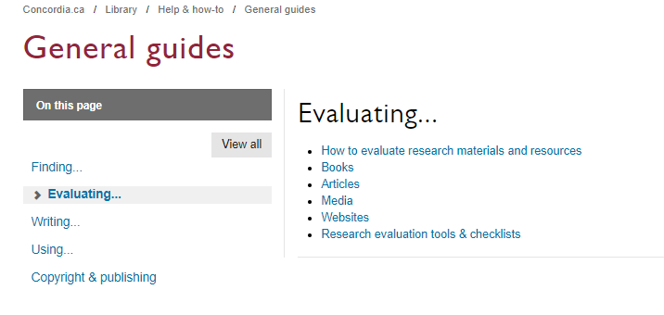

Slide 63
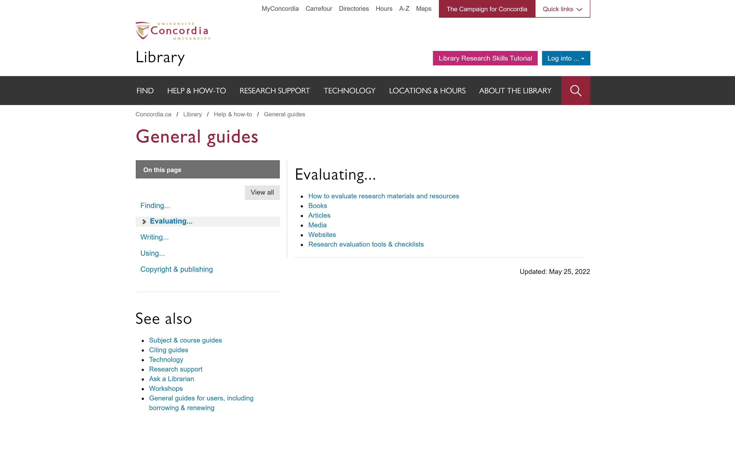
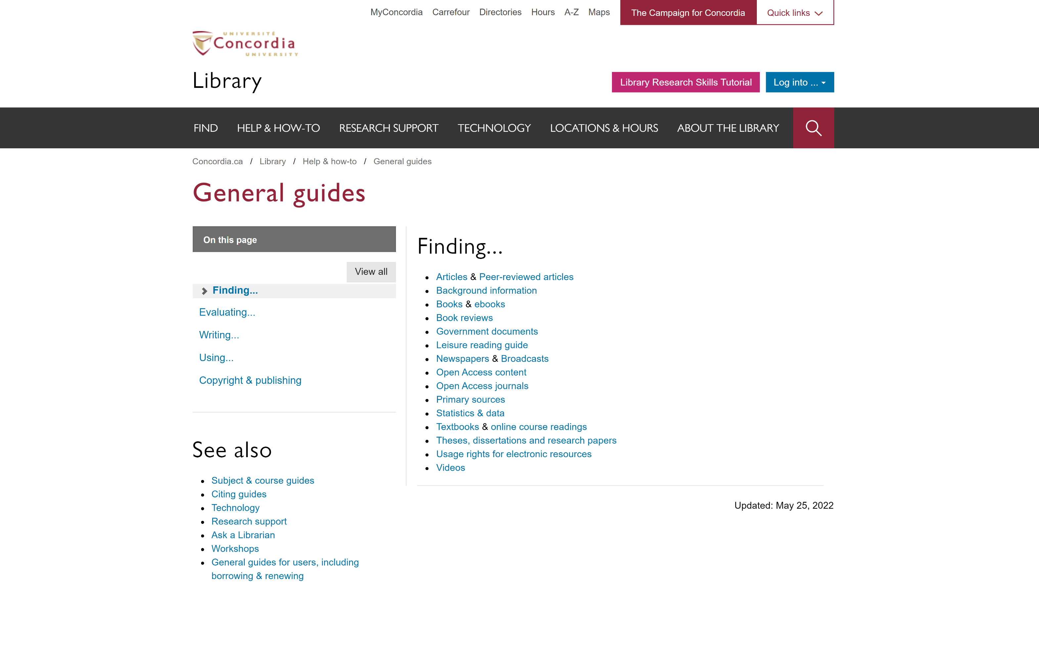
Concordia Library Website - Navigating General Guides
library.concordia.ca/help/guides.php?guid=finding

Slide 64
library.concordia.ca/help/citing/

Slide 66
The Library is there to support you with your research too.

Slide 67
Concordia Library Website – Ask a Librarian

Slide 69
Éthel Gamache Webster Library LB 505-07 ethel.gamache@concordia.ca

