Slide 1
Library Orientation for HIST 403:
Methodology in History
LIBRARY
Monday, January 23, 2023
Vince Graziano
History Librarian
vince.graziano@concordia.ca

Slide 2
Workshop Outline
Books and articles in Sofia
Journal articles in History databases
  America: History & Life
  Historical Abstracts
Primary sources:
  What are primary sources?
  Evaluating primary sources
  Primary sources in Sofia
  Newspaper databases
  Archive databases

Slide 3
Books and articles in Sofia
Sofia Discovery Tool is used in all Quebec University Libraries
  Can be a starting point for library research
  Ability to search local library (default), QC university libraries, and libraries worldwide
Catalogue includes all electronic and physical books, videos etc available at Concordia Library
Discovery service includes all full-text articles to which Concordia Library has access
Operators: AND and OR must be in uppercase.
Interlibrary Loan and Article/Chapter Scan built in
Does NOT replace databases
Introductory Video:
  Searching Sofia

Slide 4







Electronic Journals
Collections:
  Project MUSE (Recent issues)
  JSTOR (Older issues)
  Oxford Journals (recent and archive)
  Cambridge University Press
  Wiley-Blackwell
  Sage Journals
  Taylor & Francis (Routledge)
  Academic Search Complete (EBSCO)
  ProQuest Central
  Periodicals Archive Online (1802-2000)
  Many other electronic journal collections

Slide 5




Academic Electronic Books
Collections:
  Oxford Scholarship Online (recent and ongoing)
  Cambridge University Press e-books
    Package:1995-2007, with individual book additions
  Project MUSE E-books (university presses)
  Springer E-book Collection
    Includes Palgrave Macmillan (2010-)
  Taylor & Francis (Routledge)
  ACLS Humanities E-book
  Canada Commons
  Ebook Central (ProQuest)
  EBSCO E-books
  Many other electronic books

Slide 6
Journal Articles in History
History Databases
  America: History & Life (AHL)
    1964-onward on EBSCO platform
    Covers only Canadian and USA history
    Combined searched with Historical Abstracts
  Historical Abstracts (HA)
    1955-onward on EBSCO platform
    Covers world history, excluding Canada and US
    Combined searched with America: History & Life
Databases with History Content
  Arts & Humanities Database
    1924-onward on ProQuest platform
  Humanities & Social Sciences Index Retrospective
    1907-1984 on EBSCO platform
    Combined search with AHL and HA
  Academic Search Complete
    Huge multidisciplinary database on EBSCO platform
    Dates vary by journal
    Combined search with AHL and HA

Slide 7
Boolean Operators & search capabilities
Boolean searching is based on an algebraic system of logic created by George Boole, a British 19thc. mathematician & philosopher
AKA logical operators or search operators
Boolean Operators:
  AND United States AND history
  OR autobiography OR memoir
  NOT history NOT literature
Search capabilities:
  “ ” for phrases “United States”
  * for truncation Canad*
  Nesting () Canad* AND history AND (autobiograph* OR memoir)
Note: multiple search boxes are also a form of nesting
Note: Databases do not require the operators to be in uppercase
EXCEPTION: UPPERCASE operators MUST be used in Sofia

Slide 8
Subject Searching
Subject searching is more accurate & specific
Thesaurus or Index
  List of terms used in a database
Subject Headings in Sofia for books
  Created by the Library of Congress
  Sources of subjects in article records are not specified
Subjects include:
  People
  Events
  Places
  Topical subject headings

Slide 9




To Find the Full Text
Use the to go to the journal site
Use the to go directly to PDF
3. Search Sofia
  Perform a title search for the journal
  Perform a title search for the article
4. Article/Chapter Scan & Deliver
  In Sofia, click on the title of the book to see the Access Options
  Look for:
  Compliance with Canadian Copyright Act & Copibec agreement
5. Request an Interlibrary Loan
  in Sofia
    This option appears only if we change the search to other QC libraries or libraries worldwide
  Allow 1 to 2 weeks for delivery of printed books
  Allow 2 to 4 days for delivery of articles and chapters by links in email

Slide 10
What are Primary Sources?
Primary sources provide first-hand testimony or direct evidence concerning a topic under investigation. They are created by witnesses or recorders who experienced the events or conditions being documented.
These sources are often created at the time when the events or conditions are happening, but they can also include autobiographies, memoirs, and oral histories recorded later.
Primary sources are characterized by their content, regardless of whether they are available in original format such as manuscripts, letters, diaries, etc., or in facsimile format such as microform, digital, or print.

Slide 11
Evaluating Primary Sources
When and by whom was this document created?
Who is the author/creator, and why did he or she create the document?
Who is the intended audience for the document?
  Use clues from the document itself, its form, and its content,
How does the document reflect or mask such factors as class, race, gender, ethnicity? Reflect or mask the regional background of its author/creator?
How does the author/creator describe, grapple with, or ignore contemporaneous historical events?
From a literary perspective, does the author/creator employ any generic conventions, such as similes, metaphors, and other rhetorical devices?
With what aspects of the document (content, form, style) can you most readily identify or not?
  Does the document remind you of contemporaneous or present-day cultural forms that you have encountered?
  Which seem most foreign to you? Why?

Slide 12
Primary Sources in Sofia
Search for primary sources in Sofia by using the Library of Congress Subject Headings (LCSH) → mainly for books
LCSH features standard subdivisions that identify and retrieve primary sources
Advantage is that LCSH terms are portable to other university library catalogues in Canada & USA
Note: these subdivisions are used for the documents themselves or a listing of documents identified as a bibliography or catalogue (usually paired with sources)
Some subdivisions include (must search in subject):
  Sources → Main subdivision for primary sources
  Diaries
  Correspondence
  Interviews
  Personal narratives
  Slave narratives
  Captivity narratives
  Pamphlets
  Oral history
  Description and travel
  Early works to 1800

Slide 13
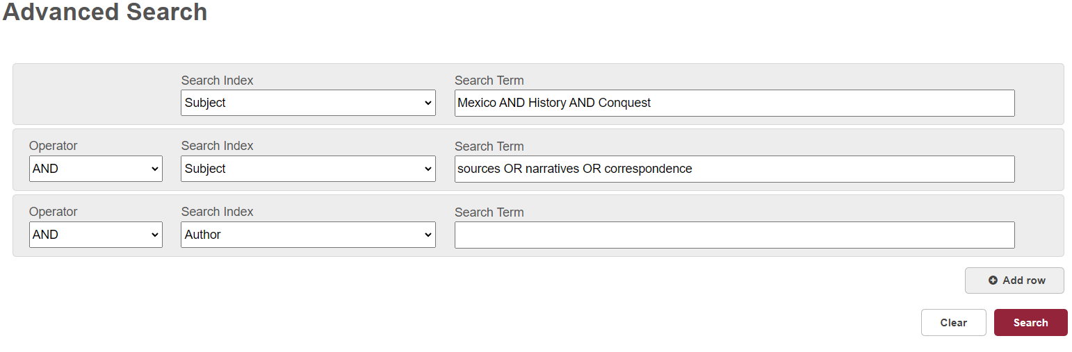
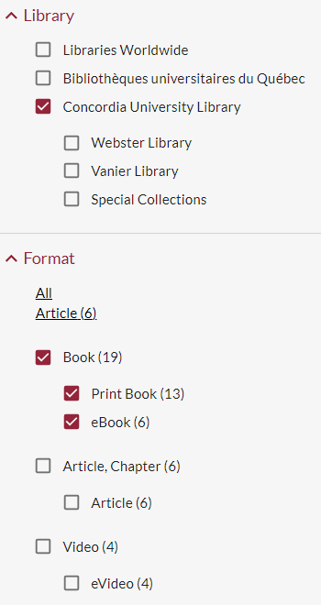
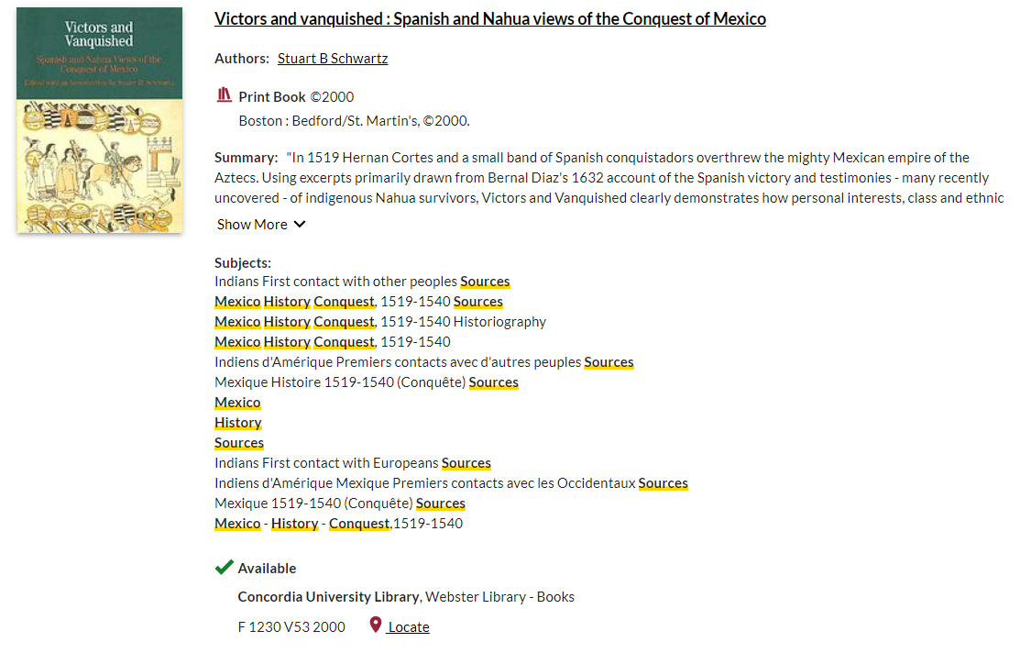
Primary Sources in Sofia Example

Slide 14
Newspapers in Electronic Format
Current:
  US Newsstream (~1980-2001)
  Canadian Newsstream (1977 for Globe & Mail, 1984-today)
  International Newsstream (~1980-today)
  Factiva (~1980-today)
    US, Canadian & International
  More: Current Newspaper databases at Concordia Library
Historical:
  ProQuest Historical Newspapers: New York Times (1851 to 3 years ago)
  ProQuest Historical Newspapers: Washington Post (1877-2001)
  ProQuest Historical Newspapers: Irish Times (1859 to 2 years ago)
  ProQuest Historical Newspapers: Wall Street Journal (1889-2010)
  ProQuest Historical Newspapers: Globe & Mail (1844-2017)
  ProQuest Historical Newspapers: Toronto Star (1894-2019)
  Times Digital Archive Times of London (1785-2014)
  Google News Archive – very selective coverage
  More: Historical Newspapers & Magazines

Slide 15
Archive Databases in Libraries
Collections from physical archives & major research libraries
  Great variation in size
  Digitized collections or parts of collections packaged and sold by vendors to libraries, often via consortia
  Major vendors are ProQuest, Gale, Adam Matthew, Alexander Street Press
Search Fields
  Great variation from database to database
  Standard fields may include keyword, author/creator, title, and full text
  Customized fields may include “sub-collection” or section, fonds, etc
  Filters may include date, document type, document features, place of publication
  Some include a subject field, but it is very different from standard subjects such as the Library of Congress Subject Headings
Examples
  British and Irish Women's Letters and Diaries, American Periodicals, British Periodicals, Empire Online, East India Company, and many others
Exceptions
  A few archive databases provide records for downloading into library catalogues
  Usually for books, these records can be searched in Sofia, without full text searching
  Subject headings and name authorities by the Library of Congress are included
  Examples: Canadiana, Early English Books Online (EEBO), Eighteenth Century Collections Online (ECCO)

Slide 16
Challenges of Archive Databases
Primary source documents are presented “AS IS” with little to no human intervention
Challenges for searching primary source databases include:
  Personal names and place names
    Abbreviations, pseudonyms, spelling variations, former place names, abbreviations of names, titles
  Language usage
    Many spelling variations and abbreviations
    Words that are now considered pejorative or offensive
    Figurative language and expressions
    Definitions of words may be different
Reference resources for help with names and English language words
  Biographical dictionaries
    Search Sofia by Subject: biography dictionaries
    Add a qualifier in Subject: country or occupation, ex: historians biography dictionaries
  Place name dictionaries
    Search Sofia by Subject: names geographical dictionaries
    For origins, search Sofia by Subject: names geographical etymology dictionaries
    Add a qualifier in Subject: country (for the UK, use Great Britain)
  Language dictionaries: historical
    Oxford English Dictionary (OED): international historical definitions, search by spelling variation is possible
      OED is a modern English dictionary: Modern English begins around1500
      Dictionary of Old English A to I (DOE), 450-1100, Middle English Compendium, 1100-1500
    Merriam Webster online dictionary has some etymological information

Slide 17
Databases: Indexes vs. Archives
Databases of secondary sources are INDEXES (with some full text)
Databases of primary sources are ARCHIVES (with some exceptions)
Differences between INDEXES & ARCHIVES
  Purpose of an INDEX: to present a complete listing of the contents of journals and other documents that usually represent a discipline, without necessarily providing full text (ex: Historical Abstracts)
  Purpose of ARCHIVES: to present the full text of a specific collection identified by theme, document type, nationality, time period, and other criteria
Features | Indexes | Archives
Subject Headings | Yes | Rarely
Name Authorities | Yes | Rarely
Boolean operators | Yes | Yes
Proximity operators | No | Some
Full text | 0%-~60,70% | 100%
Full text searching | Few | ~98%

Slide 18
Proximity Operators
Used to define distance between words or phrases
Effective strategy when searching full text of long documents
Check the database help pages for usage and syntax of proximity operators
  Some archive databases do not have this capability
NEAR
  Use NEAR to find terms when order doesn't matter
  Add a numerical value to the operator
  Examples with syntax:
    slave* NEAR5 sugar
    slave* NEAR/5 sugar
    Finds documents that contain slave* and sugar within five or fewer words of each other
WITH or PRE
  Use WITH or PRE to find terms in order, or the first term followed by the second term
  Add a numerical value to the operator
  Examples with syntax:
    Canada WITH3 Confederation
    Canada WITH/3 Confederation
    Canada PRE/3 Confederation
    Finds documents that contain Confederation within three or fewer words after Canada

Slide 19
Archive Databases
Complete list of primary source databases at Concordia
Selected List:
  American Periodicals – 1741-1940
  Archives of Sexuality and Gender – 16th to 20th century, 1940-
  British Periodicals Collection I – II – 1681-1939
    Includes articles about the history of Europe
  Canadiana - 1600s to ~1925
  China, trade, politics & culture – 1793-1908
  Early encounters in North America – 1534-1850
  Early English books online – EEBO – 1475-1700
  East India Company – 1595-1947
  Eighteenth Century Collections Online - ECCO
  Empire online – 1492 to 20th century
  Entertainment Industry Magazine Archive – 1880-2000
  Indigenous Peoples of North America - 16th to 20th centuries
    Includes papers of the Indian Rights Association, 1882-1986

Slide 20
Archive Databases
Selected list (cont’d):
  Maclean's Digital Magazine Archive – 1905-2015
  Manchester Medieval Sources
  Media History Digital Library
    Full-text, full-images of historical magazines & journals in media /cinema
  North American immigrant letters, diaries and oral histories – 1840-1920
  North American Indian thought and culture – 18th to 21st centuries
  North American women's letters and diaries - colonial to 1950
    USA and Canadian women
  Oral history online 20th century to present
  Picture Post Historical Archive -1938-1957
  ProQuest U.K. Parliamentary Papers – 1801 onward
  Punch Historical Archive – 1841-1992
  Slavery, Abolition & Social Justice – 1490-2007
  State Papers Online (SPO) British – 1509-1782
  Women and social movements in the United States – 1600-2000

Slide 21
Help is Available
Library website: help & how-to
History subject guide
Chicago citation style guides
Chicago Manual of Style (full text online)
Ask Us
  E-mail form
  Chat with our staff
  Ask Us Desks at the entrance to Webster Library on LB2
Ask Vince:
  Pease use email only: vince.graziano@concordia.ca
  When sending an email, please state your name (if no signature) and the course (HIST 403: Methodology in History)
  Office hours: by appointment, in-person or on ZOOM
  Many questions can be answered by email

