Slide 1
HIST 498:
Montreal Performing Arts
Archives & Histories
LIBRARY
Wednesday, November 9, 2022
Vince Graziano
History Librarian
vince.graziano@concordia.ca

Slide 2
Workshop Outline
Library research process
Searching Sofia for books and articles
Finding articles in databases:
  America: History & Life
  Performing Arts Periodical Database
  International Bibliography of Theatre and Dance
  Entertainment Industry Magazine Archive
Finding Videos
  Theatre in Video

Slide 3
Library Research Process
Select appropriate resource(s) in which to conduct your search for your topic (Sofia and Databases)
Apply a relevant search strategy, using the facets on the left side to refine the search
Analyze results (too many, too few, off topic, just right)
Revise search strategy, if necessary, or change database(s), or search in multiple databases
Re-analyze results
Access documents

Slide 4
Books and articles in Sofia
Sofia Discovery Tool is used in all Quebec University Libraries
  Can be a starting point for library research
  Ability to search local library (default), QC libraries, and libraries worldwide
Catalogue includes all electronic and physical books, videos etc available at Concordia Library
Discovery service includes all full-text articles to which Concordia has access
Interlibrary Loan and Article/Chapter Scan built in
Does NOT replace databases
Introductory Video:
  Searching Sofia

Slide 5
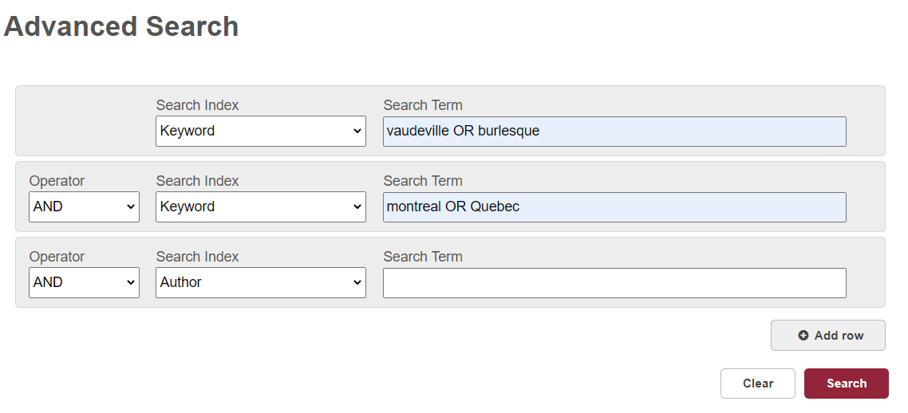
Searching Sofia
Use the facets on the left side to refine the search:
Format: Select Article or Book
Book (optional limits):
Publication Year: Last X years or Year Range
Language: English
Articles (recommended limits):
Content Type: peer-reviewed
Optional limits:
Publication Year: Last X years or Year Range
Language: English
Analyze results
This search retrieves 79 records

Slide 6
Article Databases
  America: History & Life
    1964-onward
    Covers only Canadian and USA history
    Combined searched with Historical Abstracts
  Historical Abstracts
    1955-onward
    Covers world history, excluding Canada and USA
    Combined searched with America: History & Life
  Performing Arts Periodicals Database
    Covers theatre, dance, music, cinema
    International in scope
  International Bibliography of Theatre and Dance
    Covers all aspects of theatre and performance in 126 countries
    1936 onward
  Entertainment Industry Magazine Archive
    50 magazines: Variety, Billboard, Boxoffice, Stage (London)
    1880-2000
    Primary sources

Slide 7
Theatre in Video
Theatre in Video
  One of several video databases produced by Alexander Street Press, a subsidiary of ProQuest
  More than 700 videos
  Includes all 38 of Shakespeare’s plays produced by BBC Worldwide
  Two types: performances and documentaries
  Performances: films and recorded stage performances
  Ability to view videos and transcripts side by side
    Transcript highlighted for current dialogue and moves along at pace of dialogue

Slide 8
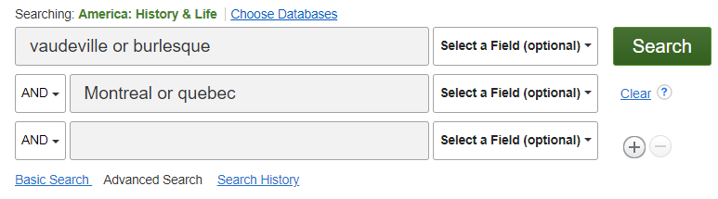
Searching America: History & Life
This search retrieves only 8 records.
This indicates that other databases must be used.

Slide 9
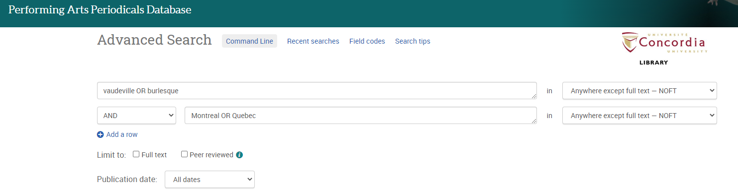
Searching Performing Arts Periodicals Database
This search retrieves only 14 records,
9 of which are scholarly journals.
This indicates that other databases must be used.

Slide 10
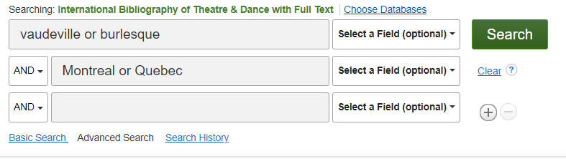
Searching International Bibliography of Theatre and Dance
This search retrieves only 13 records.

Slide 11
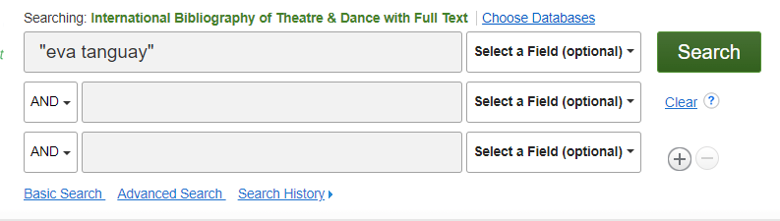
Searching International Bibliography of Theatre and Dance
Eva Tanguay was the so-called “Queen of Vaudeville”
She performed in North America, including Quebec.
This search retrieves only 2 articles.

Slide 12
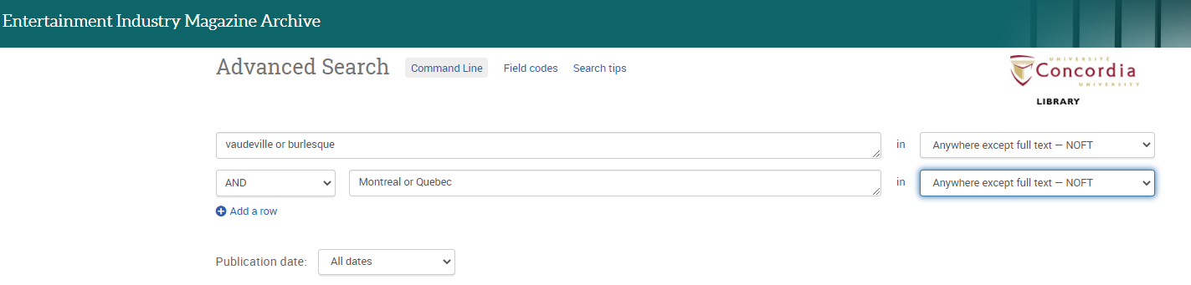
Searching Entertainment Industry Magazine Archive
This search retrieves 542 records.
Use the facets on the left side to refine the search:
Publication Date:
Enter a date range: 1895-1945
Reduces results to 244 articles, all of which are full-text primary sources.
Optional: SORT: Oldest First

Slide 13
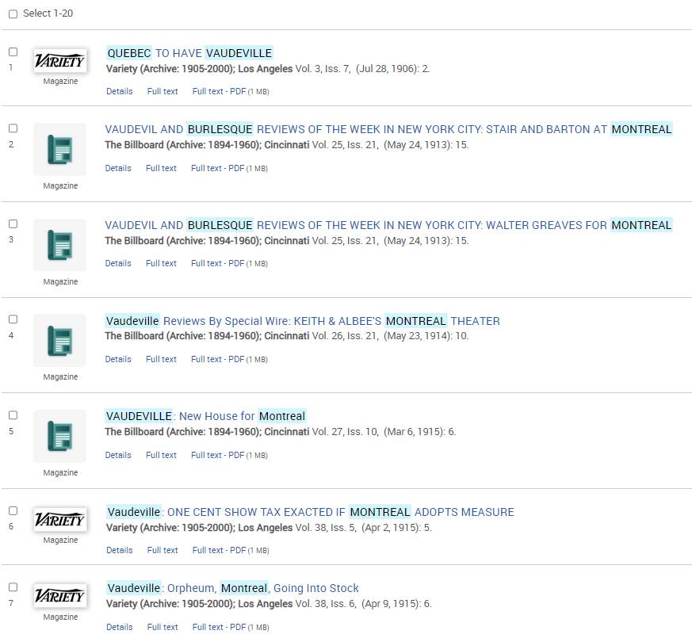
Sample records retrieved in Entertainment Industry Magazine Archive (Oldest First)

Slide 14

Searching Entertainment Industry Magazine Archive
This search retrieves 250 articles, of which 246 were published between 1905 and 1942.
This database retrieved the most records for this topic.
Searching a few databases is part of the library research process.

Slide 15
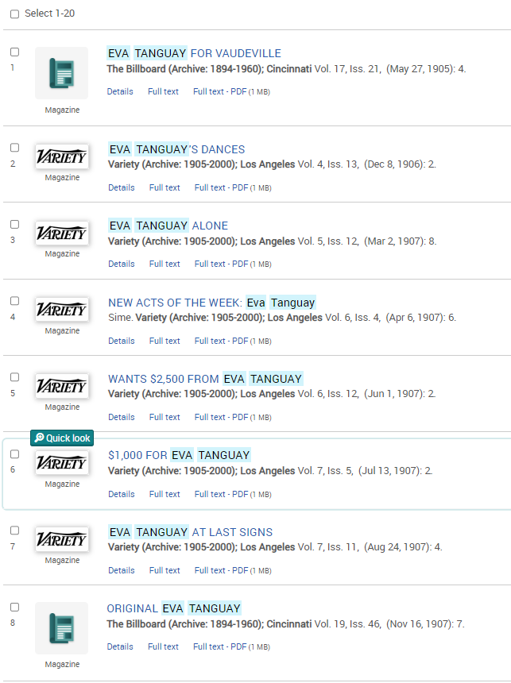
Sample records retrieved in Entertainment Industry Magazine Archive

Slide 16
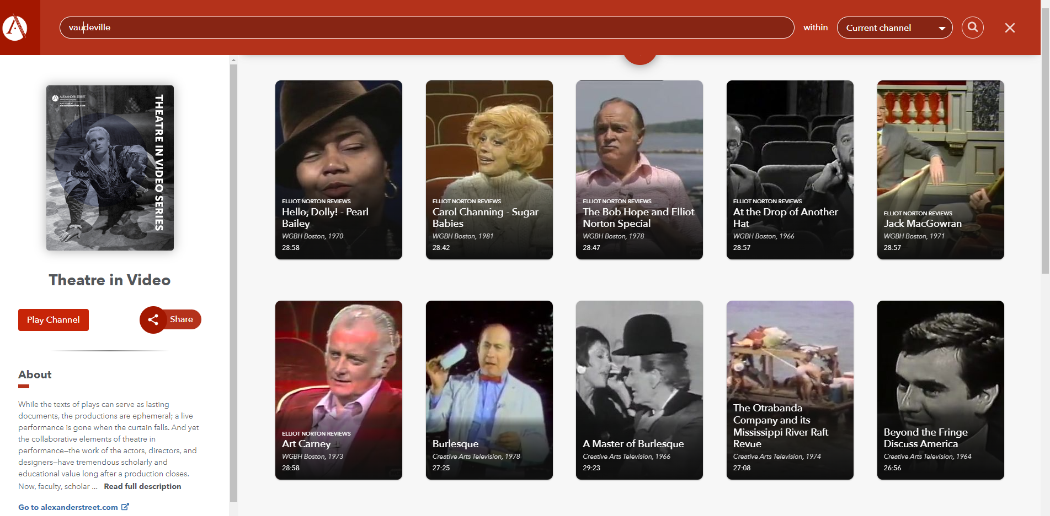
Searching Theatre in Video
This search retrieves 26 videos

Slide 17






Electronic Journals
Collections:
  Project MUSE (Recent issues)
  JSTOR (Older issues)
  Oxford Journals (recent and archive)
  Wiley-Blackwell
  Sage Journals
  Taylor & Francis (Routledge)
  Academic Search Complete (EBSCO)
  ProQuest Central
  British Periodicals I and II (1681-1939)
  American Periodicals (1741-1940)
  Periodicals Archive Online (1802-2000)
  Many other electronic journal collections

Slide 18





Electronic Books
Collections with substantial humanities content:
  Early English Books Online (EEBO) – 1473-1700
  Eighteenth Century Collections Online (ECCO)
  Canadiana (until c. 1925)
  Oxford Scholarship Online (recent and ongoing)
  Cambridge University Press e-books (Package:1995-2007, with individual book additions)
  Project MUSE E-books (university presses)
  Springer E-book Collection, includes Palgrave Macmillan (2010-)
  Taylor & Francis (Routledge)
  ACLS Humanities E-book
  Canada Commons
  Ebook Central (ProQuest)
  EBSCO E-books
  Many other electronic books

Slide 19
Search Operators
AND Vaudeville AND Montreal
OR vaudeville OR burlesque
NOT performance NOT dance
“ ” for phrases “Eva Tanguay"
* for truncation feminis*
Nesting () (Montreal OR Quebec) AND (vaudeville OR burlesque)
Note: multiple search boxes are also a form of nesting
Note: Databases do not require the operators to be in uppercase.
EXCEPTION: UPPERCASE operators MUST be used in Sofia

Slide 20
Subject Searching
Subject searching is more accurate & specific
Thesaurus
  List of terms used in a database
Subject Headings in Sofia for books
  Created by the Library of Congress
Subjects include:
  People
  Events
  Places
  Topical subject headings

Slide 21




To Find the Full Text
Use the to go to the journal site
Use the to go directly to PDF
3. Search Sofia
  Perform a title search for the journal
  Perform a title search for the article
4. Article/Chapter Scan & Deliver
  In Sofia, click on the title of the book to see the Access Options
  Look for:
  Compliance with Canadian Copyright Act
5. Request an Interlibrary Loan (COLOMBO)
  in Sofia
    This option appears only if we change the search to other QC libraries or libraries worldwide
  Allow 1 to 2 weeks for delivery of printed books
  Allow 2 to 4 days for delivery of articles and chapters by email

Slide 22
Help is Available
Library website: help & how-to
History Subject Guide
Chicago Manual of Style (online)
Chicago Citation Style
Ask Us
  E-mail form
  Chat with our staff
  Ask Us Desks
    Entrance to Webster Library
Ask Vince:
  vince.graziano@concordia.ca
  Office hours: by appointment on ZOOM or in person
  Many questions can be answered by email

