Slide 1
Library Workshop: ENGL 210 Introduction to Essay Writing
LIBRARY
Wednesday, October 25, 2023
Vince Graziano
English Librarian
vince.graziano@concordia.ca

Slide 2
Workshop Outline
Research process
Sofia for books and articles
Article databases
Academic Search Complete
Boolean operators, search capabilities & facets
Finding sources & search strategy
Evaluation of resources
Citation style
Help is available

Slide 3
Research Process
Define the topic
Can be refined as you discover more information
Narrow the topic
Use Who, What, When, Where questions
Gather background information to learn more about your topic
Encyclopedias provide a general overview of a topic
Search for Encyclopedias in Sofia
Develop a working thesis statement or research question
Can be refined at any point in the research process
Find and evaluate sources
Encyclopedias → Books → Articles
Cite the sources
Use Citation Style Guides or the MLA Handbook (e-version)
Write the paper

Slide 4
Books and articles in Sofia
Sofia Discovery Tool is used in all Quebec University Libraries
Can be a starting point for library research
Ability to search local library (default), QC university libraries, and libraries worldwide
Catalogue includes all electronic and physical books, videos etc available at Concordia Library
Discovery service includes all full-text articles to which Concordia Library has access
Operators: AND and OR must be in uppercase.
Interlibrary Loan and Article/Chapter Scan built in
Does NOT replace databases
Introductory Video:
Searching Sofia

Slide 5
Article Databases
Identify database(s) for your topic
Use Subject & course guides
Use the list of databases by subject
Academic Search Complete
Huge interdisciplinary database
More than 7,300 full-text peer-reviewed journals
Offers indexing & abstracts for another 12,500 journals
More than 600 active full-text popular periodicals
Coverage is mainly from 1965 onward, with some coverage going back to 1887

Slide 6
To Find the Full Text
Use to go to the journal site
Use to go directly to the PDF
3. Search Sofia
Perform a title search for the journal
Perform a title search for the article
4. Article/Chapter Scan & Deliver
In Sofia, click on the title of the book to see the Access Options
Look for the button Request Chapter Scan in red
Compliance with Canadian Copyright Act & Copibec agreement
5. Request an Interlibrary Loan
Look for the button Request Interlibrary Loan in red
For books and articles in other libraries select QC libraries or libraries worldwide
Allow 1 to 2 weeks for delivery of printed books
Allow 2 to 4 days for delivery of articles and chapters by links in email

Slide 7
Electronic Books
Collections of academic & scholarly books
Can be used as a checklist for quality scholarly material
Oxford University Press E-books
Cambridge University Press E-books
Package:1995-2007, with individual book additions
Project MUSE E-books (university presses)
Springer E-book Collection
Includes Palgrave Macmillan (2010-)
Taylor & Francis (Routledge)
ACLS Humanities E-book
Canada Commons
Mainly Canadian university presses
Ebook Central (ProQuest)
EBSCO E-books
Many other electronic books

Slide 8
Electronic Journals
Collections of academic & scholarly journals:
Can be used as a checklist for quality scholarly material
Project MUSE (Recent issues)
JSTOR (Older issues)
Oxford Journals (Oxford University Press)
Cambridge University Press
University of Chicago Press
University of California Press
University of Toronto Press
Wiley-Blackwell
Sage Journals
Taylor & Francis (Routledge)
Academic Search Complete (EBSCO)
ProQuest Central
Periodicals Archive Online (1802-2000)
Many other electronic journal collections

Slide 9
Boolean Operators, search capabilities & facets
Boolean searching is based on an algebraic system of logic created by George Boole, a British 19thc. mathematician & philosopher
AKA logical operators or search operators
Boolean Operators:
AND (narrows a search) Video games AND teenagers
OR (widens a search) teenagers OR adolescents
NOT (eliminates words) youth NOT children
Search capabilities:
“ ” for phrases “video games”
* for truncation teen* adolescen*
Nesting () “video games” AND violen* AND (teen* OR adolescen*)
Facets:
To limit or refine the search, select facets on the left side of the results screen.
Four major facets:
1. Peer-reviewed (for journal articles), 2. Language, 3. Publication date, & 4. Document type or Format (book, article, etc.)

Slide 10
Subject Searching
Subject searching is more accurate & specific
Narrows the search & retrieves fewer records
Thesaurus or Index
List of subject terms used in a database
Subject Headings in Sofia for books
Created by the Library of Congress
Subjects include:
People
Places
Events
Topical subject headings

Slide 11
Finding Sources & Search Strategy
Identify the main concepts of your topic as keywords or phrases
A search strategy begins with concepts
Eliminate words that are not concepts, such as “causes” “effects” “impact” etc.
Generate 1-2 synonyms for each keyword, if appropriate
Use the keywords as your search strategy
Select library resources in which to search
Sofia to find books & articles
Interdisciplinary or subject databases to find articles
Use Boolean operators & search capabilities in a search strategy
Use facets or limiters to refine the search
Analyze results
Are the retrieved records on topic?
Too many records retrieved? Too few records retrieved? Is it just right?
Modify the search, if necessary
Re-analyze results

Slide 12
Topic: Concepts & Synonyms
Topic:
Effects of violent video games on teenagers
Working thesis statement:
There is sufficient evidence to suggest that exposure to violent video games contributes to increased aggression in teenagers.
Concepts:
Violence
Video games
Teenagers
Generate synonyms
Violence: aggression
Video games: computer games
Teenagers: adolescents, youth

Slide 13
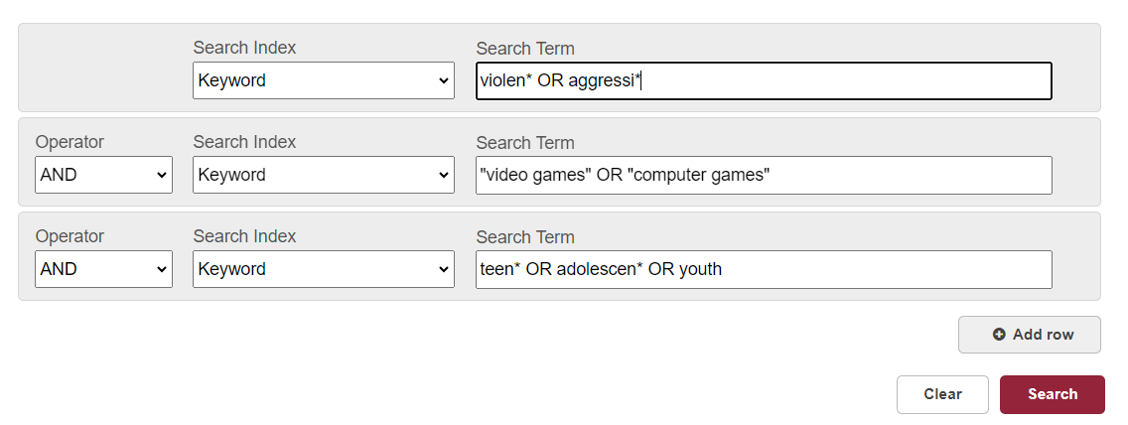
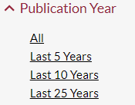
Searching in Sofia
Select Advanced Search
Search strategy:
This search retrieves 495 articles & 86 books.
Use the facets on the left to refine your search:
Format: article or book
Content Type: Peer Reviewed
Publication Year: last 10 years
Language: English (optional)

Slide 14
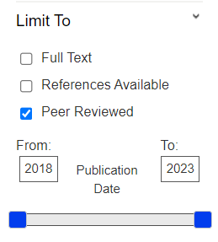
Searching in databases
Select a database: Academic Search Complete
Search strategy:
Use the facets on the left to refine your search:
Peer-reviewed
Date range: 2018-2023
Language: English (optional)

Slide 15
Evaluation Criteria
Purpose/audience
Authority/authorship
Currency/timeliness
Coverage/relevance
Accuracy/documentation
Objectivity/thoroughness

Slide 16
Evaluation of Resources
Purpose/audience
What is the purpose of the document?
Why was it created? To entertain? To sell? Click bait? To persuade? To inform? To advance knowledge?
Who are the intended readers? Experts/scholars? General public? Children?
Is the readership level appropriate for your research?
Authority/authorship
What are the credentials/expertise & organizational affiliation of the author/creator? Affiliation: University? Learned society?
For journal articles: Is it peer-reviewed?
Who is the publisher of the journal or book?
University press? Academic press? Learned society? Professional association? Governmental organization?
All are appropriate for academic essays
If you cannot find information regarding the authority of the author or publisher, you should not use the source.

Slide 17
Evaluation of Resources (cont’d)
Currency/timeliness
When was it published/created/updated?
Is this date appropriate for your topic?
Coverage/relevance
Is the information and content relevant to your research paper or project topic?
Does the source provide a superficial treatment, or a detailed analysis?
Accuracy/documentation
Is the information accurate and does it have bibliographic references?
What are the sources of information used by the author/creator?
Objectivity/thoroughness
Is the material objective and free of advertising, bias, and hidden agendas?
Is the language impartial?
Is the statistical evidence credible?
Conclusions should be based on research and supported evidence.

Slide 18
Citation Styles
MLA Handbook
Full-text electronic version of the MLA Handbook
Use the appendices:
Appendix 2: Citation Examples is a long list of citations for different publication types
Appendix 1: Abbreviations
Appendix 3: Guide to English Grammar
Appendix 4: Sample Papers in MLA Style
Chicago Manual of Style
Full-text electronic version of the Chicago Manual
Part Two: Style and Usage
Part Three: Documentation
Documentation I: Notes & Bibliography
Documentation II: Author-Date References

Slide 19
Help is Available
Library website: help & how-to
Literatures in English subject guide
Shorter citation style guides
Ask Us
E-mail form
Chat with our staff
Ask Us Desks at entrance to Webster Library on LB2
Ask Vince:
Pease use email only: vince.graziano@concordia.ca
Office hours: by appointment, in-person or on ZOOM
Many questions can be answered by email
My retirement begins December 1, 2023

