Slide 1
Searching For scholarly information:
Where & How
Library session for ENCS 282
Chloe Lei
Teaching & Research Librarian, Engineering & Computer Science
chloe.lei@concordia.ca
Except where otherwise noted, this presentation is licensed under a CC BY 4.0 license.

Slide 2
Agenda
Where to search?
How to evaluate?
What are scholarly sources?
How to access library tools?

Slide 3
What search tool do you use to find academic information?
Notes:
A warm-up question to the class: What search tool do you use to find academic information?

Slide 4
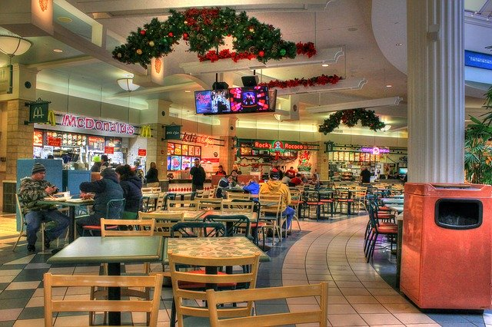

What is the difference?
Google scholar
Library databases
Volume | Quantity | Quick
Depth | Quality | Thorough
Left image: Yinan Chen, Dining Court, public domain, https://pixabay.com/photos/dining-court-shopping-mall-corridor-347314/
Right image: Jason Briscoe, Cooking, public domain, https://unsplash.com/photos/VBsG1VOgLIU
Notes:
Searching in Google Scholar – finding something to eat in a food court : Quick and fast in nature, a lot of results retrieved with a simple search.
Searching in Library Databases – Cooking at home: More nuanced and complex in nature, takes a bit more time.
Speed vs process

Slide 5

Where should you search?
Library Discovery Tool
AI Tools
IEEE Xplore
(Library Database)
Google/Google Scholar
Engineering Village
(Library Database)
Grey literature (e.g. government documents, NGO reports, working papers, newsletters, patents, preprints)
Notes:
Google Scholar’s Inclusion Guidelines: https://scholar.google.com/intl/en/scholar/inclusion.html#overview
Google Scholar Metrics: Google Scholar Metrics Help
The Library definitely feels the impact of AI tools. Among them are questions about finding references and citations that don’t exist, and questions about how to cite contents generated by tools such as ChatGPT.

Slide 6
How is using chatgpt different from googling?
Notes:
Based on your experience, when looking for information, how is using ChatGPT different from using Google?

Slide 7
How are they different?
Google
chatgpt
Information retrieval
Index of web-based information
List-based results, one-way interaction
Retrieve results based on ranking algorithms (e.g. keyword matching, relevance, page linking)
Information generation
Human-like responses to prompts
Conversation-based results, often very persuasive
Generate unique responses based on what it has learned about patterns and sequences of words from massive training datasets
Notes:
Both tools are for general purposes. They both give you information on various topics, but the nature is quite different.
ChatGPT is often very useful for brainstorming ideas and summarizing concepts, however, it is not the best tool for verifying facts and finding articles and sources. As GenAI tools such as ChatGPT are based on statistical models, they don’t really recognize facts, and sometimes have the tendency to hallucinate and make up inaccurate or fake information.
Interesting time with a lot of developments and uncertainties.
AI literacy pertains to understanding AI’s principles, applications, and ethical considerations. It involves not only the ability to use AI tools effectively (e.g. experiment with the tools, what are good uses and not so good uses), but also the capacity to evaluate their outputs critically (e.g. pros and cons, strengths and weaknesses, hallucinations, deepfakes, favour mainstream perspectives), to understand their underlying mechanisms (e.g. bias in training data, inability to recognize logics and common sense), and to contemplate their ethical and societal implications (e.g. environmental impact, labour issues, privacy and security). AI literacy is not just for computer professionals but for everyone.
Evaluating AI Literacy in Academic Libraries: A Survey Study with a Focus on U.S. Employees
https://crl.acrl.org/index.php/crl/article/view/26409/34344 .

Slide 8
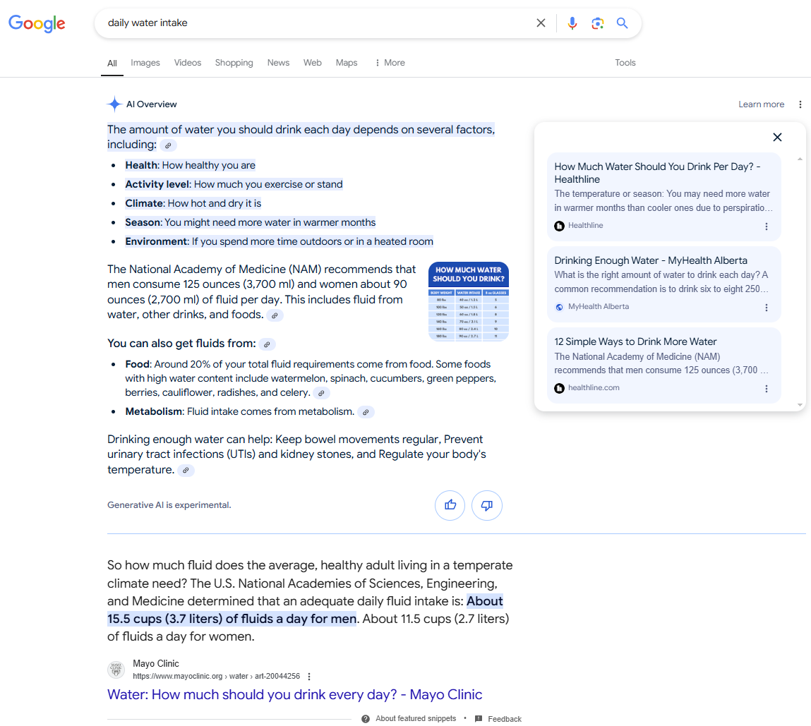

The search as we know it is changing
GenAI-powered functionality is being introduced in major search engines such as Google and Bing
The AI Overview does point to actual links, but the summary is subject to hallucination/confabulation
Google has the disclaimer “Generative AI is experimental” in its AI Overview

Slide 9
Acknowledging the use of AI tools or AI-generated content
Be transparent and document the process
Acknowledge functional uses (e.g. edit a passage, generate an outline, summarize an article) of AI tools where appropriate (e.g. Introduction, Declaration, Method).
Provide a citation whenever you paraphrase, quote, or incorporate into your own work any content (e.g., text, image, data) that was created by AI tools.
  Include the prompt used in the text. For long responses and interactions, provide it as an appendix or as a direct link (via a browser extension like ShareGPT or A.I. Archives)
  An example in IEEE style:
When prompted with “Is the left brain right brain divide real or a metaphor?” the ChatGPT-generated text indicated that although the two brain hemispheres are somewhat specialized, “the notation that people can be characterized as ‘left-brained’ or ‘right-brained’ is considered to be an oversimplification and a popular myth” [1].
[1] Text generated by ChatGPT, OpenAI, May 21, 2024, https://chat.openai.com/chat.
Adapted from Citing AI-generated content in Chicago Manual of Style and a FAQ in Chicago Manual of Style.
Notes:
There is currently no official stylistic recommendations from IEEE for referencing AI-generated content. IEEE citation style requires any citation and style issues not covered by its own style manual to be addressed using the Chicago Manual Style.
Here is the FAQ in Chicago style addressing citing AI-generated content: https://www-chicagomanualofstyle-org.lib-ezproxy.concordia.ca/qanda/data/faq/topics/Documentation/faq0422.html
For comparison, here is APA style’s take on citing AI-generated content: https://apastyle.apa.org/blog/how-to-cite-chatgpt

Slide 10
Evaluating information
strategies and considerations
Notes:
Misinformation and disinformation are not unique to AI tools. It has been a problem way before ChatGPT came along.
No matter where you find the information, it is important to examine it and think about the accuracy, credibility, and reliability side of things. Ease, Speed, Popularity does not necessarily equal to Accuracy, credibility, reliability.

Slide 11
Think, pair, share
Talk to the person next to you for 5 minutes:
What are some ways to ensure that the information you find online is accurate and reliable?

Slide 12
evaluating internet information
What do fact checkers do?
Spend more time scanning the snippets on the results page before clicking
Know what you read before you read it
More lateral reading than vertical reading
Caulfield, M. (2019, June 19). SIFT (The Four Moves). Hapgood. https://hapgood.us/2019/06/19/sift-the-four-moves/
Wineburg, S., & McGrew, S. (2019). Lateral Reading and the Nature of Expertise: Reading Less and Learning More When Evaluating Digital Information. Teachers College Record, 121(11), 1–40. https://doi.org/10.1177/016146811912101102
Notes:
Fact checkers check claims on the internet, such as Do You Need Eight Glasses of Water Per Day? https://www.snopes.com/fact-check/water-works-2/
In the Wineburg & McGrew (2019) study, participants were asked to evaluate articles about bullying on the websites of the American Academy of Pediatrics (“the Academy”) and the American College of Pediatricians (“the College”). Despite the similarity in names, the two organizations could not be more different.
Fact checkers tend to get a sense of the information neighbourhood on the results page before clicking, top results aren’t necessary the most accurate results.
If you are unsure of an author or organization, before even reading the article on the website closely, look it up early on, it’d help you whether you should even spend time on reading it.
Lateral reading is to leave a website and open a new tab to verify certain things on the original website. It is counter-intuitive, but if you want to understand a website better, you need to leave it.
Additional sources:
Stanford History Education Group, Civic Online Reasoning, https://cor.stanford.edu/
CrashCourse (2020), Navigating Digital Information: https://www.youtube.com/playlist?list=PL8dPuuaLjXtN07XYqqWSKpPrtNDiCHTzU
Civix, https://newsliteracy.ca/

Slide 13


BE MORE INTENTIONAL
Consider these factors as much as possible
Who is behind the information?
What is the evidence?
What do other sources say?
Who is the intended audience?
What is scope/depth/breadth?
How current is the information?
Do the sources confirm or contradict with your prior beliefs?
Caulfield, M. (2019, June 19). SIFT (The Four Moves). Hapgood. https://hapgood.us/2019/06/19/sift-the-four-moves/
Wineburg, S., & McGrew, S. (2019). Lateral Reading and the Nature of Expertise: Reading Less and Learning More When Evaluating Digital Information. Teachers College Record, 121(11), 1–40. https://doi.org/10.1177/016146811912101102
Notes:
Other than considerations about the source itself, sometimes a healthy dose of self-reflection can help you understand your own prior beliefs and/or bias. For example, keywords matter when you are searching, e.g., coffee consumption benefits vs coffee consumption risks could get you different search results.

Slide 14
types of information sources
What is considered scholarly?

Slide 15
Navigating scholarly information
Answer poll questions on Mentimeter

Slide 16
Contextualize the problem with information
You need to design a playground for a neighbourhood
Economical
Environmental
Political
Legal
Social
Cultural
Historical
Government data and statistics
Trade magazines
Photos
Encyclopedias
Materials properties
Books
Handbooks
Standards and codes
Conference proceedings
Maps
Technical reports
Research articles
Van Epps, A., & Cardella, M. (2013). Scout the lay of the land: Understanding the broader context of a design project. In M. Fosmire & D. Radcliffe (Eds.), Integrating Information into the Engineering Design Process (pp. 101-114). West Lafayette: Purdue University Press.
Notes:
For designing a playground, some possible questions:
-The appeal of the playground. Will children want to go there?
-Location within the neighborhood. Will families walk or drive?
-How much parking is available?
-Places for parents to sit
-Shade
-Ability to accommodate activities for children of different ages, activities that children of different ages can do together, and activities that keep 10 to 15 children occupied at the same time
-Bathrooms, and possibly water fountains
Some examples of contextual information include city or county building and zoning ordinances, culture of the community near the proposed location, budget, existing site conditions (grass, asphalt, pitch, drainage), local climate, and accessibility of the site for workers and future users. Various questions or considerations around budget can produce additional constraints or opportunities in a design project, be it finding additional or different equipment, or using a contractor or local volunteers for construction and/or installation.
Too narrow or specific to find any information, then step back
Not all are scholarly information, not everything is perfect presented the way you want it
Sometimes information is simply not available, or you need to consult the community directly, or access to any company intranets

Slide 17
library discovery tool
The main library search tool
Notes:
A demo on the website.

Slide 18
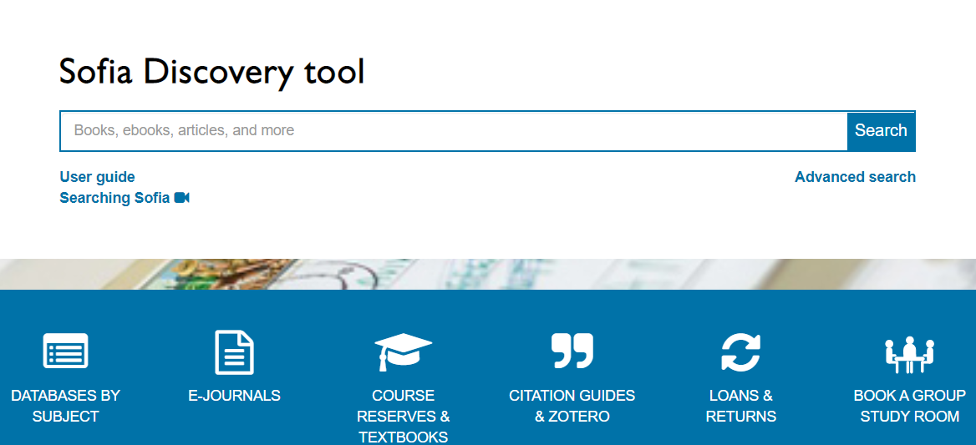
library discovery tool
Front and centre on the library homepage
A good starting point for a general search across library resources
Answer questions such as:
  Does the library have this book?
  Does the library have this journal article?
  Does the library have some background/overview information on a topic?
Notes:
An example of a title search: Work, health and wellbeing in the construction industry (ebook available)

Slide 19
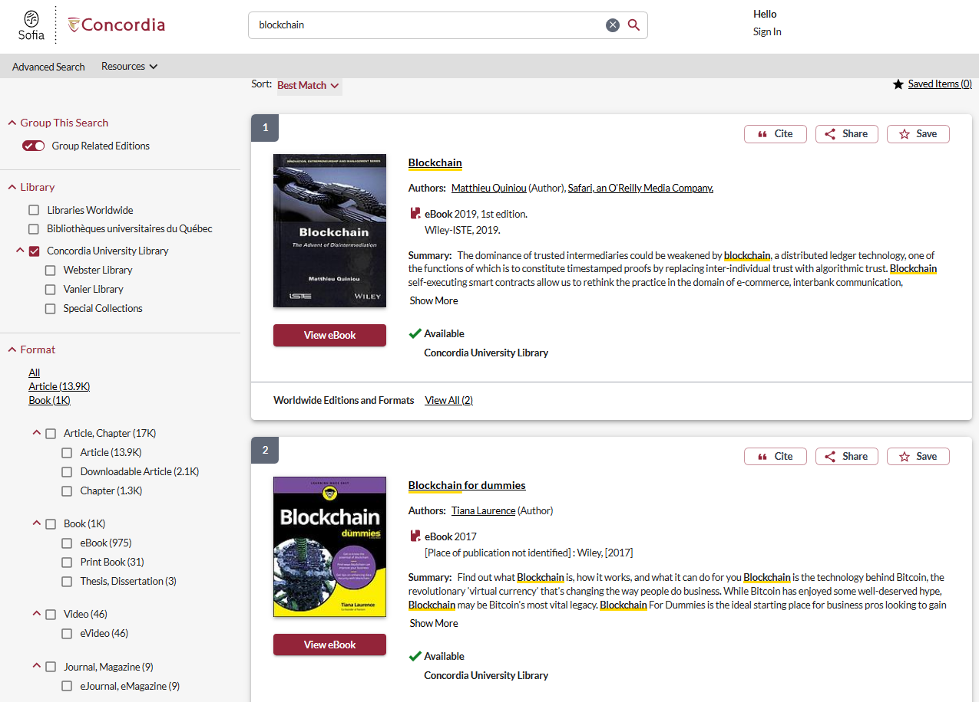
library discovery tool
A search for a broad keyword such as blockchain
Refine options include:
  Format types (e.g. ebooks)
  Publication years
Shows results with Concordia full text access by default
  Easily expand to other university libraries in Québec or Worldwide
  Easily make requests for items from other university libraries
Notes:
An example search for the topic: lithium battery

Slide 20
Library databases
Over 400 of them organized by discipline

Slide 21






Library databases
Content is usually more in-depth and specialized
More options to search, expand, or refine
Answer questions such as:
  Where can I find journal articles on a specific aspect of a topic
  How can I combine different elements/keywords in a search?

Slide 22
Engineering village
A closer look at an engineering database

Slide 23
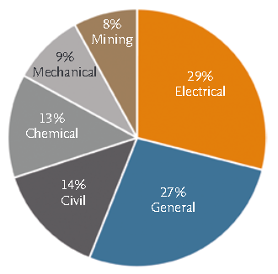
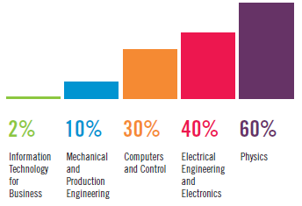
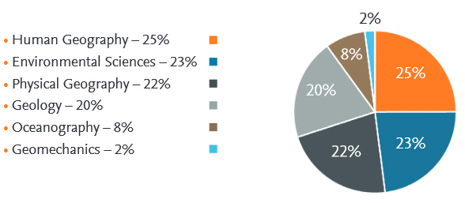
What content is included?
With a coverage of 1884 to the present, the three indexes Compendex, Inspec, and GEOBASE provide content in general engineering as well as more specialized engineering disciplines.
Compendex
Inspec
GEOBASE
Notes:
Sources:
https://www.elsevier.com/__data/assets/pdf_file/0011/56378/Ei-Compendex-factsheet.pdf
https://www-engineeringvillage-com.lib-ezproxy.concordia.ca/search/cvp/display.url
https://www-elsevier-com.lib-ezproxy.concordia.ca/__data/assets/pdf_file/0004/56407/IET-Inspec-factsheet.pdf
http://www.theiet.org/resources/inspec/about/
https://www.elsevier.com/__data/assets/pdf_file/0003/56424/Geobase-factsheet.pdf

Slide 24
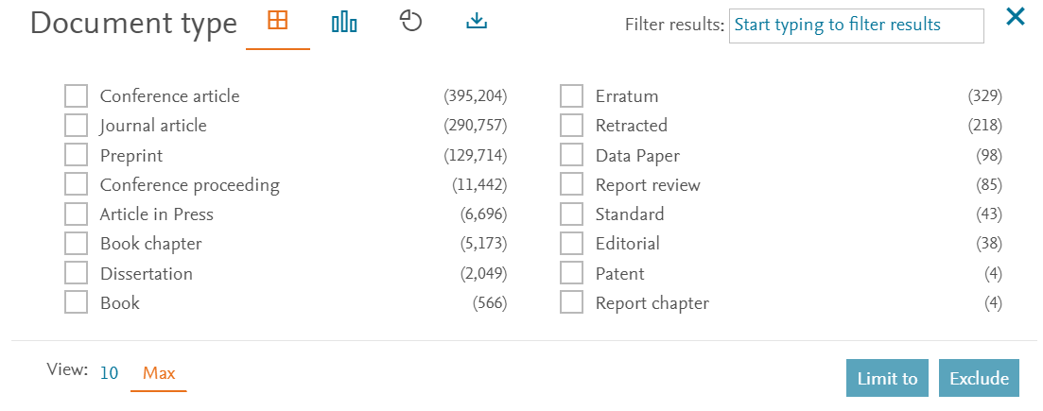
Is the content peer-reviewed?
Journal articles are peer-reviewed
Some conference articles/proceedings are peer-reviewed
Recently, preprints have been included in the results in Compendex
Preprints are NOT peer-reviewed, but are helpful in exploring the latest papers
Notes:
https://www-elsevier-com.lib-ezproxy.concordia.ca/solutions/engineering-village/content/selection-criteria

Slide 25
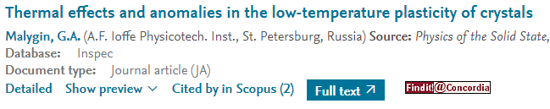
How to access full text?
Full text may be readily available. If not, the “Find it @ Concordia” button can help check for full text availability in the library.
  “Full text” button, if one exists
  “Find it @ Concordia” button to check the library’s other subscriptions. If not available, request it via Interlibrary Loan.

Slide 26
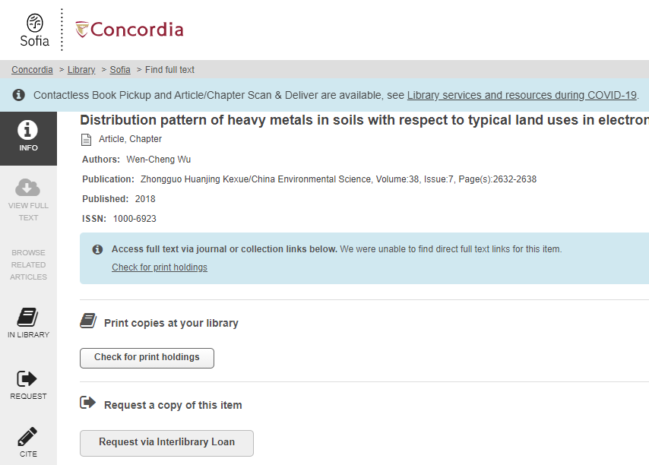
Interlibrary loan
If Concordia Library doesn’t have it, use Interlibrary Loan
Takes a few days or longer to process depending on the item

Slide 27
A quick demo of engineering village
Notes:
Keywords: playground design
Limit to:
-Journal articles
-Urban planning, design (Controlled vocabulary)
-Canada

Slide 28

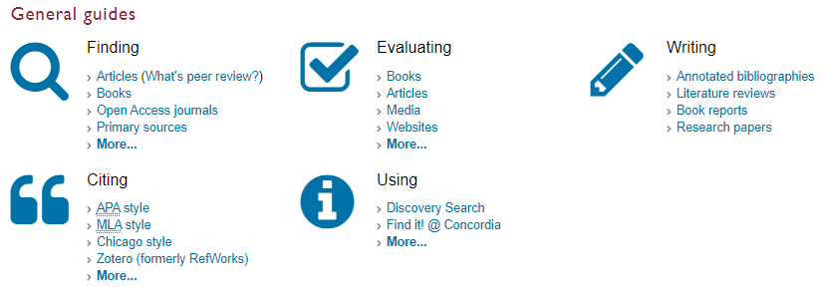
Help & how-to guides
Subject guides are available for all schools, including one for Engineering and Computer Science.
General guides cover various topics from peer review articles to annotated bibliography.
Notes:
https://library.concordia.ca/help/

Slide 29
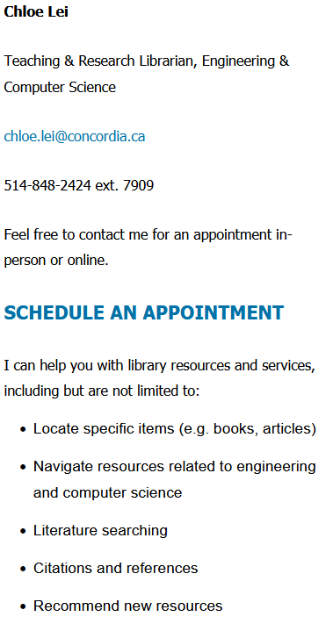
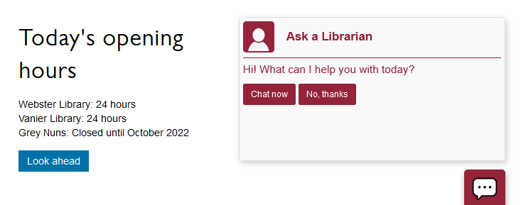
Ask a librarian
Contact the library in-person, by email, chat, or phone.
Contact your subject librarian (that’s me!)
Notes:
https://library.concordia.ca/help/questions/

Slide 30
Questions?

