Slide 1
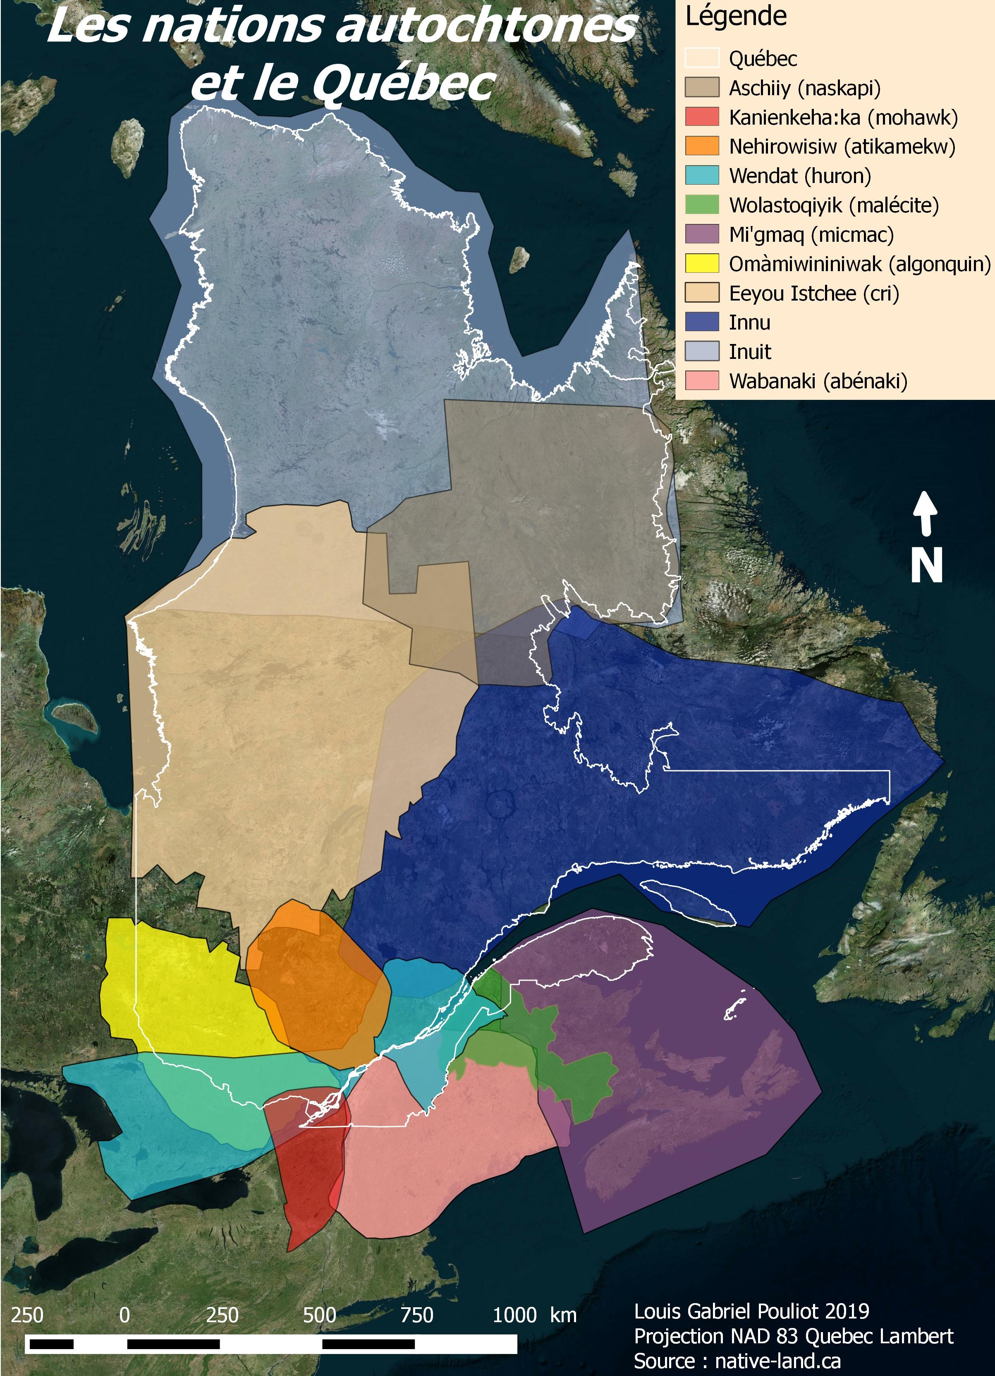

Library Research Workshop
EDUC 445 Fall 2025
Michelle Lake
michelle.lake@concordia.ca
Susie Breier
susie.breier@concordia.ca
Louis Gabriel Pouliot, CC BY-SA 4.0 via Wikimedia Commons

Slide 2
USING THE LIBRARY
WHY BOTHER?
WHAT SHOULD EVERY STUDENT KNOW?

Slide 3

USING THE LIBRARY: GETTING HELP

Slide 4






Getting help in the Library
Ask Us desk, chat, email or phone
FOR QUICK OR GENERAL QUESTIONS
Google: ask concordia library
2) Contact your subject librarian(s)
FOR MORE IN-DEPTH CONSULTATIONS
Icons on this slide are from the noun project

Slide 5
Susie Breier (she/her/elle)
Education Librarian
AskSusie Office Hours
on Zoom
Tuesdays 3:30-5:30 pm
AskUs Desk Fridays 3-5 pm
or by appointment
Email: susie.breier@concordia.ca
FIND ME:
Google:
concordia library education
concordia.ca/library/guides/education

Slide 6
Michelle Lake (she/her/elle)
Government Publications & First Peoples’ Studies Librarian
Ask Us Desk hours:
Wednesdays 3-5pm
Thursdays 12-1pm
Email: michelle.lake @concordia.ca
FIND her:
Google:
michelle lake concordia library
library.concordia.ca/find/government/

Slide 7

TODAY
Using the library / Getting help
Locating Primary & Secondary Sources
Quebec Provincial Resources
Locating Quebec Education Policy
Citing: APA

Slide 8
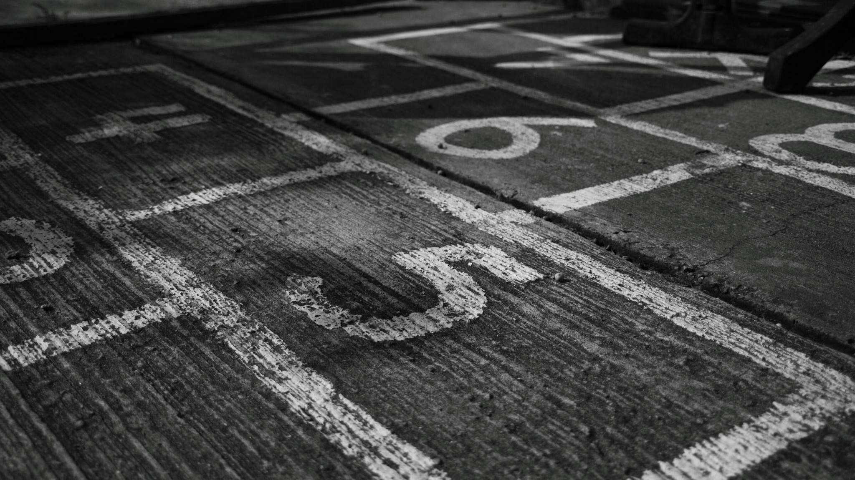
LOCATING PRIMARY & SECONDARY SOURCES – WHAT ARE THEY?

Slide 9
Types of sources
Secondary Sources: works that discuss a subject, but which are written after the time that the event/s occurred (by someone other than an eyewitness) and works that contain explanations/interpretations/analysis/judgments/discussions of past events
Includes:
books and journal articles written by academic researchers, affiliated with universities, colleges and other academic institutions,
usually having gone through a peer review process. Published by university presses and in academic journals.
news and media sources including newspapers, news websites and other media.
Primary sources: first-hand accounts of events, materials created by participants or witnesses of the event/s under study, and original records created at the time that events occurred
Includes:
government publications, legislation & policies, websites or statistics written and published by governments
publications and websites written and published by international organizations, non-governmental organizations, & independent institutions
data
news and media sources including newspapers, news websites and other media.
Adapted from UTSC Library

Slide 10
START WITH
SECONDARY SOURCES
THEY MAY POINT YOU TO RELEVANT PRIMARY SOURCES

Slide 11
SECONDARY SOURCES:
BOOKS & ARTICLES

Slide 12
SECONDARY SOURCES –
RESEARCH TOOLS
Sofia – mainly for finding books at Concordia & beyond
Library Databases - mainly for finding articles
Google Scholar - find articles, books, theses
BAnQ Catalogue – mainly for finding books at the BAnQ
AI ???
see also the module: Choosing your Search Tool from our Critical Toolkit for Navigating Information

Slide 13
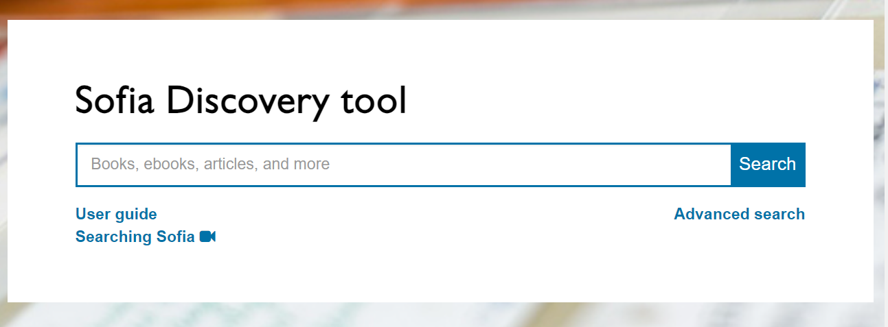
1. Sofia: pros & cons
PRO: great for finding what we have: BOOKS, videos, articles
PRO: easily REQUEST material from Quebec University Libraries and libraries around the world
OK: quick topic searches
CON: often not useful for
advanced or subject-
specific searches

Slide 14


2. Library Databases
historical
America History & Life
INCLUDES CANADA & QUEBEC HISTORY
Current scholarly articles about historical subjects
  JSTOR
  Scholarly articles, including historical

Slide 15
2. Library Databases
mostly current
ProQuest Combined Canadian
Canadian newspapers, magazines, academic journals and more.
Érudit
French & English journals, books, theses and more from Canada, Quebec & France.
Academic Search Complete (EBSCO)
multidisciplinary, mostly scholarly, little Canadian and Quebec content
Education Source & ERIC (EBSCO)
scholarly journals and reports in the field of Education, little Canadian and Quebec content.
You can search all three EBSCO databases COMBINED

Slide 16
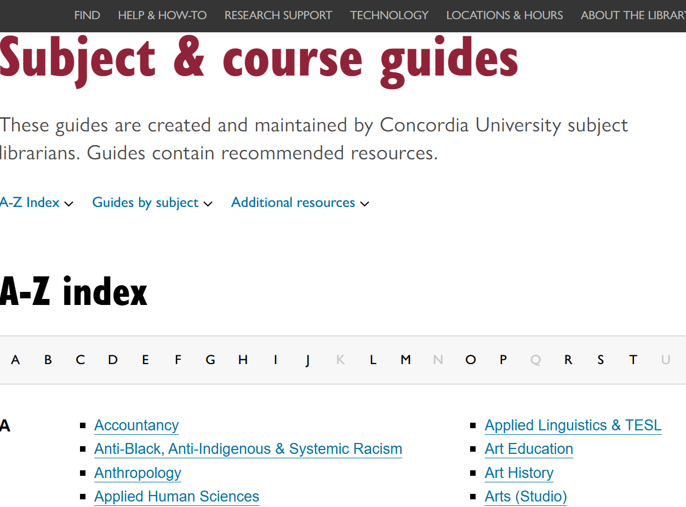
Library Databases - FYI
you can always find more
Concordia Library website:
Subject Guides
  Ex:
  First Peoples Studies
  Education
Specialized Guide:
Government Information –includes SEARCH tool
Database Finder
  Ex: - By content type
  Canadian + Canadian News
  Government Information (all countries)

Slide 17
Library Databases - USING THEM sample search - Advanced Search mode
("institut national d’excellence en éducation" OR "national institute for excellence in education")
AND
(teacher* OR enseignant*)
AND
(training OR formation OR “professional development” OR “développement professionnel” OR competenc*)
see also this handout

Slide 18
3. Google Scholar
U.S.-o-centric, not as good for Canadian and Quebec material
Includes scholarly articles, books, theses
No advanced filters such as source type, but can filter by date
Use “related articles” or “cited by”
Can set it up to access Concordia online resources

Slide 19
Comparison
Library Databases vs Google Scholar
("institut national d’excellence en éducation" OR "national institute for excellence in education")
AND
(teacher* OR enseignant*)
AND
(training OR formation OR “professional development” OR “développement professionnel” OR competenc*)
("institut national d’excellence en éducation" OR "national institute for excellence in education") (teachers OR enseignants) (training OR formation OR “professional development” OR “développement professionnel” OR competencies)

Slide 20
Search strategies: Boolean operators and more
LIBRARY DATABASES (EBSCO etc)
GOOGLE SCHOLAR
use OR for alternative terms / ideas / synonyms
use quotation marks " " for phrases
use AND to combine concepts
use * to substitute word endings
use OR for alternative terms / ideas / synonyms
use quotation marks " " for phrases
DON'T use AND (it is implied)
DON'T use * (happens automatically)

Slide 21

why does it matter where you search?

Slide 22
PRIMARY SOURCES

Slide 23
PRIMARY SOURCES - HISTORICAL RESEARCH TOOLS
Google? + AI ??? + Wikipedia!
BAnQ numérique ( search tool for Québec historical digitized books, maps, journals, magazine, photographs)
BAnQ Histoire du Québec et patrimoine (the same digitized resources, organized by category):
    Revues et journaux québécois
    Les Lignes du temps du Québec
    Livres imprimés et anciens
See all the resources on the slides below – Quebec Provincial Resources & Locating Quebec Educational Policy

Slide 24
PRIMARY SOURCES - HISTORICAL CONCORDIA LIBRARY RESEARCH TOOLS
Canadiana online (digitized books, newspapers, government documents, and other primary sources chronicling Canada’s history and heritage.)
From the Canadian History Subject Guide: Primary Source Databases

Slide 25
PRIMARY SOURCES- CURRENT
CONCORDIA LIBRARY RESEARCH TOOLS
  Canada Commons (includes reports from Canadian public policy institutes, government agencies, advocacy groups, university research centres, think-tanks, and other public interest groups)
  Canadian News Databases - try especially:
    Canadian Newsstream
    Eureka

Slide 26
TODAY update #1
Using the library / Getting help
Locating Primary & Secondary Sources
Quebec Provincial Resources
Locating Quebec Education Policy
Citing: APA

Slide 27
Quebec Provincial Resources Part 1
Histoire de l’éducation au Québec: grands textes politiques et legislatifs (1791 onwards)
Documents politiques et parlementaires du Québec (1608 onwards )
Publications Québec: Laws and regulations
LégisQuébec: Annual Statutes, Annual Regulations (1994 onwards)
HeinOnline Database: Statutes of Québec (1845 onwards) - searchable
Annual Laws of Quebec & Lois Annuelles (Recueils) (both 1867 onwards)

Slide 28
Quebec Provincial Resources
Part 2
Quebec National Assembly:
Projets de loi/bills (1996 onwards)
Publications
Journal des débats (general description)
  FIND: débats de l’Assemblée nationale (1908 onwards)
Le travail en commission
  Comission de la culture et de l’education (2011 onwards)
Rapport sur le cheminement des projets de loi présentés à l'Assemblée nationale du Québec

Slide 29
REMINDER from your prof
Useful Québec & Canada Links
Quebec Education Act: Légis Québec
MEES Basic School Regulations: also from Légis Québec
QPAT Information (including the 2024 updated collective agreement): https://qpat-apeq.qc.ca/technical-meetings/collective-agreement-2023-2028/
Canadian Charter of Rights and Freedoms: https://www.justice.gc.ca/eng/csj-sjc/rfc-dlc/ccrf-ccdl/
Quebec Charter of Human Rights and Freedoms: C-12 - Charter of human rights and freedoms
Quebec Charter of Human Rights and Freedoms (kid-friendly): Charter of Human Rights and Freedoms | CDPDJ

Slide 30
TODAY update #2
Using the library / Getting help
Locating Primary & Secondary Sources
Quebec Provincial Resources
Locating Quebec Education Policy
Citing: APA

Slide 31
Locating Quebec Education Policy

Slide 32
What is policy?
The Education policy in each province is meant to ensure that a structure is in place which will allow for the development of the personal capacities of each individual. The educational structure will also facilitate the development of those skills needed by society, and inculcate and foster those values advocated by the community.
Educational policy is formulated alongside other government policies and in accordance with meta-policies which governments endorse at any particular time.
Education Policy – Canadian Encyclopedia

Slide 33
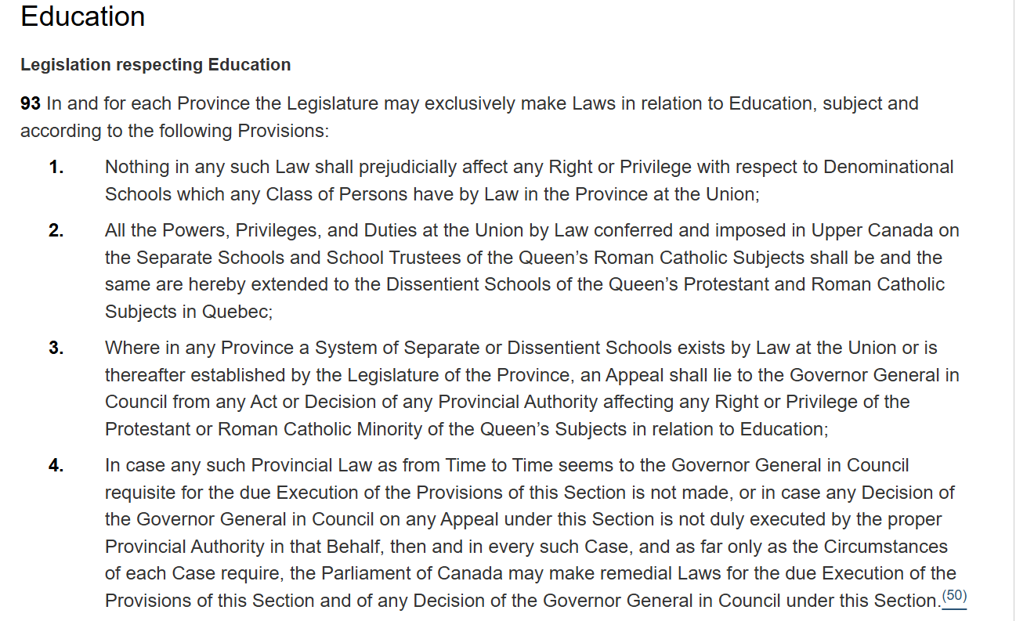
Canadian Constitution and the Charter of Rights & Freedoms
The Constitution is the supreme law of Canada; all other laws must be consistent with the rules set out in it. If they are not, they may not be valid.
Constitution Act, 1867, 30 & 31 Vict, c 3 at s 93 (UK), reprinted in RSC 1985, Appendix II, No 5.

Slide 34
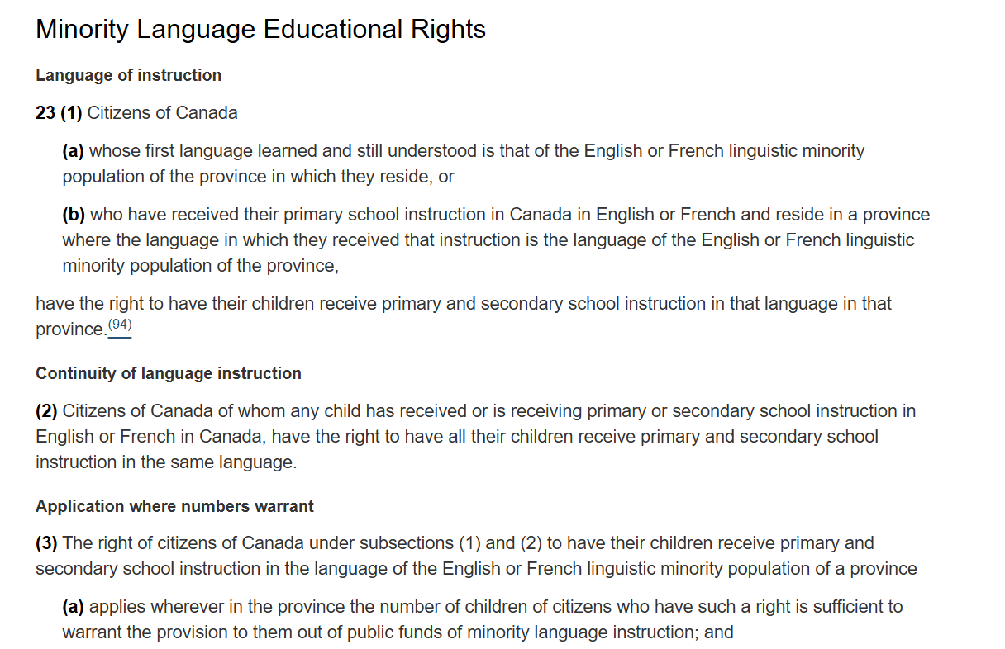
Constitution: Charter of Rights & Freedoms
Since the Charter of Rights & Freedoms is part of the Constitution of Canada, it is the most important law we have in Canada.
Canadian Charter of Rights and Freedoms at s 23, Part 1 of the Constitution Act, 1982, being Schedule B to the Canada Act 1982, 1982, c 11 (UK).

Slide 35
Quebec Education Act –where does it fit in
Constitution of Canada (Section 93)
Canadian Charter of Rights & Freedoms (Section 23)
Quebec Charter of Human Rights and Freedoms (Sections 40-42)
Charter of the French Language
Education Act (Quebec)
Amendments
Regulations

Slide 36
Glossary
The word “legislation” includes laws and regulations. In Quebec, there are both federal and provincial laws and regulations, as well as municipal bylaws.
Provincial legislative assembly - government/law-making body in a province, in Quebec it is known as the National Assembly
MNA/députés – members of the National Assembly, the legislators
Bill – a proposal to create a new law or change or repeal an existing law
Act (Statute) – a law that has passed through the legislative process and comes into force. A bill becomes an Act (Statute).
Example: Bill 101 became the Charter of French Language, bill numbers are reused in each new session of the legislature
Statutes – collection of Acts: Act, law and statute are all terms that can be used to mean the same thing
Regulation - A regulation is a rule that indicates how a statute is to be enforced, they provide support for the laws, are an instruments of the law
Amendments – modifications or changes to existing laws (acts/statutes)

Slide 37
Legislation (laws & regulations)
Federal laws and regulations: The Parliament of Canada creates federal laws and regulations.
Provincial laws and regulations: The National Assembly of Quebec creates the laws (Acts & Statutes) and regulations of Quebec.
  Regulations: Because our society is so complex, more laws are being enacted today than ever before. If our lawmakers had to deal with all the details of all the laws, the task would be nearly impossible.
  To solve this problem, Parliament and provincial and territorial legislatures often pass laws to give departments or other government organizations the authority to make specific laws called regulations. Regulations carry out the purposes of the general laws or expand on them. They have the force of a law.

Slide 38
Quebec Legislative Process
Public bills are proposed by the government or MNA
A public bill is a bill of general interest (as opposed to a private bill). It applies to the entire population or a significant portion of the population: bills on the minimum wage, on health and safety at work, on education, etc.
Any member of Parliament may introduce a public bill, provided that the bill does not seek to spend state revenues or impose a tax or duty. Only ministers are authorized to introduce a bill with such financial implications.
The Member of Parliament/member of the National Assembly who presents a public bill is referred to as the author of the bill.
In fact, most public bills are prepared and presented by minister in accordance with the legislative programme that the government has set for itself.
A “public government bill”/ « projet de loi public du gouvernement » is a bill introduced by a minister.
A bill presented by a member of parliament is called a "public bill of a member of parliament”/ « projet de loi public de député ».

Slide 39
Quebec Legislative Process
Stages of progress of a public bill - HOW TO LOOK UP A BILL: the National Assembly
The various stages should normally take place at separate sessions of the Assembly.
Presentation: The author of the bill (MNA, minister or députés) submits it to the Assembly so that it can begin its study. Usually, within an hour of a bill being presented, the text can be consulted online, in the list of bills under study .
Committee consultations: This optional step allows MNA’s to learn the opinions and real needs of the people or organizations affected by a bill. To do this, the Government House Leader proposes that the bill be sent to a parliamentary committee for consultations.
Adoption of the principle: at this stage, the MNA’s debate in the Assembly the spirit and principle of the bill.
Detailed study in committee: the study of the bill continues in parliamentary committee or in plenary committee (which brings together the 125 MNA’s of the Assembly). The choice of committee is made according to the scope of the committees' competence ; its members examine each of the articles of the bill.
Consideration of the committee's report: The Assembly decides on the results of the committee's work. It must adopt this report for the bill to proceed to this stage.
Adoption of the bill: this is the last stage of the study of a bill before its sanction.
At stages 4, 5 and 6, the bill can be amended , meaning that its author (MNA or minister) or another MNA can make changes to it. However, at the final stage, when the bill is adopted, only the author can propose changes.

Slide 40
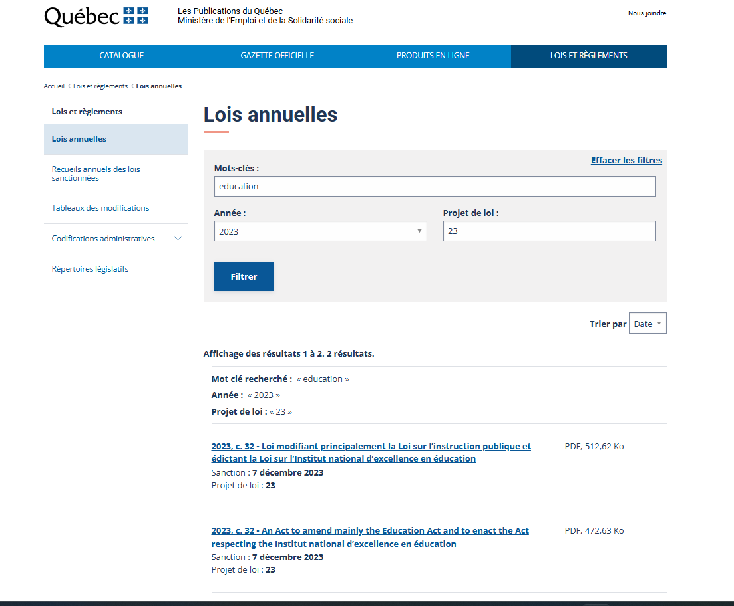
Let’s locate a law

Slide 41
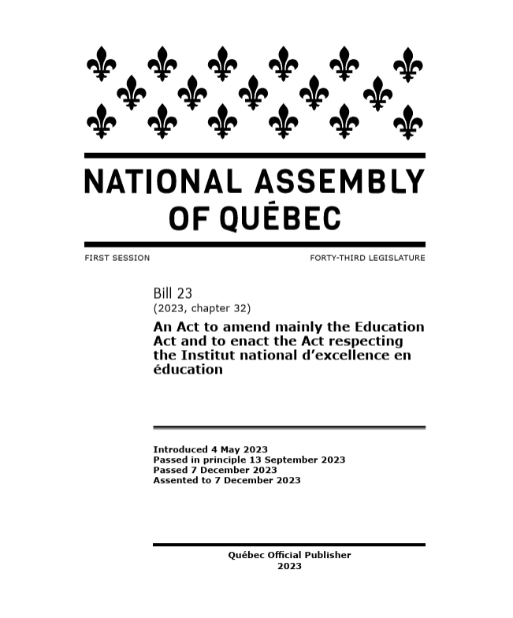
Looking at the Act
When: 1st session of the 43rd legislature of the National Assembly
A Bill is a proposed law presented to the National Assembly, after it goes through the parliamentary process it becomes an Act
What: An Act (law) amending Education Act
Process: the steps the bill goes through in the National Assembly to become an Act

Slide 42
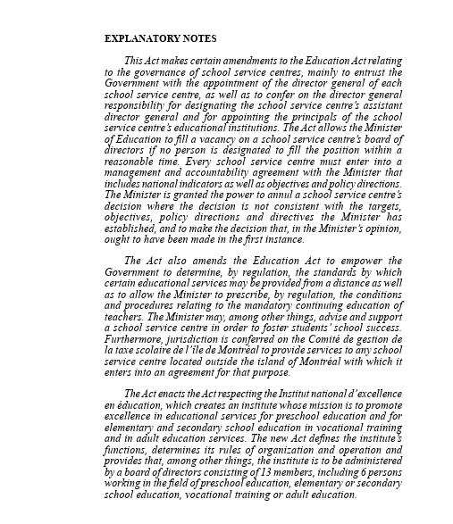
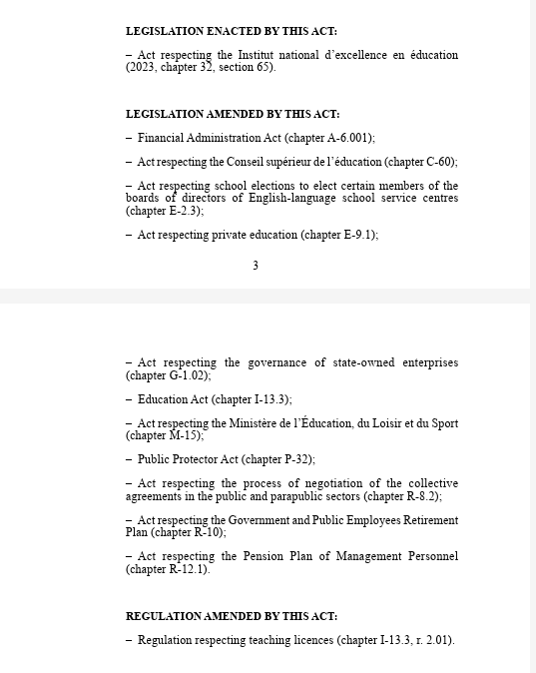
Inside the text of the Act

Slide 43
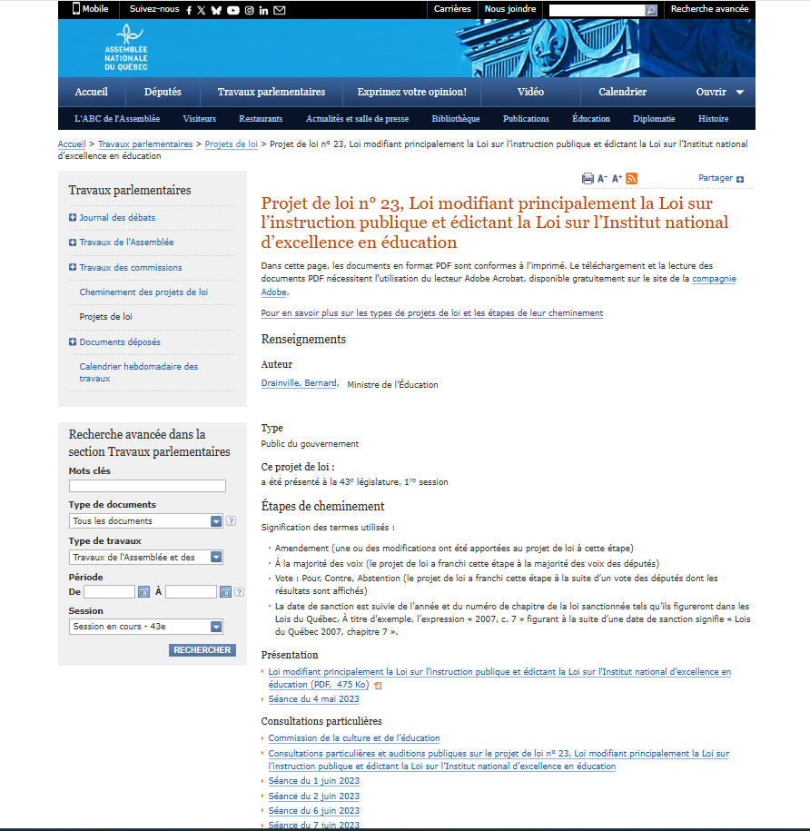
National Assembly website: bill 23 landing page
On the National Assembly website, you can trace a bil/projet de loi through the legislative process
From initial presentation of the bill, through the committee studies and reports, votes, adoption and sanctioning/passing of the law.

Slide 44
Committee Work
Commission de la culture et de l’éducation/Committee on Culture and Education (2011 onwards)
Contains the work of the committee, including detailed studies of bills, public consultations about proposed laws and amendments to laws, reports for the National Assembly to review in the process of bill making
Special consultations and public hearings on Bill 23, An Act to amend mainly the Education Act and to enact the Act respecting the Institut national d’excellence en éducation
  Debates, evidence, memoirs/briefs (from the public and experts), reports

Slide 45
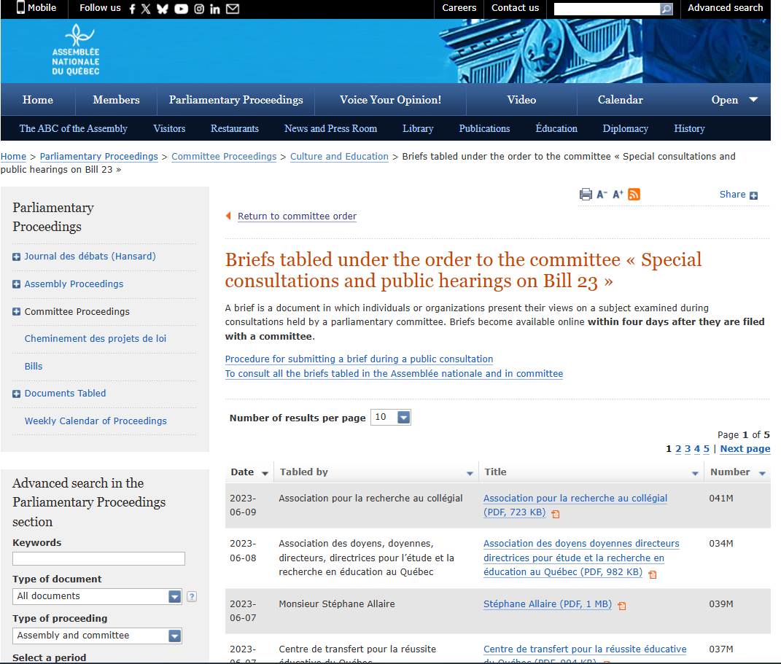
Example of a brief and how it is related to a bill

Slide 46
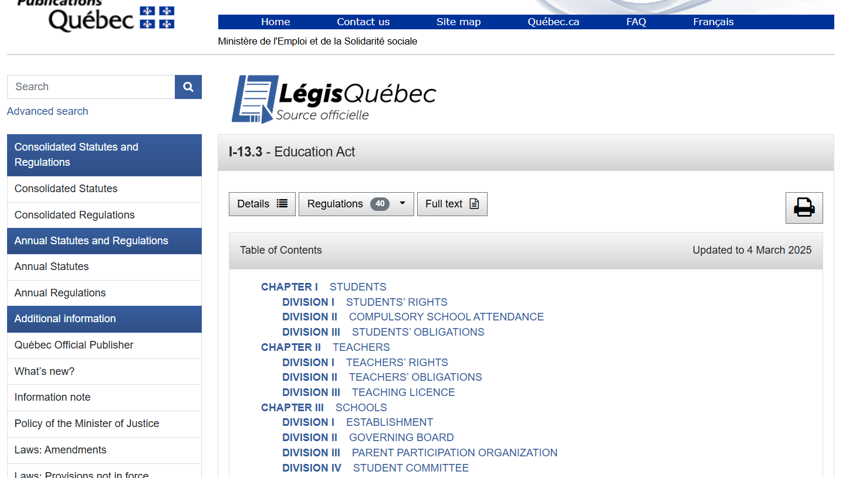
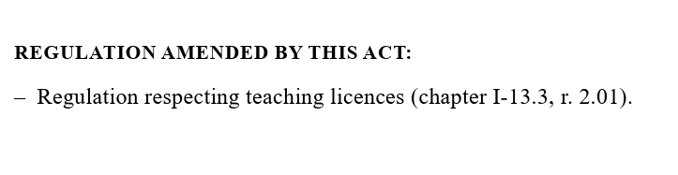
LegisQuebec site: Education Act

Slide 47
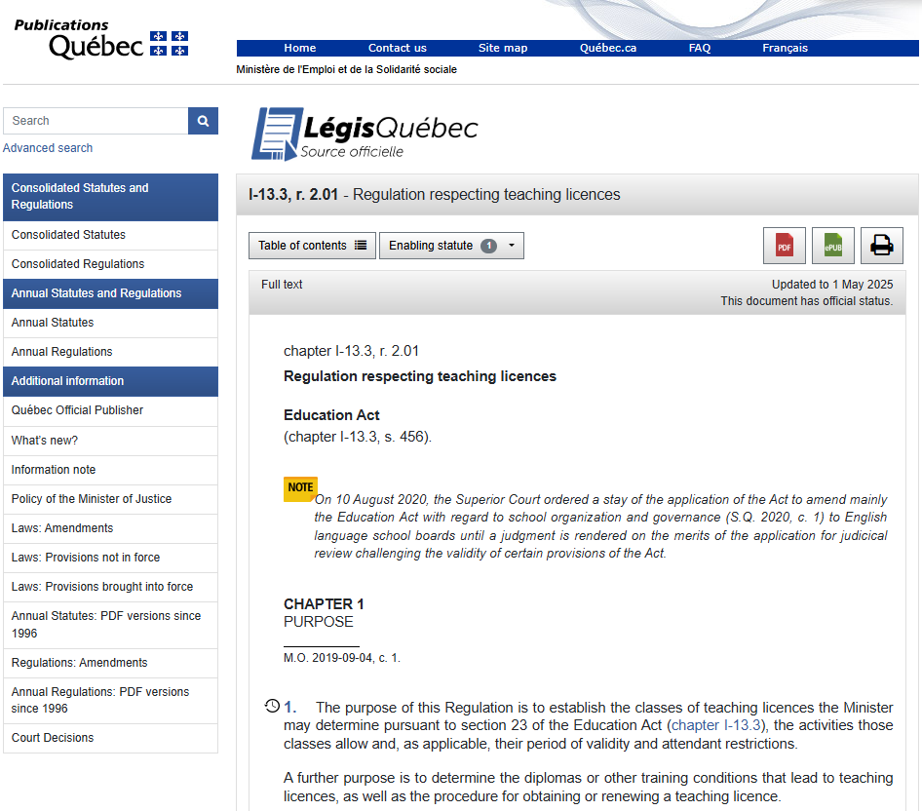
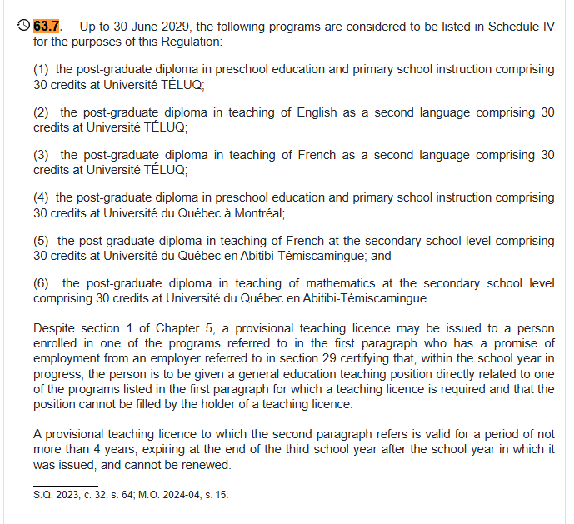



Subsection: regulation respecting teaching licenses

Slide 48
TODAY update #3
Using the library / Getting help
Locating Primary & Secondary Sources
Quebec Provincial Resources
Locating Quebec Education Policy
Citing: APA

Slide 49
APA
Citations & References
Next set of slides adapted from those of Aeron MacHattie​, Teaching & Research Librarian

Slide 50
WHAT IS CITATION FOR?
Making visible the work you put into your research
Giving credit for ideas and following copyright rules
Allowing readers to replicate findings and/or check on accuracy of claims/conclusions
Helping readers follow up on interesting resources
(Situating your voice in the scholarly conversation)

Slide 51
Thoughts about citing and citational practices
MORE THOUGHTS ABOUT CITING
This is a challenge for all of us: Reflect on the way you approach referencing the work of others in your own writing, presenting and thinking. Whose work do you build on to make arguments ... Who are you citing, and why do you cite them (and not others)?
Eve Tuck, K. Wayne Yang, Rubén Gaztambide-Fernández,"Citation Practices" Critical Ethnic Studies, April 2015
See also, from our Critical Information Literacy Toolkit: Who's Citing Whom and Inclusive Voices

Slide 52
CITATION BASICS
CITATION BASICS

Slide 53
HOW, WHEN & WHERE
TO CITE
HOW
Use only one citation style per paper – Iie APA
Use automatic citation generators (optional)
Use a citation style guide
Identify what your source is before you cite it
WHEN
Information or facts that are not common knowledge
    ex. the Eiffel tower is in Paris vs. the Eiffel tower receives 7 million visitors per year
  both “direct quotes” and paraphrasing
WHERE
In-text citations at the end of the sentence
End-of-text citations in a list of sources (References)

Slide 54
MOST IMPORTANT:
Use a CITATION STYLE GUIDE!
Examples:
  APA Formatting and Style Guide (Purdue OWL)
  Citing Canadian government documents: APA style
  Tableau synthèse de références du style APA 7e édition
  (from U Laval, includes publication gouvernementale, Loi et règlement)
  more Canadian government document style guides
  more APA style guides

Slide 55
IN-TEXT CITATIONS
Come at the end of the sentence where you quote or paraphrase a source
Refer the reader to a complete list of sources at the end of your paper

Slide 56
IN-TEXT CITATIONS: DIRECT QUOTES
Hakkinen and Akrami (2014) found that “individuals are receptive to climate change communications, regardless of ideological position” (p. 65).

Slide 57
IN-TEXT CITATIONS: PARAPHRASING
People from any ideological background are open to hearing about climate change (Hakkinen & Akrami, 2014).

Slide 58
END-OF-TEXT: REFERENCES
Come at the end of your paper in an alphabetized list of all the sources you used
Consist of thorough citations containing all information needed to successfully identify each source
Called References in APA style

Slide 59
END-OF-TEXT REFERENCES
APA FORMAT EXAMPLES ARTICLES, CHAPTERS, THESES

Slide 60
APA LAWS, BILLS & REGULATIONS:
Act respecting the Institut national d’excellence en éducation, CQLR chap. I-13.021 (2023). https://www.legisquebec.gouv.qc.ca/en/document/cs/I-13.021
Bill 23, An Act to amend mainly the Education Act and to enact the Act respecting the Institut national d’excellence en education, 43rd Legislature, 1st Session (2023). https://www.assnat.qc.ca/en/travaux-parlementaires/projets-loi/projet-loi-23-40-1.html

Slide 61
APA GOVERNMENT OR NGO REPORTS
Richard, M., & Brassard, C. (2017). Mémoire dans le cadre de la consultation relative à la création d’un institut national d’excellence en éducation (INEÉ) . Université TÉLUQ. https://r-libre.teluq.ca/1353/
Ministère de l’Éducation et de l’Enseignement supérieur du Québec (2017). Pour la création d’un institut national d’excellence en éducation: Document de consultation. https://www.education.gouv.qc.ca/fileadmin/site_web/documents/PSG/politiques_orientations/consultation_institut_excellence-hires.pdf

Slide 62
APA JOURNAL, MAGAZINE, NEWS ARTICLES:
Doherty, T. J., & Clayton, S. (2011). The psychological impacts of global climate change. American Psychologist, 66(4), 265-276. https://doi.org/10.1037/a0023141
Peterzell, J. (1990, April). Better late than never. Time, 135(17), 20–21. https://time.com/archive/6714632/better-late-than-never-3/
Burke, J. (2020, March 26). COVID-19: Uncertainty takes the stage for Montreal Theatre. Montreal Gazette, A4. https://lib-ezproxy.concordia.ca/login?url=https://www.proquest.com/blogs-podcasts-websites/covid-19-uncertainty-takes-stage-montreal-theatre/docview/2383524233/se-2

Slide 63
APA BOOKS:
Peña Devon Gerardo, Calvo, L., McFarland, P., & Valle, G. R. (Eds.), Mexican-origin Foods, Foodways, and Social Movements: Decolonial Perspectives. Fayetteville: University of Arkansas Press.
Notes:
Edited by

Slide 64
APA BOOK CHAPTERS:
Guillen, R. (2017). Growing Justice in the Fields: Farmworker Autonomy and Food Sovereignty. In D. G. Peña, L. Calvo, P. McFarland, & G. R. Valle (Eds.), Mexican-origin Foods, Foodways, and Social Movements: Decolonial Perspectives (pp.235-250). Fayetteville: University of Arkansas Press.
Notes:
Edited by

Slide 65
APA THESIS/DISSERTATION:
Zambrano-Vazquez, L. (2016). The interaction of state and trait worry on response monitoring in those with worry and obsessive-compulsive symptoms [Doctoral dissertation, University of Arizona]. UA Campus Repository. https://repository.arizona.edu/handle/10150/620615
Notes:
Edited by

Slide 66
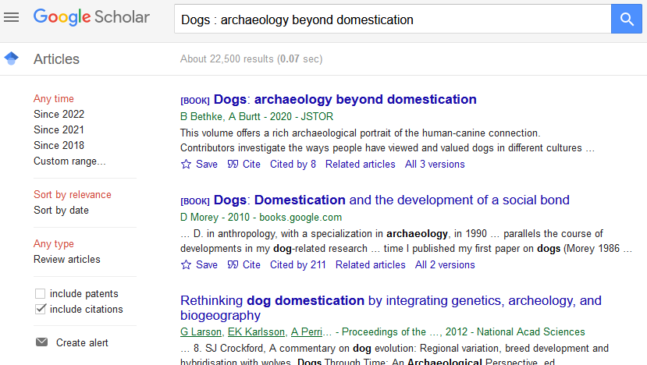
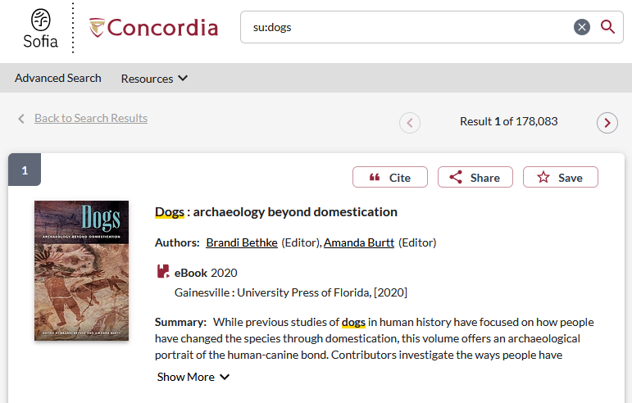

AUTOMATICALLY GENERATED CITATIONS

Slide 67
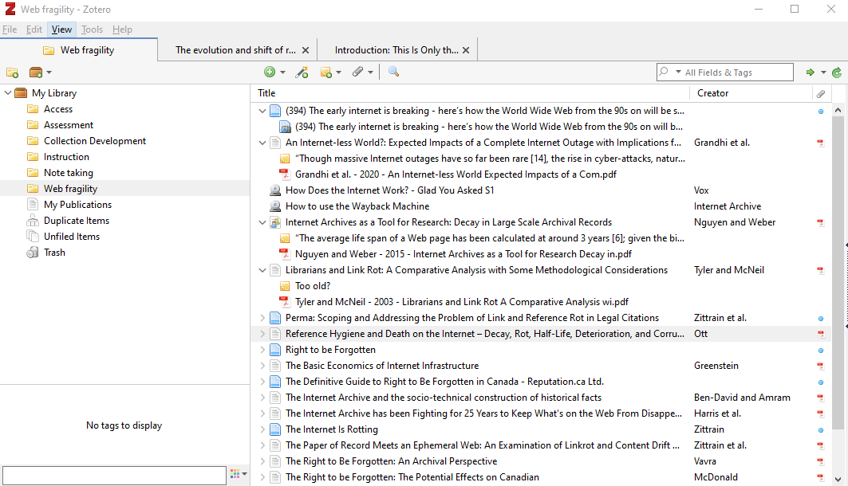
BIBLIOGRAPHIC MANAGERS
Programs that build a database of your research material.
At Concordia we use: ZOTERO

Slide 68
REMINDER:
Use a CITATION STYLE GUIDE!
Examples:
  Citing Canadian government documents: APA style
  Tableau synthèse de références du style APA 7e édition
  (from U Laval, includes publication gouvernementale, Loi et règlement)
  more Canadian government document style guides
  more APA style guides

