Slide 1

LING 473 Advanced Phonology
Library workshop
Éthel Gamache, librarian
ethel.gamache@concordia.ca

Slide 2

Agenda
Ice-breaker activity
Library website, CMLL research guide
Searching Sofia, the Library Discovery tool, and using Interlibrary loans
Searching in databases for scholarly articles
  Academic Search Complete
  Linguistics and Language Behavior Abstracts (LLBA)
  Using Google Scholar
  Activity: explore your source or topic with the class

Slide 3
Ice-breaker activity
I use or have used library services.
I know how to evaluate a source (is it reliable, of good quality?).
When I search for articles, I often find what I’m looking for.
I prefer to use Google / Scholar to find scholarly articles.
I have attended a library workshop before.
I’ve met with a librarian to find relevant sources for an assignment.
Move your fingers
Touch your head
Play air piano
Wave
Take a bow
Clap your hands
This activity was created by K-Lee Fraser, University of Toronto Scarborough, K-Lee's Remixed Information Literacy Games. (unpublished)

Slide 4
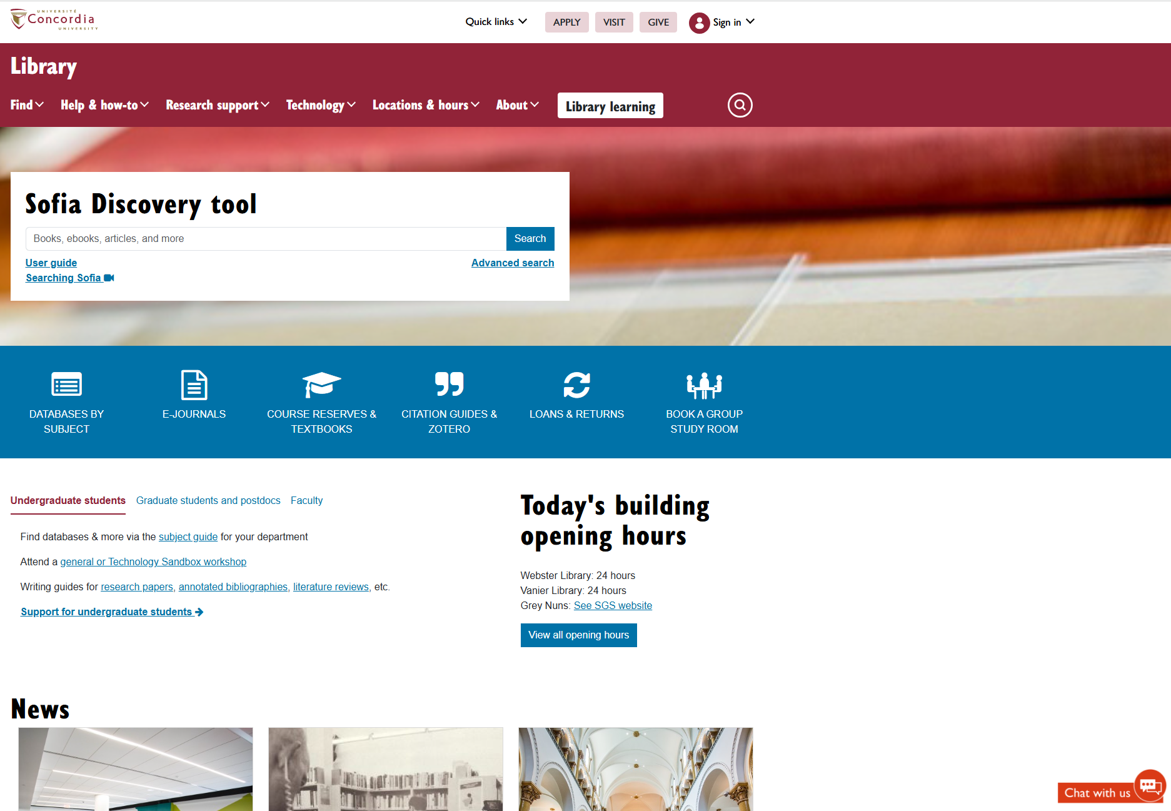
Library website
https://library.concordia.ca/

Slide 5
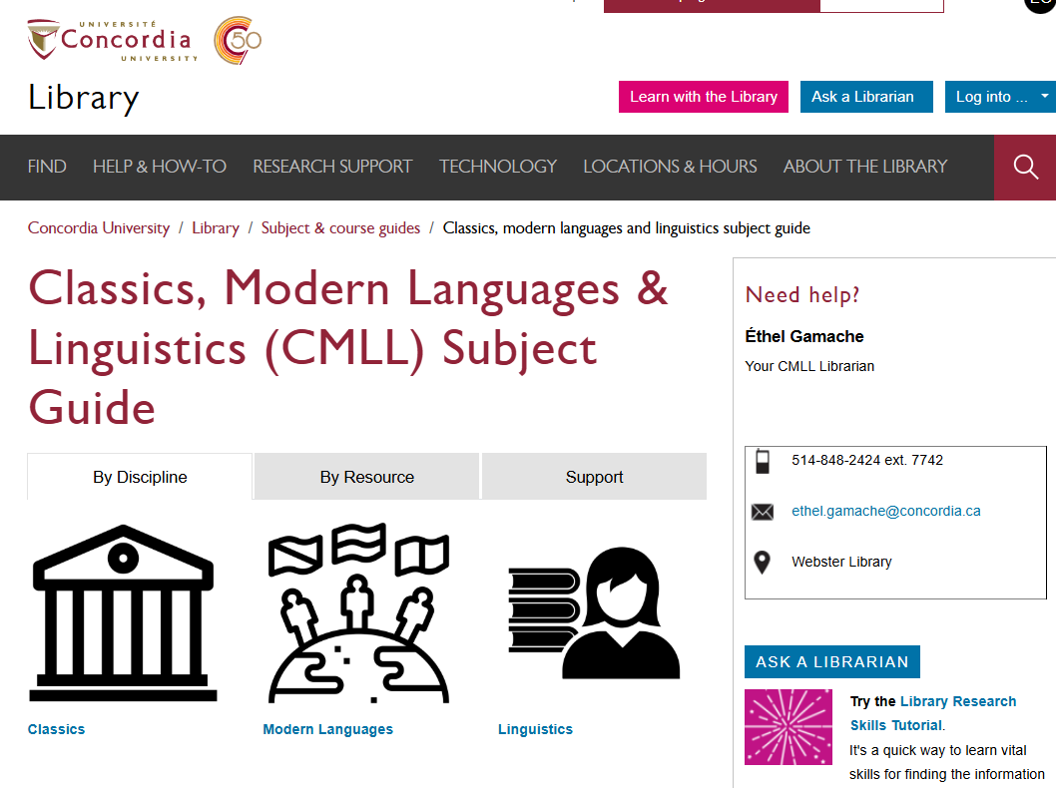
CMLL research guide
https://www.concordia.ca/library/guides/classics.html

Slide 6
Activity
Talk to your neighbour about your research project or a specific interest in phonology.
Discuss 3 keywords that describe it.

Slide 7
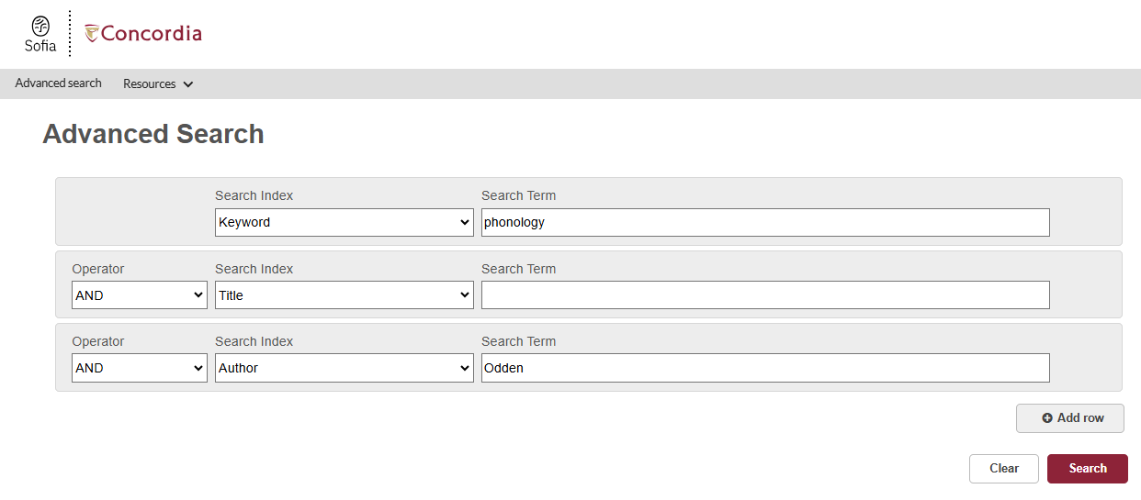
Sofia, the Library Discovery tool
https://concordiauniversity.on.worldcat.org/discovery

Slide 8
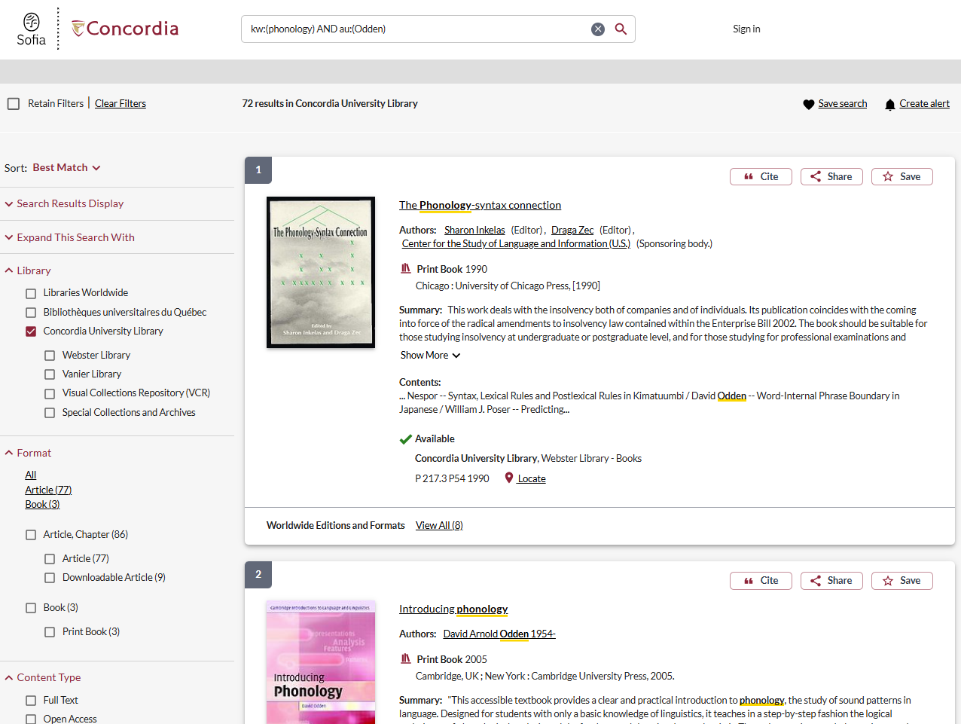
Results page

Slide 9
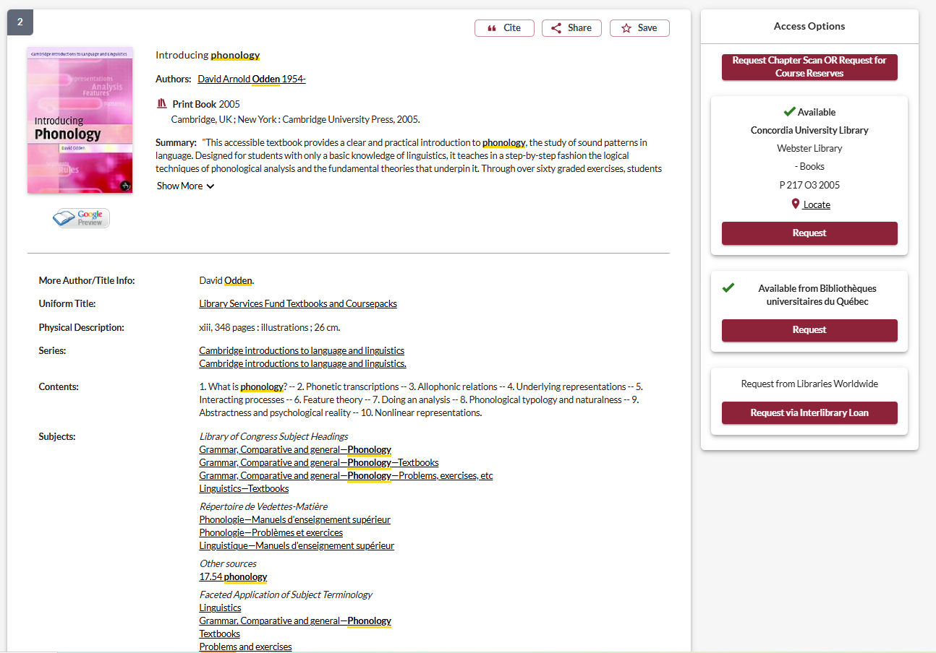
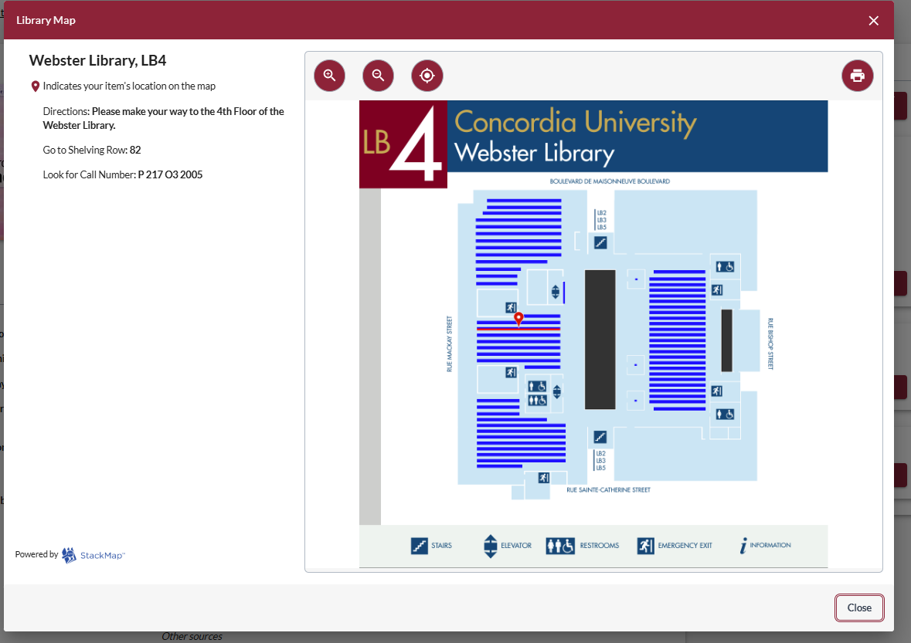

Record page
Notes:
Record page / catalog(ue) record

Slide 10

Requesting a book via Interlibrary loans (ILL) within Sofia

Slide 11


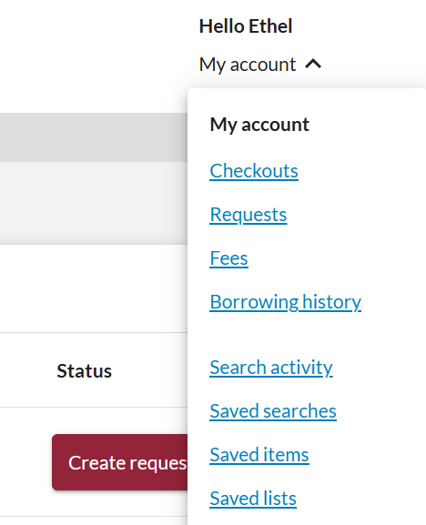

About the Interlibrary Loans (ILL) service
ILL requests are made directly in the Sofia Discovery tool:
“Request via Interlibrary Loan” button
Form available under the “Requests” tab in "My Account".

Slide 12

Concordia article/chapter scan & deliver service
Book chapter and journal article scans from Concordia’s print collection can now be requested and tracked in Sofia.
Look for the “Chapter Scan” button in the Access Options panel.

Slide 13

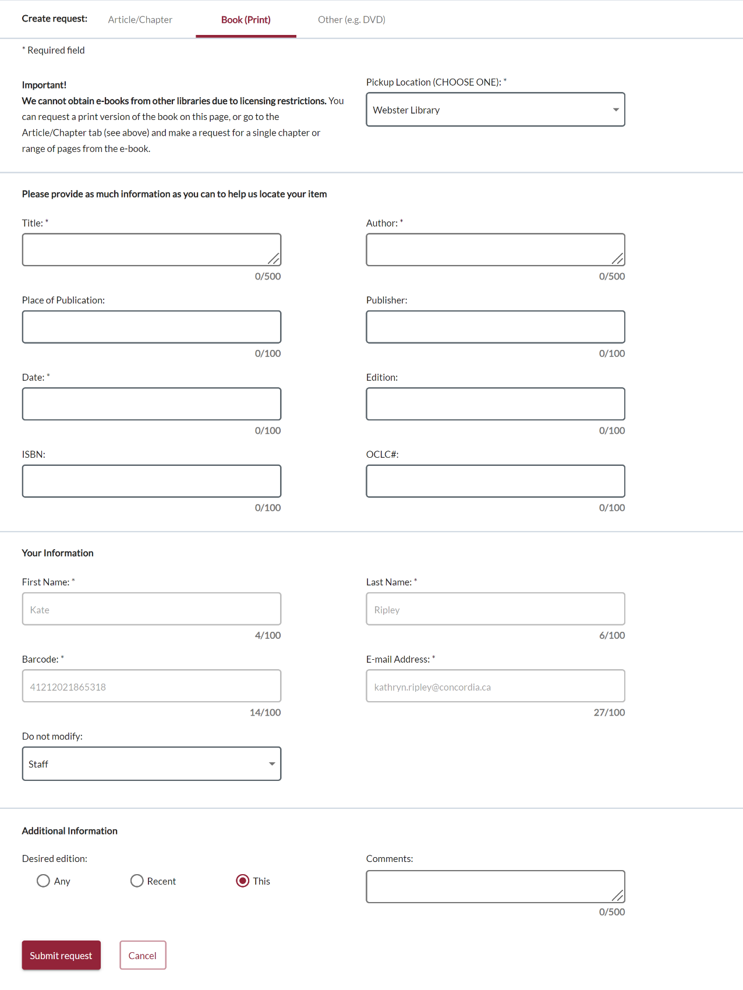
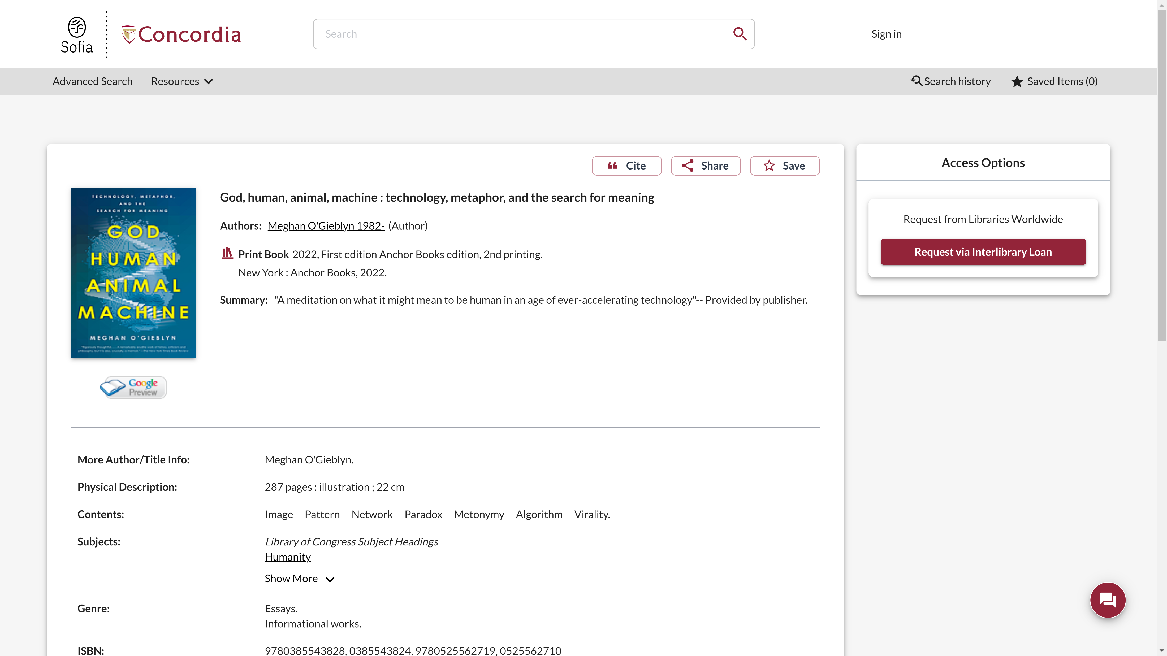
Sofia Discovery Tool request via Interlibrary loan

Slide 14
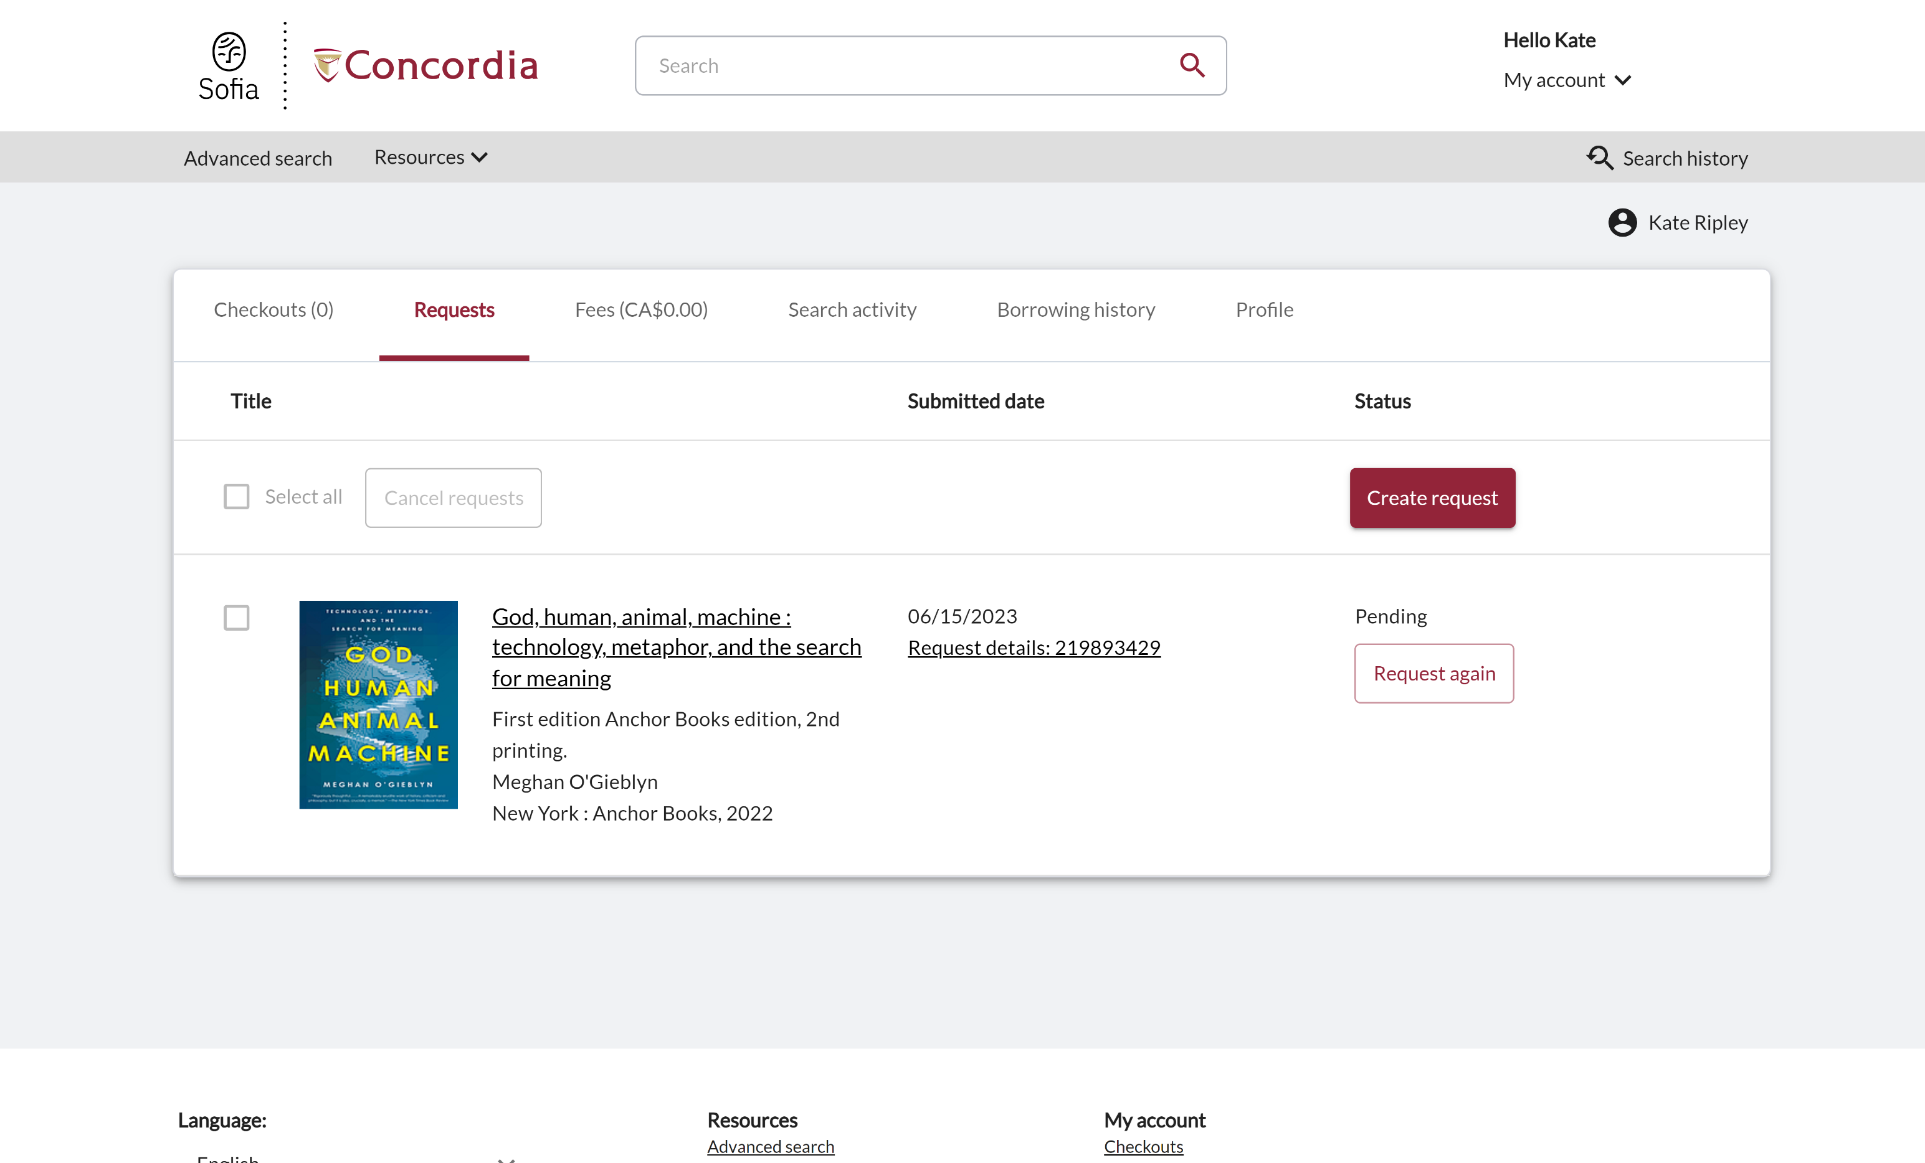
Check the status of your request under the "Requests" tab.

Slide 15
About
Interlibrary loan
You will receive email notifications when your ILL request is available for pickup or download.
Physical items can be picked up at the Circulation/Loans desks at either Vanier or Webster Library.
ILL requests can be borrowed for 30 days, with up to 4 automatic renewals, or until item is recalled. More about Loans

Slide 16

The peer-review process

Slide 17
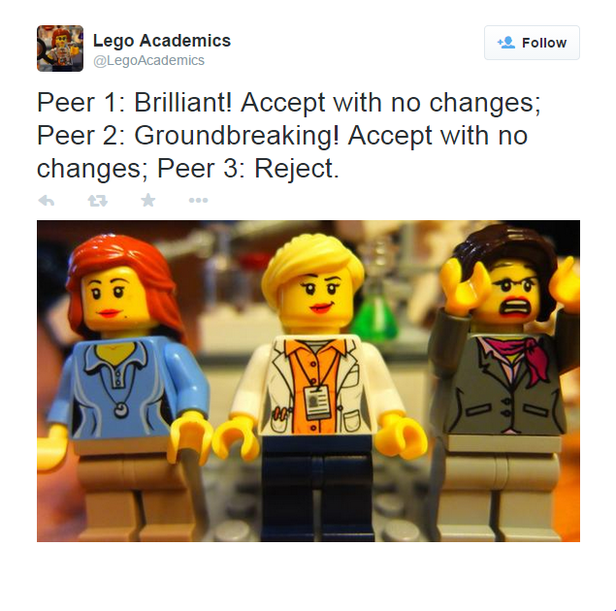
The peer-review process
Peer-reviewed
Referred
Scholarly
Image source:
Yates, D. [@LegoAcademics]. (2014, August 12). Peer 1: Brillant! Accept with no changes; Peer 2: Groundbreaking! Accept with no changes; Peer 3: Reject. [Tweet]. Twitter. https://twitter.com/LegoAcademics/status/499205005468262400/photo/1

Slide 18
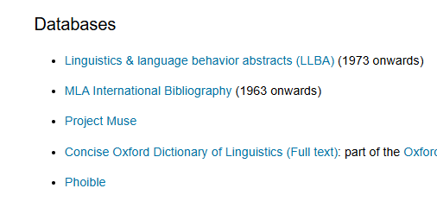
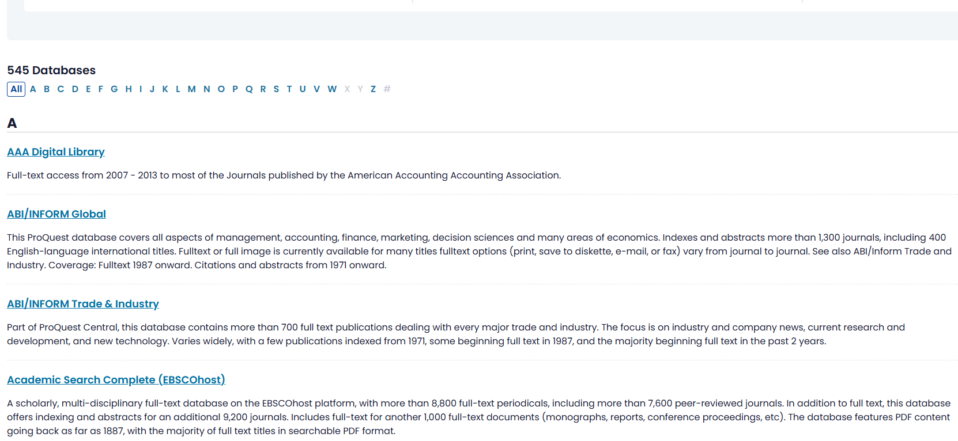
Databases
Databases A to Z
https://concordiauniversity.libguides.com/az/databases
Databases suggested on the CMLL research guide
https://www.concordia.ca/library/guides/classics/linguistics-og.html#db

Slide 19
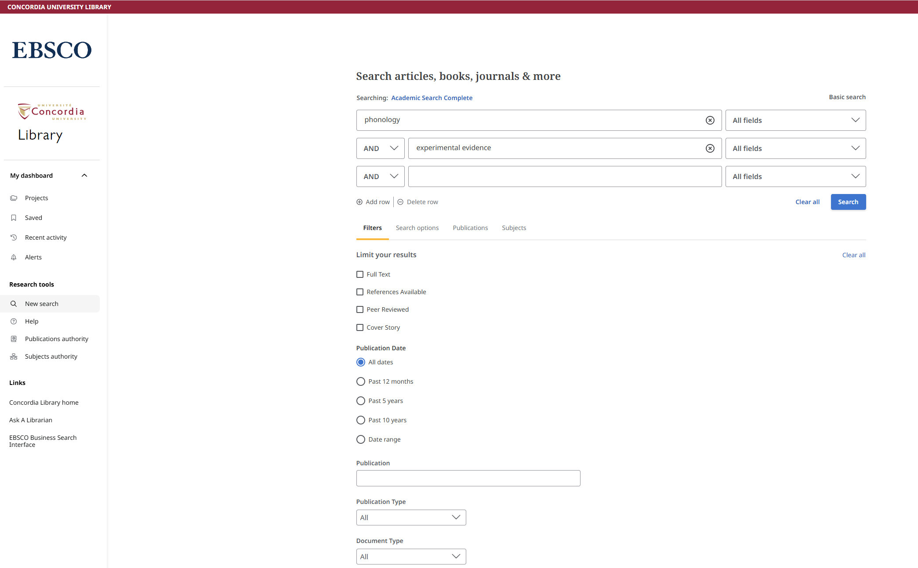
Multidisciplinary datadase – Academic Search Complete

Slide 20
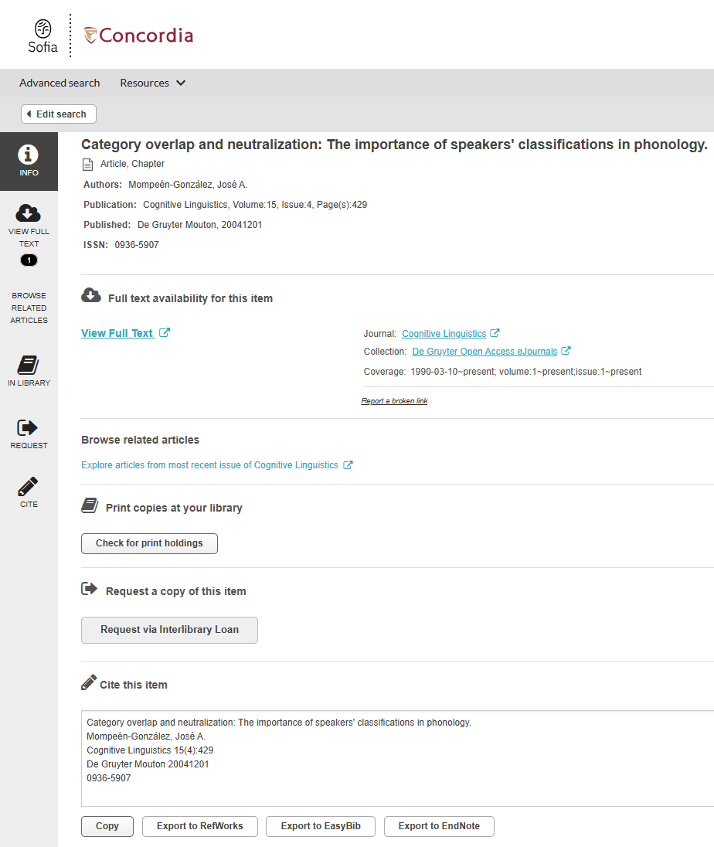

Link resolver – Find it @Concordia

Slide 21
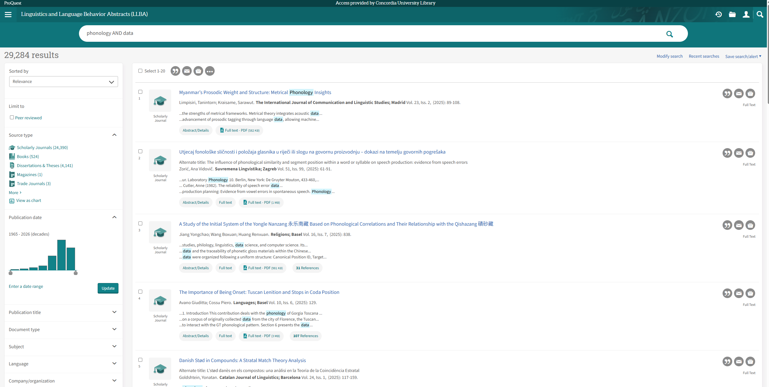
Subject-specific database: Linguistics and Language Behavior Abstracts (LLBA)

Slide 22
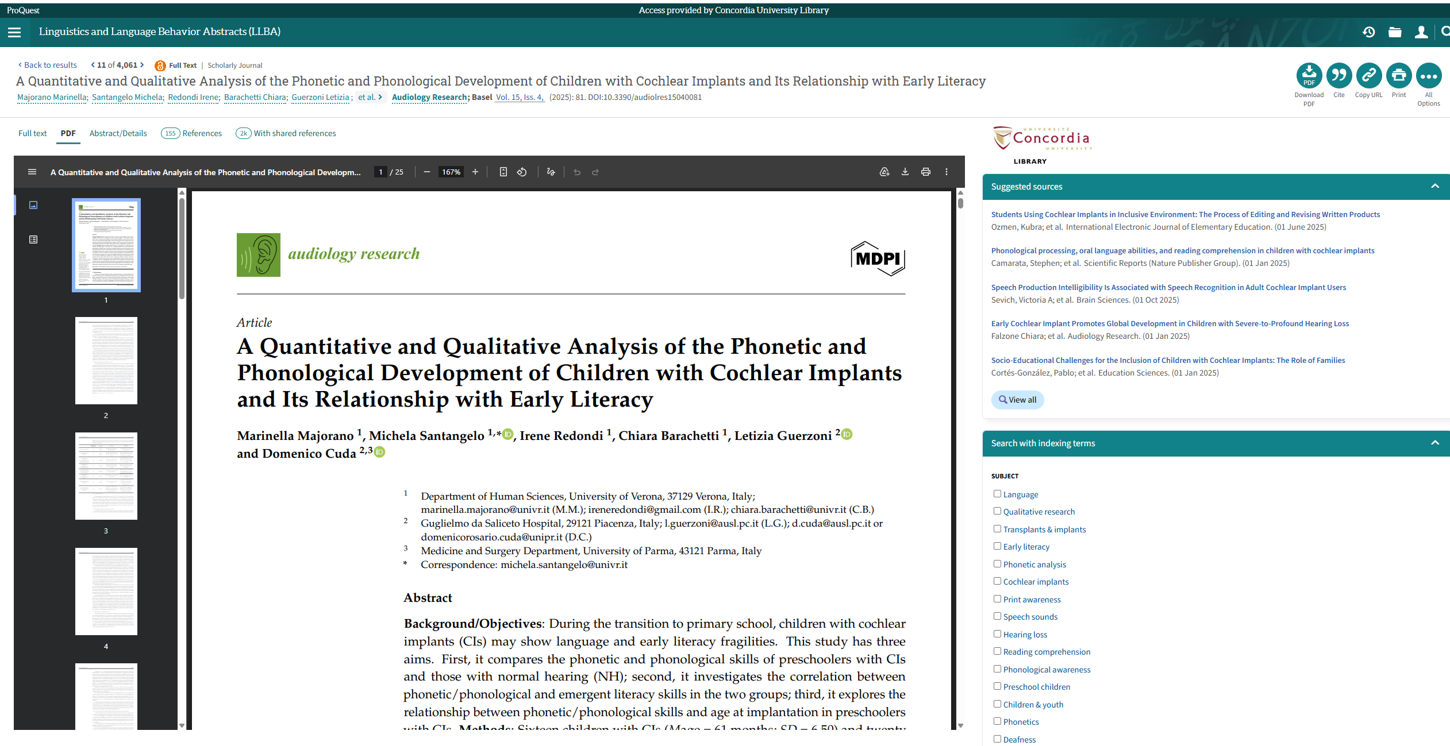
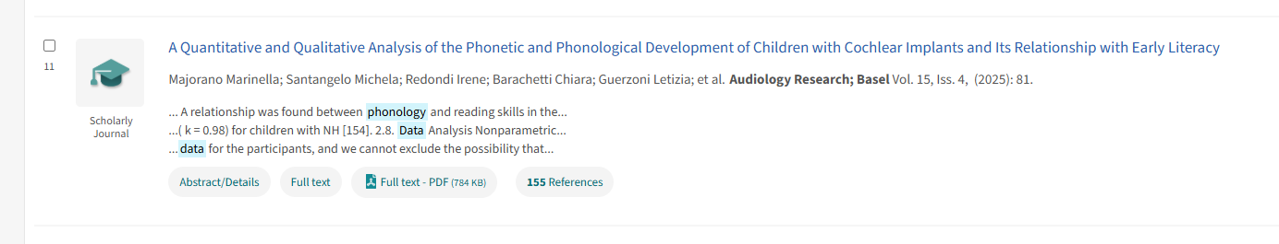

Slide 23
Databases to discover
Academic Search Complete
JSTOR
Année Philologique
MLA International Bibliography
Linguistics and Language Behavior Abstracts (LLBA)

Slide 24

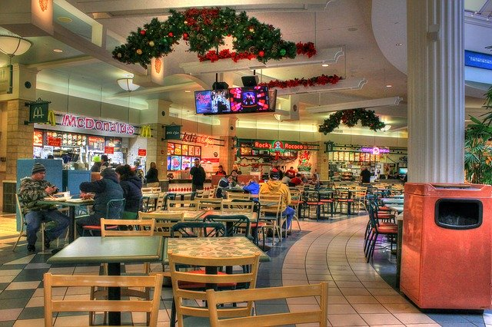

On using Google Scholar
Google scholar
Library databases
Volume | Quantity | Quick
Depth | Quality | Thorough
Left image: Yinan Chen, Dining Court, public domain, https://pixabay.com/photos/dining-court-shopping-mall-corridor-347314/
Right image: Jason Briscoe, Cooking, public domain, https://unsplash.com/photos/VBsG1VOgLIU

Slide 25
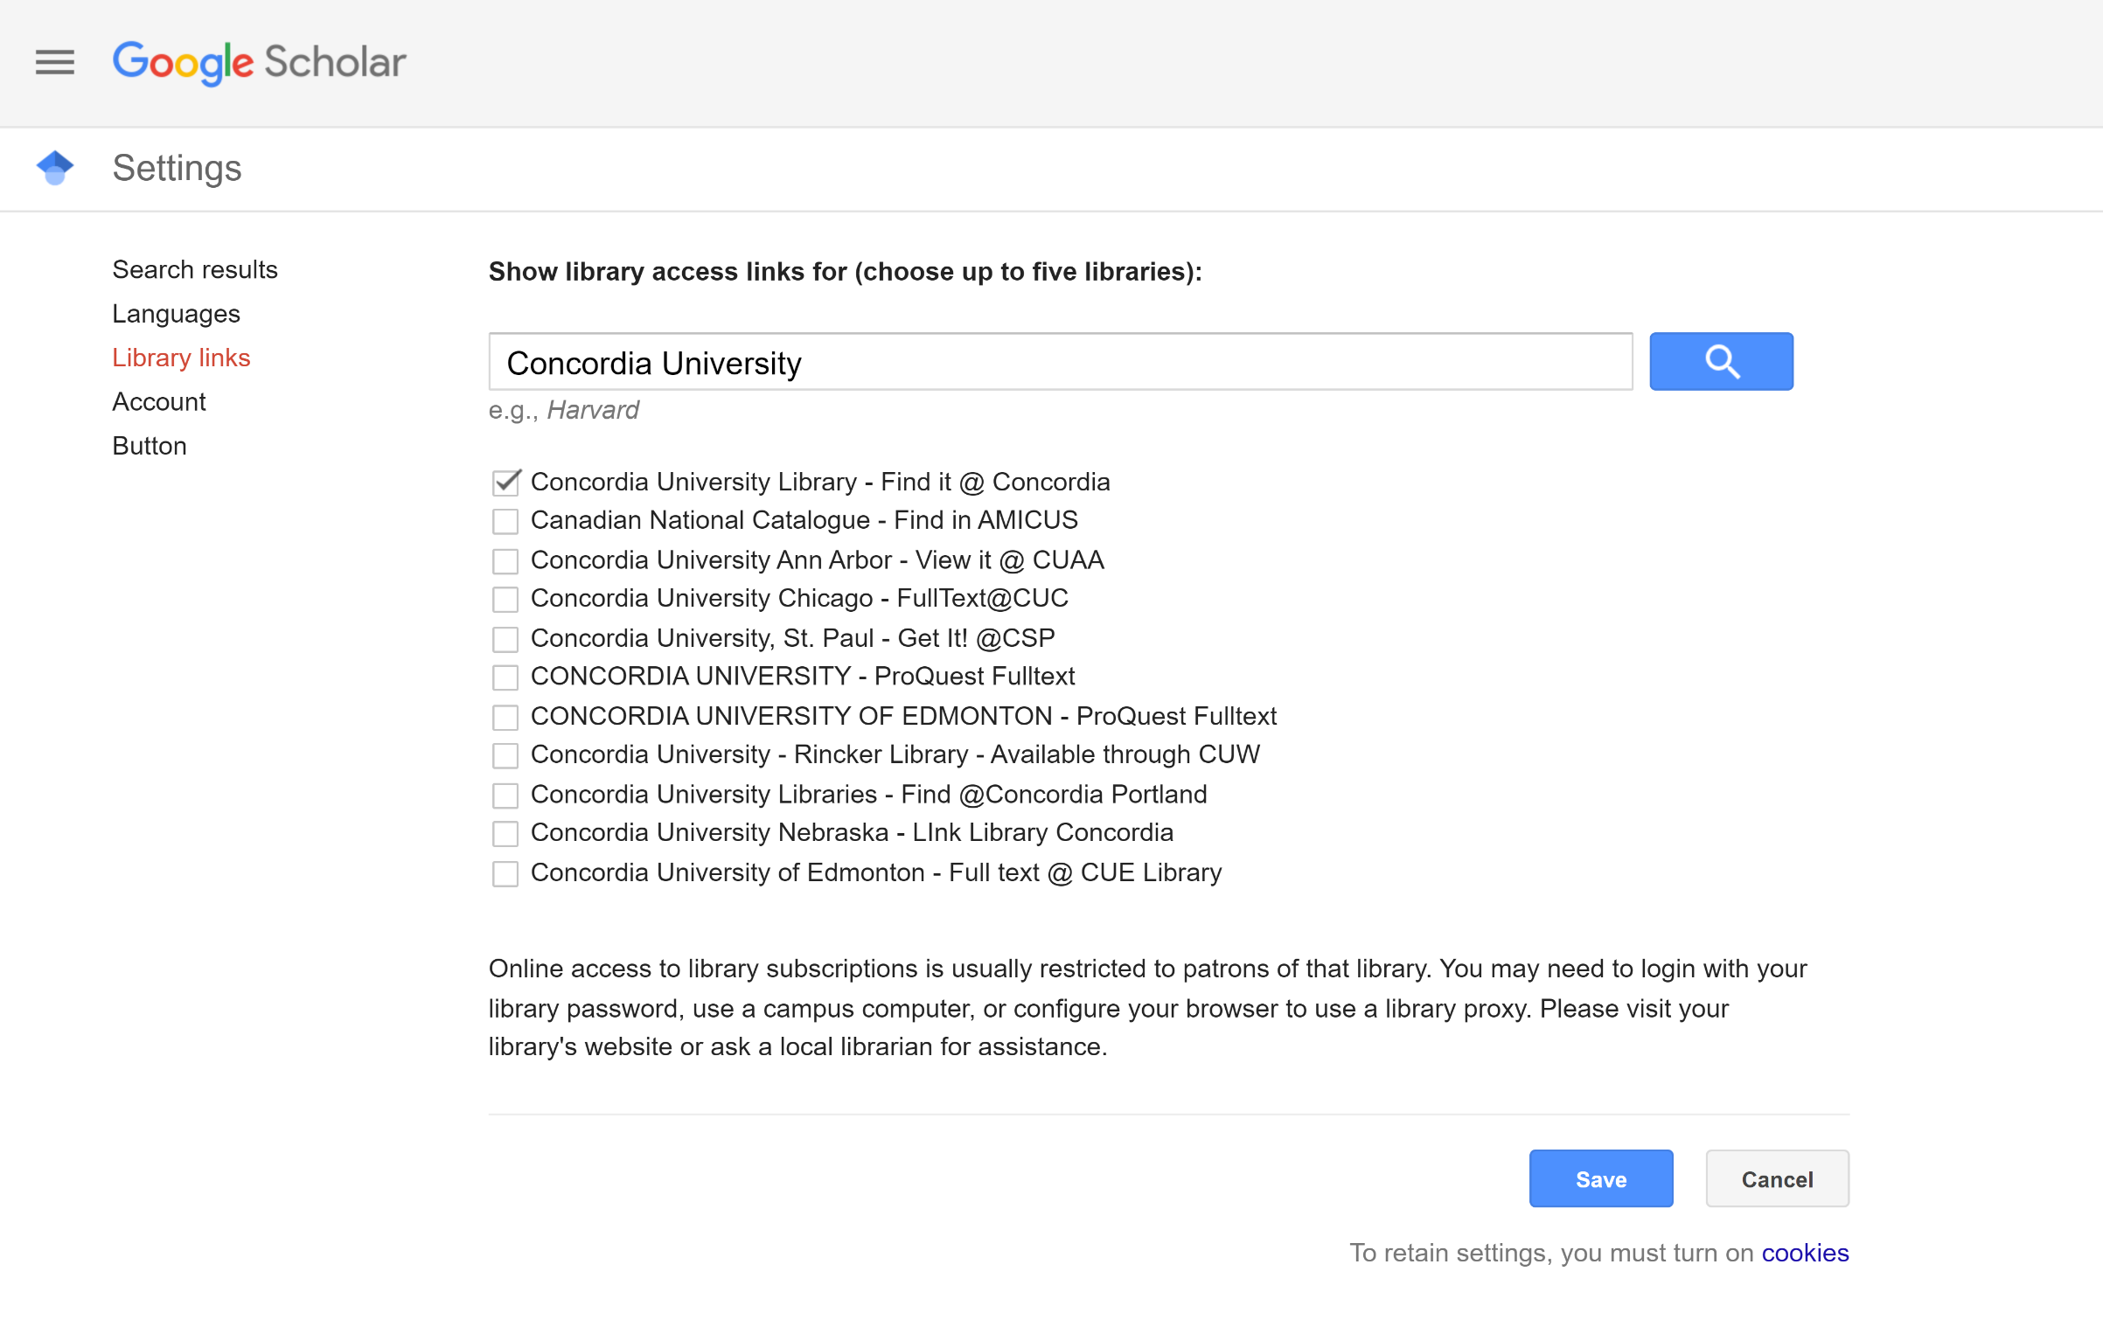
Google Scholar – select a library access link

Slide 26
Activity - How would you find these documents?
Goldrick, M. (2011). Linking speech errors and generative phonological theory. Language and Linguistics Compass, 5(6), 397–412.
Trask, R. L., and Peter Stockwell. Language and Linguistics : The Key Concepts. Second edition, Routledge, 2007.
Linguistics and Language Behavior Abstracts (LLBA). SilverPlatter Information Cambridge Scientific Abstracts; Sociological Abstracts, Inc. ProQuest LLC.

Slide 27

Activity: Let’s find more of what you value!
Recommendations based on content, authors, publishers, formats

Slide 28
What to do if you want more of … ?
Course material! Phonology: A Formal Introduction by Charles Reiss & Alan Bale.
LING 473 Class Bibliography

Slide 29
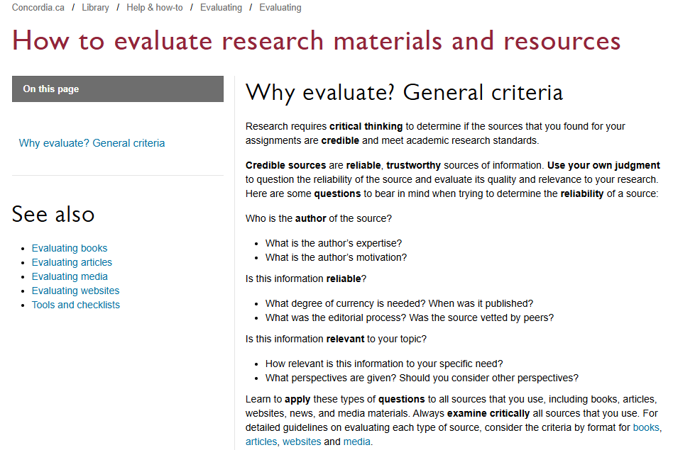
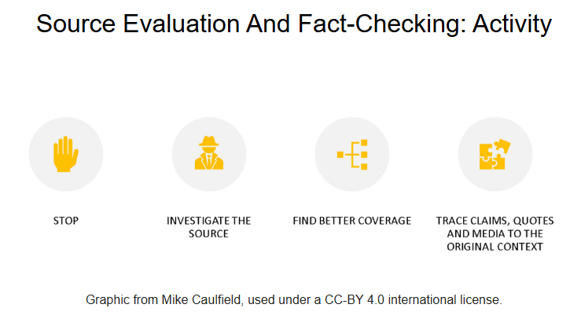
Evaluating resources
https://library.concordia.ca/help/evaluating/evaluating.php
https://library.concordia.ca/apps/critical-toolkit/course.html?courseID=27406

Slide 30
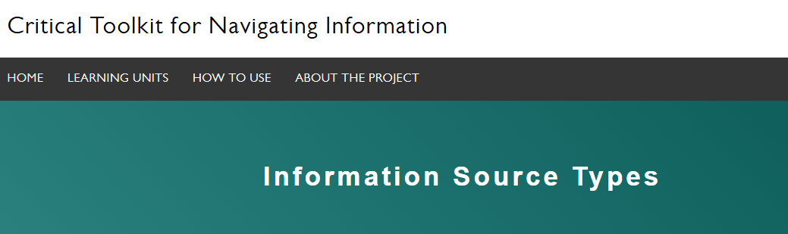
Activity
https://library.concordia.ca/apps/critical-toolkit/course.html?courseID=27594
Notes:
https://library.concordia.ca/apps/critical-toolkit/course.html?courseID=27594

Slide 31

Questions?

Slide 32
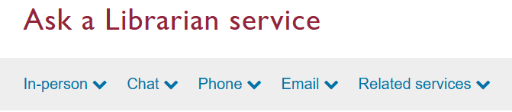
Thank you for your participation!
Your librarian: Éthel Gamache
ethel.gamache@concordia.ca
https://library.concordia.ca/help/questions/

