Slide 1
LING 436 Comparative Indo-European Linguistics Library workshop
Éthel Gamache
Librarian
ethel.gamache@Concordia.ca

Slide 2
Plan
Library website highlights
CMLL subject guide
Using Sofia: research, access and Interlibrary loan
Databases: Academic Search Complete and Année philologique
Evaluating documents

Slide 3
How to find and access resources – Navigating the Library website

Slide 4
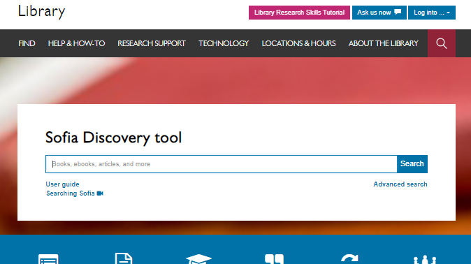

Slide 5
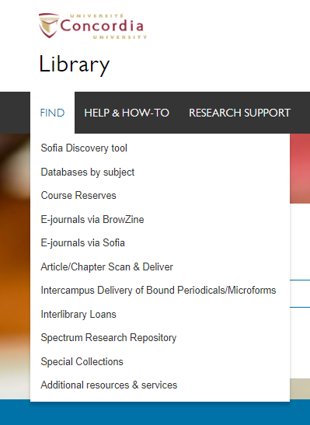

Slide 6
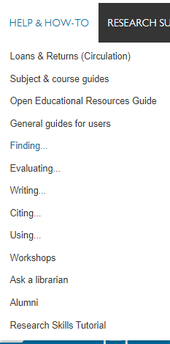

Slide 7
How to find and access resources – your Subject guide

Slide 8
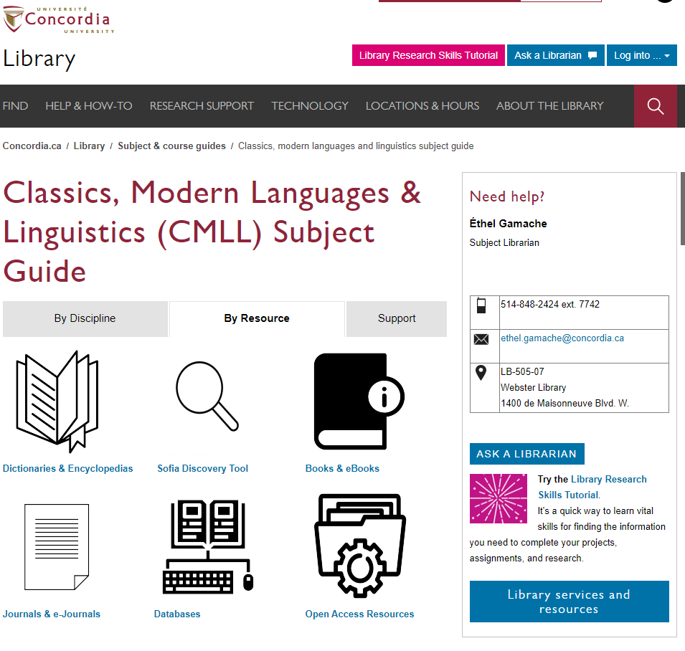

Slide 9
How to find and access resources – Using Sofia, the discovery tool

Slide 10
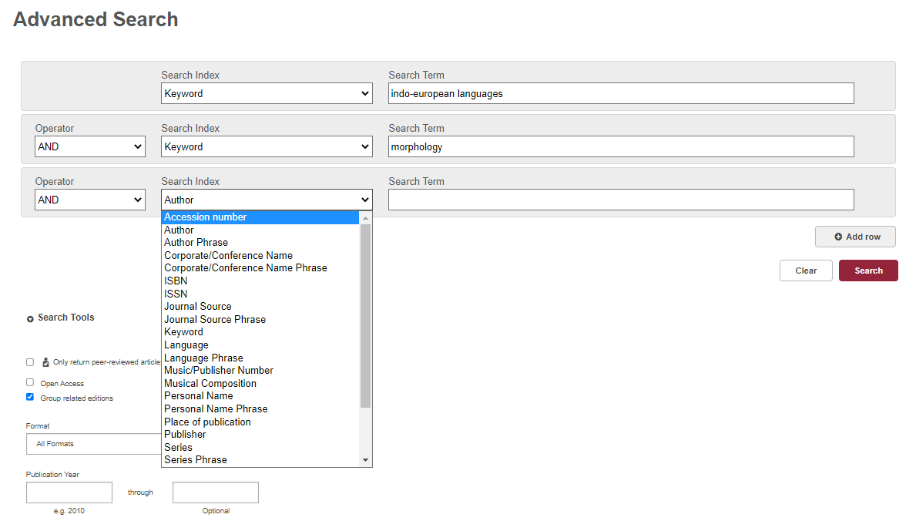
Sofia

Slide 11
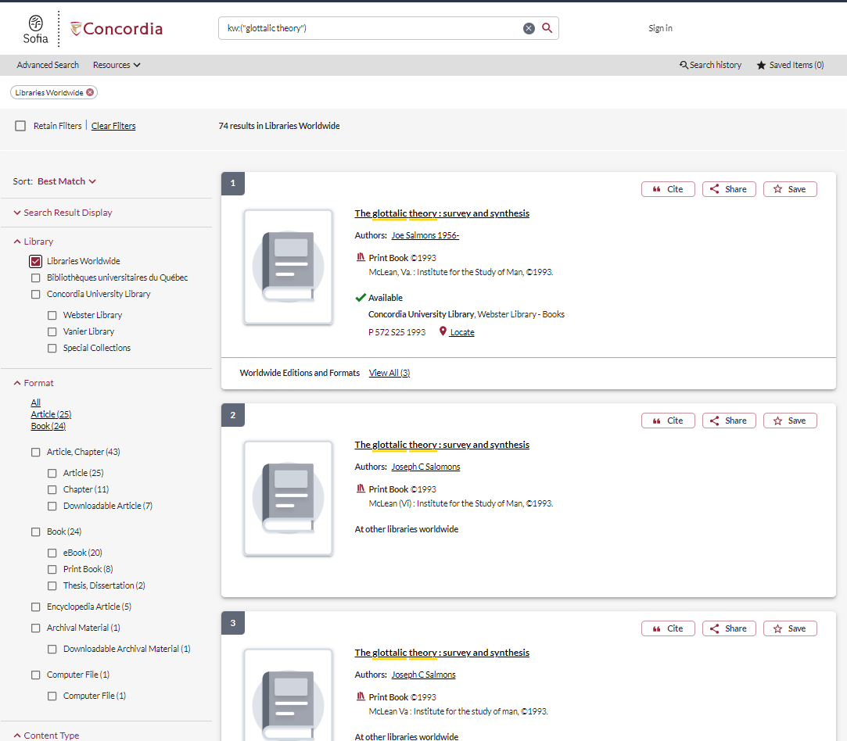

Slide 12
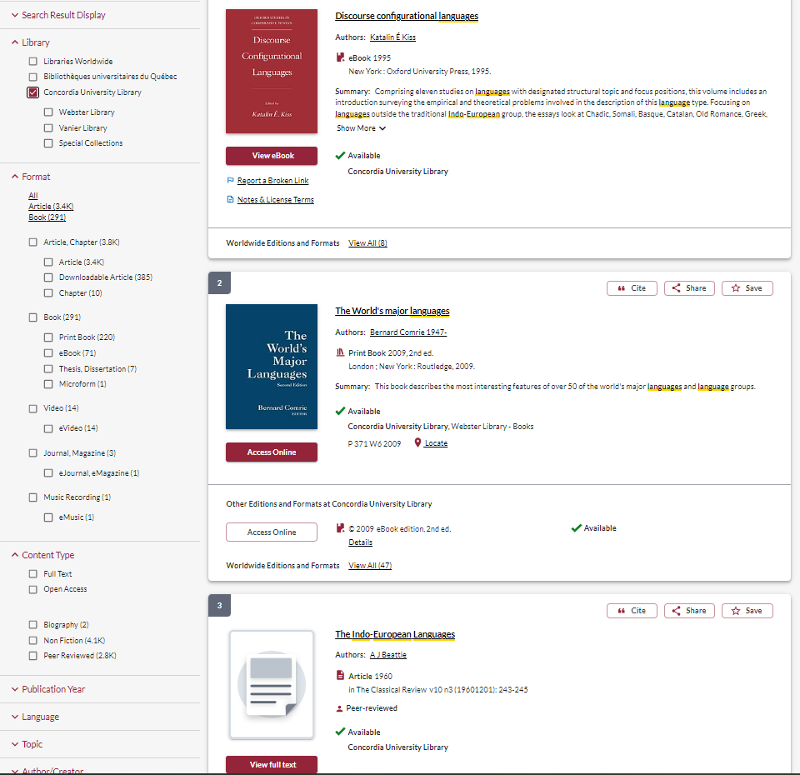
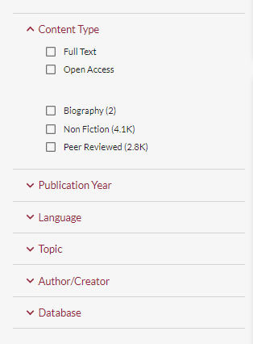

Slide 13
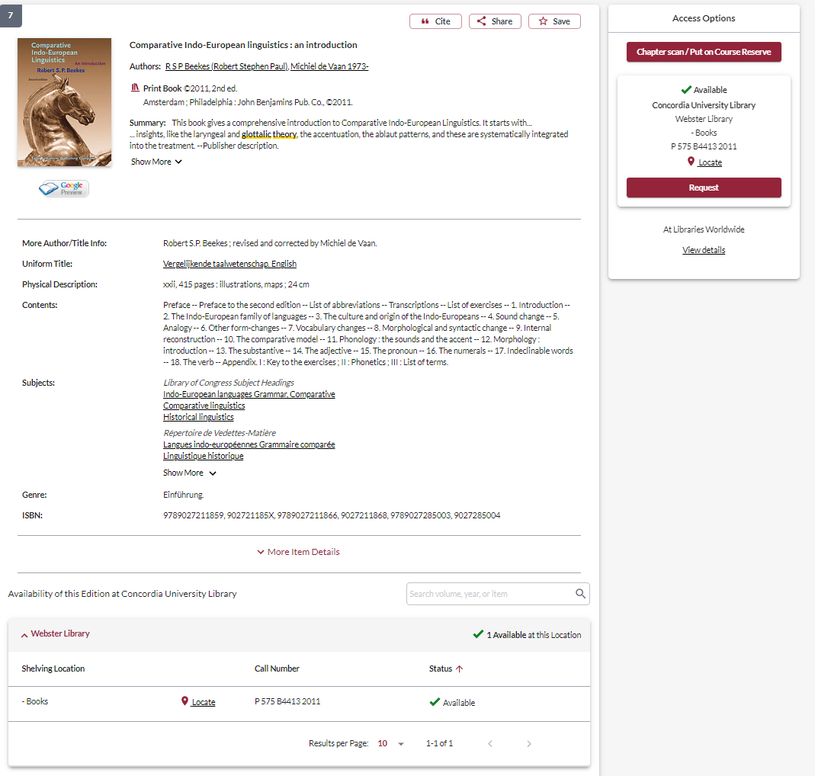
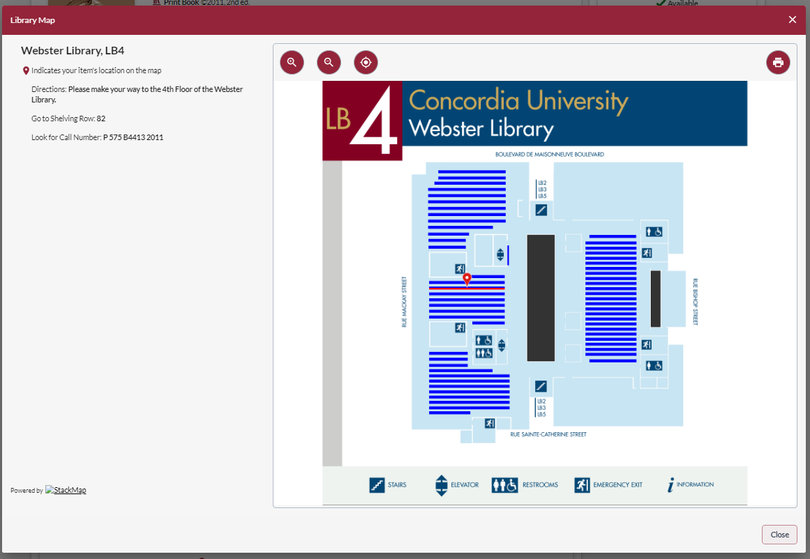
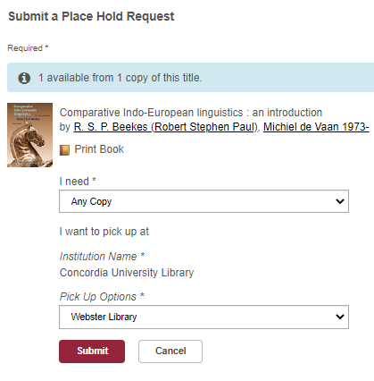

Slide 14
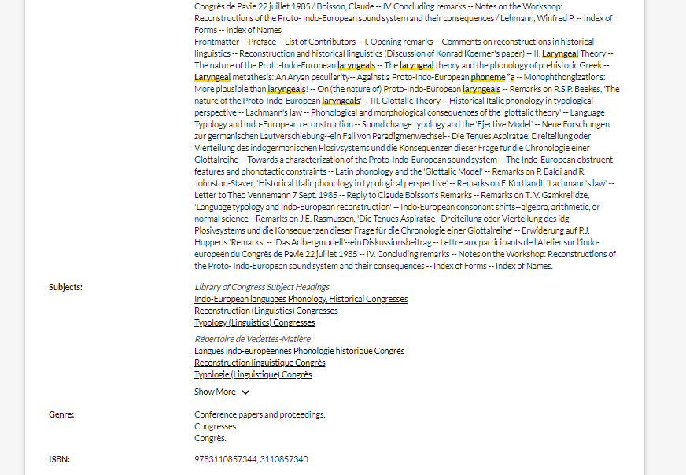

Slide 15
Using Interlibrary loan within Sofia

Slide 16
What is the new interlibrary loans (ILL) service?
ILL requests are made directly in the Sofia Discovery tool:
“Request via Interlibrary Loan” button
Form available under the “Requests” tab in "My Account".

Slide 17
Concordia article/chapter scan & deliver service
Book chapter and journal article scans from Concordia’s print collection can now be requested and tracked in Sofia.
Look for the “Chapter Scan” button in the Access Options panel.

Slide 18
Example – Request a book ("Request via Interlibrary Loan")

Slide 19
Notes:
Let's take a look first at requesting a book via libraries worldwide. If users are having trouble finding an item through Concordia Library or one of the Quebec university libraries, they can expand their search to "libraries worldwide" in Sofia.
If a user was looking to request this book, we can see that there is no "request" button through Concordia or network loans. Users will need to place an ILL request by selecting the "request via interlibrary loan" under the "access options panel". If they wanted a specific chapter scan, they would be able to select the "chapter scan" button, but we will take a look at that process later in today's presentation.

Slide 20
Notes:
The user will need to login to their Sofia account, and will then be brought to this form for book requests (this is a partial view of the form on the screen here). We want to encourage users to try as often as they can to find the record in Sofia, as if they place the ILL through the "request via ILL button", the request form will autofill a lot of information from the record such as ISBN, OCLC#, title, etc. Which is very helpful for staff.
The form will default to a "LOAN" service type. There is messaging to the right explaining that users should select LOAN for a complete document. For a scanned chapter they can select "copy". If by chance users wanted a chapter scan and request it in this way, it won't necessarily be a big issue as the request will still appear in Tipasa. I'll explain this in more detail when we go over article/chapter scan requests.
Be sure to specify the pickup location as Webster or Vanier. It defaults to Webster – we could not get the form to have a blank default for this field.

Slide 21
Notes:
At the bottom of the form, you will see an “additional information” section. You can add in any other information pertaining to the request and/or specify the desired edition.
Submit request.

Slide 22
Notes:
At the bottom of the form, you will see an “additional information” section. You can add in any other information pertaining to the request and/or specify the desired edition.
Submit request.

Slide 23
Check the status of your request under the "Requests" tab.
Notes:
The request can then be found in the requests tab, along with the status. I will show you examples later on of all the different kinds of statuses a user might see, along with how they can monitor their requests.
This "unknown" status shows up for a few moments right after placing a request, it will update quickly to a "submitted" status.

Slide 24
You will receive email notifications when your ILL request is available for pickup or download.
Physical items can be picked up at the Circulation/Loans desks at either Vanier or Webster Library.
ILL requests can be borrowed for 30 days, with up to 4 automatic renewals, or until item is recalled.

Slide 25
Example – Request a book (blank form)

Slide 26
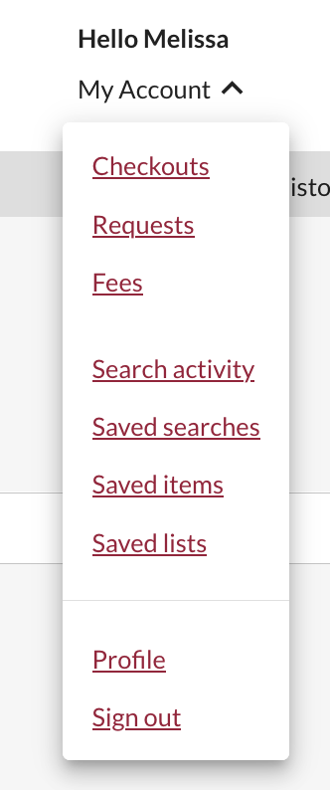
Sign in to "My Account" and select "Requests".
Click on "Create request".
Notes:
Some users might have all the information on hand for their request, or simply just have a difficult time finding the record in Sofia.
Their other option for placing a book request via ILL is to fill out the blank book request form.
Users will need to sign into their My account, and go to the requests option in the drop down menu. Then click on create request

Slide 27
Select Webster or Vanier Library.
Notes:
Select the “Book” form. Fill out the form by providing as much detail as they can to help us locate the item. For the complete book, be sure to select “LOAN”. Select the desired pickup location.

Slide 28
Notes:
Submit the request and then the user can go to their requests tab to view all their requests.

Slide 29
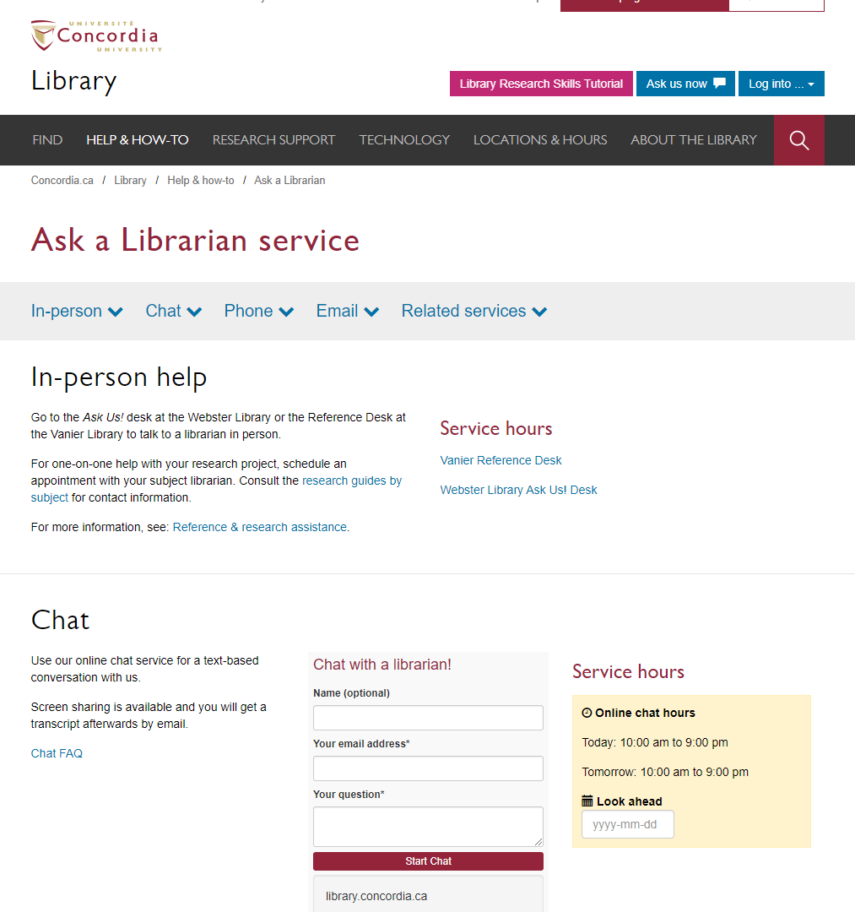
If you have any difficulty finding a document,
reach out to the library team!

Slide 30
Searching for articles with databases – Academic Search Complete

Slide 31
The peer-review process
Yates, D. [@LegoAcademics]. (2014, August 12). Peer 1: Brillant! Accept with no changes; Peer 2: Groundbreaking! Accept with no changes; Peer 3: Reject. [Tweet]. Twitter. https://twitter.com/LegoAcademics/status/499205005468262400/photo/1

Slide 32
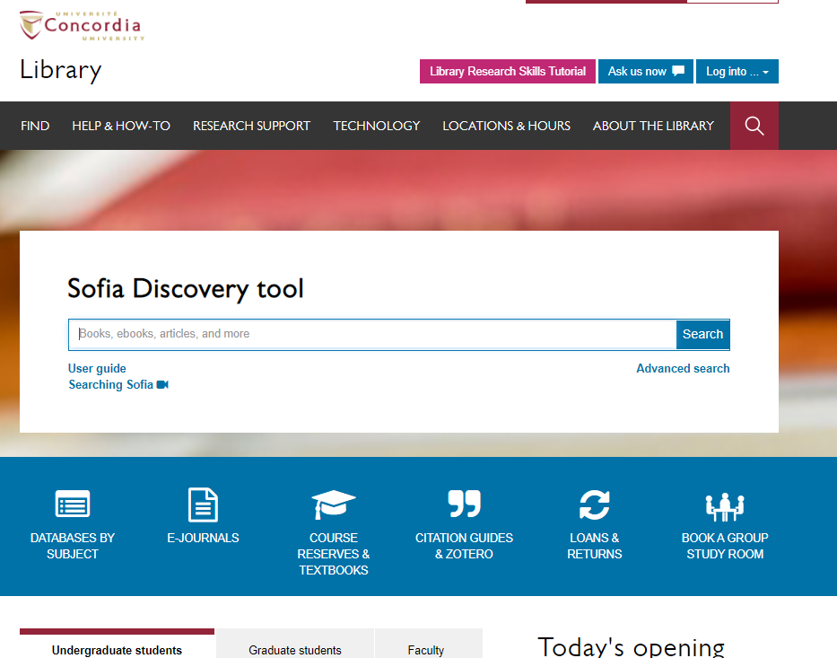

Slide 33
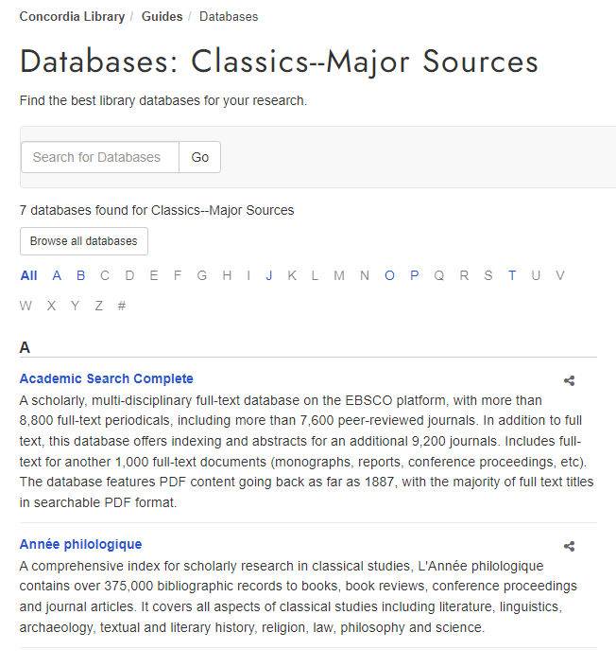

Slide 34
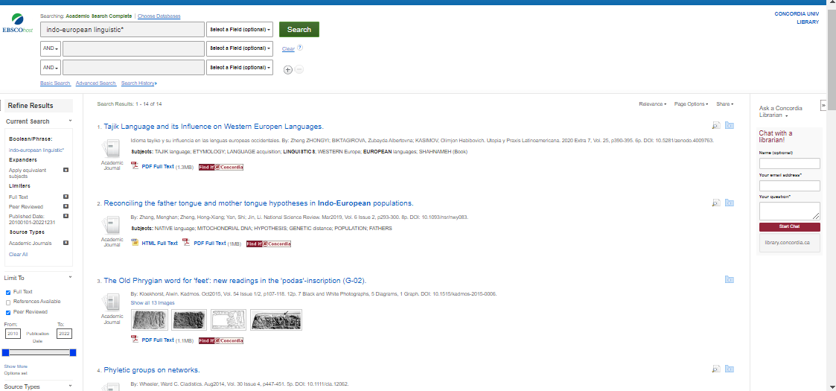

Slide 35
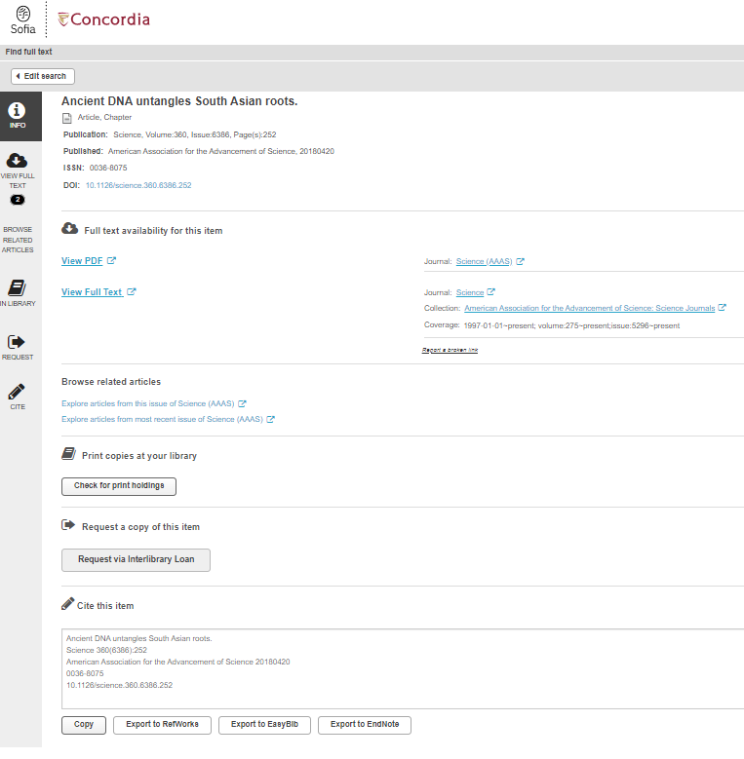

Slide 36
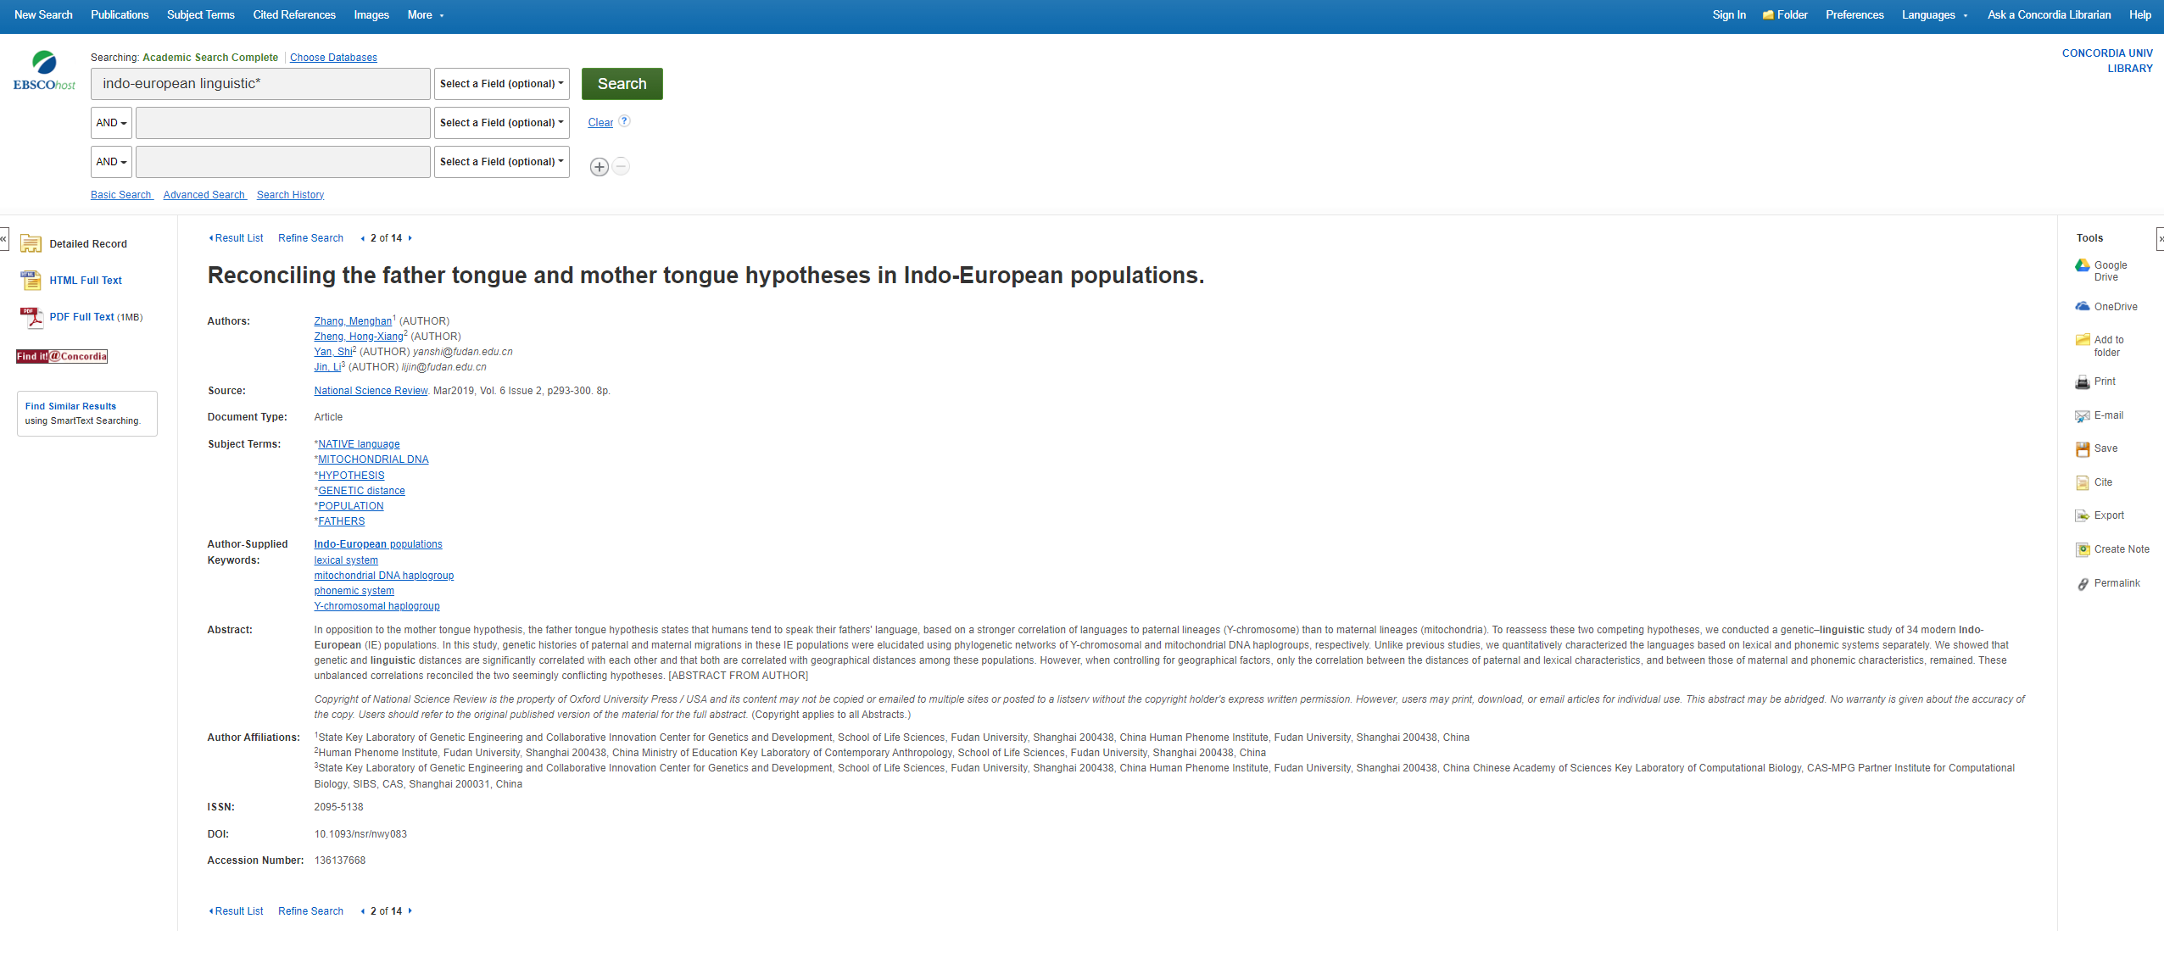

Slide 38
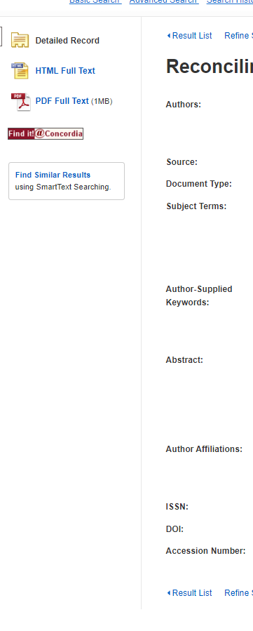

Slide 39
Searching for articles with databases – Année philologique

Slide 40
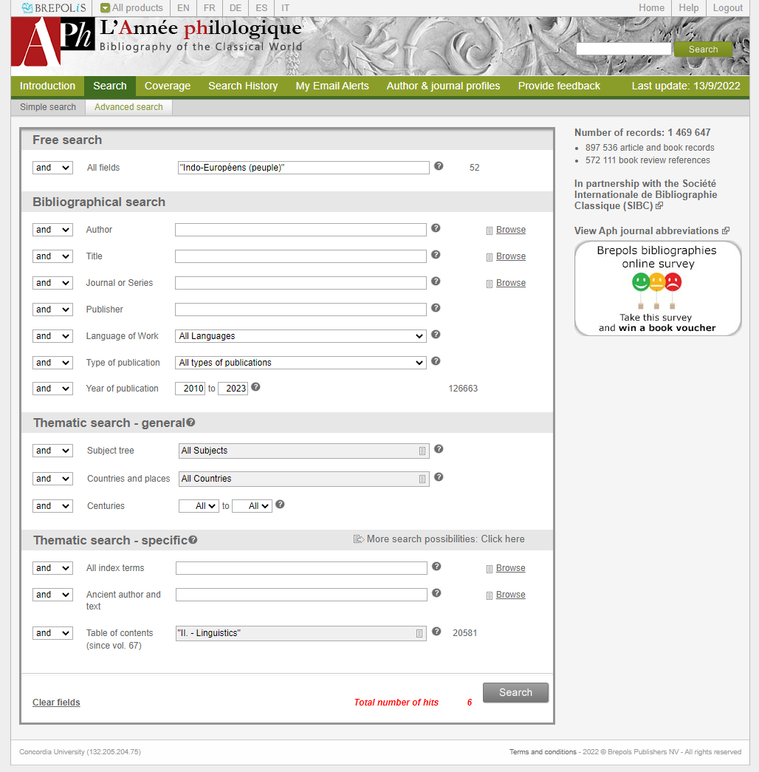

Slide 41
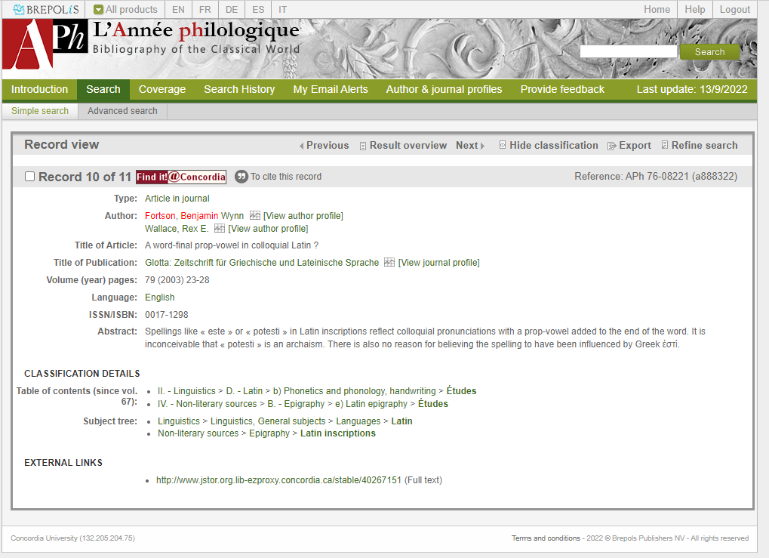

Slide 42
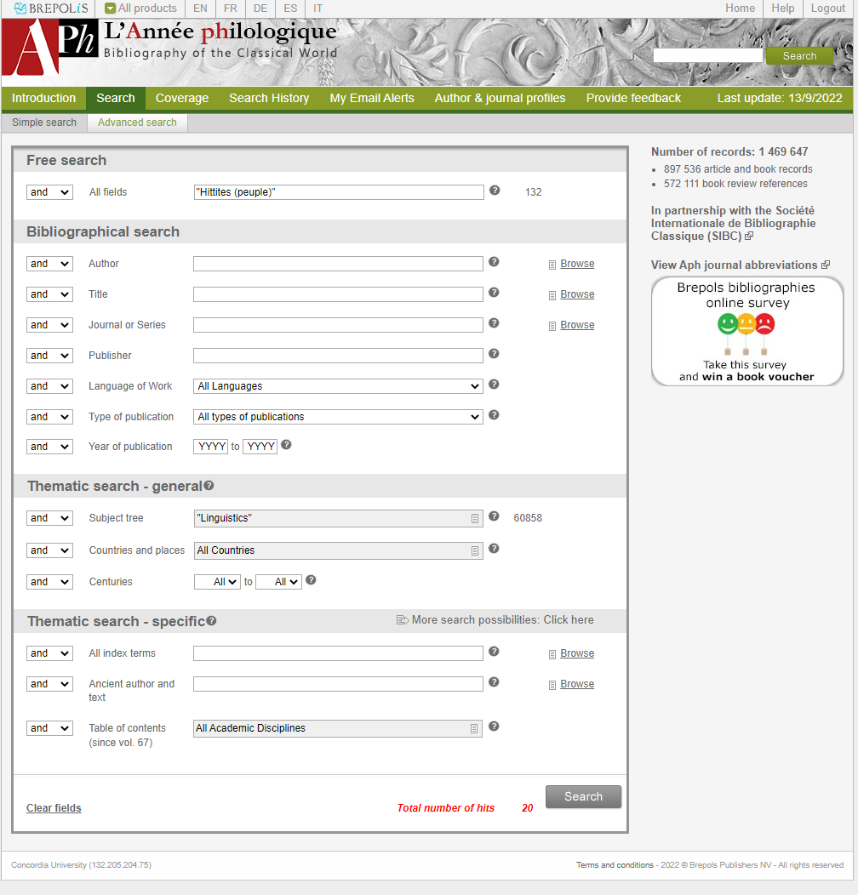

Slide 43
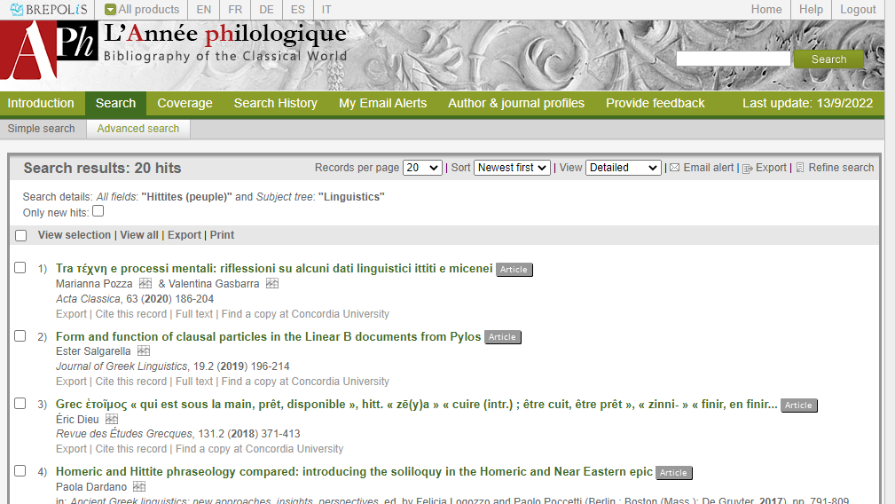

Slide 44
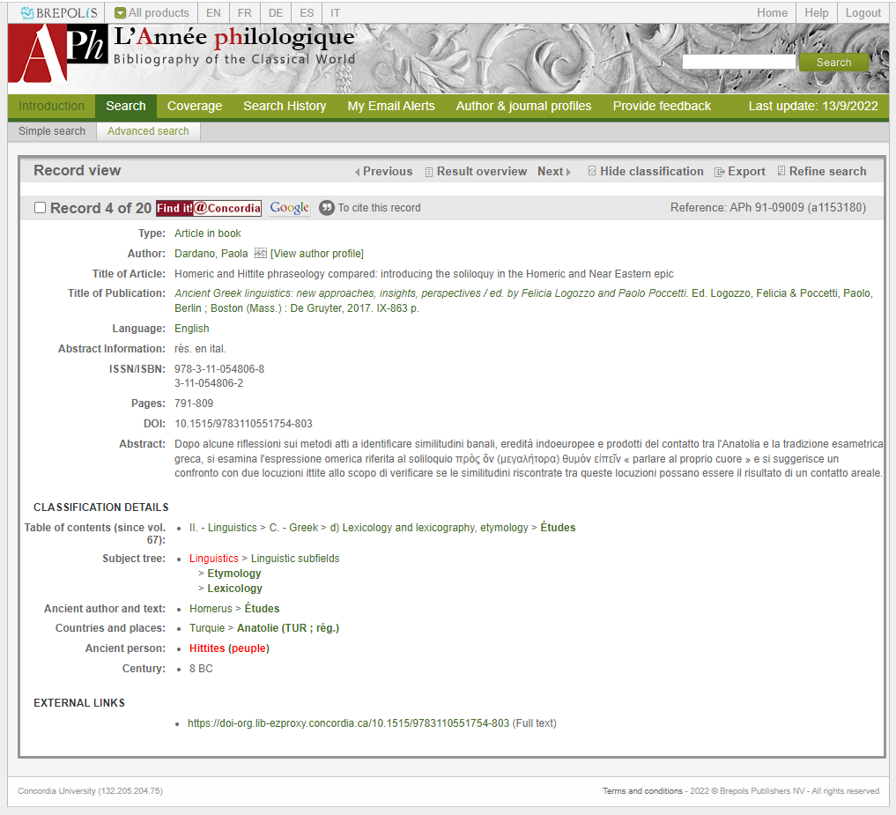

Slide 45
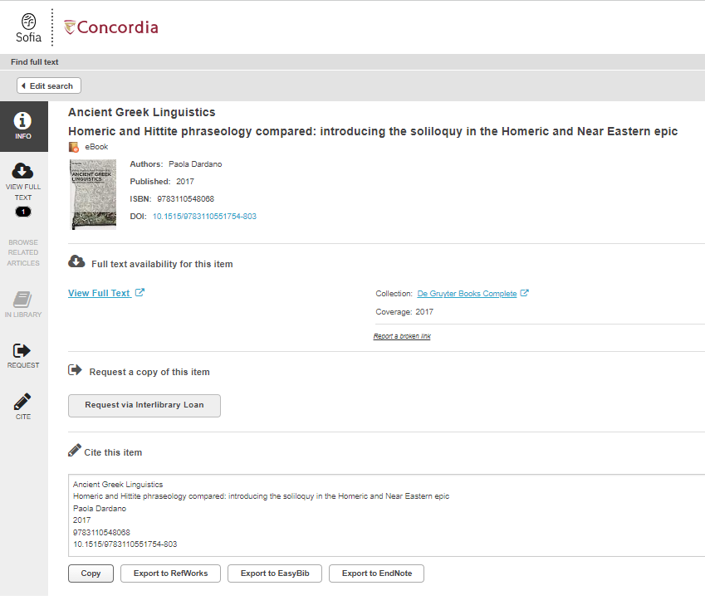

Slide 46
How are Google Scholar and a database different?
Source: https://howardcc.libguides.com/c.php?g=52041&p=428654

Slide 47
What is the difference?
Google scholar
Library databases
Volume | Quantity | Quick
Depth | Quality | Thorough
Left image: Yinan Chen, Dining Court, public domain, https://pixabay.com/photos/dining-court-shopping-mall-corridor-347314/
Right image: Jason Briscoe, Cooking, public domain, https://unsplash.com/photos/VBsG1VOgLIU
Notes:
Searching in Google Scholar – finding something to eat in a food court
Searching in Library Databases – Cooking at home
Speed vs process

Slide 48
Where should you search?
Library Discovery Tool
Academic Search Complete
(Library Database)
Google Scholar
Eureka.cc
(Library Database)
Grey literature (e.g. government documents, NGO reports, working papers, newsletters, preprints)

Slide 49
How to find and access resources – Using Google Scholar

Slide 50
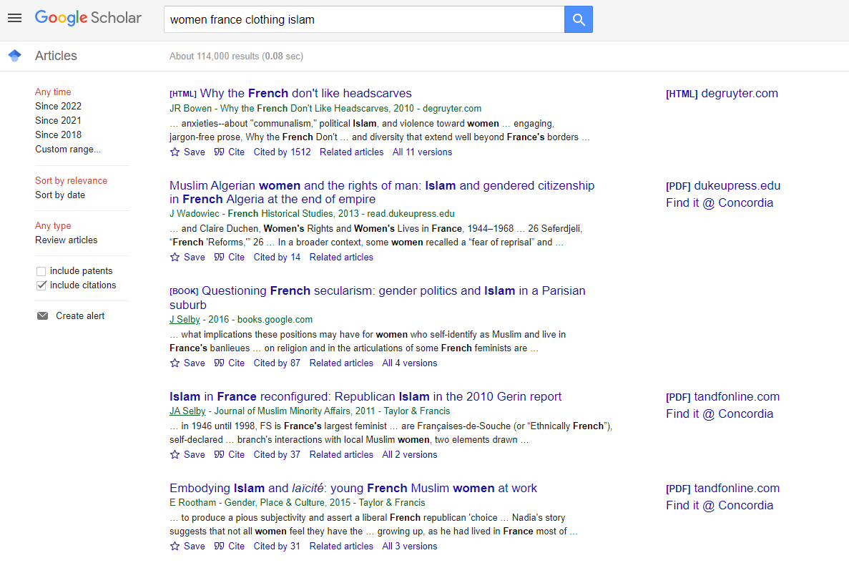

Slide 51
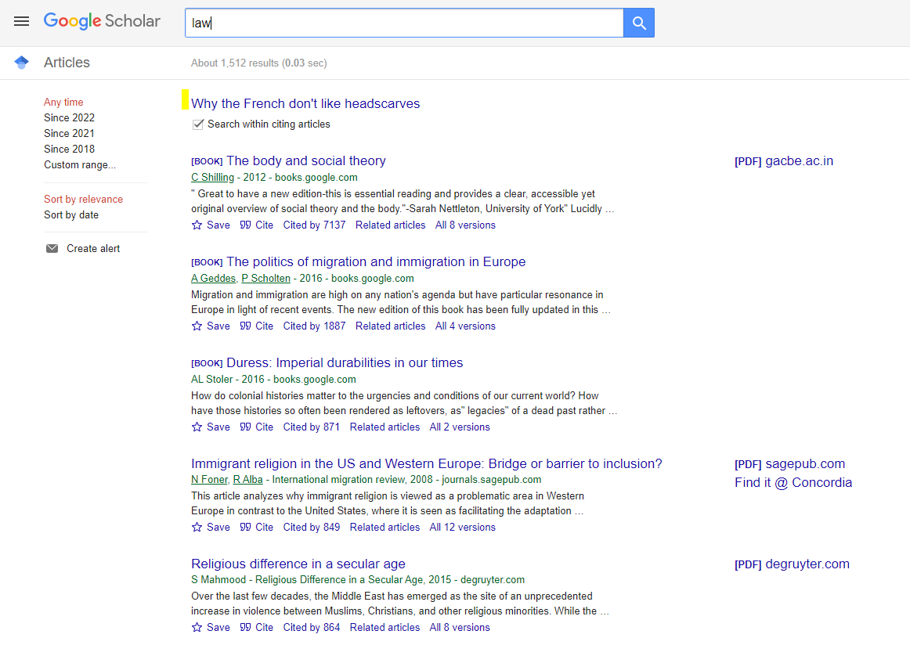

Slide 52
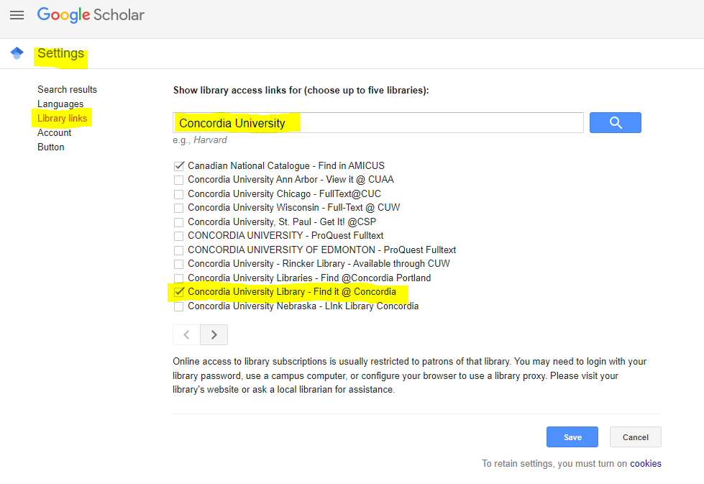

Slide 53
How to find and access resources – Academic Search Complete

Slide 54
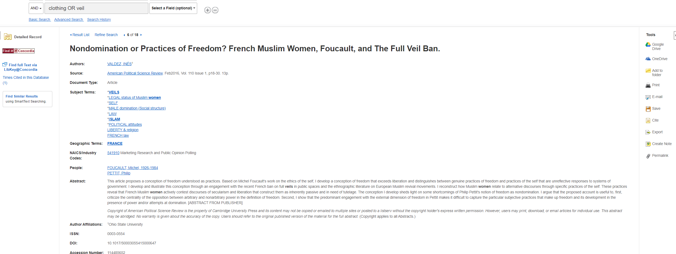

Slide 55
You do have access to many resources!

Slide 56
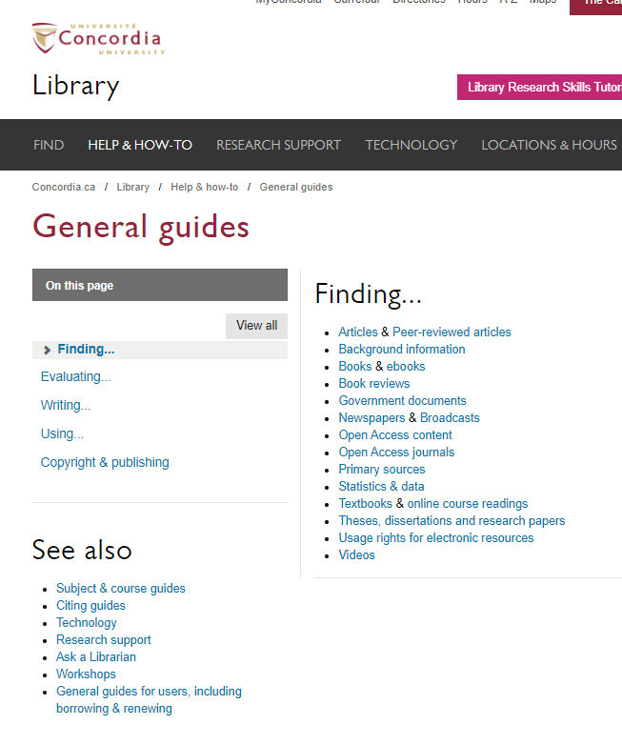

Slide 57
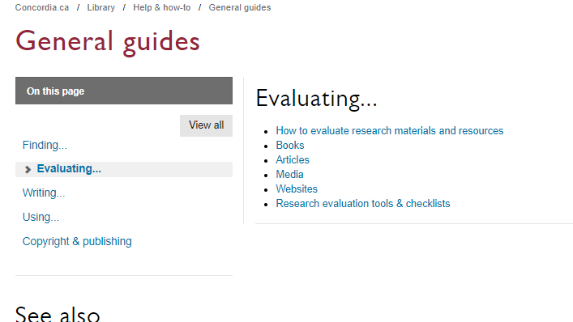

Slide 58
Evaluating exercise
In team of 2 or 3, discuss the quality and potential uses (for an assignment? for entertainement? to develop your curiosity?) of the documents given to you.
Share your notes with the class.

Slide 59
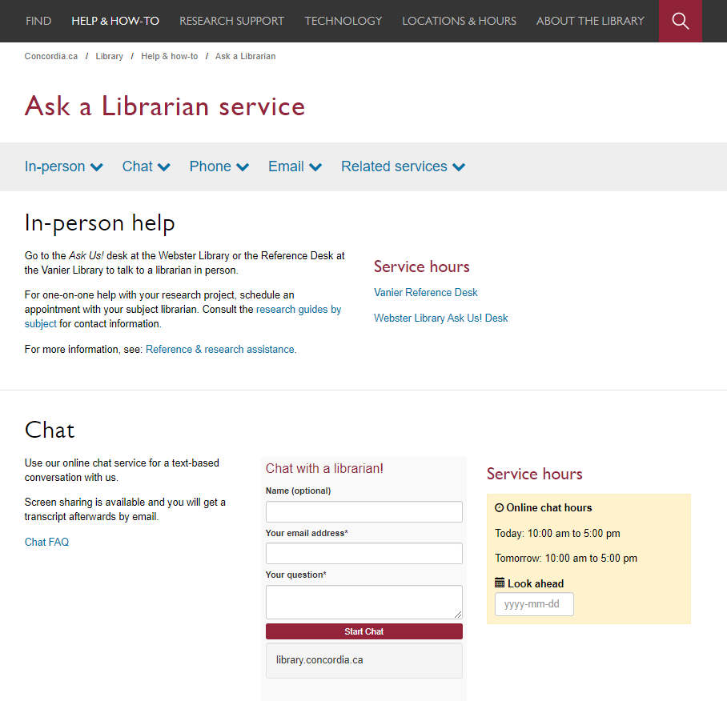

Slide 60
Questions? Comments?
Éthel Gamache
ethel.gamache@concordia.ca
Presentation and handouts will be on the subject guide,
https://www.concordia.ca/library/guides/religion/courseguides.html

