Slide 1

School of Community and Public Affairs Library Orientation
Michelle Lake
Subject Librarian for The School of Community and Public Affairs, First Peoples Studies, Poli Sci and Government information
Michelle.Lake@Concordia

Slide 2

Your Subject Librarian
Who am I?
Michelle Lake, librarian for Political Science, the School of Community and Public Affairs, First Peoples Studies and Government Publications
Michelle.Lake@Concordia.ca / Book a one-on-one Zoom consultation or an in-person appointment
What do I do?
  Provide research support in consultations & teach workshops
  Academic research topics: search development & strategies, keywords, subject searching, library databases, journals and books
  Help you find and access materials, including scholarly materials, Indigenous scholarship, government documents, public policy, grey literature, etc.
  Build online guides, resources and pathfinders to help students locate research materials
  Help with citation issues
  Choose the books we buy for my subject areas: First Peoples studies, political science, public policy, community and public affairs and government information

Slide 3
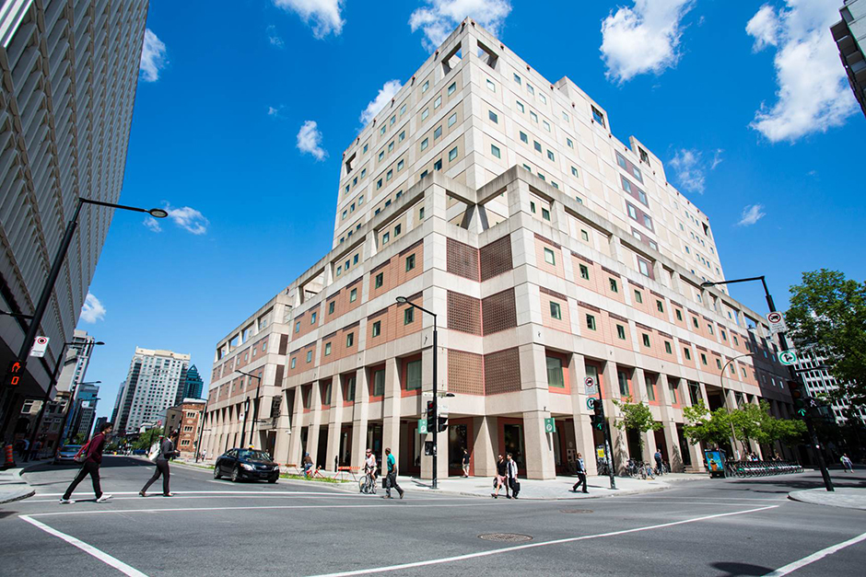
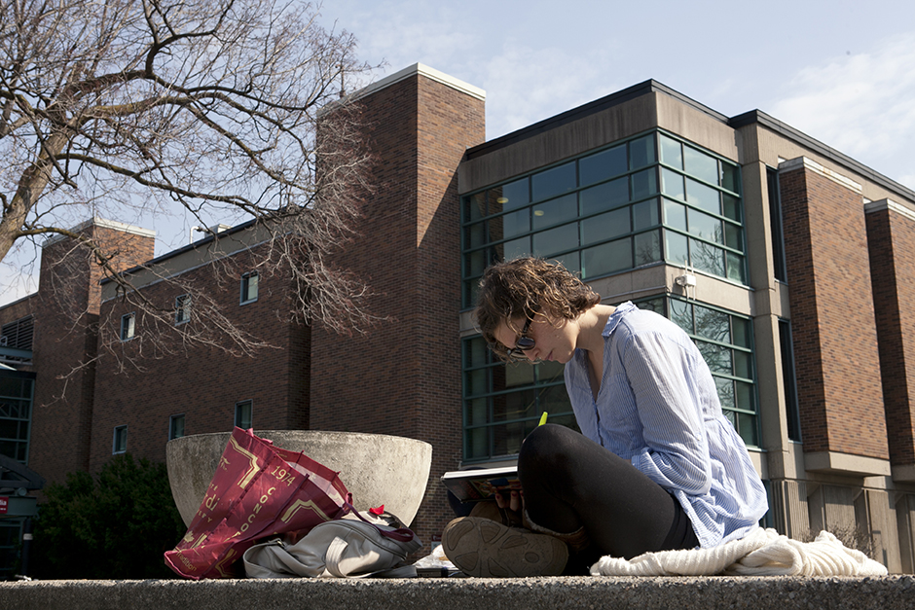
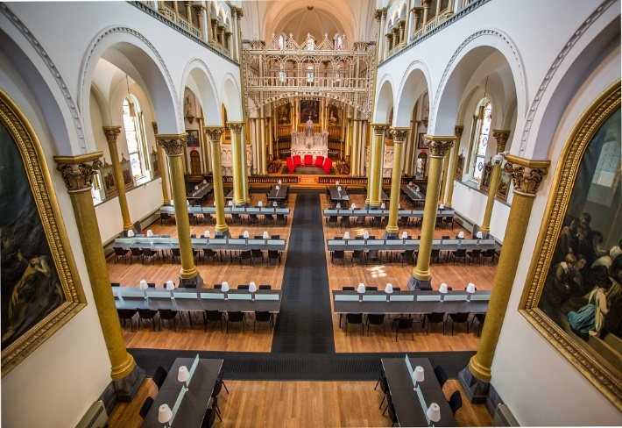
Webster Library (LB) – SGW Campus
24/7 access - between 11pm – 7am access with your student card
2nd, 3rd, 4th, and 5th floor of LB - “Library Building”
Poli Sci, Public policy, Government Info, Maps, History, Social Sciences, Humanities, Engineering & Fine Arts
Technology Sandbox
Course Reserves Room
Bookable group study rooms, presentation practice rooms
Silent pods
Vanier Library (VL) – Loyola Campus
24/7 access - between 11pm – 7am access with your student card
1st, 2nd, and 3rd floor VL – “Vanier Library”
Sciences, Psychology, Communications & Journalism
Special Collections
Bookable group study rooms
Grey Nuns (GN) – SGW Campus
(1190 Guy St.)
Mon-Thurs 9am-9pm, Fri 9-5pm
Access with student card
Group Study Rooms
Quiet Study
Bring your own device
Outlets/Wifi
No collections

Slide 4

Library Services
Your student card is your library card.
You need it to:
borrow books (up to 100 a time)
borrow a laptop (for 3 days) and other technology like tablets, chargers, headphones and cameras
print on campus (add money to your Dprint account)
access the library overnight during 24/7 hours.
Webster library has 5 book scanners (And Vanier has 2!) that can be used for free to scan chapters from our print books and email them to yourself as a PDF.
To use Library databases, access online articles and ebooks when you are off campus, login with your MyConcordia Netname and password.

Slide 5
Course Reserves

Slide 6
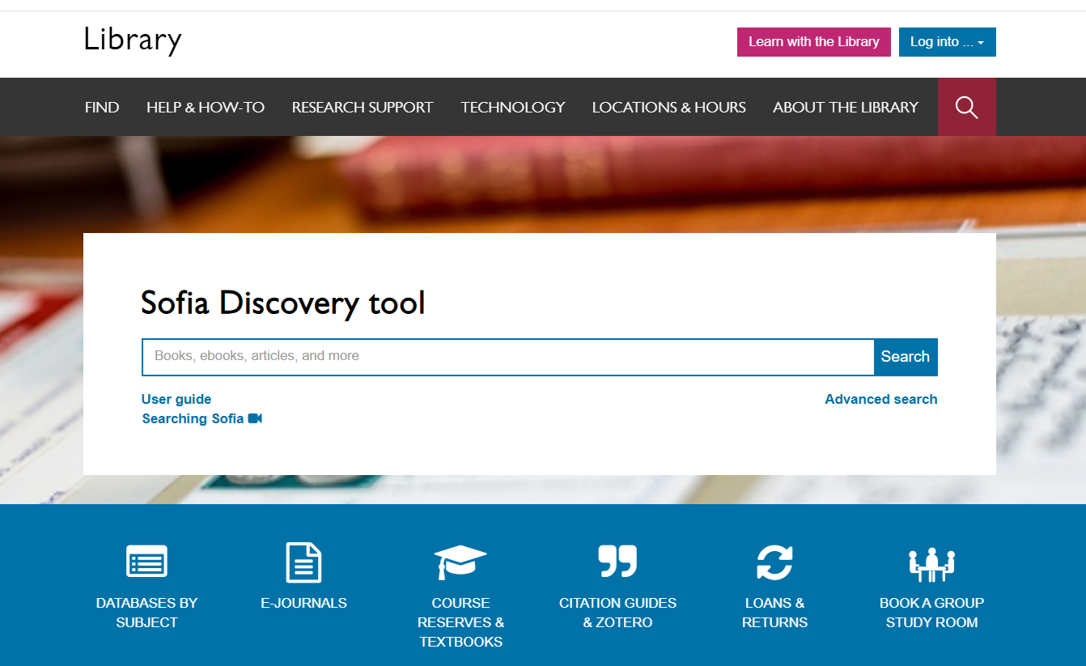
Click here to login to eReserves!

Slide 7
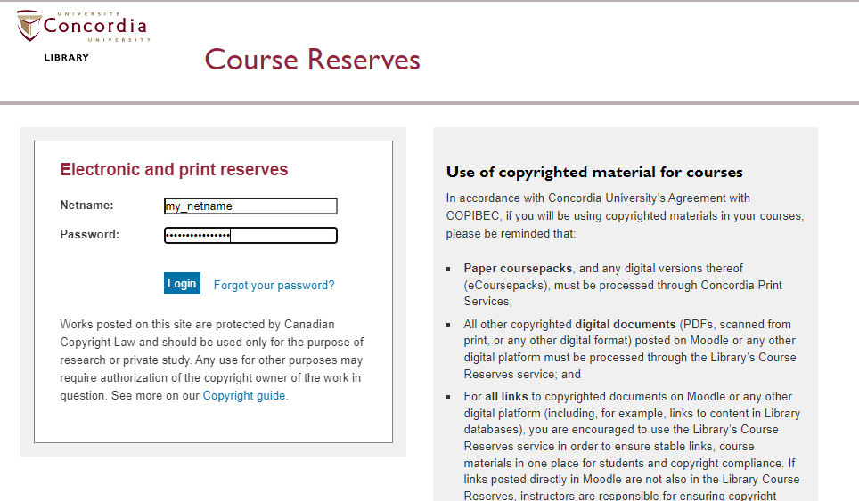

Slide 8
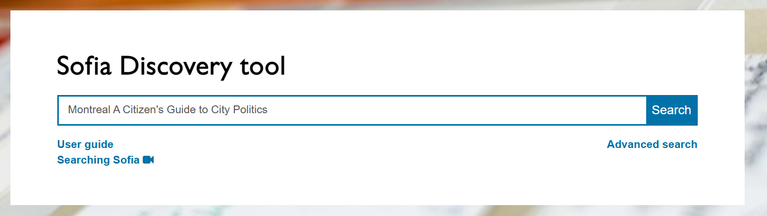
Prince, J., Shragge, E., Henaway, M. (Eds).(2021), Montreal: a citizen’s guide to city politics. Montreal: Black Rose Books.

Slide 9
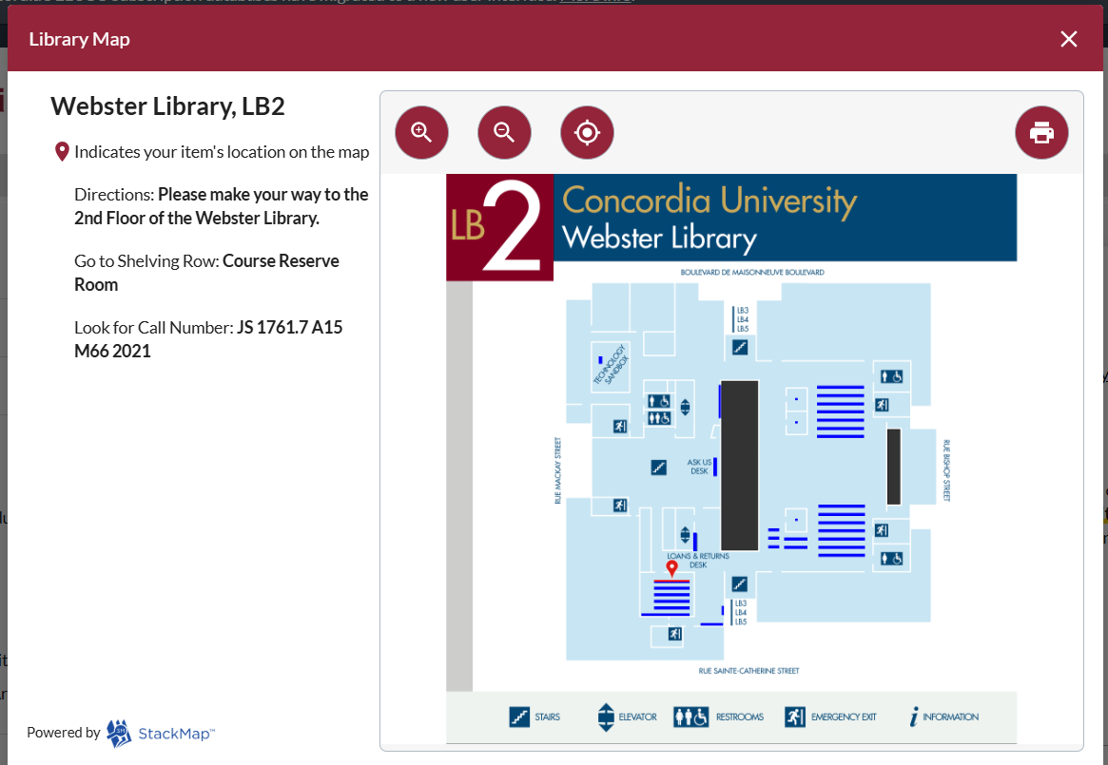
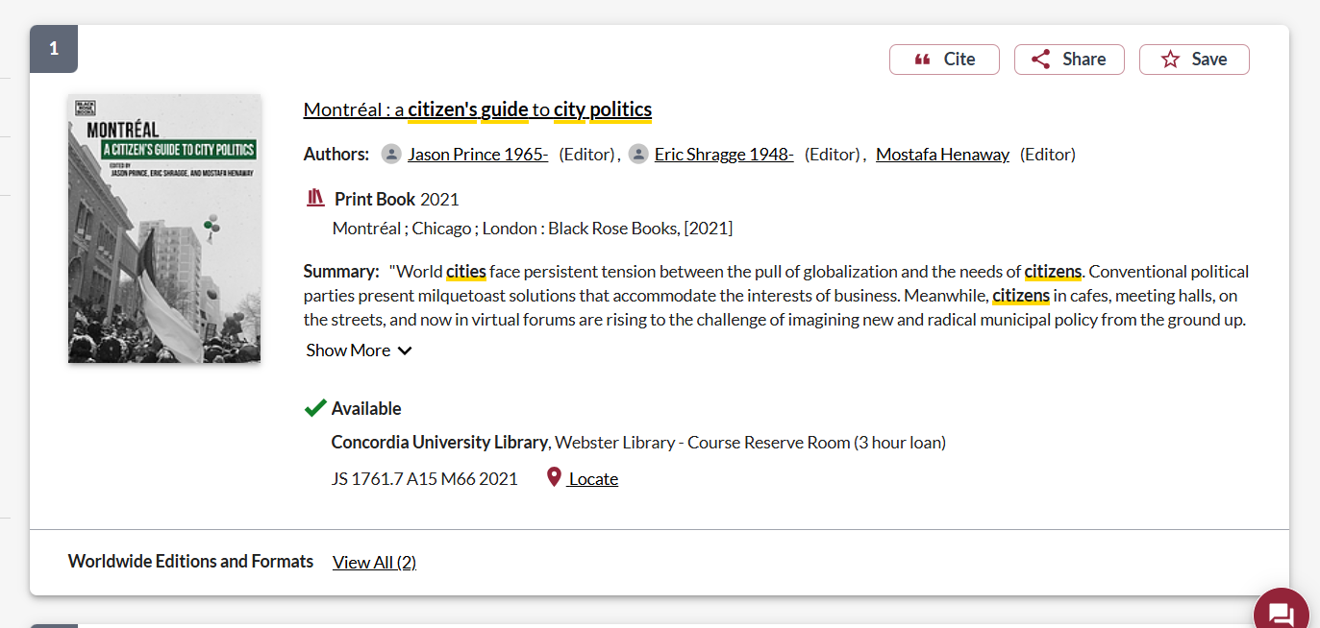

Slide 10
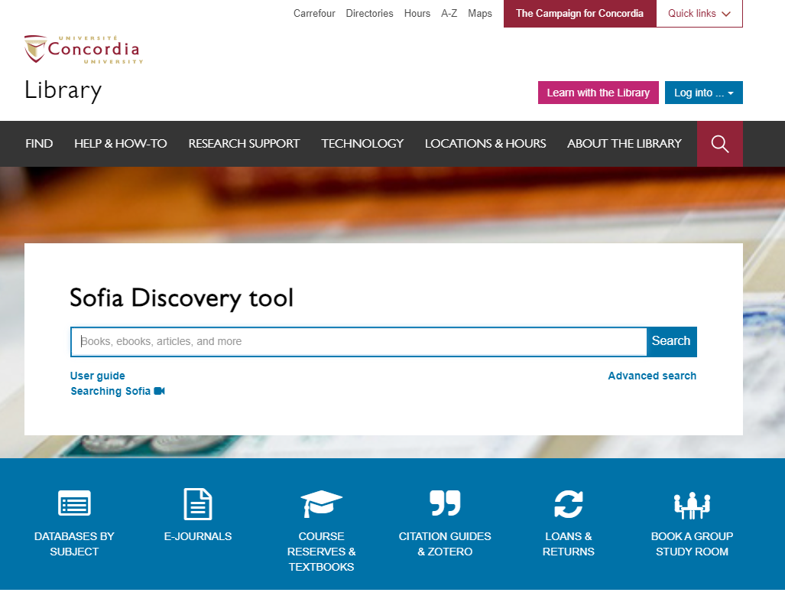
Library website: https://library.concordia.ca/
Use the Sofia Discovery tool to find print books, ebooks, and journal articles from the library.
Book a study room in the library for 2 or more people to use for up to 3 hours

Slide 11
How do I find something in the library when I have the title, and citation information?

Slide 12
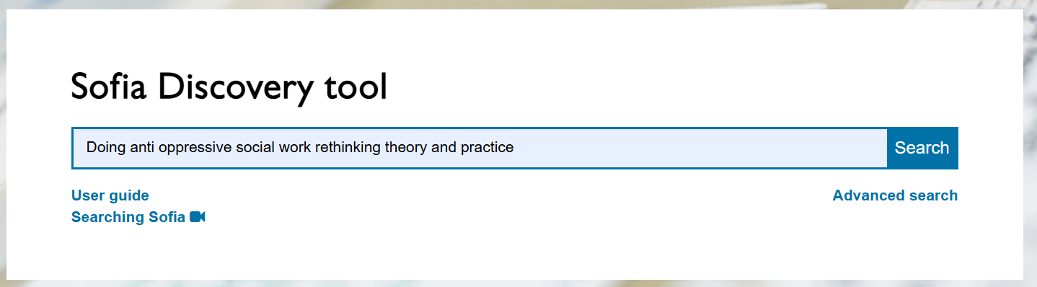
Baines, D., Clark, N., & Bennett, B. (Eds). (2022). Doing anti-oppressive social work: rethinking theory and practice. 4th edition. Winnipeg: Fernwood Publishing.

Slide 13
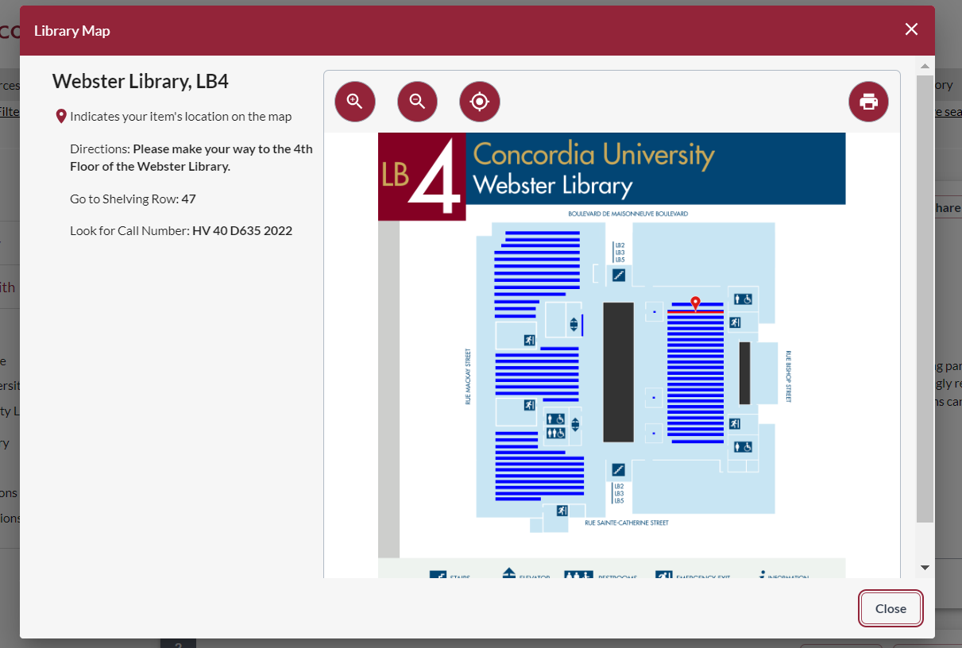
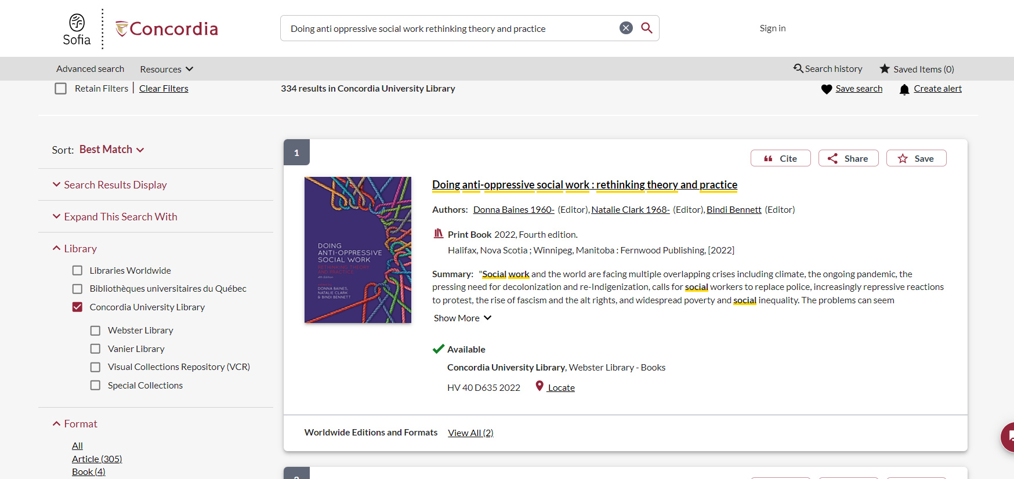

Slide 14
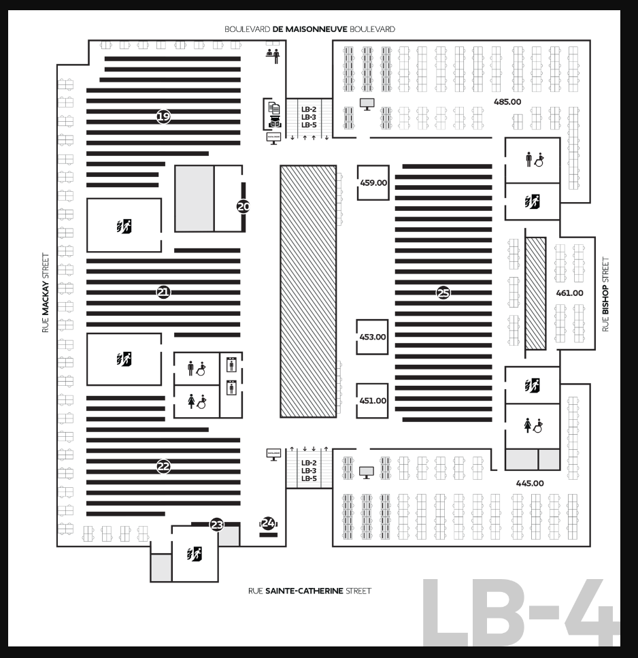
Where to find print books in the library
J-JZ
H-HX
Political Science, political institutions, public administration, and government J-JZ – 4th floor of Webster Library
Social Sciences, economics, statistics, labour, sociology, social history, social problems, families, women, public finance, communities, social and public welfare, social work H-HX – 4th floor of Webster Library
History of North America (US & Canada), Indigenous Peoples in North America E, FC – 3rd floor of Webster Library

Slide 15
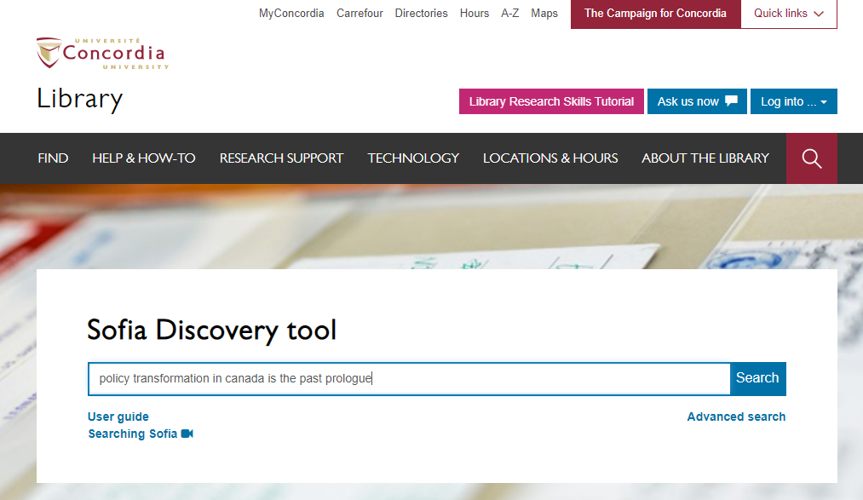
Winter, J. Environmental Policy Transformations and Canada at 150. In: Tuohy, C.H., Borwein, Loewen, P.L., & Potter A. (eds) Policy transformation in Canada: is the past prologue?. University of Toronto Press, 2019.
Book chapters
Always search for the title of the book, to see if we have access it to it in Sofia.

Slide 16
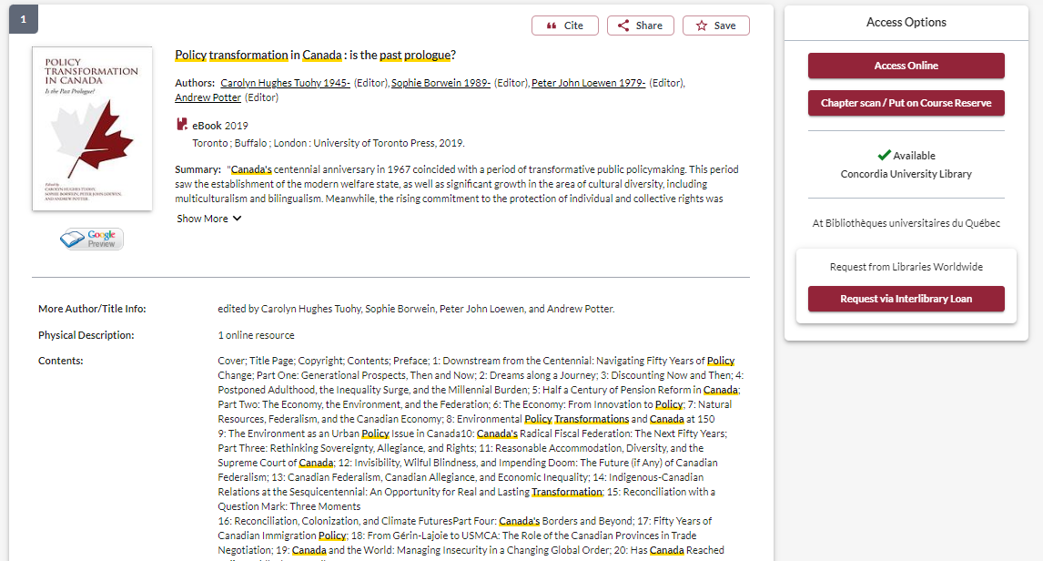

Slide 17
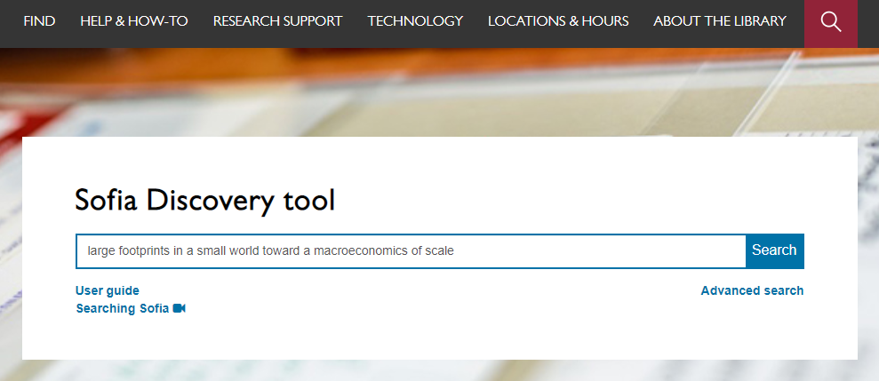
Dale, A., & Lenore, N. (2009). Large footprints in a small world: toward a macroeconomics of scale. Sustainability: Science, Practice, & Policy, 5(1), 9-19.
Always search for the article title in to find access to it through Sofia.

Slide 18
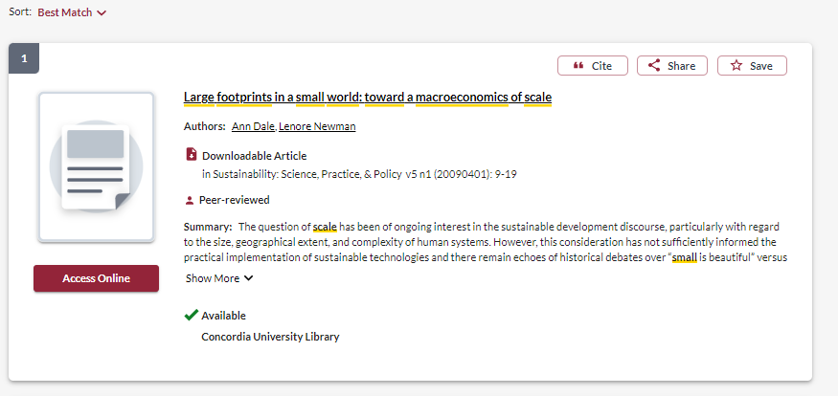
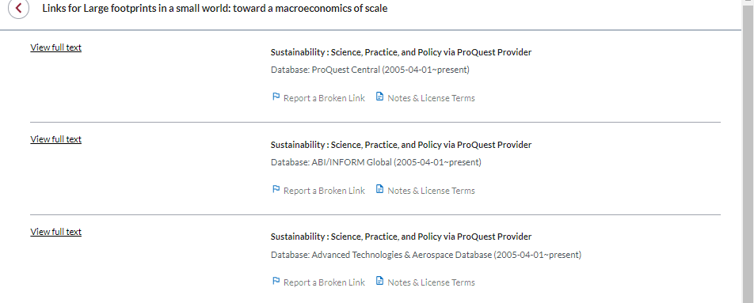

Slide 19
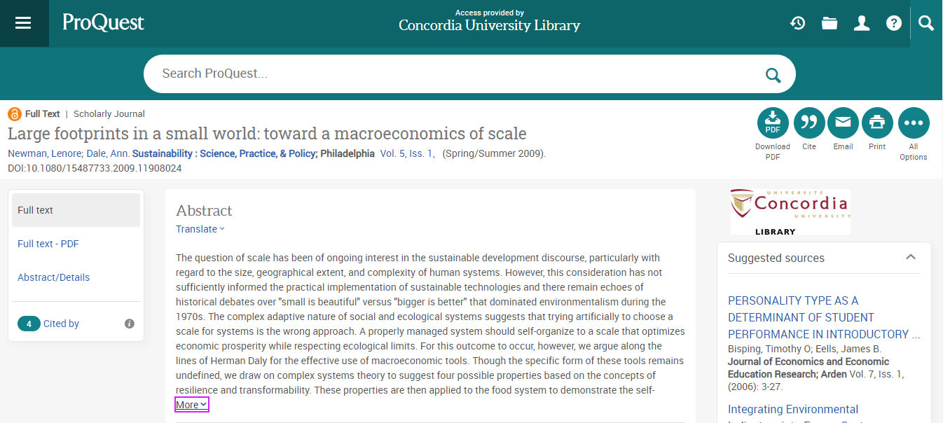

Slide 20
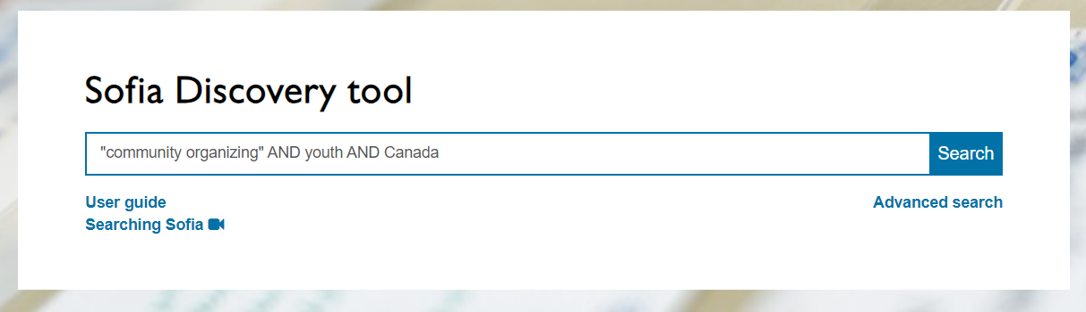
Sofia Search for books and articles – by keyword

Slide 21
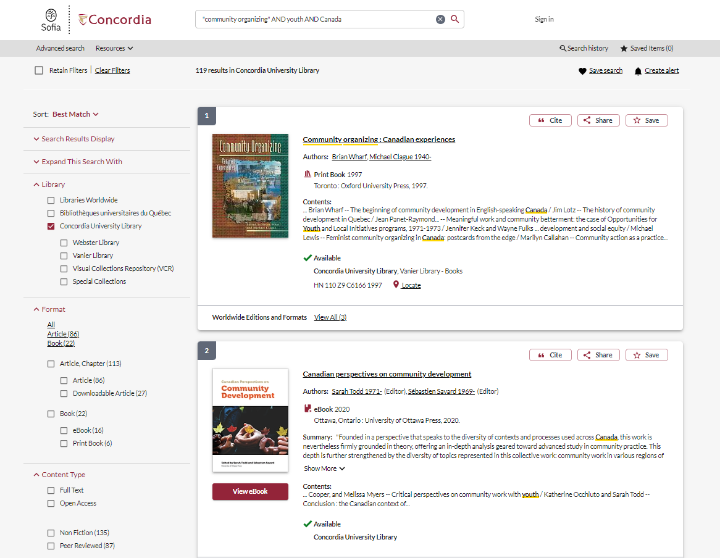
Use the options from this menu to narrow down results

Slide 22
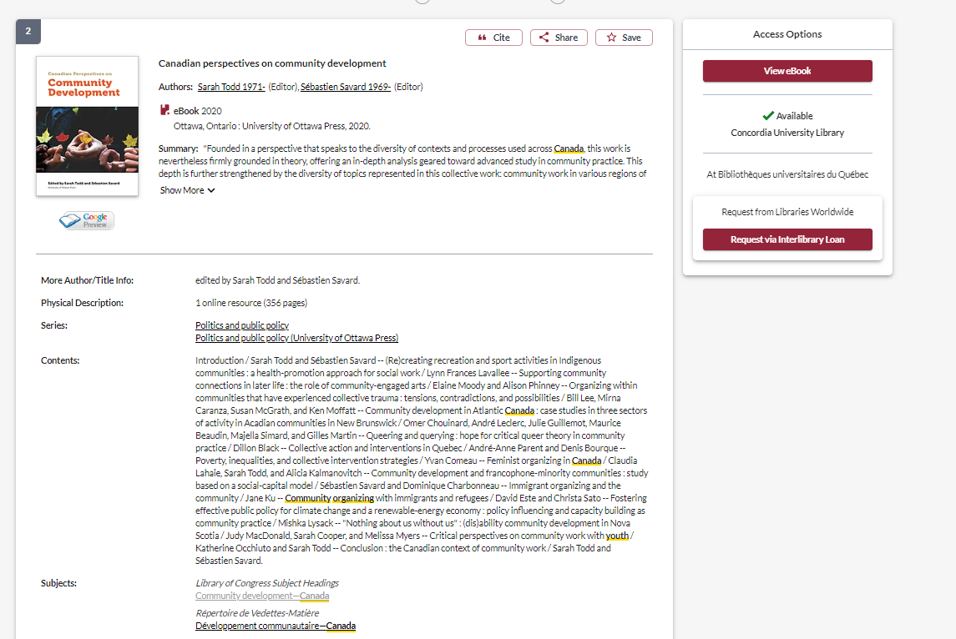
Use the subjects to find other similar resources

Slide 23
What will I find in Sofia?
Academic peer reviewed books (ebooks and print books)
Academic textbooks
Non-academic books
Academic journal articles (peer reviewed and non-peer reviewed)
Government documents
NGO documents
International Organization publications
Films: streaming and DVD

Slide 24
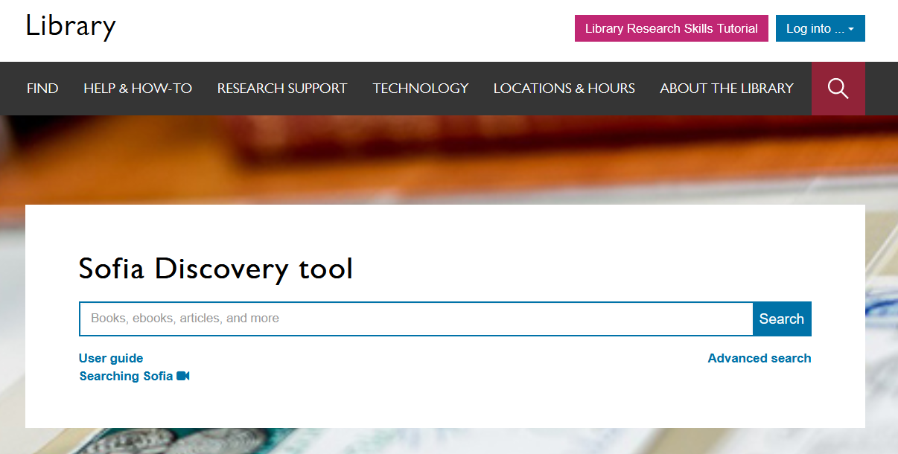
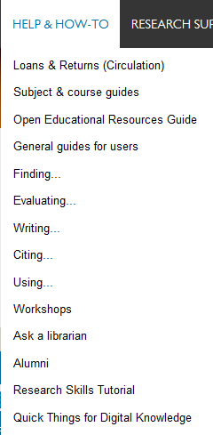

Notes:
You can also access these guides from the main library homepage by clicking on the help and how to menu and then select subject and course guides. These are great place to start for finding databases and other information for your discipline.

Slide 25
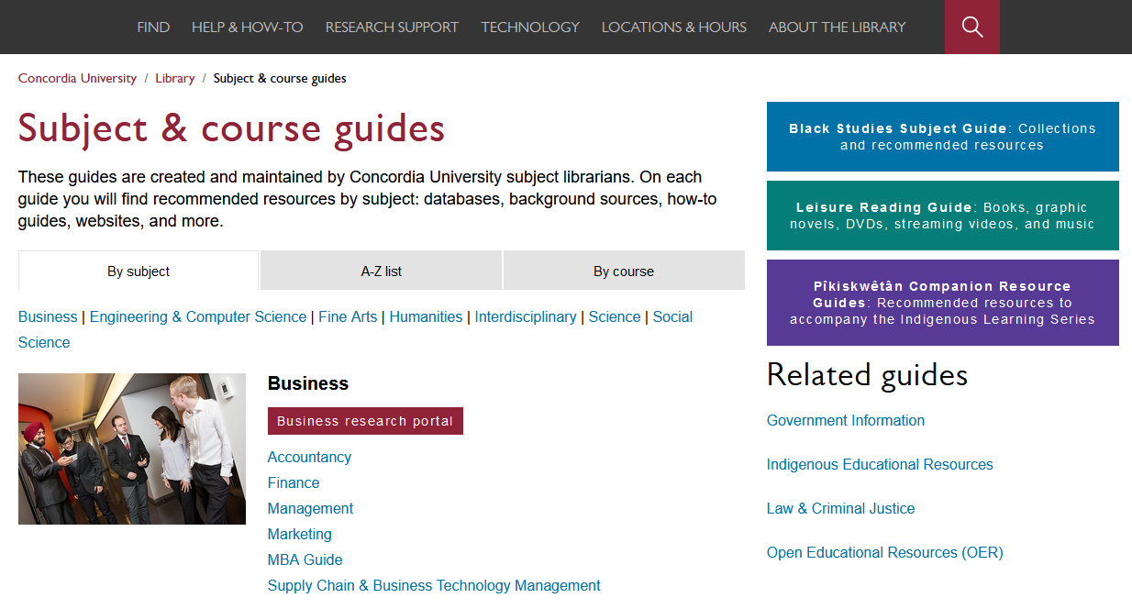
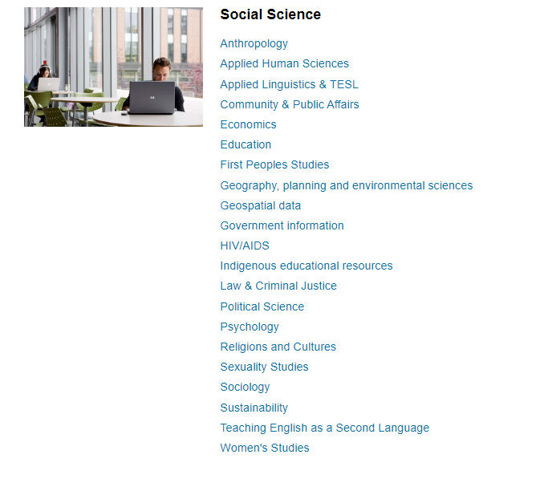
Subject and course guides
Notes:
The subject and course guides are some of the most helpful guides. They are created and maintained by the library’s subject librarians – librarians who are experts at supporting research in your field. The guides contain recommended resources for each subject, including the best databases to use, background sources like encyclopedias and handbooks, how-to guides for finding trickier resources like primary sources, lists of useful websites and online tools. The guides also have links you can use to contact your subject librarians if you have any questions or need help working on a project.

Slide 26
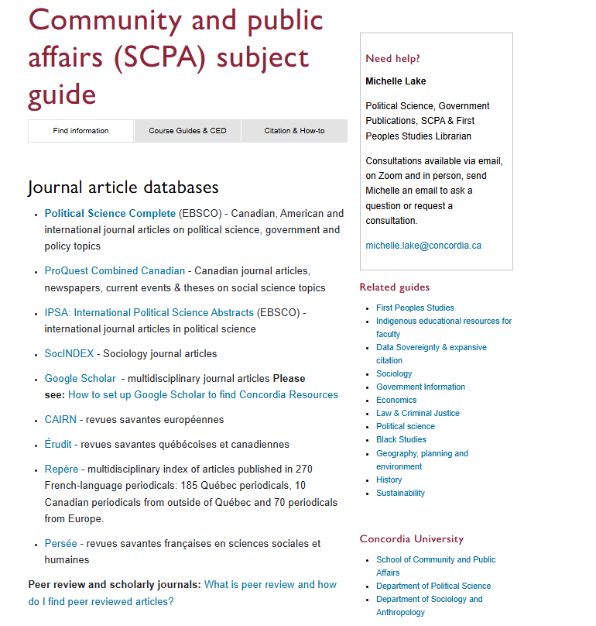

Slide 27
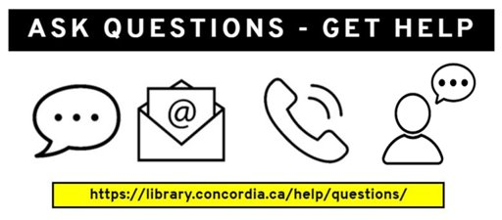
Need help, ask us!

