Slide 1
SCPA 201: Intro to Public Policy and the Public Interest – Library Workshop
Michelle Lake
SCPA, Political Science, FPST and Government Publications Librarian
Michelle.Lake@Concordia.ca

Slide 2
Who am I?
Michelle Lake, librarian for the School of Community and Public Affairs, First Peoples Studies, Political Science, and Government Publications
Michelle.Lake@Concordia.ca / Make an appointment or ask a question
What do I do?
Provide research support
Help students with library databases
Help students find and access materials they need
Help with citation issues
Choose the books we buy for the above subject areas

Slide 3
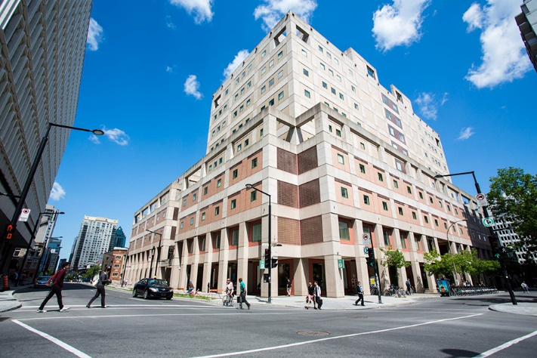
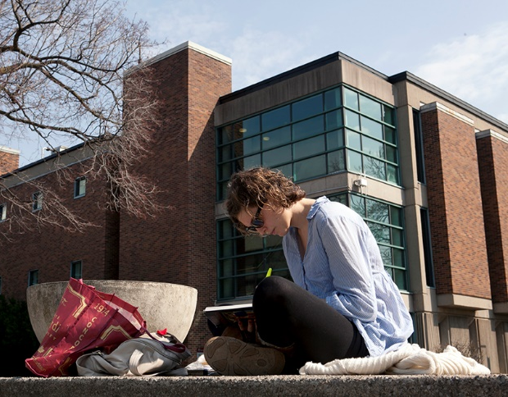
The Librar(ies)
24/7 access, with student card, after 11pm
Webster Library (LB) – downtown on SGW campus & Vanier Library (VL) on Loyola campus
Webster: Social Sciences, Humanities, Business, Engineering & Fine Arts
Vanier: Science(s), Health, Communications, Journalism and Psychology
Course Reserves Room(s): have the required undergraduate print textbooks for the courses taught at that campus (for example: Webster has the Political Science and SCPA course reserves)

Slide 4
Library Services
Your student card is your library card.
You need it to:
borrow books (up to 100 a time)
borrow a laptop and other technology (for 24 hours)
print on campus (add money to your Dprint account)
access the library overnight during 24/7 hours.
Webster library has 5 book scanners (And Vanier has 2!) that can be used for free to scan chapters from our print books and email them to yourself as a PDF.
To use Library databases, access online articles and ebooks when you are off campus, login with your MyConcordia Netname and password.

Slide 5
Electronic Course Reserves

Slide 6
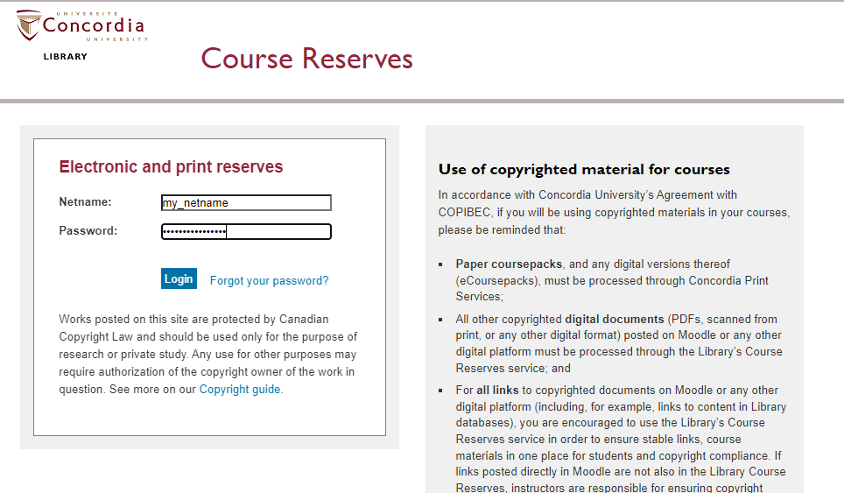

Slide 7
How can I find out if the library has an item (book, book chapter, article) I’m looking for?

Slide 8
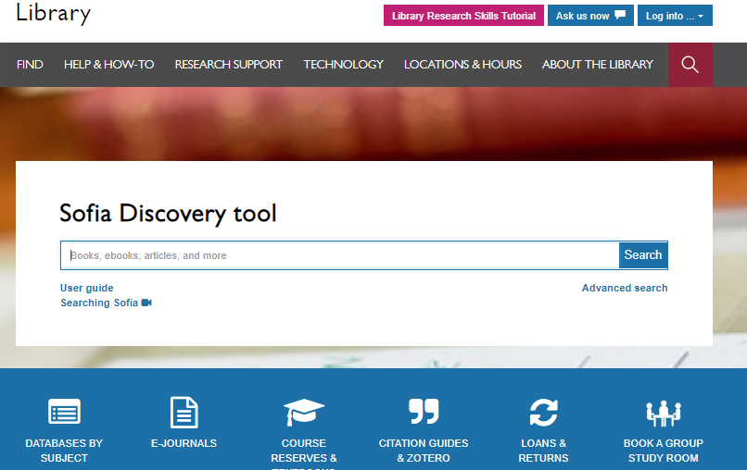

Slide 9
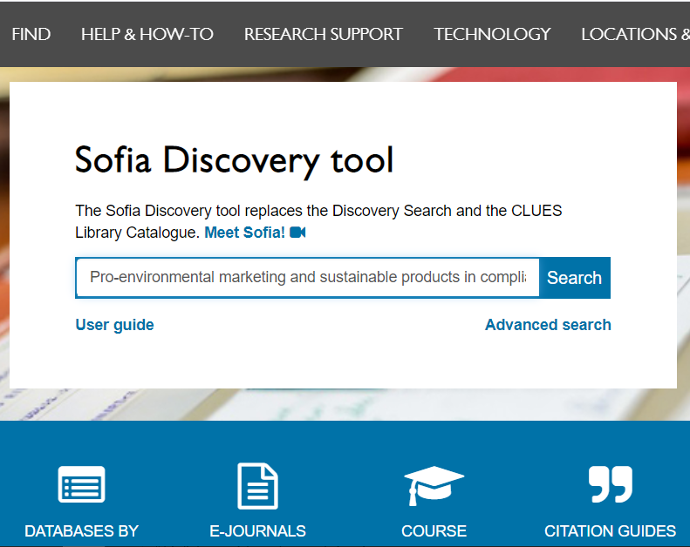
Search for library books, ebooks, films, articles

Slide 10
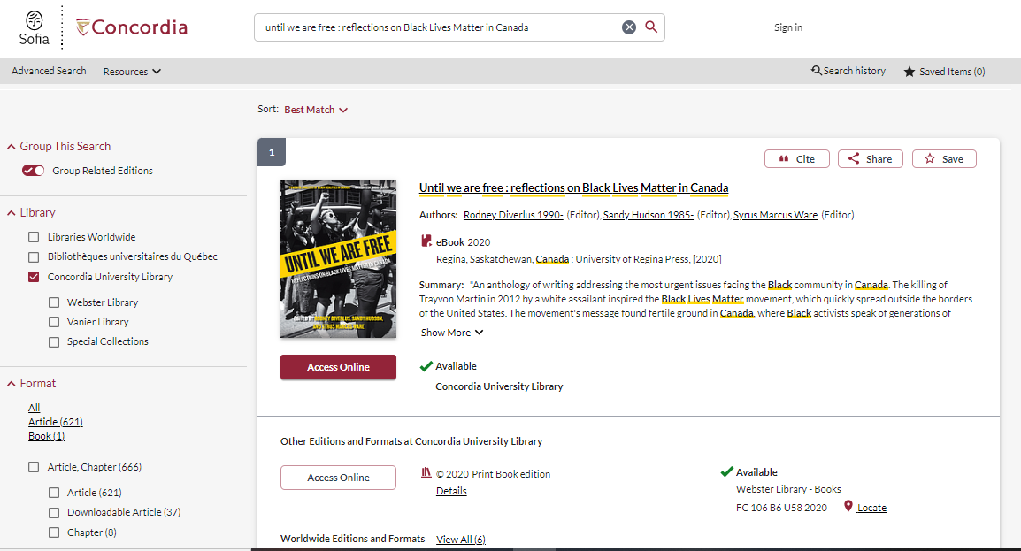

Slide 11
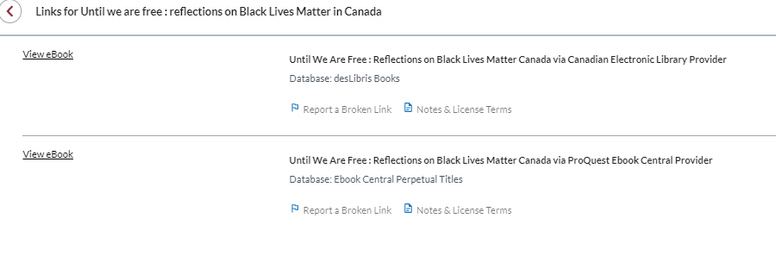
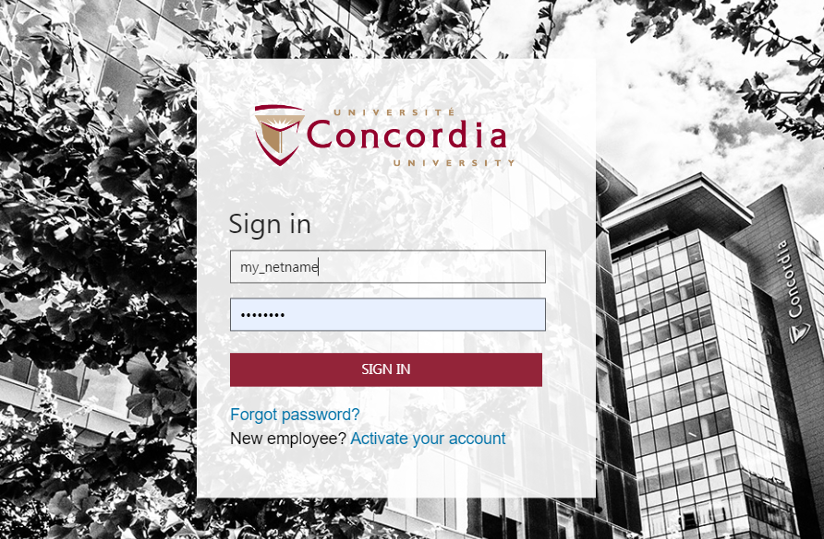

Slide 12
Often ebooks have restrictions on downloading and printing pages; reading the book online is usually the best option

Slide 13
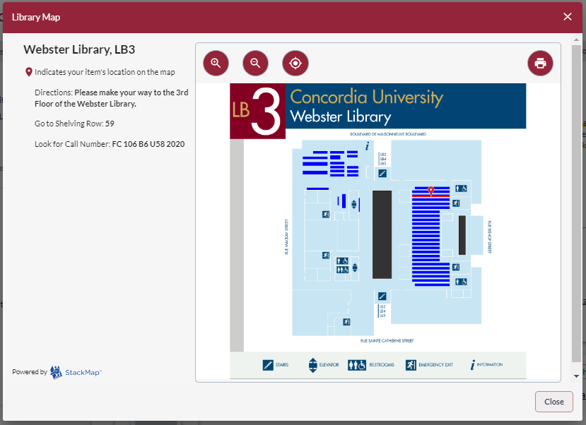

Slide 14
Winter, J. Environmental Policy Transformations and Canada at 150. In: Tuohy, C.H., Borwein, Loewen, P.L., & Potter A. (eds) Policy transformation in Canada: is the past prologue?. University of Toronto Press, 2019.
Always search for the title of the book, to see if we have access it to it in Sofia.

Slide 15
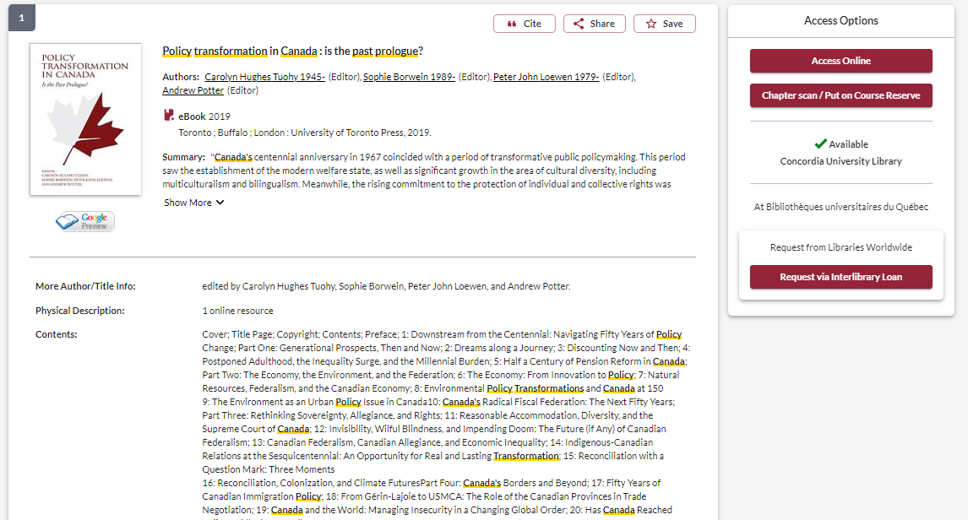

Slide 16
Dale, A., & Lenore, N. (2009). Large footprints in a small world: toward a macroeconomics of scale. Sustainability: Science, Practice, & Policy, 5(1), 9-19.
Always search for the article title in to find access to it through Sofia.

Slide 17
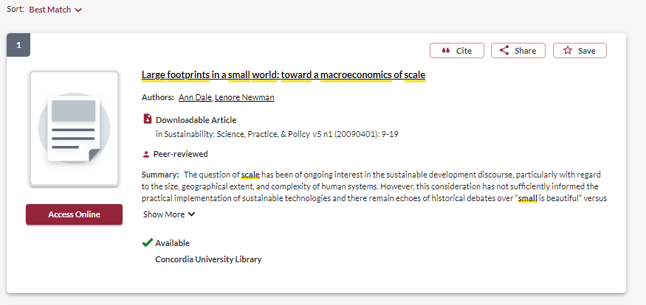
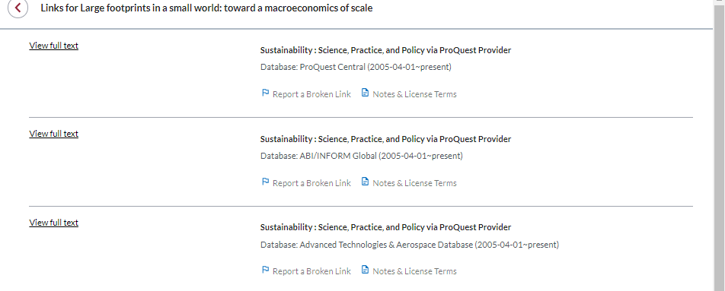

Slide 18
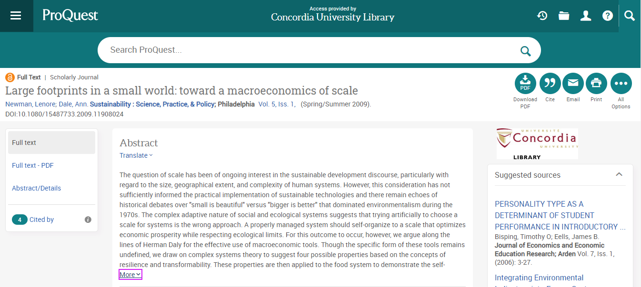

Slide 19
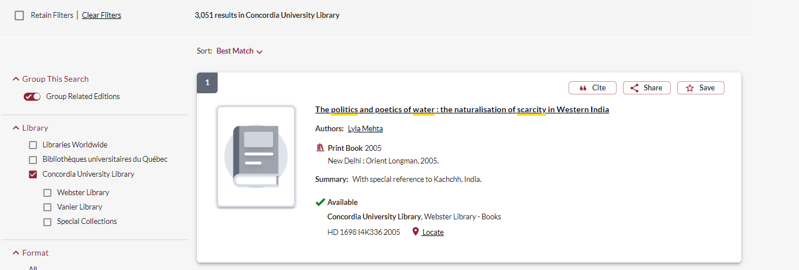
Network Loans

Slide 20
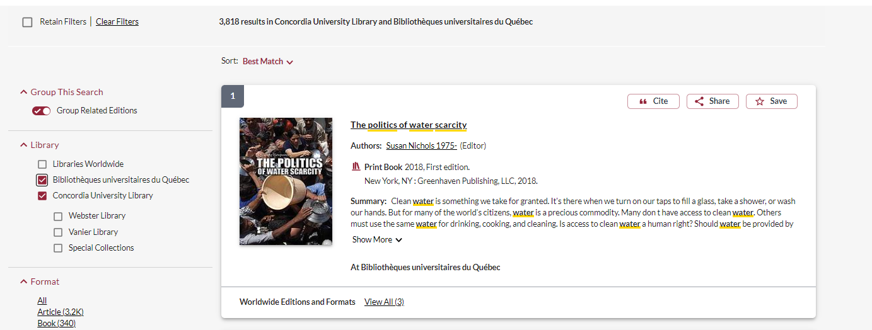
Request the book and it will be delivered to Concordia for your use

Slide 21
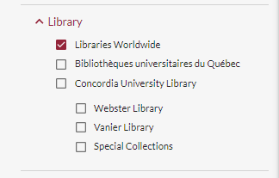
Request a book via Interlibrary Loan
I found this book searching in ‘Libraries worldwide’ and it is not in Concordia’s collection, or in any Quebec university libraries

Slide 22
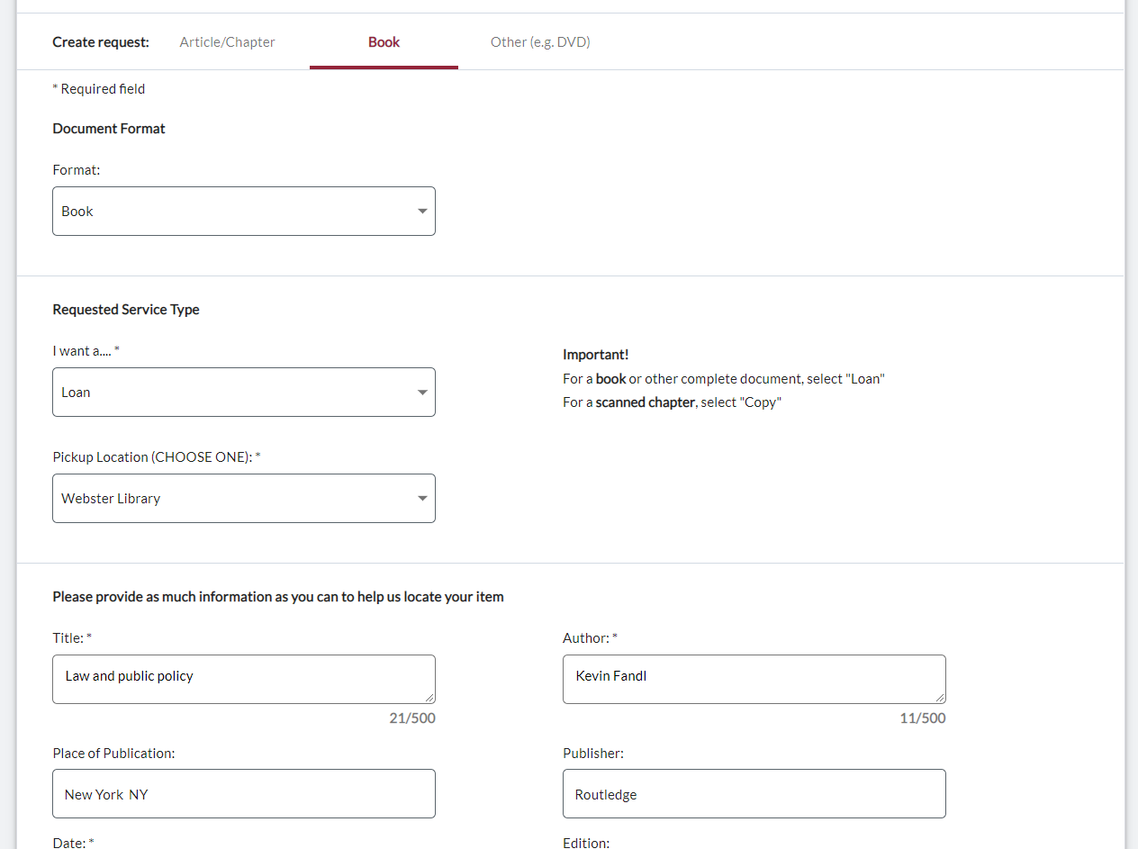

Slide 24
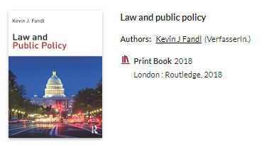
Check the status of your request under the "Requests" tab.​

Slide 25
Research Essay
The research essay is a term paper on a topic of your choice related to a public policy issue, possibly looking at it from a comparative (objectivist versus relational ontology) perspective.
Worth 35%
A - denotes work that is of exceptional quality. Exceptional quality is represented by evidence of engagement with information and ideas in course materials and lectures, and from other sources, thoroughness, careful thinking, integration of material across topics, logical reasoning, precise and artful writing.

Slide 26
Topic: Immigration policy in Quebec

Slide 27
What words are we going to search with?

Slide 28
Immigration policy in Quebec
Keywords:
Immigration
Policy
Quebec

Slide 29
Synonyms or alternative words
Immigration
Immigrant
Migration
Migrant
Refugee
Policy
Policies
Regulations
Laws
Legislation
Avoid unnecessary or linking words like:
effects, impact, consequences, influence, results, importance, significance, causes, etc.

Slide 30
How do we combine search words for the best possible results?
AND: combines concepts and limits your results
Democracy AND environment
Law OR legislation
“climate change”
“social policy”
OR: allow you to insert synonyms or alternative terms and increases your results
“quotation marks”: If you put two or more words in quotation marks, that exact phrase will be searched and limits your results.

Slide 31
How do you start your research? Where do you look first?

Slide 32
Sofia Searching
Always type AND, OR in ALL CAPS in Sofia searches

Slide 33
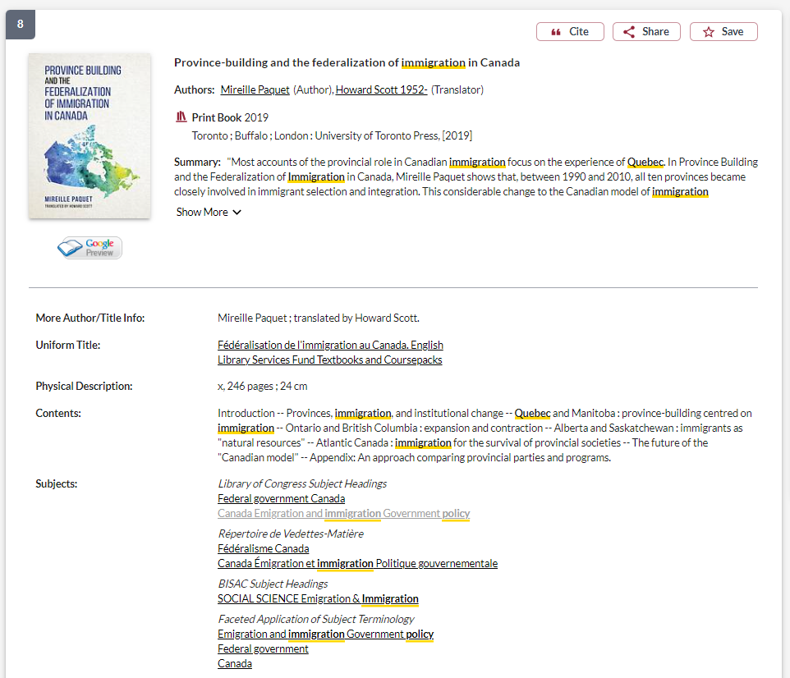
Look for useful subject headings and click for more resources

Slide 34
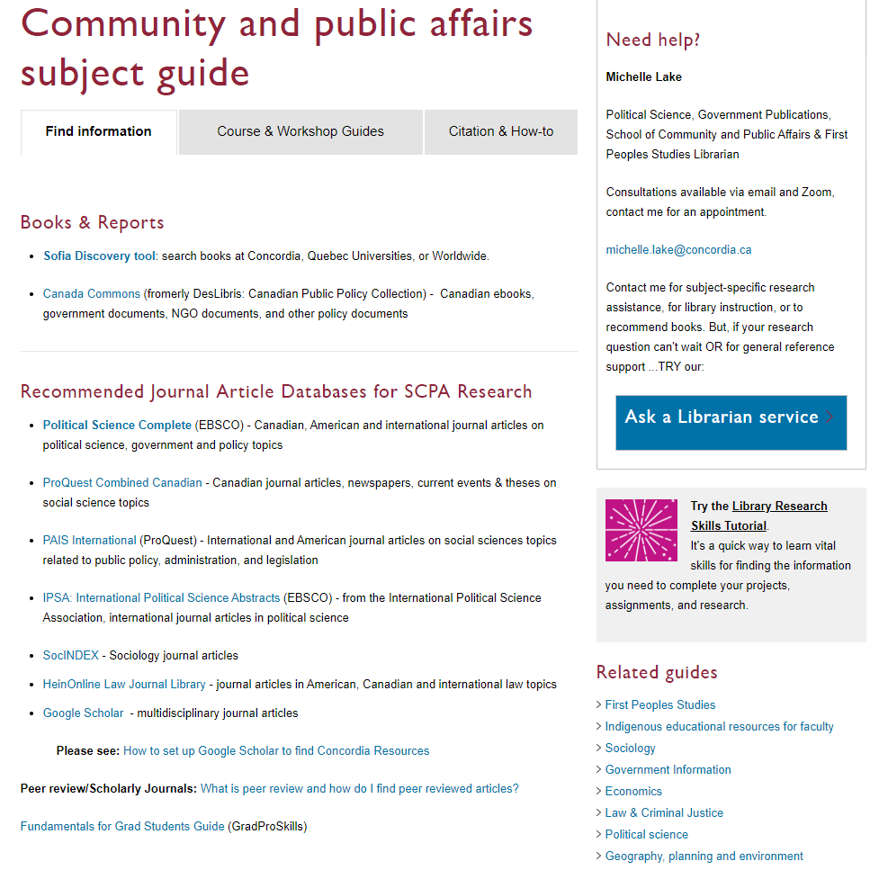
SCPA Subject Guide

Slide 35
Political Science Complete – for journal articles
Each of the main concepts is in its own search box, combined with AND
All the synonyms combined with OR are in the separate search boxes

Slide 36
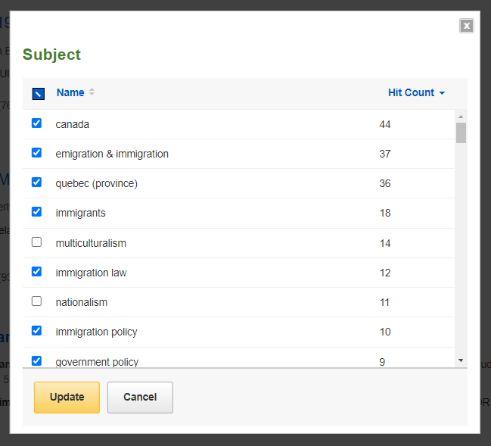
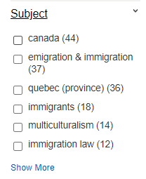
Using the limits in a database

Slide 37
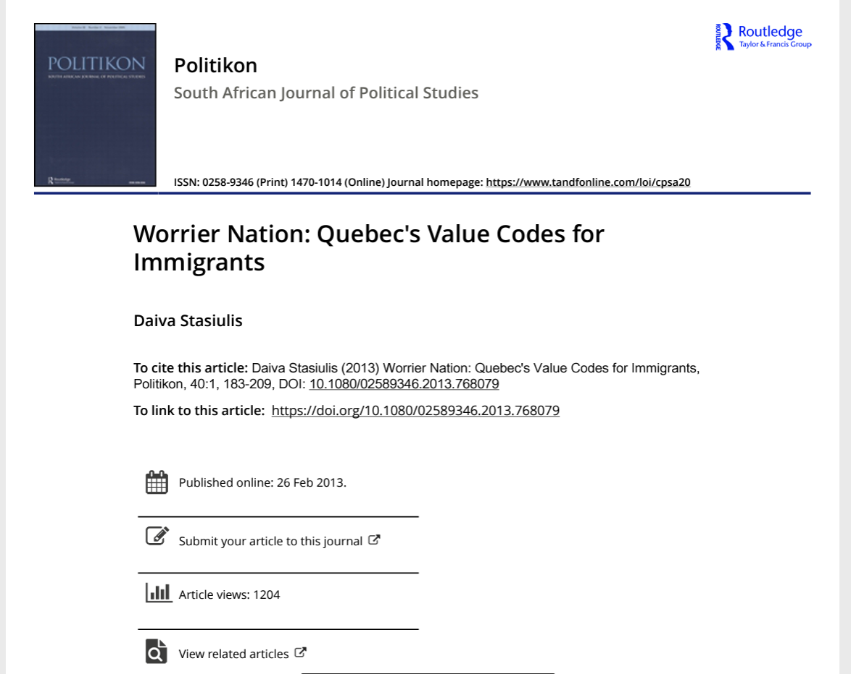
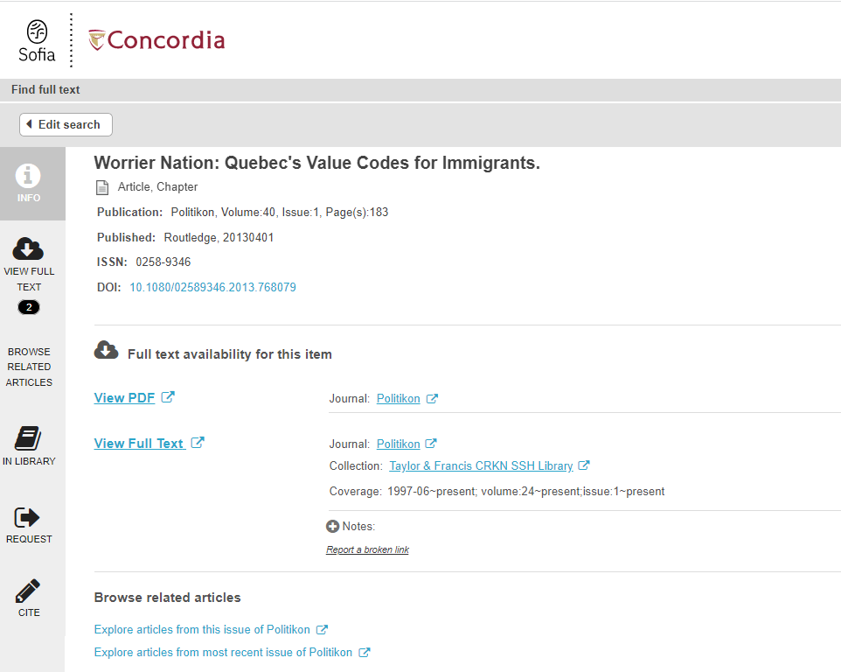
If there is no PDF, click on Find it @ Concordia for access to the article

Slide 38
What is peer review? What are peer reviewed, scholarly articles?

Slide 39
Has the article gone through the peer review process? What is peer review? Peer review is a system used to decide if an article should be published in a peer-reviewed journal. Each paper submitted to a peer-reviewed journal is read and evaluated by experts in the article’s subject area. The reviewers assess the article’s validity, importance, and originality, and then recommend whether it should be printed in the journal. The reviewers’ suggestions are considered by the journal’s editor, who makes the final decision about whether to accept or reject the article. Criteria for evaluating academic or scholarly articles

Slide 40
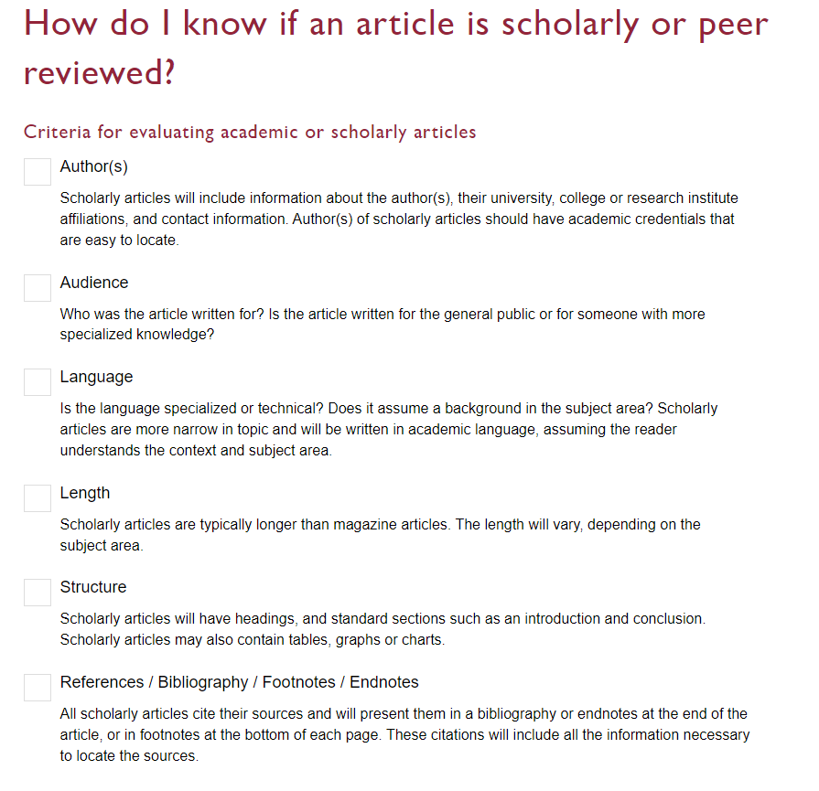

Slide 41
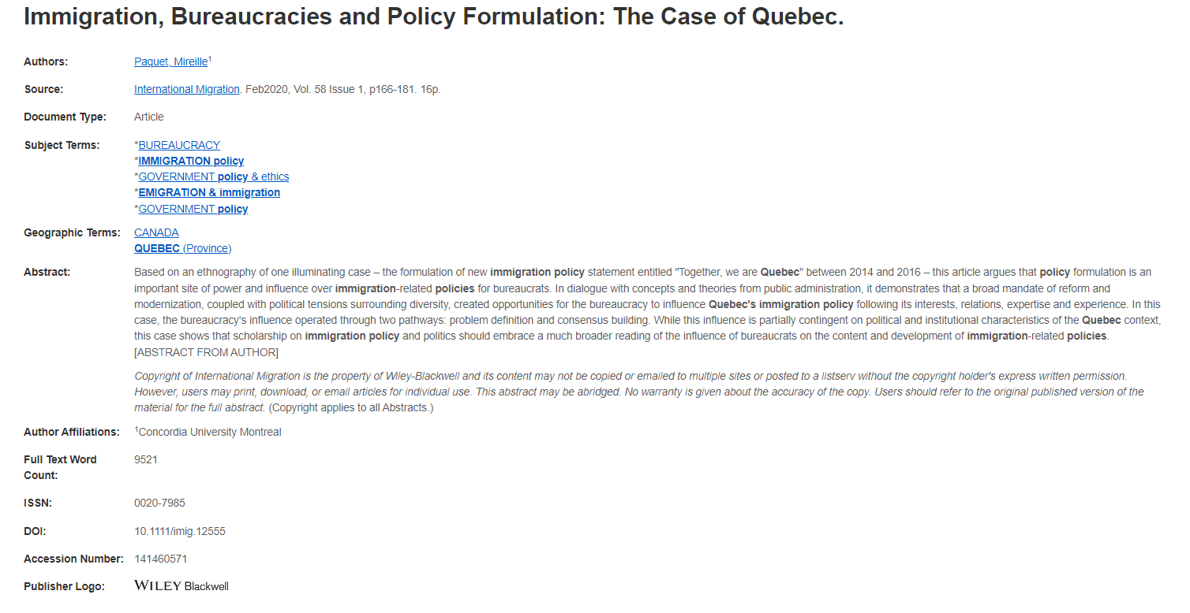
Author
Length: between 15-30 pages
The author is a Concordia faculty member

Slide 42
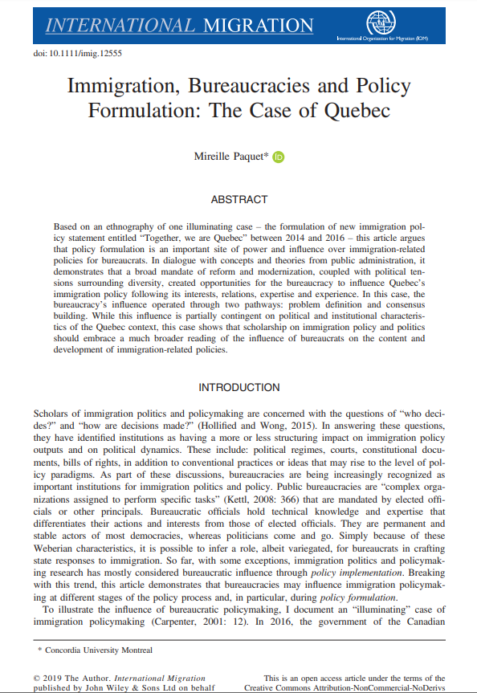
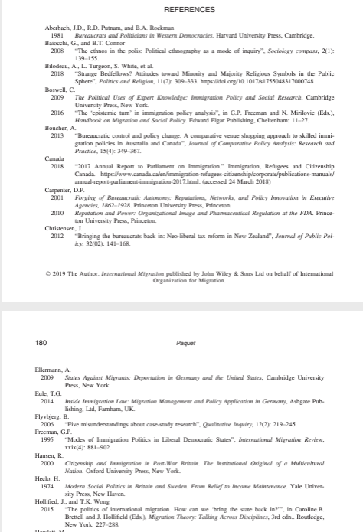
Structure: the article has sections and headings, there is also a methods section and a conclusion
References: An extensive reference list of scholarly sources and citations
Audience/Language: specialist language used, for a specific audience of readers

Slide 43
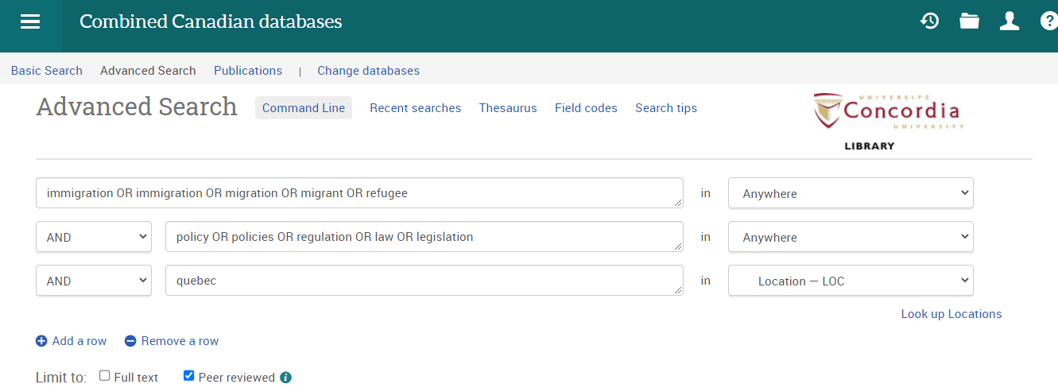
ProQuest Combined Canadian
Using the same keywords and synonyms I used in Political Science Complete, I will perform another search in this Canadian journal database.
Note, I’m searching Quebec as a Location, and I’ve already checked off ‘peer reviewed’ as an option.

Slide 44
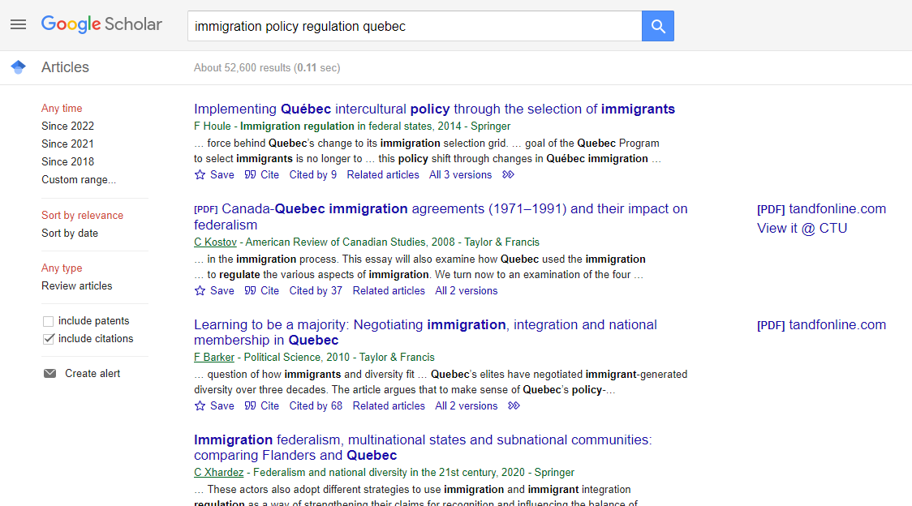
Google Scholar

Slide 45
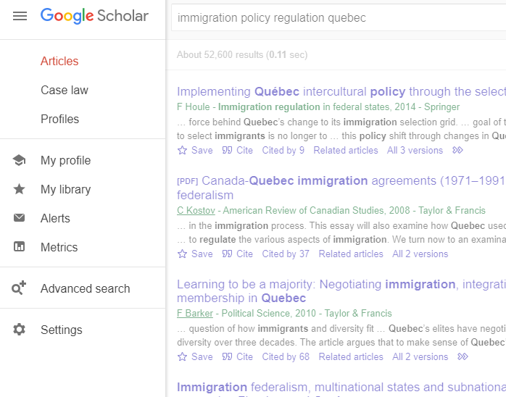
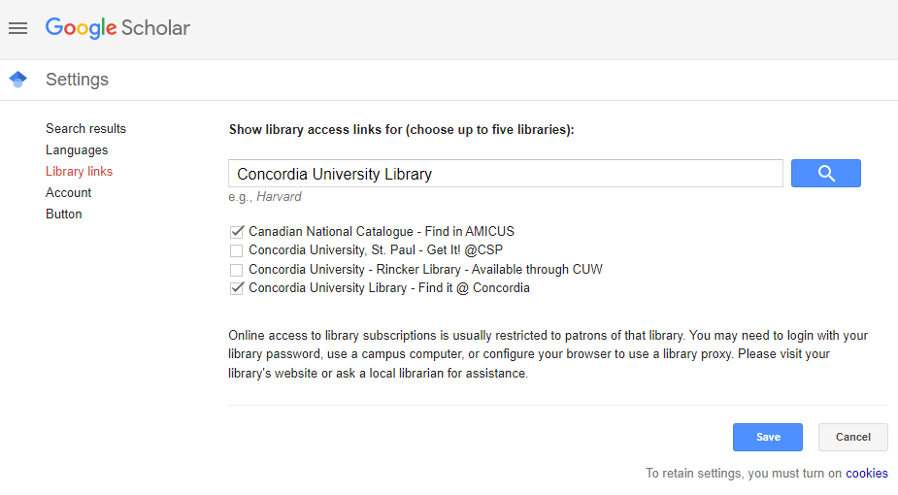

Slide 46
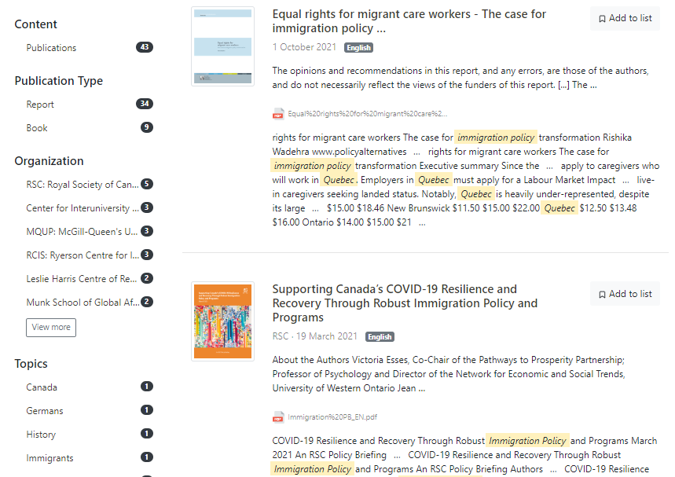
I narrowed to 2021 and found about 50 results.
Canada Commons includes scholarly ebooks and publications from independent publishers, and public policy papers from think tanks and government.

Slide 47
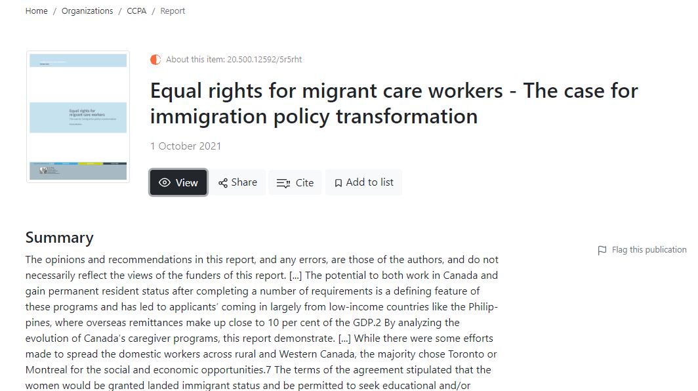

Slide 48
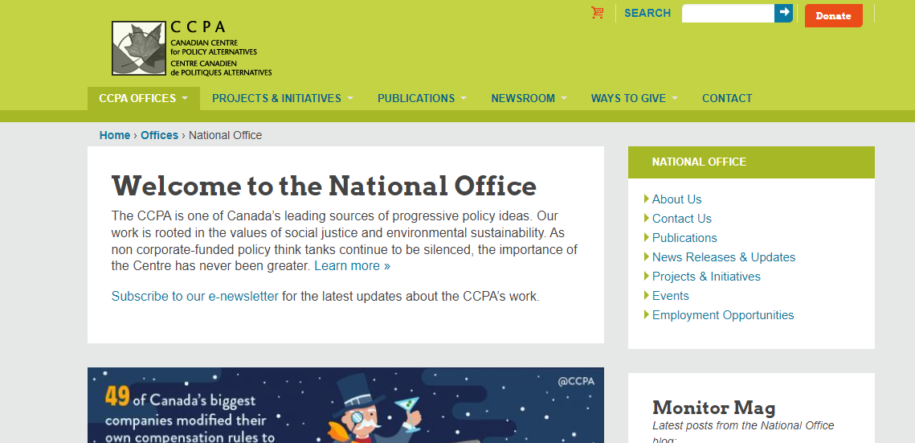
Always evaluate your sources! Who are the authors? What is the organization?

Slide 49
There is help available!
Michelle.Lake@Concordia.ca

Slide 50
Key points from today’s workshop
Go through the library website to connect to everything we have access to at Concordia
Use a SCPA recommended database to find journal articles
Think about and plan your keywords and search strategy
Evaluate all your sources
There is help available at the library!

