Slide 1

Introduction to Black Studies in the Canadian Context Library Workshop
Michelle Lake
Subject Librarian: Political Science, SCPA, First Peoples Studies, Government Information and Black Studies

Slide 2
Who am I?
Michelle Lake, librarian for Political Science, the School of Community and Public Affairs, First Peoples Studies, Government Publications and Black Studies
Michelle.Lake@Concordia.ca / Make an appointment on Zoom or in person, or ask a question
What do I do?
  Provide research support in consultations & teach workshops
  Academic research topics: search development & strategies, keywords, subject searching, library databases, journals and books
  Help you find and access materials, including scholarly materials, newspapers & media, government documents, grey literature, etc.
  Assist with citation issues
  Choose the books we buy for the above subject areas

Slide 3
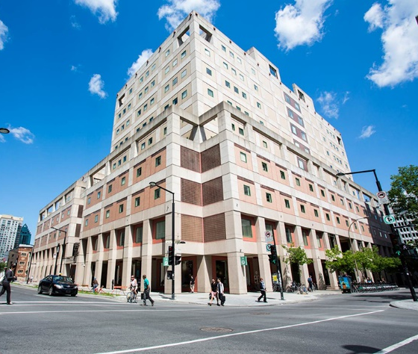
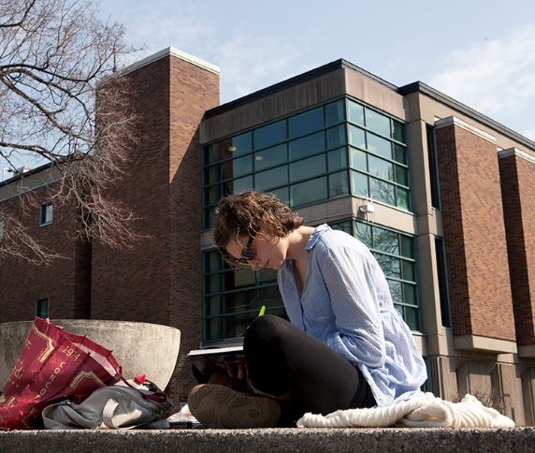
The Librar(ies)
24/7 access, with student card, after 11pm
Webster Library (LB 2-5) – downtown on SGW campus: Social Sciences, Humanities, Business, Engineering & Fine Arts
Vanier Library (VL 1-3) on Loyola campus: Sciences, Health, Communications, Journalism & Psychology
Group study rooms available for booking on the library website, 3 hour slots
Course Reserves Room(s): borrow print textbooks and required reading for the courses taught at that campus (BLST course reserves are downtown at Webster library)
The Technology Sandbox /Makerspace at Webster Library, 10am-5pm weekdays

Slide 4

Library Services
Your student card is your library card.
You need it to:
borrow books (up to 100 a time)
borrow a laptop (3 day loan) and other technology
print on campus (add money to your Dprint account)
access the library overnight during 24/7 hours.
Webster library has 5 book scanners (And Vanier has 2!) that can be used for free to scan chapters from our print books and email them to yourself as a PDF.
To use Library databases, access online articles and ebooks when you are off campus, login with your MyConcordia Netname and password.

Slide 5
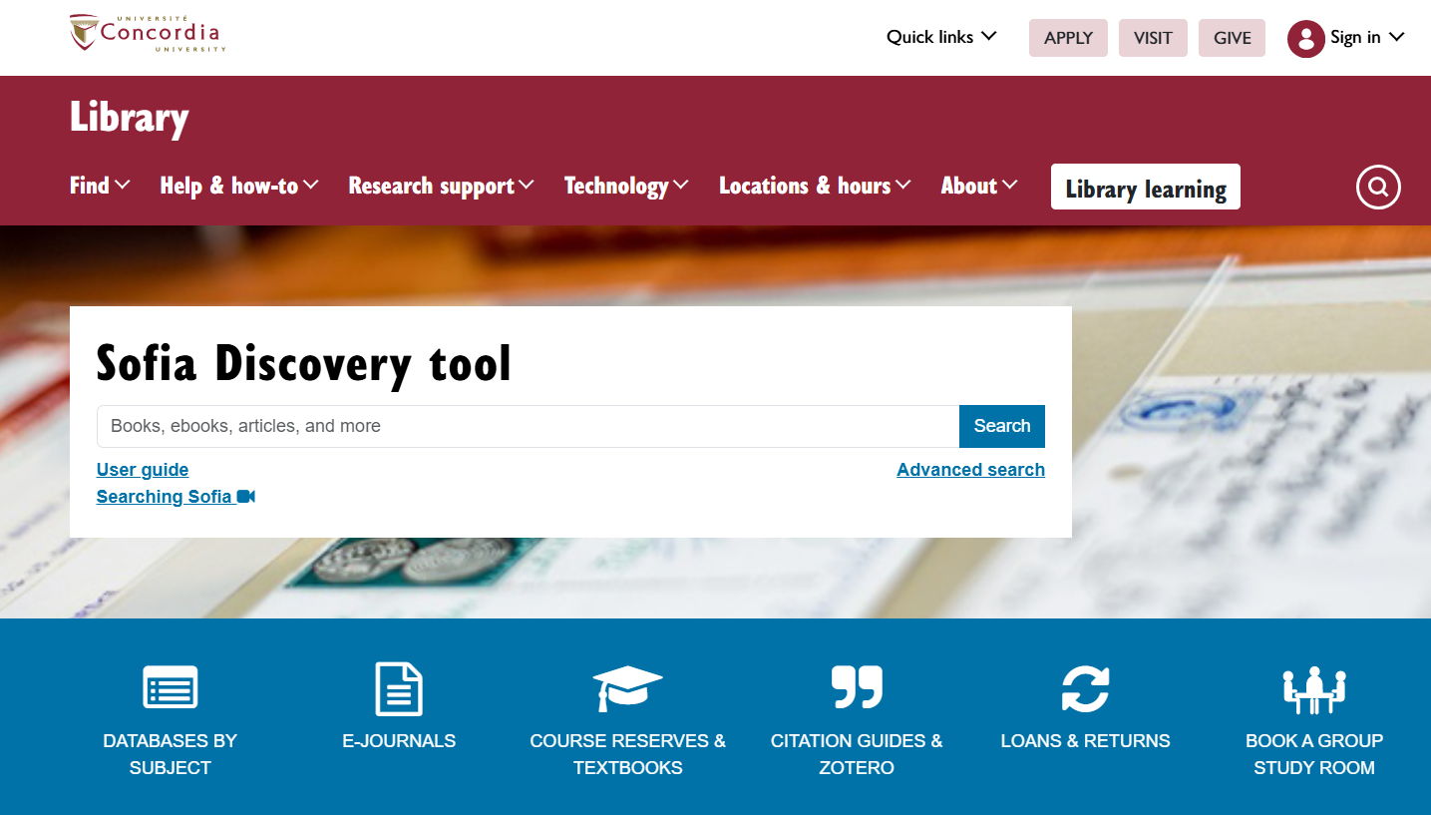
Library website: https://library.concordia.ca/
Use the Sofia Discovery tool to find print books, ebooks, and journal articles from the library.
Book a study room in the library for 2 or more people to use for up to 3 hours

Slide 6
Click here to login to eReserves!

Slide 7
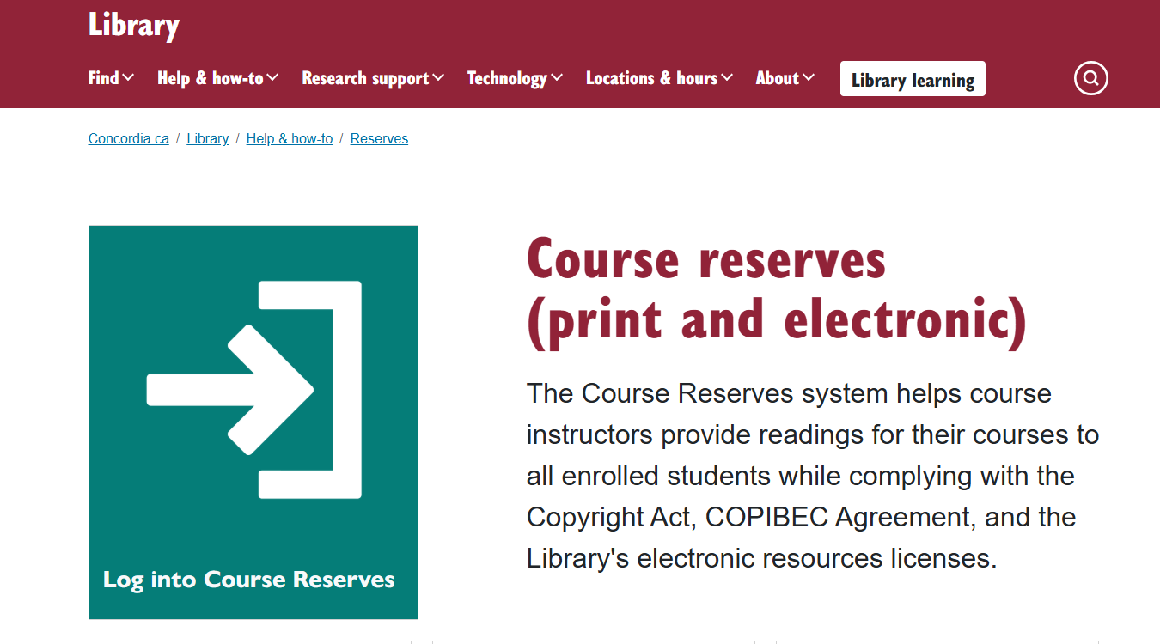

Slide 8
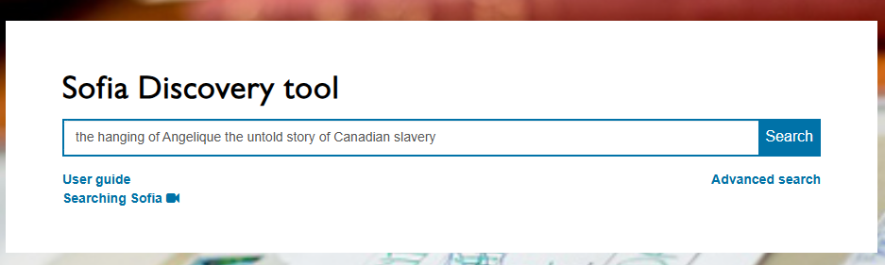
Print Reserves Example:
Afua Cooper, (2006) The Hanging of Angelique: The Untold Story of Canadian Slavery and the burning of Old Montreal. University of Georgia Press.

Slide 9
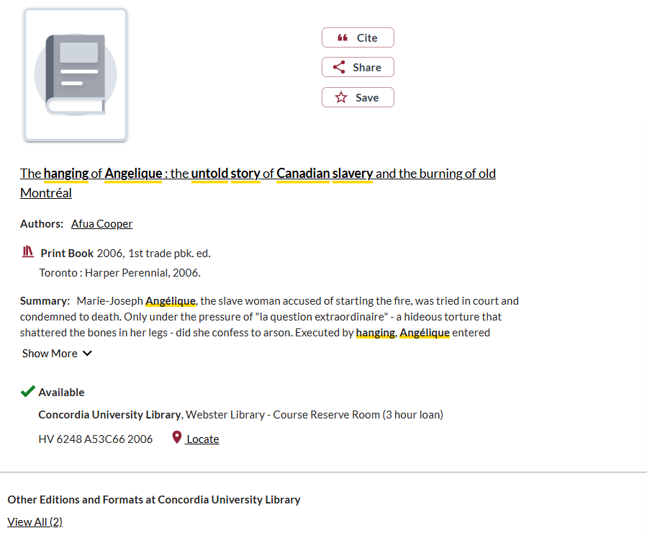
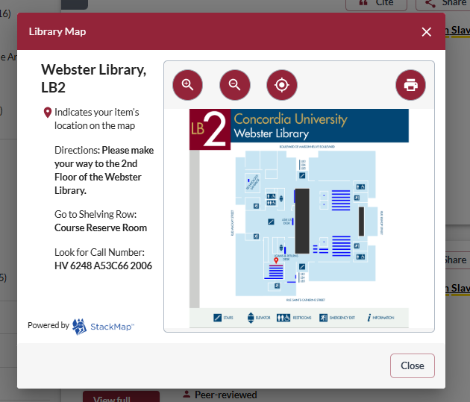

Slide 10
How can I find out if the library has access to an item I’m looking for?

Slide 11
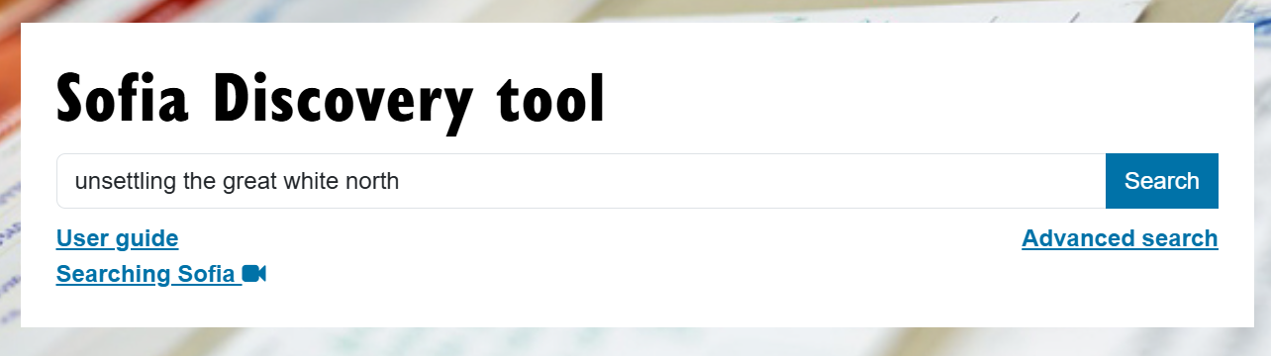
Johnson, M. , & Aladejebi, F. (Eds). (2022). Unsettling the Great White North: Black Canadian History. University of Toronto Press.

Slide 12
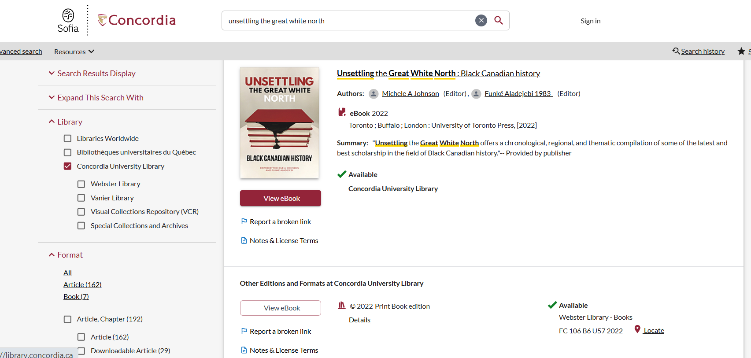

Slide 13
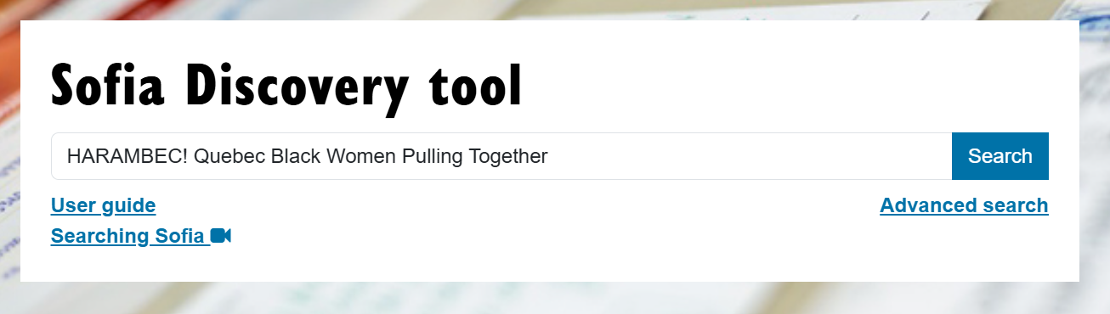
Small, S., & Thornhill E. M. A. (2008). HARAMBEC! Quebec Black Women Pulling Together. Journal of Black Studies 38(3): 427-442.

Slide 14
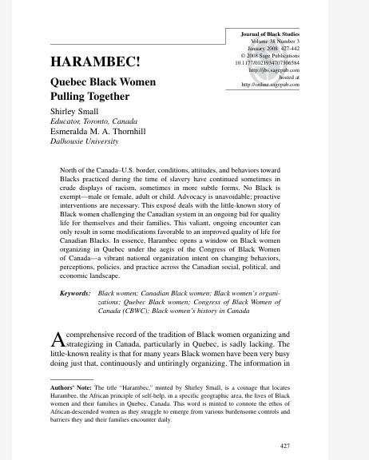
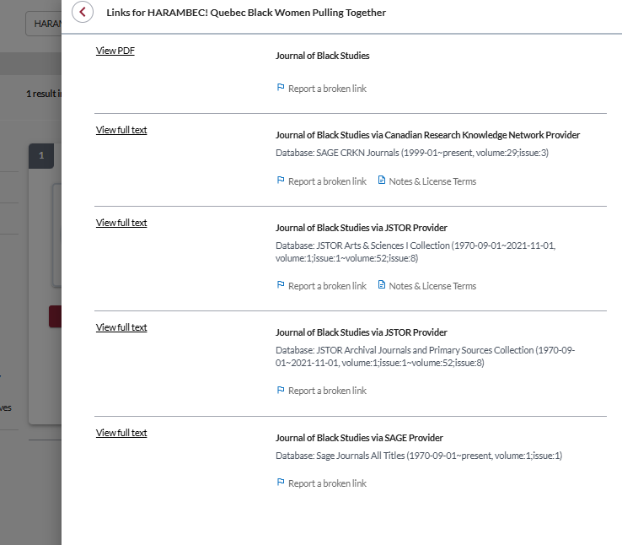
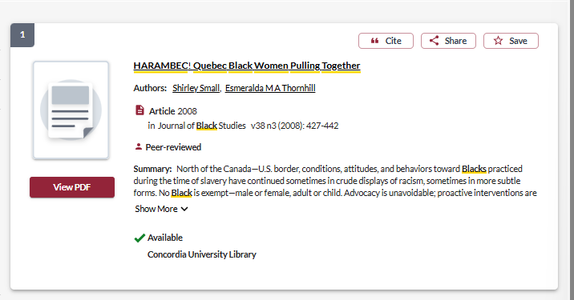

Slide 15
Searching in Sofia

Slide 16
What will I find in Sofia?
Academic peer reviewed books (ebooks and print books)
Academic textbooks
Non-academic books
Academic journal articles: peer reviewed
Government documents
International Organization publications
NGO/Think Tank/Organizational publications
Films
Special Collections materials
Curriculum collection/children’s books

Slide 17

Search strategies

Slide 18
How do we combine search words for the best possible results?
AND: combines concepts and limits your results
activism AND education
state OR government
OR: allows you to insert synonyms or alternative terms and increases your results

Slide 19
How do we combine search words for the best possible results?
“quotation marks”: If you put two or more words in quotation marks, that exact phrase will be searched and limits your results.
“Black Canadians”
“Black lives matter”
Music*
Finds: music, musician, musicians, musical
* - when you add an asterisk on the end of a word, your results will contain all the words with those endings or suffix

Slide 20
Avoid Searching with linking words
Each author may use different linking words when discussing similar topics.
Effects
Impact
Consequences
Influence
Results
Importance
Significance
Response
Emphasis
Causes
You don’t want your search to be limited to those books and articles that only contain the word “effect” or “consequence”

Slide 21
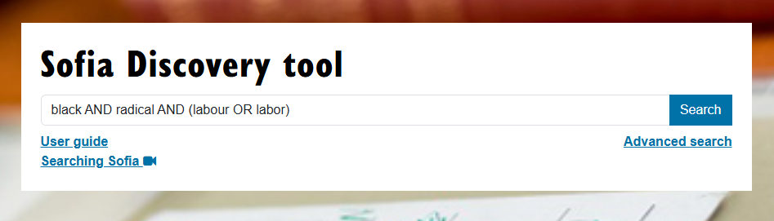
Sofia Search

Slide 22
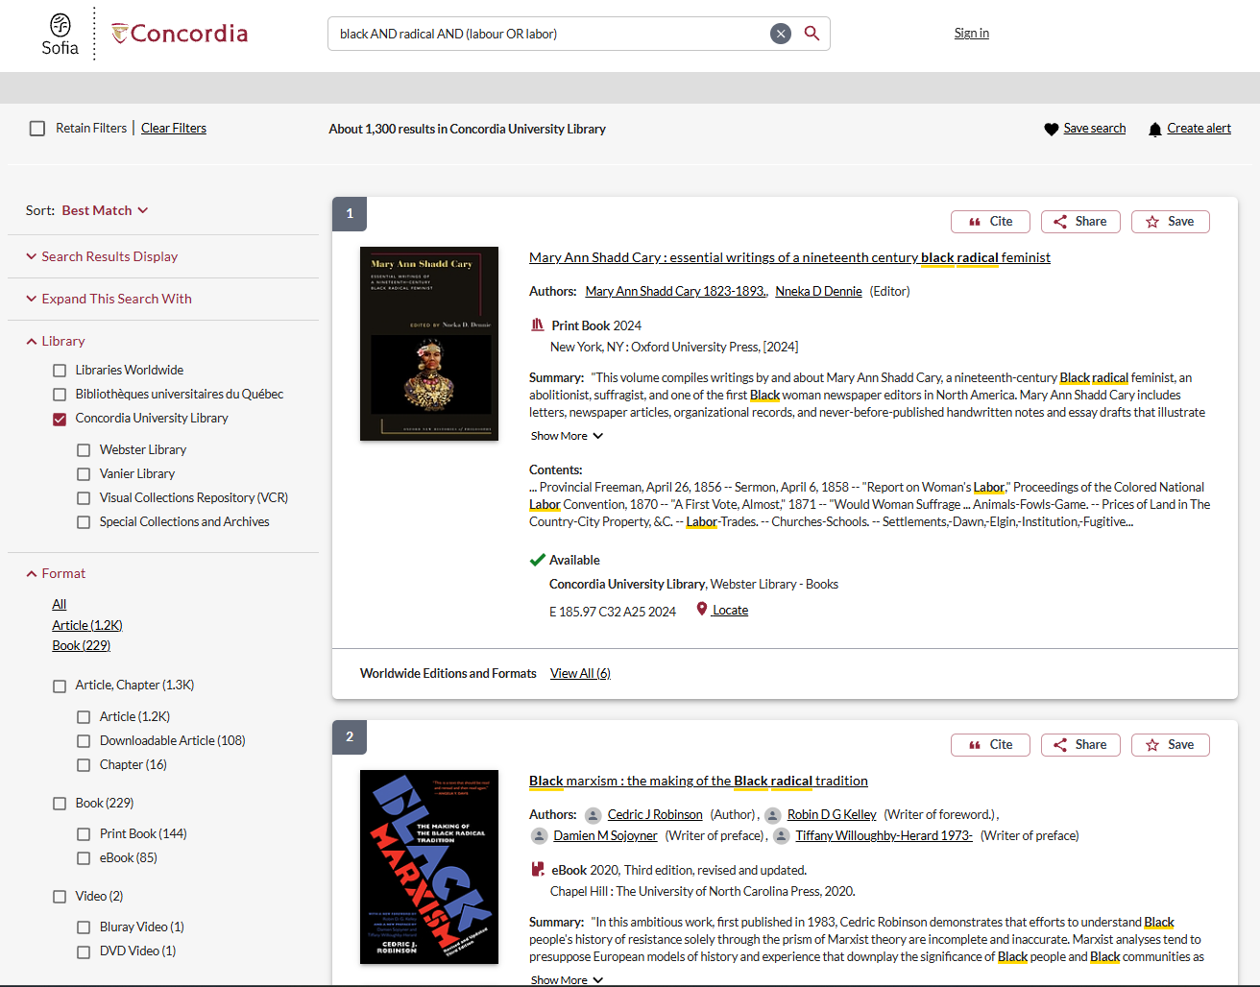
Use the limiters in the left menu to narrow down your results

Slide 23
Libraries as colonial institutions
“The library is always an ideological structure. It’s not just what goes into the library that matters, but how it’s organized and under which norms.”
Daniel Heath Justice, Ph.D, ACRL Choice Webinar: Indigenous Literatures, social justice and the decolonial library (2019)
“When we look at collections, the actual ‘information’ contained in libraries and how it is organized, we can see that it (surely by accident) somehow manages to construct a reality wherein whiteness is default, normal, civilized and everything else is Other.”
nina de jesus, Locating the library in institutional oppression, In the library with the lead pipe (Sept 24, 2014)

Slide 24
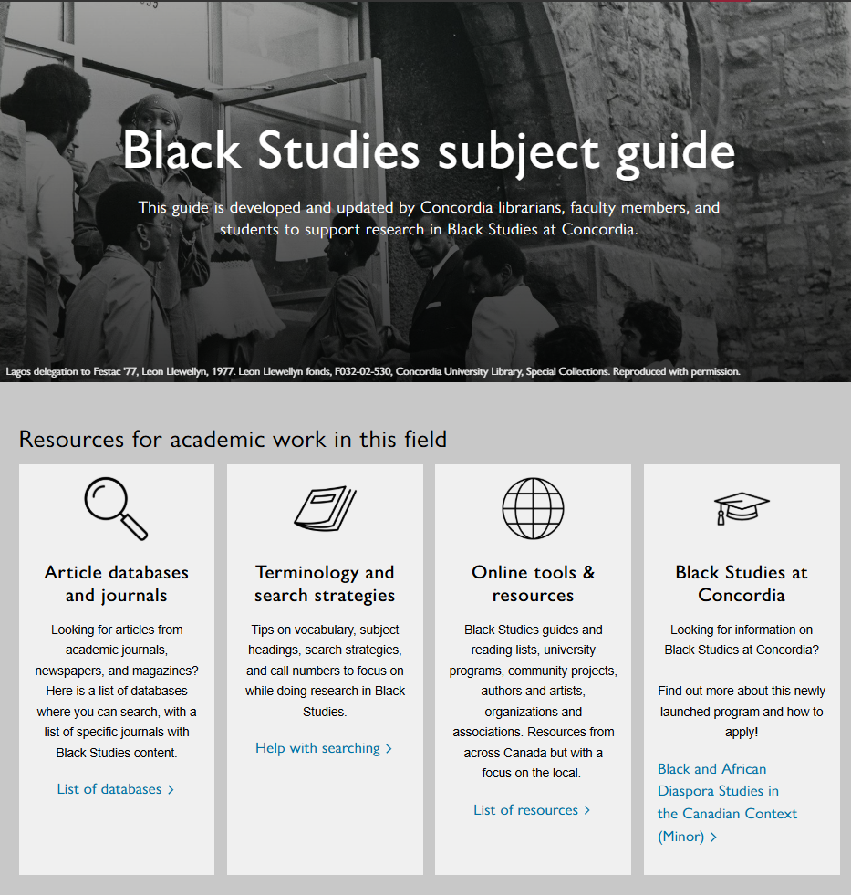
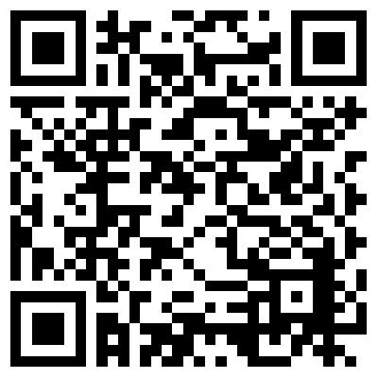

Slide 25
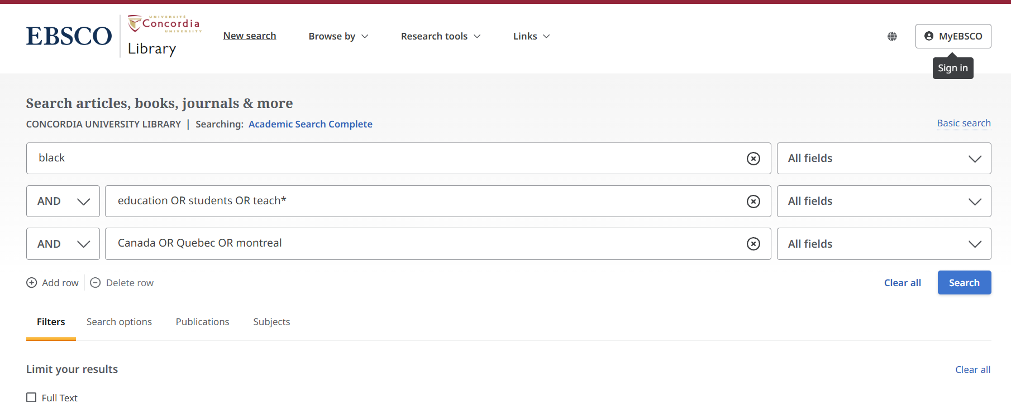
Academic Search Complete: interdisciplinary database search

Slide 26
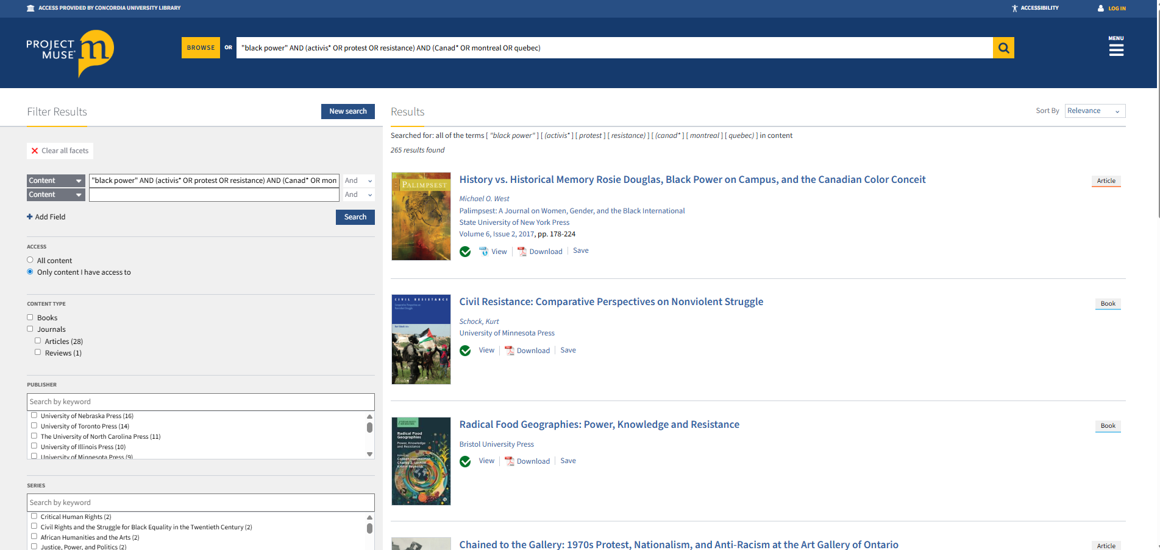
Project Muse: Interdisciplinary database of scholarly articles and books
Limit options

Slide 27
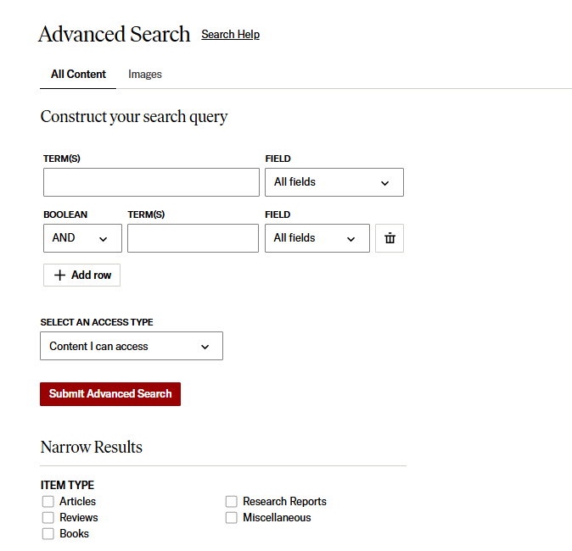
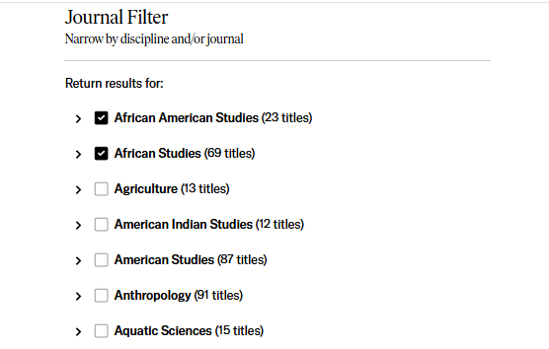
JSTOR: disciplinary journal searching

Slide 28
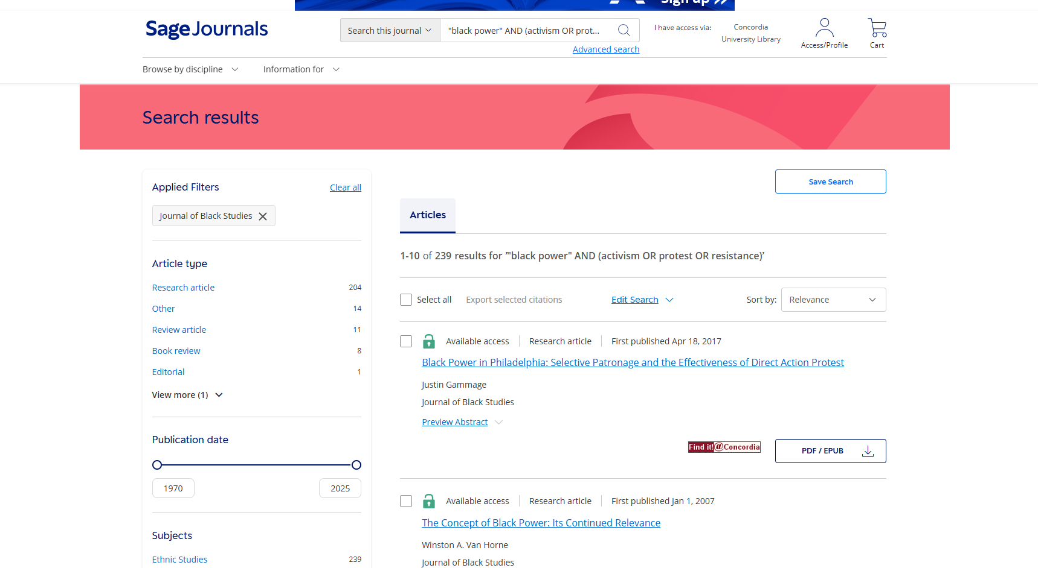
Searching directly in individual journals: Journal of Black Studies

Slide 29
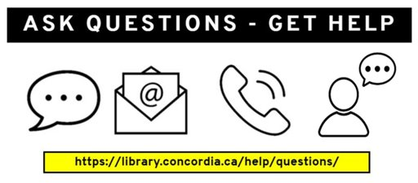
Need help, ask us!
Michelle.Lake@concordia.ca

